Slide 1
Beam Background on CEPC Luminosity Calorimeter (Lumical)
Ma Renjie(Nanjing University) Zhang lei(Nanjing University)

Slide 2
Contents
Introduction
Guniea Pig++
Pair Production
Background Estimation
Background by GPIG++
Conclusion

Slide 3
Introduction
Lumical aims to reach luminosity precision to 10^-4.Therefore,the beam induced background is significant.
Background:
Single Beam
Touschek Scattering;Beam Gas Scattering;Beam Thermal Photon Scattering;Synchrotron Radiation
Luminosity Related
Beamstrahlung->Pair Production

Slide 4
Guniea Pig++
Guniea Pig++ is a beam-beam interaction simulation C code,offering a high modelisation electronmagnetic and quantum phenoma occuring during e+ beam e- beam collision.
Provides beam particles distribution after interactions as well as background and luminosity spectra
Bunch particles dynamics(classical）
Beam beam interaction(QED)
On Lumical,We use it to simulate Pair Production Background.

Slide 5
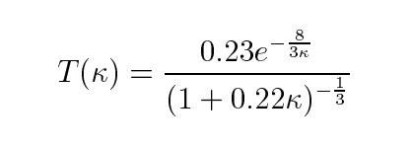
Pair Production(major contribution)
Coherent Pair Creation:γ→e+ e-(in magnetic field B)
Incoherent Pair Creation:
In GPIG++,virtual photon assumed to be real
Spectrum:
To Beamstrahlung:
modified Bessel Functions
Symmertric in CMS(Obivious)

Slide 6
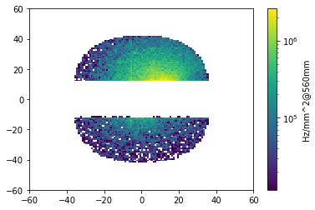
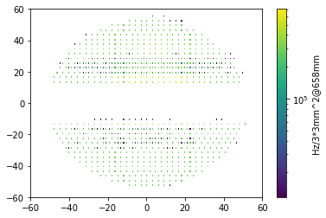
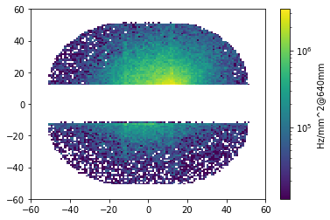
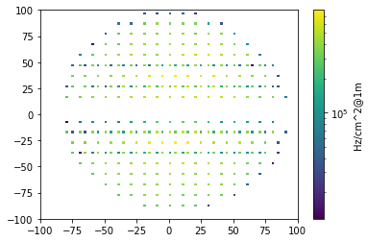
Background Estimation（From H. Shi）
except for synchrotron radiation
Si 1
Lyso 1
according to
/cefs/higgs/shihy/tools/CEPCSW_Latest/CEPCSW/Test/Whole
CMSEnergy:Higgs
Background:10^6Hz/mm^2@SiPM(~1mm^-2/Bunch)(BhaBha Signal ≈10^3Hz/mm^2)
10^4Hz/mm^2@Lyso 1(~10^-2mm^-2/Bunch)
10^3Hz/mm^2@Lyso 2(~10^-3mm^-2/Bunch)
decrease with the increasing of |z|
Si 2
Lyso 2
LYSO | Average Hit Rate (MHz/cm2) | Max Hit Rate(MHz/cm2) | Max Occupancy(%)
LYSO I@658mm | 3.37 | 7.82 | 9.10
LYSO II@1m | 0.479 | 0.798 | 11.15
asymmetry along y axis

Slide 7
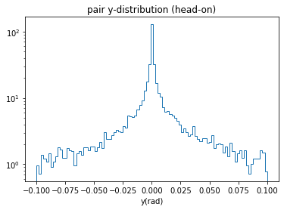
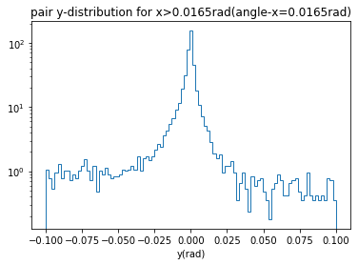
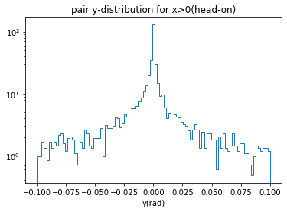
Background by Guinea Pig++ ——CEPC Higgs mode
Beam Crossing Angle ≠0
Head-On Collision
asymmetry is opposite in the opposite z direction
symmetric
asymmetry along y axis is related to x!

Slide 8
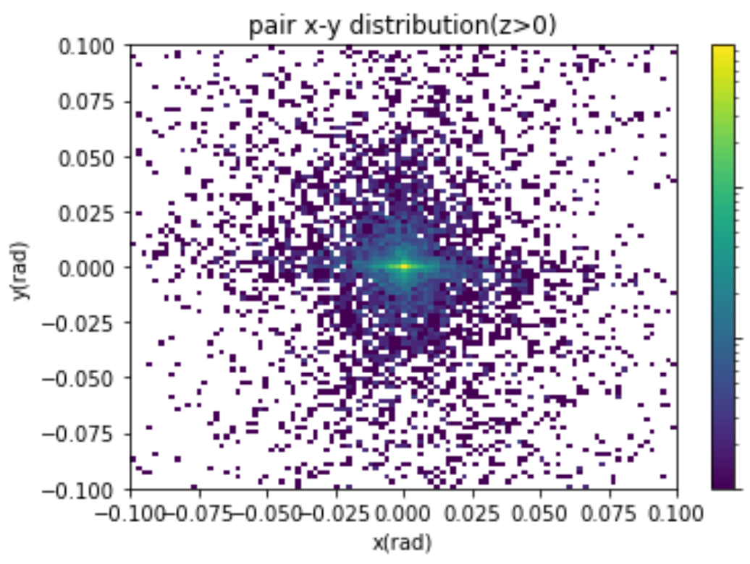
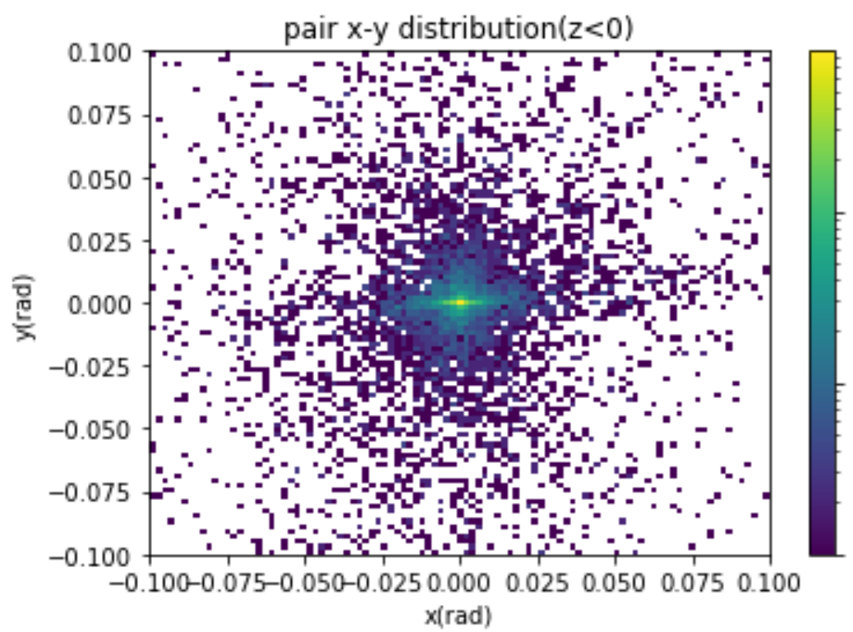
Background by Guinea Pig++ ——CEPC Higgs mode
-- --Pair x-y distribution in head-on Collision
The cutoff for the Pt of the virtual photon(equvalent) and x-y asymmetry in CMS may cause y asymmetry in collision with beam crossing angle.
a sketch map for cutoff(y>0 is cut more)
beam size effect
lack of events
program bug
Possible Reasons

Slide 9
Conclusion
Preliminary estimation of background on Lumical
Problems of the results and possible explaination for it
Specific reasons of y asymmetry and ’pxpypz<0‘
Other Generator such as CAIN can be compared

