Slide 1
Si tracker Readout system
Baseline:
Sensor: 2D AC-LGAD
Preamp: OTKRoc
Conceptual design
Wire-bonding from LGAD to PCB
OTKRoc preamp and digitalization
Digital signal sent to Peripheral Board, via connector or Flex

Slide 2
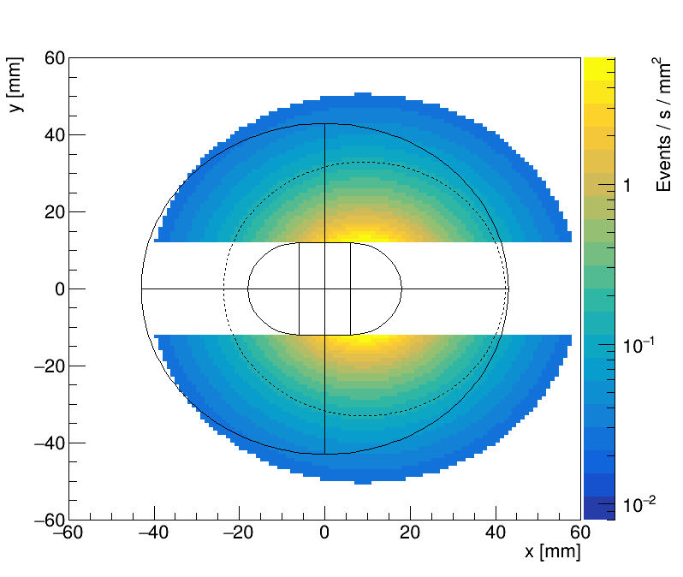
Bhabha acceptance
Dashed line: 90% of the all cross section
We have contingency to surpass Sigma(qq->Z) ~ 40 nb

Slide 3
Circule design

Slide 4
Polygon design

Slide 5
PEB position

Slide 6
One question raised today: Cooling ?

Slide 7
Energy deposit in 1st layer LYSO

