Slide 1
2023.04.23
Update to full LumiCal
Read Bhlumi events
LYSO bars z= 647-670mm
of LumiCal before flange
2023
Coding log
InX3TB for X3TB95, delete codes relevant to TB95,
used in UGEOM UDET,
Z= 647 670 mm
24 mm
39 mm
y= mm
21
18
15
12
56 mm
Θ=.03245
Θ=.03133
Θ=.02781
Θ=.02686
39 mm
Θ=.02318
Θ=.02238
Θ=.01855
Θ=.01791
+x
-7.27 mm
+7.27
12 mm
12 mm
54.7 mm
Studyt shower Shoot IL=2, NUMBV2=18
θ=0.024 φ=1.474
@z=64.7cm @z=67.cm
r=1.553, x=.15, y=1.546 r=1.6083 x=.1554 Y=1.601
1
1
1
1
6
6
6
6
1
1
1
1
6
6
6
6
1
1
1
1
6
6
6
6
1
1
1
1
1
1
1
6
6
1
1
6
6
1
1
6
6
1
1
1
1
1
6
6
1
1
6
6
1
1
6
6
1
1
1
6
6
1
1
6
6
1
1
6
6
1
1
1
6
6
6
1
1
1
6
6
6
1
1
1
6
6
6
1
1
1
6
6
6
1
1
1
6
6
6
1
1
1
6
6
6
1
1
1
1
1
6
6
6
1
1
1
6
6
6
1
1
1
1
6
6
1
1
6
6
1
1
1
6
6
1
1
1
6
6
1
1
6
1
1
6
1
6
1
6
1
6
1

Slide 2
2024.08.30
Build Qbar LYSO det
LYSO bars z= 900-1100mm
Before QMAG, dupipe 855-1110 mm
Shooting IL=2, NUMBV2=11
Center (0, 29, 900), θ=0.0322, φ=1.57
@z=90cm @z=110.cm
r=2.9, x=0, y=2.9 r=3.54 x=0 Y=3.54
2024 new stack
1
1
1
6
6
1
Z= 900 1100 mm
1
6
6
1
1
y= mm
104
94
84
74
64
54
44
34
24
14
Θ=.1023
Θ=.0934
1
1
6
6
1
1
1
6
6
1
1
6
6
1
1
6
6
1
1
6
6
1
1
6
6
1
1
6
6
1
1
6
1
6
1
1
6
1
6
1
1
1
6
6
1
1
6
6
1
1
+x
Θ=.04885
Θ=.03998
-13.45
+13.45
Diamond box
X= 26.6, 27.0 mm
Y= -13, +13 mm
Θ=.03776
Θ=.03090
Cu pipe
10-13mm
Θ=.02666
Θ=.02181
Θ=.01555
Θ=.01273
114 mm
QbarXc, QbarYc(22,10)
NQlyr 22 to 5
LQbarXYc zy n-,q+
UGEOM layer: nN01~qQ10
1
1
6
6
1
1

Slide 3
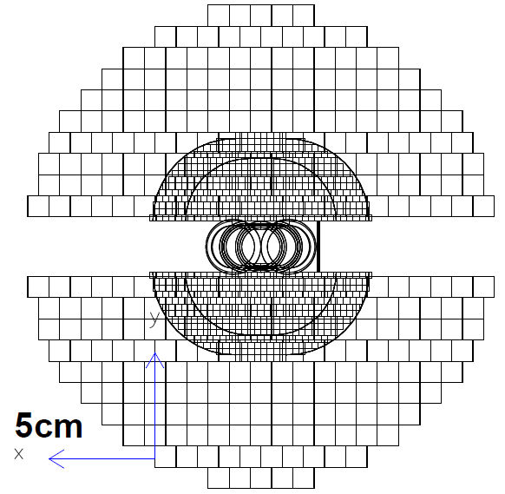
UGEOM
central rectangular decks GSDVN into 3 box
z y
mDL0~9
pUL0~9
2024
new stack
PGON xc= ± 1.35 cm z=90-110 cm
z x GSDVN into 6+L*3
mRC0~9
pLC0~9
GEANT> exe gin3kumec#lysoxy
SUBROUTINE LbarID(Chset,Chdet,NumBV2, Xc,Yc,Zc, Rc,Phc)
Studyt shower IL=0~9
θ=0.025 φ= 90º = 1.571 rad IL=1, NUMBV2=2
@z=90 cm @z=110.cm
x=0., r=y=2.250 x=0. Y=2.751
θ=0.037 φ=90º = 1.571 rad IL=2, NUMBV2=2
@z=90 cm @z=110.cm
x=0., r=y=3.332 x=0. Y=4.072

Slide 4
Corner the corner fixed
x’=12
z’=zc-475/2 10mm inner rad. +2mm thick
=zc-(L/2∙cosθ+7∙sinθ) rotate half tube, rectangular center
L=474.84
apply L=474.8 from zc use θ=.90/180*pi
z’= zc -L/2∙cosθ +.08 -12∙sinθ = zc-237.48
θ=atan(7.5/475) = .01579 = .9046º
X=19.5
X=17.5
內束流管
X=13.75
Corner
x’=17.5-10∙cosθ
z’=zc+475/2
=zc+L/2∙cosθ+5∙sinθ
L=474.90
apply L=474.8, θ=.90/180*pi
x’=xc’+L/2∙sinθ= 3.75+3.748 =7.498
z’=zc’+L/2∙cosθ = 417.58+237.37= 654.95
X=12
X=10
θ
TUBS rotate center shifted
xc’=13.75-5/cos θ-5∙cosθ=3.75
zc’= zc+ 5∙sinθ = 417.58
Z=180
xc= 0
zc= 417.5
x’=xc’-L/2∙sinθ= 3.75-3.748 =.002
z’=zc’-L/2∙cosθ = 417.58-237.37= 180.21
Beam line Z=655
Rotated TUBS half tube Al 2mm thick L=474.8, dZ<=475mm
θ=atan(6/75) = .07983 = 4.574º
apply L=74.3, θ=4.6º
X=25.5
X=23.5
x’=13.47+12∙cosθ = 25.43
x’=13.47+10∙cosθ = 23.44
12∙sinθ+L∙cosθ=75
L=74.04
X=22.5
X=20.5
Corner apply L=74.3, θ=4.6º
x’=xc’+L/2∙sinθ = 10.5+2.98 =13.479
z’=zc’+L/2∙cosθ = 817.9+37.03= 854.93
X=39/2
X=19.5
X=35/2
θ
TUBS rotate center shifted
xc’= 20.5-5/cos θ-5∙cosθ=10.5
zc’= zc+ 5∙sinθ = 817.9
Y-crotch 絝檔
x’=xc’-L/2∙sinθ = 10.5-2.98 = 7.52
z’=zc’-L/2∙cosθ= 817.9-37.03= 780.87
xc= 0
zc= 817.5
Z=780
Z=805
Beam line Z=855
Rotated TUBS half tube Al 2mm thick L=74.0, dZ<=75mm

