Slide 1



Computing Center, IHEP, CAS
National HEP Data Center
教程：基于HepAI远程模型的AI翻译应用
张正德 HepAI小组

Slide 2
教程目标
本教程目标：
  入门基于FastAPI开发API服务
  学习基于HepAI框架开发远程模型
  学习基于Gradio开发AI应用界面
  整合成基于大模的翻译Web应用
技术栈：
  集成开发环境和工具：VSCode、Git
  编程语言：Python
  环境管理：Conda
  依赖库：FastAPI，HepAI，Gradio
参考代码：https://code.ihep.ac.cn/hepai/hai-translator.git

Slide 3

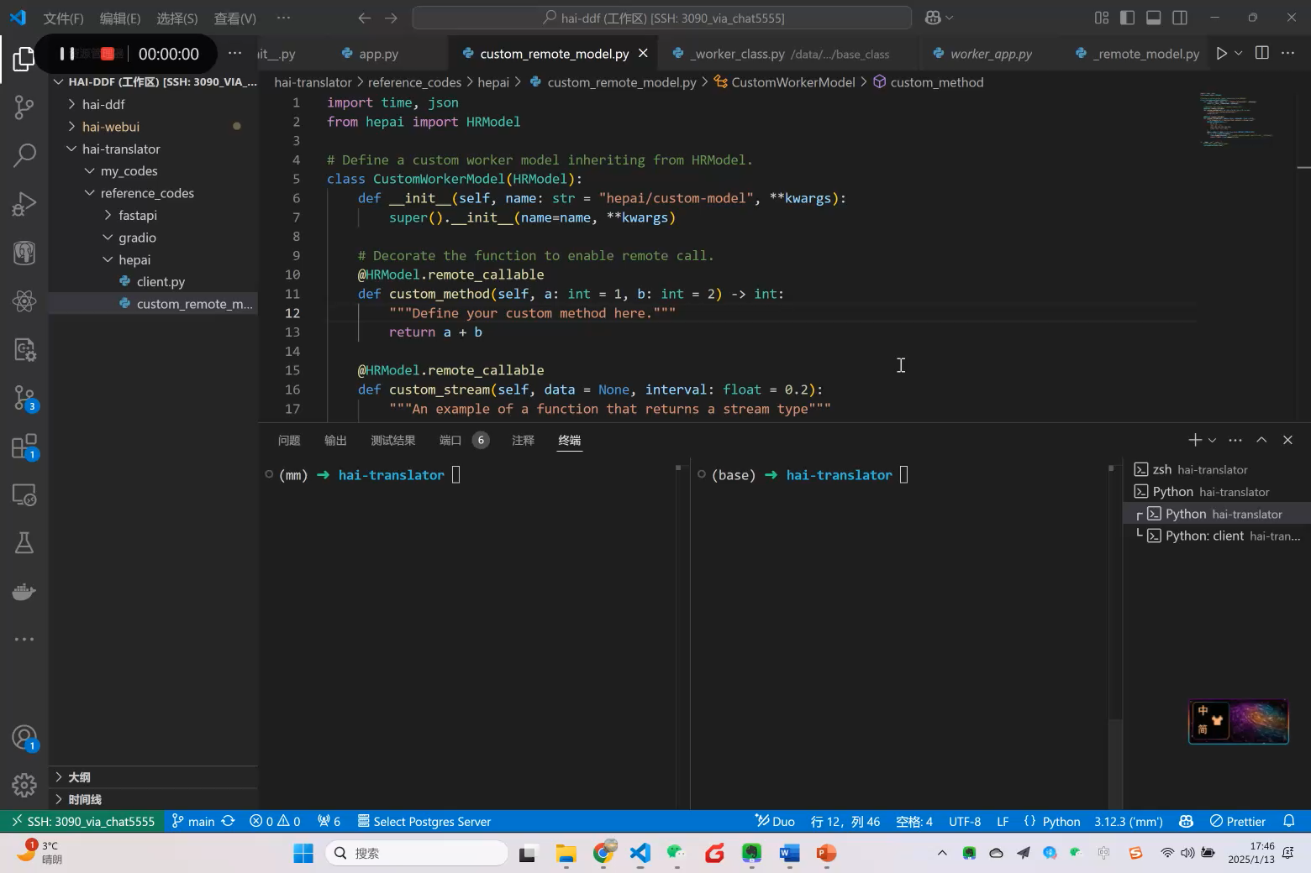
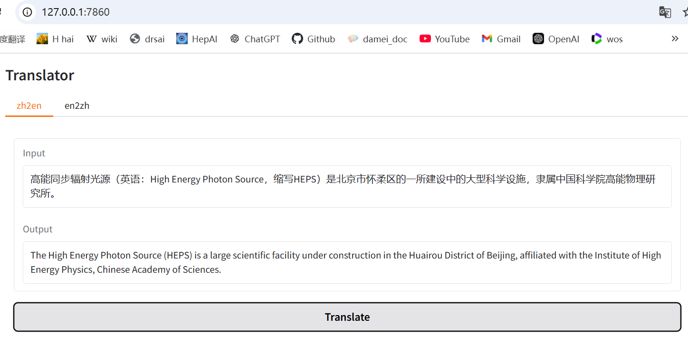
学习路线
FastAPI
HepAI
Gradio
Hello world网页
访问网页:http://localhost:8000
显示Hello world
远程模型服务
- Python对象运行在云端
- 实现本地对象的调用方法相同调用它。
一个基于Gradio翻译界面
访问网页: http://locahost:8001
显示一个翻译界面
一个翻译应用
组装起来
中译英、英译中
成果：

Slide 4
Part 1 FastAPI

Slide 5
FastAPI学习内容
01 快速开始，实现Hello world网页
02 自定义FastAPI类和路由组，为开发大型应用打下基础
03 加载前端代码，形成网页服务

Slide 6
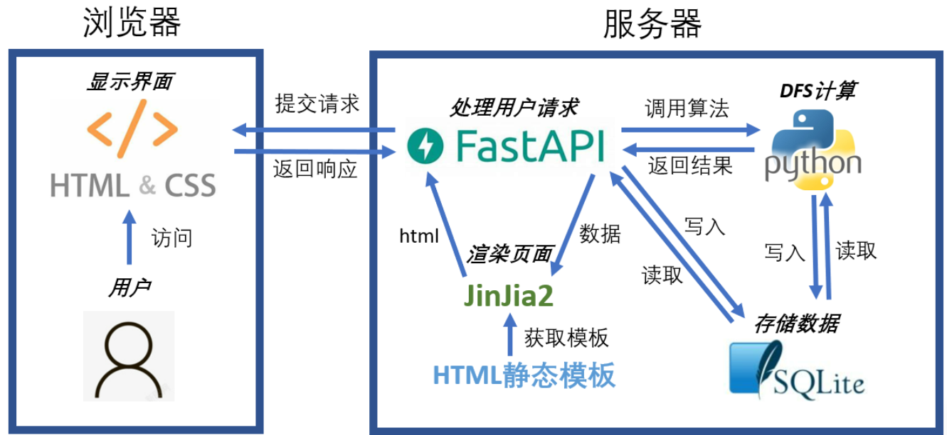
FastAPI
系统架构图

Slide 7
FastAPI
01 快速开始
from fastapi import FastAPI
from pydantic import BaseModel
app = FastAPI()
# 定义一个数据模型，用于接收 POST 请求的数据
class Item(BaseModel):
name: str
price: float
is_offer: bool = None
# 创建一个 GET 请求的路由
@app.get("/")
def read_root():
return {"Hello": "World"}
# 创建一个 GET 请求的路由，带参数
@app.get("/items/{item_id}")
def read_item(item_id: int, q: str = None):
return {"item_id": item_id, "q": q}
# 创建一个 POST 请求的路由
@app.post("/items/")
def create_item(item: Item):
return {"name": item.name, "price": item.price*2, "is_offer": item.is_offer}
启动：uvicorn main:app --reload
发起请求：
示例1：
curl -X GET http://127.0.0.1:8000/
返回值：{"Hello": "World"}
示例2：
curl -X GET http://127.0.0.1:8000/items/1?q=example
返回值：{"item_id": 1, "q": "example"}
示例3：
curl -X POST "http://127.0.0.1:8000/items/" -H "Content-Type: application/json" -d '{"name": "Sample Item", "price": 29.99, "is_offer": true}’
返回值：{"name": "Sample Item", "price": 59.98, "is_offer": true}
定义路由
定义标准输入

Slide 8
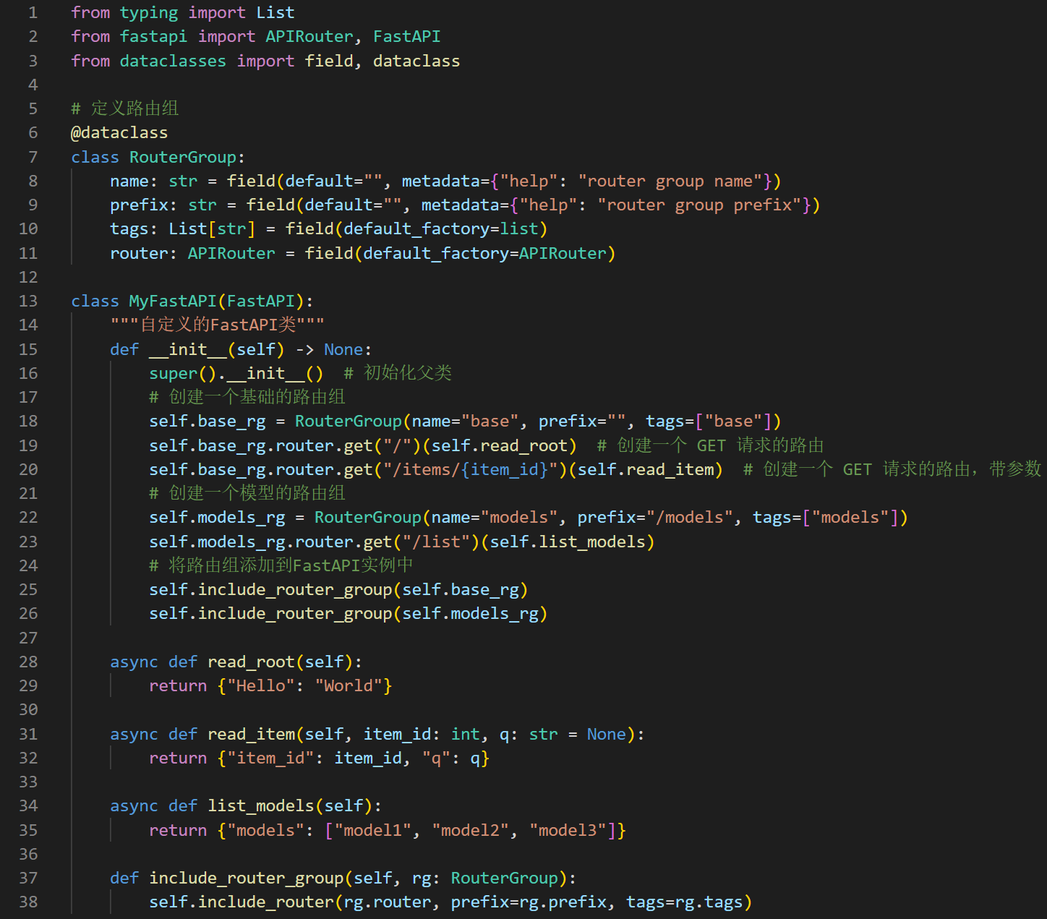
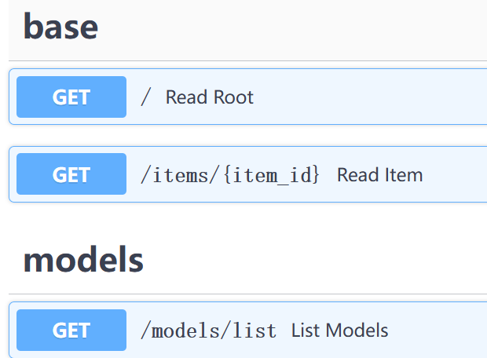
FastAPI
02 自定义FastAPI类和路由组
启动：uvicorn main:app --reload
查看文档：http://localhost:8000/docs
初始化路由组
发起请求：
示例1：
curl -X GET http://127.0.0.1:8000/
返回值：{"Hello": "World"}
示例2：
curl -X GET http://127.0.0.1:8000/models/list
返回值：{"models":["model1","model2","model3"]}
Notes:
from typing import List
from fastapi import APIRouter, FastAPI
from dataclasses import field, dataclass
# 定义路由组
@dataclass
class RouterGroup:
name: str = field(default="", metadata={"help": "router group name"})
prefix: str = field(default="", metadata={"help": "router group prefix"})
tags: List[str] = field(default_factory=list)
router: APIRouter = field(default_factory=APIRouter)
class MyFastAPI(FastAPI):
"""自定义的FastAPI类"""
def __init__(self) -> None:
super().__init__() # 初始化父类
# 创建一个基础的路由组
self.base_rg = RouterGroup(name="base", prefix="", tags=["base"])
self.base_rg.router.get("/")(self.read_root) # 创建一个 GET 请求的路由
self.base_rg.router.get("/items/{item_id}")(self.read_item) # 创建一个 GET 请求的路由，带参数
# 创建一个模型的路由组
self.models_rg = RouterGroup(name="models", prefix="/models", tags=["models"])
self.models_rg.router.get("/list")(self.list_models)
# 将路由组添加到FastAPI实例中
self.include_router_group(self.base_rg)
self.include_router_group(self.models_rg)
async def read_root(self):
return {"Hello": "World"}
async def read_item(self, item_id: int, q: str = None):
return {"item_id": item_id, "q": q}
async def list_models(self):
return {"models": ["model1", "model2", "model3"]}
def include_router_group(self, rg: RouterGroup):
self.include_router(rg.router, prefix=rg.prefix, tags=rg.tags)
if __name__ == "__main__":
app = MyFastAPI()
import uvicorn
uvicorn.run(app, host="0.0.0.0", port=8000)

Slide 9
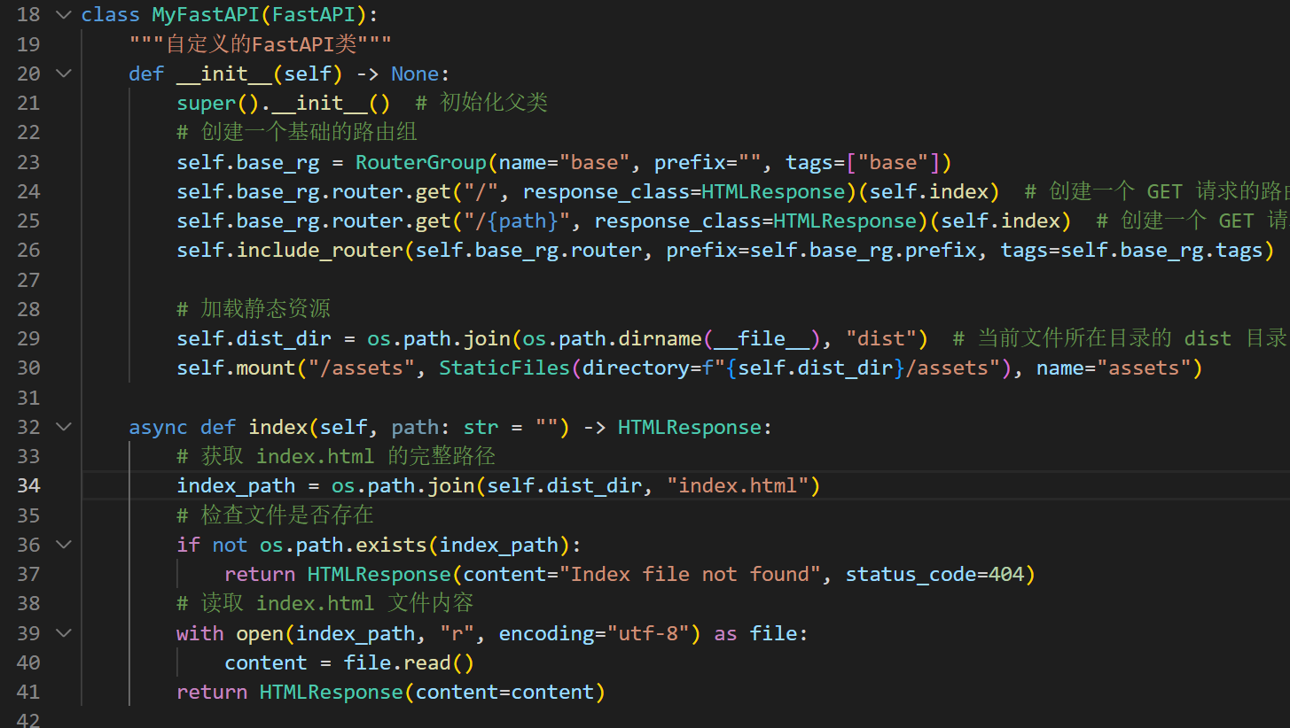

FastAPI
03 加载前端代码形成网页服务
继承FastAPI
浏览器打开：
http://localhost:8000/
显示：
读取静态前端文件
返回网页响应
启动：uvicorn main:app --reload
加载dist文件夹下的前端静态文件，用户发起请求时返回HTML响应
Notes:
import os
from typing import List
from fastapi import APIRouter, FastAPI
from fastapi.responses import HTMLResponse
from fastapi.staticfiles import StaticFiles
from dataclasses import field, dataclass
# 定义路由组
@dataclass
class RouterGroup:
name: str = field(default="", metadata={"help": "router group name"})
prefix: str = field(default="", metadata={"help": "router group prefix"})
tags: List[str] = field(default_factory=list)
router: APIRouter = field(default_factory=APIRouter)
class MyFastAPI(FastAPI):
"""自定义的FastAPI类"""
def __init__(self) -> None:
super().__init__() # 初始化父类
# 创建一个基础的路由组
self.base_rg = RouterGroup(name="base", prefix="", tags=["base"])
self.base_rg.router.get("/", response_class=HTMLResponse)(self.index) # 创建一个 GET 请求的路由1
self.base_rg.router.get("/{path}", response_class=HTMLResponse)(self.index) # 创建一个 GET 请求的路由1
self.include_router(self.base_rg.router, prefix=self.base_rg.prefix, tags=self.base_rg.tags) # 将路由组添加到FastAPI实例中
# 加载静态资源
self.dist_dir = os.path.join(os.path.dirname(__file__), "dist") # 当前文件所在目录的 dist 目录
self.mount("/assets", StaticFiles(directory=f"{self.dist_dir}/assets"), name="assets")
async def index(self, path: str = "") -> HTMLResponse:
# 获取 index.html 的完整路径
index_path = os.path.join(self.dist_dir, "index.html")
# 检查文件是否存在
if not os.path.exists(index_path):
return HTMLResponse(content="Index file not found", status_code=404)
# 读取 index.html 文件内容
with open(index_path, "r", encoding="utf-8") as file:
content = file.read()
return HTMLResponse(content=content)
if __name__ == "__main__":
app = MyFastAPI()
import uvicorn
uvicorn.run(app, host="0.0.0.0", port=8000)

Slide 10
Part 2 HepAI Remote Model

Slide 11
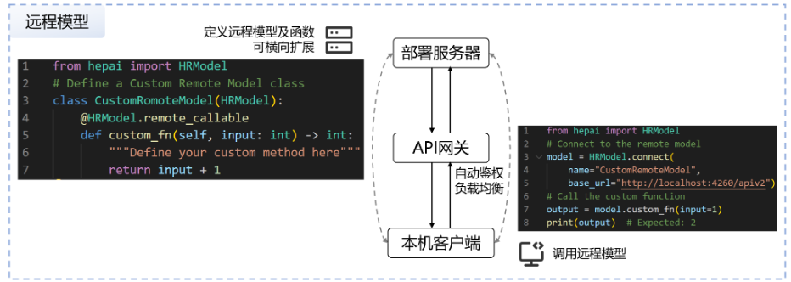
HepAI远程模型基本原理
远程模型（Remote Model），通过将模型等任意软件程序搭载到Worker中部署到云端服务器，搭配高能AI客户端实现远程模型等低延迟、分布式调用。
https://aiapi001.ihep.ac.cn/mkdocs/

Slide 12
HepAI远程模型
01 快速开始-服务端代码
import time, json
from hepai import HRModel
# Define a custom worker model inheriting from HRModel.
class CustomWorkerModel(HRModel):
def __init__(self, name: str = "hepai/custom-model", **kwargs):
super().__init__(name=name, **kwargs)
# Decorate the function to enable remote call.
@HRModel.remote_callable
def custom_method(self, a: int = 1, b: int = 2) -> int:
"""Define your custom method here."""
return a + b
@HRModel.remote_callable
def custom_stream(self, data = None, interval: float = 0.2):
"""An example of a function that returns a stream type"""
DEFAULT_STREAM_DATA = [
1, 2, 3,
"x", "y", "z",
[[1, 2], [3, 4], [5, 6]],
{"a": "b", "c": "d"},
]
data = data if data is not None else DEFAULT_STREAM_DATA
for i, x in enumerate(data):
time.sleep(interval) # 注：此处为了演示，故意加了延迟，实际使用时应该去掉
yield f"data: {json.dumps(x)}\n\n"
if __name__ == "__main__":
# Run the custom worker model.
CustomWorkerModel.run()
自定义远程函数
运行后打开：
API文档 http://localhost:4260/docs
SSE(Server Sent Event)标准流式输出）

Slide 13
HepAI远程模型
02 快速开始-客户端代码
from hepai import HRModel
model = HRModel.connect(
name="hepai/custom-model",
base_url="http://localhost:4260/apiv2"
)
funcs = model.functions() # Get all remote callable functions.
print(f"Remote callable funcs: {funcs}")
# 请求远程模型的custom_method方法
output = model.custom_method(a=1, b=2)
assert isinstance(output, int), f"output: type: {type(output)}, {output}"
print(f"Output of custon_method: {output}, type: {type(output)}")
# 测试流式响应
stream = model.get_stream(stream=True) # Note: You should set `stream=True` to get a stream.
print(f"Output of get_stream:")
for x in stream:
print(f"{x}, type: {type(x)}", flush=True)
连接远程模型，获得Python对象
运行后打开：
API文档 http://localhost:4260/docs
请求自定义方法
遍历流式响应结果
运行 python client.py

Slide 14

HepAI远程模型
通过HepAI客户端可以访问已部署的模型
03 HepAI Client
① 设置.env文件
② 编写代码
将API-KEY保存在.env中
注：为防止泄露，请勿把API-KEY存放在代码内
import os, sys
from hepai import HepAI, ChatCompletion
from dotenv import load_dotenv
load_dotenv(f'{os.path.dirname(__file__)}/.env')
#
client = HepAI(
base_url="https://aiapi001.ihep.ac.cn/apiv2",
api_key=os.getenv("DDF2_API_KEY"),
)
models = client.models.list()
print(f"Models: {models}")
q = "hello"
a: ChatCompletion = client.chat.completions.create(
model="openai/gpt-4o",
messages=[
{"role": "system", "content": "You are a friendly AI."},
{"role": "user", "content": q},
]
)
print(f"Q: {q}")
print(f"A: {a.choices[0].message.content}")
初始化客户端，需要请求端点和API-KEY
列出可用模型
请求gpt-4o模型
③ 运行 python 03_llm_client.py

Slide 15
HepAI远程模型
04 Translator Server
① 编写代码
class TranslatorModel(HRModel):
@HRModel.remote_callable
def translate(
self,
input: str,
mode: Literal["en2zh", "zh2en"] = "zh2en"
) -> int:
prompt = f"Translate the following Chinese text into English: `{input}`" if mode == "zh2en" \
else f"Translate the following English text into Chinese: `{input}`"
# 请求模型
a: ChatCompletion = self.client.chat.completions.create(
model="openai/gpt-4o",
messages=[
{"role": "system", "content": self.system_prompt},
{"role": "user", "content": prompt},
]
)
return a
定义翻译函数
运行 python 04_translator_server.py
Notes:
from typing import Literal
import time, json, os
from hepai import HRModel, HepAI, ChatCompletionChunk, ChatCompletion
from dotenv import load_dotenv
load_dotenv(f'{os.path.dirname(__file__)}/.env')
class TranslatorModel(HRModel):
def __init__(self, name: str = "hepai/translator", **kwargs):
super().__init__(name=name, **kwargs)
self.client = HepAI(
base_url="https://aiapi001.ihep.ac.cn/apiv2", api_key=os.getenv("DDF2_API_KEY"))
self.system_prompt = """
Objective:
Develop a highly efficient and accurate translation model capable of seamlessly translating text between Chinese and English. The model should maintain context, tone, and meaning, ensuring that translations are both natural and faithful to the source material.
Capabilities:
Bidirectional Translation:
Translate Chinese text to English with precision, preserving the original meaning and cultural nuances.
Translate English text to Chinese with accuracy, ensuring clarity and contextual relevance.
Contextual Understanding:
Analyze the context of the source text to provide translations that are coherent and contextually appropriate.
Recognize idiomatic expressions, cultural references, and domain-specific terminology, offering suitable translations.
Tone and Style Adaptation:
Adapt the tone and style of the translation to match the source text, whether formal, informal, technical, or conversational.
Ensure that the translated output aligns with the intended audience and purpose.
Error Handling:
Identify and correct potential errors in grammar, syntax, and semantics during the translation process.
Provide suggestions for ambiguous or unclear phrases to enhance translation accuracy.
User Feedback Integration:
Incorporate user feedback to continuously improve translation quality and adapt to evolving language use.
Instructions for Use:
Input the text you wish to translate, specifying the source and target languages if necessary.
Review the translated output for accuracy and make any adjustments as needed.
Utilize feedback mechanisms to report any translation issues or suggestions for improvement.
Examples:
Chinese to English:
Input: "今天天气很好。"
Output: "The weather is nice today."
English to Chinese:
Input: "The free-electron laser is a powerful research tool."
Output: "自由电子激光是一种强大的研究工具。
"""
@HRModel.remote_callable
def translate(
self,
input: str,
mode: Literal["en2zh", "zh2en"] = "zh2en"
) -> int:
prompt = f"Translate the following Chinese text into English: `{input}`" if mode == "zh2en" \
else f"Translate the following English text into Chinese: `{input}`"
# 请求模型
a: ChatCompletion = self.client.chat.completions.create(
model="openai/gpt-4o",
messages=[
{"role": "system", "content": self.system_prompt},
{"role": "user", "content": prompt},
]
)
return a
if __name__ == "__main__":
# Run the custom worker model.
tm = TranslatorModel()
a: ChatCompletion = tm.translate("你好")
print(a)
tm.run()

Slide 16
HepAI远程模型
04 Translator Client
编写代码
from hepai import HRModel, ChatCompletion
model = HRModel.connect(
name="hepai/translator",
base_url="http://localhost:4260/apiv2"
)
funcs = model.functions() # Get all remote callable functions.
print(f"Remote callable funcs: {funcs}")
input = "你好"
input = "Develop a highly efficient and accurate translation model capable of seamlessly translating text between Chinese and English. The model should maintain context, tone, and meaning, ensuring that translations are both natural and faithful to the source material."
input = "高能同步辐射光源（英语：High Energy Photon Source，缩写HEPS）是北京市怀柔区的一所建设中的大型科学设施，隶属中国科学院高能物理研究所。"
output: dict = model.translate(input=input, mode="zh2en")
print(output["choices"][0]["message"]["content"])
请求翻译函数
运行 python 05_translator_client.py
Notes:
from typing import Literal
import time, json, os
from hepai import HRModel, HepAI, ChatCompletionChunk, ChatCompletion
from dotenv import load_dotenv
load_dotenv(f'{os.path.dirname(__file__)}/.env')
class TranslatorModel(HRModel):
def __init__(self, name: str = "hepai/translator", **kwargs):
super().__init__(name=name, **kwargs)
self.client = HepAI(
base_url="https://aiapi001.ihep.ac.cn/apiv2", api_key=os.getenv("DDF2_API_KEY"))
self.system_prompt = """
Objective:
Develop a highly efficient and accurate translation model capable of seamlessly translating text between Chinese and English. The model should maintain context, tone, and meaning, ensuring that translations are both natural and faithful to the source material.
Capabilities:
Bidirectional Translation:
Translate Chinese text to English with precision, preserving the original meaning and cultural nuances.
Translate English text to Chinese with accuracy, ensuring clarity and contextual relevance.
Contextual Understanding:
Analyze the context of the source text to provide translations that are coherent and contextually appropriate.
Recognize idiomatic expressions, cultural references, and domain-specific terminology, offering suitable translations.
Tone and Style Adaptation:
Adapt the tone and style of the translation to match the source text, whether formal, informal, technical, or conversational.
Ensure that the translated output aligns with the intended audience and purpose.
Error Handling:
Identify and correct potential errors in grammar, syntax, and semantics during the translation process.
Provide suggestions for ambiguous or unclear phrases to enhance translation accuracy.
User Feedback Integration:
Incorporate user feedback to continuously improve translation quality and adapt to evolving language use.
Instructions for Use:
Input the text you wish to translate, specifying the source and target languages if necessary.
Review the translated output for accuracy and make any adjustments as needed.
Utilize feedback mechanisms to report any translation issues or suggestions for improvement.
Examples:
Chinese to English:
Input: "今天天气很好。"
Output: "The weather is nice today."
English to Chinese:
Input: "The free-electron laser is a powerful research tool."
Output: "自由电子激光是一种强大的研究工具。
"""
@HRModel.remote_callable
def translate(
self,
input: str,
mode: Literal["en2zh", "zh2en"] = "zh2en"
) -> int:
prompt = f"Translate the following Chinese text into English: `{input}`" if mode == "zh2en" \
else f"Translate the following English text into Chinese: `{input}`"
# 请求模型
a: ChatCompletion = self.client.chat.completions.create(
model="openai/gpt-4o",
messages=[
{"role": "system", "content": self.system_prompt},
{"role": "user", "content": prompt},
]
)
return a
if __name__ == "__main__":
# Run the custom worker model.
tm = TranslatorModel()
a: ChatCompletion = tm.translate("你好")
print(a)
tm.run()

Slide 17
Part 3 Gradio

Slide 18

Gradio学习内容
https://www.gradio.app/
Gradio 是一个开源的 Python 库，旨在简化机器学习模型和数据科学应用的用户界面开发。它允许开发者快速创建交互式的 Web 界面，使用户可以通过浏览器与模型进行交互，而无需编写复杂的前端代码。

Slide 19
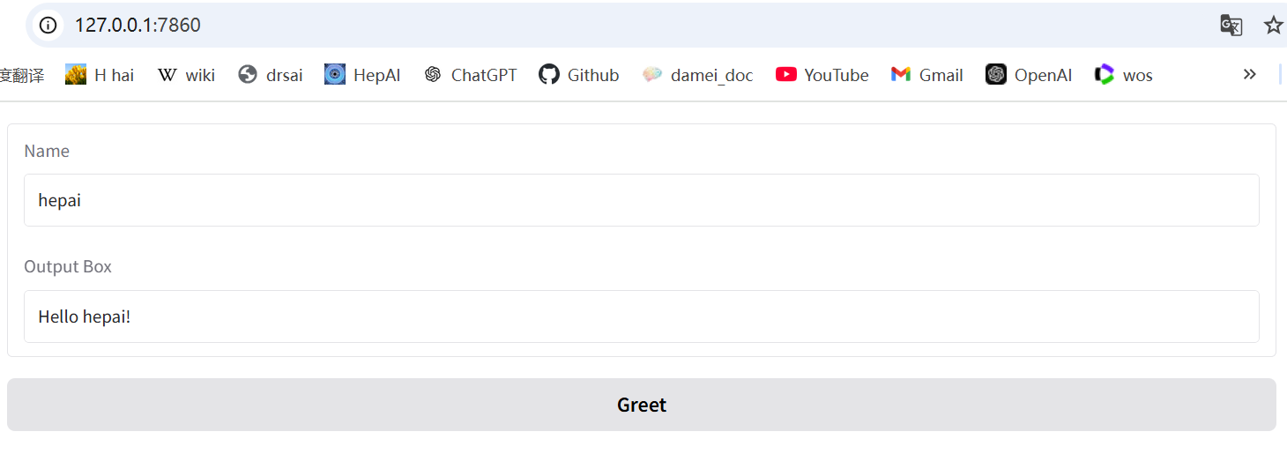
Gradio
01 快速开始
① 编写代码
import gradio as gr
def greet(name):
return "Hello " + name + "!"
with gr.Blocks() as demo:
name = gr.Textbox(label="Name")
output = gr.Textbox(label="Output Box")
greet_btn = gr.Button("Greet")
greet_btn.click(fn=greet, inputs=name, outputs=output, api_name="greet")
demo.launch()
② 运行 python 01_gradio_blocks.py
③ 运行后打开http://127.0.0.1:7860
Notes:
from typing import Literal
import time, json, os
from hepai import HRModel, HepAI, ChatCompletionChunk, ChatCompletion
from dotenv import load_dotenv
load_dotenv(f'{os.path.dirname(__file__)}/.env')
class TranslatorModel(HRModel):
def __init__(self, name: str = "hepai/translator", **kwargs):
super().__init__(name=name, **kwargs)
self.client = HepAI(
base_url="https://aiapi001.ihep.ac.cn/apiv2", api_key=os.getenv("DDF2_API_KEY"))
self.system_prompt = """
Objective:
Develop a highly efficient and accurate translation model capable of seamlessly translating text between Chinese and English. The model should maintain context, tone, and meaning, ensuring that translations are both natural and faithful to the source material.
Capabilities:
Bidirectional Translation:
Translate Chinese text to English with precision, preserving the original meaning and cultural nuances.
Translate English text to Chinese with accuracy, ensuring clarity and contextual relevance.
Contextual Understanding:
Analyze the context of the source text to provide translations that are coherent and contextually appropriate.
Recognize idiomatic expressions, cultural references, and domain-specific terminology, offering suitable translations.
Tone and Style Adaptation:
Adapt the tone and style of the translation to match the source text, whether formal, informal, technical, or conversational.
Ensure that the translated output aligns with the intended audience and purpose.
Error Handling:
Identify and correct potential errors in grammar, syntax, and semantics during the translation process.
Provide suggestions for ambiguous or unclear phrases to enhance translation accuracy.
User Feedback Integration:
Incorporate user feedback to continuously improve translation quality and adapt to evolving language use.
Instructions for Use:
Input the text you wish to translate, specifying the source and target languages if necessary.
Review the translated output for accuracy and make any adjustments as needed.
Utilize feedback mechanisms to report any translation issues or suggestions for improvement.
Examples:
Chinese to English:
Input: "今天天气很好。"
Output: "The weather is nice today."
English to Chinese:
Input: "The free-electron laser is a powerful research tool."
Output: "自由电子激光是一种强大的研究工具。
"""
@HRModel.remote_callable
def translate(
self,
input: str,
mode: Literal["en2zh", "zh2en"] = "zh2en"
) -> int:
prompt = f"Translate the following Chinese text into English: `{input}`" if mode == "zh2en" \
else f"Translate the following English text into Chinese: `{input}`"
# 请求模型
a: ChatCompletion = self.client.chat.completions.create(
model="openai/gpt-4o",
messages=[
{"role": "system", "content": self.system_prompt},
{"role": "user", "content": prompt},
]
)
return a
if __name__ == "__main__":
# Run the custom worker model.
tm = TranslatorModel()
a: ChatCompletion = tm.translate("你好")
print(a)
tm.run()

Slide 20
Gradio
02 基于LLM的翻译app
① 编写代码
② 运行 python 02_translator_app.py
import gradio as gr
from hepai import HRModel
translator = HRModel.connect(
name="hepai/translator",
base_url="http://localhost:4260/apiv2"
)
def translate(input_text, mode="zh2en"):
output: dict = translator.translate(input=input_text, mode=mode)
return output["choices"][0]["message"]["content"]
def translate_en2zh(input_text):
return translate(input_text, mode="en2zh")
with gr.Blocks() as demo:
gr.Markdown("## Translator")
with gr.Tab("zh2en"):
input = gr.Textbox(label="Input")
output = gr.Textbox(label="Output")
greet_btn = gr.Button("Translate")
greet_btn.click(fn=translate, inputs=input, outputs=output, api_name="translate")
with gr.Tab("en2zh"):
input = gr.Textbox(label="Input")
output = gr.Textbox(label="Output")
greet_btn = gr.Button("Translate")
greet_btn.click(fn=translate_en2zh, inputs=input, outputs=output, api_name="translate")
demo.launch()
③ 运行后打开http://127.0.0.1:7860
Notes:
from typing import Literal
import time, json, os
from hepai import HRModel, HepAI, ChatCompletionChunk, ChatCompletion
from dotenv import load_dotenv
load_dotenv(f'{os.path.dirname(__file__)}/.env')
class TranslatorModel(HRModel):
def __init__(self, name: str = "hepai/translator", **kwargs):
super().__init__(name=name, **kwargs)
self.client = HepAI(
base_url="https://aiapi001.ihep.ac.cn/apiv2", api_key=os.getenv("DDF2_API_KEY"))
self.system_prompt = """
Objective:
Develop a highly efficient and accurate translation model capable of seamlessly translating text between Chinese and English. The model should maintain context, tone, and meaning, ensuring that translations are both natural and faithful to the source material.
Capabilities:
Bidirectional Translation:
Translate Chinese text to English with precision, preserving the original meaning and cultural nuances.
Translate English text to Chinese with accuracy, ensuring clarity and contextual relevance.
Contextual Understanding:
Analyze the context of the source text to provide translations that are coherent and contextually appropriate.
Recognize idiomatic expressions, cultural references, and domain-specific terminology, offering suitable translations.
Tone and Style Adaptation:
Adapt the tone and style of the translation to match the source text, whether formal, informal, technical, or conversational.
Ensure that the translated output aligns with the intended audience and purpose.
Error Handling:
Identify and correct potential errors in grammar, syntax, and semantics during the translation process.
Provide suggestions for ambiguous or unclear phrases to enhance translation accuracy.
User Feedback Integration:
Incorporate user feedback to continuously improve translation quality and adapt to evolving language use.
Instructions for Use:
Input the text you wish to translate, specifying the source and target languages if necessary.
Review the translated output for accuracy and make any adjustments as needed.
Utilize feedback mechanisms to report any translation issues or suggestions for improvement.
Examples:
Chinese to English:
Input: "今天天气很好。"
Output: "The weather is nice today."
English to Chinese:
Input: "The free-electron laser is a powerful research tool."
Output: "自由电子激光是一种强大的研究工具。
"""
@HRModel.remote_callable
def translate(
self,
input: str,
mode: Literal["en2zh", "zh2en"] = "zh2en"
) -> int:
prompt = f"Translate the following Chinese text into English: `{input}`" if mode == "zh2en" \
else f"Translate the following English text into Chinese: `{input}`"
# 请求模型
a: ChatCompletion = self.client.chat.completions.create(
model="openai/gpt-4o",
messages=[
{"role": "system", "content": self.system_prompt},
{"role": "user", "content": prompt},
]
)
return a
if __name__ == "__main__":
# Run the custom worker model.
tm = TranslatorModel()
a: ChatCompletion = tm.translate("你好")
print(a)
tm.run()

Slide 21
Backup

Slide 22
进阶-VSCode调试模式
代码Debug时，你还在用print()输出变量，再运行吗？太low了
Fansy的办法是VSCode调试模式。
知识点：
1 断点
2 运行调试模式
3 步入、步出、继续运行、重启
4 当前变量和调用堆栈
5 变量监测
技巧：如何设置可步入Python库的代码？设置Justmycode: False

Slide 23
进阶-配置Nginx
Notes:
随着规模的增长，大模型在复杂下游任务上表现为能力涌现
文本内学习：无需修改模型参数，仅通过输入-输出示例作为上下文条件，即可执行相应任务，根据示例数可分为无参考样例学习zero-shot learning，单参考样例学习one-shot learning和多参考样例学习Few-show learning。

