Slide 1
CEPC ITK/OTK Survey
11/14/2024
Xiangyi Mu, Sheng Dong

Slide 2
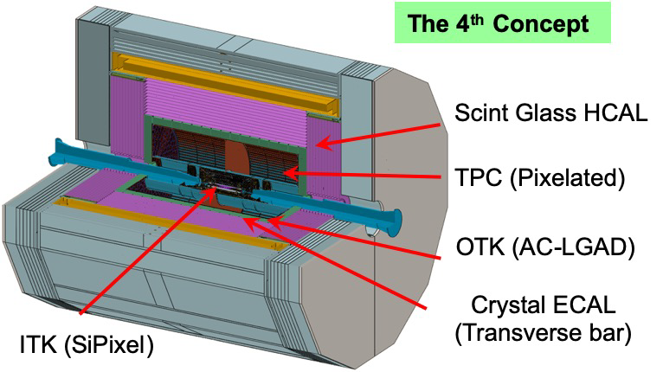
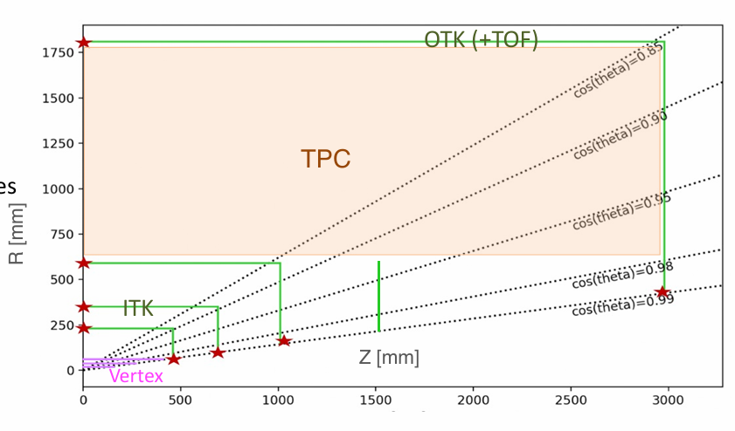
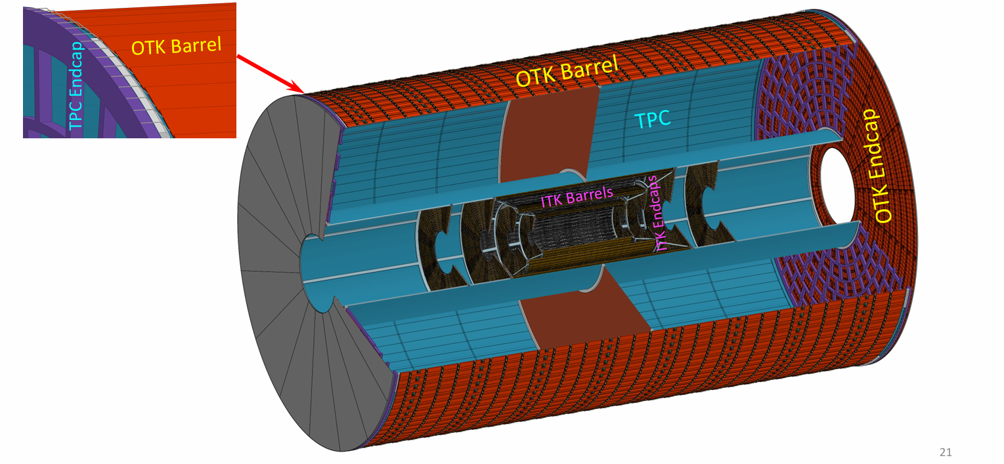
OTKB ~ 70 m², OTKE ~ 20m²

Slide 3
HVCMOS R&D for ITK

Slide 4
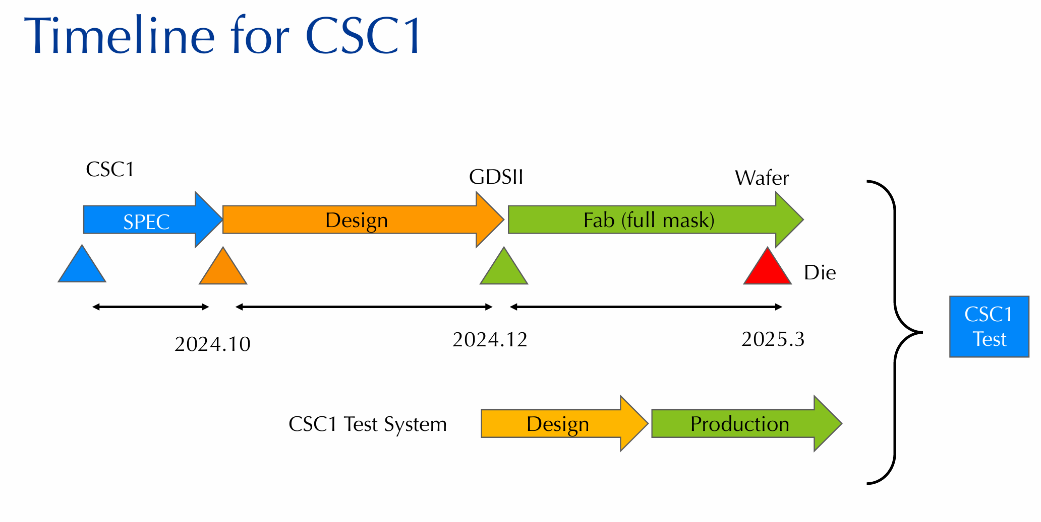

Slide 5
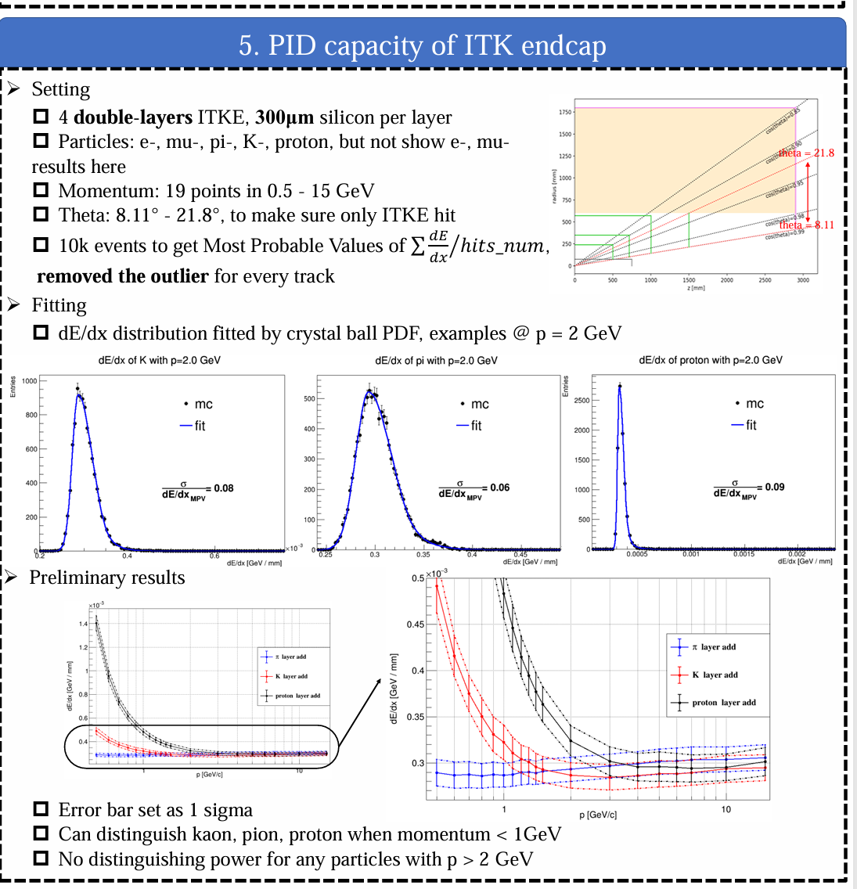

Slide 6
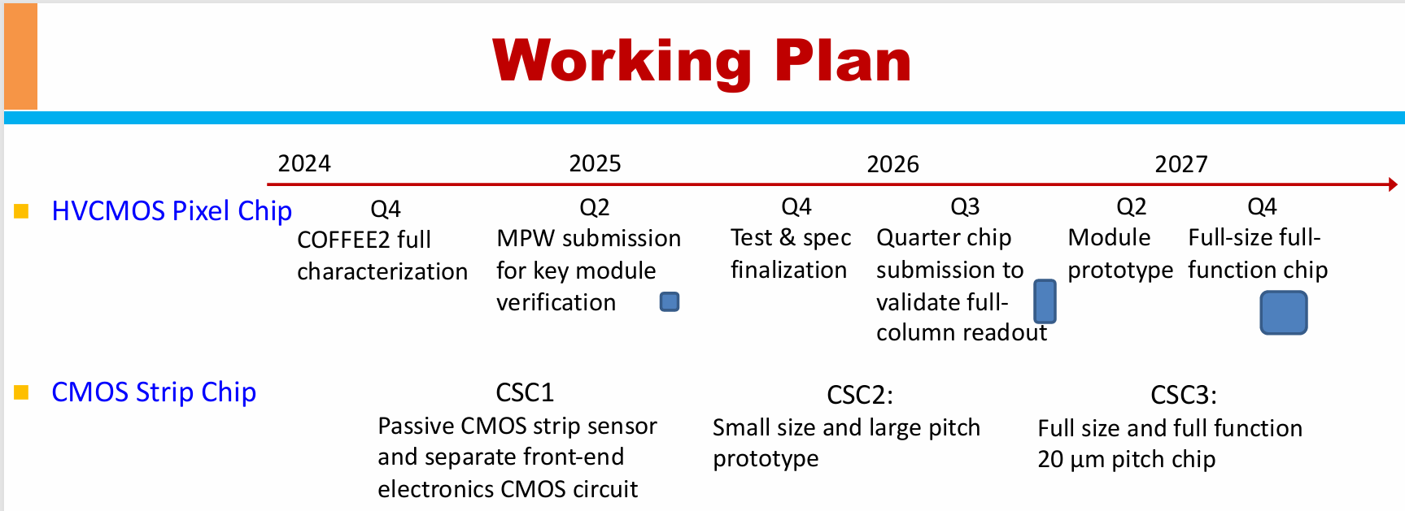

Slide 10
