Slide 1
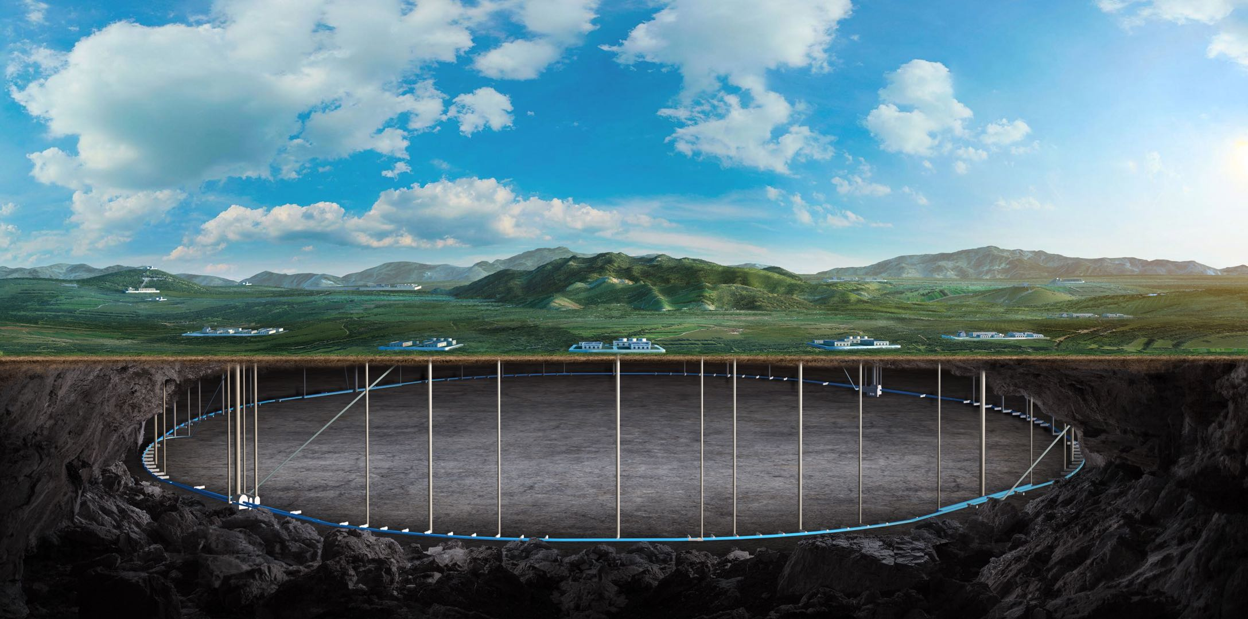
CEPC vertex Detector
Zhijun Liang

Slide 2
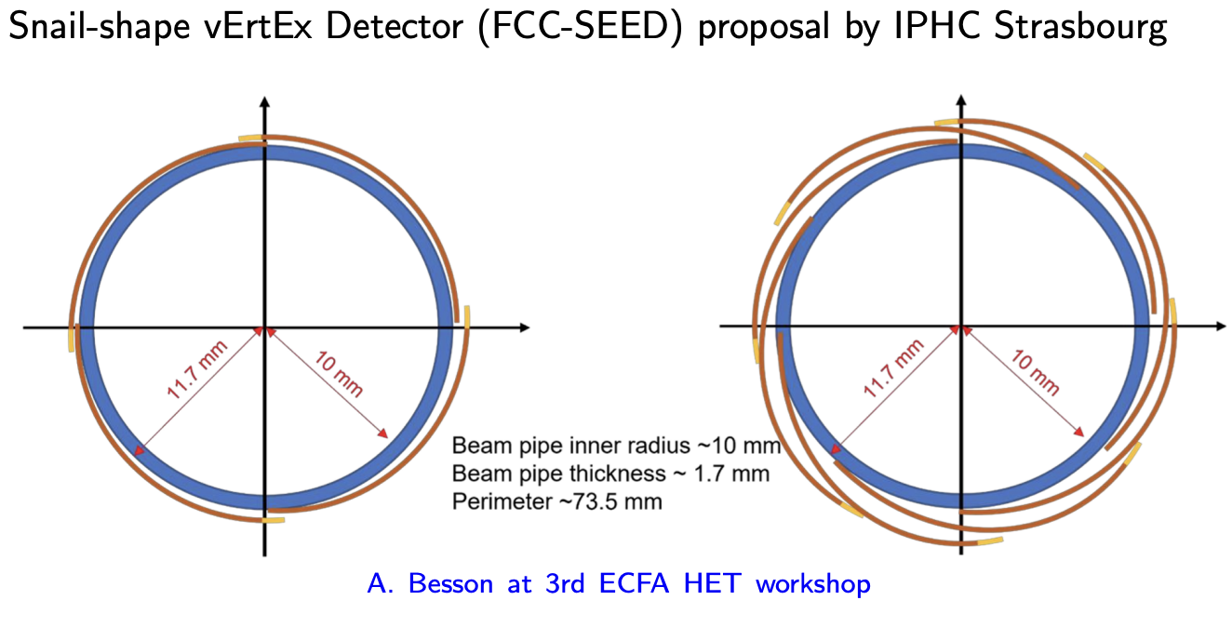
International collaboration
Ying presented CEPC vertex talk in Pixel2024 conference
Feedback is very positive
Meeting with Jérôme Baudot (vertex group leader in IPHC ) in Pixel2024
Agree to collaboration in FCPPL and DRD3 framework
Apply for new proposals for vertex chip R & D in FCPPL and DRD3 projects
Discuss exchanging designers for collaboration
Our people can contribute to TJ 65nm DRD3 common project
Their people can contribute to CEPC vertex chip design
Identified research area:
Digital on top design
Physics layout and performance study

Slide 3
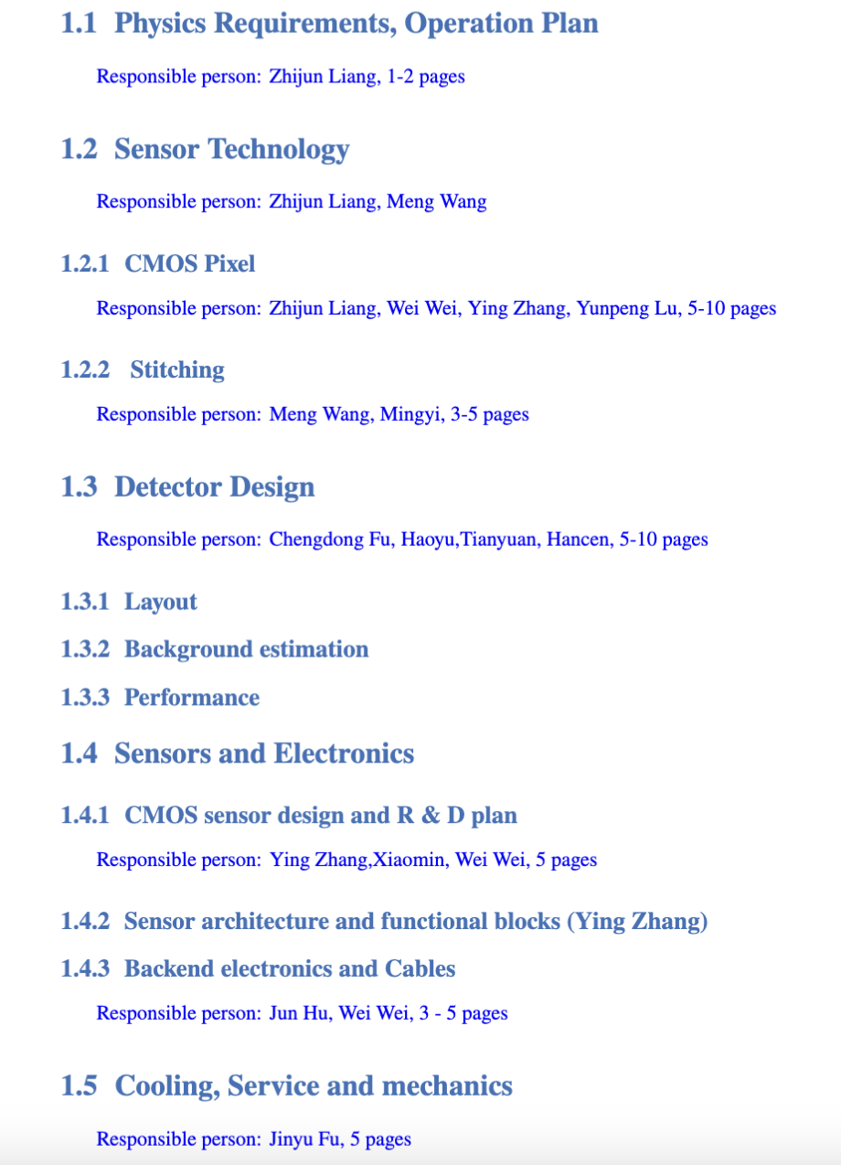
Ref-TDR
R & D part
In progress
Detector design
Physics Layout (50%)
Stitching design (1st draft ready)
Mechanics (in progress, ~ 1 week)
https://latex.ihep.ac.cn/project/6745179fef5108a66841008a

Slide 4
Backup

