Slide 1
Progress and Plan
Mingyi Dong
2024.11.18

Slide 2
Progress last week
 | Planned tasks last week | Time needed (day) | person in charge
1 | MDC HV test and cosmic-ray test | 1/2 | Mingyi Dong | Done
2 | CGEM cosmic-ray test | 1/2 | Italy team | Done
3 | Joint testing of CGEM and MDC | 1/2 | Mingyi Dong, Italy team | Done
4 | Installation of shielding plates for CGEM | 2 | Italy team, Jinyu Fu | Move to next week
5 | Preparation for pushing EEMC to its original position | 1 | Facilities Operation group (Jing Xiaoping) | Move to next week

Slide 3
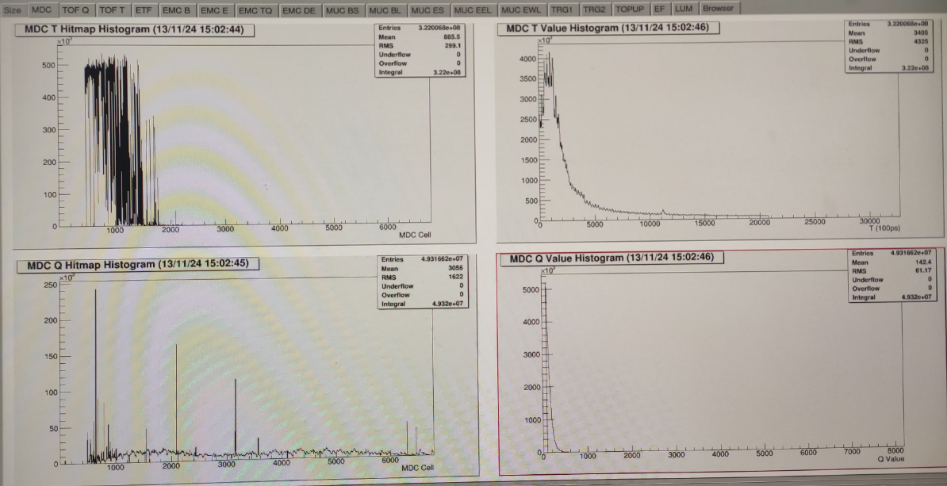
Noise issue during the tests
Nov. 12
Power on electronics and HV of MDC and CGEM simultaneously. Both systems can work
Large noise was found in T measurement of MDC

Slide 4
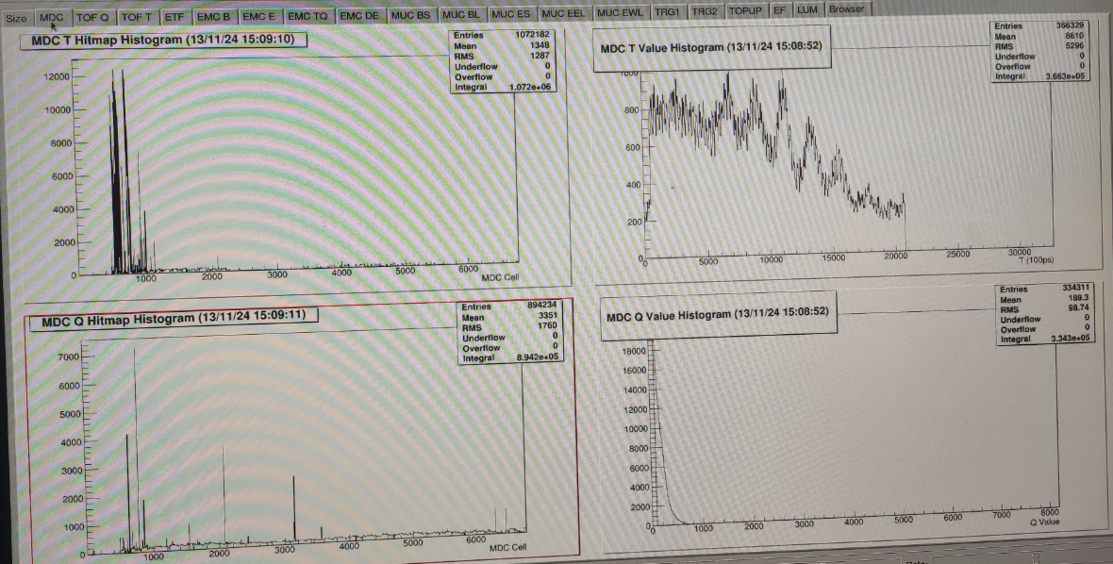
Noise
The noise is mainly in the step part of the drift chamber
The inner layer is the largest, and the outer layer becomes smaller
Noise has a larger impact on time measurement
Noise has a larger impact on the even layers of MDC (readout electronics is at the east end)
Even if CGEM is turned off, there are still a few channels with noise

Slide 5
Testing
Grounding tests
Change the connection of CGEM ground connection, no big change of noise (Giulio)
Removed the preamplifier of MDC from the “tower”, and disconnected the preamplifier from the “tower” ground. Significant change of noise was found
Test noise with a oscilloscope
Time threshold scan

Slide 6
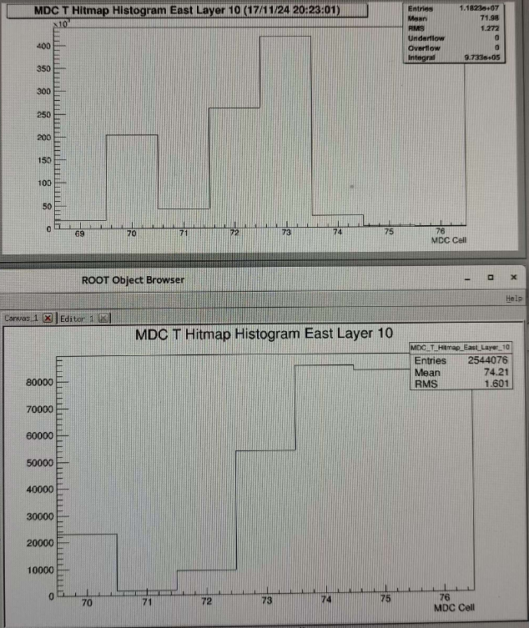
Noise
Removed the preamplifier of MDC from the “tower”, and disconnected the preamplifier from the “tower” ground. Significant change of noise was found
Preamplifier of L10-10
Related to CGEM grounding?
(powered off everything, disconnected the ground, plug –out the power supply. The ground of CGEM and MDC still connect together)

Slide 7
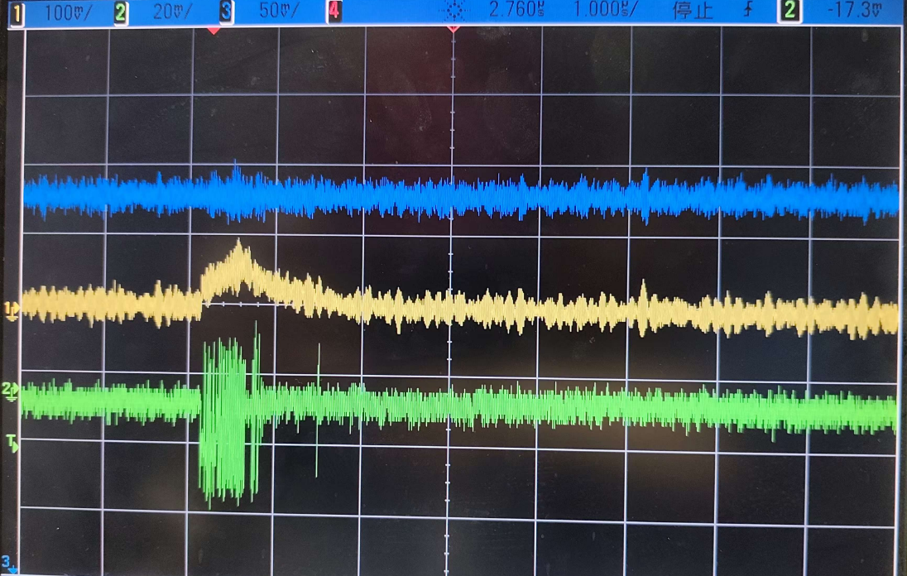
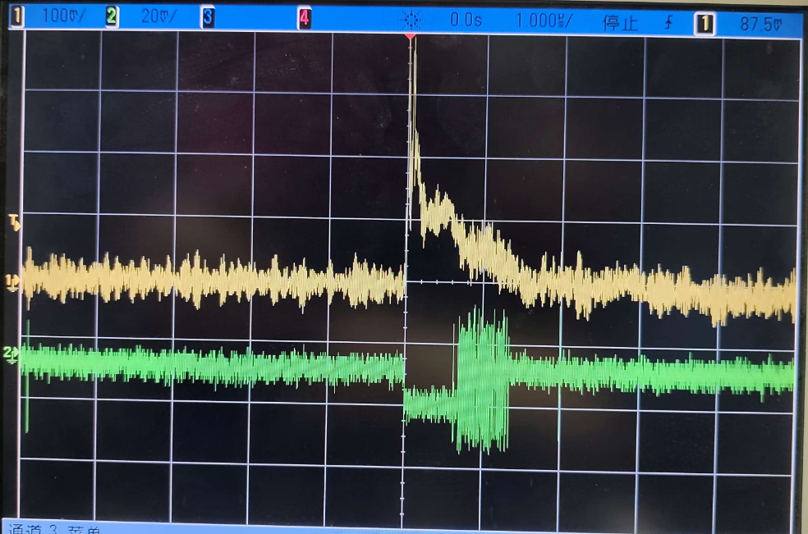
Test noise with oscilloscope
L11-ch1

Slide 8
Plan for next week
 | Tasks | Time needed (day) | person in charge
1 | Joint testing of CGEM and MDC | 2 | Mingyi Dong, Italy team
2 | Test and reduce the noise | 5 | Mingyi Dong, Italy team
3 | Trial Installation of shielding plates for CGEM | 2 | Italy team, Jinyu Fu

Slide 9
Backup

Slide 10
Schedule (may be updated each week)
No. | tasks | Duration（day） | Start time and stop time | Sub-system involved | Status
1 | Removal of equipment of machine |  | July 1- Aug. 6 | Utility, Small angle lum. Detector and ZDD, Beam pipe, slow control | done
2 | Pull-out of EEMC |  |  | Utility, EMC, TOF, MDC | done
3 | Removal of inner chamber（Operate simultaneously on both sides ） | 51 | Aug. 7- Sep.7 Sep.8- Sep. 28 | MDC, MDC electronics, Gas, Mechanics, Laser measurement group, Trigger, DAQ, Slow control | done
4 | Installation of CGEM | 44 | Sep.29- Nov. 13 | CGEM group, MDC, MDC electronics, Gas, Mechanics, Laser measurement group, Trigger, DAQ, Slow control | On Schedule
5 | Recover EEMC |  | Nov. 14-Dec.30 | Utility, EMC, TOF, MDC | Plan to change the start date from Nov. 12 to Nov. 29
6 | Recover equipment of machine |  |  | Utility, Small angle lum. Detector, ZDD, Beam pipe, slow control
total |  | 180 days | July 1- Dec.30

