Slide 1
Three ionization measurement methods
Updated methods
Counting Method
Distance Method
Energy Method
Previously we use the counting method for the dN/dx reconstruction
Two more methods (distance method and energy method) are being investigated

Slide 2
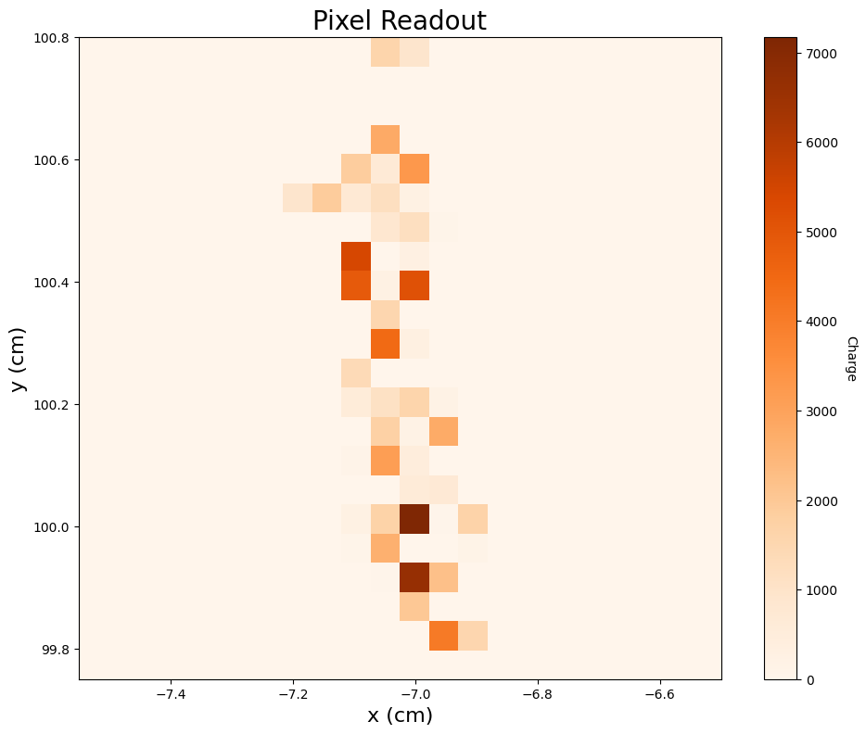
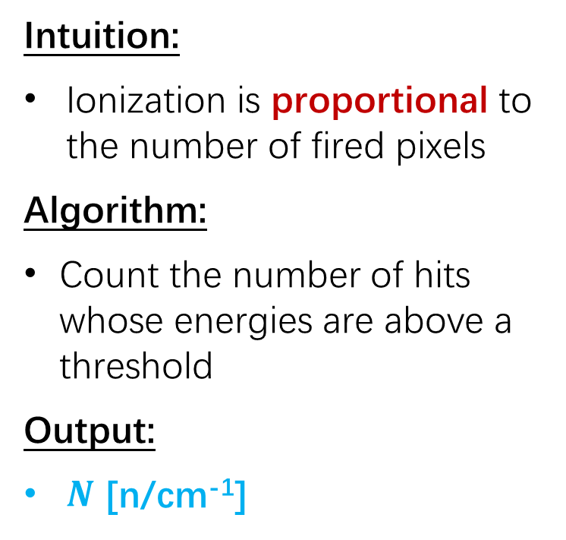
Counting method
Intuition:
Ionization is proportional to the number of fired pixels
Algorithm:
Count the number of hits whose energies are above a threshold
Output:
$N$ [n/cm⁻¹]

Slide 3


Distance method
Track
d: Projected distance w.r.t. to the track direction
Intuition:
Ionization is inverse proportional to the average distance between hits
Algorithm:
Sort the hits along the track direction
Calculate the projected distances with respect to the track direction between adjacent hits
Average the distances and take the reciprocal
Output:
$D$ [cm⁻¹]

Slide 4
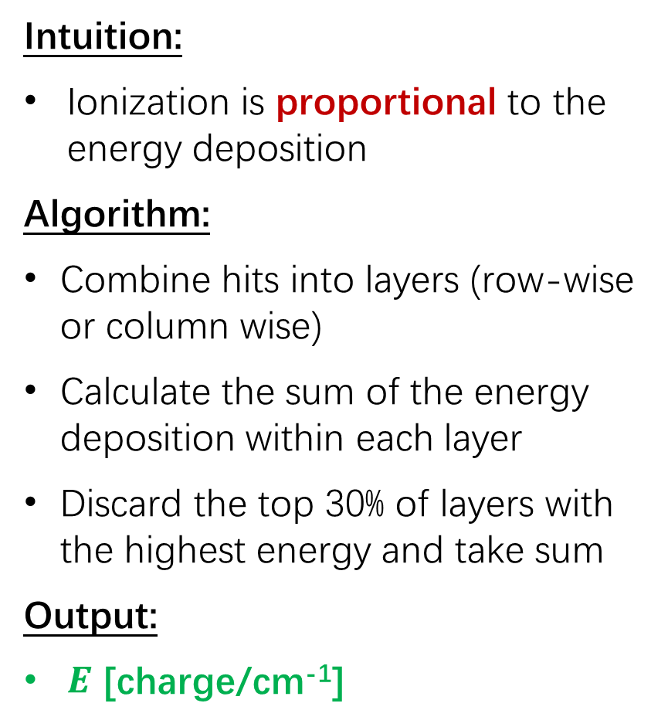
Energy method
Intuition:
Ionization is proportional to the energy deposition
Algorithm:
Combine hits into layers (row-wise or column wise)
Calculate the sum of the energy deposition within each layer
Discard the top 30% of layers with the highest energy and take sum
Output:
$E$ [charge/cm⁻¹]
Sum the energies over a layer

Slide 5
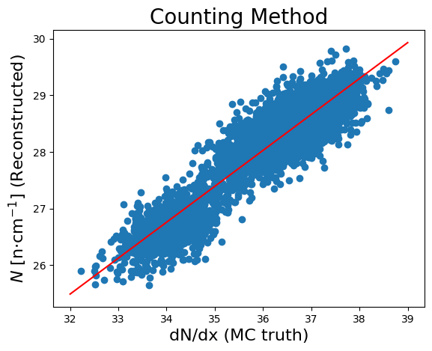
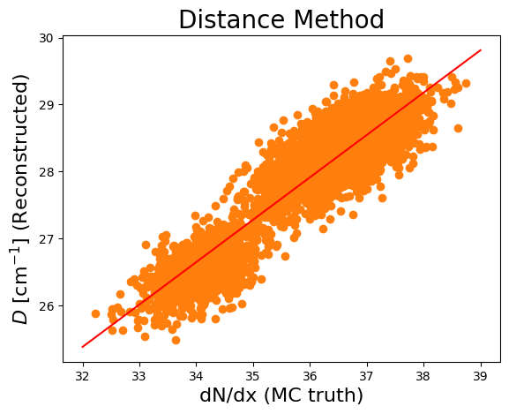
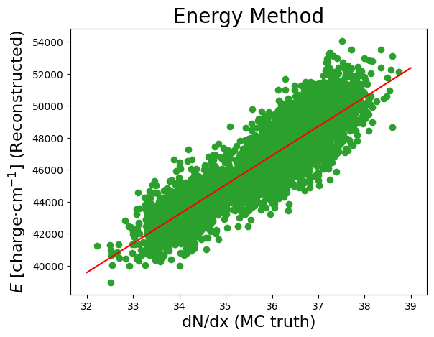
Reconstructed variables vs. MC truth
Drift distance = 10 cm
The reconstructed variables have good linearities w.r.t. the MC truth, which means they can be used for reconstruction

Slide 6
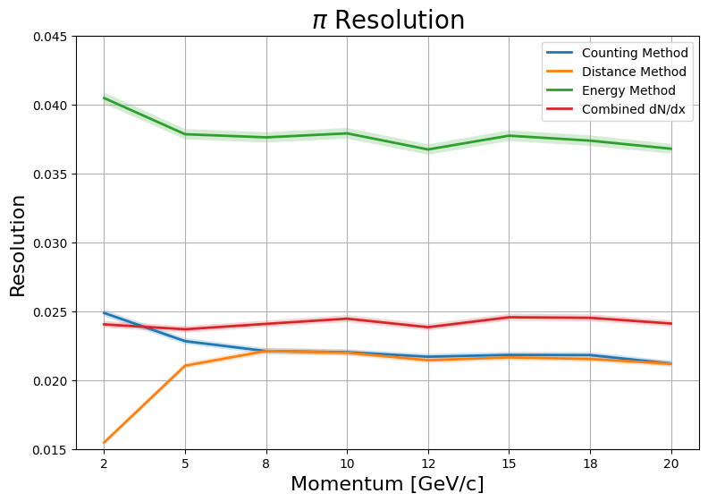
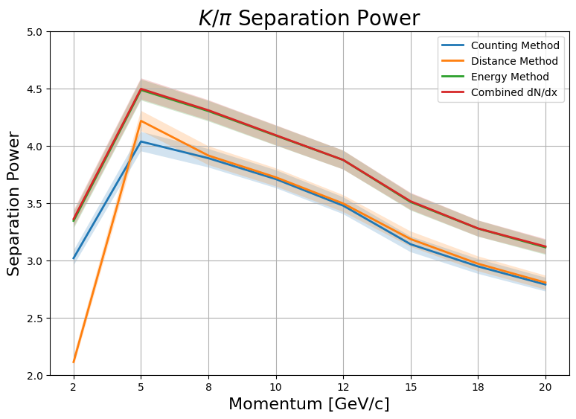
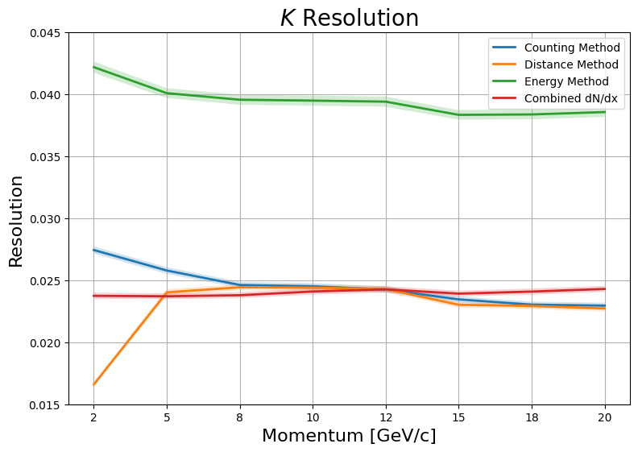

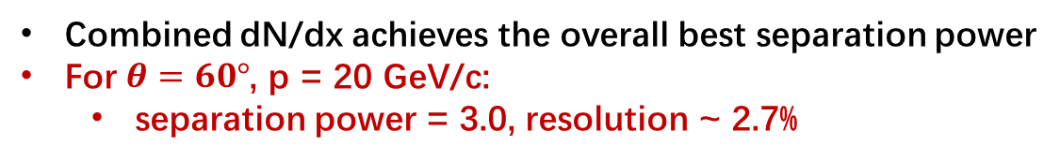
PID performances (II)
$θ=60°$, track length ~ 1.4 m
Combined dN/dx achieves the overall best separation power
For $θ=60°$, p = 20 GeV/c:
  separation power = 3.0, resolution ~ 2.7%

Slide 7
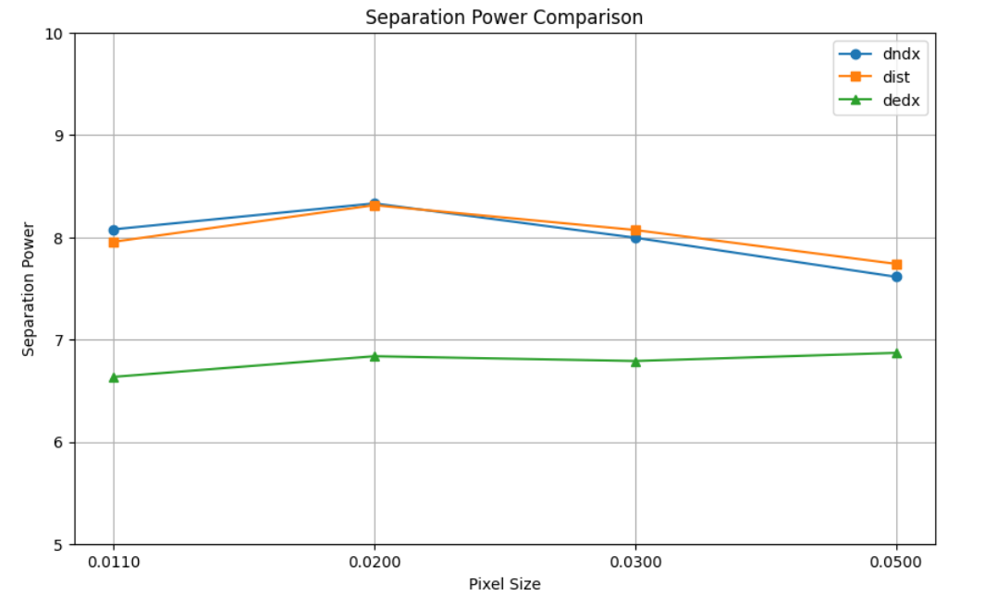
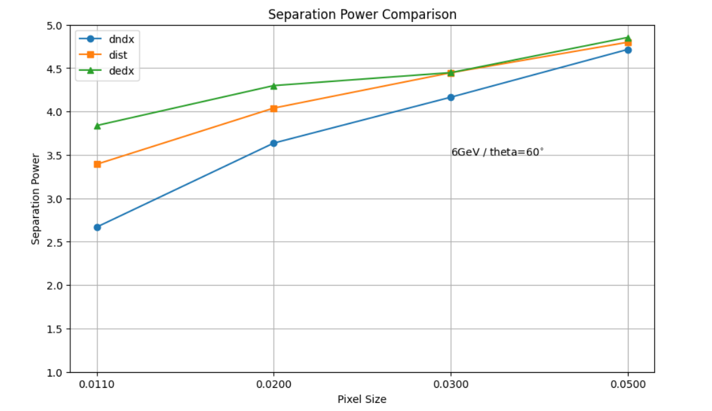
PID performances (III)
performance with different pixel size(using primary ionization infomation)
performance with different pixel size(using full ionization infomation)
Secondaries have a significant impact on the reconstruction results.

Slide 8
