Slide 1
Average speed of sound in neutron stars
Michał Marczenko
arxiv:2407.15486
Xuefeng Ma
2024.11.22

Slide 2
1.Introduction
2.Results
3.Summary

Slide 3
Introduction
The equation of state(EOS): $p(ε)$, provides a relationship between the thermodynamics pressure $p$ and the energy density $ε$.
Speed of sound: $c_{s}^{2}$, its derivative with respect to the energy density.
At low temperature,
The low-density EOS$←$chiral effective field theory; $c_{s}^{2}<1/3$
Asymptotically $←$ pQCD; $c_{s}^{2}→1/3$
The density range found in neutron stars (NSs) is not accessible
by any of these methods.

Slide 4
Speed of sound exhibits a local maximum
Rapid increase in the speed of sound beyond its conformal value in dense matter
is associated with rapid disappearance of trace anomaly.
What is the consequences of the vanishing of the trace anomaly?

Slide 5
Average speed of sound in neutron stars
Speed of sound: $c_{s}^{2}≡\frac{dp}{dε} (1)$, $0≤c_{s}^{2}≤$1
Connection between the speed of sound and trace anomaly $∆$
$$c_{s}^{2}=\frac{1}{3}−∆−∆^{′} (2)$$
Where the trace anomaly scaled by the energy density reads
$$∆=\frac{ε−3p}{3ε}=\frac{1}{3}−\frac{p}{ε} (3)$$
and its derivative is
$$∆^{′}=\frac{d∆}{dlnε}=ε\frac{d∆}{dε} (4)$$

Slide 6
Average speed of sound in neutron stars
The ratio of the central pressure to the central density in NSs can be reinterpreted as the average speed of sound as follows:
$$\left\langle c_{s}^{2}\right\rangle =\frac{1}{ε}\int_{0}^{ε}{dε^{′}c_{s}^{2}=\frac{1}{ε}\int_{0}^{ε}{dε^{′}\frac{dp}{dε^{′}}=\frac{p}{ε}}} (5)$$
the average speed of sound over energy interval $\left\langle 0,ε\right\rangle$, and$0≤\left\langle c_{s}^{2}\right\rangle ≤1$.
Using Eq.(5), rewrite Eq.(2) and (3) : $$∆=\frac{1}{3}−\left\langle c_{s}^{2}\right\rangle , \left(6\right)$$
$$∆^{′}=\left\langle c_{s}^{2}\right\rangle −c_{s}^{2}, (7)$$
∆ increases when $c_{s}^{2}$ is smaller than $\left\langle c_{s}^{2}\right\rangle$ and decreases when $c_{s}^{2}$ is larger than $\left\langle c_{s}^{2}\right\rangle$.

Slide 7
Average speed of sound in neutron stars
$$∆=\frac{1}{3}−\left\langle c_{s}^{2}\right\rangle , \left(6\right)$$
$$∆^{′}=\left\langle c_{s}^{2}\right\rangle −c_{s}^{2}, (7)$$
The restoration of conformal symmetry requires a simultaneous convergence of $c_{s}^{2}$ and $\left\langle c_{s}^{2}\right\rangle$ to $1/3$.
The trace anomaly vanishes when $\left\langle c_{s}^{2}\right\rangle$ reaches $1/3$, which means that it must exceed the conformal value at smaller energy densities.

Slide 8
Consequences of vanishing trace anomaly
Assume that the trace anomaly vanishes at some finite energy density $ε_{c}$,
$$∆_{c}=0↔{\left\langle c_{s}^{2}\right\rangle }_{c}=1/3$$
If the EOS is known up to ${ε_{l}<ε}_{c}$, the average can be separated into two segments,
Namely
$$\begin{aligned}{\left\langle c_{s}^{2}\right\rangle }_{c}&=\frac{1}{ε_{c}}\int_{0}^{ε_{c}}{dε^{′}c_{s}^{2}=}\frac{1}{ε_{c}}\int_{0}^{ε_{l}}{dε^{′}c_{s}^{2}+\frac{1}{ε_{c}}\int_{ε_{l}}^{ε_{c}}{dε^{′}c_{s}^{2}}} \\ ={\left\langle c_{s}^{2}\right\rangle }_{l}\frac{ε_{l}}{ε_{c}}+α\left(1−\frac{ε_{l}}{ε_{c}}\right)=\frac{1}{3} (10)\end{aligned}$$
Where${\left\langle c_{s}^{2}\right\rangle }_{l}={p_{l}}/{ε_{l}}$ is the average speed of sound over the energy interval $\left\langle 0,ε_{l}\right\rangle$
and is assumed to be known, and
$$α=\frac{1}{ε_{c}−ε_{l}}\int_{ε_{l}}^{ε_{c}}{dεc_{s}^{2}} \left(11\right) α=\frac{{\left\langle c_{s}^{2}\right\rangle }_{c}−{\left\langle c_{s}^{2}\right\rangle }_{l}{ε_{l}}/{ε_{c}}}{1−{ε_{l}}/{ε_{c}}} (12)$$

Slide 9
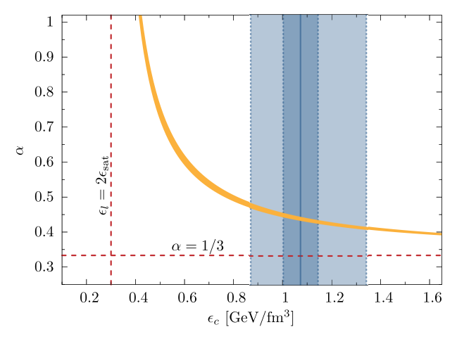
Results
One can use the low-density EOS to determine the value of $α$ and estimate the lower bound for the maximum of speed of sound in the cores of NSs.
$$α=\frac{{\left\langle c_{s}^{2}\right\rangle }_{c}−{\left\langle c_{s}^{2}\right\rangle }_{l}{ε_{l}}/{ε_{c}}}{1−{ε_{l}}/{ε_{c}}} (12)$$
The author requires that $ε_{c}$ has to reproduce the estimated central energy density of maximally massive neutron stars, which yields $α=0.41−0.49.$
Indicating that the speed of sound exceeds the conformal value at energy densities between $ε_{l}$ and $ε_{c}$.

Slide 10
Results
Eq. (10) can also be used to estimate the minimal value of ${\left\langle c_{s}^{2}\right\rangle }_{c}$ for which $α≥1/3$.
Taking the same $χ$EFT constraint, ${\left\langle c_{s}^{2}\right\rangle }_{c}≥0.26$ at the 95% confidence level of $ε_{TOV}$.
$$∆_{c}≤0.07$$
Consequences of vanishing trace anomaly
The assumption that the trace anomaly is non-negative $0≤\left\langle c_{s}^{2}\right\rangle {≤1}/3$
Under the assumption that $∆≥0$ at all densities, the average speed of sound cannot exceed 1/3 and the speed of sound must develop a local maximum above $c_{s}^{2}=\frac{1}{3}$ at energy density $ε≤ε_{c}$.

Slide 11
Summary
The large speed of sound is a consequence of the restoration of conformal symmetry in the heaviest NSs.
The existence of the peak in speed of sound could be potentially linked to the positive definiteness of the trace anomaly.

