Slide 1
Baseline for SiPM readout
Reuse the ASIC scheme from ECAL or HCAL
Revise according to the constraints from cooling and mechanical structure of the detector

Slide 2
Alternative: discrete device scheme
FEB (Front-end Electronics Board)
  Commercial chips with radiation tolerance based on past studies for particle physics experiments
  FPGA based TDC for TOA and TOT measurement with ~1 ns time resolution
  ADC for charge measurement or TOT calibration
  DAC for threshold setting or SiPM bias voltage adjustment

Slide 3
Near-term test environment
Reuse JUNO-TAO electronics for readout, clock synchronization and TDAQ
  To accelerate the development schedule

Slide 4
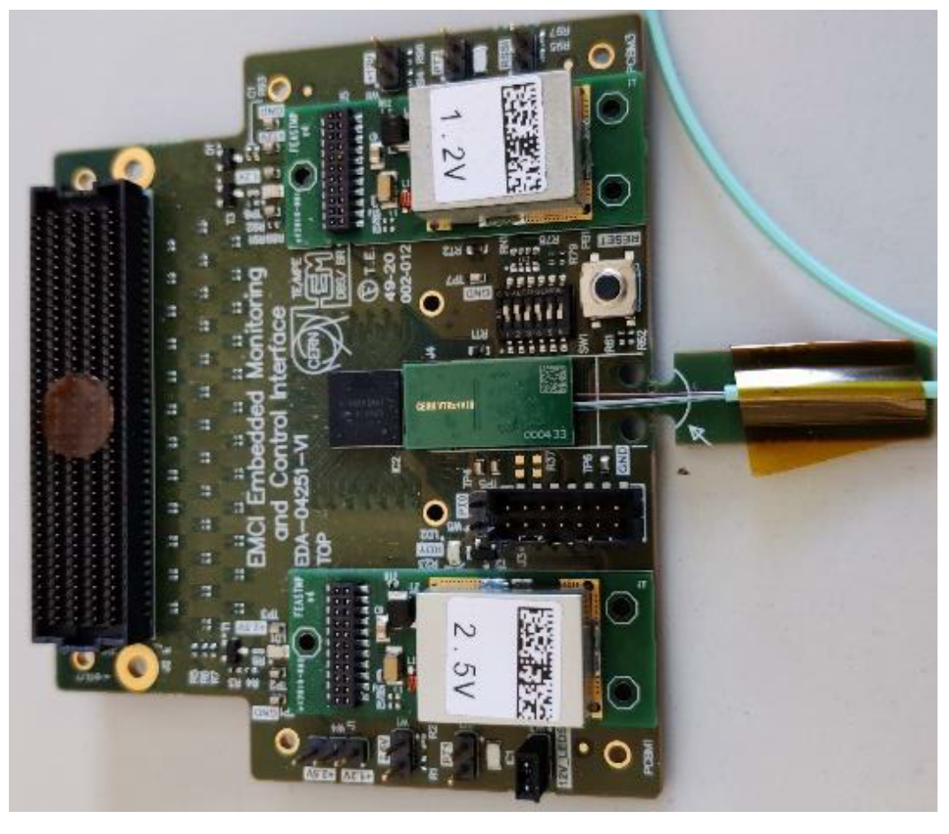
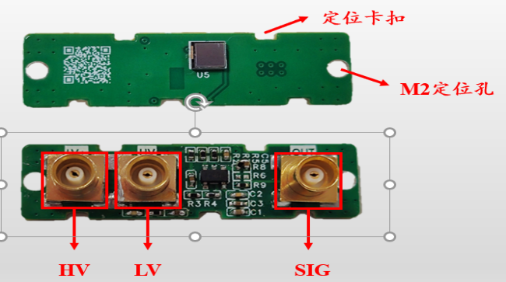
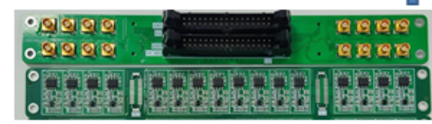
Stage scheme (M x N x O)
SiPM
AMP
Discri
TDC
8~16 ch
Data aggregation
Data Link
Optical Module
TDAQ
LV-3
LV-2
LV-1
LV-2
HV-1
HV-Filter
HV-2
FEE
xM
xN
xO
Example:
For each module
For each ch
For each sector

Slide 5
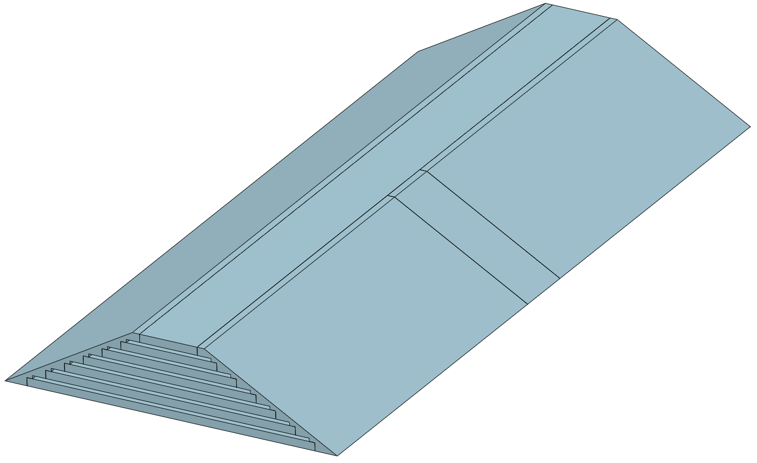
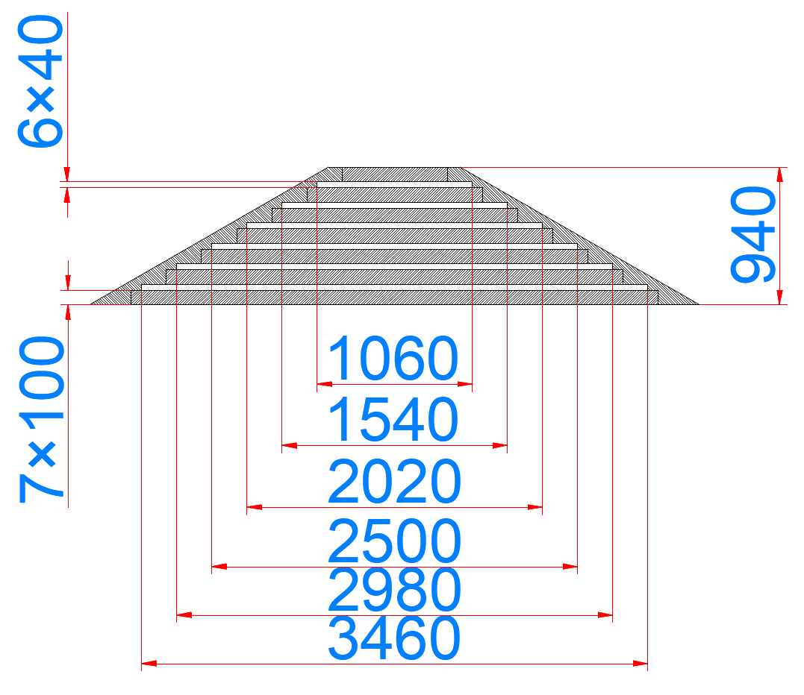
Barrel sector
A
 | M | N |  | O
 | ch | 32-ch TDC board | Raw data rate / bps | Aggregation board
A | 336 | 13 | 161.28 M | 1
B | 663 | 24 | 318.24 M | 1
Total per sector | 1998 | 74 | 959.04 M | 4
Total barrel (12 sectors) | 23976 | 888 | 11.51 G | 48
B
B
A

Slide 6
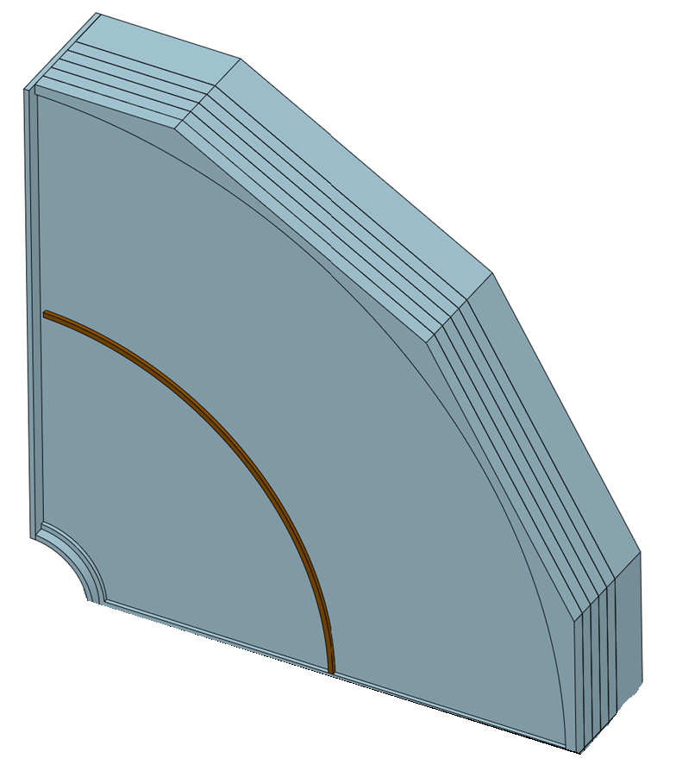
Endcap quadrant
 |  | M | N |  | O
 |  | ch | 32-ch TDC board | Raw data rate / bps | Aggregation board
Inner | sector | 72 | - | - | -
 | quadrant | 288 | 9 | 276.5 M | 1
 | endcap | 3456 | 36 | 3.32 G | 4
 | Total | 6912 | 72 | 6.64 G | 8
Outer | sector | 128 | - | - | -
 | quadrant | 1536 | 48 | 737.3 M | 2
 | endcap | 6144 | 192 | 2.95 G | 8
 | Total | 12288 | 384 | 5.90 G | 16

Slide 7
Bandwidth requirement
Muon | Readout Channel | Hit rate/Hz (preliminary worst case) | Data format | Raw data rate / Gbps
Barrel | 23976 | 10 k | 48bit (8b BX+ 10b ADC + 2b range + 9b TOT + 7b TOA+ 4b chn ID + 8b chip ID) | 11.51
Inner endcaps | 6912 | 10k~100 k, Average 20 k |  | 6.64
Outer endcaps | 12288 | 10 k |  | 5.90
Total | ~43.2 k |  |  | ~24.04

Slide 8
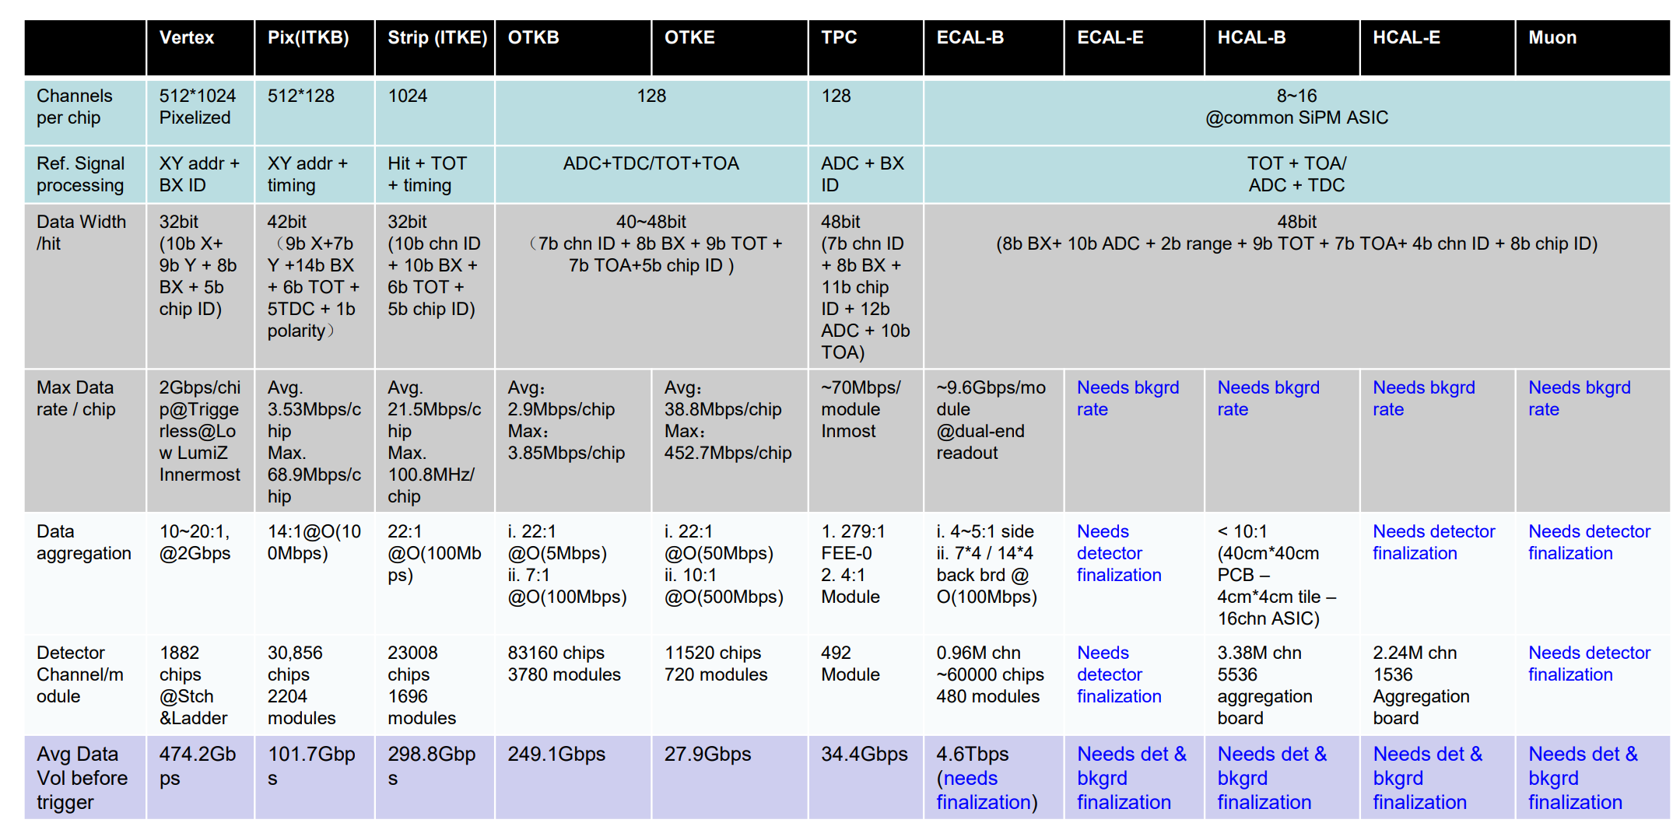
bandwidth requirement
Avg. 15.36 Mbps/chip
Max. 153.6 Mbps/chip
<=24:1
@ O (368.7 Mbps)
43.2k ch
72 Aggregation board
~ 24.04 Gbps

Slide 9
Backup

Slide 10
