Slide 1
Group Meeting
Ziyu Liu
liuziyu@mail.nankai.edu.cn

Slide 2
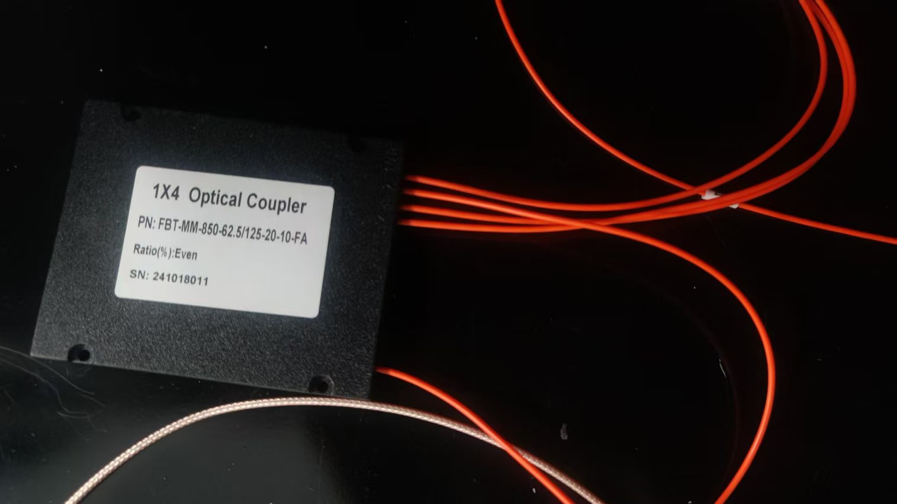
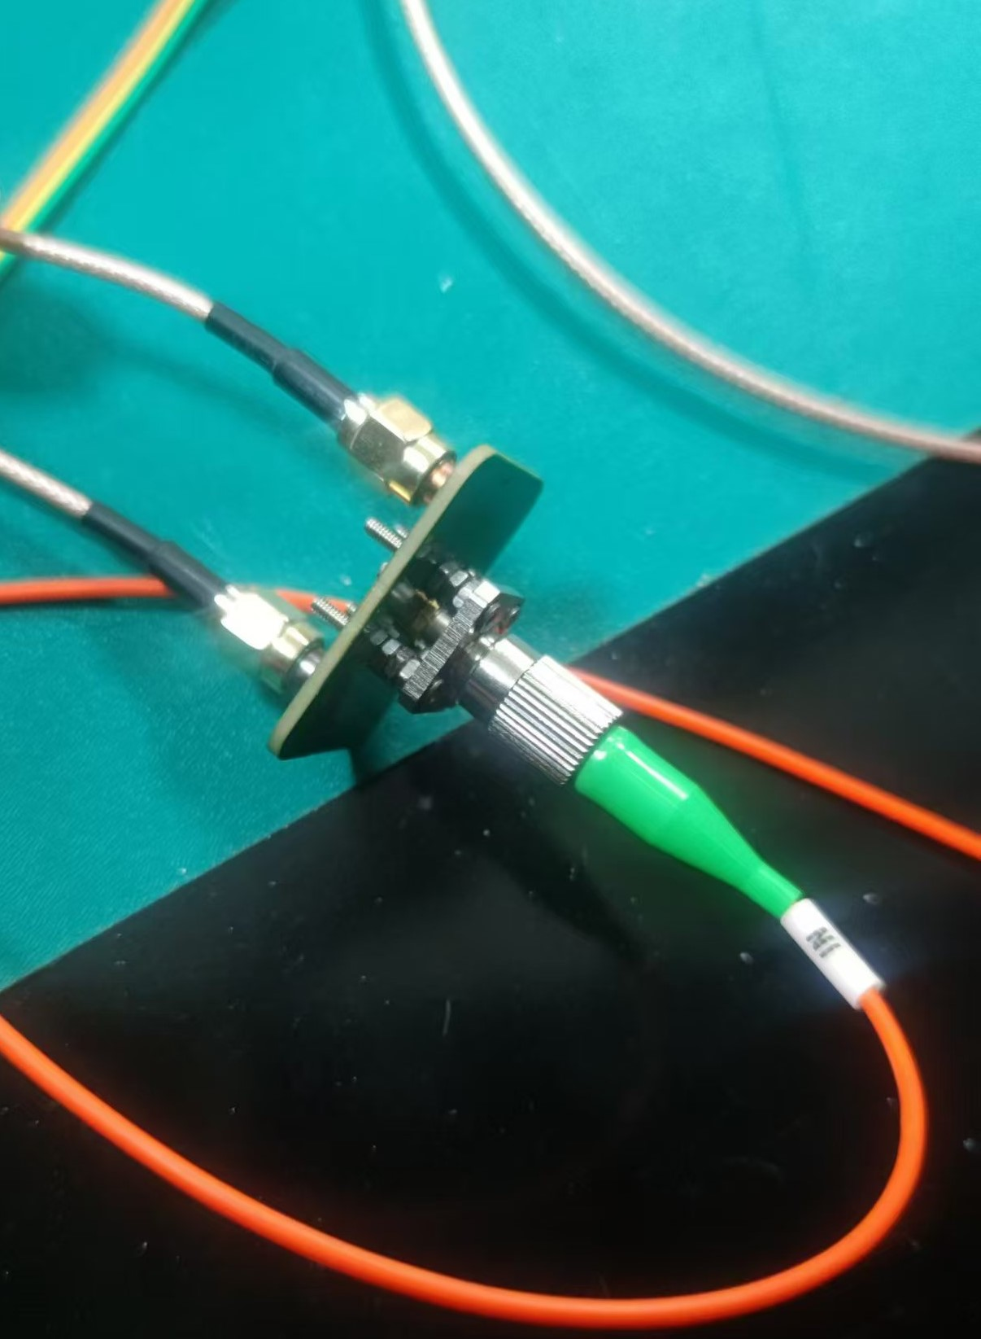
Laser calibration system
做了一个激光分束的组件，如左图所示，LD和光纤中间使用一个法兰连接。光纤分束器如右图所示，这是一个1x4的光纤分束器，工作波长在850 nm。

Slide 3
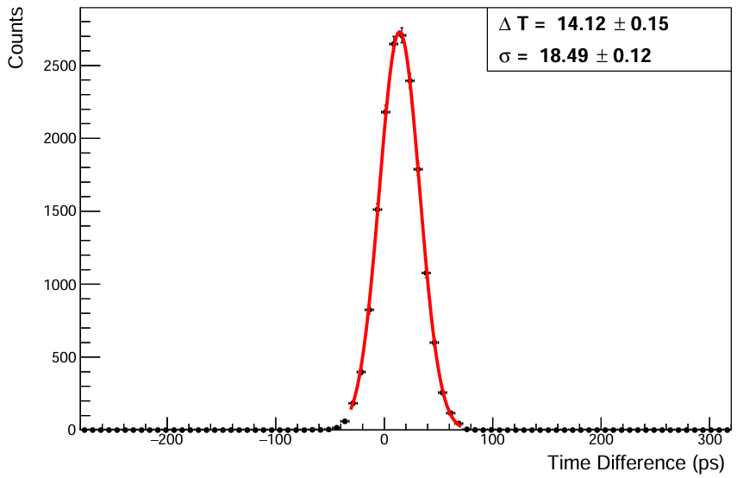
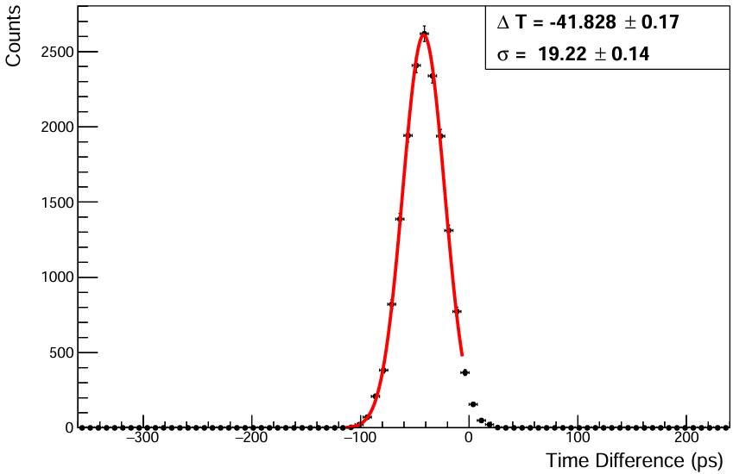
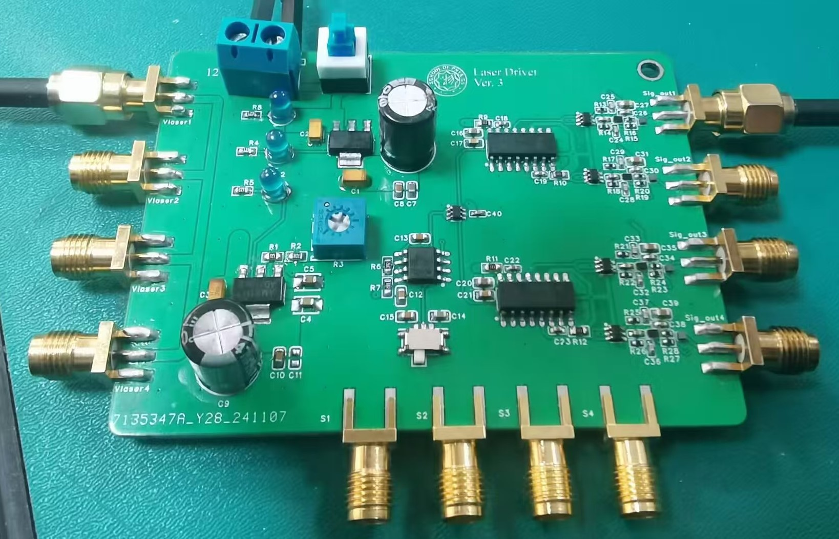
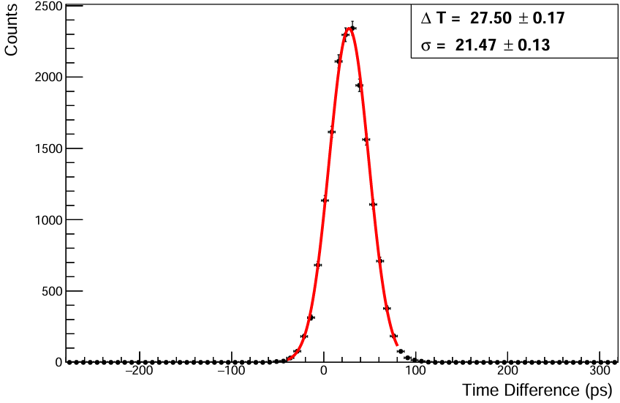
Laser calibration system
laser
ΔT=T_{n}-ΣT/3
Bias voltage 13 V
time difference (ΔT) between two channels

Slide 4
Back up

Slide 5
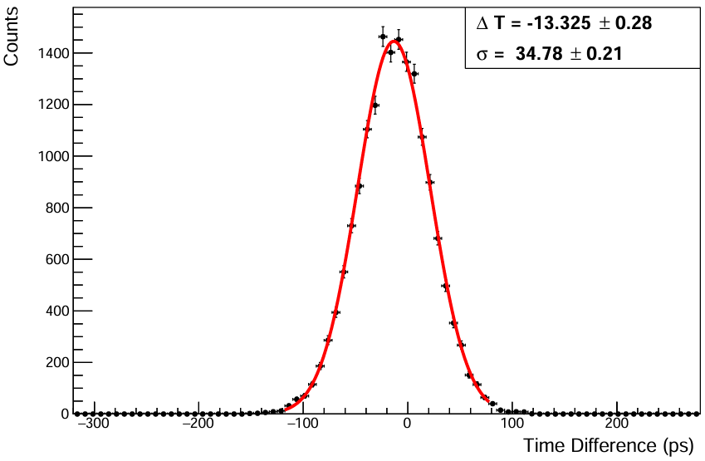
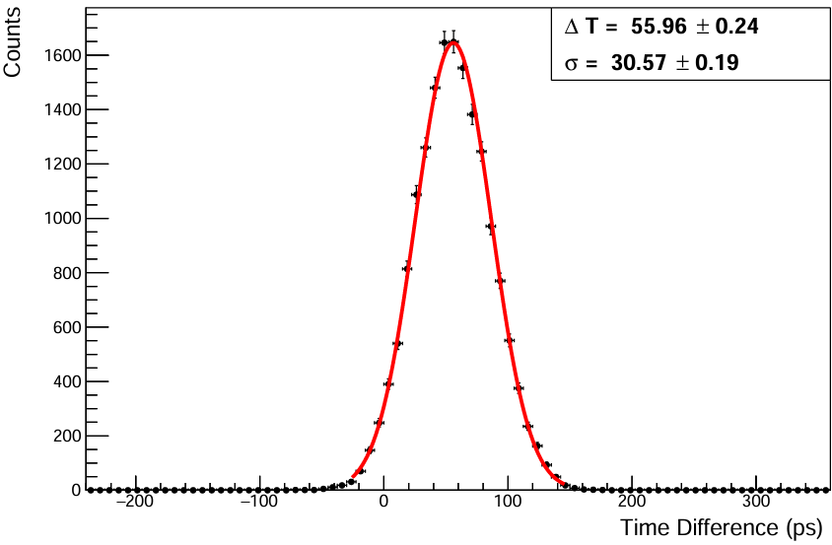
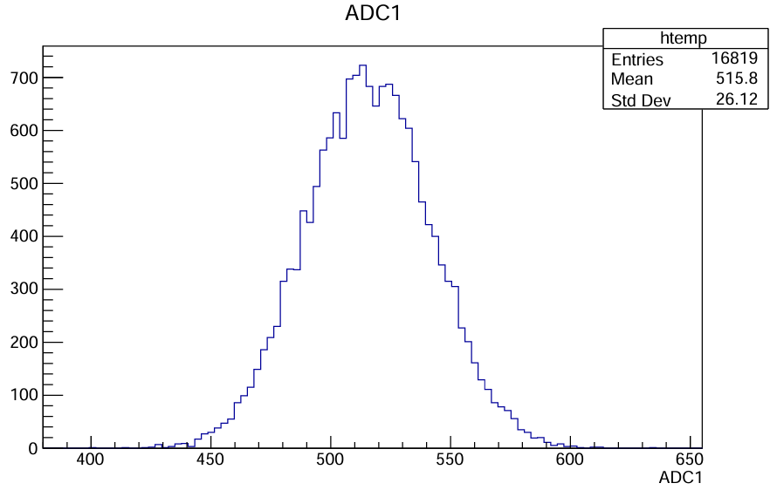
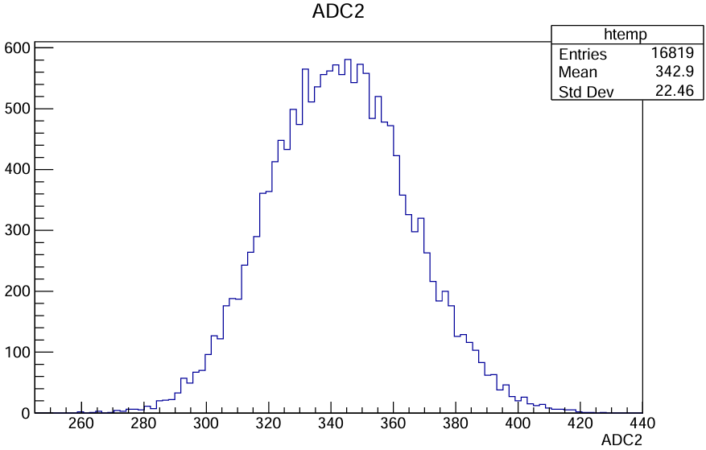
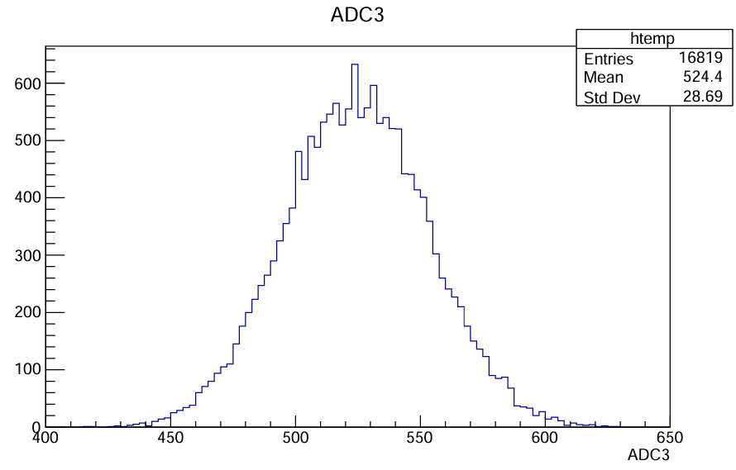
Δt
ΔT=T_{n}-T_{m}
ADC
Bias voltage 13 V

Slide 6
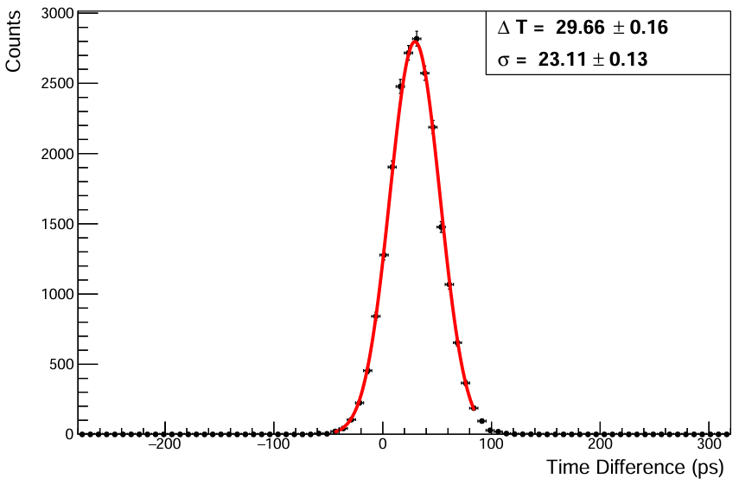
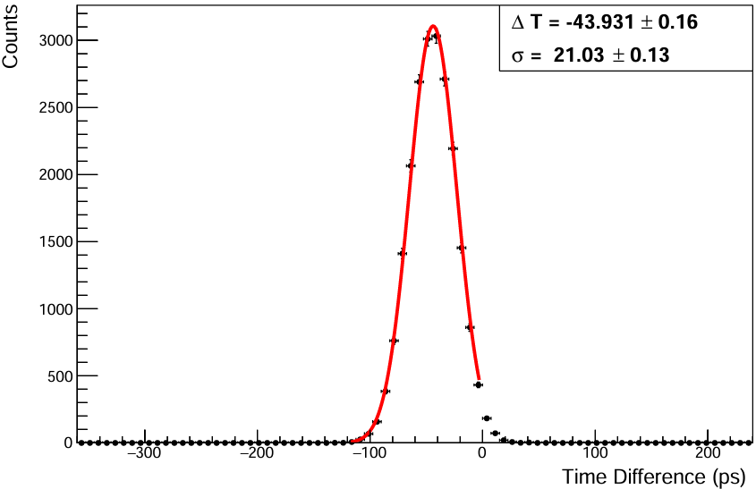
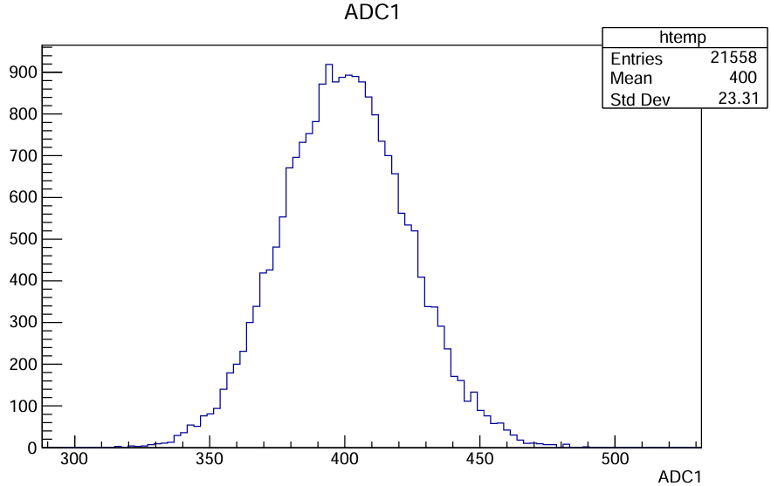
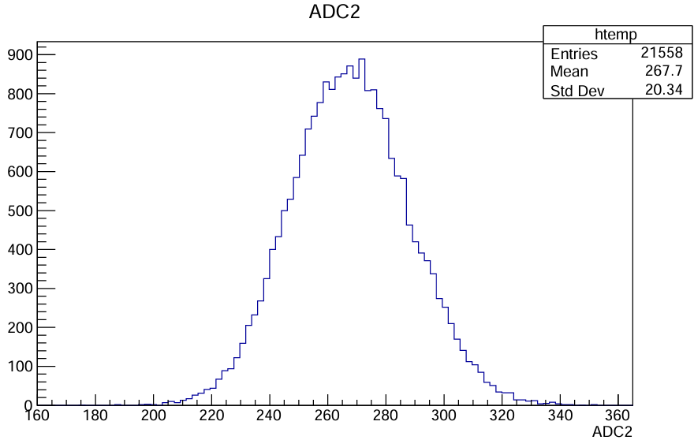
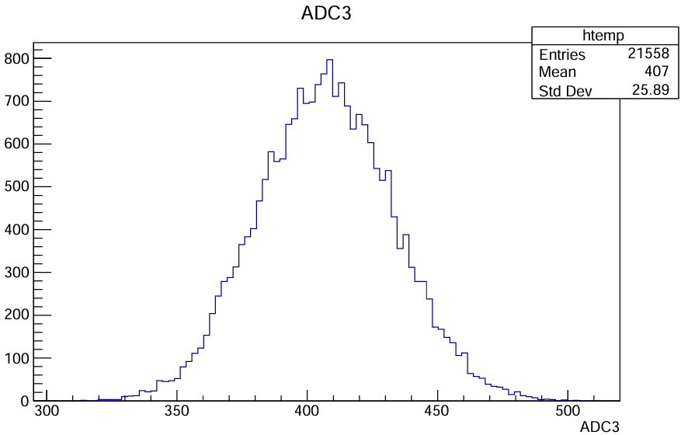
Δt
ADC
ΔT=T_{n}-ΣT/3
Bias voltage 12 V~

Slide 7
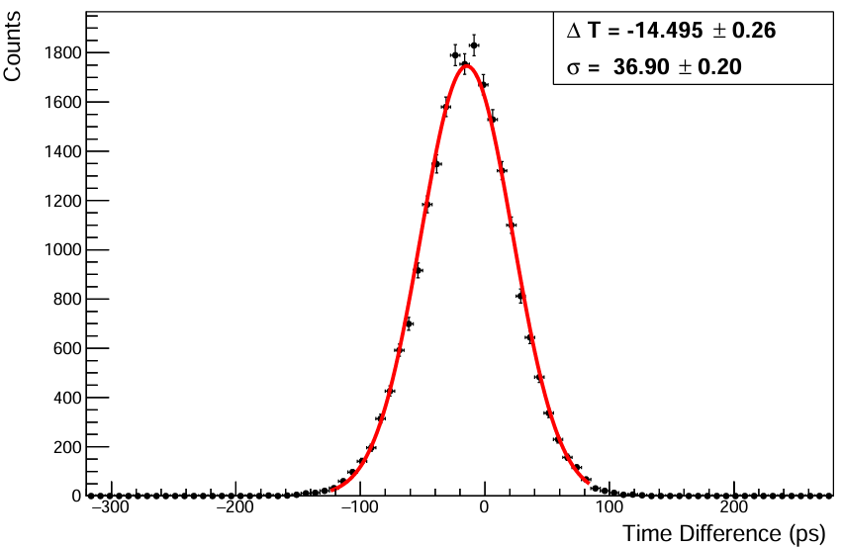
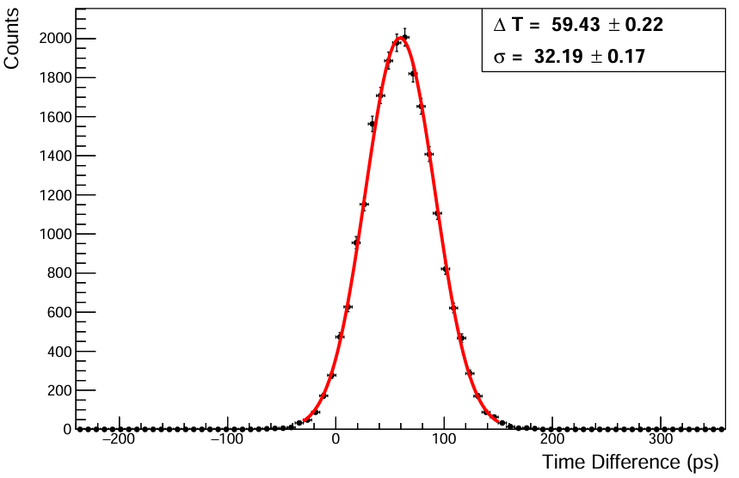
Δt
ΔT=T_{n}-T_{m}
Bias voltage ~12 V

Slide 8
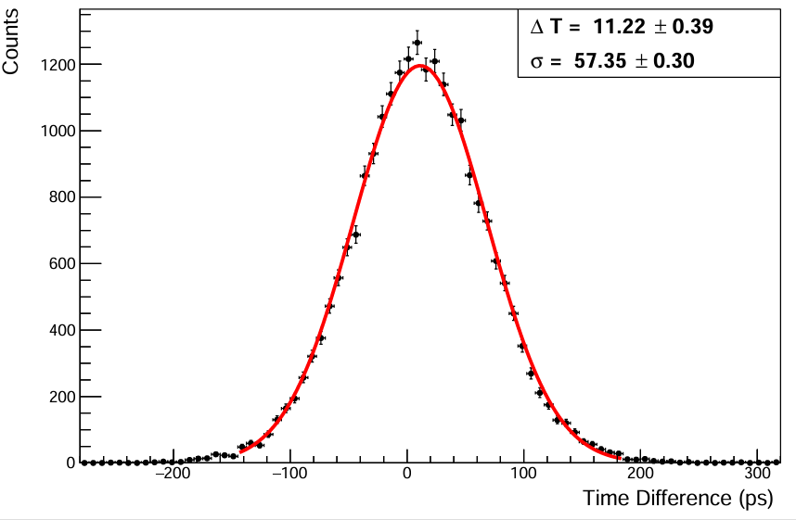
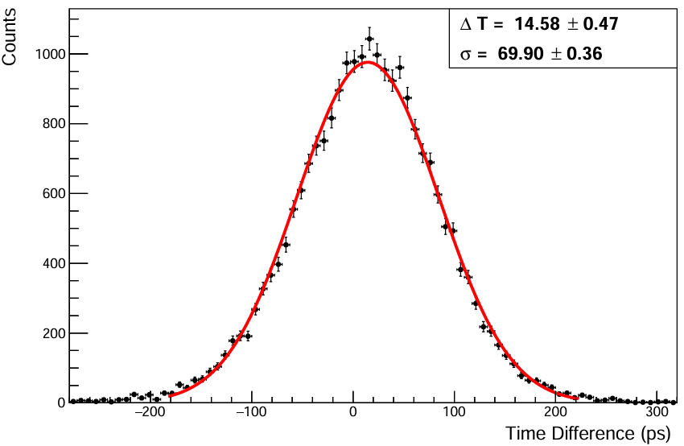
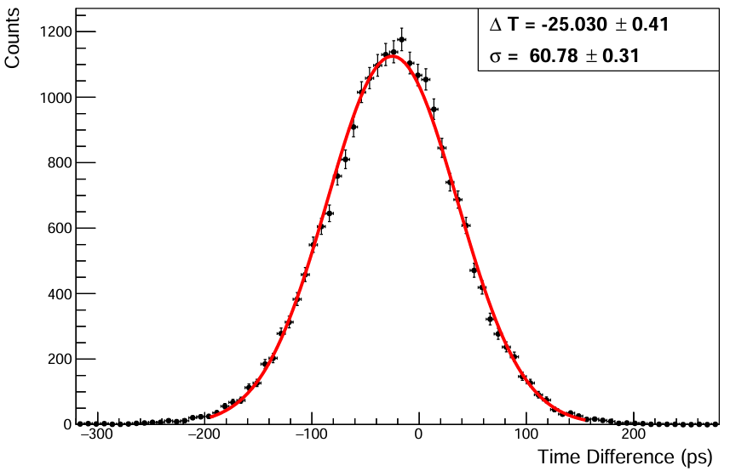
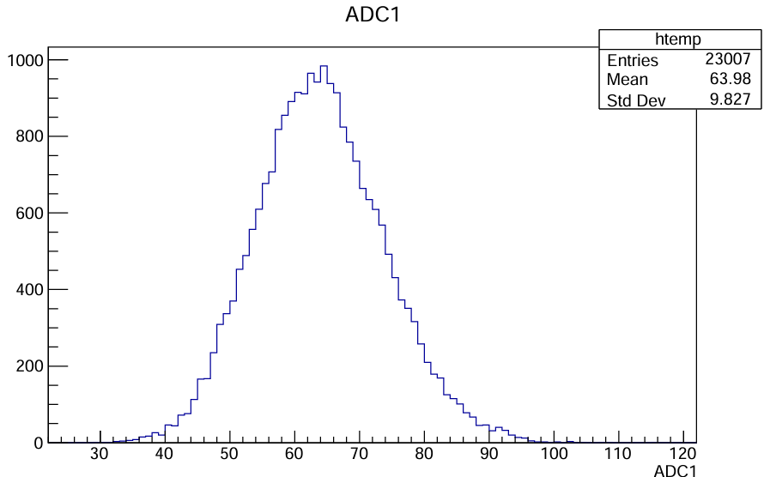
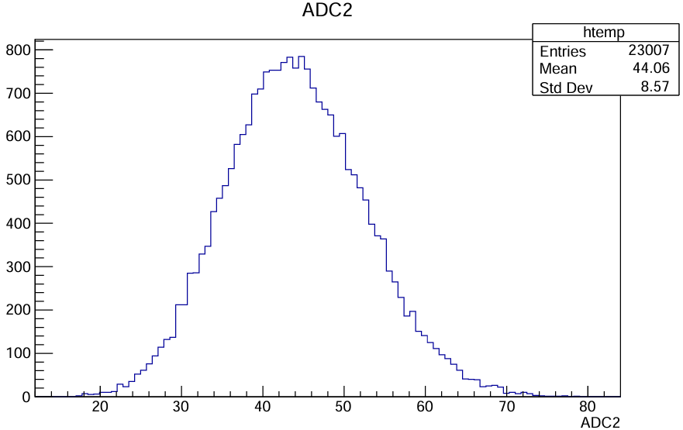
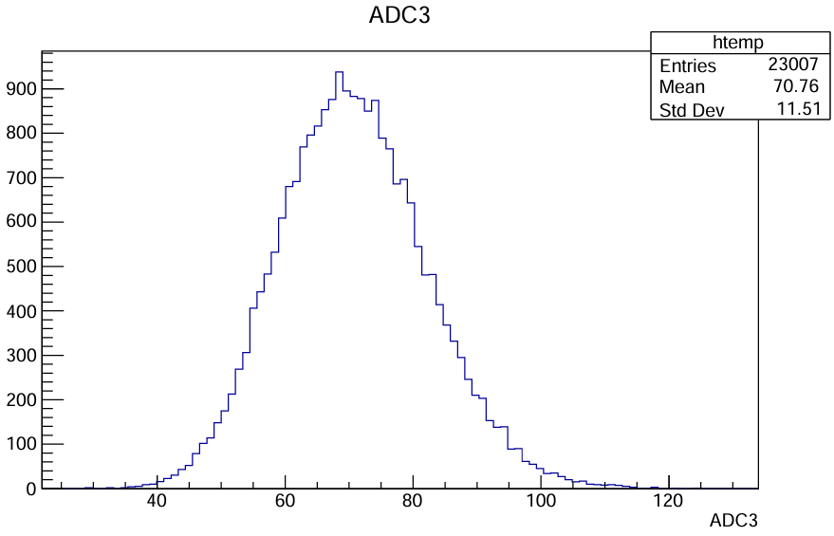
Δt
ADC
ΔT=T_{n}-ΣT/3
Bias voltage 11 V

Slide 9
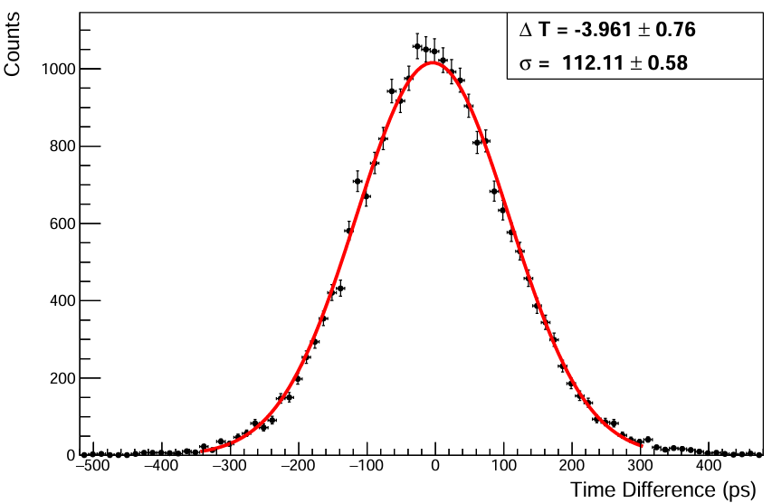
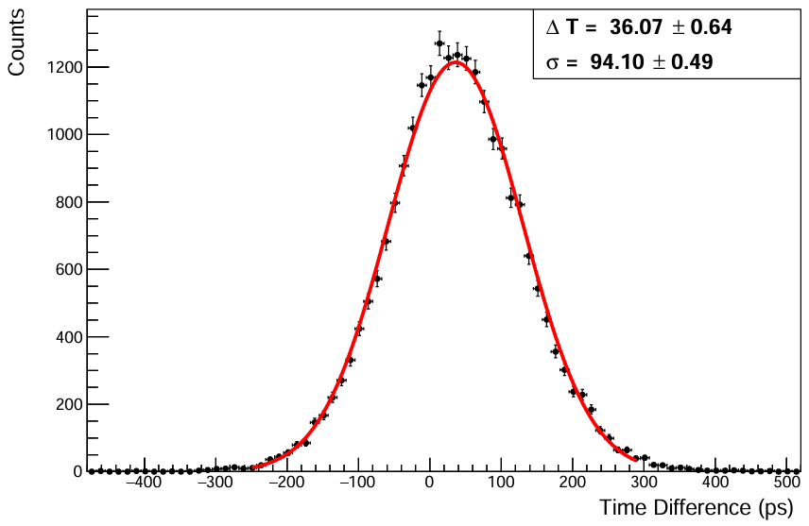
Δt
ΔT=T_{n}-T_{m}
Bias voltage 11~ V

