Slide 1
Study of $γγ→γψ(2S)$ at BelleII
2024.11.22

Slide 2
Data sample and MC simulation
MC simulation:
Signal MC
using TREPS, M=3.922GeV/$c^{2}$,$J^{PC}=2^{++}.$
Decay chain: $χ_{c_{2}}\left(3930\right)→γψ\left(2S\right),$ $ψ\left(2S\right)→π^{−}π^{+}J/ψ$, $J/ψ→π^{−}π^{+}$or $μ^{−}μ^{+}$.
Number: $5×{10}^{5}$.
ISR event
officially produced. (it is main background.)
Decay chain: $e^{−}e^{+}→nγ_{ISR}+ψ\left(2S\right)$.
Number: $1×{10}^{6}$.
Low-multiplicity($e^{+}e^{−}μ^{+}μ^{−},e^{+}e^{−}e^{+}e^{−},llXX,hhISR$)
officially produced.
Luminosity:361/fb
Data sample:
Data
Quarkonium skim sample(on resonance)
Luminosity:364/fb

Slide 3
Evaluation of ISR events
$The cross section of the ISR production of ψ\left(2S\right):$(Belle 2013)
$σ_{Born}(e^{+}e^{−} Mode)=\left(15.1±0.2±0.8\right)pb$
$σ_{Born}(μ^{+}μ^{−} Mode)=\left(14.1±0.2±0.9\right)pb$
$The Branch ratio of ψ\left(2S\right)→π^{+}π^{−}J/ψ:$(PDG2022)
$Br(ψ\left(2S\right)→π^{+}π^{−}J/ψ)=\left(34.68±0.30\right)\%$
$The Branch ratio of J/ψ→e^{+}e^{−}/μ^{+}μ^{−}:$(PDG2022)
$Br(J/ψ→e^{+}e^{−})=\left(5.971±0.032\right)\%$
$Br(J/ψ→μ^{+}μ^{−})=\left(5.961±0.033\right)\%$
$$N_{events}=σ×ℒ×Br(ψ\left(2S\right)→π^{+}π^{−}J/ψ)×Br(J/ψ→l^{+}l^{−})$$
$$scale factor=\frac{N_{event}}{N_{gen}}=\frac{219973}{{10}^{6}}=0.22$$

Slide 4
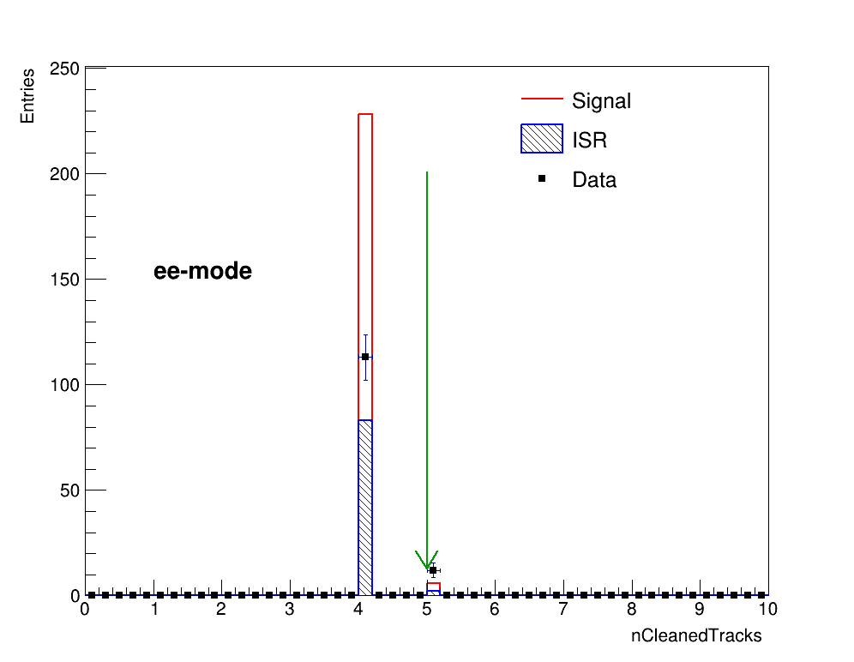
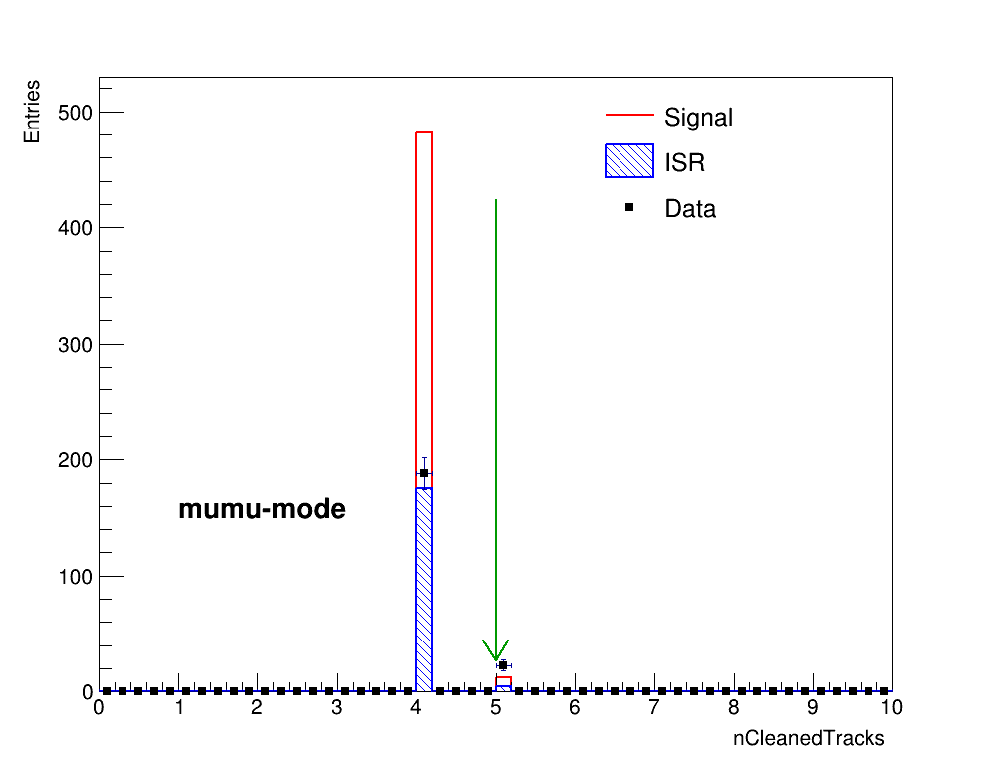
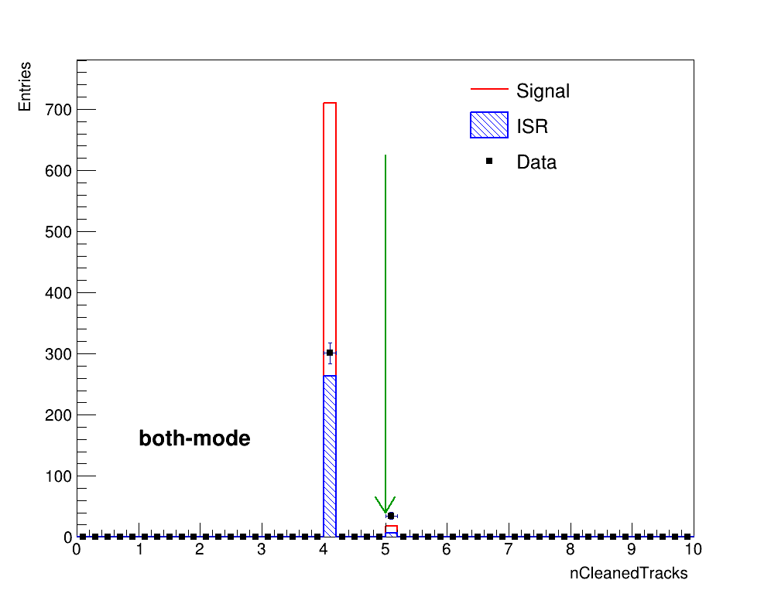
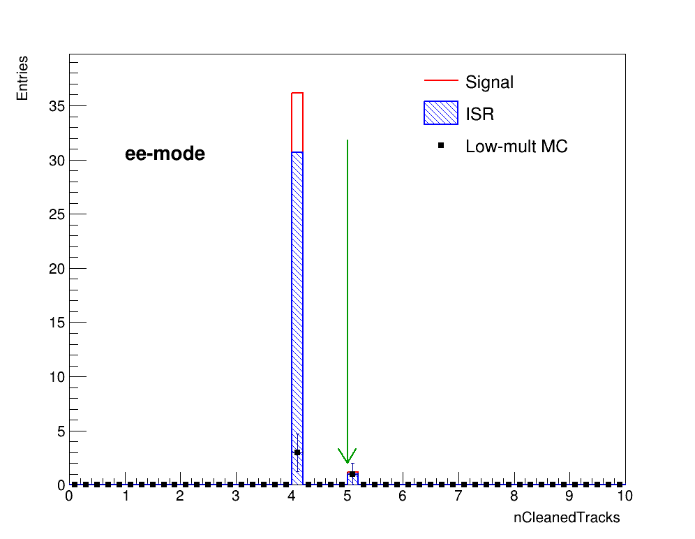
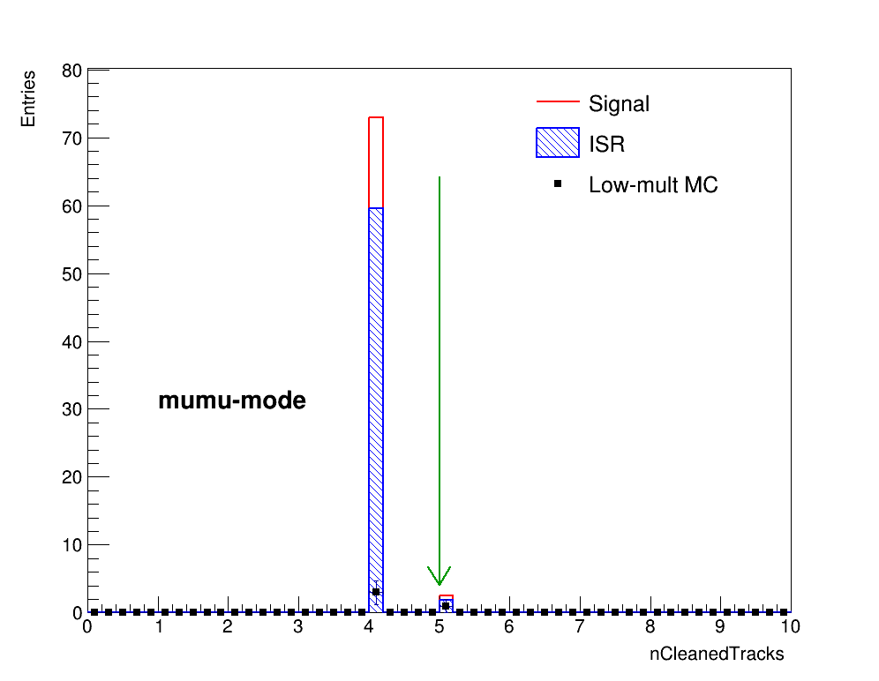
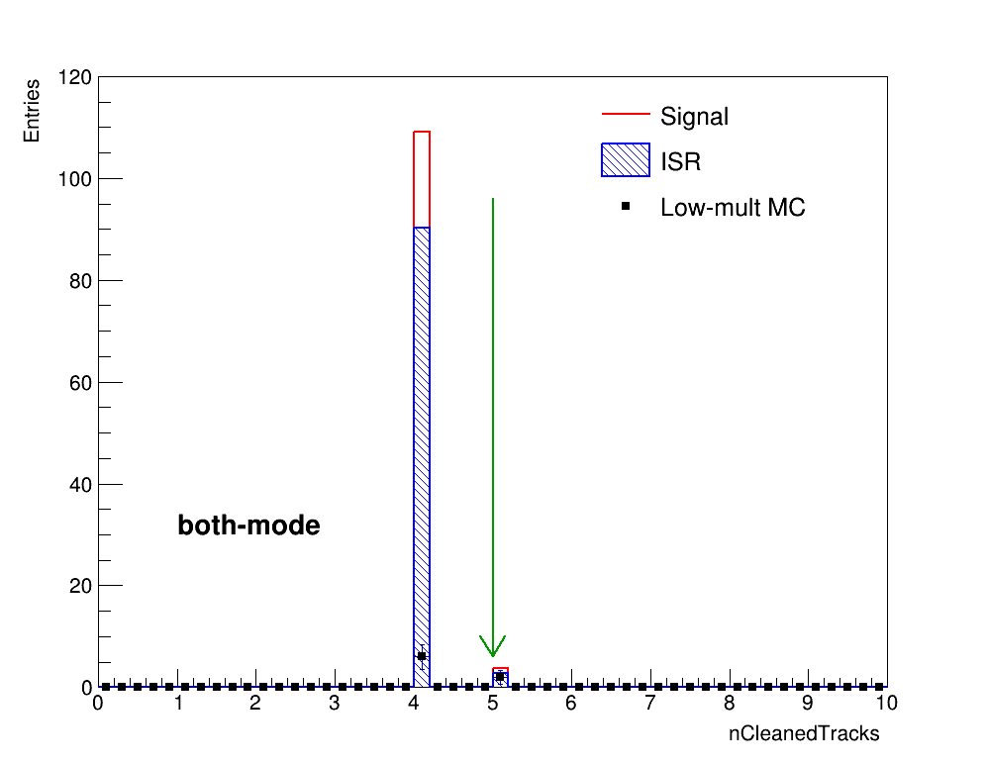
Number of charged tracks
$N_{track}<5$ is required.

Slide 5
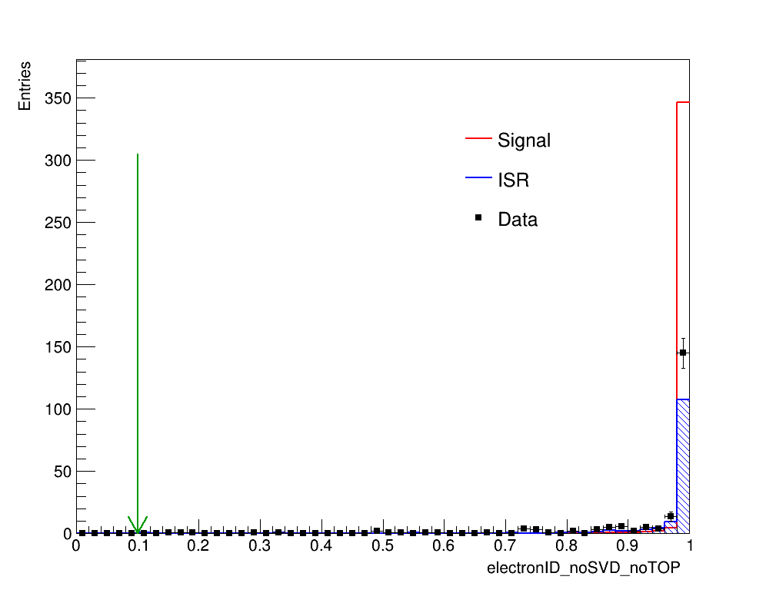
Particle Identification-electronID
Require one electron candidate to have eID_noSVD_noTOP > 0.9 to study another electron candidate.
Both electron candidates are required to have eID_noSVD_noTOP > 0.1.

Slide 6
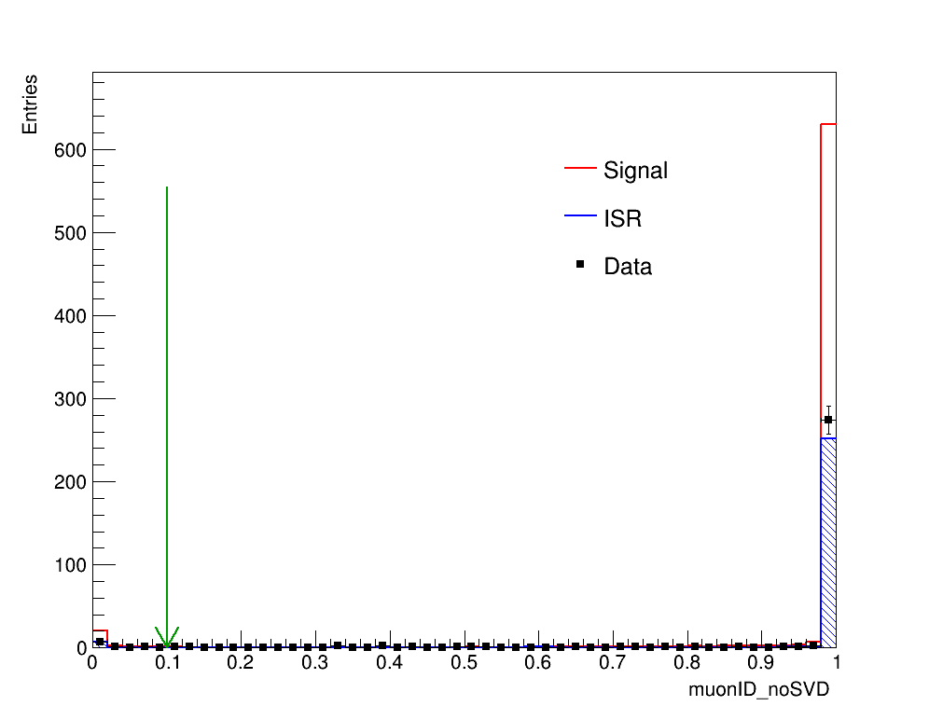
Particle Identification-muonID
Require one muon candidate to have muonID_noSVD > 0.9 to study another muon candidate.
Muon could have $L\left(μ\right)=0$.
One of muon candidate should have $L\left(μ\right)>0.1$.

Slide 7
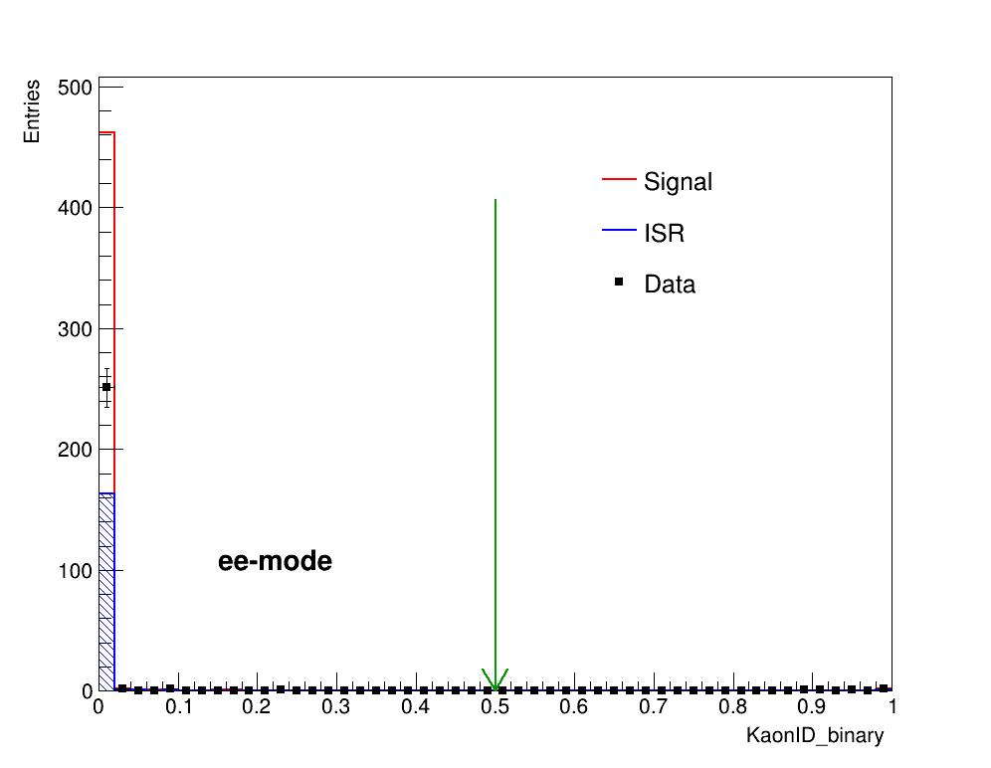
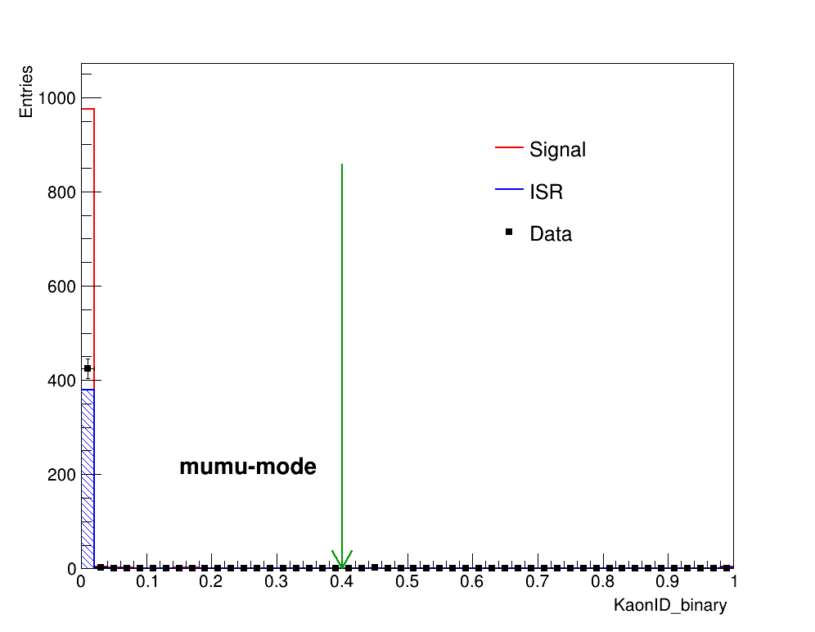
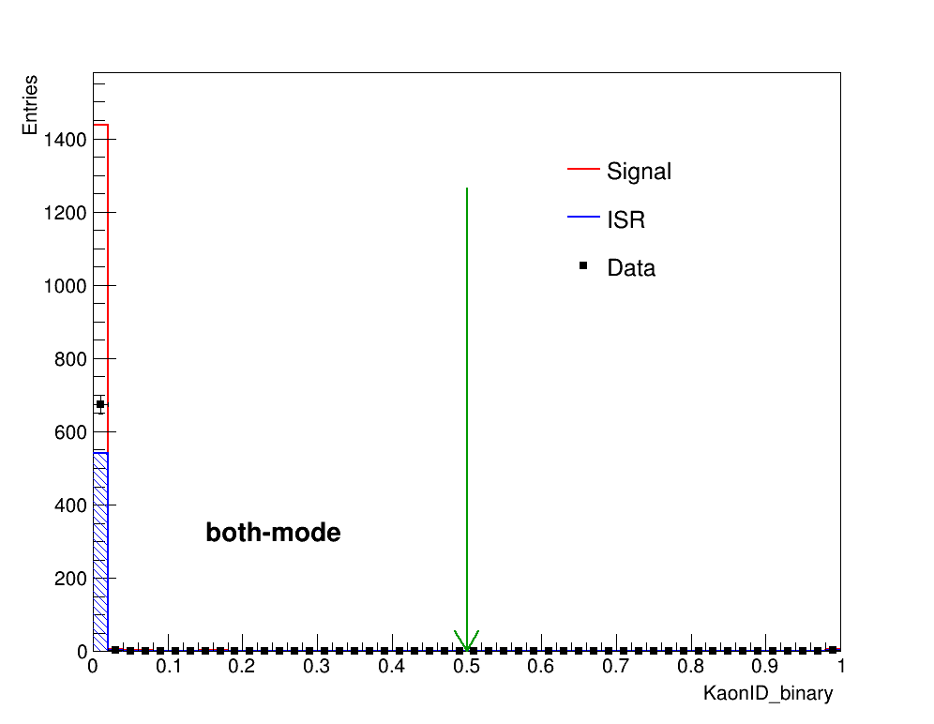
Particle Identification-kaonID
$KaonID_{binay}<0.5$ is required.

Slide 8
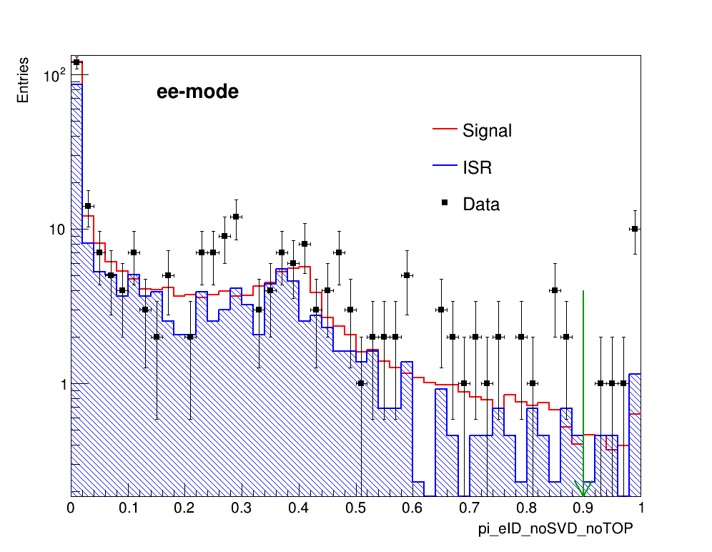
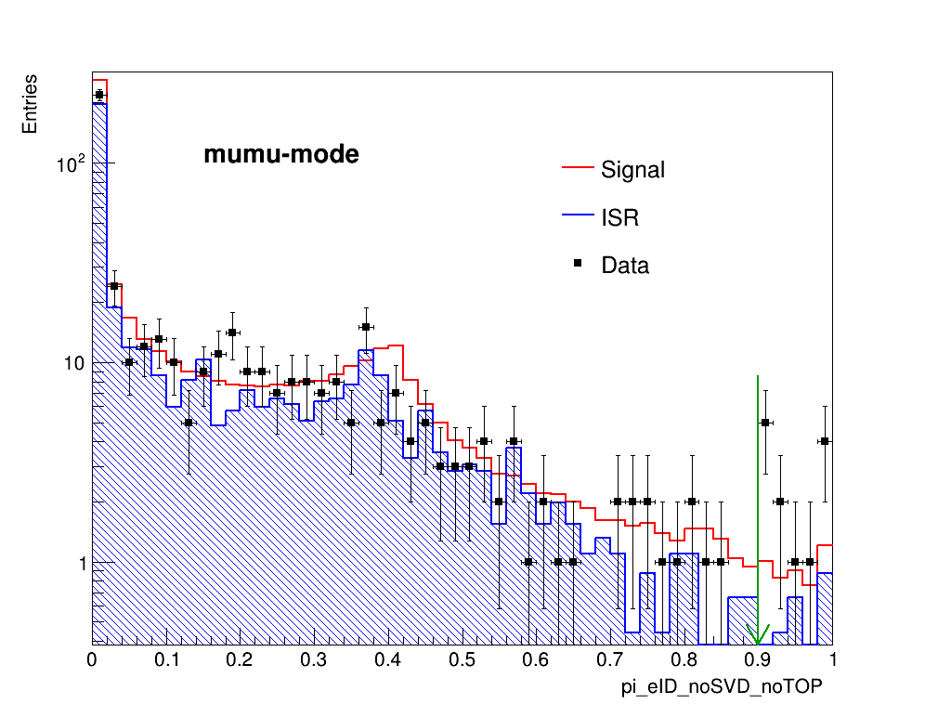
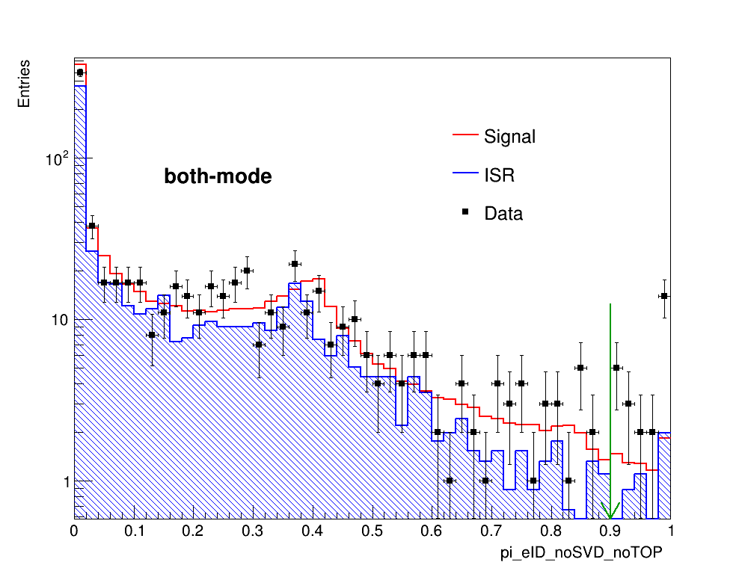
Particle Identification-electronID
$L(e)<0.9$ to remove $γ$-conversion background.

Slide 9
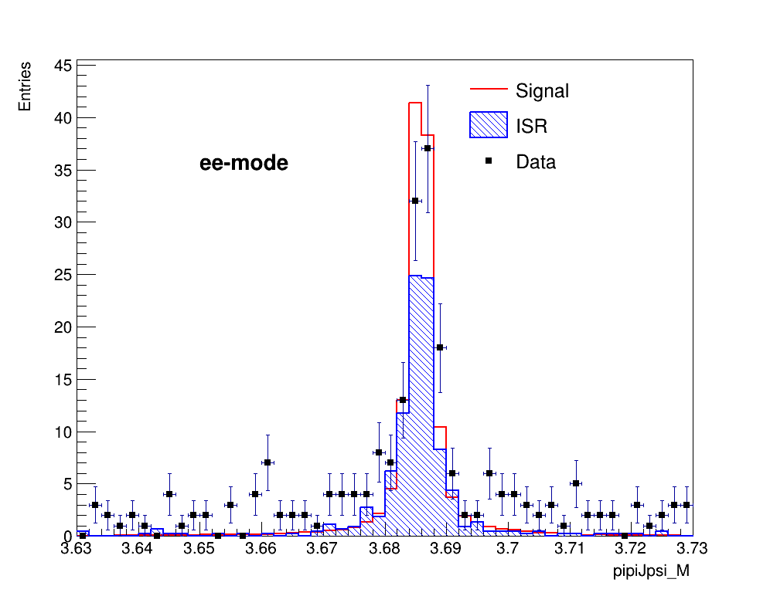
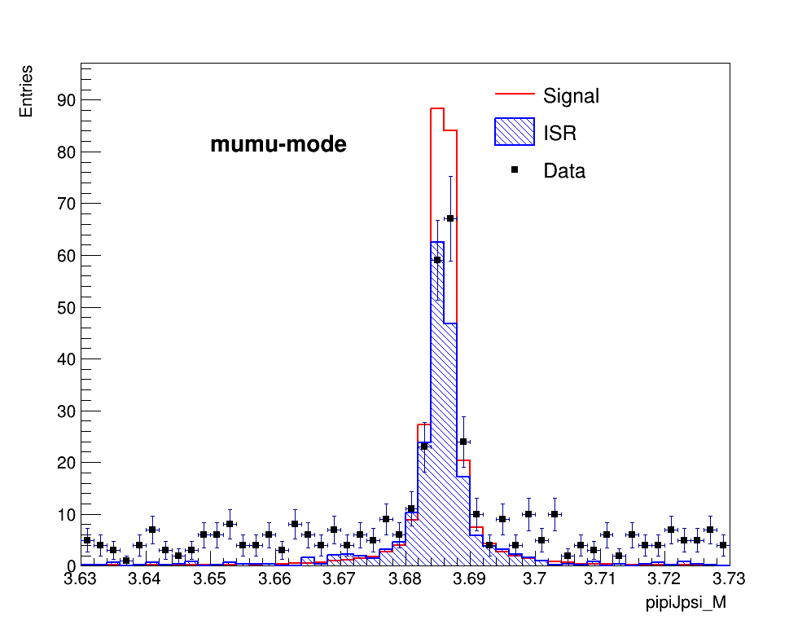
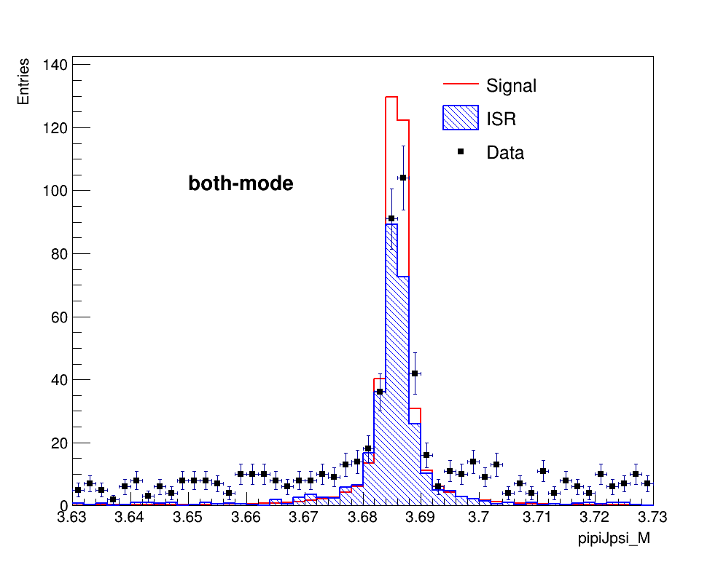
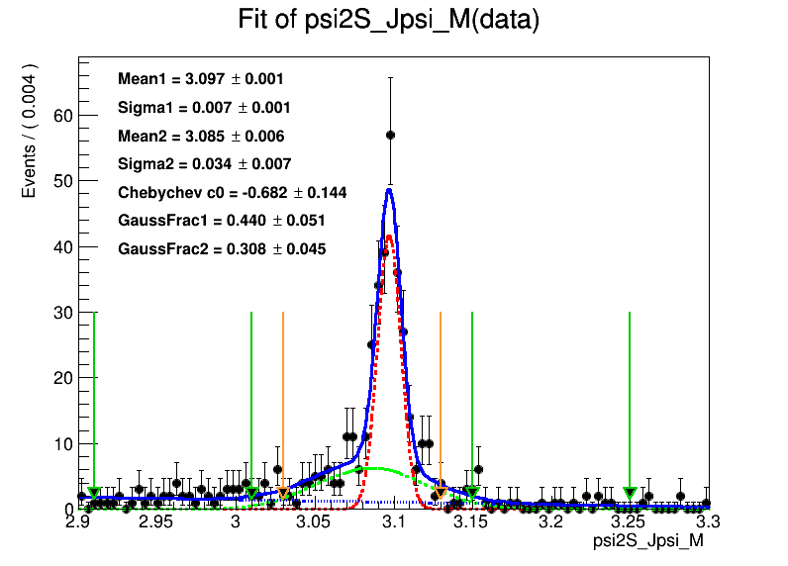
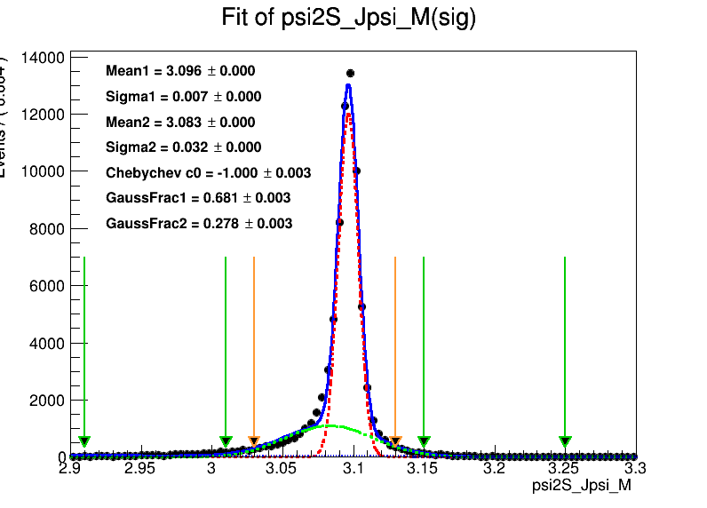
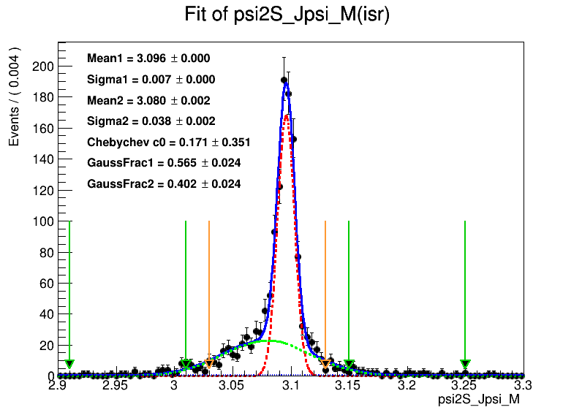
$J/ψ$ $signals$

Slide 10
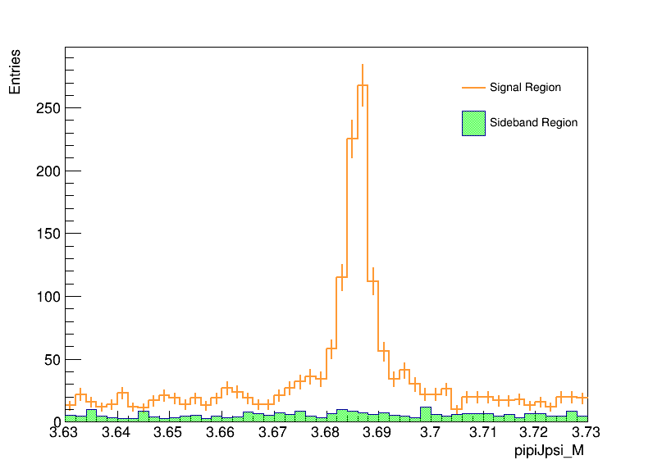
$J/ψ$ $signal and sideband region$
Signal region: $3.03<M_{l^{+}l^{−}}<3.13$
Sideband region: $2.91<M_{l^{+}l^{−}}<3.01 \&\&3.15<M_{l^{+}l^{−}}<3.25$

Slide 11
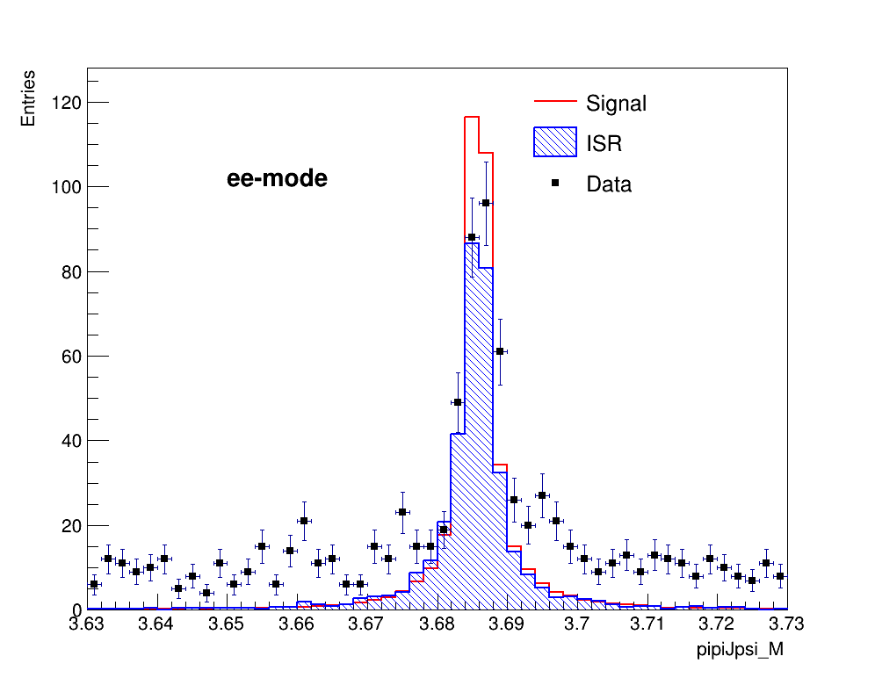
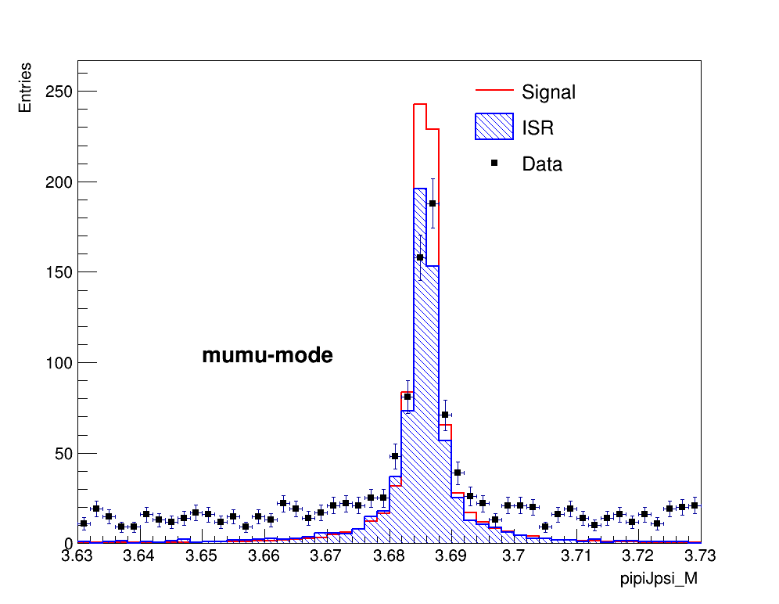
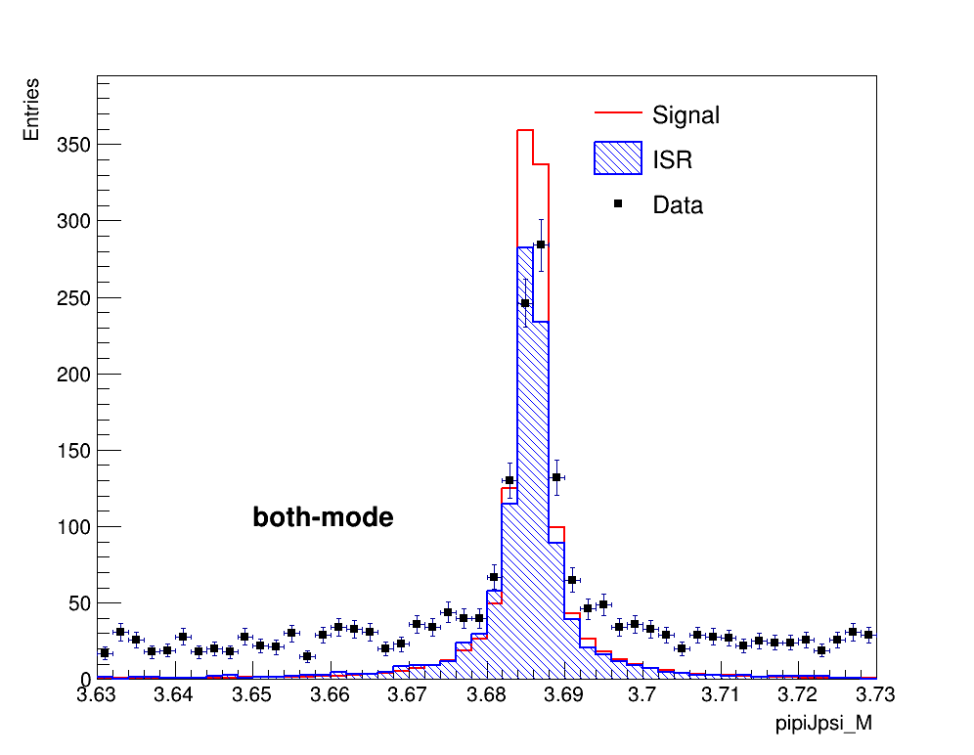
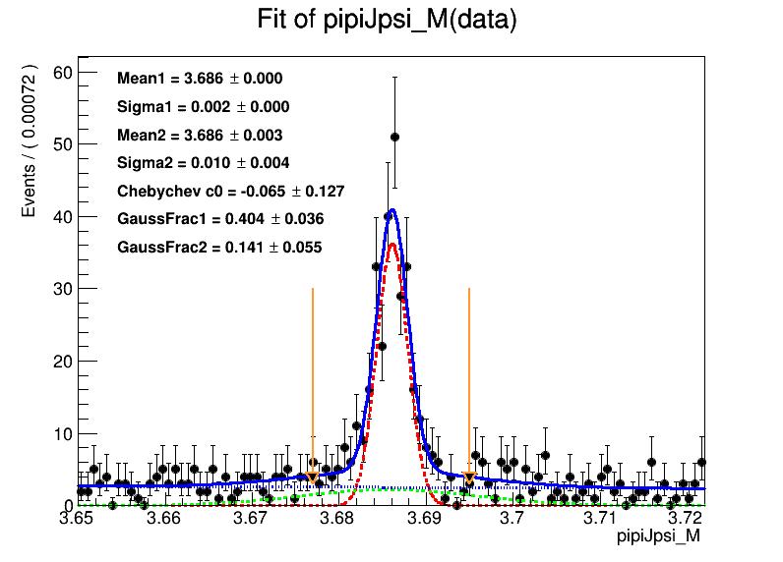
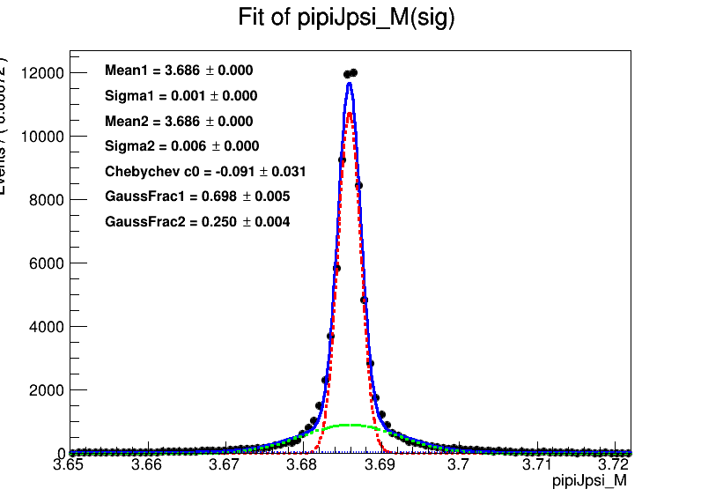
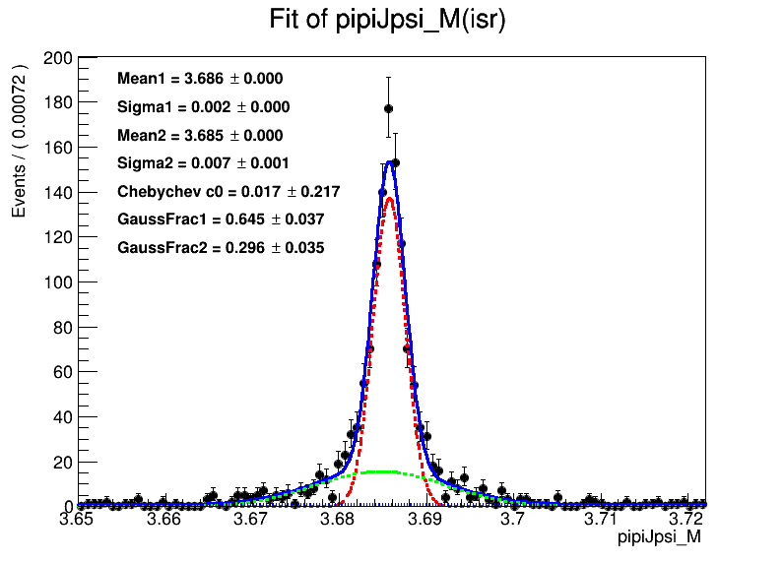
$ψ(2S)$ $signals$

Slide 12
$ψ(2S)$ $signal and sideband region$
$M_{π^{+}π^{−}J/ψ}$ is defined as $M_{π^{+}π^{−}J/ψ}=M_{π^{+}π^{−}l^{+}l^{−}}−M_{l^{+}l^{−}}+m_{J/ψ}$.
Signal region: $\left|M_{π^{+}π^{−}J/ψ}−m_{ψ\left(2S\right)}\right|<3σ$,here we take $σ$= 3 MeV.
Sideband region: $\left|M_{π^{+}π^{−}J/ψ}−m_{ψ\left(2S\right)}±12σ\right|<4.5σ$.

Slide 13
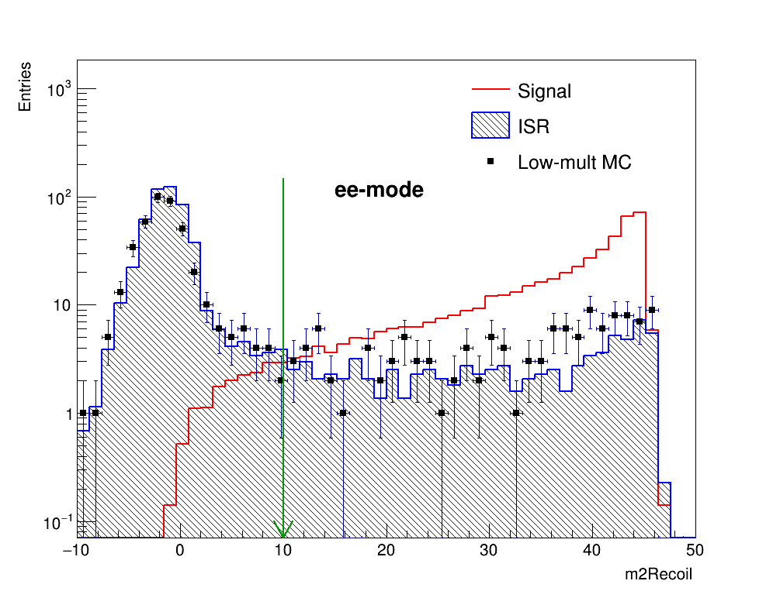
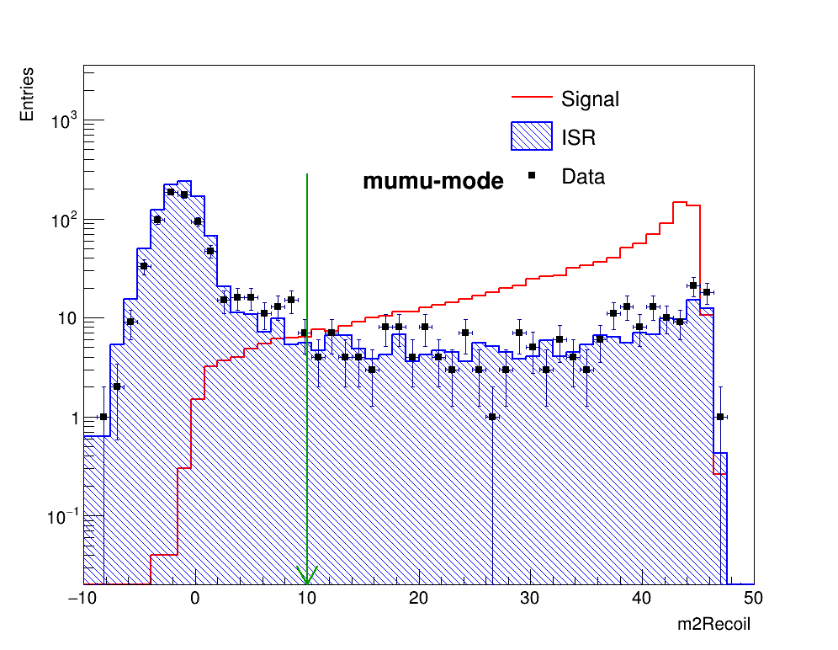
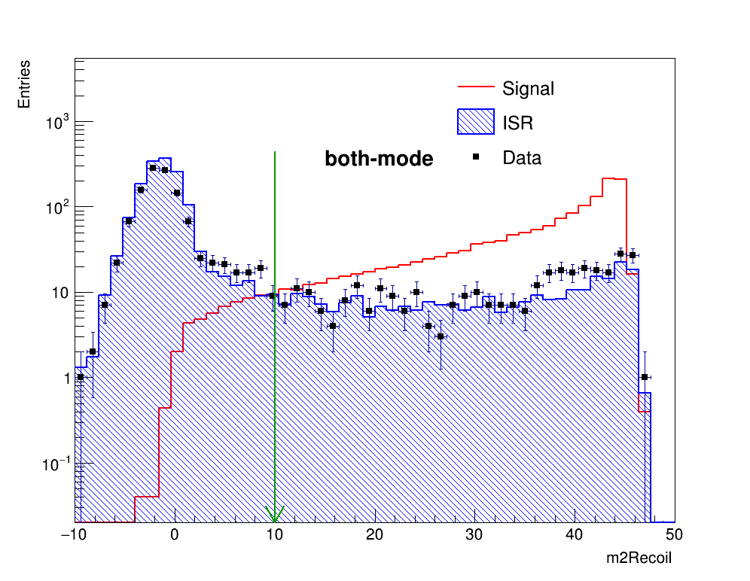
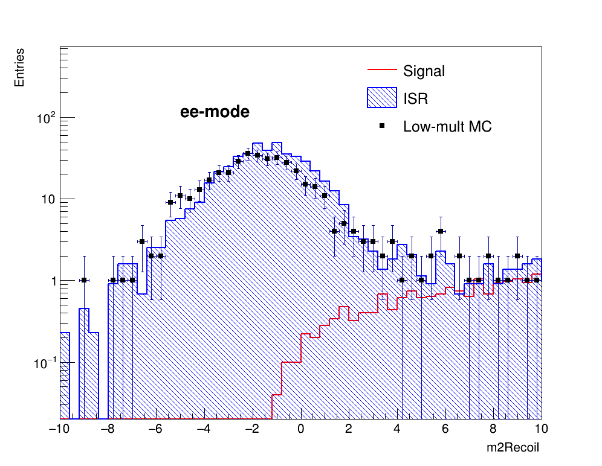
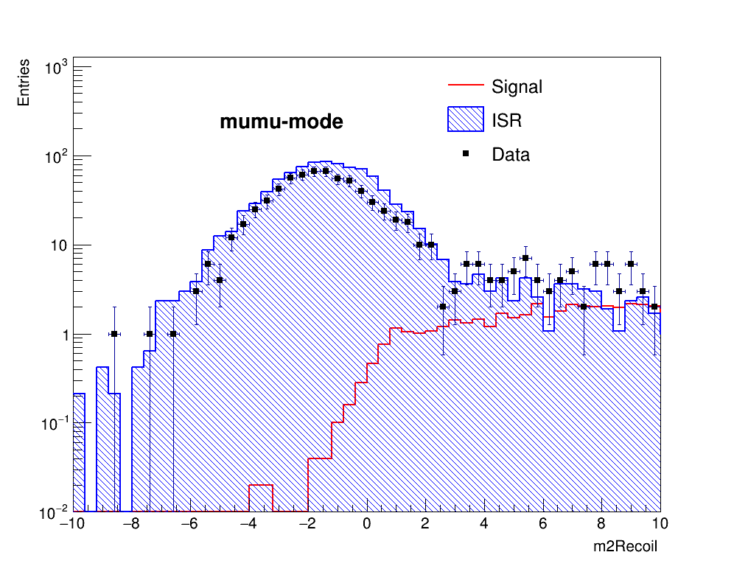
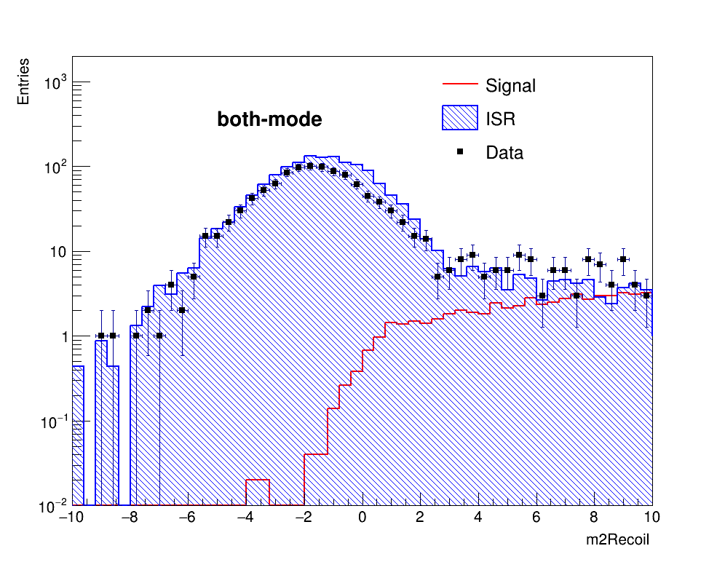
Recoil of $γψ(2S)$

Slide 14
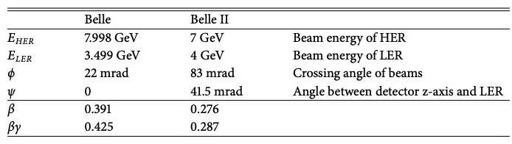
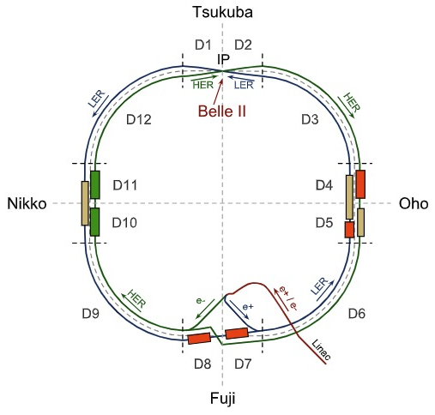
Beam parameters of super KEKB
HER 7 GeV, LER 4 GeV, HER angle:+41.5 mrad, LER angle:-41.5 mrad.
Lorentz-invariant Mandelstam variables $s$:
$s=m_{1}^{2}+m_{2}^{2}+2E_{1}E_{2}−2\vec{p_{1}}∙\vec{p_{2}}$
$\sqrt{s}≈2\sqrt{7∗4}≈10.583 GeV$
Boost vector in (x,0,z)
let $ψ=41.5 mrad$
Beam momenta:
HER (7sin$ψ$,0,7cos $ψ$), LER (4sin$ψ$,0,-4cos $ψ$)
boost vector(11sin$ψ$,0,3cos $ψ$)
$$\sqrt{s}=10.57389325786920331041GeV$$
boost vector: (0.45636897,0,2,9974701)
$θ=0.0057692395934144867 rad$ (动量与z轴夹角)

Slide 15
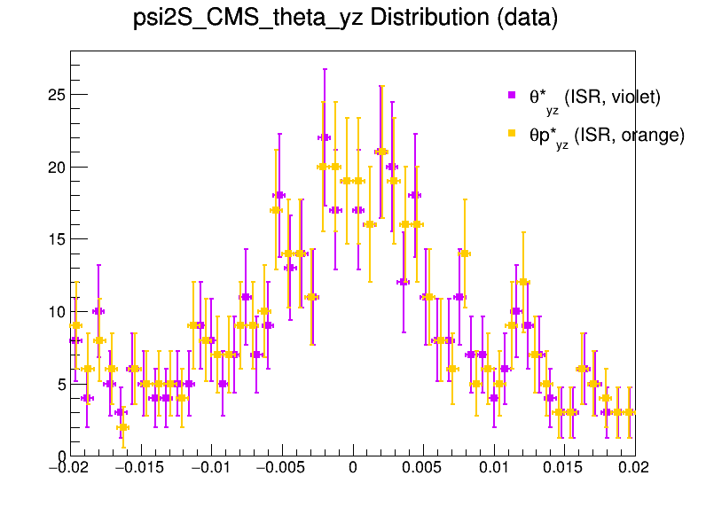
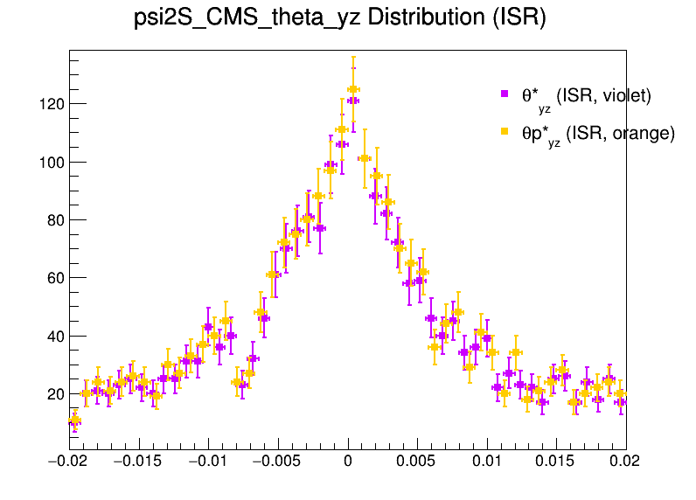
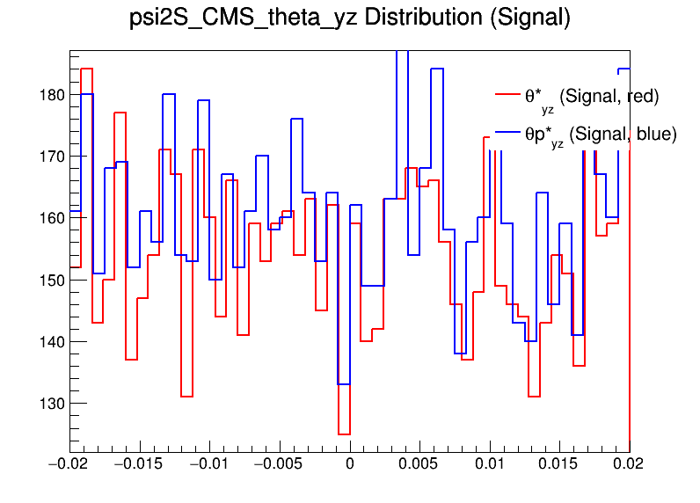
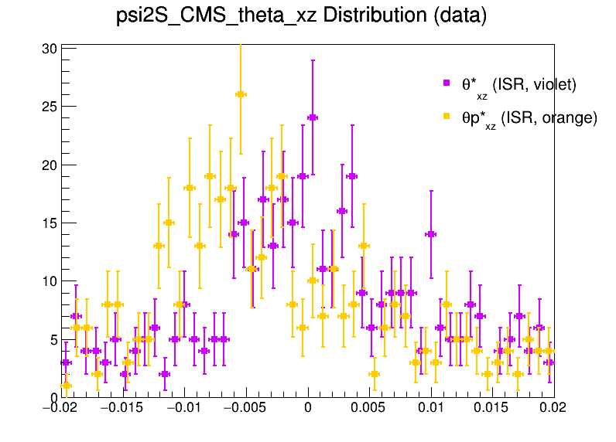
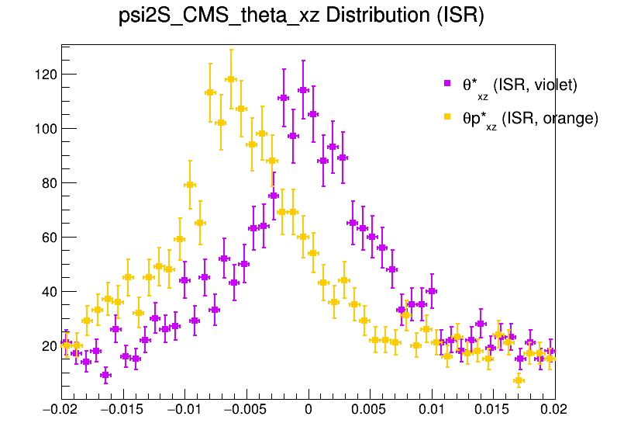
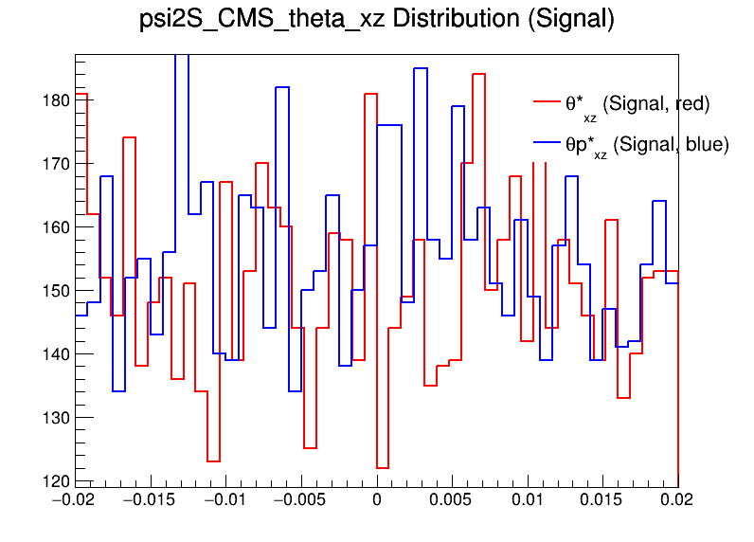
Study on transverse momenta-Angle check

Slide 16
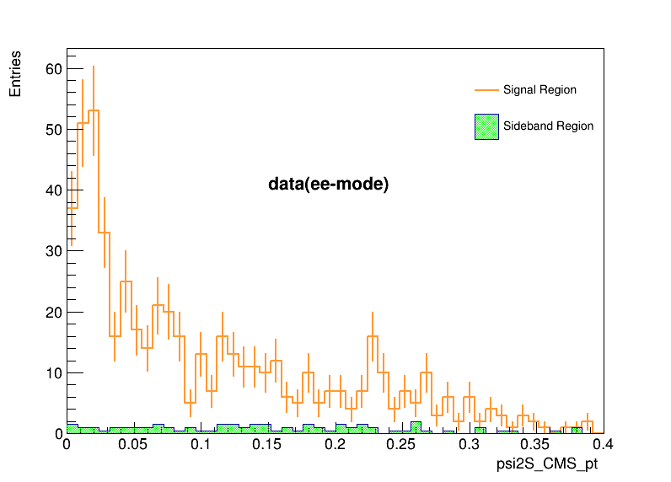
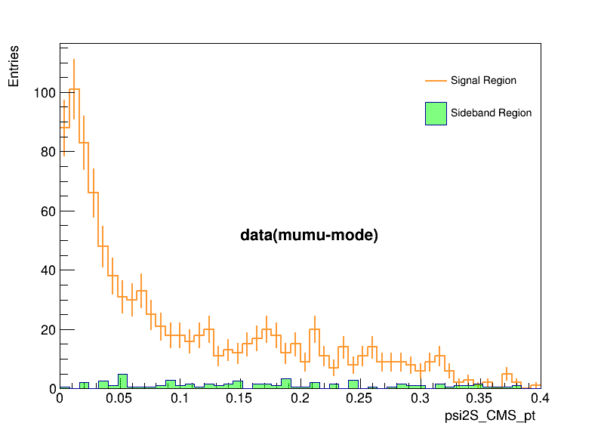
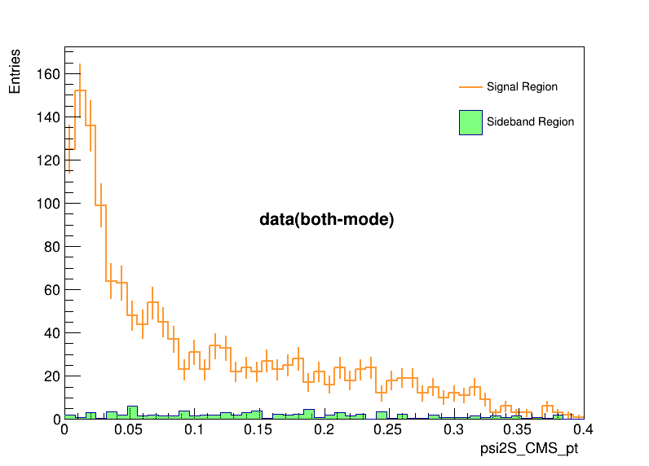
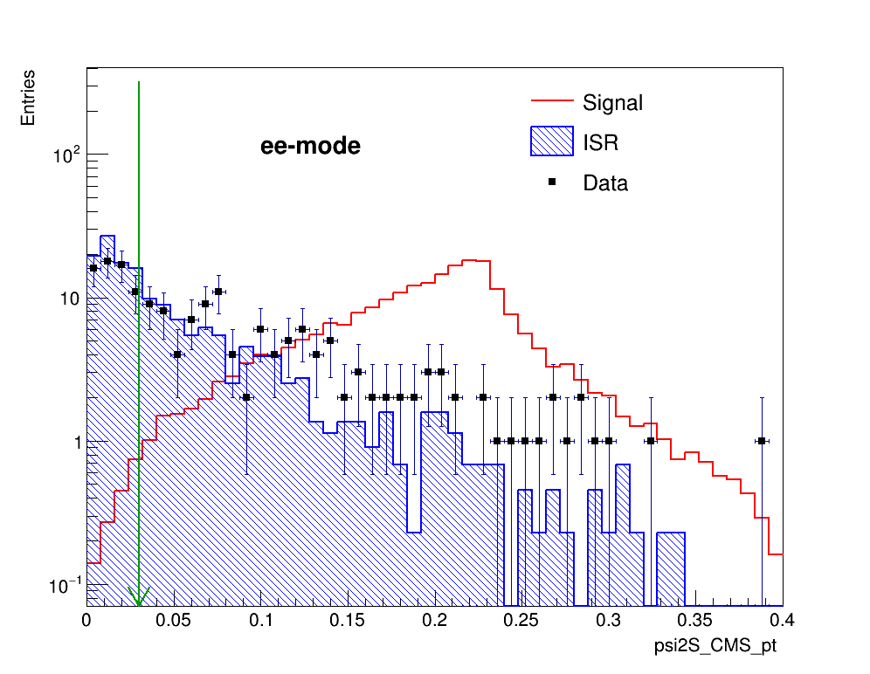
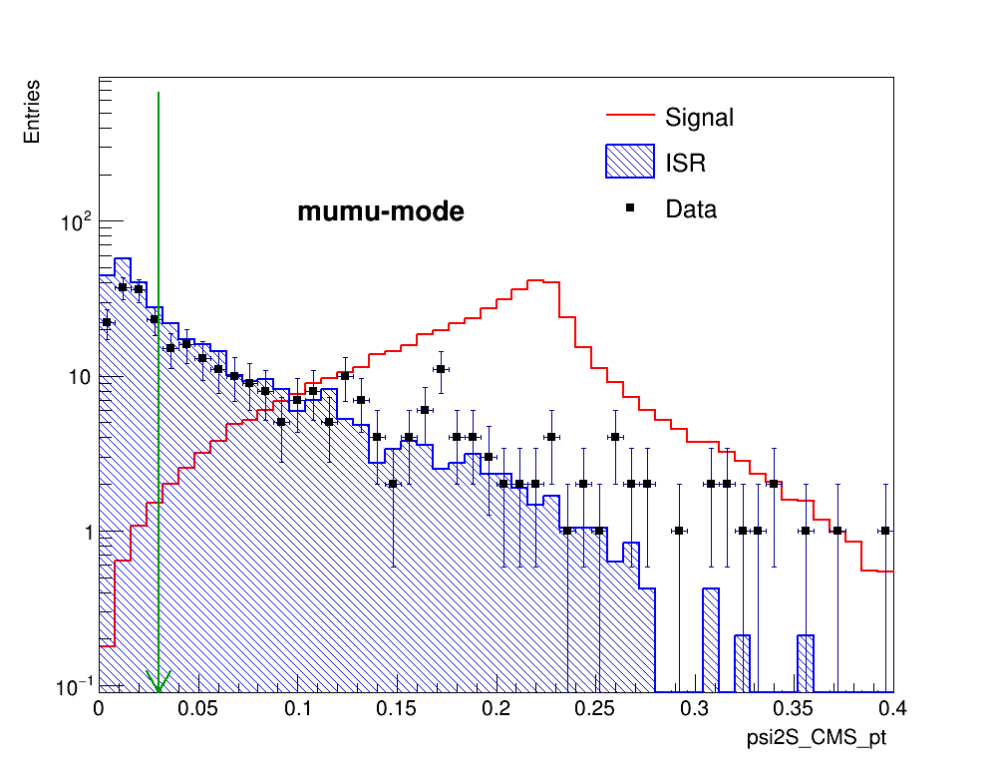
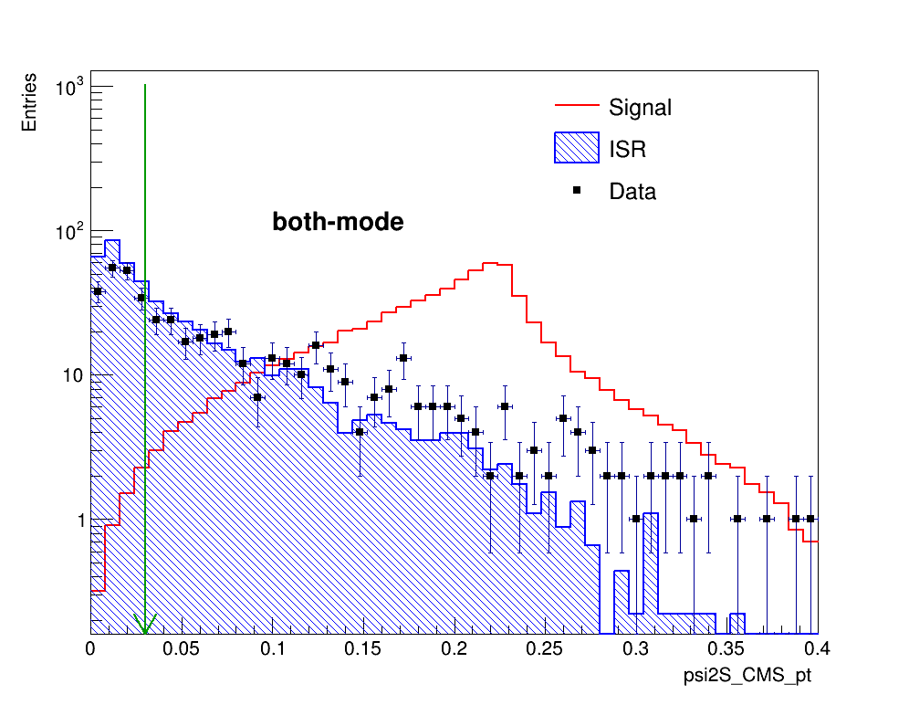
Transverse momenta of $P_{t}^{∗}$

Slide 17
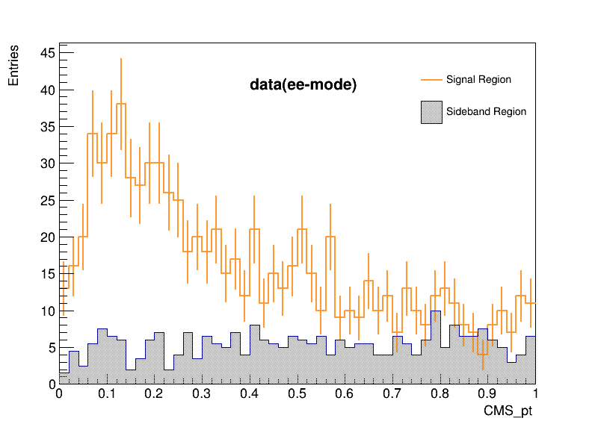
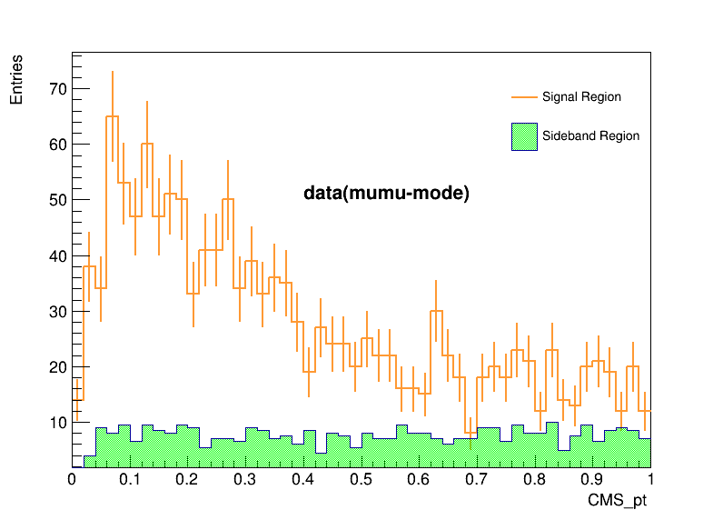
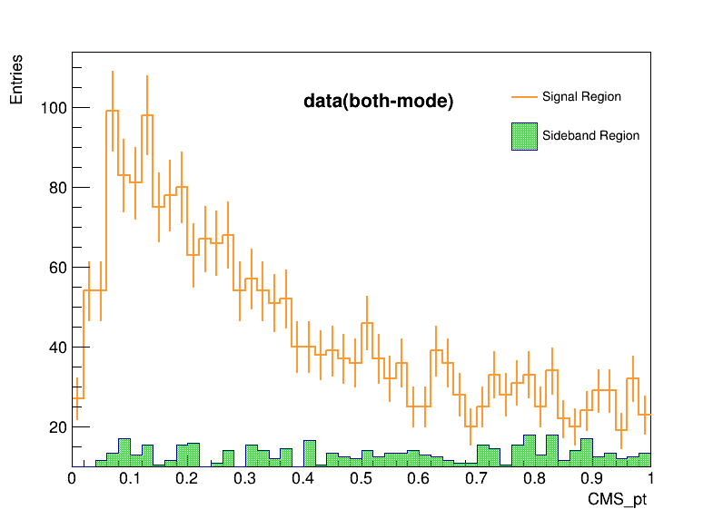
Transverse momenta of $P_{t}^{∗}$

Slide 18
Transverse momenta of $P_{t}^{∗}$
data
isr
sig

Slide 19
Energy of $γ$

Slide 20
$M_{γψ(2S)}$distribution

Slide 21
$M_{γψ(2S)}$vs $E_{γ}$distribution

Slide 24
Cut flow
Event selections | Rec. eff. (signal) | Rec. eff. (isr)
nCleanedTracks < 6 | 0.404738 | 0.113630
lepton PID selection | 0.402680 | 0.110870
pion PID selection | 0.387390 | 0.103695
good track(dr dz) | 0.387390 | 0.103695
electron ID of pion | 0.324804 | 0.088792
Jpsi Mass window | 0.295804 | 0.071295
psip Mass window | 0.265448 | 0.060783
m2Recoil | 0.256462 | 0.010780
gamma_E | 0.233098 | 0.004768
CMS_pt | 0.146926 | 0.002377
psi2S_CMS_pt | 0.146044 | 0.001243
gamma psip InvM | 0.145692 | 0.001227
belle | 0.144 | 0.0007
Pion PID Selection:
From binaryKID < 0.4 to binaryKID < 0.5
Electron ID of pion:
From pi_EID < 0.9 to pi_EID < 0.8
Jpsi mass window:
Belle: $\left|M_{l^{+}l^{−}}−m_{J/ψ}\right|<4σ,σ=11MeV$
Belle2: $3.03<M_{l^{+}l^{−}}<3.13$
psip mass window:
Belle: $\left|M_{π^{+}π^{−}J/ψ}−m_{ψ\left(2S\right)}\right|<3σ,σ=2.8 MeV$
Belle2: $\left|M_{π^{+}π^{−}J/ψ}−m_{ψ\left(2S\right)}\right|<3σ,σ=3 MeV$

Slide 25
Event Selection
For tracks:
$nCleanedTracks<6$
$dr<0.5$
$dz<2$
For $π^{±}$:
$ℛ=\frac{ℒ(K)}{ℒ\left(K\right)+ℒ(π)}<0.5$
${electronID}_{noSVDnoTOP}<0.9$
For $l^{±} (l=μ or e)$:
${electronID}_{noSVDnoTOP}^{1}>0.1 and {electronID}_{noSVDnoTOP}^{2}>0.1(l=e)$
${muonID}_{noSVDnoTOP}^{1}>0.1 or {muonID}_{noSVDnoTOP}^{2}>0.1(l=μ )$
For $J/ψ$:
$3.03<M_{J/ψ}<3.13$
For $γ$:
$E_{γ}>0.1 GeV$
For $ψ\left(2S\right)$:
$\left|M_{ψ\left(2S\right)}−3.686\right|<0.009 GeV/c^{2}$
$P_{t}^{∗}(ψ\left(2S\right))>0.03$
For $γψ\left(2S\right)$:
$P_{t}^{∗}(γψ\left(2S\right))<0.2$
$m2Recoil>10$
$3.7<M_{γψ\left(2S\right)}<4.2$

Slide 26
Punzi FOM
$$FOM=\frac{ε_{signal}}{\frac{a}{2}+\sqrt{N_{exp}}}$$
Where $ε_{signal}$ is the efficiency of signal MC, $a$ is the significance value. It is set to be 5. $N_{exp}$ is the expected number of backgrounds and is estimated by

Slide 27
Efficiency Curve (before eff. correction)
belle
belle2

Slide 28
Study of $γγ→γψ(2S)$ at Belle

Slide 29
Data sample and MC simulation
MC simulation:
Signal MC
using TREPS, M=3.922GeV/$c^{2}$,$J^{PC}=2^{++}.$
Decay chain: $χ_{c_{2}}\left(3930\right)→γψ\left(2S\right),$ $ψ\left(2S\right)→π^{−}π^{+}J/ψ$, $J/ψ→π^{−}π^{+}$or $μ^{−}μ^{+}$.
Number: $5×{10}^{5}$.
ISR event
using PHOKHARA
Decay chain: $e^{−}e^{+}→nγ_{ISR}+ψ\left(2S\right)$.
Number: $1×{10}^{6}$.
Data sample:
Data
$Υ\left(4S\right)$ resonance sample
Luminosity:711/fb

Slide 30
Evaluation of ISR events
$The cross section of the ISR production of ψ\left(2S\right):$(Belle 2013)
$σ_{Born}(e^{+}e^{−} Mode)=\left(15.1±0.2±0.8\right)pb$
$σ_{Born}(μ^{+}μ^{−} Mode)=\left(14.1±0.2±0.9\right)pb$
$The Branch ratio of ψ\left(2S\right)→π^{+}π^{−}J/ψ:$(PDG2022)
$Br(ψ\left(2S\right)→π^{+}π^{−}J/ψ)=\left(34.68±0.30\right)\%$
$The Branch ratio of J/ψ→e^{+}e^{−}/μ^{+}μ^{−}:$(PDG2022)
$Br(J/ψ→e^{+}e^{−})=\left(5.971±0.032\right)\%$
$Br(J/ψ→μ^{+}μ^{−})=\left(5.961±0.033\right)\%$
$$N_{events}=σ×ℒ×Br(ψ\left(2S\right)→π^{+}π^{−}J/ψ)×Br(J/ψ→l^{+}l^{−})$$
$$scale factor=\frac{N_{event}}{N_{gen}}=\frac{222317+207246}{{5X10}^{5}}=0.859126$$

