Slide 1
Overview of the muon facility MLF J-PARC
MUSE (Muon Science Establishment)
2nd WS of Muon Science Technology and Industry, 10/Jan/’25
Muon Sci. Sec. MLF Div. J-PARC Naritoshi Kawamura

Slide 2
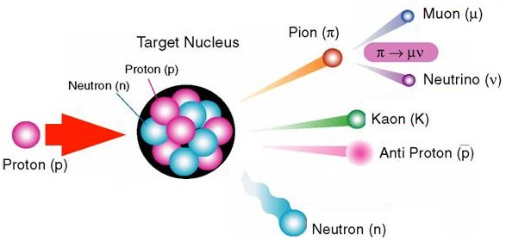
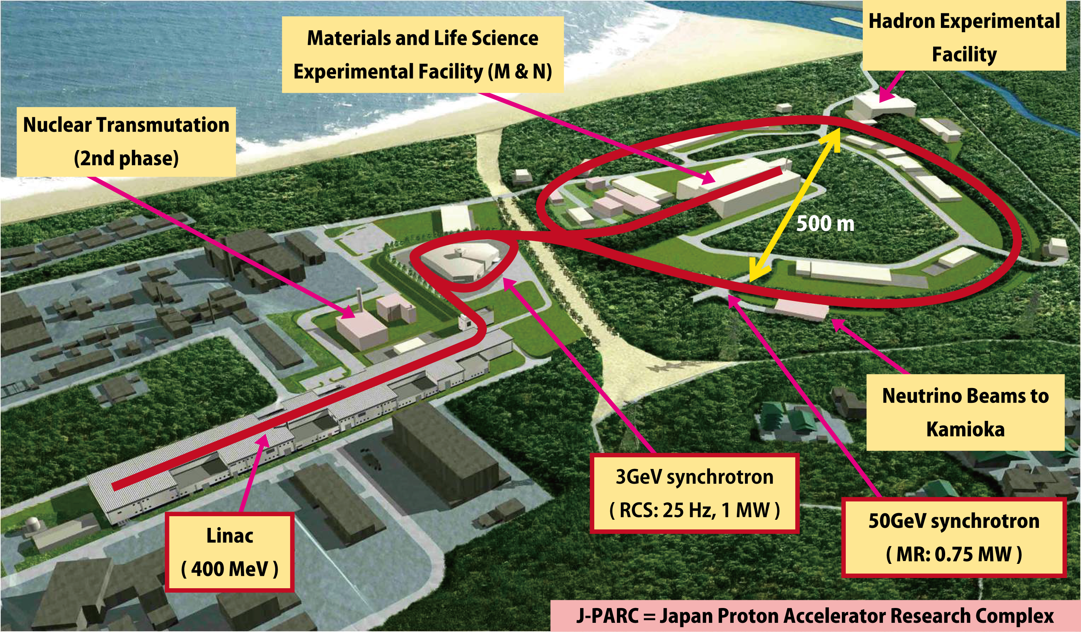
Ｊ－ＰＡＲＣ
3 accelerators
400 MeV linac
3GeV synchrotron (RCS)
30GeV synchrotron (MR)
Materials and Life Science Facility
Hadron facility
Neutrino facility
Nuclear transmutation research
(under design)
4 facilities

Slide 3
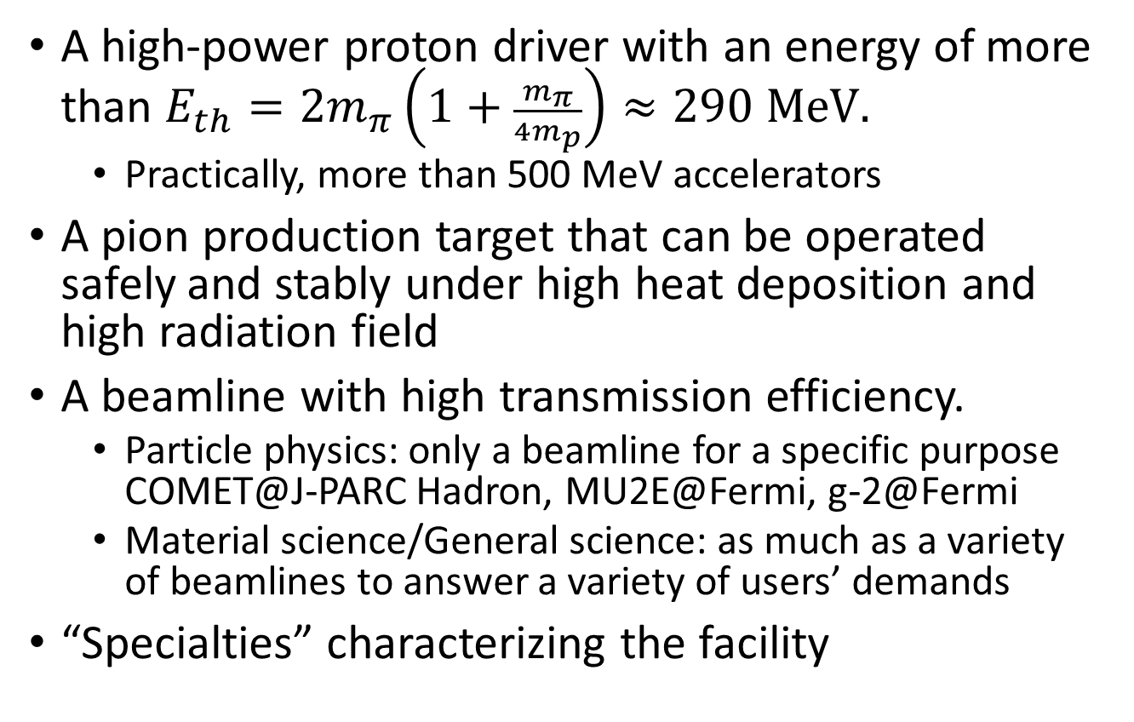
Requirements of a muon facility
A high-power proton driver with an energy of more than $E_{th}=2m_{π}\left(1+\frac{m_{π}}{4m_{p}}\right)≈290 MeV.$
  Practically, more than 500 MeV accelerators
A pion production target that can be operated safely and stably under high heat deposition and high radiation field
A beamline with high transmission efficiency.
  Particle physics: only a beamline for a specific purpose
  COMET@J-PARC Hadron, MU2E@Fermi, g-2@Fermi
  Material science/General science: as much as a variety of beamlines to answer a variety of users’ demands
“Specialties” characterizing the facility

Slide 4
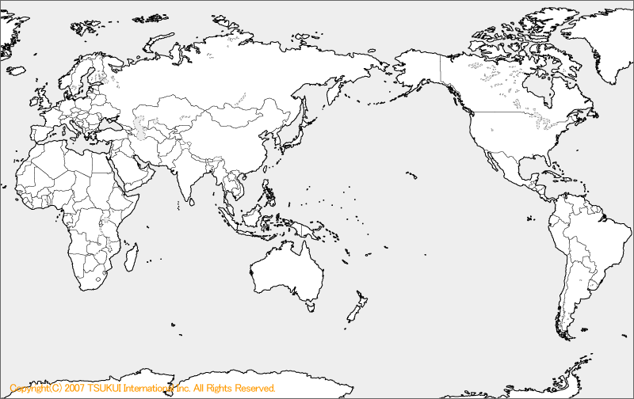
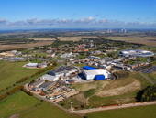
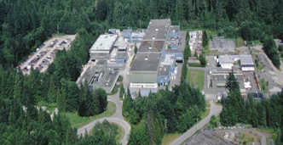
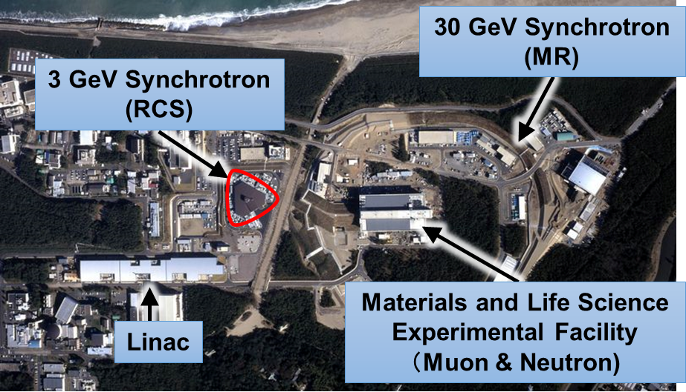
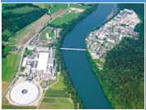
Meson factories in the world
ISIS
(Pulse)
J-PARC
(Pulse)
TRIUMF (CW)
PSI (CW)
MuSIC (CW)
Country | Japan |  | The U.K. | Switzerland | Canada
Facility | J-PARC MUSE | RCNP MuSIC | RAL ISIS | PSI | TRIUMF
proton energy [GeV] | 3.0 | 0.39 | 0.8 | 0.59 | 0.52
proton intensity [MW] | 1.0 | 0.0004 | 0.16 | 1.4 | 0.05
μ⁺ [/s] (surface) | 3×10⁸ (U line) | 2×10⁴ (50MeV/c) | 6×10⁵ | 6×10⁸ (μE4) | 2×10⁵
μ⁻ [/s] | 1×10⁷ | 10⁴ | 7×10⁴ | 2×10⁷ | (5×10⁴)
CW / Pulse | Pulse (25Hz) | CW | Pulse (50Hz) | CW | CW

Slide 5
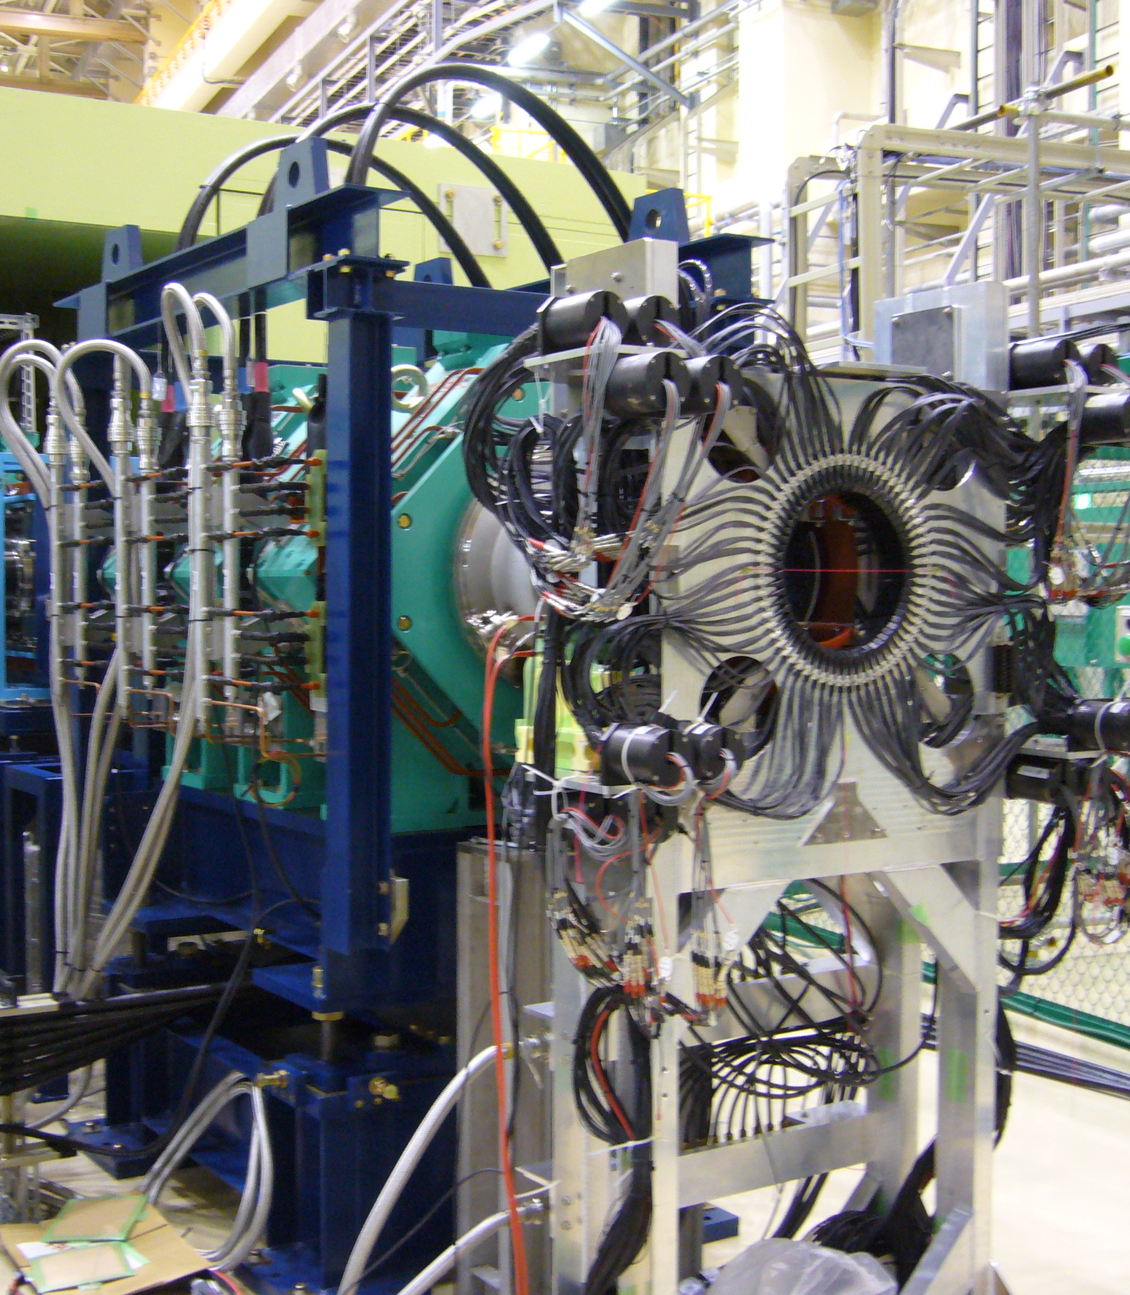

Time Structure - Pulse and CW
Pulse beam
（Synchrotron; J-PARC, ISIS）
  Good S/N under high BG
  Long-time observation
  (relaxation >10 μs)
  Particle identify
  Low time reso. around $t_{0}$
  (Muonium rotation)
CW beam
(Cyclotron; PSI, TRIUMF)
  Practical limit in the beam int. due to pile up events.
  （MORE in PSI was solved.）
pulsed muon beam
gate
time
20µs
20ms
CW muon beam
A highly segmented spectrometer is required
continus b.g.
time

Slide 6
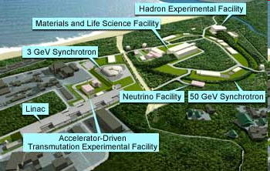
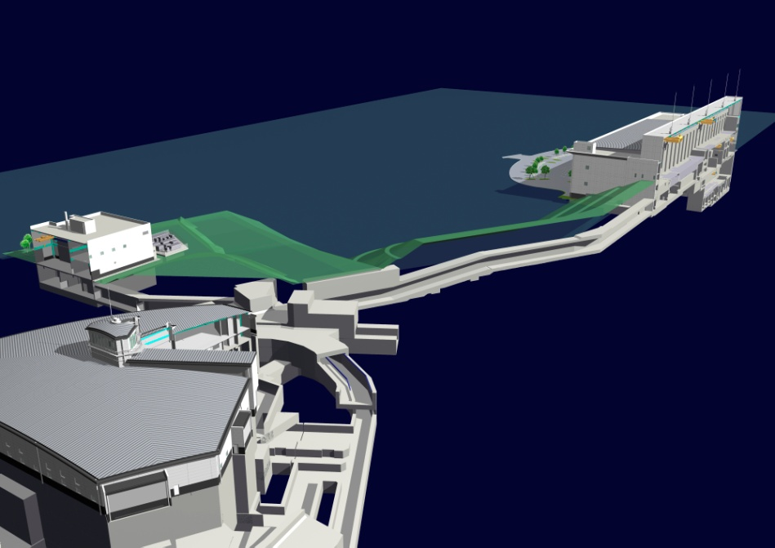
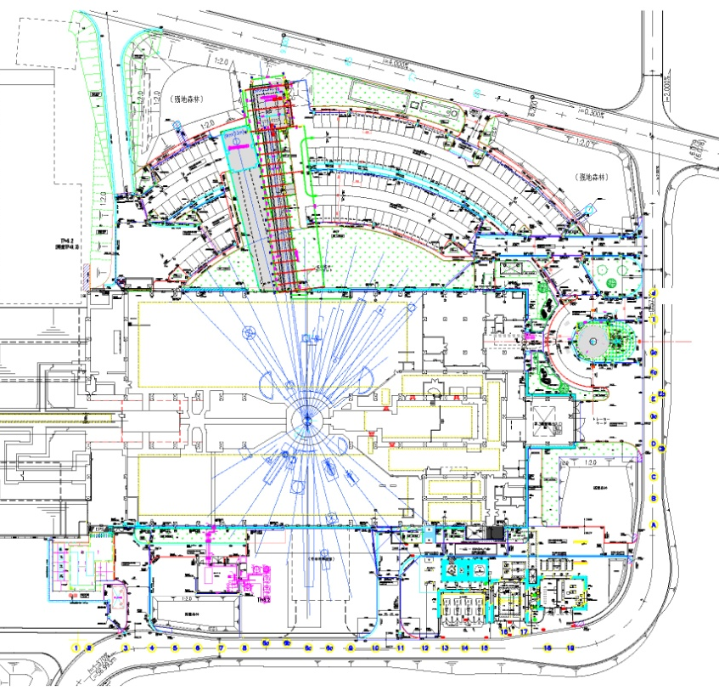
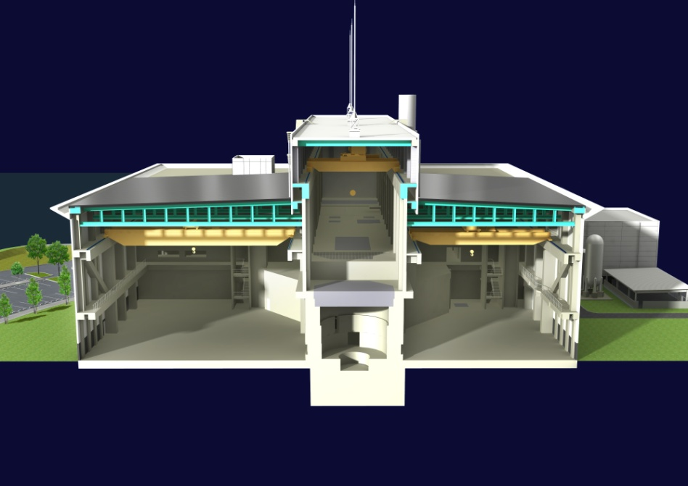
Materials and Life Science Facility
MLF
RCS (3GeV333μA)
Muon target
Spallation neutron target
Exp. Hall #1
Exp. Hall #2
Exp. Hall #1
Cascade target
μ
n
Exp. Hall #2
100%
4 kW
>90%
2×10¹⁵ p/s
@1MW
graphite
mercury
Beam transport tunnel

Slide 7
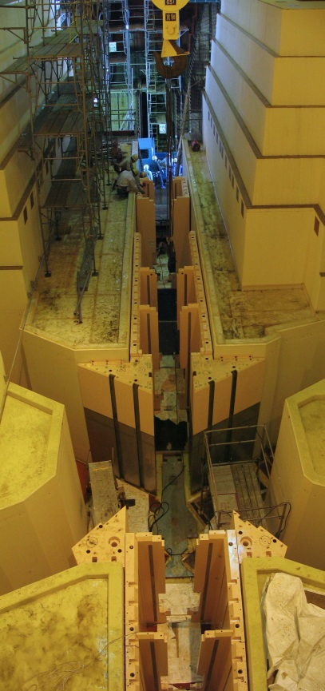
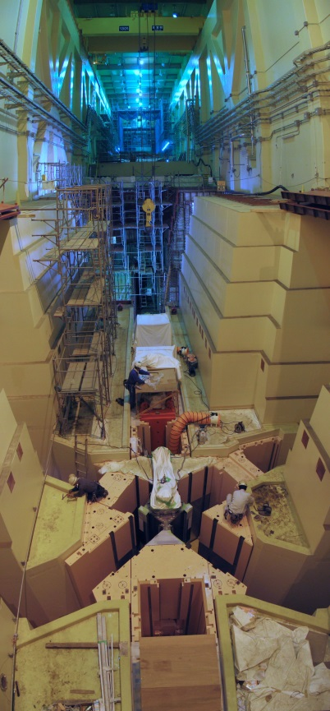
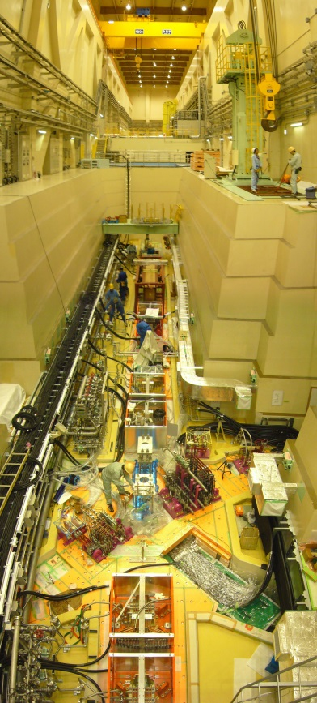
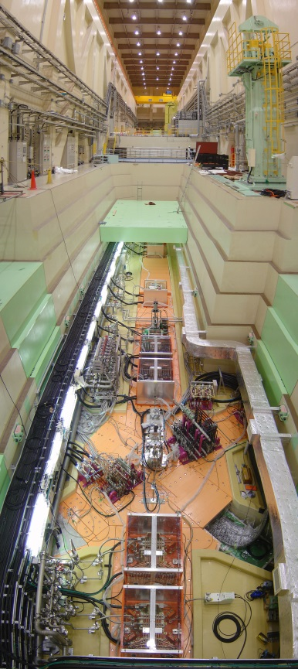
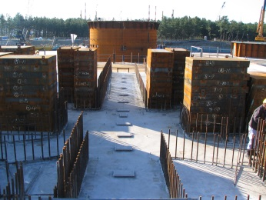
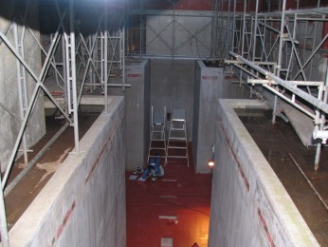
The chronicle of the construction
4/Nov/04
11/May/06
28/Jun/06
29/May/07
13/Jul/07
cask
BT-line magnets
Vacuum parts
(duct, pillow seal, and so on)
guide shields
buried iron blocks
21/Oct/05
roof-shield hatch
M-line magnets
target chamber
air circulator
base plates
FY2004 | FY2005 | FY2006 | FY2007
buried iron block
base plate
BT magnet
M magnet
CW pipe, cabling
alignment plate
air circulator
cask
★MTAC
guide shield
BT shield
roof shield hatch
target chamber
vacuum parts
system commissioning

Slide 8
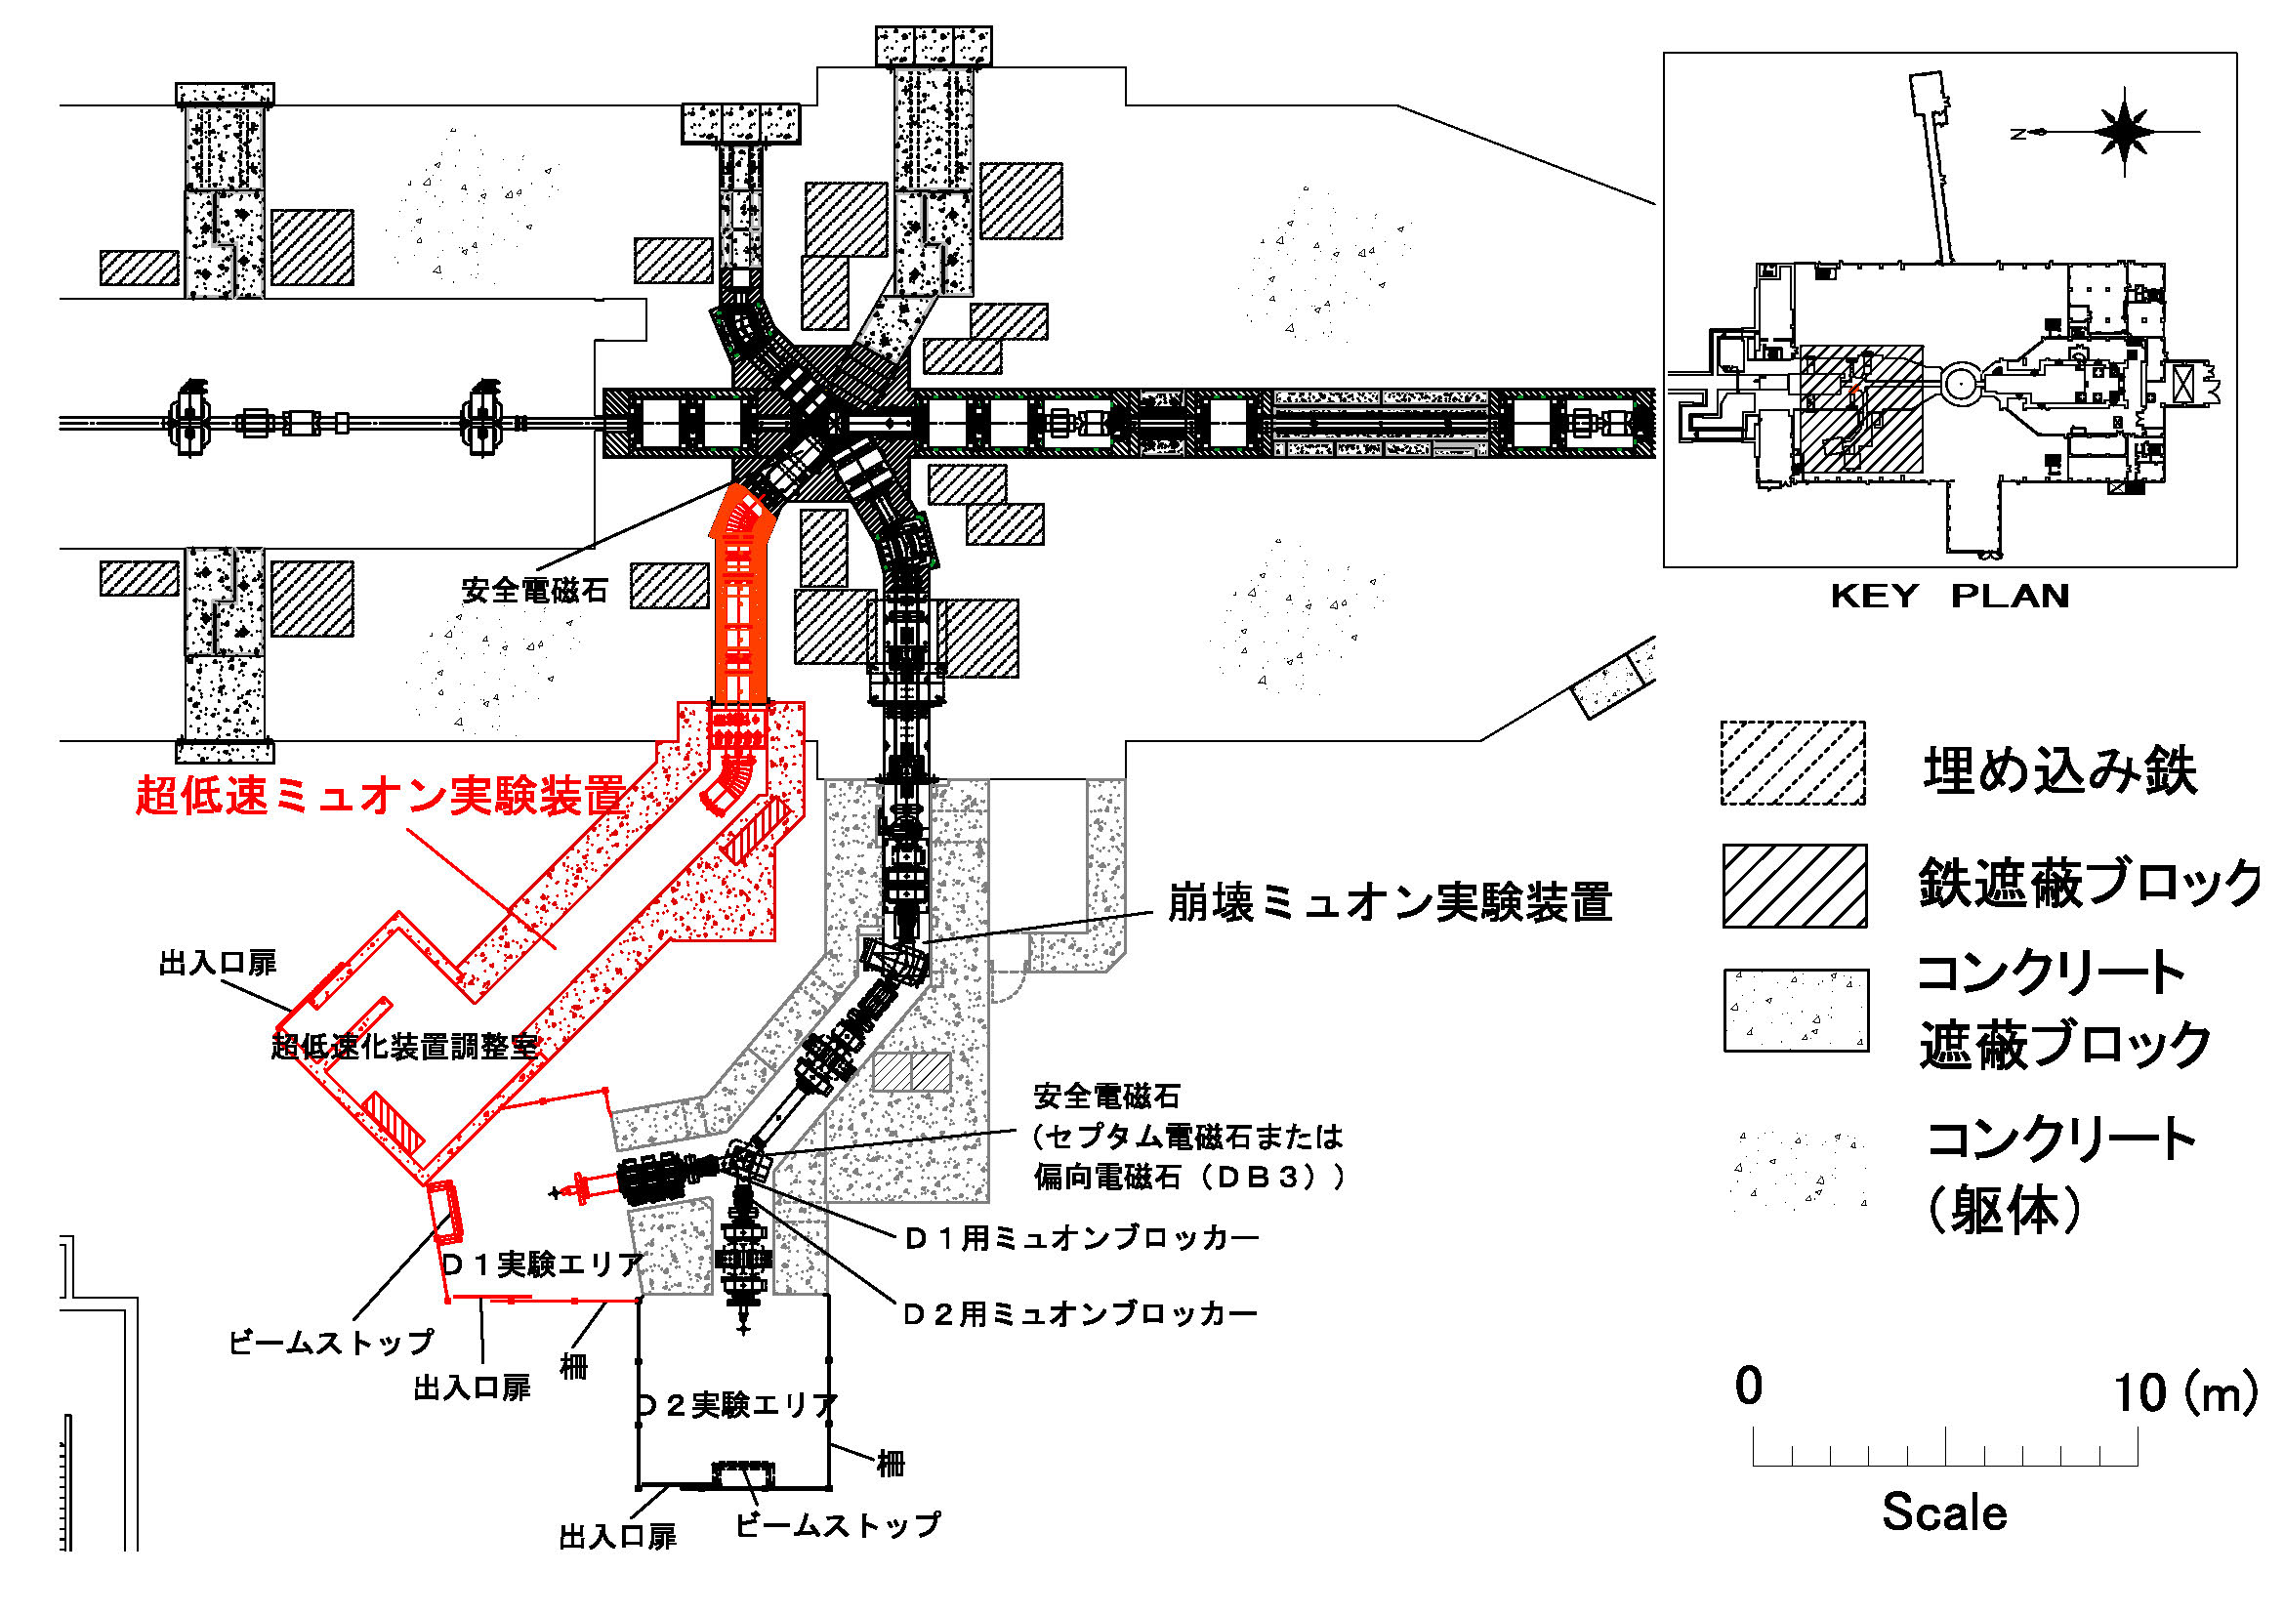
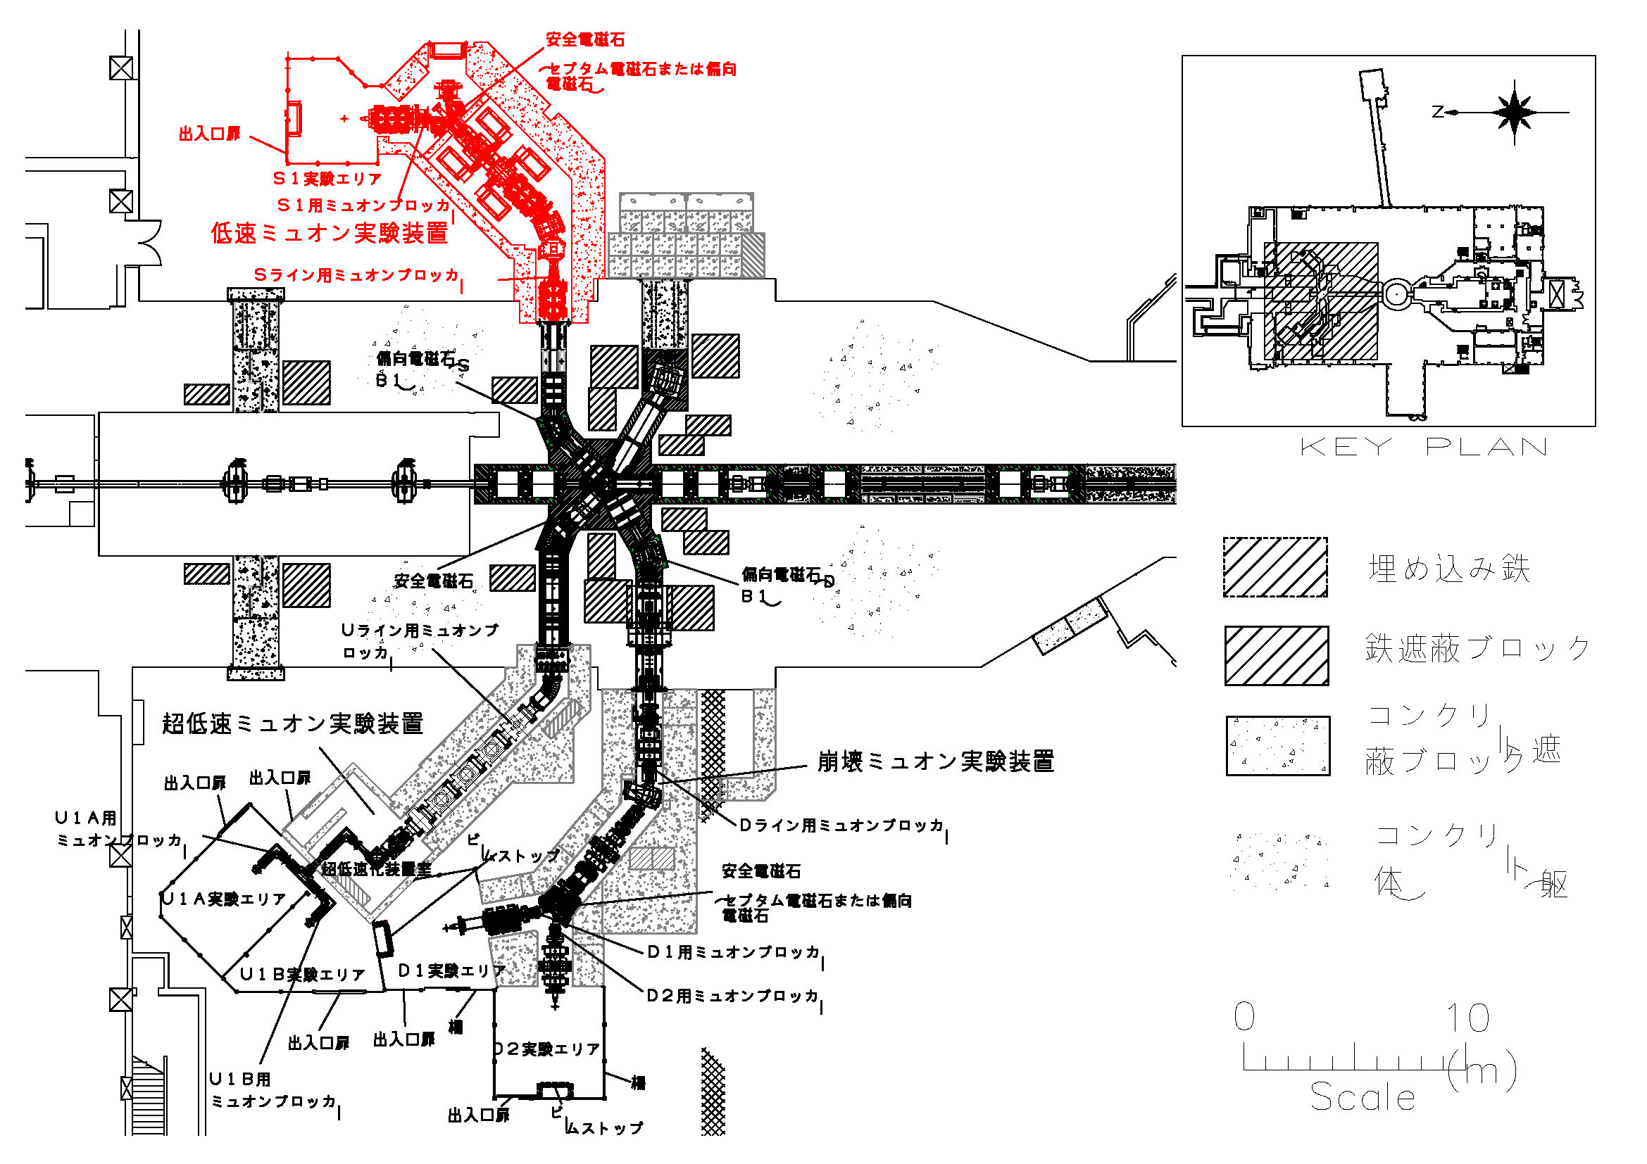
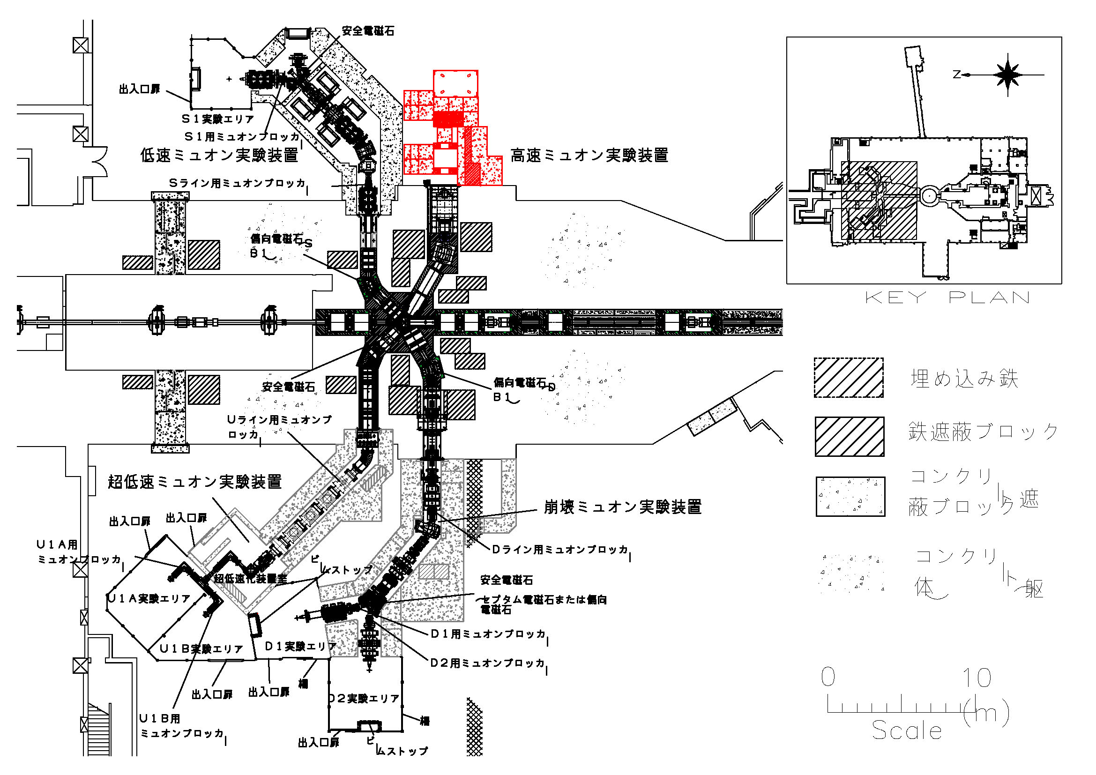
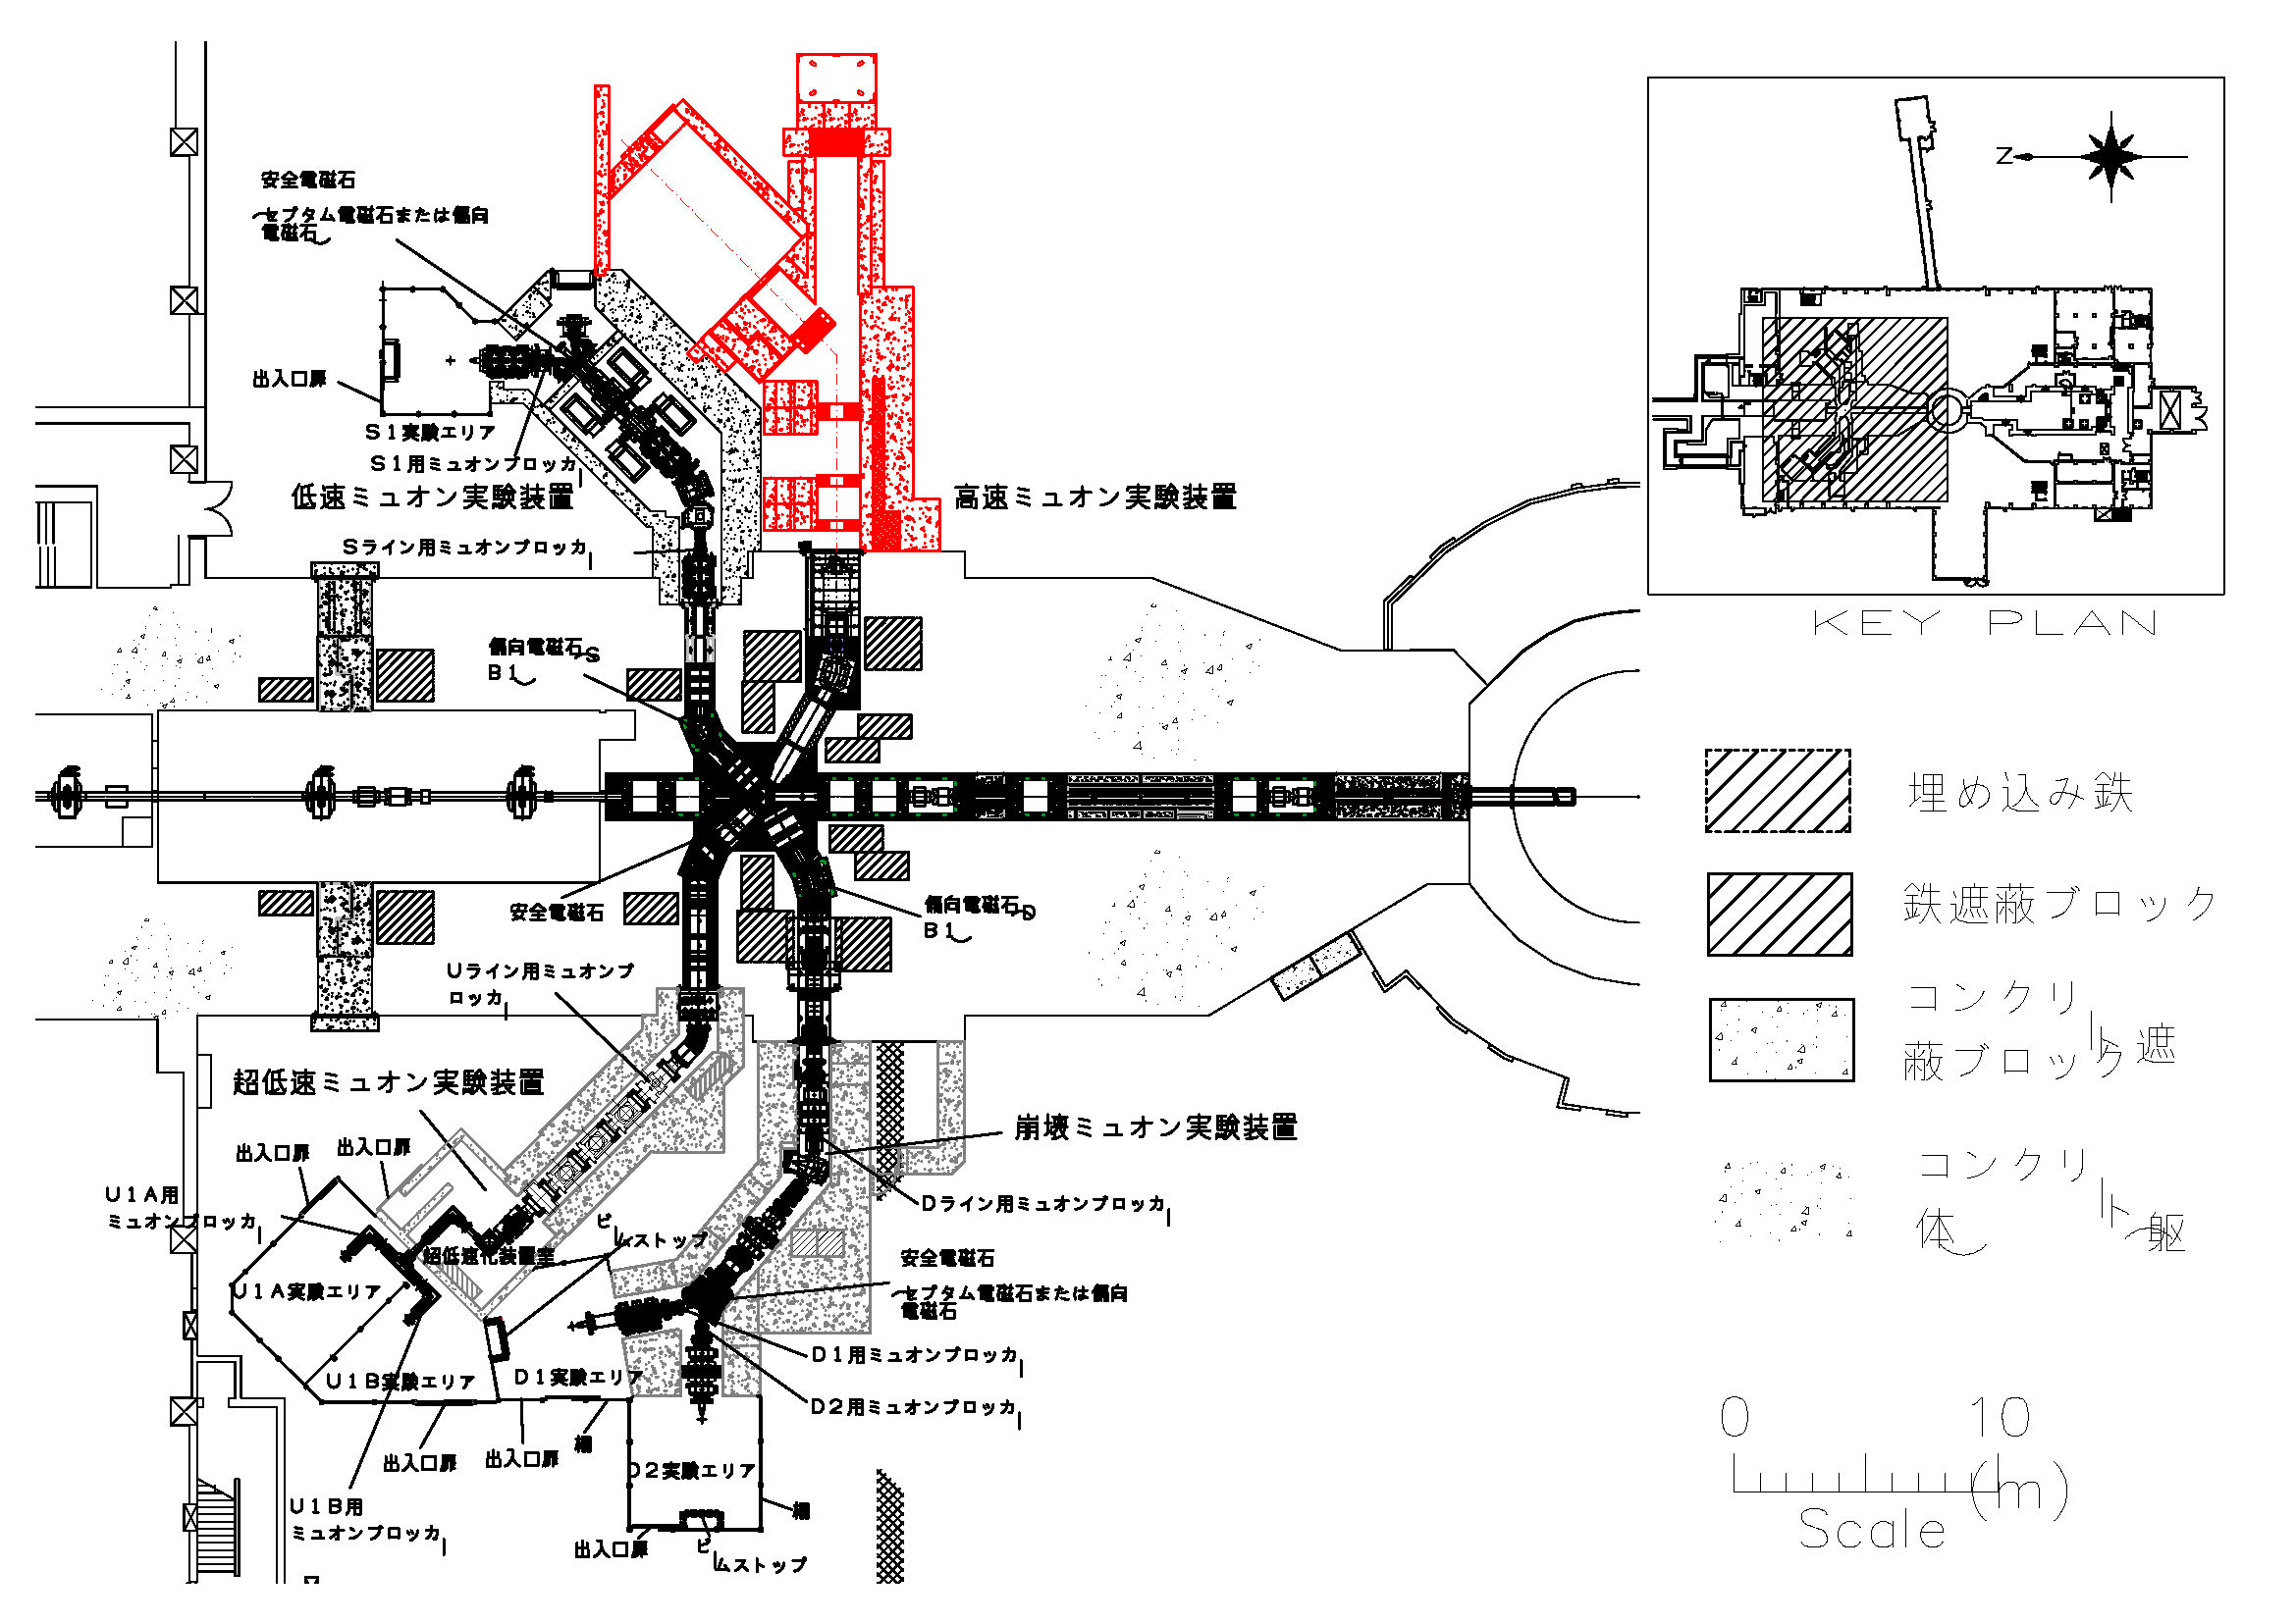
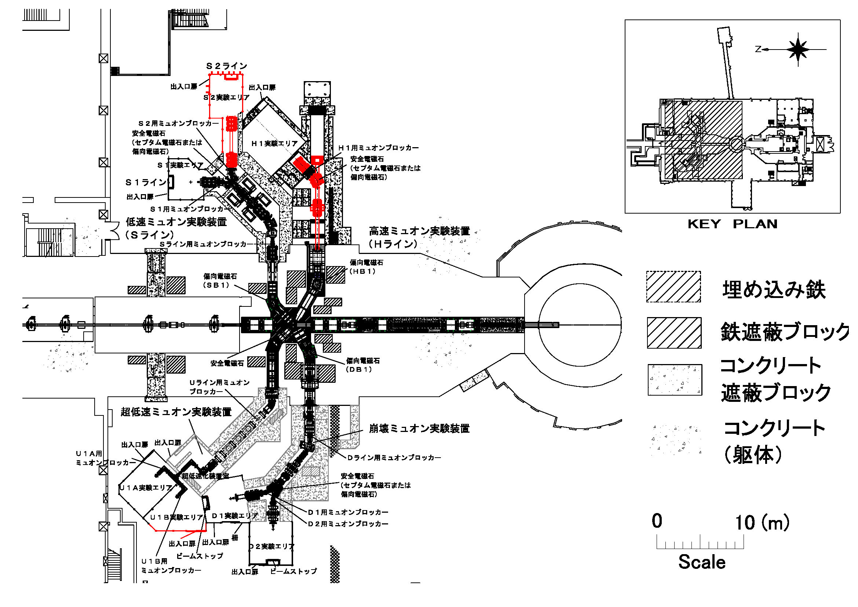
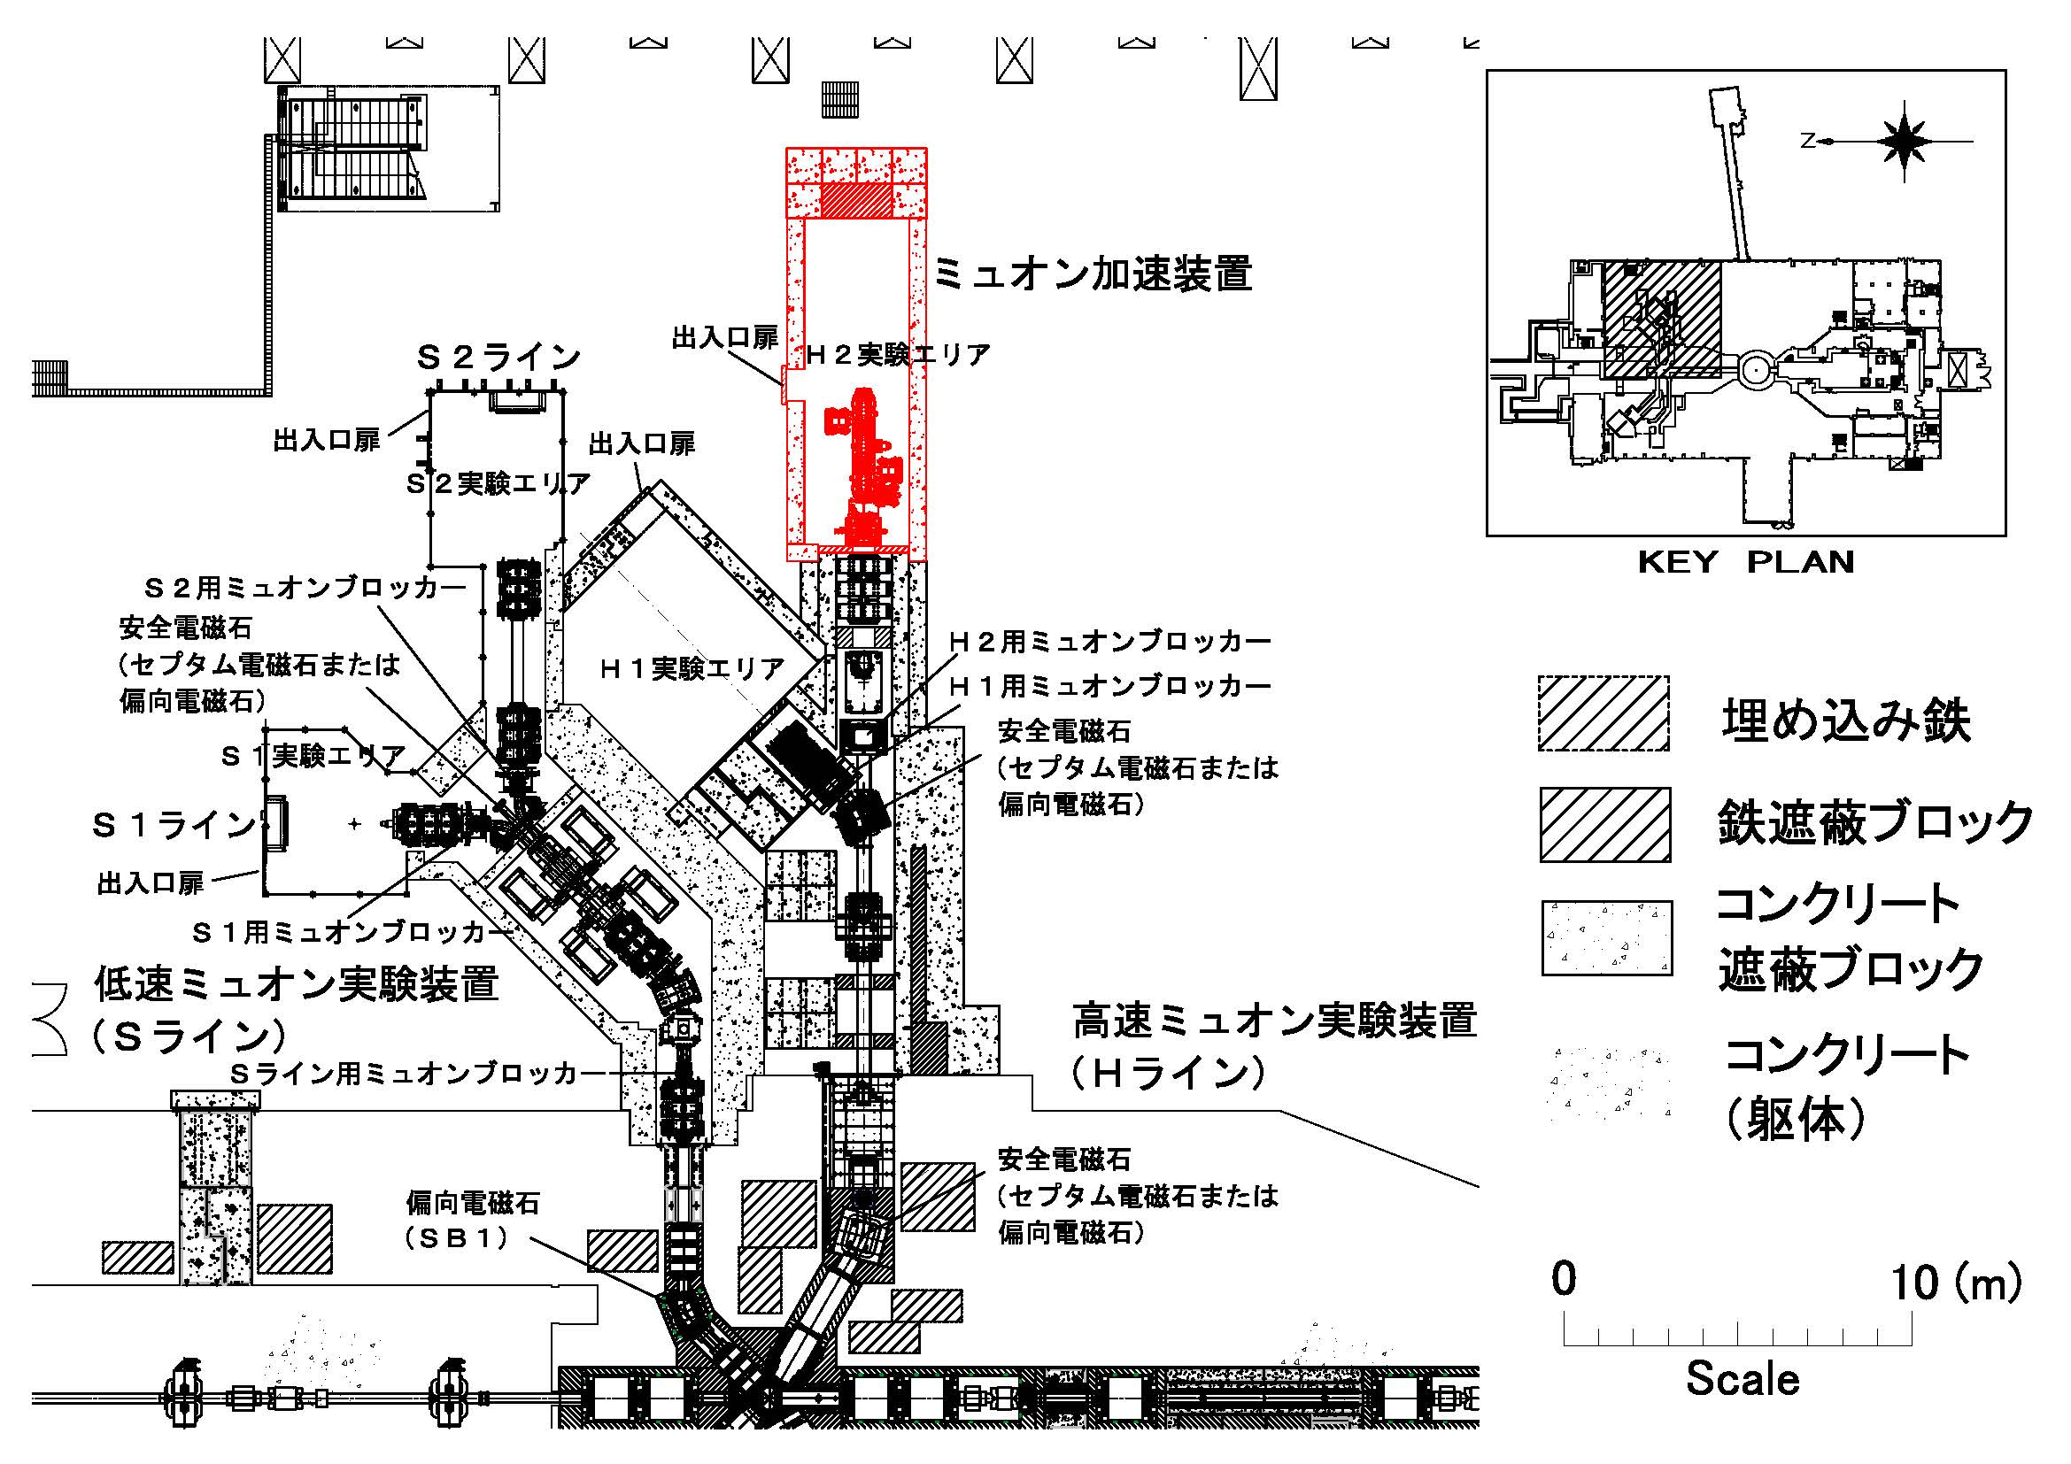
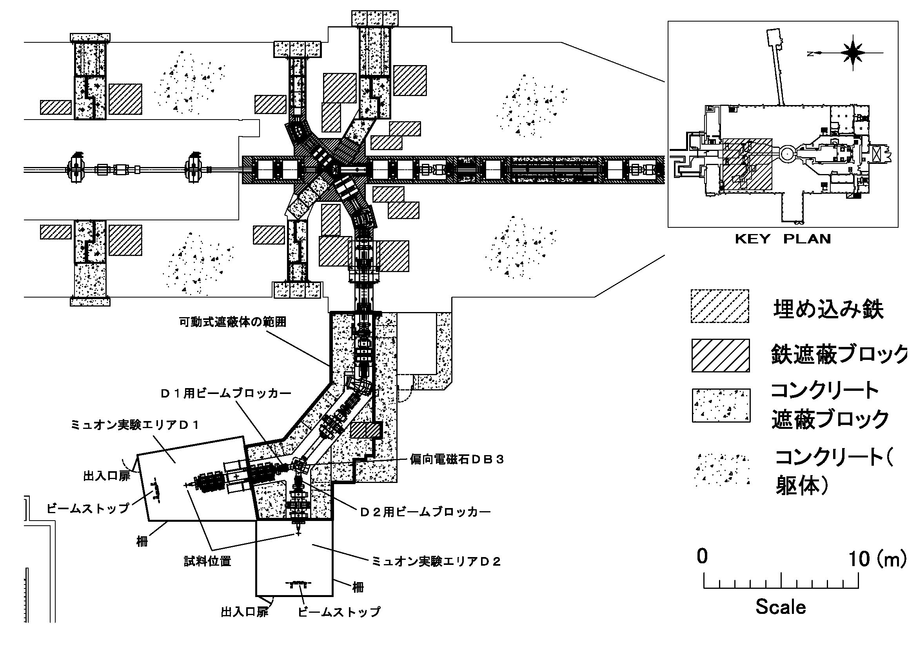
History of facility extension
2008
2011
2013
2015
2016
2020
2022

Slide 9
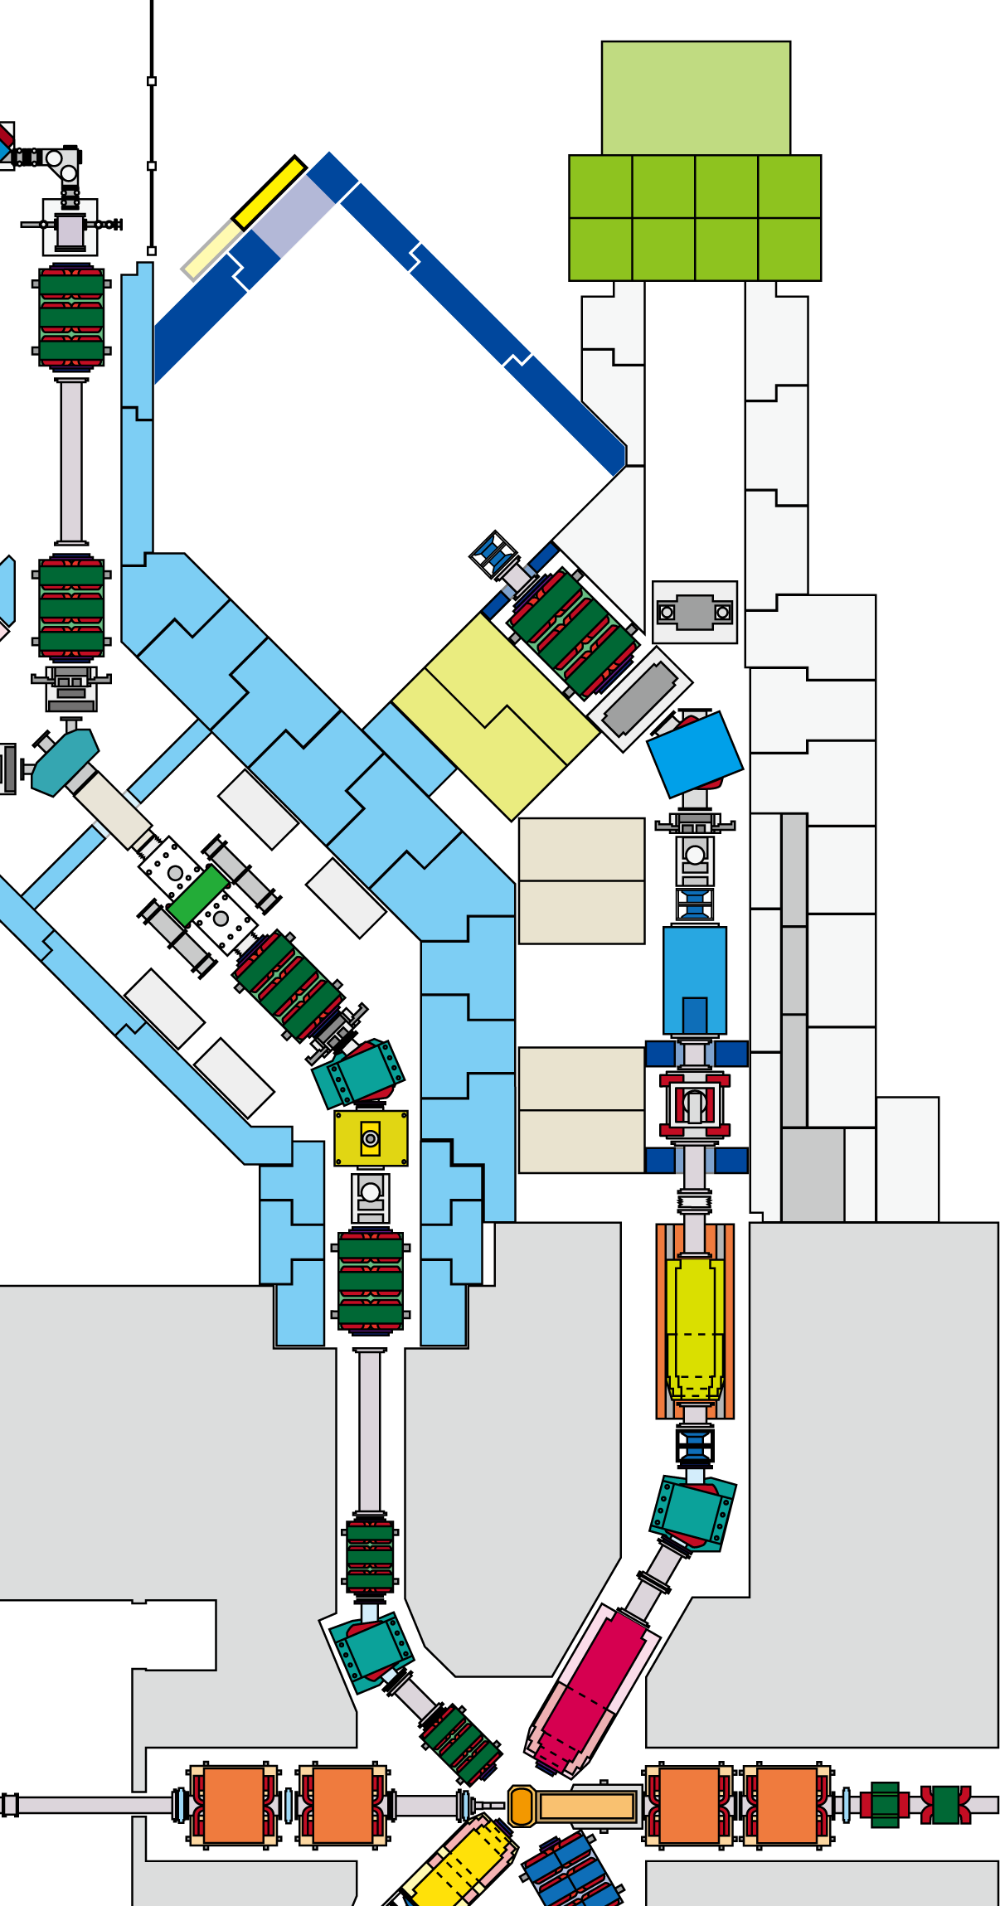
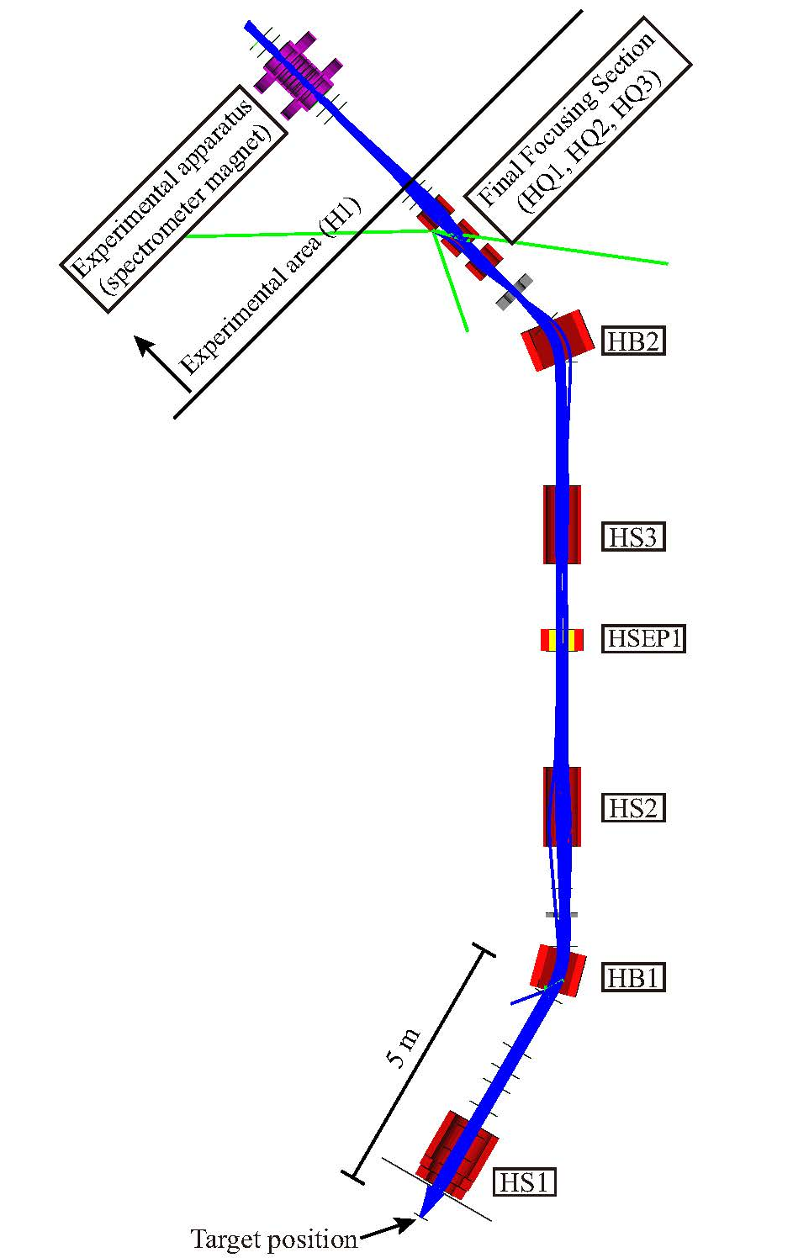
H line construction history
2022.1.27 official approval of operation
2022.1.25 inspection by NRA
2022.1.15 test beam
2020～2021 cabling/piping work
magnets in the downstream
2017～2019 electric sub-station
J-PARC center started to secure the extra budget to proceed with the H line construction.
2016 Radiation shield in the exp. hall
2014 Remaining devices in the M2 tunnel
2012 Frontend magnet
2010～ Conceptual design
2016
2014
2012

Slide 10
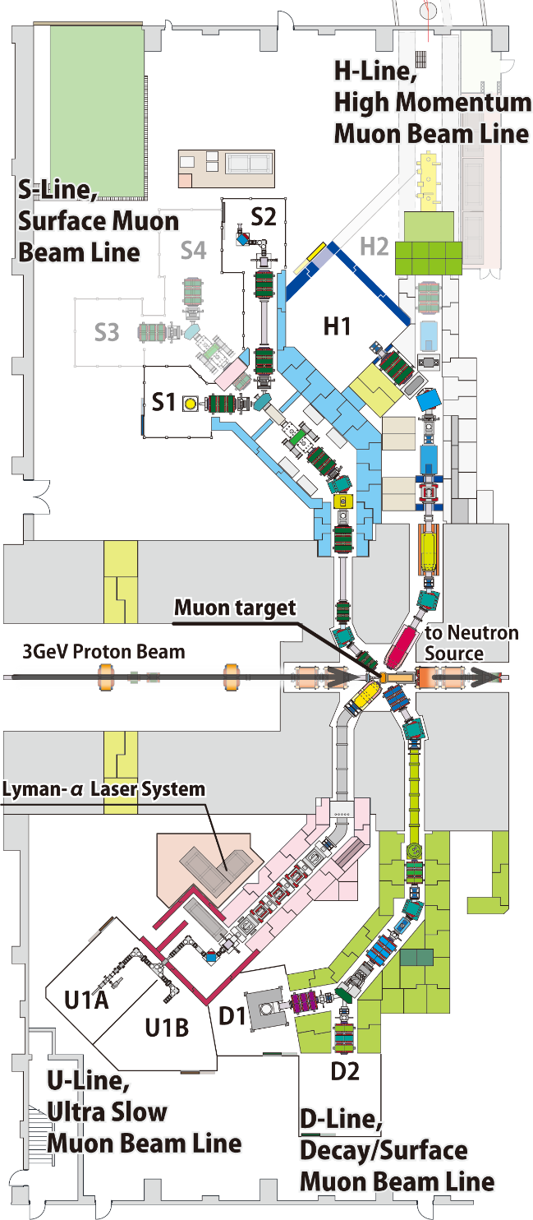
Muon Facility in MLF, MUSE
Surface muon （4 MeV）
dedicated to bulk µSR
in 4 experimental areas
w/ various sample env:
ultra-low temperature
high magnetic field
pulsed excitations etc.
High-intensity surface and high-energy cloud
muon （<4 - 50 MeV）
for general purpose “fundamental physics”
requiring high precision,
high sensitivity
S-line
µ⁺
H-line
µ⁺/µ⁻
4 areas
Simultaneous use
High Intensity
General Use
Ultra slow muon
（0.1 - 30 keV）
surface/sub-surface /interface sciences (U1A)
Test-bench for TμM (U1B)
Decay and surface muon
（100 keV - 50 MeV）
to answer a variety of users’ demands with
μSR spectrometer (D1)
general purpose (D2)
U-line
µ⁺
D-line
µ⁺/µ⁻
Ultra Slow Muon
Surface/Interface
General Use

Slide 11
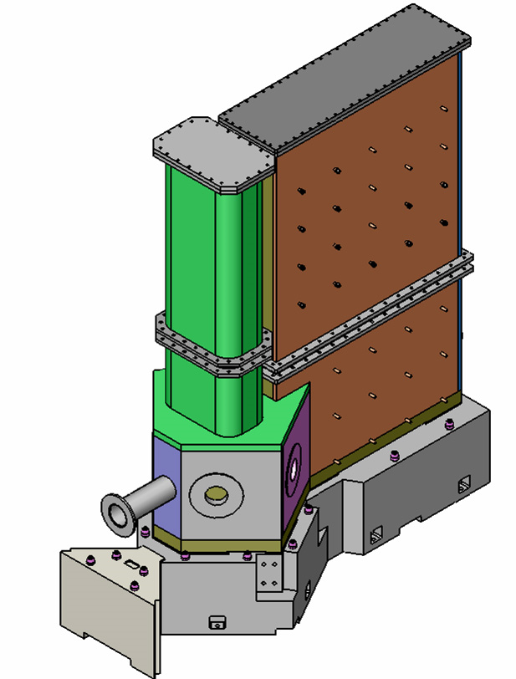
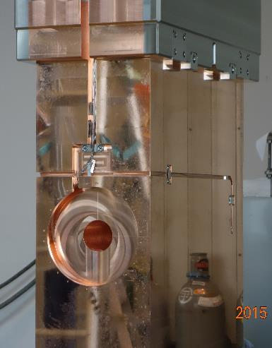
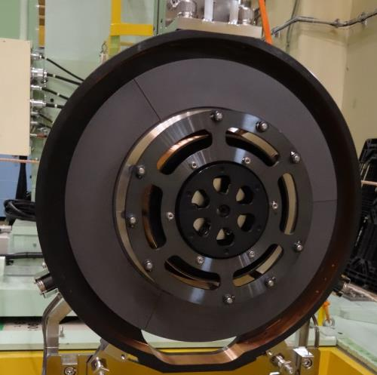
Muon Production Target
Rotating target
To prolong the lifetime of the target against DPA, operation started.
#1: 2014-2019
#2: 2019-
Heat deposit：4 kW
Graphite disk: rad. cooling
Bearing, jacket: water cooling
Monitors: motor torque, vacuum level, Q-mass for outgas. IR-Radiation thermometer is going to be operated.
Two Scrapers (proton collimator)
Scrape the scattered protons by the target
Renewed in 2015.
Heat deposit：20 kW＠No1
Water cooling
Thermocouple thermometers
μ
p
μ
Vacuum vessel
In service since 2008
Hea deposit：10 kW
Water (>90%) and air cooling
Thermocouple thermometers

Slide 12
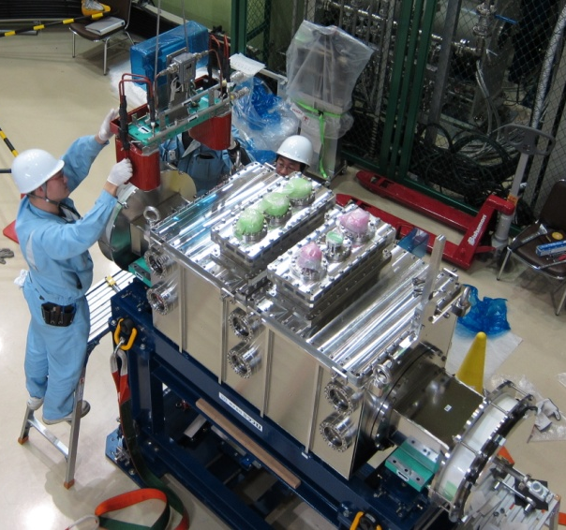
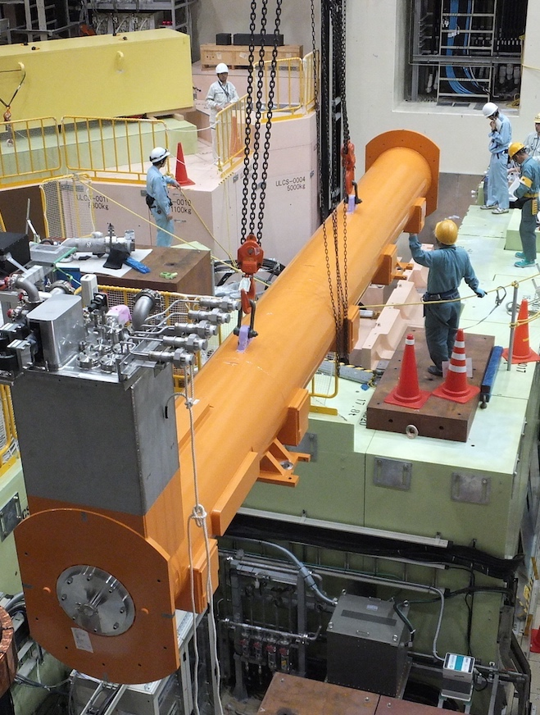
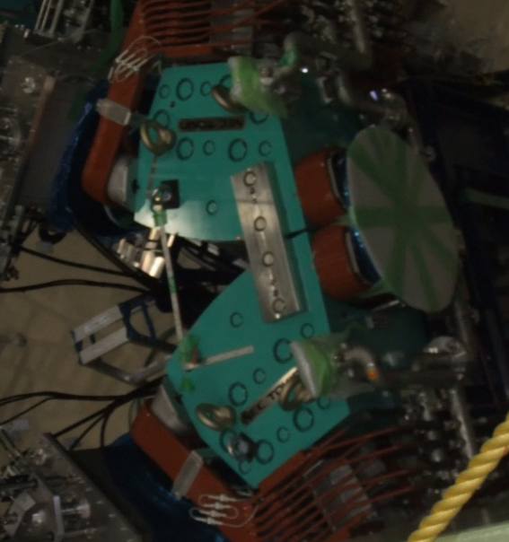
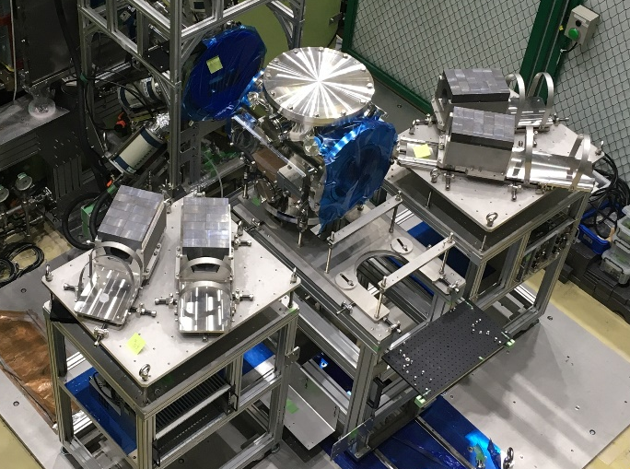
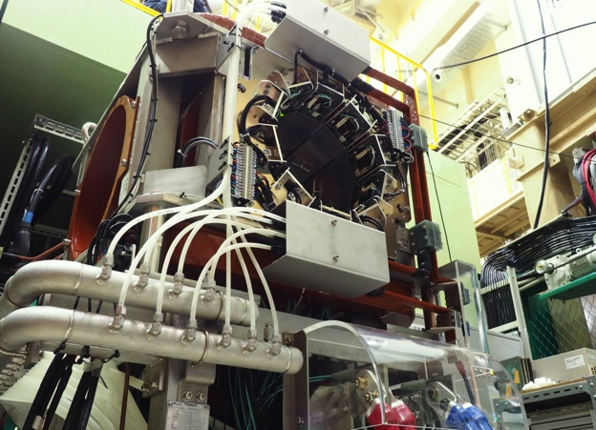
D-line: A decay/surface muon beamline
Double pulse structure due to accelerator bunch
Each pulse is distributed to D1 and D2 areas with a kicker magnet.
Kicker magnet
100 ns
π
600 ns
to D1
to D2
Septum magnet
S.C. Solenoid magnet replaced in FY2015
μ
D2: General purpose
(open space) area
D1: μSR
μSR spectrometer
elemental-analysis chamber

Slide 13
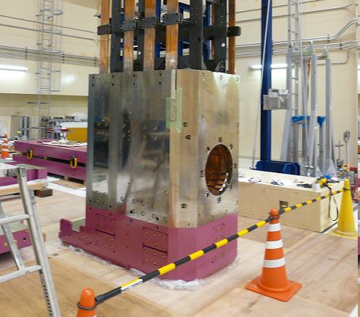
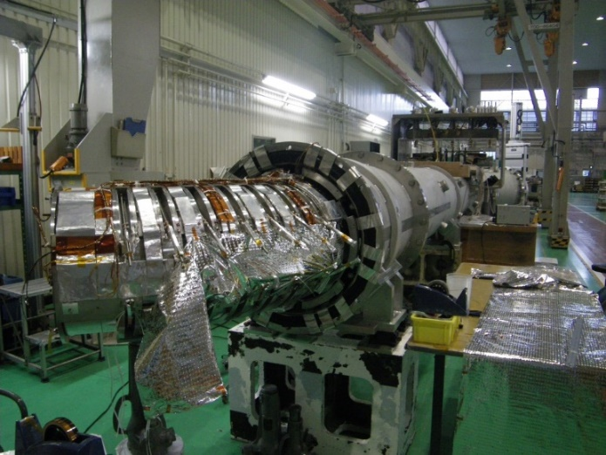
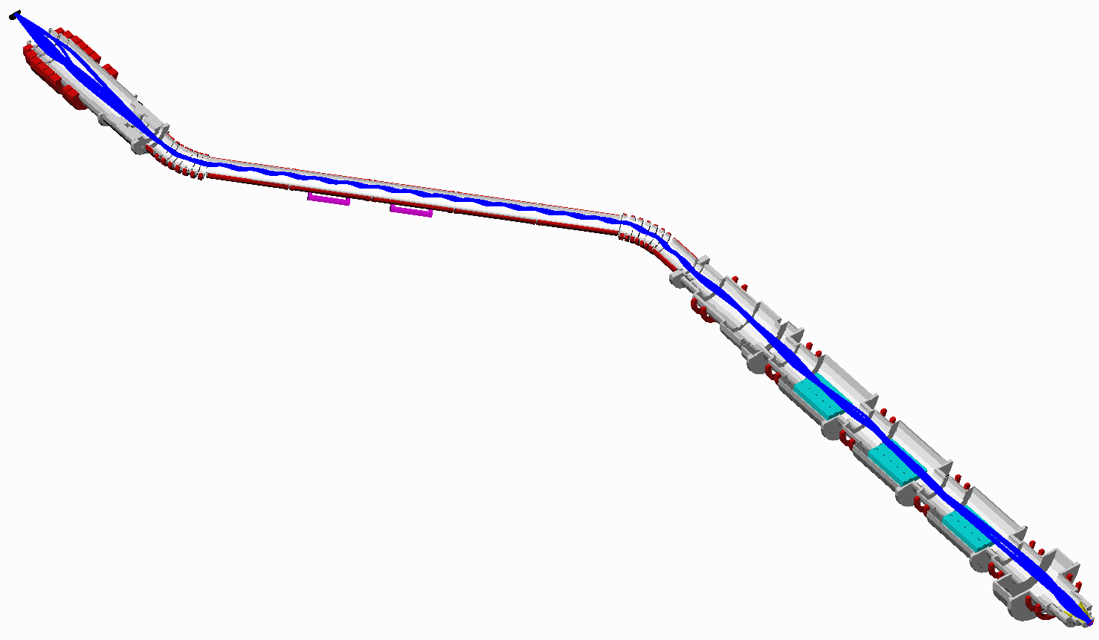
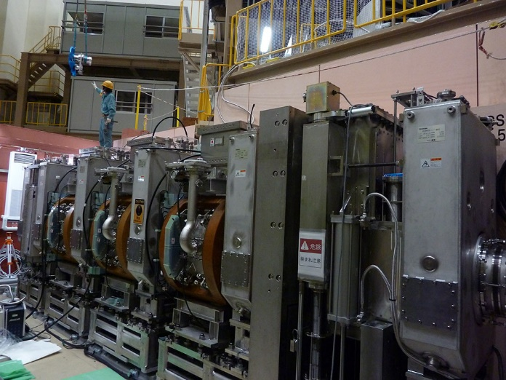
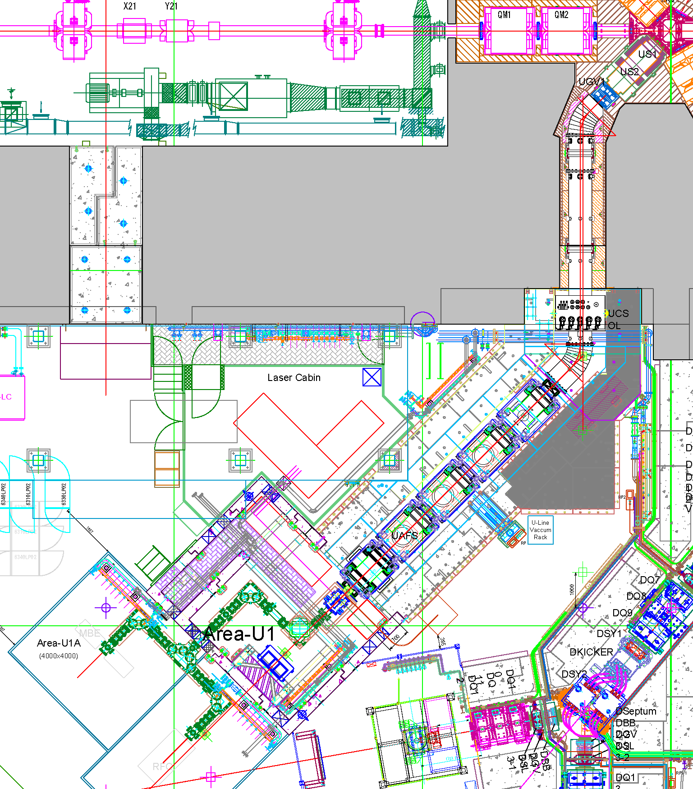
U-line: The highest intensity beamline for USM
proton
NC large aperture capture solenoid
SC curved solenoid
SC focusing solenoid w/ wien filters
All beamline magnets are axial focusing
The world strongest pulsed muon: 2×10⁸ μ⁺/s, 1×10⁷ μ⁻/s

Slide 14
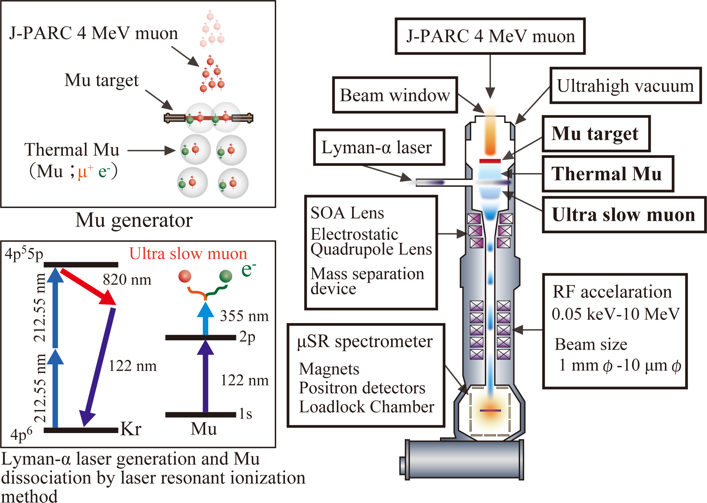
U-line: Generation of Ultra slow muon (USM)
W(2000C)
USM is generated by the laser resonant ionization method synchronized with the muon beam pulse.

Slide 15
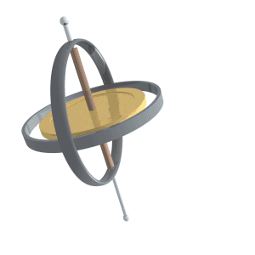
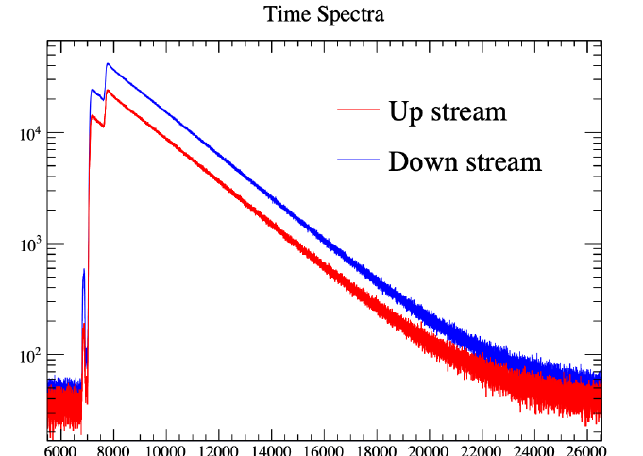
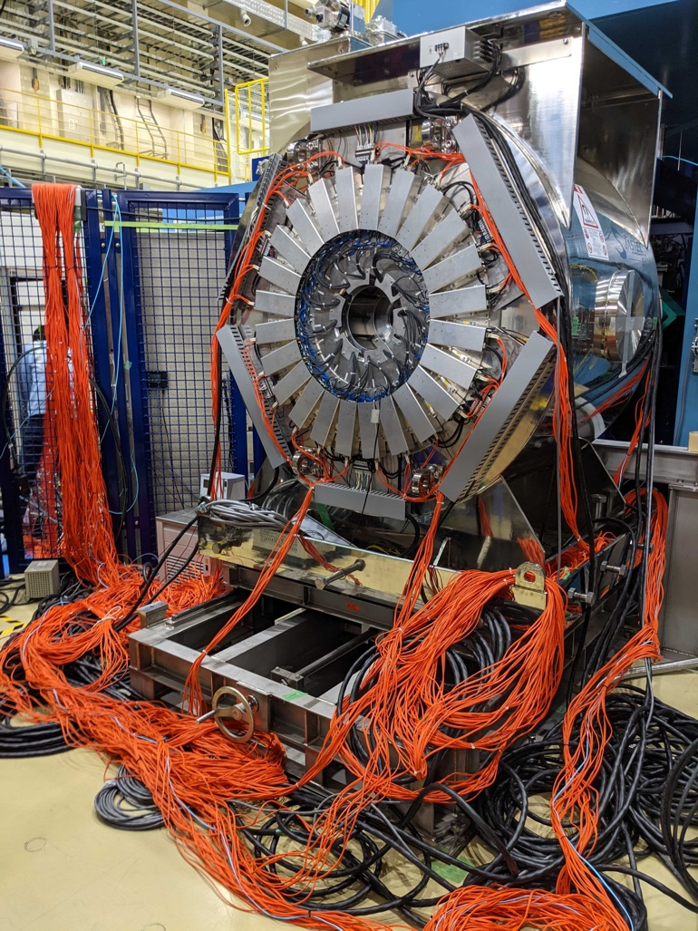
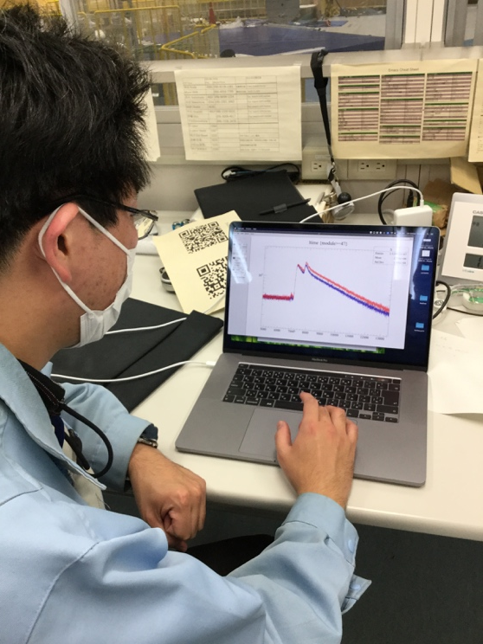
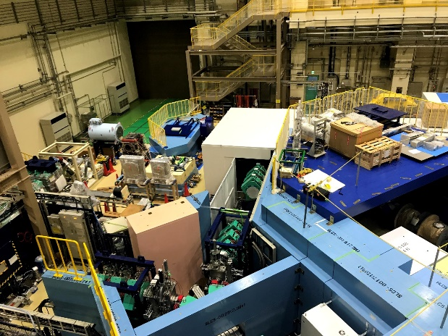
S-line: A surface muon beamline
In the S1 area, a μSR spectrometer was placed.
The S1 area is one of the busiest ones, and users are switching every few days.
The S2 area is partially funded by Okayama-univ. group to perform high-precision measurement of the Mu 1s-2s level.
S line is dedicated to transport surface muon beam.
By using two kicker system, S line provides muon beams to all 4 areas simultaneously.
At present two experimental areas, S1 and S2, were completed.
S4
S2
S3
Kicker
S1
Kicker
S2
The 1st spectrum of 5-T magnet
Pulse μSR: Highly segmented spectrometer is necessary to avoid the distortion of time spectrum due to pileup.
Cf. 5-T magnet needs 3008-ch
S1
A. Koda’s presentation

Slide 16
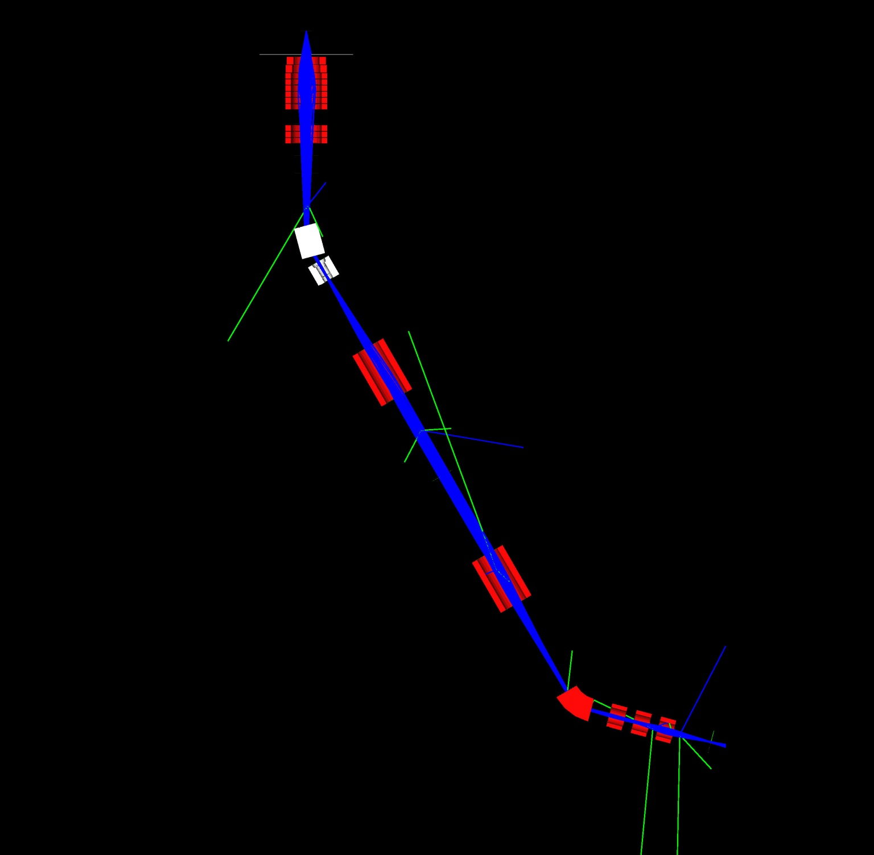
H-line: Generic-purpose High-intensity beamline
3GeV proton
Instrument specification of H1
Beam Intensity:
1×10⁸ μ⁺(surface)/s
2×10⁶ μ⁻(28 MeV/c cloud)/s
2×10⁷ μ⁻(40 MeV/c cloud)/s
4×10⁷ μ⁻(>50 MeV/c cloud)/s
Beam spot size:
∅30-35 mm
Capture solenoid (HS1)
Bending magnet (HB1)
↑beam transport tunnel
Gate valve (HGV1)
Kicker magnets and/or
wien filers are installable
Adopting a new beamline concept which is confirmed by a particle tracking simulation, the H line is designed to provide a high-intensity beam with a wide-range momentum tunability to each of several areas.
The muon beamline of MLF-TS2 inherited this concept.
+B
Transport solenoid
(HS2 and HS3)
-B
Septum or bending magnet (HB2)
Experimental area #1
Conceptual design was proposed by J. Doornbos, TRIUMF.
Experimental area #2 and #3

Slide 17





H-line: feature prospects (the world’s first muon acc.)
The studies in the H1 area
DeeMe:
muon-to-electron conversion search
MuSEUM:
High-precision measurement of muonium
Ｈ line bldg.
ＭＬＦ bldg.
Ｈ1
H line
H1
Ｈ line
H2
Cooling
H line bldg. （plan）
Acceleration
Accumulation
Transmission Muon Microscope
Observation of whole living cell owing to high transmittance capability of muon
g-2/EDM exp.
Searching for BSM.

Slide 18





MLF Target Station2
J-PARC TS2
Integration of neutron and muon sources (world's first)
J-PARC proton accelerator intensity (1 MW) increased to 1.5 MW
1 MW (17 Hz) for TS1 and 0.5 MW (8 Hz) for TS2
TS1
TS2
3GeV RCS
This project was selected as one of “The Medium- to the Long Term Academic Research Strategy” by the Science Council of Japan although the budget has not been guaranteed yet.
6e+14
5e+14
4e+14
3e+14
2e+14
1e+14
0
Neutron Brightness
J-PARC
TS2
Integrated neutron and muon target
ESS
SNS TS2
Brightness (n/cm²/sr/Å/s)
J-PARC
TS1
Muon Capture Solenoid
Rotating tungsten target
SNS
Proton beam
Neutron Focusing Devices
Neutron Detectors
Moderator & reflector
0 2000 4000
Neutron:
10 (target) x 2 (device) → 20 times gain of brightness
Emission time (μs)
Brightness of MLF TS2 will be the world's highest compared to the next plan of overseas facilities
Muon:：
10 (target) x 5~10 (Muon capture solenoid) → 50 ~100 times gain of flux

Slide 19
Summary
The world’s highest-intensity pulsed muon facility, MUSE, coexists with the neutron facility J-PARC.
In MUSE, we have 4 unique beamlines to answer a demand of various muon sciences; material science, atomic and molecular physics, particle physics, industrial application, elemental analysis, heritage science, etc.
The biggest disadvantage in muon science is there are only 5 facilities in the world. This loses a lot of users’ chances. We welcome a new facility in China.
Thank you. 謝謝

