Slide 1
Overview of the ISIS Muon beamlines
Adrian Hillier, ISIS Muon Group
2nd Workshop on Muon Technology and Industry, CSNS
January 2025

Slide 2
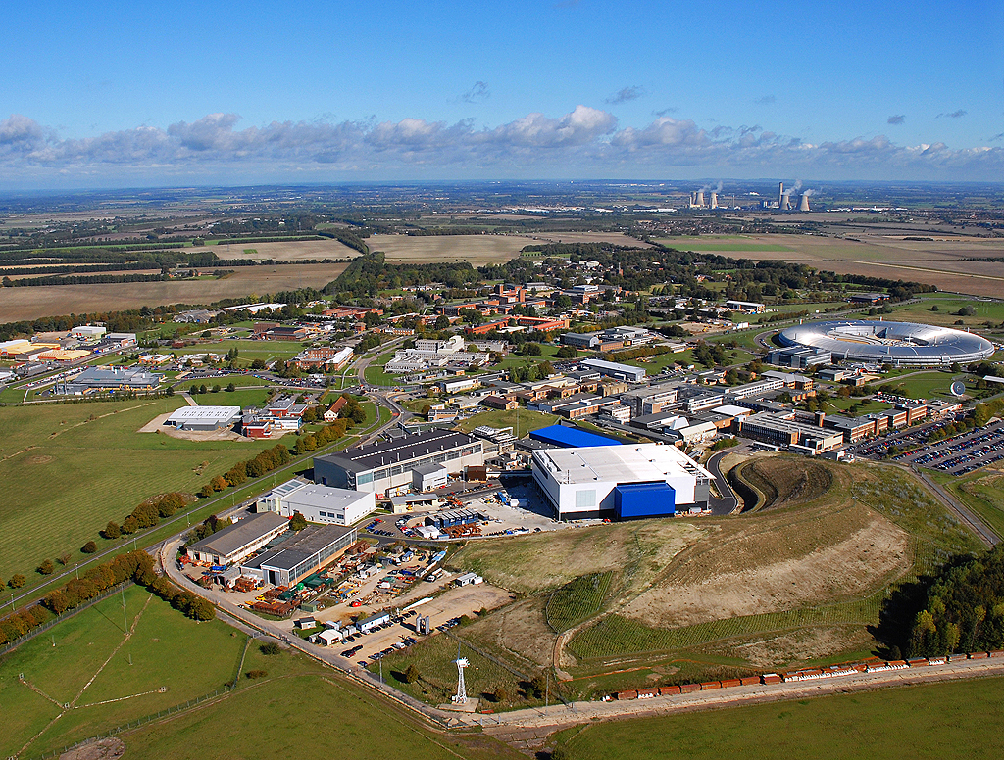

STFC Rutherford Appleton Laboratory
ISIS Pulsed Neutron and Muon Source

Slide 3
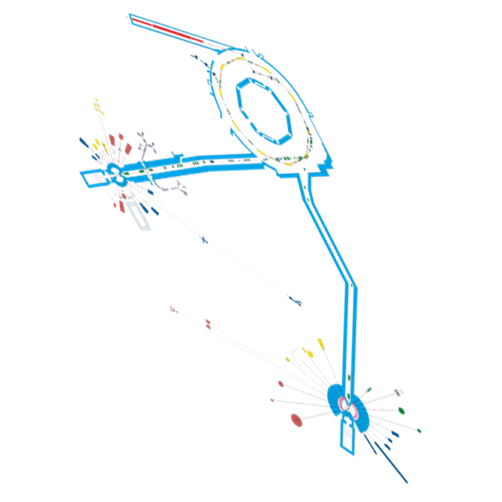
ISIS Pulsed Neutron and Muon Source

Slide 4

Notes:
This year we are celebrating 40 years of ISIS operation. Forty years characterised by scientific excellence, technical innovation and leadership. 40 years that includes 35,000 proposals to use the facility; 80,000 instrument days delivered; 60,000 user visits from 40 countries; and over 15,000 publications.
ISIS is a world-leading asset for UK science and has the potential to continue to be, well into the future.

Slide 5
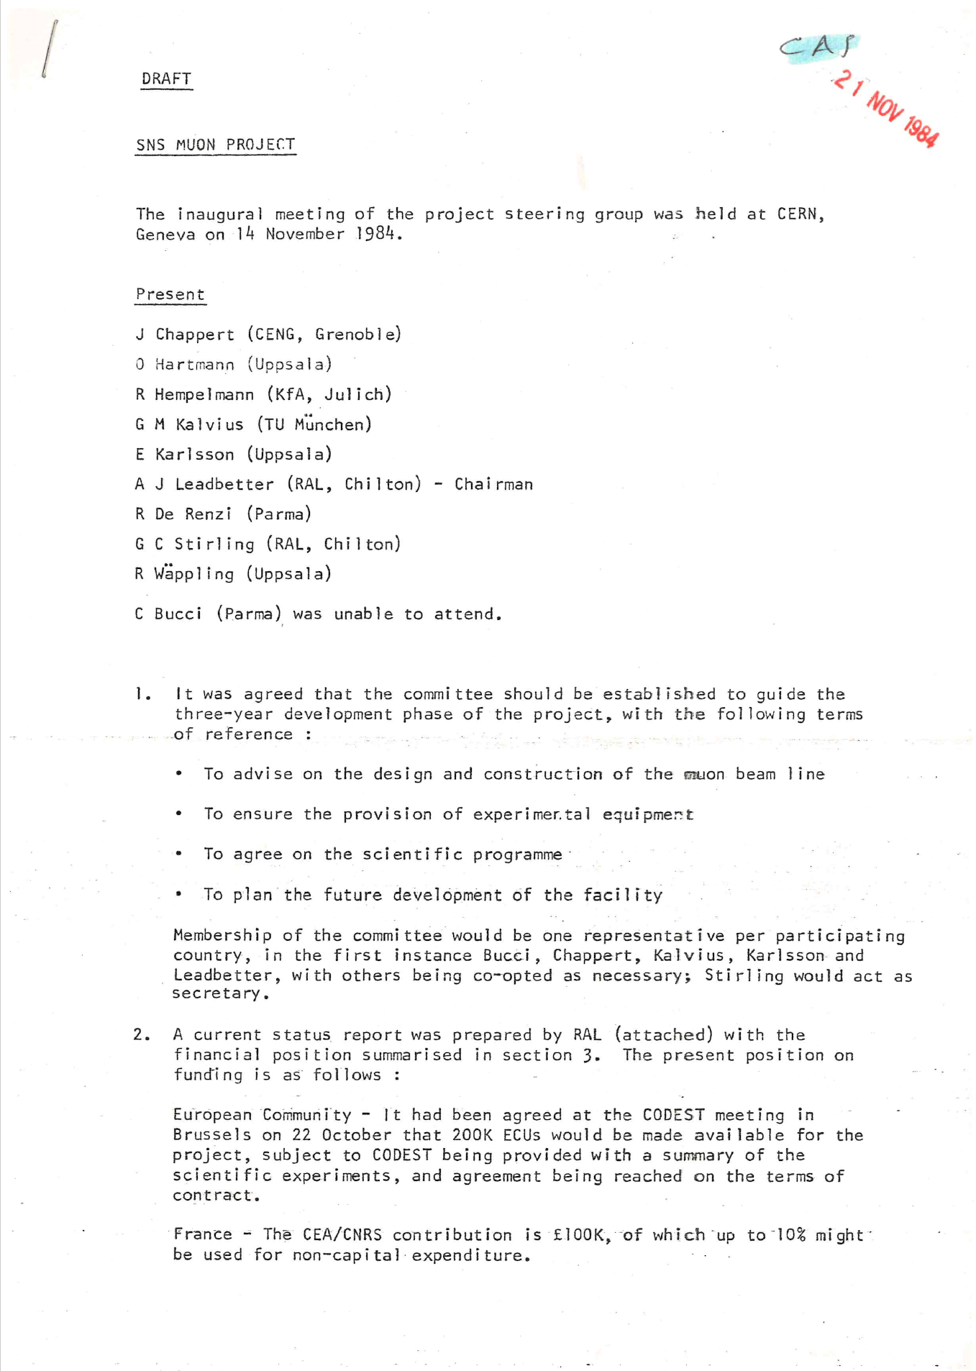
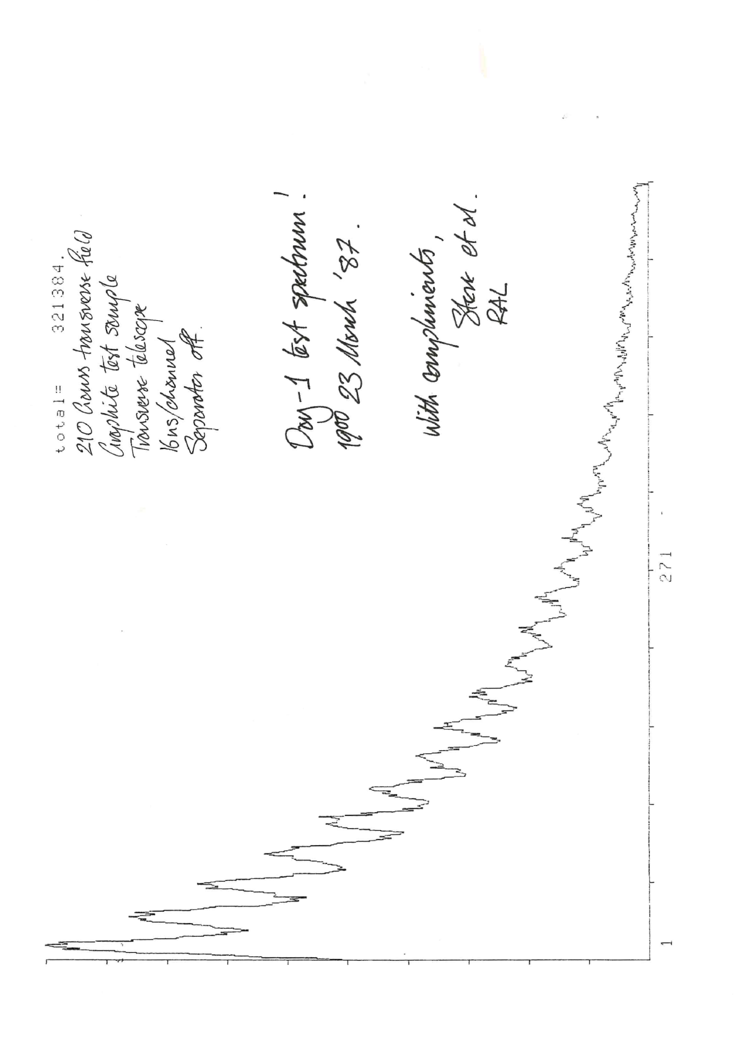
40 years since the inception of muons
14 November 1984 – first meeting to discuss the concept of muons at ISIS
2.5 years later first muons

Slide 6
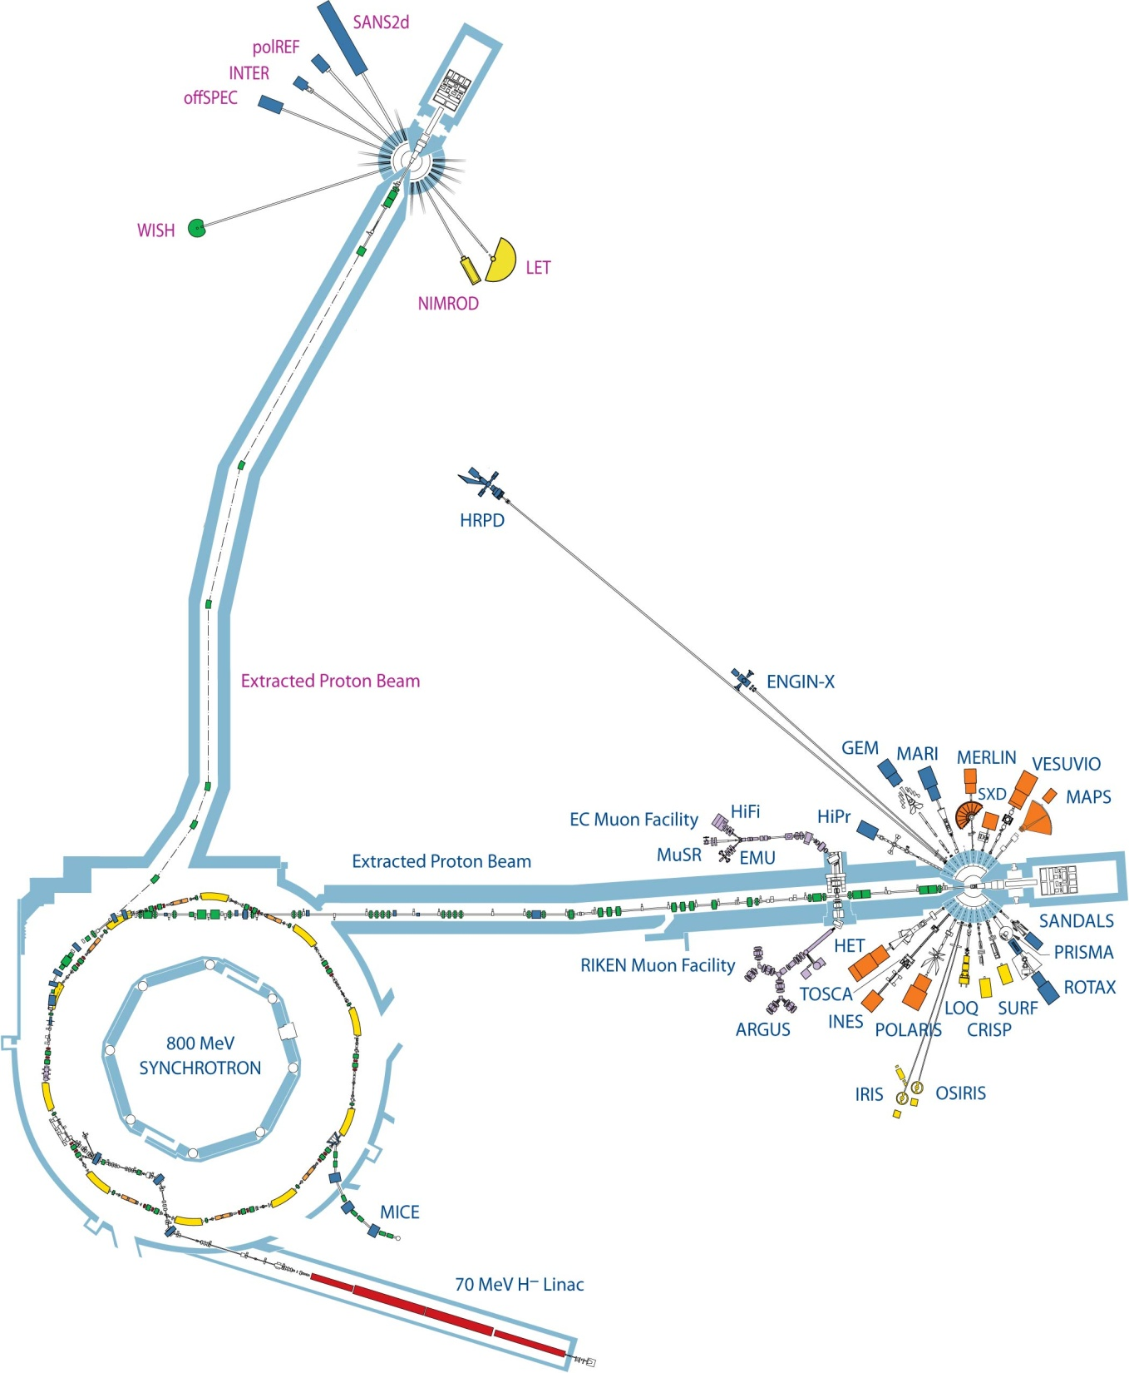

Muons at ISIS
MuX/MEIS

Slide 7
Muons Instruments at ISIS
EC Muons
Fixed Momentum Muons ~27MeV/c
Positive muons
Longitudinal fields upto 5 T
Transverse fields upto 600+ G (pulse width limited)
Temperature range 30mK – 2000K
Laser excitation
Pulsed techniques e.g. RF, EF, Light, ac susceptibility
RIKEN
Variable Momentum Muons ~15 – 90 (120) MeV/c
Positive or negative muons
Longitudinal fields up to 0.4 T
Transverse fields up to 600+ G (pulse width limited)
Temperature range 30mK – 500K
Pressure
Elemental Analysis
Ports for long term experiments
e.g. proton charge radius experiment
MuX/MEIS

Slide 8
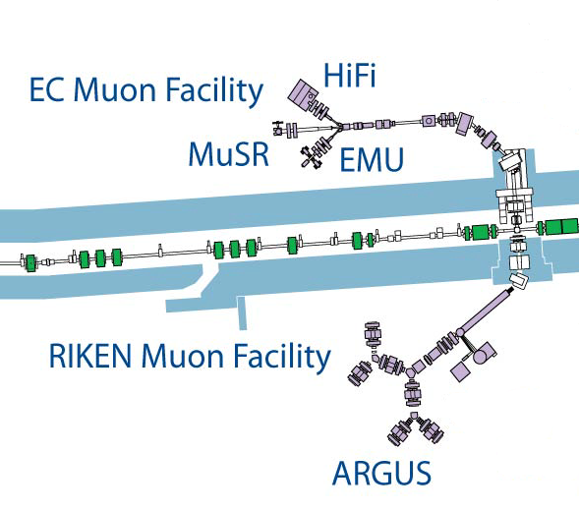
ISIS Muon Instrument Suite
Instrument | Detectors | Rate (MEv/h) [Double pulse]
ARGUS | 192 | 50 [100]
EMU | 96 | 150
HiFi | 64 | 80
MuSR | 64 | 70
Surface muons
Also within the RIKEN-RAL Muon Facility:
Negative muon elemental analysis – MuX
Effects of Muons on electronics - MEIS
FAMU muonic hydrogen experiment – Port 1
Muon development beamline – Port 3
MuX/MEIS
Surface and decay muons

Slide 9
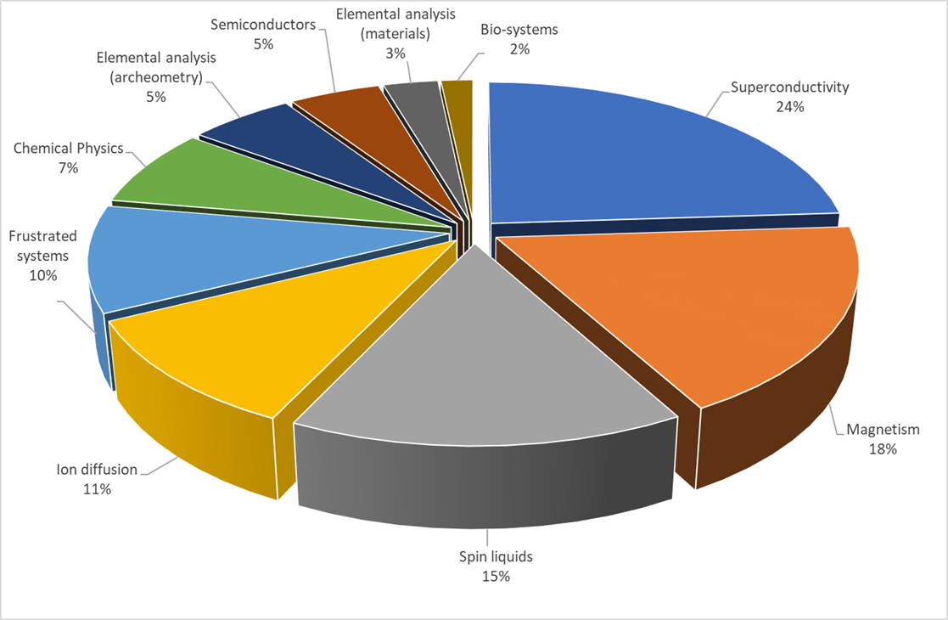
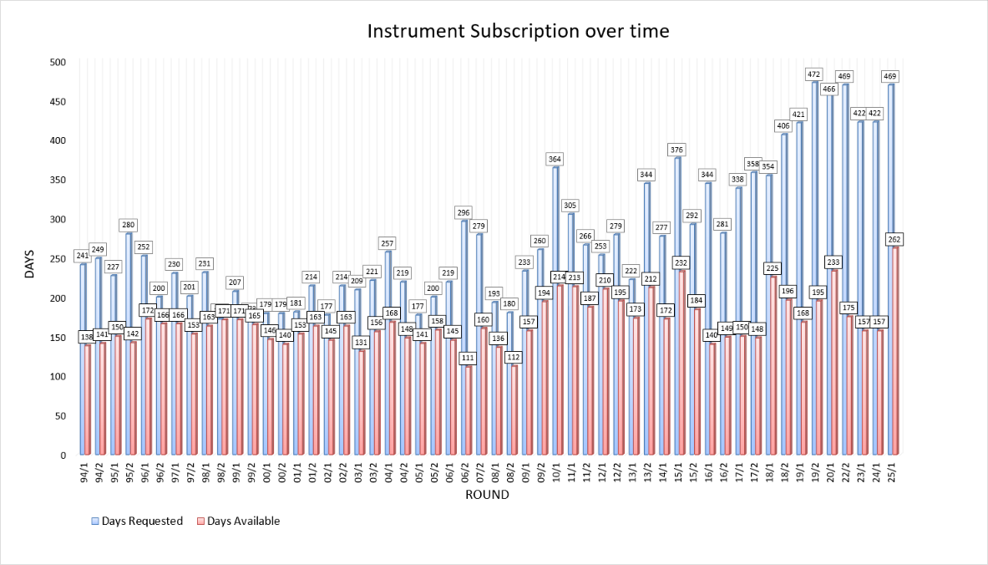
Breath of Science now

Slide 10
Current Projects

Slide 11
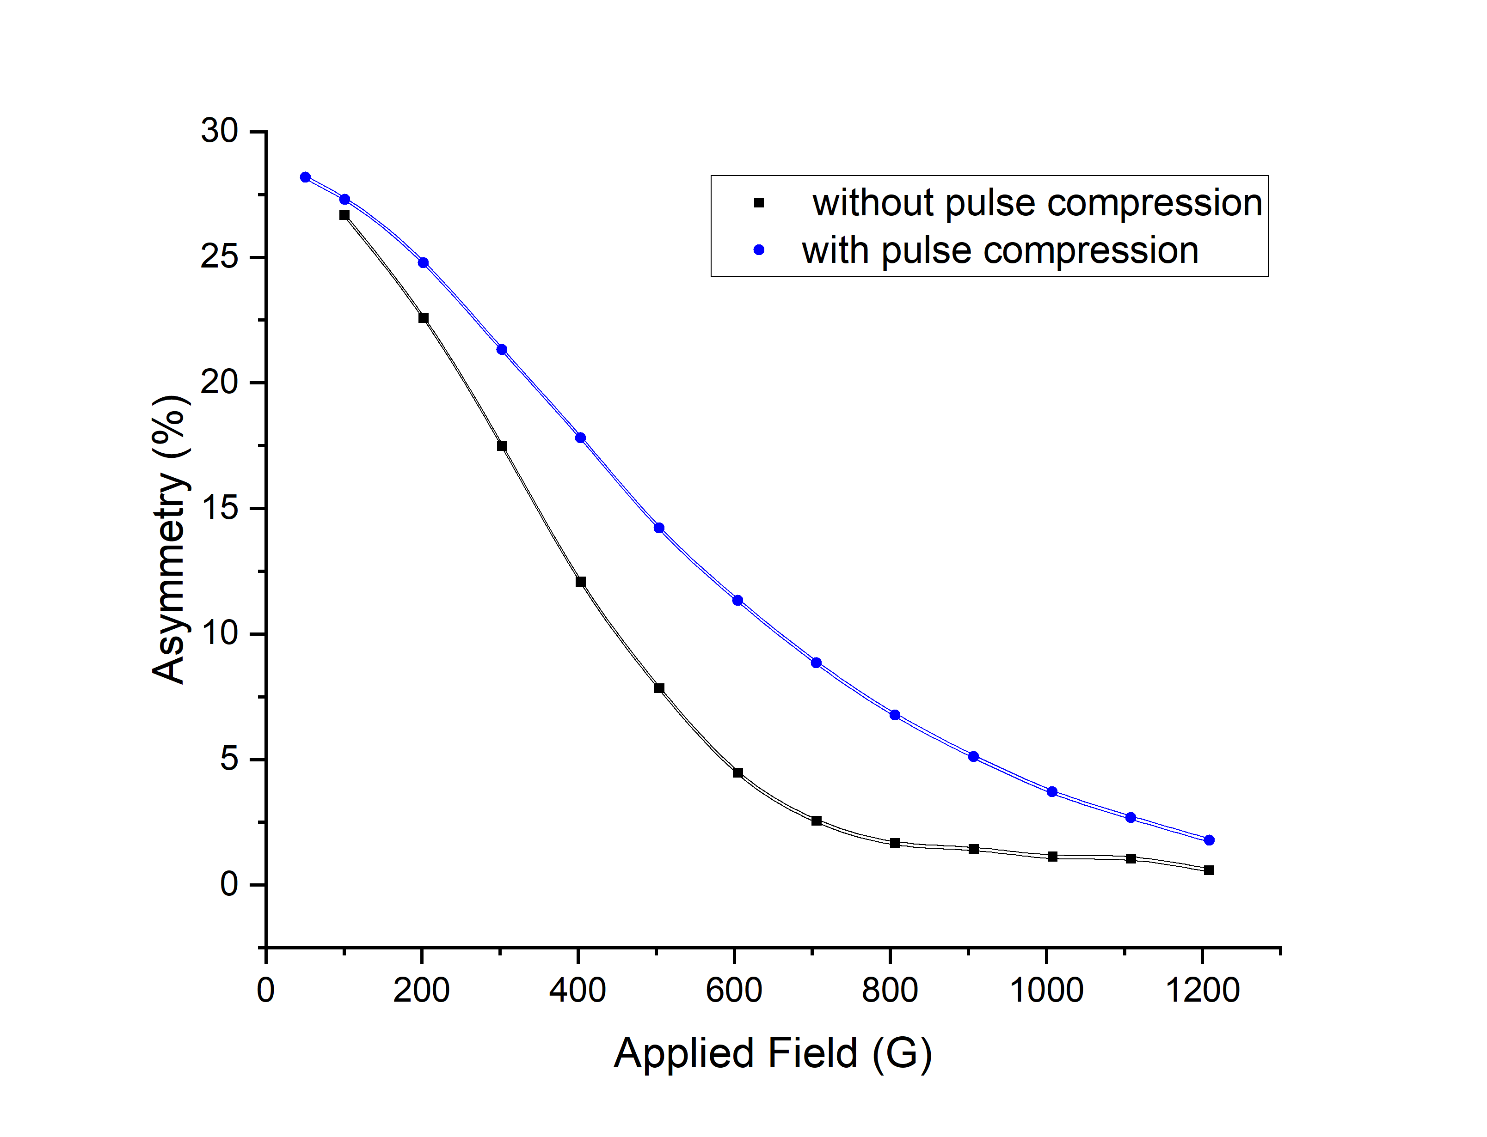
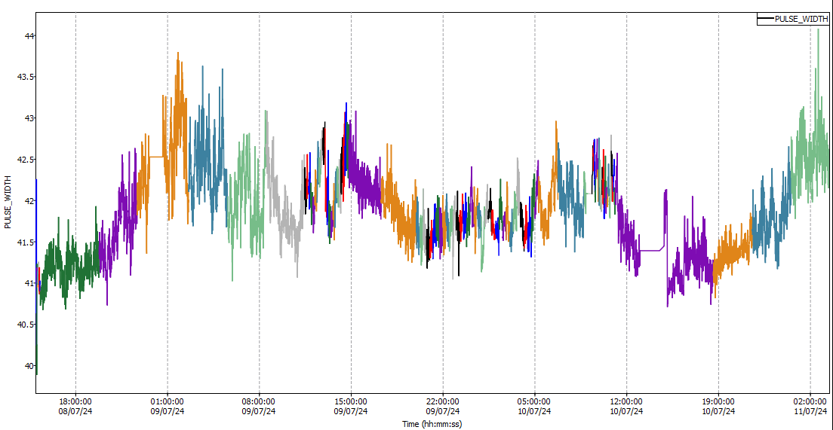
ISIS Proton Pulse Compression
Improving the performance of the muon spectrometers by optimising the proton beam
Shorter pulses give a better frequency response
Rotating phase space in the final stages of the proton acceleration reduces the pulse width (time)
Frequency response with and without pulse compression – MuSR Cycle 23_5

Slide 12
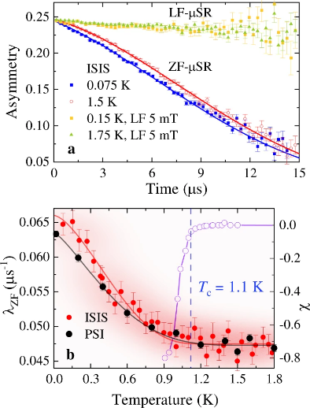
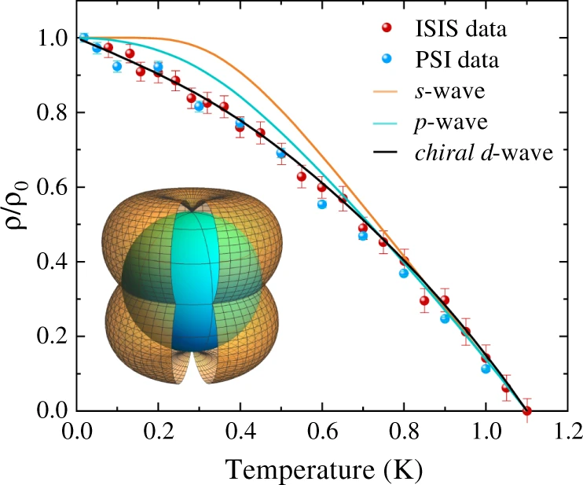
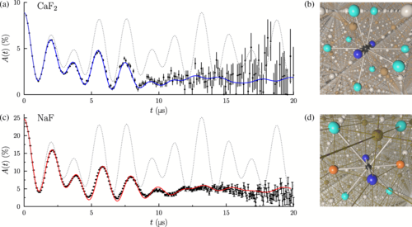
Super-MuSR Science Drivers
Weak relaxations and detailed material characterisation
Explicit calculation of
relaxation functions
Using both high rate and resolution
K. Tustain et al., npj Quantum Materials 5, 74 (2020)
J. M. Wilkinson and S. J. Blundell,
Physical Review Letters 125, 087201 (2020)
P.K. Biswas et al., Nature
Communications 12, 2504 (2021)

Slide 13
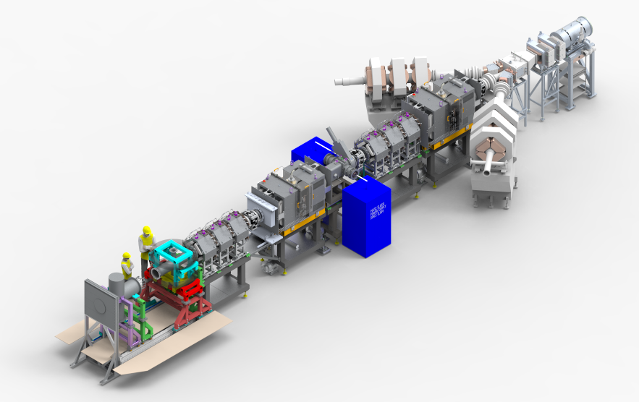
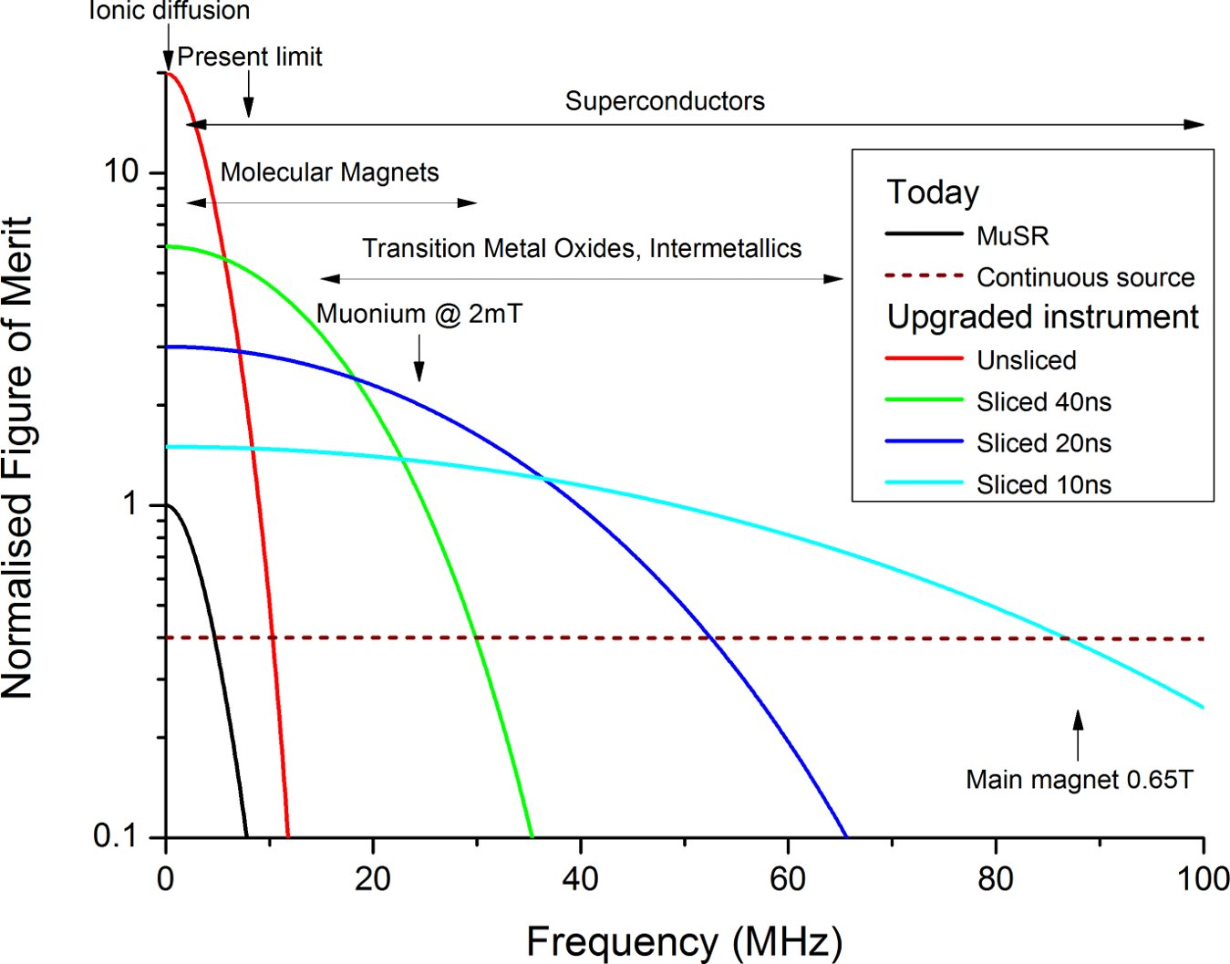
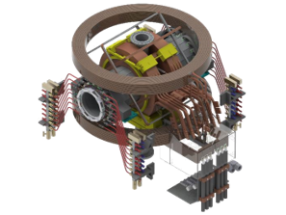
Super-MuSR
Detector and instrument improvements
Beamline improvements
  Use full muon flux and maximise information per muon
  New transverse magnet and cruciform with flypast tube
  Better zero-field (correcting quadrupolar terms)
  Pulse slicer reducing muon pulse length to ~10ns
  Spin rotators allowing higher transverse field experiments

Slide 14
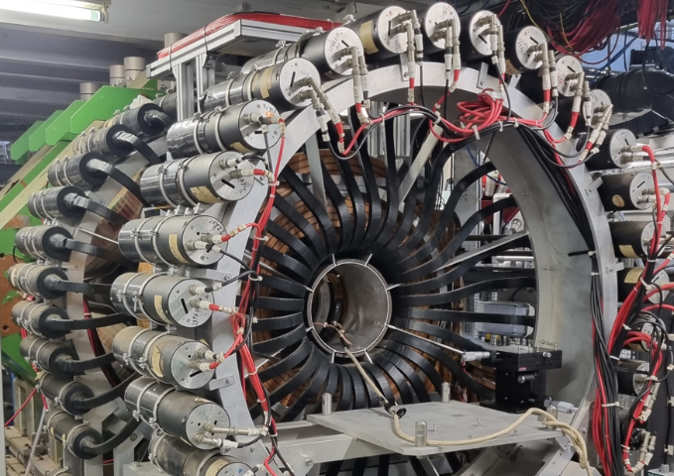
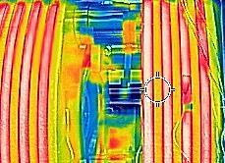
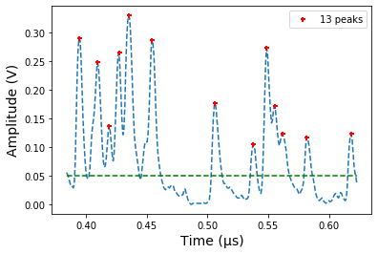



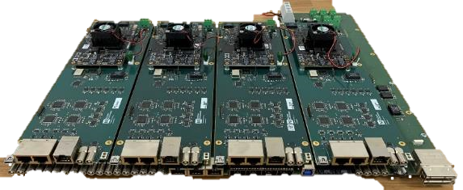
To meet the SuperMuSR Specification:
One detector
Add 900 more detectors and shrink them to fit inside the 350mm bore of the magnet
Mitigate against the heat and field from the magnet
Overhaul signal processing and data pipeline to improve rate capability & stability
Notes:
Points to make:
Need to make a detector with a LOT of channels in a small space and also improve the signal processing for rate & stability.
mention the increase in rate capability that peak fitting gives you compared with fixed discrimination?

Slide 15
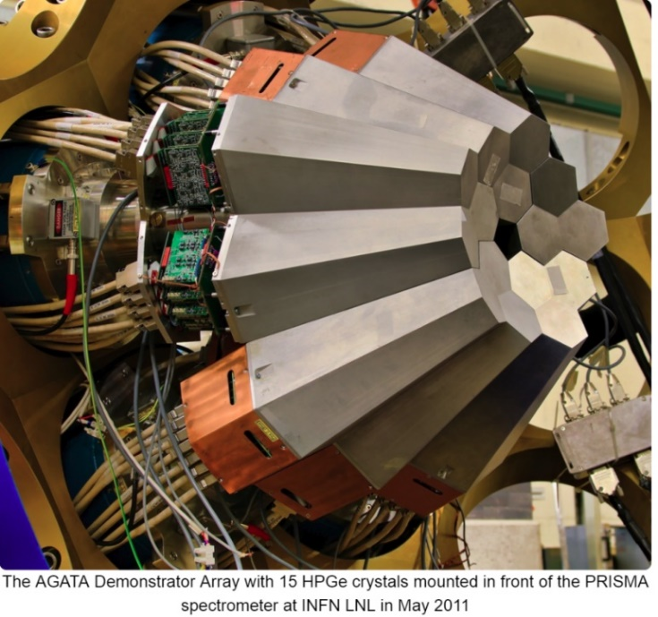
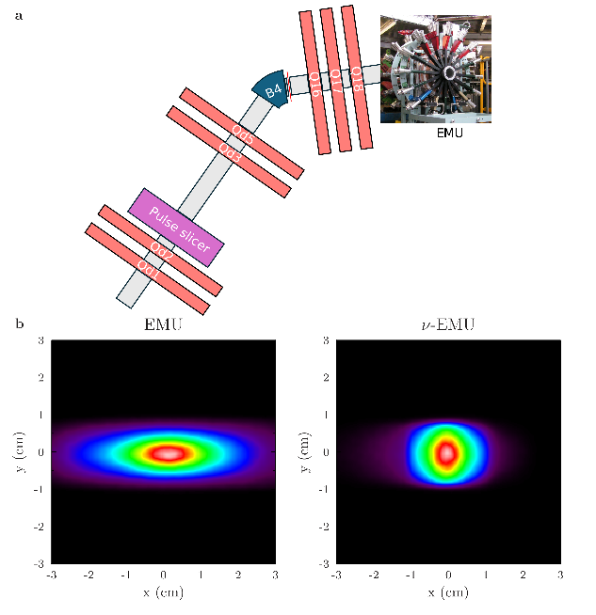
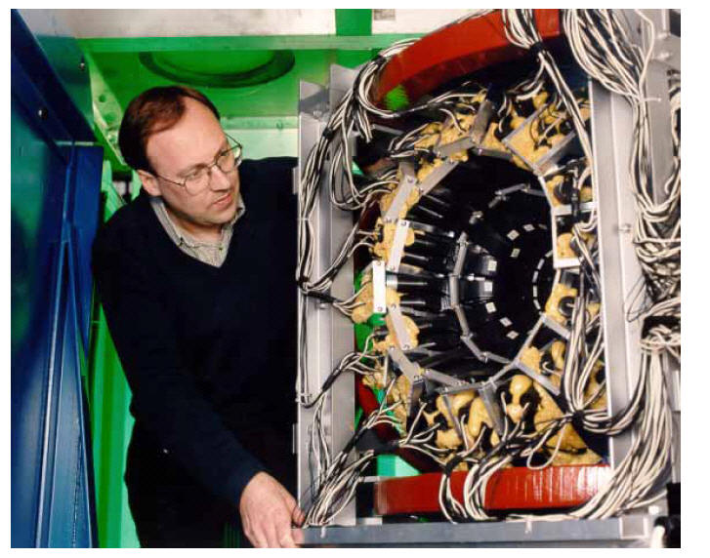
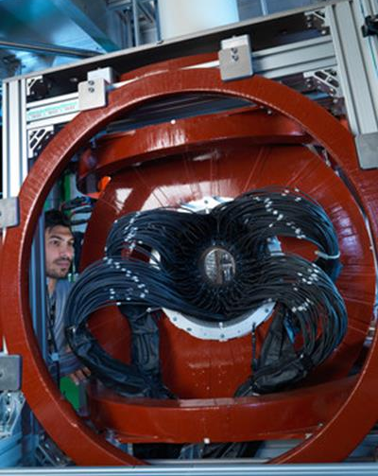
Our Future Plans:
Proposed Endeavour+ instruments
MuX
NuEMU
Chimera
New instrument for elemental analysis x100 in rate
x5 data rate, improved frequency response
Optimised µSR spectrometer for RIKEN-RAL facility

Slide 16
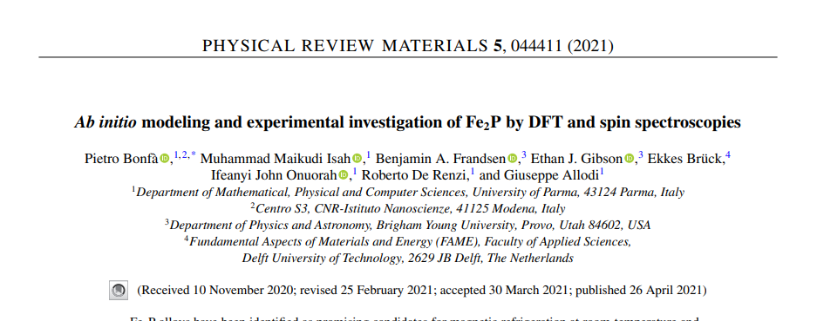
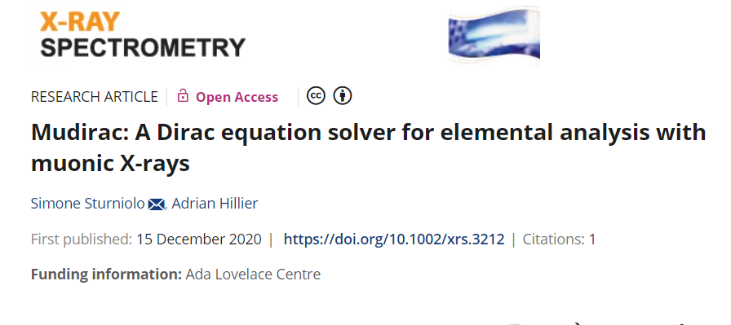
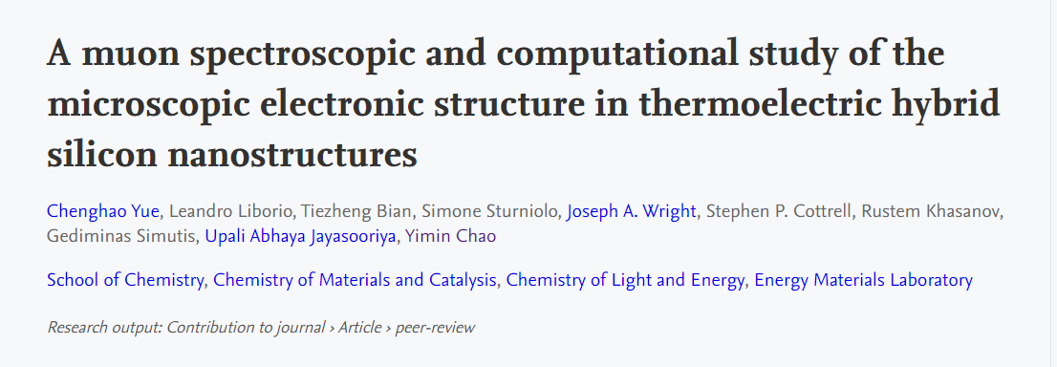
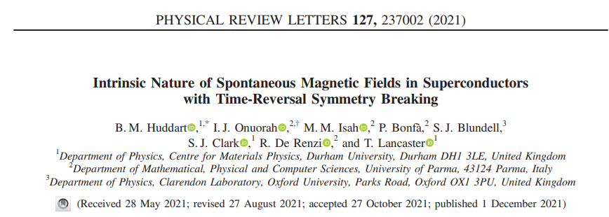
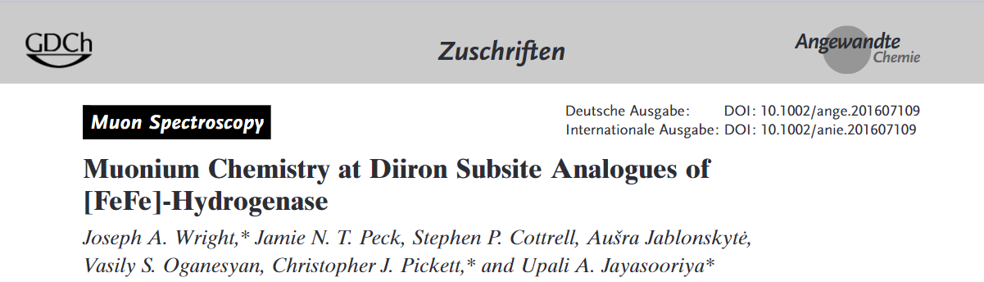
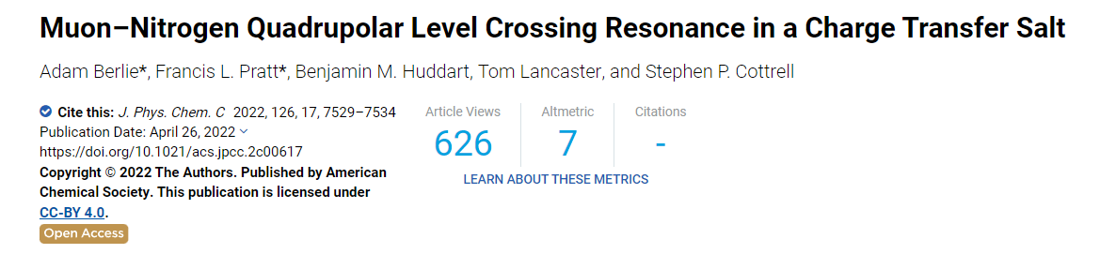
New ‘Instrument’ - COMET
COMET – Computationally Optimised Muon Experimental Techniques
Continued development of a sustainable interactive analysis package for muon data, WIMDA.
Development of sustainable software for simulation of the response of the muon polarisation - ‘Quantum-MuSpinSim’.
Development of DFT methods for determining the muon site/charge state in materials, ‘pymuon-suite’ to aid these calculations and ‘Muon Galaxy’ as a user interface.
Development of ‘MuDirac’ for muonic x-ray measurements.
Development of machine learning applications for muons.
Development of e-learning materials for training.

Slide 17
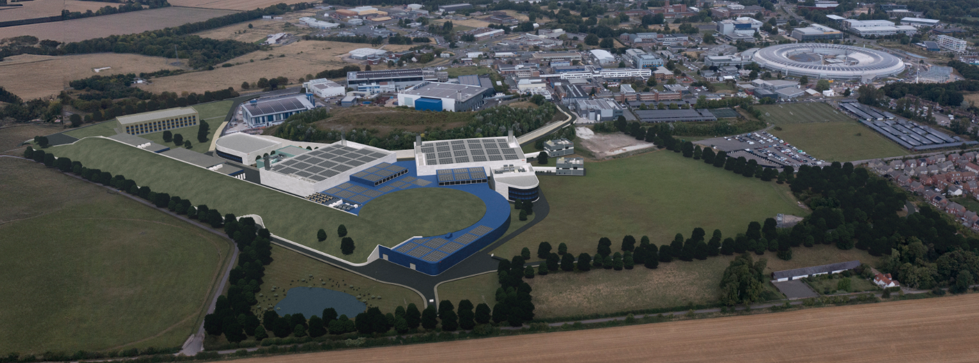
ISIS-II: the successor to ISIS
The UK‘s next-generation neutron and muon source
  ISIS‘s scientific leadership with (more) mordern technologies
2030s
2040s
ISIS-II at RAL

Slide 18
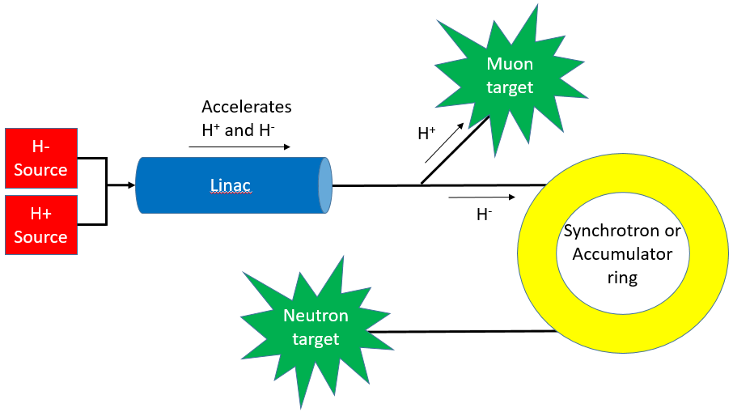
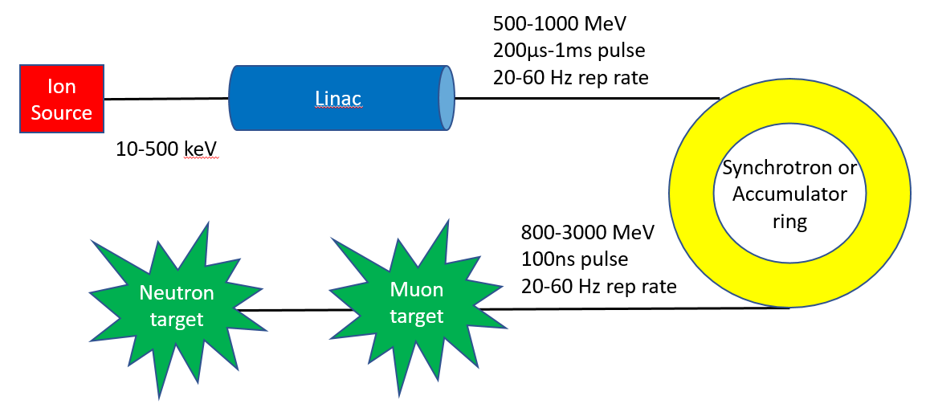
Muon target: Comparing two options
TS1
TS2
Simultaneously accelerates both H⁺ and H⁻
in LINAC
H⁺ used for muon generation,
H⁻ to synchrotron
Tailor the time structure for our purposes
(by changing H⁺ injection)
Flux will be moderate
Familiarity, reliable, low cost
At least 10X improvement in muon flux
  significant upgrade on TD-μSR
  future LE-μSR source
  other muon applications
... Likely option

Slide 19
Science Highlights

Slide 20
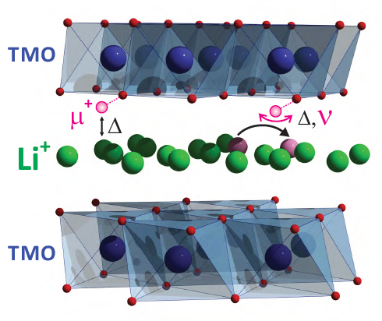
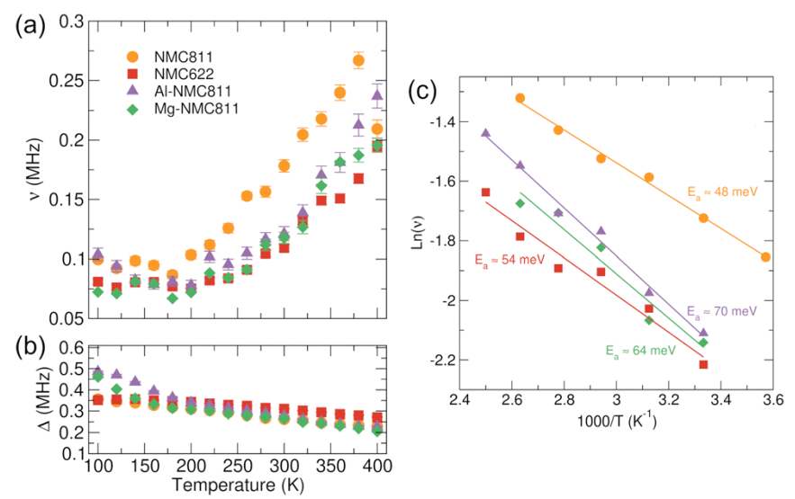
Positive muons study ionic motion
Atomic-scale probe of ionic motion
  Ion moves past implanted muon
  Hopping rate -> D_{ion}
  Activation barrier(s) from D_{ion}(T)
Particularly suited to Li⁺, Na⁺
  Uses nuclear magnetic moment
  (e.g. Li⁺, Na⁺, I⁻ ideal, Mg²⁺ OK, Ca²⁺, Zn²⁺ very hard)
Effective in paramagnetic materials
  Muons see distinct nuclear and electronic signals
In-situ cells now in high demand
Active user community in UK, Europe and Japan (~10% muon use)
  Several groups in UK (EPSRC, Faraday & Innovate UK funded)
  Sweden and Switzerland active
  Toyota have been regular users for over a decade (both academic and industrial work)
Cathode materials results

Slide 21
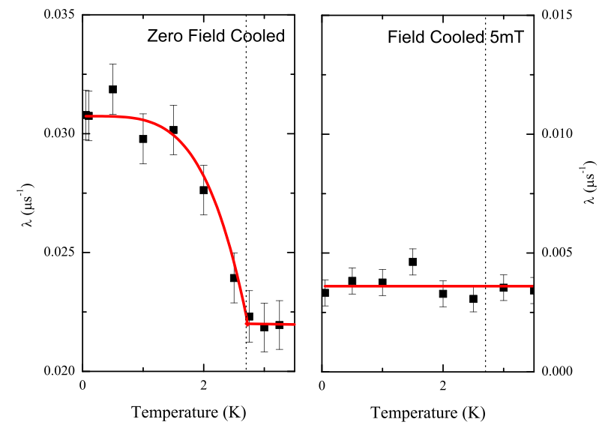
Time Reversal Symmtry breaking in superconductors
ZFμSR on LaNiC₂
3.0 K
50 mK
Spontaneous, quasi-static fields appearing at T_{c}
⇒ superconducting state breaks time-reversal symmetry
Group Theory suggests non-unitary superconductivity
DFT confirms it is not a muon induced effect
Hillier et al PRL 102 117007 (2009)

Slide 22
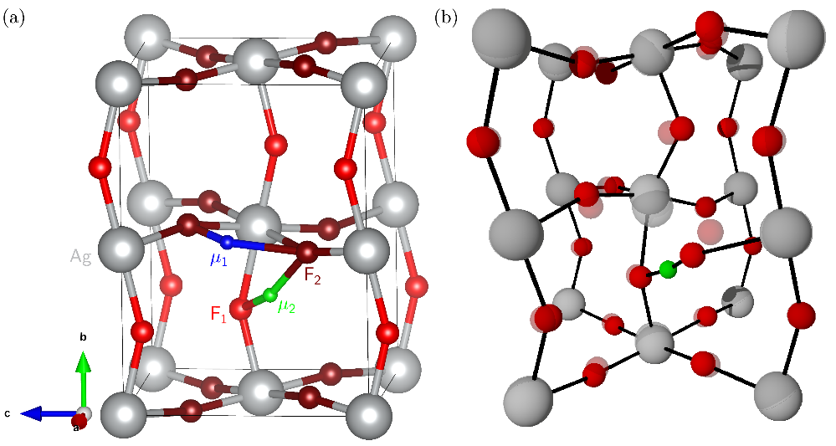
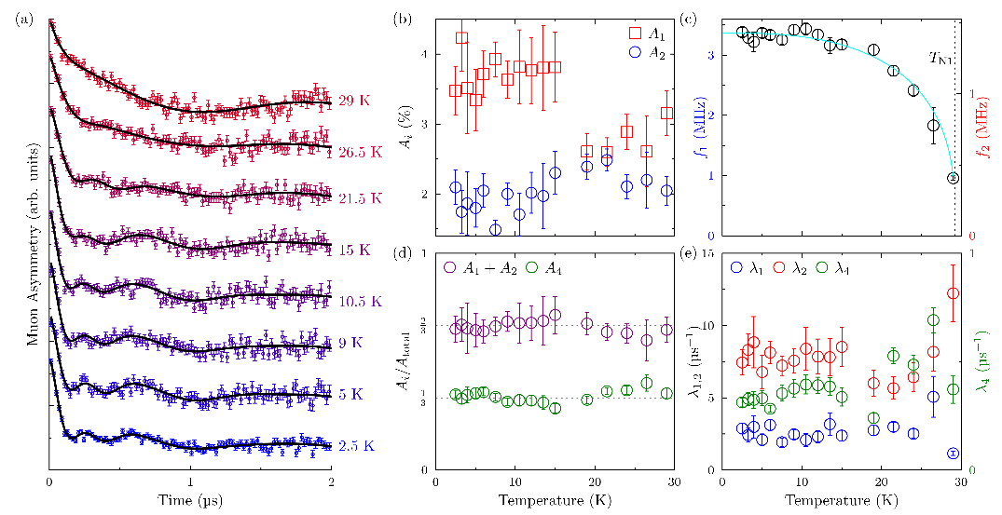
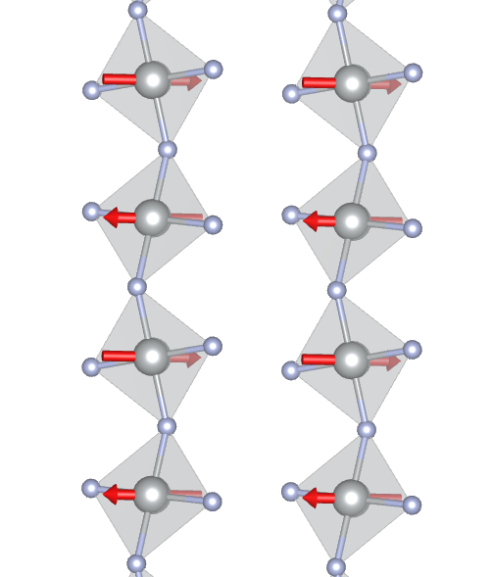
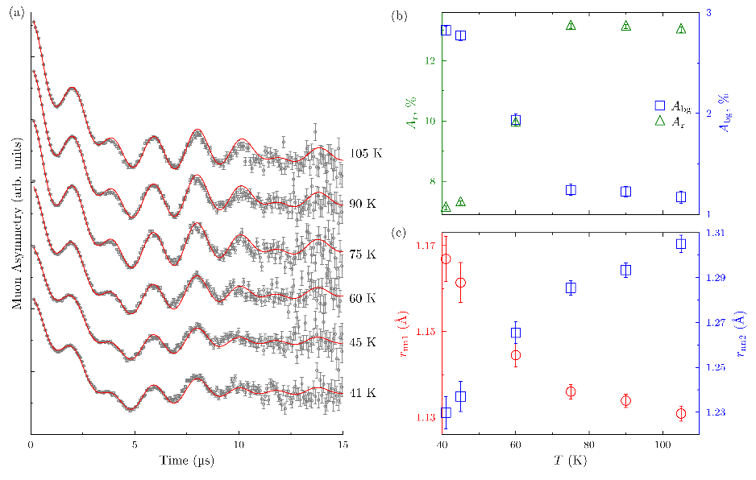
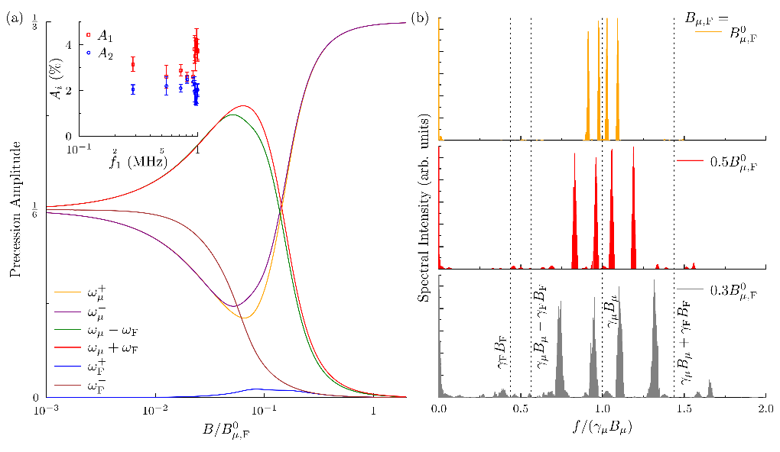
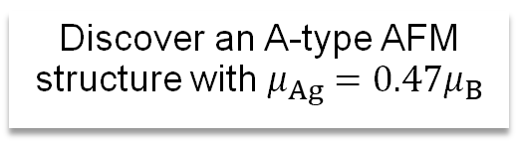
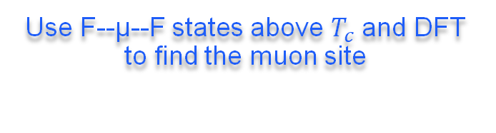
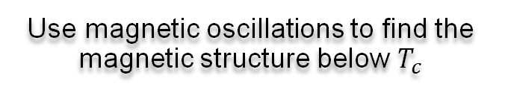
KAgF₃: Using F--µ--F states to measure magnetic materials
Discover an A-type AFM structure with $μ_{Ag}=0.47μ_{B}$
Use F--µ--F states above $T_{c}$ and DFT to find the muon site
Use magnetic oscillations to find the magnetic structure below $T_{c}$
J. M. Wilkinson et al., PRB 107 144422 (2023)

Slide 23
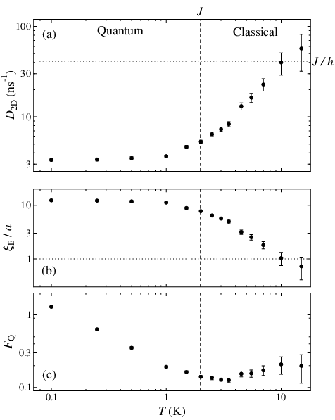
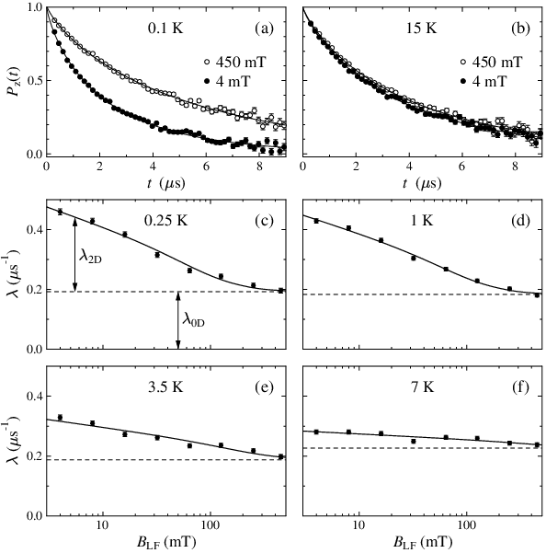
Using wide-range LF to study Quantum Spin Liquids
Crossover
EMU range (0 – 0.45 T) is good
HiFi range (0 – 5 T) is better
(from latest data on YbZn₂GaO₅)
2D spin diffusion
Entanglement length
Quantum Fisher Info.

Slide 24
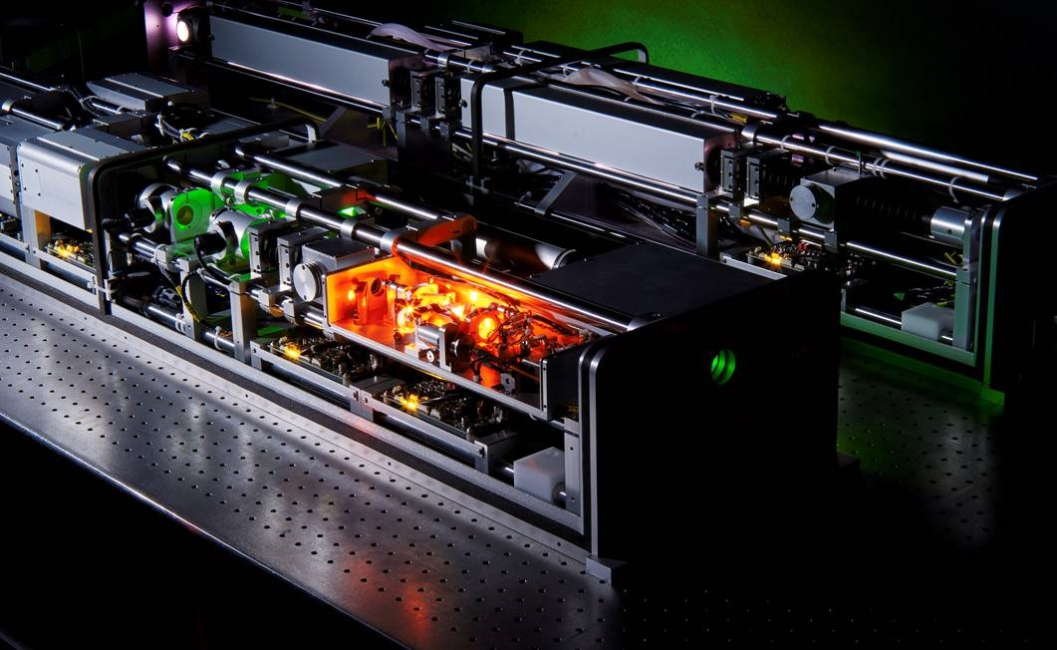
Photo-µSR
Semiconductors have been the key subject of photo-µSR studies
Topical issues in industry,
Si photovoltaics and related surface passivation techniques
carrier transport plays a key role in determining device performance.
Photovoltaic devices (including perovskite compounds),
Power semiconductors and wide-gap semiconductors
Induced local fields (photo-magnetism), where photo-µSR can grow
Magnetism
Organic molecules
Nuclear hyperpolarisation
Dynamic nuclear polarisation.
Muonium reactivity on vibrationally excited hydrogen molecules and showed that the technique can provide a powerful new tool for gaining information about potential energy surfaces for other chemical reactions
In combination with the ALC technique,
studies of electronic states in excited organic semiconductor molecules,
difficult systems to study with other techniques.

Slide 25
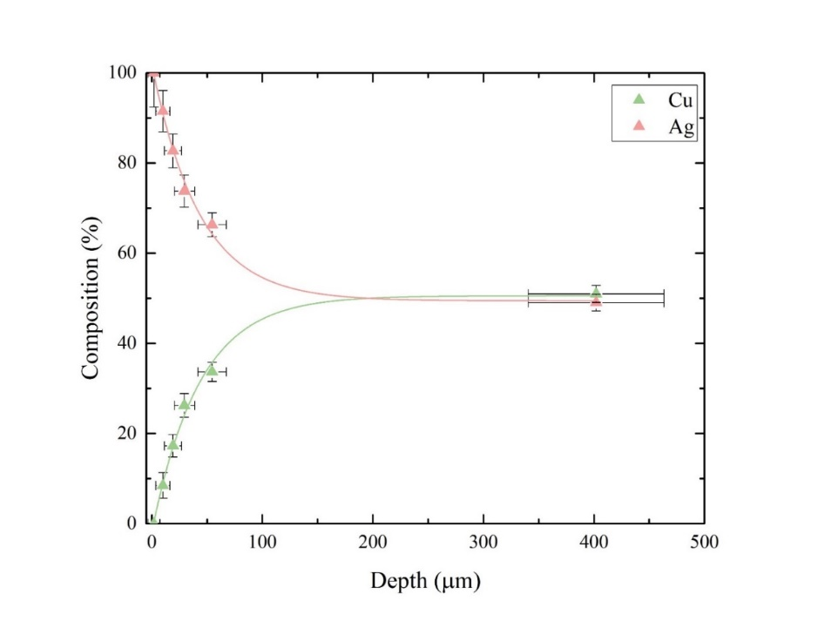
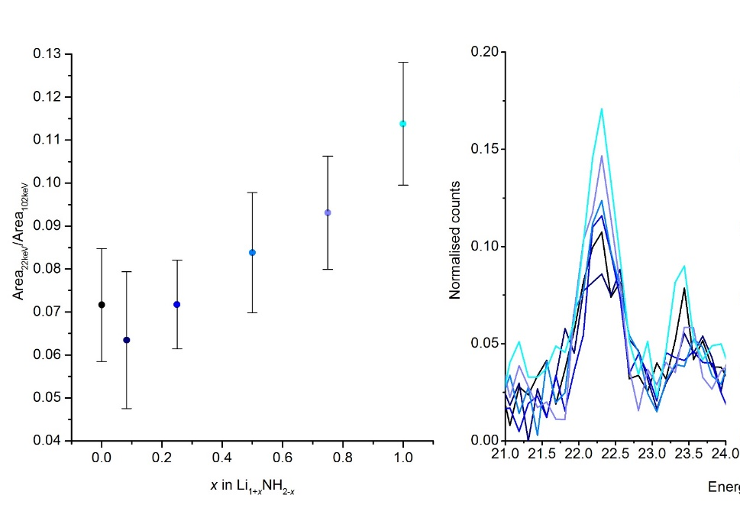


Negative muons Elemental Analysis
Diverse science areas
  Cultural Heritage
      Bronze Age artefacts
      Mary Rose artefacts
      Swords
      Cannon Balls
      Sundials
      Coins
      Mirrors
      Statues
      Florence baptistery gates
      (gates of paradise)
  Solar cells
  Piezoelectric devices
  Li batteries
  Steel, corrosion and carbon composition
  Meteorites
  Biomaterials
  Industry
Imaging
Depth Profiling Julia Domna Roman Coin
Lithium amide imide (LiNH₂ – Li₂NH)

Slide 26
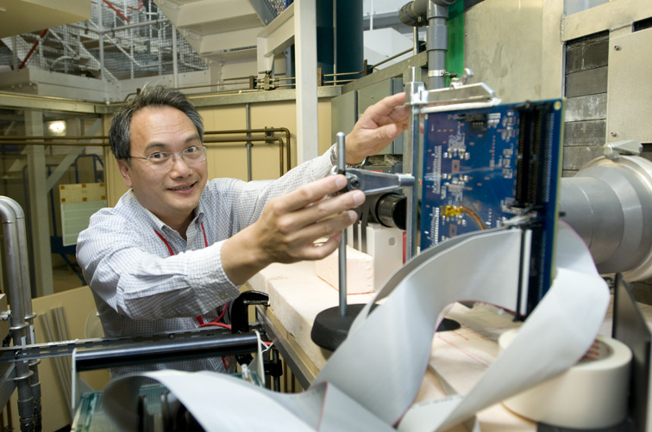

Protecting electronics from cosmic invaders
Single event upsets (SEUs) occur when high energy particles hit microelectronics, causing devices to malfunction. Solar flares and cosmic rays are the main sources of such particles and, with the ubiquitous nature and rapid advances in microelectronics; it’s an area of intense interest. The semiconductor industry is looking ahead by understanding how and why devices might become vulnerable.
“Our experiments are about understanding the probability of these events, which represents an important contribution to the semiconductor industry. This will inform future design decisions, enabling manufacturers to develop devices that are less susceptible to muon SEUs.”
Professor Bhuva, Vanderbilt University
doi: 10.1109/IRPS.2014.6860585

Slide 27
Summary
Diverse Science Program
  Ion-diffusion,
  Magnetism and superconductivity,
  Quantum materials
  Functional materials,
  Bio-materials,
  Reaction kinetics,
  Cultural heritage
  Industry
Science program leads the instrument development:
  Super-MuSR: a fantastic new instrument which meets the demands of the user community
  Endeavour+ three instrument upgrades proposed driven by our science needs
    MuX
    NuEMU
    Chimera
Science program for muons is strong, not just at ISIS

Slide 28












John Wilkinson
Adrian Hillier
Koji Yokoyama
Sayani Biswas
Steve Cottrell
Alex Louat
Rhea Stewart
James Lord
Adam Berlie
Francis Pratt
Mark Telling
Peter Baker

Slide 30




Muons then and now

Slide 31
Super-MuSR project progress
Pulse Slicer PSUs: Ordered
Pulse Slicer: In construction
Quadrupoles: Order placed
Spin Rotator PSUs: Delivered
Spin Rotators: Components
Ordered
Steering magnets: Designed
Slits: Designed
Spectrometer Detectors: Prototyping
Digitisers: Delivered
Magnets: Existing and Designed
PSUs: All but one existing or delivered
Notes:
May want to animate the different parts

Slide 32











Negative muons Elemental Analysis - usage
Diverse science areas
  Cultural Heritage
      Bronze Age artefacts
      Mary Rose artefacts
      Swords
      Cannon Balls
      Sundials
      Coins
      Mirrors
      Statues
      Florence baptistery gates
      (gates of paradise)
  Solar cells
  Piezoelectric devices
  Li batteries
  Steel, corrosion and carbon composition
  Meteorites
  Biomaterials
  Industry

Slide 33

Elemental Imaging and Tomography
µ⁻
Al
C
The spectrum from an area of 20x20 pixels next to the C, Al and Fe₂O
Image reconstruction of 5 mm aluminium rods in 20 mm carbon cylinder.
Radiating lines are artefacts from high-frequency components
Line between the Al rods is likely caused by rotation axis misalignment.
Fe₂O₃
C
Al

Slide 34









Signals are streamed directly to a broker
Lots of particles arrive at the detector
NI DAQ 121
2024: SCD Ada Lovelace Centre
Data Analysis & Retention
Event Filtering
Event Formation Unit
Creation of .nxs files and archiving
Power Signal Processing: options from peak-finders to Machine Learning.
Flexibly select the events that are important for analysis. Filter on parameters such as sample temperature or laser status.
Notes:
"The design of this pipeline is strongly influenced on the ESS streaming based data acquisition architecture, which was a collaborative project between the ESS DMSC and ISIS."
worth highlighting
that fact that the core of the architecture is the same as what was done for the ESS and
b) the fact that we are using off the shelf, standard, open source technologies wherever possible.
A large benefit is using the skills ISIS has from the ESS collaboration and taking advantage of standard/off the shelf software solutions where possible
Contact Dan Nixon / Dan Kirk

Slide 35





Charge carrier kinetics in semiconductors
Carrier-Mu interaction depolarises muon signal
  Relaxation rate tells
  carrier density
HIFI Laser for optically generating carriers in semiconductors
By changing the pulse delay, one can measure carrier lifetime spectrum
  Even in
  completed solar cells
Depth-dependent measurements enable carrier kinetics study
within a wafer
Applicable to many semiconductors. So far:
Si, Ge, SiC, GaAs
General-purpose setup for
light-pump muon-probe experiments
Review of Scientific Instruments 87, 125111 (2016).
Phys. Rev. Lett. 119, 226601 (2017).
Appl. Phys. Lett. 115, 112101 (2019).
Appl. Phys. Lett. 118, 252105 (2021).
Journal of Applied Physics 132, 065704 (2022).
Journal of Applied Physics 136, 055707 (2024).

Slide 36


Radio- Frequency techniques – Final State determination
Example from work on Gold nanoparticles
Mu reacting with 8 nm GNPs (6G TF)
Sequence of events …
Mu formed in silica escapes the mesopores,
Quickly diffuses to a GNP,
Loses e⁻ spin to metal, i.e. Mu -> µ⁺
(chemisorption reaction), hence Mu relaxation
Mu is ‘disappearing’, but how do we know the final state is diamagnetic (µ⁺)?
RF-uSR is the answer!
There is a huge increase in the resonance amplitude when GNPs are present (black curve) compared to the bare silica (red curve)

Slide 37










Endeavour
SANDALS-II :
Count rate x5 due to
Coverage*efficiency*
Collimation
LMX : factor 10 vs SXD
ε-MAP: bridge capability gap
Between ENGIN-X and IMAT
Resolution/flux
OSIRIS+ : flux gain (guide) x5
Silicon detector upgrade x2 coverage
TOSCA+ : use of PSD
130 to >14000 pixels
Super-MuSR:
20x current data rate (1Tb/cycle)
HRPD-X : 40 fold increase in data size
Should still be manageable.
WISH-II
MUSHROOM :
Count rate : 40x LET

Slide 38



Effects of Muons on Electronics
  A team of researchers from Universities of Osaka, Tokyo and Kyushu and KEK, RIKEN, ISIS have collaborated on research on two experiments
  Investigating the effects of cosmic muons on semiconducting devices.
  Negative muons give a higher error rate than positive muons
  Measuring the emissions from negative muon capture helps understand the effects

Slide 39



Depth Profiling Julia Domna
Clear evidence of surface enrichment
Probed non-destructively
Core composition:
51(1) wt% Silver
49(1) wt% Copper
Compares well with a similar coin
No 83 46(1 or 2) %
Gilter and Ponting 2003
Hampshire et al, Heritage 2019

Slide 40

Lithium amide imide (LiNH₂ – Li₂NH)
HYDROGEN STORAGE:
LiNH₂ + LiH ↔ Li₂NH + H₂
2θ (°)
H₂
vacuum
H₂
vacuum
H₂
time
Synchrotron X-ray powder diffraction shows hydrogen release occurs via range of intermediate stoichiometry values – key to easily reversible hydrogen storage
Quantifying the stoichiometry is difficult. By diffraction the scattering (both X-ray and neutron) is dominated by the nitrogen.
David and Makepeace

Slide 41


Catalysis
Users have been exploring two systems
Mu addition to Benzene on Gold nanoparticles
Catalytically active metal sites for metallo-enzyme Fe-Fe hydrogenase
Study of uncapped GNPs should provide a better understanding of catalytic effect of reaction on metal surface
Simple mimic molecules allow us to understand reaction mechanisms to understand catalytic effects of these systems
Developing links with the Catalysis Community
Wright UEA
Fleming, TRIUMF

Slide 42


MuX
Instrument dedicated to elemental analysis studies.
Phase 1:
Provision of a new data acquisition system (replacing obsolete electronics).
Provision of a low-energy segmented detector for measurement of low-Z elements.
Phase1b:
Provision of ‘off the shelf’ HPGe detectors, electronics and support frame
Phase 2:
Development of new instrument with improved detector coverage with high segmentation.

Slide 43
NuEMU
Reduced beam spot (with a ~43% reduced area compared to EMU’s current spot) to better match user demands for measuring newly discovered materials, which often come in very small volumes
Time sliced muon pulse for improved frequency response (5 X EMU)
Very high data rates (5 X EMU) using a new detector array optimised for longitudinal time differential μSR, but with a capability for high frequency pulsed RF measurements (to 500 MHz).
Laser illumination capability, served by the present laser system.
High homogeneity Transverse Field coils designed for Mu studies, and particularly for gas phase measurements with an extended muon stopping distribution.

Slide 44
Chimera
Higher rates from double
  A quiet magnetic environment on RIKEN.
Development of novel experiments exploiting beam synchronous pulsed stimuli
  pulsed RF, illumination, E-field, etc. Measurements to long times is often essential for this work.
Variable momentum – exploiting a wide range of sample environments.
  Development of gas sample pressure cells.
  Development of solid sample pressure cells
Developing a µ⁻SR programme.
  Enabling µ⁺SR and µ⁻SR experiments to be carried out in an identical environment, already shown to be key to developing an understanding of ion diffusion in battery materials.
Optimised µSR spectrometer for RIKEN-RAL facility

Slide 45
Future Projects: Low Energy Muons
The proposed SWARM instrument
exploit this development to address a notable gap in ISIS’s measurement capabilities
deliver a high flux pulsed beam of muons with material implantation depths in the 5-200 nm
This would benefit the ISIS science programme across all the key science strategy areas,
with particular focus on
quantum science
energy materials.
New and complementary science investigations
thin films,
topological materials
proximity effects and the motion of spin and charge through heterostructures.
It may also lead to the further development of muon imaging techniques that could be applied to biological systems.

Slide 46




Operando measurements of Li-cathode materials
Operando measurements are now a large fraction of all battery material studies at ISIS
  Mainly cathode cycling
  Also solid electrolytes and interfaces
Results on Li-NMC811 shown on the right
  Field fluctuation rate changes smoothly, as expected from industrial cell performance
  Distinct changes in Δ at structural phase changes show that cell is cycling well
  Correlated with dQ/dV because both depend on structural changes
More recent studies of other materials show sharper changes in both parameters
Better cell making has improved the signal
I. McClelland et al.,
Chem. Mater. 2023, 35, 4149

Slide 48



Celebrating 40 years of neutrons at ISIS
On 16 December 2024, ISIS will mark 40 years since first neutrons.
Leading up to this significant milestone, ISIS is planning a series of events that celebrate four decades of scientific discoveries, technological innovation and productive partnerships.
Notes:
https://www.isis.stfc.ac.uk/Pages/40-Years-of-ISIS-Celebratory-Event-Calendar.aspx
1916h first neutrons
June ‘85 0.1muA
6 instruments
Spring ‘86 25muA

Slide 49





Computing enables new insight into Mu dynamics
QUANTUM can model a system
Spin Hamiltonian
Density matrix calculation for time evolution
Muon spin polarization P(t) A(t)
Muon signals from semiconductors
Always a convolution of
a few Mu states
e.g. in n-type GaAs,
why no relaxation at RT,
where the slow relaxation
at low T come from?
What‘s going on ??
With a model, one can deconvolute μSR time spectra
The model was confirmed with optically generated excess carriers
For more information, see
Phys. Rev. Res. 6, 033140 (2024).

Slide 50

RIKEN-RAL Refurbishment – almost complete
Approximately £3.5M
Focus on infrastructure
  Power supplies – final supply being install now
  Vacuum systems
  Shielding
  Cabling
  Sample environment
  Separator refurbishment – on-going
  And much more…

Slide 51

RIKEN-RAL Solenoid replacement
Still the original solenoid
Showing signs of age
Procurement in-progress
Simple automated control
Cryogen-free
Warm bore
Operating costs greatly reduced
Emissions from 379 to 47 Tonnes CO2e per year

Slide 52

Low Energy Muons
SWARM
Development of a low energy beamline and
spectrometer.
Phase 1:
Simulation, design and testing of
prototype muon cooling apparatus
(collaboration with CSNS).
Or Laser cooling (J-PARC)
Phase 2:
Design of full beamline and instrument with
associated development projects.
Phase 3:
Instrument build and commissioning.

Slide 53

Lithium diffusion in LiMnPO₄ detected with μ±SR
A combination of μ±SR has been used to measure lithium-ion diffusion in a magnetic battery material.
Can measure the diffusion of charge carriers such as Li⁺
Can be ambiguous when distinguishing between Li⁺ and μ⁺ mobility in positive muon diffusion
μ⁻ species won't diffuse, even at high temperatures
Opportunity to develop this technique
Facility development student worked on analysis
Need instrumentation improvements
DOI: 10.1103/PhysRevResearch.2.033161​​

Slide 54
Theoretical support
SO(3)xC_{2v} | Gap function (unitary) | Gap function (non-unitary)
¹A₁ | Δ(k)=1 | -
¹A₂ | Δ(k)=k_{x}k_{Y} | -
¹B₁ | Δ(k)=k_{X}k_{Z} | -
¹B₂ | Δ(k)=k_{Y}k_{Z} | -
³A₁ | d(k)=(0,0,1)k_{Z} | d(k)=(1,i,0)k_{Z}
³A₂ | d(k)=(0,0,1)k_{X}k_{Y}k_{Z} | d(k)=(1,i,0)k_{X}k_{Y}k_{Z}
³B₁ | d(k)=(0,0,1)k_{X} | d(k)=(1,i,0)k_{X}
³B₂ | d(k)=(0,0,1)k_{Y} | d(k)=(1,i,0)k_{Y}
*
breaks only U(1) x SO(3)
Non-unitary
Hillier, Quintanilla & Cywinski,
PRL 102 117007 (2009)
* C.f. Li2Pd3B & Li2Pt3B,
H. Q. Yuan et al. PRL’06

Slide 55

Time reversal symmetry breaking in a number of systems
Sudeep Kumar Ghosh et al 2021 J. Phys.: Condens. Matter 33 033001

Slide 56

Roman Gold Coins
Near Surface and Interior have the same composition
Tiberius and Hadrian: no detectable levels of silver or copper
Julian: silver detected, in agreement with XRF measurements
The lack of surface enrichment in the debased coin of Julian is particularly interesting.
The state had a vested interest in hiding the debasement, as an impure gold coin at this time undermined trust in the gold coinage.
The explanation favoured here is that the state undertook an ‘honest’ debasement of the gold in order to avoid deceiving the user.
This was in order to preserve long term trust that the purity the user could ‘assess’ on the outside was representative of the purity of the gold coin as a whole.
Green et al, J. Arch Sci (2021)

Slide 57
Key developments – Detectors
Current Challenges:
Very high instantaneous count rate
Most counts in the first 1.5 us
Electronic limits our counts per detector
Opportunity
  Digitising the raw detector output
    Post-process this data
  Bringing event mode data acquisition
  Boost to data rates to all muon instruments (x2-3)

Slide 58





Tile performance – Photon collection
musrSim
K. Sedlak(2012)
Courtesy: P. Baker, R. Afonso, P. Singkanipa

Slide 59

Forty Years On
How do the original goals for the surface muon instruments compare with Super-MuSR?

Slide 60


Comparison with the goals in 1983
Pulse slicing:
1983 goal was for 10ns (fwhm)
2023 goal is for 10ns (base-to-base)
2024 progress is on course to achieve this
Spin rotation:
1983 goal was for 90 degrees
2023 goal is for 75 degrees
2024 progress is on course to achieve this

Slide 61


Comparison with the goals in 1983
The 1983 goals assumed a 5cm carbon target at 200uA and 50Hz
Today we have a 1cm carbon target at 200uA and 40pps
Comparing muons per pulse:
Super-MuSR ~25% of rate expected in 1983
Because of thinner target, smaller beam spot,
and narrower momentum bite
Also 50% more beamlines…

Slide 62


Super-MuSR
Detector and instrument improvements
Beamline improvements
  Use full muon flux and maximise information per muon
  New transverse magnet and cruciform with flypast tube
  Better zero-field (correcting quadrupolar terms)
  Pulse slicer reducing muon pulse length to ~10ns
  Spin rotators allowing higher transverse field experiments

Slide 63
Muon Sample Environment
Seven dilution fridge inserts (40mK -300 K)
Six 3He insert (0.3 – 300 K)
One bottom loading 3He (0.3-50 K)
Eight He4 cryostats (+ 2 Janis) (1.5- 300 or 400K)
Two mini cryostats (4- 400 K)
One high temperature mini cryostat (10 – 600K)
Two CCRs (10-600K)
Hot plate furnace (RT – 1000 K)
Light furnace (RT- 1500 K)
Pressure Cell 0- 6.4 kbar 1.5-300 K
Laser variable wavelength
Pulse Stimuli: Radio Frequency, Electric Field, Light, Microwave, pulsed current
Chemistry freeze pump thaw
A range of Liquid and Gas cells

Slide 64
Endeavour Science
Materials for the Future
  Improved catalysis
  Semiconductors
  Glasses
  Spintronics
  Superconductors
  Thin films
  Magnetic materials
Biosciences & Health
  Seeing H in proteins and biomolecules
  Studying complex, multi-component samples
  Structure and dynamics
Clean Growth
  Battery materials and other energy storage
  H-storage
  Carbon capture materials
  New materials for power plants, fusion, wind turbines
  Lighter, stronger materials
  New solar cell materials
+ international
+ training

Slide 65







Exploiting RIKEN-RAL beamline capabilities
Exploiting unique capabilities
+ and – spin relaxation experiments
High momentum e.g. Pressure
Elemental analysis
FAMU
Electronic irradiation
Depth Profiling Julia Domna 3rd Century coin - CE 211 to 217

Slide 66

Super MuSR FY 23/24 Progress
Bought DC power supplies for Steering magnets and sample magnets
Started planning pre-build and install
Prelim. Design Review for Spectrometer
Final Design Review for Spin Rotator
Bought Spin Rotator Feedthroughs
Contract placed pulse slicer pulsed power supply
Pulse Slicer Testing to de-risk
Prelim. Design Review for Beam Pipe
Kicked off mechanical and electrical services design
Final Design Review for Quadrupoles
Passed Project Implementation Readiness Review
Receipted ~£600k for design and large components on PS PS
Final Design Review for Detector nets
Vacuum Window testing kicked off
Bought Separator power supply and 75% Spin Rotator Power supplies
Critical Design Review for Manifold
Kicked off variable aperture design with external company…PDR booked
Critical Design Review for Sample Magnets
Critical Design Review for Pulse Slicer
Ordered final digitisers and receipted 95%
Detectors change request approved
Pulse Slicer PS change request approved
R106 Pre-build space agreed

Slide 67


Decoupling bulk and surface recombination properties in silicon by depth-dependent carrier lifetime measurements
Muons, as a bulk probe of materials, have been used to study the depth profile of charge carrier kinetics in Si wafers by scanning the muon implantation depth.
Charge carrier kinetics in semiconductors is one of the most important properties in device characterization and optimization, which ultimately determines the overall device performance
The depth-dependent lifetime spectra enable us to accurately and uniquely measure the bulk carrier lifetime and surface recombination velocity
Significant and direct industrial interest, with CPPF allocated by BID for new experimental geometry
Published in: K. Yokoyama; J. S. Lord; J. Miao; P. Murahari; A. J. Drew; Appl. Phys. Lett. 118, 252105 (2021): DOI: 10.1063/5.0054291

Slide 68
In-operando muon studies
Not
rechargeable
Rechargeable
Started by studying an all-solid-state cell showing evidence for irreversibility below a critical voltage
  Ionic motion dropped sharply at critical voltage
Recently published results from Faraday Institution FutureCat project on cathode material
  See details as a function of voltage that couldn’t be probed ex-situ
Series of upcoming experiments accepted and many proposals in the latest round
  Investigating chemistries that can’t be studied ex-situ
  15% of days requested on EMU in the last proposal round were for in-operando battery experiments
Discharge

Slide 69
Exploiting RIKEN-RAL beamline capabilities
Exploiting unique capabilities
+ and – spin relaxation experiments
High momentum e.g. Pressure
Elemental analysis
FAMU
Electronic irradiation
Depth Profiling Julia Domna 3rd Century coin - CE 211 to 217

