Slide 1

Overview of MELODY
2nd Workshop on Muon Science Technology and Industry
Yu Bao
IHEP/CSNS
On behalf of MELODY collaboration
2025.1.10

Slide 2
Outlines
MAIN CONTENT
1
CSNS and CSNS-II
（1） Target station
（2） Muon Beamlines
（3） Spectrometers
2
Physics Design of MELODY
3
Technical design and timeline
4
Summary

Slide 3
China Spallation Neutron Source
1
CSNS
Guangzhou
Dongguan
Shenzhen

Slide 4
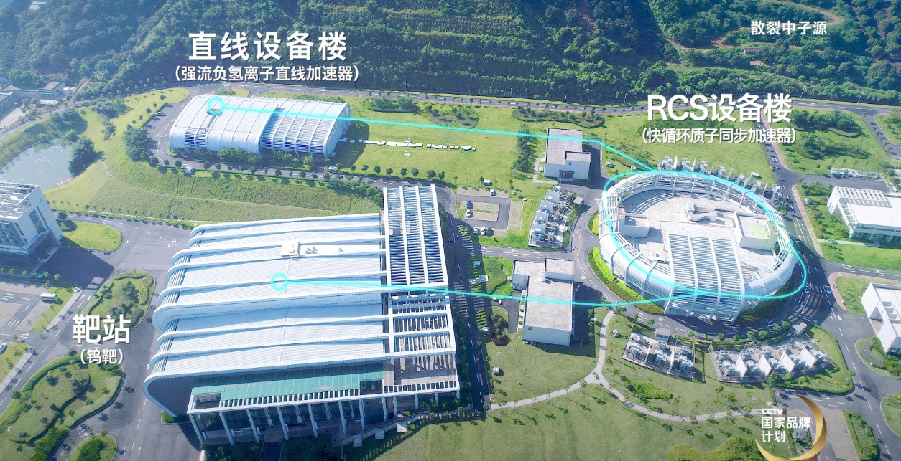
China Spallation Neutron Source（CSNS）
1
MELODY
Accelerator: 170kW 25Hz 1.6GeV proton beam
Neutron Spectrometers: 9 built and 2 under construction

Slide 5
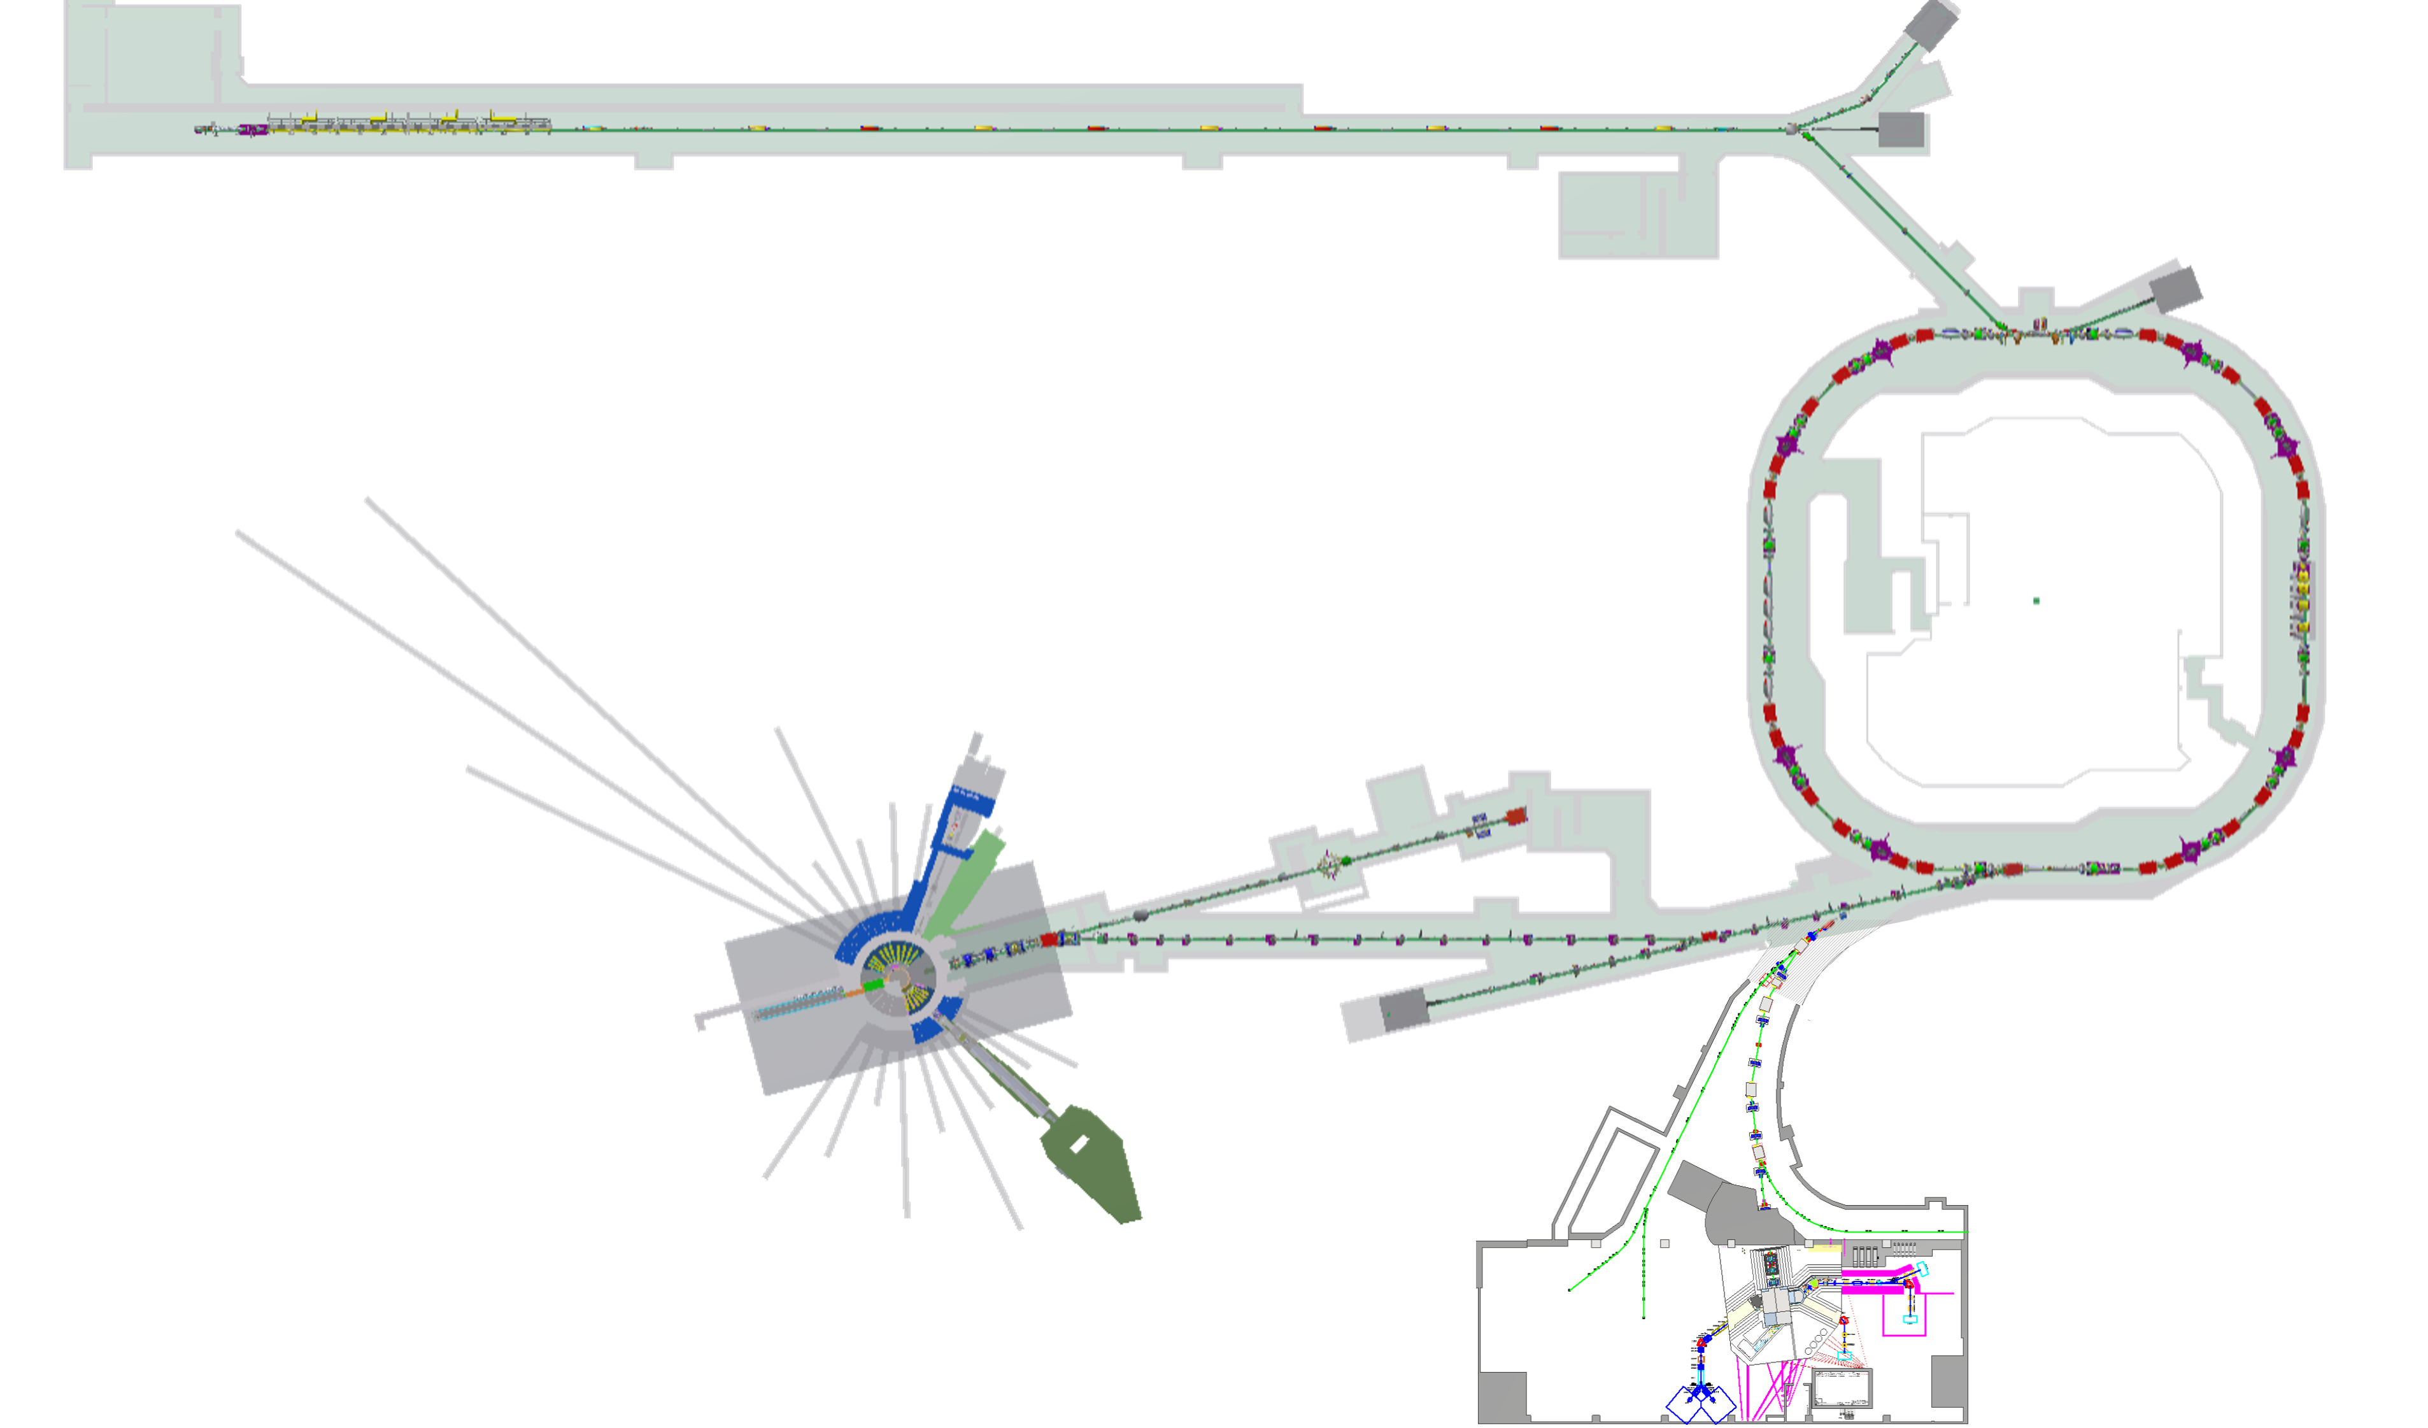
CSNS II Project (Approved on Jan. 11, 2024)
1
300MeV SC
9 more neutron spectrometers
500 kW
500 kW
MELODY

Slide 6
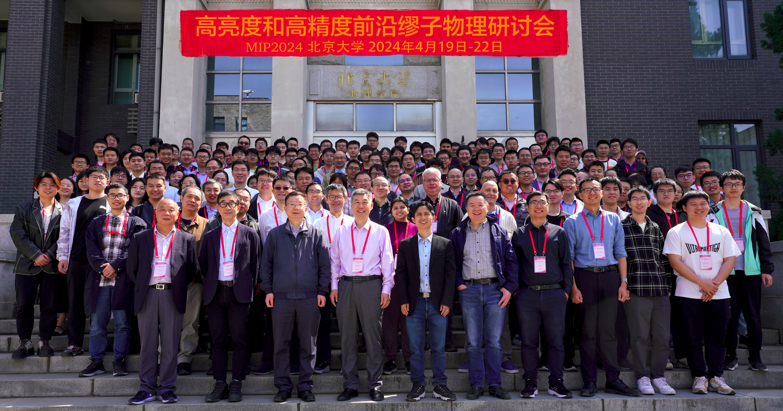
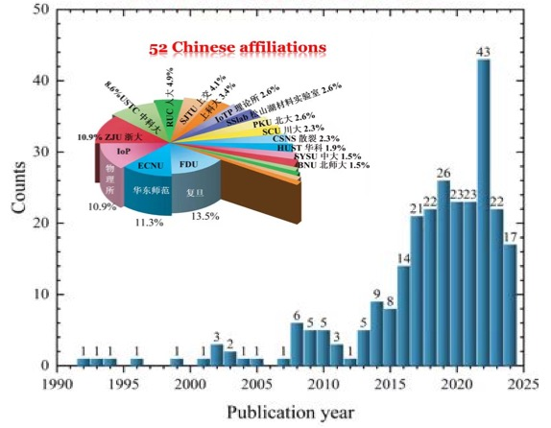
Chinese Muon Community
2
muSR users
Particle Physicists
USTC
Fudan University
IOP
Zhejiang University
…
Peking University
IHEP
SJTU
SYSU
…
Element Analysis
IHEP
CIAE
Museums
…

Slide 7
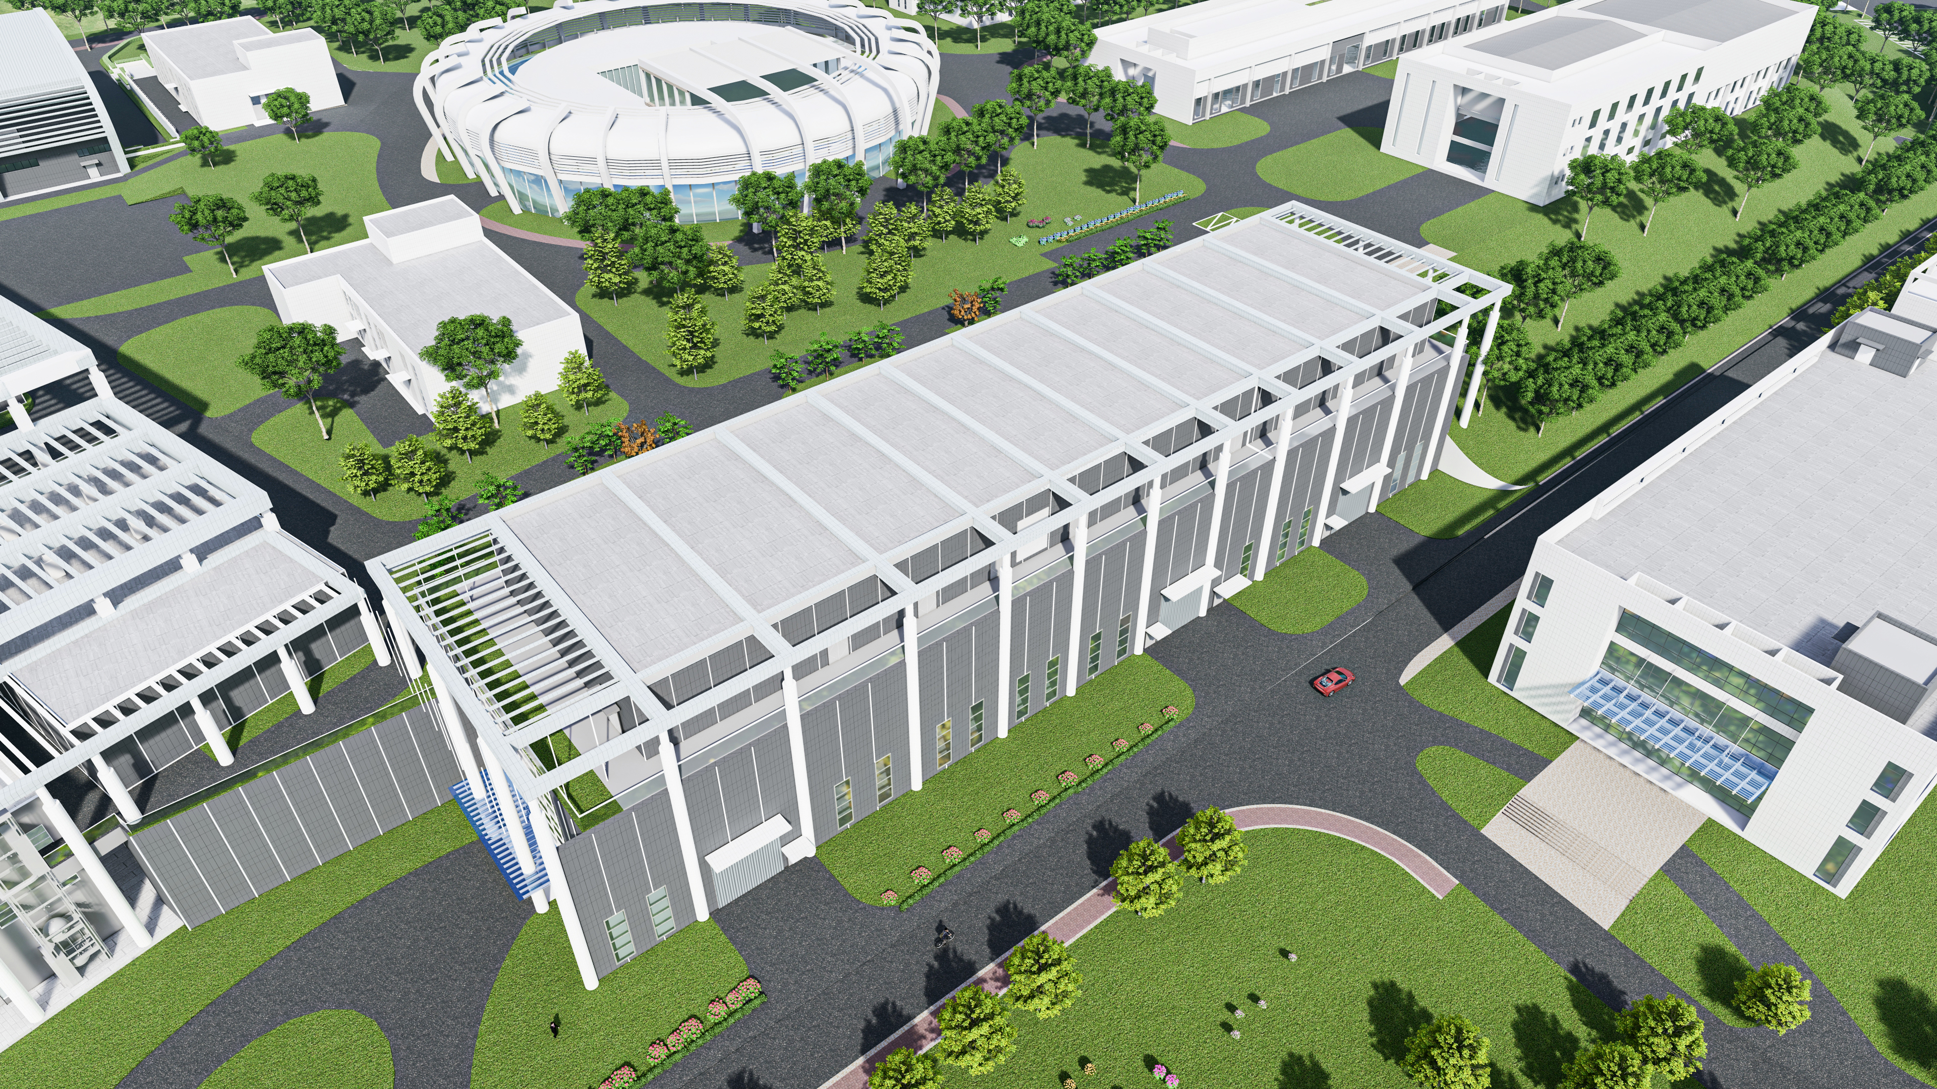
Architectural Design of MELODY
03
MELODY

Slide 8
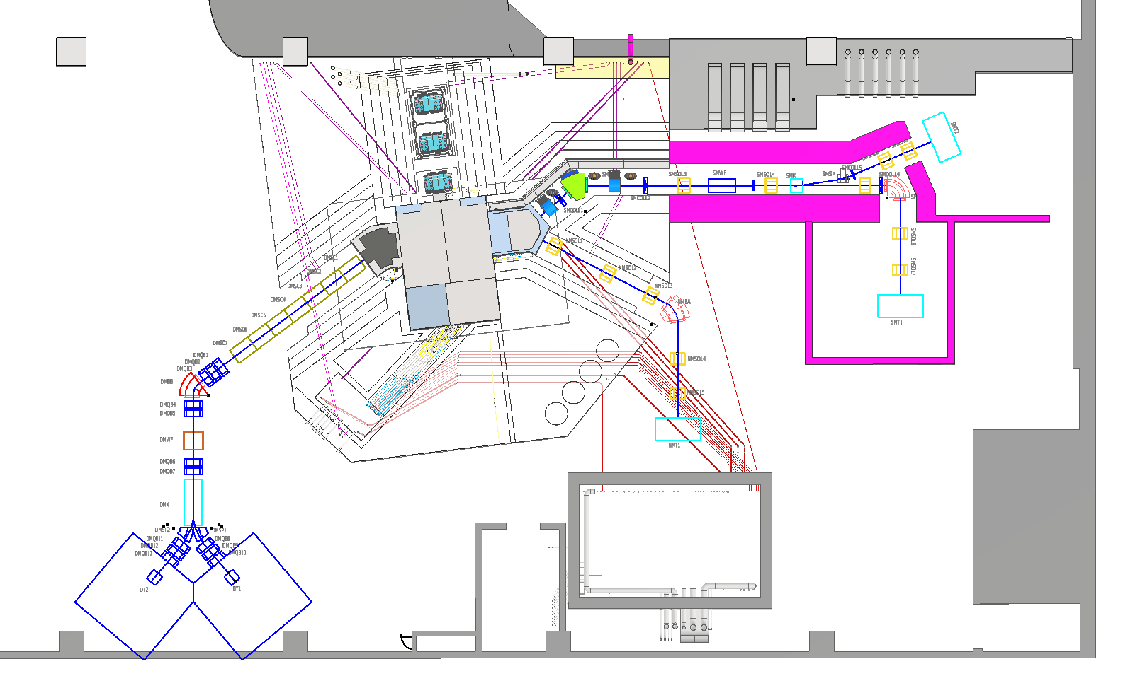
Overview Of MELODY
03
Proton Beam
Proton:
1.6 GeV, 20kW, 1Hz
SMBT
SMT2
Target：
Cu, 10cm
NMBT
DMBT
Beamlines：
Surface Muon
Decay Muon
Negative Muon
Waste Target
NMT
Reserved
SMT1
Spectrometer：
muSR
MIXE
Water Cooling system (underground)
control room
Sampling room
DMT2Reserved
DMT1 Reserved

Slide 9
3.1
Design features
Target
  Stand-alone target: more freedom to design
  Thick target: 10 cm interaction length
  Copper Target: high production
Beamlines
  Surface Muon: Solenoid focusing; AI optimized; Large acceptance
  Negative Muon: by-product, low cost, dedicated μ⁻ beam
  Decay Muon: Large acceptance; wide applications
muSR spectrometer
  High Asymmetry: 0.3
  Large number of detectors: 3024 units

Slide 10
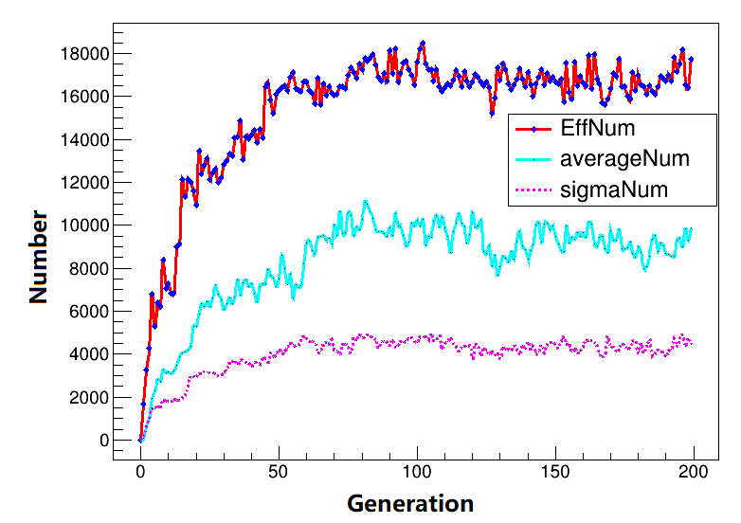
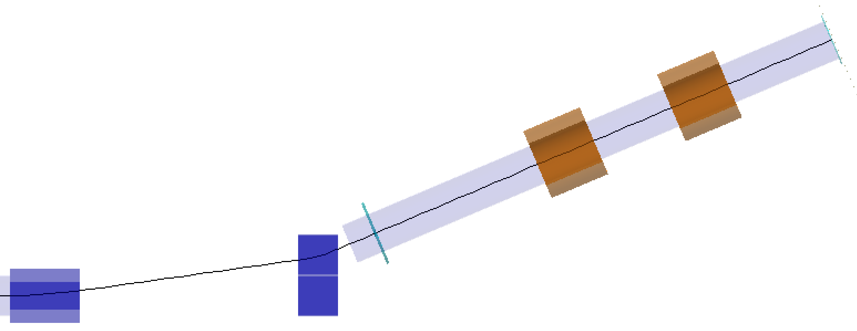
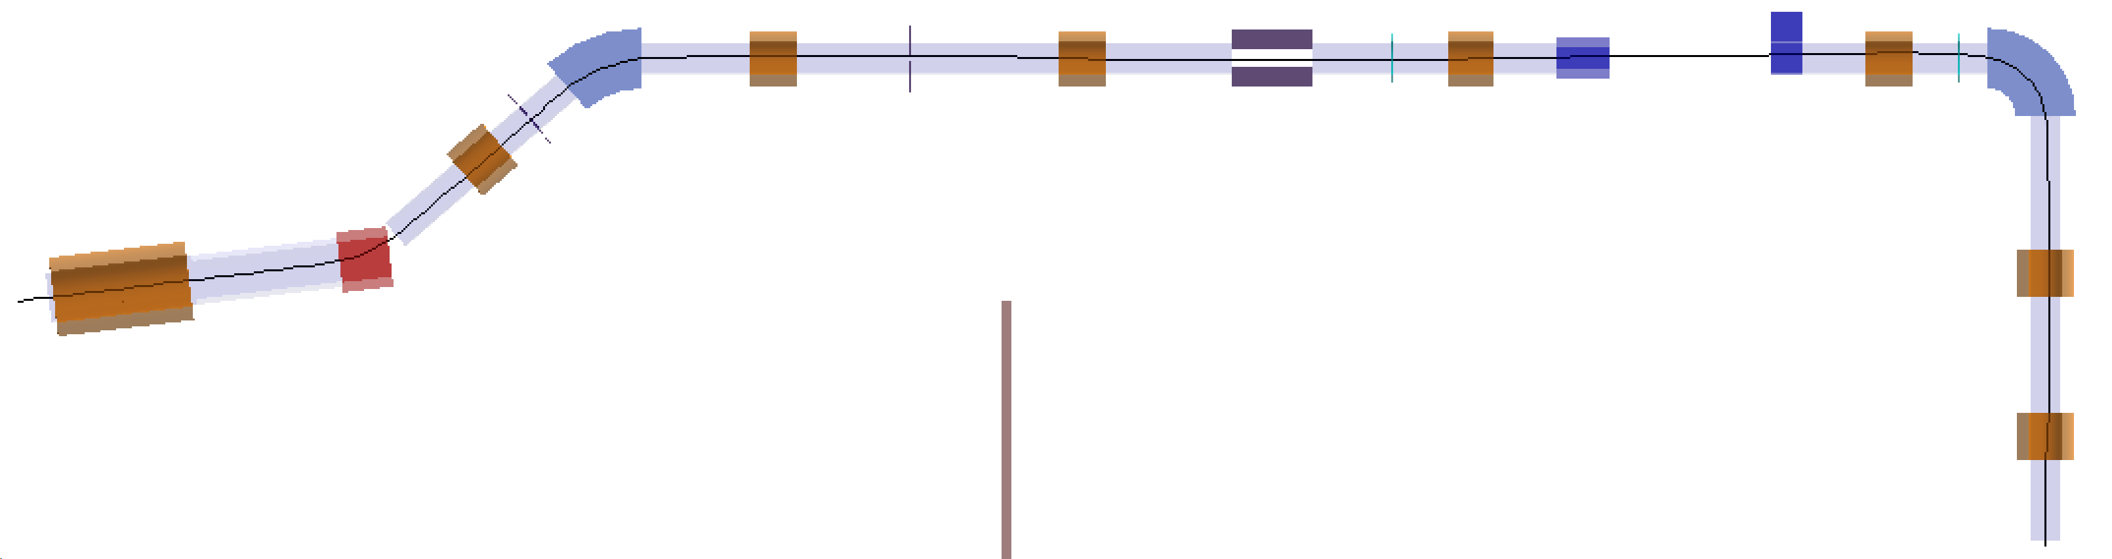
3.1
Surface Muon Beam
Design parameters
Momentum：28 MeV/c, Polarizability：>95%
Intensity：>10⁵ μ/s, Positron background：<1%
Optical design by Transport
Fully focusing solenoids, 3 dipole bending magnet.
SMWF, SMK, 5 collimators
Deflection angle: SMBA @34, SMBB @40.9, SMBC @90, Kicker @8, Septum @15
optical design
AI optimization
SMT2
SMSOL9
Features: Fixed energy @4 MeV, higher acceptance, cost-effective
SMSOL8
Coll5
2 terminals:
SMT1 for muSR
SMT2 for R&D
SMBB
Coll2
Coll3
SMK
Coll4
SMBC
Proton
Coll1
SMSOL2
SMSOL3
SMWF
SMSOL4
SMSP
SMSOL5
SMSOLX
SMSOL1
SMSOL6
SMBA
Layout of SMBT
SMSOL7
SMT1

Slide 11
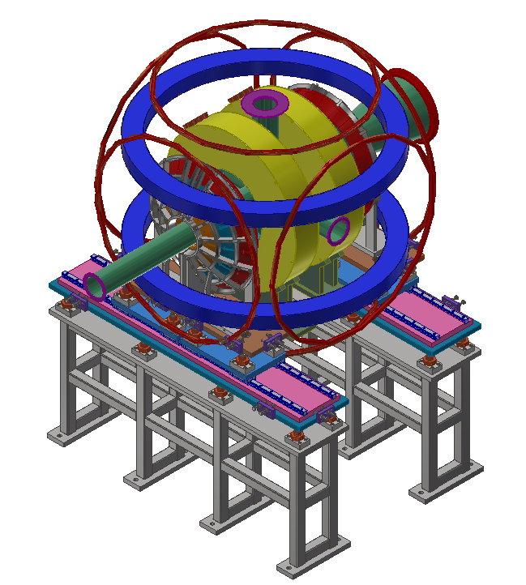
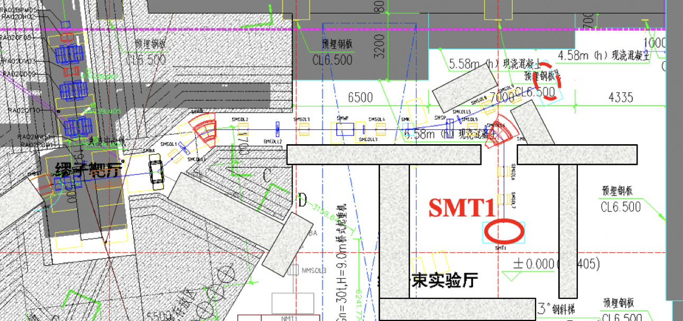
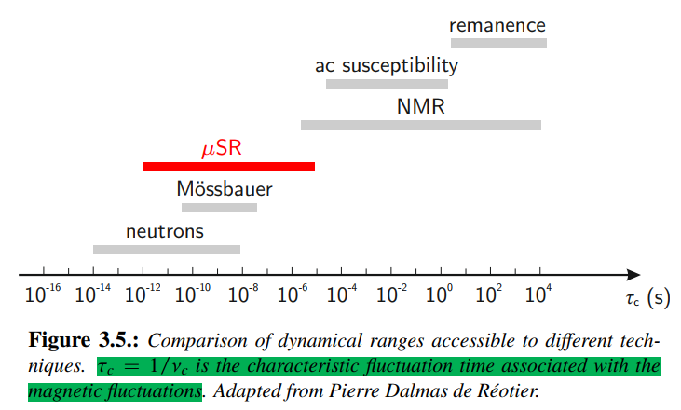
3.2
Science for SMT1
Dedicated beam for muSR
MuSR：Magnetic material, superconductivity, battery, semiconductor
Spectrometer Design
~1584 detector units in the first stage (~3024 units in total)
Counting Rate：~ 3.8×10⁷ e⁺/hour @1 Hz (~76 MEvent/hour in total)
Asymmetry：> 0.3
Pulse length：~130 ns (consider slicing to 10 ns)
Temperature: 2-300 K with cryostat
LF: 0-5000 G
TF: 0-400 G
Beam spot: Ф10-30 mm

Slide 12
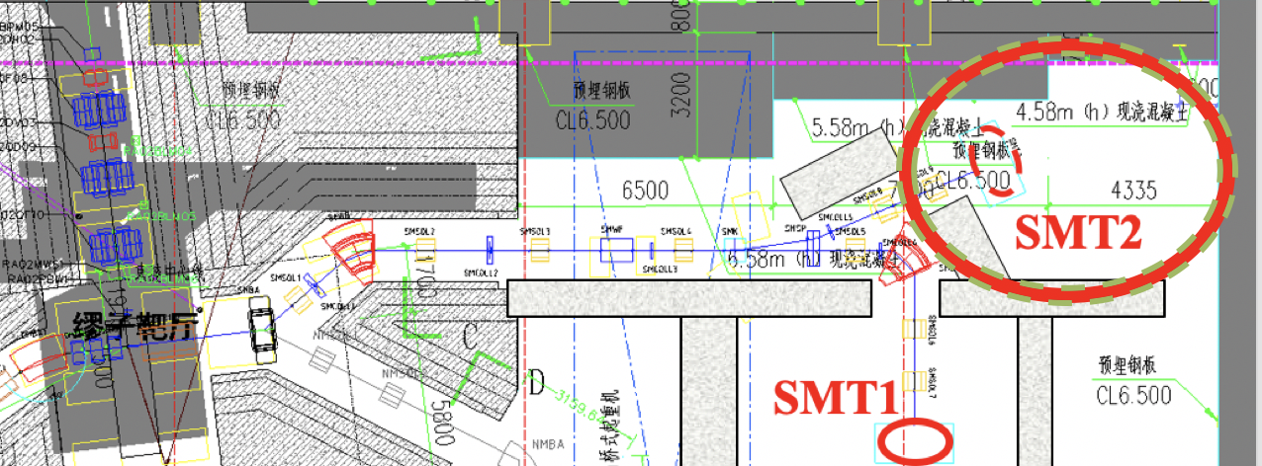
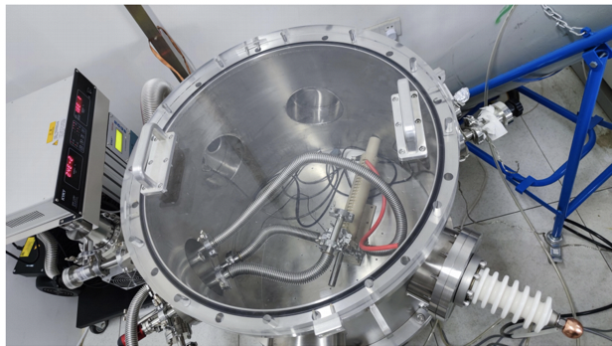
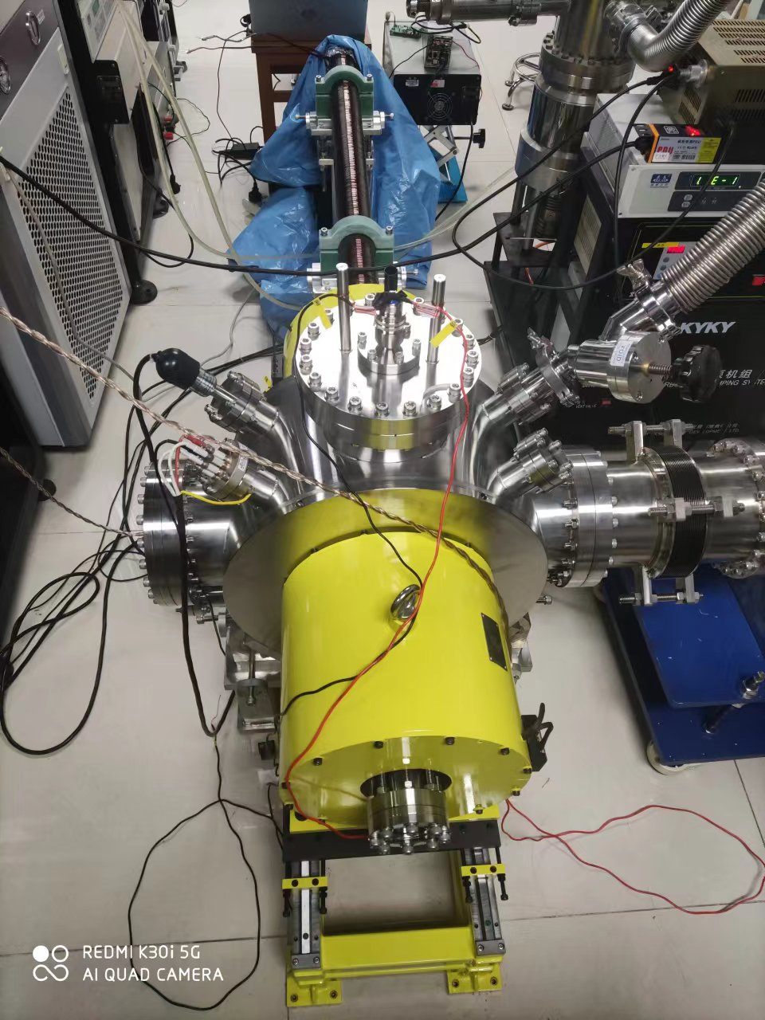
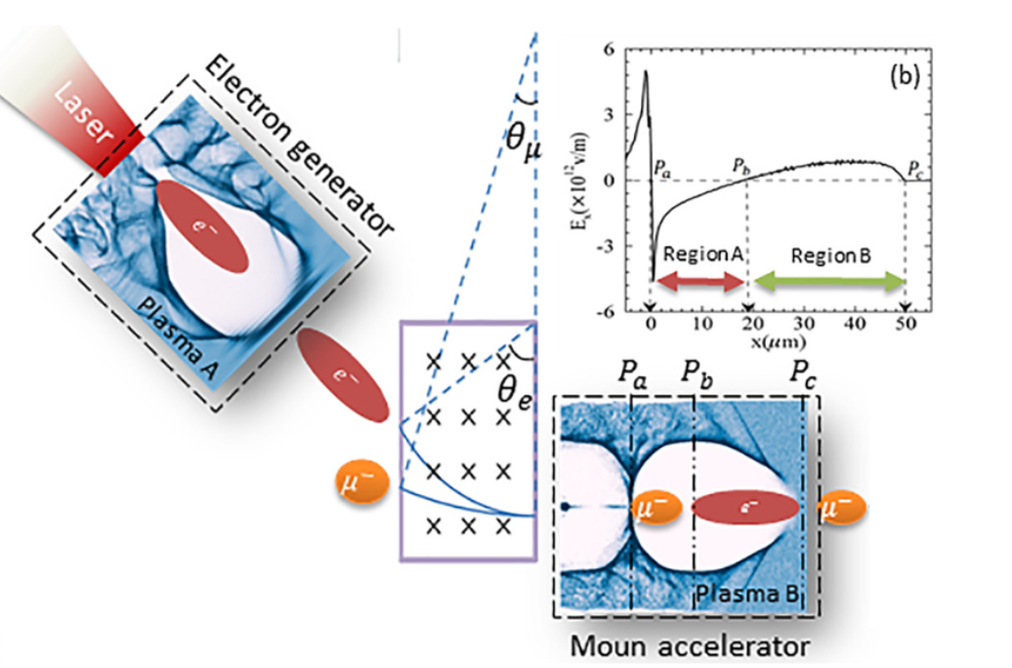
3.2
Science for SMT2
Muon technology development
Muon moderation
Muonium experiments
Muon acceleration
More muSR spectrometers
  LGAD detectors
Muon moderation
Muonium production
Muon PW acceleration

Slide 13
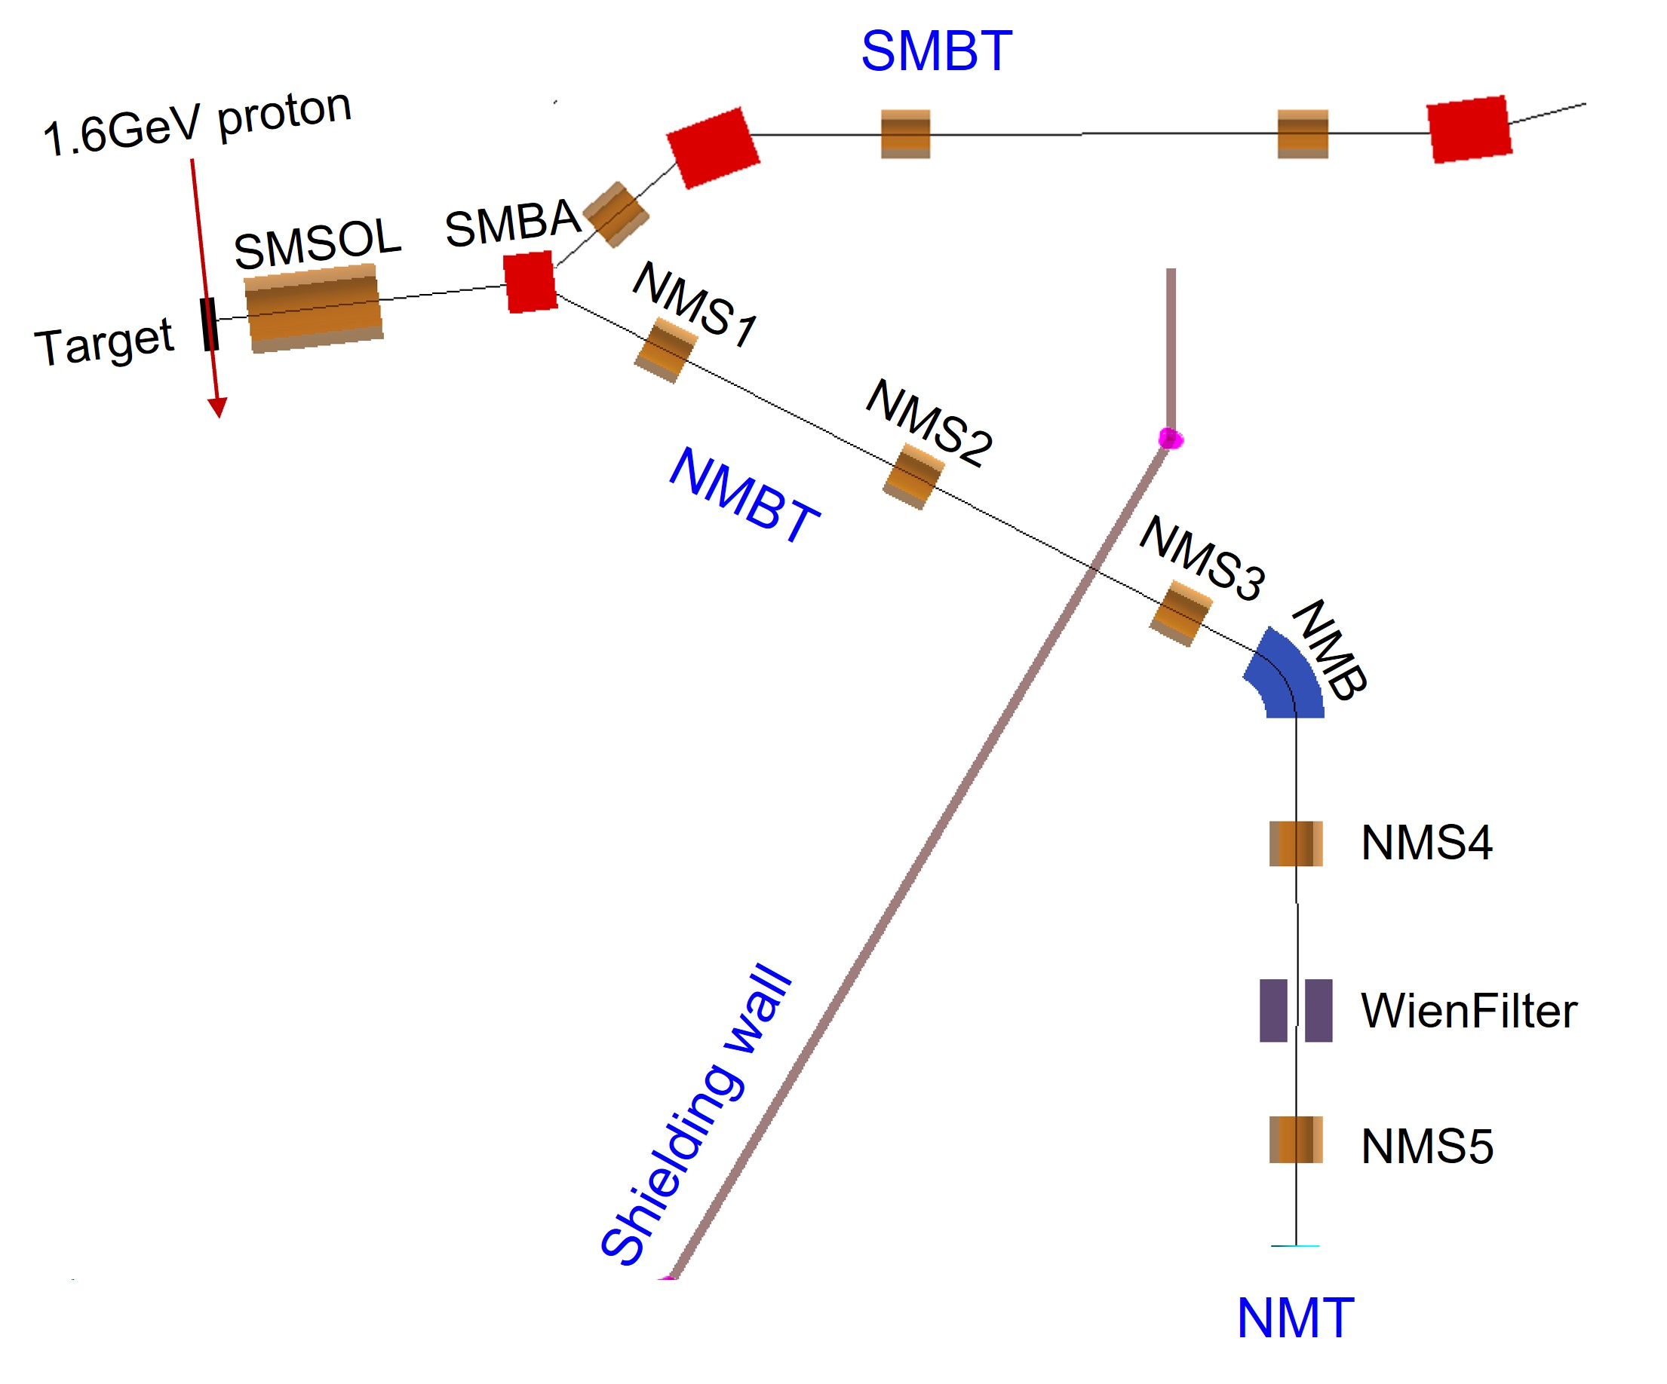
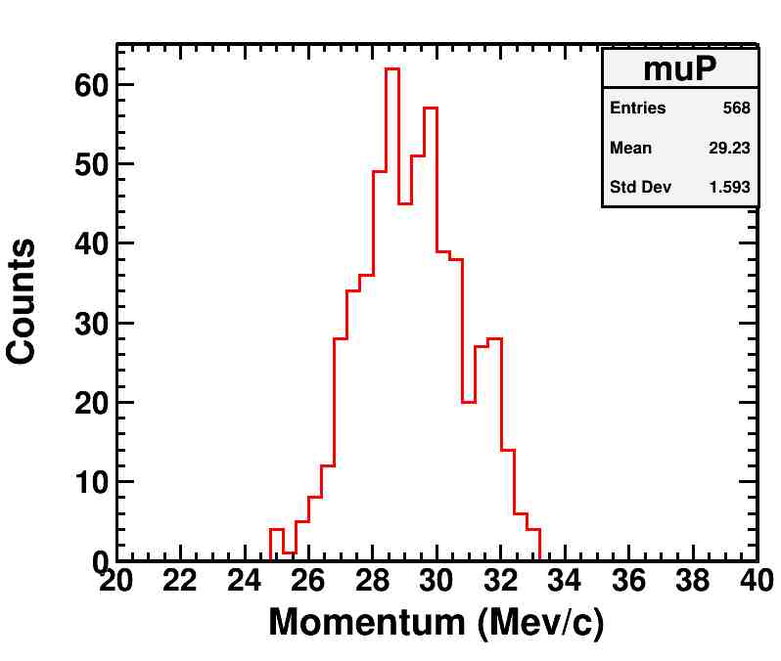
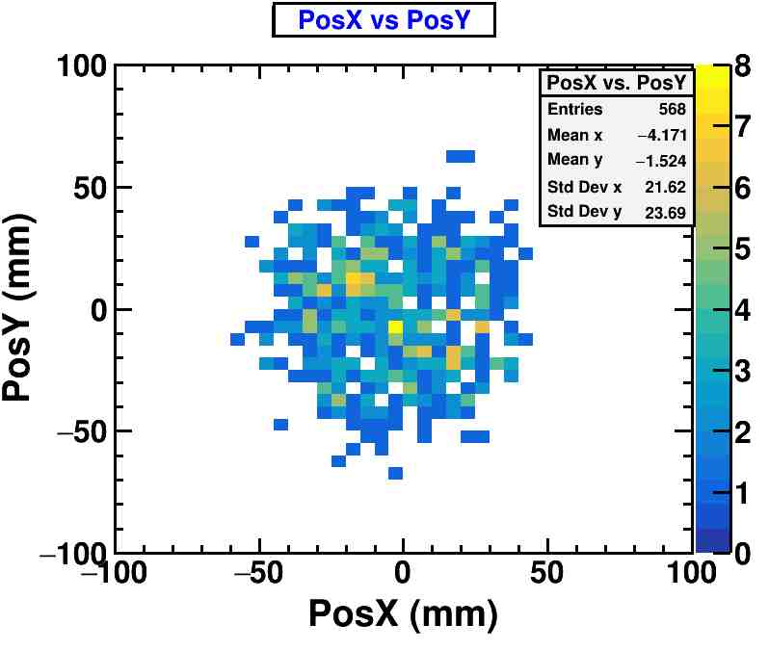
3.2
Negative Muon Beam
NMBT: Dedicated μ⁻ beam
5 focusing solenoids
1 dipole magnet
1 wien filter
Beam parameters
Momentum：29 MeV/c @13% (FWHM)
Penetration：~ 50 μm in Fe
Beam size： Φ100 mm
Beam intensity：4.4×10⁵ Hz (Φ100 ratio>90%)

Slide 14
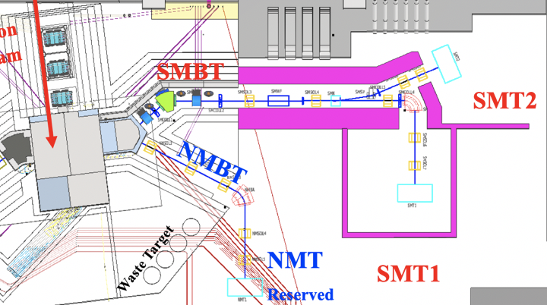
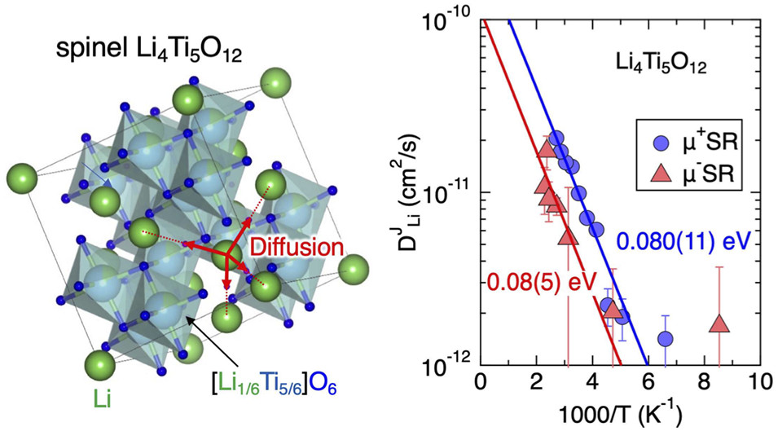
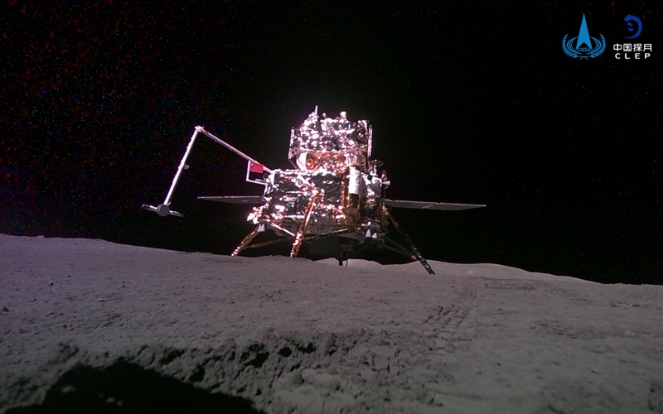
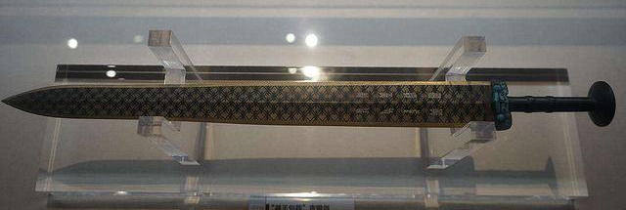
3.2
Science for NMT
Non-destructive elemental analysis: Muon Induced X-ray Emission (MIXE)
  Sensitive for almost all elements (including C, N, O)
  No activation for samples
  Archeology:
    Palace Museum
    National Museum
    Guangdong Museum
    FURUKAGE Conservation center
μ⁻ and μ⁺ study on Li⁺ battery anodes
J. Phys. Chem. C 2022, 126, 25, 10506
Moon soil
Elemental analysis for Archeology
14

Slide 15
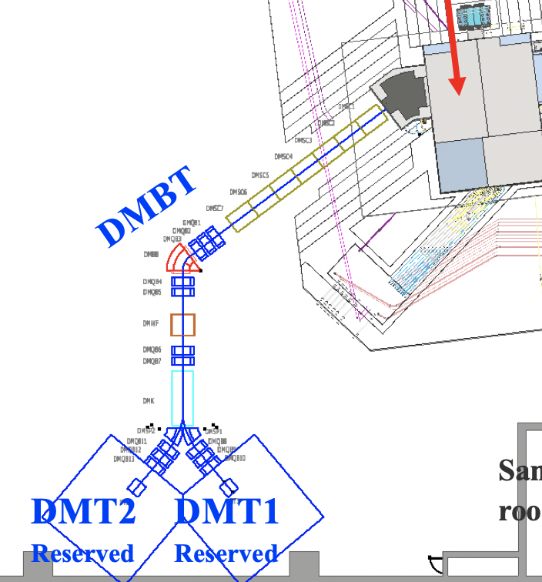
3.2
Science for DMT
High-energy MuSR
Thick Samples
Depth scan MIXE
Depth scan for archaeology
Single Event Effect
Large capture cross section of μ⁻
Muon
Imaging
Thick samples
Samples in container
High field
Thick moon rock
Batterries
Momentum: 20 ~ 120 MeV/c
Charge: + or -
Intensity: 10⁵~10⁷ muon/s
Penetration in Cu: 1 ~ 50 mm
Polarization: 50% ~ 99%
Decay muon beamline with 2 terminals

Slide 16
Design Parameters
Proton driver | Power | Repetition | Energy | Time Structure |  | σ_{x} | σ_{y}
 | 20 kW | 1 Hz | 1.6 GeV | 120ns/409ns |  | 3.1 mm | 8.5 mm
Muon beam | Surface Muon (SMBT) |  | Negative Muon (NMBT) |  |  | Decay Muon (DMBT)
Momentum | 28 MeV/c |  | 28 MeV/c |  |  | 20~120 MeV/c
dp/p | 6% |  | 13% |  |  | 8% @ 120 MeV/c
Beam spot | Φ10mm-Φ100mm |  | Φ100mm |  |  | Φ30mm
Intensity | 10⁵-10⁷ μ⁺/s |  | 4×10⁵ μ⁻/s |  |  | 4×10⁶ μ⁺/s
Polarization | > 95% |  | ~ 20 % |  |  | > 70%
Pulse width | 130 ns (SP) ~ 520ns (DP) |  | 520 ns |  |  | 130 ns (SP) ~ 520ns (DP)
Spectrometer | Segments | Asymmetry | Count Rate |  | FOM: A²*R | Temperature |  | LF/TF
 | 1584/3024* | ~0.3 | 38/76* MEv/h |  | 2.9/5.8* | 2K ~ 300K |  | 5000 G/ 400 G
* Can be upgraded to

Slide 17
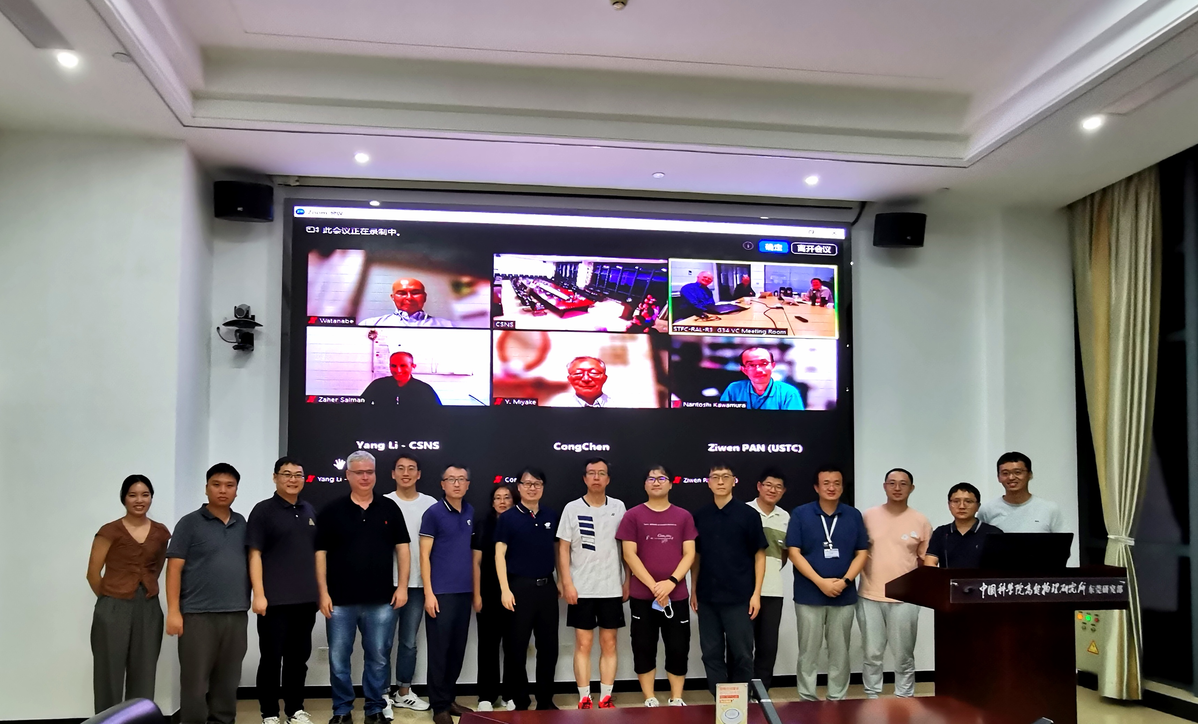
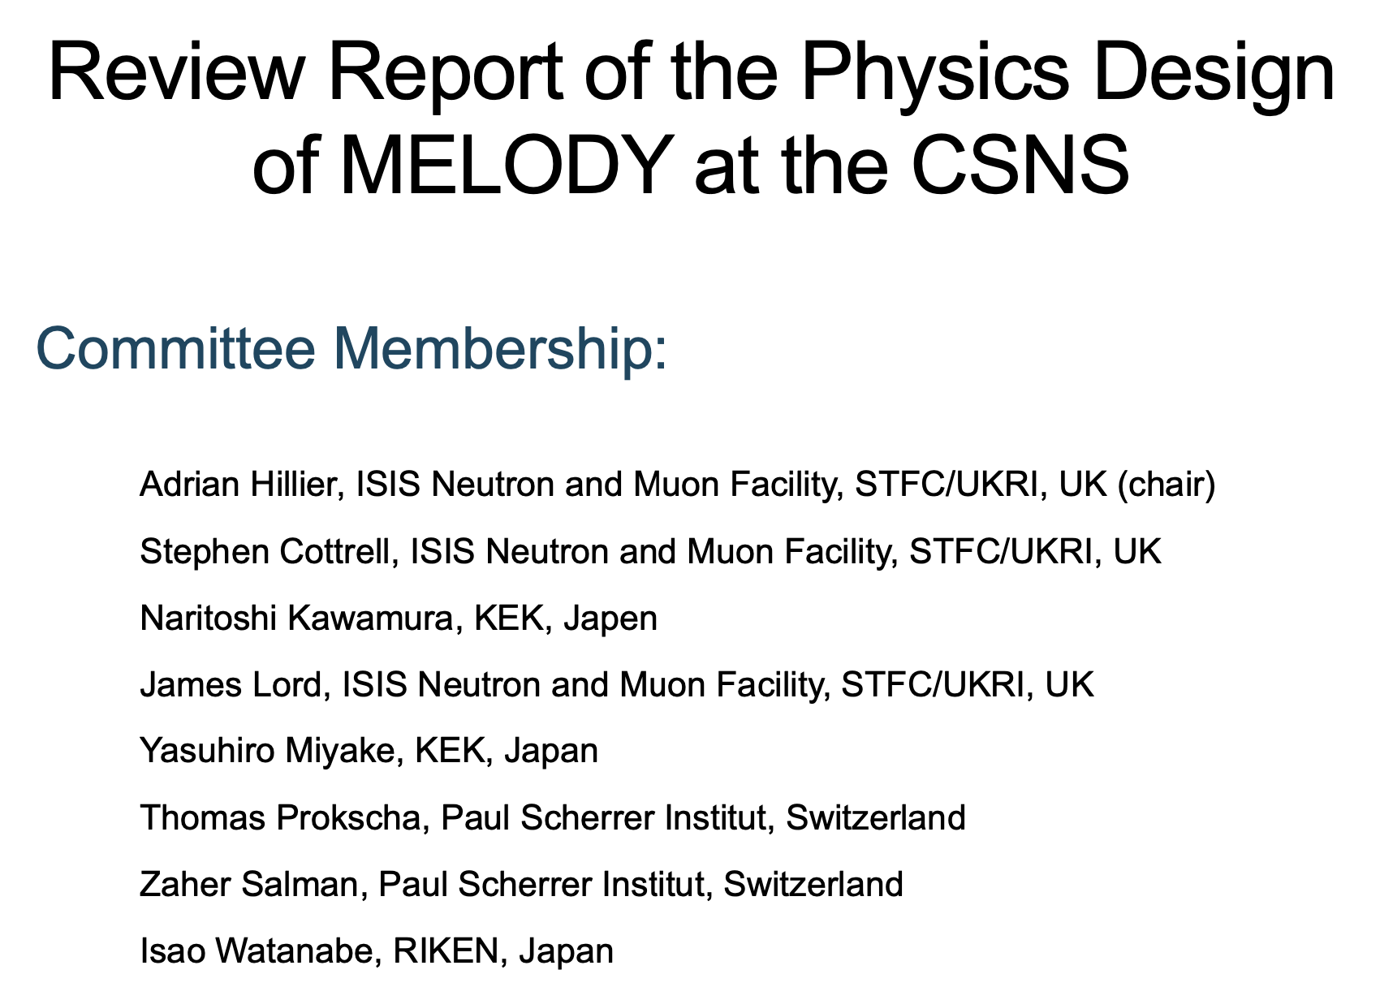
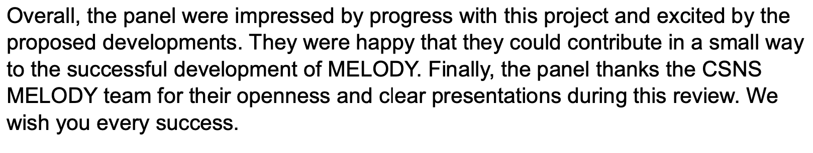
Physics Design Review
July 1st, 2024

Slide 18
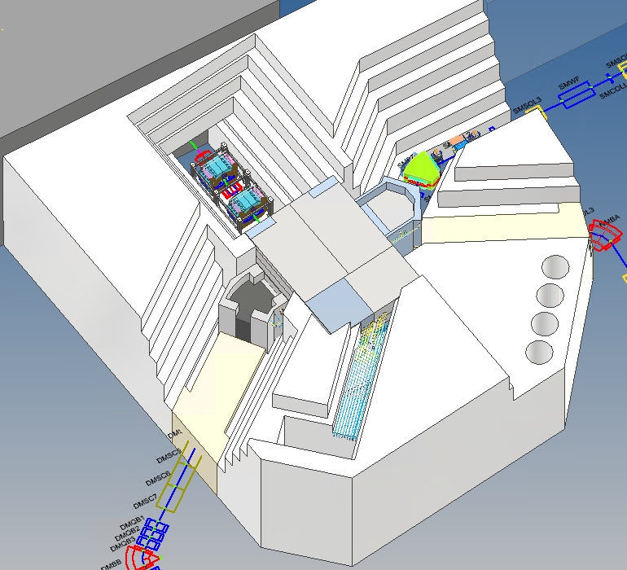
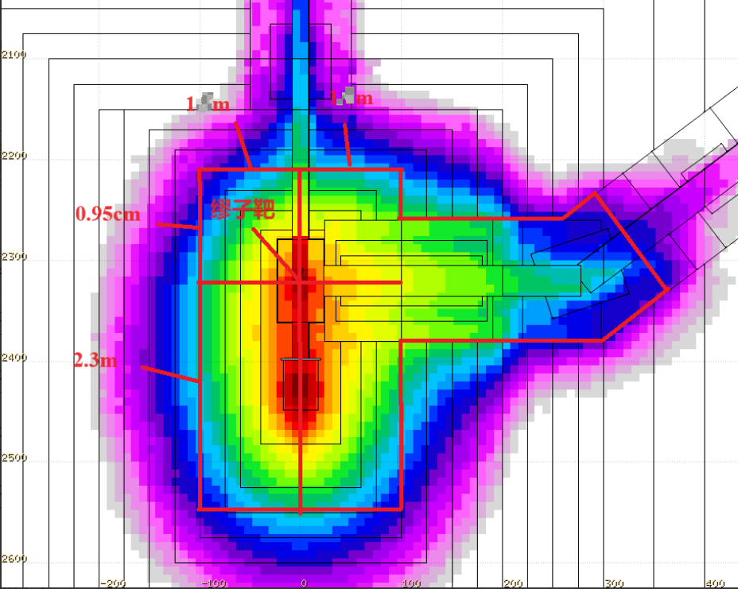
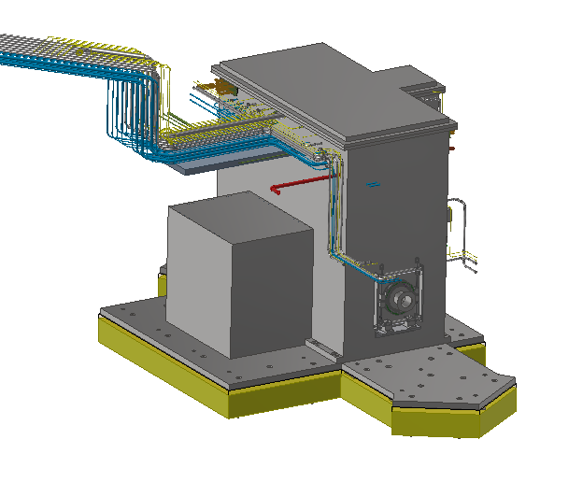
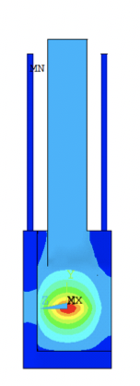
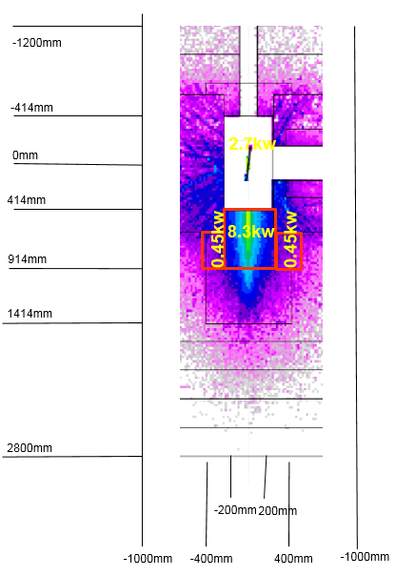
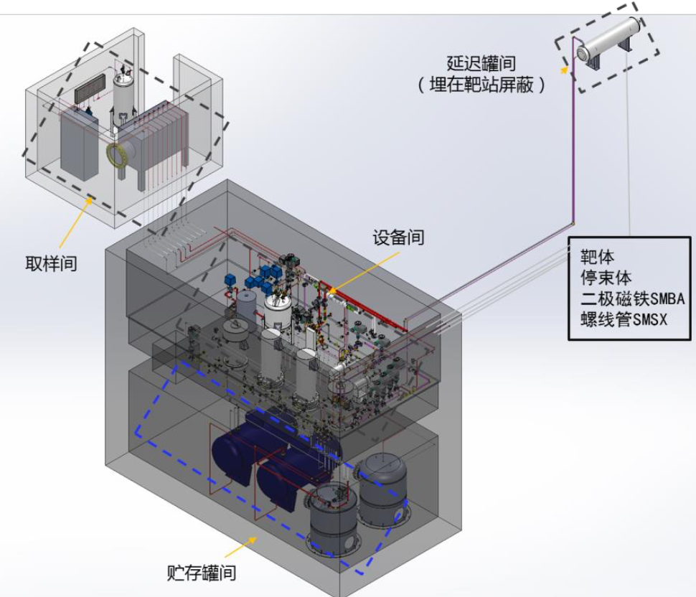
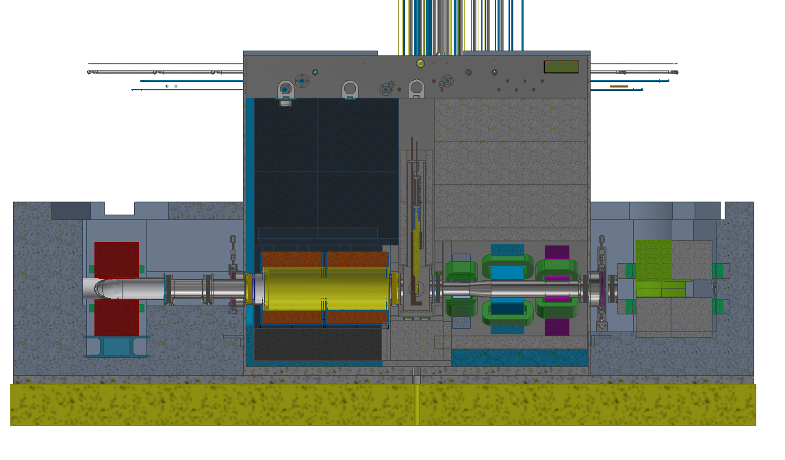
4
Technical Design Progress – Target
Radiation dose
Helium Gas Tank
Heat and temperature
Water cooling system
Positioning

Slide 19
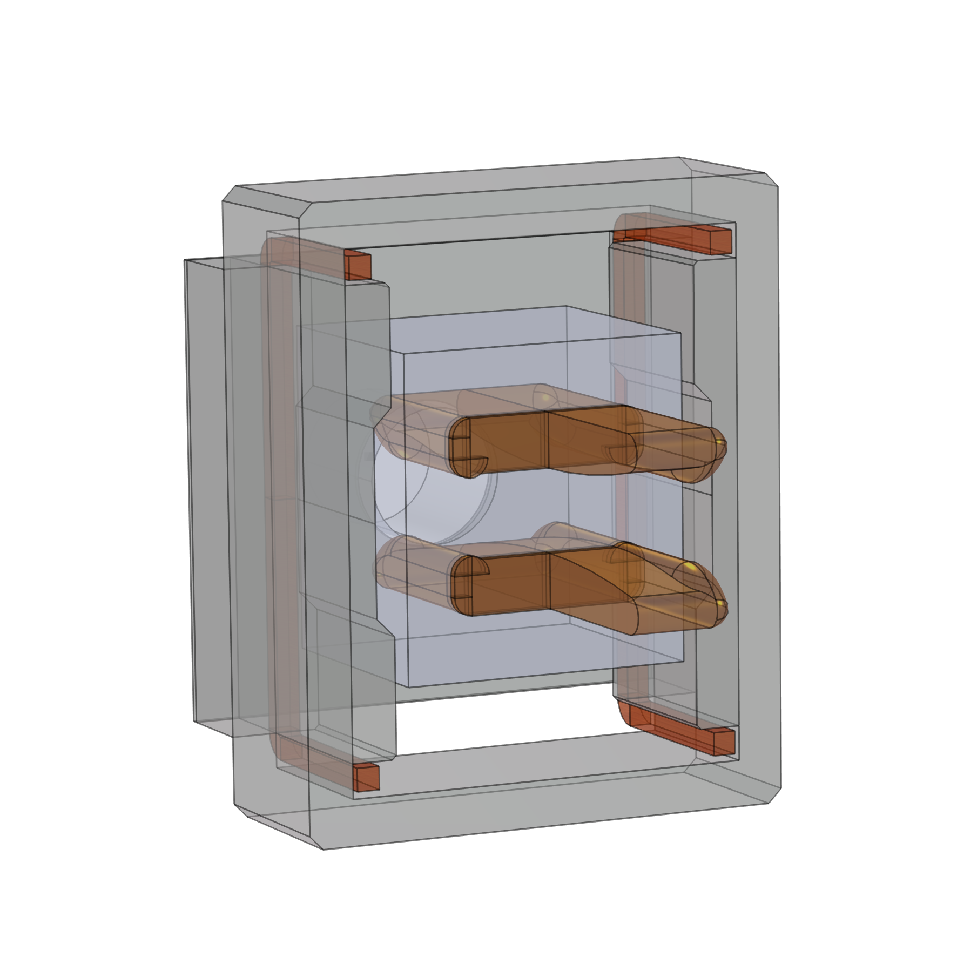
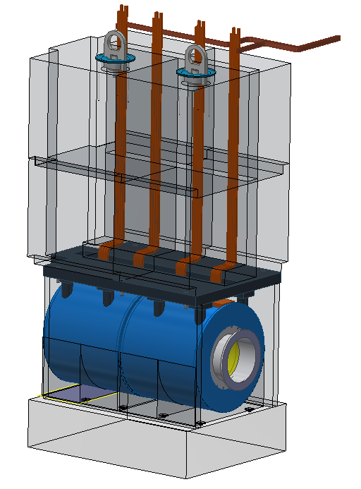
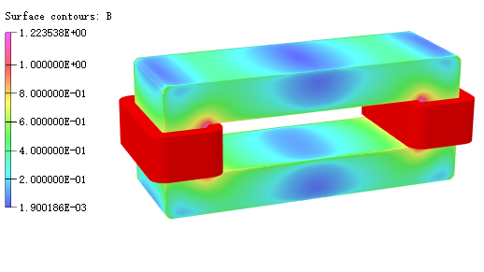
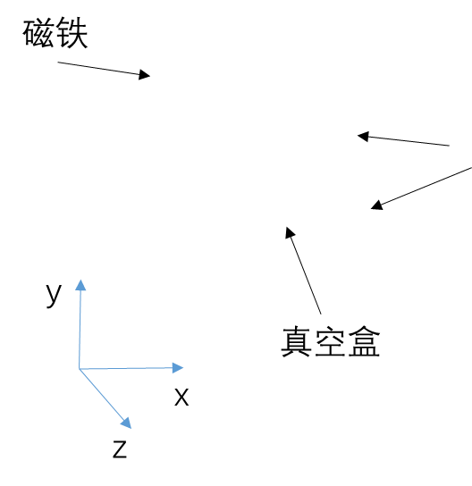
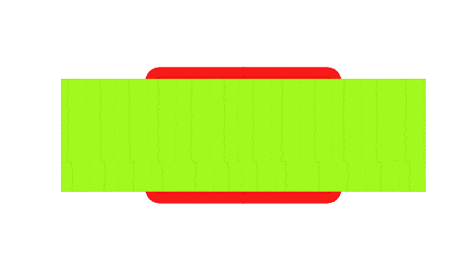
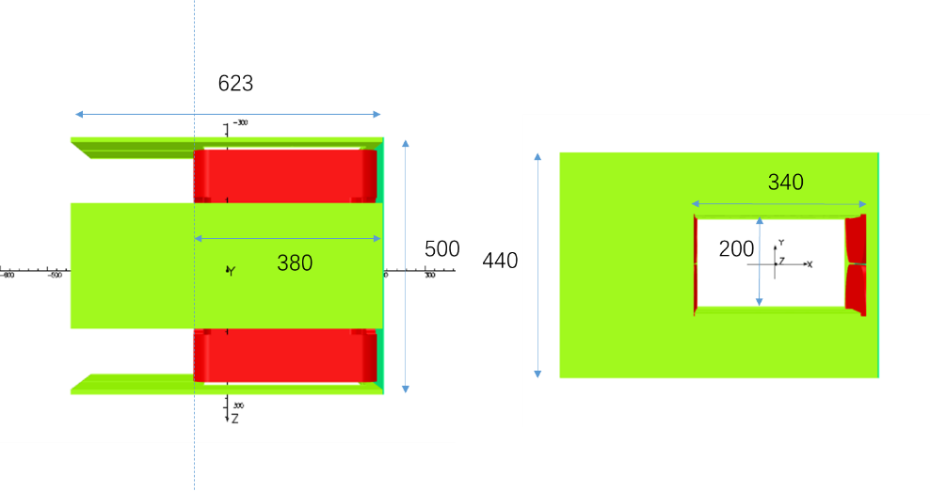
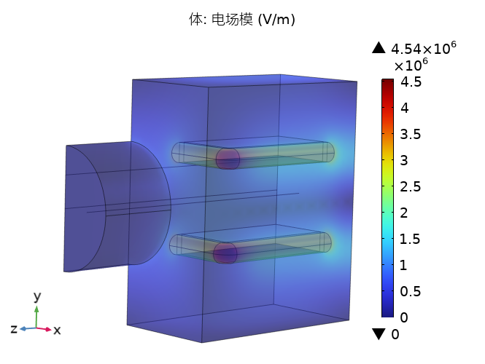
4
Technical Design Progress – Beamlines
电极
Dipole for splitting
μ⁺ and μ⁻
Wien Filter:
Model and field
Capture solenoid
with MIC coil
Kicker and septum magnets

Slide 20
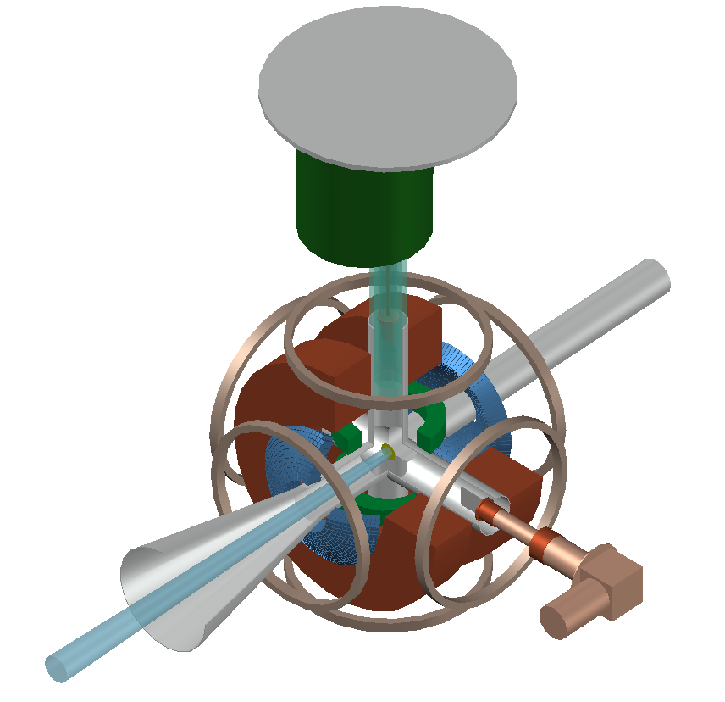
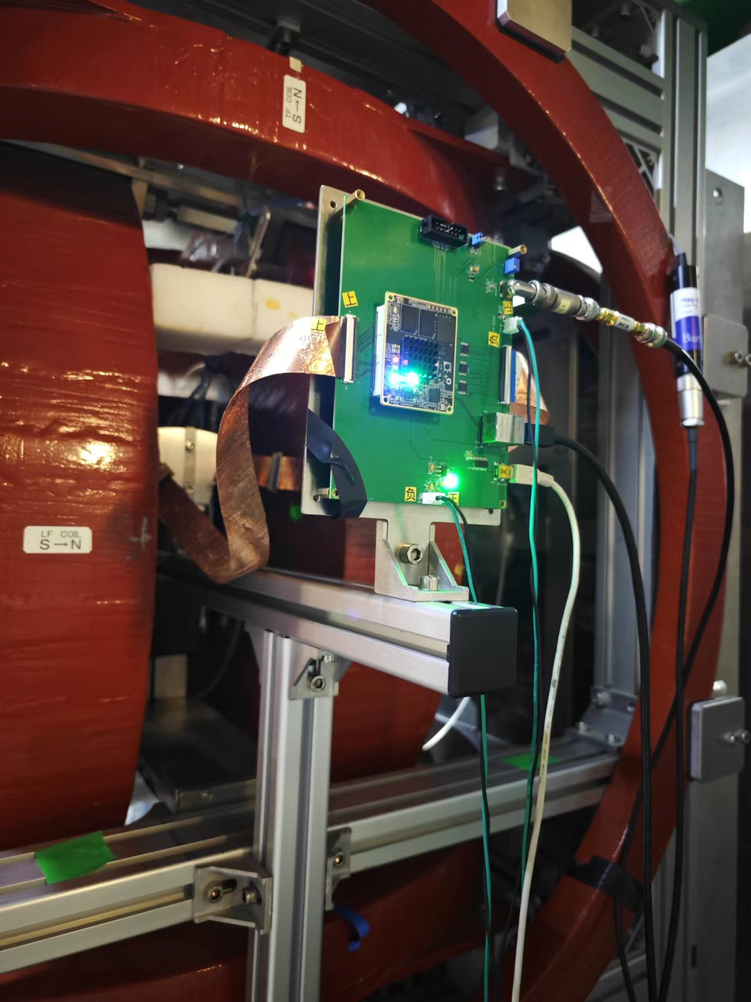
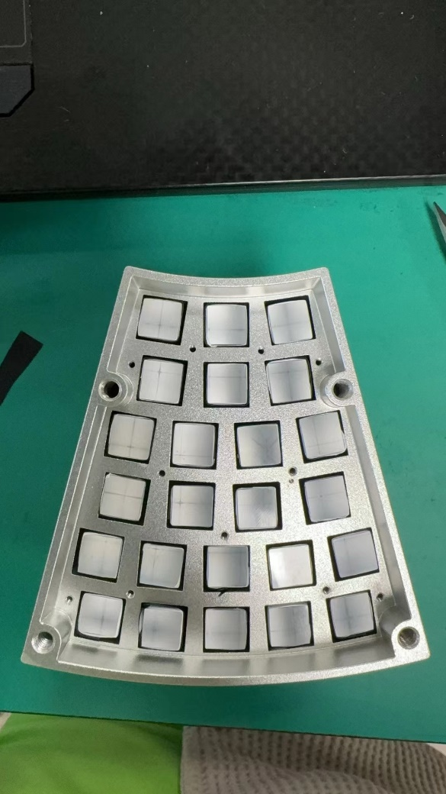
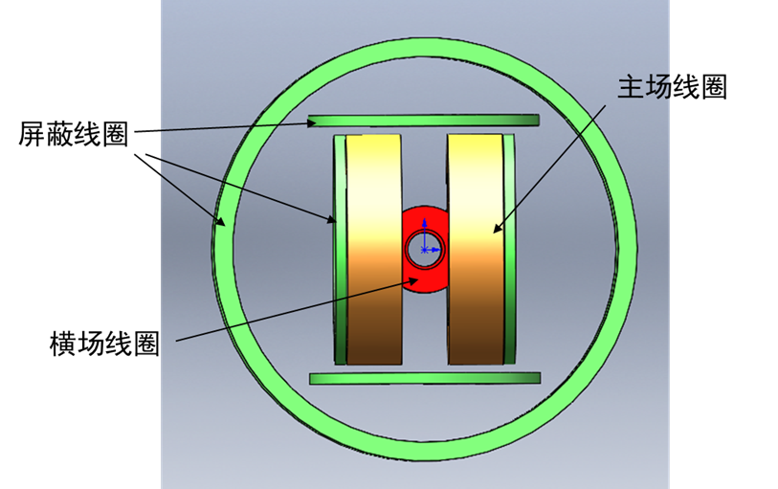
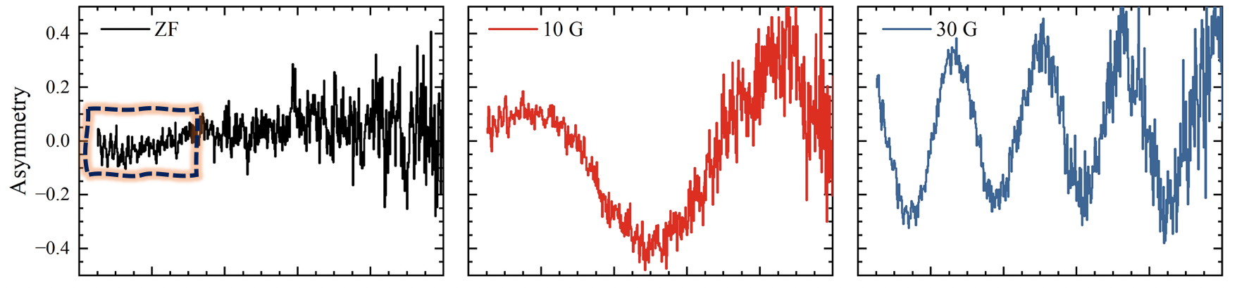
4
Technical Design Progress – Spectrometer
Homogeneity < 50ppm
Test @ ISIS

Slide 21
4
Timeline of MELODY
Complete of Muon Hall
Start trial run

Slide 22
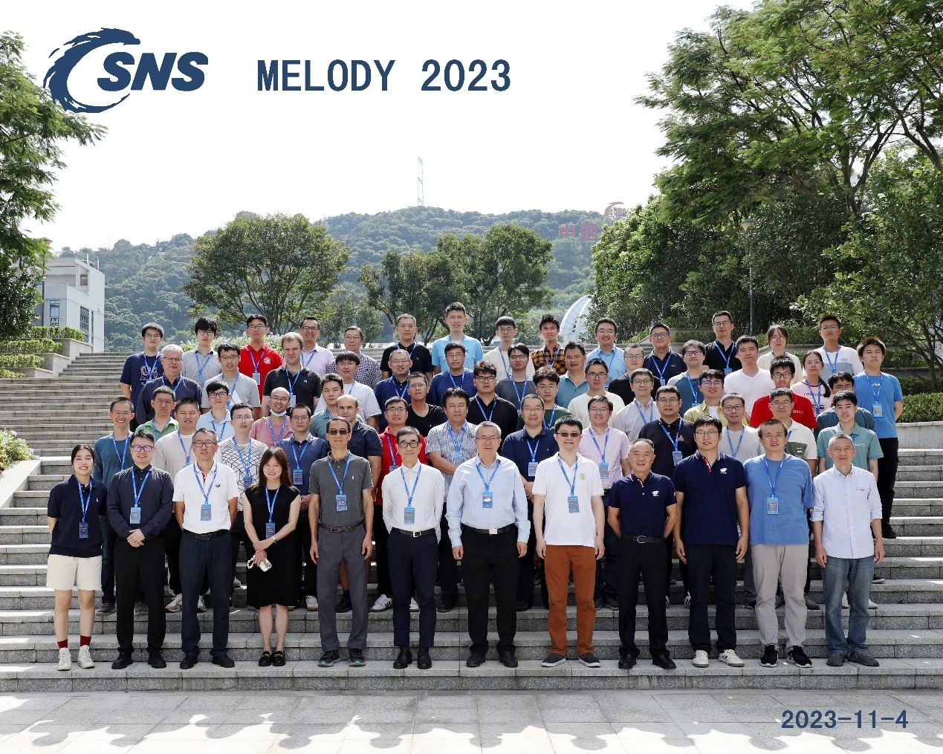
First workshop of MELODY
Nov. 3-4, 2023

Slide 23
MELODY TEAM
Target： Chen Wu、 Lei Liu、Gang Zhang、Ning He、Zhiduo Li、Nikos Vasiloploss、Jiaxin Chen、Zhixin Tan、Yu Liu、Congju Yao、Yongji Yu、Guangyuan Wang、Junsong Zhang、Huihong Liang、Huayan He、Xiaoyin Mo
Beamlines：You Lv、Cong Chen、 Guangdong Liu 、Changdong Deng、Yuwen Wu、Junhao Wei、Xin Qi、Wenqing Zhang、Pengcheng Wang、Yuliang Zhang、Yongcheng He
Spectrometer：Qiang Li、Ziwen Pan、Yang Li、You Lv、Ruirui Fan、Haiyan Du、Yuhang Guo、Hao Liang、Tianyi Yang、Bangjiao Ye

Slide 24
SUMMARY
05
MELODY has been approved and started construction
Physics design of MELODY has been reviewed by international experts
The surface muon beam will be constructed first. The negative muon beam and the decay muon beam will be built in the future
We will be able to welcome all of you in 5 years!
THANKS!

