Slide 1


Quantum Critical Spin-Liquid in Geometrically Frustrated Kagome Lattice Investigated by Muon Spin Relaxation and Neutron Scattering
Devashi Adroja
ISIS Facility
Rutherford Appleton Laboratory
UK
2nd Workshop on Muon Science Technology and Industry
10-11 Jan 2025
CSNS, IHEP, CAS
Notes:
Thanks to Profs. Yu Bao, Jie Ma, Yang Li, H. Luo

Slide 2
Collaborators
R. Tritahi, A.D. Hillier, S. Sharma, S. Langridge, F. Demmel, D. Keen, H. Walker, G. Stenning, F. Pratt, R. Perry (ISIS Facility)
C. Ritter, M. Koza (ILL, Grenoble)
T. Takabatake, C. Yang (Hiroshima University, Japan)
W. Higemoto, T. Ito (ASRC, JAE, J-PARC, Japan)
A. Sundaresan (JNCASR, India), A. Bhattacharyya (RMVERI, India)
Strydom (Johannesburg University, SA)
Qimiao Si (Rice University, USA)
Notes:
A. Severing (Cologne)

Slide 3
Outline
Introduction
Experimental investigations on CeRh_{1-x}Pd_{x}Sn
    Structural and Physical properties
    Muon spin rotation and relaxation study
Inelastic neutron scattering (INS)
Neutron powder diffraction study
Conclusions

Slide 4
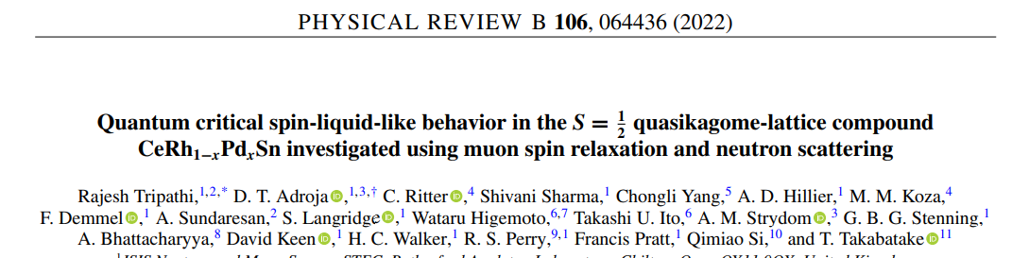

Slide 5
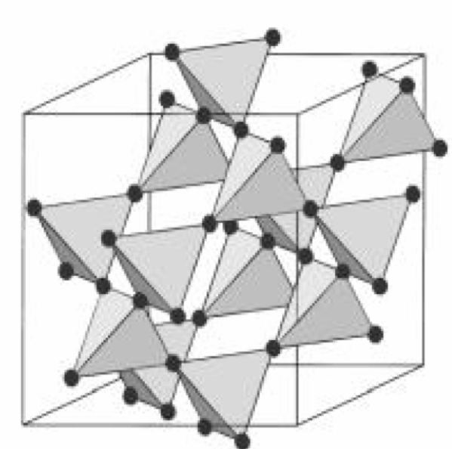
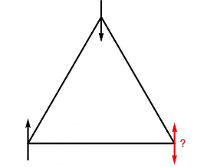
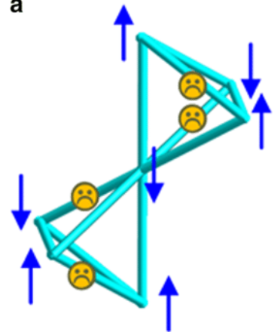
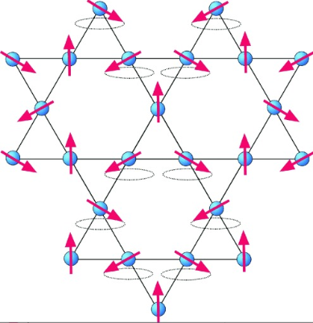
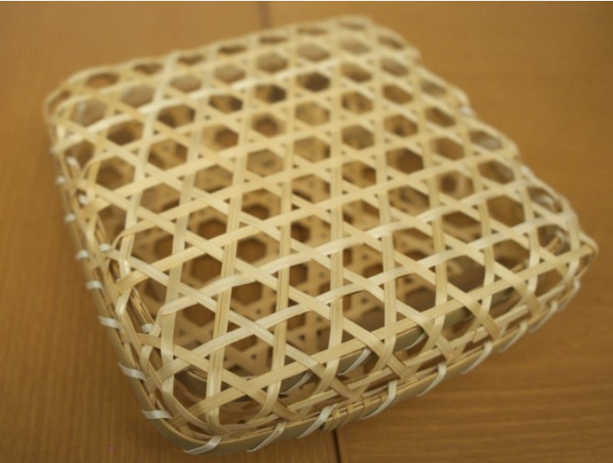
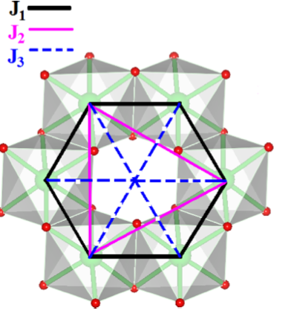
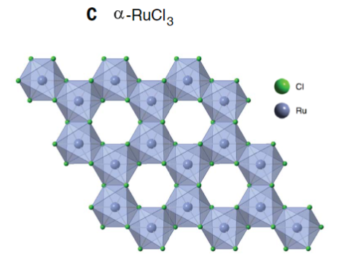
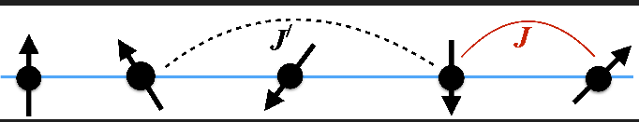
Introduction: Geometrical Frustrated Lattice
2D Kagome lattice
Topological Flat bands and Dirac cone. CDW superconductivity: AV₃Sb₅ (A = K, Rb, Cs)
3D Pyrochlore Lattice
A network of corner-sharing tetrahedra
2D Triangular lattice.
Quantum Spin-liquid
1D spin-chain. Quantum fluctuations, Tomonaga-Luttinger liquid. Spin dimerization and Halden gap:
C₁₄H₁₈CuN₄O₁₀
2D Kitaev Honeycomb lattice Quantm Spin liquid
Notes:
Experimental identification of QSLs
Japanese weave (kago=basket, mé=eye or hole)
Spin ice materials and magnetic monopoles.
he spins fractionalize into Majorana fermions and form a topological quantum spin liquid (QSL) in the ground state. It was soon recognized that a family of complex iridium oxides, as well as ruthenium chloride, with honeycomb structure are magnetic insulators and accommodate essential ingredients of the Kitaev model, due to the interplay of electron correlation and spin-orbit coupling. This initiated a race to materialize the Kitaev QSL and to capture the signature of Majorana fermions
a A ground-state configuration for collinear spin order when the nearest-neighbour couplings are antiferromagnetic. This ground state is highly degenerate, but lattice distortion may stabilise one configuration. Four antiferromagnetic couplings are satisfied in each tetrahedron and two are frustrated as indicated by ‘sad face’ symbols; this construct is useful for the more complex frustrated configurations shown in Fig. 4. b Non-collinear spin order for situation (a) can give rise to the ‘all-in all-out’ configuration, where all magnetic moments point towards or away from the centre of each B-site tetrahedron, preserving cubic symmetry and with each antiferromagnetic coupling partly frustrated. c Strong dipolar interactions can lead to a related ‘2-in 2-out’ spin ice order, with two spins pointing in and two pointing out of each tetrahedron when spin–spin couplings are weakly ferromagnetic. This is also shown as one of the magnetic phases for γ-Fe2SiO4 in Fig. 5
Monopole 3-in and 1 out
Kagome lattice materials have fascinated scientists for a long time because they provide a window into quantum phenomena such as geometrical frustration, topology, and strong correlations.

Slide 6
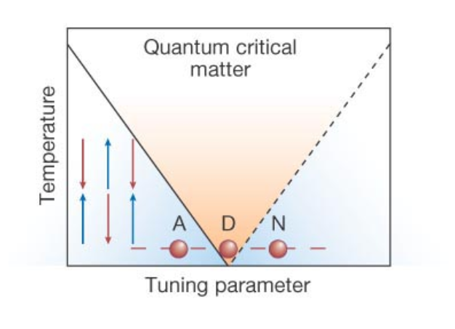
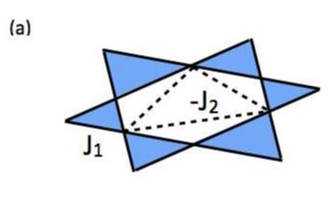
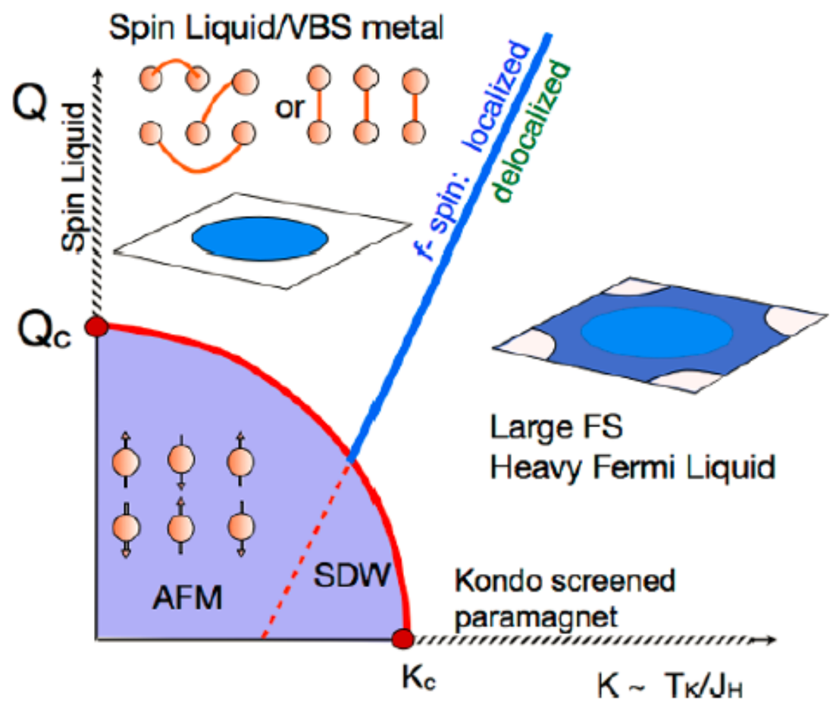
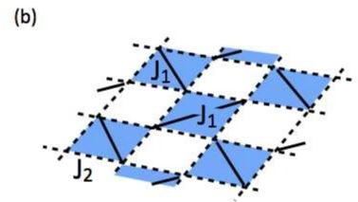
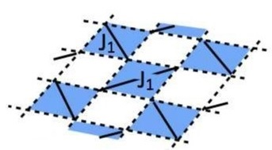

Introduction: Frustration in the Kondo lattice
Frustration
Coleman & Schofield (2005)
P. Coleman et al. 2010 J. Low Temp. Phys. 161 182
Kagome lattice
CePdAl and YbAgGe
Shastry-Sutherland lattice
J₂
Kondo strength
Ce₂Pd₂Sn and Yb₂Pd₂Pb
Phase diagram of the geometrically frustrated Kondo lattice
Notes:
In Ce2.15Pf1.95Sn1-yIny SSL phase exist at x=0 between 4.5 K and 2.2 K

Slide 7
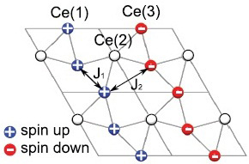
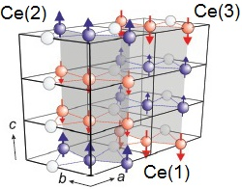
Partially geometrically frustrated CePdAl with quasi-kagome lattice
Magnetic structure of c plane
3D Magnetic structure of CePdAl
Localized
moment
μ_{Ce}= 1.6 μ_{B} // c
T_{N}= 2.7 K
Hexagonal ZrNiAl-type structure
A. Dönni et al. 1996 J. Phys.: Condens. Matter 8 11213
V. Fritsch et al. 2014 Phys. Rev. B 89 054416
Ce ions form an equilateral triangles in the c plane.
2/3 of Ce moments participate in the AFM long-range order
1/3 of Ce moments are disordered below T_{N} = 2.7 K,
How about frustration effects in isostructural Ce compounds?

Slide 8
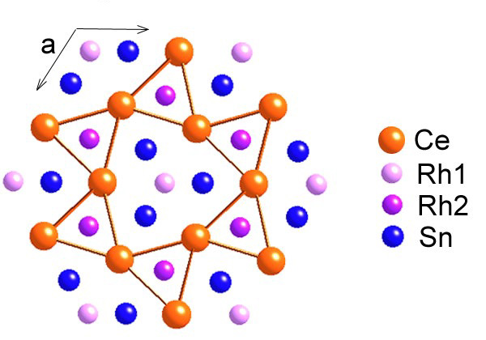
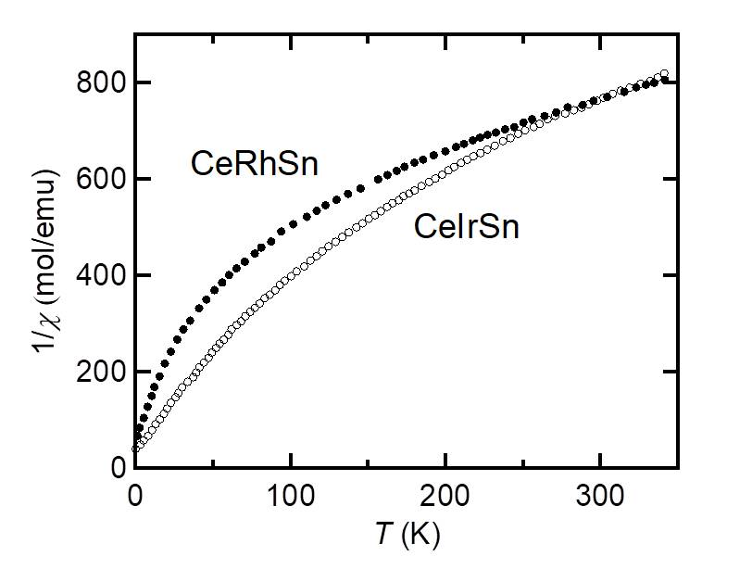
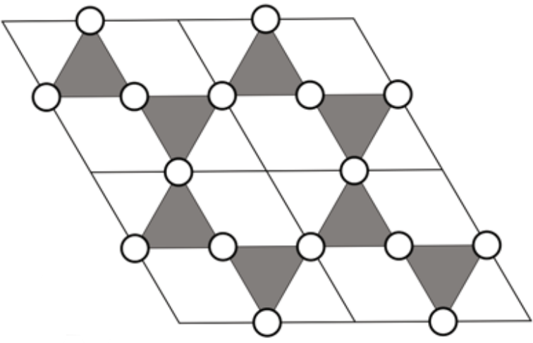
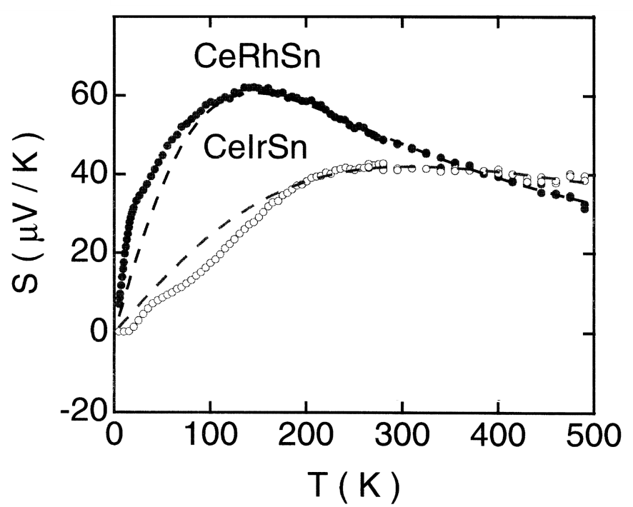
CeRhSn and CeIrSn in the valence fluctuation regime
Undistorted kagome lattice for comparison
Inverse χ(T) for polycrystals
Rh
Ir
B. Chevalier et al.,
Solid State Sci. 8,
1000 (2006).
 | a (Å) | c (Å) | − Θ_{P}(K) T_{K}(K)
CeRhSn | 7.443 | 4.089 | ~400 240
CeIrSn | 7.438 | 4.076 | ~300 480
CePdAl | 7.217 | 4.231 | T_{N}=2.7 6
Thermopower of polycrystals
Rh
T_{Sm}
T_{K}(K) = 1.6T_{Sm}
High T_{K} ⇒ No magnetic order occurs.
For CeRhSn polycrystal, NFL behaviors in χ(T) and C/T ∝ T ^{-n} (n~0.5) for 1.5 < T < 5 K.
A. Ślebarski et al., Phil. Mag. 82, 943 (2002).
Ir
Y. Bando, TT. et al.,
JALCOM. 313,
1 (2000).
Notes:
We have focused on CeRhSn and CeIrSn possessing a similar quasi-kagome lattice as in CePdAl. The inverse magnetic susceptibility has a large and negative paramagnetic Curie temperature, approximately -300 to -400 K. The thermopower has a broad maximum. These two properties are characteristics of Ce compounds in the valence fluctuating regime. If we estimate the Kondo temperature T_{K} as 1.6 times of the maximum temperature, then T_{K} of 480 K for CeIrSn is twice higher than that for CeRhSn. Because of the high TK, no magnetic order occurs. For CeRhSn polycrystal, NFL behaviors in chai and specific heat were first reported by Slebarski.

Slide 9
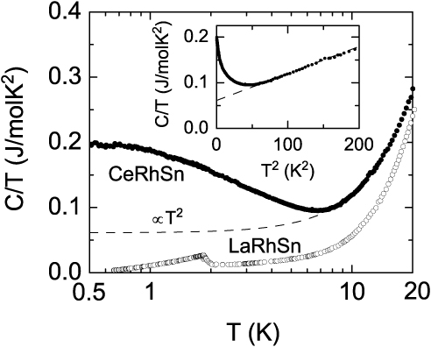
Quantum criticality in Quasi-Kagome CeRhSn
Non Fermi liquid behaviors in CeRhSn,
M. S. Kim et al. 2003 Phys. Rev. B 68 054416
Magnetic susceptibility
Electrical resistivity
Specific heat
C/T ∝−ln T and shows saturation below 0.7 K
not consistent with the
NFL behaviors in ρ and χ
.
χ(T) shows a power-law
behavior T ^{–n} (n =1.1, B // c).
ρ(T) decreases with T ^{n}(n ≤ 1.5)
Notes:
CeRhSn single crystal exhibits strongly anisotropic resistivity and magnetic susceptibility. The resistivity is lager along the a axis, and exhibits a broad maximum at 70 K. At low temperatures, the power of T is 1.5 and 1.0.
The susceptibility exhibits an Ising behavior along the c axis and diverges like this. However, the specific heat divided by T becomes constant on cooling to 0.5K, not consistent with the NFL behaviors in rho and chai.

Slide 10
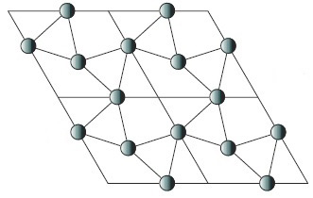
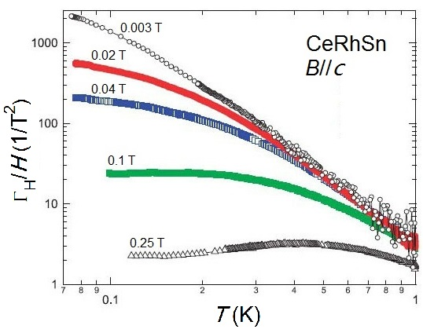
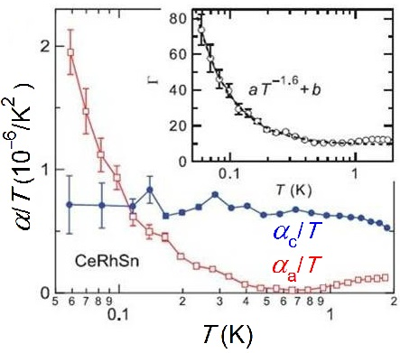
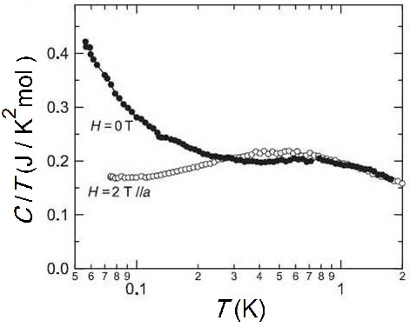
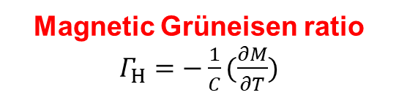
Zero-field quantum criticality in CeRhSn
Y. Tokiwa et al. 2015 Sci. Adv. 1 e1500001
c
Quasi-kagome plane
Ce
a
Magnetic Grüneisen ratio
$Γ_{H}=−\frac{1}{C}(\frac{∂M}{∂T})$
Uniaxial thermal expansion
coefficient α_{a}/T diverges
C/T diverges, T 0
C/T : under 2 T, below 0.5 K,
NFL to FL.
Г_{H} : diverges below 1 K,
saturation under B // c = 0.25 T
quantum criticality driven by
geometrical frustration in the
c-plane
A zero-field QCP
A zero-field QCP
Notes:
The black dotted line indicates a power-law divergence) and Γ_{H} provide evidence for a zero-field QCP.
The anisotropy of linear thermal expansion coefficient: which only displays quantum critical behavior along the a axis and not along the c axis → geometrical frustration drives quantum criticality in this system

Slide 11
Structural and Physical properties of CeRh_{1-x}Pd_{x}Sn

Slide 12
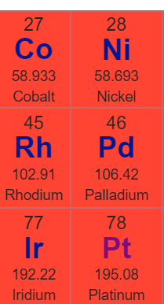
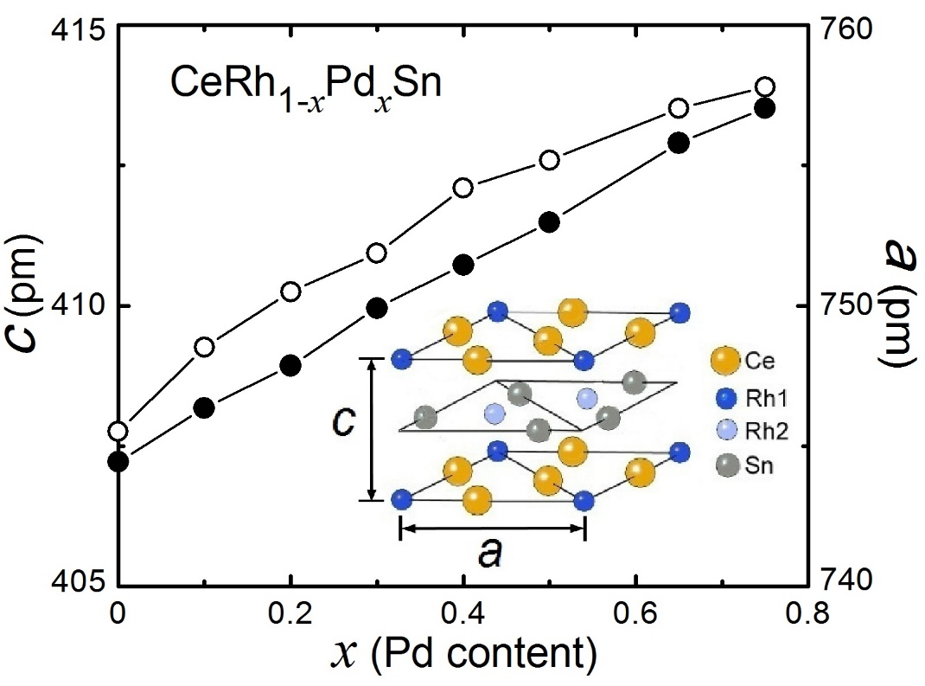
Structural property of CeRh_{1-x}Pd_{x}Sn
The results of EPMA are consistent with the nominal composition for x ≤ 0.5.
With increasing x, the quantity of impurity phase Ce(Rh_{1-X}Pd_{X})₂Sn₂ increased.
The real compositions of x in CeRh_{1-x}Pd_{x}Sn phase were 0.65 and 0.75 for
X = 0.7 and 0.8, respectively.
The structure switches to the orthorhombic TiNiSi-type for x > 0.8.
Electron doping effect
Doping with Rh for Pd
4d-electron number
c axis parameter
c-f hybridization
Kondo screening
AFM order would be induced

Slide 13
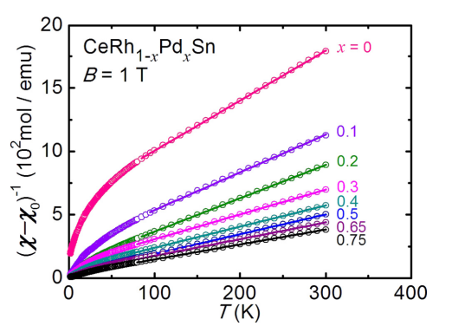
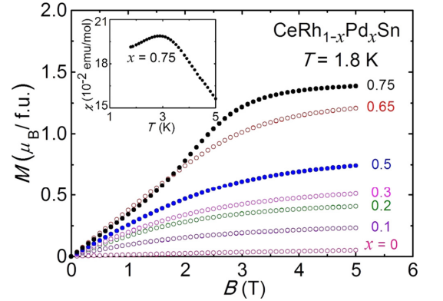
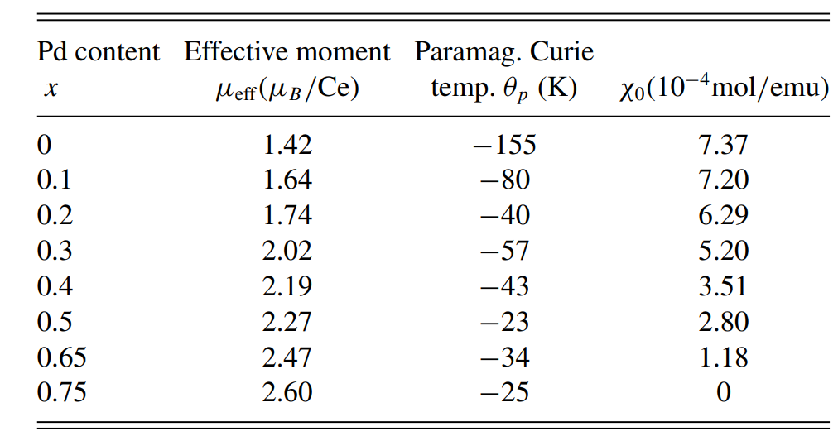
Magnetic susceptibility χ(T) of CeRh_{1-x}Pd_{x}Sn
C. L. Yang et al, Phys. Rev. B 96, 045139 (2017)
Notes:
TABLE I. Parameters obtained by the fits with the modified Curie-Weiss form χ = C/(T − θp) + χ0 to the averaged magnetic susceptibility data {χ(B ) + 2χ(B⊥)}/3 at T > 100 K, where χ(B ) and χ(B⊥) were measured, respectively, in external fields of 1 T applied parallel and perpendicular to the samples of CeRh1−xPdxSn preferentially oriented along the c axis. μeff, θp, and χ0 are the effective magnetic moment, paramagnetic Curie temperature, and temperature independent term, respectively

Slide 14
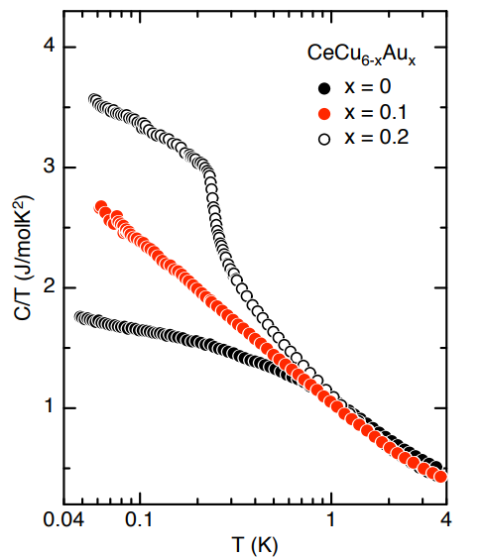
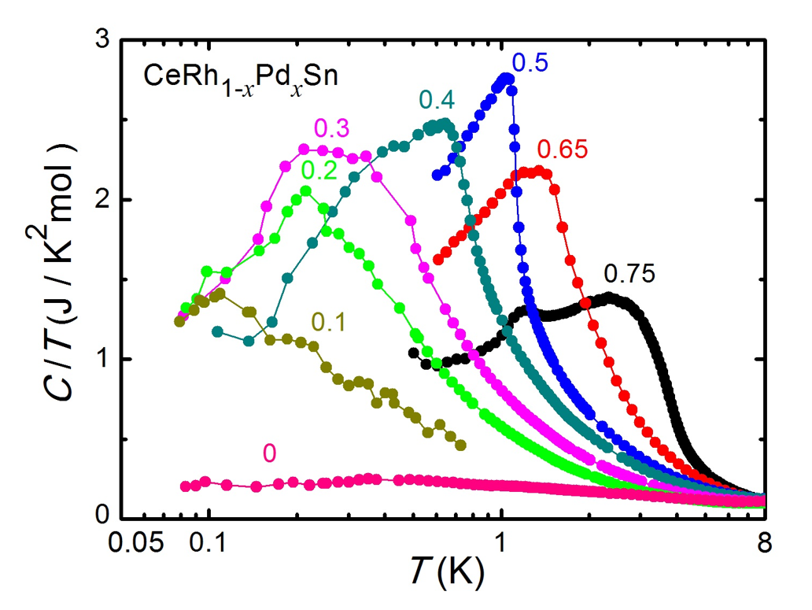
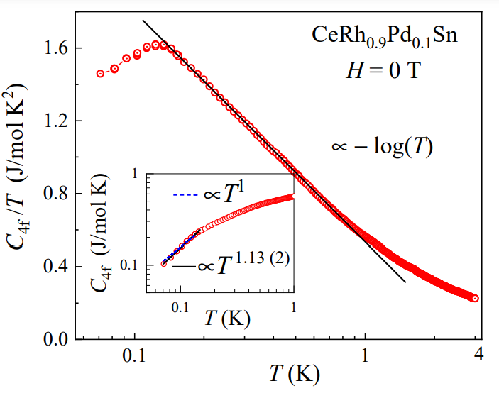
Heaty capacity of CeRh_{1-x}Pd_{x}Sn
Polycrystalline
Single crystal
A. Schröder, H. v. Löhneysen
x = xc = 0.1: C/T ∝ -ln T;
Δρ ∝ T (NFL)
X > Xc=0.1 I AFM
C. L. Yang et al, Phys. Rev. B 96, 045139 (2017)
R. Tripathi et al, Phys. Rev. B 106, 064436 (2022)
A linear increase in magnetic specific heat is expected at low temperatures in a gapless QSL
Notes:
We can therefore anticipate that the broad peak in the specific heat arises from short-range magnetic correlations, reflecting the fact that the system is close to a magnetic QCP. On the other hand, in a gapless QSL, a linear increase in magnetic specific heat is expected at low temperatures [45]

Slide 15
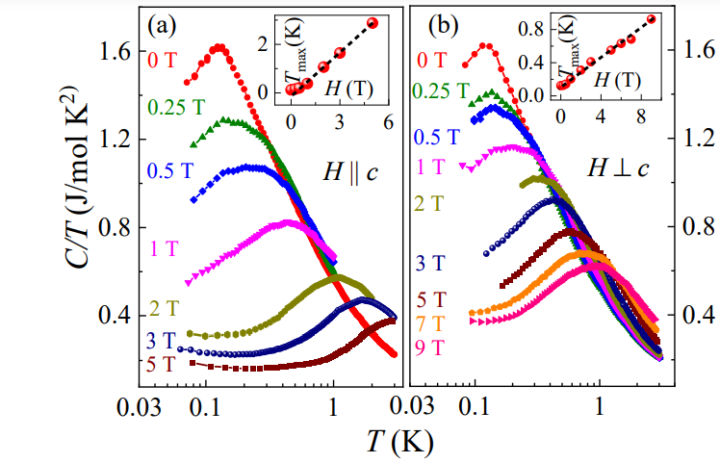
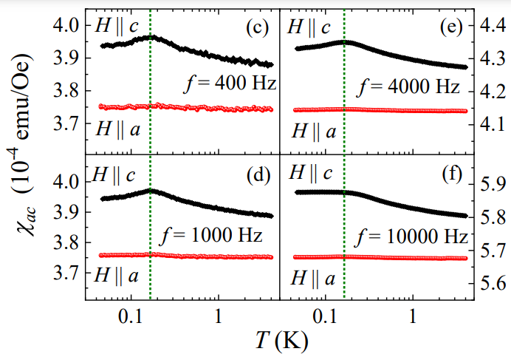
Heaty capacity and χ_{ac}(T) of CeRh_{0.9}Pd_{0.1}Sn
Single crystal x=0.1
Single crystal x=0.1
Frequency independent peak for H// c
This confirms that the x=0.1 single crystal does not have a spin-glass transition.
R. Tripathi et al, Phys. Rev. B B 106, 064436 (2022)
Notes:
Tmax increases linearly with increasing the field parallel and perpendicular to the c-axis.
This suggests Zeeman splitting of the Ce ground state doublet, where at zero field, the splitting could arise from the fluctuating internal field due to short-range order.

Slide 16

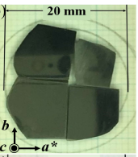
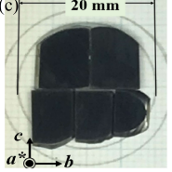
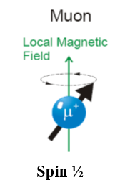
Muon spin rotation and relaxation (μSR) study on CeRh_{0.9}Pd_{0.1}Sn single crystals
μ || c-axis
μ ⊥ c-axis
Single crystals CeRh_{1-x}Pd_{x}Sn (x = 0.1) were grown by the Czochralski method in an RF induction furnace with an argon gas atmosphere.
R. Tripathi et al, Phys. Rev. B 106, 064436 (2022)
Notes:
magnetic moment 3.2 x proton
Decay into positron, τ ~ 2.2 μs

Slide 17
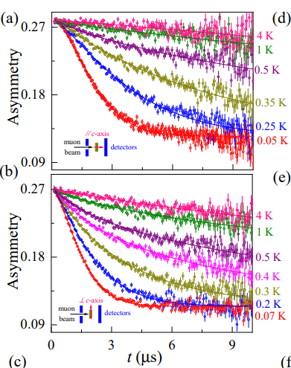
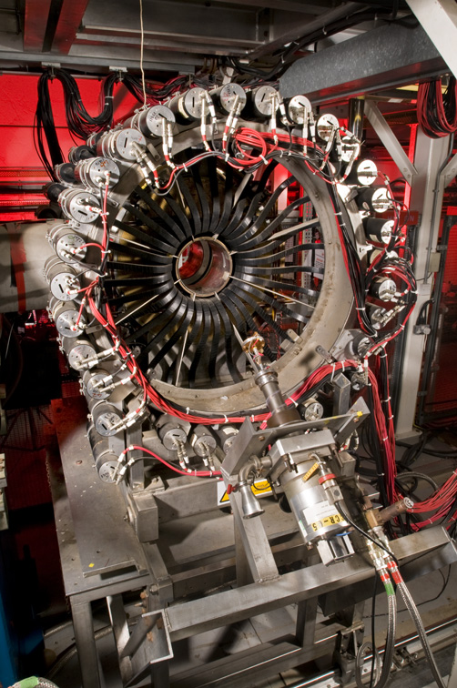
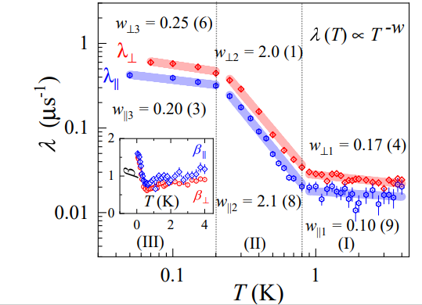
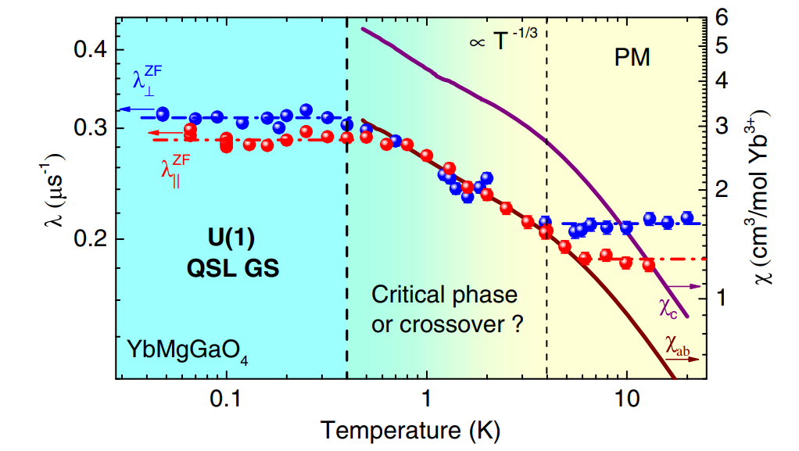
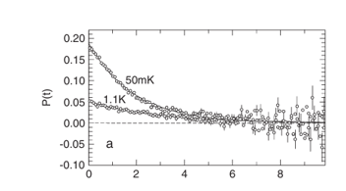

ZF-μSR study on CeRh_{0.9}Pd_{0.1}Sn single crystals
MuSR@ISIS
Y. Li et al, PRL 117, 097201 (2016)
// c
CeRhSn ZF, A. SCHENCK et al (2004)
⊥ c
2D frustrated QSL, λ can be described by a power-law, λ(T) ∝ T^{−w}
t (µs)
R. Tripathi et al, Phys. Rev. B 106, 064436 (2022)
Notes:
Abg=0.117
Region I- λ hardly dependent on temperature → the system is close to its paramagnetic limit.
Region II- Crossover- λ increases steeply with the decrease of temperature→ evidence for a slowing down of the spin dynamics, likely resulting from the building up of short-range correlations.
Region III- λ(T) levels off →slow changes with temperature without a critical slowing down of the electronic spin fluctuations.
This constant low-temperature behavior of λ is an universal characteristic of several SL candidates.

Slide 18
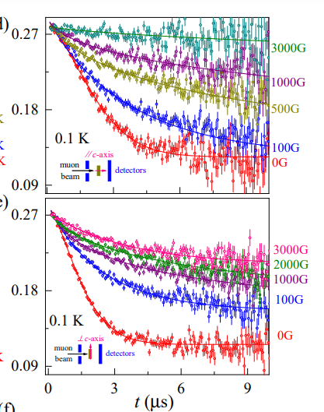
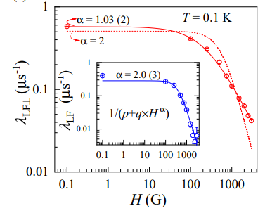


LF-μSR study on CeRh_{0.9}Pd_{0.1}Sn single crystals
Analysis of field dependent λ
Redfield equation
// C
Asymmetry
⊥ C
τ is spin auto-corelation time
Fluctuation rate υ = 1/τ
T = 0.1 K τ = 30 ns
υ = 33. MHz
Power-law behaviour for λ_{LF⊥}
Notes:
The LF-µSR results suggest that the out of kagome plane spin fluctuations are responsible for the SL behavior.
For S = 1/2 V-based Kagome SL T=0.02 K
υ = 470 MHz
J. C. Orain et al
JPCM:cs551 012004 (2014)

Slide 19
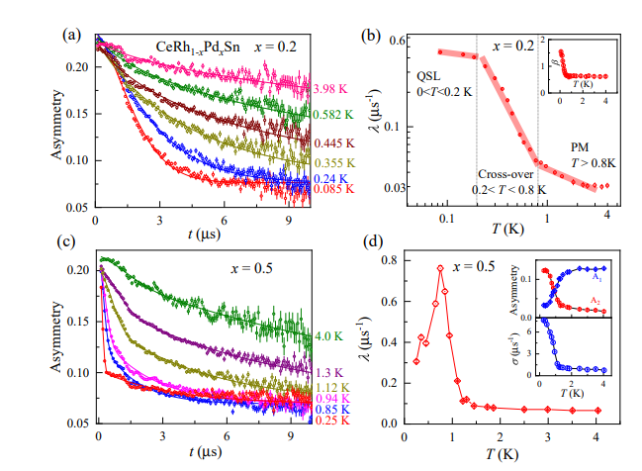
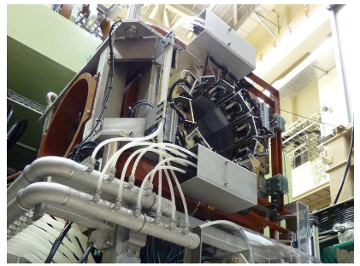

ZF-μSR study on CeRh_{1-x}Pd_{x}Sn x=0.2 & 0.5 polycrystals
D1 spectrometer
SL behaviour is observed in x=0.2
While long range magnetic ordering is observed in x=0.5

Slide 20
Inelastic Neutron Scattering Investigations on CeRh_{1-x}Pd_{X}Sn
Low energy measurements were carried on IN6 at ILL
High energy measurements were carried out on MERLIN at ISIS Facility

Slide 21
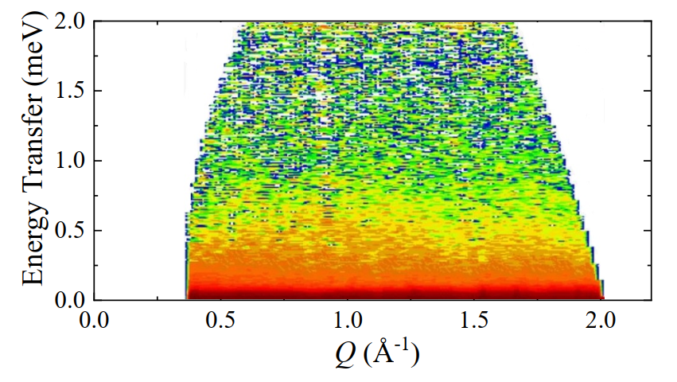
Low energy INS study on Ce(Rh_{1-x}Pd_{x})Sn (x = 0.1)
Continuous gapless excitations →U(1) SL
The low energy inelastic neutron measurements on the powder sample of CeRh_{0.9}Pd_{0.1}Sn do reveal the presence of gapless magnetic excitations, as found in U(1) SL. The low energy INS measurement on the large single crystals are highly essential to further shed light on the nature of the SL ground state for x = 0.1.
R. Tripathi et al, Phys. Rev. B B 106, 064436 (2022)

Slide 22
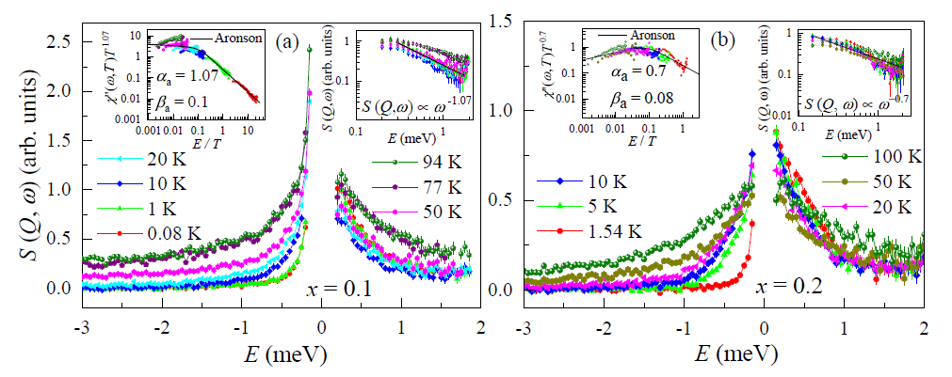
Low energy INS study on CeRh_{1-x}Pd_{X}Sn
IN6 at ILL
X=0.1
X=0.2
A very similar scaling behaviour has also been observed in other non Fermi liquid systems such as
UCu_{5-x}Pd_{x} (α=0.33), CeRh_{0.8}Pd_{0.2}Sb (α=0.77), Ce_{0.7}Th_{0.3}RhSb (α=0.33) and CePd_{0.15}Rh_{0.85} (α=0.6), CeCu_{6-x}Au_{x} (α=0.75) by M. C. Aronson et al., (1995), J.-G. Park et al., (2002), J. So et al., (2002), D. T. Adroja et al., (2007), A. Schröder et al., (1998), respectively.

Slide 23


Neutron diffraction study on CeRh_{0.25}Pd_{0.75}Sn
D20 at ILL and GEM at ISIS Facility
V. Fritsch et al (2016)
CePdAl
T=1.5 K/2 K
There exist three allowed irreducible representations (IREPS),
Γ₁¹ , Γ₂¹ , Γ₃², having respectively 1, 2 and 6 basis vectors (BV)
1.5 K/2K data fit better with Γ₂¹
μ_{ord}= 1.22 (1) µ_{B}/Ce-atom
T= 0.5 K
Two magnetic phases refinment
K₁= (0 0 0.4) 76% and K₂= (0 0 0.5) 24%
Symmetry analysis of K₂ gives five IREPS:
Γ₁¹ + Γ₂¹ + Γ₃²+ Γ₄²+ Γ₅^{2,}
with respectively 1, 1, 1, 4, and 2 BVs. Γ₂¹ give the best fit
μ_{ord}= 1.37 (1) µ_{B}/Ce-atom with assumption the same moment value of Ce in both bases.
K₁= (0 0 0.4)
K₁= (0 0 0.4)
K₁= (0 0 0.4)
K₁= (0 0 0.4)
K₂= (0 0 0.5)
K₂= (0 0 0.5)

Slide 24



Neutron diffraction study on CeRh_{0.5}Pd_{0.5}Sn
0.06 K
0.45 K
0.85 K
1.3 K
CeRh_{0.5}Pd_{0.5}Sn
Diff=0.06 K -1.3 K

Slide 25
Conclusions
The ZF-µSR relaxation rate suggests the presence of dynamic spin fluctuations persisting even at T = 0.05 K without static magnetic order in the single crystal sample with x = 0.1.
The ground state of x = 0.1 (namely, a constant λ and a linear T-dependence in C4f) can be attributed to a metallic spin-liquid near the quantum critical point (QCP) in the frustrated Kondo lattice
The LF-µSR results of the single crystal samples of x = 0.1 with the muon beam along and perpendicular to the c-axis suggest that the out of kagome plane spin fluctuations are responsible for the SL behaviour
Low energy INS study in x = 0.1 and 0.2 indicates gapless excitations, a typical behaviour observed for the NFL systems near QCP where the neutron dynamical susceptibility exhibits E/T scaling
ND reveals incommensurate longitudinal spin density wave ground state with Ce moment along the
c-axis below 4 K in x = 0.75 sample and no presence of magnetic frustration.
In x=0.5 we have observed the magnetic diffuse scattering at 0.06 K.
Notes:
Our high energy INS shows a very weak and broad scattering in x = 0 and 0.1, which transforms into well-localized CEF excitations with increasing x.

Slide 26





Thank you very much for your attention

Slide 27






High energy INS study on CeRh_{1-x}Pd_{X}Sn
MERLIN at ISIS
CeRh_{1-x}Pd_{X}Sn
CEF analysis
CeRh_{1-x}Pd_{X}Sn x=0.5
Ce point symmetry is C_{2v}
The solid black lines show the fit to the
Lorentzian functions.
B₂⁰ = – 1.01, B₂² = 0.244, B₄⁰ = – 0.017,
B₄² = – 0.222 and B₄₄ = 0.159 (meV)

Slide 28

Muon site from dipolar dipolar coupling
A. SCHENCK et al,
Journal of the Physical Society of Japan
73, 3099 (2004)
(1/3, 2/3 0)

Slide 29





Slide 30



c-axis contraction in CeTSn by c-f hybridization
Ce
Rh/Ir2-Sn
M.S. Kim , PhD Thesis,
(2003) Hiroshima Univ.
Data of RERhSn, R. Mishra et al.,
Z. Naturforsch. 56b, 589 (2001).
Notes:
You see here that the lattice parameters of CeRhSn and CeIrSn are smaller than that expected from the series of trivalent rare-earth compounds. The remarkable shrinkage along the c axis indicates strong hybridization of the Ce 4f sate with the 4d electrons of Rh2 or 5d electrons of Ir2 in the neighboring layers, not in the same layer.

Slide 31

Rutherford Appleton Laboratory
Harwell Science and Innovation Campus
Harwell Science & Innovation Campus
Diamond
X-Rays
Diamond –X Rays
ISIS
TS2
Neutrons
TS1
Neutrons
Muons
ISIS – Neutrons and Muons
Notes:
Total 28 instruments on TS-1
Total 13 instruments on TS-2

Slide 32




Quantitative investigation of the Kondo interaction in CeRh_{1-x}Pd_{x}Sn
Martin Sundermann and Andrea Severing
The experimental data have been compared to simulations of the spectra using calculations including full multiplet (fm) and configuration interaction (CI) using theXTLS9.0 code by A Tanaka
For the CI part we use the simplified model by Imer et al. where the valence states are represented by only one ligand stat.
O. Niehaus et al Z. Natur forschung B 70, 253264 (2015)
Notes:
FIG.3. (Coloronline)(a)Ce3dcore-levelHAXPESdataof CeRh1 xPdxSnwithx=0,0.1,0.3,0.5,0.75. atT=60Kaf ternormalizationtotheintegratedintensitybeforesubtract inganintegratedbackground(BG)(dashedblackline),plas mons(solidblackline),andtheSn3semissionintensity(cyan line).BGandplasmonsarespecimenofthe30%Pdanalysis. (b)Ce3demission linesafter subtractionofBG, plasmons, andSn3s.Theredrulerindexesthecontributing4fcon gu rations,f0,f1,andf2. Insets: enlargedregionsoff0andf2 emission. (c)Resultsof the fmCI simulations for theCe3d emissionusingtheCIparametersaslistedinTableI.

Slide 33


Slide 34





Slide 35


Slide 36


λ_{LF⊥}(μs⁻¹)

Slide 37



CeRhSn single crystal: Anisotropic ρ(T) and χ(T)
Mo-Sung. Kim , TT. et al., PRB 68, 054416, (2003).
Resistivity ρ(T)
Susceptibility χ(T)
Specific heat C/T
T ^{−1.1}
T ^{−0.35}
10倍
ρ_{a}(T)/ρ_{c}(T) ≈ 3~5
χ_{c} / χ_{a} ≈ 10 at T < 2 K
C/T ⇒ constant as T ⇒ 0.5 K.
not consistent with the
NFL behaviors in ρ and χ
ρ_{a}(T): maximum at 70 K
χ ∝ T ^{−n}
n = 0.35 (B ӀӀ a),
1.1 (B ӀӀ c)
ρ ∝ T ^{n}, n = 1.5 (ӀӀ a),
1.0 (ӀӀ c)
Notes:
CeRhSn single crystal exhibits strongly anisotropic resistivity and magnetic susceptibility. The resistivity is lager along the a axis, and exhibits a broad maximum at 70 K. At low temperatures, the power of T is 1.5 and 1.0.
The susceptibility exhibits an Ising behavior along the c axis and diverges like this. However, the specific heat divided by T becomes constant on cooling to 0.5K, not consistent with the NFL behaviors in rho and chai.

Slide 38

Introduction: Experimental identification of QSLs
a
b
c
d
J. Wein et al, npj Quantum Materials volume 4, Article number: 12 (2019)
Notes:
In addition to 1D system with competing NN and NNN interactions

Slide 39



Magnetic frustration in metallic systems
Two-dimensional spin lattice
P. Coleman et al. J. Low Temp. Phys. 161 182 (2010)
Triangular lattice
Kagome lattice
Shastry-Sutherland lattice
J'
J'
J
J₂
Three spins can not be all anti-parallel
When J₁ / J₂ is large enough, AFM order is destroyed
Three-dimensional pyrochlore lattice
L. Balents, Nature (London) 464, 199 (2010).
Competing magnetic interactions among localized moments can not be simultaneously satisfied.
Magnetic frustration with
spin fluctuations
FM interaction is frustrated due to
different Ising axes of spins
Notes:
Magnetic frustration in metallic systems has been less studied compared with insulating systems. The frustration has a geometrical origin. Well known systems are the triangular lattice, Kagome lattice, Shastry Sutherland lattice, and pyrochlore lattice. In a kagome lattice, for example, the nearest neighbor AFM interaction J1 competes with the next nearest neighbor FM coupling J2. When the ratio J1 over J2 is large enough, the AFM order is destroyed.
In these lattices, competing magnetic interactions among localized moments can’t be simultaneously satisfied. So it leads to magnetic frustration with spin fluctuations.

