Slide 1
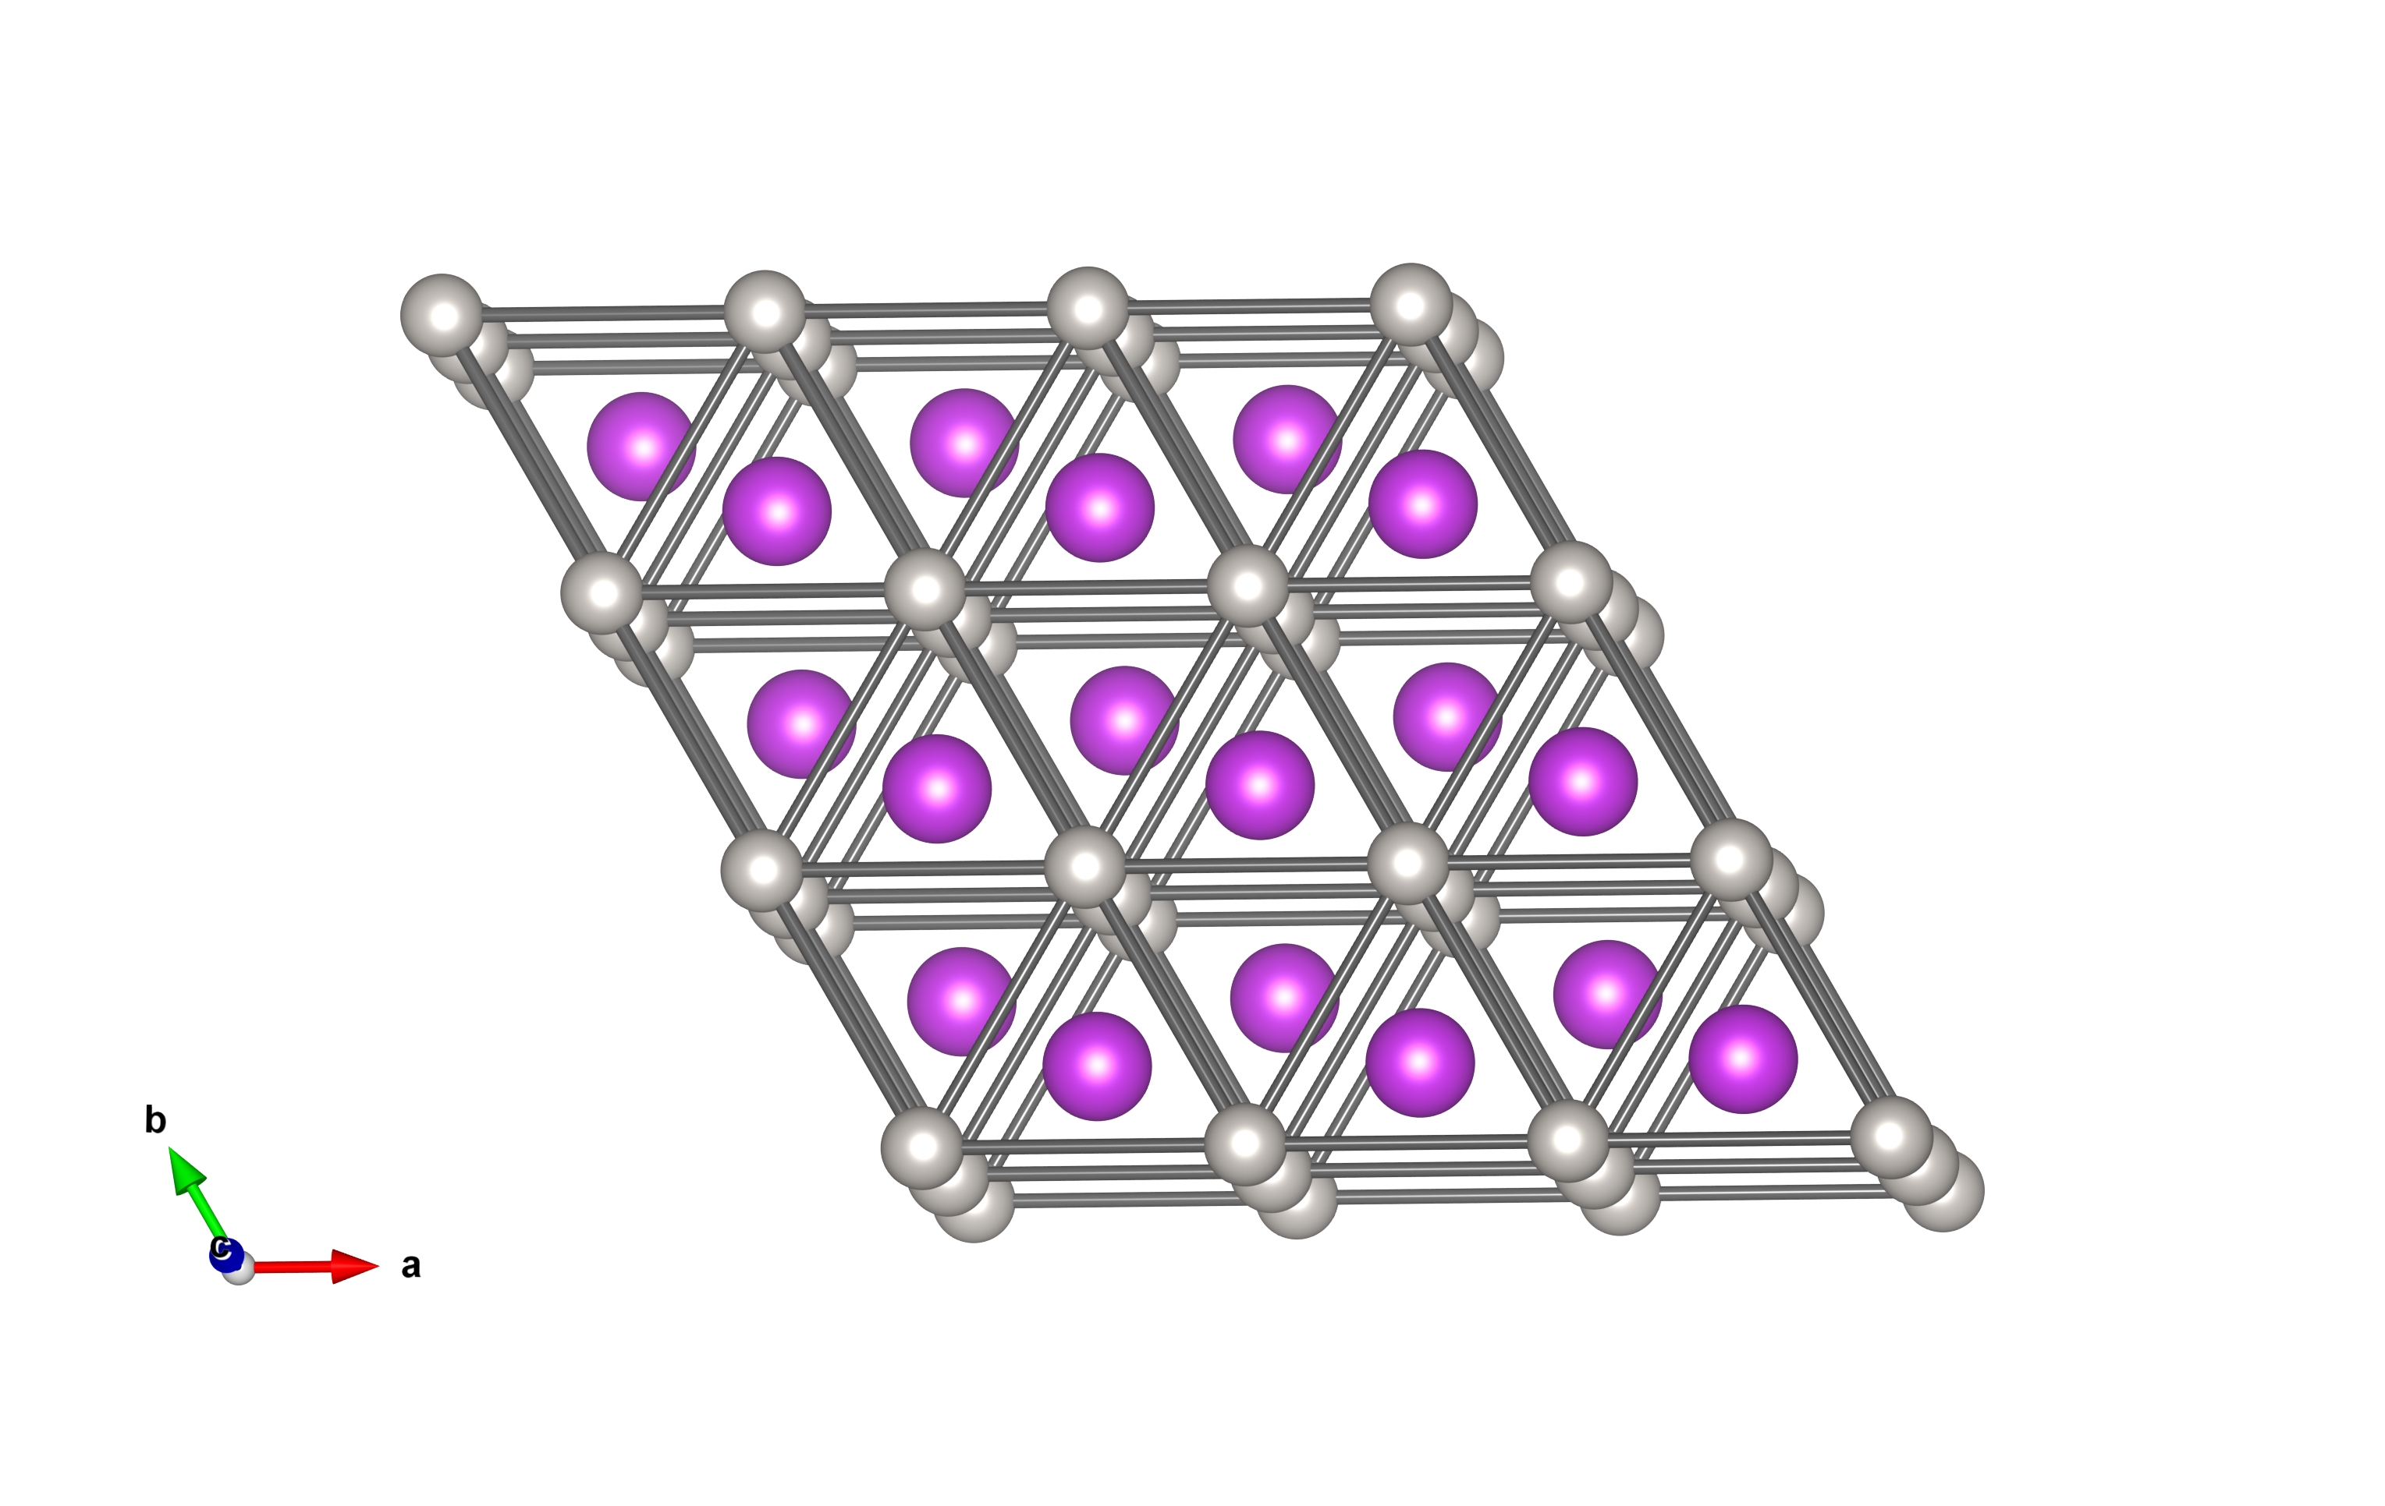
Searching for Broken Symmetries in Superconductors with Muons
Graeme Luke
Dept. of Physics & Astronomy
McMaster University

Slide 2
Quantum Materials
Materials whose essential properties go beyond semi-classical particles.
Collective properties governed by fully quantum behaviour
Strong electronic correlations, often resulting in some kind of order such as magnetic, superconducting, topological…
Fundamental degrees of freedom: charge, spin, orbit and lattice become intertwined.
Emergence of novel excitations/quasiparticles/behaviour.

Slide 3
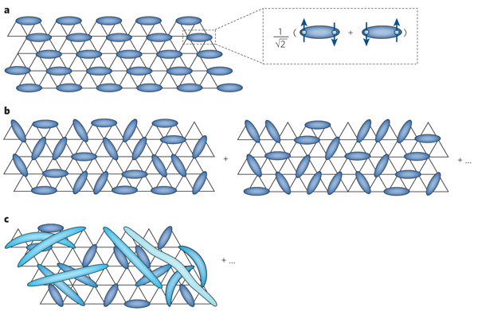
Quantum Spin Systems
Role of quantum fluctuations in Quantum spin systems (eg. spin 1/2).
Neel state not an eigenstate of Heisenberg Hamiltonian.
increasingly bad for low-d, low spin.
Quantum spin liquid: originally suggested by Anderson for 2-D spin 1/2 -RVB.
Spin liquid, Quantum spin liquid states
Emergent excitations include monopoles, spinons, holons.
Balents, Nature 464, 199 (2010).

Slide 4
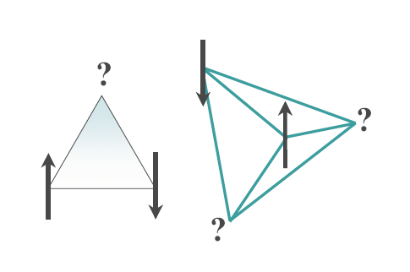
Geometrical Frustration
No periodic arrangements of moments which can simultaneously minimize energy.
Can have large number of classically degenerate ground states.
Leads to competing low temperature phases and enhanced quantum mechanical spin dynamics.
Possible emergent phenomena, quasiparticles.

Slide 5
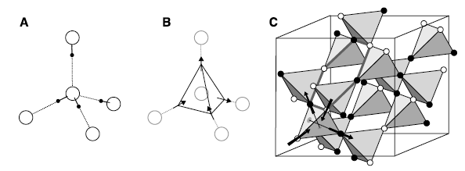
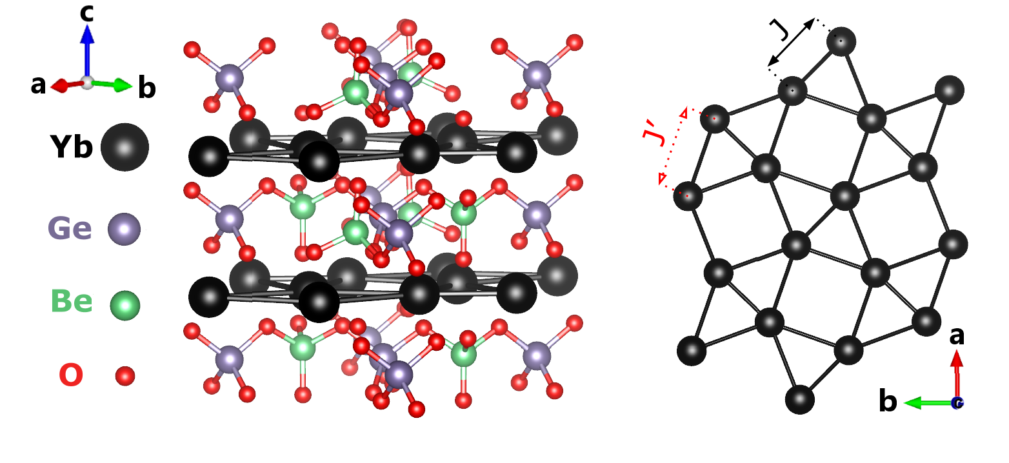
Lattices Promoting Geometrical Frustration
Stacked Triangular
Pyrochlore
Kagome
Shastry-Sutherland J1-J2

Slide 6
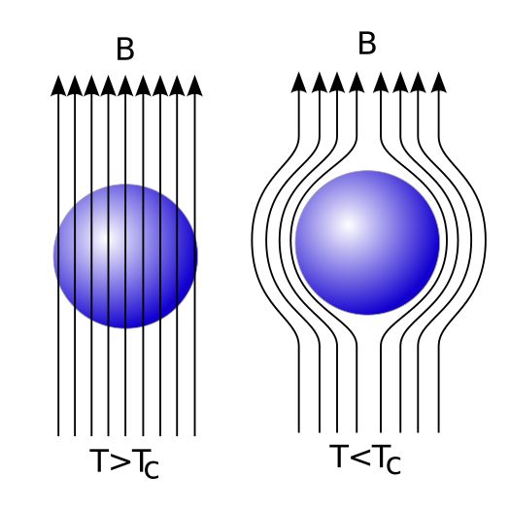
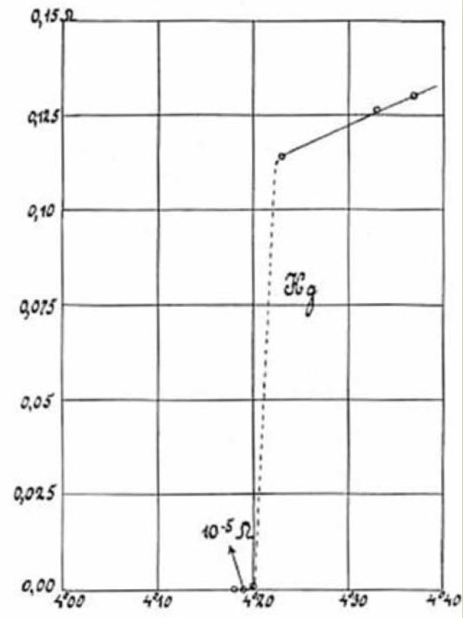
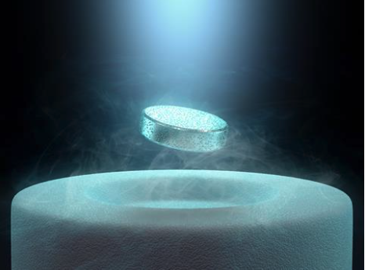
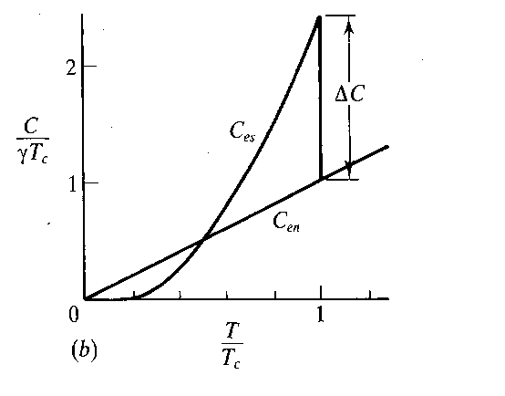
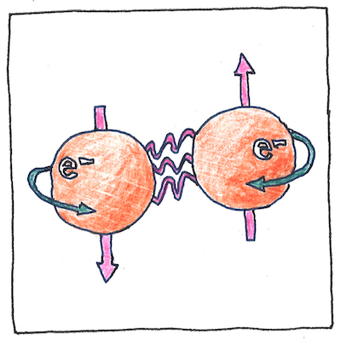
Superconductivity

Slide 7
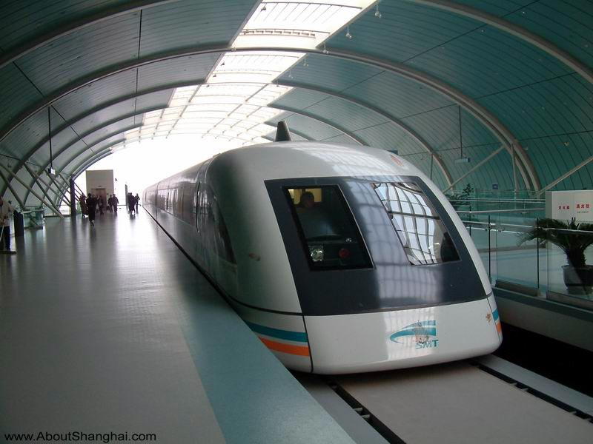
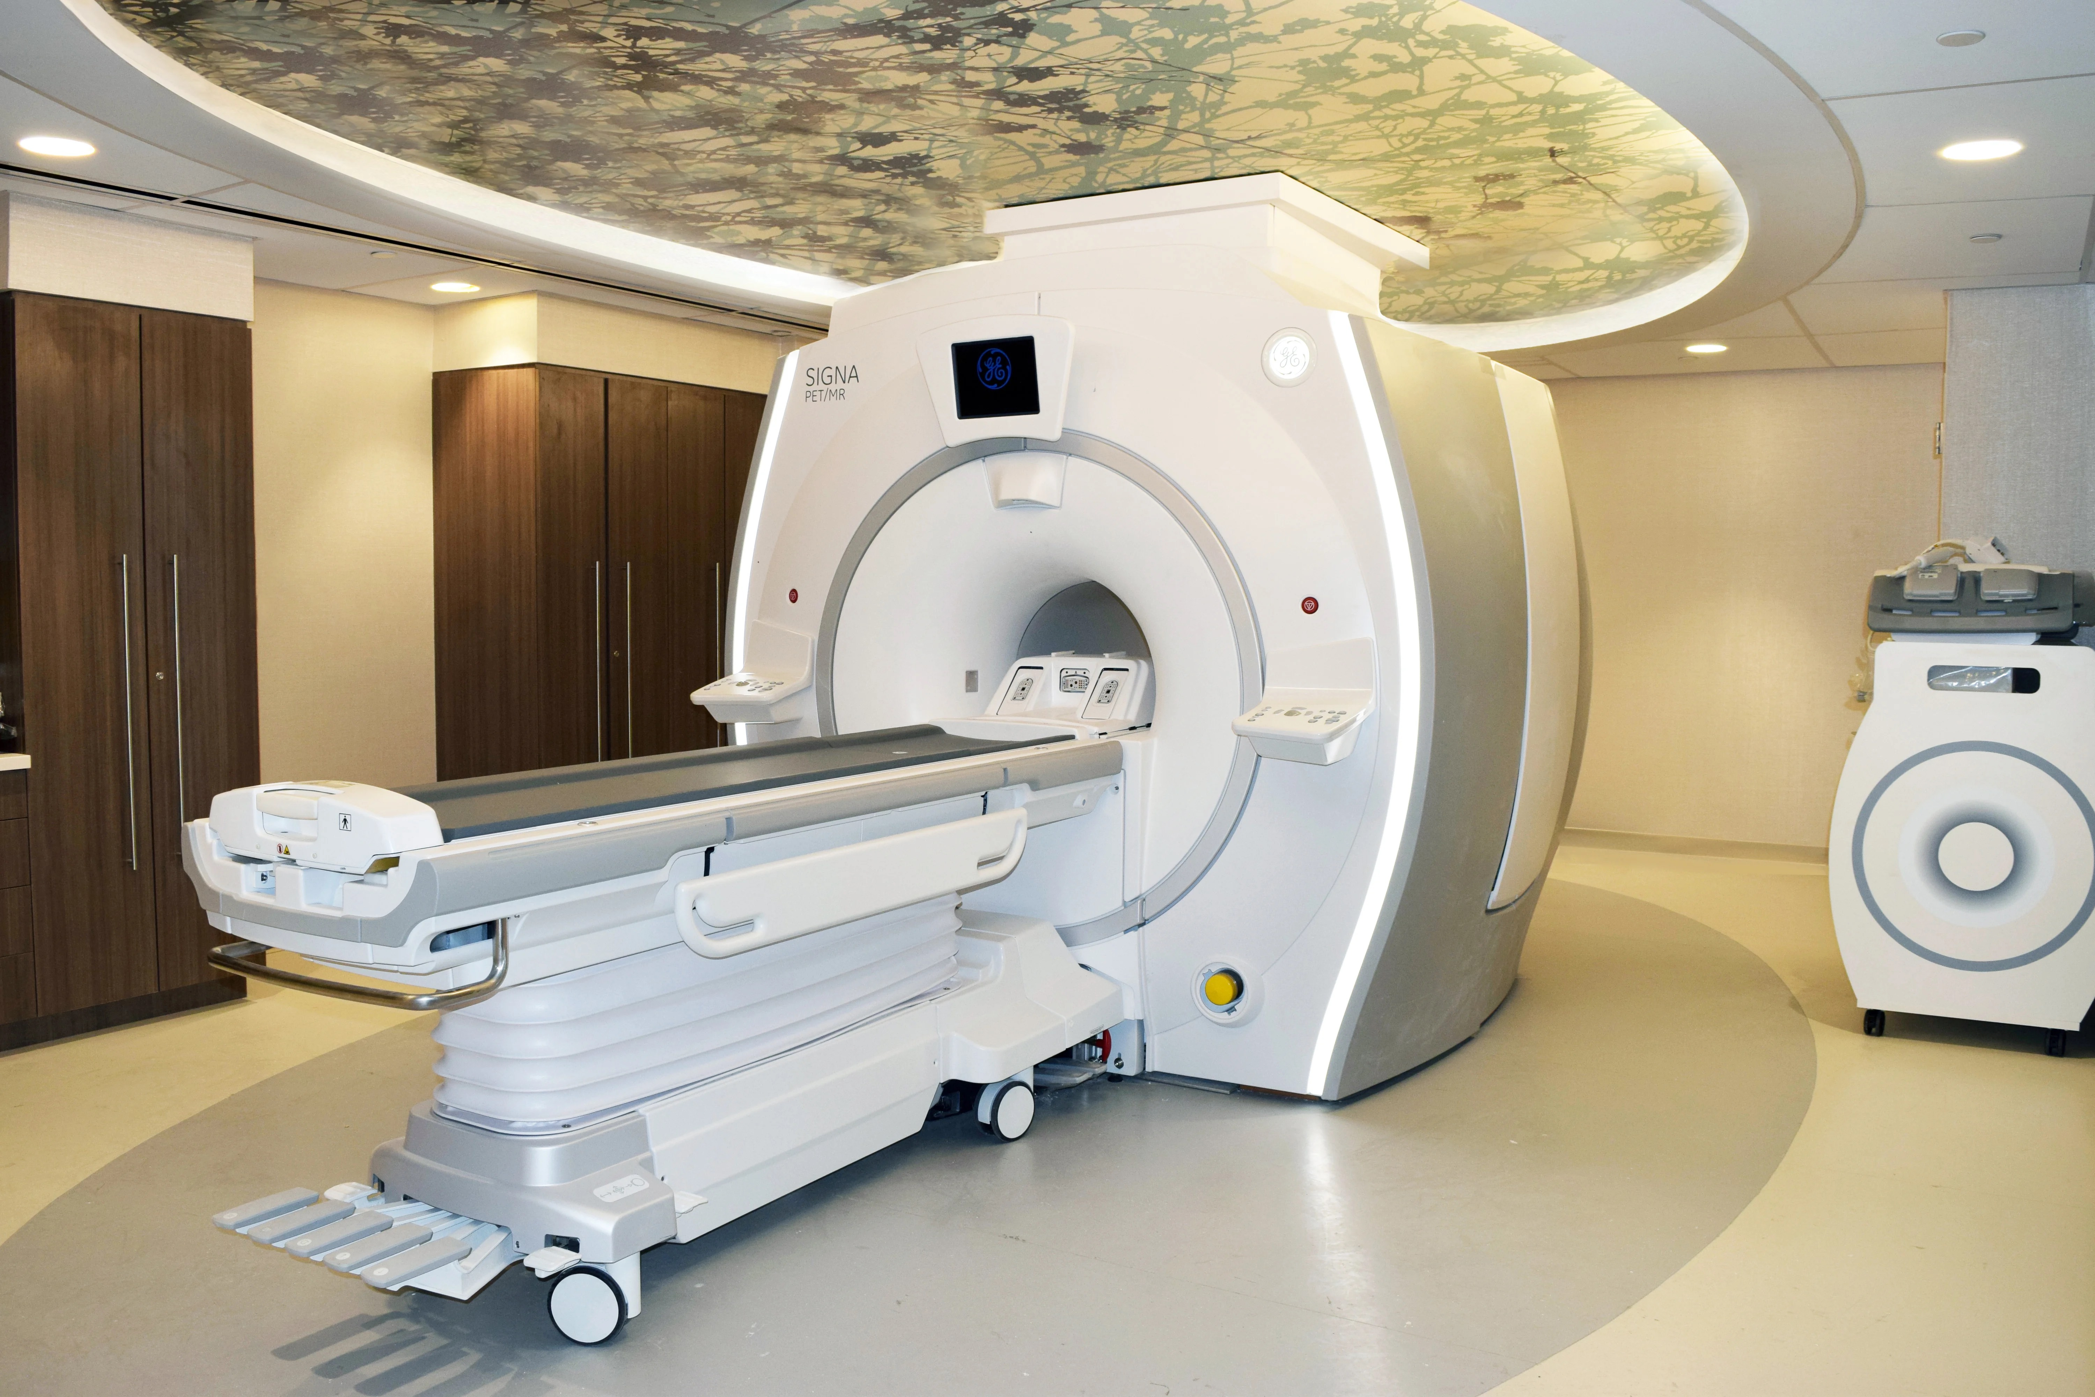
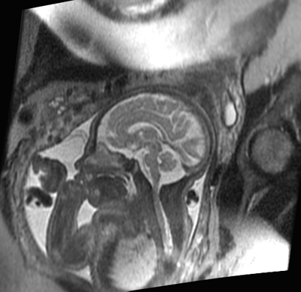
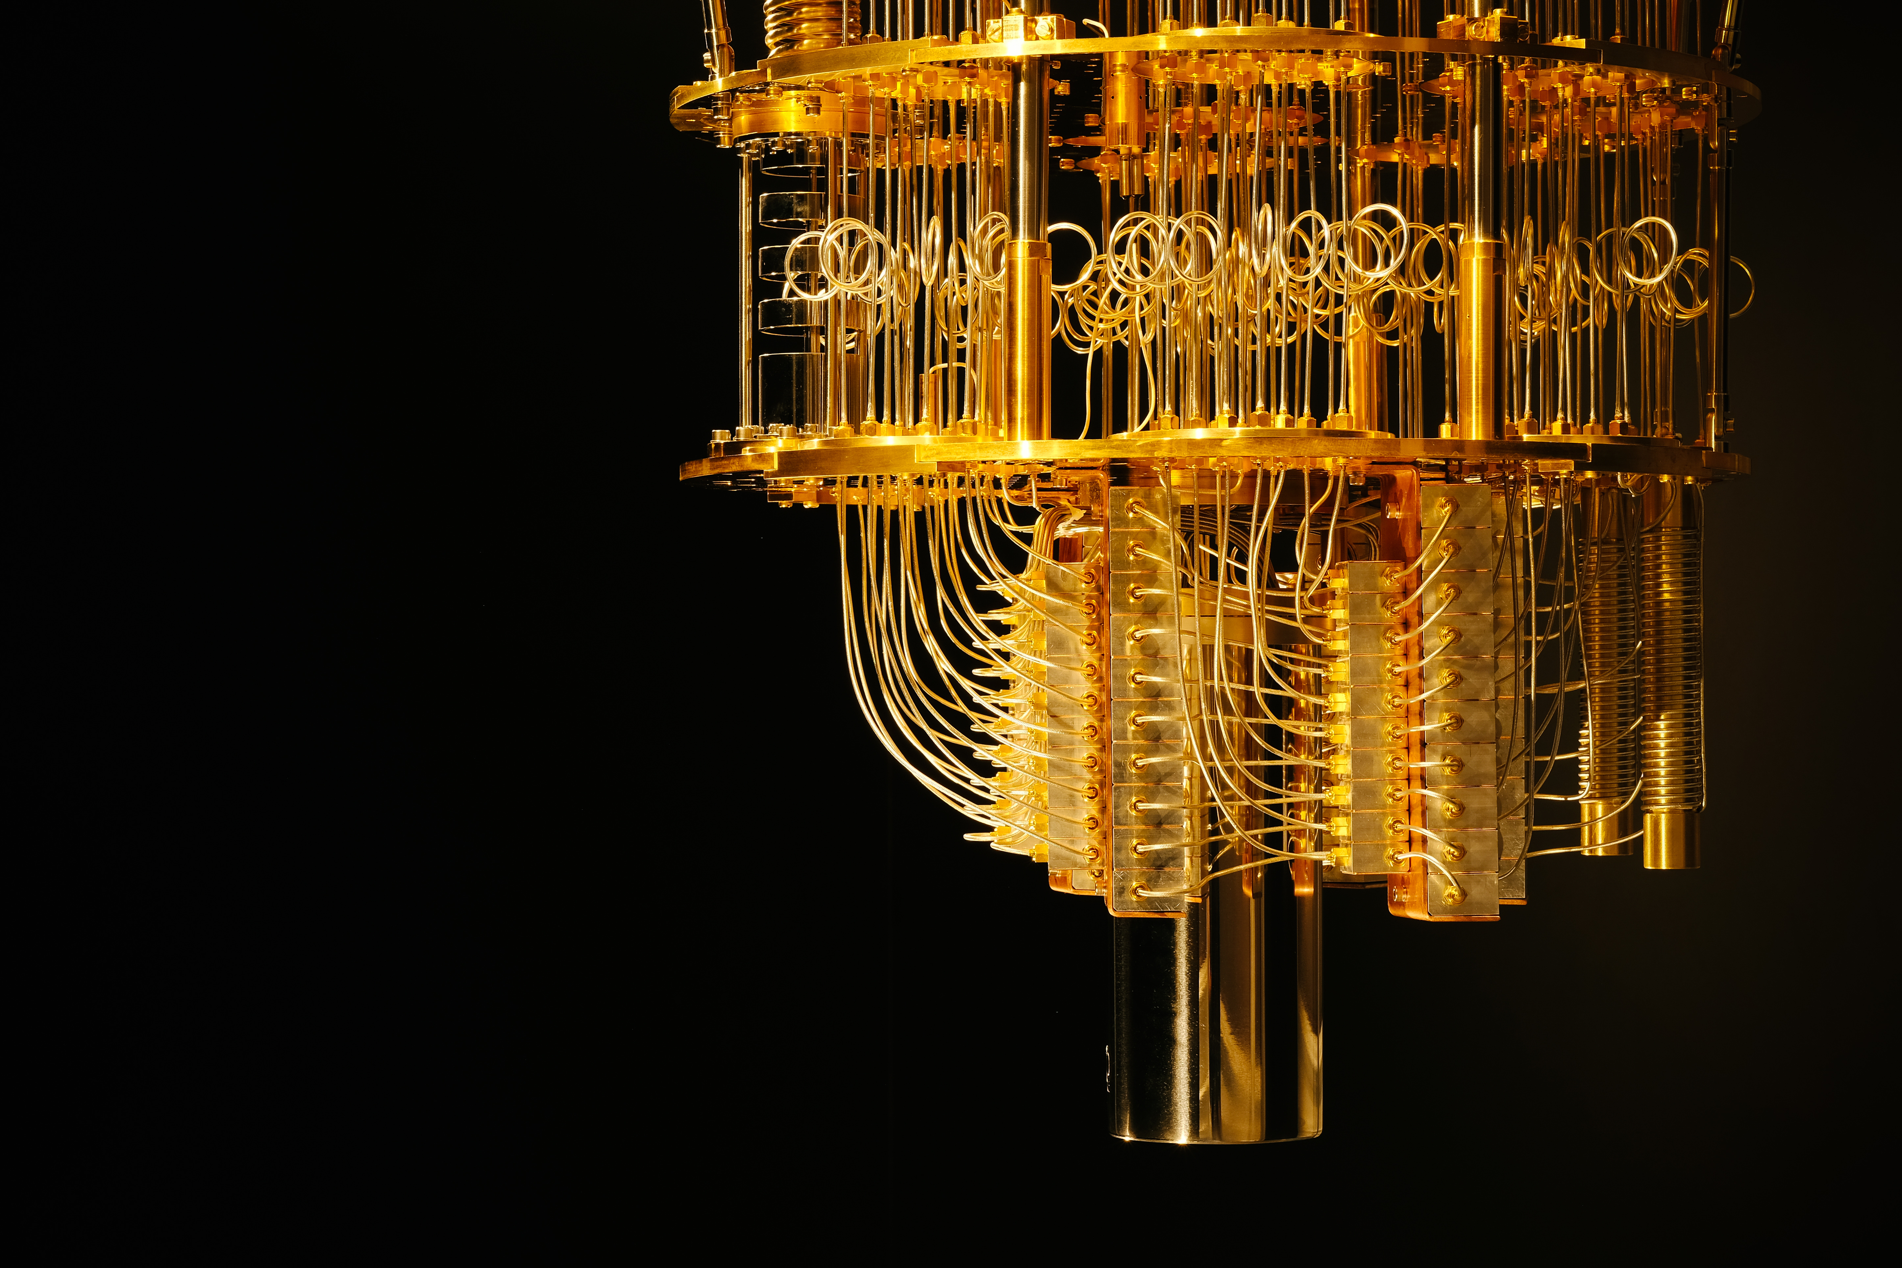
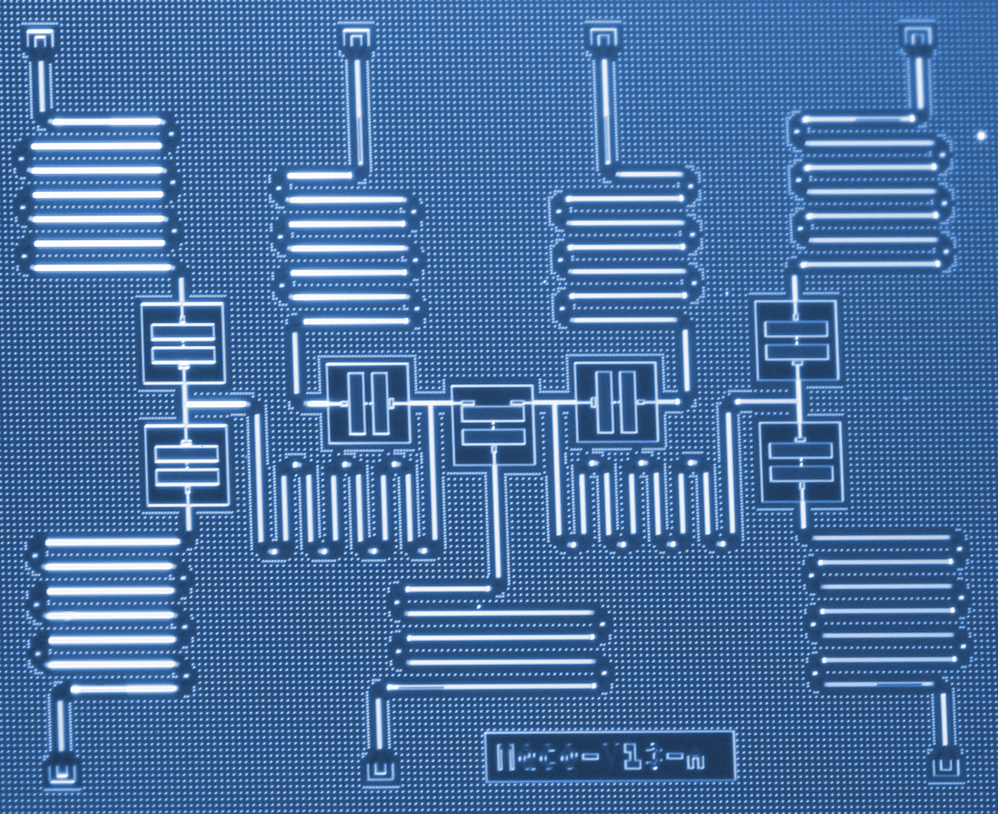
Superconductivity

Slide 8
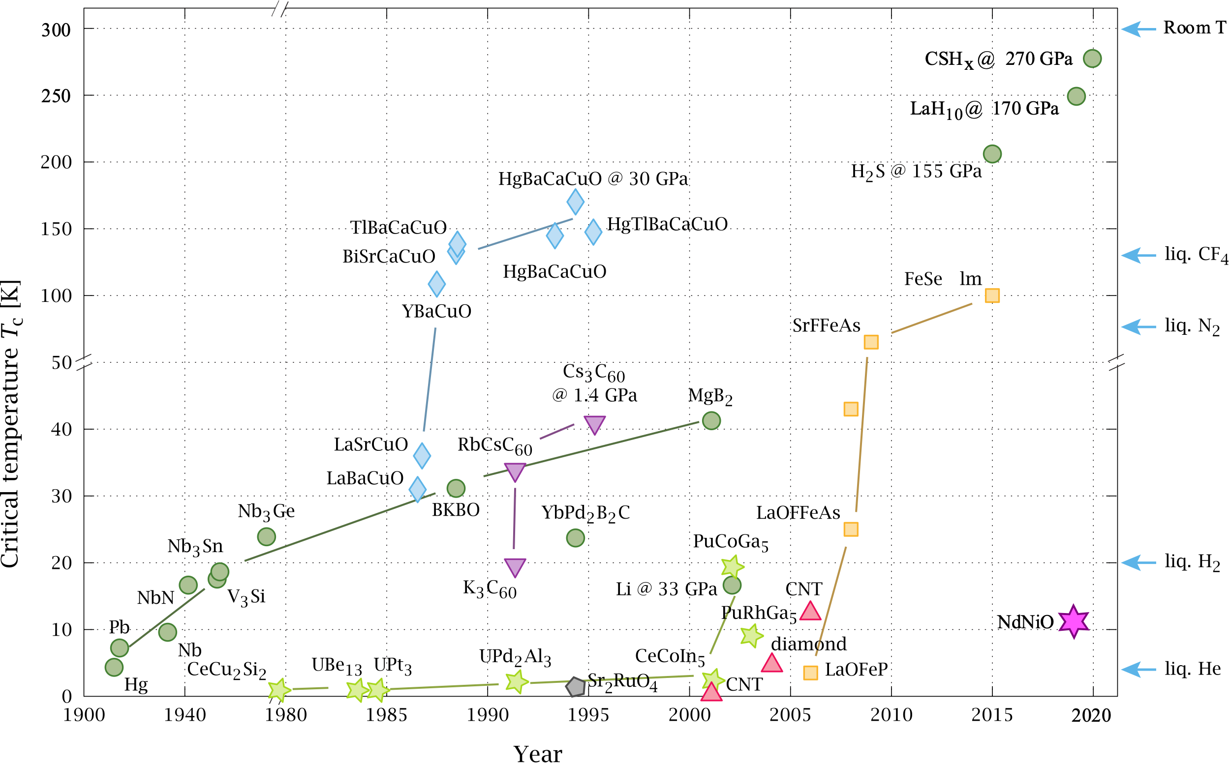
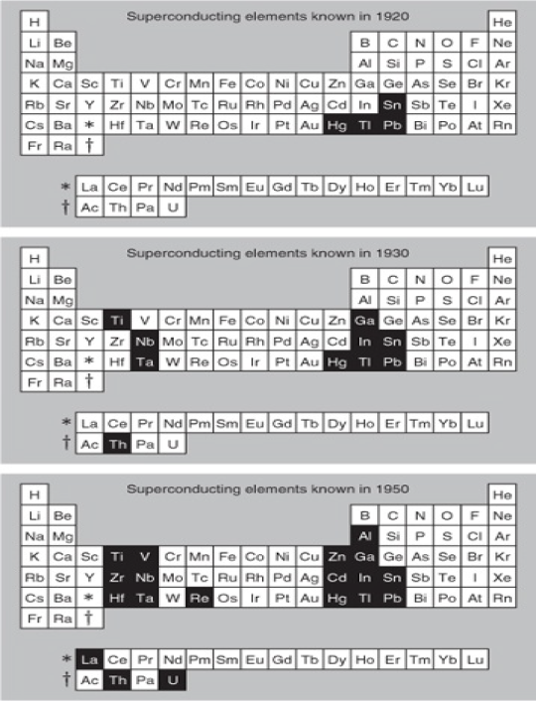
Superconductivity in Elements and Compounds
Blundell
Wikipedia

Slide 9
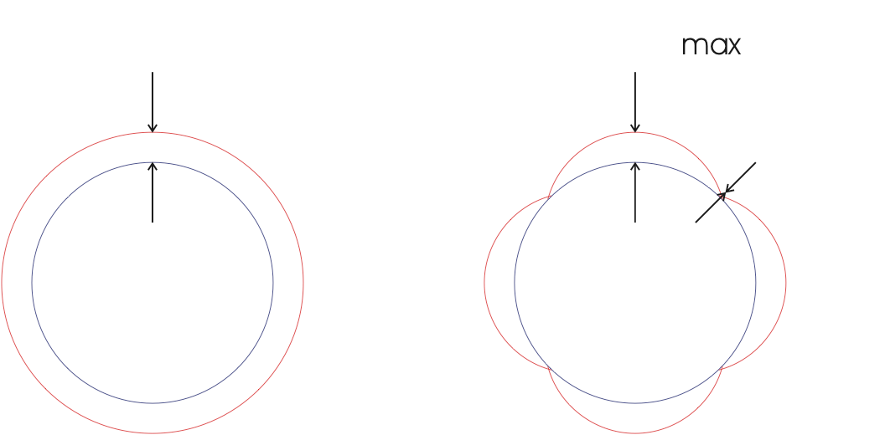
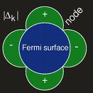
Unconventional Superconductivity
Bi-2212
$$Δ=Δ$$
$$Δ(\overset{⃗}{k})=Δ$$
$$Δ=0$$
Ding et al., PRB 54, 9678 (1996)
Conventional
Δ(k) has symmetry of crystal
Usually Δ(k)=Δ (s-wave)
Unconventional
Δ(k) has lower symmetry
Possible nodes in gap.
Other broken symmetries

Slide 10
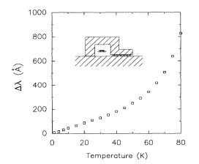
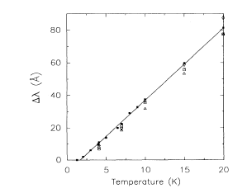
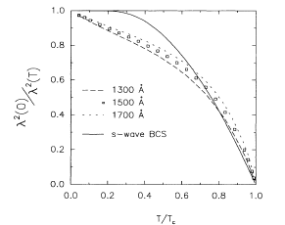
Pairing Symmetry – Penetration Depth
𝜆(0) from 𝜇SR measurements

Slide 11
Unconventional Superconductivity
Adenwalla et al., (1990)
ultrasound
Trappmann, Lohneysen, and Taillefer, (1992)
Trappmann, Lohneysen, and Taillefer, (1991)
Multiple SC phases vs. B, P
Luke et al., PRL 72, 1466 (1993).

Slide 12
Routes to Unconventional Superconductivity
Conventional SC (BCS): electron phonon interaction overcomes Coulomb repulsion via retardation.
Strongly correlated metals, electrons retain more localized character (Coulomb > electron-phonon): retardation less effective.
Other interactions (eg. spin fluctuations)
Superconductivity near magnetic quantum critical point.
Role of crystal structure, such as presence/absence of inversion symmetry.
ASOC gives mixture of spin-singlet/spin-triplet pairs, with possibility of broken TRS, gap nodes, multiple gaps.
Topologically non-trivial bands hosting SC.

Slide 13
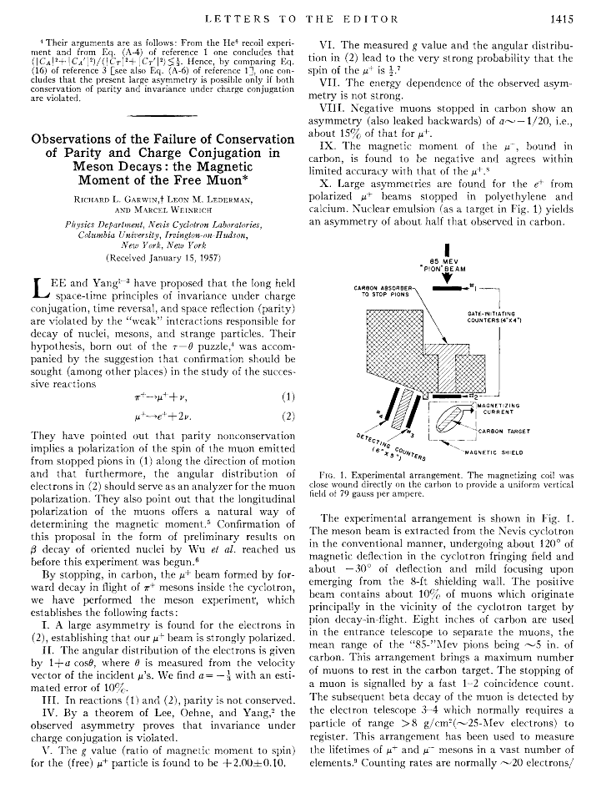

Slide 14
Pion → Muon → e⁺
μ⁺e⁺+ν_{e}+ν_{μ} (2.2μs)
<a> = 1/3
π⁺μ⁺+ν_{μ} (26ns)

Slide 15
μSR Technique

Slide 16
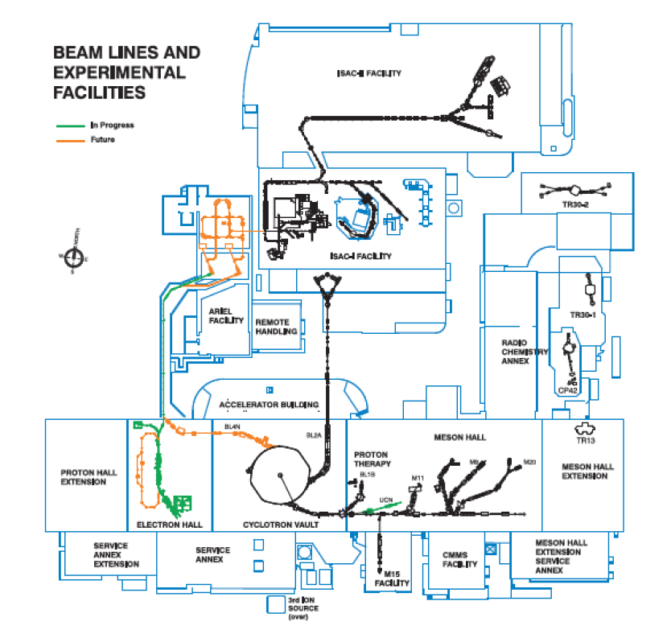
TRIUMF

Slide 17
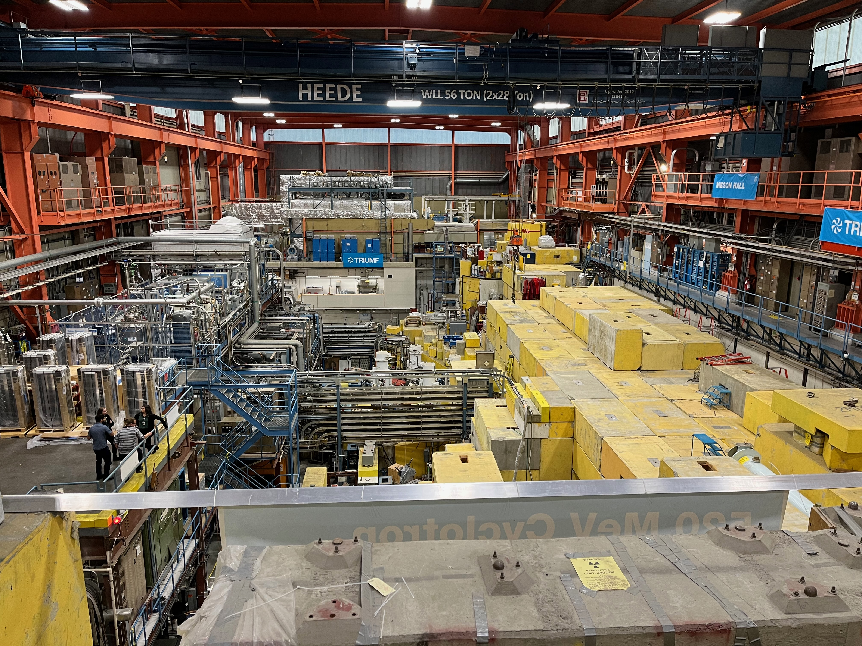

Slide 18
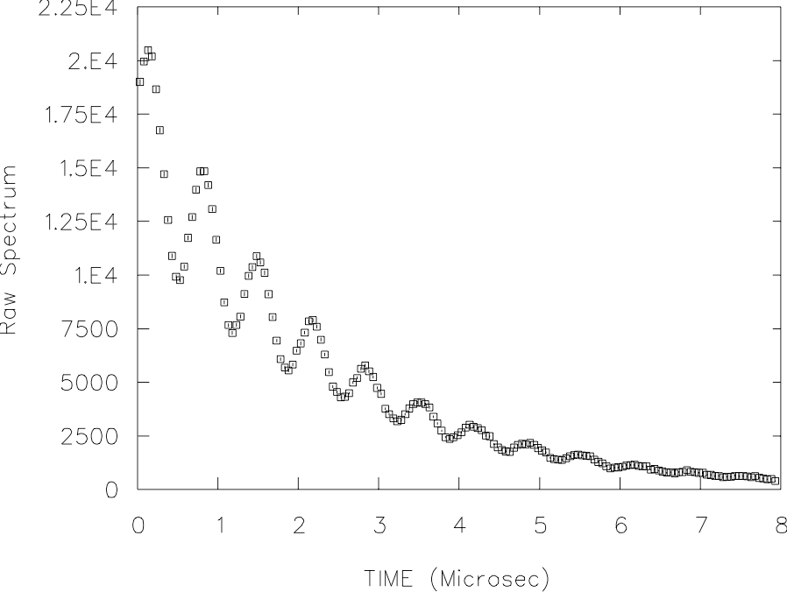
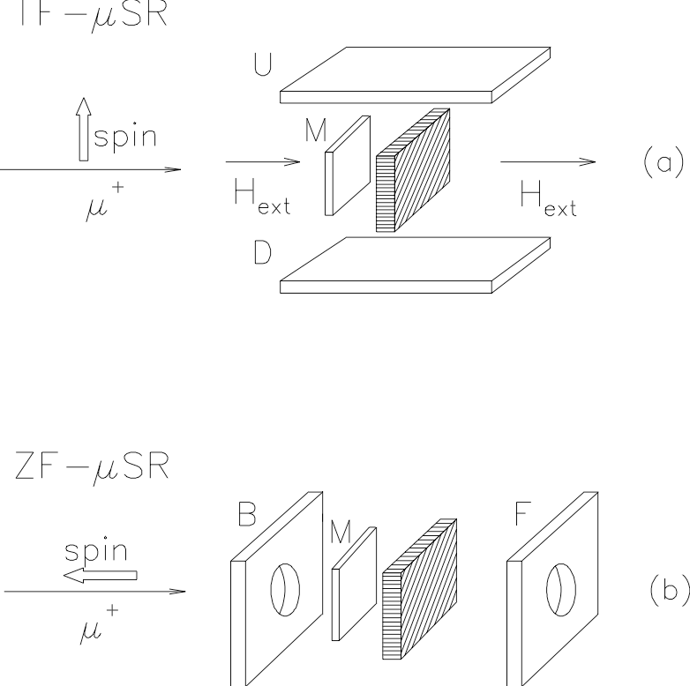
Experimental Geometry
τμ=2.2μs

Slide 19
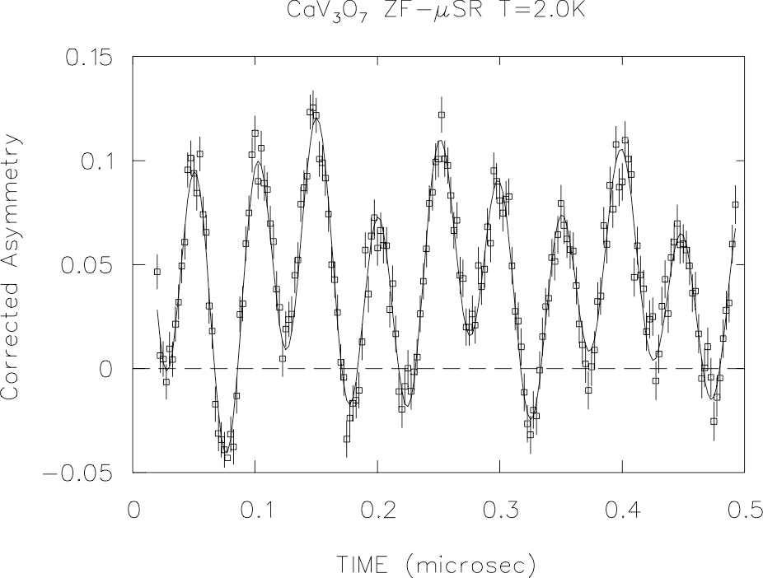
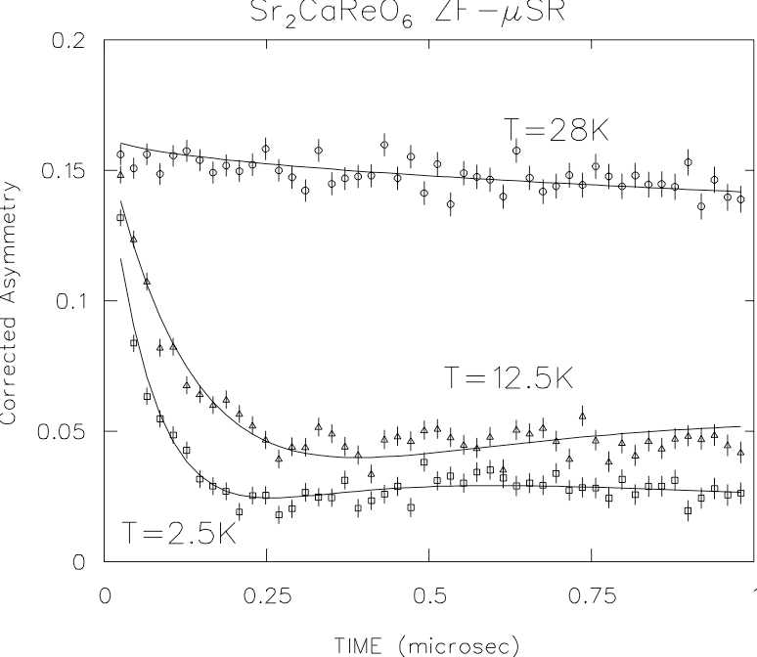
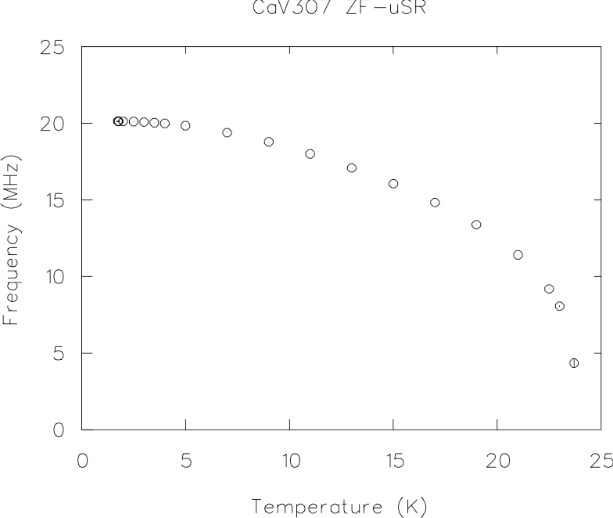
Zero Field ZF-μSR
Ordered state, ν∝ Moment ∝$\sqrt{I_{B}}$
Random frozen spins give characteristic relaxation.

Slide 20
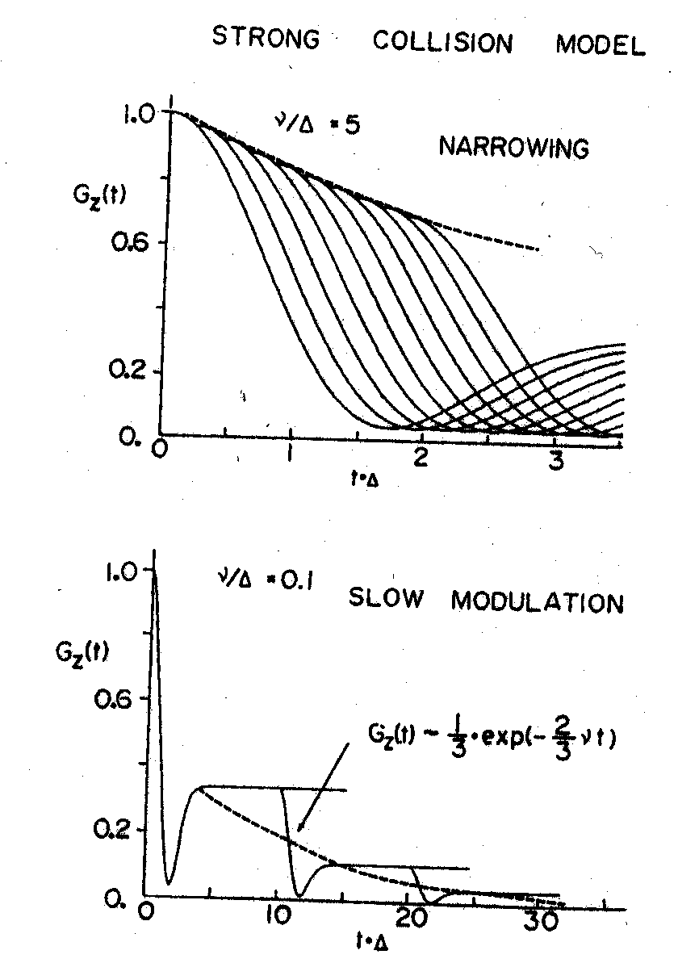
Spin Fluctuations - Dynamics
Longitudinal Field µSR

Slide 21
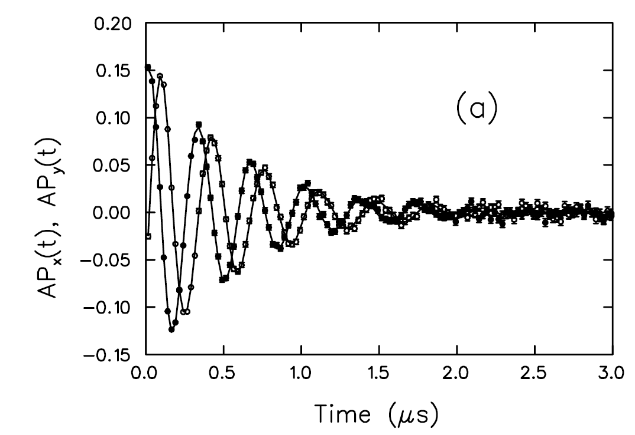
Transverse Field µSR
Amplitude: volume fraction of signal.
Frequency: local field at muon site(s): Knight shift
Field of 8T gives 1GHz precession
Max field of ~0.2T at pulsed facility due to pulse width, pion lifetime.
Damping: Field inhomogeneity: line shape gives field distribution.

Slide 22
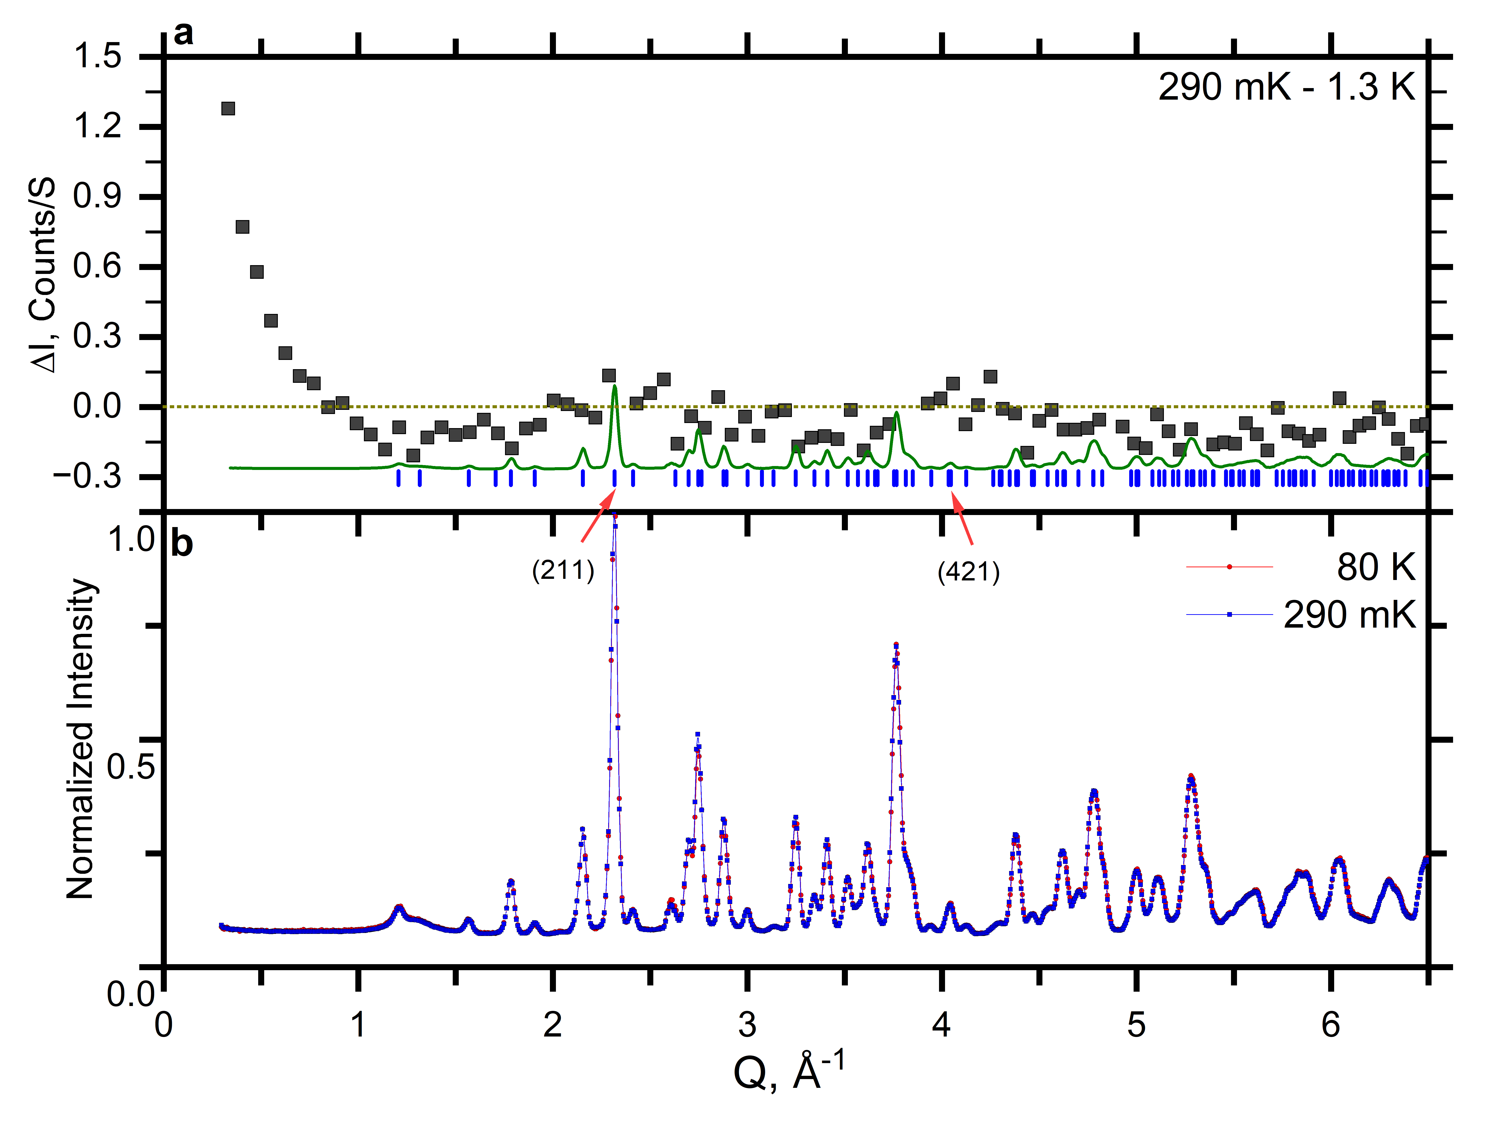
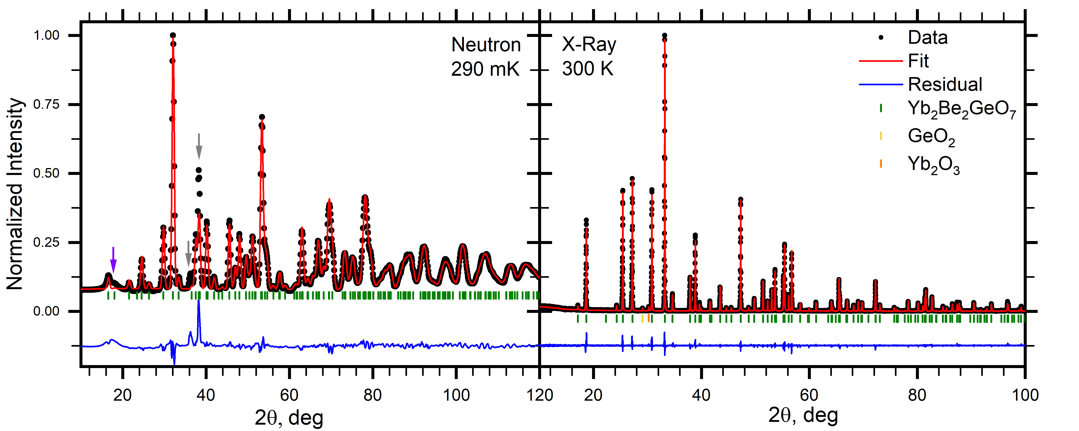
Quantum Spin Liquid Ground State in Shastry-Sutherland Lattice Material: Yb2Be2GeO7

Slide 23
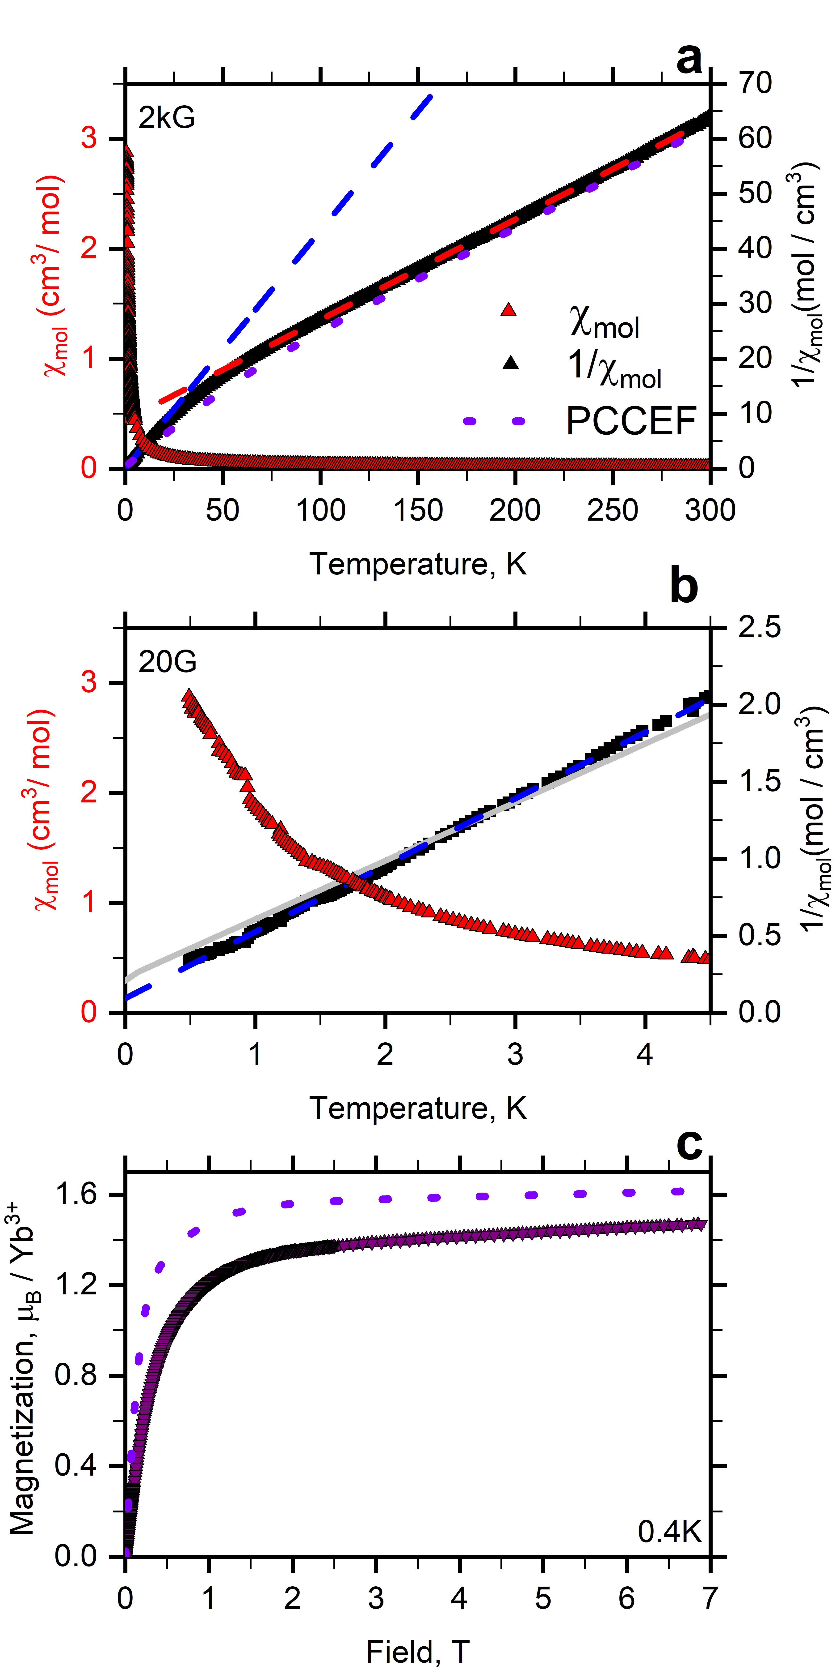
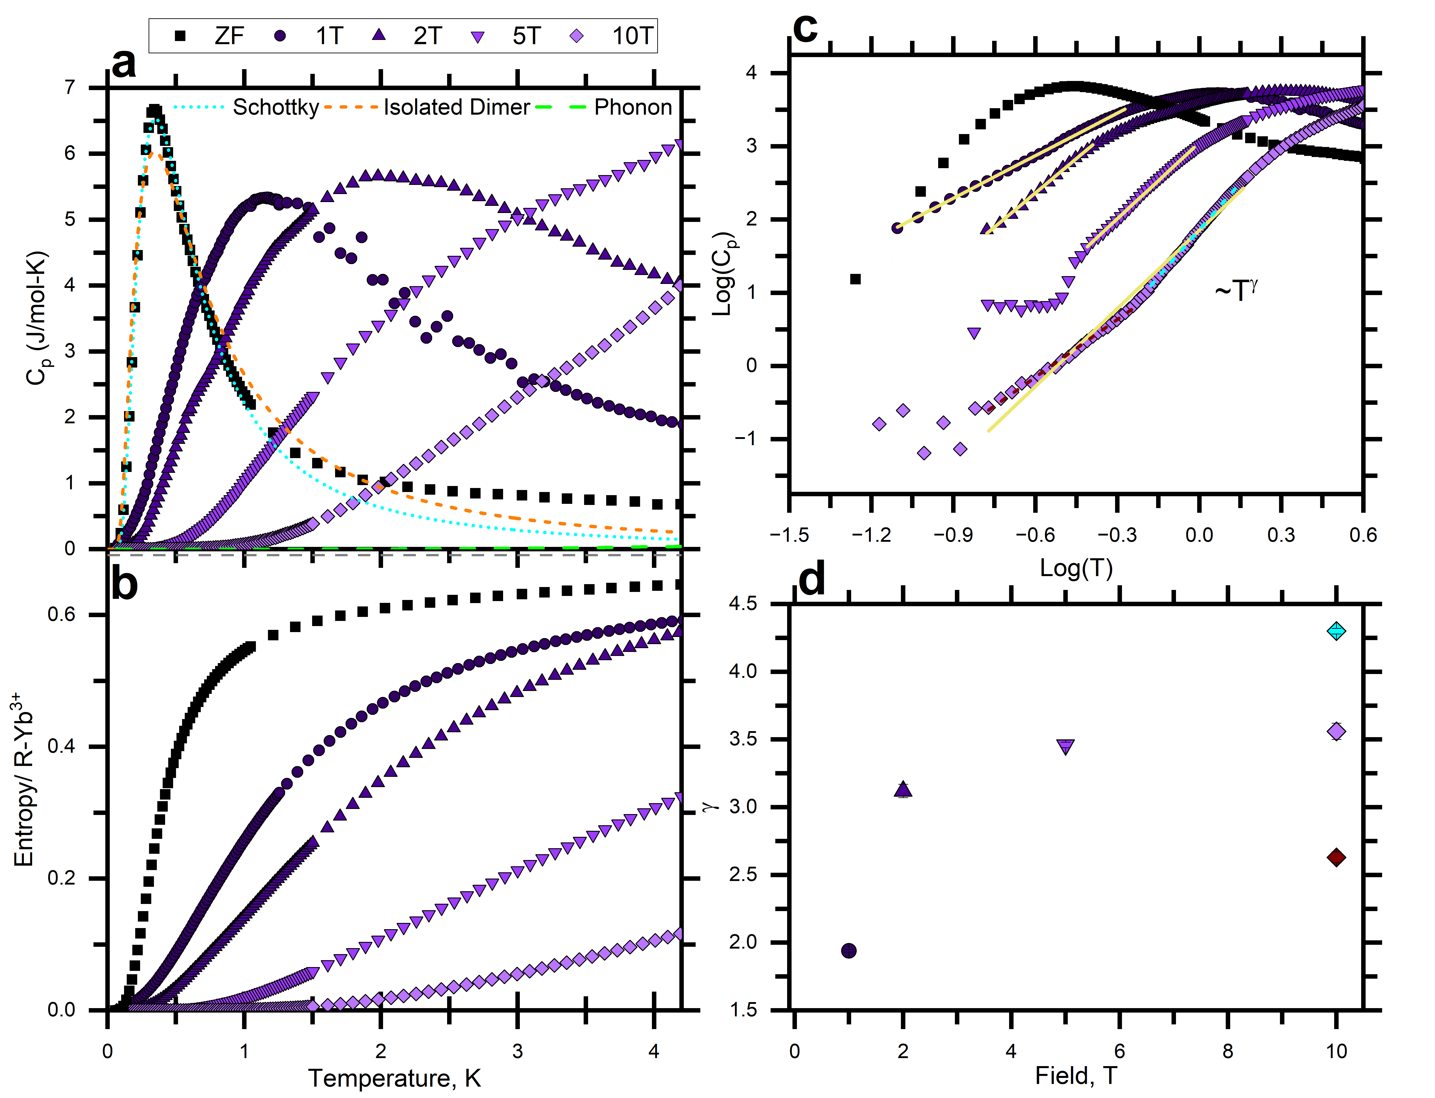
Quantum Spin Liquid Ground State in Yb2Be2GeO7
Heat Capacity
Magnetic Susceptibility

Slide 24
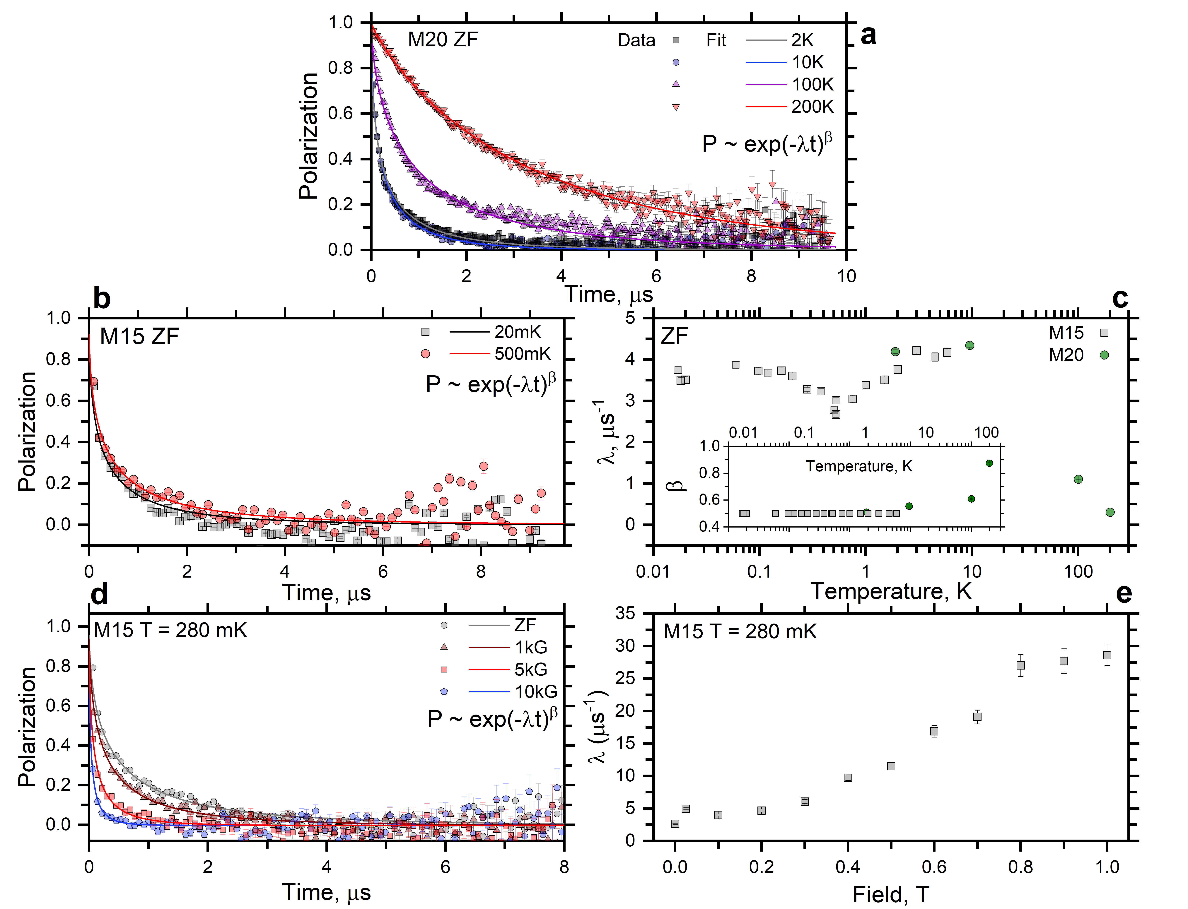
Muon Spin Relaxation in Yb2Be2GeO7
No precession seen at any temperatures
Increasing relaxation with decreasing temperature
depopulating crystal field levels
slowing down of spin fluctuations.
Relaxation essentially plateaued below 10K.
At low temperature, LF relaxation rate increases with increasing field indicating increased low frequency spin fluctuations present.
Closing of gap with field above 0.2T.
Yb2Be2GeO7 is a gapped quantum spin liquid candidate
Pula et al., Phys. Rev. B 110, 014412 (2024). (2 days ago!)

Slide 25
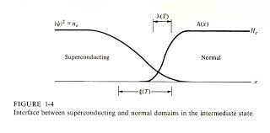
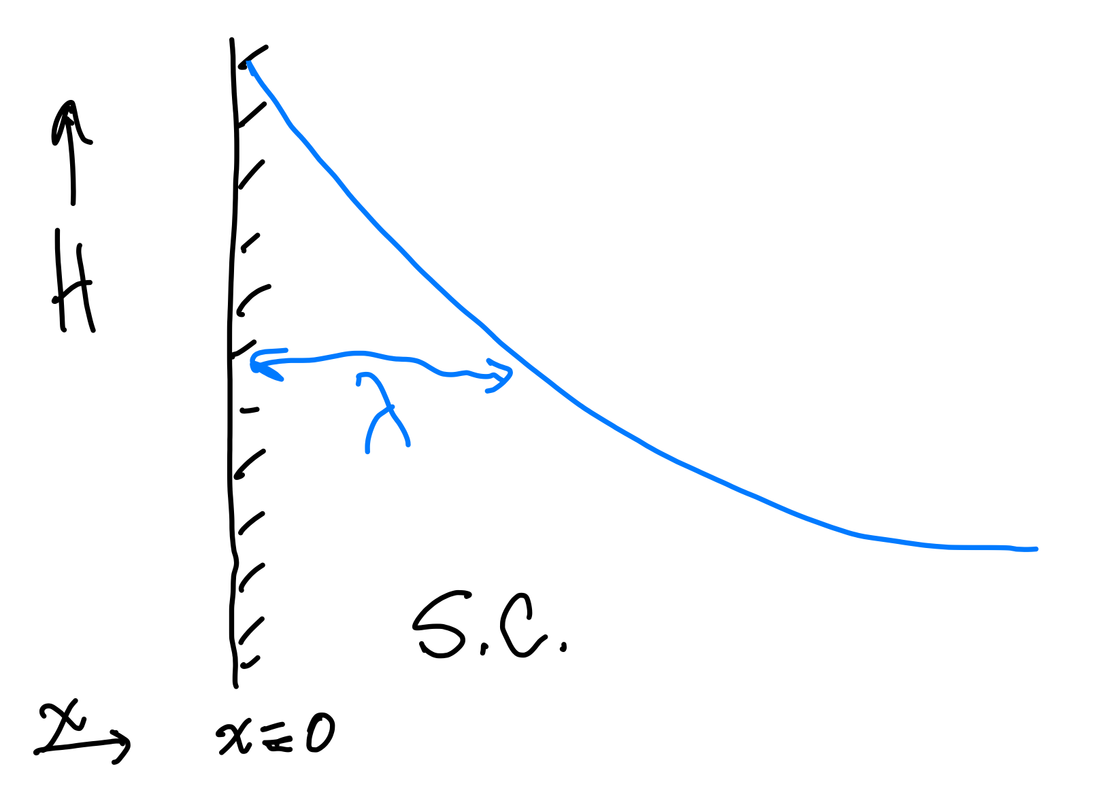
Length Scales in Superconductivity
Penetration Depth & Coherence Length
$ξ$: variation of SC order parameter
size of Cooper pair
size of vortex core
$λ$: length scale for field screening

Slide 26
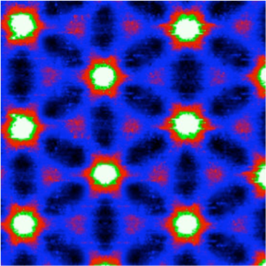
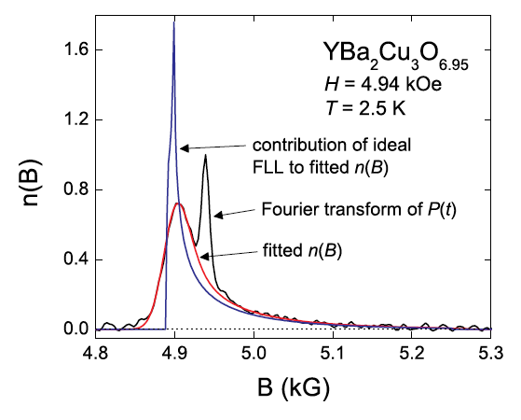
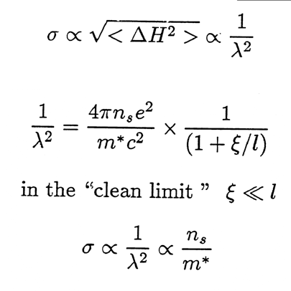
Type-II Superconductors: Vortex State
2 lengthscales: λ, ξ
Disorder: broadening of line shape features (convolute with Gaussian).
J.C. Davis website
Ceramics - Gaussian
Sonier, Rep. Prog. Phys. 70, 1717 (2007).

Slide 27
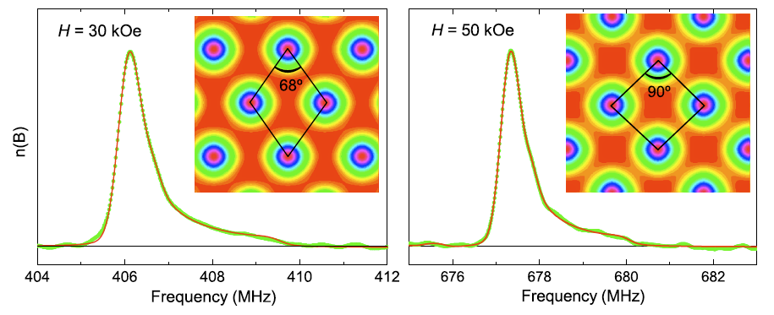
Vortex Lattice Field Distribution
Yaouanc et al., Phys. Rev. B 55, 11107 (1997).
V3Si
$$λ$$
$$ξ$$

Slide 28
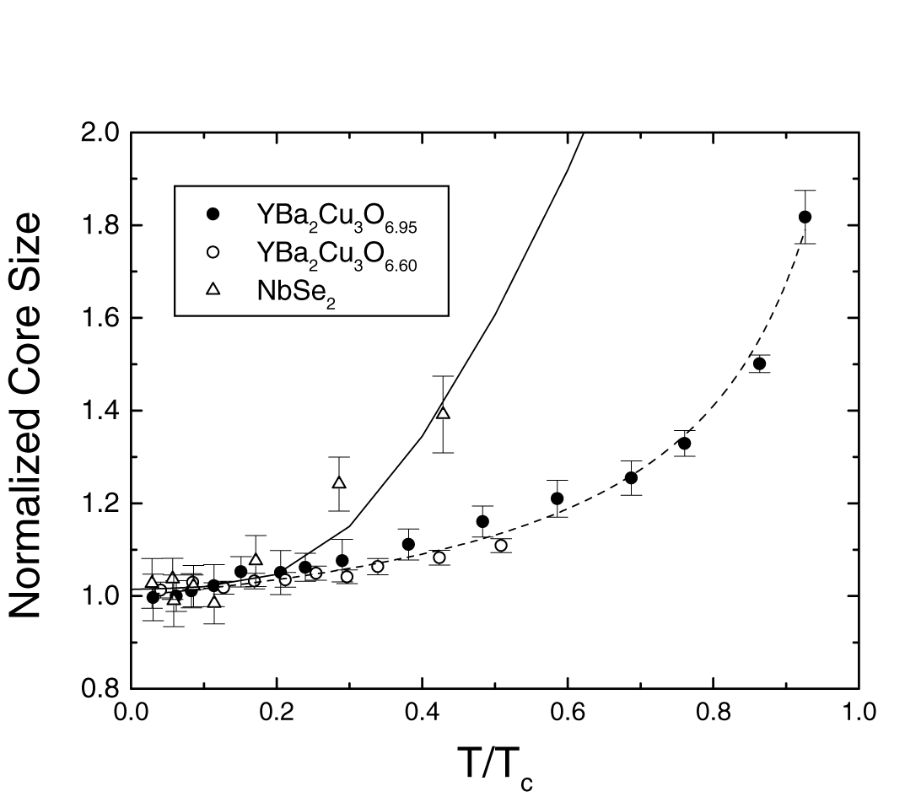
Superfluid density & Vortex Core Size
Sonier et al.
Curve is ZF μ-wave result. (Hardy et al.)
Linear T-dependence due to d-wave pairing (gap nodes)
High field flattening due to q.p.’s at gap nodes.
Weak dependence of 𝝃 on T indicates absence of bound states in vortex cores.

Slide 29
Spin Orbit Coupling w/o Inversion Symmetry
TaReSi & TaRuSi
Re/Ru
Si
Ta
$$Δ(0)/k_{B}T_{c}=1.4$$
Sajilesh K P and R.P. Singh, Supercond. Sci. Technol. 34, 055003 (2021).

Slide 30
Transverse Field $μ$SR
$$σ∼\frac{n_{s}}{m^{*}}$$
SOC
Sharma et al., PRB 108, 144510 (2023).

Slide 31
Zero Field $μ$SR
Broken TRS in TaRuSi
Conserved TRS in TaReSi
C${}_{2v}$ point group: Broken TRS only with weak SOC
Sharma et al., PRB 108, 144510 (2023).
SOC
Quintanilla et al., Phys. Rev. B 82, 174511 (2010)

Slide 32
Role of Spin Orbit Coupling
DFT (Addison Richards & Erik Sorensen)
TaReSi
TaRuSi
SOC

Slide 33
Broken TRS in $C_{2v}$
[ unitary: $Δ(\overset{⃗}{k})Δ^{†}(\overset{⃗}{k})∝I$ ]
Hillier, Quintanilla and Cywinski, PRL 102, 117007 (2009).

Slide 34
Non-Unitary Triplet Pairing in TaRuSi with weak SOC
Isostructural SC’s w/o inversion symmetry
ZF-$μ$SR shows broken TRS in TaRuSi, conserved TRS in TaReSi
TF-$μ$SR shows isotropic s-wave (conventional) SC in TaReSi
TF-$μ$SR shows multi-gap SC in TaRuSi
DFT indicates weak SOC in TaRuSi, strong SOC in TaReSi
Symmetry analysis attributes SC state in TaRuSi to non-unitary triplet pairing state.

Slide 35
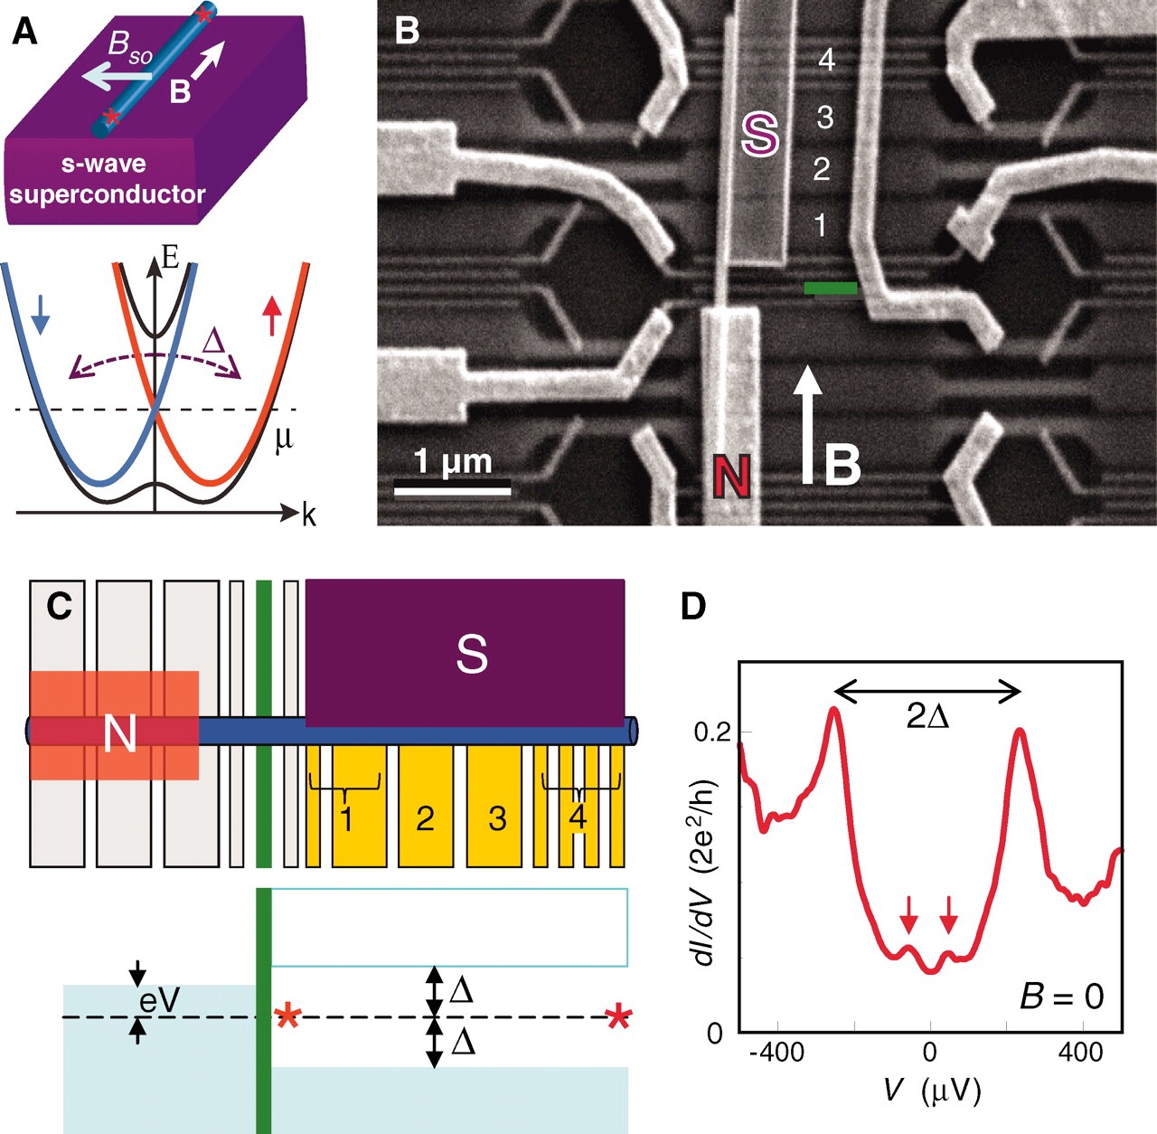
Topological Superconductivity
Majorana Fermions
Normal fermions can be represented as composed of two Majorana fermions (which are their own anti-particles).
Interest comes if Majoranas can be spatially separated, independently probed.
immune to decoherence
Possible application to quantum computation.
Exist in vortex cores of chiral superconductors (eg. $k_{x}±ik_{y}$): Sr2RuO4?
predicted in vortex cores of topological surface state coupled to bulk s-wave superconductor (Fu & Kane, PRL 100, 096407).
M. Franz, Nature Nanotech. 8, 149 (2013)
Luke et al., Nature 394, 156 (1998).
Mourik et al., Science 336, 1003 (2012).

Slide 36
Topological Superconductivity?
Hexagonal crystal structure
Hexagonal structure: Dirac cones, flat bands.
BiPt : Superconductivity reported in 1952 (Alekseevskii), 1953 (Matthias).
only Tc reported (around 1.2K-1.3K)
Cao et al., Nature 595, 526 (2021)
Twisted tri-layer Graphene

Slide 37
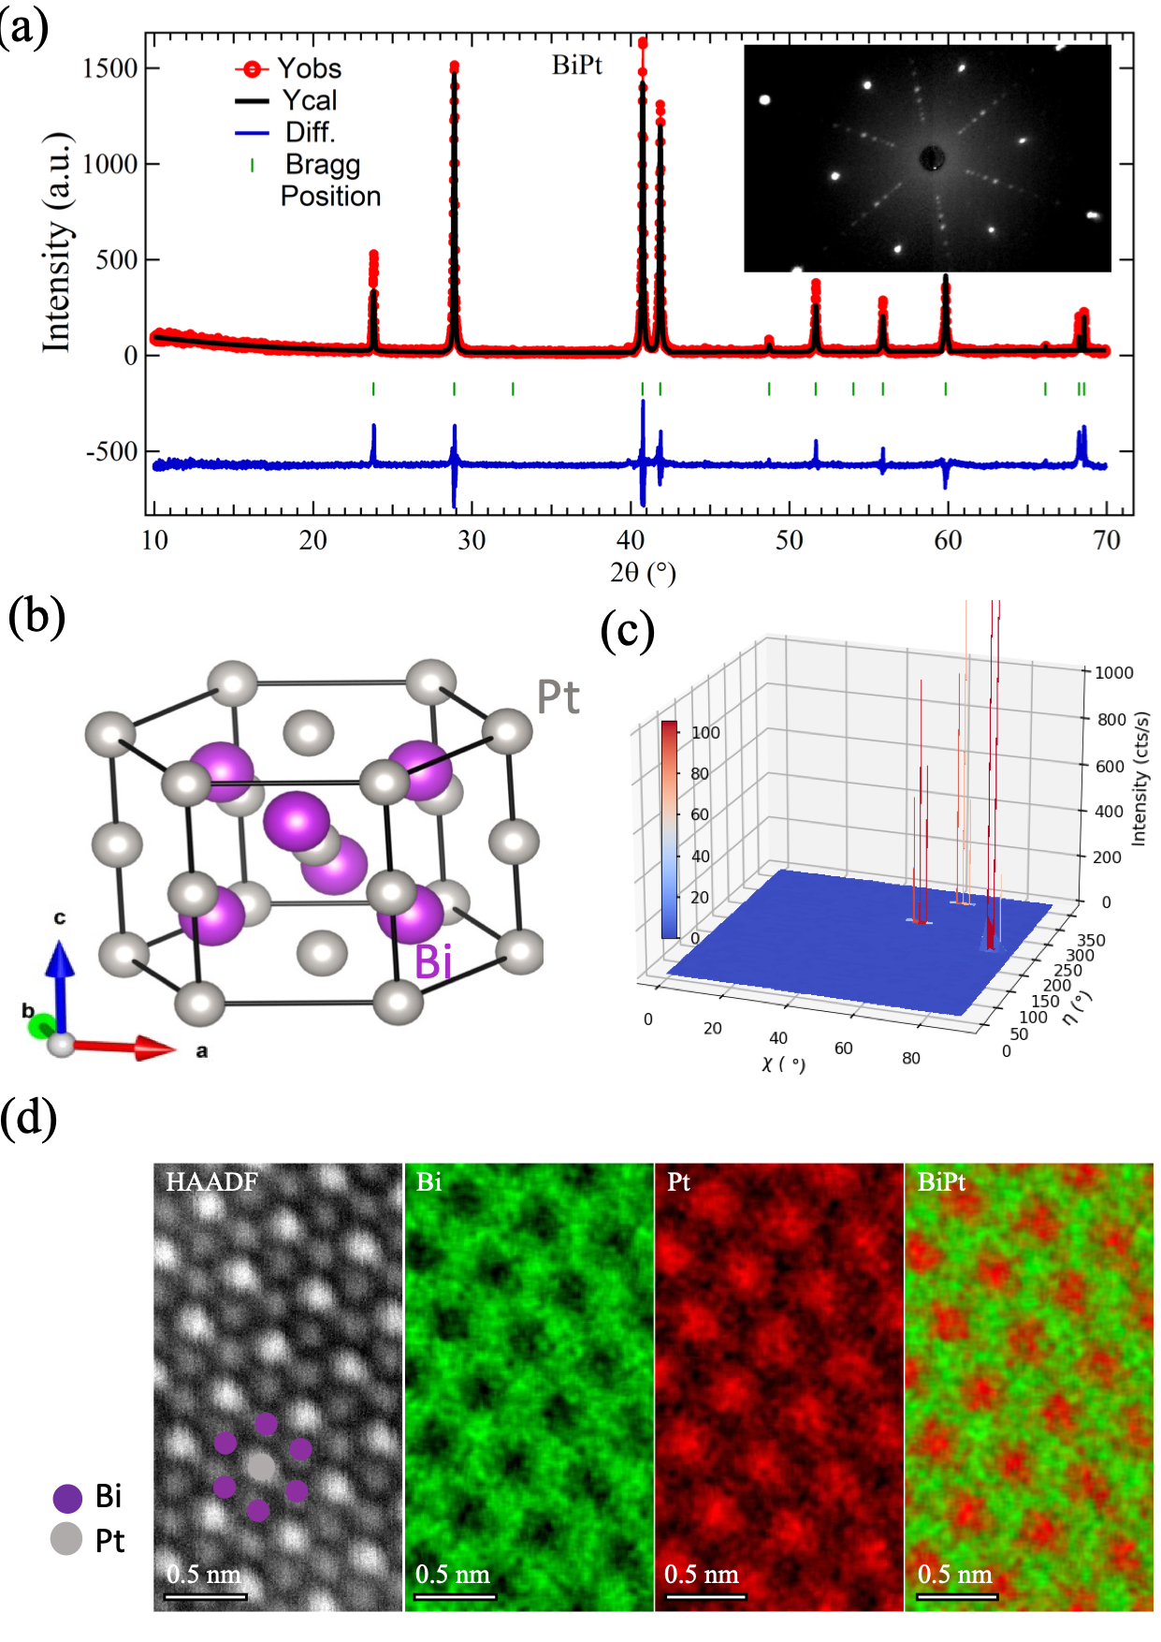
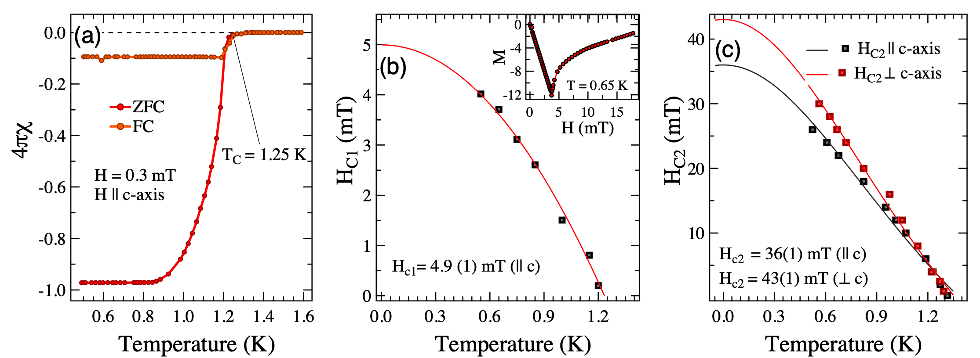
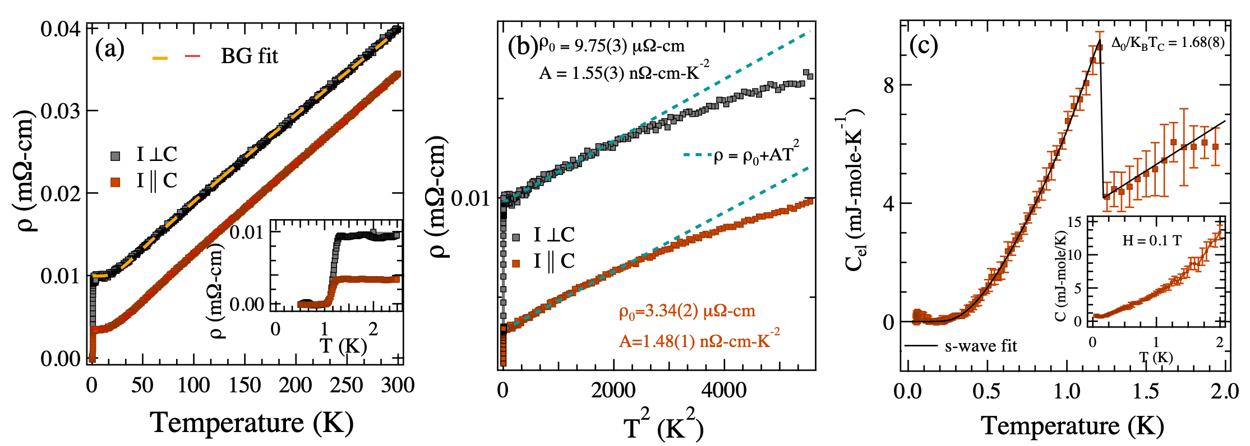
BiPt

Slide 38
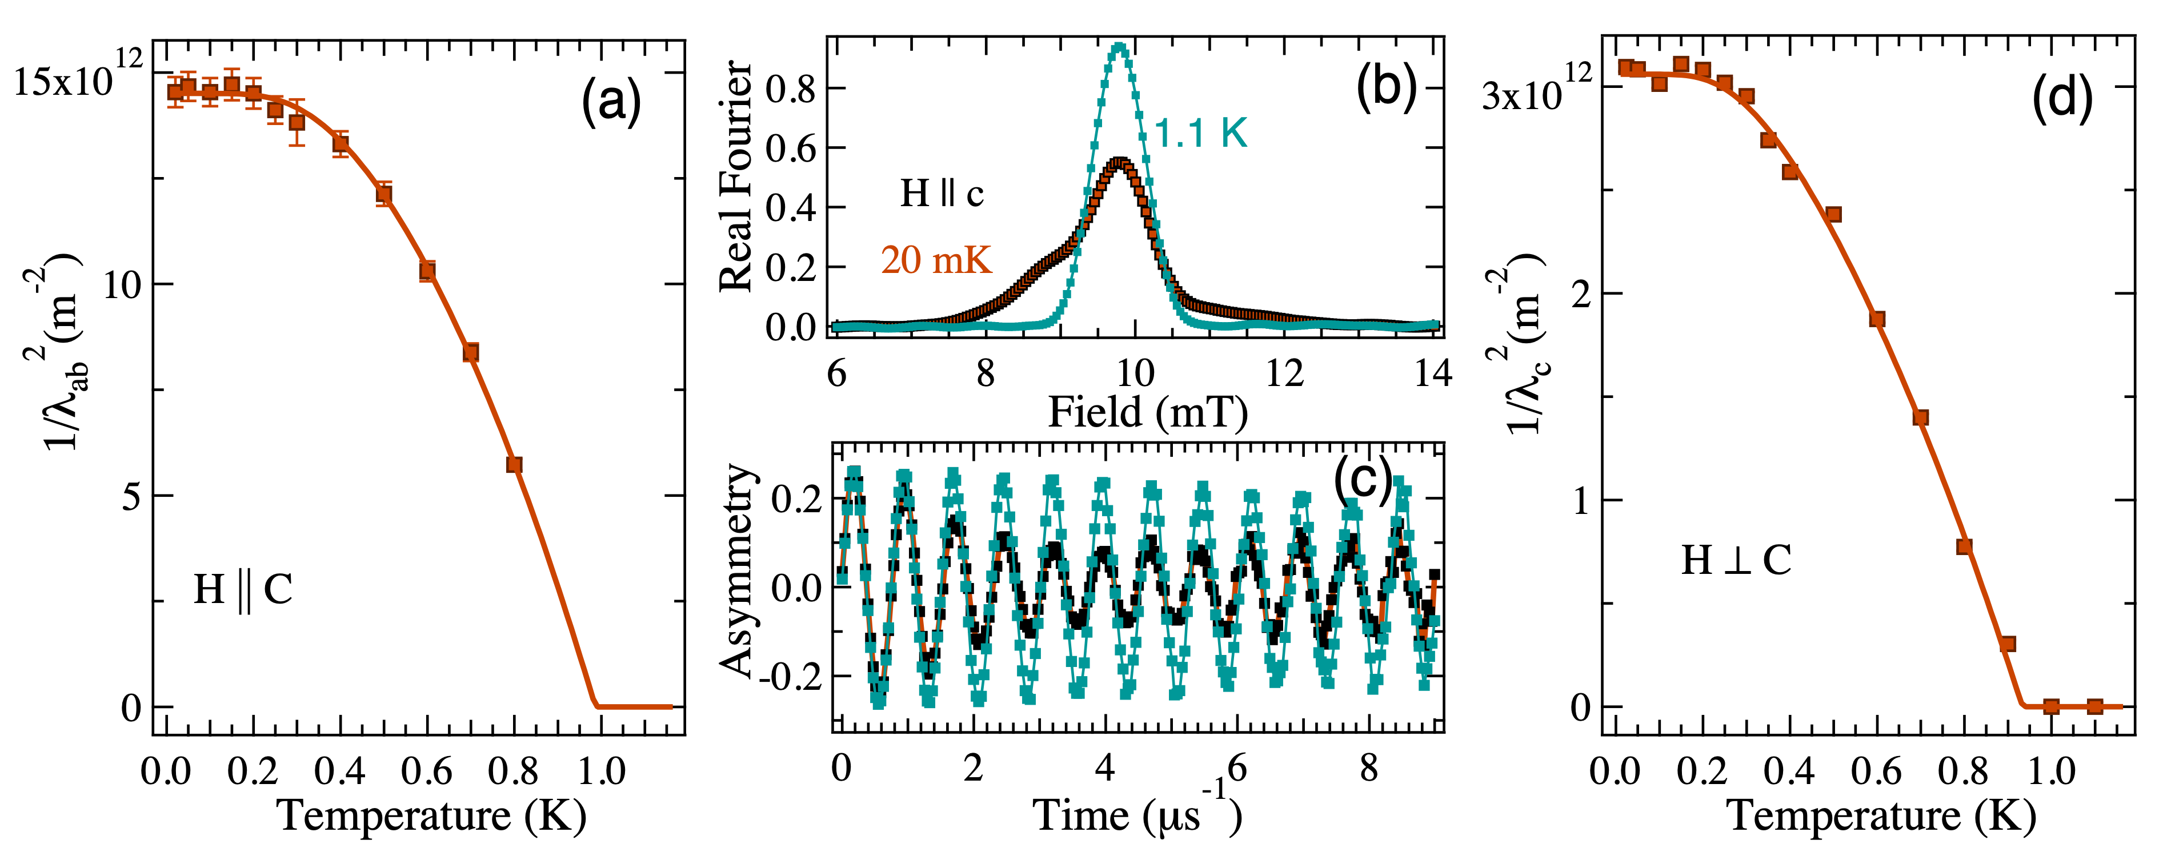
BiPt
Anisotropic (Abrikosov) Lineshape
Anisotropic superfluid density

Slide 39
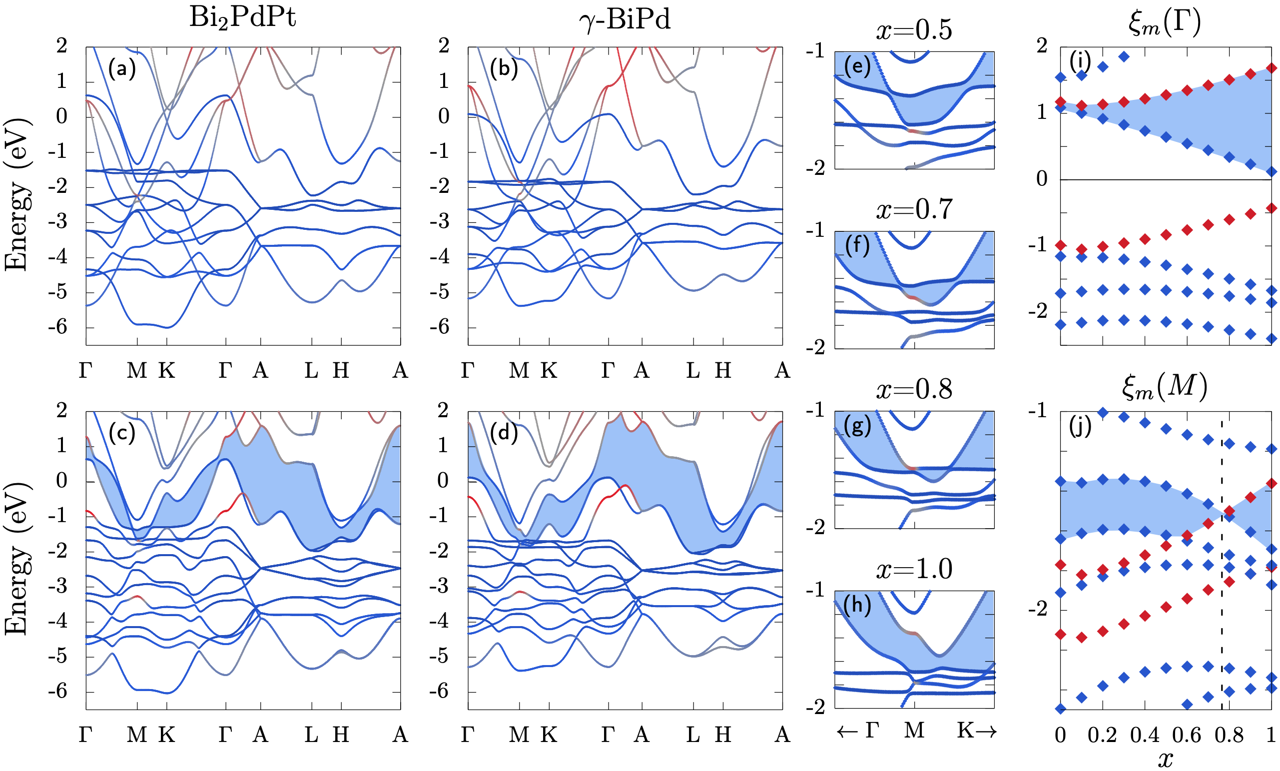
BiPt1-xPdx DFT
BiPt1-xPdx changes from topologically trivial to non-trivial around x=0.75.
hexagonal BiPd not stabilized in bulk, but predict Dirac crossing at Fermi level for surface state.
Sharma et al., Phys. Rev. B 109, 224509 (2024)

Slide 40
BiPt1-xPdx
Hexagonal crystal structure
predicted to exhibit Dirac band crossings, flat bands which potentially support topologically non-trivial behaviour.

Slide 41
BiPt0.5Pd0.5 Muon Spin Rotation/Relaxation
BiPt0.5Pd0.5 fully gapped with preserved time reversal symmetry.
Next steps, proceed to higher Pd substitution levels.
Sharma et al., Phys. Rev. B 109, 224509 (2024)

Slide 42
Current Muon Sources
3 Sources co-located with neutron sources
New sources under development in China, Korea.

Slide 43
Current CW Muon Sources

Slide 44
Current Pulsed Muon Sources

Slide 45
Low Energy Muons - PSI
Conventional surface muons have stopping range of 140 mg/cm²
Thin film samples/surfaces require reduced depth penetration.

Slide 46
Muon Moderation

Slide 47
Low Energy Transport

Slide 48
Muon Trigger

Slide 49
Low Energy uSR- PSI

Slide 50
Unconventional Superconductivity
Synthesis, Characterization & Identification
Multiple routes to unconventional superconductivity
Strong correlations, cooperative crystal structure critical.
Muons provide a real space/volume sensitive probe.
Thanks for your attention!

Slide 51
Coming Soon: TRIUMF M9H
4T 6 port magnet with DR,SiPM spectrometer
First muon decay channel explicitly designed for delivery of transversely spin polarized beams.
High energy decay muons (µ⁺/µ⁻), suitable for pressure cells, muonic x-rays for elemental analysis.

