Slide 1
Superconductivity research using muons:
Rhea Stewart, ISIS Muon Group
rhea.stewart@stfc.ac.uk
2nd Workshop on Muon SciEnce TechnoLOgy and InDustrY
CSNS, Dongguan, January 9th – 12th 2025

Slide 2
Superconductivity research using muons: characterising spin-orbit driven proximity effects in Pt/Nb thin films
Rhea Stewart, ISIS Muon Group
rhea.stewart@stfc.ac.uk
2nd Workshop on Muon SciEnce TechnoLOgy and InDustrY
CSNS, Dongguan, January 9th – 12th 2025

Slide 3
Central theme of this work
Focus: manipulating the superconductivity in a conventional superconducting thin film using magnetic and high spin-orbit materials and measuring these effects with muons.
Superconducting proximity effects and why they are interesting
Using low energy muons (LEM) to characterise magnetic and superconducting effects at interfaces
A summary of LEM results on ferromagnetic-superconducting proximity effects in Nb thin films
The motivation for moving from ferromagnetism to spin-orbit control of the superconductivity
Results and the development of new theory for spin-orbit driven proximity effects in Pt/Nb thin films
Flokstra, M., Stewart, R., Yim, CM. et al. Spin-orbit driven superconducting proximity effects in Pt/Nb thin films. Nat Commun 14, 5081 (2023)
(and other references as indicated)

Slide 4
Acknowledgements & contributions
Machiel Flokstra & Steve Lee
Christopher Trainer, Chi Ming Yim & Peter Wahl – STM results to complement MUSR
Nathan Satchell & Gavin Burnell, Sample growth and development
Andreas Suter, Thomas Prokscha & Elvezio Morenzoni Low energy muon instrument scientists
Jos Cooper, Christy Kinane, Nathan Satchell & Sean Langridge PNR measurements on structural and magnetic properties of S/F systems.
Irina Bobkova & Alexander Bobkov Development of quasiclassical theory on high spin-orbit – superconductor interfaces that was key to interpreting the muon data

Slide 5
Proximity Systems
Novel effects and even new states of matter can arise at interfaces between materials with different types of electronic order.
Symmetry(-ies) broken
L1
L2

Slide 6
Proximity Systems -> Applications
Novel effects and even new states of matter can arise at interfaces between materials with different types of electronic order.
Symmetry(-ies) broken
L1
L2
For example, combining different superconducting, magnetic and semiconducting materials is a very active area of research as people move towards new electronic devices.

Slide 7
Superconducting proximity effects
ferromagnet
superconductor
Heavy metal

Slide 8
Superconducting proximity effects
ferromagnet
superconductor
Heavy metal
Effect of exchange field

Slide 9
Superconducting proximity effects
ferromagnet
superconductor
Heavy metal
2. Effect of spin-orbit
Effect of exchange field

Slide 10
Superconducting proximity effects
ferromagnet
superconductor
Heavy metal
2. Effect of spin-orbit
Effect of exchange field
spin degeneracy lifted
Fermionic statistics require SPOT = -1
Singlet
Triplet

Slide 11
Superconducting proximity effects
ferromagnet
superconductor
Heavy metal
2. Effect of spin-orbit
Effect of exchange field
spin degeneracy lifted
Fermionic statistics require SPOT = -1
Pairs can gain a magnetisation (spin).
Pairs can become anti-symmetric in time (orbital).
Singlet
Triplet

Slide 12
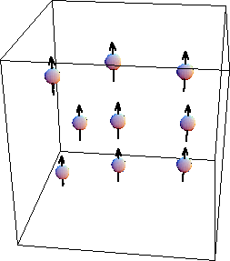
The TF muon spectroscopy technique
‘asymmetry’ (t) =
N_{A}(t) – N_{B}(t)
= a₀G_{x}(t) cos(ωt)
N_{A}(t) + N_{B}(t)
muons
detector A
non-relaxing polarisation
relaxing polarisation
magnetic field
detector B
Oscillation frequency -> magnitude of the local magnetic field
Local magnetic field is altered by the superconducting state, which can be seen as a change in the oscillation frequency.

Slide 13
The TF muon spectroscopy technique
‘asymmetry’ (t) =
N_{A}(t) – N_{B}(t)
= a₀G_{x}(t) cos(ωt)
N_{A}(t) + N_{B}(t)
muons
detector A
non-relaxing polarisation
relaxing polarisation
magnetic field
detector B
Oscillation frequency -> magnitude of the local magnetic field Damping -> field homogeneity
Muons stop in materials at a depth determined by their incident energy and the density of the material.

Slide 14
Low energy muons applied to superconducting proximity systems
Depth of implantation controlled via selection of the momentum of the incoming muons
Muons
Layer 1
Layer 2
Stopping distribution
Implantation depth
7keV, <x>=21 nm
27keV, <x>=82 nm
Sample local flux density B(x) as a function of depth

Slide 15
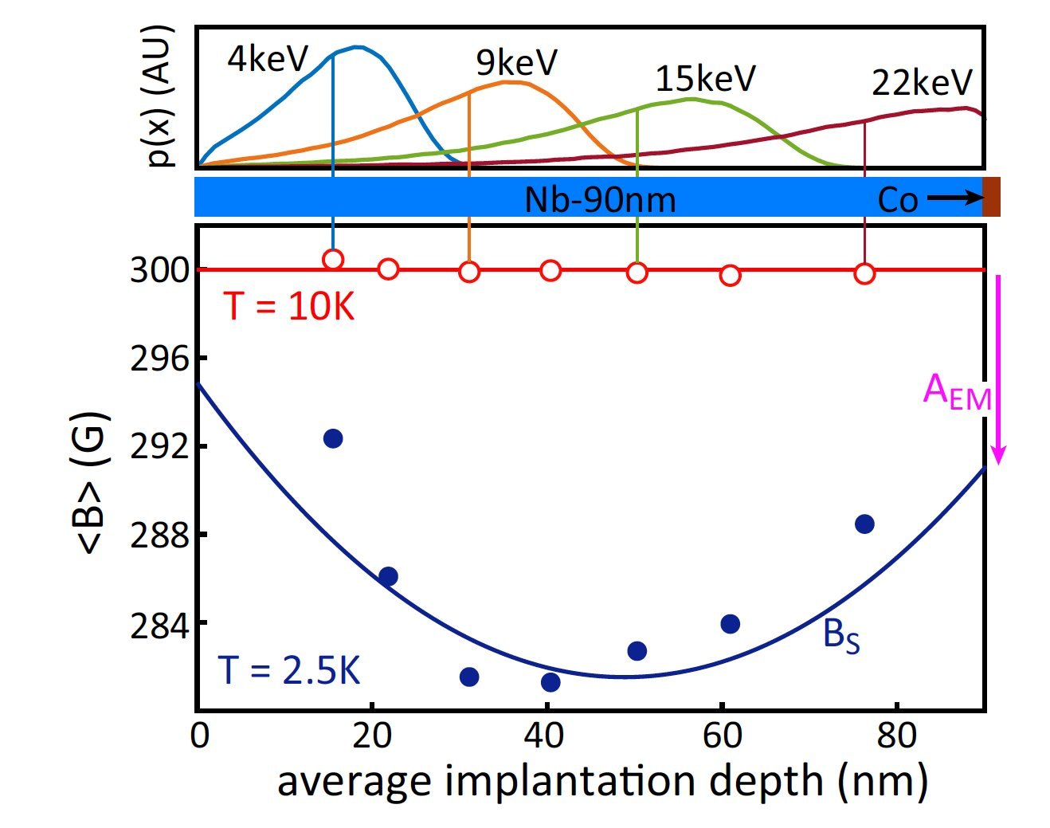
Low energy muons applied to superconducting proximity systems
Depth of implantation controlled via selection of the momentum of the incoming muons
Muons
Layer 1
Layer 2
Stopping distribution
Implantation depth
7keV, <x>=21 nm
27keV, <x>=82 nm
Sample local flux density B(x) as a function of depth

Slide 16
Low energy muons applied to superconducting proximity systems
Depth of implantation controlled via selection of the momentum of the incoming muons
Muons
Layer 1
Layer 2
Stopping distribution
Implantation depth
7keV, <x>=21 nm
27keV, <x>=82 nm
Sample local flux density B(x) as a function of depth

Slide 17
Low energy muons applied to superconducting proximity systems
Depth of implantation controlled via selection of the momentum of the incoming muons
Muons
Layer 1
Layer 2
Stopping distribution
Implantation depth
7keV, <x>=21 nm
27keV, <x>=82 nm
Sample local flux density B(x) as a function of depth

Slide 18
Low energy muons applied to superconducting proximity systems
Depth of implantation controlled via selection of the momentum of the incoming muons
Muons
Layer 1
Layer 2
Stopping distribution
Implantation depth
7keV, <x>=21 nm
27keV, <x>=82 nm
Sample local flux density B(x) as a function of depth

Slide 19
Low energy muons applied to superconducting proximity systems
Depth of implantation controlled via selection of the momentum of the incoming muons
Muons
Layer 1
Layer 2
Stopping distribution
Spatial average -> full quantitative spatial dependence requires a clear ansatz e.g. asymmetric Meissner profile for S/F:
Implantation depth
7keV, <x>=21 nm
27keV, <x>=82 nm
Sample local flux density B(x) as a function of depth

Slide 20
Measurable consequences of having manipulated the spin state – a summary of what muons are sensitive to
In the Meissner state of superconducting proximity systems, we expect changes to both orbital and spin contributions to local flux that the muon experiences due to unconventional superconducting pairs.
This means we can use TF-MuSR to measure the local flux, above and below Tc, as a function of muon implantation energy and characterise superconducting proximity effects at buried interfaces.
Quantitative interpretation of the data often requires application of theory models, and systematic studies where interface properties are tuned to manipulate the measured effects.
Importantly, cannot distinguish spin and orbital contributions from LEM alone. Need to model the data with appropriate theory.

Slide 21
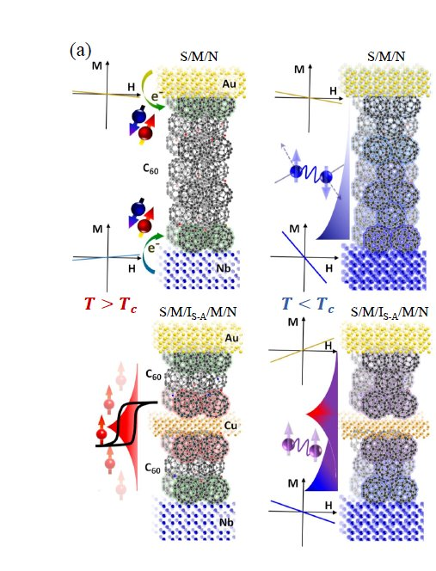
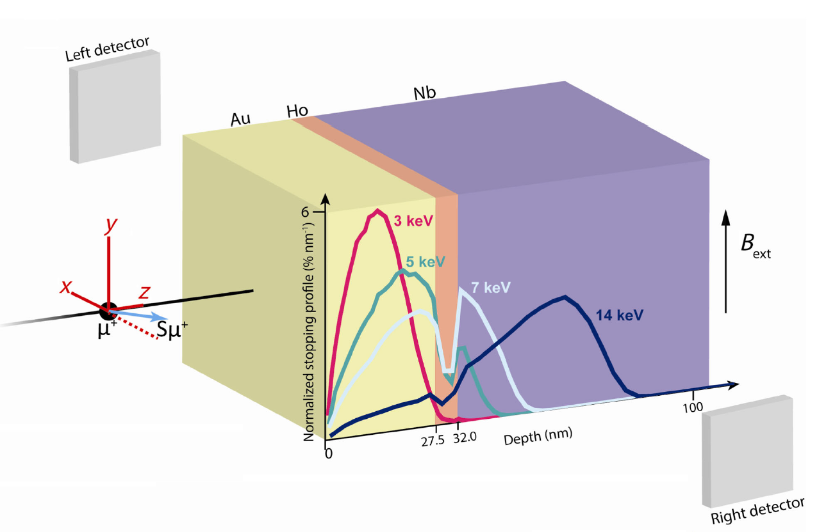
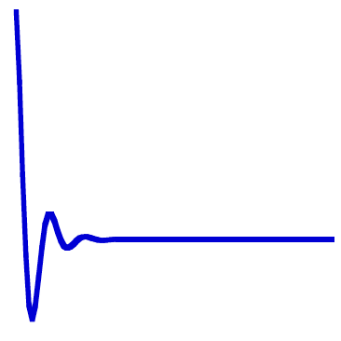
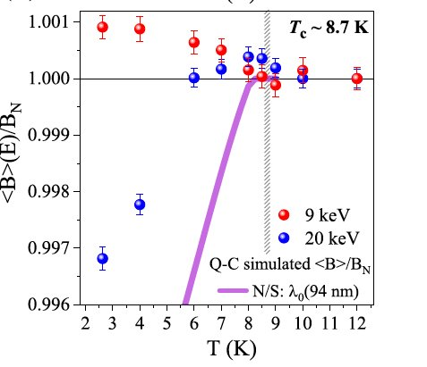
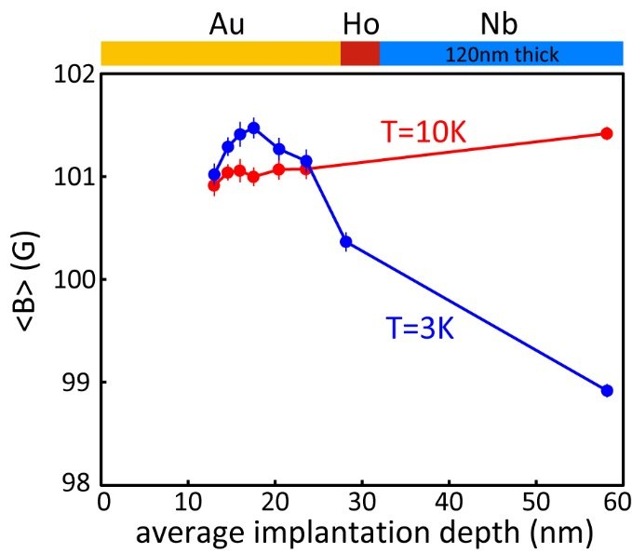
Superconducting proximity – screening effects
Flux profiles across N/S and S
superconductor – ferromagnet
Paramagnetic screening
Ferromagnet
Superconductor
Matthew Rogers et al, Communications Physics volume 4, Article number: 69 (2021)
A. Di Bernardo, Z. Salman et al., PHYSICAL REVIEW X 5, 041021 (2015).
Notes:
What is important here?
Typically conventional superconductivity being manipulated by some conflicting state of matter – archetypical example is the FM but a lot of interest in AFM, high S-O etc.
Correlations affected by the material properties of the host they 'leak into' and can become unconventional e.g. Spatial modulation of pair wave function, odd-freq. S-wave pairs that screen with the applied field to add to it. Super weird. Pairs possess NET SPIN.
Why do we do it? Insight into unconventional pairing mechanisms that are not easily realised in bulk system – play with the relevant degrees of freedom. Also, to work towards useful applications – superconducting spintronics where here we care about propagation of net spin pairs over long distances from the superconductor – A CHALLENGE!
But how do we study these systems – obviously a lot of transport measurements (name a couple specifics), PNR is powerful, some SANS, but I will talk about LE-MuSR since that is what I have used most.

Slide 22
Superconducting proximity – electromagnetic proximity
$$d_{f}$$
Typically assume M is trapped for a thin single domain F layer (aside from inverse proximity)
Superconductor
$$M_{o}$$
Notes:
What is important here?
Typically conventional superconductivity being manipulated by some conflicting state of matter – archetypical example is the FM but a lot of interest in AFM, high S-O etc.
Correlations affected by the material properties of the host they 'leak into' and can become unconventional e.g. Spatial modulation of pair wave function, odd-freq. S-wave pairs that screen with the applied field to add to it. Super weird. Pairs possess NET SPIN.
Why do we do it? Insight into unconventional pairing mechanisms that are not easily realised in bulk system – play with the relevant degrees of freedom. Also, to work towards useful applications – superconducting spintronics where here we care about propagation of net spin pairs over long distances from the superconductor – A CHALLENGE!
But how do we study these systems – obviously a lot of transport measurements (name a couple specifics), PNR is powerful, some SANS, but I will talk about LE-MuSR since that is what I have used most.

Slide 23
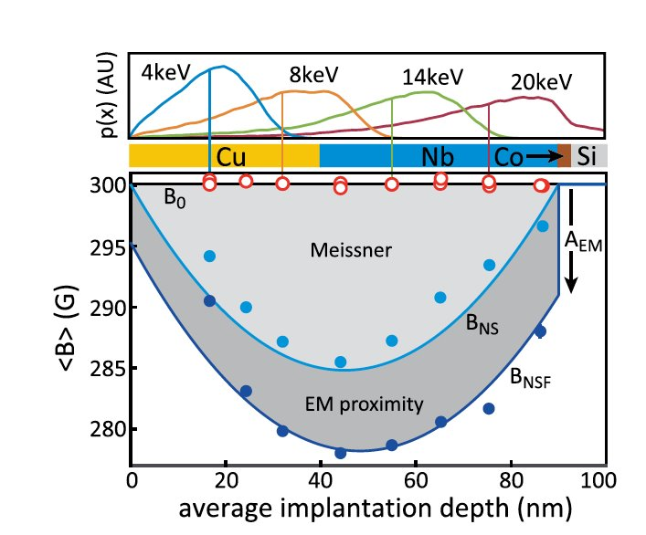
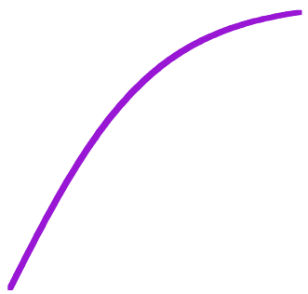
Superconducting proximity – electromagnetic proximity
Response of the macroscopic wavefunction to the vector potential due to M in F ​
$$d_{f}$$
Superconductor
$$M_{o}$$
z
$$ψ(x)$$
Applied field
$$d_{f}$$
x
$$M_{o}$$
Direct contact of condensate with M in F
Superconductor
Vacuum
Ferromagnet
S. Mironov et. al. Appl. Phys. Lett. 113, 022601 (2018)
Phys. Rev. Lett. 120, 247001 (2018)
Zh. Devizorova et. Al. Phys. Rev. B 99, 104519 (2019)
Appl. Phys. Lett. 115, 072602 (2019)
A. F. Volkov et. al. Phys. Rev. B 99, 144506 (2019)
Phys. Rev. B 100, 020505(R) (2019)
Notes:
What is important here?
Typically conventional superconductivity being manipulated by some conflicting state of matter – archetypical example is the FM but a lot of interest in AFM, high S-O etc.
Correlations affected by the material properties of the host they 'leak into' and can become unconventional e.g. Spatial modulation of pair wave function, odd-freq. S-wave pairs that screen with the applied field to add to it. Super weird. Pairs possess NET SPIN.
Why do we do it? Insight into unconventional pairing mechanisms that are not easily realised in bulk system – play with the relevant degrees of freedom. Also, to work towards useful applications – superconducting spintronics where here we care about propagation of net spin pairs over long distances from the superconductor – A CHALLENGE!
But how do we study these systems – obviously a lot of transport measurements (name a couple specifics), PNR is powerful, some SANS, but I will talk about LE-MuSR since that is what I have used most.

Slide 24
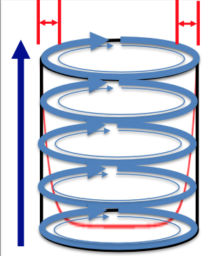
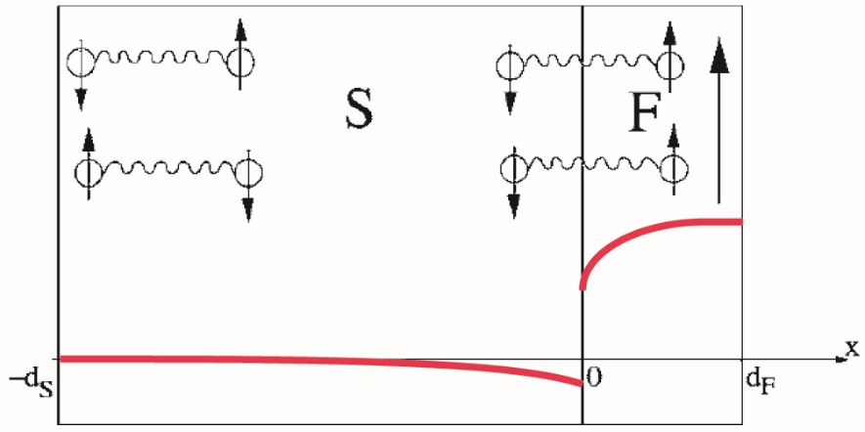
Superconducting proximity – spin versus orbital effects
λ
Penetration depth
The above examples of diamagnetic/paramagnetic shielding are orbital effects with a length scale ~λ
B
Can also have spin polarisation contributions to the magnetisation e.g. the inverse proximity effect with a length scale ~ ξ
Cu
Nb
1
Cu
Nb
Co
2
Cu
Nb
Cu
Co
3
$$20 nm\sim 2ξ$$
1
3
2
Length scale ~ξ
S. Bergeret, Rev. Mod. Phys. 77, 1321 (2005)

Slide 25
From ferromagnets to high spin-orbit materials
A large body of work on superconductor-ferromagnet interfaces: singlet-triplet pair mixing FFLO analogue, odd frequency pairs, long range triplet pairing, flux logic etc.
Recent experimental and theoretical developments in using interfacial Rashba S-O interaction to generate equal triplet (long range) pairs -> easier route to integrating superconductivity with traditional spintronics devices.
Amundsen et al Colloquium: Spin-orbit effects in superconducting hybrid structures (2022).
Jeon, K.-R. et al, Nat. Mater. 17, 499-503 (2018)
However, theory, and FMR measurements, have suggested these effects can be generated without the exchange field from the ferromagnet layer!
Chunli Huang, Ilya V. Tokatly, and F. Sebastian Bergeret, Phys. Rev. B 98, 144515 (2018) ...and several others

Slide 26
Sample structures
SM1
Cu(40)
Nb(50)
}
Reference samples for MuSR measurements on the Pt/Nb bilayer
SM2
Cu(40)
Pt(x)
Nb(50)
SM3
Pt(60)
Nb(90)
Layer thicknesses carefully chosen
Sample series developed to introduce, and modify, spin-orbit coupling at the interface between a superconductor and a normal metal.
Build on results for well-characterised Nb, Cu/Nb and Cu/Nb/Co systems measured previously.

Slide 27
Scanning Tunnelling Spectroscopy Results on Au(5)/Pt(x)/Nb
(almost) fully developed proximity induced gap through 2nm of Pt
reduces to ~10%Nb through 10nm of Pt
Important result is that the coherence length of Pt ~ 10nm and superconducting pairs pass through ~10nm Pt
Temperature dependence in good agreement with calculations using the Usadel theory (with input material parameters extracted from transport measurements).

Slide 28
Low energy muon results for Cu(40)/Nb(50) and Cu(40)/Pt(10)/Nb(50) – finding a benchmark signal
SM1: without the Pt spacer layer the Cu becomes highly proximitised and a large diamagnetic screening develops due to the long electronic mean free path. (cf Phys. Rev. Lett. 120, 247001 (2018).
SM2: significant reduction in screening both sides of the interface (cf STS results through 10nm Pt).
These effects can be modelled using quasiclassical Usadel formalism (B(x)) WITHOUT S-O.
Thin platinum spacer layer acts like a vacuum interface.

Slide 29
Low energy muon results for Pt(60)/Nb(96)
19keV
SM3: thicker Nb -> stronger screening-> amplify effects that scale with screening current.
19keV measurement suggests significant discrepancy to expected screening of Nb!

Slide 30
Temperature and magnetic field scaling of the muon signal in Pt(60)/Nb(96)
Temperature
Quasiclassical theory would predict a linear temperature dependence -> not what we observe.
Meissner screening is linear with field -> not what we observe.
Magnetic field

Slide 31
The need to include spin-orbit to describe the data
interface
interface
difference
Pre-existing theory unable to describe the interface contribution or T and B dependence of the signal.

Slide 32
Adding spin-orbit coupling to the calculation
A paramagnetic contribution can appear at the interface due to triplet pairs generated by Meissner currents in the presence of S-O coupling (although this doesn’t capture the unusual temperature dependence).
calculated T dependence
Convolute with muon stopping profile

Slide 33
Adding spin-orbit coupling to the calculation
A paramagnetic contribution can appear at the interface due to triplet pairs generated by Meissner currents in the presence of S-O coupling (although this doesn’t capture the unusual temperature dependence).
calculated T dependence
Could instead be a spin galvanic effect due to the interaction between S-O coupling and itinerant electrons in the Pt as in:
S.V. Mironov et al, Appl. Phys. Lett. 124, 252601 (2024)
Convolute with muon stopping profile

Slide 34
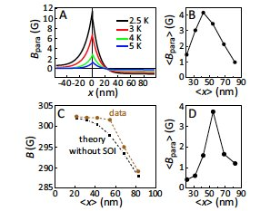
Summary and main conclusions
Low energy muons are a quantitative probe of magnetic interface effects, where full spatial information may be extracted given appropriate theory models.
Superconducting proximity systems host a range of unconventional superconducting states and offer the opportunity to tune superconductivity for fundamental study or application to superconducting spintronics.
Spin-orbit interactions can generate spin polarization in a superconductor even without the presence of a magnetic layer!
We have observed a spin-orbit induced net paramagnetic contribution arising in a Pt/Nb bilayer, where further low energy muon experiments are needed to confirm the origin.
This work is an important step in integrating superconductivity with conventional spintronics since correlations can propagate over long distances, in the absence of an exchange field, and without the need for complicated sample structures.

Slide 36
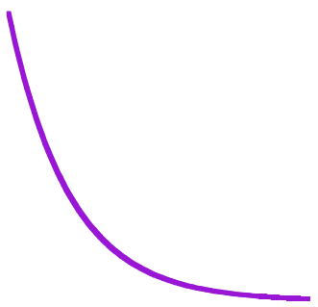
Superconducting proximity – screening effects
superconductor – normal metal
Flux profile across N/S and S
ξ
Cu (40 nm)
Nb (50 nm)
Coherence length
Nb (90 nm)
Metal
Superconductor
* Diamagnetic shielding
ξ_{n}
Can be calculated from 'conventional' theory models.
Phys. Rev. Lett. 120, 247001 (2018)
* Subtleties depending on how mean free path compares to coherence length
Notes:
What is important here?
Typically conventional superconductivity being manipulated by some conflicting state of matter – archetypical example is the FM but a lot of interest in AFM, high S-O etc.
Correlations affected by the material properties of the host they 'leak into' and can become unconventional e.g. Spatial modulation of pair wave function, odd-freq. S-wave pairs that screen with the applied field to add to it. Super weird. Pairs possess NET SPIN.
Why do we do it? Insight into unconventional pairing mechanisms that are not easily realised in bulk system – play with the relevant degrees of freedom. Also, to work towards useful applications – superconducting spintronics where here we care about propagation of net spin pairs over long distances from the superconductor – A CHALLENGE!
But how do we study these systems – obviously a lot of transport measurements (name a couple specifics), PNR is powerful, some SANS, but I will talk about LE-MuSR since that is what I have used most.

