Slide 1

Neutron scattering and muSR study on the QSL behavior of Pr₂Ga₂BeO₇
Jie Ma
Shanghai Jiao Tong University
2025.01.10.

Slide 2

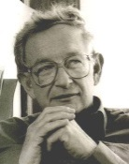
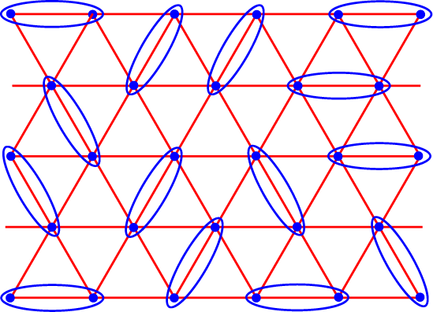
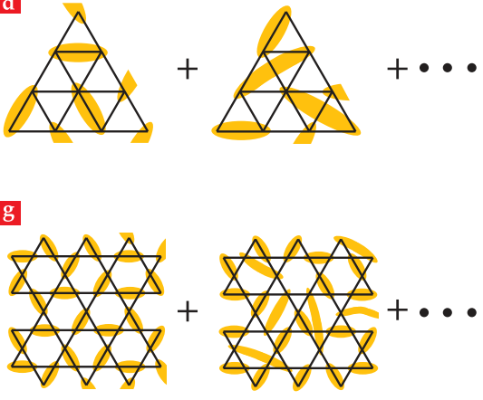
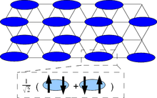
Quantum Spin Liquid
Competing or contradictory constraints on a large fraction of the magnetic sites ─ geometric magnetic frustration
Quantum Spin Liquid
?
─ No magnetic long-range ordering
─ No symmetry broken
─ Fractional excitation: spinon
─ Strong fluctuation at low energy
?
?
Superconductor
P.W. Anderson 1973、1987
Phys. Tod. 69, 30 (2016).
2

Slide 3

Quantum Spin Liquid
Competing or contradictory constraints on a large fraction of the magnetic sites ─ geometric magnetic frustration
Quantum Spin Liquid
─ No magnetic long-range ordering
─ No symmetry broken
─ Fractional excitation: spinon
─ Strong fluctuation at low energy
  Anyons in an exactly solved model
  α-RuCl₃
3

Slide 4
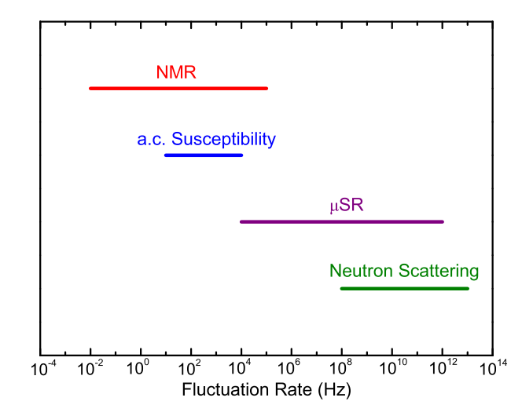

Quantum Spin Liquid
Competing or contradictory constraints on a large fraction of the magnetic sites ─ geometric magnetic frustration
Identification of quantum-spin-liquid
Specific heat measurements: the low-energy density of states
Thermal transport measurements: localized or itinerant excitations
Neutron scattering/Nuclear-magnetic resonance: excitations and correlations
Frustration
Spin-orbital (Wilson Ratio)
R = [4π²k_{B}²χ₀] / [3(gμ_{B})²γ]
Nature 540 22 (2016); Nat. Phys. 17, 726 (2021); Nat. Comm. 13, 5796 (2022)
4

Slide 5
Quantum Spin Liquid
Competing or contradictory constraints on a large fraction of the magnetic sites ─ geometric magnetic frustration
Identification of quantum-spin-liquid
Specific heat measurements: the low-energy density of states
Thermal transport measurements: localized or itinerant excitations
Neutron scattering/Nuclear-magnetic resonance: excitations and correlations
Examples of quantum-spin-liquid
Material | Lattice | Θ_{cw} (K) | J (K)
κ-(BEDT-TTF)₂Cu₂(CN)₃ | anisotropic triangular | -375 | 250
EtMe₃Sb[Pd(dmit)₂]₂ | anisotropic triangular | -375~-325 | 220-250
YbMgGaO₄ | Triangular | -4 | 1.5
Na₄Ir₃O₈ | Hyperkagome | -650 | 430
PbCuTe₂O₆ |  | -22 | 15
ZnCu₃(OH)₆Cl₂ (herbertsmithite) | Kagome | -314 | 170
Cu₂Zn(OH)₆FBr (barlowite) | Kagome | -200 | 170
Rb₂Cu₃SnF₁₂ | Kagome | -100 | 154.4
Ca₃Cr₇O₂₈ | Distorted Kagome |  | -9
PRL 91, 107001 (2003); PRL 100, 087202 (2008); PRL 95, 177001 (2005); JACS 130, 2922 (2008); Nat. Phys. 6, 865 (2010); Nature 464, 199 (2010); npj Quant. Mater. 4, 12 (2019); npj Comp. Mater. 8, 10 (2022).
5

Slide 6
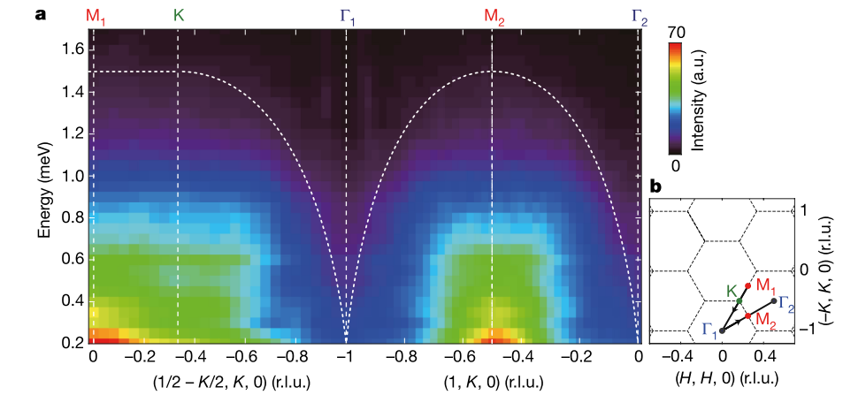
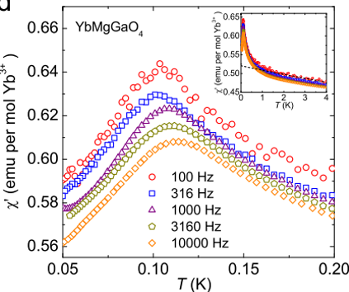
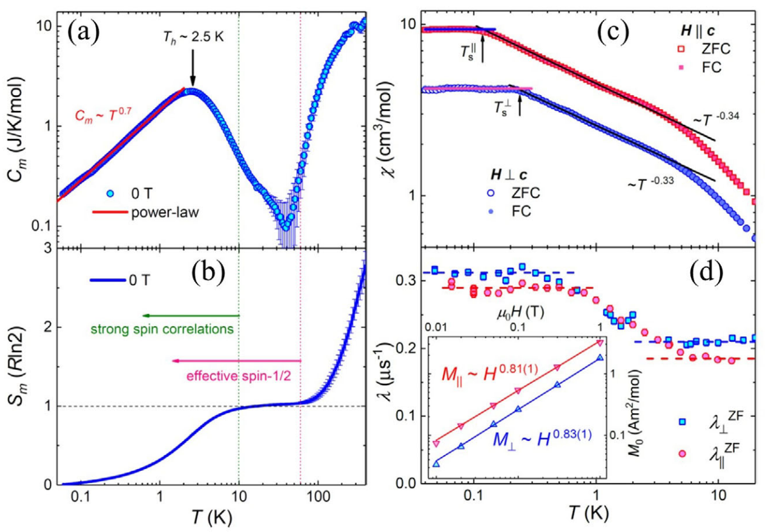
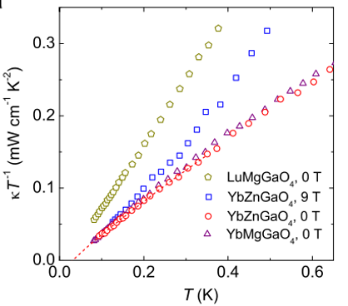
YbMgGaO₄
(a) QSL’ evidences:
C_{m} ≈ T^{0.7} below ≈2K, gapless low-energy spin excitations;
𝜇SR spectra: no spin freezing down to 48 mK with robust dynamics and strong (zero-point) quantum fluctuations;
Continuous spin excitations.
(b) Evidences against QSL:
AC susceptibility shows strong frequency-dependent peaks around 0.1K, spin glass ?
Thermal conductivity indicates no contribution from magnetic excitations.
Nature 540, 559 (2016); PRL 117, 267202 (2016); Adv. Quant. Technol., 1900089 (2019); npj Quant. Mater. 4, 12 (2019).
6

Slide 7
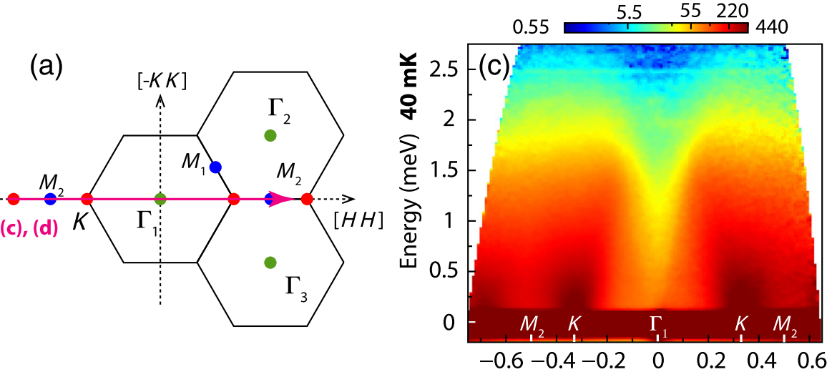
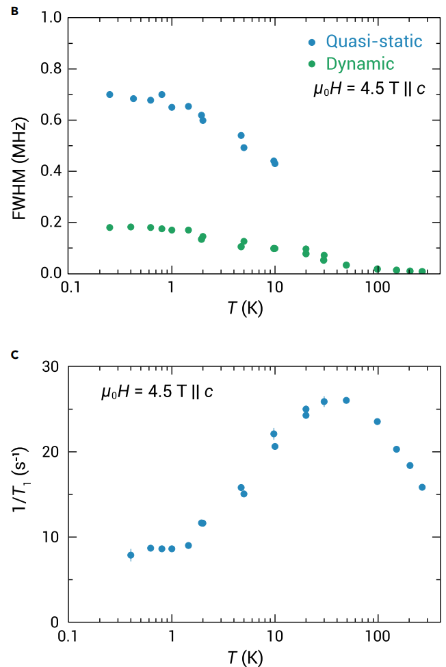
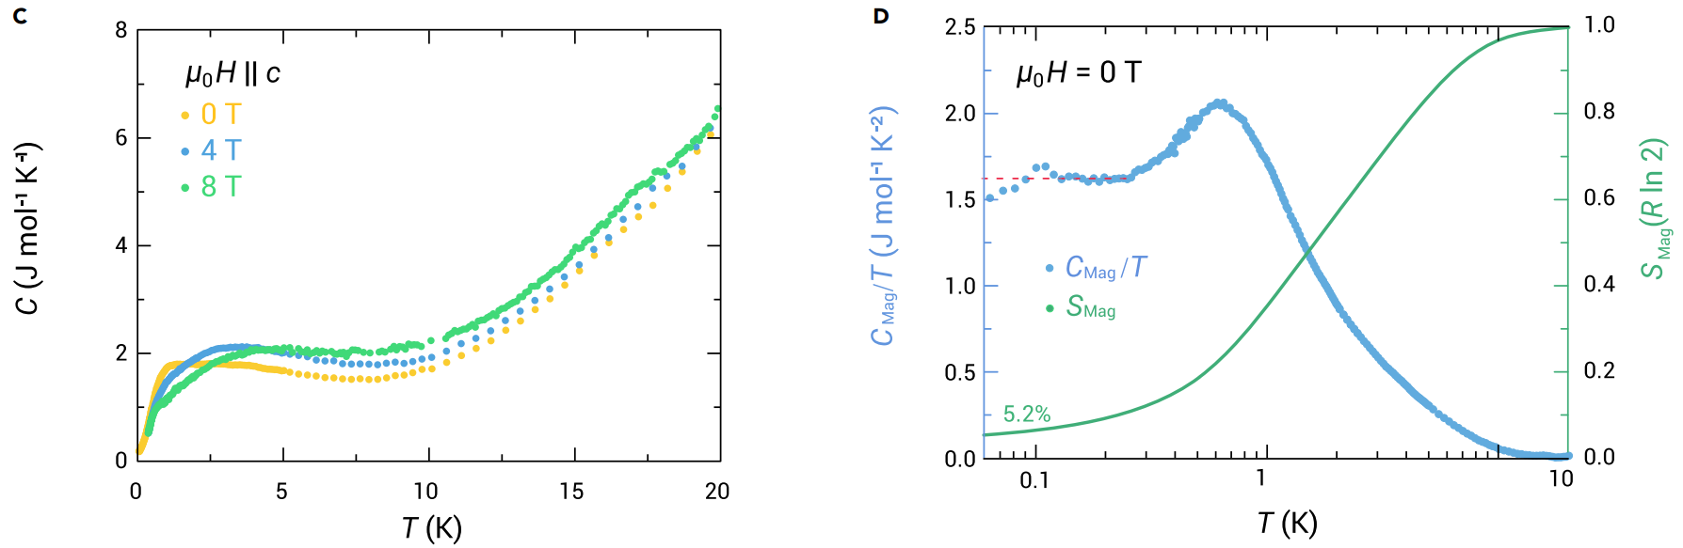
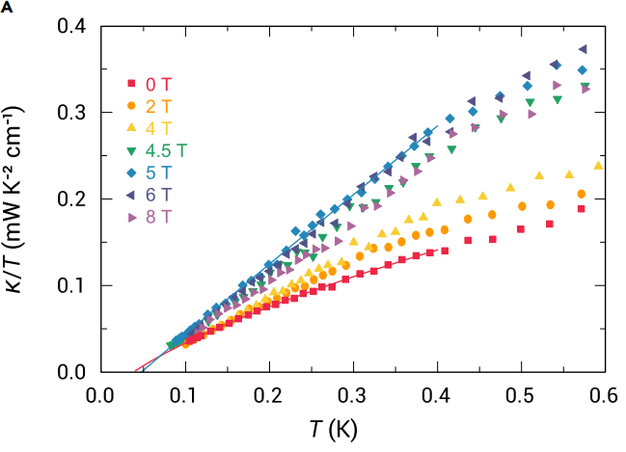
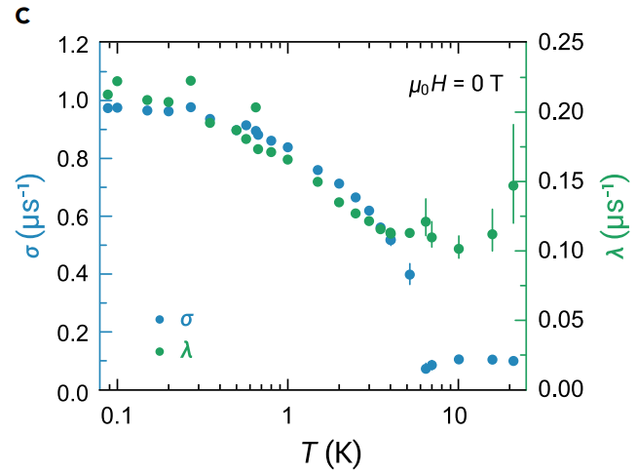
NaYbSe₂
(a) QSL’s evidences:
C_{m}/T (<0.5 K) is almost a constant, indicating the spinon Fermi surface spin liquid;
the 𝜇SR spectra show no spin freezing with robust dynamics and strong quantum fluctuations;
Continuous spin excitations by INS.
NMR indicates the coexistence of short-range magnetic order and QSL
(b) Evidences against QSL:
Thermal conductivity indicates no contribution from magnetic excitations.
PRX 11, 021044 (2021); The Inn. 4, 100459 (2023).
7

Slide 8
Thermal conductivity
Material | Structure | κ₀/T (WK⁻²m⁻¹) | Note
EtMe₃Sb[Pd(dmit)₂]₂ | triangular | 0.194 | sample dependent, zero κ₀/T term reported
1T-TaS₂ | triangular | 0.05 | sample dependent, zero κ₀/T term reported
PbCuTe₂O₆ | hyperhyperkagome | 0.0075 | depletion of spinon transport below 0.3 K
YbMgGaO₄ | triangular | 0.0058 | spinon-phonon scattering, zero κ₀/T term reported
Na₂BaCo(PO₄)₂ | triangular | 0.0062 | T_{N} = 148 mK
κ₀/T value (nonzero or zero) is sample dependent;
pretty small due to spin-phonon scatterings;
demises while approaching 0 K as an effect of strong disorder, magnetic ordering, or possibly a gap opening.
8

Slide 9
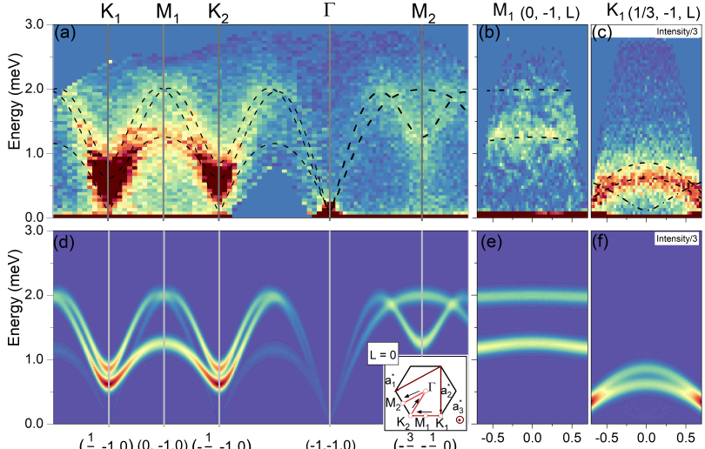
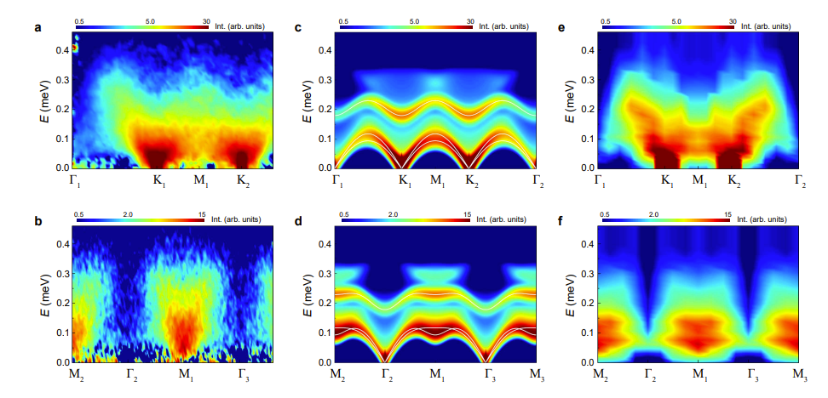
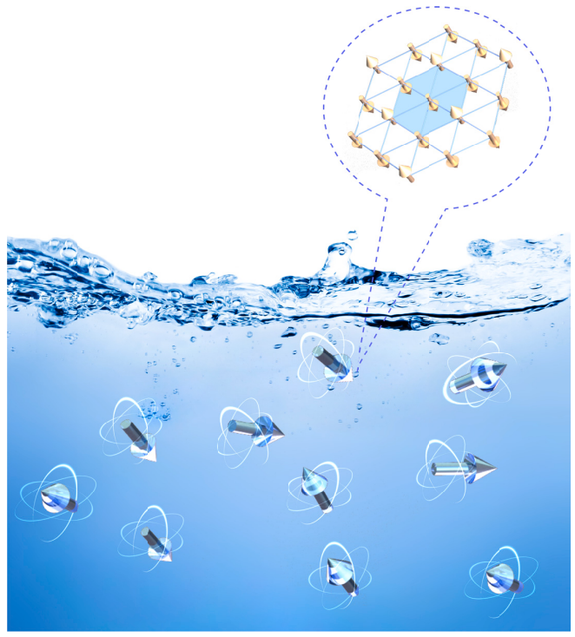
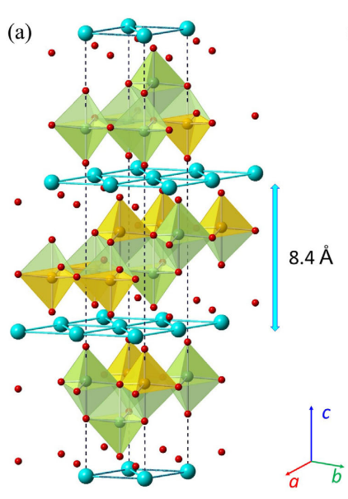
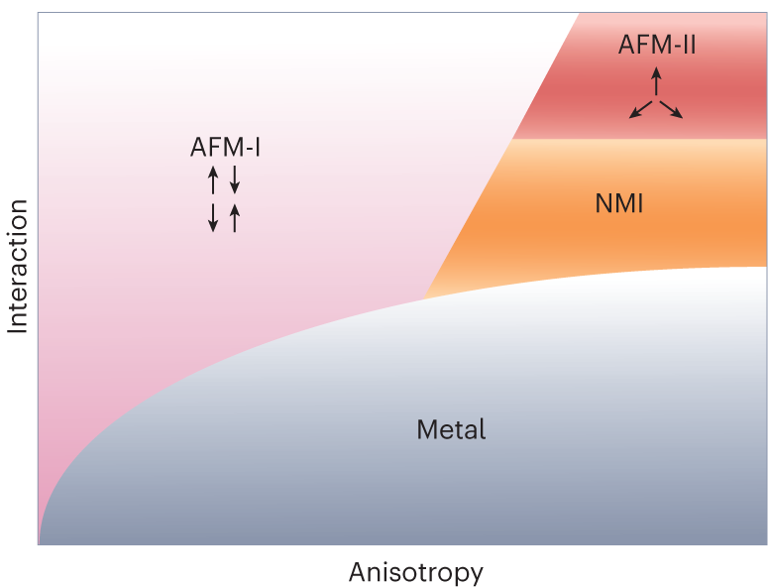
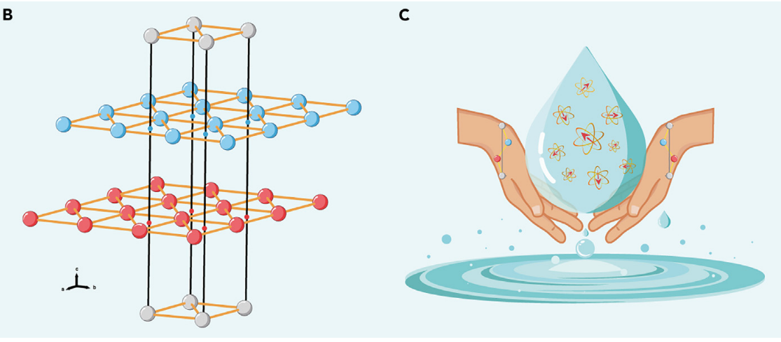
Is there a pure QSL?
Ba₃MnSb₂O₉
Na₂BaCo(PO₄)₂
PRB 108, 174424 (2023); arxiv 2402.07730 (2024)
Adv. Quant. Technol., 1900089 (2019); The Inn. 4, 100484, (2023); Nat. Phys. 19, 922 (2023).
9

Slide 10
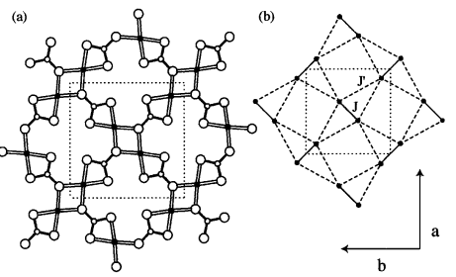
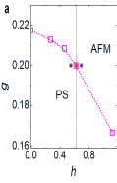
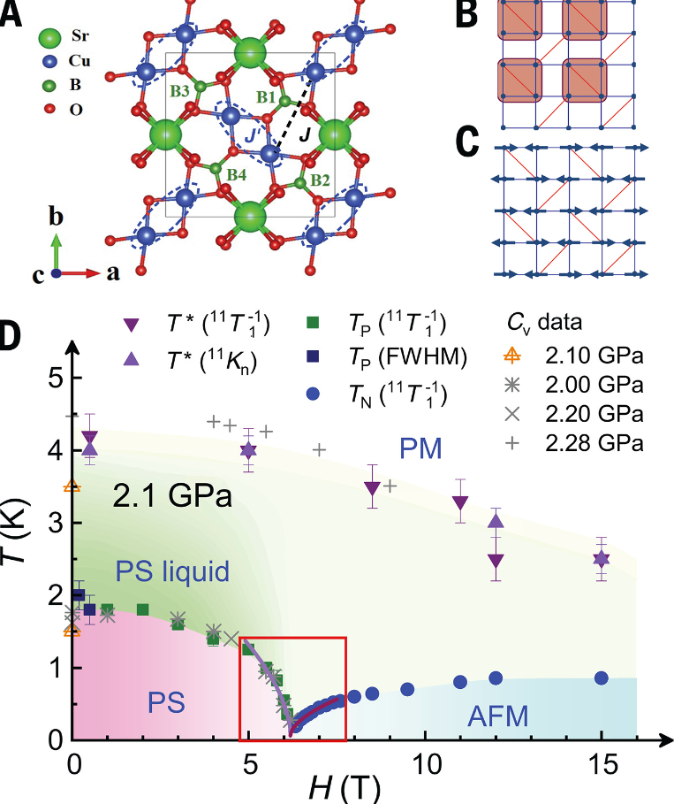
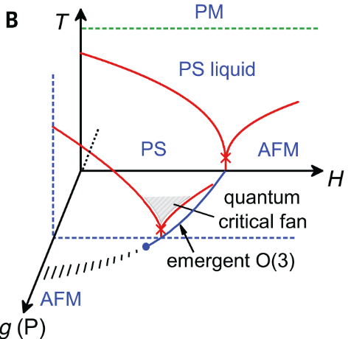
Shastry-Sutherland lattice
2D spin systems with a finite spin gap for high-Tc, CaV₄O₉
SrCu₂(BO₃)₂
1) rectangular CuO4
2) triangular BO3
Phys. Rev. Lett. 82, 3168 (1999)
Deconfined Quantum Critical Point
10
Science 380, 1179 (2023)
Notes:
物理学家对朗道相变理论是否可以统一描述所有物态相变产生了疑问。其中一个重要的问题是在两种自发对称破缺态之间是否存在连续的量子相变。以磁驱动的价键固体态和反铁磁态间的相变为例，由于两种态分别发生了晶格平移和自旋旋转两种互不相容的对称破缺，在朗道相变理论框架下，它们之间只能发生不连续的一级相变。在本世纪初，一些理论物理学家提出该相变可能是连续的，即超越朗道理论范式的解禁闭量子临界，在其附近呈现出新奇的解禁闭分数化元激发。这些早期的理论工作为量子相变的研究打开了一个全新的方向，然而长久以来一直缺乏有力的实验证据支持。
dimer singlets to a plaquette valence bond solid (PVBS) then to an AFM state by increasing J₁/J₂.

Slide 11
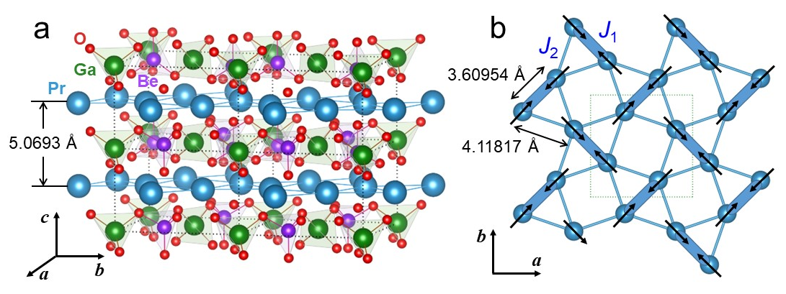
Pr₂Ga₂BeO₇
arXiv:2405.13628
Shastry-sutherland lattice of Pr₂Ga₂BeO₇
─ Pr³⁺ ions form orthogonal dimers
─ Ga/Be-O polyhedra along the c-axis
XXZ-type spin model on an SSL
─ non-Kramers Pr³⁺
─ 4f², L = 5, and S = 1
─ J = 4, 9-fold CEFs
─ no plaquette, nor AFM
─ Gapless by anisotropy
11
Notes:
the introduction of XY-type spin anisotropy on SSL is the key
First, only S^{z} transforms as a magnetic dipole, the S^{x} and S^{y} components transform as magnetic quadrupoles;
Second, the model generically exhibits spin anisotropy Δ ≠ 1.
For the Heisenberg SSL, strong spin frustration drives the plaquette-to-AFM transition close to a deconfined quantum critical point (DQCP), but whether a QSL can be stabilized is still under debate.
In the XXZ SSM, DMRG calculation, a state exhibiting neither plaquette nor AFM order but algebraically decaying spin correlation for Δ ≥ 2.5.
This implies a gapless QSL ground state stabilized by increasing the spin anisotropy. This QSL-like state in our model provides a natural explanation to the experimental findings of absence of magnetic ordering but existence of spinon in Pr₂Ga₂BeO₇.

Slide 12
Thermal conductivity
Thermal conductivity along the a or c axis
κ₀/T (0.0105 and 0.0095)
κ/T = a + bT,
a: spinon excitations, bT: spinons and acoustic phonons.
Material | Structure | κ₀/T (WK⁻²m⁻¹)
EtMe₃Sb[Pd(dmit)₂]₂ | triangular | 0.194
1T-TaS₂ | triangular | 0.05
PbCuTe₂O₆ | hyperhyperkagome | 0.0075
YbMgGaO₄ | triangular | 0.0058
Na₂BaCo(PO₄)₂ | triangular | 0.0062
─ κ₀/T are the largest among the studied magnetic oxide QSLs
─ the T linear behavior of κ persists down to the lowest temperature measured as 70 mK.
12
Notes:
14 T: high magnetic field smear out the residual thermal conductivity, the energy scale exceed the bandwidth of spinons and completely suppress the fermionic spin excitations

Slide 13
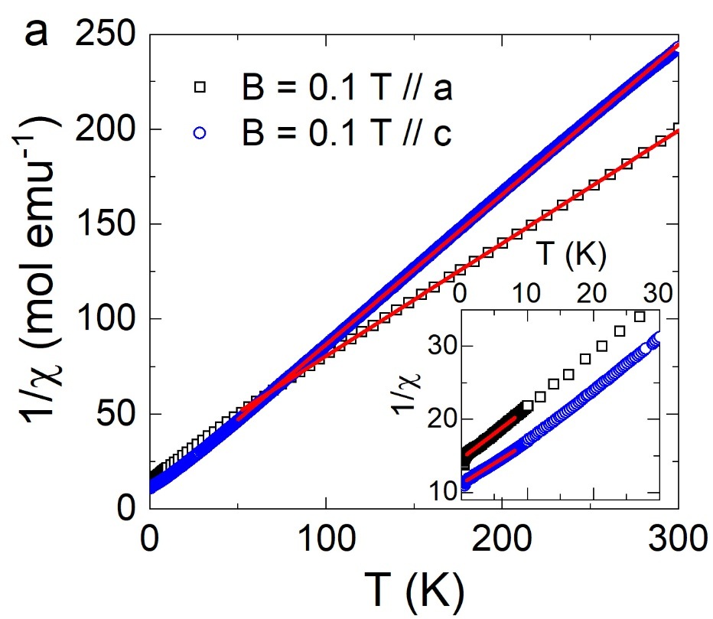
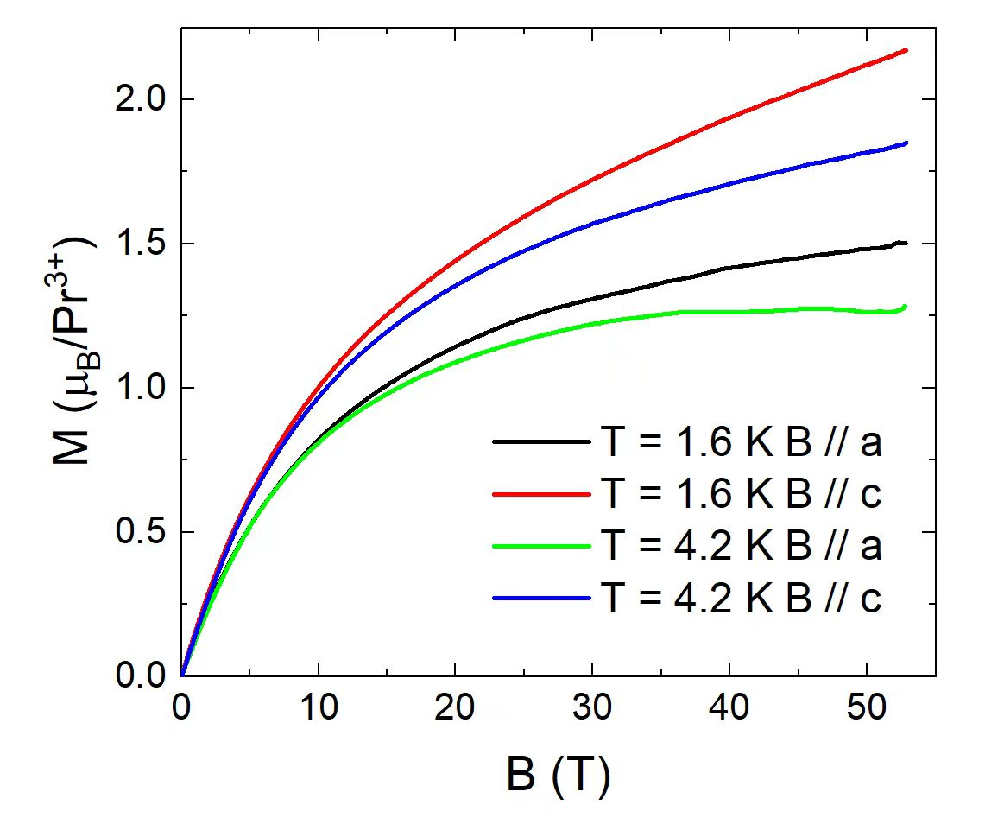
Magnetization
B//a
─ θ_{CW} = - 35.83(7) K, μ_{eff} = 3.67(1) μ_{B}
─ θ_{CW} = - 21.34(1) K, μ_{eff} = 3.40(9) μ_{B}
B//c
─ θ_{CW} = - 9.79(8) K, μ_{eff} = 3.18(3) μ_{B}
─ θ_{CW} = - 19.98(3) K, μ_{eff} = 3.77(3) μ_{B}
─ Weak temperature dependence
─ Non-linear magnetic field
─ Not saturated up to 50 T
─ Weak spin anisotropy.
13
Notes:
a weak temperature dependence and a non-linear magnetic field response.
not saturated value up to 14 T, may be related to the low-energy CEF effects.
no field-induced transitions are detected for all curves and the magnetization along the c axis is larger, which means a weak spin anisotropy.

Slide 14
Heat Capacity
─ The specific heat suppressed below 10 K by field
─ Phonon is negligible below 10 K
─ Field-induced anomaly 1 K and shifts to higher temperature with field
─ Anisotropy along a- and c-axis
14
Notes:
a field-induced anomaly is observed around 1 K and it becomes more significant and shifts to higher temperature with increasing magnetic field. The similar behaviors were observed for B // c,
It is notable that the low-temperature specific heat at zero field, which is mainly the magnetic contribution, displays a T² dependence for 0.2 < T < 3 K, as shown in Fig. S3(a).

Slide 15
Thermal conductivity
Thermal conductivity along the a- and c-axis under field
─ No field-induced transition
─ Spins are polarized at high magnetic fields for 151mK (phonon)
─ Saturation field is temperature-depedent
─ Anisotropy
15

Slide 16
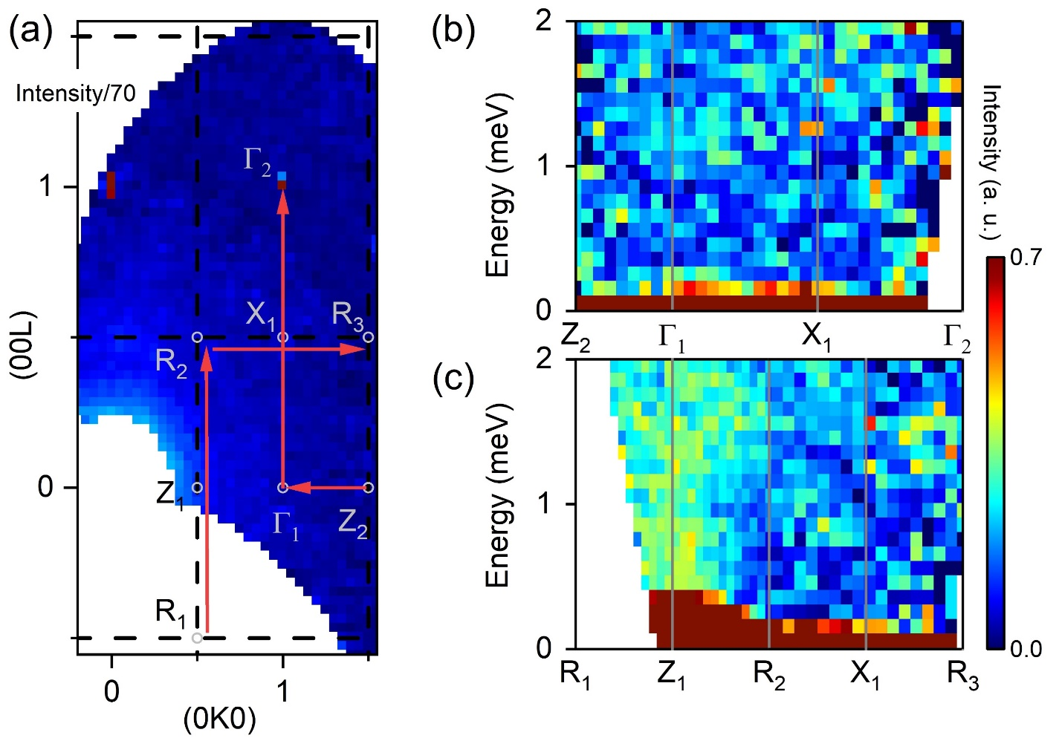
Dynamic spectrum
16

Slide 17
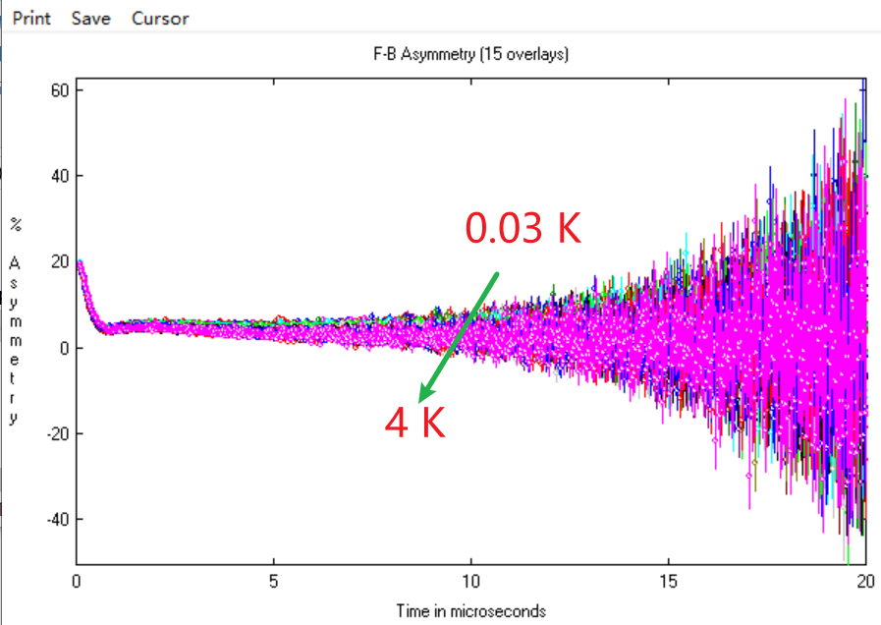
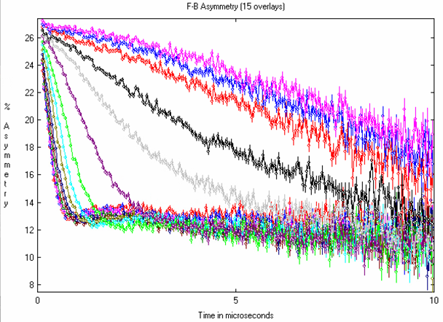
MuSR--data
250 K
2 K
No oscillation is seen in the ZF and LF -μSR spectra within the time window up to 20 μs, even down to 30 mK.
Notes:
α estimated as 1.215
α estimated as 0.9167

Slide 18
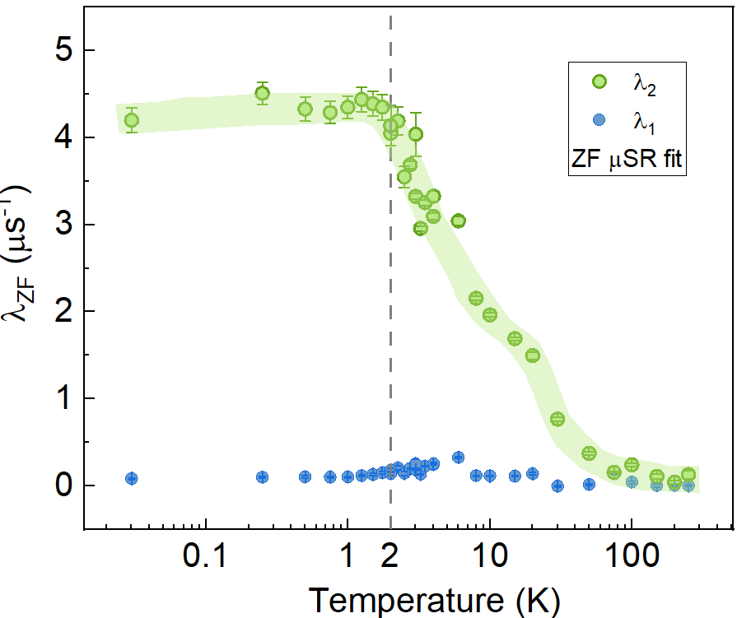
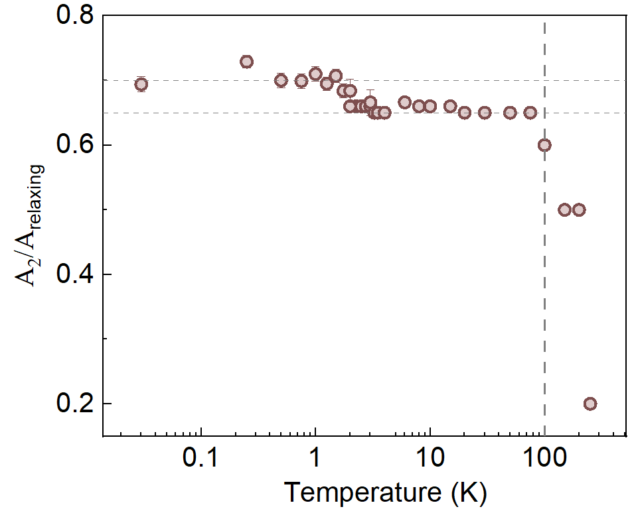
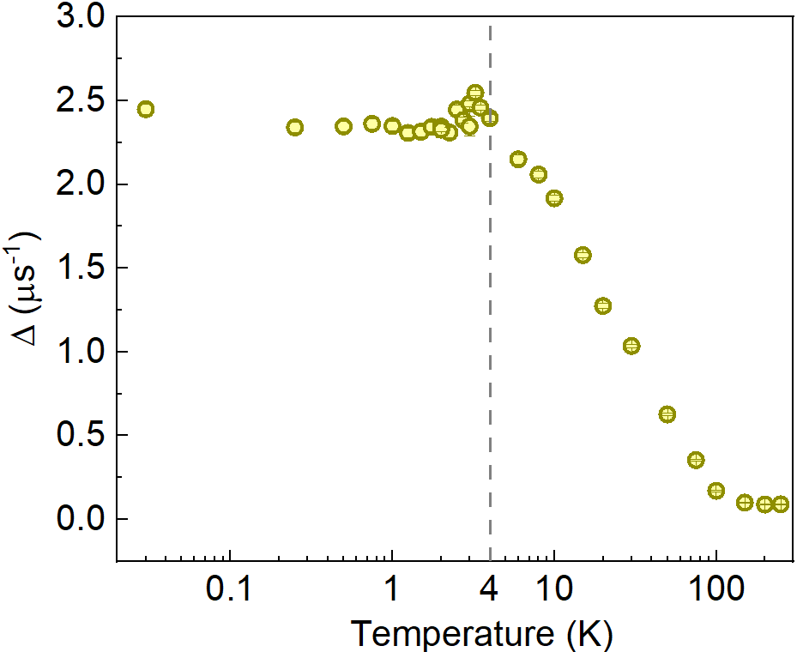

Fitting results-ZF
A$sy\left(t\right)=A_{0 }{\text{+} A}_{1}G^{kT}⋅ⅇ^{−λ_{tail}⋅t}$ + $A_{2}⋅ⅇ^{−λ_{2}⋅t}$
3: Upon further cooling, λ₂ shows temperature-independent plateau-like behavior between 2 K and 30 mK. The low-temperature plateau of muon relaxation rates is a sign of persistent spin dynamics.
4: The observed behavior of ∆ is both strongly temperature dependent and at low temperatures very large. A likely explanation comes via a hyperfine enhancement of the Pr nuclear moments

Slide 19
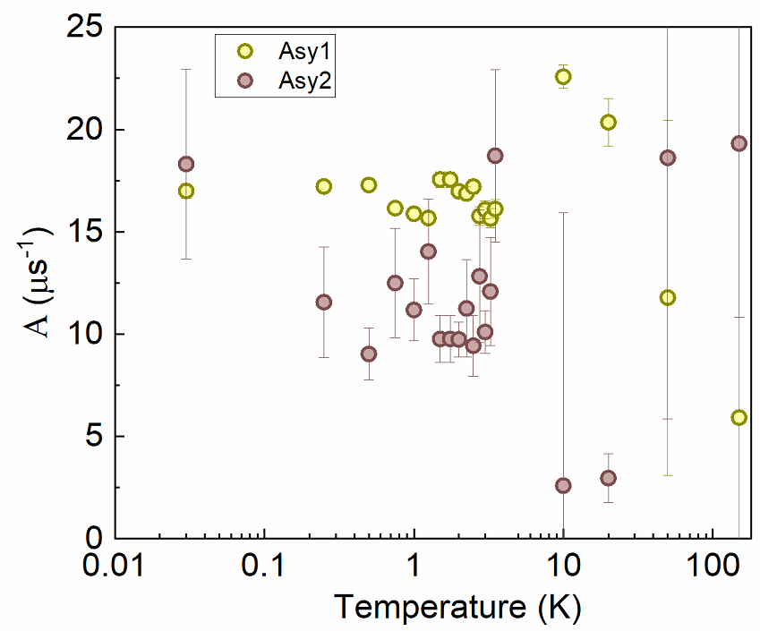
Fitting results-considering internal field

Slide 20
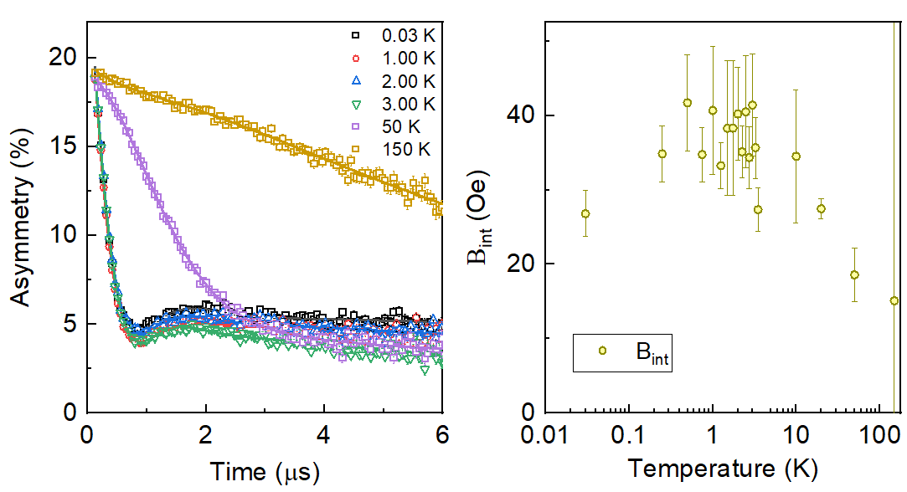
Fitting results-considering internal field

Slide 21
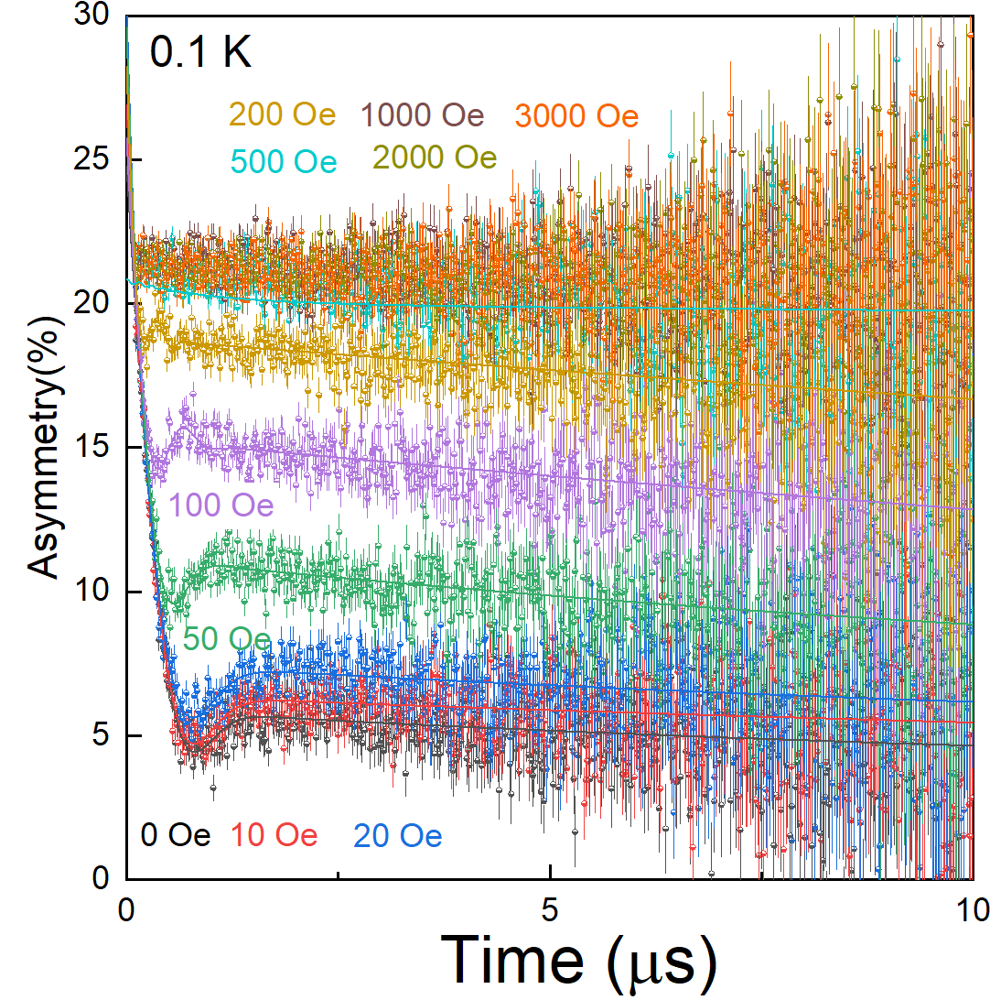
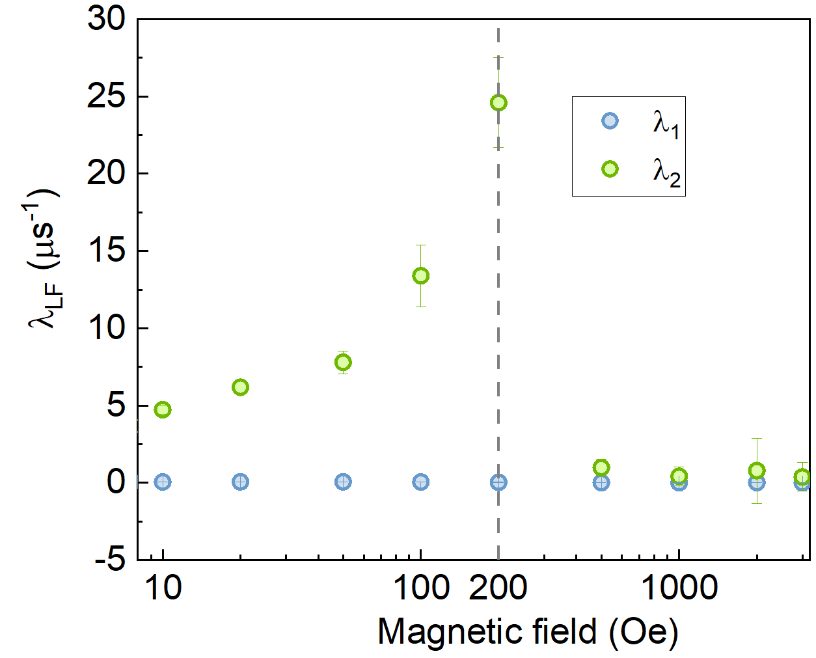
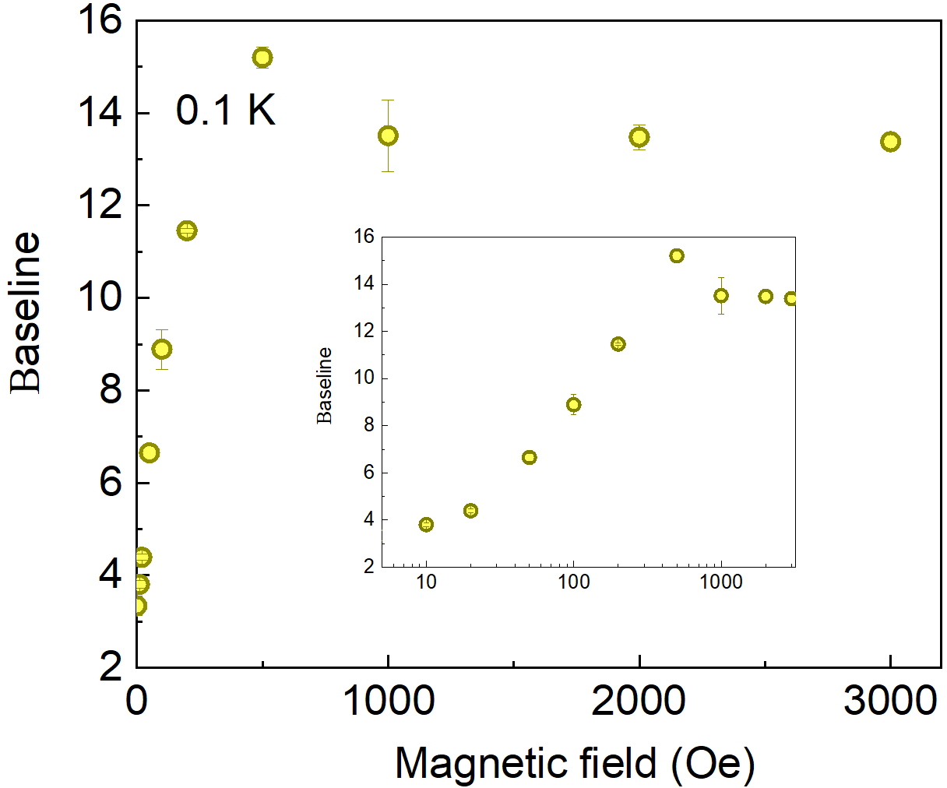

Fitting results-LF
A$sy\left(t\right)=A_{0 }{\text{+} A}_{1}G^{kT}⋅ⅇ^{−λ_{tail}⋅t}$ + $A_{2}⋅ⅇ^{−λ_{2}⋅t}$
The muon depolarization may be decoupled in an applied LF above 200 Oe based on the sudden decrease in relaxation time λ₂.

Slide 22
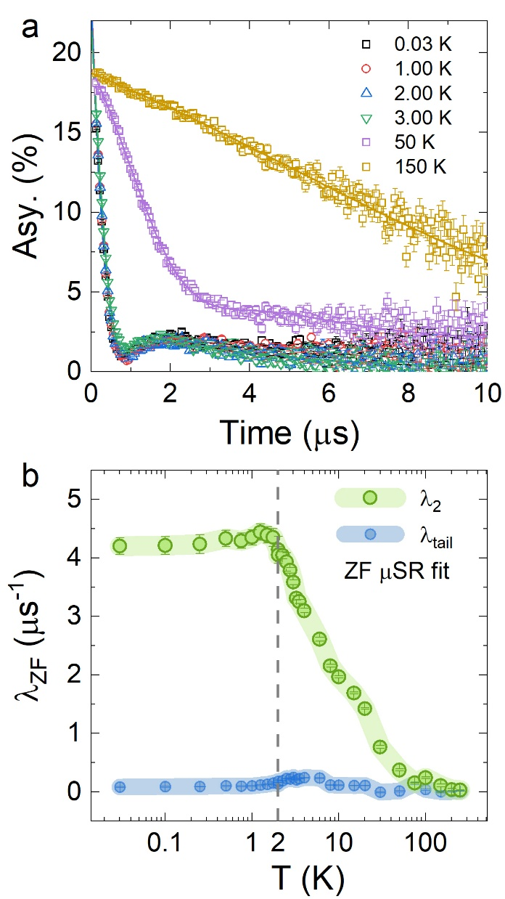
Conclusions
  QSL behavior is observed in a Shastry-Suntherland system
  The spin anisotropy could competite with J1 and J2
  (Sz dipole, Sx and Sy are
  quadrupole)
  g-factor, torque magnetory
  Pr₂Ga₂BeO₇ no plateau,
  Nd₂Ga₂SiO₇ no 1/3 plateau,
  But 1/6 and 2/3
22
Notes:
XY-type spin anisotropy on SSL is the key

Slide 23
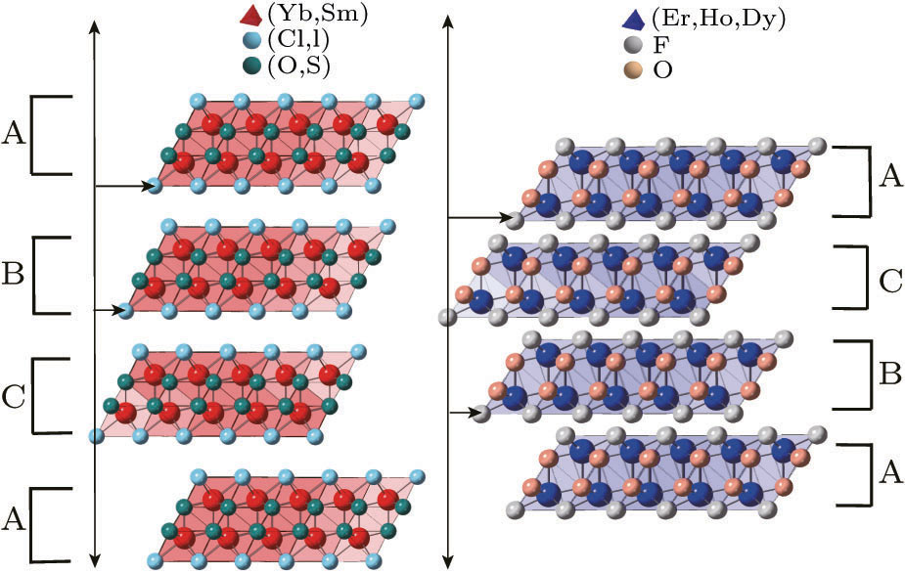
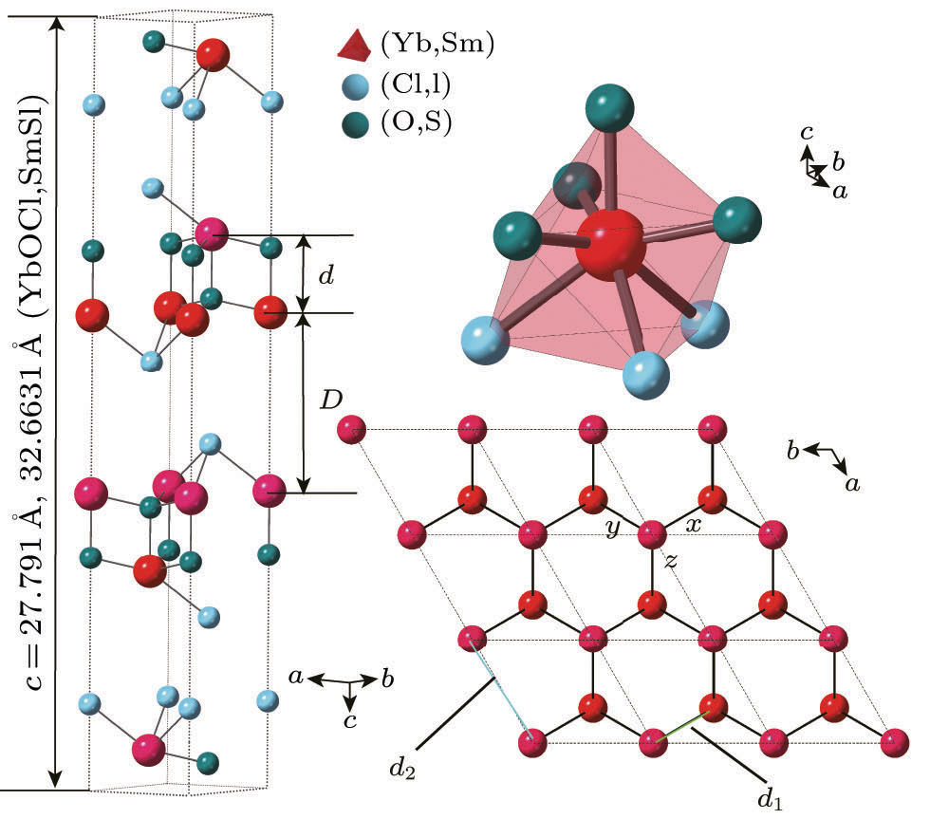
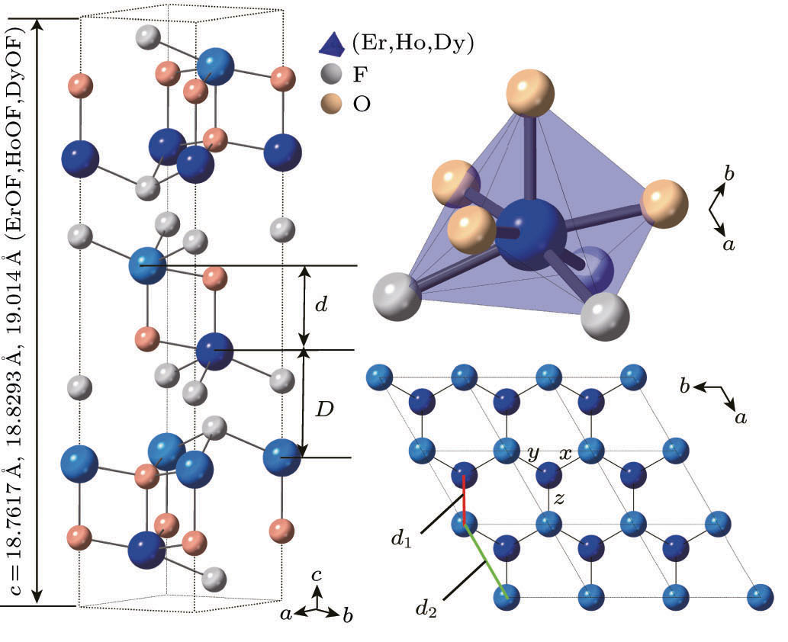
Quantum Spin Liquid Candidate
REChX (RE = rare earth; Ch = O, S, Se, Te; X = F, Cl, Br, I)
Chin. Phys. Lett. 38， 047502 (2021)

Slide 24
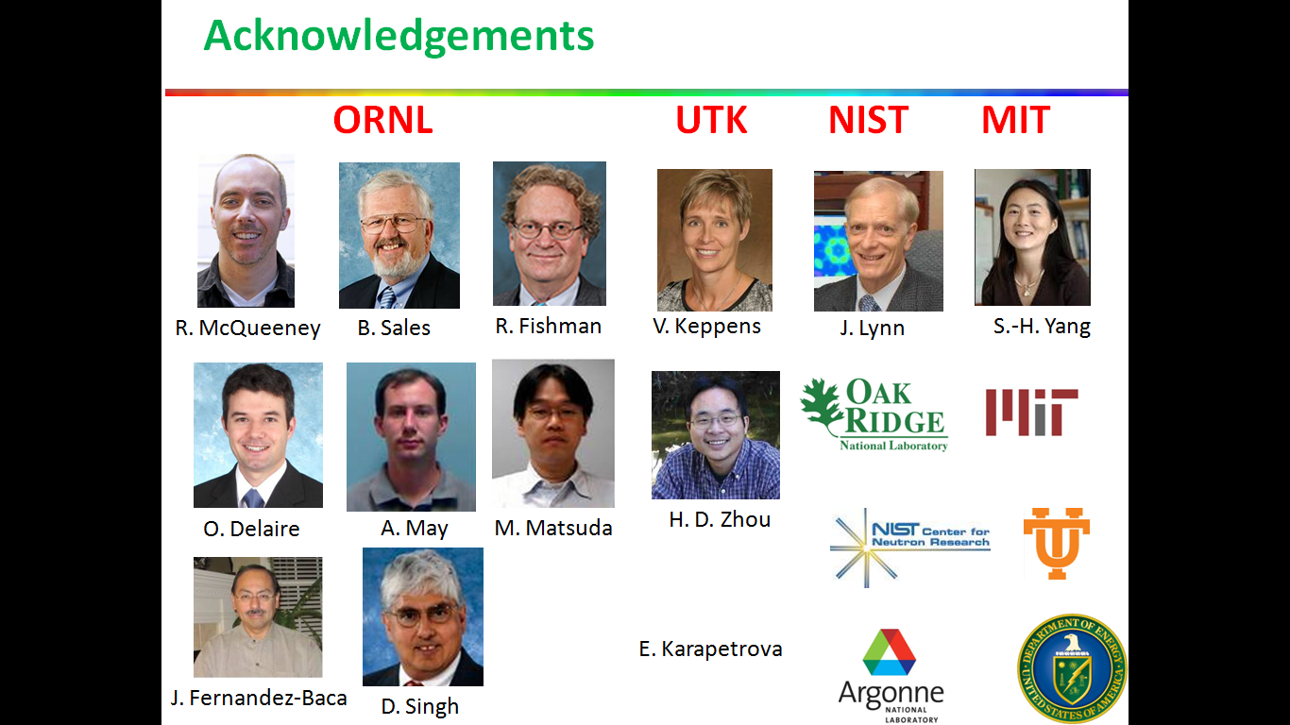















Acknowledgements
Sample synthesis and characterization:
A. Brassington, H. D. Zhou, H. Wang, W. Xie
Thermal conductivity:
C. Kim, H. Yang, N. Li, X.F. Sun
Theoretical calculation:
Y. Wan, C. Liu, R. Yu, J. G. Park
Neutron Scattering:
SNS & HFIR: M. Matsuda, T. Hong etc.
JRR-3: H. Kikuchi, T. Masuda
ISIS: D. Adroja
FRM-II, J-Parc, PSI, ANSTO, etc
μSR:
MuSR: P. J. Baker
East China Normal University
Tian Shang
Shanghai Jiao Tong University
M. F. Shu
24

Slide 25
Thanks!

Slide 26
Thermal conductivity
zero κ₀/T term with other supporting evidence for QSL state
Material | Structure | Other signatures for QSL
κ-(BEDT-TTF)₂Cu₂(CN)₃ | triangular | linear-T dependent specific heat
ZnCu₃(OH)₆Cl₂ | Kagome | power law of specific heat, continuum mode
YCu₃(OH)_{6.5}Br_{2.5} | Kagome | T² dependent specific heat, continuum mode
NaYbSe₂ | Triangular | linear-T dependent specific heat, continuum mode, plateau of muon spin relaxation rate
Ca₁₀Cr₇O₂₈ | Bilayer-Kagome | continuum mode, plateau of muon spin relaxation rate, linear-T dependent specific heat
26

Slide 27
Fitting results-considering internal field

