Slide 1

μSR Investigation of Novel Magnetic Semiconductors
Fanlong Ning 宁凡龙
School of Physics, Zhejiang University
(Material synthesis + μSR + NMR)
MELODY – CSNS (Dongguan)
Jan-11th, 2025
Supported by MOST, NSFC and ZJ-NSF

Slide 2
In collaboration with:
Y.J. Uemura’ Group (Columbia)
G.Luke’ Group (McMaster)
Changqing Jin’s Group (IOP)
Experiments:
Dr. Huiyuan Man (now a postdoc at Standford with Prof. Kathryn Moler)
Dr. Cui Ding (now a postdoc at Tsinghua with Prof. Qikun Xue)
Dr. Shengli Guo (now in industry)
Dr. Licheng Fu, Dr. Yilun Gu, Yao Zhao, Kai Wang
Acknowledgement
TRIUMF: Prof. Jess Brewer, Dr. Syd Kreizman, Dr. Bessam Hitti
Jianhua Zhao(Semi), Kai Chang (Semi), Kaiyou Wang(Semi)，Igor Zutic (Buffalo), S. Maekawa (JAEA), Bo Gu(KITS), Igor Mazin (Navy), Ravin Bhatt (Princeton), Xin Wan (ZJU), Chao Cao (HZNU)

Slide 3
Outline
Motivations
Introduction of some newly fabricated DMSs
----- Li_{1+y}(Zn_{1-x}Mn_{x})As
----- N-type Ba(Zn_{1-x}Co_{x})₂As₂
c. Microscopic characterization
----- μSR results on bulk form DMSs
-----NMR results on Li_{1.1}(Cd_{1-x}Mn_{x})P and Li_{1.15}(Zn_{1-x}Mn_{x})P

Slide 4


Magnetism
(since 400 B.C.)
Semiconductors
(since 1700s)
Magnetic Semiconductors
(since 1960s)

Slide 5
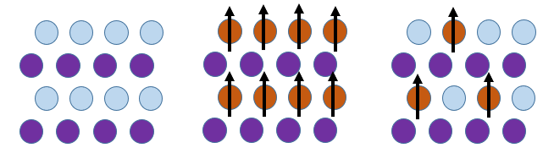
Spintronics and Magnetic Semiconductors
Charge
Electronics
We want to create
“spintronics”, and use
not only charge but
also spin information
Electron
+
Spin
Spintronics
Non magnetic
Semiconductor
Condensed Magnetic
Semiconductor
Diluted Magnetic
Semiconductor
Notes:
依靠技术的进步和材料的研发

Slide 6

The Development of Magnetic Semiconductors
2D, Topoligcal, Antiferromagnetic：
CrI₃、Bi₂Se₃:Mn、MnPS₃…
Ⅲ-Ⅴ：
(Ga,Mn)As、(In,Mn)As、
(Ga,Mn)N …
Ⅱ-Ⅵ：
(Cd,Mn)Te、(Zn,Co)S…
Concentrated：
EuO、EuS…
New, Novel…?
Bulk form, Decoupled Charge and Spin Doping：
(Na,Ca)(Zn,Mn)₂As₂, Li(Zn,Mn)As, (Ba,K)(Zn,Mn)₂As₂
(Ba_{1-x}K_{x})(Cu_{2-x}Mn_{x})Se₂,(La,Ba)(Zn,Mn)AsO…

Slide 7
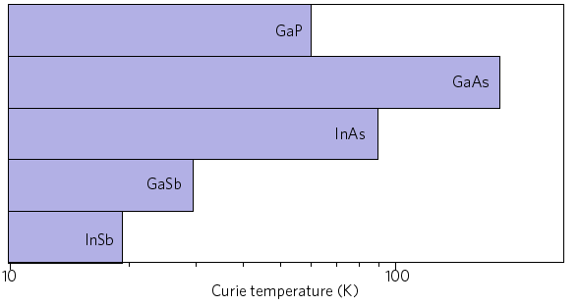
Ga_{1-x}Mn_{x}As and Why bulk form DMS?
Ga_{1-x}Mn_{x}As, T_{C}~200K, limited for practical applications; holes and spins are all
introduced by Mn atoms (Jianhua Zhao’s group in Institute of Semiconductor, Beijing)
Mismatch of valences for Mn²⁺ and
Ga³⁺ atoms, chemical solubility is less
than 1% in bulk form
Only low dimensional thin film can be
fabricated with Molecular Beam Epitaxy
Mn²⁺ substitution for Ga³⁺ introduces holes and spins
μSR, NMR and neutron scattering are limited to investigate thin film.
Highly debates on the mechanism
DMS in bulk form is highly expected!
Doped with Mn
Currently achieved highest Tc in various
III-V DMS thin films
(Dietl et al, Nature Materials, 2010, (9)965)

Slide 8
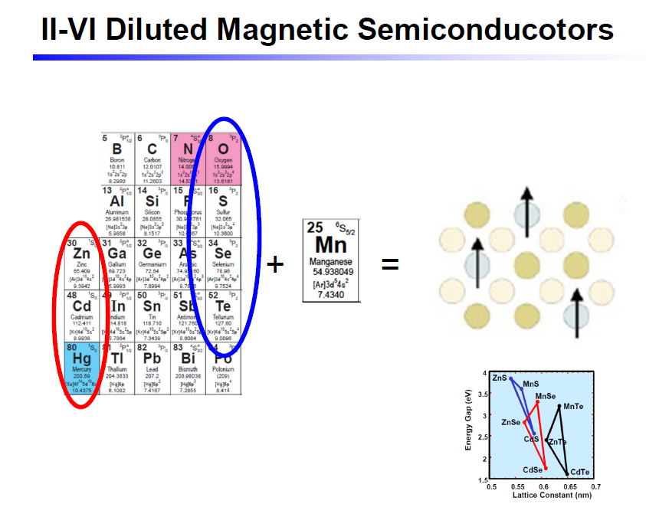
Spin Glass Ordering, saturation moment ~0.01μ_{B}

Slide 9
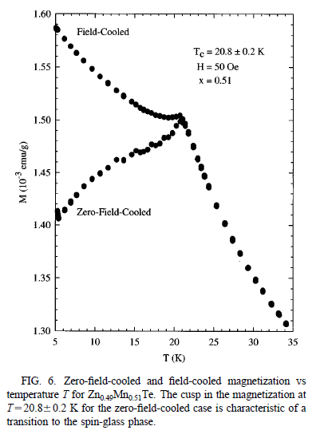
Zn_{0.49}Mn_{0.51}Te
Zn and Mn valences of “+2”,
No solid solution limit
the doping can be as high as ~70%
Mn ions do not provide carriers,
only provide local moment
Difficult to control density and type
of carriers
0.003 μ_{B}/Mn
ZnSe/ZnTe→FeSe
(“11” family of Fe-based SC）
Phys Rev B, 58, 12876 (1998)

Slide 10
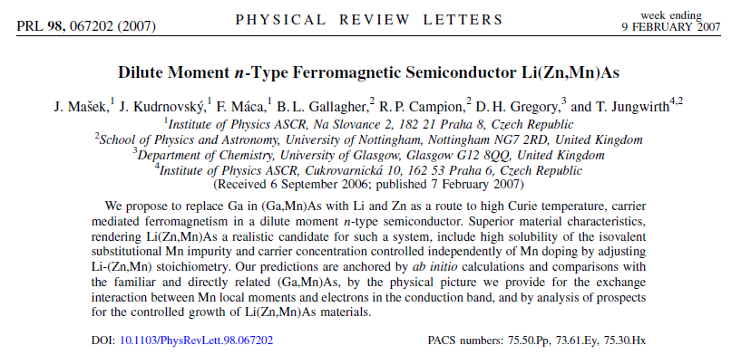

Slide 11
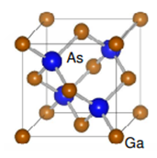
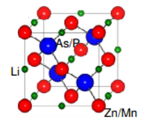
“III-V” “I-II-V” “II-VI”
(Li⁺Zn²⁺) = Ga³⁺
LiZnAs = GaAs
(Li⁺As³⁻) = Se²⁻
→ Zn(LiAs) = ZnSe
LiZnAs (1.6ev)
LiZnP (2.04ev)
LiCdP (1.30ev)
GaAs (1.42ev)
Ga_{1-x}Mn_{x}As: Mn dope both spins and holes
Li_{1+y}(Zn⁺²_{1-x}Mn⁺²_{x})As, Li_{1+y}(Zn⁺²_{1-x}Mn⁺²_{x})P, Li_{1+y}(Cd⁺²_{1-x}Mn⁺²_{x})P (T_{C} ~40-50K)
: decouple spins and carriers
Mn doping induces local moments
Li extra or deficiencies create carriers---use Li to control the type of carriers
(C.Q. Jin’s group in IOP, Z. Deng et al, Nature Comm.,2011, PRB 2013)
LiZnAs → LiFeAs
(“111” family of Fe-based SC）

Slide 12
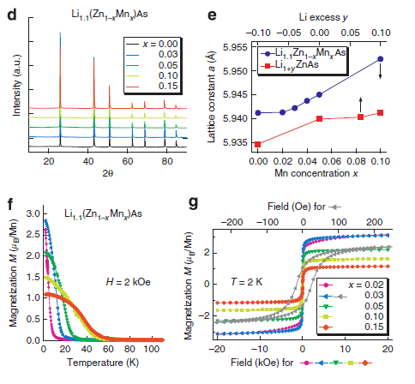
“111”- Li_{1+y}(Zn⁺²_{1-x}Mn⁺²_{x})As （T_{C} ~ 50 K)
Saturation moments continuously
decrease with more Mn
Effective moment is 5~6μ_{B}/Mn，
high spin state
Coercive field ~ 50 Oe，
for magnetic manipulation
Z. Deng et al, Nature Communications (2011)

Slide 13
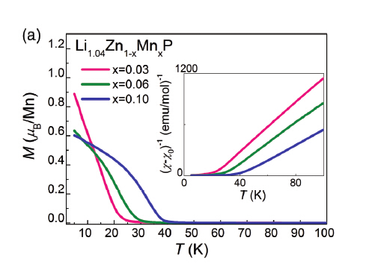
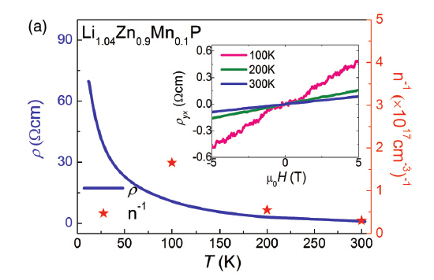
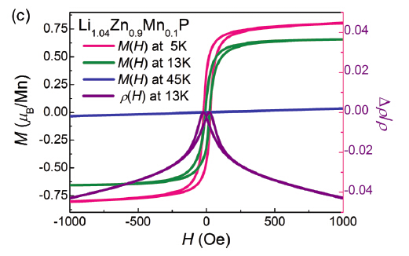
Li_{1+y}(Zn⁺²_{1-x}Mn⁺²_{x})P: Max T_{C} ~ 40 K
Deng et al, PRB 88,081203(R) (2013)

Slide 14
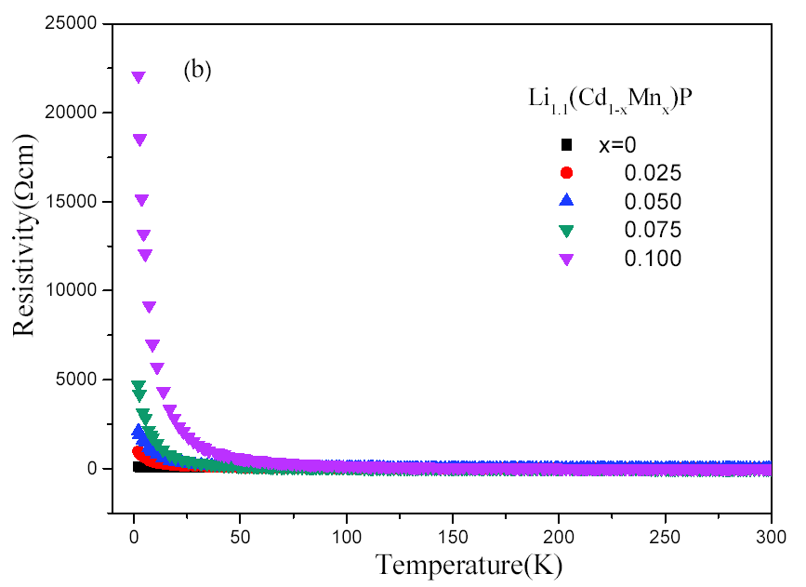
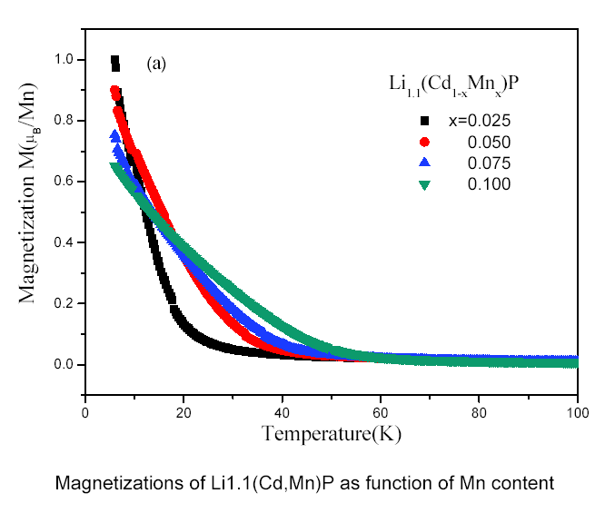
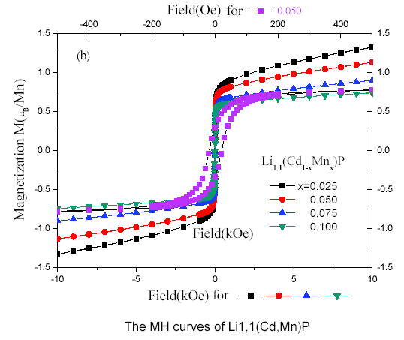
Li_{1+y}(Cd⁺²_{1-x}Mn⁺²_{x})P
Wei Han et al, Scientific Reports 9, 7490 (2019)
T_{c}
T_{c} and moment size at 6K
x*(100%)
T_{c}
Mn(6K)
2.5
21
1.00
5.0
28
0.90
7.5
35
0.75
10
43
0.65

Slide 15
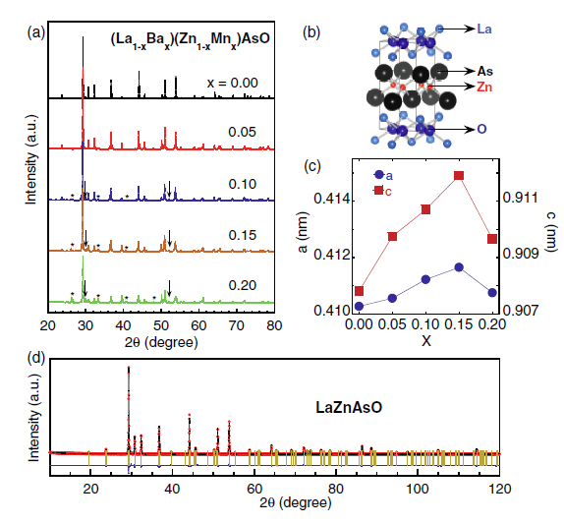
(La_{1-x}Ba_{x})(Zn_{1-x}Mn_{x})AsO T_{C} ~40K
Isostructral to Fe-based SC
“1111”-LaFeAsO_{1-x}F_{x}
LaZnAsO → LaFeAsO
(“1111” family of Fe-based SC）
C. Ding and F.L. Ning, PRB 88, 041102 (2013)

Slide 16
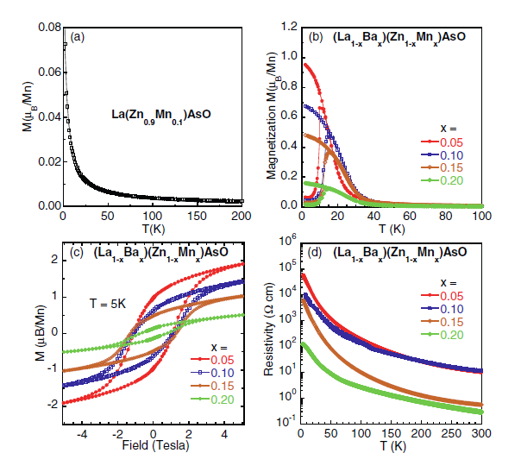
(La_{1-x}Ba_{x})(Zn_{1-x}Mn_{x})AsO T_{C} ~40K
T_{C}
doping Mn only, paramagnetic state
Only when carriers are doped via Ba
substitution for La, FM ordering is observed
From resitivity, semiconducting behavior
Large coercive field ~ 1 Tesla
C. Ding and F.L. Ning, PRB 88, 041102 (2013)

Slide 17
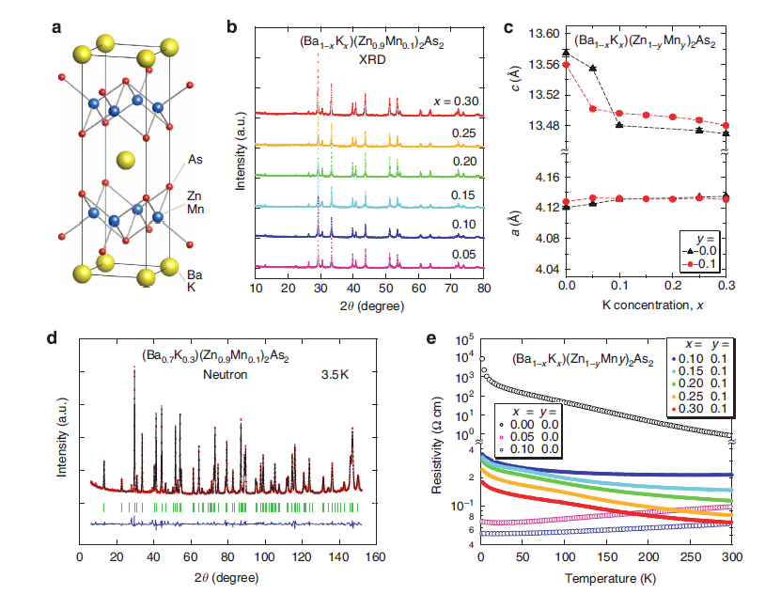
(Ba_{1-x}K_{x})(Zn_{1-y}Mn_{y})₂As₂ T_{C} ~180K
K. Zhao et al, Nature Communications, 4, 1442 (2013)

Slide 18
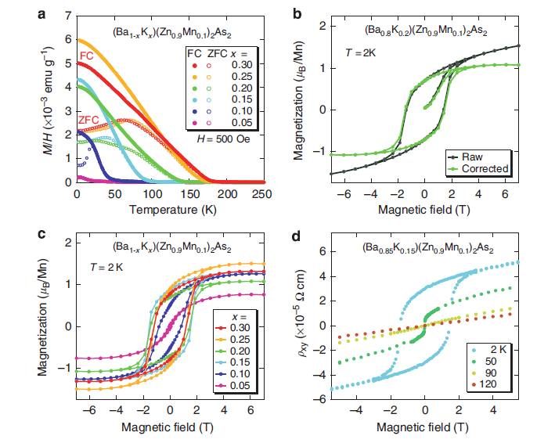
(Ba_{1-x}K_{x})(Zn_{1-y}Mn_{y})₂As₂ T_{C} ~180K
K. Zhao et al, Nature Communications, 4, 1442 (2013)

Slide 19
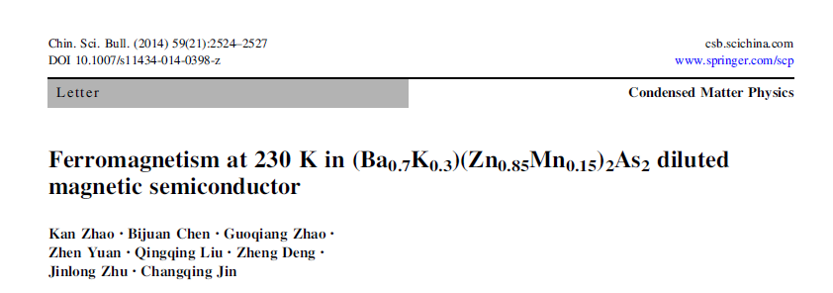
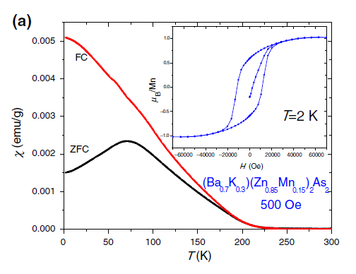
Record T_{C} ~ 200K
Ga_{1-x}Mn_{x}As
BaZn₂As₂ → BaFe₂As₂
(“122” family of Fe-based SC）
T_{C} ~ 230K

Slide 20
Fabricate new DMS and what we have
GaAs ------------ (Ga_{1-x}Mn_{x})As ------------------------ MnAs
FM, T_{c} ~ 210K(film) FM, T_{c} ~ 320K
LiZnAs --------- Li(Zn_{1-x}Mn_{x})As ----------------------- LiMnAs
“111” FM, T_{c} ~ 55K(bulk) AFM, T_{N}~ 400K
I-II-V (Nature Comm. 2011, IOP)
BaZn₂As₂ ---- (Ba_{1-y}K_{y})(Zn_{1-x}Mn_{x})₂As₂ ---------------- BaMn₂As₂
“122” FM, T_{c} ~ 230K(bulk) AFM, T_{N}~ 620K
II-II-V (Nature Comm. 2013, IOP)
LaZnAsO ---- (La_{1-y}Ba_{y})(Zn_{1-x}Mn_{x})AsO --------------- LaMnAsO
“1111” FM, T_{c} ~ 40K(bulk) AFM, T_{N} ~ 320K
(PRB 2013, Zhejiang)
“32522” ---- (Sr₃La₂O₅)(Zn_{1-x}Mn_{x})₂As₂ --------------- AFM(?)
FM, Tc ~ 40K(bulk)
(EPL 2014, Zhejiang)
“42622” ---- (Sr_{1-x}K_{x})₄Ti₂O₆(Zn_{1-x}Mn_{x})₂As₂ --------------- AFM(?)
FM, Tc ~ 25K(bulk)
(To be submitted, Zhejiang)

Slide 21
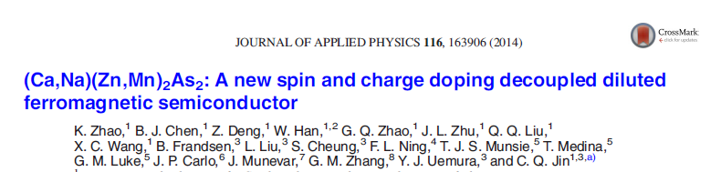
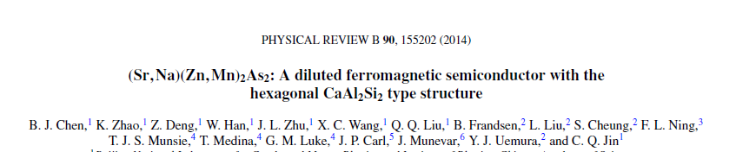
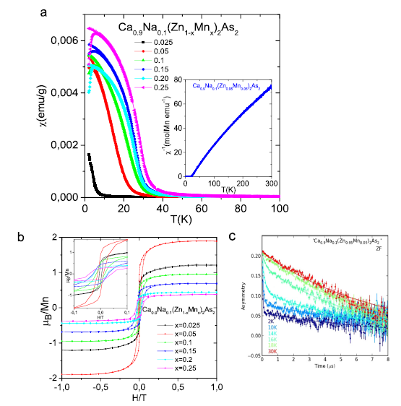
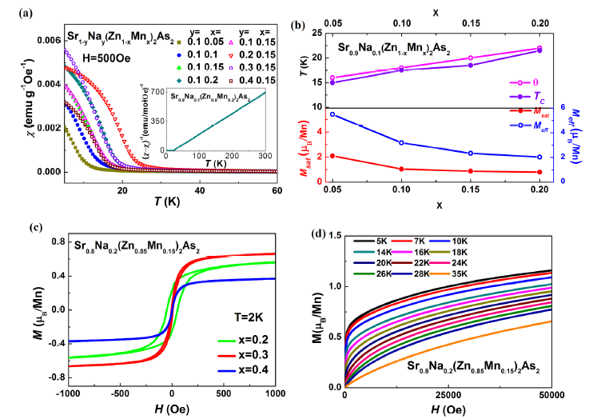

Slide 22
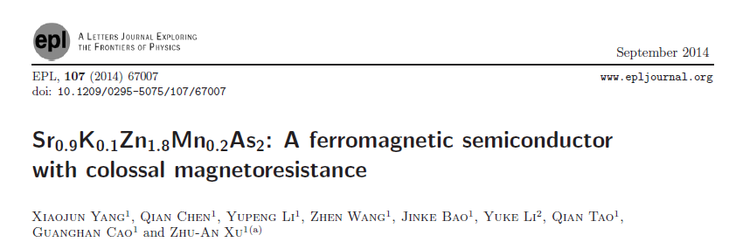
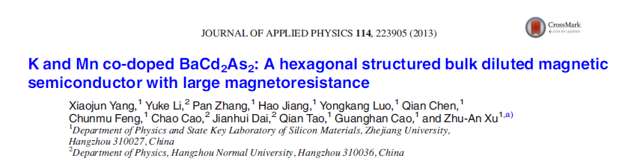
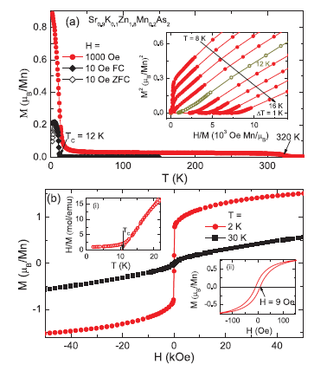
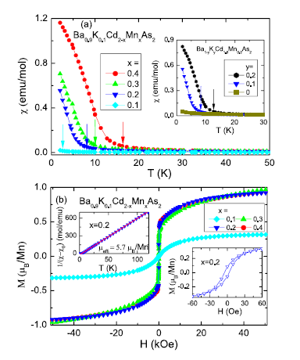

Slide 23
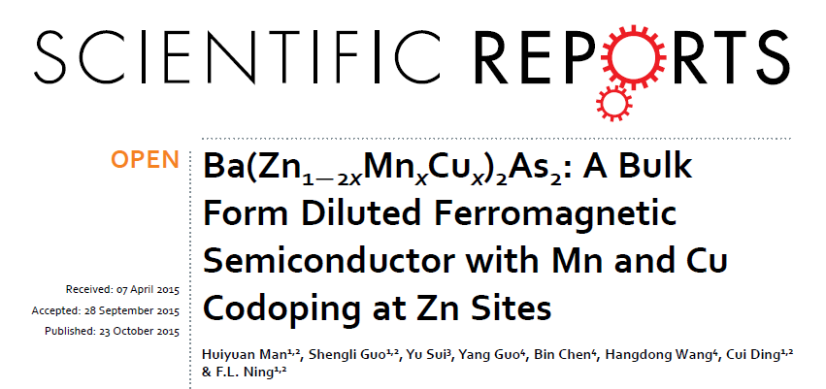
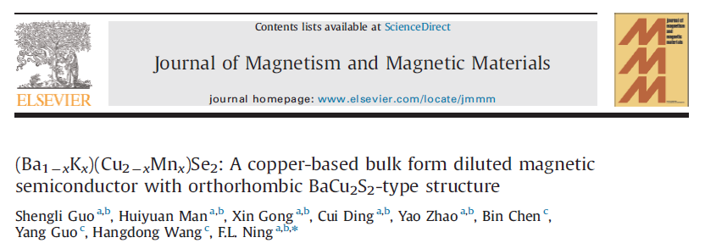
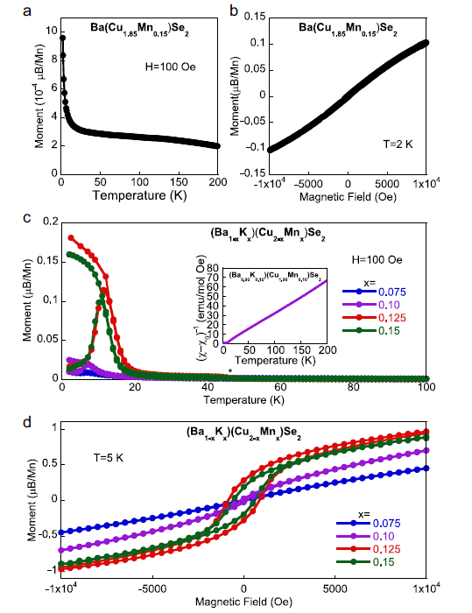
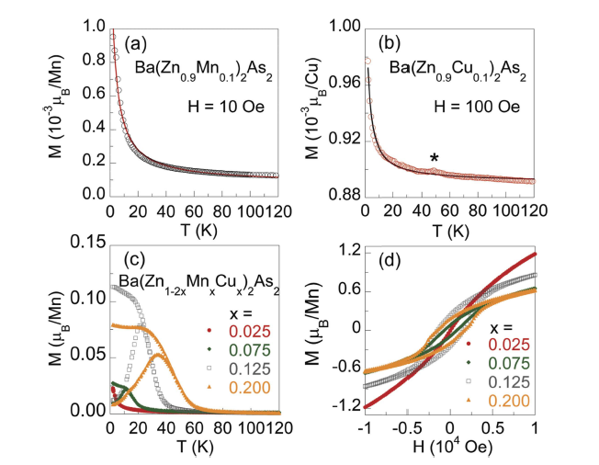

Slide 24
Ga_{1-x}Mn_{x}As Tc ~ 200K(film)
Li(Zn_{1-x}Mn_{x})As Tc ~ 55K(bulk)-----”111”
(Ba_{1-y}K_{y})(Zn_{1-x}Mn_{x})₂As₂ Tc ~ 230K(bulk)---”122”
P-type DMS
(La_{1-y}Ba_{y})Zn_{1-x}Mn_{x}AsO Tc ~ 40K(bulk) ---”1111”
(Sr₃La₂O₅)(Zn_{1-x}Mn_{x})₂As₂ Tc ~ 40K(bulk)---”32522”
(Sr_{1-x}K_{x})₄Ti₂O₆(Zn_{1-x}Mn_{x})₂As₂ Tc ~ 25K(bulk)---”42622”
For making junctions, n-type DMS are expected!

Slide 25
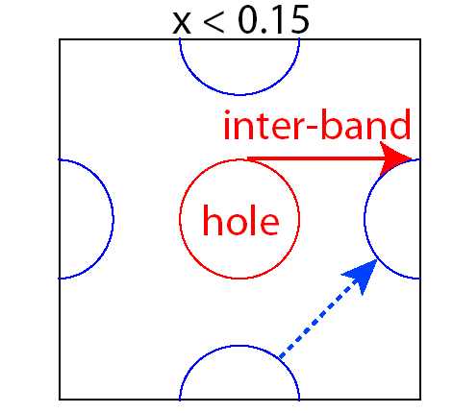
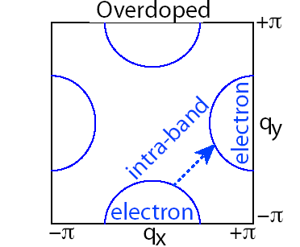
“122” – Ba(Fe_{1-x}Co_{x})₂As₂- SC
Tc = 25 K
Doping Co,
introduce electrons
F.L. Ning et al, JPSJ 78, 013711(2009)
F.L. Ning et al, PRL 104, 037001 (2010)

Slide 26
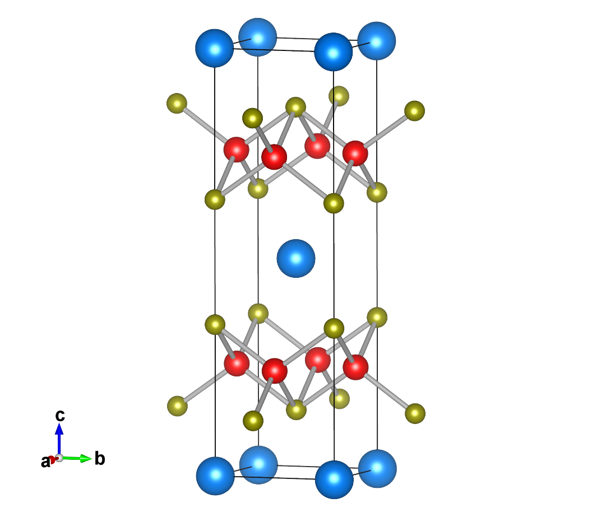
“122” - BaZn₂As₂
Ba
As
Zn ← Co
The idea here is:
---Co introduce both moments and electrons
（Started the work in 2013)

Slide 27
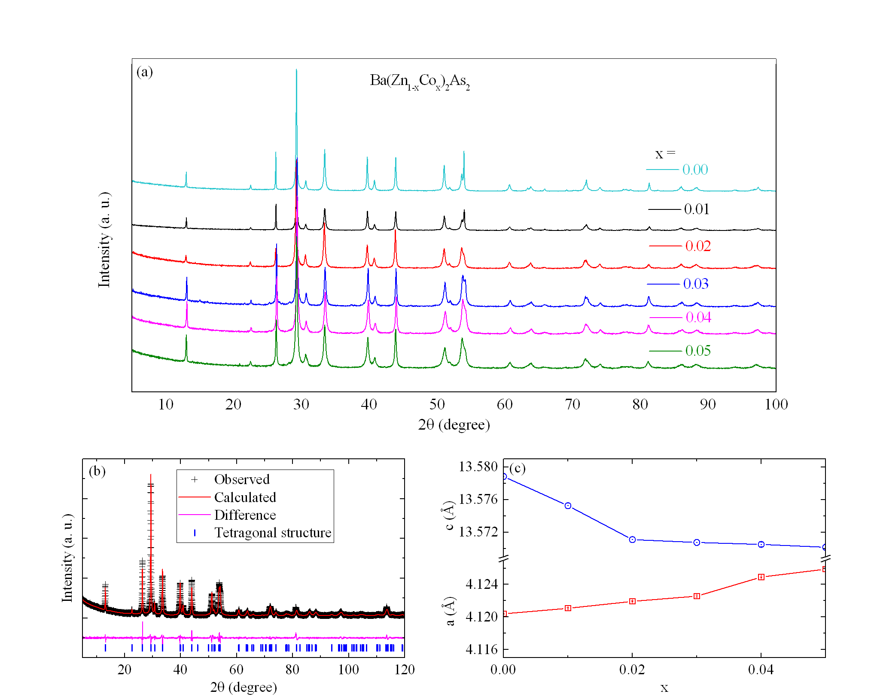
Until 2016: Shengli Guo obtained pure phase
﻿Ba
﻿Zn/Co
﻿As
S.L. Guo and F.L. Ning et al, PRB 99,155201 (2019).

Slide 28
S.L. Guo and F.L. Ning et al, PRB 99,155201 (2019).

Slide 29
S.L. Guo and F.L. Ning et al, PRB 99,155201 (2019).

Slide 30
Ba(Zn_{0.96}Co_{0.04})₂As₂

Slide 31
Ba(Zn_{0.96}Co_{0.04})₂As₂
S.L. Guo and F.L. Ning et al, PRB 99,155201 (2019).

Slide 32
S.L. Guo and F.L. Ning et al, PRB 99,155201 (2019).

Slide 34
-n VS. T plot

Slide 35
Negative Seebeck coefficient
S.L. Guo and F.L. Ning et al, PRB 99,155201 (2019).

Slide 36
Effects of chemical pressure on Ba(Zn,Co)₂As₂
Ba(Zn_{0.96}Co_{0.04})₂(As_{1-y}Sb_{y})₂
Doping Sb → Negative chemical pressure, T_{C} decreases
(Licheng Fu and Fanlong Ning, Scientific Reports 2022)

Slide 37
Effects of chemical pressure on Ba(Zn,Co)₂As₂
(Ba_{1-x}Sr_{x})(Zn_{0.96}Co_{0.04})₂As₂
Doping Sr----→ Positive chemical pressure, T_{C} increases
(Licheng Fu and Fanlong Ning, Scientific Reports 2022)

Slide 38
Effects of chemical pressure on Ba(Zn,Co)₂As₂
(Ba_{1-x}Sr_{x})(Zn_{0.96}Co_{0.04})₂As₂
Doping Sr----→ Positive chemical pressure, T_{C} increases
T_{C}
(Licheng Fu and Fanlong Ning, Scientific Reports 2022)

Slide 39
New Diluted Ferromagnetic Semiconductors (Zhejing U)
(La_{1-x}Ba_{x})(Zn_{1-x}Mn_{x})AsO (T_{C} =40K) (PRB，2013)
(SrLa₂O₅)(Zn_{1-x}Mn_{x})₂As₂ (T_{C} =40K) (EPL，2014)
Li_{1+y}(Zn_{1-x}Cr_{x})As (T_{C} =210K) (JAP，2014)
Ba(Zn_{1−2x}Mn_{x}Cu_{x})₂As₂ (T_{C} =70K) (SR, 2015)
(Ba_{1-x}K_{x})(Cu_{1-x}Mn_{x})Se₂ (T_{C} =18K) ( JMMM, 2016)
Li(Zn_{1-2x}Mn_{x}Cu_{x})As (T_{C} =33K) (JPCM, 2016)
La(Zn_{1−2x}Mn_{x}Cu_{x})AsO (T_{C} =8K) (EPL, 2016)
(La_{1−x}Ca_{x})(Zn_{1−x}Mn_{x})AsO (T_{C} =30K) (JPCM, 2016)
La(Zn_{1−2x}Mn_{x}Cu_{x})SbO (T_{C} =15K) (EPL, 2017)
Ba(Zn_{1-x}Co_{x})₂As₂ (T_{C} =40K) (N-type, PRB, 2019)
(Sr_{1-x}K_{x})F(Zn_{1-x}Mn_{x})Sb (T_{C} =40K) (JMMM, 2019)
Cu₂(Zn_{1-x}Mn_{x})(Sn_{1-y}Al_{y})Se₄ (T_{C} =5K) (JMMM, 2022)
(Ba_{1-x}K_{x})(Zn_{1-y}Mn_{y})₂Sb₂ (T_{C} =275K？ In preparation, 2020)
(Ca_{1-x}Na_{x})(Zn_{1-y}Mn_{y})₂Sb₂ (T_{C} =10K) (CPB, 2020)

Slide 40
Sample | T_{C} (K) | Structure | a (Å) | b (Å) | c (Å) | Gap (eV)
Li(Zn,Cr)As | 218 | cubic | 5.929 | 5.929 | 5.929 | 1.6
Li(Zn,Mn,Cu)As | 33 | cubic | 5.941 | 5.941 | 5.941 | 1.6
(Ba,K)(Cu,Mn)₂Se₂ | 18 | orthorhombic | 9.610 | 4.219 | 10.793 | 1.3
Ba(Zn,Co)₂As₂ | 45 | tetragonal | 4.125 | 4.125 | 13.571 | 0.2
Ba(Zn,Mn,Cu)₂As₂ | 70 | tetragonal | 4.140 | 4.140 | 13.300 | 0.2
(La,Ba)(Zn,Mn)AsO | 40 | tetragonal | 4.112 | 4.112 | 9.107 | 1.5
(La,Sr)(Zn,Mn)AsO | 35 | tetragonal | 4.105 | 4.105 | 9.106 | 1.5
(La,Ca)(Zn,Mn)AsO | 30 | tetragonal | 4.102 | 4.102 | 9.076 | 1.5
La(Zn,Mn,Cu)AsO | 8 | tetragonal | 4.101 | 4.101 | 9.073 | 1.5
La(Zn,Mn,Cu)SbO | 15 | tetragonal | 4.228 | 4.228 | 9.565 | 0.3
SrF(Zn,Mn,Cu)Sb | 40 | tetragonal | 4.293 | 4.293 | 9.526 | -
(Sr₃La₂O₅)(Zn,Mn)₂As₂ | 40 | tetragonal | 4.261 | 4.261 | 27.675 | -

Slide 41
Sample | T_{C} (K) | Structure | a (Å) | b (Å) | c (Å) | Gap (eV) | group
Li(Zn,Mn)P | 34 | cubic | 5.766 | 5.766 | 5.766 | 2.0 | Jin
Li(Cd,Mn)P | 45 | cubic | 6.071 | 6.071 | 6.071 | 0.6 | Jin
Li(Zn,Co,Mn)As | 40 | cubic | 5.950 | 5.950 | 5.950 | 1.6 | Jin
Li(Zn,Mn)As | 50 | cubic | 5.941 | 5.941 | 5.941 | 1.6 | Jin
(Ca,Na)(Zn,Mn)₂As₂ | 33 | hexagonal | 4.160 | 4.160 | 7.025 | 0.1 | Jin
(Sr,Na)(Zn,Mn)₂As₂ | 24 | hexagonal | 4.233 | 4.233 | 7.291 | 1.2 | Jin
(Sr,K)(Zn,Mn)₂As₂ | 12 | hexagonal | 4.232 | 4.232 | 7.280 | 0.2 | Xu
(Sr,Na)(Cd,Mn)₂As₂ | 13 | hexagonal | 4.444 | 4.444 | 4.438 | 0.2 | Jin
(Ba,Na)(Zn,Mn)₂As₂ | 16 | tetragonal | 4.117 | 4.117 | 13.433 | 0.2 | Jin
(Ba,K)(Zn,Mn)₂As₂ | 230 | tetragonal | 4.130 | 4.130 | 13.509 | 0.2 | Jin
(Ba,K)(Cd,Mn)₂As₂ | 16 | hexagonal | 4.499 | 4.499 | 7.692 | 0.4 | Xu
(La,Ca)(Zn,Mn)SbO | 40 | tetragonal | 4.228 | 4.228 | 9.566 | 0.3 | Jin
(Ba,K)F(Zn,Mn)As | 30 | tetragonal | 4.241 | 4.241 | 9.538 | 0.9 | Jin
(La,Sr)(Cu,Mn)SO | 200 | tetragonal | 3.996 | 3.996 | 8.519 | 3.1 | Xu

Slide 42
In past several years, our collaboration team (Uemura & Jin & Ning)
published ~ 60 papers on DMS
1, S.L. Guo et al, PRB 99, 155201 (2019)
2, L.C. Fu et al, JMMM 483, 95 (2019)
3, Y.L. Gu et al, JOS 40, 081506 (2019)
4, G.X. Zhi et al, Cond Matt 3, 42(2018)
5, S.L. Guo et al, CPB 27, 097502(2018)
6, Yao Zhao et al, EPL 120, 47005 (2017)
7, F.F. Zhu et al, APL 111, 062106 (2017)
8 S.L. Guo et al, EPL 114, 57008 (2016)
9, S.L. Guo et al, JMMM 400, 295 (2016)
10, Cui Ding et al, JPCM 28, 026003 (2016)
11, S.L. Guo et al, JPCM 28, 366001 (2016)
12, H.Y. Man et al, Scientific Reports 5, 15507 (2015)
13, Cui Ding et al, Science China (2014)
14, Cui Ding et al, EPL 107, 17004 (2014)
15, F.L. Ning et al, PRB 90, 185023 (2014)
16, H.Y. Man et al, EPL 105, 67004 (2014)
17, Q. Wang et al, JAP 115, 083917 (2014)
18, J.C. Lu et al, EPL 103, 67001 (2013)
19, C. Ding et al PRB 88, 041102(R) (2013)
20, C. Ding et al PRB 88, 041108(R) (2013)
21, W. Han et al, Scientific Reports 9, 7490 (2019)
22, Y. Peng et al, CPB 28, 057501 (2019)
23, G.Q. Zhao et al, JPCM 30, 254001 (2018)
24, G.X. Gu et al, APL 112, 032402 (2018)
25, Sun Fei et al, CPL 34, 0256 (2017)
26, R. Wang et al, AIP Advances 7, 045017 (2017)
27, Sun Fei et al, PRB 95, 094412 (2017)
28, B.J.Chen et al, Scientific Reports 6, 36578 (2016)
29, B.Frandsen and Uemura et al, PRB 94, 094102 (2016)
30, F. Sun et al, PRB 93, 224403 (2016)
31, H. Suzuki and Fujimori et al, PRB 92, 215320 (2015)
32, H. Suzuki and Fujimori et al, PRB 91, 140401 (2015)
33, K. Zhao et al, Chin. Sci. Bull. (2014)
34, B.J. Chen et al PRB 90, 155202 (2014)
35, B.J. Chen et al JAP 116,163906 (2014)
36, W. Han et al, Science China (2013)
37, Z. Deng et al, PRB 88, 081203(R) (2013)
38, K. Zhao et al, Nature Comm. 4, 1442 (2013)
39, Z. Deng et al, JPCS 400, 032033 (2012)
40, Z. Deng et al, Nature Comm. 2, 422 (2011)

Slide 43
Outline
a. Introduction of some newly fabricated DMSs
“111”, 122”,”1111”, “42622”,”32522”
----- Li_{1+y}(Zn_{1-x}Mn_{x})P
----- n-type Ba(Zn_{1-2x}Co_{x}Mn_{x})₂As₂
b. Microscopic characterization
----- μSR results on (Ga,Mn)As and Li_{1.15}(Zn_{1-x}Mn_{x})P
-----NMR results on Li_{1.1}(Cd_{1-x}Mn_{x})P and Li_{1.15}(Zn_{1-x}Mn_{x})P

Slide 44
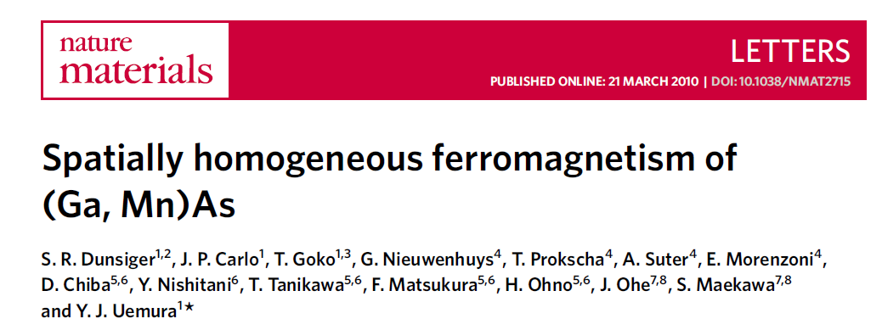
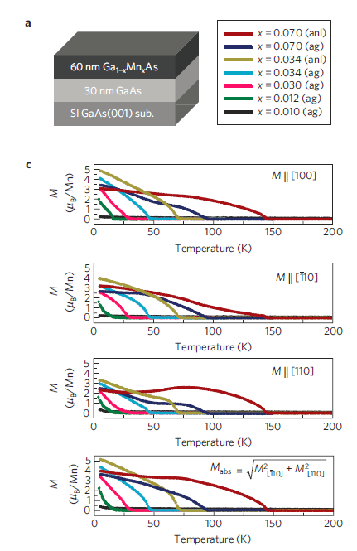
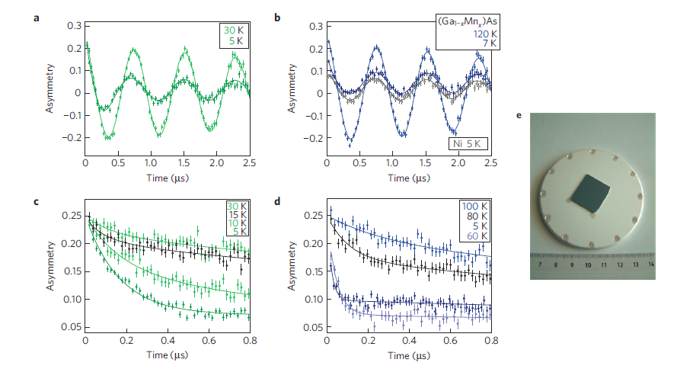
μ SR experiments were conducted in PSI

Slide 45
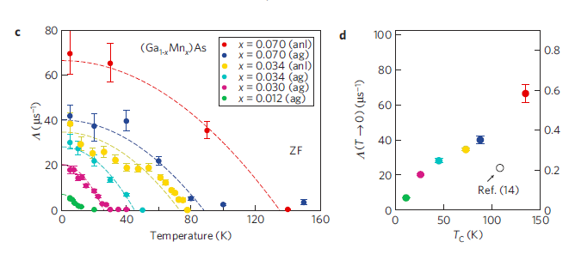

Slide 46
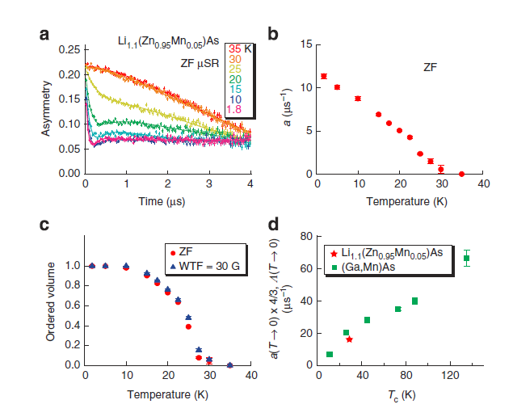
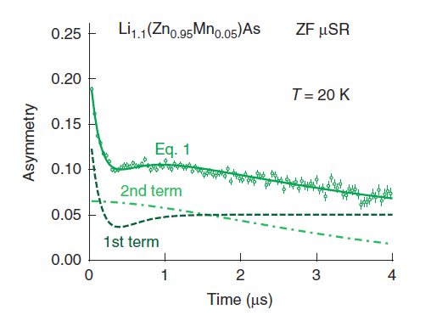


Li_{1.1}(Zn_{0.95}Mn_{0.05})As (T_{C} ~ 30 K)
a_{s} --- relaxation rate (static local field amplitude)

Slide 47
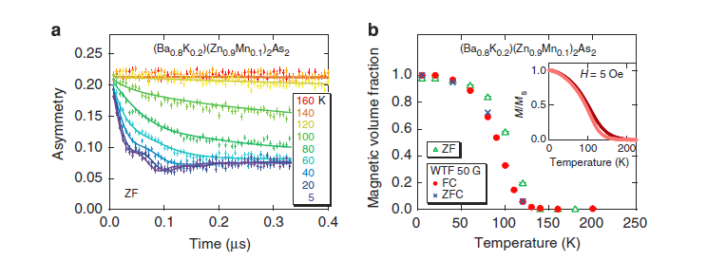
“122” (Ba_{1-x}K_{x})(Zn_{1-y}Mn_{y})₂As₂ (T_{C} ~180 K)

Slide 48
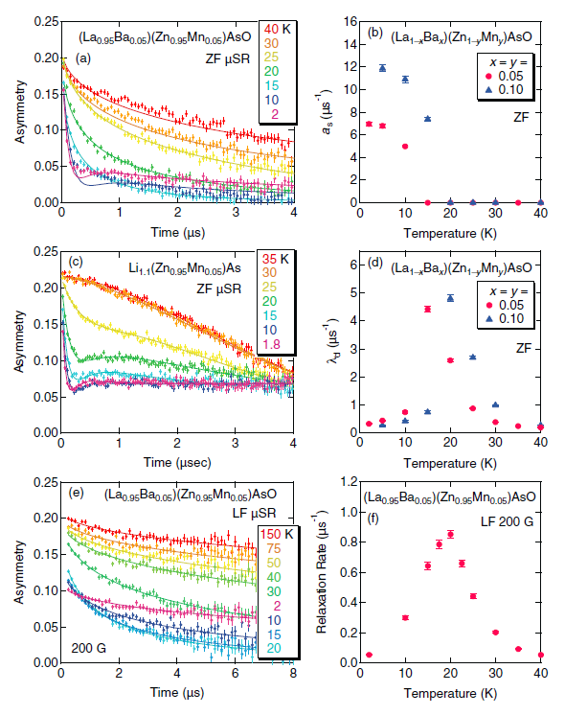
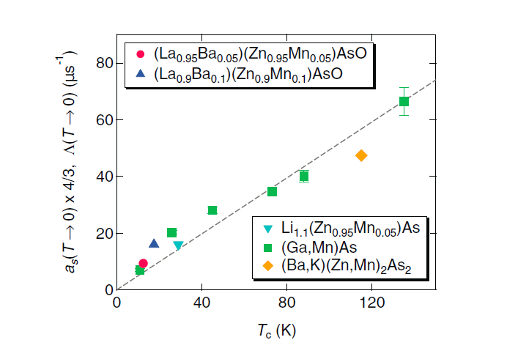
“1111” (La_{1-x}Ba_{x})(Zn_{1-x}Mn_{x})AsO T_{C} ~ 40K

Slide 49
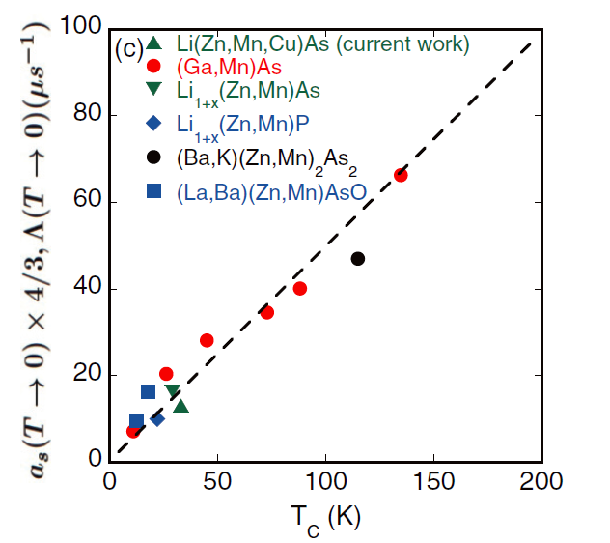
Static local field amplitude a_{s}:
which is proportional to the
individual ordered moment
size multiplied by the moment
concentration
S. Dunsiger, Nature Material, 2009
C. Ding, Physical Review B, 2013
K. Zhao, Nature Communications, 2013
Z. Deng, Nature Communications, 2011
F.L. Ning, Physical Review B, 2014
T_{C}: which is a measure of the effective
average ferromagnetic interaction

Slide 50
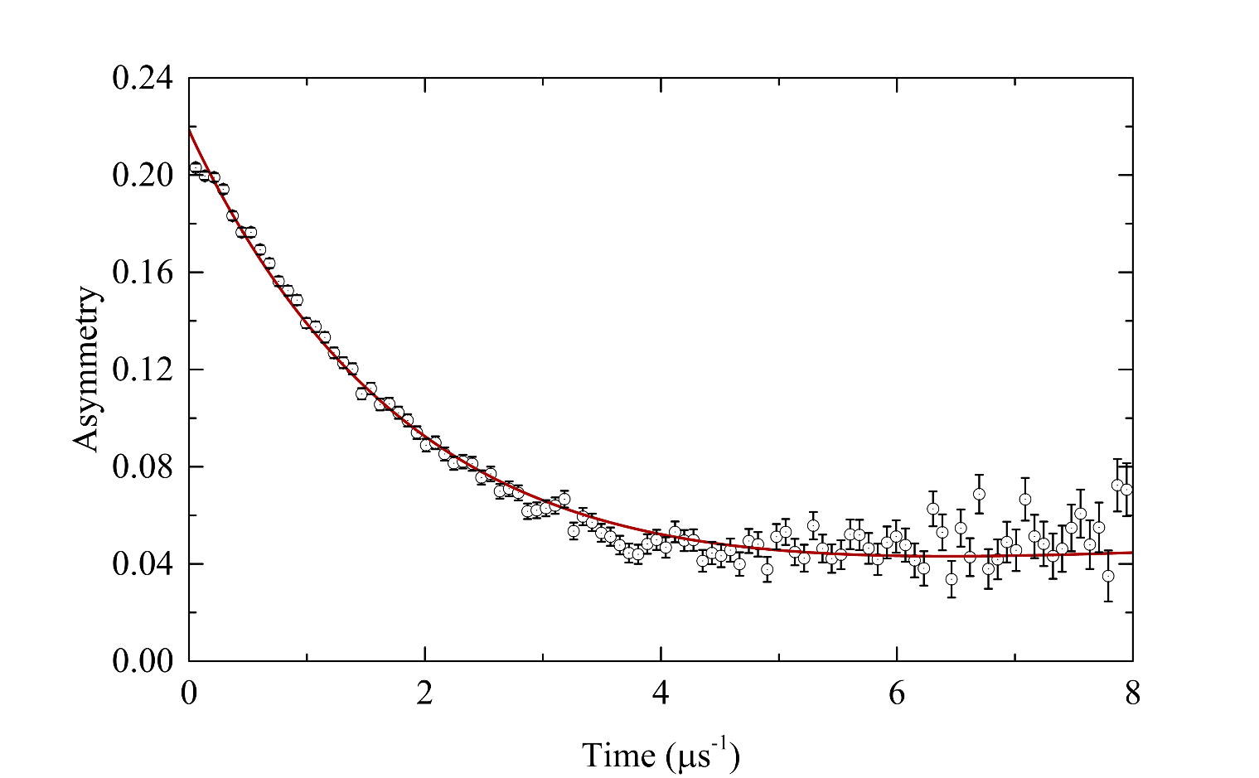
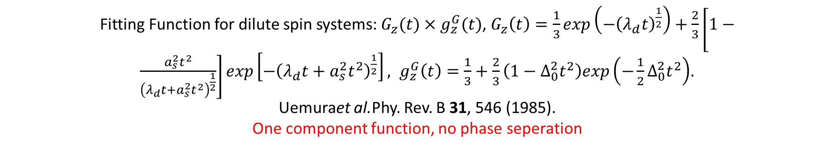
Zero field (ZF-) MuSR asymmetry spectra of Ba(Zn_{0.95}Co_{0.05})₂As₂ at 2 K
Fitting Function for dilute spin systems: $G_{z}(t)×g_{z}^{G}(t)$, $G_{z}\left(t\right)=\frac{1}{3}\exp\left(−{\left(λ_{d}t\right)}^{\frac{1}{2}}\right)+\frac{2}{3}\left[1−\frac{a_{s}^{2}t^{2}}{{\left(λ_{d}t+a_{s}^{2}t^{2}\right)}^{\frac{1}{2}}}\right]exp\left[−{\left(λ_{d}t+a_{s}^{2}t^{2}\right)}^{\frac{1}{2}}\right], g_{z}^{G}\left(t\right)=\frac{1}{3}+\frac{2}{3}\left(1−Δ_{0}^{2}t^{2}\right)exp\left(−\frac{1}{2}Δ_{0}^{2}t^{2}\right)$.
Uemuraet al.Phy. Rev. B 31, 546 (1985).
One component function, no phase seperation

Slide 51
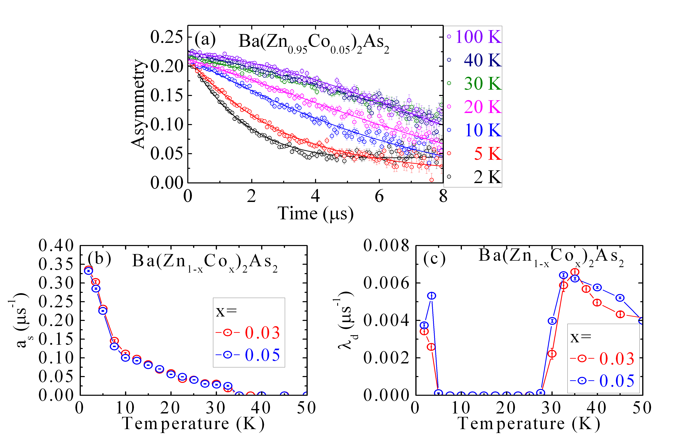
ZF-MuSR results for Ba(Zn_{1-x}Co_{x})₂As₂
Static field arises below T_{C}

Slide 52
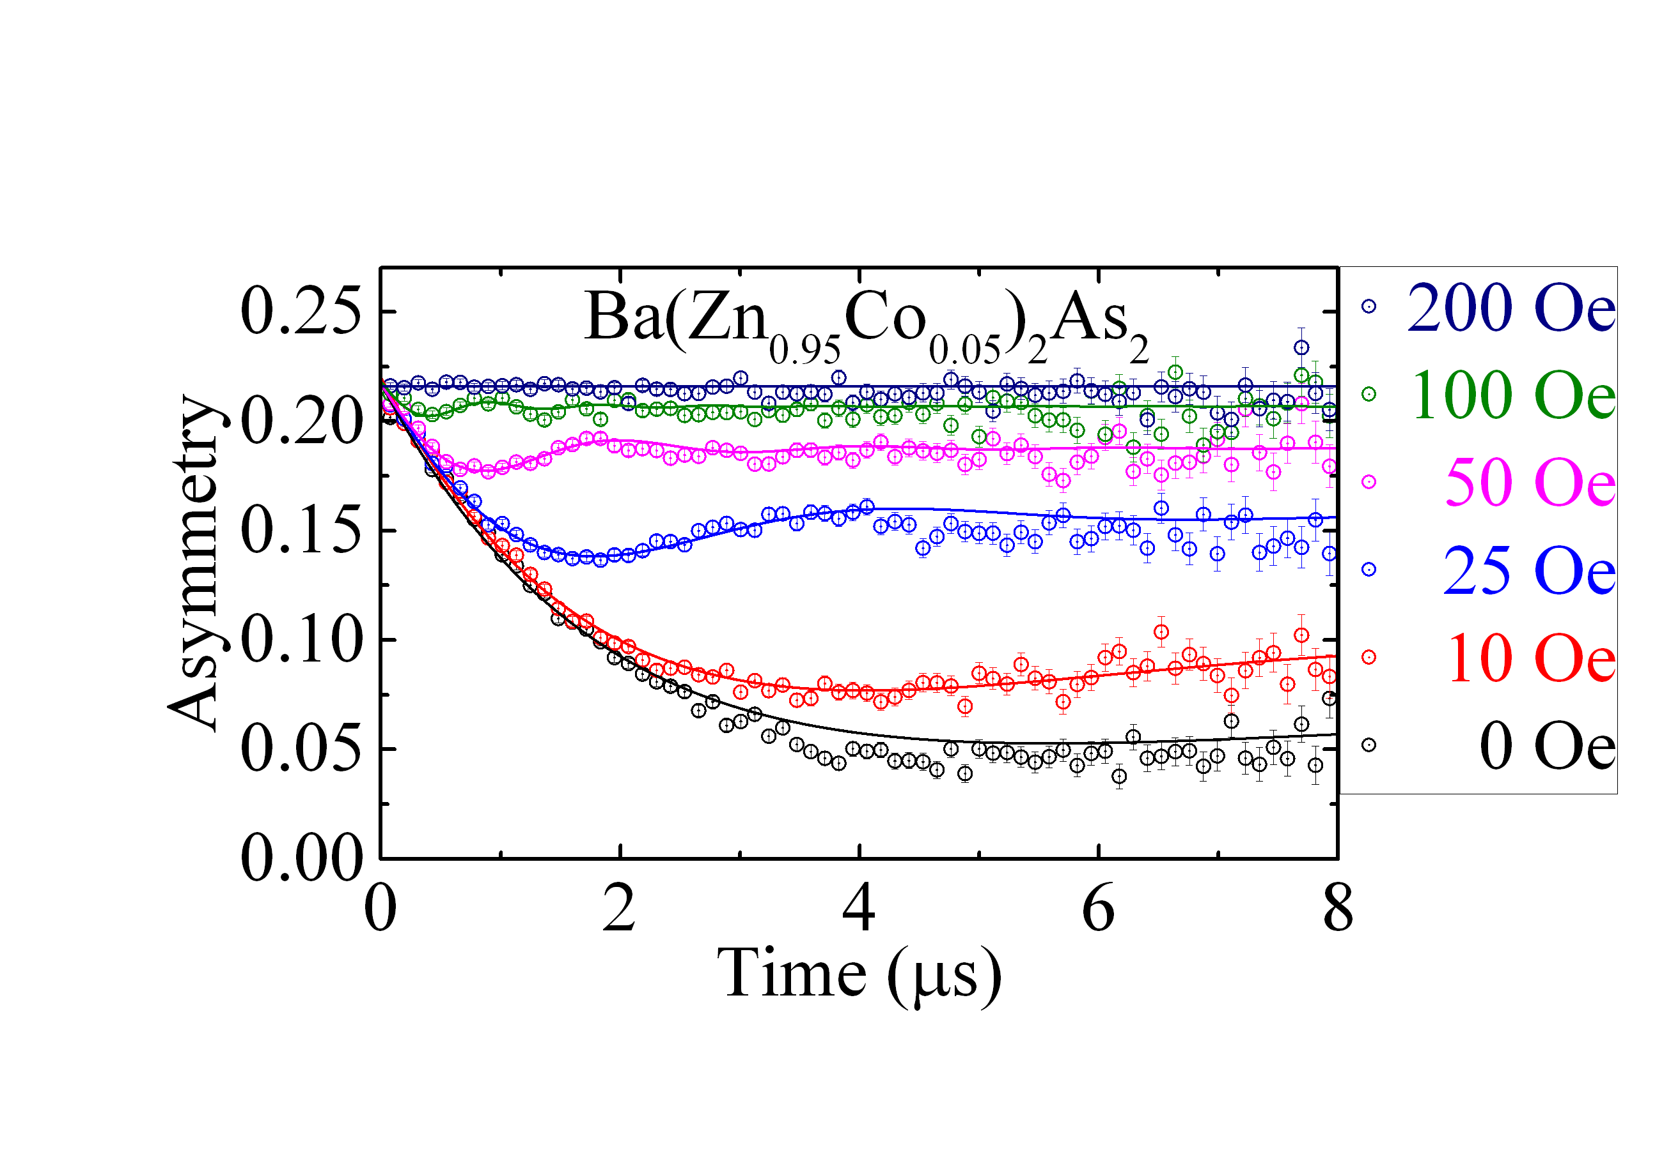
Longitudinal field (LF-) MuSR results for
Ba(Zn_{1-x}Co_{x})₂As₂ at 2 K
The asymmetry is fully decoupled at ~ 100 Oe.
Conclusion: the internal field at 2 K muon suffered is fully static and magnitude is ~ 10 Oe.

Slide 53

Temperature scan 100 Oe LF-MuSR results for
Ba(Zn_{1-x}Co_{x})₂As₂

Slide 54
Ferromagnetic exchange coupling is much larger in this system compared these other p-type systems.

Slide 55
Several advantages of bulk form DMS materials:
Synthesized in thermally equilibrium condition, less defects are expected;
Bulk form, single crystals are available, for NMR, neutron, μSR measurements;
Carriers can be doped at different ionic sites, for example for BaZn₂As₂, K
substitution for Ba introduces holes, while Mn substitution for Zn introduces electrons;
Charge and spin doping are decoupled, each can be precisely controlled and tuned;
Iso-structural to its superconductor, antiferromagnet variant, junctions via As layer
can be made;
Thin films of parent compound LaZnAsO and BaZn₂As₂ have been successfully made;
(Ba_{1-y}K_{y})(Zn_{1-x}Mn_{x})₂As₂: T_{C} = 230 K for now, thin film may achieve higher T_{C}? (FeSe-SC)
Share the same origin of ferromagnetism as (Ga,Mn)As, helpful to understand the
general mechanism;

Slide 56
Conclusions
Series of bulk DMSs with (highest T_{C} = 230 K) have been fabricated, and these DMSs have common mechanism with (Ga,Mn)As, and can serve as model systems to study the ferromagnetism in DMS
A n-type DMS Ba(Zn_{1-x}Co_{x})₂As₂ (T_{C} = 45K) have been successfully synthesized
NMR and μSR: Mn atoms are homogenously doped, the ferromagnetic ordering is from Mn in the ionic Zn site
NMR results are consistent with a carrier mediated ferromagnetism picture.
Now with the same 122 tetragonal structure, junctions could be made via As layer between following materials:
N-type DMS Ba(Zn_{1-x}Co_{x})₂As₂ (T_{C} = 45K)
P-type DMS (Ba_{1-y}K_{y})(Zn_{1-x}Mn_{x})₂As₂ (T_{C}=230K)
Superconductor Ba(Fe_{1-x}Cox)₂As₂ (T_{c}=25K)
Antiferromagnet BaMn₂As₂ (T_{N}=625K)
Paramagnetic BaCo₂As₂
Thank you for your attention!

Slide 57
Outline
a. Introduction of some newly fabricated DMSs
“111”, 122”,”1111”, “42622”,”32522”
----- Li_{1+y}(Zn_{1-x}Mn_{x})P
----- n-type Ba(Zn_{1-2x}Co_{x}Mn_{x})₂As₂
b. Microscopic characterization
----- μSR on Li_{1.15}(Zn_{1-x}Mn_{x})P
-----NMR results on Li_{1.1}(Cd_{1-x}Mn_{x})P and Li_{1.15}(Zn_{1-x}Mn_{x})P

Slide 58
“III-V” versus “I-II-V” semiconductors
GaAs (1.42ev)
LiZnAs (1.6ev)
LiZnP (2.04ev)
LiCdP (1.30ev)
Li_{1.1}(Cd⁺²_{0.9}Mn⁺²_{0.1})P and Li_{1.15}(Zn⁺²_{0.9}Mn⁺²_{0.1})P
decouple spins and carriers
Mn doping induces local moments
Li extra or deficiencies create itinerant or localized carriers
----- use Li to control the type of carriers

Slide 59


⁷Li NMR line shape ---- Li_{1.1}CdP
Spin echo inten(arb.)
For ⁷Li:
Nuclear spin = 3/2
Gyromagnetic ratio = 16.546MHz/Tesla
B_{ext} = 4.5 Tesla → f_{resonance} = 74.457MHz
Single line with line width = 4KHz
No additional Li line found for extra 10% Li
6 Cd atoms at N.N. site, all Li have the same
environment -----define it as Li(0) site
Cd
Li
Li
P
Cd/Mn

Slide 60

⁷Li NMR line shape ---- Li_{1.1}CdP
Linewidth:
~7KHz at 4.2K
~4KHz at 280K
Spin echo inten(arb.)
Knight shift:
~ 0.001% at 4.2K
~ 0.005% at 280K

Slide 61
⁷Li NMR line shape ---- Li_{1.1}Cd_{0.9}Mn_{0.1}P
10% Mn doped into Cd sites, the probability to find n = 0, 1, 2, 3, 4, 5, 6 Mn atoms at N.N. sites are P(n) = C₆^{n}(0.1)^{n}(0.9)^{6-n}
Cd
Cd
Cd
Cd
Cd
Li
Li
Li
Li
Li
Mn
Mn
Mn
Mn
Li(0): 53%
Li(1): 35%
Li(2): 10%
Li(3): 1.5%
Li(4): 0.1%
Li(0):Li(Mn) ~ 50%:50%

Slide 62
⁷Li NMR line shape
---- Li_{1.1}Cd_{0.9}Mn_{0.1}P
Key features:
Li(0) line preserve but broaden
Li(Mn) line appears, broad peak at left hand
Li(Mn) line has a large negative shift
Integrated area, Li(Mn):Li(0) = 50:50

Slide 63

⁷Li NMR line shape ---- Li_{1.1}Cd_{0.9}Mn_{0.1}P
Li(Mn)
Li(0)
Key features:
Frequency shifts of Li(Mn) follows
a Curie-Weiss law
Li(0) continuously broaden from
20KHz (at 290K) to 240KHz (at 4.2K)
~ 10 times broadening. Line width follow
a Curie-Weiss law
For Li(0) site in the parent
compound Li_{1.1}CdP, only increase from
4KHz (at 280K) to 7KHz (at 4.2K).
Spin echo inten(arb.)

Slide 64
Frequency VS. Temperature
Frequency of Li sites VS. T
74.6
Li(0) of Li
CdP
74.5
1.1
74.4
Negative frequency shift:
---hyperfine coupling constant
between ⁷Li nuclear spin and
surrounding electrons is negative
Li(0)
74.3
Li
Cd
Mn
P
1.1
0.9
0.1
f(MHz)
74.2
Li(Mn) of Li
Cd
Mn
P
74.1
1.1
0.9
0.1
74
73.9
73.8
0
50
100
150
200
250
300
T(K)

Slide 65
Li_{1.1}Cd_{0.9}Mn_{0.1}P
The line broadening of Li(0)
which do not have Mn at N.N.
is the same as the frequency
shifts of Li(Mn).
Li(0) and Li(Mn) sites are
electronically coupled!

Slide 66

Li_{1.1}Cd_{0.9}Mn_{0.1}P
Li_{1.15}Zn_{0.9}Mn_{0.1}P
Mn atoms are homogenously distributed in the compound, and no Mn clusters exist.
Consistent with 100% magnetic ordered volume from μSR experiment.
The ferromangetic ordering is intrinsic, from the Mn atoms in the ionic sites in I-II-V DMS! It is NOT from spurious phase.

Slide 67

Spin dynamics----Li_{1.15}Zn_{0.9}Mn_{0.1}P and Li_{1.1}Cd_{0.9}Mn_{0.1}P
T_{c} = 25K
T(K)
T₁ of Li(Mn) is 50 times shorter than T₁ of Li(0)
Below T_{c}, for both Li(Mn) and Li(0) sites, T₁ decrease
C. Ding et al., Physics Review B 88, 041108 (R) (2013).

Slide 68



Spin dynamics----Li_{1.15}Zn_{0.9}Mn_{0.1}P
For Li(Mn) site, 1/T₁ ~ constant
Spin fluctuations are locked
at T range ~100 K, J~ 100K
For Li(0) site, 1/T₁ ~ a +bT
Korringa relation,
Related to information of carriers
Li(Mn) represent “spins”
Li(0) represent “carries”
Carrier mediated ferromagnetism!
T(K)
Moriya’s exchange narrowed regime
Moriya's Gaussian approximation for the
spin-spin correlation function
Z~ 10³ is the number of Mn sites within the
range of Mn-Mn interactions
Characteristic frequency of the Mn spin fluctuations

Slide 69
Conclusions
Series of bulk DMSs with (highest T_{C} = 230 K) have been fabricated, and these DMSs have common mechanism with (Ga,Mn)As, and can serve as model systems to study the ferromagnetism in DMS
A n-type DMS Ba(Zn_{1-x}Co_{x})₂As₂ (T_{C} = 45K) have been successfully synthesized
NMR and μSR: Mn atoms are homogenously doped, the ferromagnetic ordering is from Mn in the ionic Zn site
NMR results are consistent with a carrier mediated ferromagnetism picture.
Now with the same 122 tetragonal structure, junctions could be made via As layer between following materials:
N-type DMS Ba(Zn_{1-x}Co_{x})₂As₂ (T_{C} = 45K)
P-type DMS (Ba_{1-y}K_{y})(Zn_{1-x}Mn_{x})₂As₂ (T_{C}=230K)
Superconductor Ba(Fe_{1-x}Cox)₂As₂ (T_{c}=25K)
Antiferromagnet BaMn₂As₂ (T_{N}=625K)
Paramagnetic BaCo₂As₂
Thank you for your attention!

