Slide 1
Muon Users’ Society in Japan
Koichiro SHIMOMURA
IMSS, KEK/J-PARC
2nd Workshop on Muon Science Technology and Industry

Slide 2
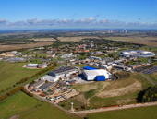
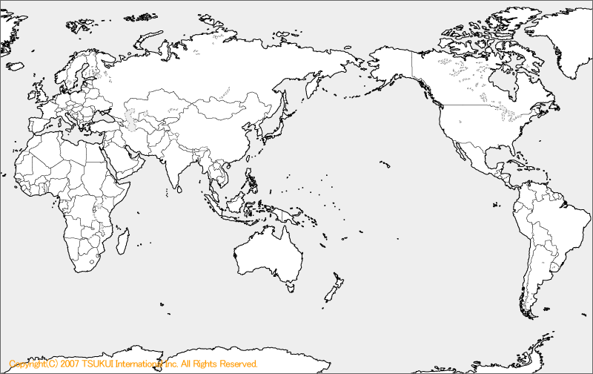
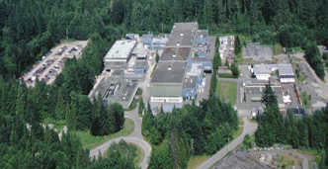
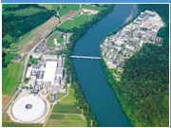
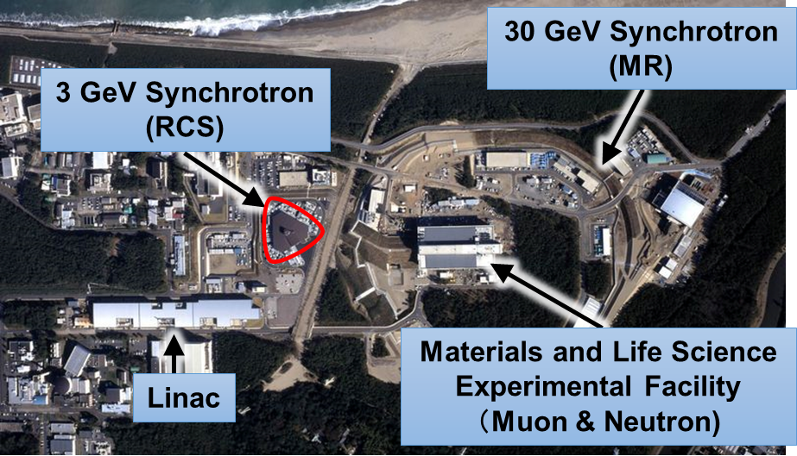
Meson factories in the world
ISIS
(Pulse)
TRIUMF (DC)
J-PARC
(Pulse)
PSI (DC)
MuSIC (DC)
Country | Japan |  | The U.K. | Switzerland | Canada
Facility | J-PARC MUSE | RCNP MuSIC | RAL ISIS | PSI | TRIUMF
proton energy [GeV] | 3.0 | 0.39 | 0.8 | 0.59 | 0.52
proton intensity [MW] | 1.0 | 0.0004 | 0.16 | 1.4 | 0.05
μ⁺ [/s] (surface) | 3×10⁸ (U line) | 2×10^{４} (50MeV/c) | 6×10⁵ | 6×10⁸ (μE4) | 2×10⁵
μ⁻ [/s] | 1×10⁷ | 10⁴ | 7×10⁴ | 2×10⁷ | (5×10⁴)
DC / Pulse | Pulse (25Hz) | DC | Pulse (50Hz) | DC | DC

Slide 3
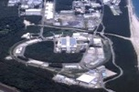
Features of the Pulsed and Continuous Wave
Pulsed
MUSE
~300 ns
DC
MUSIC
e
e
e
e
e
e
e
e
γ
γ
γ
γ
γ
μ⁻
μ⁻
μ⁻
μ⁻
time
time
time window ~ 40ms
time window ~ 100us
 | JPARC MuSE（Synchrotron） | RCNP MuSIC （Cyclotron）
Rate | µ＋ ~ 10⁸ cps µ- ~ 10⁷ cps High-intensity pulsed beam Center for condensed matter research | µ＋ 〜10⁵ cps µ- ~10⁴ cps Nuclear research Unsealed RI handling
Beam Features | One injection at a time Muons are not specified No upper limit on event rate Small background | Identification of incoming muons and decay electrons, one at a time,Event rate limit (muon pileup) Large background
Electron observation (time spectrum observation, µSR, etc.) | Observation of spin relaxation in the long time region (>10µs) (µSR) High segmentation (electron pileup) | Measurement of physical properties in the high time resolution and high field rotation (µSR) High time resolution detector
γand X-ray observation (energy observation, elemental analysis, etc.) | High segmentation (X-ray pileup) Activation analysis, delayed γ-ray observation | High repetition rate is the key Detector is simple Prompt γ-ray observation

Slide 4


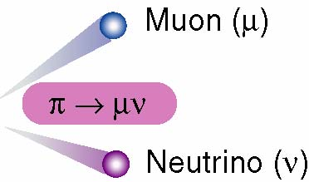
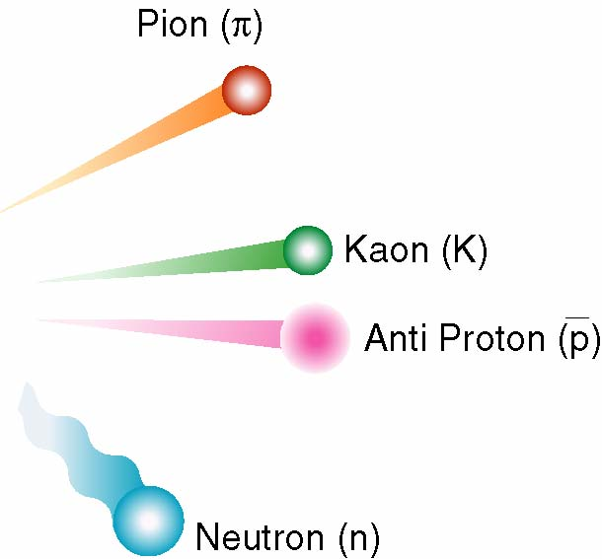
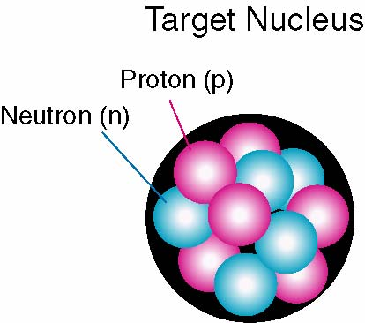
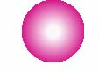
Versatile Quantum Beams for Microscopic World
Japan Proton Accelerator Research Complex
Power-frontier accelerators and
multi-purpose user facilities
Proton (p)
3 GeV, 30 GeV
spallation
Variety of secondary particles generated with
high-energy and high-intensity protons

Slide 5
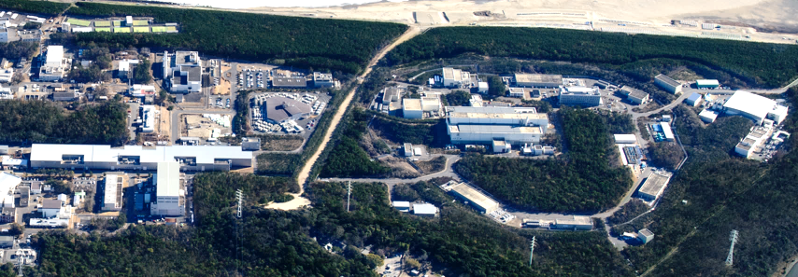
Japan Proton Accelerator Research Complex
Transmutation Experimental Facility
(Phase II)
Materials and Life Science Experimental Facility
Hadron Experimental Facility
Neutrino Experimental Facility
1 km
area : 65 ha
January 2016
neutrino beam
500 m
3-GeV Synchrotron
→ 99.95％ of
light speed
Linac
→ 71% of light speed
→ 97% of
light speed
underground
30-GeV Synchrotron
Super-Kamiokande
3 proton accelerators
and 3 experimental facilities

Slide 6
International Collaboration

Slide 7
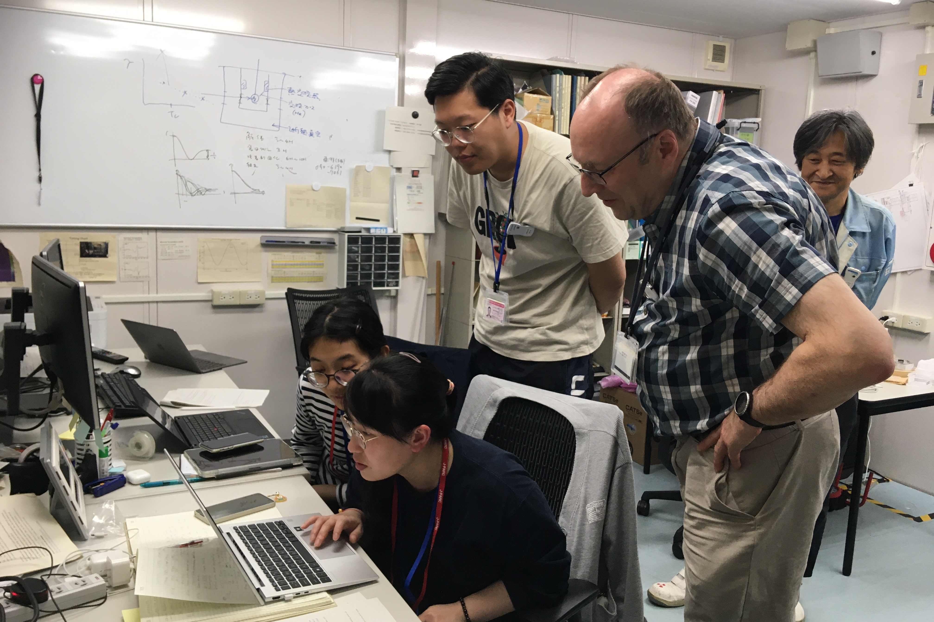
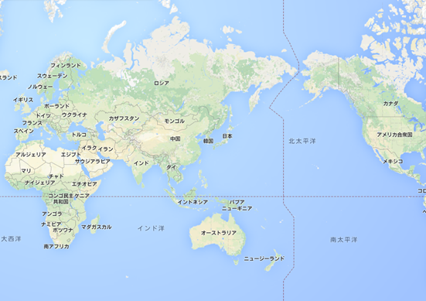
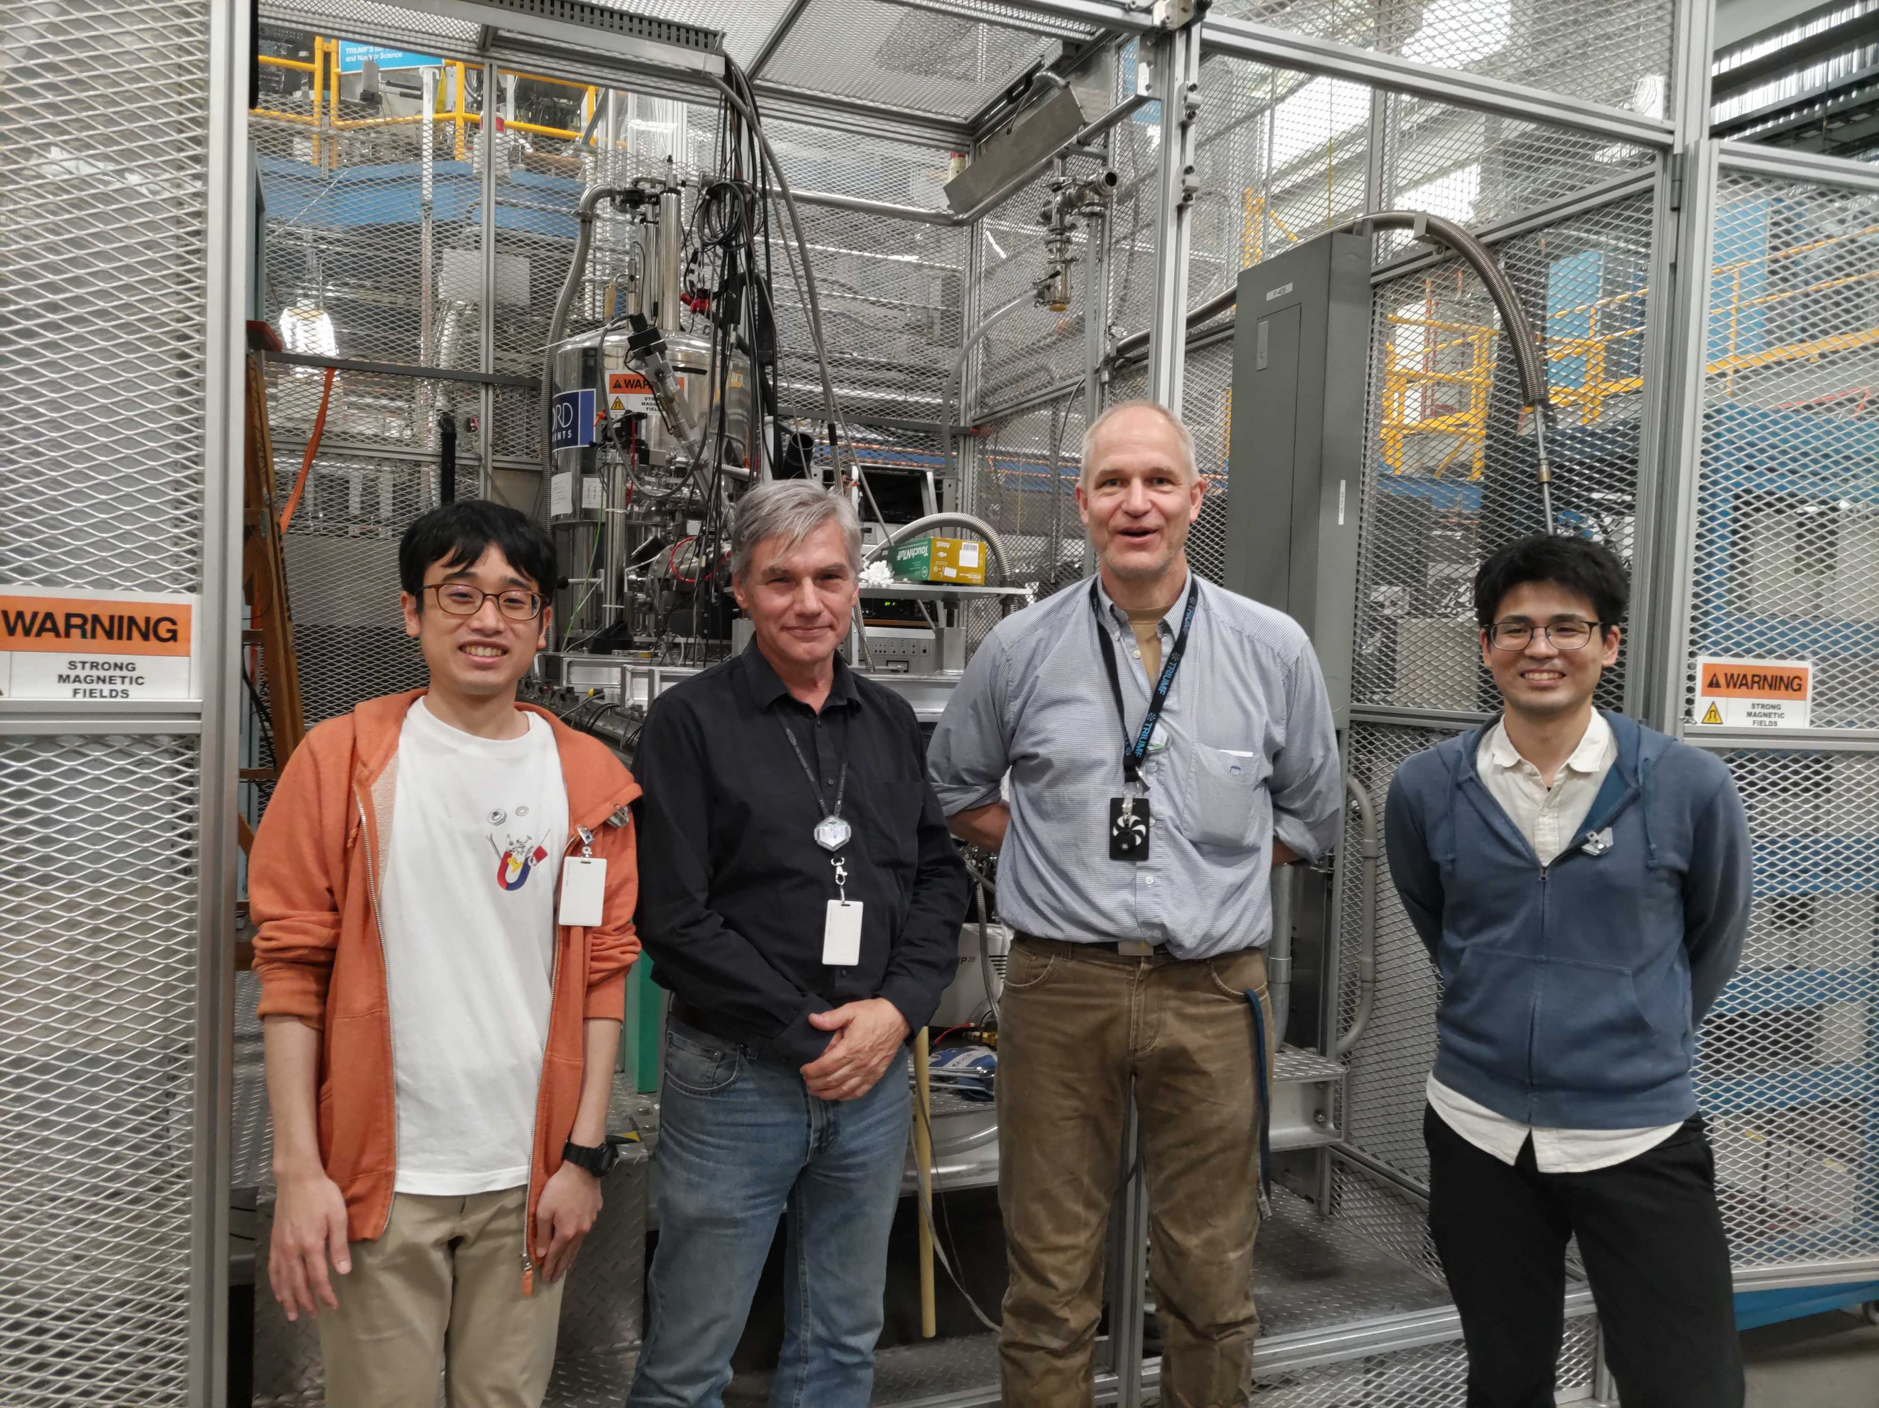
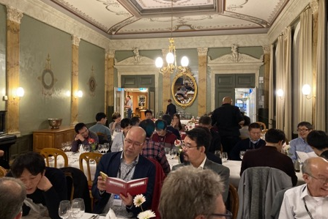
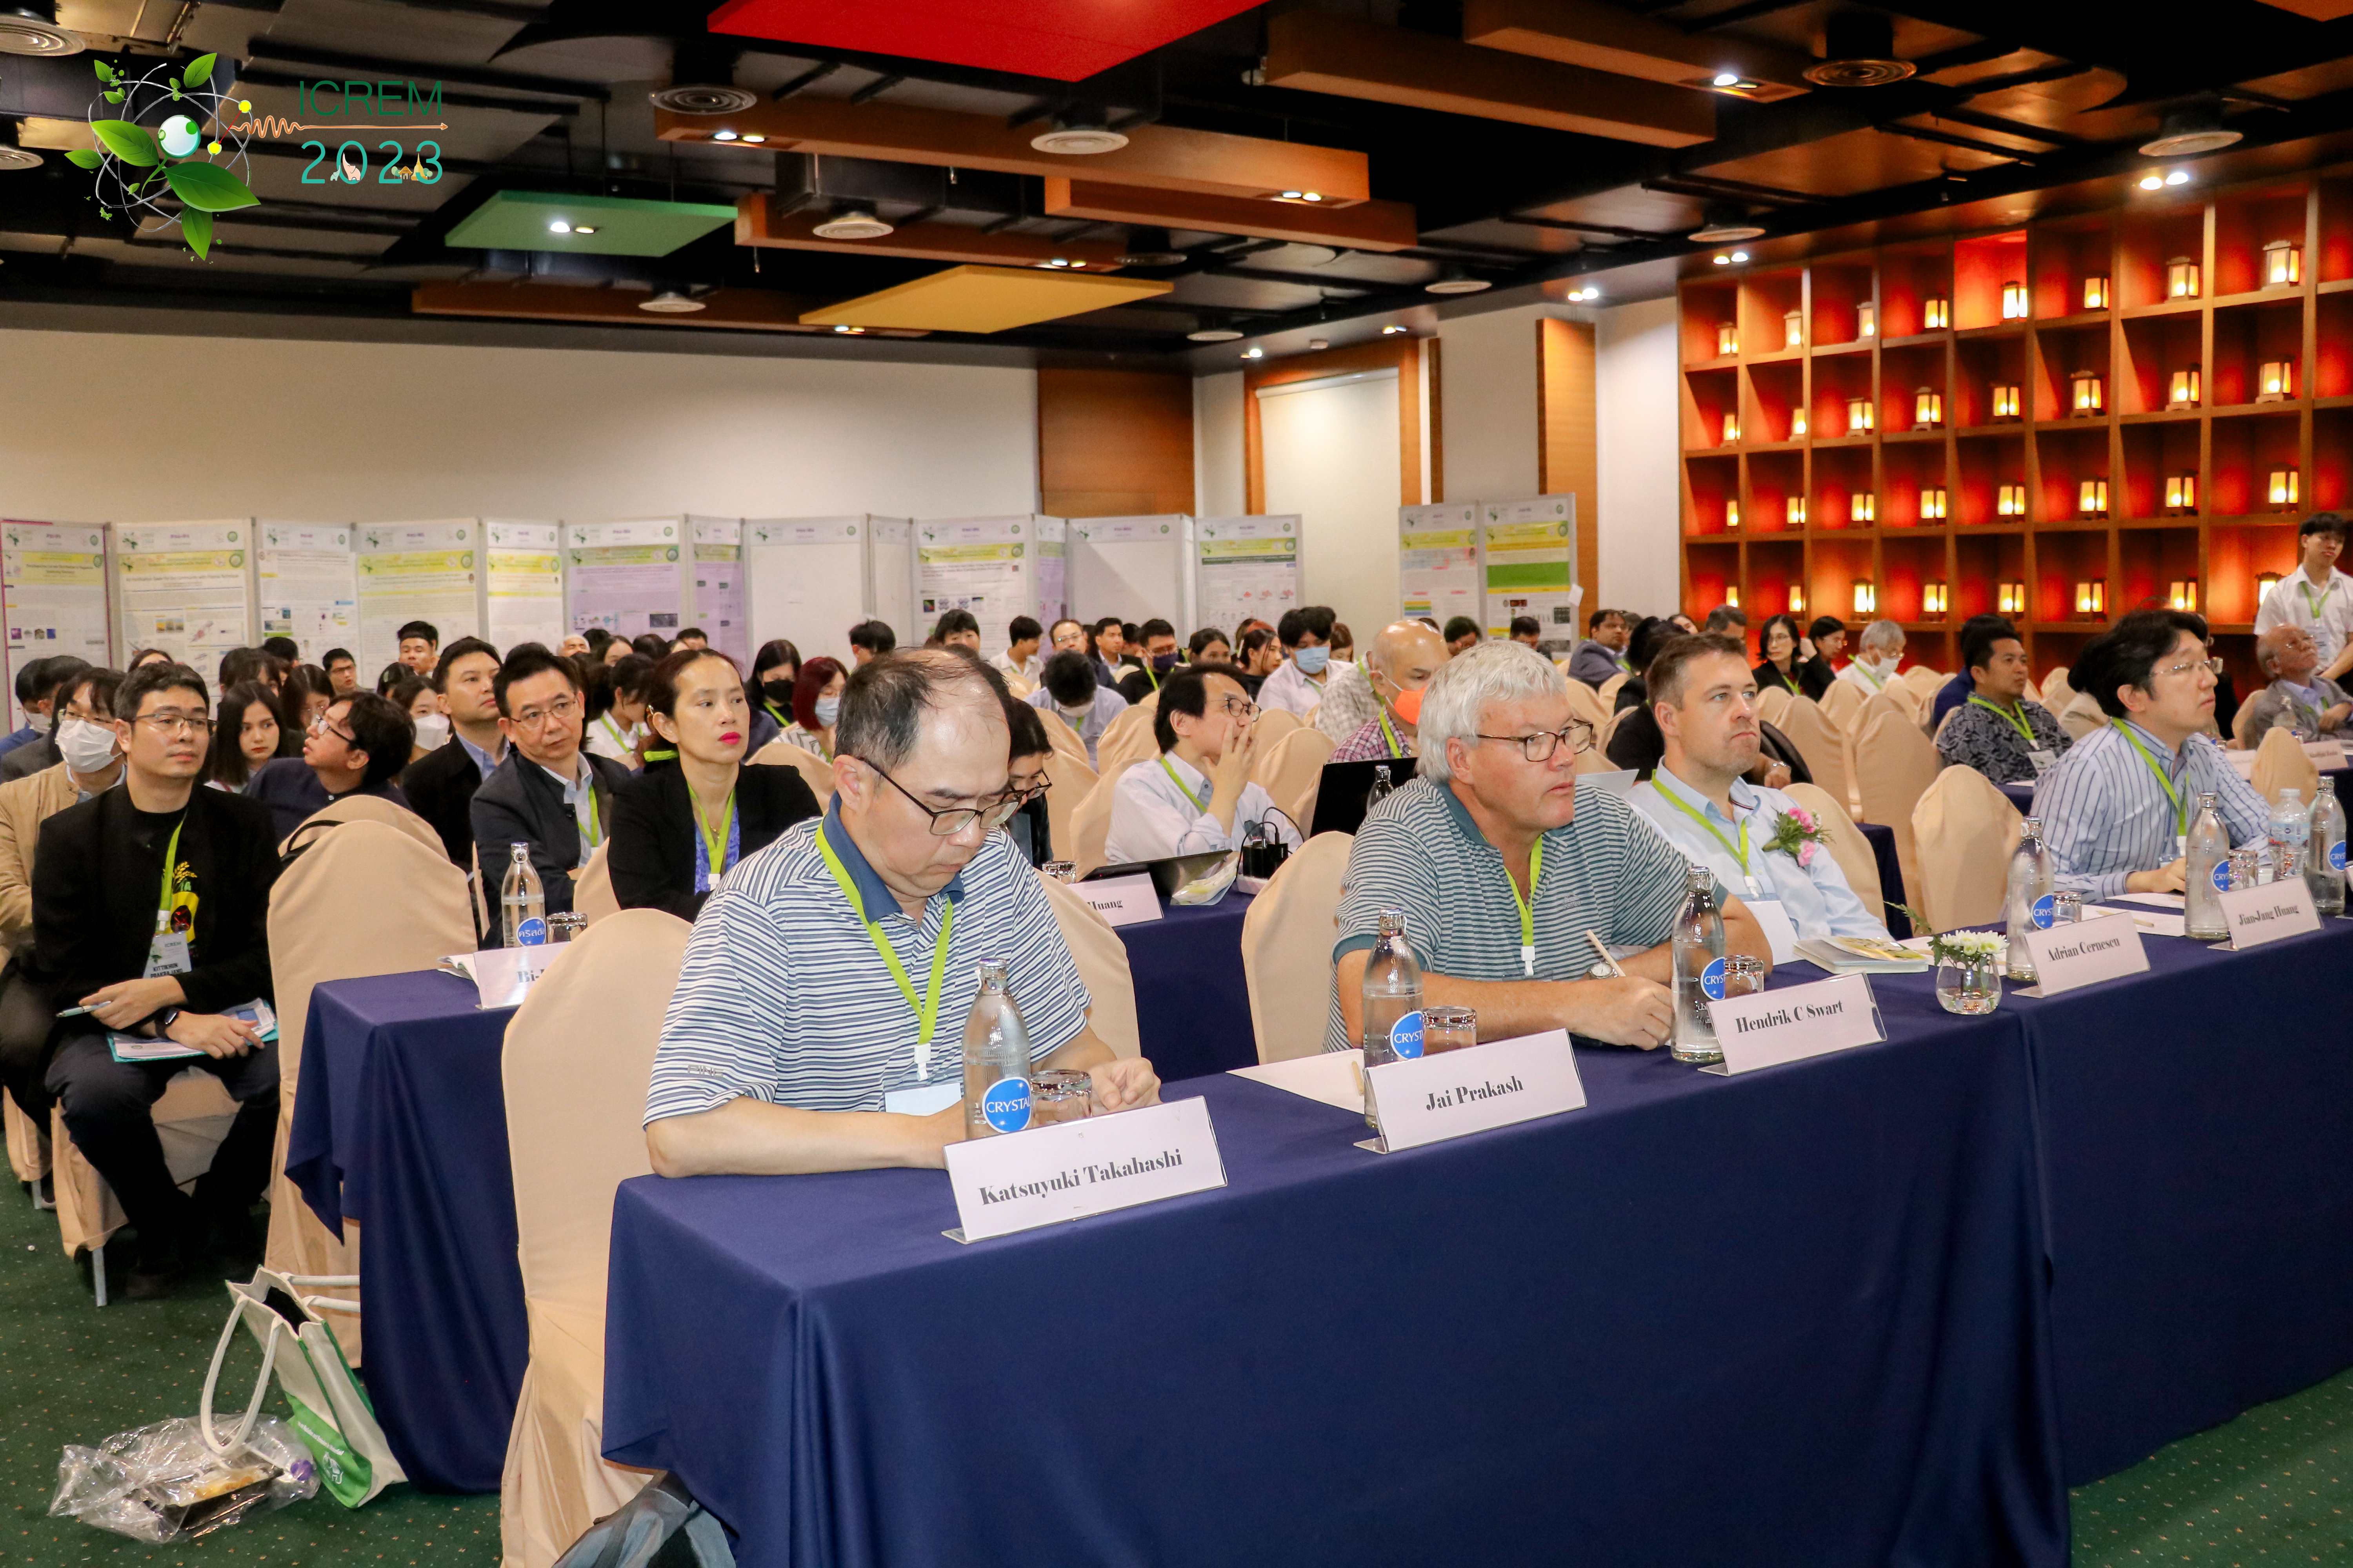
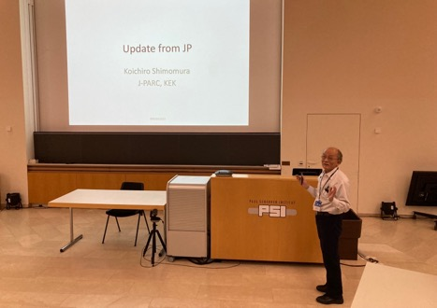
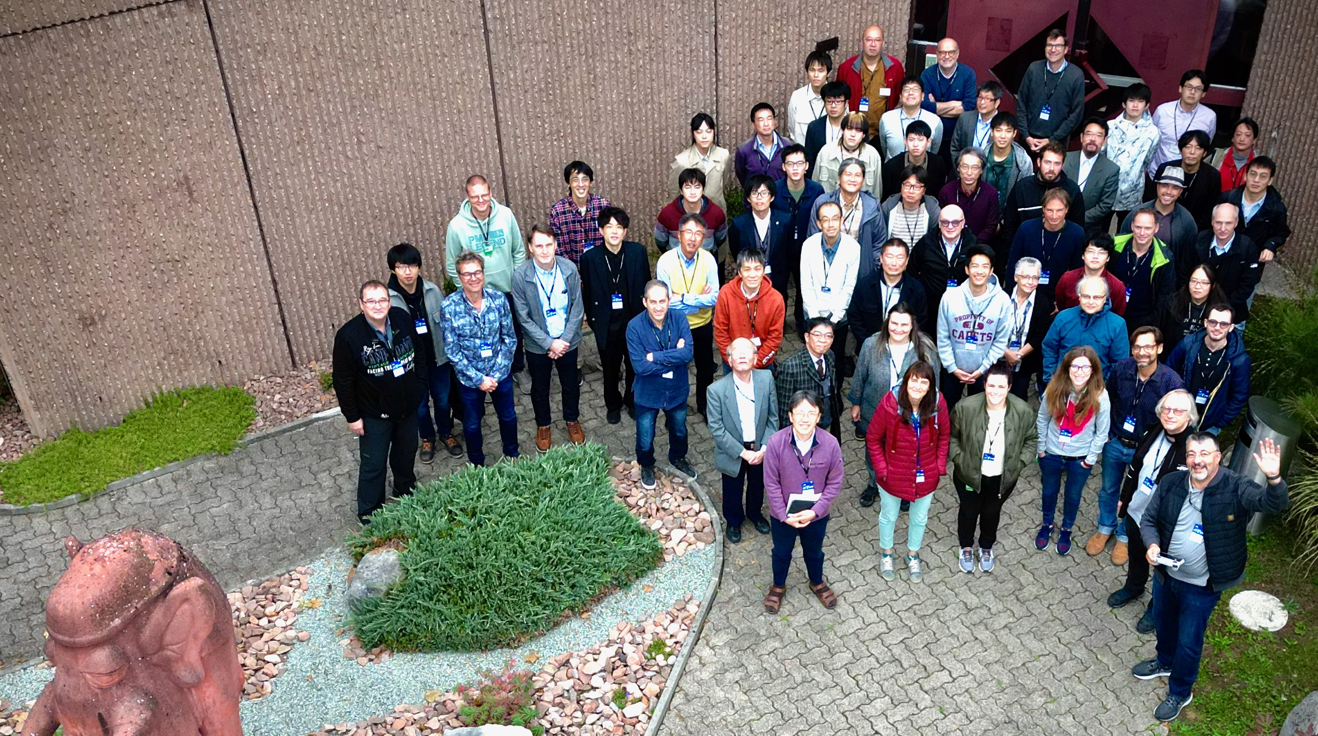
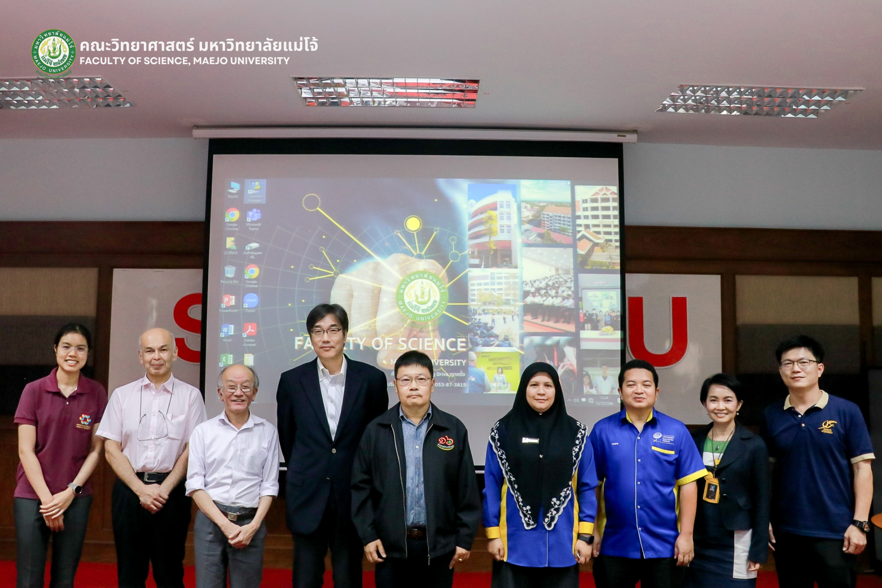
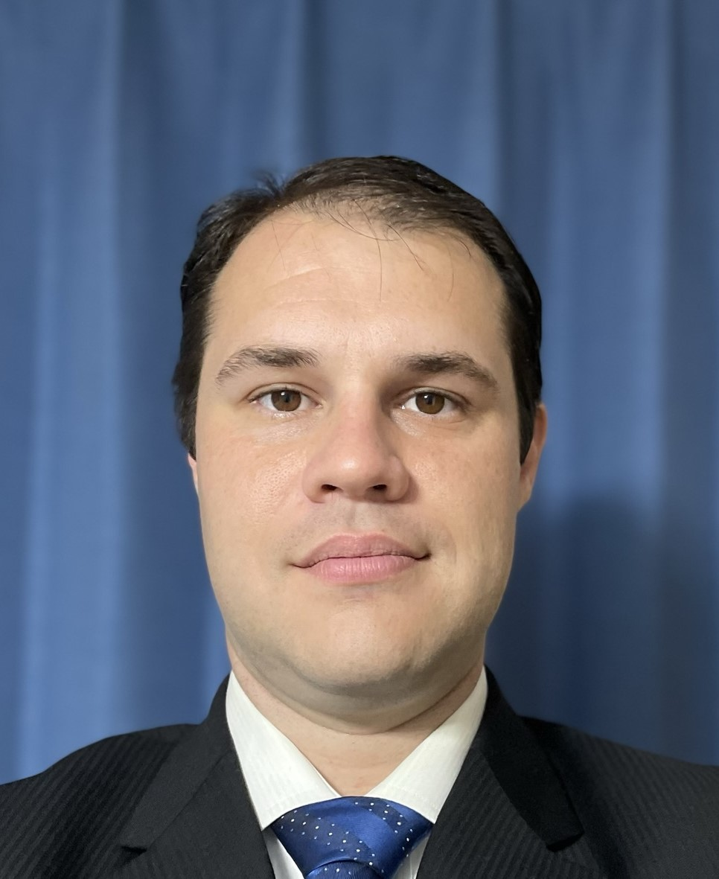
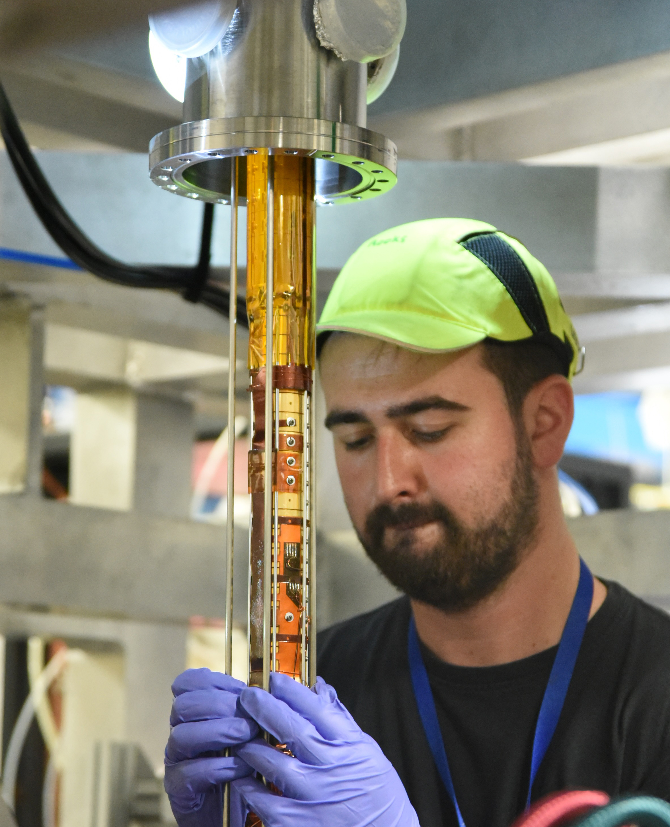
Attempts to international collaboration
RAL(ISIS)
TRIUMF
PSI(SμS)
RCNP
J-PARC(MLF)

Slide 8

Attempts to international collaboration
2024
Cyprus
Cyprus Institute

Slide 9
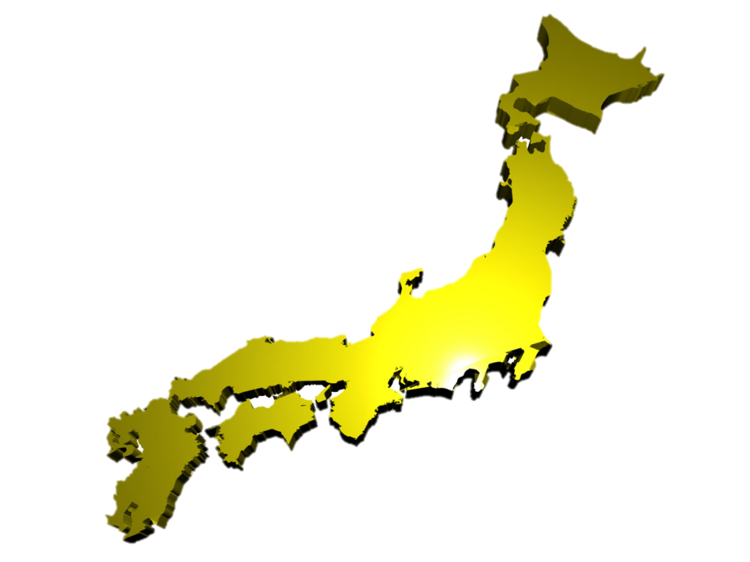






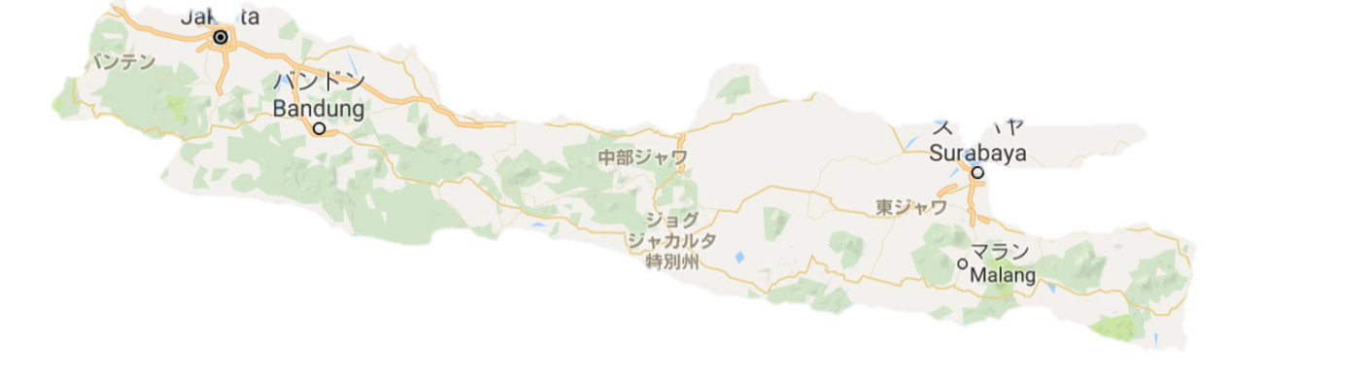






IPA
RIKEN-Hokkaido U.
Students belongs to their own universities and live near/in RIKEN to work with RIKEN researchers.
The degree is awarded from their universities.
The scholarship is available from RIKEN.
Free accommodations are provided.
Competitions are applicable.
Long Term 3 years
Short Term 3-6 month

Slide 10



















RIKEN-Hokkaido U.
Japan-UK
Japan Domestic
RIKEN-Malaysia
JRA/IPA
RIKEN-Indonesia
JRA/IPA

Slide 11
Domestic Collaboration

Slide 12
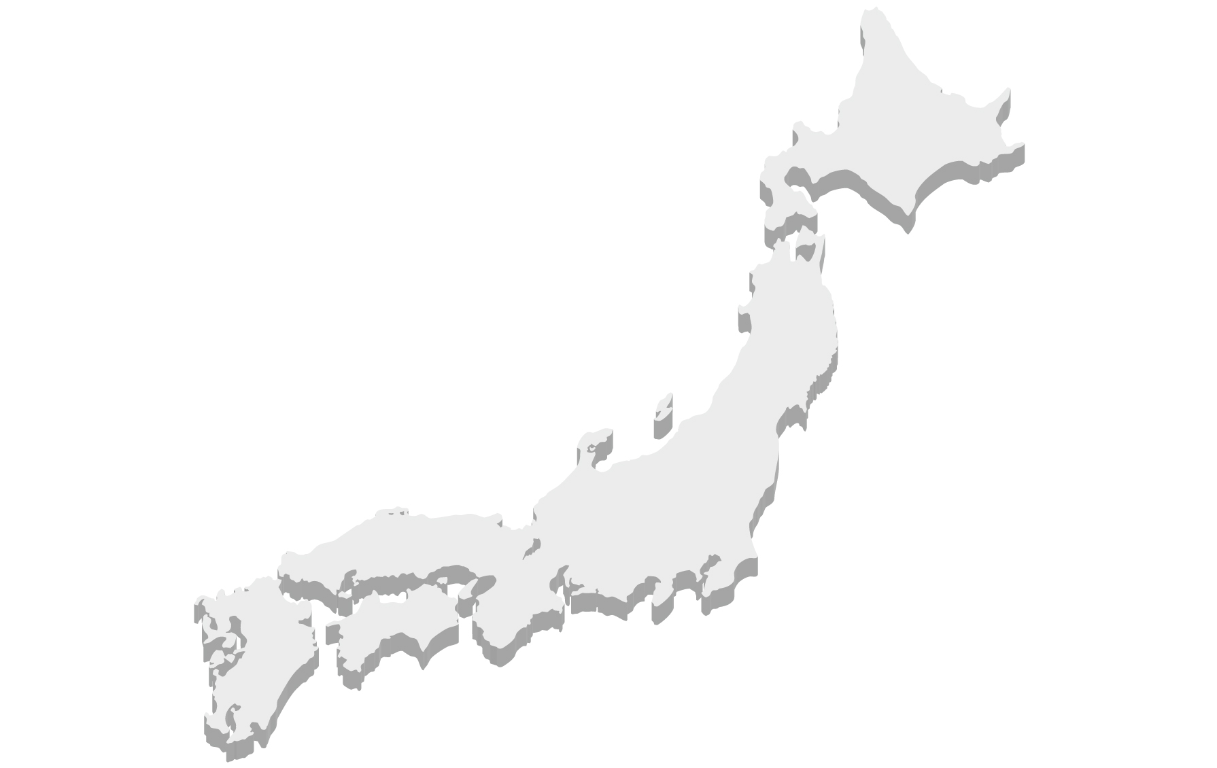
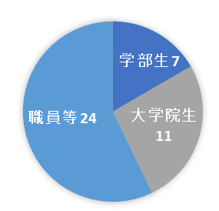




Attempts to domestic collaboration
Univ. of Toyama
Niigata Univ.
Muroran Institute of Technology
Integration of arts and sciences
Fundamental Physics
mSR
Equipment Development
Kyoto Univ.
Research Center for Nuclear Physics
RIKEN
Osaka Univ.
Saitama Univ.
Osaka Metropolitan Univ.
Shibaura Institute of Technology
Participants of mSR Rotating Lectures
Spring-8
Univ. of Electro-Communications
Institute for Materials Research, Tohoku Univ.
Shimane Univ.
Kitasato Univ.
Ibaraki Univ.
Students
7
Okayama Univ.
Univ. of Tokyo
International Christian Univ.
Staff, etc.
24
Graduate Students
11
Hiroshima Univ.
Sophia Univ.
National Museum of Japanese History
Kyushu Univ.
National Museum of Nature and Science
Saga Univ.
Nagoya Univ.
Univ. of Yamanashi
Showa Pharmaceutical Univ.

Slide 13

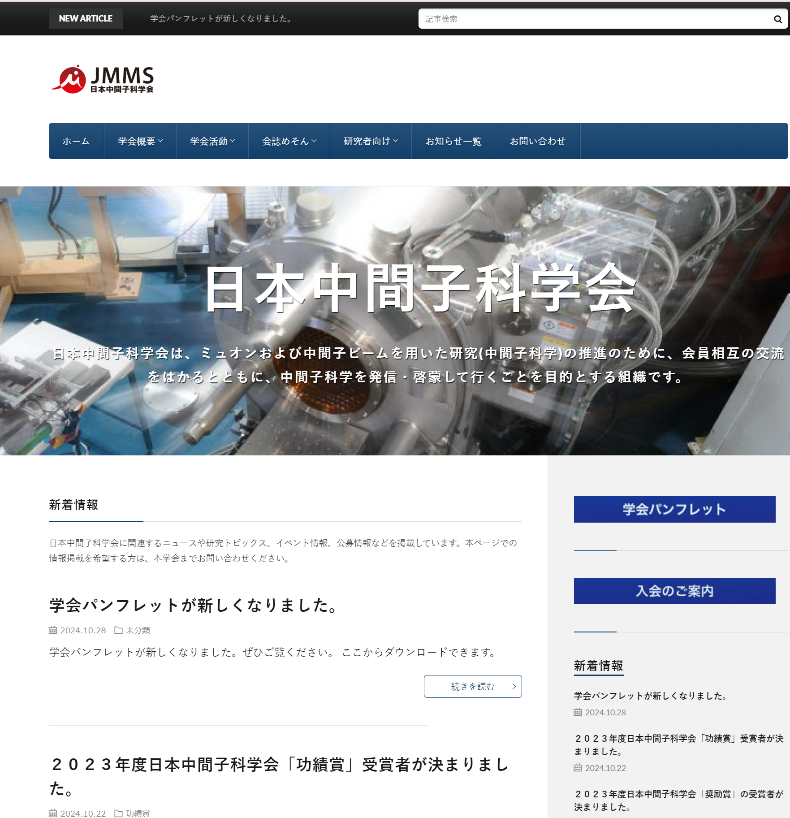

Society of Muon and Meson Science of Japan

Slide 14
Press released science highlight

Slide 15

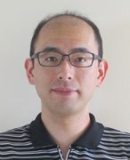
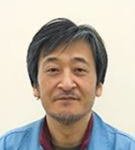
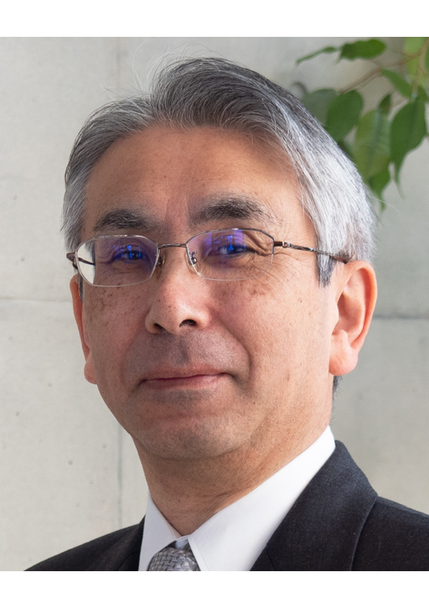
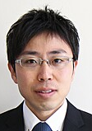
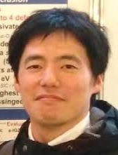
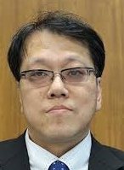
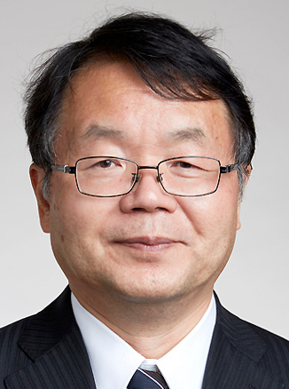



S1: Element strategy initiative for electronic materials
Metastable hydrogen state affecting the electronic properties of power semiconductor β-Ga2O3 revealed
M. Hiraishi
H. Okabe
MUSE's high intensity beam enables high precision measurement of µSR spectra in the time region after 15 µs.
Mu⁺
A. Koda
R. Kadono
?
No relaxation is observed → Mu⁻ is suggested to be diffusing fast while temporarily going through Mu⁰ state.
?
Mu⁻
↑Prediction from the ambipolarity model: In addition
to the previously identified donor Mu state (Mu⁺), an acceptor Mu state is predicted to exist as a hydride (Mu⁻) .
T. Ohsawa
N. Ohashi
←Local electronic states of Mu/H predicted from DFT calculations and supported by µSR
IMSS-KEK：M. Hiraishi, H. Okabe, A. Koda, R. Kadono
NIMS：T. Ohsawa, N. Ohashi
Titech：K. Ide, T. Kamiya, H. Hosono
H/Mu
K. Ide
T. Kamiya
M. Hiraishi et al., Phys. Rev. B 107, L041201 (2023):
Press release on February 6, 2023.
Muon
（J-PARC MLF）
H. Hosono

Slide 16
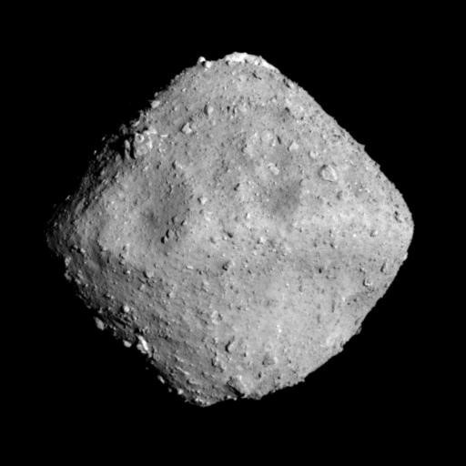
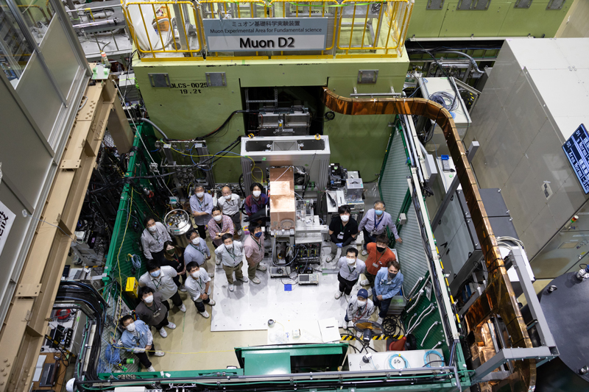
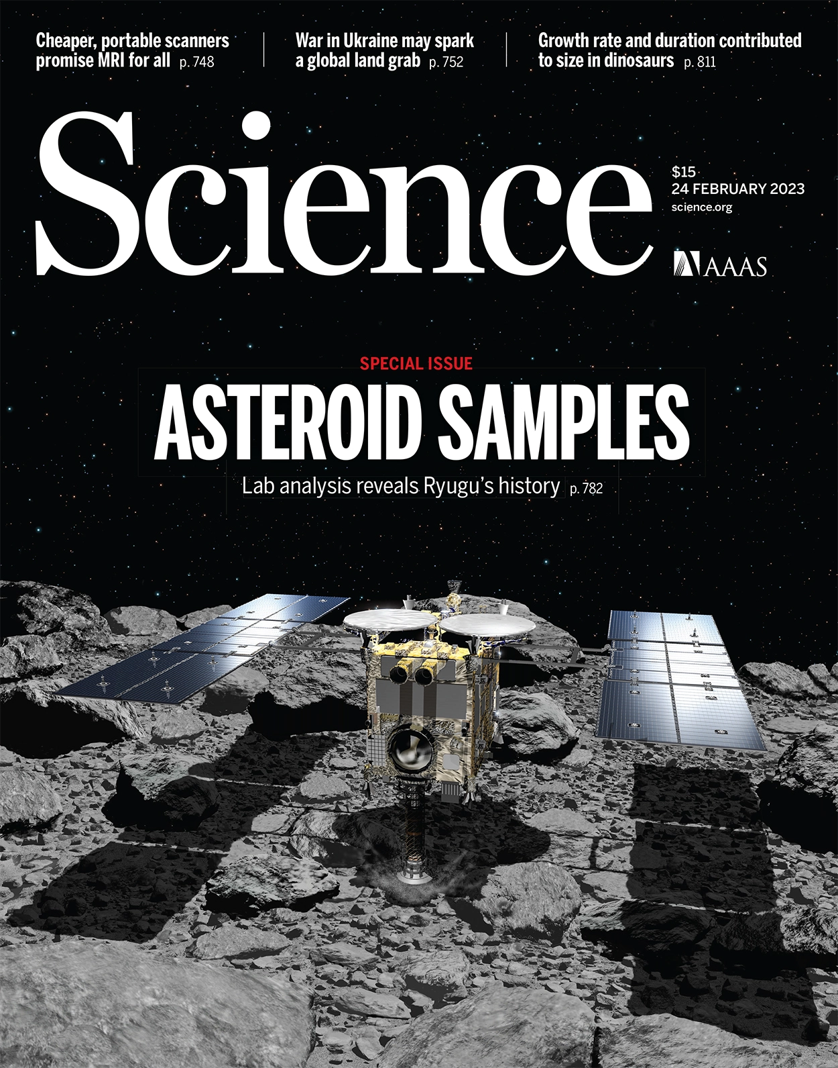
Muon Facility Muse @ MLF
Asteroid samples returned by the Hayabusa2 mission,
Muon measurement contributed to quantify C, Si, Mg and O concentrations as a part of the initial analysis that was performed soon after the sample recovery to the Earth. (collaboration with the initial analysis team (STONE) led by T. Nakamura.)
→ New standard of element composition of primordial solar system
Ryugu
Muon D-Line
Ex. The μC-Kα is 75 keV versus the fluorescence C-Kα is 0.3 keV (200 times larger !)
Cover:
Science vol. 379, No. 6634
Muon-induced characteristic X-rays is an ideal method for studying the amount and the distribution of elements that are contained inside a sample.
Sample
1 mm
T. Nakamura et al., DOI：10.1126/science.abn8671
16

Slide 17
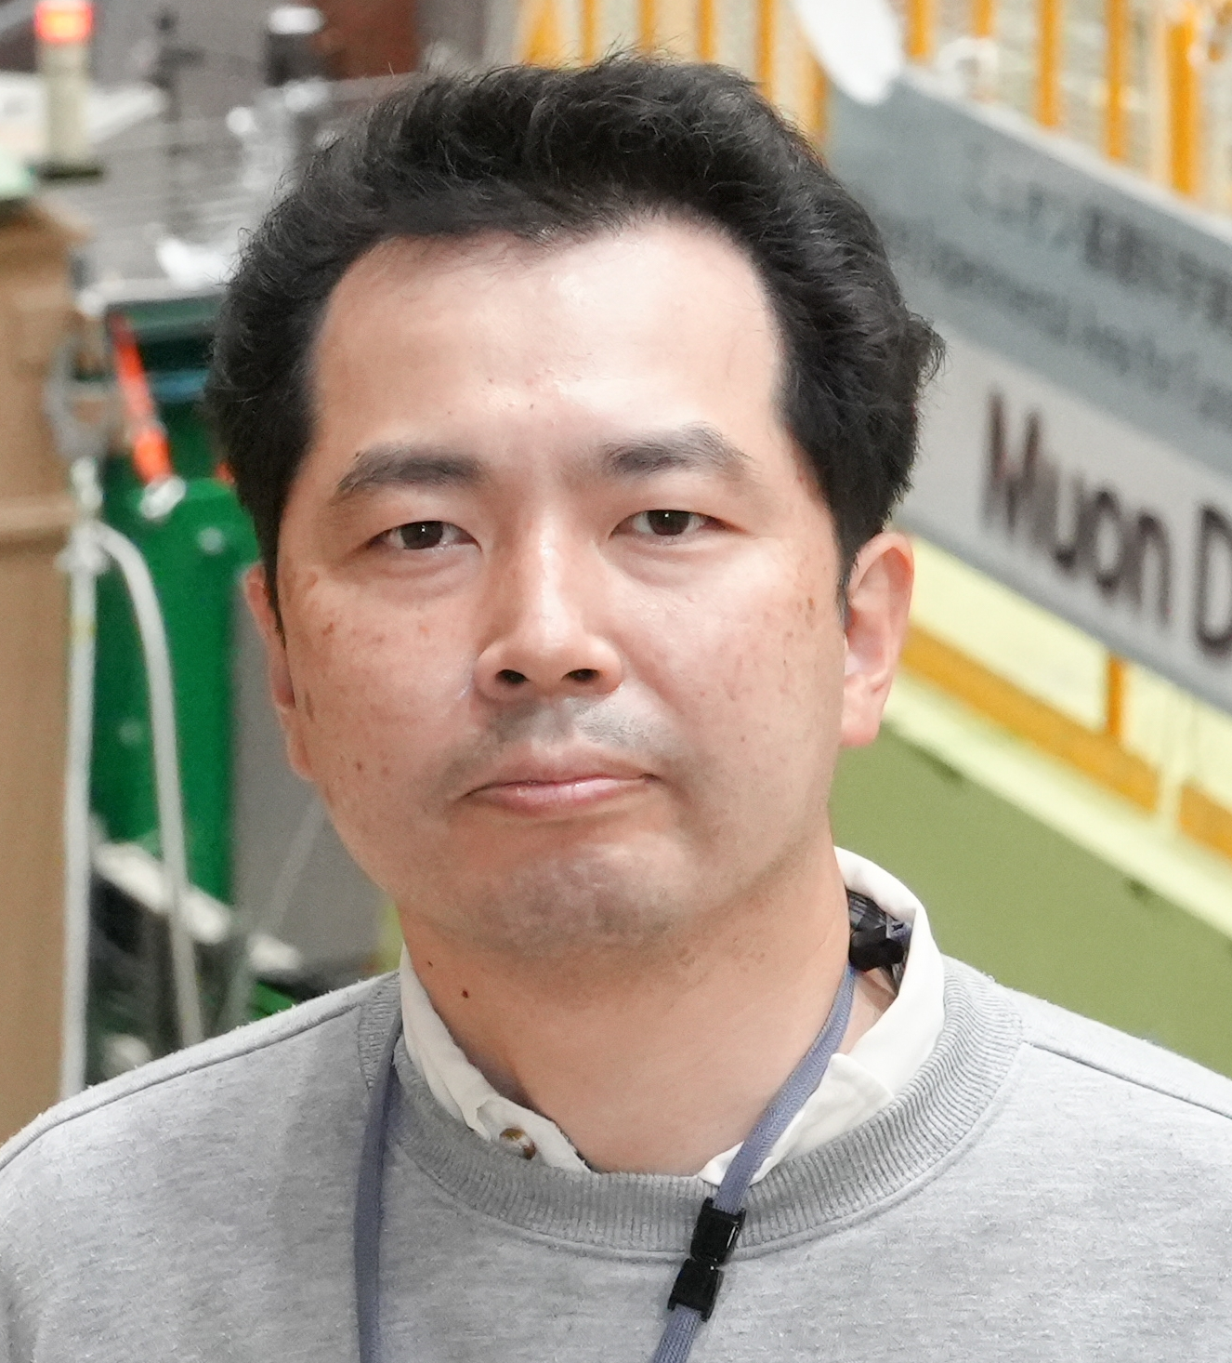
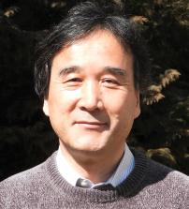
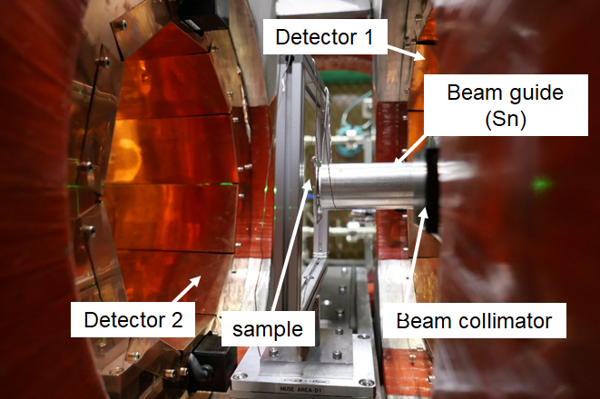
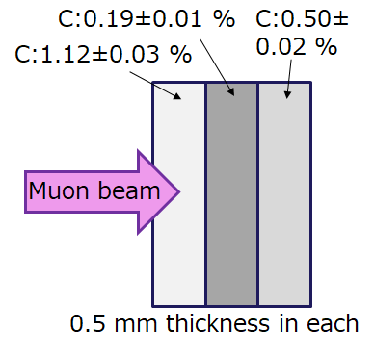
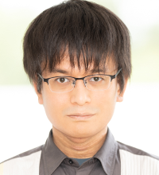
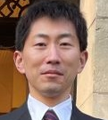
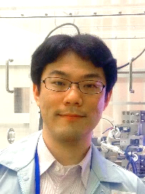
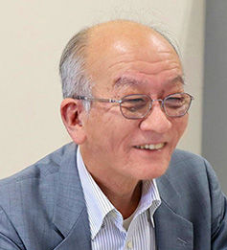
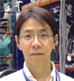

D line: elemental analysis by muon lifetime analysis
Non-destructive carbon contents quantification in steel by muon lifetime measurement
PRESS Release (2024.2.9.)
Dr. K. Ninomiya
(Osaka Univ.)
Dr. K. Kubo
(ICU)
Dr. M. Inagaki
(Kyoto Univ.)
Dr. G. Yoshida
(KEK)
Development of a non‑destructive depth‑selective quantification method for sub‑percent carbon contents in steel using negative muon lifetime analysis
Dr. S. Takeshita
(KEK)
Dr. K. Shimomura
(KEK)
K. Ninomiya et al., Scientific Reports, 14, 1797 (2024) DOI：10.1038/s41598-024-52255-5
Dr. W. Higemoto
(JAEA)
Dr. T. Saito (Natl. Mus. Jpn. Hist.)

Slide 18
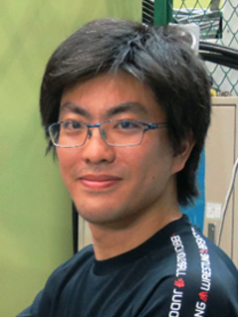
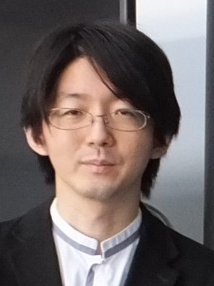
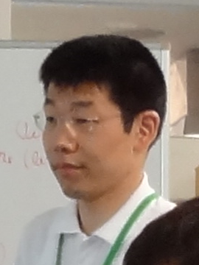
S1: Transient μSR
New data acquisition method for efficient use of J-PARC high-intensity beam
S. Nishimura
M. Hiraishi
J. G. Nakamura
H. Okabe
M. Miyazaki
A. Koda
Information such as sample temperature, magnetic field, and μSR data are integrated in real time for each muon pulse to generate multidimensional data.
Continuous µSR measurements are possible even when the sample itself undergoes gradual change with time, resulting in more efficient use of the beam.
S. Nishimura et al., NIM-A 1056, 168669 (2023):
Press release on Nov. 16, 2023.
R. Kadono

Slide 19
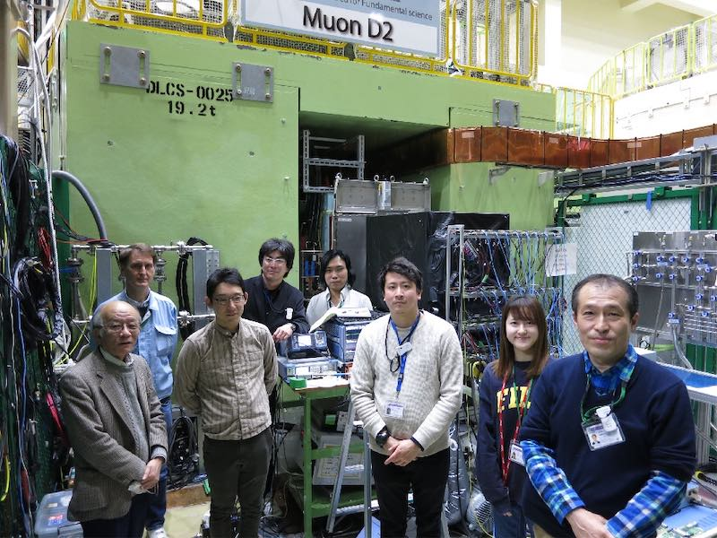
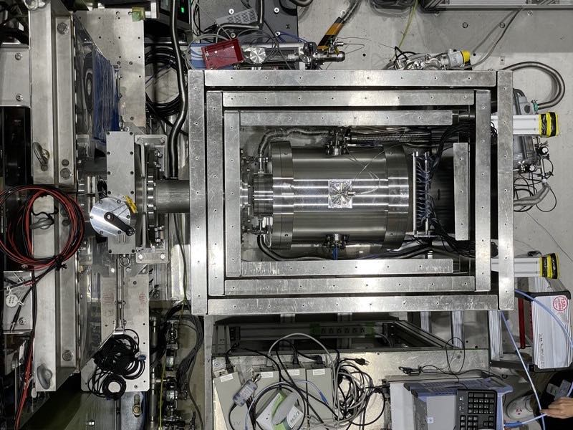
D line: precision spectroscopy of muonic He atoms
Muonic helium ground-state hyperfine structure measurements at zero field
— World record improved for the first time in 40 years —
µHe
Ground state muonic helium
HFS structure and low-field
Zeeman splitting
3 atm
Breit-Rabi Diagram
Δν(µHe) = 4464.980(20) MHz [4.5ppm]
4 atm
Improved Measurements of Muonic Helium Ground-State Hyperfine Structure at a Near-Zero Magnetic Field
P. Strasser et al., Phys. Rev. Lett. 131, 253003(2023):
DOI: 10.1103/PhysRevLett.131.253003
10.5 atm

Slide 20




D line: High-resolution X-ray spectroscopy of muon atoms
Physics under ultra-high electric field opened up by Muon Atoms
The energy of muonic X-rays was determined with extremely high accuracy using a TES detector
with an energy resolution 10 times higher than that of conventional semiconductor detectors
Superconducting Transition-Edge Sensor (TES) Microcalorimeter
PRESS
Quantum Electrodynamics Verified with Muonic Atoms
Proof-of-Principle Experiment for Testing Strong-Field Quantum Electrodynamics with Exotic Atoms: High Precision X-Ray Spectroscopy of Muonic Neon
T. Okumura et al., Phys. Rev. Lett. 130, 173001 (2023)

Slide 21
Integration Research of Humanities and Sciences

Slide 22






























A combination of a humanities researcher and a science-based quantum beam developer!
Archaeology Research Laboratory, Museums
Muon Beam Experiment
National Museum of Japanese History
Tsutomu Saito, Shinichiro Fujio, Yoshifumi Ueno, Tetsuya Shinozaki
High Energy Accelerator Research Organization, Institute of Materials Structure Science
Koichiro Shimoura, Yasuhiro Miyake, Motonobu Tampo, Soshi Takeshita, Naritoshi Kawamura, Katsuhiko Ishida, Patrick Strasser, Izumi Umegaki, Shogo Doiuchi, Akiko Hashimoto, Yuta Ishikake
National Museum of Nature and Science
Takahiko Kutsuna
Osaka Univ. Tekijuku Commemoration Center
Kyoko Takahashi
International Christian Univ. Kenya Kubo
Okayama University
Naoko Matsumoto, Akira Seike, Etsuyo Yamamoto,
Koji Yoshimura
Osaka Univ. Akira Satou, Kentaro Terada
Hiroshima Univ. Kazuhiko Ninomiya
Yamanashi Prefectural Museum Saigan Mai
Univ. of Tokyo Yoshio Takahashi
Matsue City Cultural Properties Research Division
Tohoku Univ. Kiichiro Oishi
Archaelogical Institute of Kashihara, Nara pref.
Hokkaido Univ. Yoshiaki Kiyanagi
Ibaraki Univ. Yutaka TANAKA
Tokyo Denki Univ. Yoshinari Abe
Kyoto Tachibana Univ. Kentaro MINAMI
Univ. of Yamanashi Kaoru Ijima
Tokyo Univ. of the Arts Fumiyoshi KIRINO
National Museum of Nature and Science Shigekazu Yoneda
Tokyo National Museum Toshiyuki Torigoe
Okinawa Pref. Cultural Assets Div.
Tsutomu Arakaki
Hitachinaka City Buried Cultural Properties
Research Center Kenichi Inada
Humanities researchers and science quantum beam developers
Sen-Oku Hakukokan Museum Mamoru Hirokawa
Nagoya Castle Research Center Misako Asahi
Ancient Orient Museum Makiko Tsumura
Advisor: Nobuhiro Kosugi
Steady progress has been made with 9 symposiums held to date on the integration of the humanities and sciences!
Symposium on the Integration of Humanities and Science
“Quantum Beams Explore History”
The Horizon of Humanities and Science Integration Weaved by Accelerators
The 1st
27-28 Jul. 2019
at National Museum of Nature and Science
The 2nd
25-26 Dec. 2019
at Osaka Univ. Nakanoshima Center
The 3rd
25-26 Sep.2020
at ZOOM
The 4th
28-29 Jan.2021
at ZOOM
The 5th
9-10 Sep. 2021 at ZOOM
The 6th
7-8 Jan. 2022
at Osaka Univ. Toyonaka Campus/zoom
The 7th
2-3 Nov.2022
at KEK Tsukuba Campus
The 8th
2-3 Nov. 2023
at National Museum of Nature and Science
The 9th
1-2 Nov. 2024
at AKIHABARA Convention Hall

Slide 23


9th Symposium on the Integration of Humanities and Science
“Quantum Beams Explore History”
-The Horizon of Humanities and Science Integration Weaved by Accelerators
Progress in FY2024
大阪大学
髙橋京子
集合写真
1-2 Nov. 2024 at AKIHABARA Convention Hall, Akihabara, Tokyo
The symposium consisted of lectures by 12 Japanese researchers in the humanities and sciences.The symposium was held on-site with approximately 70 participants on both days.
所長の
講演写真

Slide 24
K Program

Slide 25

Key and Advanced Technology R&D through Cross Community Collaboration Program
Innovative positioning, structural imaging and other applications using cosmic ray muons.
from 2024 to 2029
“Development of core technology to produce compact, artificially intense muons”

Slide 26
K Program R&D Organization
Research and Development Item 1
Compact muon source
Laser system
OISHI, KAMIOKA,
WADA, SAITO, SAKASHITA, TSUKIHANA
Muonium Generation and Extraction
Extraction Equipment
KIMURA
Research and Development Item 2
Feedback systems
IIJIMA, SUZUKI
Compact muon accelerator
Feedback systems
OTANI, FUTATSUKAWA
Overall Summary
SHIMOMURA (P.I.)
RF source
TAKAYANAGI, FUWA
Diagnostic Equipment
IIJIMA, INAMI
Research and Development Item 3
R&D Organization
KEK
  JAEA
  Nagoya Univ.
  RIKEN
Imaging technology
NAGATANI
Research and Development Item 4
Compact muon source accelerator
Cyclotron
OKUNO, NAKAZAWA, MIYAKE
Cooperating Institutions
Osaka Univ., RCNP
  Kyoto Univ.
  Unibv. of Tokyo, CNS
Research and Development Item 5
CARA
OKUNO, KANDA, KAMAKURA
Fusion and Verification
SHIMOMURA (P.I.), KAWAMURA, YAMAZAKI, MIBE, FUJII
MERIT
OKUNO, MORI, ISHI

Slide 27
Summary
International Collaboration
Domestic Collaboration
Integration Research of Humanities and Sciences
K program

