Slide 1
μSR software at ISIS
Francis Pratt
ISIS Muon Group

Slide 2
Outline of talk
Experiment control software: transition from SECI to IBEX
Digital muons: positron peak detection via software
Event mode: data acquisition and reduction to standard format via slicing
Data storage format: NeXus hierarchical data structure for muons
Data analysis: Mantid and WiMDA programs for analysing μSR data
Computational support for data analysis: muon sites and spin simulation

Slide 3
Experiment Control
SECI (Sample Environment Control interface) was used for many years on ISIS neutron and muon instruments
Control is now migrating to a new more flexible system called IBEX
https://github.com/ISISComputingGroup/ibex_user_manual/wiki/
SECI
Single node architecture (+API)
Control via Labview VIs
GUI is part of the program
OpenGenie scripting language
IBEX
Client-server architecture
Control via EPICS IOCs
(Labview VIs can be wrapped as IOCs)
GUI runs on a client
genie_python scripting language
All ISIS muon instruments are expected to complete migration to IBEX in 2025

Slide 4
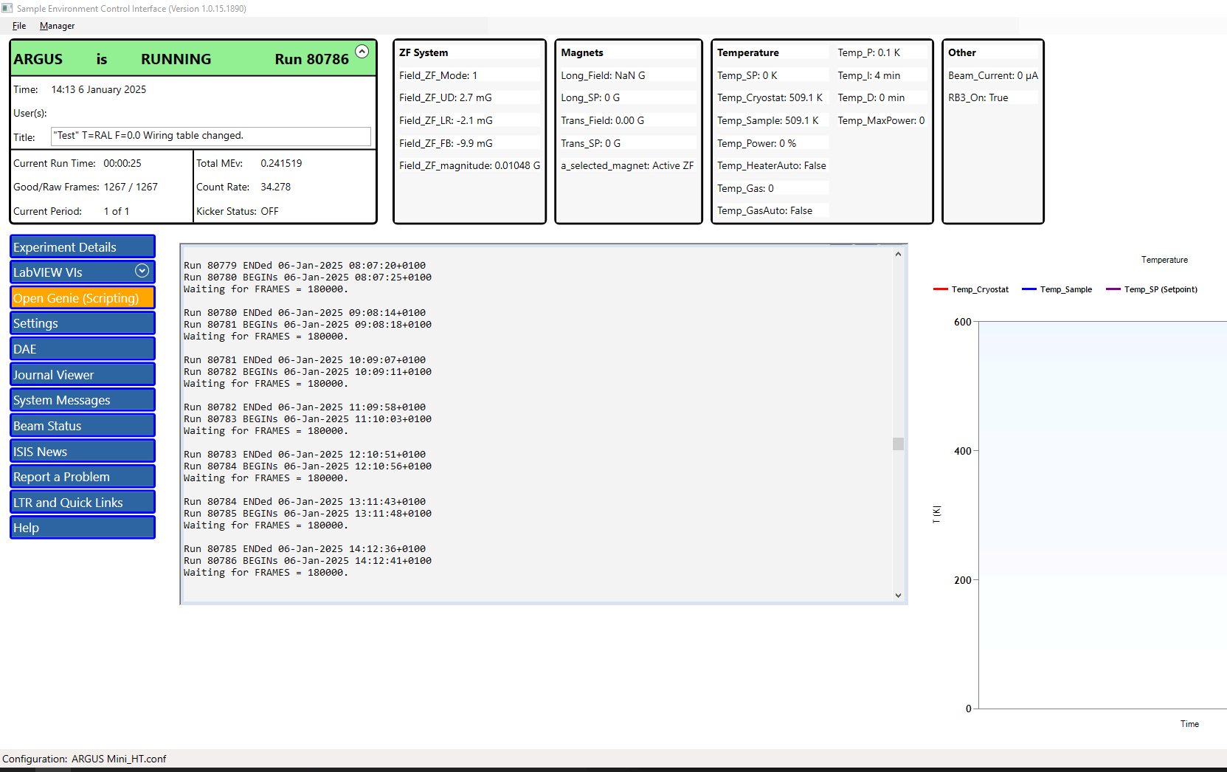
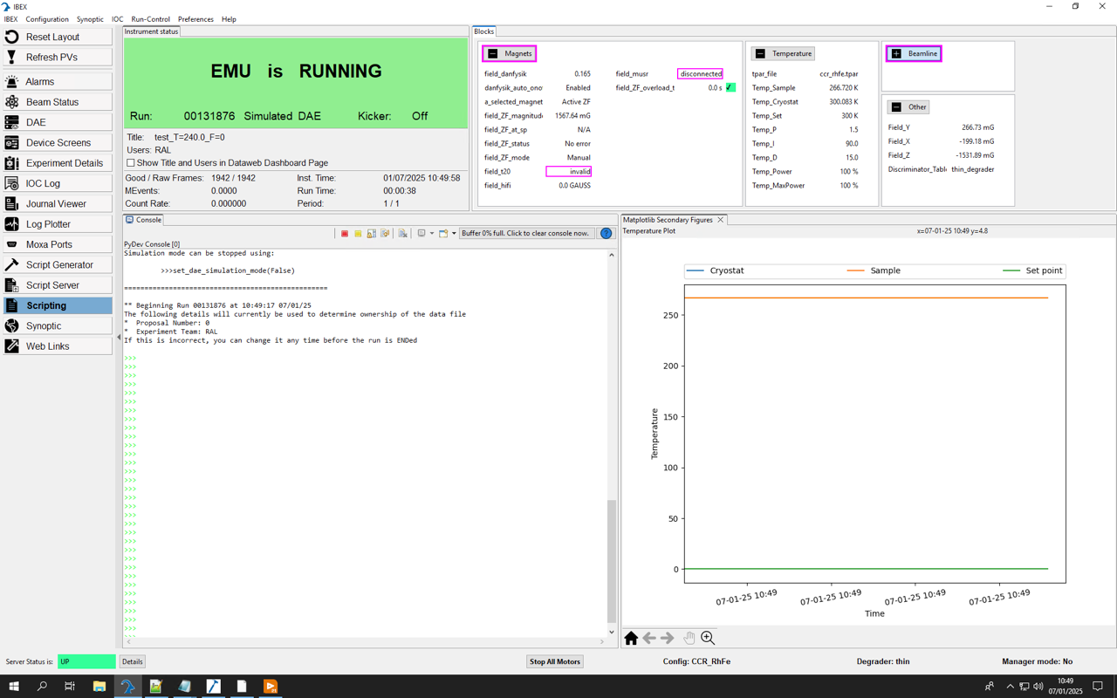
Experiment Control
SECI GUI
IBEX GUI

Slide 5
Digital Muons
Positron discrimination using fast digitisers and digital signal processing,
rather than analogue electronics (Dan Pooley et al, MUSR2020)
Conventional - low rate
High rate (conventional)
High rate (using DSP)
Significant improvement expected for high-intensity pulsed muons
D E Pooley et al 2023 J. Phys.: Conf. Ser. 2462 012028

Slide 6
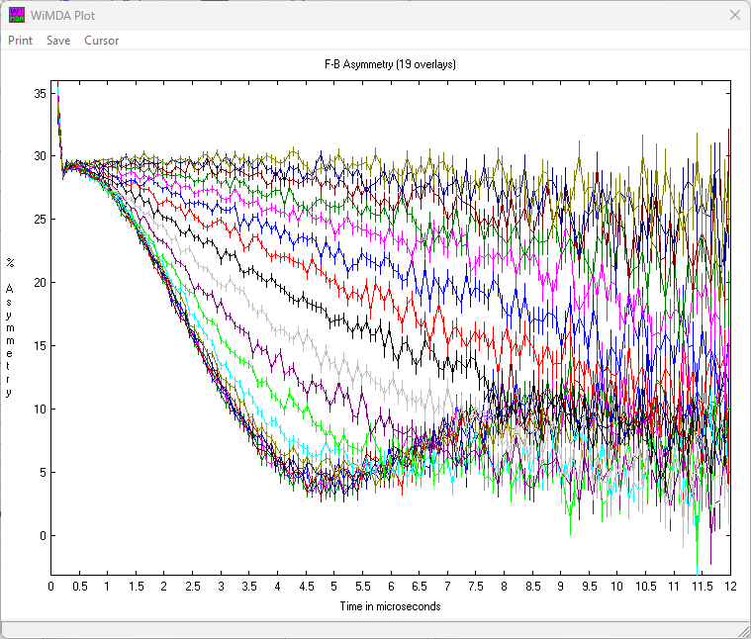
Event Mode
Event mode is already in use on some neutron instruments
We can now extend this to muons via the SuperMUSR project
Example of an event mode run covering a linear temperature sweep in Cu, split into 19 slices
Some benefits of of Event Mode
Can choose how to slice data after the measurement rather than having to fix it during the measurement
Can filter out problematic parts of the data after the measurement
Can tune the trade off between resolution and statistics, e.g. in ALC spectroscopy
Can study slowly evolving processes, e.g. in electrochemical cells
Dec 24 test run on HiFi taken by Isao Watanabe

Slide 7
NeXus Data Format
All neutron and muon instruments at ISIS use NeXus as the primary data format
The NeXus data format uses the HDF (Hierarchical Data Format) standard
Key advantages of using the NeXus data format
Metadata including sample environment and beamline logs are stored in the same file as the data
The ISIS data analysis tools WiMDA and Mantid are designed to use NeXus data
Both event mode data and histogram mode data can be stored in a NeXus file
It is an extensible format, new features can be added without affecting backward compatibility
NeXus at other muon facilities
Automatic conversion to NeXus format is available at the J-PARC muon instruments on D1 and S1
Conversion to NeXus format is also available for PSI data via their web data interface
https://www.nexusformat.org
https://www.hdfgroup.org

Slide 8

Data Analysis: Mantid
Mantid (Manipulation and Analysis Toolkit for Instrument Data) is a long-running large software project involving ISIS and other international collaborators
The project aim has been to process neutron and muon data under one program (MantidWorkbench)
The muon part was developed by ISIS Computing with input from the ISIS Muon group
Matching the capabilities of WiMDA was one of the first tasks set for the muon part
In Feb 2022 problems with this approach for the muon part led to a reappraisal and at that point ISIS Computing decided to switch to supporting the existing WiMDA code for muon data analysis
No further development of the muon side of Mantid will be made, but the last version of the muon part remains available to use within Mantid
Mantid for muons still provides some useful features for instrument setup and diagnostics and scripted data analysis

Slide 9

Data Analysis: WiMDA
History of WiMDA
WiMDA stands for Windows Muon Data Analysis
One single program to read and analyse muon data from different facilities with a simple, interactive GUI
I started working on it in 1998, with the original report presented in 2000 (Physica B 289-290, 710)
Written in the Delphi/RAD Studio version of Object Pascal (>40,000 lines of code, source given on request)
Delphi itself dates from 1995 and is still going strong, now being on version 28
A free ‘Community Edition’ of Delphi is available and a Delphi compatible Free Pascal Compiler is also available, matched with Lazarus as a free IDE (useful for user fitting)
WiMDA is the current ISIS-supported data analysis tool for ISIS muon data
Free to download and use independently from https://shadow.nd.rl.ac.uk/wimda/
It can also be run on the ISIS IDAaaS server at https://isis.analysis.stfc.ac.uk/

Slide 10
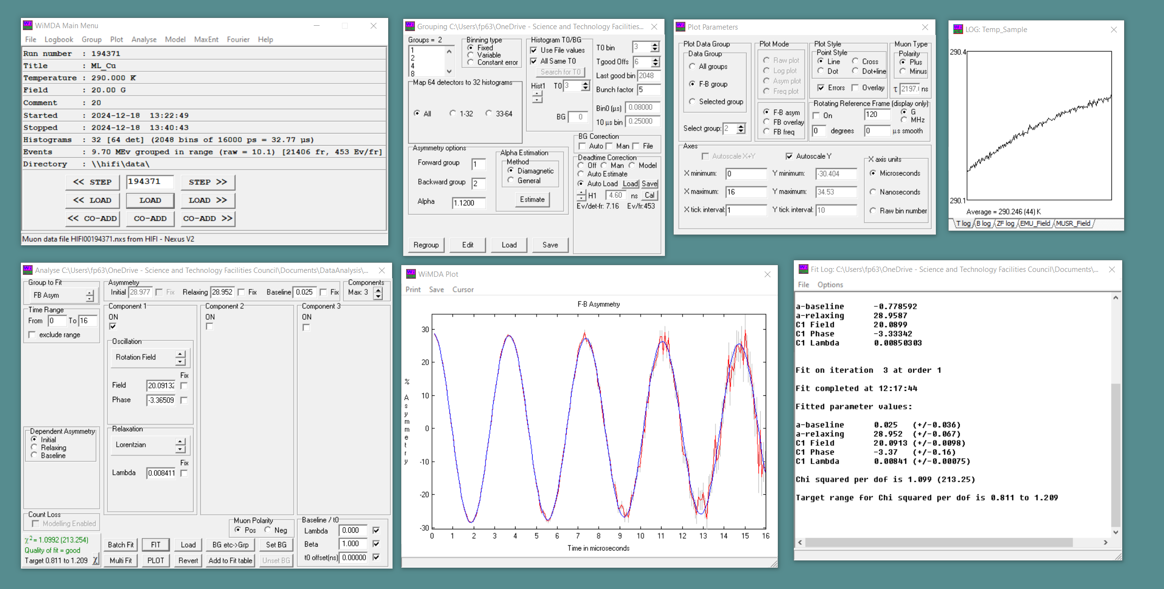
WiMDA GUI

Slide 11
WiMDA: Key Features and Areas for Development
Key Features
  User-friendly intuitive interactive interface
  Works equally well with pulsed and continuous source data
  Time-domain analysis with up to seven relaxation components (including BG)
  Frequency-domain analysis using both Fourier and Maximum Entropy methods
  Dedicated mode for μ⁻SR analysis
Areas for Development
  Support for analysing event-mode data
  Enhanced global fitting
  More sophisticated fitting engine

Slide 12
Computational Support for Data Analysis
From DFT modelling of muon sites to internal fields and predicted spectra:
Proposed magnetic structures
Measured internal fields B_{i}
Measured nuclear field distributions Δ_{i}
DFT+μ relaxed structure in the form of a cif file
Computed internal fields B_{i}
Computed nuclear field distributions Δ_{i}
DipoleCalc
Muon
site
model
DFT+μ output as an
out file (Gaussian) or magres file (CASTEP/QE)
Computed ALC spectra
Computed QLCR spectra
Computed ZF/LF relaxation functions
CalcALC
Measured ALC spectra
Measured QLCR spectra
Measured ZF/LF relaxation functions
COMET: Computationally Optimised Muon Experimental Techniques

Slide 13
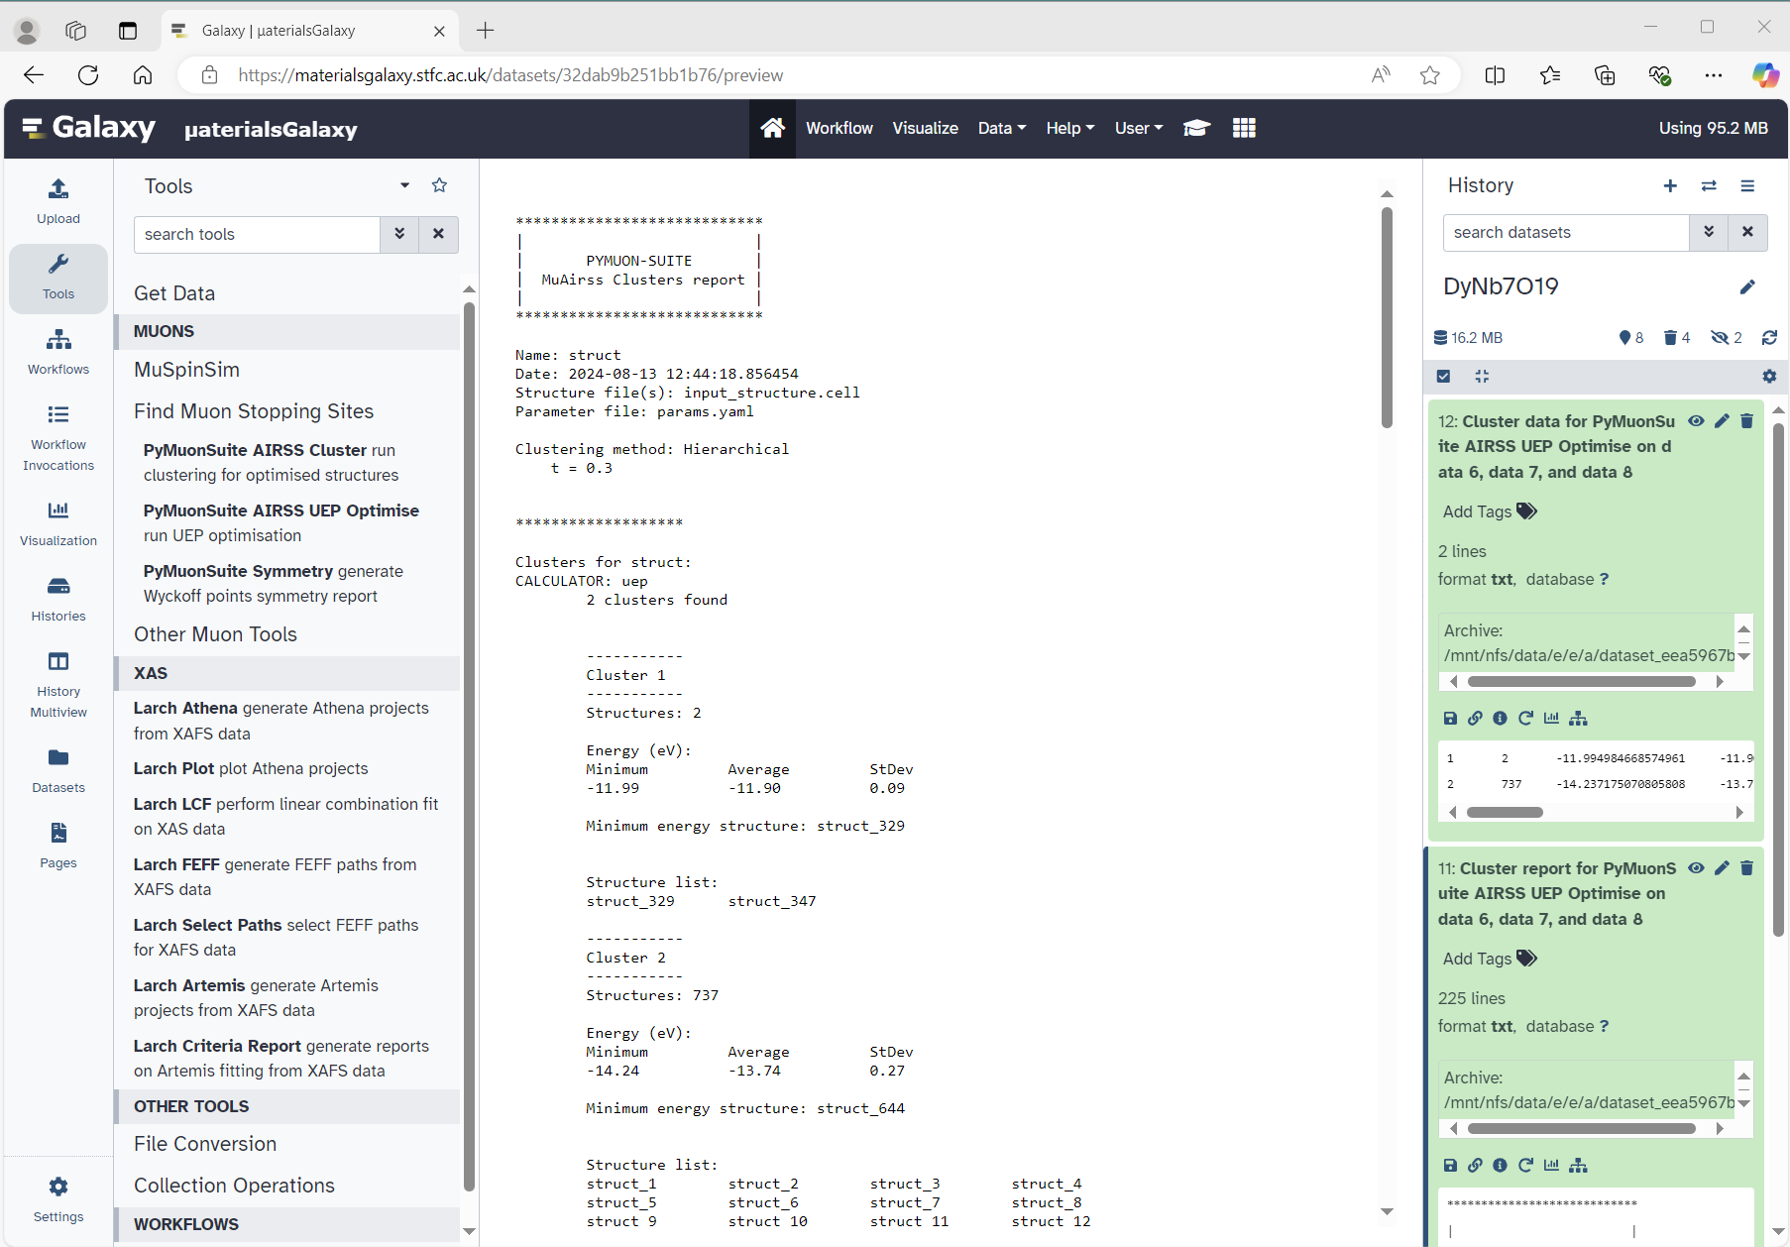
Site Calculation via DFT/UEP
Uses a charge density map derived from a Density Functional Theory (DFT) calculation
No muon is included, so we are using the Unperturbed Electrostatic Potential (UEP)
This method is suitable for systems where the electronic perturbation by the muon is expected to be small
The Materials Galaxy Framework is used to analyse clusters of muon stopping sites associated with potential minima
Materials Galaxy is being developed by STFC Scientific Computing Department
Materials Galaxy:
https://materialsgalaxy.stfc.ac.uk/

Slide 14
Site Calculation via DFT+μ
In general, the muon-induced distortion also needs to be included, requiring a DFT+μ calculation
Add muons to raw structure in a set of trial positions spanning the unit cell and relax the structures
Use clustering methods to analyse relaxed structures and determine stopping sites
The MuFinder program is a tool developed by ISIS/Durham student Ben Huddart to streamline this process
It uses CASTEP plane-wave DFT either running locally or remotely on a facility for HPC
MuFinder program:
https://gitlab.com/BenHuddart/mufinder
CASTEP DFT:
https://www.castep.org

Slide 15
Site Calculation for Single Molecules via DFT+μ
The gaussian code is well suited to making DFT+μ calculations on single molecules
The CalcALC program manages such single molecule calculations and the interpretation of results via ALC spectra
CalcALC can automatically send jobs and receive output from the STFC SCARF Compute Cluster or jobs can be managed manually using other computing hosts
CalcALC can also read MAGRES output files produced by Quantum Espresso and CASTEP and predict corresponding ALC and QLCR spectra
CalcALC program:
https://shadow.nd.rl.ac.uk/calcalc/
SCARF:
https://www.scarf.rl.ac.uk

Slide 16
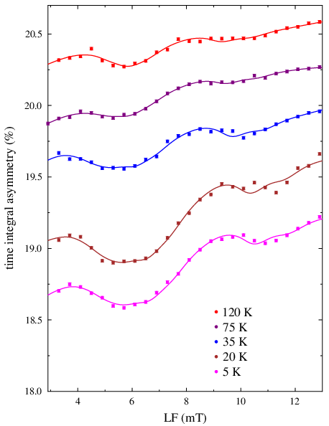
Simulation Tools for Muon Spin Polarisation
Two Python libraries available for simulation of muon spin polarisation:
Quantum ISIS, James Lord
available via a CalcALC installation:
or via a Mantid installation:
        https://www.mantidproject.org/installation/index
MuSpinSim STFC-SCD, Leandro Liborio et al
        https://github.com/
        muon-spectroscopy-computational-project/muspinsim
https://shadow.nd.rl.ac.uk/calcalc/
Recent example: QLCR for V in the
kagome CDW superconductor RbV₃Sb₅
Bonfa et al arXiv:2411.04848v1

Slide 17
Summary
Transition to IBEX experimental control for ISIS muons is due to complete in 2025
Digital muons and event mode are being developed in conjunction with SuperMUSR
NeXus provides a flexible data structure for both event mode and histogram mode
WiMDA provides the ongoing framework for ISIS-supported muon data analysis
Muon site and spin simulations allow a more quantitative analysis of μSR results via the COMET approach

