Slide 1
Institute of Physics, CAS
μSR study on the van der Waals cluster magnet Nb₃Cl₈
Lin Yang
Institute of Physics, Chinese Academy of Sciences
the 2nd workshop on Muon Science Technology and Industry, @CSNS
2025.01.11

Slide 2
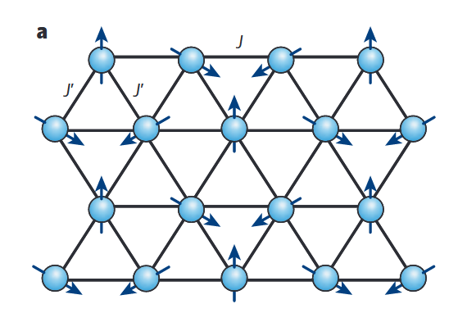
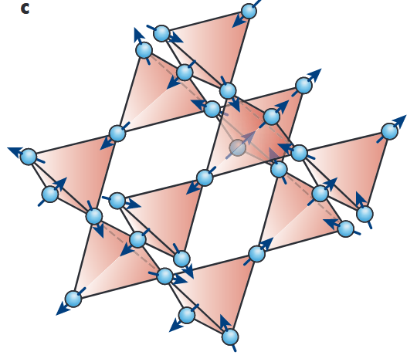
Quantum Spin Liquid
Resonating Valence Bond (RVB) States in spin-1/2 systems
Properties of QSL:
Strong quantum fluctuations
long-range quantum entanglement
No long-range magnetic order at 0 K
Geometrical frustrations enhance quantum fluctuations
Rep. Prog. Phys. 80, 016502(2017)
Nature 464, 199–208 (2010)

Slide 3
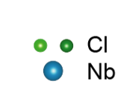
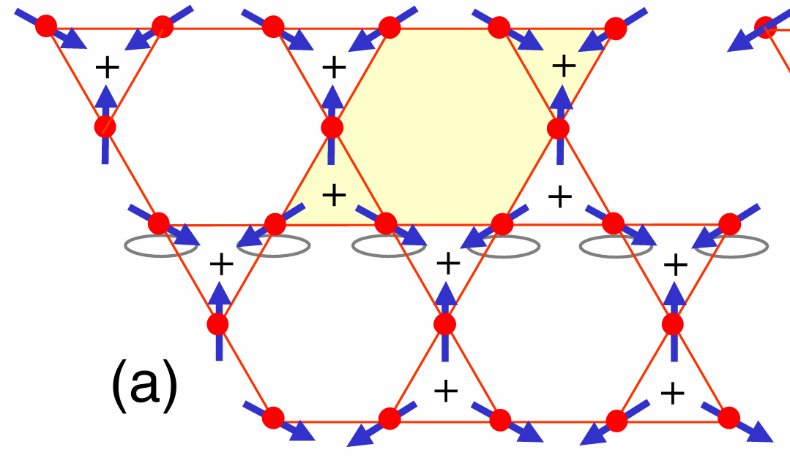
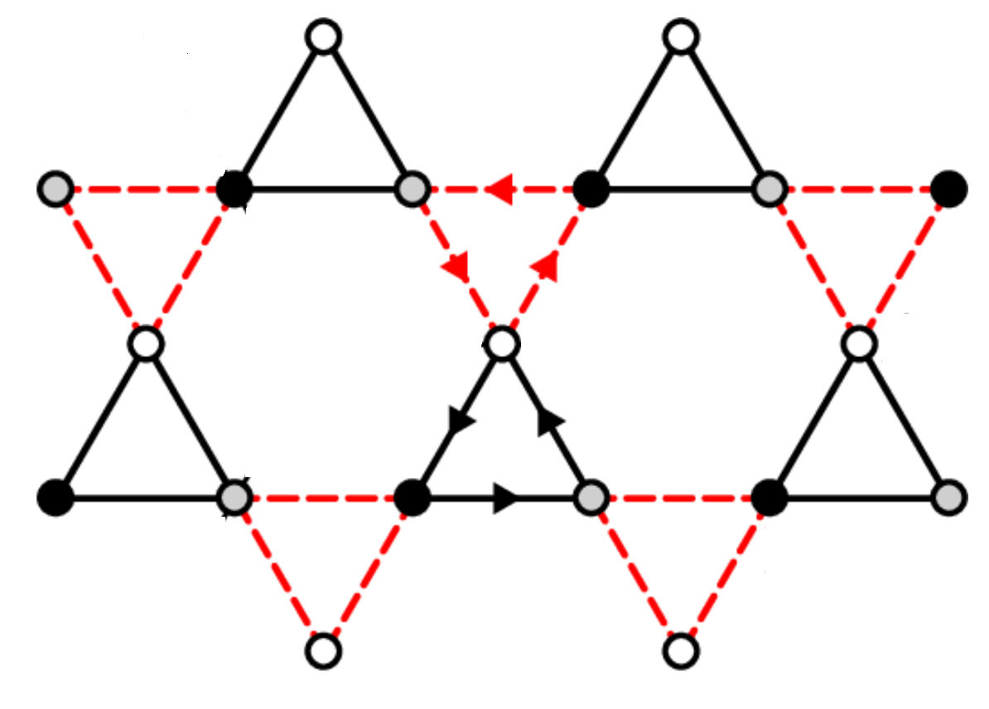
Breathing Kagome lattice in Nb₃Cl₈
Kagome Lattice
van der Waals force
Breathing Kagome layer in Nb₃Cl₈
Breathing Kagome Lattice
a₂
a₁=2.81Å
a₂=3.93Å
a₁

Slide 4
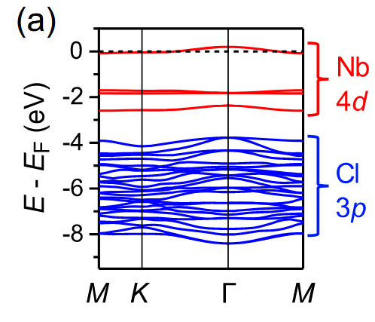
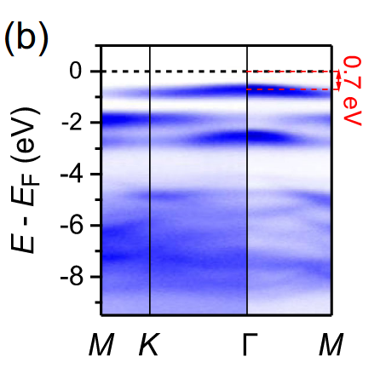
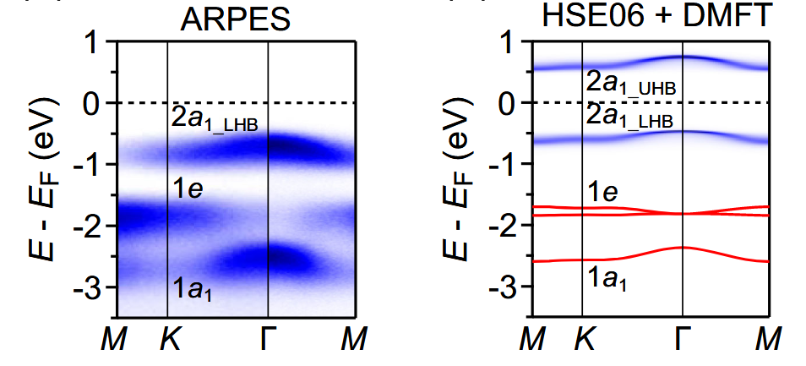
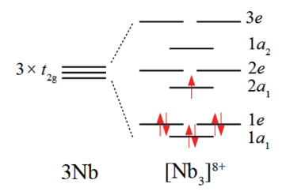
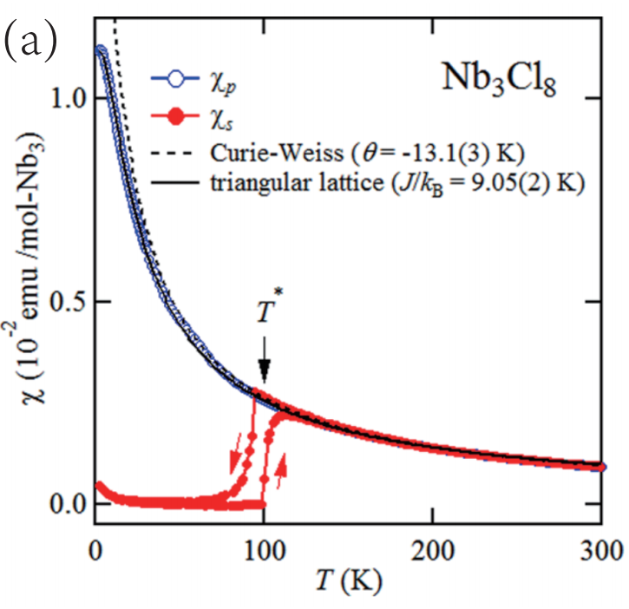
Band structure in Nb₃Cl₈
correlation
single-particle approximation
Mott Insulator
$$θ=−13.1\left(3\right) K \\ p_{eff} = 1.691\left(9\right) μ_{B}$$
S=1/2
Phys. Rev. X 13, 041049 (2023)
Inorg. Chem. Front. 4, 481(2017)
Notes:
strong correlation effects

Slide 5
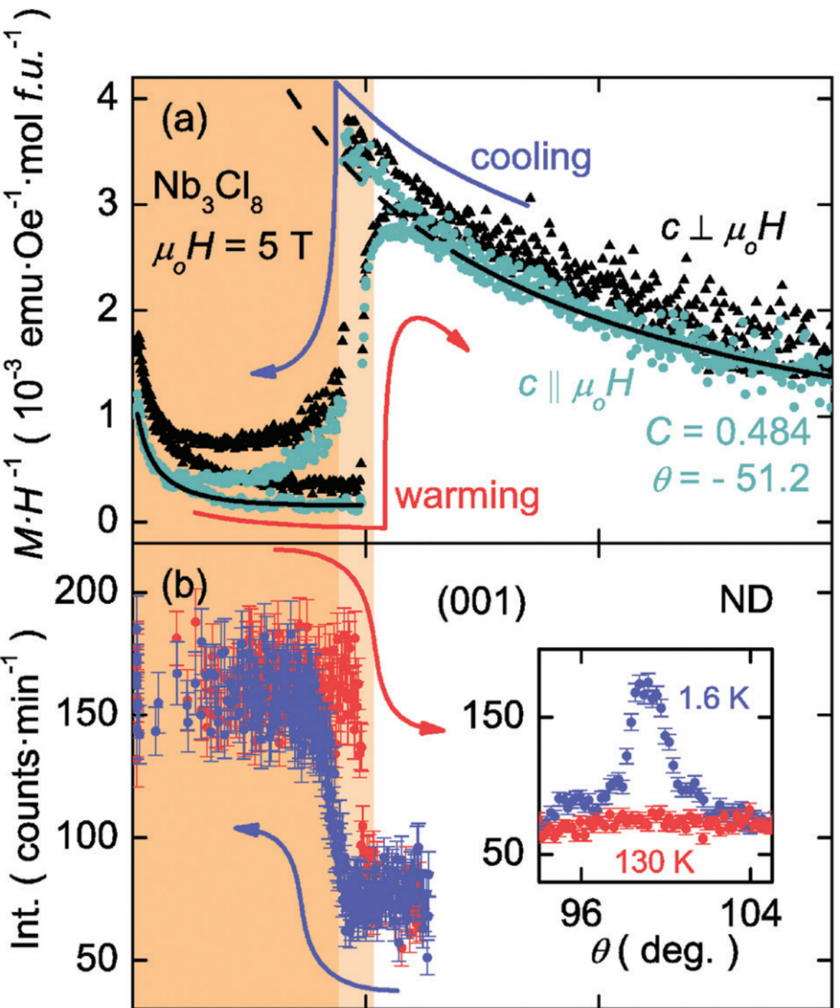
Structural and magnetic transition in Nb₃Cl₈
paramagnetic – nonmagnetic in single crystal Nb₃Cl₈
high temperature magnetic phase
(HTMP)
Inorg. Chem. Front. 4, 481(2017)

Slide 6
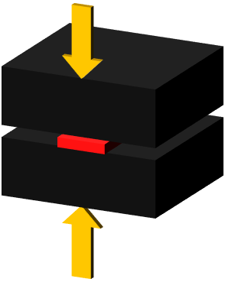
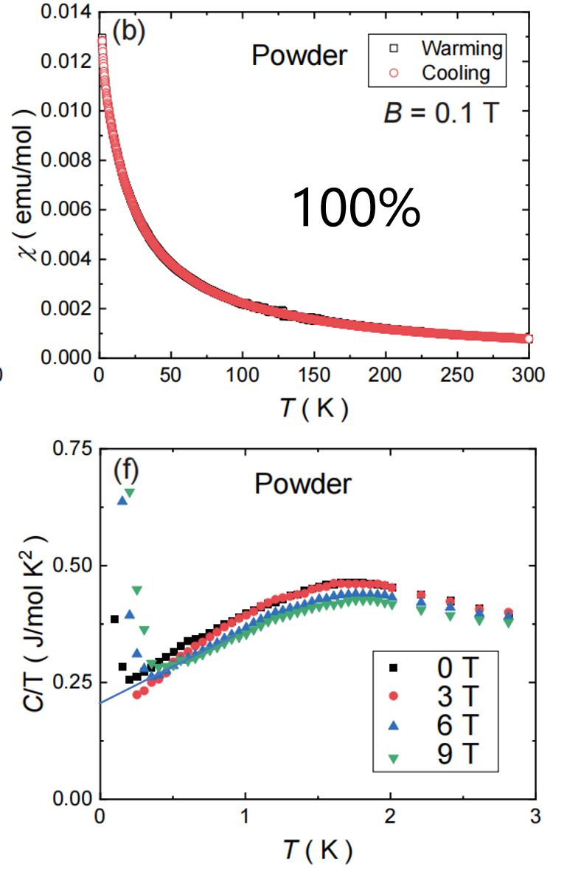
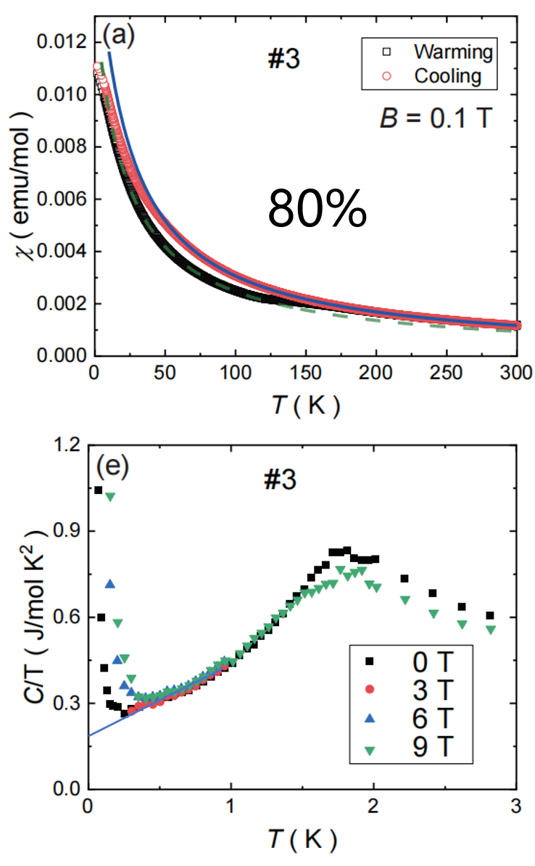
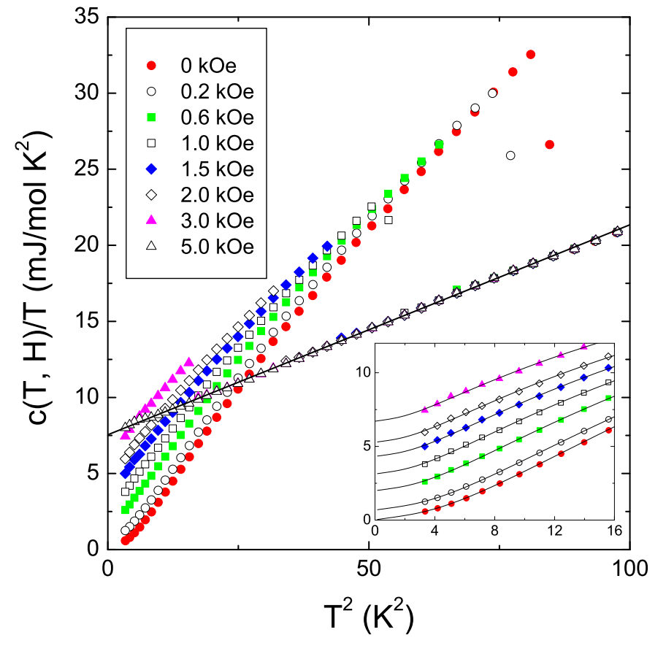
Magnetic behavior of HTMP in Nb₃Cl₈
pressure along c-axis
single crystal
HTMP
HTMP
T = 0.1K, no magnetic order
large γ
Nb element
$γ$ = 0.227 J mol/K²
$γ$ = 0.223 J mol/K²
$γ$ = 0.01 J mol/K²

Slide 7
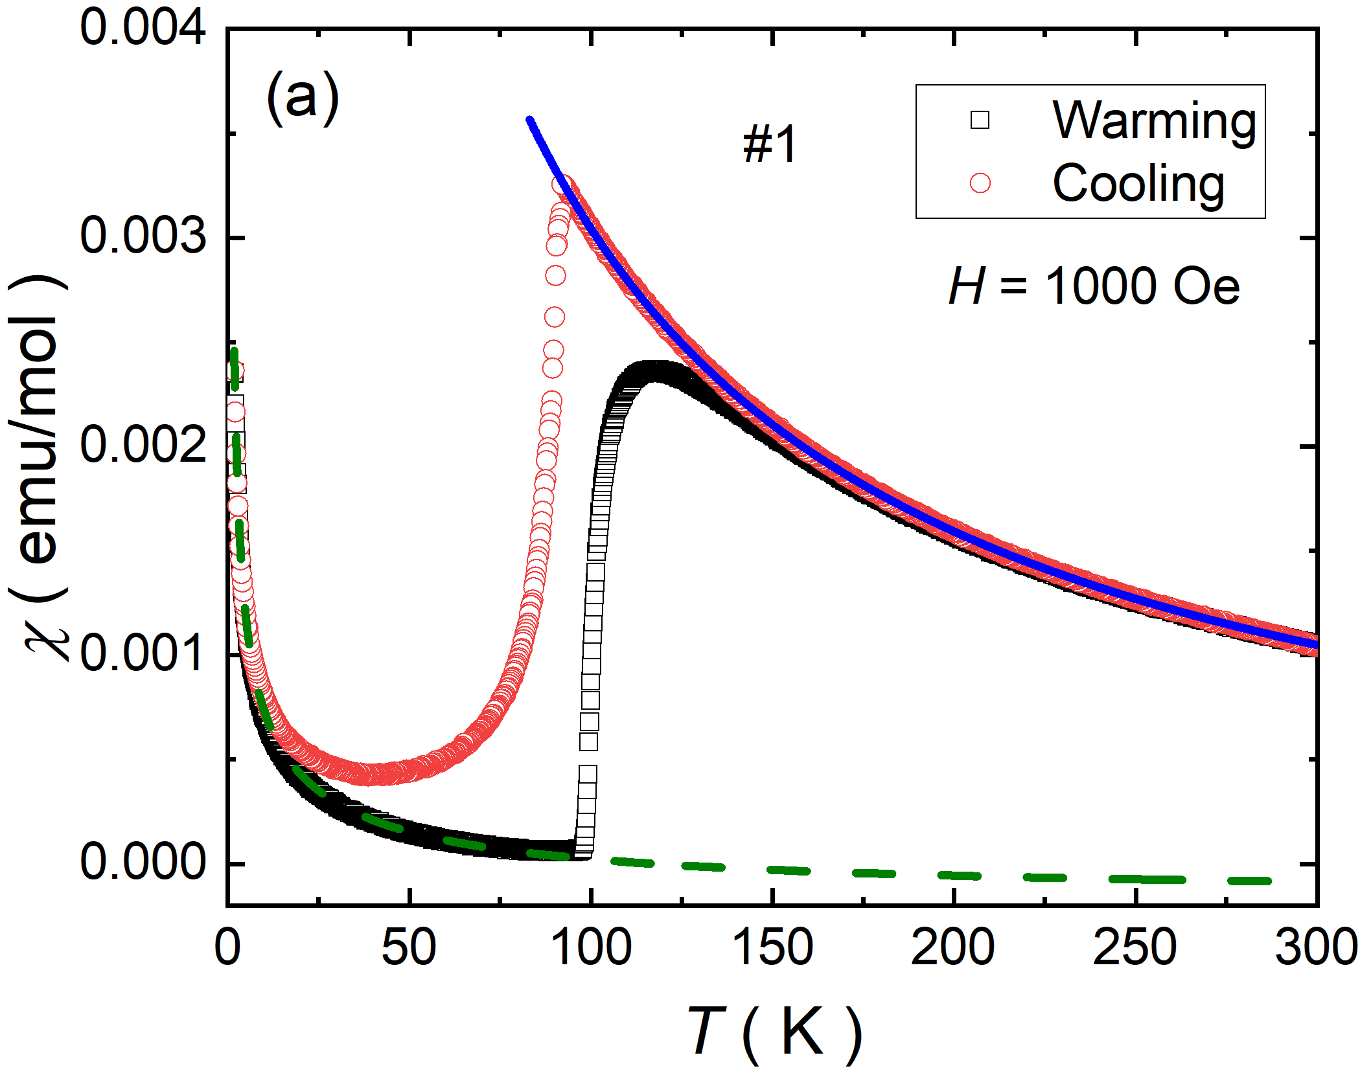
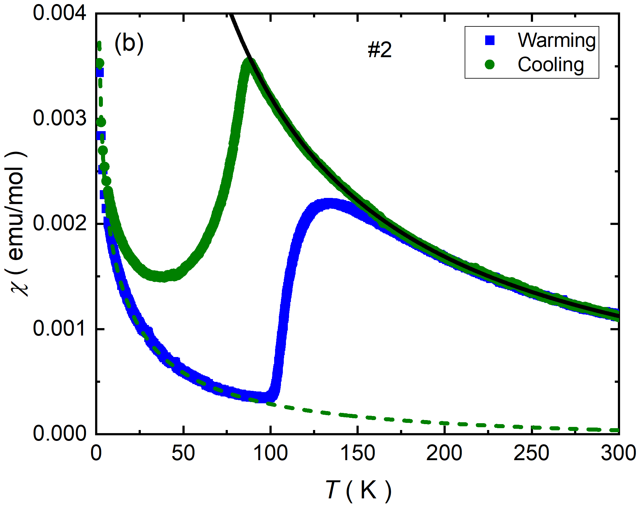
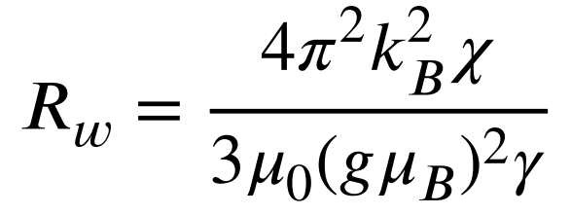
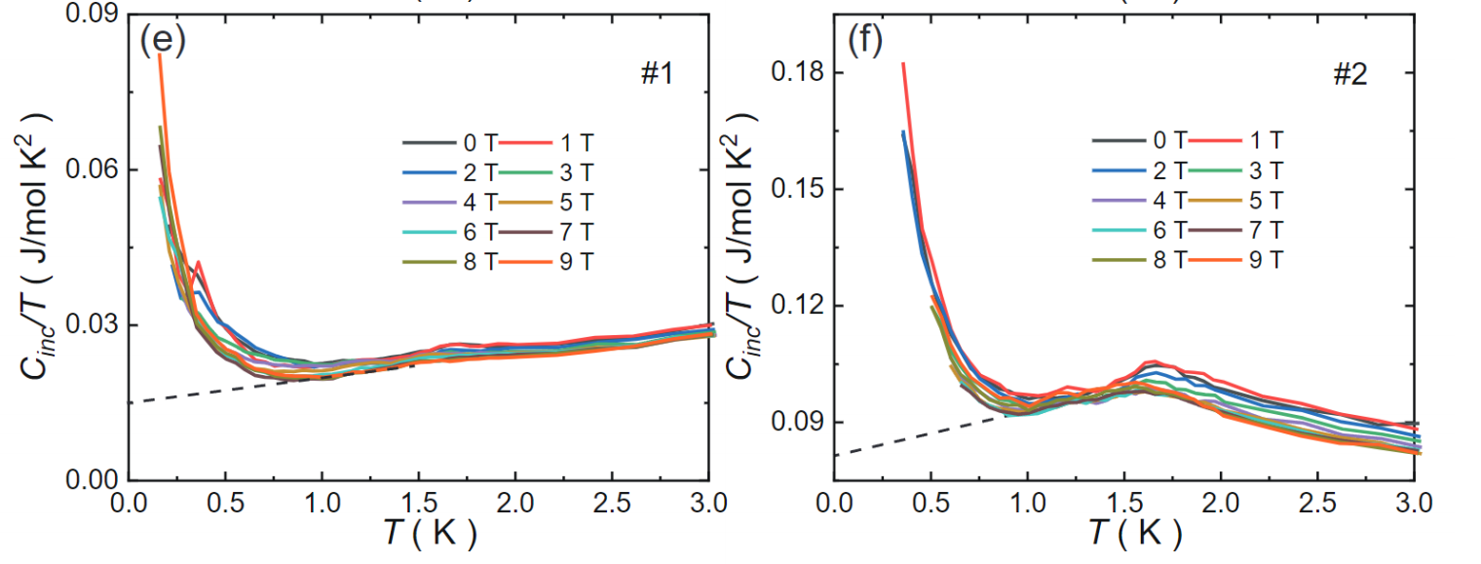
Magnetic behavior of HTMP in Nb₃Cl₈
Wilson ratio:
influence of spin-orbit coupling
4.5%
11%
HTMP
HTMP
Nb₃Cl₈ $R_{ω}$~ 1 - 4
Fermi gas: $R_{ω}$ = 1
Spinon Fermi surface QSL

Slide 8
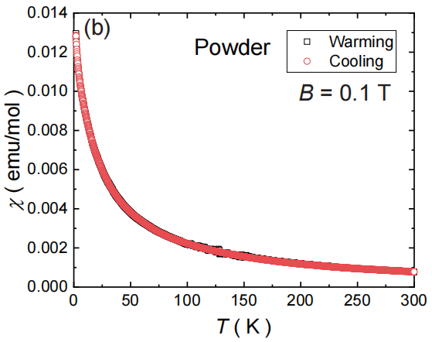
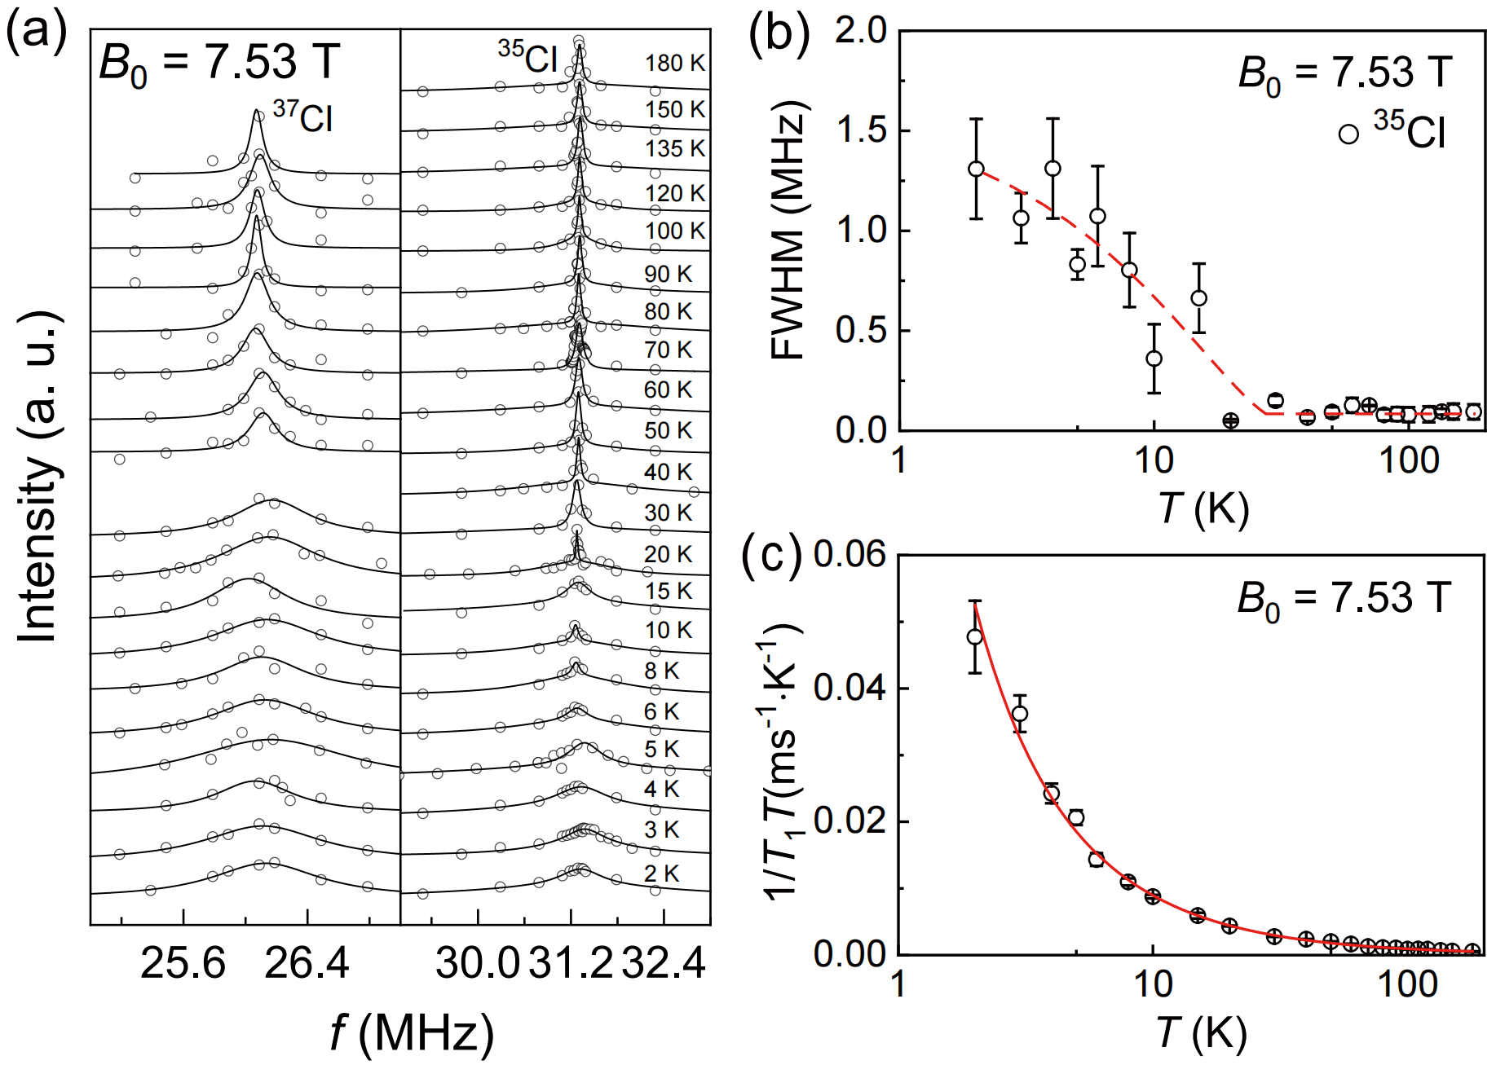
NMR results of Nb₃Cl₈

Slide 9
μSR results of Nb₃Cl₈ (zero field)
No long-range magnetic order down to 75 mK
persistant fluctuation
Slow down
$$P_{z}\left(t\right)=A\left(\frac{1}{3}+\frac{2}{3}\left(1−Δ^{2}t^{2}\right)e^{−\frac{Δ^{2}t^{2}}{2}}\right)e^{−λt}+A_{bg}$$
Static Kubo-Toyabe (KT) damping function：
Static field distribution：
$\frac{Δ}{γ_{ν}}≈3.8$Oe
dynamics

Slide 10
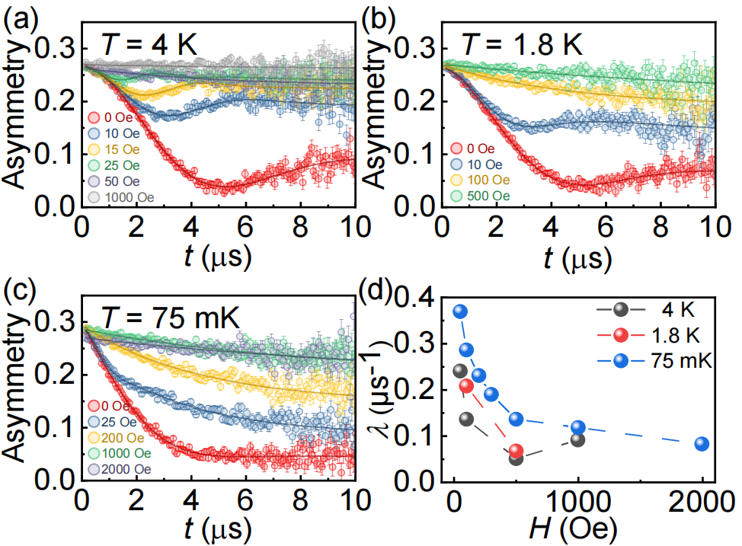
μSR results of Nb₃Cl₈ (longitudinal field)
$H_{L}=0$Oe, damping static KT function (ZF mode)
$0<H_{L}<40$Oe，dynamic KT function:
$$G_{z}\left(t\right)=g_{z}\left(t\right)+ν\int_{0}^{t}{g_{z}\left(τ\right)G_{z}\left(t−τ\right)dτ}, \\ g_{z}\left(t\right)=A\left[1−\frac{2Δ^{2}}{ω_{L}^{2}}\left(1−\cos\left(ω_{L}t\right)e^{−\frac{1}{2}Δ^{2}t^{2}}\right)+\frac{2Δ^{4}}{ω_{L}^{4}}ω_{L}\int_{0}^{t}{\sin\left(ω_{L}τ\right)e^{−\frac{1}{2}Δ^{2}τ^{2}}}dτ\right]$$
$H_{L}>40$Oe, relaxation function：
$$P_{z}\left(t\right)=Ae^{−λ_{LF}t}+A_{bg}$$

Slide 11
μSR results of Nb₃Cl₈ (longitudinal field)
$H_{L}>40$Oe, relaxation function：
$$P_{z}\left(t\right)=Ae^{−λ_{LF}t}+A_{bg}$$
general correlation function:
Redfield formula (x=0, failed):
$$λ_{LF}\left(B_{L}\right)=2Δ^{2}\int_{0}^{∞}{{\left(\frac{τ}{t}\right)}^{x}}exp\left(−νt\right)cos\left(2πγ_{μ}B_{L}t\right)dt$$
x = 0.40, 0.41, and 0.61 at 4, 1.8 and 0.075 K, respectively
Notes:
Redfield formula:weakly correlated spin dynamic system

Slide 12
Conclusion
The high-temperature magnetic phase (HTMP) can be realized in polycrystalline or pressure-induced Nb₃Cl₈
No long-range magnetic order down to 75 mK at HTMP
Persistent fluctuations in Nb₃Cl₈
Possible quantum spin liquid state at HTMP in Nb₃Cl₈ – spinon Fermi surface
Further study: inelastic neutron scattering on HTMP
persistant fluctuation
Slow down

Slide 13
Acknowledgements
Shiliang Li and Huiqian Luo (IOP CAS, supervisors)
Bo Liu (IOP CAS, heat capacity measurements)
Detong Wu and Youguo Shi (IOP CAS, sample synthesis)
Rhea Stewart and Devashibhai Adroja (ISIS RAL, $μ$SR measurements and analysis)
Xin Han, Jun Luo and Rui Zhou (IOP CAS, NMR measurements)
Thanks for your attention!

