Slide 1

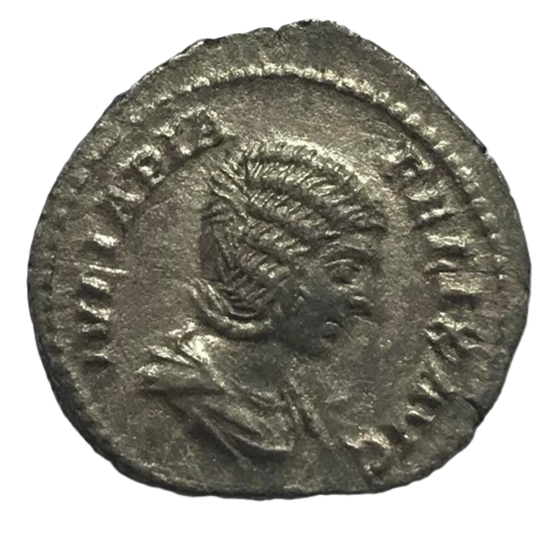
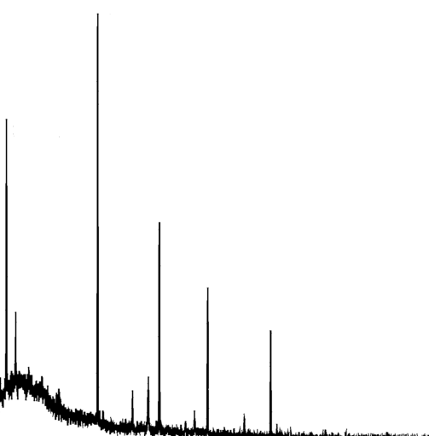
Archaeological artefacts: Probing deep beneath the surface
µ⁻
Results:
Depth: 1 mm
Element wt%
Cu 68
Sn 21
Pb 3
.
.
.
Sayani Biswas
2nd MELODY Workshop, CSNS, China
11th January 2025

Slide 2
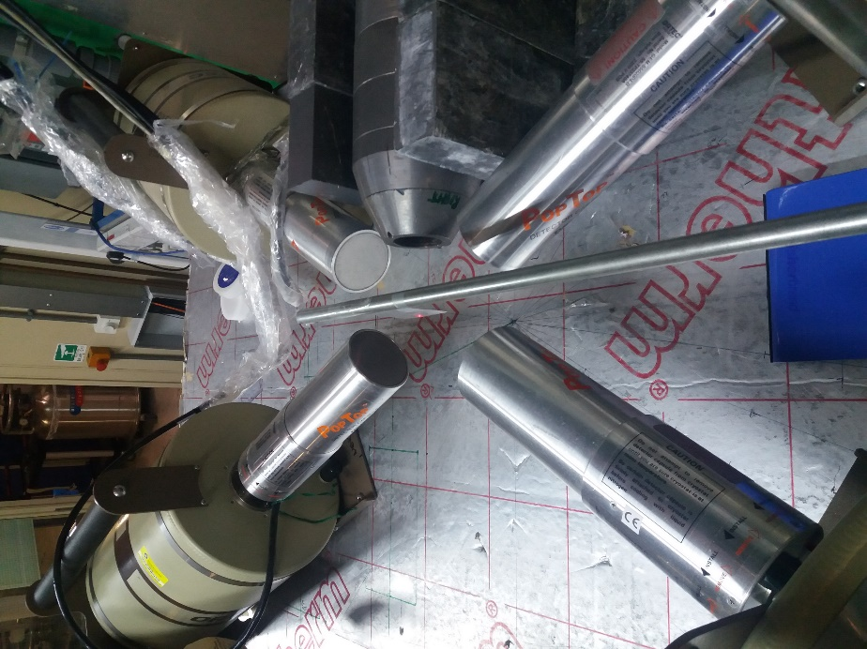
Outline
MuX setup at ISIS
Ge X-ray detector
low-energy
Ge X-ray detector
0.1-10 MeV
Archaeological artefacts: The approach so far
The μXES technique
Muonic X-ray Emission Spectroscopy
Case studies:
  1) Roman silver coins
  2) Roman gold coins
Take-home messages
Sample
μ⁻ beam
Ge X-ray detector
low energy
Ge X-ray detector
0.1-10 MeV

Slide 3
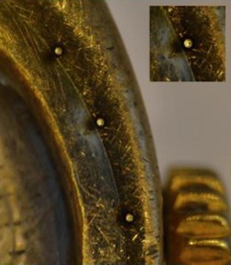
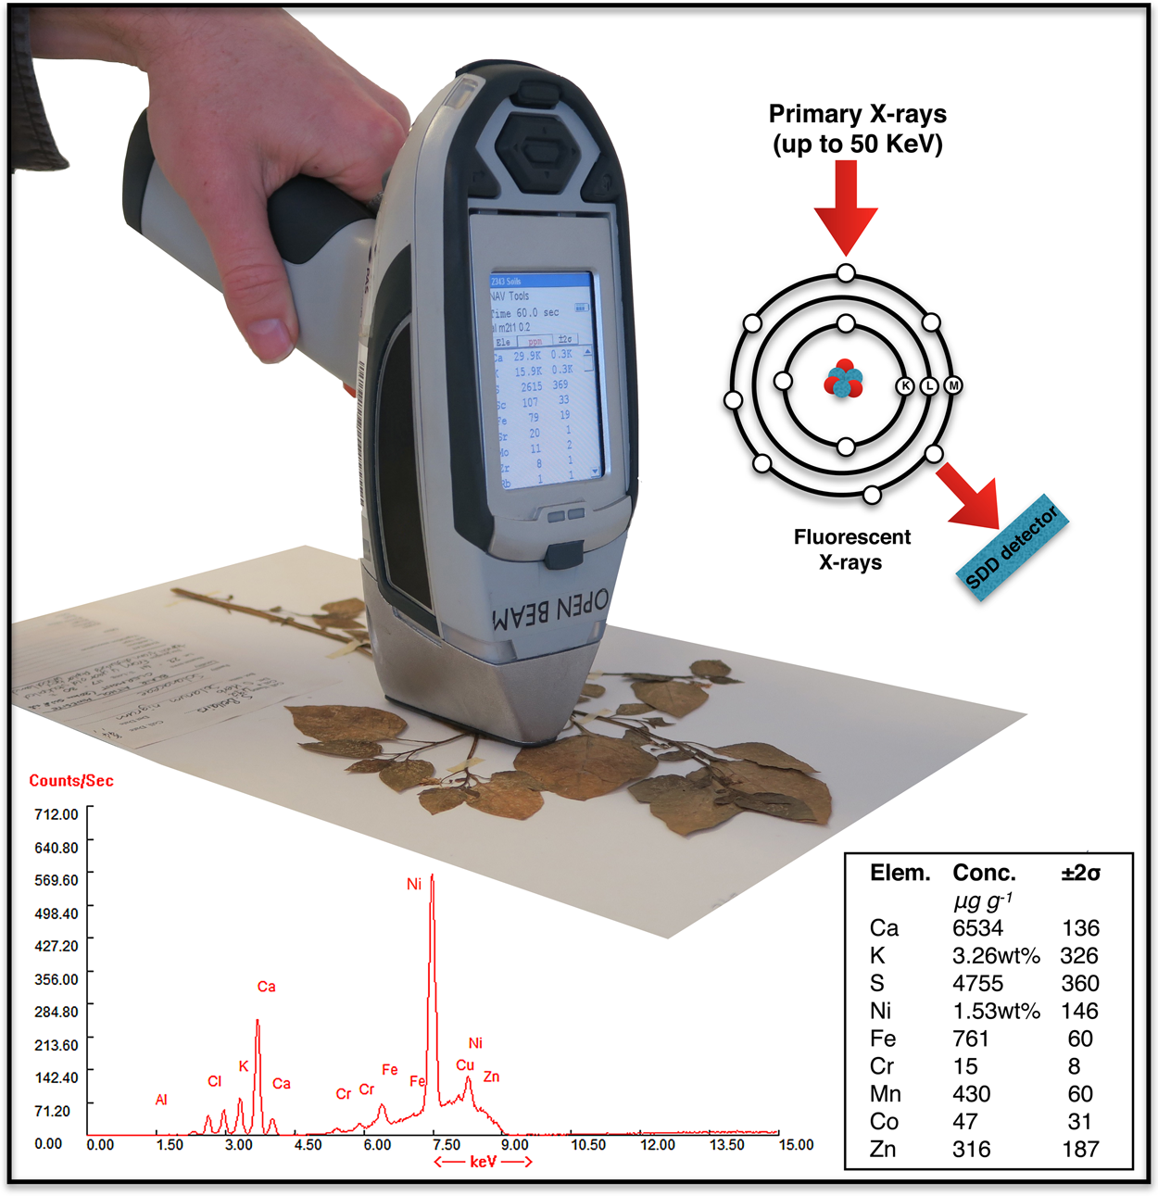
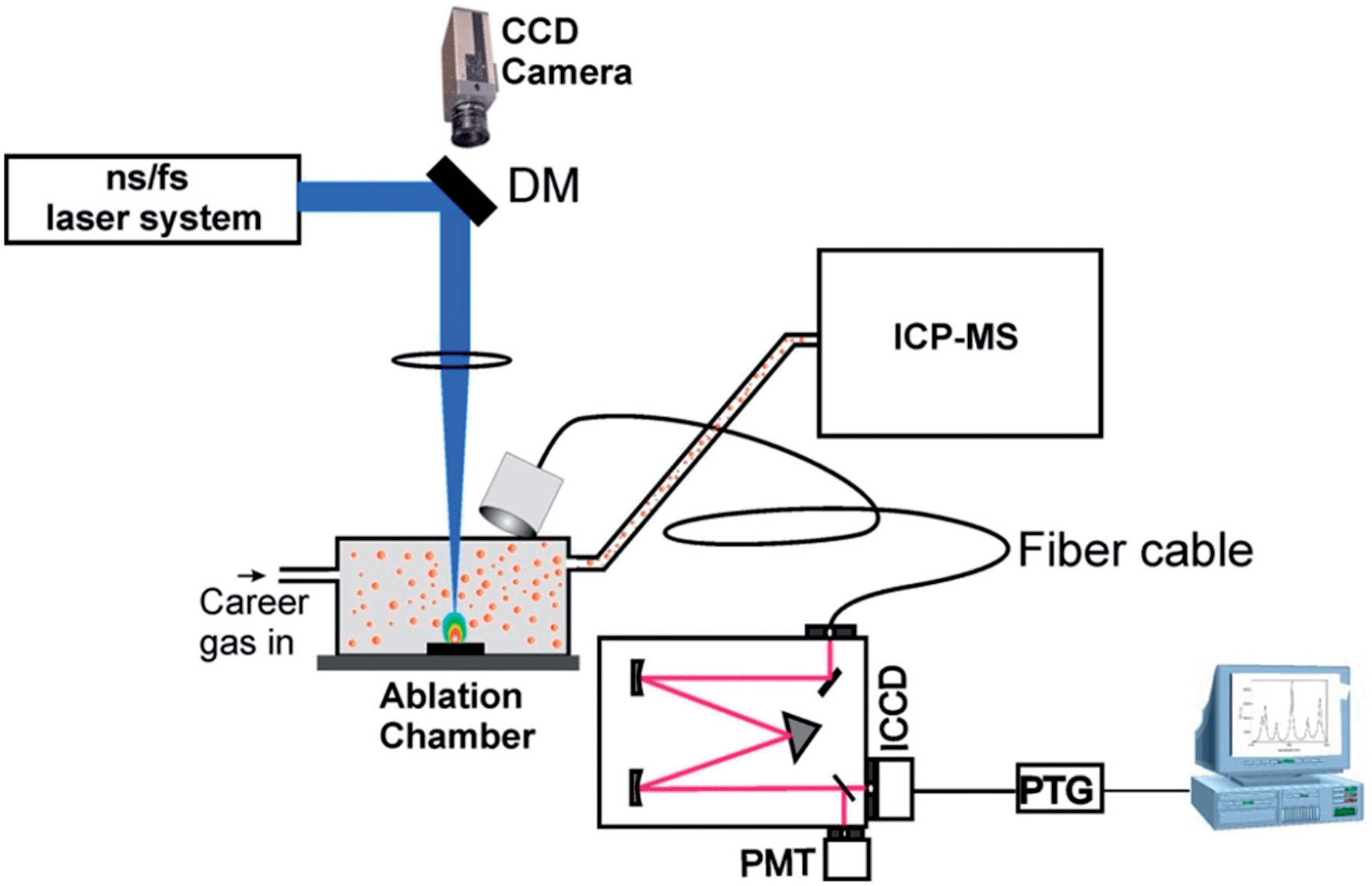
Archaeological artefacts: The approach so far
pXRF
A. van der Ent et al., Sci Rep 9, 4746 (2019)
LA-ICP-MS
N. L. LaHaye et al., J Anal. At. Spectrom. 29, 2267-2274 (2014)

Slide 4
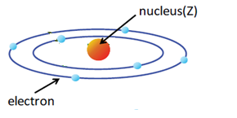
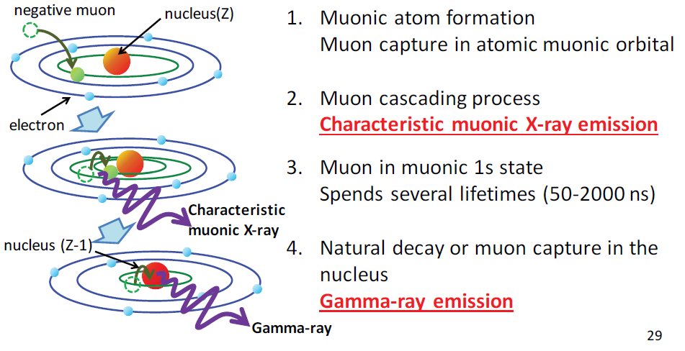
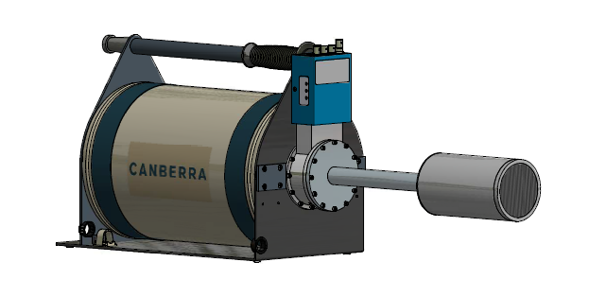

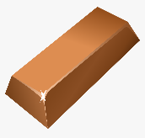
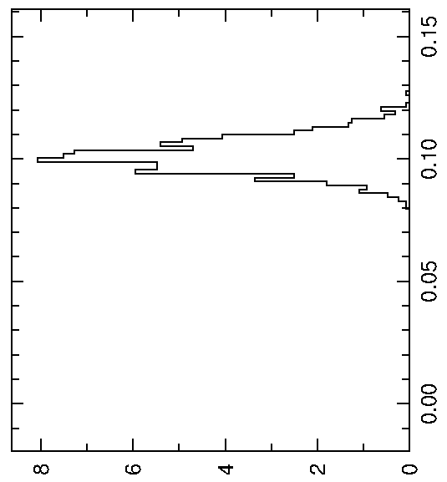
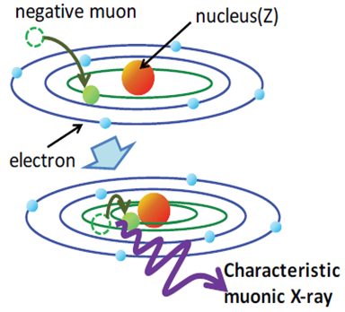
The μXES technique
1) The atom:
4) Emission of γ-rays:
p = 45 MeV/c
dp/p = 2%
Energy ~ 9 MeV
HPGe
2) Muon capture by atom:
Momentum, p (MeV/c)
µ⁻ (p, dp/p)
3) Emission of muonic X-rays:
Pure Cu (Z = 29)
d ~ 1mm
Pure Cu
(simulation)
HPGe
Depth, d (cm)

Slide 5
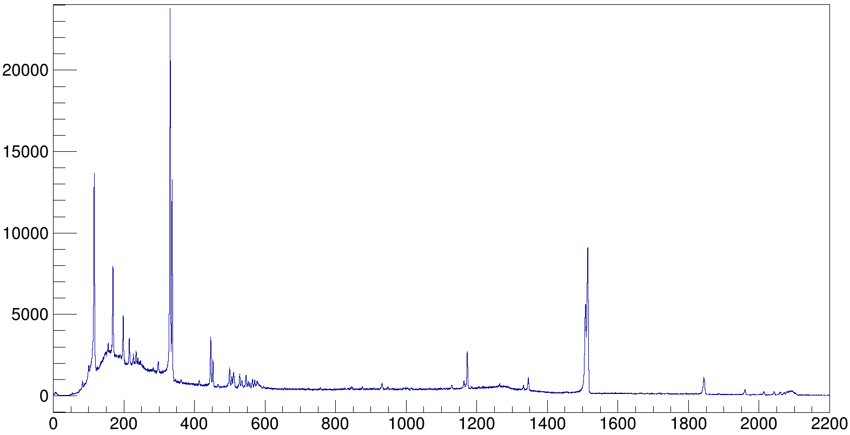
The μXES technique
1) The atom:
Pure Cu
(Z = 29)
Counts
K_{α} : 8.0 keV
K_{β} : 8.9 keV
µ-K_{α} : 1514 keV
µ-K_{β} : 1844 keV
µ-Paschen
(M series)
µ-Balmer
(L series)
L. Gerchow, S. Biswas et al, Rev. Sci. Instrum. 94, 045106 (2023)
p = 45 MeV/c
dp/p = 2%
Energy ~ 9 MeV
HPGe
µ-K_{α}
2) Muon capture by atom:
µ-Lyman
(K series)
Momentum, p (MeV/c)
µ⁻ (p, dp/p)
µ-K_{β}
Energy (keV)
Pure Cu (Z = 29)
d ~ 1mm
Pure Cu
(simulation)
Non-destructive and depth-selective
Sensitive to all elements
Isotope determination
Oxidation state identification
HPGe
Depth, d (cm)

Slide 6
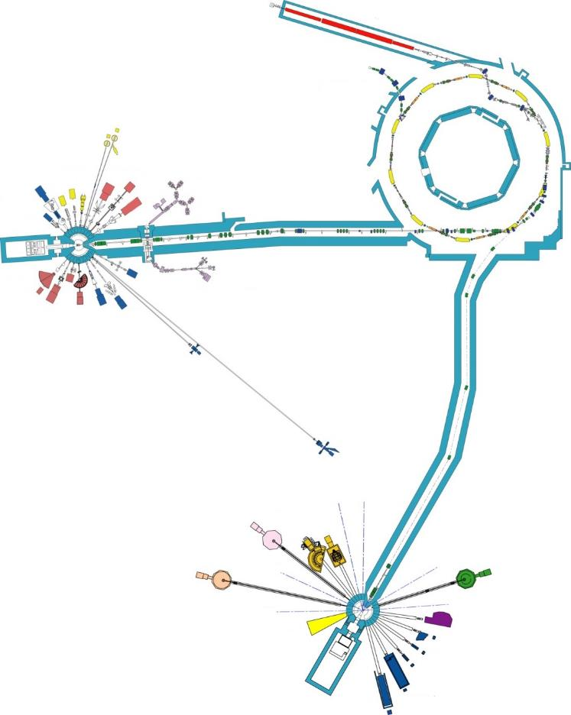
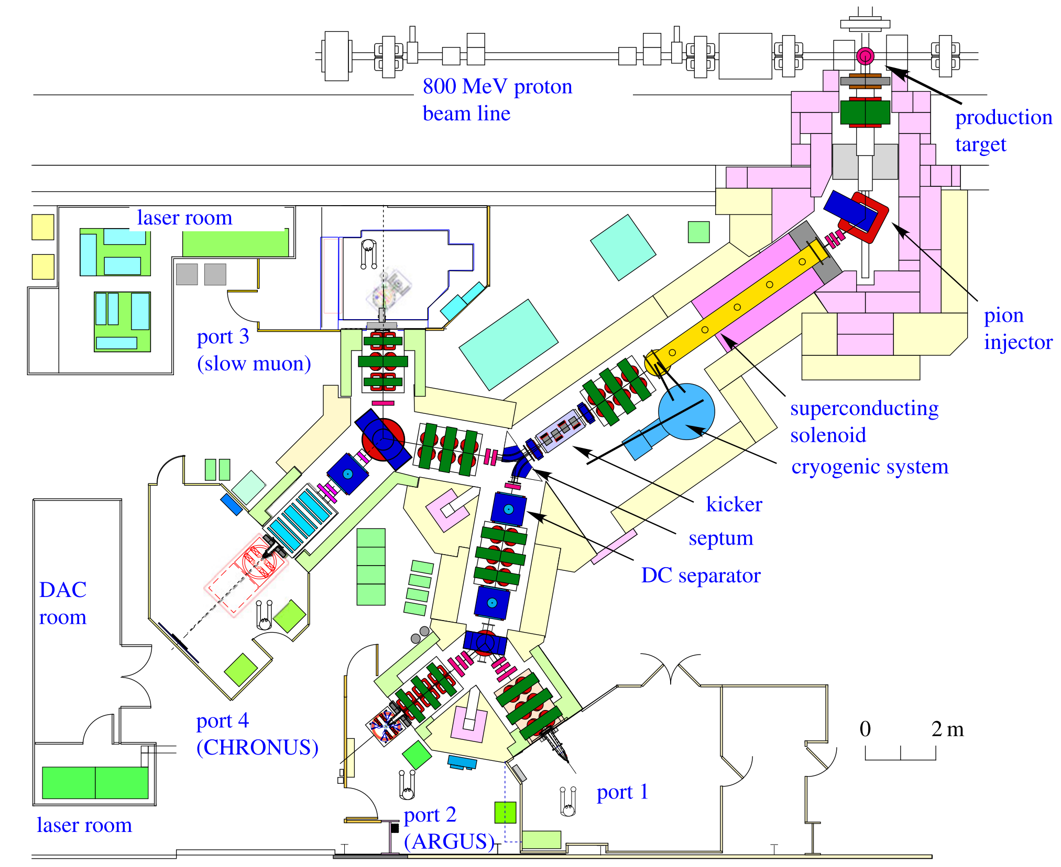
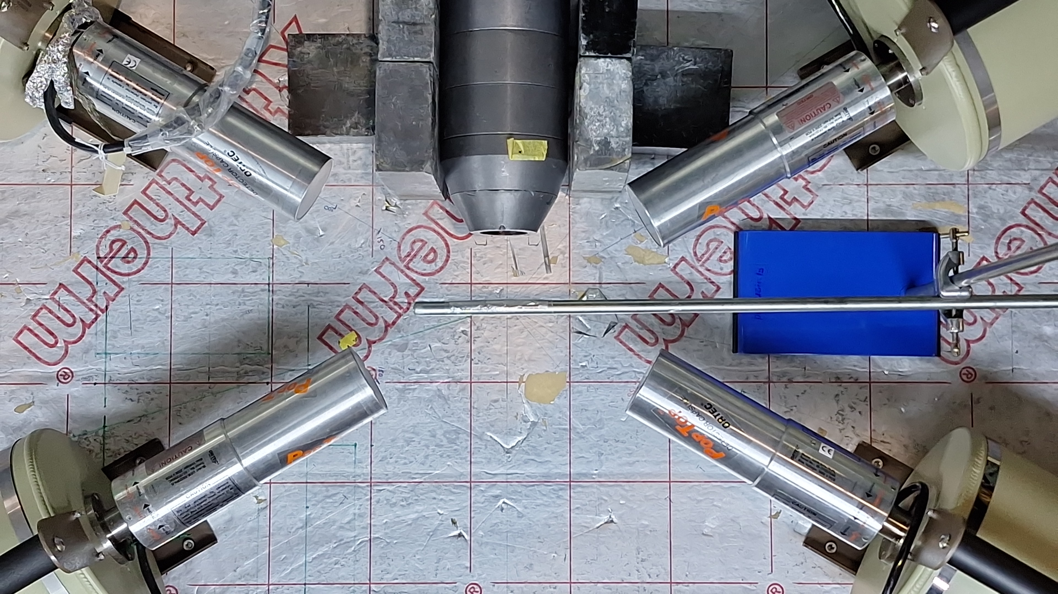
The μXES technique
Creating muons at ISIS
C, 45°
10mm
RIKEN-RAL Muon
facility
T
EC Muon
facility
MuX setup
Currently, we perform the
experiments in port 4

Slide 7
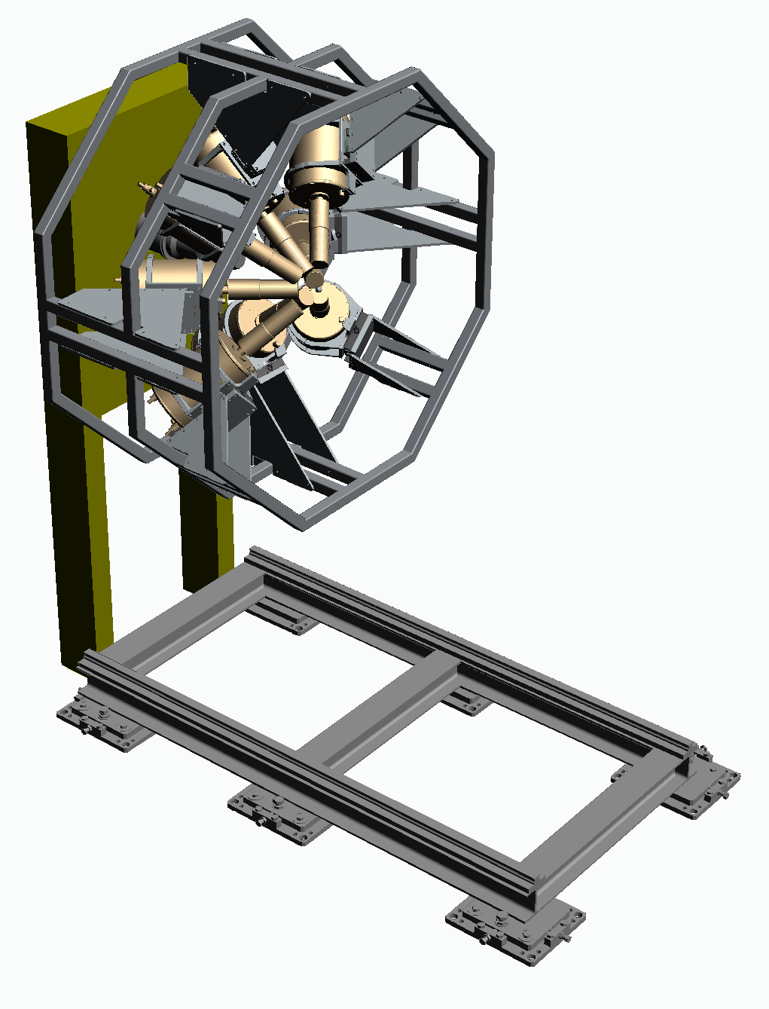
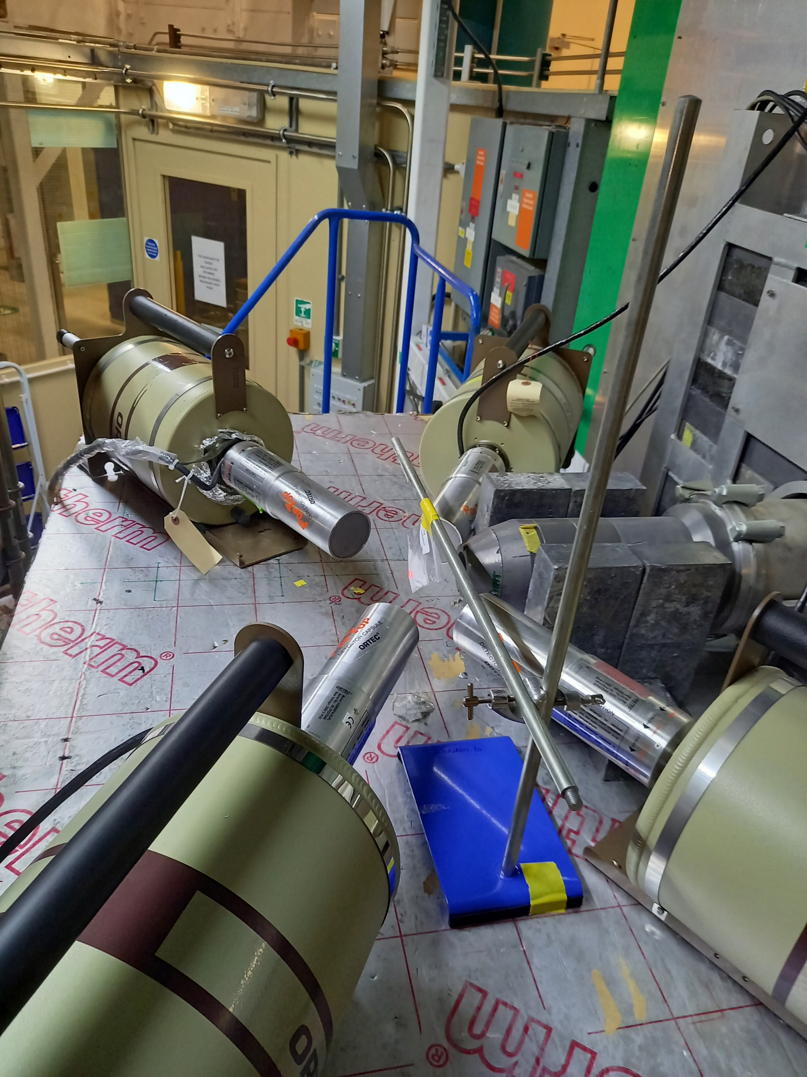
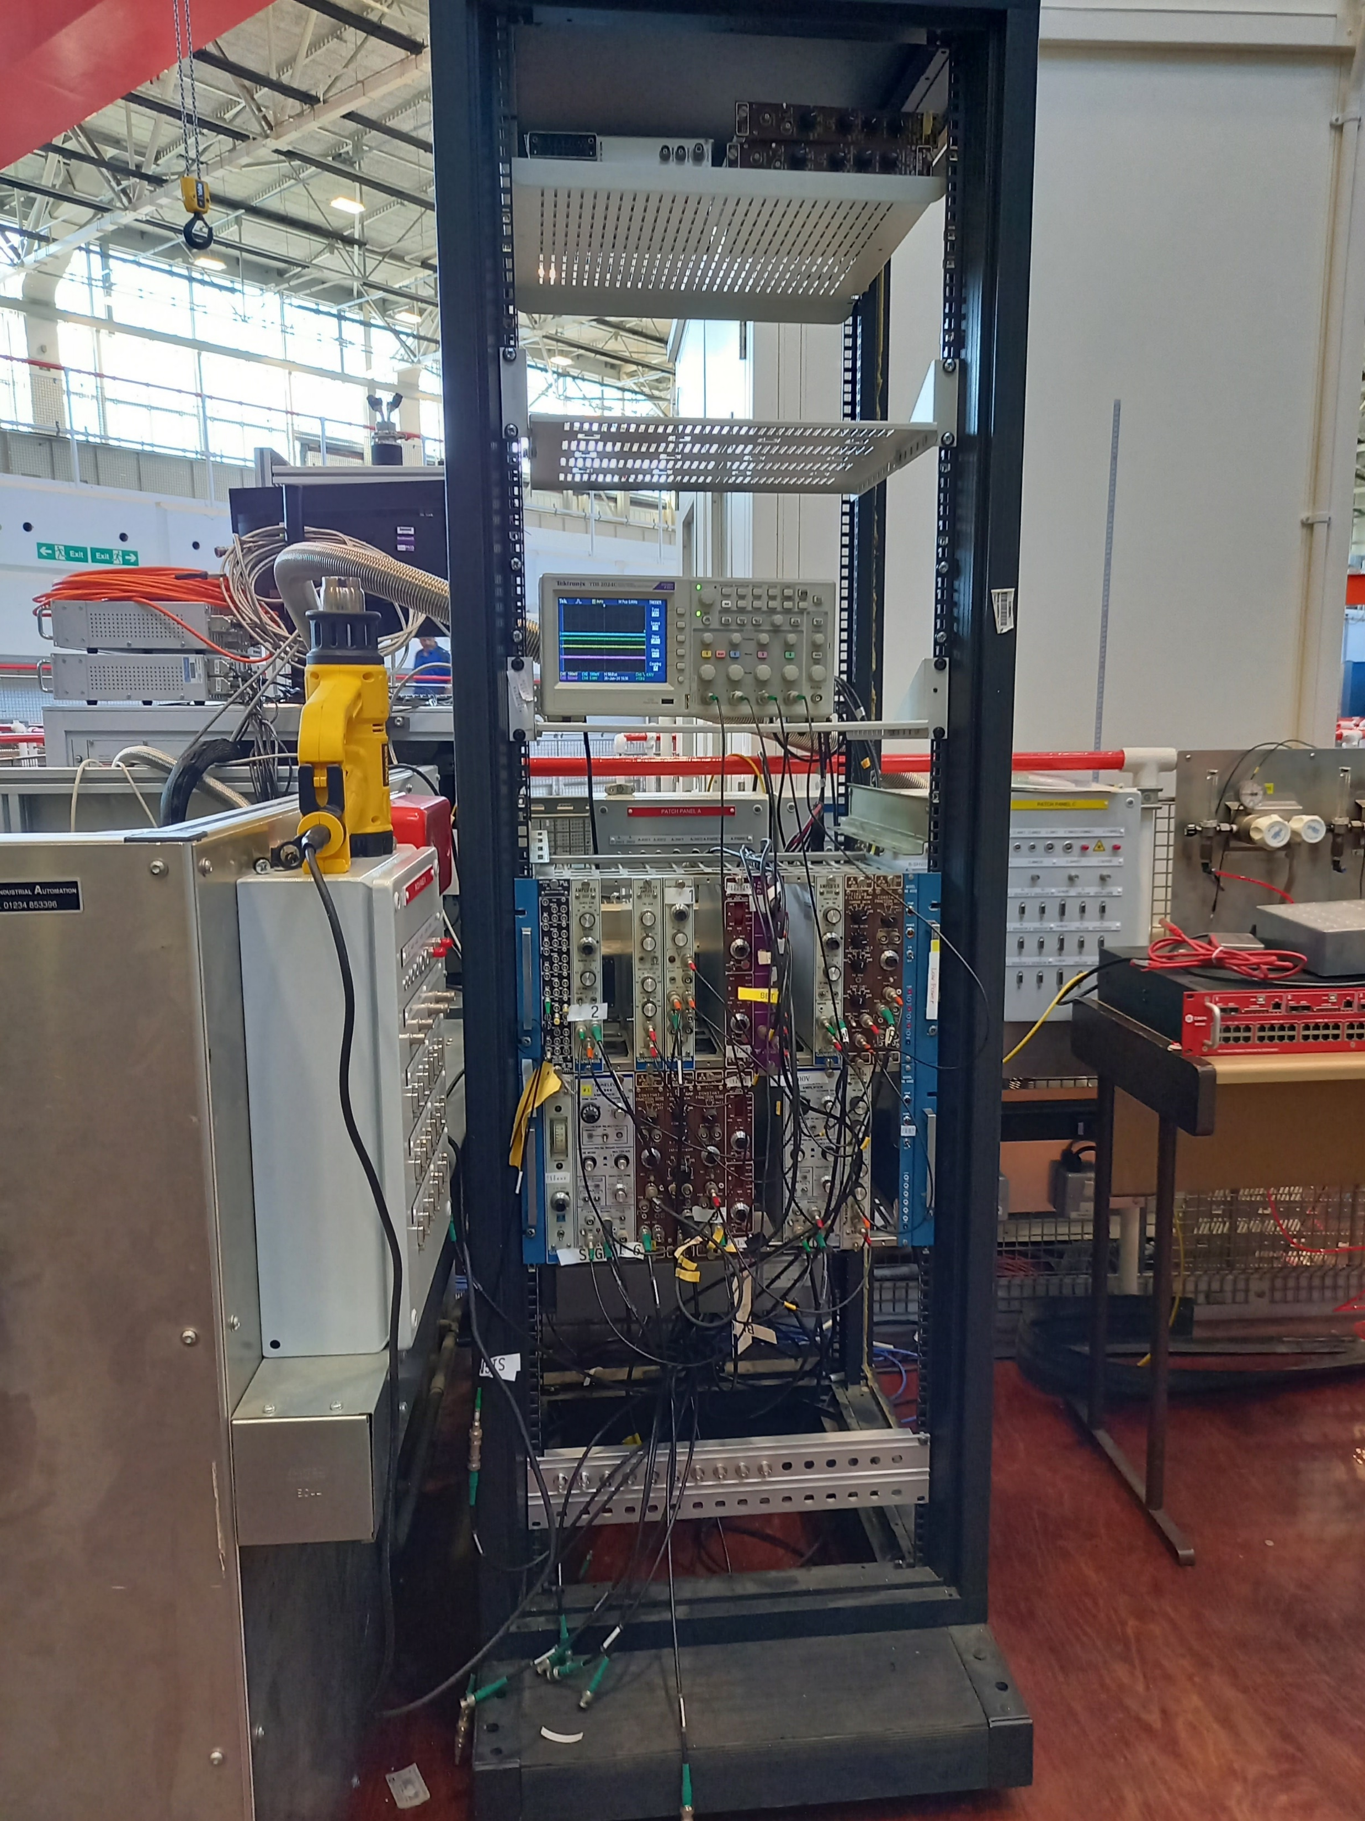
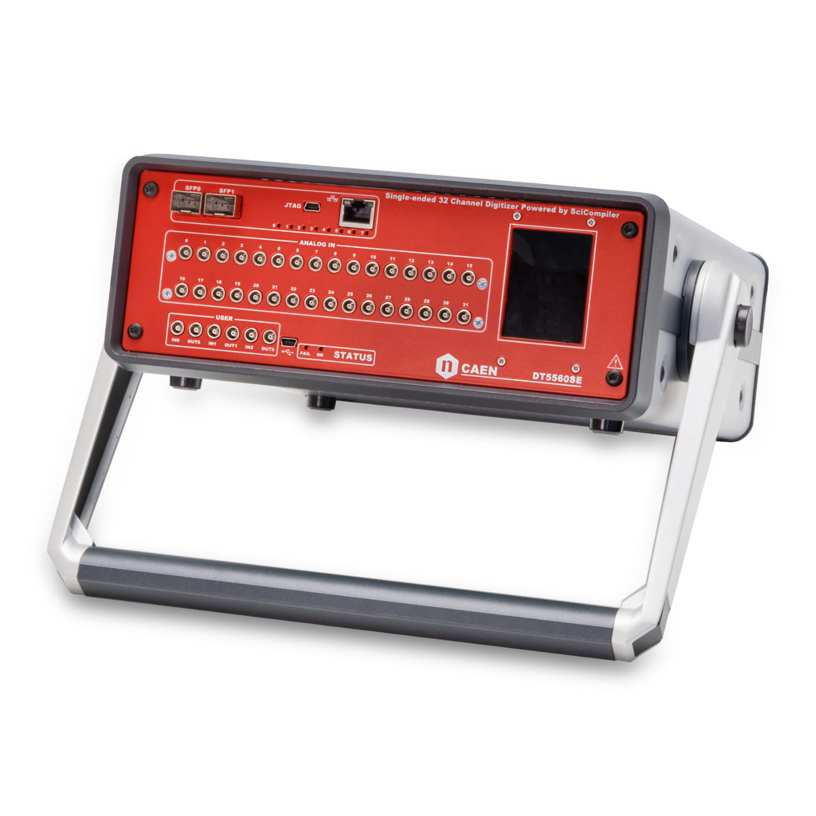
The μXES technique
MuX setup at ISIS and recent developments
sample

Slide 8
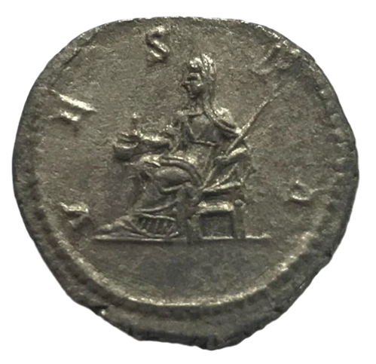
Case Studies
1) Roman silver coins:
Silver coinage formed the backbone of state finance in the Roman Empire
The fineness and quality of a coinage is often taken by historians to be a comment on the fiscal health of the issuing state
Yet very little is really known about its fineness and chemical composition
Many of the existing analyses are inadequate to answer key questions
Samples for analysis are commonly taken from the surfaces, or from just beneath the surfaces, of silver coins, and these are not representative of the original alloys used, leading to erroneous estimates of overall composition
denarius of Julia Domna
3rd century (211-217 CE)
B. V. Hampshire et al, Heritage 2, 400-407(2019)

Slide 9
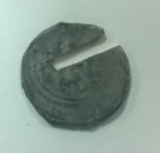
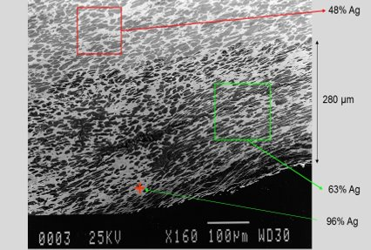
Case Studies
1) Roman silver coins:
SEM-EDS
core
surface
Image from: Matthew Ponting, Liverpool University

Slide 10
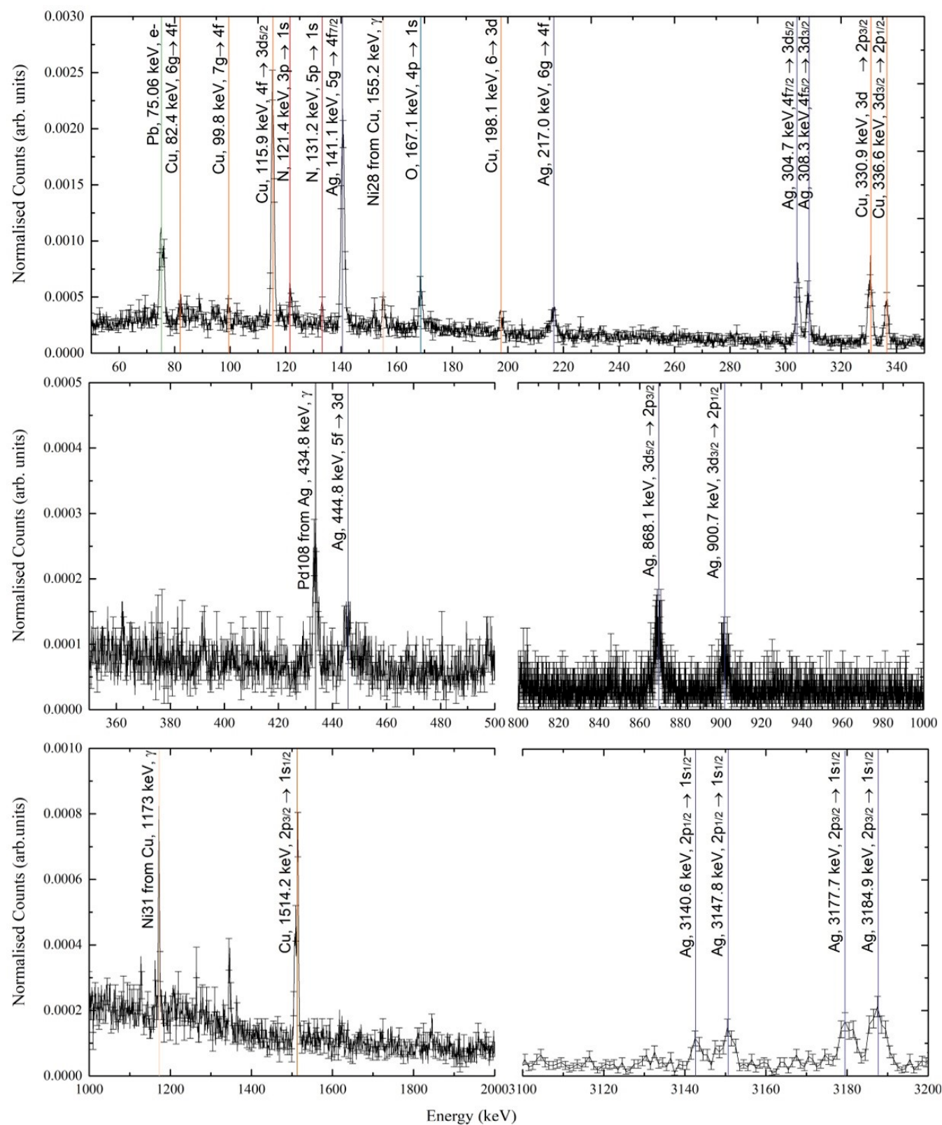
Case Studies
1) Roman silver coins:
35 MeV/c
402±61 μm
denarius of Julia Domna
Muon momentum = 17, 18, 19, 20, 22, and 35 MeV/c
B. V. Hampshire et al, Heritage 2, 400-407(2019)
¹⁰⁹Ag
¹⁰⁷Ag

Slide 11
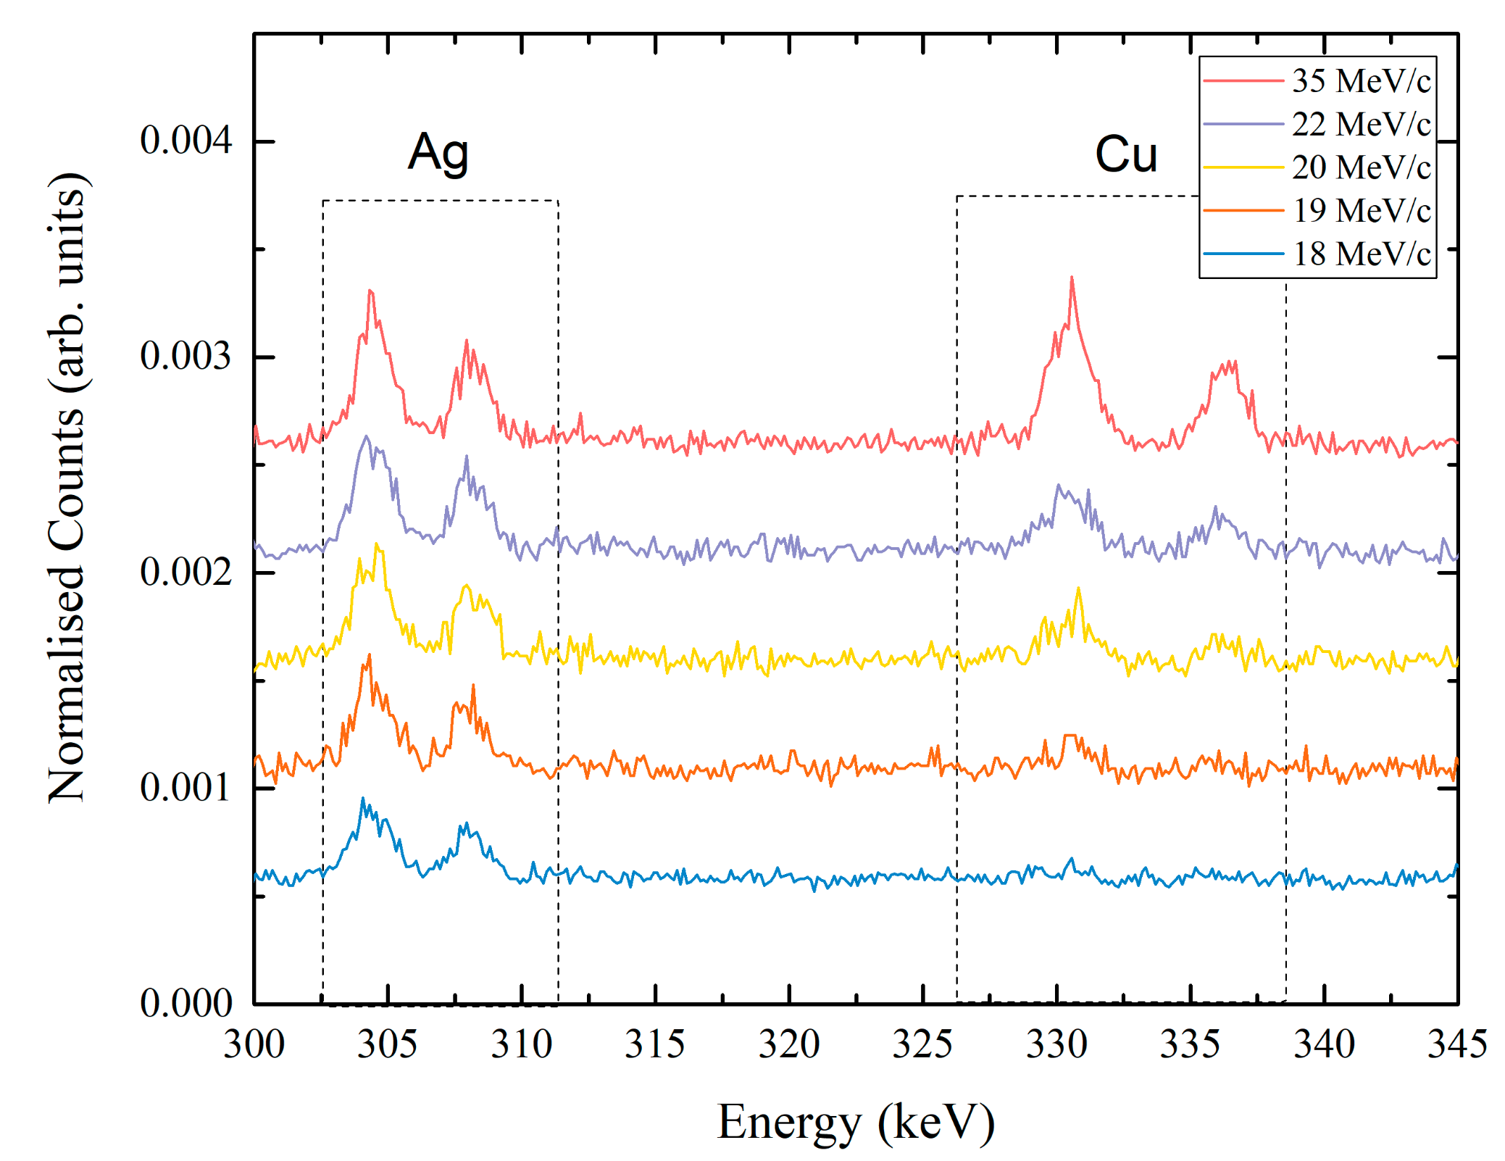
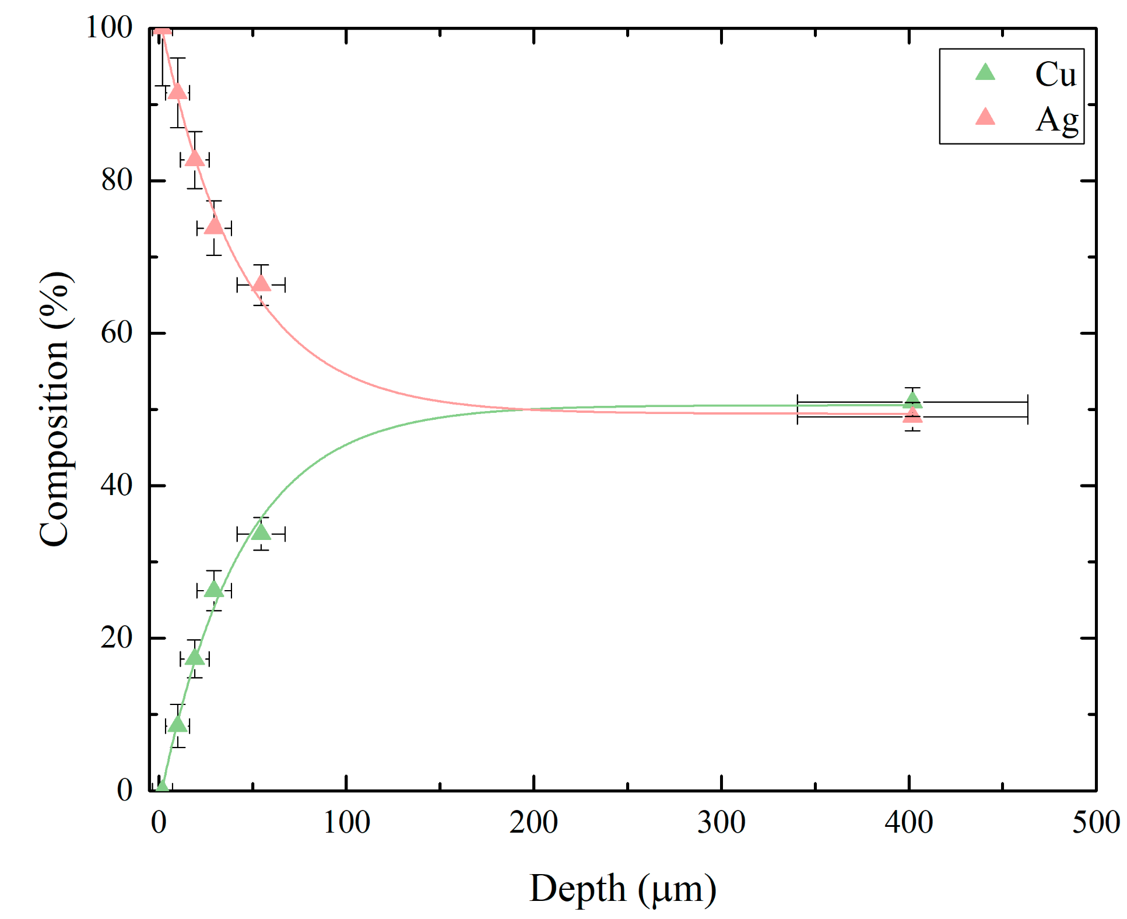
Case Studies
1) Roman silver coins:
51(1)% Ag
49(1)% Cu
B. V. Hampshire et al, Heritage 2, 400-407(2019)
190 µm

Slide 12
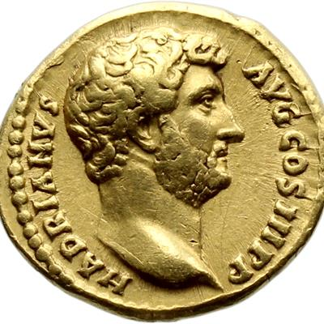
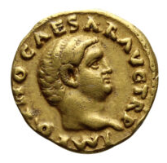
Case Studies
2) Roman gold coins:
During the AD 68/9 Civil Wars: Galba, Otho, Vitellius and then Vespasian fought for and gained control over the Roman empire - a period of serious and sustained disruption.
Existing analyses shows a minor reduction in the purity of the gold coinage.
Using X-ray fluorescence and µXES, a number of heavily debased gold coins issued during the AD 68/9 and many slightly debased coins issued in their immediate aftermath.
Debased Civil War gold coinages were indeed produced; that copper was used to debase Roman gold coins during this time, c. 185 years earlier than first shown
The metallurgical evidence from the gold coinage show the AD 68/9 Civil Wars caused significant and sustained disruption to the Roman economic system.
aurei from the “year of four emperors”
AD 68/9
G. A. Green et al, Archaeological and Anthropological Sciences 14, 165 (2022)

Slide 13
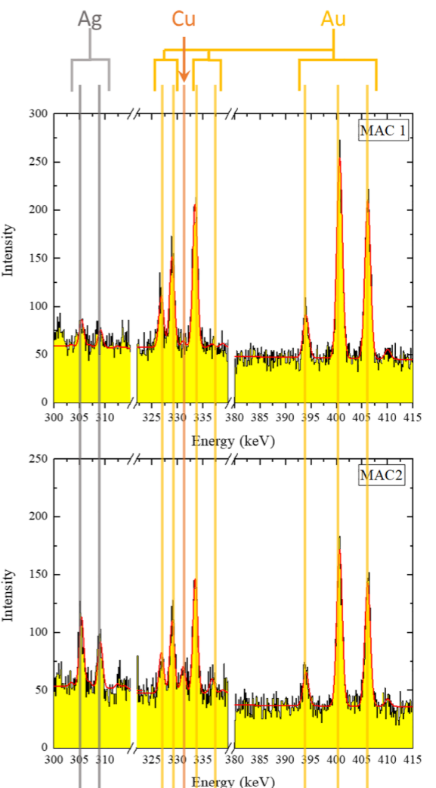
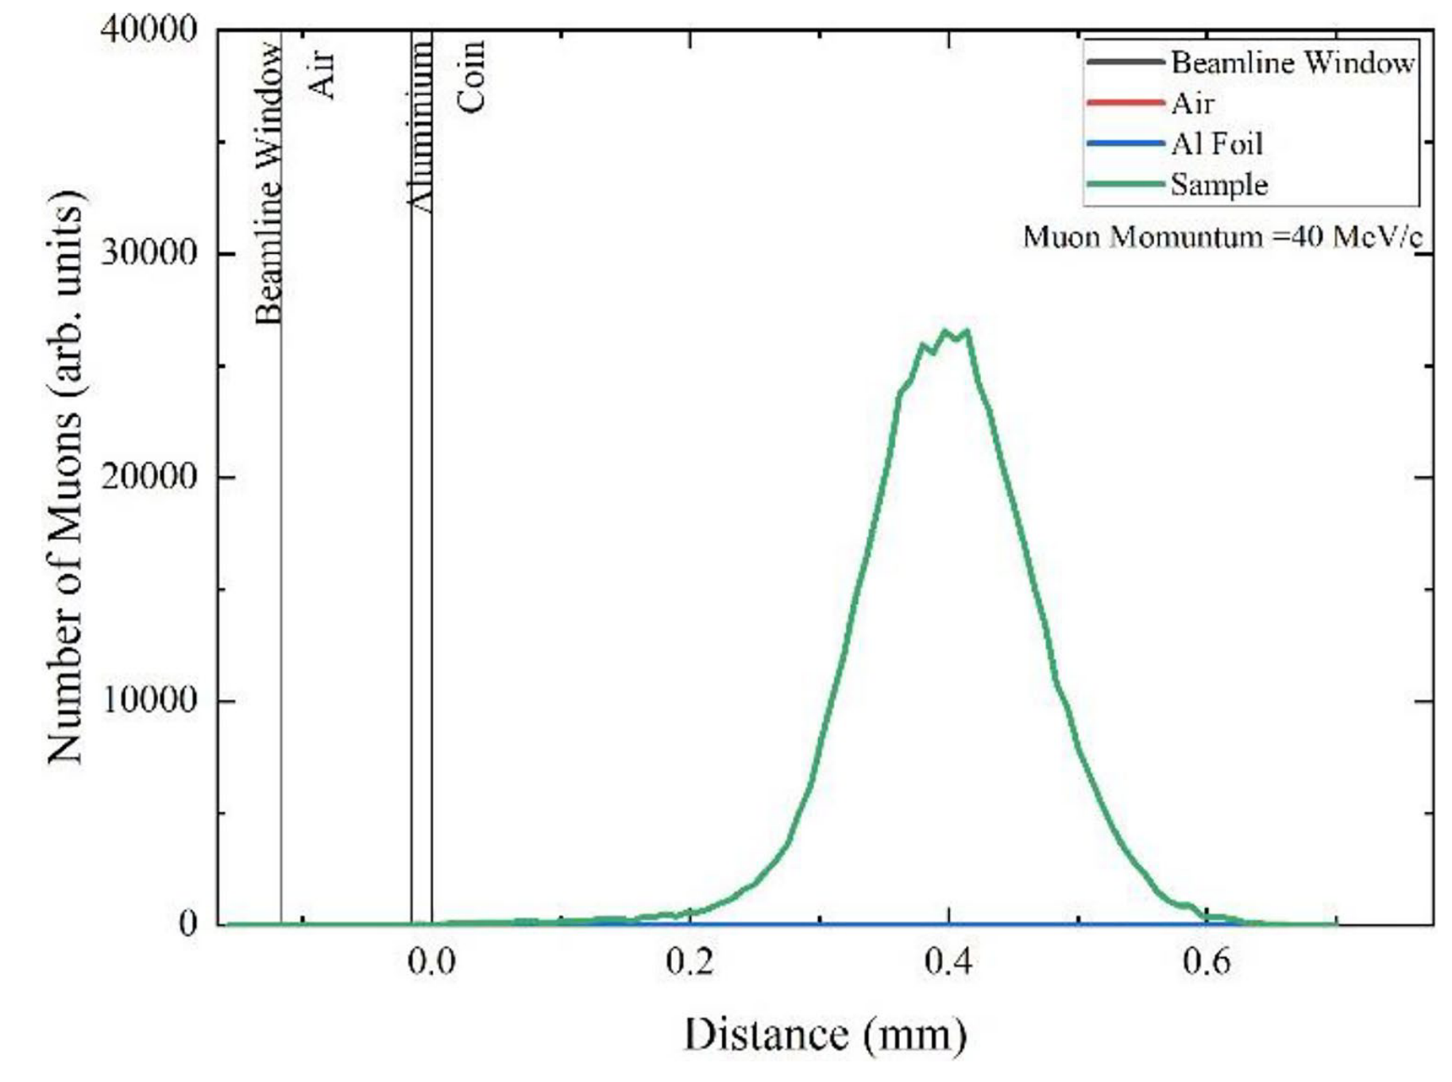
Case Studies
2) Roman gold coins:
aurei from the “year of four emperors”
Muon momentum = 40 MeV/c
Micro-Analysis Consultants Ltd. (MAC) standards
MAC 1: 94% Au, 4.5% Ag, 1 %Cu
MAC 2: 75% Au, 19% Ag, 5% Cu
Ag₇₀Au₃₀: 30% Au, 70%Ag
44 aurei (measured with XRF) → 12 aurei measured with µXES
G. A. Green et al, Archaeological and Anthropological Sciences 14, 165 (2022)

Slide 14
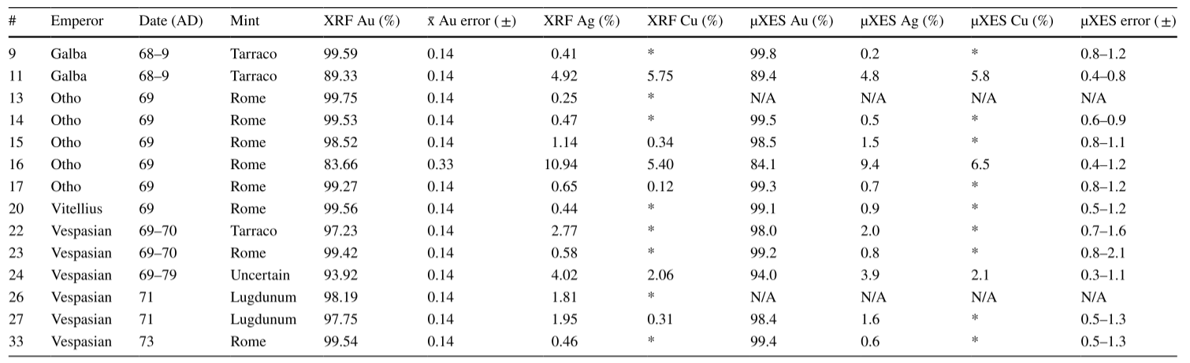
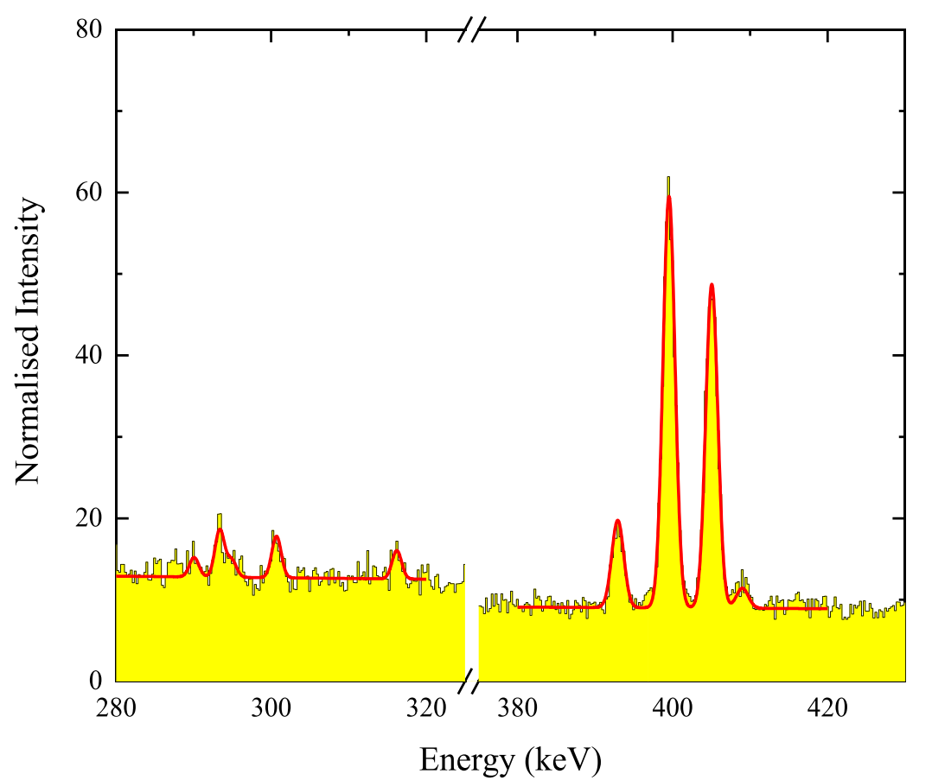
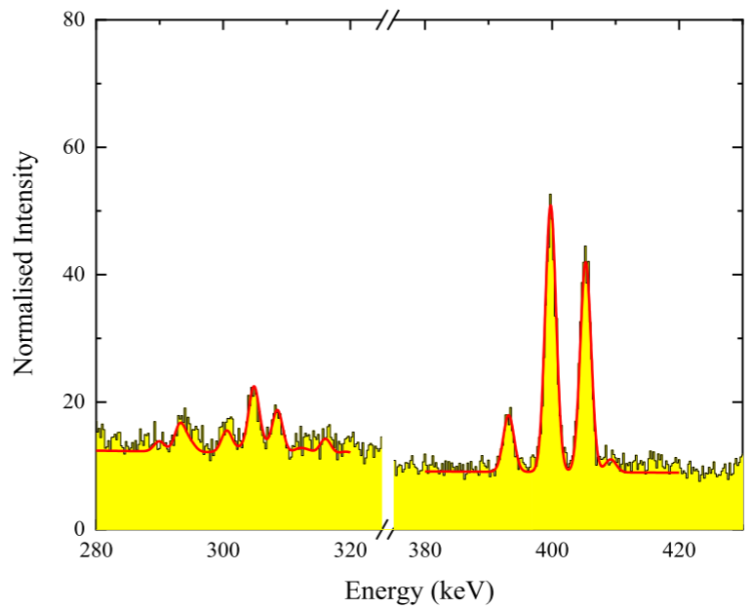
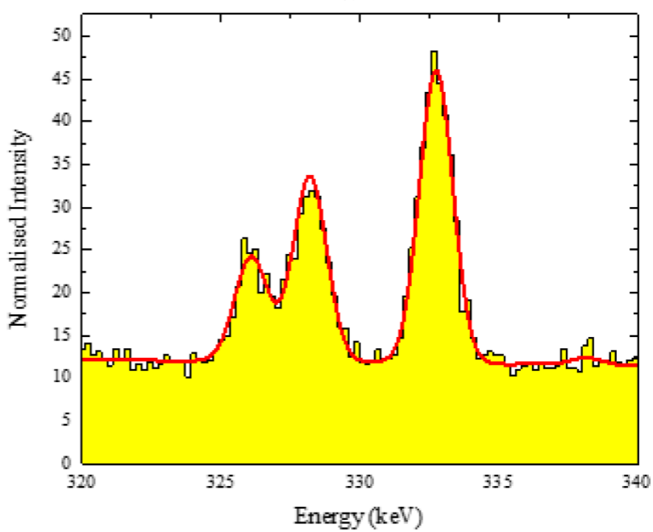
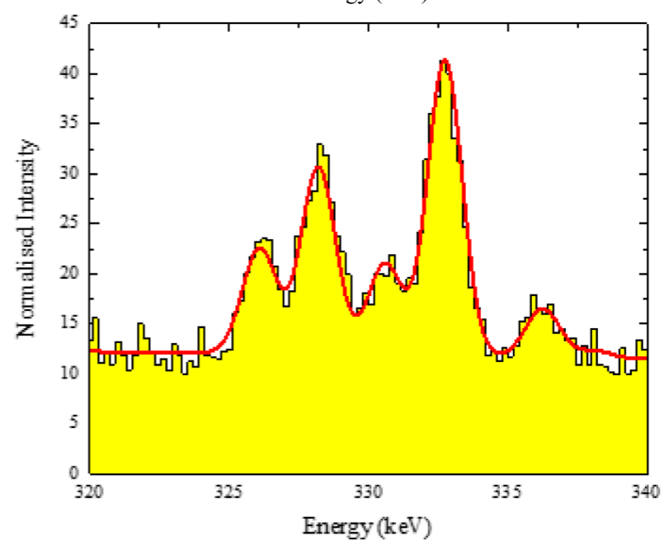
Case Studies
2) Roman gold coins:
aurei from the “year of four emperors”
Muon momentum = 40 MeV/c
Micro-Analysis Consultants Ltd. (MAC) standards
MAC 1: 94% Au, 4.5% Ag, 1 %Cu
MAC 2: 75% Au, 19% Ag, 5% Cu
Ag₇₀Au₃₀: 30% Au, 70%Ag
44 aurei (measured with XRF) → 12 aurei measured with µXES
Coin 14
(Otho)
Coin 16
(Otho)
Cu
Ag
G. A. Green et al, Archaeological and Anthropological Sciences 14, 165 (2022)

Slide 15
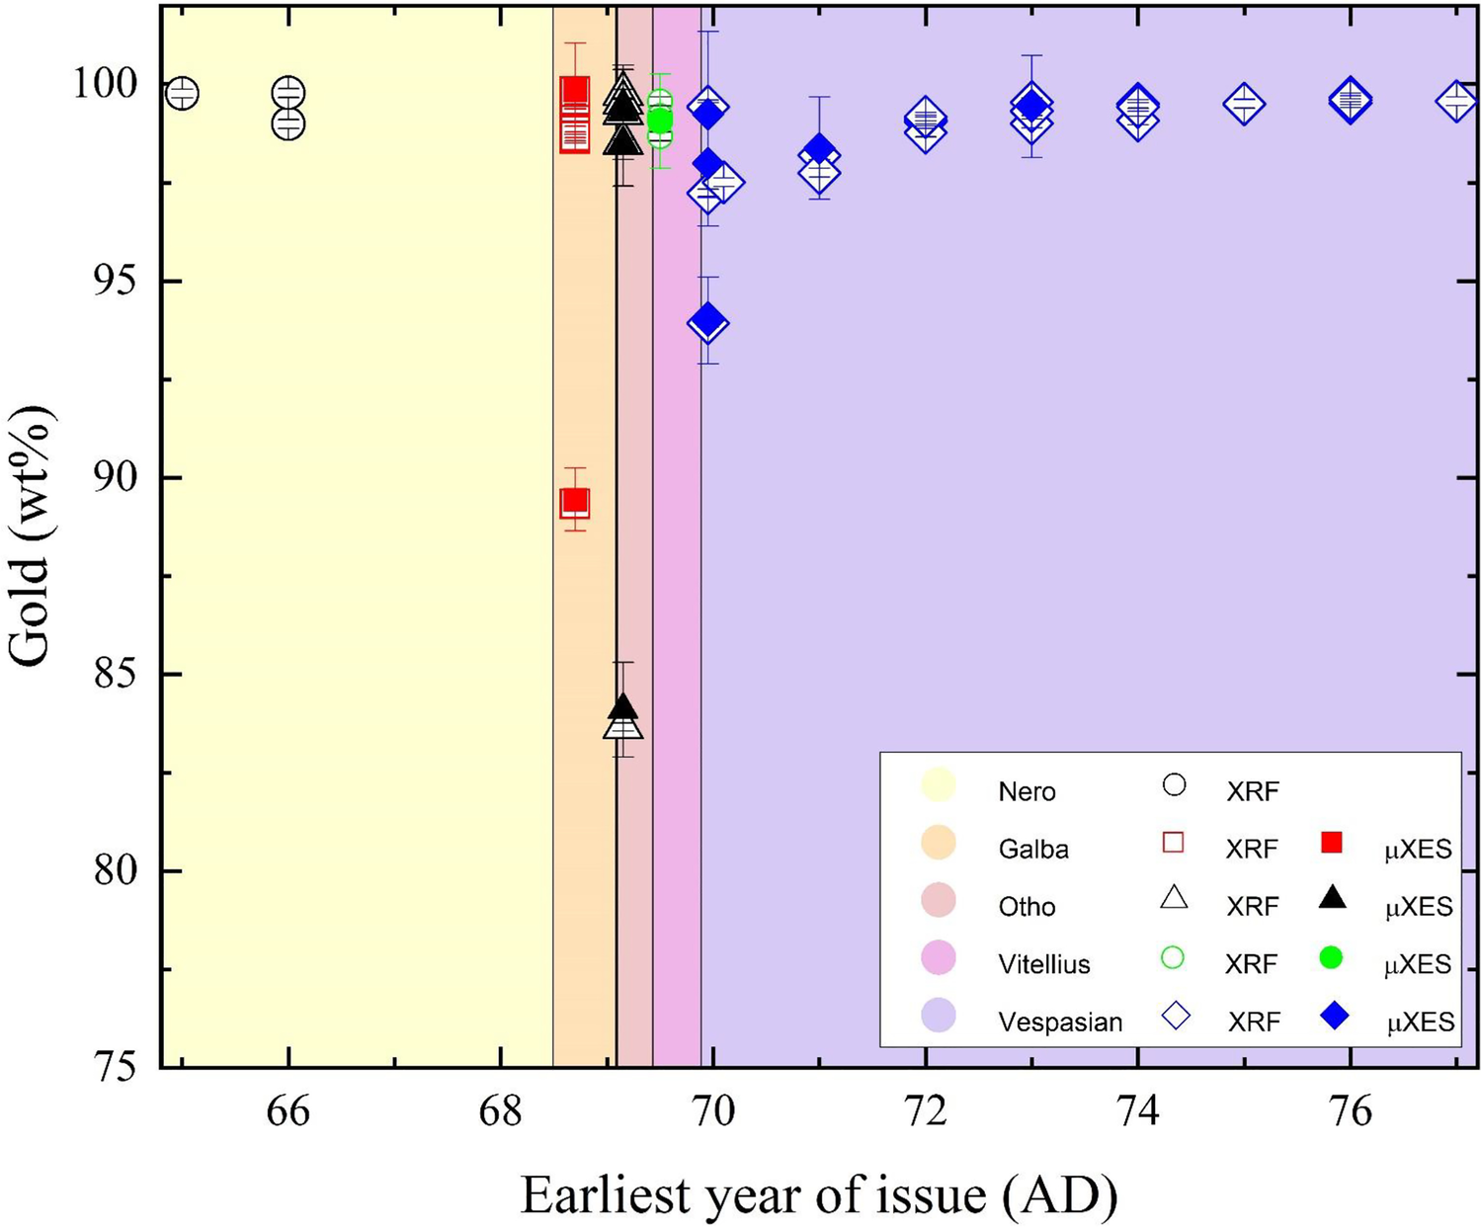
Case Studies
2) Roman gold coins:
aurei from the “year of four emperors”
Muon momentum = 40 MeV/c
Micro-Analysis Consultants Ltd. (MAC) standards
MAC 1: 94% Au, 4.5% Ag, 1 %Cu
MAC 2: 75% Au, 19% Ag, 5% Cu
Ag₇₀Au₃₀: 30% Au, 70%Ag
44 aurei (measured with XRF) → 12 aurei measured with µXES
G. A. Green et al, Archaeological and Anthropological Sciences 14, 165 (2022)

Slide 16
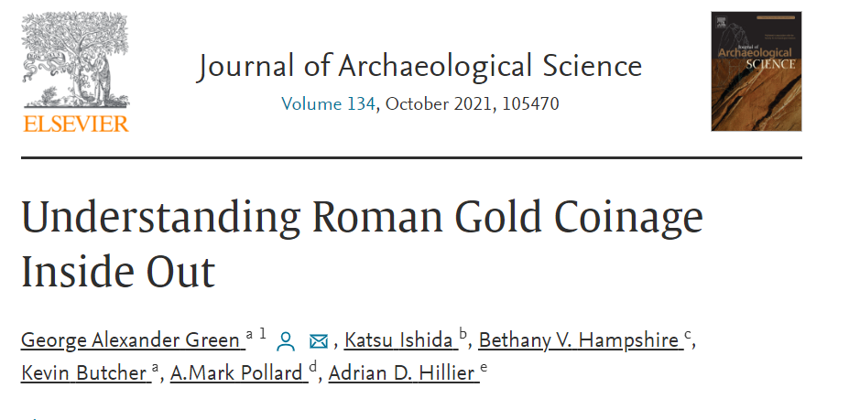
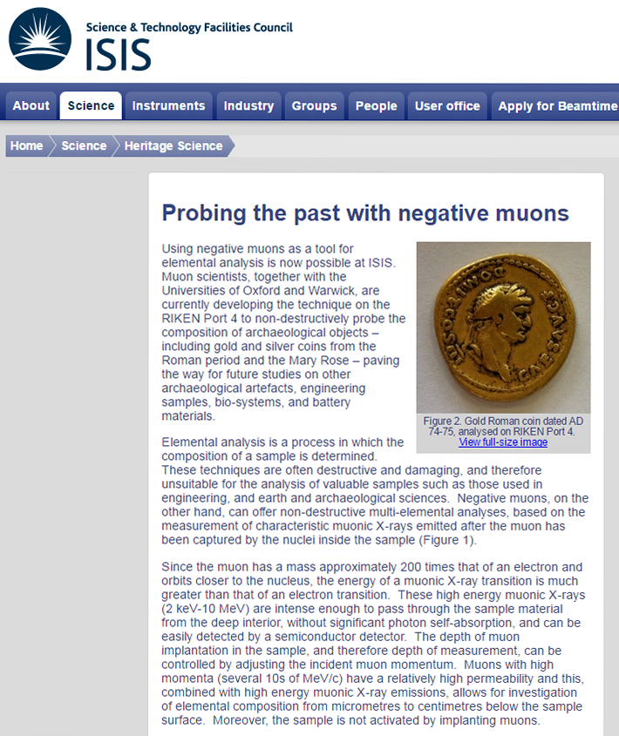
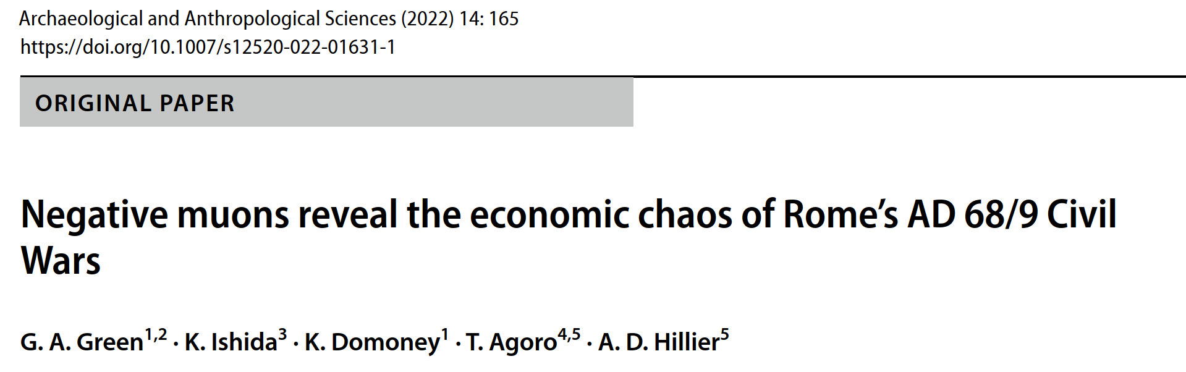
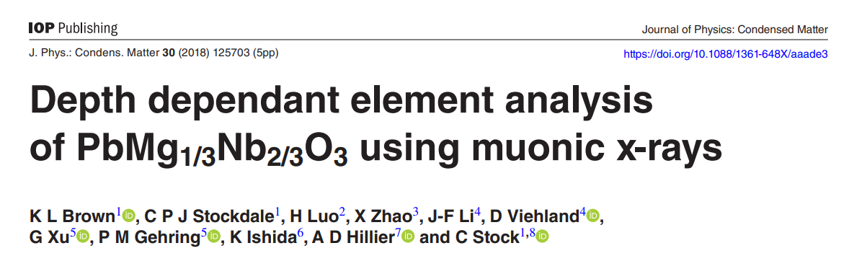
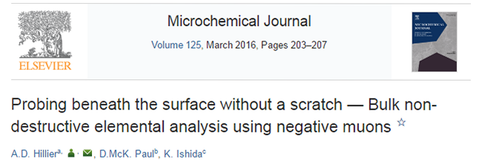
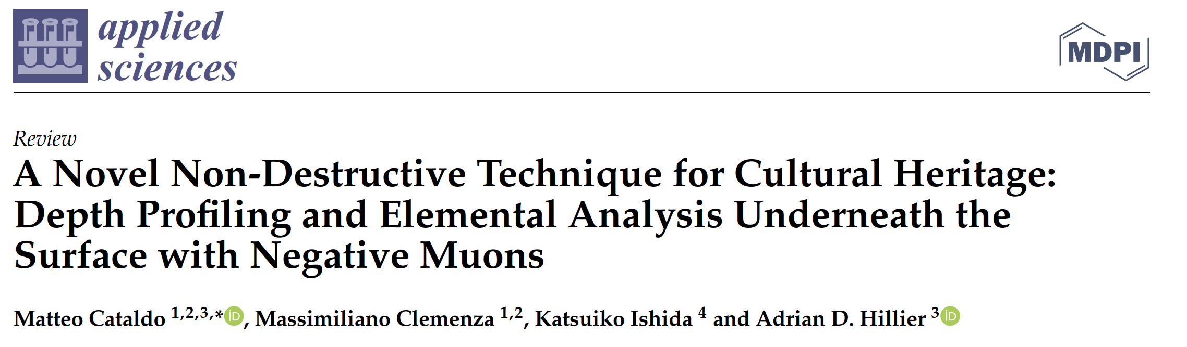
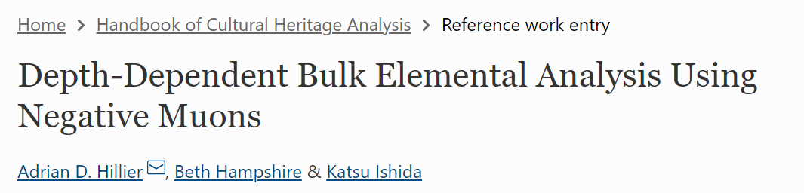
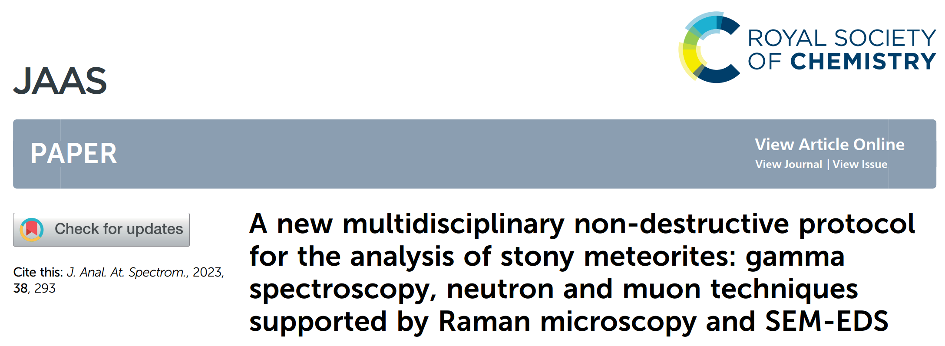
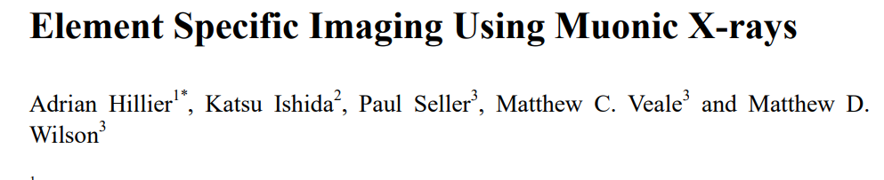
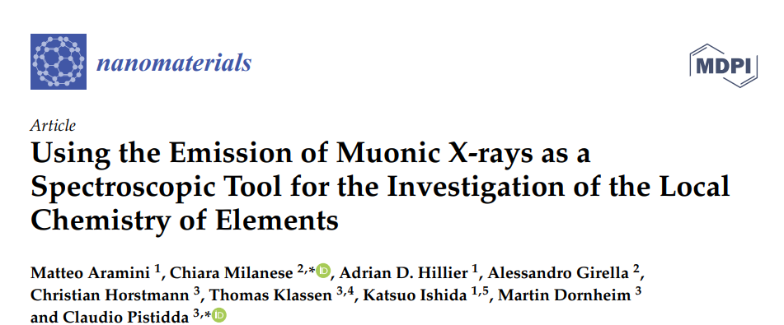
Take-home messages
  Cultural Heritage
      Bronze Age artefacts
      Mary Rose artefacts
      Baptismal Gates
      Swords
      Cannon Balls
      Sundials
      Coins
      Faience and glass
  Solar cells
  Piezoelectric devices
  Li batteries
  Advanced engineering
Hillier et al in Handbook of Cultural Heritage analysis
Cataldo et al, Appl. Sci 2022

Slide 17
Take-home messages
Strengths of the μXES technique:
Non-destructive and depth-selective elemental analysis
Probe deep inside a sample (at least a few centimetre depending on the density of the sample)
Sensitive to all elements in the periodic table (Z ≥ 3)
Negligible radioactivity introduced in the sample
Perform isotopic composition
Possibility to determine the oxidation state of the element
Elemental mapping
Limitations of the μXES technique:
Detection limit ~sub-wt%

Slide 18




Acknowledgements
Me!
Muon Instrument
Scientist
Setup R&D (with K. Ishida)
Software Development for MuX
Setup R&D (with A. D. Hillier)
Software development for MuX
Scheduling of RIKEN beamtimes
Adrian D. Hillier
Head of muon
group
Matea Bjørklund
Industrial Placement
Student
Software Development for MuX

Slide 19
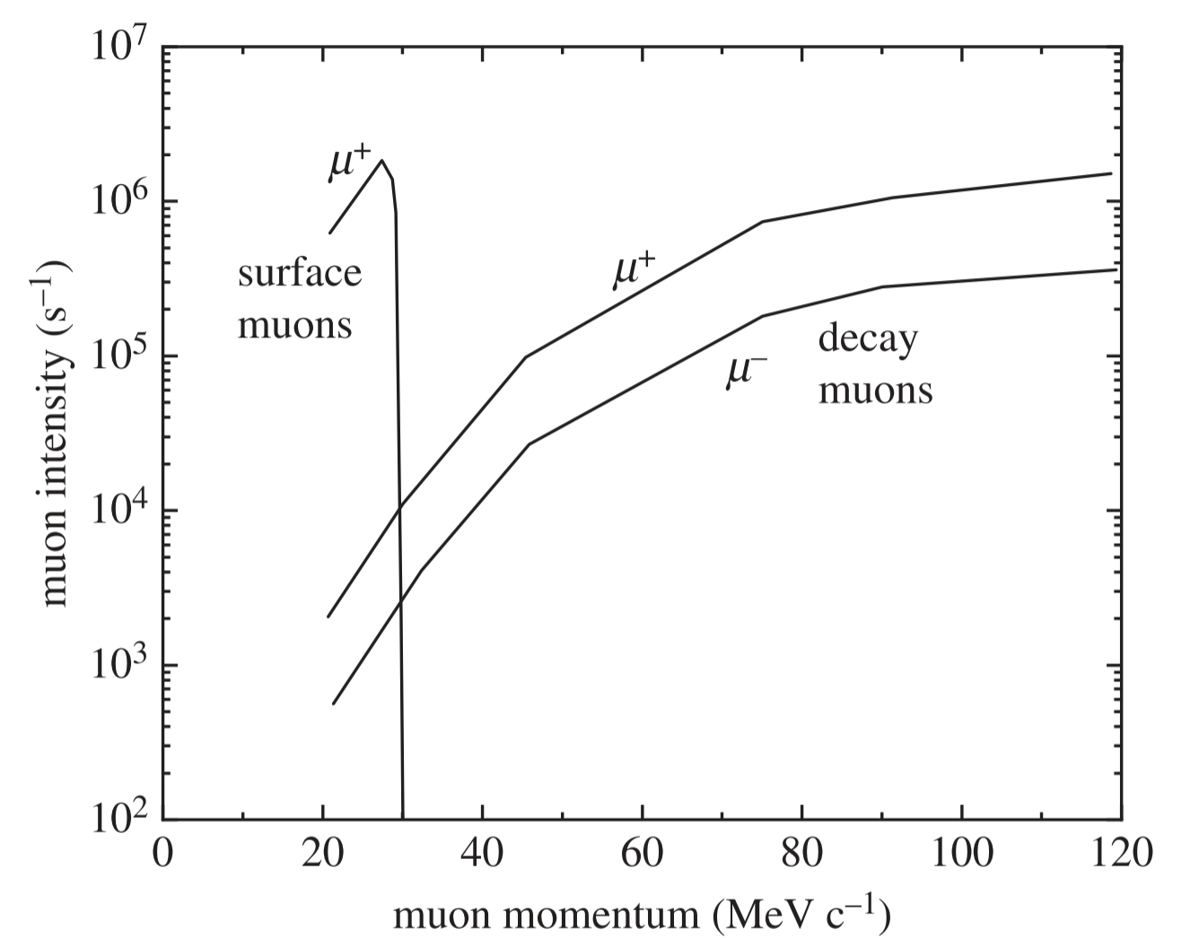
µ-XES experiments at ISIS
C, 45°
10mm
Muon momentum range:
17 MeV/c – 120 MeV/c
(currently 90 MeV/c)
Decay-channel
Currently, we perform the
µ-XES experiments in port 4
A. D. Hillier et al, Phil. Trans. R. Soc. A (2019)

Slide 20
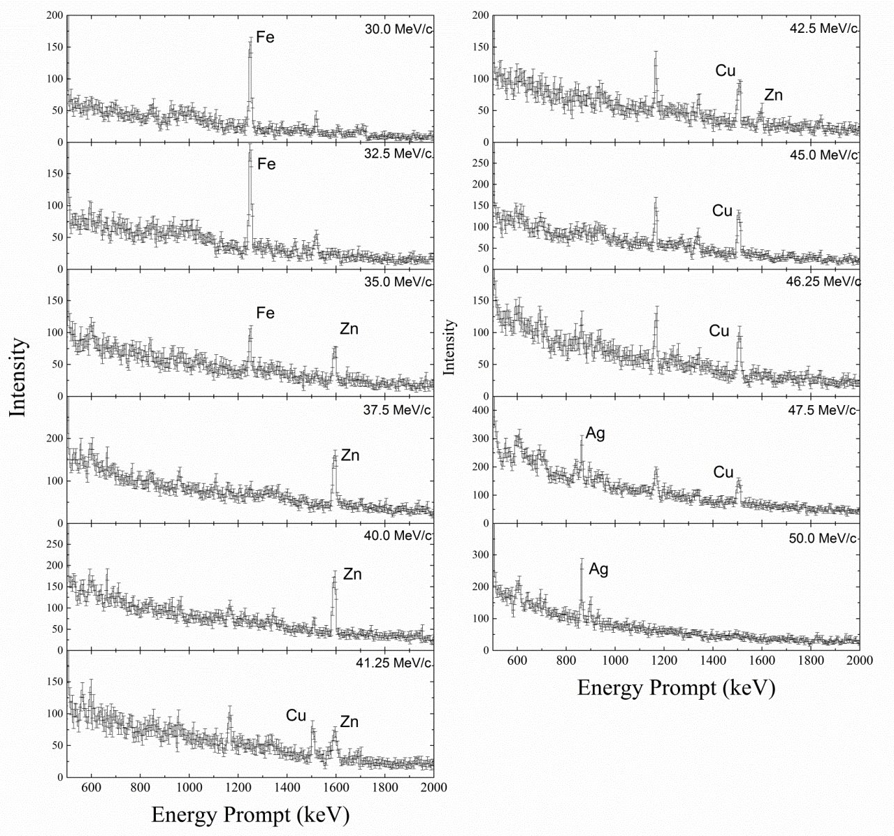
Experimental Setup
Proof-of-concept sample 1
Ag
1000μm
MuX
Fe
500μm
μ⁻ beam
Sample
μ⁻ beam
Zn
500μm
Cu
500μm
A. D. Hillier et al, Microchemical Journal (2016)

Slide 21
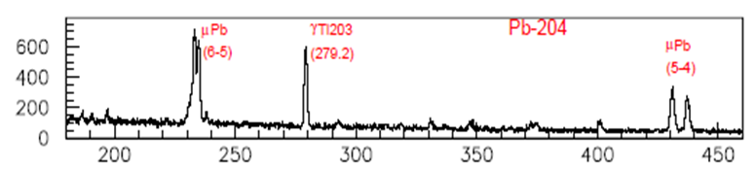
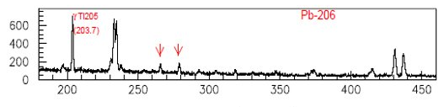

Experimental Setup
Proof-of-concept sample 2
²⁰⁴Pb
²⁰⁶Pb
7/2⁺
7/2⁺
794.8
720.1
5/2⁺
5/2⁺
401.4
416.0
Proof-of-concept sample 3
3/2⁺
3/2⁺
279.2
203.7
K_{α}
M. Aramini et al, Nanomaterials
2020, 10(7), 1260
1/2⁺
1/2⁺
²⁰⁵Tl
²⁰³Tl
K_{β}
K. Ishida et al, in preparation

Slide 22


Experimental Setup
Other technical developments: Elemental Mapping
Fe₂O₃
Beam Collimator
C
Al
Sample face on
Sample from above
HEXITEC Detector
CdTe within the detector housing
A. D. Hillier et al, JPS Conf. Proc. 21, 011042 (2018)

Slide 23




v_{µ} ~ velocity of atomic electron ~ 2 x 10⁶ m/s
-> atomic capture
of muon
(formation of
muonic atom)
What can we achieve with negative muons (µ⁻)?
Muonic
X-rays
t ~ 10⁻¹³ s
= 10⁻⁴ ns
For Fe
(Z = 26)
depth
9
Fate of captured muon ?
µ⁻momentum (p)
-> kinetic energy (T)
(relativistic mechanics)
Sample (pure element like gold;
alloy like bronze; compound like plastic)
Muon decay
~ 100 ns (for high Z)
2) Nuclear capture:
$μ^{−}+p →n+ υ_{μ}$
For Fe
(Z = 26)
For Mn
(Z = 25)
→
γ-ray emission

