Slide 1

Evidence of spin density waves in high temperature superconductor La₃Ni₂O_{7-δ}
Reporter: Ying Wang
Supervisor: Prof. Lei Shu
Physics Department, Fudan University
Date: 2025/01/10
Notes:
Good afternoon, dear scholars, thank you for joining me today. I am Ying Wang, a graduate student from Prof. Lei Shu’group in Physics Department, Fudan University. Thank you for giving me this chance to present here. I’m gonna introducte this MuSR study from out group: spin density waves in high temperature superconductor Lanthanum three nickel two oxygen seven minus delta. In the morning, Prof Shu has mentioned this work and I will do into details.
about 35 s

Slide 2
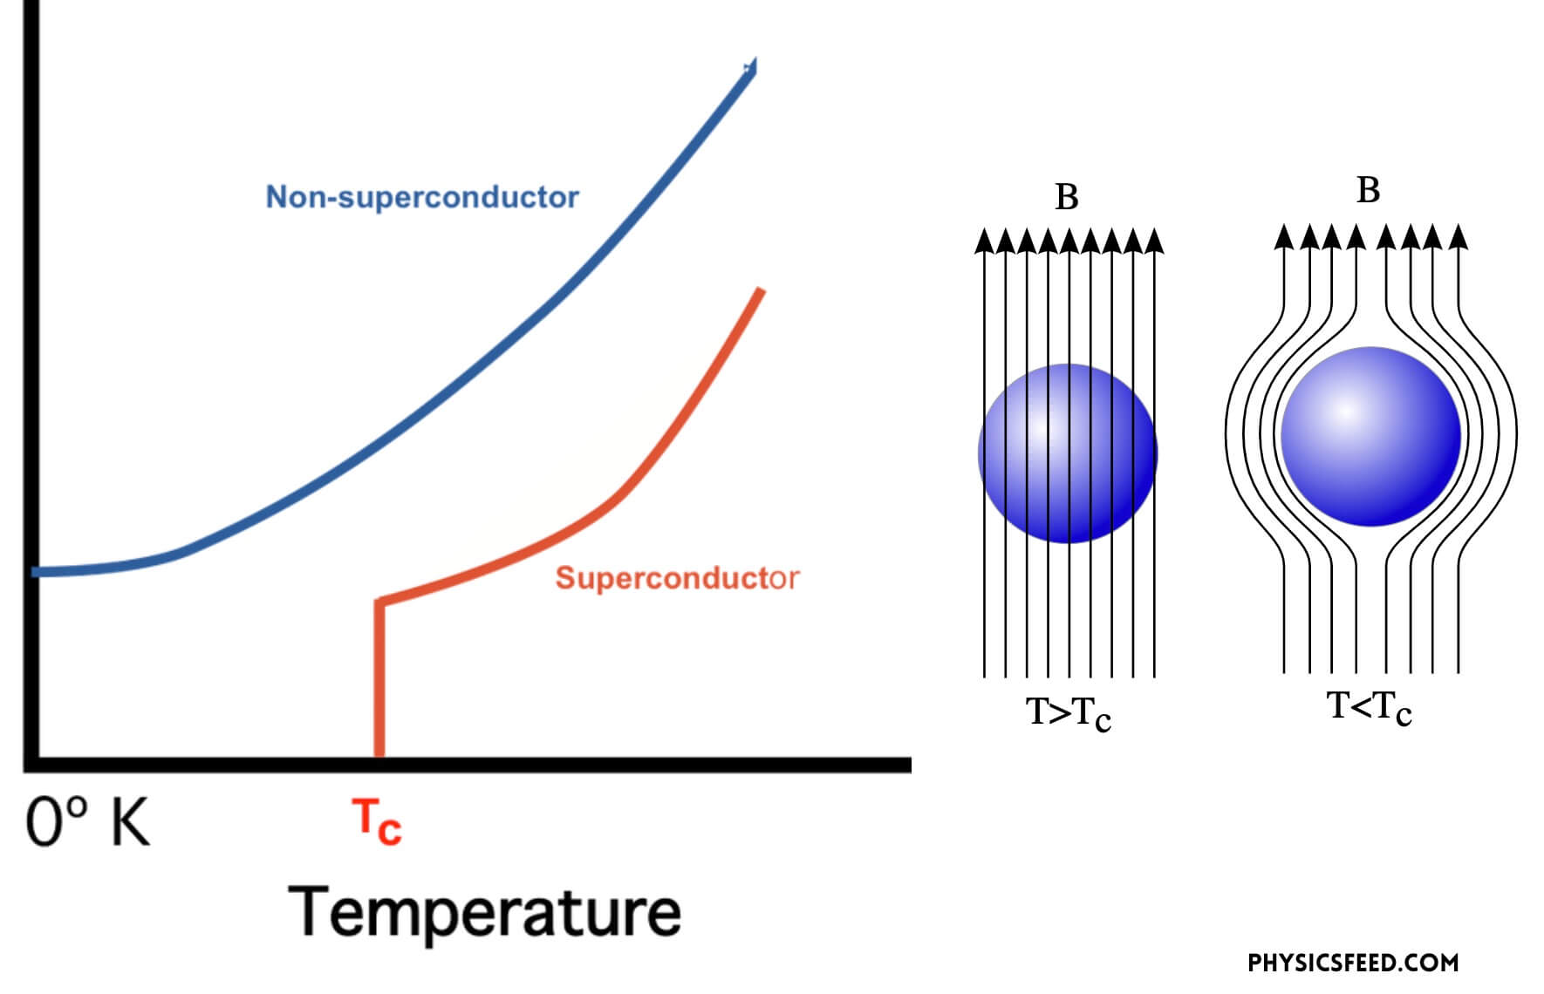
Superconductivity
Notes:
As we are familiar with, superconductivity was first discovered by physicist Onnes in 1911. It means that under certain conditions, the electronic resistance suddenly drops to zero and complete diamagnetism appears . Because of the lossless conductivity of current, superconducting materials have been considered for a wide range of applications.
about 25 s
相信在座的各位对超导并不陌生，超导是指物质在一定条件下，电阻降为零并且表现出完全抗磁性的现象。由于可以无损耗地传导电流，超导材料被认为具有广泛的应用前景。

Slide 3
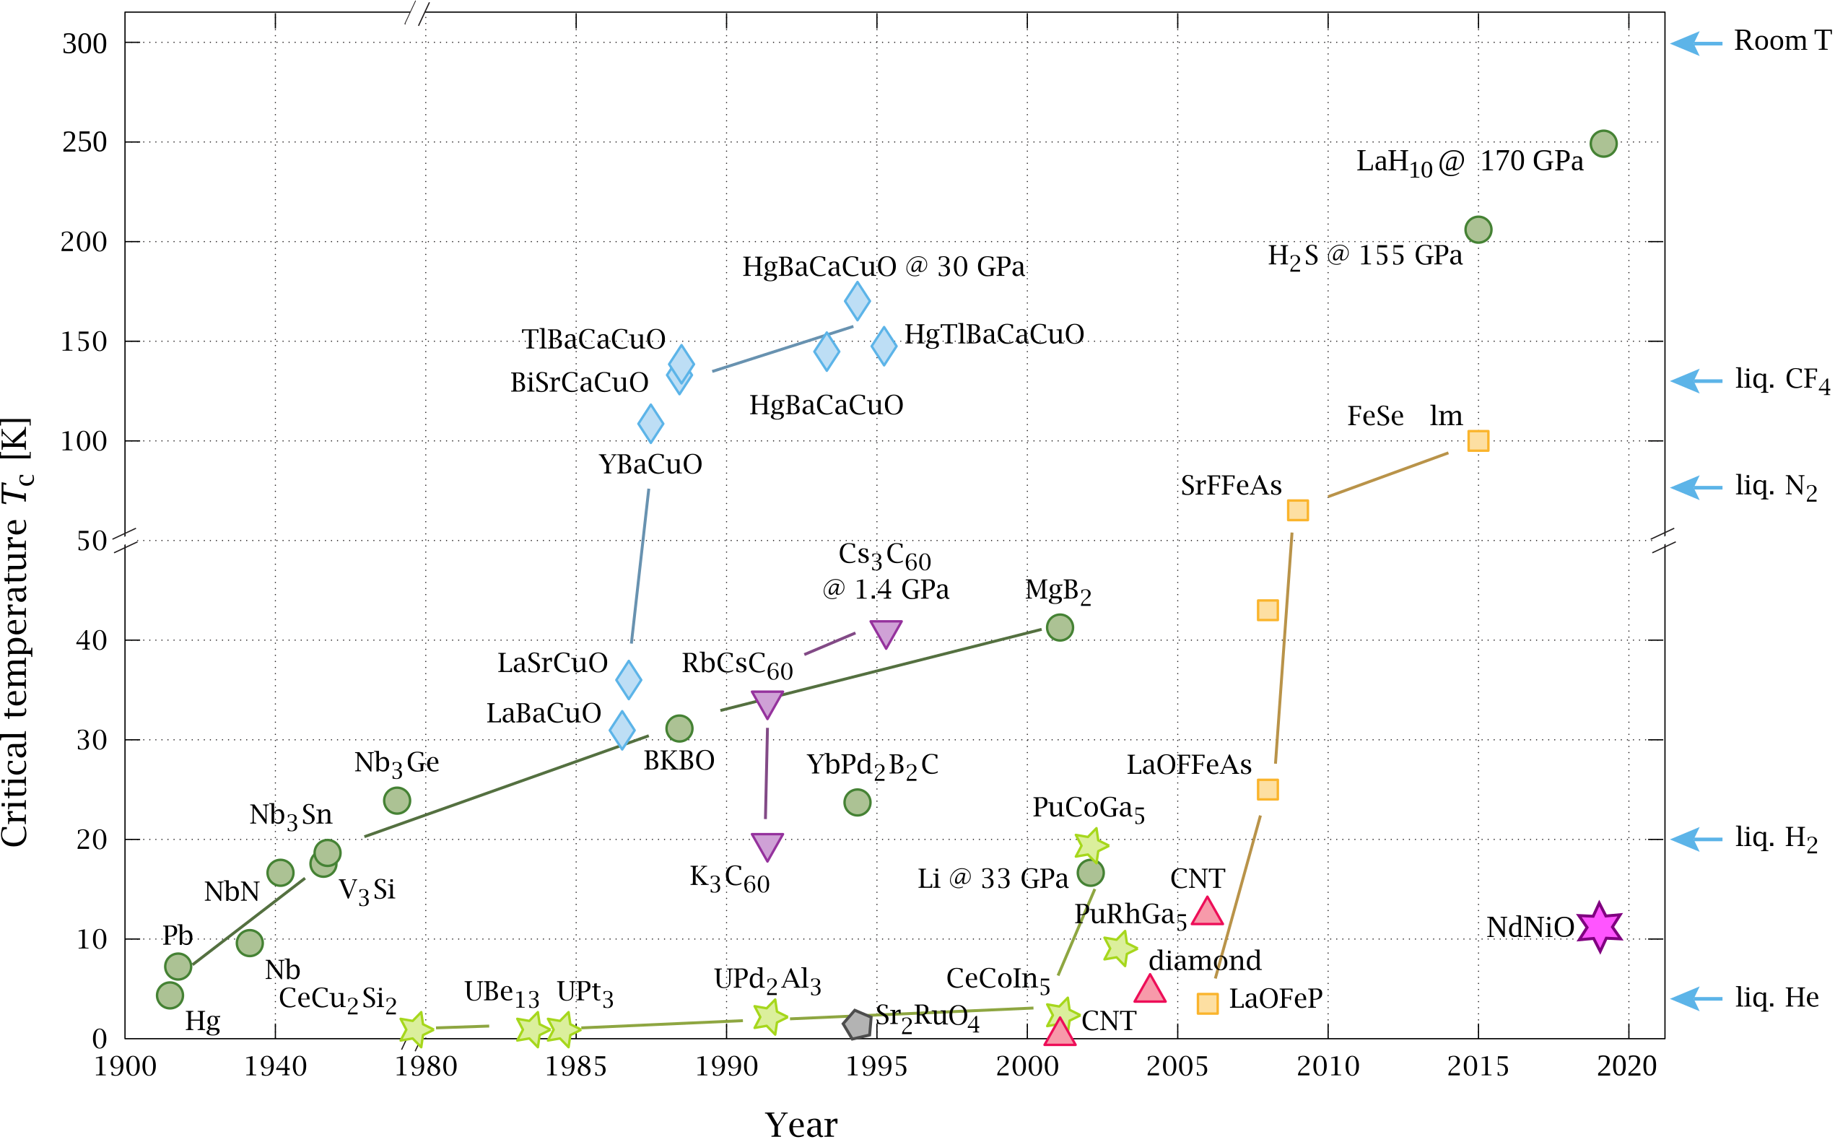
Timeline of Superconductor Discoveries
Notes:
At early stage, superconductors with relatively low Tc were discovered. Low Tc greatly limites the application. Later，with SC discovered in more materials, In 1987, first superconductor with Tc exceed the liquid nitrogen boiling point were first discovered in cuprate systems. High Tc SC that cannot be explained by traditional electron-phonon coupling theory are called unconventional superconductors. Since then, understanding the mechanism of unconventional superconductivity and searching for new high-Tc superconducting systems have become long-term challenges.
about 1 min
早期发现的常规超导材料，目前已经能被BCS理论较好的理解，越来越多的超导材料被发现，而在1987年，人们首次在铜氧化物体系中首次制成了超导转变温度突破液氮温区的高温超导体。由于其较高的超导转变温度不能用传统电声耦合理论理解，因此被称为非常规超导体。从那以后，理解非常规超导机理、和寻找新的高温超导体系一直是一项长期的挑战

Slide 4
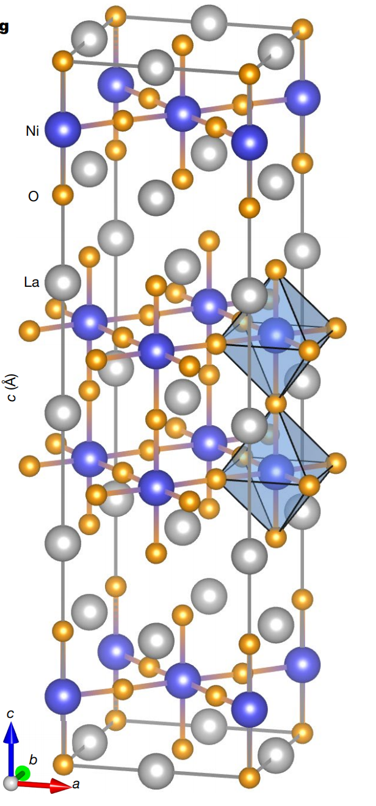
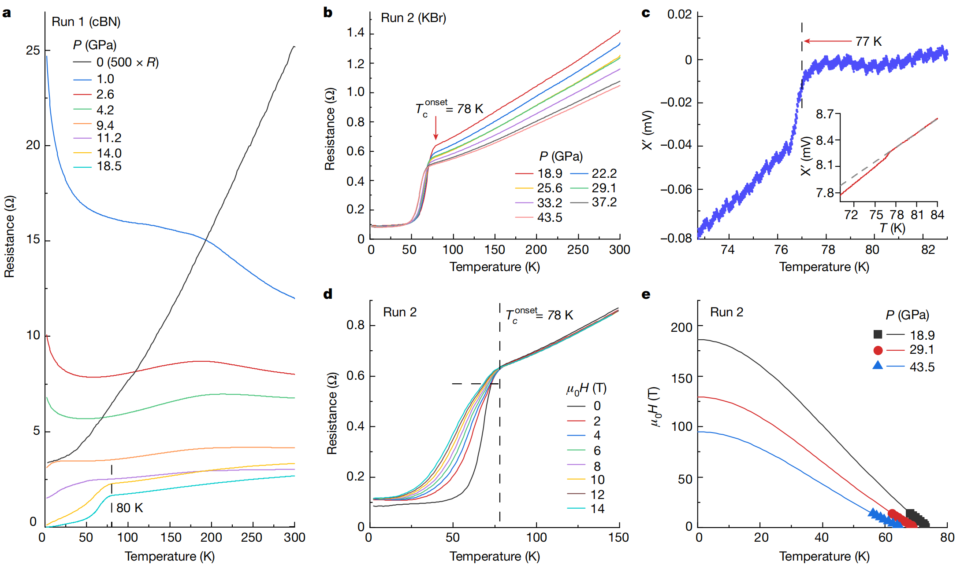
Possible Ni-based HTSC La₃Ni₂O_{7-δ}
M. Wang et al. Nature 621, 493 (2023)
T_{c} = 80 K under 14 GPa
Diamagnetism measurements reveal bulk SC with volume fraction ~48% (M. Wang et al. arXiv: 2404.11369)
Notes:
In 2024, Professor Meng Wang's group at Sun Yat-sen University observed superconducting signs with Tc reaching 80 K in the Lanthanum three nickel two oxygen senven single crystals under high pressure.
Later researches comfirmed zero resistance and diamagnetism, indicating this material became the first nickelate superconducting material that break through the liquid nitrogen temperature range.
therefore, after cuprates and iron-based high-Tc material, this new discovered Sc provides a brand-new platform for studying the mechanism of high Tc superconductivity , and has attracted widespread attention( from theorists and experimental scientists).
about 1 min
在去年六月份，中山大学王猛教授课题组，在LNO327单晶施加高压的条件下观察到了超导迹象，超导转变温度高达80 K，后续的研究中测量到到了零电阻与体超导，证实了这一高温超导转变，使得327成为首个突破液氮温区的镍氧化物超导材料。这一发现为理解高温超导机理提供了全新的平台和线索，因此受到了引起了理论和实验学家的广泛关注。

Slide 5
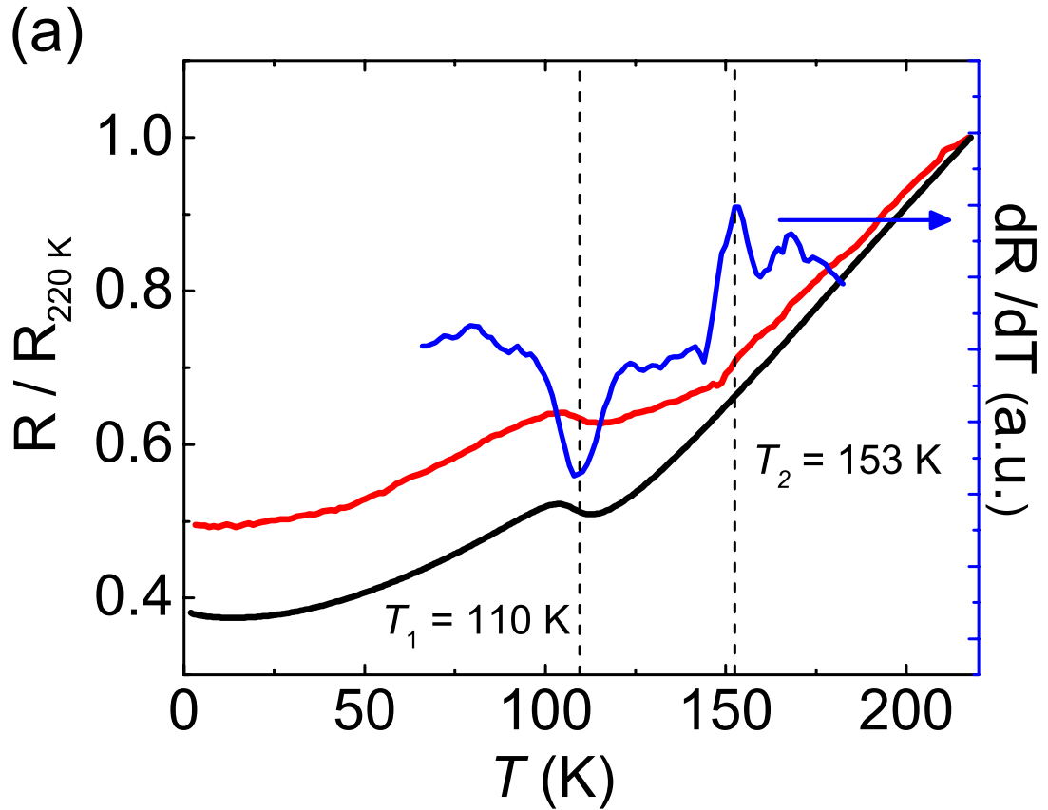
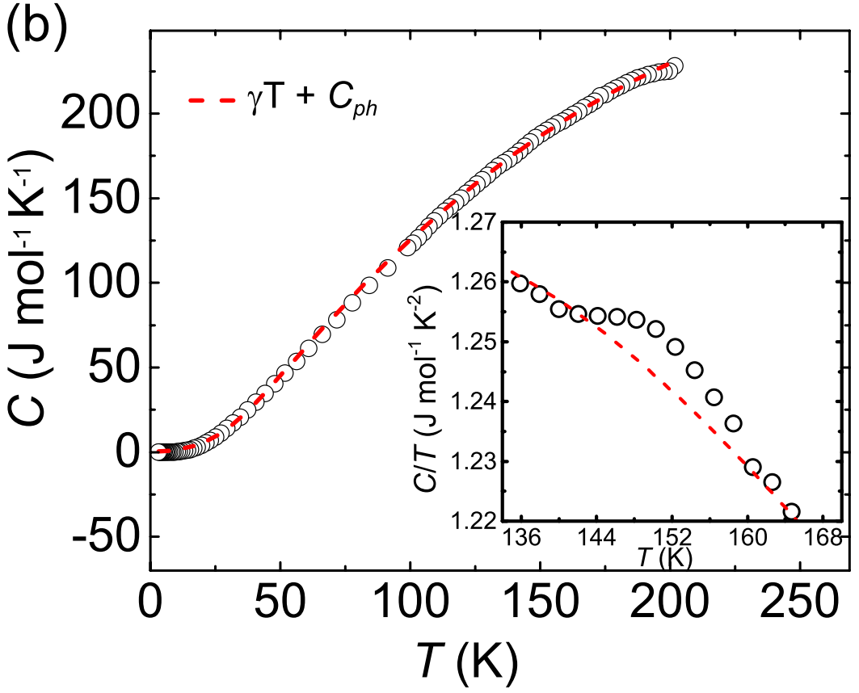
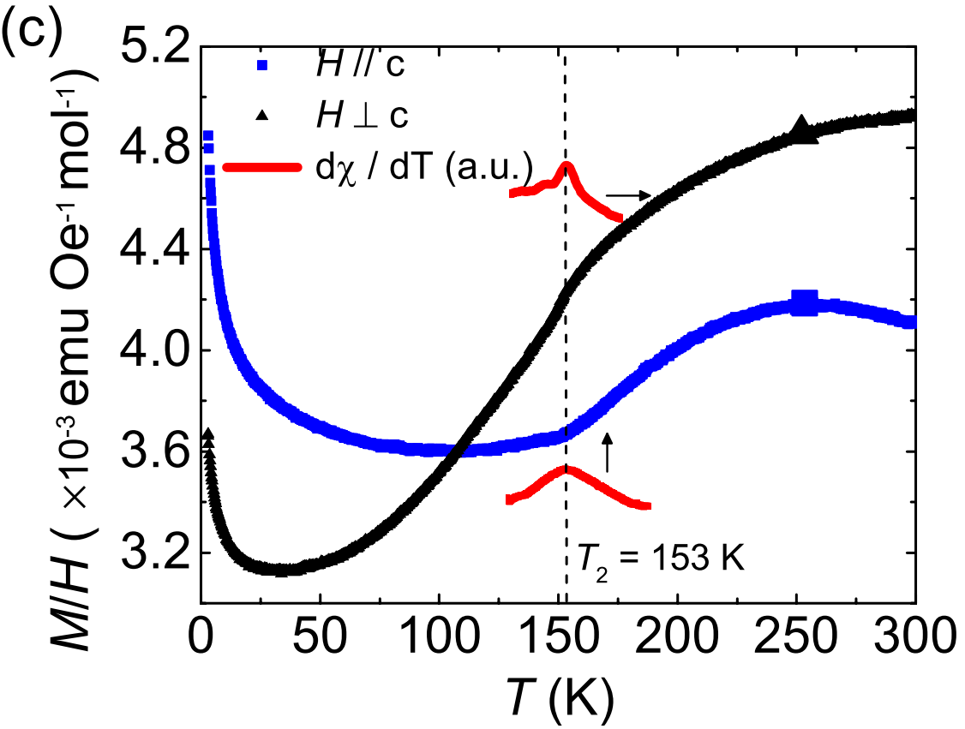
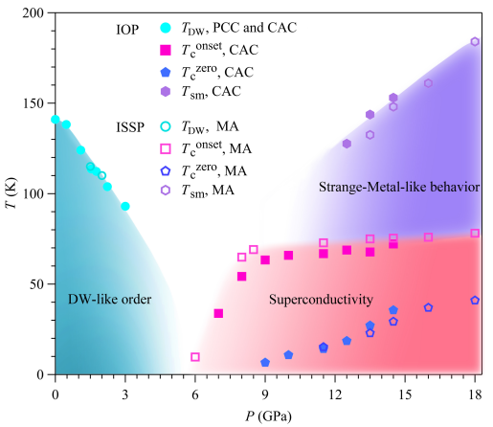
Signature of Density Waves in La₃Ni₂O₇
Temperature dependence of (a) resistance, (b) heat capacity, (c) magnetic susceptibility of La₃Ni₂O₇ single crystals.^{[1]}
Signature of DW near 150 K
SC arises near the possible QCP
[1] Sci. China Phys. Mech. Astron. 66, 217411 (2023)
[2] Phys. Rev. X 14, 011040 (2024)
The T-P phase diagram of polycrystalline La₃Ni₂O_{6.93} ^{[2]}
Notes:
During the process of studying this material, scientists fiind that Physical properties of 327, including resistivity/specific heat capacity/magnetic susceptibility exhibited very weak density-wave like anomalies around 150 K, which could only be clearly observed through the first derivative of the physical quantities. Moreover, this characteristic temperature can be gradually suppressed when applying external pressure. Besides, from the temperature-pressure phase diagram, it appears that high-pressure superconductivity occurs near the quantum critical point of this density wave like order.
about 45 s
Why would they think it as DW?

Slide 6
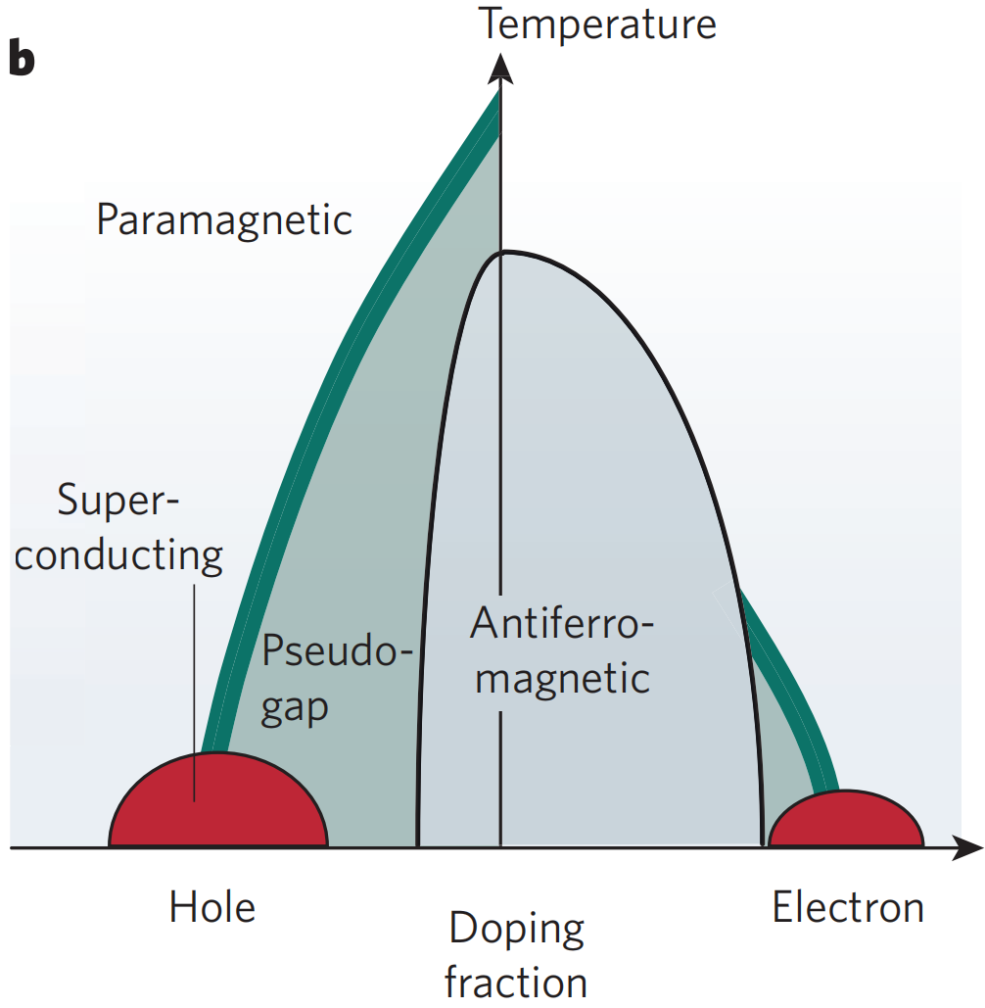
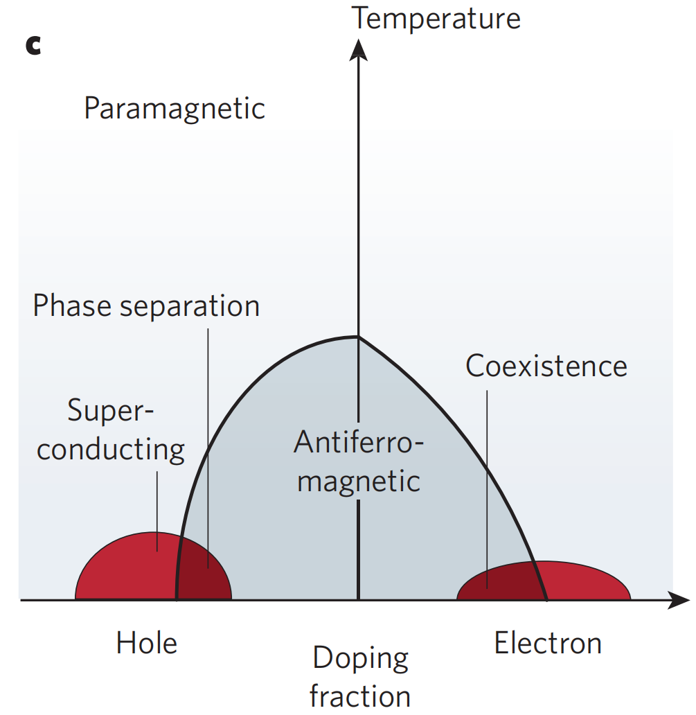
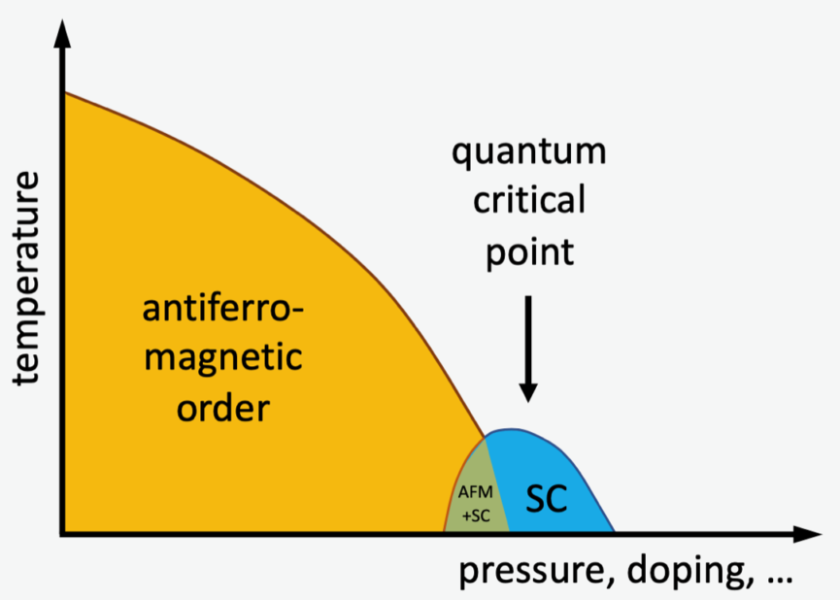
Similarity of Unconventional SC
a
b
c
Schematic phase diagram for a. cuprates, b. 122 family of iron-based superconductors^{[1]} and c. Ce-based heavy Fermion superconductors.
[1] Nature 464, 183–186 (2010)
Notes:
This reminds us that in many unconventional SC systems, superconductivity appears near a quantum critical point (QCP). For examples, In classic cuprates, iron-based 122 material family, and Cerium-based heavy fermion systems, their parent compounds all possess antiferromagnetic ground states and superconductivity all appears near AFM QCP. Based on this simmilarity of there systems, the prevailing view is that unconventional superconductivity is closely related to magnetism, and are lead by pairing caused by strong electronic correlations.
而这种超导出现在QCP附近的特征广泛存在于非常规超导体系中。我们回顾比较经典的铜基，铁基122以及Ce基重费米子115体系的超导相图，发现这些典型非常规超导体的母体均具有反铁磁基态，且超导出现在反铁磁量子临界点附近，也正是基于这种共性，目前主流观点认为非常规超导与磁性密切相关内容，强电子关联促成了非常规超导的配对。
about 50 s
double check the view.

Slide 7
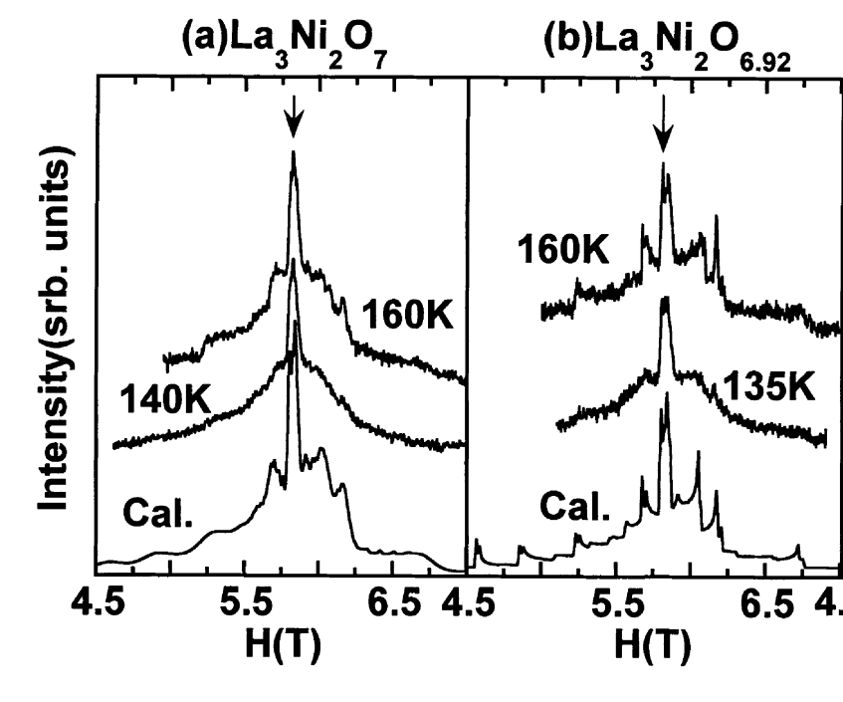
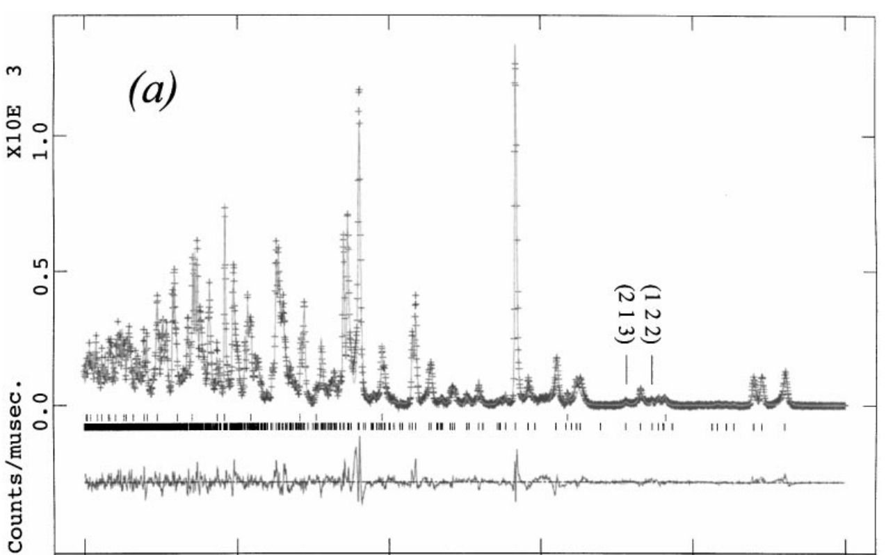
What is the Ground State of La₃Ni₂O₇?
Neutron powder diffraction^{[1]}
¹³⁹La NMR of polycrystalline La₃Ni₂O_{7-δ} ^{[2]}
Magnetic susceptibility of La₃Ni₂O₇ single crystals.^{[3]}
No sign of SDW?
[1] J. Phys. Chem. Solids. 62, 195 (2001)
[2] J. Solid State Chem. 152, 517 (2000)
[3] Sci. China Phys. Mech. Astron. 66, 217411 (2023)
Notes:
However, in the 327 material, the situation seemed to be different. Although signs of a density wave transition were observed around 150 K, at early stage of magnetism study, researches using magnetism-sensitive methods, such as powder neutron scattering, NMR139La and low-temperature magnetic susceptibility, did not observe a magnetic ground state. This leads us to wonder what the transition at 150 K actually is, and whether 327 has a magnetic ground state. Given that unconventional superconductivity is closely related to magnetism, These questions are essential for understanding the high pressure unconventional superconducting mechanism in 327,
about 50 s
然而在327体系中情况似乎有所不同，尽管在150 K附近观察到了密度波转变的迹象，但是早期的对磁性敏感的探测手段，如粉末中子散射/¹³⁹LaNMR以及低温磁化率中，都没有观察到327存在一个磁基态。这让我们思考，150K的转变到底是什么，以及327是否具有磁性基态。考虑到磁性与非常规超导间的密切关联，确定327的基态磁性，对于理解其高压下的非常规超导机理至关重要。

Slide 8
MuSR Study on Polycrystalline La₃Ni₂O_{7-δ}
Phys. Rev. Lett. 132, 256503 (2024)
(Editor`s suggestion & the cover of volume)
Notes:
Based on these unsolvable questions, and because of the advantages of MuSR in detecting weak local magnetism mentioned in previous talks, our group used MuSR to study the magnetic ground state of this polycrystalline lantanum three nickel two oxgen seven pollycrystalline at atmospheric pressure.
得益于MuSR在磁性探测上的优势，我们利用MuSR研究多晶327在常压下的磁性基态。
0.5 min

Slide 9
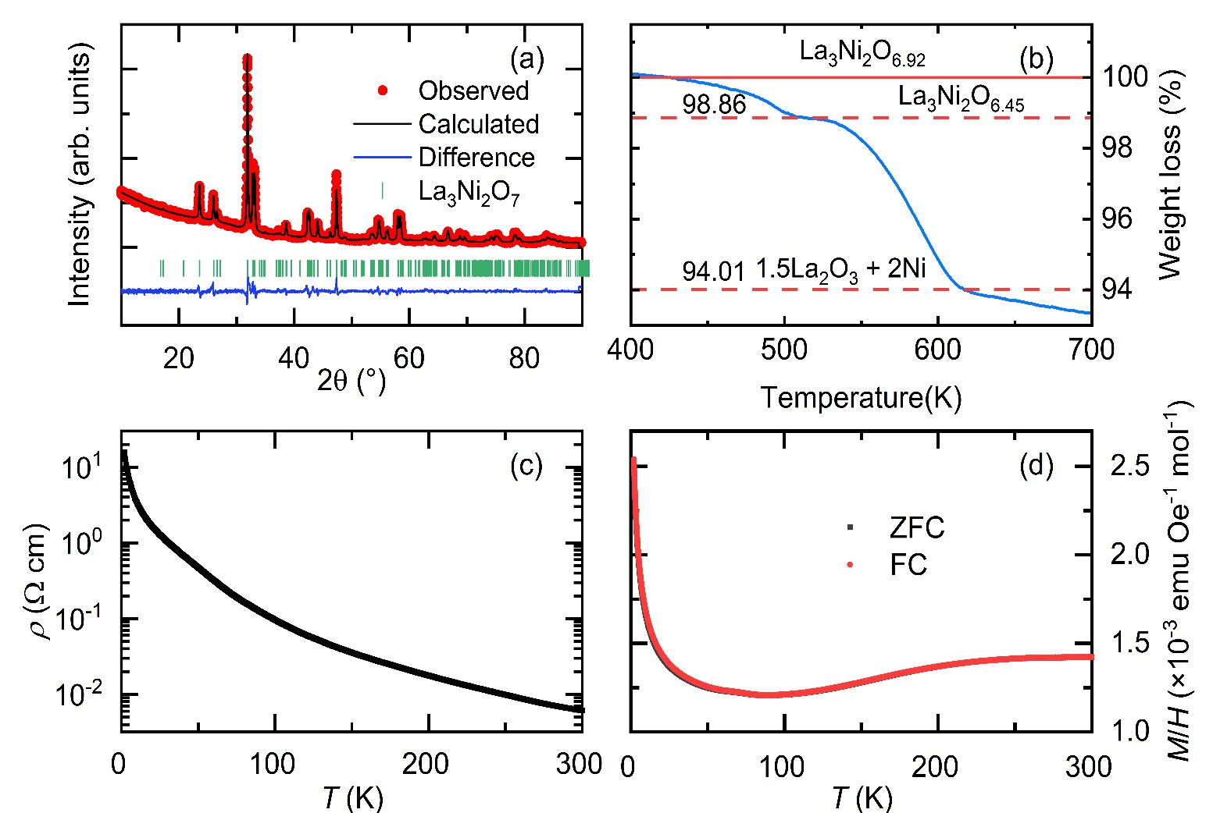
Sample characterization
Single phase polycrystalline with space group Amam(#63)
δ ~ 0.08, about 1% oxygen deficiency
No anomaly around 150 K
No sign of magnetic order from magnetic susceptibility
Notes:
Before MuSR experiment, because of the natural apical oxygen deficiency in the 327 material, which is closely related to the specific physical properties, we first characterized the sample in detail.
The refinement of the powder XRD pattern confirmed the purity of the single-phase in the sample. We then used the thermogravimetry technique to determine the accurate oxygen content and obtained delta about 0.08, indicating only 1% oxygen deficiency.
We then measured the electronic resistivity and magnetic susceptibility. Consistent with previously reported resistivity results for powder samples, we did not see any anomalies relating to density waves near 150 K. The magnetic susceptibility data also showed no sign of magnetic order at low temperatures.
由于327材料中天然存在氧缺位，且材料的物理性质与具体氧含量密切相关，所以我们首先对样品进行了细致的表征。
粉末X射线衍射实验确认了样品的单相和纯净。我们进一步使用热重分析法测量了我们样品的具体氧含量，得到δ~0.08，大约存在1%的氧缺位。说明我们样品中的氧缺位较少。
我们测量了样品的电阻率和磁化率，和先前对粉末样品的报道一致，我们并没有观察到150 K附近表现出密度波形式的异常。磁化率数据在低温下也没有表现出磁有序的迹象。
about 1 min

Slide 10
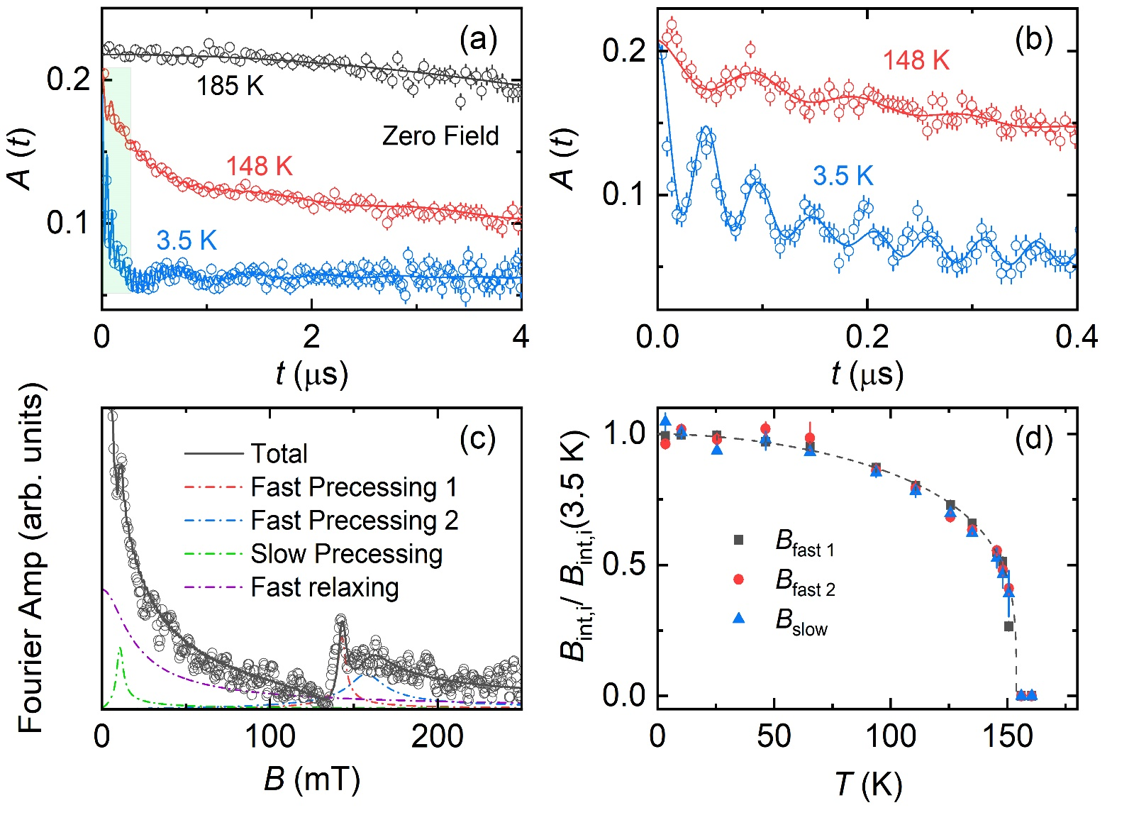
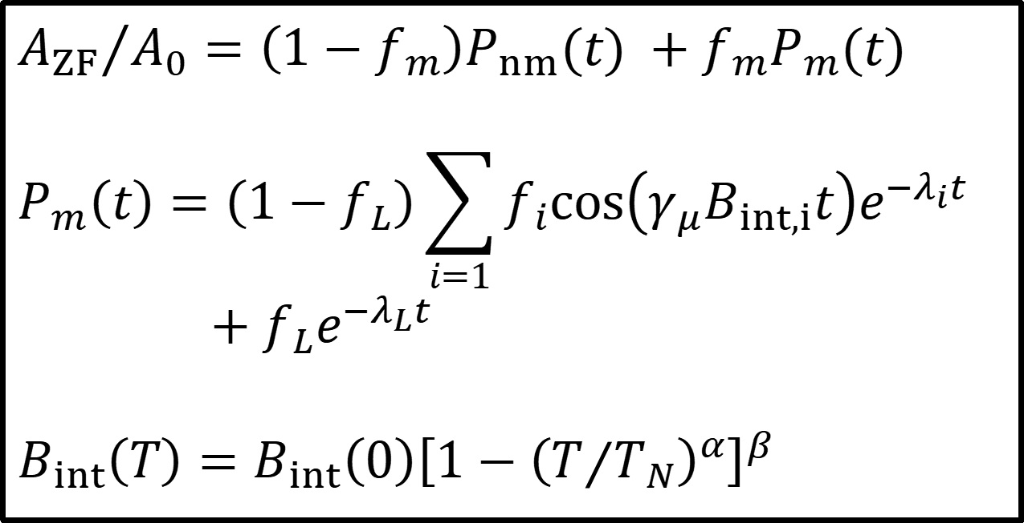
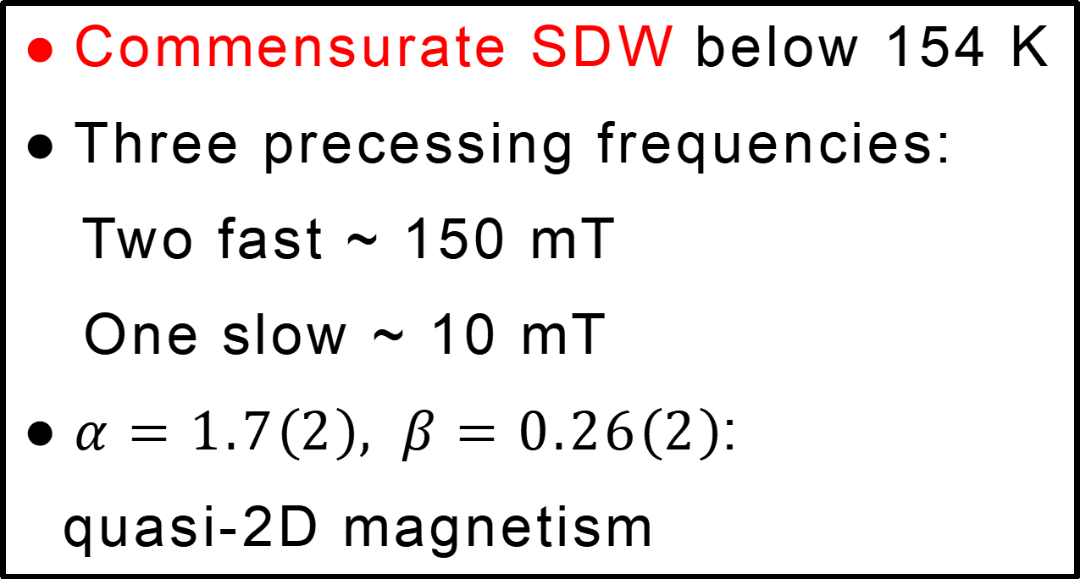
Zero Field MuSR
$${A_{ZF}}/{A_{0}=\left(1−f_{m}\right)P_{nm}(t) }+f_{m}P_{m}(t)$$
$$P_{m}\left(t\right)=\left(1−f_{L}\right)\sum_{i=1}{f_{i}cos\left(γ_{μ}B_{int,i}t\right)e^{−λ_{i}t}}$$
$+f_{L}e^{−λ_{L}t}$
$$B_{int}\left(T\right)=B_{int}\left(0\right){\left[1−{\left(T/{T_{N}}\right)}^{α}\right]}^{β}$$
Commensurate SDW below 154 K
Three precessing frequencies:
Two fast ~ 150 mT
One slow ~ 10 mT
$α=1.7\left(2\right), β=0.26\left(2\right)$:
quasi-2D magnetism
Notes:
In MuSR experiment, we first use ZF-MuSR to study the magnetic ground state. As shown in Figure a, at high temperature, the system is in a paramagnetic state ,and the relaxation of asymmetry is slow. When the temperature gets lowered to below 150 K, we are surprised to find that the spectrum starts with a very obvious oscillation behavior, which indicates that the magnetic phase transition does happen.
Furthermore, Fourier analysis is performed on the asymmetry spectrum. From the Fourier spectrum, it can be seen that the oscillation is mainly manifested as three characteristic frequencies, corresponding to a low field of 10 mT and two high fields near 150 mT. In figure d, by normalizing the internal fields, we find that they have the same temperature dependence, which suggests that they reflect the same magnetic phase. The temperature dependence can be fitted with this phenomena formula, and the beta exponent obtained is close to the value expected by the quasi-two-dimensional model.
This is also consistent with the layered structure of 327.
about 1.5 min
由于入射缪子是100%极化的，我们在不加极化外场，即零场情况下测量样品本征的磁性。如图a所示，高温下体系处于顺磁态，不对称参数缓慢弛豫。而温度降低至150 K以下后，我们惊喜地发现，不对称参数谱出现了非常明显的震荡行为，这说明样品内部在150 K处确实发生了磁性相变。
进一步地，我们对不对称谱进行了傅里叶分析以获得其进动频率信息，而振动频率比上旋磁比，就可以得到局域磁场强度大小。从傅里叶谱上可以看到，不对称参数震荡主要表现为三个特征频率，分别对应一个10mT的低场和两个150 mT附近的高场。将三个内场强度做归一化，发现他们表现出相同的温度依赖关系，说明他们反映了同一个磁性相，其温度依赖关系可以用这一唯像公式拟合，得到的临界指数更接近准二维磁性的临界行为。这也和327的双层NiO面结构相符。

Slide 11
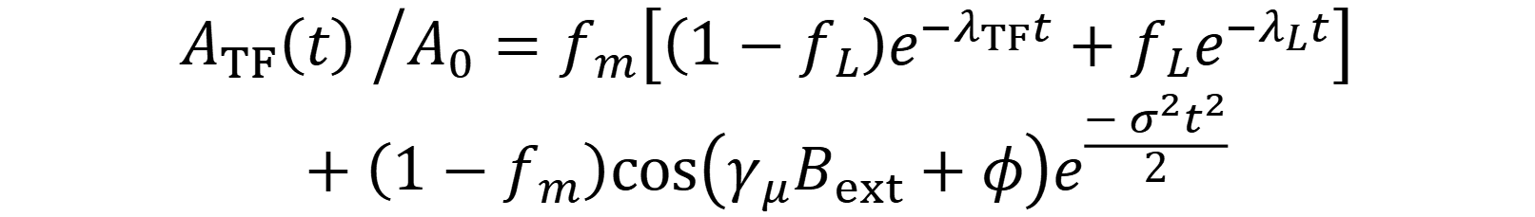
Magnetic volume fraction
$${A_{TF}\left(t\right) }/{A_{0}=f_{m}\left[\left(1−f_{L}\right)e^{−λ_{TF}t}+f_{L}e^{−λ_{L}t}\right]}$$
$$+\left(1−f_{m}\right)cos\left(γ_{μ}B_{ext}+φ\right)e^{\frac{−σ^{2}t^{2}}{2}}$$
Magnetic phase
Nonmagnetic phase
Bulk magnetism with 100% volume fraction
Notes:
After comfirming the magnetic ground state by ZF-MuSR, we next use weakTF-MuSR to help verify that the magneti state is intrinsic, by detecting the magnetic volume fraction.
In the left figure, it can be seen that, at high temperature, the sample is in a paramagnetic state, and the muons all do low-frequency precession along the external field. At low temperature, the oscillation term almost completely disappears, suggesting that the sample fully changes to a magnetic phase. The right figure describes the temperature dependency of the signals’ fraction in detail. We can see that, with the temperature decreasing, the fraction of total bulk magnetism starts to appear near 150 K, then slowly reaches nearly 100% at low temperature. Thus, we verified that this magnetic ground state does come from the main phase of sample instead of impurities.
由于MuSR是局域探测手段，我们可以探测样品内部的磁性占比。我们施加一个与缪子自旋相垂直微弱磁场，处于非磁态的样品中，缪子会沿着外场做低频振荡，由此可以分辨磁性和非磁信号体积占比。可以看到，高温下样品处于顺磁态，缪子都沿着外场做低频进动，在低温下样品处于磁性相，外场振荡项几乎完全消失，通过比较两项信号占比，我们得到样品的磁性相占比接近100%。

Slide 12
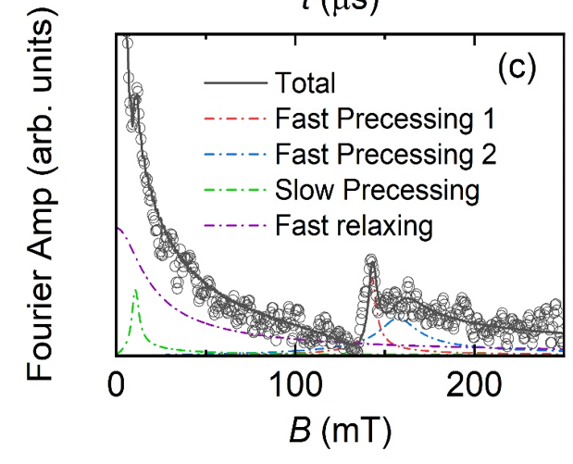
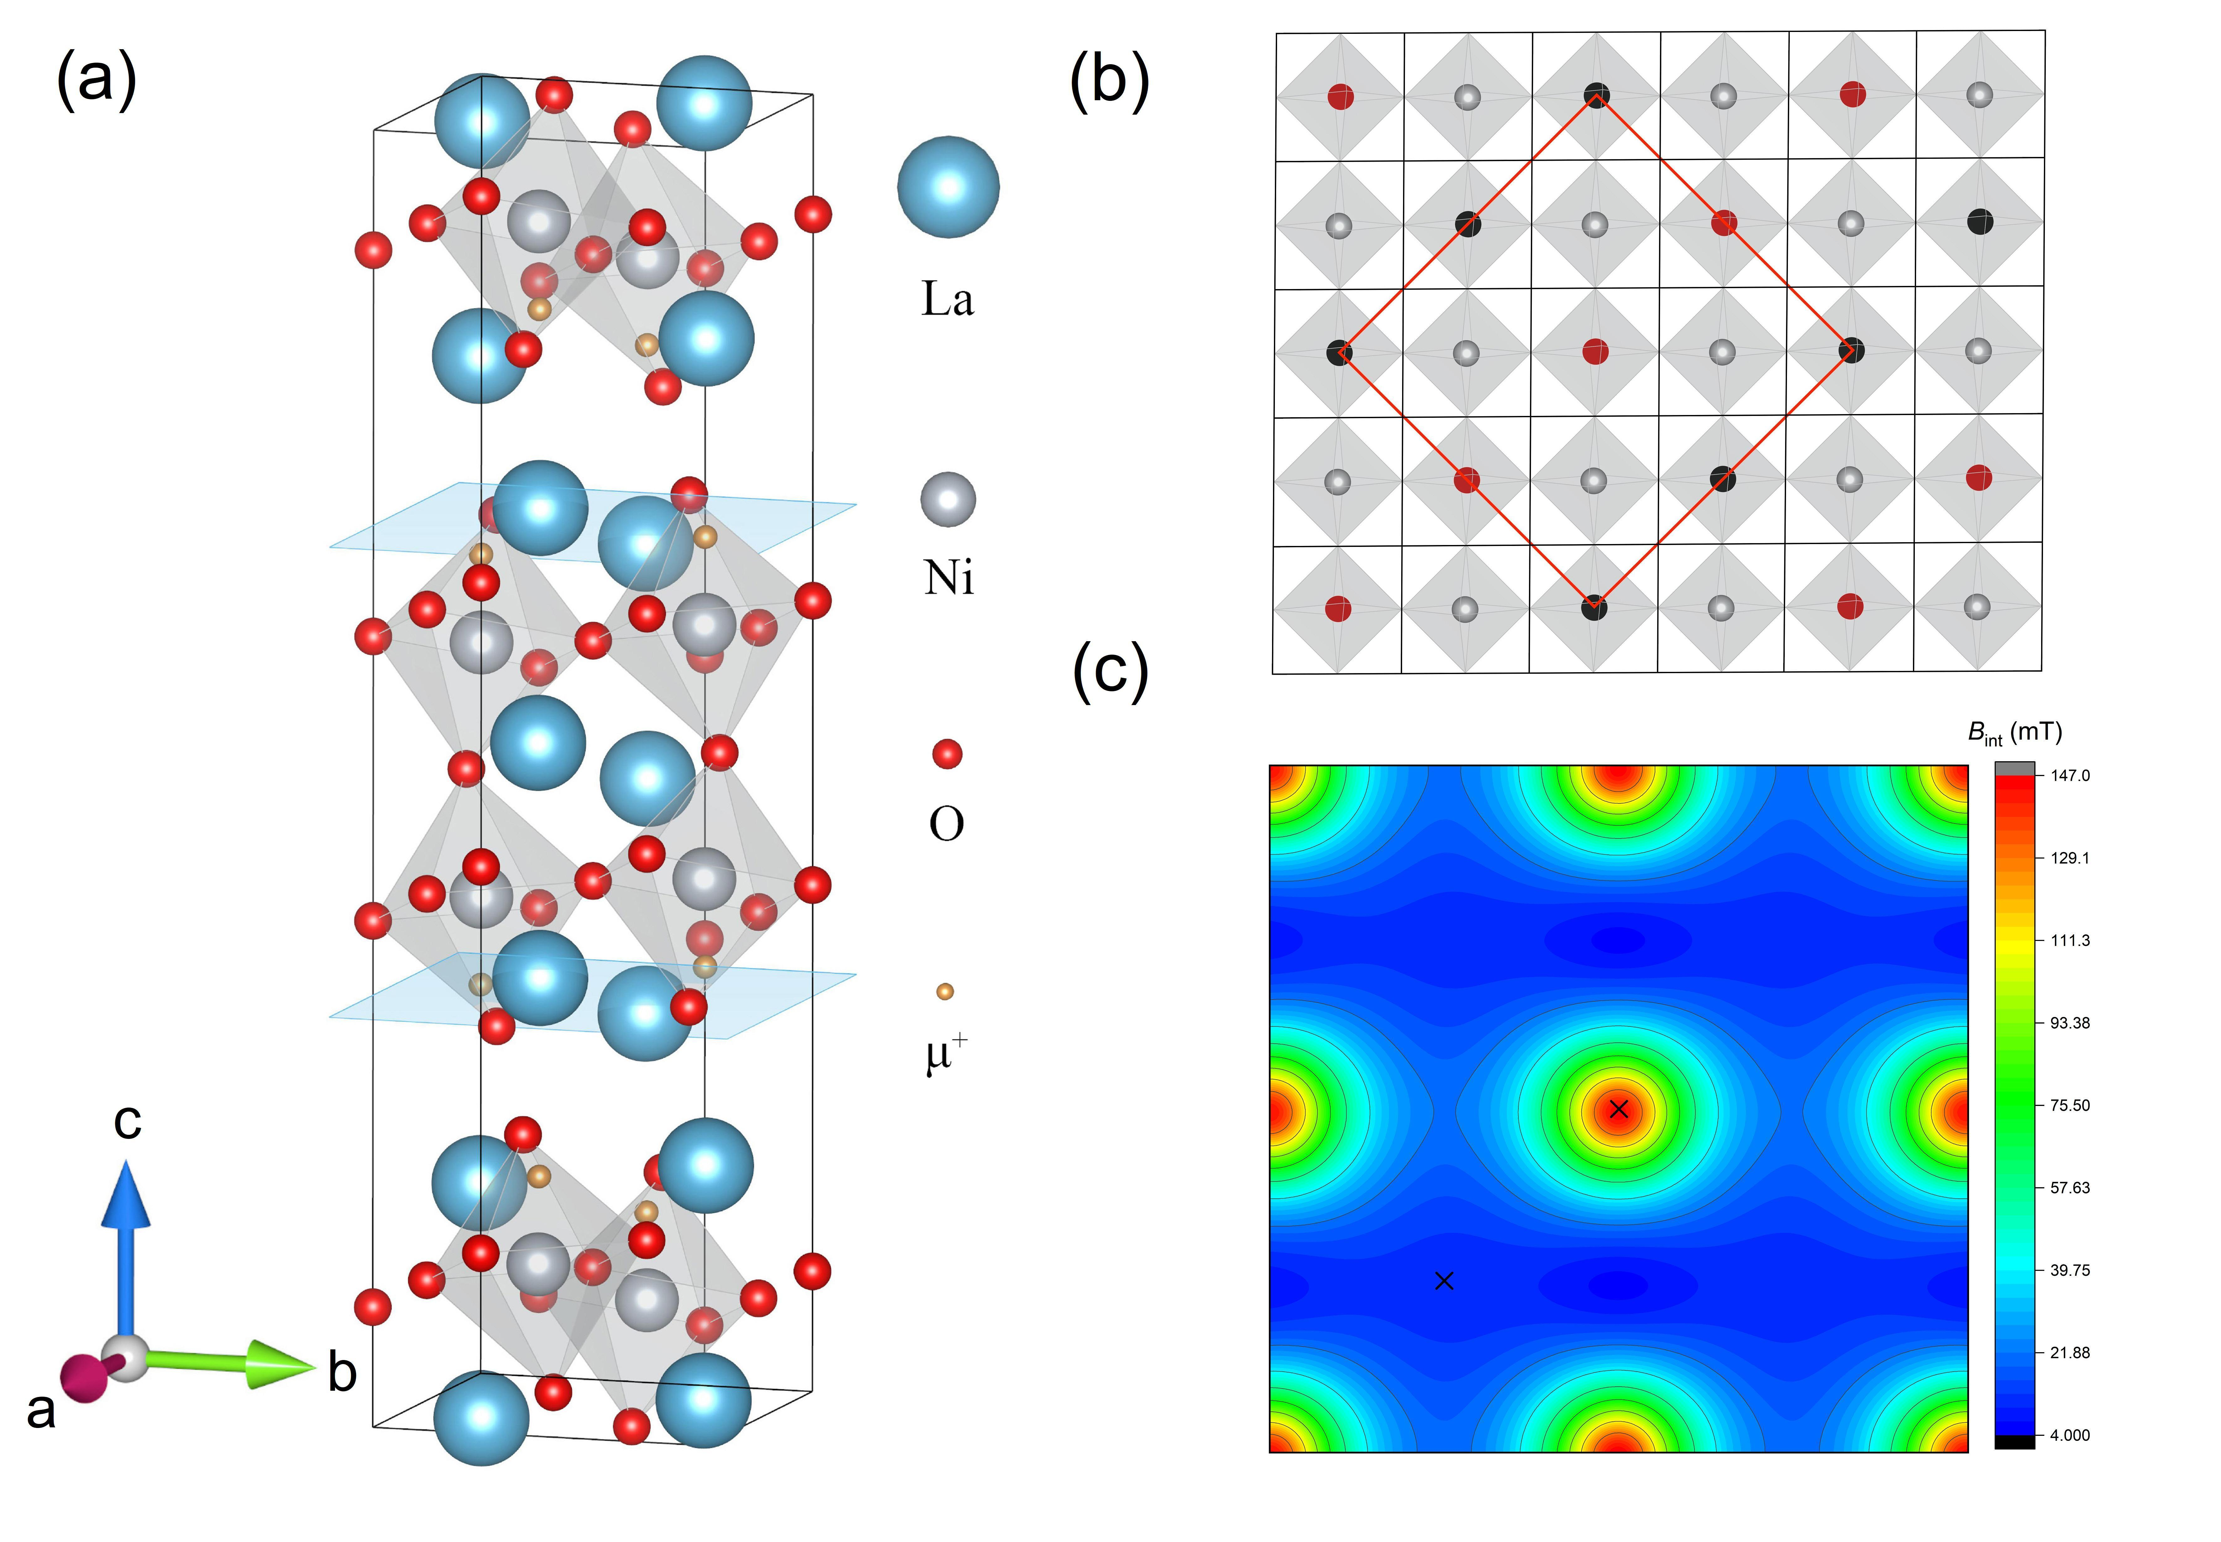
Possible Magnetic Structure
DFT+μ Geometry Optimization
Muons stop close to Ni^{2+/3+}
The low frequency is related to spinless Ni³⁺
Notes:
After confirming the presence of SDW, we want to further find possible magnetic structures. Since MuSR is not sensitive to k-space and cannot determine the magnetic structure, so we then did a qualitatively computation analysis.
Since the magnetic field sensed by muon is directly determined by where the muon stops in the lattice, we first use DFT+\mu, to compute the possible muon stopping sites. The results are shown in Figure (a). The samll hollow red circles represent for muons. Based on the calculation result and former experiment result, we find that the
low frequency signal may be relate to spinless Ni ions and the broadened high field indicates some disordered magnetic structure.
***how did you analysis that there are spinless Ni3+ ions?
Thank you a lot for your question. Let's go back to the slide and see the DFT result. We can see that if we consider the lattice symmetry only, there is only one muon stopping site, which cannot produce three different field. Since that the field sensed by muons here is mainly from Nickel ions, we think that only when there are spinless Ni3+ ions, can such a small field sensed by muons.
***Influence of oxygen deficiency
Since the muon stopping site is also close the apical oxygens, apical oxygen deficiency can lead to the distortion in lattic and causing the muons to sense the inhomogeneous distribution of local magnetic fields, as observed in MuSR experiments. We think that this inhommogenity is also inbenefit to the formation of magnetic state, which can broaden the transition temperature range and may leads to a lowered characteristic transition temperature. This is also noticed when consider the Pr-doping samples, which reduces stacking faults and oxygen deficiency a lot, and observed with a 10 K higher Tn.

Slide 13
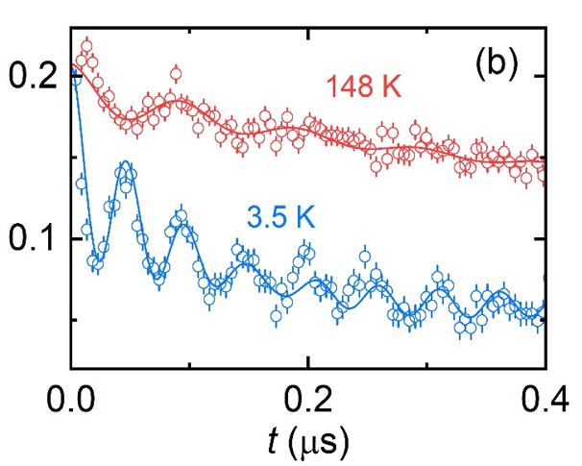
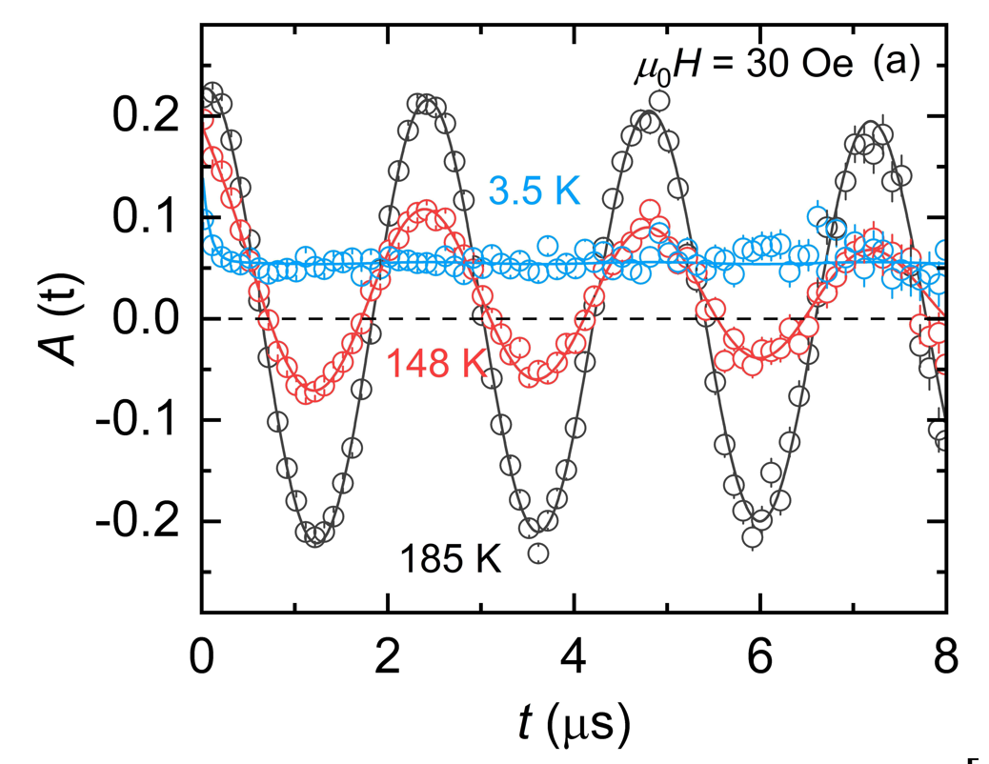
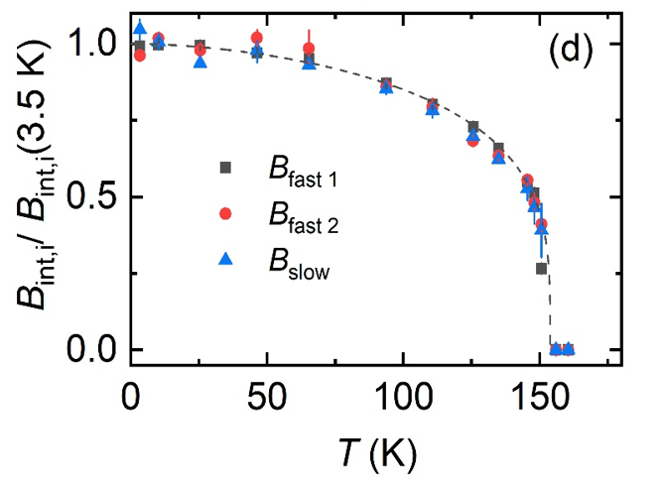
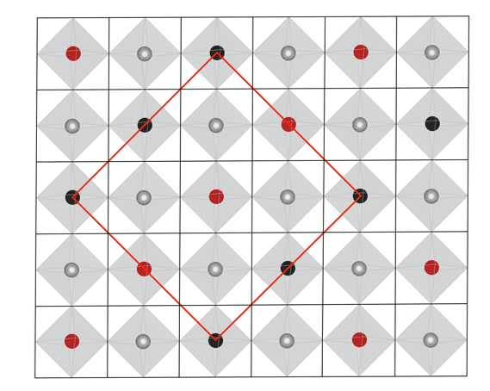
Results
ZF-MuSR:
Commensurate SDW
below 150 K
wTF-MuSR:
Bulk magnetism
DFT+μ:
Spinless Ni³⁺
Phys. Rev. Lett. 132, 256503 (2024) (Editor`s suggestion & the cover of volume)
Notes:
To conclude, we report the previously undetected commensurate Spin density wave below 150 K in this 327 material, which accounts for nearly 100% percent of magnetic volume ratio.
Combined with DFT calculation result, we find that the intrinsic field distribution detected by the muons qualitatively supports the existence of Ni3+?? ions without spin.
This discovery illustrates the unique advantages of MuSR technique when comes to the detection of weak magnetism, and also provides an important experimental basis for understanding the superconducting phase under high pressure in the nickel-oxide material.
This work was published on PRL, suggested by the editor and was the cover article of volume.
*** The relation between SDW here with SC at high pressure?
Here we are studying the in-plane long-range order, which doesn’t have to compete with the SC formed by interplane interactions. We think that the High SC might be caused by interplane antiferromagnetic fluctuations. However, the electronic correlation within the planes, can promote the phase condensing, therefore benefit the SC. Recent researches have also pointed out that there might be a new SDW coexisted with SC, Thus this might be different with the traditional competion between antiferromagnetism and SC.

Slide 14
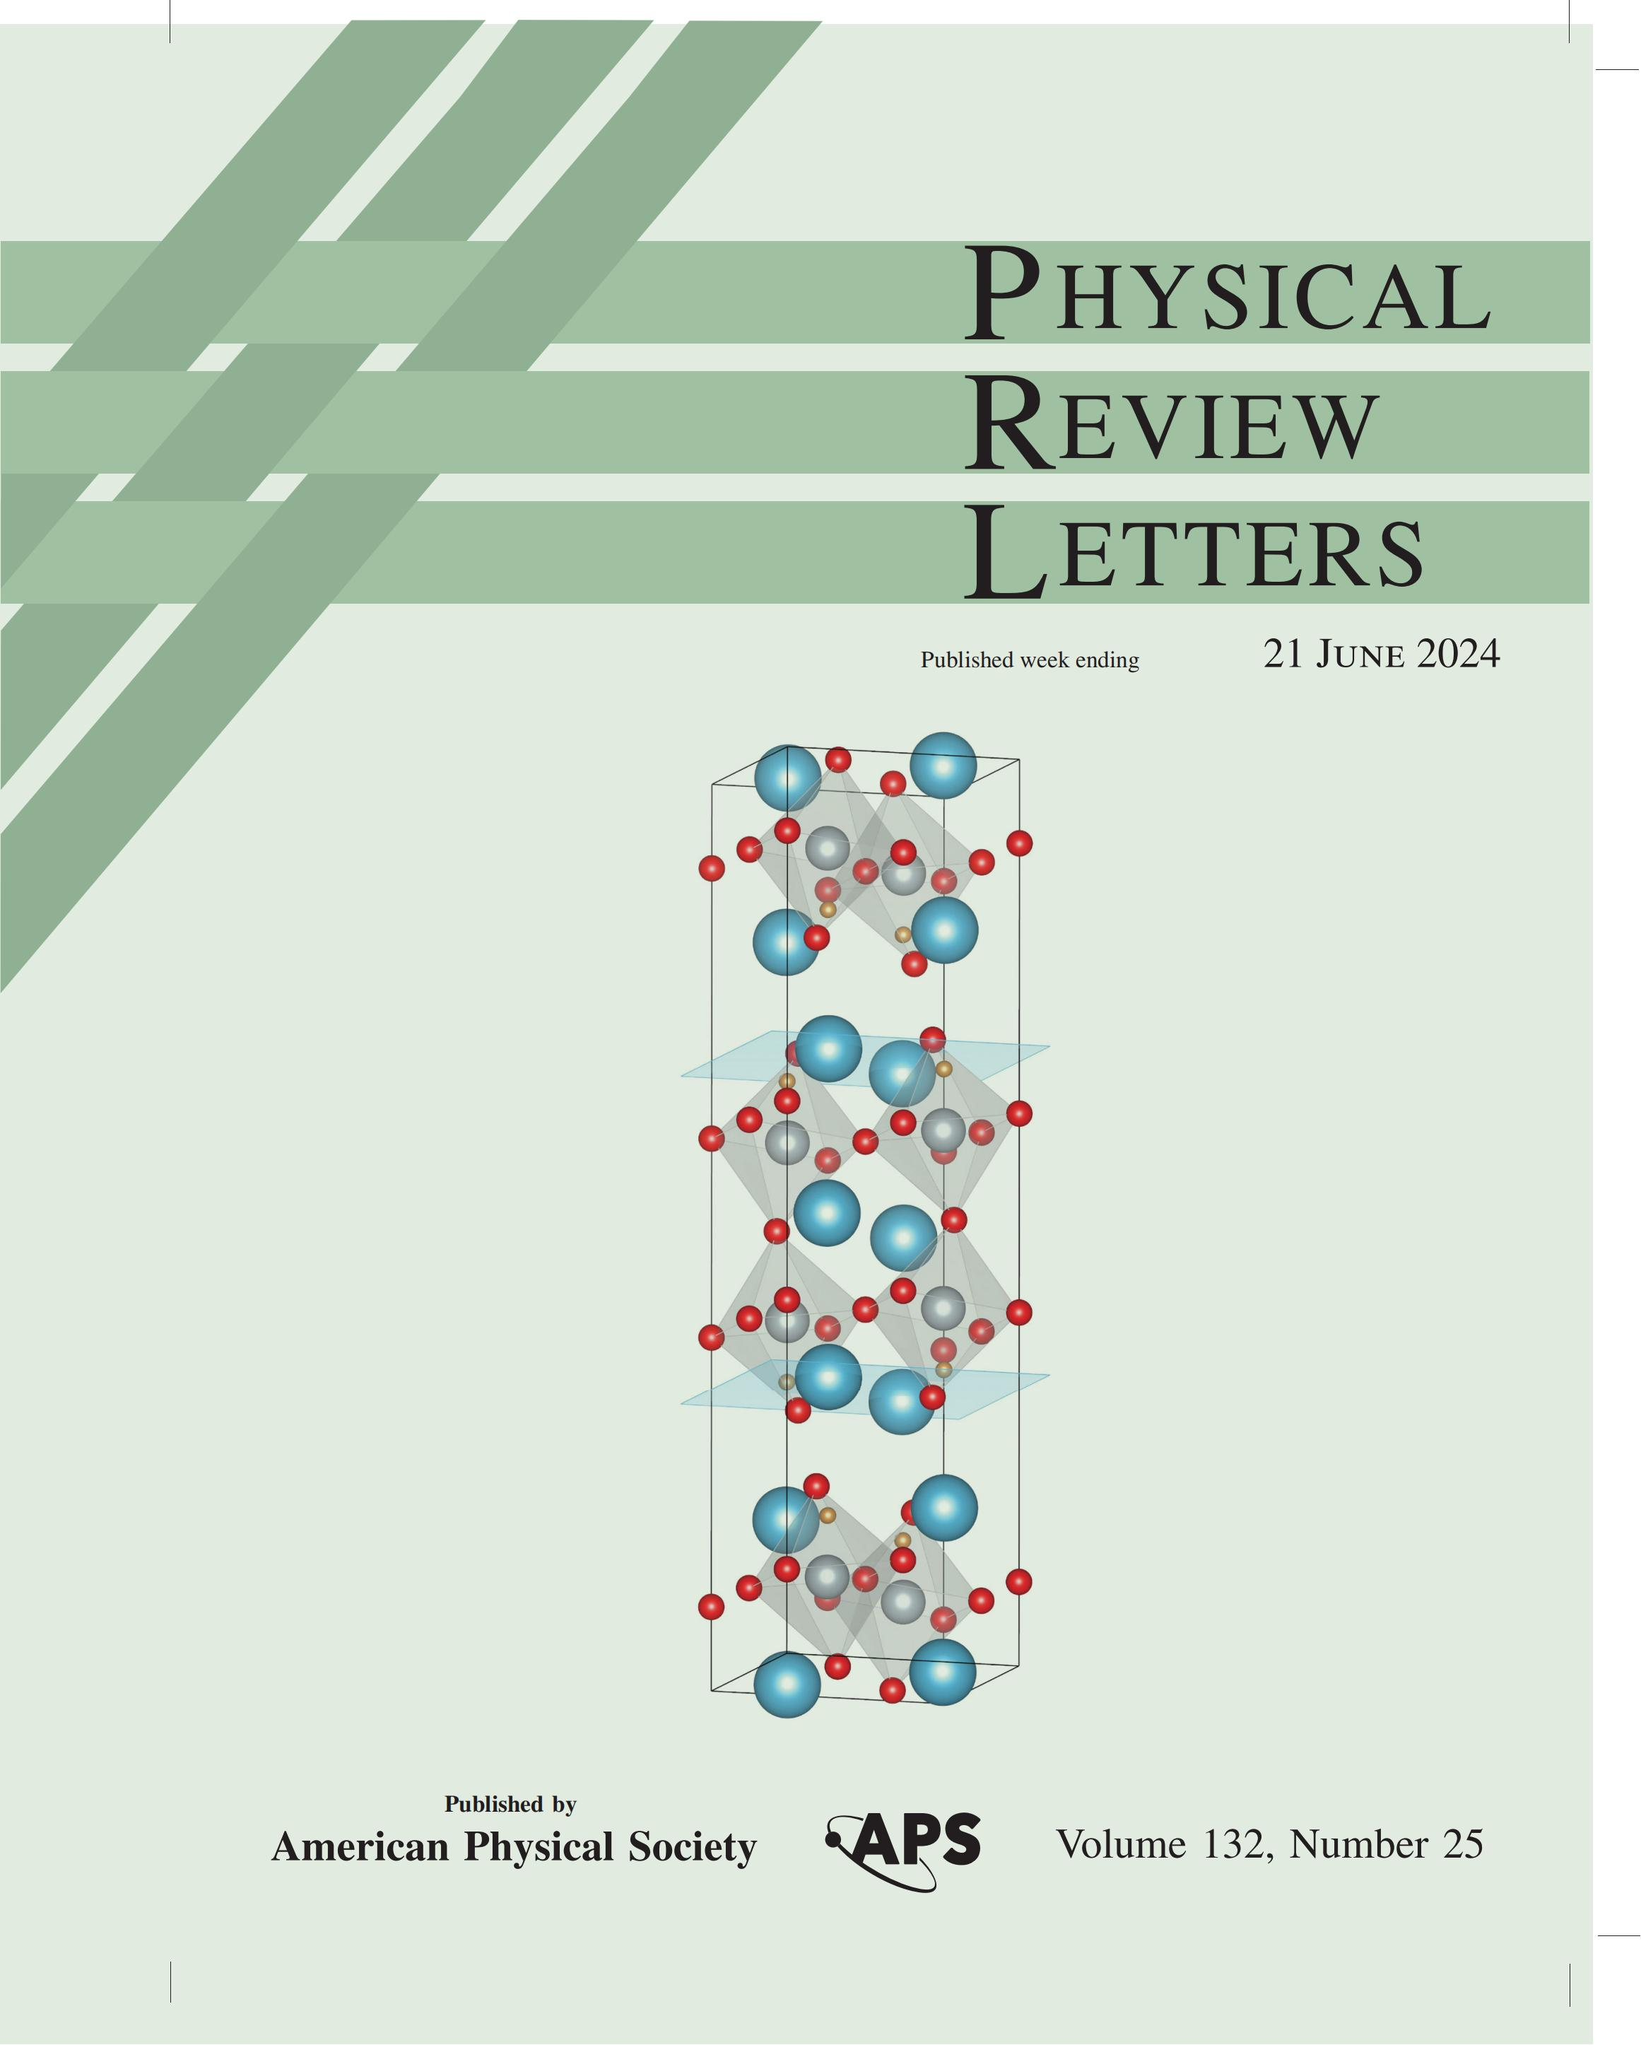



Acknowledgement
ShanghaiTech University
Xiangqi Liu, Yixuan Luo
Prof. Yanfeng Guo
Kaiwen Chen, Jiachen Jiao, Chengyu Jiang, Muyuan Zou, Qiong Wu, Xin Li
TRIUMF CMMS GROUP
G. D. Morris, B. Hitti, and D. Arsenau
Notes:
***Pressure Question
Thank you for your question. First of all, we think what MuSR observed is intrinsic, this of course is verified by the volume fraction detected. When pressure is applied, the lattice is compressed, which can cause the strengthen of exchange interactions and therefore promote the formation of magnetic ground state. Here, since the magnetic state is mainly related to the in-plane correlations. This might not be competitive with high-pressure superconductivity. Since the stronger correlation can help form phase condensing and benefit superconductivity. In conclusion, we think this is diffirent with traditional competing relation between magnetism and SC.
***Neutron
Thans you for your question. We think that the coherence here might be relatively short. Since Neutron scattering is not that sensitive to short range coherence, that might be the reason why Neutron didin't observed relative signs.

