Slide 1
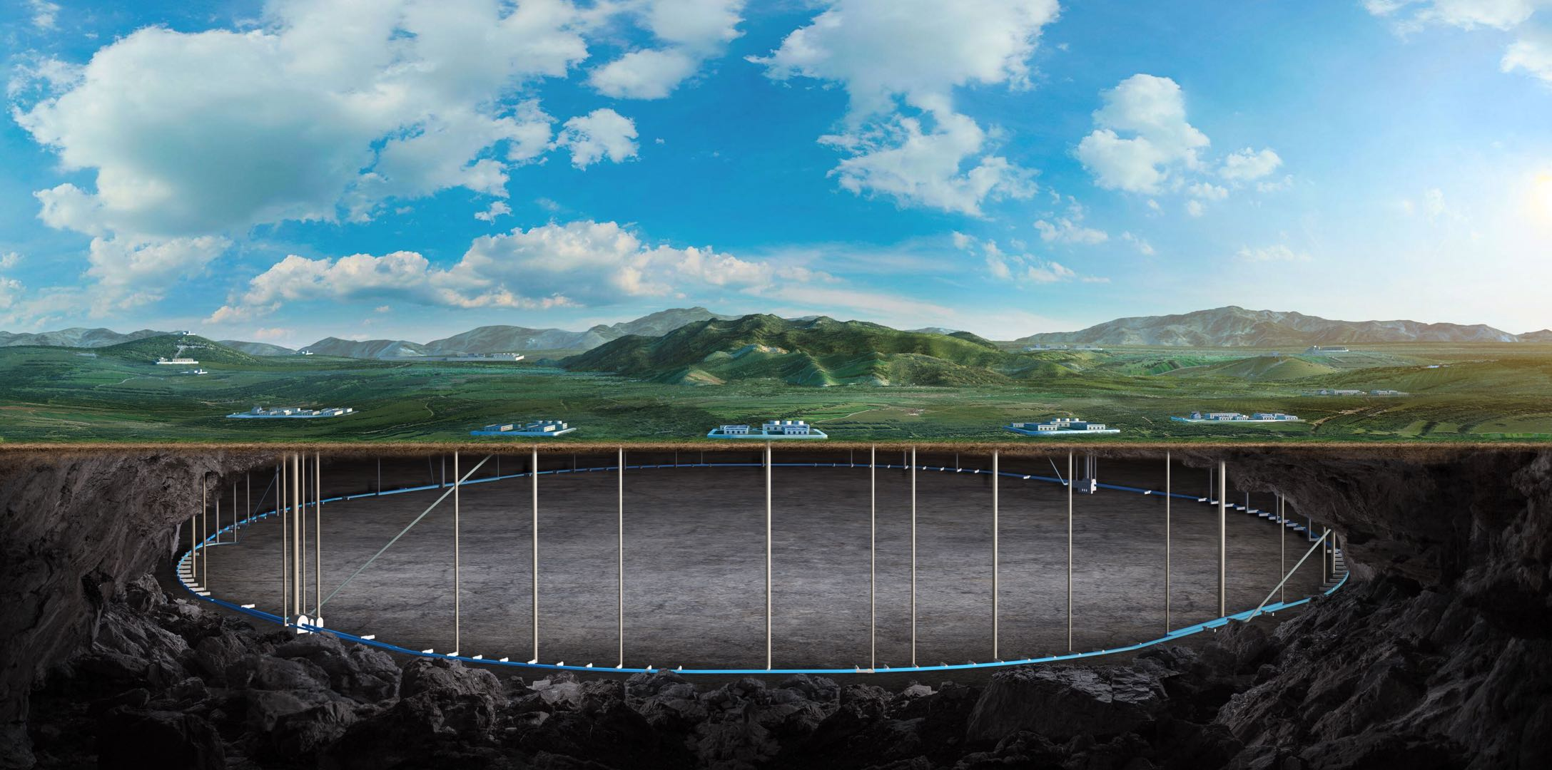
CEPC Muon Detector
--- Ref-TDR status
Xiaolong Wang (Fudan), Hengne Li (SCNU)
on behalf of the Muon Detector Group
Tuesday Meeting, 11/26/2024

Slide 2
Current Focus: TDR Edition
Main structure and editors
Software and simulation: Hengne Li
Electronics: Jie Zhang
Mechanics and testing: Zhi Wu
Backgrounds: Junhao Yin
RPC option: Jun Guo, Yuguang Xie
Overall: Xiaolong Wang

Slide 3
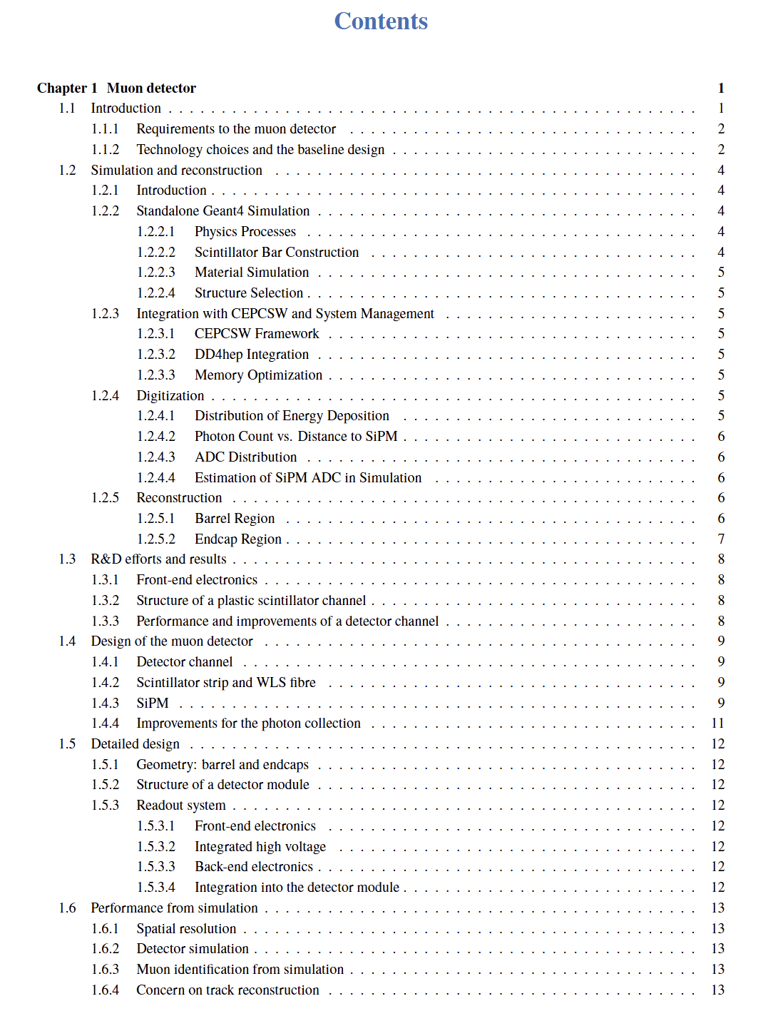
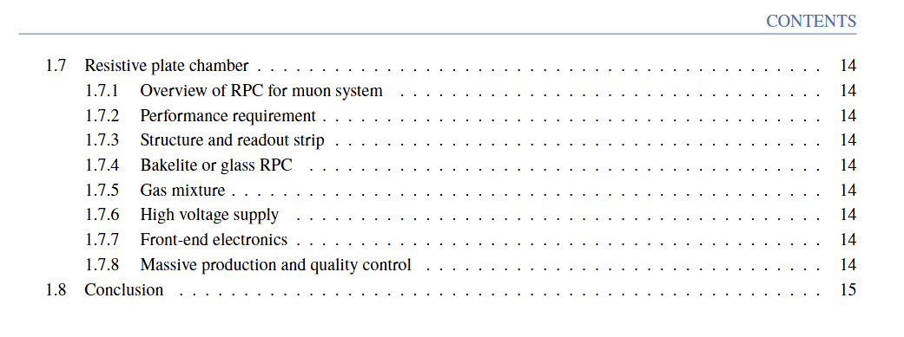
Current Focus: TDR Edition
Current status:
A main structure finished.
Materials are collected.
Some text are written in separate tools such as MS word and other online docs, to be translated into latex.

Slide 4
Update: Simulation and Reconstruction
Simulation:
Geometry codes optimization:
Large memory occupation noticed in physics production, due to overly detailed- muon geometry description codes;
Memory reduced form ~4 GB -> ~3GB
Digitization:
Endcap digitization added.
Codes are merged.
Reconstruction:
Starting with a simplified track fit algorithm, extrapolating the “Complete Tracks” to the muon system assuming a straight line extension.
Presumably sufficient for physics performance studies for the Ref-TDR.

Slide 5
Thank you!

