Slide 1
Jet Gen Match
Jiarong Li
Tsinghua & IHEP
lijr@ihep.ac.cn
2024.11. 27

Slide 2


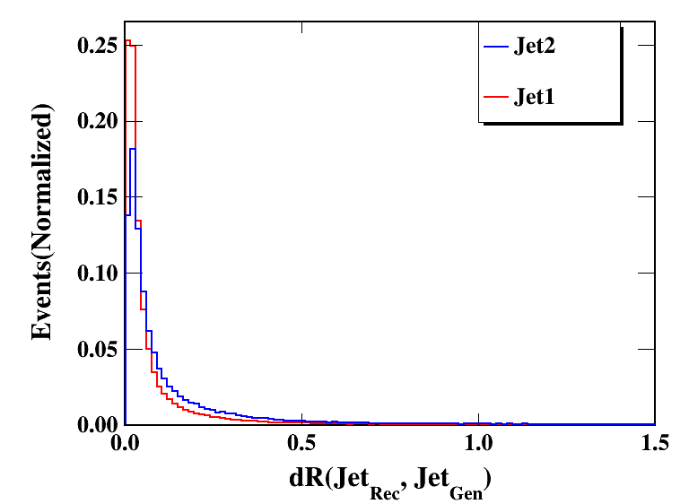
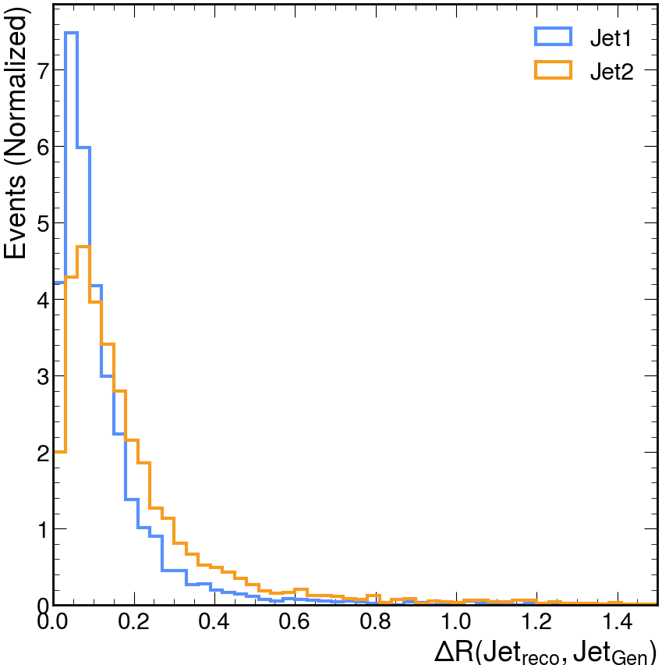
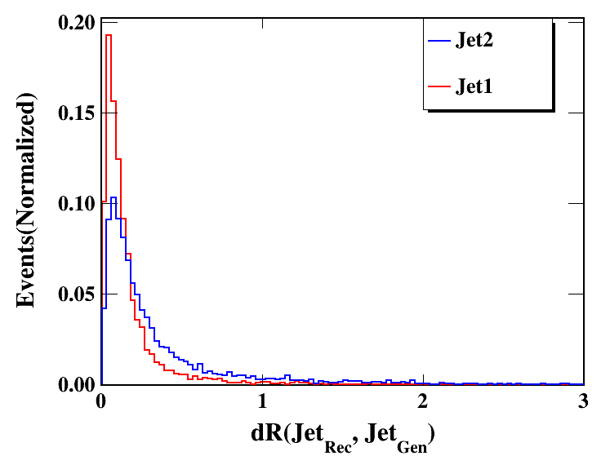

All Events: 179161
All Events: 4612
Nbin=100
Nbin=100
/cefs/higgs/zhangkl/Production/
/publicfs/cms/user/wangzebing/CEPC/CEPCSW_tdr24.9.1/CEPCSW/FullSim_samples/Rec_TDR_o1_v01_E240_nnh_gg.root
tdr24.10.0
ee → ZH → nnHgg 240 GeV

Slide 3


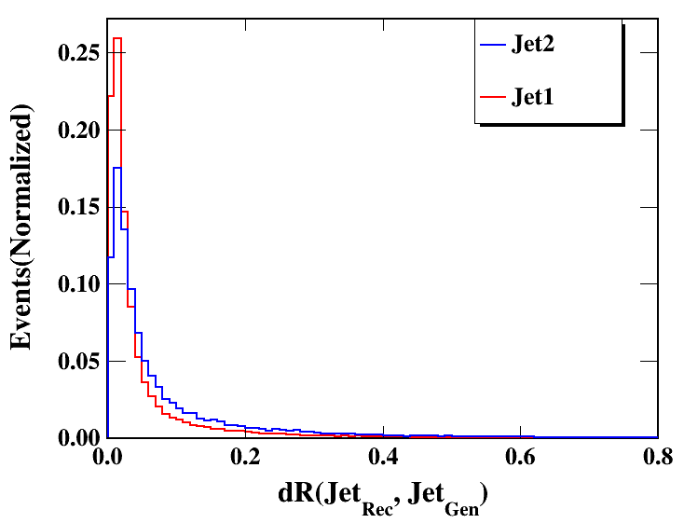
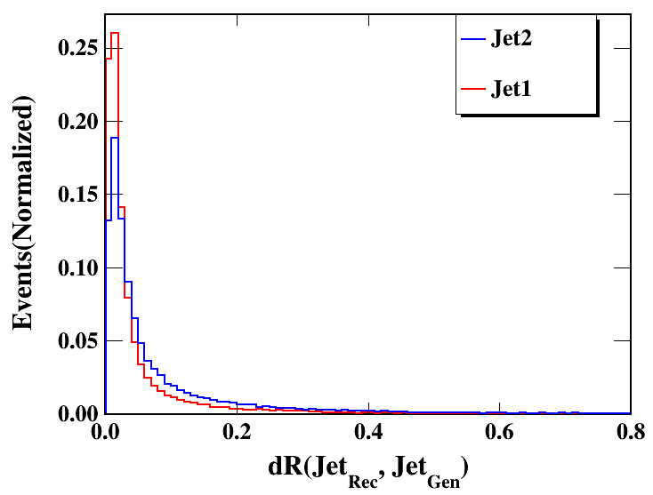
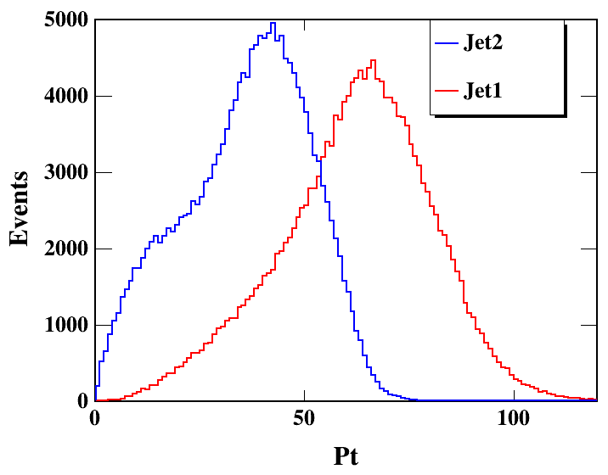
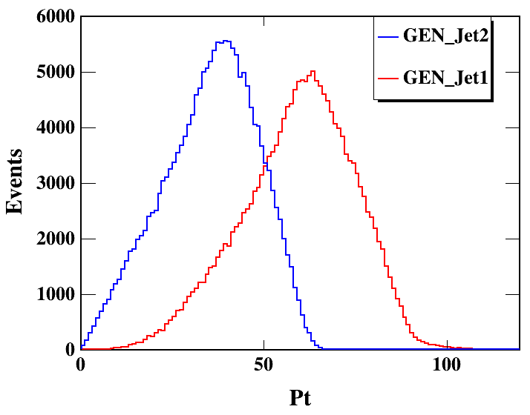
/cefs/higgs/zhangkl/Production/
All Events: 179161
tdr24.10.0
Nbin=80
Nbin=80
ee → nnHbb 240 GeV
ee → nnHcc 240 GeV
ee →ZH → nnHgg 240 GeV

Slide 4
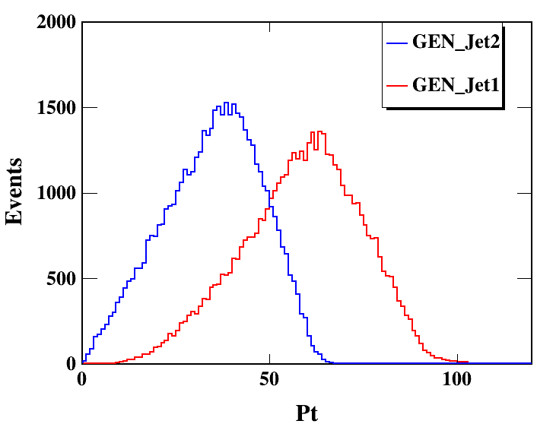
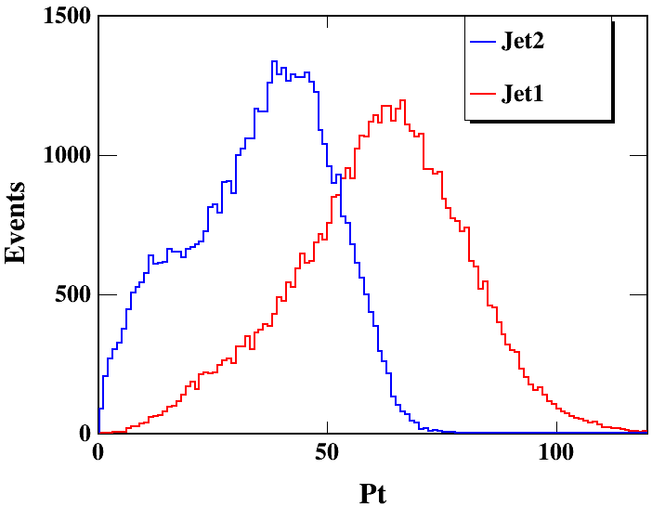
All Events: 50400
Nbin=100
Nbin=100
/cefs/higgs/zhangkl/Production/
/publicfs/cms/user/wangzebing/CEPC/CEPCSW_tdr24.9.1/CEPCSW/FullSim_samples/Rec_TDR_o1_v01_E240_nnh_gg.root
tdr24.10.0
ee → nnHgg 240 GeV
ee →ZH → nnHbb 240 GeV

Slide 5
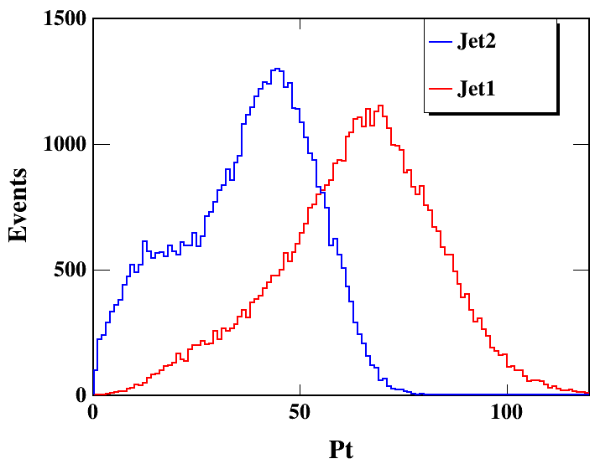
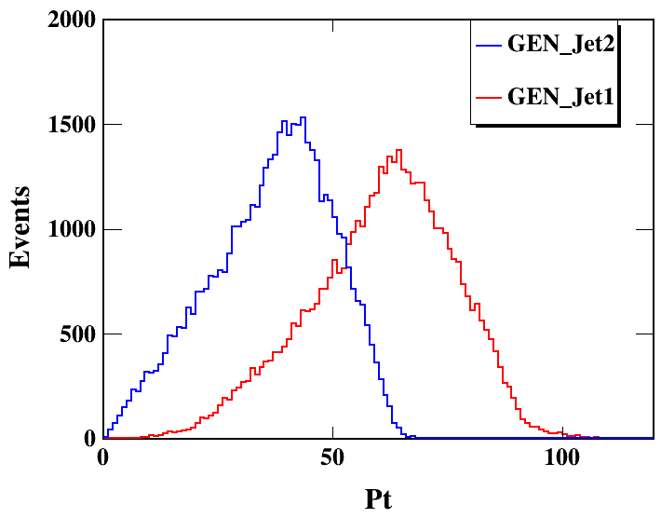
All Events: 48400
Nbin=100
Nbin=100
/cefs/higgs/zhangkl/Production/
/publicfs/cms/user/wangzebing/CEPC/CEPCSW_tdr24.9.1/CEPCSW/FullSim_samples/Rec_TDR_o1_v01_E240_nnh_gg.root
tdr24.10.0
ee → nnHgg 240 GeV
ee →ZH → nnHcc 240 GeV

Slide 6
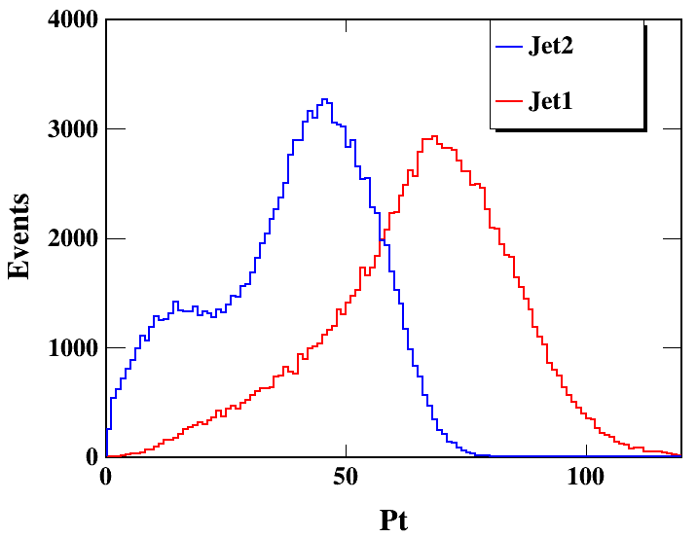
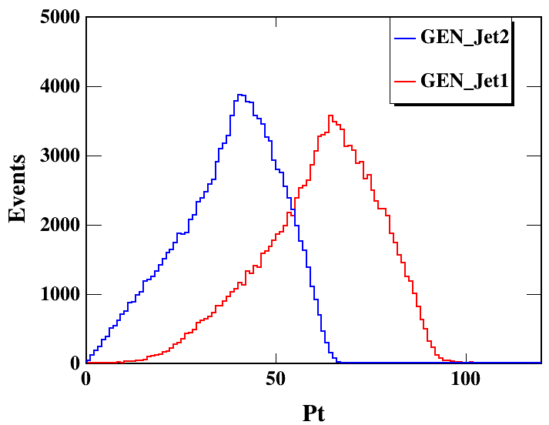
All Events: 121600
Nbin=100
Nbin=100
/cefs/higgs/zhangkl/Production/
/publicfs/cms/user/wangzebing/CEPC/CEPCSW_tdr24.9.1/CEPCSW/FullSim_samples/Rec_TDR_o1_v01_E240_nnh_gg.root
tdr24.10.0
ee → nnHgg 240 GeV
ee →ZH → nnHuu 240 GeV

