Slide 1
CEPC CAL Study
Chen boping, Liu dong
基于10月份的CEPC国际评审

Slide 6
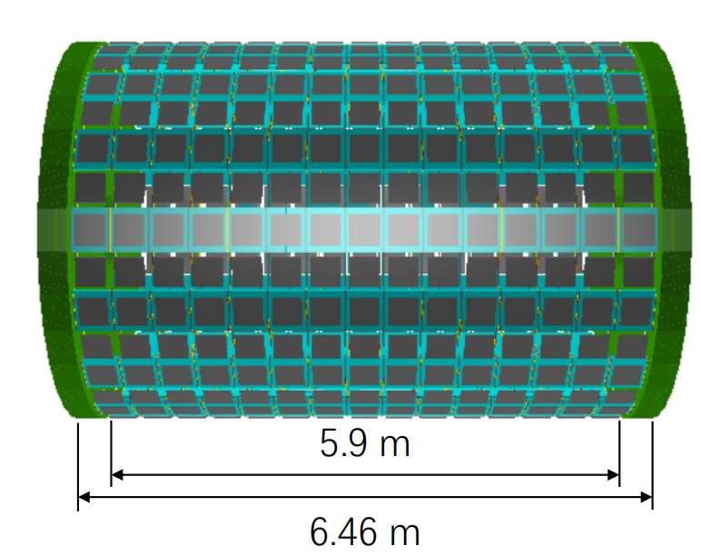
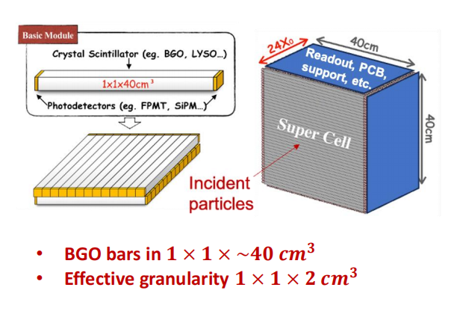
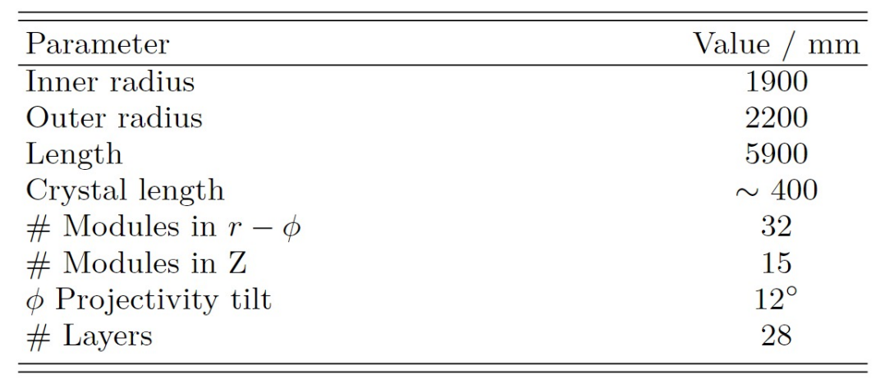
number of channels:0.964M
Avg Data Vol before trigger:460Gbps

Slide 7
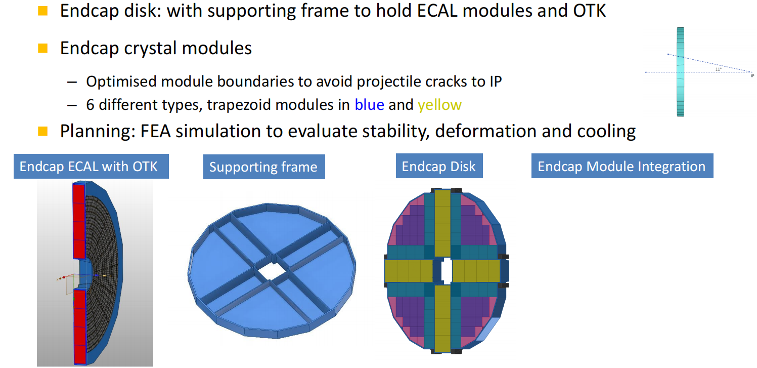
number of channels:0.387M
Avg Data Vol before trigger:250Gbps

Slide 18
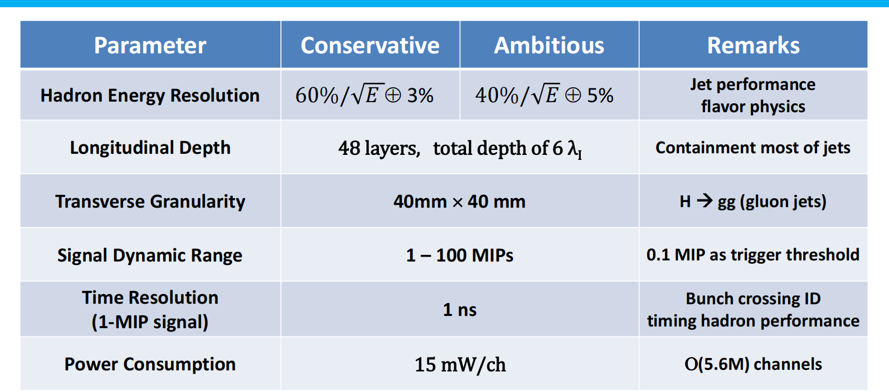

Slide 23
number of readout channels:3.38M
Avg Data Vol before trigger:811.2Gbps

