Slide 1
Baryonic CP violation at LHCb
张艳席
北京大学
第四届强子与重味物理理论与实验联合研讨会
2025.3.21 – 24, 兰州大学
Notes:
第四届强子与重味物理理论与实验联合研讨会

Slide 2
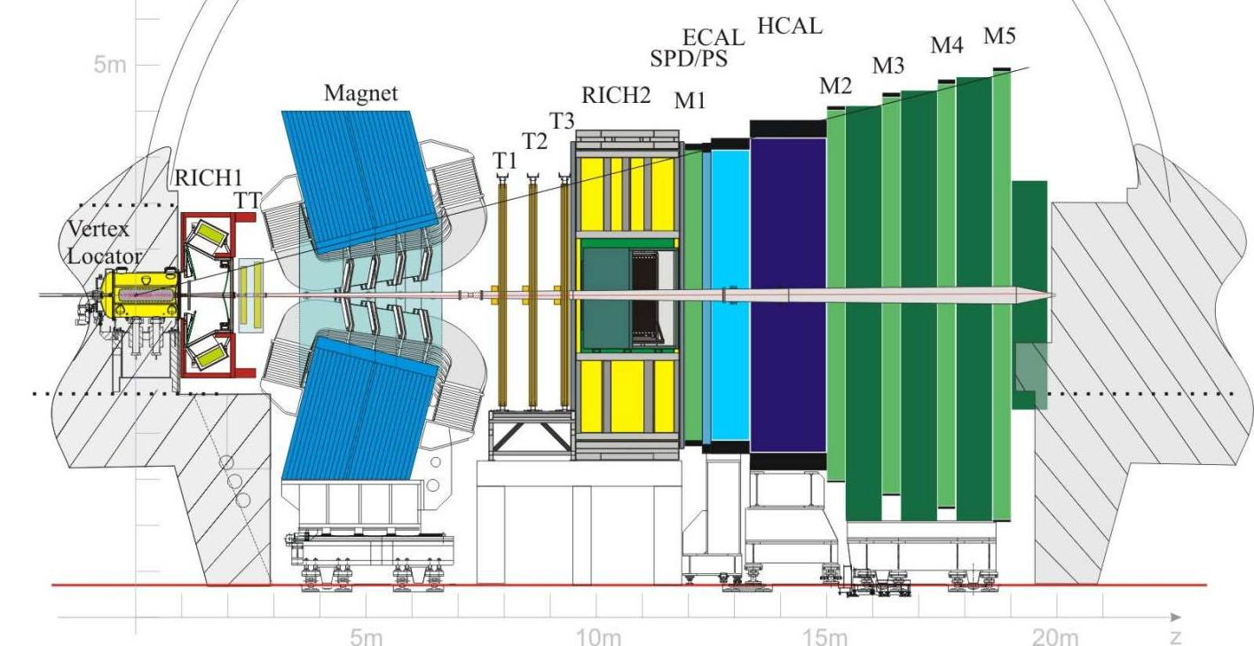
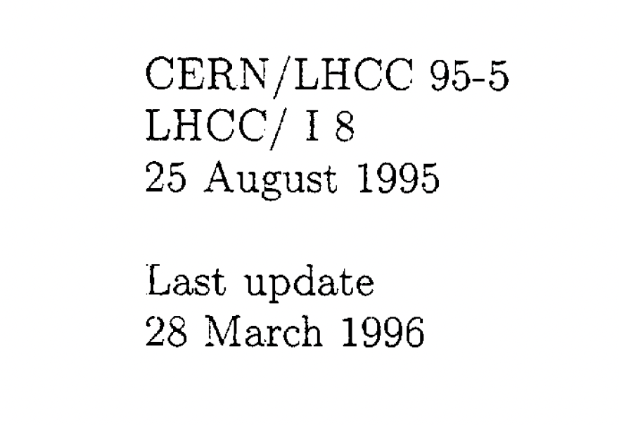
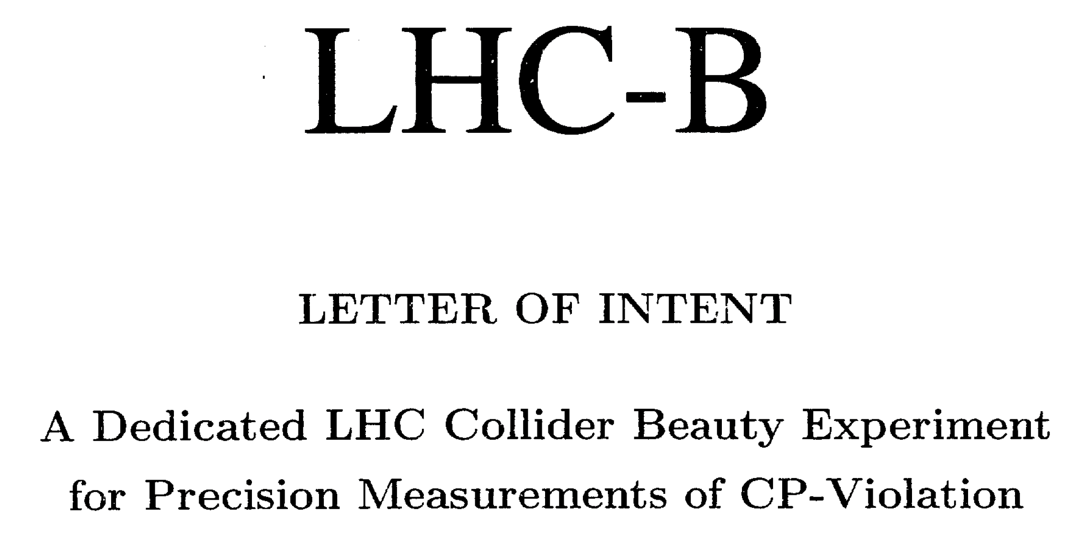

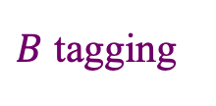
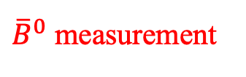
LHCb
JINST 3 (2008) S08005
IJMPA 30 (2015) 1530022
Dedicated flavor experiment at CERN for 𝑏, 𝑐 hadrons
${\overline{B}}^{0}$ measurement
$B$ tagging
Excellent vertexing, hadron PID, momentum; flexible trigger …
LHCb合作组：22个国家，102家单位，1700多名成员
LHCb中国组：清华大学、华中师范大学、高能物理研究所、中国科学院大学、武汉大学、湖南大学、华南师范大学、北京大学、兰州大学、中国科学技术大学、西北工业大学、河南师范大学

Slide 3
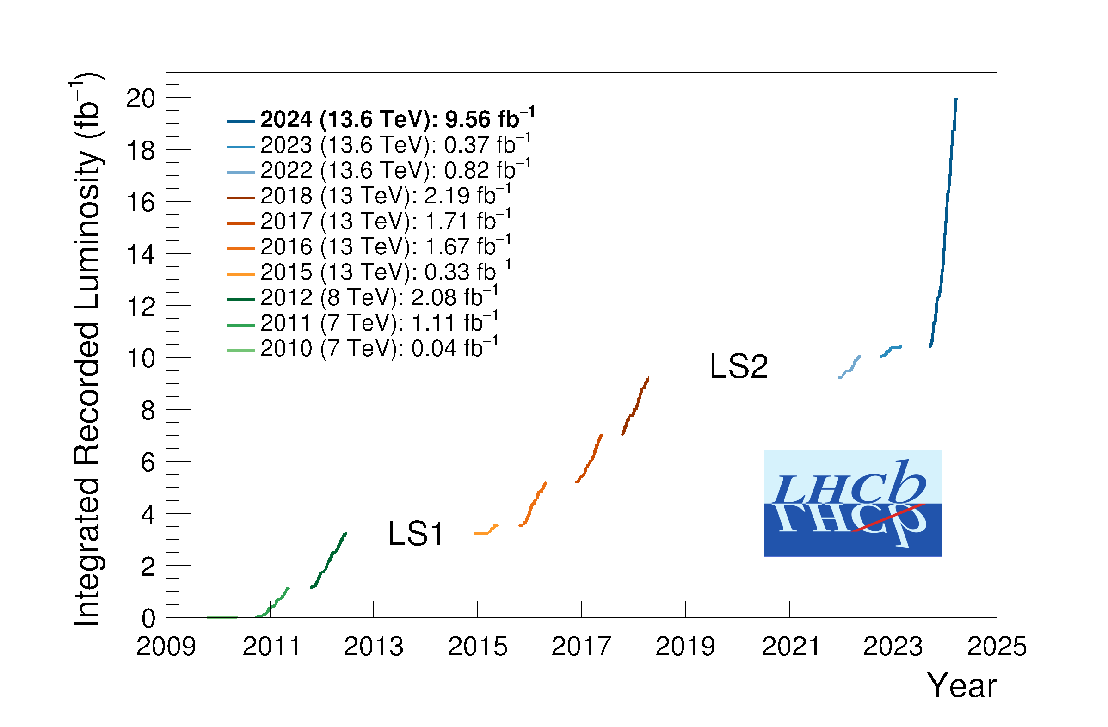
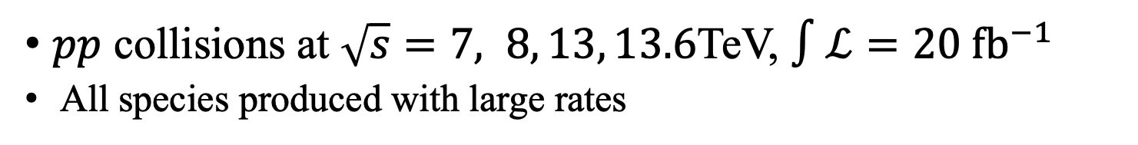


LHCb data
$pp$ collisions at $\sqrt{s}=7, 8, 13, 13.6$TeV, $∫ℒ=20 {fb}^{−1}$
All species produced with large rates
JHEP 05 (2017) 074
PRL 118 (2017) 052002
PRD 100 (2019) 031102(R)
$σ\left(pp→b\overline{b}X, 13 TeV\right)≈0.5 mb$
$B^{+}:B^{0}:B_{s}^{0}:Λ_{b}^{0}≈4:4:1:2$
Run 3…
Run 1
Run 2

Slide 4


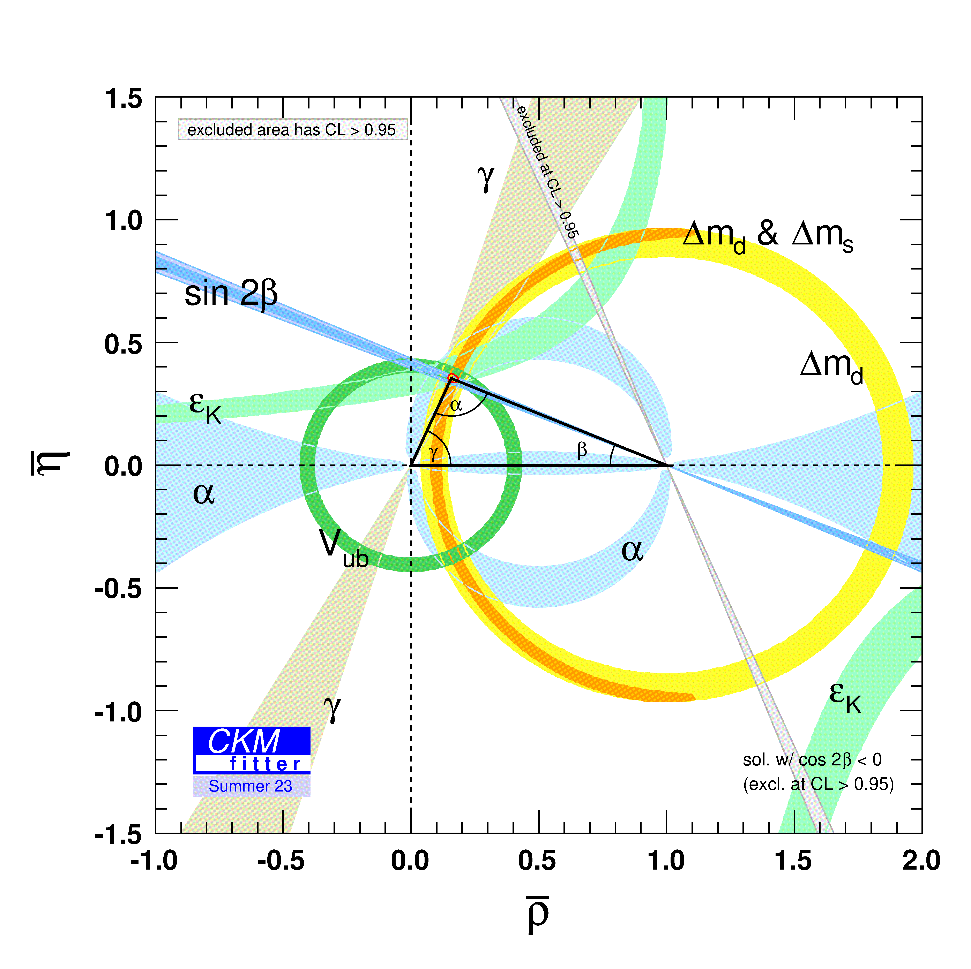
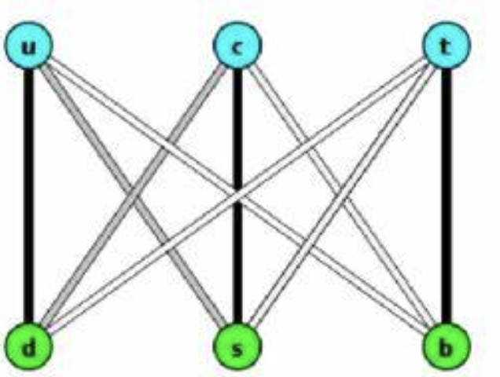
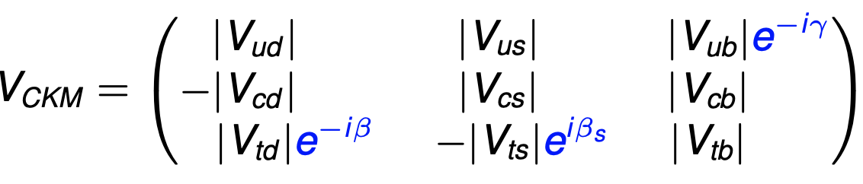
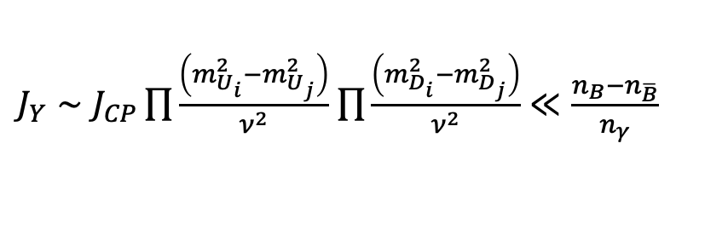

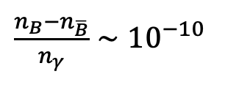
Why CP violation
Matter and antimatter asymmetry in Universe (BAU)
Baryon-violation
Sakharov
$\frac{n_{B}−n_{\overline{B}}}{n_{γ}}∼{10}^{−10}$
C and CP violation
Out of thermal equilibrium
Matter
Anti-matter
CKM mechanism
Quark mixing matrix
Established and tested through precision data
$$+𝒪({10}^{−3})$$
But insufficient to explain BAU
$J_{Y}∼J_{CP}\prod{\frac{\left(m_{U_{i}}^{2}−m_{U_{j}}^{2}\right)}{ν^{2}}}$ $\prod{\frac{\left(m_{D_{i}}^{2}−m_{D_{j}}^{2}\right)}{ν^{2}}}≪\frac{n_{B}−n_{\overline{B}}}{n_{γ}}$
A single phase parameter gives rise to quark CPV
Unitarity: four independent parameters
CP violation: phases and dynamics
BSM CP violation needed !

Slide 5
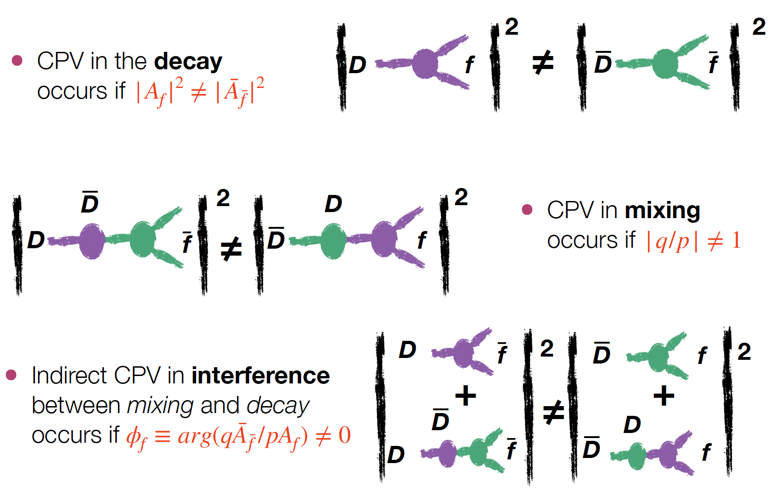
Three types of CP violation
Diract CP violation
Figure by Serena Maccolini

Slide 6
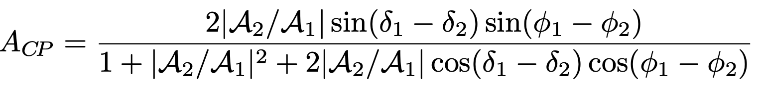
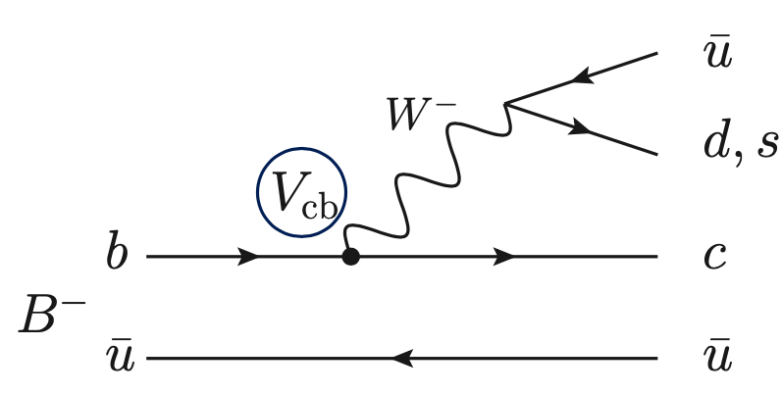
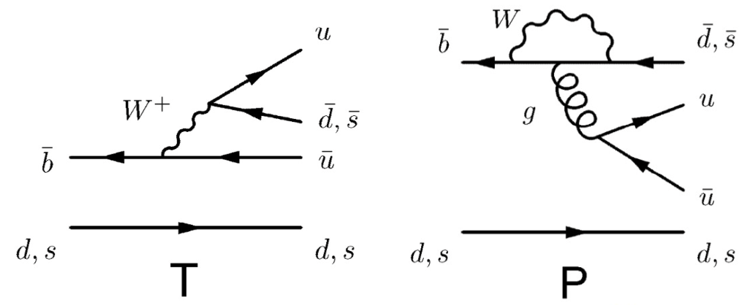
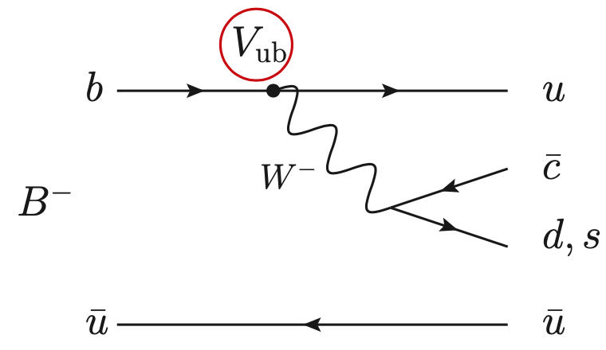









Direct CP violation
Interference between decay paths
Strong phase difference
Weak phase difference
  Tree diagrams (measuing $γ$)
  Tree and loop diagram
$$K/π$$
New physics in loops?
$$V_{cb}$$
$$V_{tq}^{∗}$$
$$D^{0}$$
$$V_{ub}$$
$$V_{ub}^{∗}$$
$${\overline{D}}^{0}$$
$$K/π$$

Slide 7
CPV for mesons

Slide 8
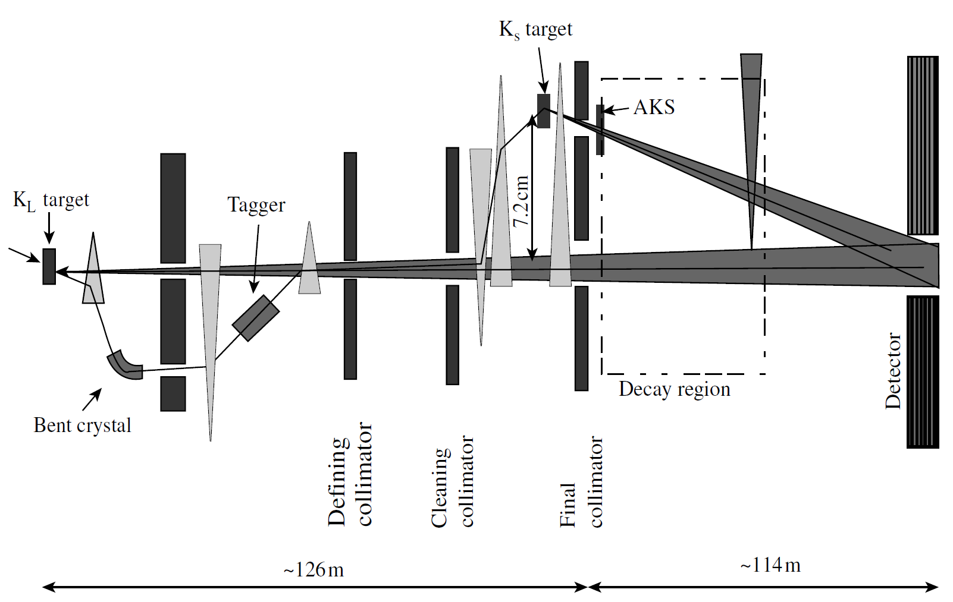
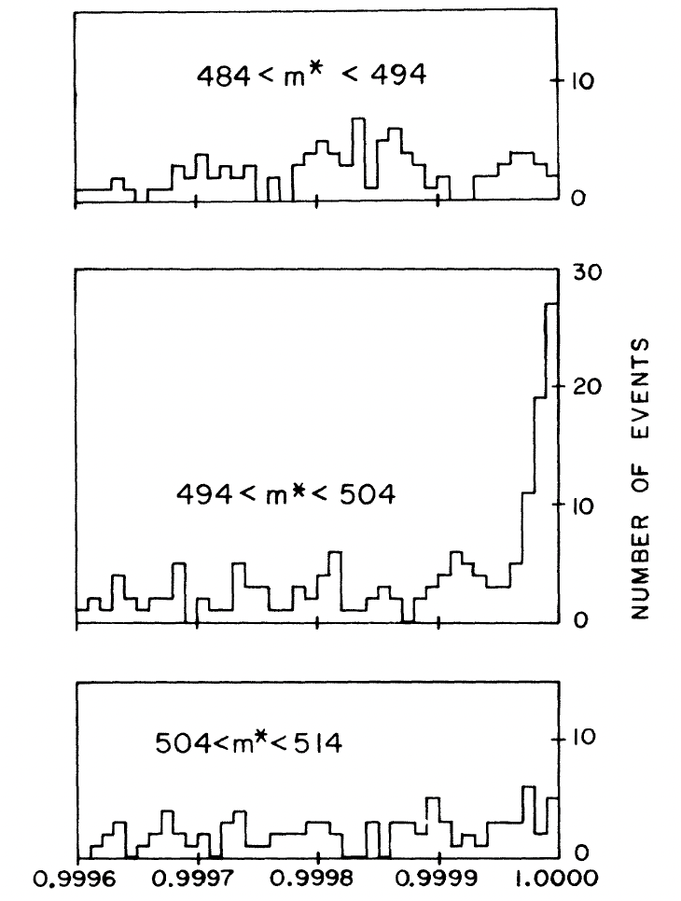
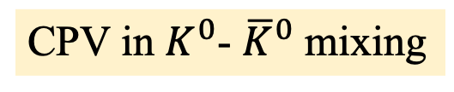
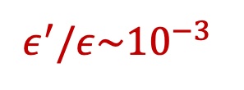
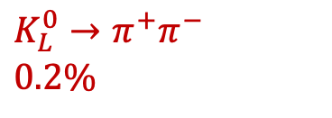
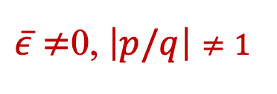
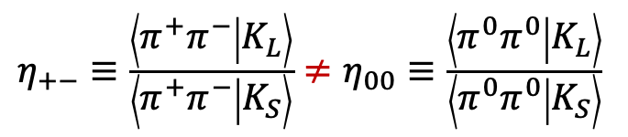
CPV in $K$ mesons
CPV in $K^{0}$- ${\overline{K}}^{0}$ mixing
Direct CPV
$\left|K_{S}\right\rangle ∝\left[\left(1+\overline{ε}\right)\left|K^{0}\right\rangle +\left(1−\overline{ε}\right)\left|{\overline{K}}^{0}\right\rangle \right]$
$η_{+−}≡\frac{\left\langle π^{+}π^{−} | K_{L}\right\rangle }{\left\langle π^{+}π^{−} | K_{S}\right\rangle }≠η_{00}≡\frac{\left\langle π^{0}π^{0} | K_{L}\right\rangle }{\left\langle π^{0}π^{0} | K_{S}\right\rangle }$
$\left|K_{L}\right\rangle ∝\left[\left(1+\overline{ε}\right)\left|K^{0}\right\rangle −\left(1−\overline{ε}\right)\left|{\overline{K}}^{0}\right\rangle \right]$
$\overline{ε}≠$0, $\left|p/q\right|≠1$
$$ε^{′}/ε\sim {10}^{−3}$$
$K_{L}^{0}→π^{+}π^{−}$
$0.2\%$
NA48

Slide 9
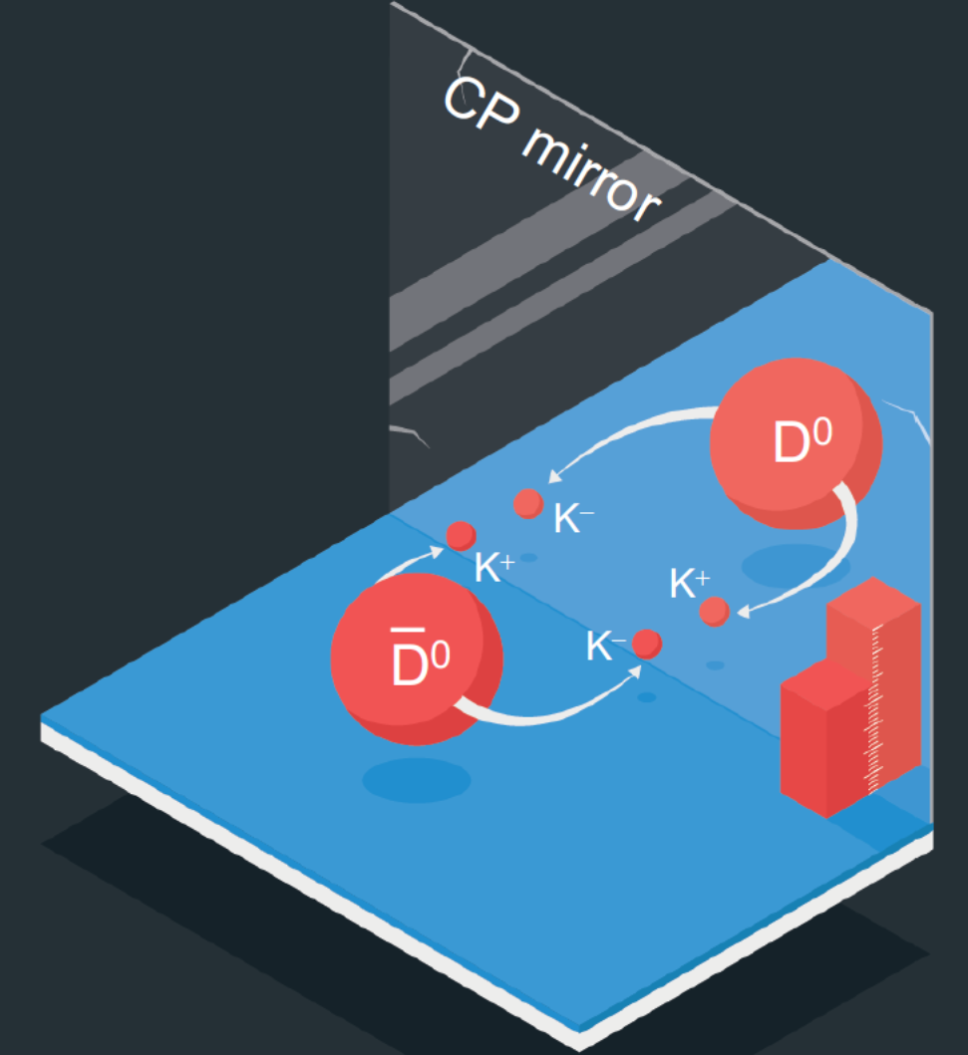
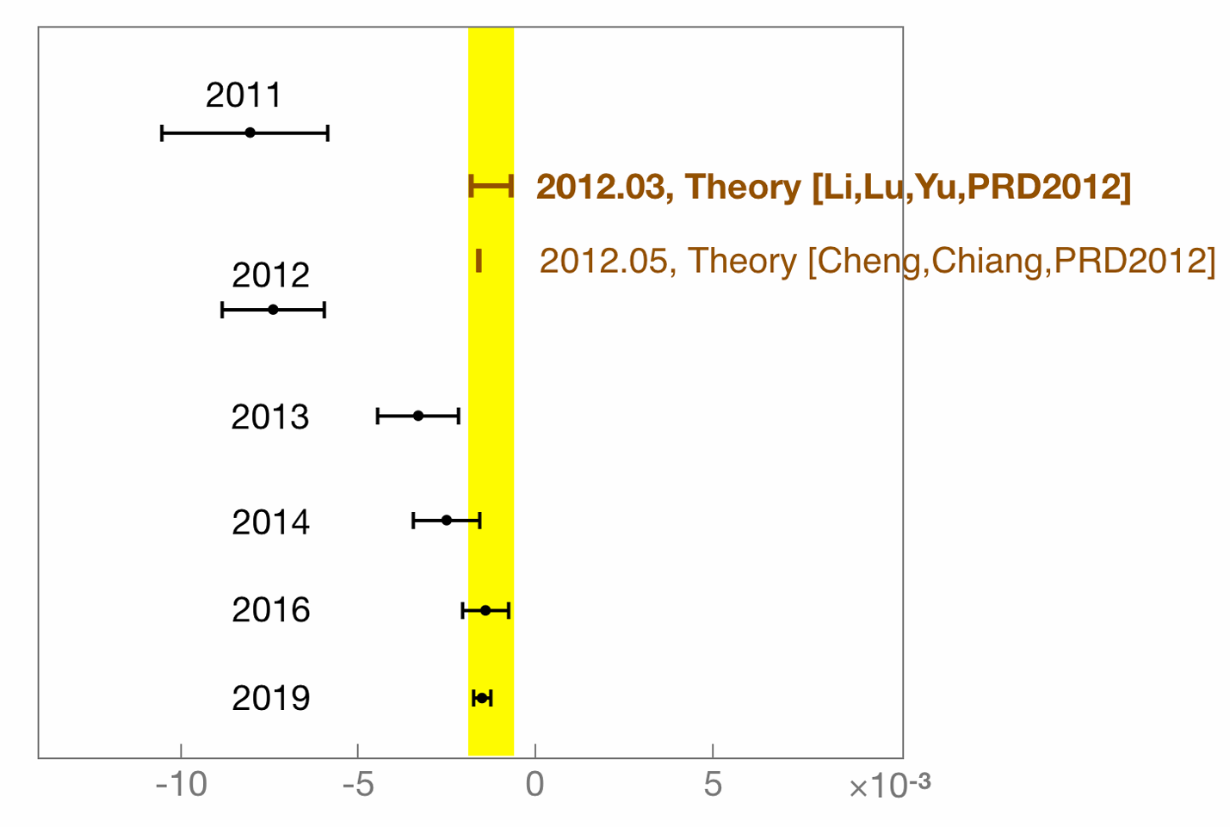
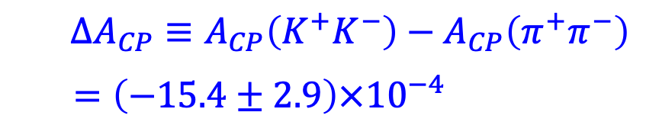
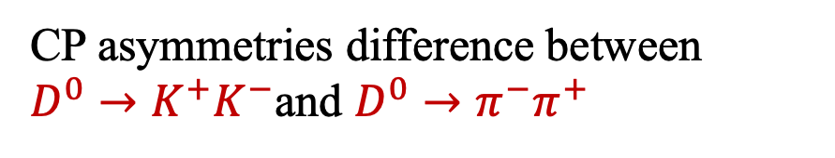
Direct CPV in charm
  CP asymmetries difference between $D^{0}→K^{+}K^{−}$and $D^{0}→π^{−}π^{+}$
$ΔA_{CP}≡A_{CP}\left(K^{+}K^{−}\right)−A_{CP}\left(π^{+}π^{−}\right)$
$=\left(−15.4±2.9\right)×{10}^{−4}$
PRL 122 (2019) 211803

Slide 10
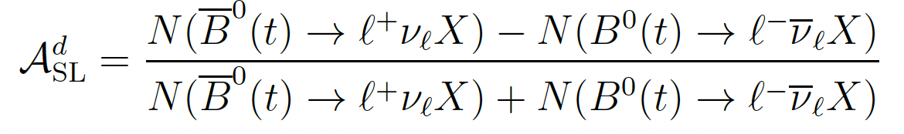
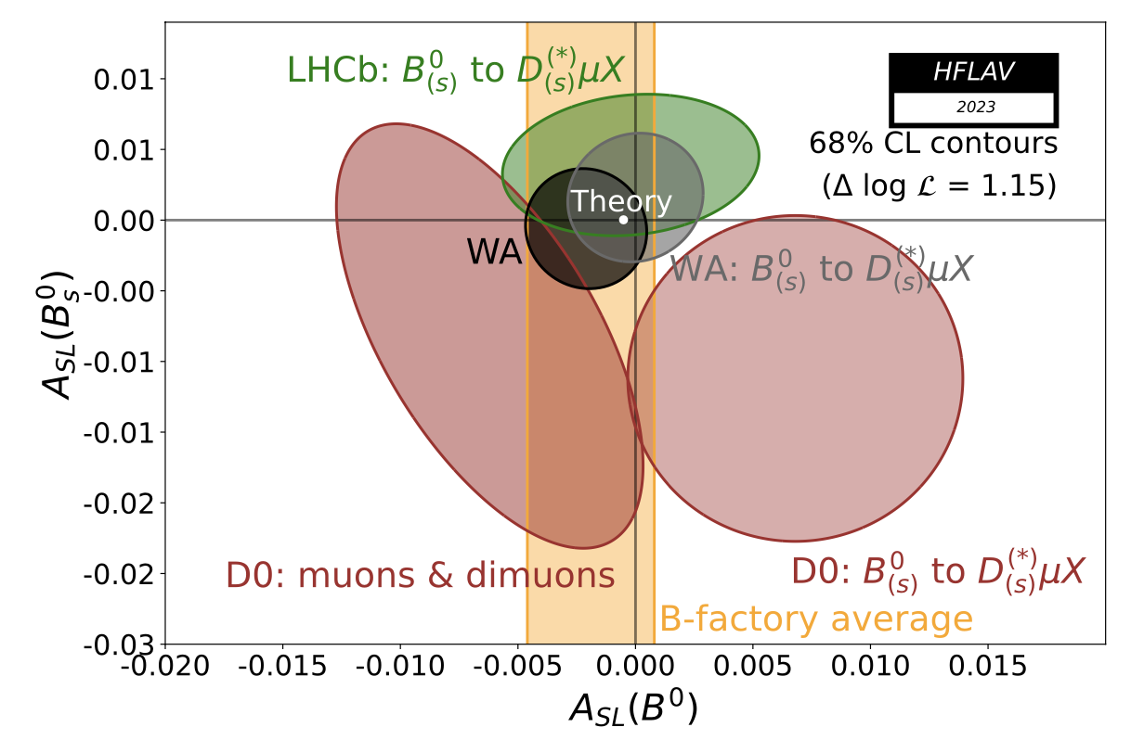
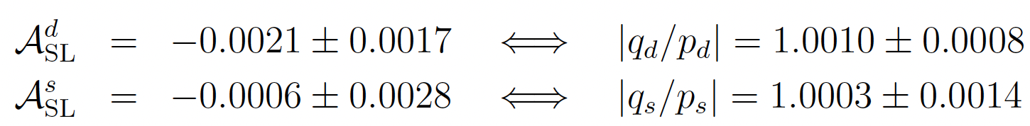
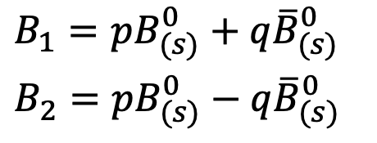
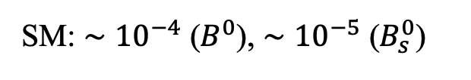
Beauty: CPV in mixing
Oscillation asymmetry
$B_{1}=pB_{(s)}^{0}+q{\overline{B}}_{(s)}^{0}$
$B_{2}=pB_{(s)}^{0}−q{\overline{B}}_{(s)}^{0}$
SM: ${∼10}^{−4}$ ($B^{0}$), ${∼10}^{−5}$ ($B_{s}^{0}$)
Eur.Phys.J.ST 233 (2024) 359
No hint of CPV in mixing

Slide 11
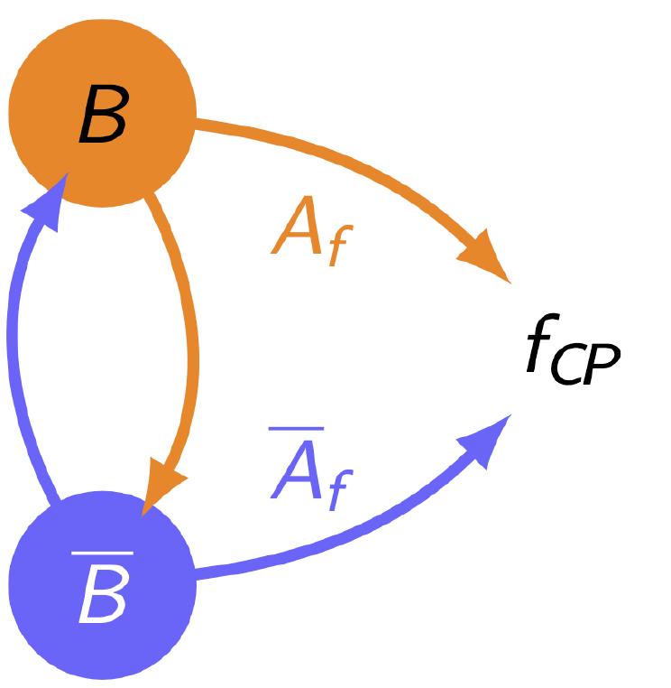
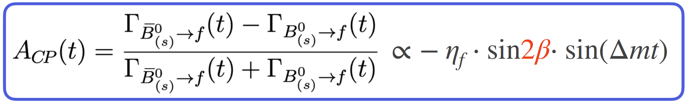
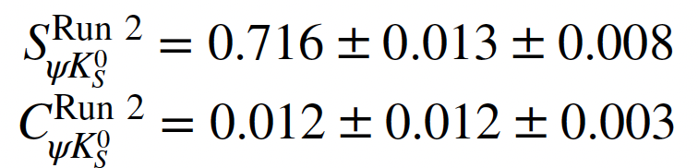
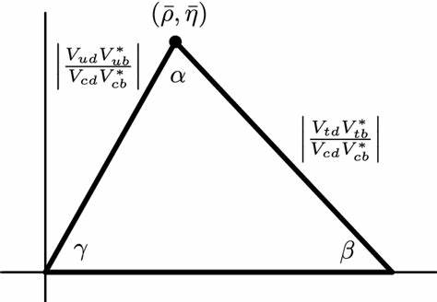
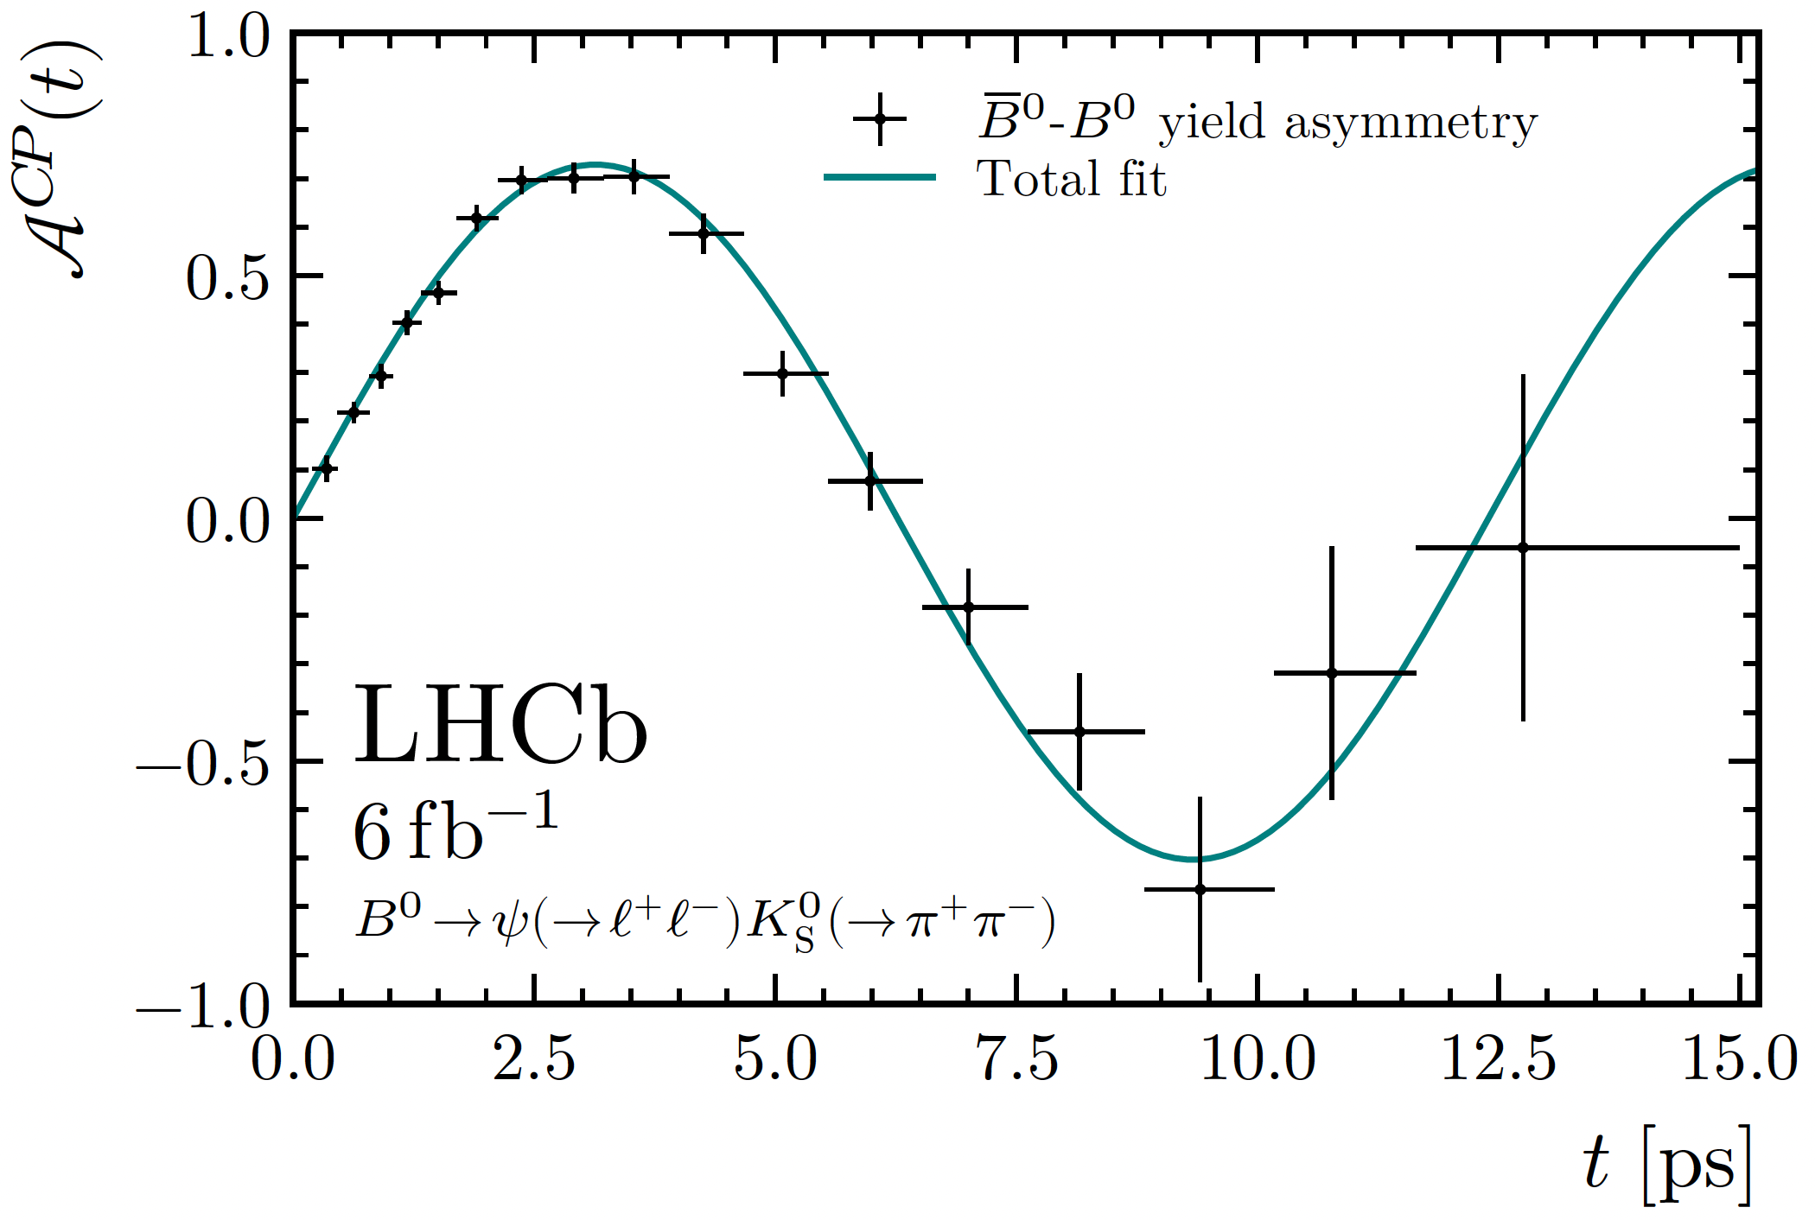
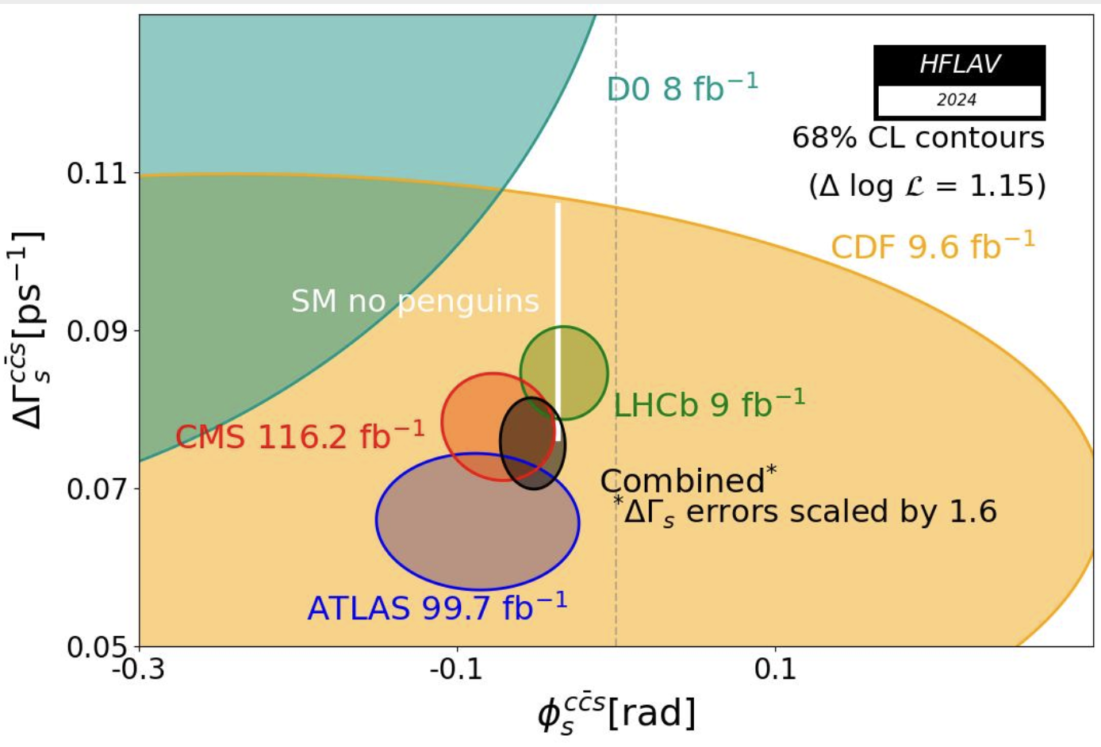

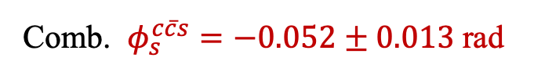
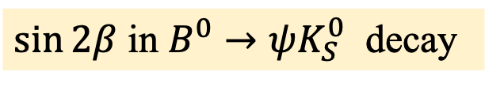

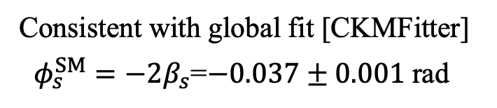
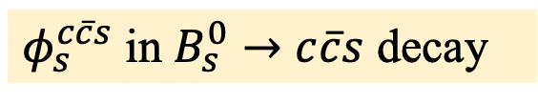

Beauty: mixing induced CPV
$\sin{2β}$ in $B^{0}→ψK_{S}^{0}$ decay
$φ_{s}^{c\overline{c}s}$ in $B_{s}^{0}→c\overline{c}s$ decay
Comb. $φ_{s}^{c\overline{c}s}=−0.052±0.013 \text{rad}$
Evidence of non-zero CPV
Consistent with global fit [CKMFitter]
$φ_{s}^{SM}=−2β_{s}$=$−0.037±0.001 \text{rad}$
$$β$$
$$B^{0}→ψK_{S}^{0}$$
$\sin{2β}$
PRL132 (2024) 021801

Slide 12
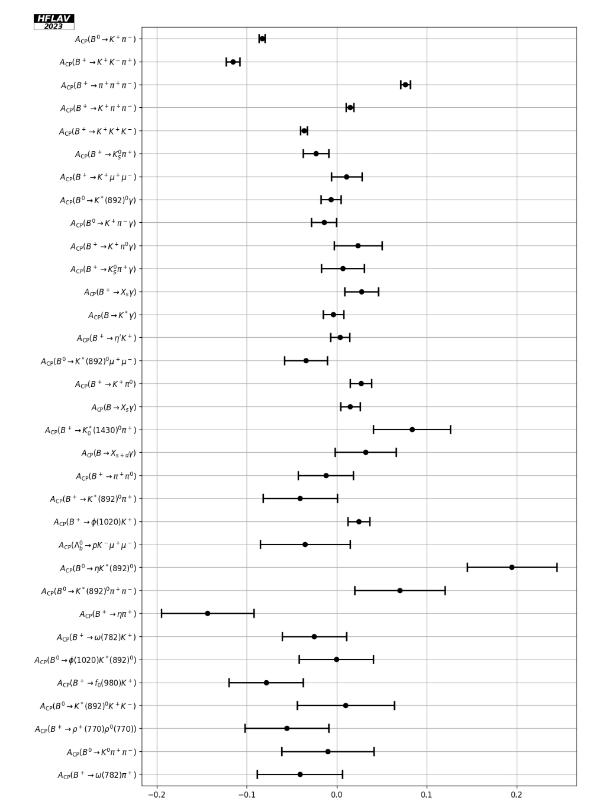
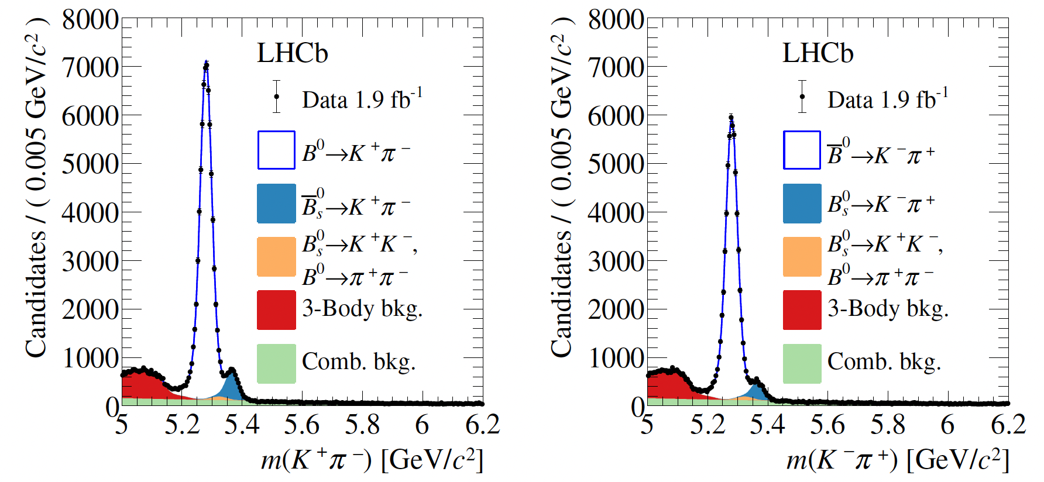




Beauty: direct CPV
Charmless decays
Interference tween tree and penguin diagrams
Possibly large CPV
$$A_{CP}^{B^{0}}=−0.083±0.005$$
$$A_{CP}^{B_{s}^{0}}=0.236±0.017$$
$$B_{\left(s\right)}^{0}→K^{+}π^{−}$$
$${\overline{B}}_{\left(s\right)}^{0}→K^{−}π^{+}$$
PRD98 (2018) 032004

Slide 13
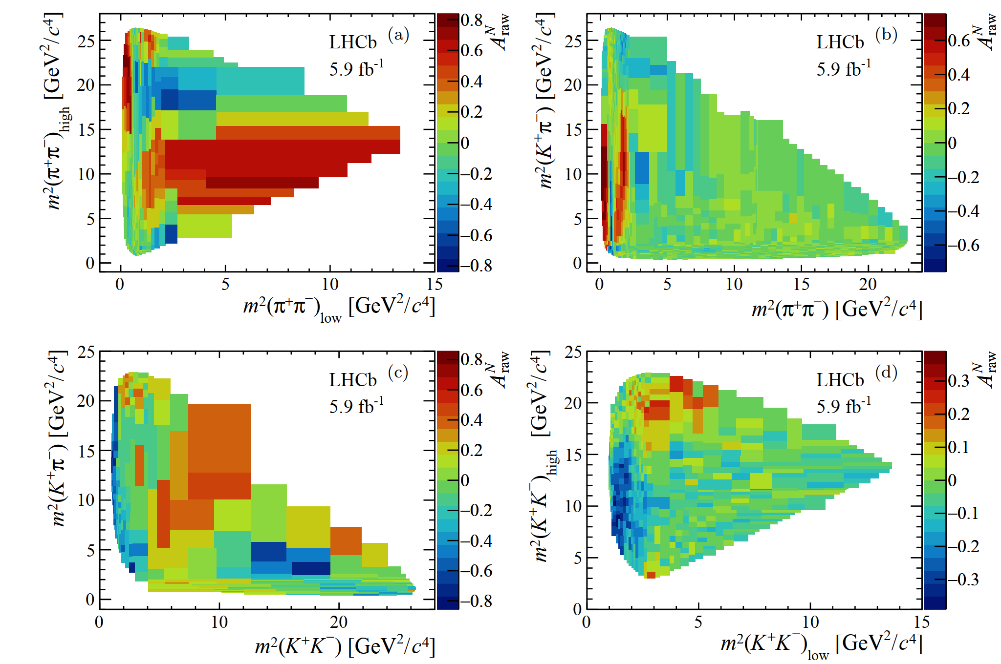




Beauty: CPV pattern for $n$-body charmless decays
PRD108(2023)012008
Varying strong phases and resonance compositions
$$B^{±}→K^{±}π^{+}π^{−}$$
$$B^{±}→π^{±}π^{+}π^{−}$$
$$B^{±}→π^{±}K^{+}K^{−}$$
$$B^{±}→K^{±}K^{+}K^{−}$$

Slide 14
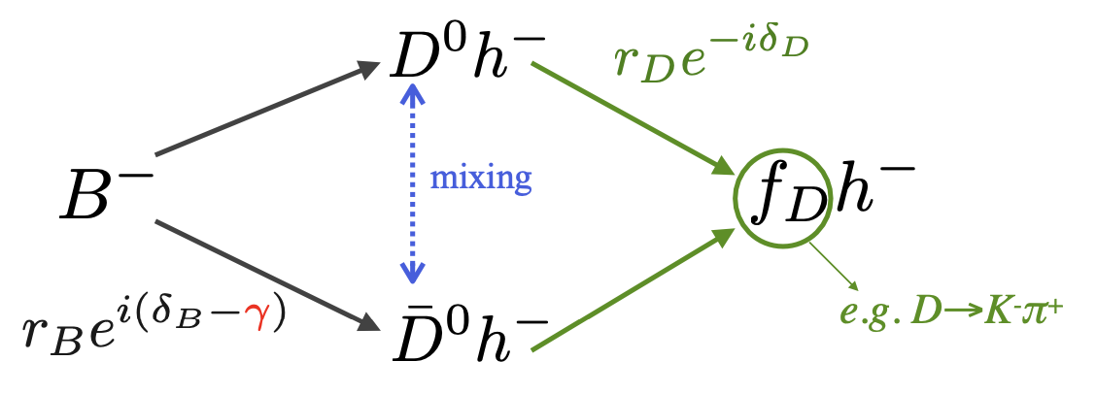
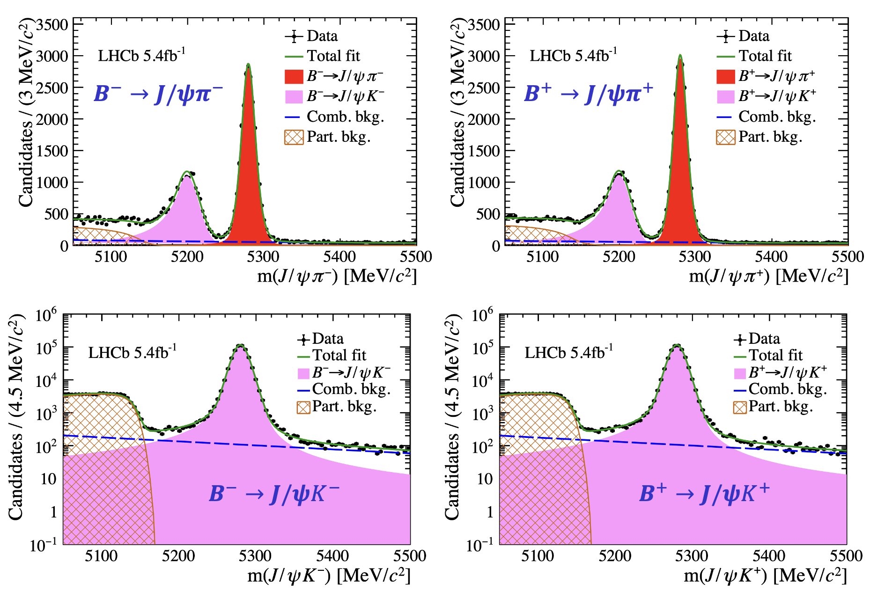
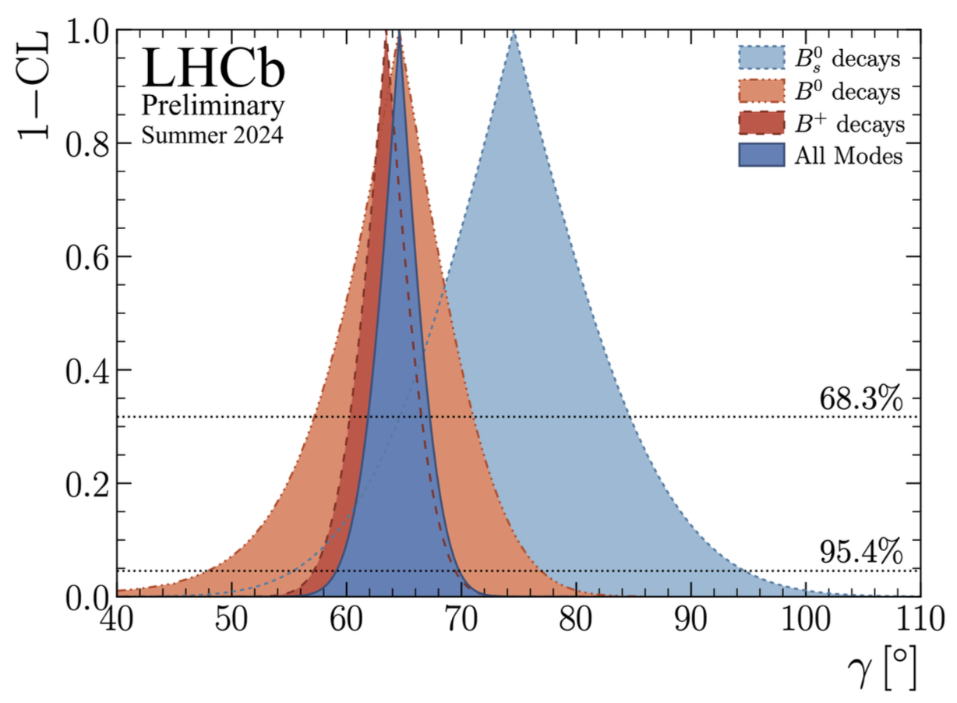
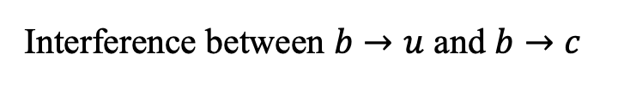







Beauty: direct CPV for $b$ to charm decays
$γ$ measurement
Evince of direct CPV in $b$ to charmonium
Interference between $b→u$ and $b→c$
$B^{+}→J/ψK^{+}$ v.s. $B^{+}→J/ψπ^{+}$
$b→c$
$${ΔA}^{CP}=\left(1.42±0.43±0.08\right)×10^{−2}$$
PRL 134 (2025) 101801
$b→u$
$γ_{LHCb}={\left(64.6±2.8\right)}^{∘}$
LHCb-CONF-2024-004

Slide 15
CPV in beauty baryons

Slide 16

Long list of efforts by LHCb

Slide 17





Why and how
EW-type baryogenesis requires large CP violation in baryons
Baryons share the same decay dynamics with mesons in the SM
$⇒$ Large CP violation in $b$-baryons is possible
Methods explored to search for CPV in baryons (complementarity)
Symmetry 15 (2023) 522
Triple product asymmetry (TPA)
Angular/Amplitude analysis
Decay parameter
Decay rate asymmetry
$A_{CP}=\frac{Γ_{b}−Γ_{\overline{b}}}{Γ_{b}+Γ_{\overline{b}}}$
Current precision: b baryon $𝒪(1∼10\%)$, c baryon $𝒪(0.1\%)$, hyperon $𝒪(0.001∼0.01\%)$
So far (22/Mar/2025), baryon CPV not established, despite some indications

Slide 18



Triple product method for $Λ_{b}^{0}→pπ^{−}π^{+}π^{−}$
Triple products in $Λ_{b}^{0}$ rest frame
P-odd asymmetries
J.-P. Wang, Q. Qin, F.-.S. Yu,
Complementary CP violation induced by T-odd and T-even correlations
arXiv:2211.07332
CP-violating observable:
P-violating observable:

Slide 19


CPV in $Λ_{b}^{0}→pπ^{−}π^{+}π^{−}$ with TPA
Evidence of of CPV ($3.3σ$) by with Run 1 data
Nature Phys. 13 (2017) 391
However, not confirmed by study with 2015-2017 data
PRD 102 (2020) 051101
No significant CP violation found in $Λ_{b}^{0}→pK^{−}π^{+}π^{−}$, $Λ_{b}^{0}→pK^{−}K^{+}K^{−}$ and $Ξ_{b}^{0}→pK^{−}{K^{−}π}^{+}$ using Run 1 data
JHEP 08 (2018) 039

Slide 20







CPV in $Ξ_{b}^{−}→pK^{−}K^{−}$ decays
PRD 104 (2021) 052010
Three body charmless $b→s$ transition, analogy to $B→Kππ$ decays
Amplitude analysis with 6 resonances
$$m_{low}\left(pK^{−}\right)$$
$$m_{high}\left(pK^{−}\right)$$
Branching fraction similar to $ℬ\left(B→Kππ\right)$ decays
No evidence of CPV

Slide 21





Baryon decay parameters
Proposed by Lee & Yang to study parity (P) violation in hyperon decay $Λ→pπ^{+}$
S and P waves
$$\frac{dΓ}{\operatorname{dcos}{θ}}=A\left(1+αP_{Λ}\cos{θ}\right)$$
$$P_{p}=\frac{\left(α+P_{Λ}\cos{θ}\right)z^{′}+βP_{Λ}x’+γP_{Λ}y′}{1+αP_{Λ}\cos{θ}}$$
Parity violating observables: $α\left(Λ/\overline{Λ}\right))$, $β\left(Λ/\overline{Λ}\right))$, $γ\left(Λ/\overline{Λ}\right))$
CP violating observables: $A_{CP}^{α}=\frac{α\left(Λ\right)+α\left(\overline{Λ}\right)}{α\left(Λ\right)−α\left(\overline{Λ}\right)}$ …
Complementary to decay rate asymmetry

Slide 22






Decay parameters and CPV in hyperons
Pioneering work to probe CPV in $J/ψ→Λ\overline{Λ}$
Nat. Phys. 15 (2019) 631
PRL129(2022) 131801
Entangled $Λ$ and $\overline{Λ}$
Many other $ψ$ to hyperon channels explored, no sign of CP violation
Decay | $$Λ\overline{Λ}$$ | $$Σ^{+}{\overline{Σ}}^{−}$$ | $$Ξ^{−}{\overline{Ξ}}^{+}$$ | $$Ξ^{0}{\overline{Ξ}}^{0}$$
$$A_{CP}$$ | $$−0.0025$$ $$±{0.0046}_{ }$$ $$±{0.0012}_{ }$$ | $$−0.004$$ $$±{0.037}_{ }$$ $$±{0.010}_{ }$$ | $$−0.006±{0.013}_{ }±{0.006}_{ }$$ | $$−0.0054$$ $$±{0.0065}_{ }±{0.0031}_{ }$$
 | PRL129 (2022) 131801 | PRL125 (2020) 052004 | Nature 606 (2022) 64 | PRD108 (2023) 3

Slide 23



Decay parameters and CPV in charm baryons
No sign of CP violation
S.S. Tang, L.-K. Li, X.-Y. Zhou and C.-P. Shen,
Symmetry 15 (2023) 91

Slide 24




Beauty and charm baryon parameters
Simultaneous angular analysis of 6 decays
  $Λ_{b}^{0}→Λ_{c}^{+}h^{−} \left(h=π, K\right)$
  with $Λ_{c}^{+}→Λ h^{+}$, $Λ→p π^{−}$
  or $Λ_{c}^{+}→pK_{s}^{0}$
PRL 133 (2024) 261804

Slide 25






P and CP violation
PRL 133 (2024) 261804
P violating $α$ parameters
First time for $Λ_{b}^{0}→Λ_{c}^{+}h^{−}$ decays
Most precise for $Λ_{c}^{+}$ decays
Confirmation of BESIII for $α(Λ→pπ^{−})$
CP violating $A_{CP}^{α}$ parameters
$A_{CP}^{α}=\frac{\left(α\left(Λ\right)+α\left(\overline{Λ}\right)\right)}{\left(α\left(Λ\right)−α\left(\overline{Λ}\right)\right)}$
Consistent with CP symmetry
Consistent with Belle and BESIII

Slide 26









More parameters for $Λ_{c}^{+}→Λh^{+}$ decays
PRL 133 (2024) 261804
No CP violation in $β$, $γ$ or phases
Weak phases consistent with zero, non-zero strong phases
$Δφ$ (weak phase)
$$0.01±0.02$$
$$−0.03±0.14$$
$Δ_{Λ_{c}^{+}}$ phase difference between two helicity amplitudes
$Δδ$ (strong phase)
$$2.693±0.017$$
$$2.57±0.19$$

Slide 27

CPV with decay rate
$A_{CP}=\frac{Γ_{b}−Γ_{\overline{b}}}{Γ_{b}+Γ_{\overline{b}}}$

Slide 28








CP asymmetry for $Λ_{b}^{0},Ξ_{b}^{0}→phhh$ decays
EPJC 79 (2019) 745
Six decay modes, yields 0.5-10K ($3 {fb}^{−1}$)
Abundant resonant structures
Example: $Λ_{b}^{0}→pK^{−}π^{+}π^{−}$
Global and local $A_{CP}$ around resonances studied, difference to $Λ_{b}^{0}→Λ_{c}^{+}π^{−}$ decay
No evidence of $A_{CP}$ with ~1% precision
Rule out global CP violation $≫5\%$

Slide 29











CP asymmetry for $Λ_{b}^{0}→DpK^{−}$
PRD104 (2021) 112008
$r_{B}∼\left|\frac{V_{ub}V_{cs}^{∗}}{V_{cb}V_{us}^{∗}}\right|∼0.4$
Sensitive to measure $γ$ with in baryon decays
CPV studied for DCS decay $D^{0}→K^{+}π^{−}$
Possibly large interference
$$A_{CP}∝r_{B}/r_{D}\sin{γ}\sin{δ}$$
Interference between $Λ_{b}^{0}→{\left(K^{+}π^{−}\right)}_{D^{0}}pK^{−}$ and $Λ_{b}^{0}→{\left(K^{+}π^{−}\right)}_{{\overline{D}}^{0}}pK^{−}$
$$A_{CP}=0.12±{0.09}_{−0.03}^{+0.02}$$
$$A_{CP}=0.01±{0.16}_{−0.02}^{+0.03}$$
(full phase space)
($M\left(pK^{−}\right)<2.2 GeV$)
$$Λ_{b}^{0}$$
$${\overline{Λ}}_{b}^{0}$$
Dalitz plot

Slide 30













CP violation in $Λ_{b}^{0}→ph^{−}$ decays
arXiv:2412.13958
Dynamics analogy to $B^{0}→h^{+}h^{−}$ decays
Large yield and high purity
CP violation predicted: ~5%
$$B^{0}/{\overline{Λ}}_{b}^{0}$$
$$K^{+}π^{−}/{\overline{p}}^{−}$$
PRD 102 (2012) 034033
PRD 95 (2017) 093001
$$\overline{u}\overline{d}$$
$$\overline{u}\overline{d}$$
Sizable CP violation not confirmed
$$A_{CP}^{pK^{−}}=\left(−1.1±0.7±0.4\right)\%$$
$$A_{CP}^{pπ^{−}}=\left(+0.2±0.8±0.4\right)\%$$
$pK^{−}$
$\overline{p}K^{+}$
$pπ^{−}$
$\overline{p}π^{+}$

Slide 31





Crucial to control systematics
arXiv:2412.13958
Subtraction of experiment induced asymmetries ($∼1\%$)
$A_{yield}=A_{CP}+A_{prod}+A_{detection}+A_{PID}+A_{trigger}$
JHEP 10 (2021) 060
Data driven corrections and use control mode $\left(Λ_{b}^{0}→Λ_{c}^{+}\left(pK^{−}π^{+}\right)π^{−}\right)$ to cancel
Good cancellation, eventually limited by $Λ_{b}^{0}→Λ_{c}^{+}π^{−}$ sample size

Slide 32




Why CP violation so small
$A_{CP}∝\left|\frac{P}{T}\right|\sin\left(δ_{T}−δ_{P}\right)\sin\left(φ_{T}−φ_{P}\right)$
One diagram overwhelming? small strong phase difference?
T
P
Dynamics more complex than mesons
Possible cancellation of S and P amplitudes
韩佳杰、余纪新、李亚等，arXiv:2409.02821
Tree amplitude dominating
Favoring multiple body decays

Slide 33







CP asymmetry in $Λ_{b}^{0}→Λh_{1}^{+}h_{2}^{−}$ decays
PRL 134 (2025) 101802
Three $Λ_{b}^{0}$ decays $Λπ^{+}π^{−}$、 $ΛK^{+}π^{−}$、 $ΛK^{+}K^{−}$; one $Ξ_{b}^{0}$ decay
$Λ_{b}^{0}→Λ_{c}^{+}\left(→Λπ^{+}\right)π^{−}$ as control channel, reduce production and detection asymmetries
3.1$σ$, evidence for CPV
$$Λ_{b}^{0}$$
$${\overline{Λ}}_{b}^{0}$$
$Λ_{b}^{0}→ΛK^{+}K^{−}$ decay

Slide 34










Local CP asymmetry for $Λ_{b}^{0}→ΛK^{+}K^{−}$
PRL 134 (2025) 101802
In analogy to $B^{+}→K^{+}K^{+}K^{−}$ decay
Two resonance-dominated regions
$$B^{±}→K^{±}K^{+}K^{−}$$
raw asymmetry
$m_{K^{+}K^{−}}<1.1$ GeV
$Λ_{b}^{0}→Λφ(→K^{+}K^{−})$ or non-resonant:
$ΔA_{CP}\left(Λφ\right)=0.150±0.055±0.021$
$m_{ΛK^{+}}<2.9$ GeV
${Λ_{b}^{0}→N}^{∗+}\left(→ΛK^{+}\right)K^{−}$: possibly via $b→u\overline{u}s$
$ΔA_{CP}\left(N^{∗+}K^{−}\right)=0.165±0.048±0.017$
(local 3.2$σ$)
Many $N^{∗+}$ may contribute to $Λ_{b}^{0}→N^{∗+}K^{−}$
Several related $N^{∗+}$channels to cross-check
${ N}^{∗+}→ΛK^{+} ⇒$ ${Λ_{b}^{0}→N}^{∗+}\left(ΛK^{+}\right)K^{−}$
$N^{∗+}→pπ^{+}π^{−} ⇒$ ${Λ_{b}^{0}→N}^{∗+}\left(pπ^{+}π^{−}\right)K^{−}$
$N^{∗+}→pπ^{0} ⇒$ ${Λ_{b}^{0}→N}^{∗+}\left(→pπ^{0}\right)K^{−}$
J.P. Wang, F.S. Yu, CPC 48 (2024) 101002

Slide 35






More local CP asymmetries
PRL 134 (2025) 101802
$m_{ΛK^{+}}<2.3$ GeV
$m_{π^{+}π^{−}}<1.7$ GeV
$Λ_{b}^{0}→N^{∗+}\left(→ΛK^{+}\right)π^{−}$
$ΔA_{CP}\left(N^{∗+}π^{−}\right)=−0.078±0.051±0.027$
$Λ_{b}^{0}→Λf(π^{+}π^{−})$
$ΔA_{CP}\left(Λf\right)=0.088±0.069±0.021$

Slide 36






CPV for charm decay $Λ_{c}^{+}→ph^{+}h^{−}$
JHEP 03 (2018) 182
Charm baryon CPV expected to be small, $\sim 0.1\%$
I. I. Bigi, arXiv:1206.4554
Golden channel: $Λ_{c}^{+}→pK^{+}K^{−}, π^{+}π^{−}$
Singly Cabibbo-suppressed ($D^{0}→KK,ππ$)
Large yields and high S/B ratio
Rich resonances
Challenging to control systematics
Measurement with Run 1 data (3 fb⁻¹)

Slide 37


?
提问方式（时间）不对?

Slide 38




From P violation to CP violation: a summary
1956
李、杨
提出
P破坏
1963
Cabibbo
提出
两代夸
克混合
1970
GIM
预言
粲夸克
1973
KM提出
三代夸克
混合机制
理论？
新的
CP破
坏源？
1957
吴健雄
发现
P破坏
1958
Goldhaber
发现
C破坏
1964
Cronin、
Fitch
发现
$K^{0}$介子
CP破坏
1974
丁肇中、
里奇特
发现
粲夸克
1977
莱德曼
发现
底夸克
1995
费米
实验室
发现
顶夸克
2001
BaBar、
Belle
发现
$B^{0}$介子
CP破坏
2013
LHCb
发现
$B_{s}^{0}$介子
CP破坏
2019
LHCb
发现
$D^{0}$介子
CP破坏
重子
CP破
坏呼之
欲出
实验？

Slide 39



LHCb (near) upgrade plan
Take data with Upgrade I detector for 50 $fb^{−1}$
  Run3 (→2026): > 20 $fb^{−1}$ data and $2×$ better trigger efficiency
Trigger efficiency
Era of 0.1% precision
Opportunities for baryon CPV
Confirmation
More decays
More dynamics
Charm baryon
Unexpected observations ?
谢谢！

Slide 40
Backup slides

Slide 41







Global analysis of CKM mechanism (4 parameters)
When LHC started
Current status
$$A={0.826}_{−0.015}^{+0.018}$$
$$λ=0.22500±0.00067$$
$$\overline{ρ}=0.159±0.010$$
$$\overline{η}=0.348±0.010$$
$$α+β+γ={\left(173±6\right)}^{∘}$$

Slide 42

CKM matrix up to $λ^{6}$

Slide 43


LHCb Upgrade II sensitivities
CERN Yellow Rep.Monogr. 7 (2019) 867
$δ<1\%$
Uncertainty
reduced by factor ~10
1% level precision
High precision charm physics

Slide 44






More information for decay paramerters

