Slide 1
Reconciling the X(2240) with the Y(2175)
Dian-Yong Chen
Southeast University
D. Y. Chen, J. Liu and J. He, Phys.Rev.D 101, 074045 (2020);
D.Y.Chen, et al., to appear

Slide 2
outline
1. Experimental Status related to Y(2175)
Y(2175) in $e^{+}e^{−}→K^{+}K^{−}$
Combined analysis of $e^{+}e^{−}→K^{+}K^{−}$ and $e^{+}e^{−}→K_{S}^{0}K_{L}^{0}$
Summary

Slide 3
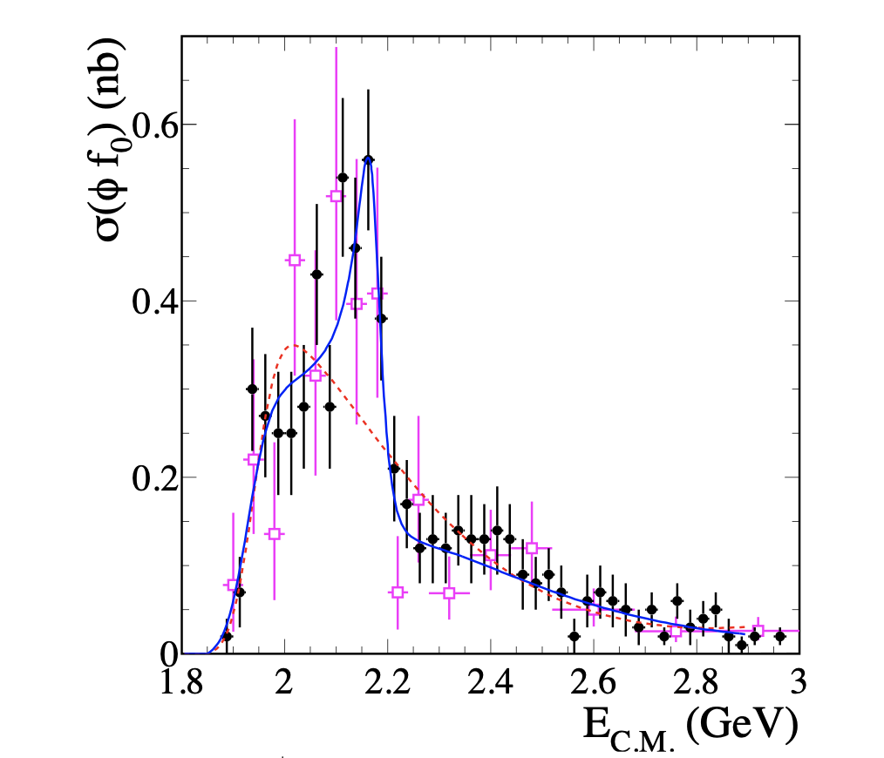
Experimental Status of Y(2175)
$e^{+}e^{−}→φf_{0}@$BABAR(2006)
PRD74.091103(2006)
Narrow structure
Nonresonance+Resonance fit
Resonance Parameter
$m=2175±10±15$ MeV
$Γ=58±16±20$ MeV

Slide 4
Experimental Status of Y(2175)
$J/ψ→η(φf_{0})@$BES(2007)
Resonance Parameter
$m=2182±10±6$ MeV
$Γ=73±23±$17 MeV
Resonance
Consistent with BABAR‘s results!
Confirmed Y(2175)
Product branching ratio
$B_{J/ψ→ηY}B_{Y→φf_{0}}B_{f_{0}→π^{+}π^{−}}$
$$=\left(3.23±0.75±0.73\right)×{10}^{−4}$$
Phys.Rev.Lett.100.102003(2008)

Slide 5
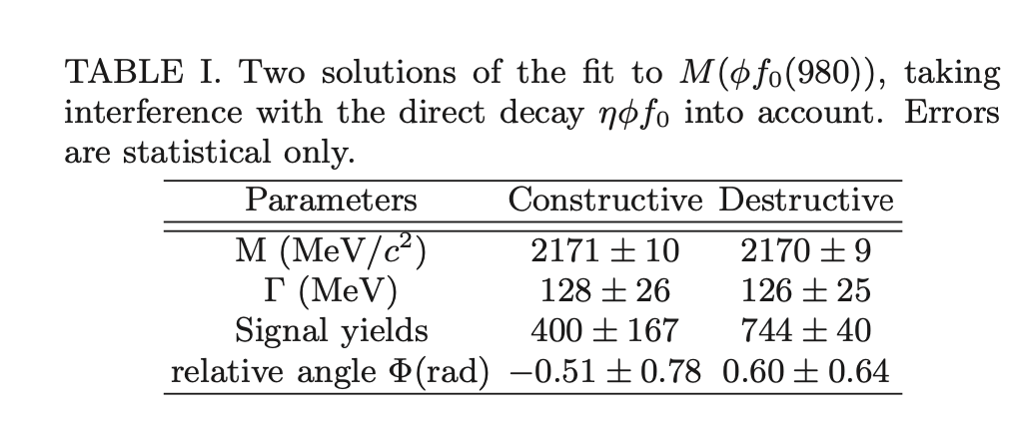
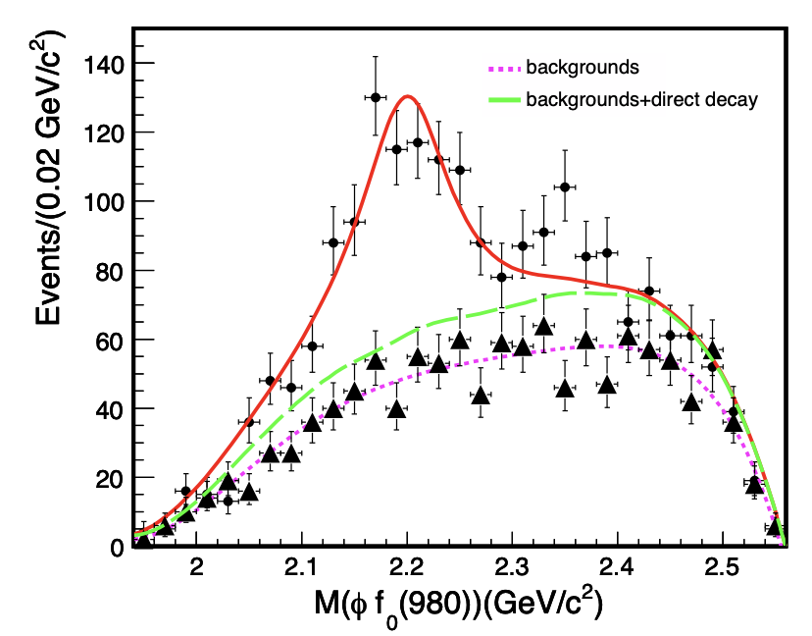
Experimental Status of Y(2175)
$J/ψ→η(φf_{0})@$BES(2014) (update analysis )
PRD91, 052017 (2015)
Product branching ratio
$$B_{J/ψ→ηY}B_{Y→φf_{0}}B_{f_{0}→π^{+}π^{−}}$$
$$=\left(1.20±0.14\right)×{10}^{−4}$$

Slide 6
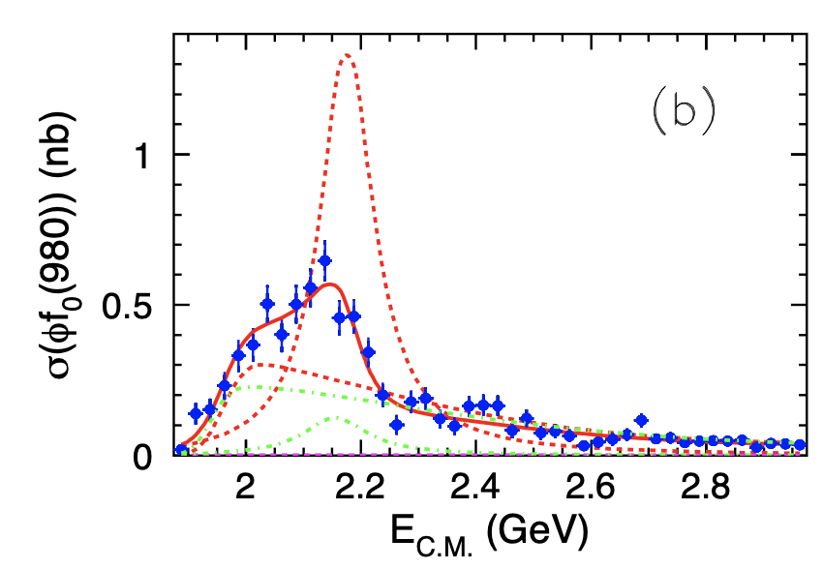
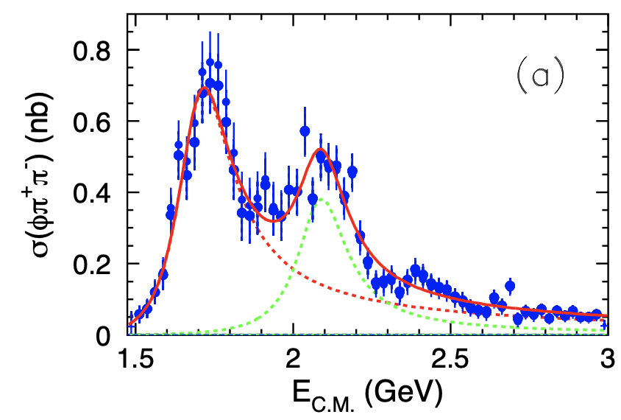
Experimental Status of Y(2175)
$e^{+}e^{−}→φf_{0}@$Belle(2008)
$e^{+}e^{−}→φπ^{+}π^{−}@$Belle(2008)
$φ$(1680)
Y(2175)
Y(2175)
Phys. Rev. D 80,031101 (2009)
Resonance Parameter
$m=2079±{13}_{−28}^{+79}$ MeV
$Γ=192±{23}_{−61}^{+25}$ MeV
Product branching ratio
$$B\left(Y\left(2175\right)→φπ^{+}π^{−}\right)B_{e^{+}e^{−}}=\left(1.10±0.10±0.12\right)×{10}^{−7}$$

Slide 7
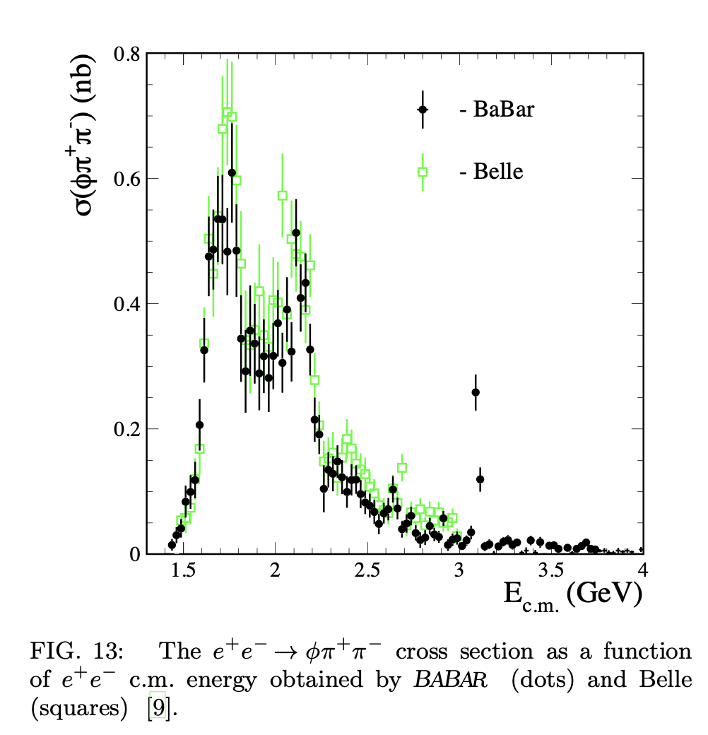
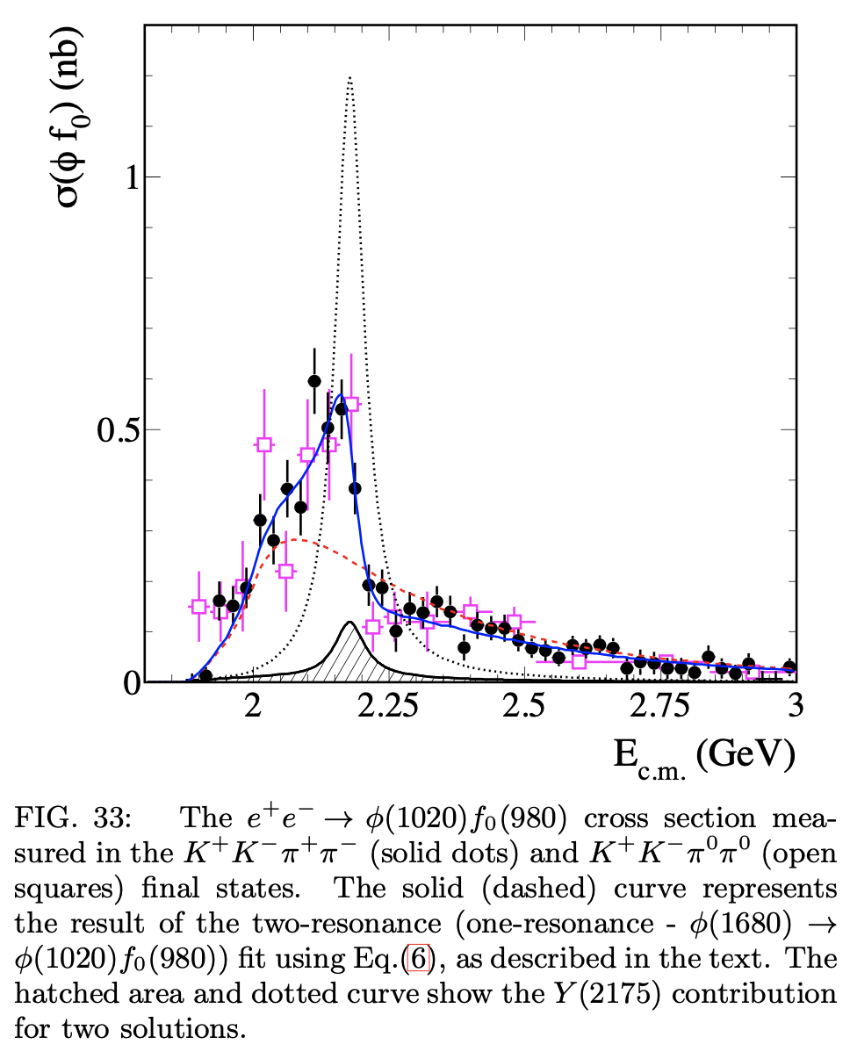
Experimental Status of Y(2175)
$e^{+}e^{−}→φf_{0}@$Belle(2012) (update)
$e^{+}e^{−}→φπ^{+}π^{−}@$BABAR(2012)
PRD86,012008(2012)
Resonance Parameter
Resonance Parameter
$m=2180±8±8$ MeV
$Γ=77±15±10$ MeV
$m=2176±14±4$ MeV
$Γ=90±22±10$ MeV

Slide 8
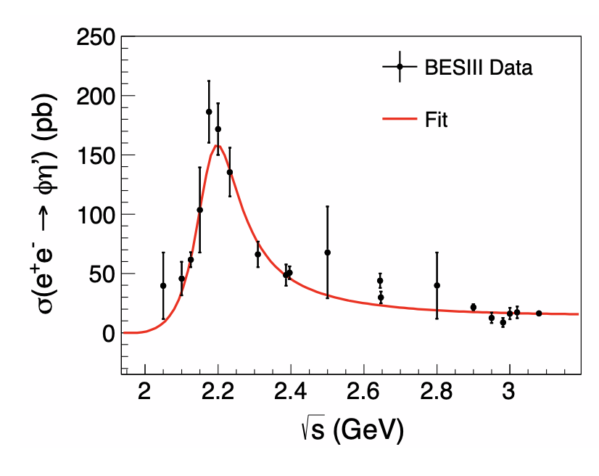
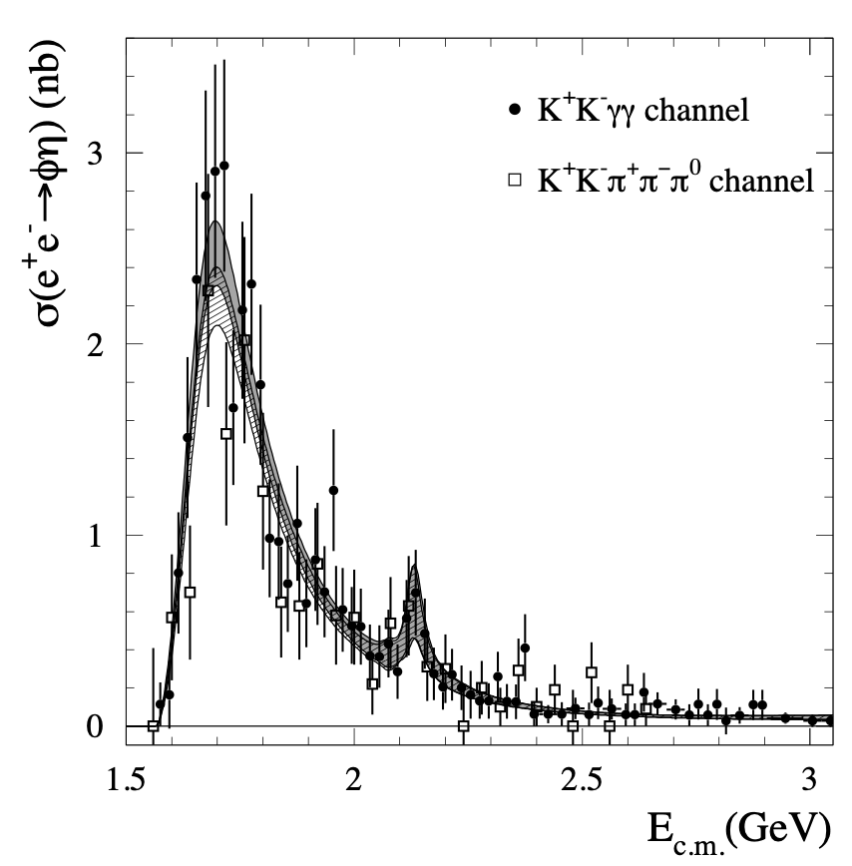
Experimental Status of Y(2175)
$e^{+}e^{−}→φη@$BABAR(2008)
$e^{+}e^{−}→φη^{′}@$BES(2020)
PRD 102, 012008 (2020)
PRD 77 (2008) 092002
$m=2125±22$ MeV
$Γ=61±50$ MeV
$m=2177.5±4.8±19.5$ MeV
$Γ=149.0±15.6±8.9$ MeV

Slide 9
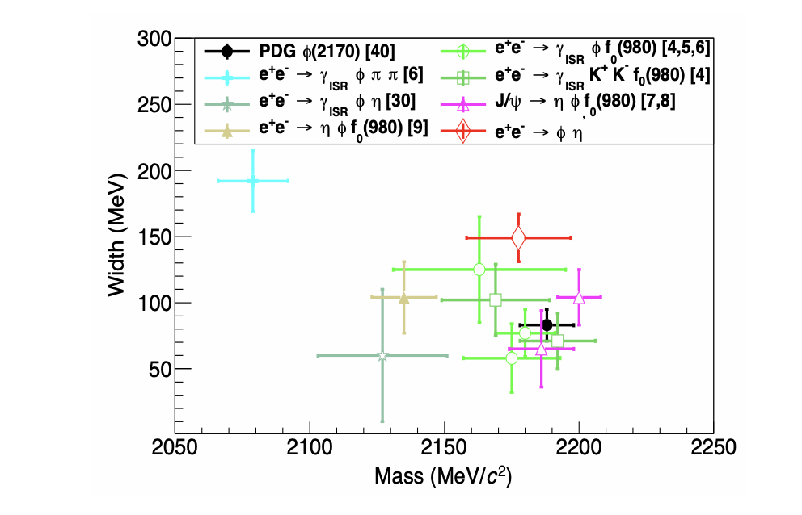
Experimental Status of Y(2175)
Resonance parameters of Y(2175)

Slide 10
Theoretical interpretations
Conventional strangeonium
3³S₁ / 2³D₁ strangeonium or their mixing state
QCD exotic state
$ss\overline{s}\overline{s}/su\overline{s}\overline{u}$ excited tetraquark state with spin 1
$s\overline{sg}$ hybrid state
Molecular state interpretations:
$Λ\overline{Λ}$, $φK\overline{K}$
Experimental observations indicate that Y(2175) contains $s\overline{s}$,
thus open strange channels are expected!

Slide 11
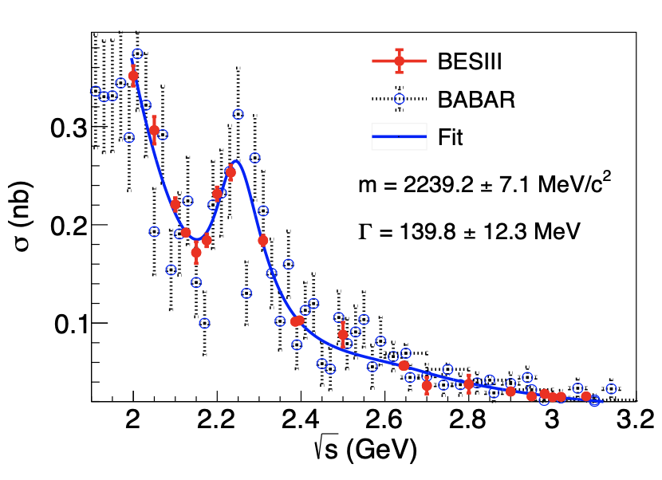
Observation of $e^{+}e^{−}→K^{+}K^{−}$
$e^{+}e^{−}→K^{+}K^{−}$@BES(2018)
Lineshape fit
No Y(2175)!
New Resonance?

Slide 12
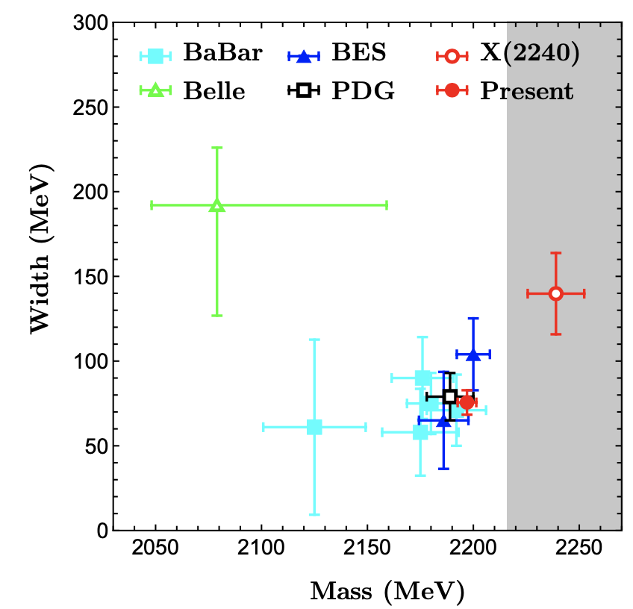
Observation of X(2240)
comparison of Y(2175) and Y(2240)
Mass: Y(2240) is inconsistent
with Y(2175)
PDG2020
$$m = \left(2188±10\right) MeV$$
$$Γ=(83±12) MeV,$$
PDG2024
$$Γ=({106}_{−18}^{+24}) MeV,m = (2164± 6) MeV$$
Width: Consistent with Y(2175) within error

Slide 13
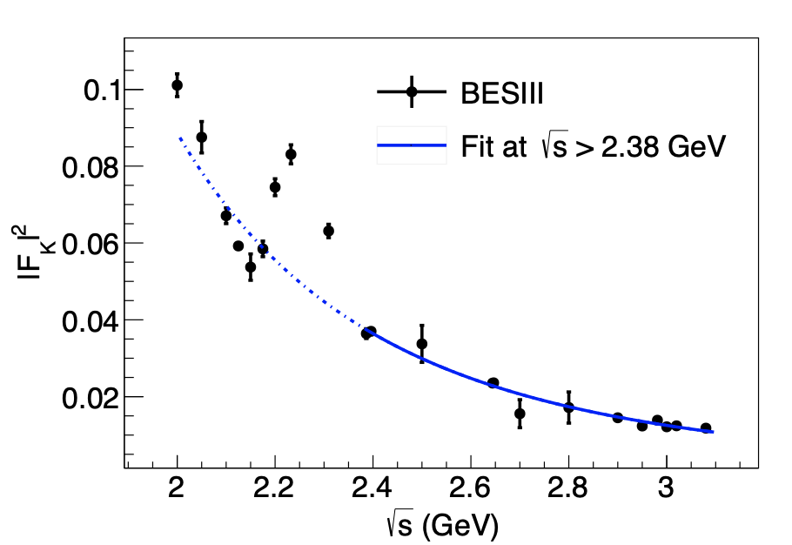
Observation of X(2240)
Kaon time-like form factor:
typical interference structure!!
$$F_{K}\left(s\right)=Aα_{s}^{2}(s)/S^{n}$$
Only valid at large s area.
The electromagnetic process are crucial!

Slide 14
Observation of X(2240)
Possible Contributions to $e^{+}e^{−}→K^{+}K^{−}$
Kaon time-like form factor + Resonance contribution
Discussion
Born cross section & Form factor
Should be the same
$$F_{K}\left(s\right)=Aα_{s}^{2}(s)/S^{n}$$
2. Interference shift the peak!!!

Slide 15
Our Fit to lineshape of $e^{+}e^{−}→K^{+}K^{−}$
Interference between direct process and resonance process
time-like form factor
Total amplitudes: $ℳ_{tot}=ℳ_{Dir}+e^{iφ}ℳ_{Res}$
Free parameters: $a,b,c,φ, m_{V},Γ_{V}$
$g_{V}=g_{VKK}m_{V}^{2}/f_{V}$

Slide 16
Our Fit to lineshape of $e^{+}e^{−}→K^{+}K^{−}$
There are only two almost degenerated data from 2.31 to 2.5 GeV.
The continuity is not as good as the precision!!!

Slide 17
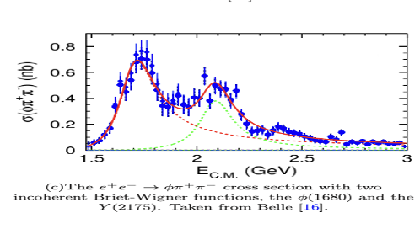
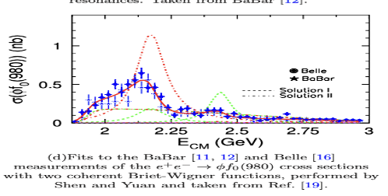
Our Fit to lineshape of $e^{+}e^{−}→K^{+}K^{−}$
Evidence of structure near 2.4 GeV
PRD98.014011

Slide 18
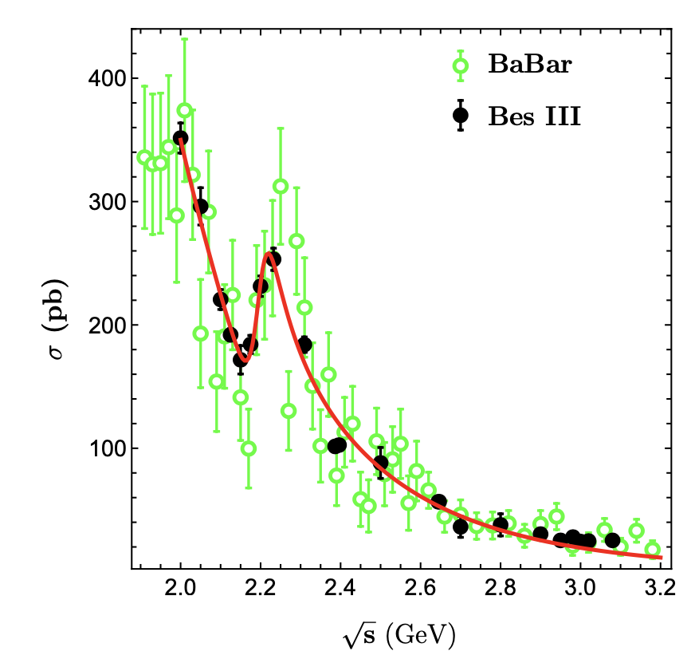
Our Fit to lineshape of $e^{+}e^{−}→K^{+}K^{−}$
excluded!!

Slide 19
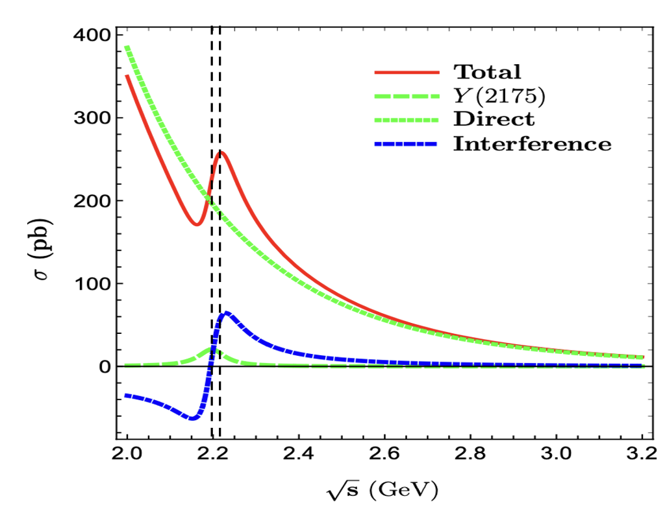
Our Fit to lineshape of $e^{+}e^{−}→K^{+}K^{−}$
Cross section peak
Resonance peak
The interference effect change the peak position
The fitted resonance parameters are consistent with Y(2175)

Slide 20
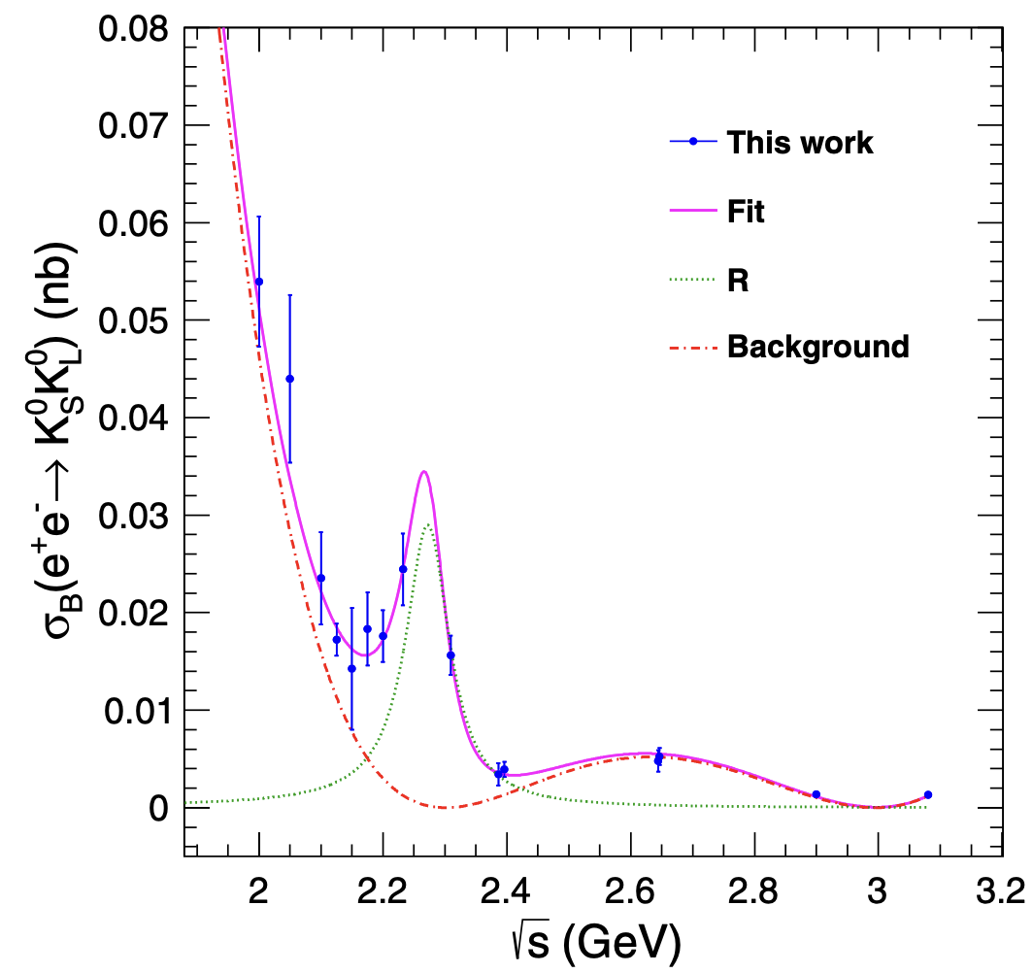
Cross sections for $e^{+}e^{−}→K_{S}^{0}K_{L}^{0}$
Resonance parameters
$M=2273.7±5.7±19.3 MeV$
$Γ=86±44±51 MeV$
PRD 104, 092014(2021)
consistent within 2σ with measurements of $e^{+}e^{−}→K^{+}K^{−}$
$\frac{σ\left(e^{+}e^{−}→K^{+}K^{−}\right)}{σ(e^{+}e^{−}→K_{S}^{0}K_{L}^{0})}∼10$
$$Γ\left(X→K^{+}K^{−}\right)≫Γ(X→K_{S}^{0}K_{L}^{0})$$
Large isospin breaking in $X\left(2240\right)→K\overline{K}$!

Slide 21
Combined analysis
Fit charged and neutral process simultaneously
Total amplitudes: $ℳ_{tot}=ℳ_{Dir}+e^{iφ}ℳ_{Res}$
Free parameters:
Resonance parameters: $m_{V}, Γ_{V}$
Charged process: $a,b,c,φ, g_{V}=g_{VKK}m_{V}^{2}/f_{V}$
Neutral process: $a^{′},b^{′},c^{′},φ^{′}, {R=g}_{V}^{′}/g_{V}$
Exclude the data around 2.4 GeV for both processes

Slide 22
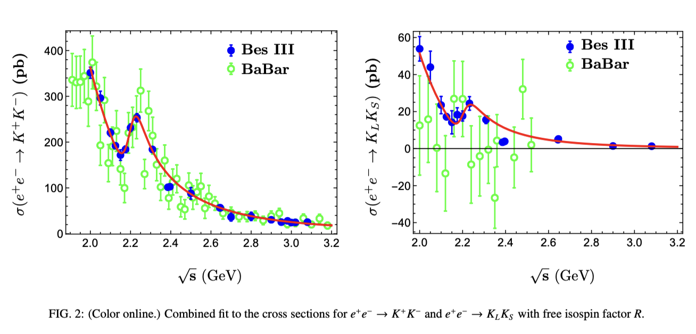
Combined analysis
Cross sections (fit with free R)
Well reproduce the experimental data with
$m=\left(2200.9±5.4\right)MeV, Γ=\left(107.1±10.9\right) MeV$

Slide 23
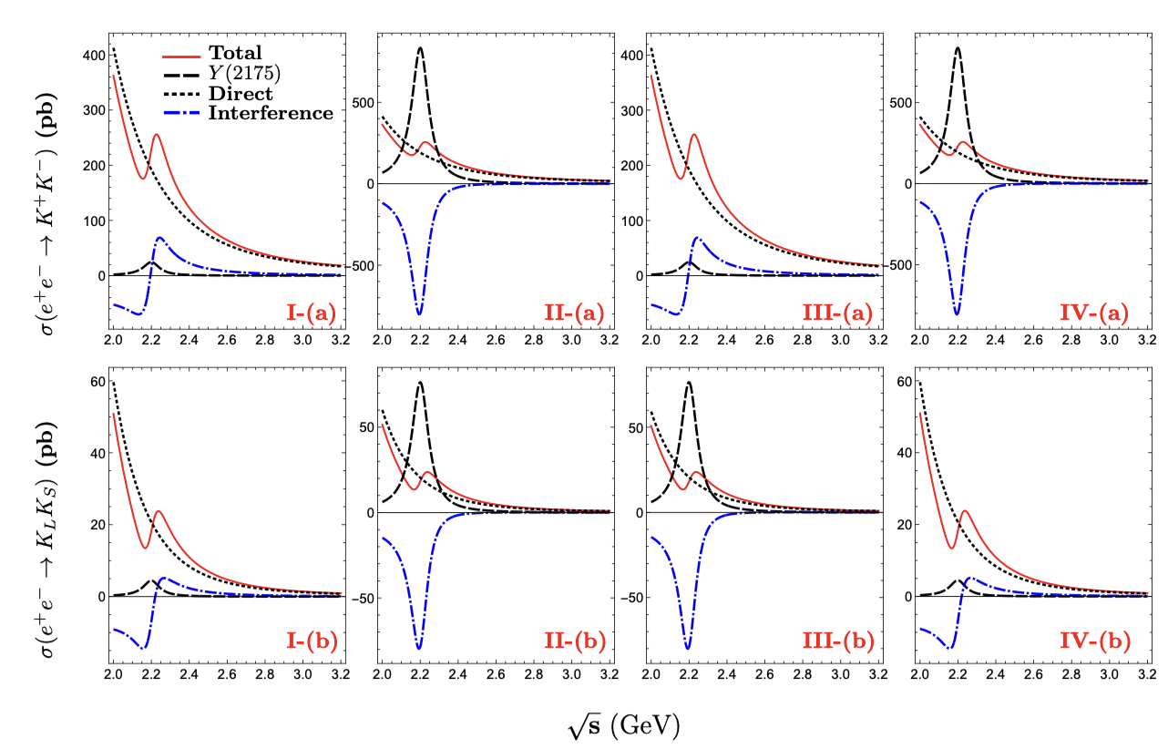
Combined analysis
Individual contributions
Constructive interference:
I(a)、III(a)/I(b)、IV(b)
Destructive interference：
II(a)、IV(a)/II(b)、III(b)
Isospin factor R
I: $0.30± 0.09$
II: $0.42±0.07$
III: $1.77± 0.11$
IV: $0.07±0.01$

Slide 24
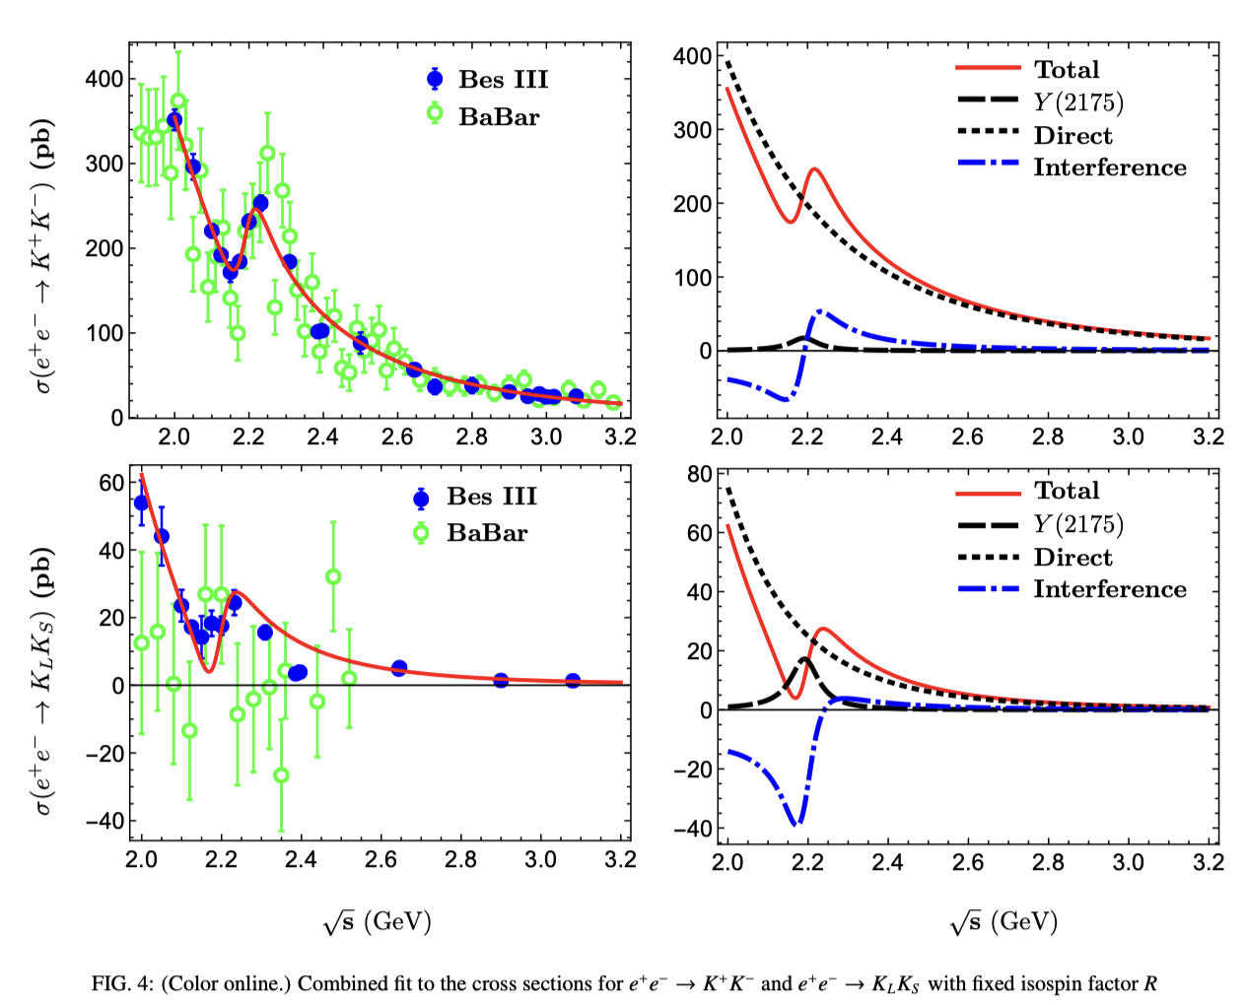
Combined analysis
Cross sections (fit with fixed R=1.0)
Resonance parameters
$$m=\left(2191.6±5.0\right)MeV,$$
$$Γ=\left(86.1±9.2\right) MeV$$
Charge channel: well reproduced,
Neutral channel: poorly reproduced
Possible reason：
additional resonance
(both I=0,1 allowed )

Slide 25
Before Summary
$e^{+}e^{−}$ annihilation process
$Γ_{ee}B\left(Y→φf_{0}\right)=\left(2.5±0.8±0.4\right)$ eV (BABAR: PRD 74,091103 (2006))
$Γ_{ee}B\left(Y→φη^{′}\right)=\left(7.1±0.7±0.7\right)$ eV (BESIII:PRD 102, 012008 (2020) )
$Γ_{ee}B\left(Y→φη\right)=\left(1.7±0.8\right)$ eV (BABAR: PRD 77 (2008) 092002)
$0∼17$ eV (Belle: Phys.Rev.D 107,012006 (2023) )
$J/ψ$ decay process
$B\left(J/ψ→ηY\right)B\left(Y→φf_{0}\right)B\left(f_{0}→π ^{+}π^{−} \right)=\left(1.20±0.14\right)×{10}^{−4}$
$B\left(J/ψ→ηY\right)B\left(Y→φf_{0}\right)∼2.4×{10}^{−4}$ BESIII: PhRD91, 052017 (2015)
$$⇒B\left(J/ψ→ηY\right)B\left(Y→φη^{′}\right)=6.8×{10}^{−4}$$
$B\left(J/ψ→φηη^{′}\right)=\left(2.32±0.06±0.16\right)×{10}^{−4}$ BESIII PRD 99, 112008 (2019)

Slide 26
Summary
Experimental measurements indicates open strange channel should be important for Y(2175)
Interferences between resonance contributions and direct coupling can shift the peak of the resonance.
By comparing the resonance parameters, our fit indicates Y(2240)$≡$Y(2175)!
What are observed $≠$ What should be observed, why?

