Slide 1
Detecting Light Dark Matter with Plasmons
第四届强子与重味物理理论实验联合研讨会
武雷
南京师范大学
in collaboration with 梁正良, 苏亮亮, 祝斌
2501.07591
PRL 134 (2025) 7, 071001

Slide 2
Outline
From WIMPs to Light Dark Matter (LDM)
Electronic Collective Excitations: Plasmons
Detecting LDM with Plasmons
Conclusions

Slide 3

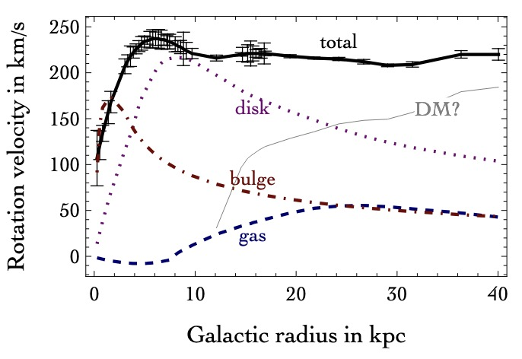
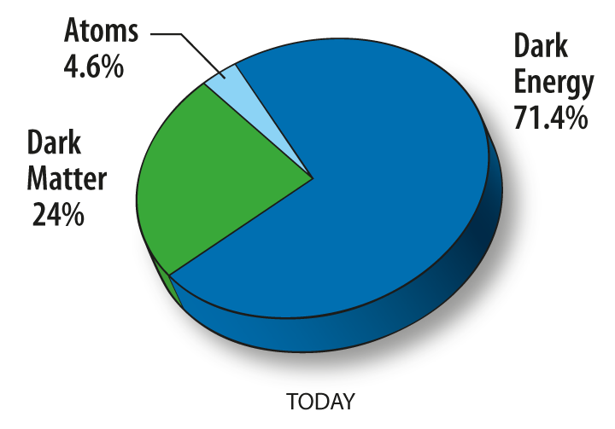
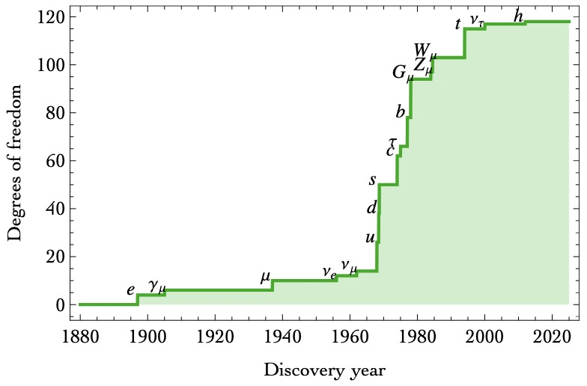
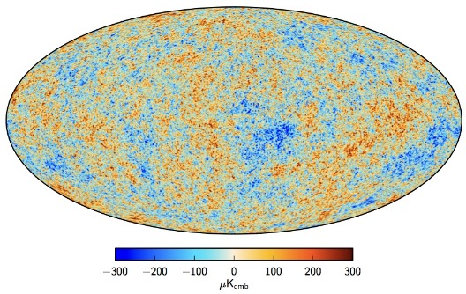
1. From WIMPs to Light DM
天文学观测
宇宙学观测
> 100 years
Dark
Matter
???
years
……
Notes:
理解暗物质本质的路注定坎坷。需要更长时间，更多的耐心。

Slide 4
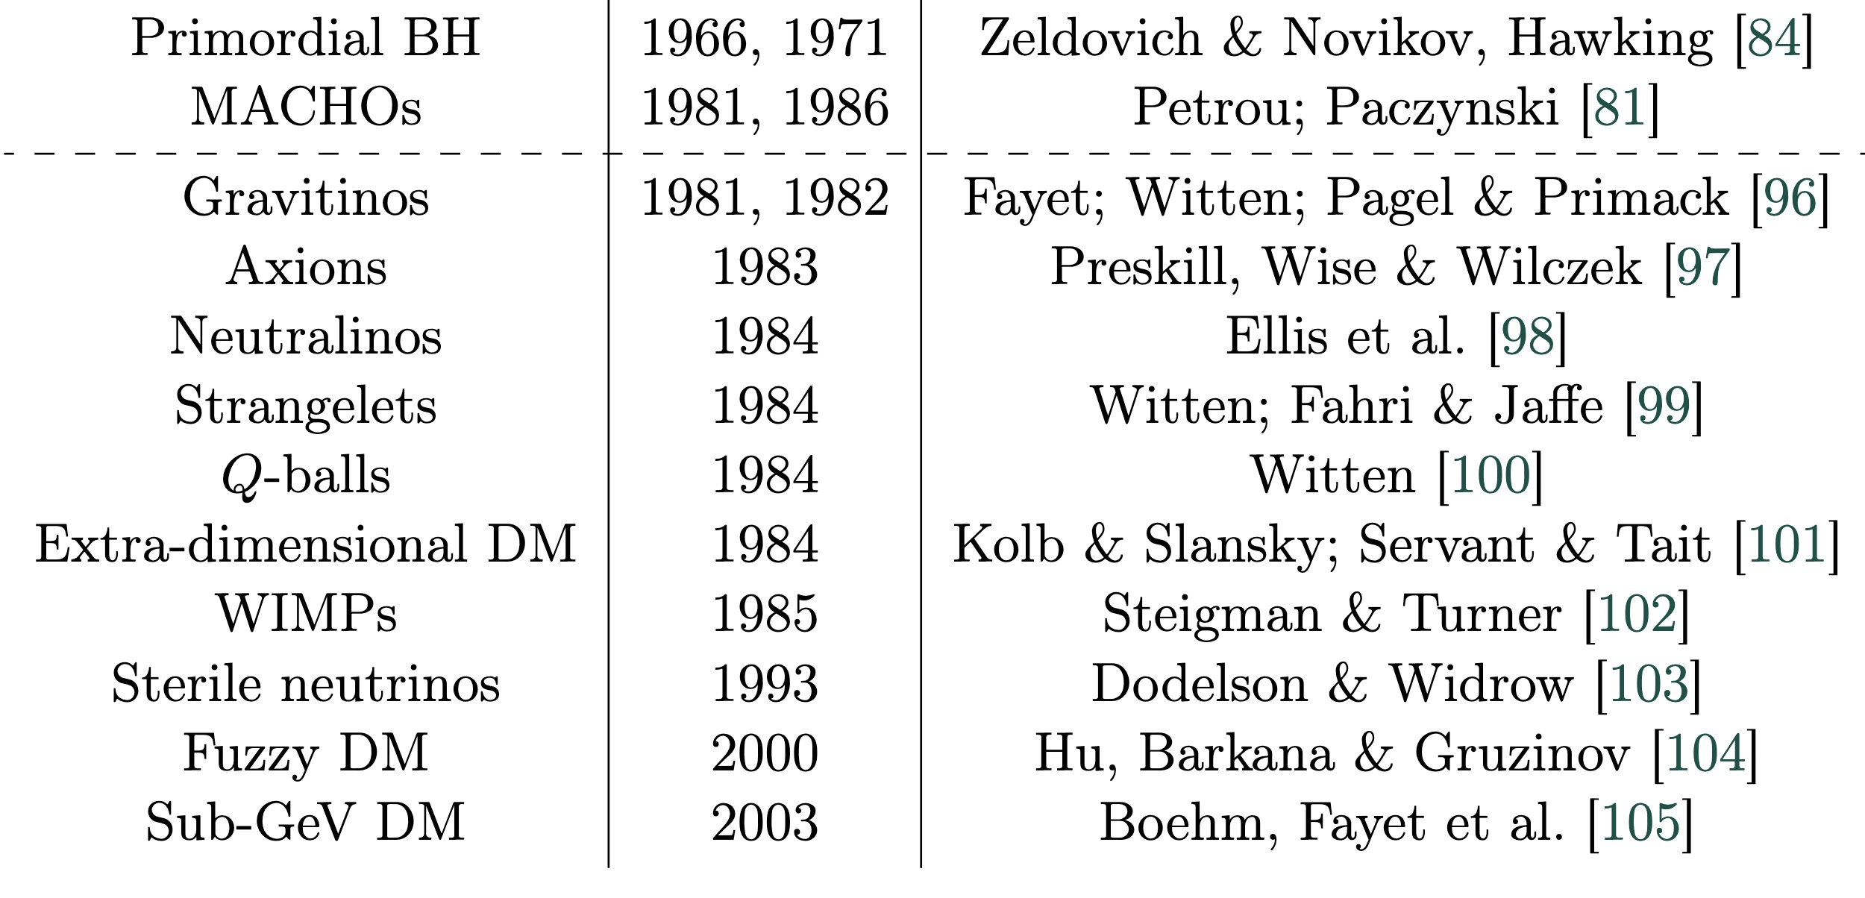
1. From WIMPs to Light DM
天体物理
粒
子
物
理
Relic
Abundance
Solution
to
Big problems

Slide 5
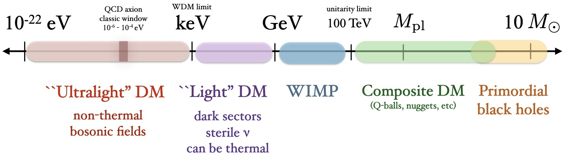
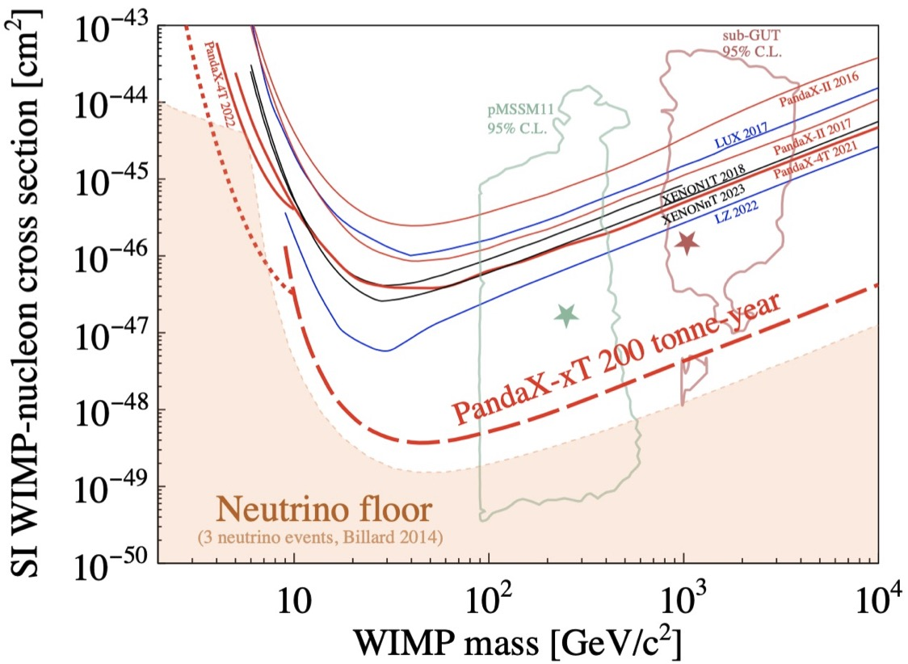
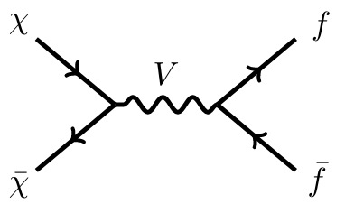
1. From WIMPs to Light DM
e.g. axion, see Jia Liu’s talk
T. Lin, 1904.07915
WIMPs
SUSY
Light DM
Below Neutrino fog
PandaX collaboration, 2402.03596

Slide 6
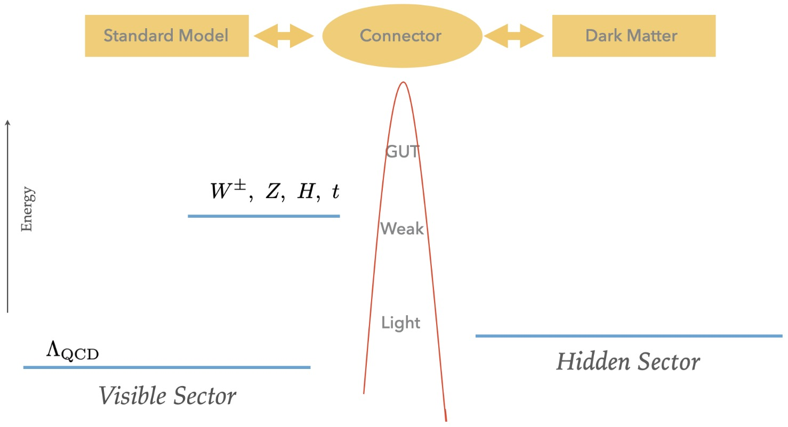
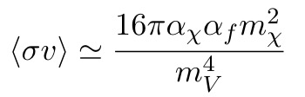



1. From WIMPs to Light DM
Hidden Valley DM
0604261
0305261
0711.4866
0803.4196
Light non-SM mediator
+
Notes:
In this talk, I will focus on the light dark matter, whose mass is lighter than a proton mass. In some way, this kind of dark matter can be considered as the variants of conventional WIMP dark matter. The light dark matter may also relate with other new physics hints, such as muon g-2, small scale structure, and etc. The probes of light dark matter are plentiful. We can probe the light dark matter from particle physics, astrophysics and cosmology. Here, I will talk about searching for light dark matter in direct detections.

Slide 7
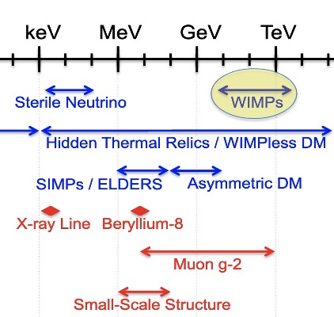
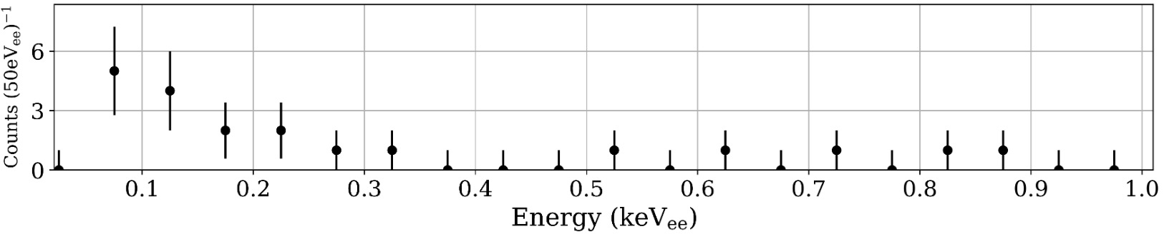
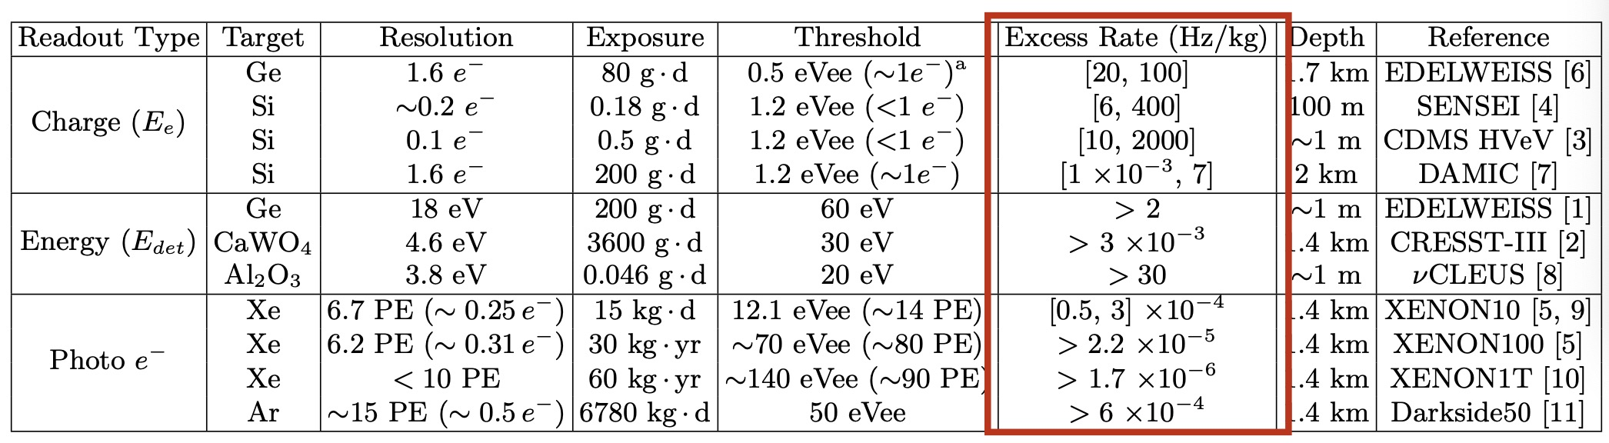

1. From WIMPs to Light DM
Data
2-3$σ$
2002.06937
Notes:
In this talk, I will focus on the light dark matter, whose mass is lighter than a proton mass. In some way, this kind of dark matter can be considered as the variants of conventional WIMP dark matter. The light dark matter may also relate with other new physics hints, such as muon g-2, small scale structure, and etc. The probes of light dark matter are plentiful. We can probe the light dark matter from particle physics, astrophysics and cosmology. Here, I will talk about searching for light dark matter in direct detections.

Slide 8
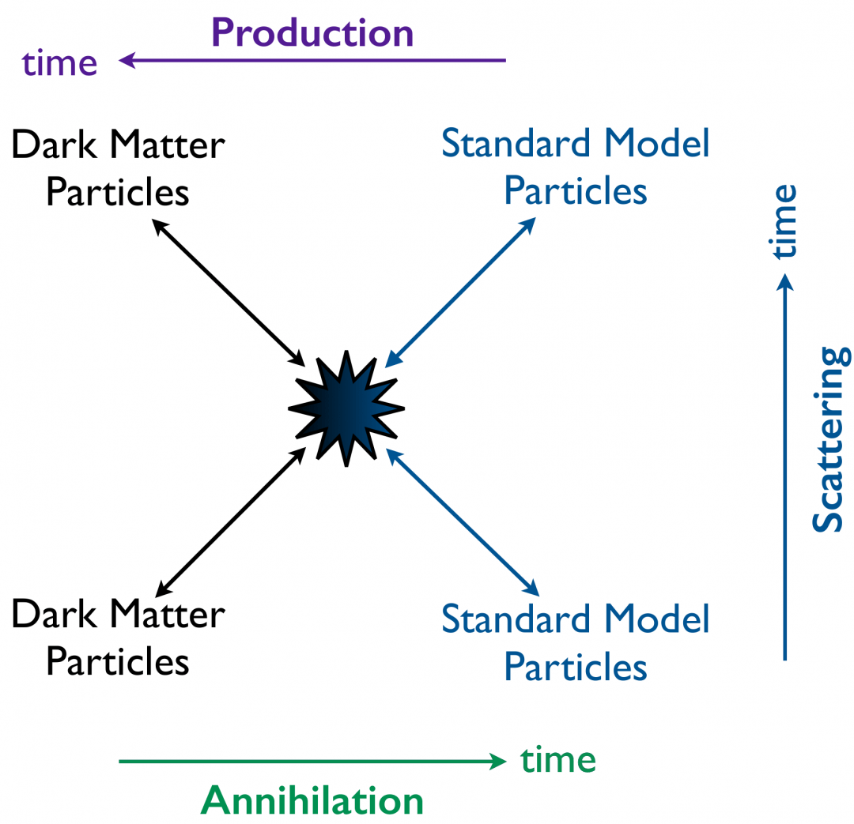
1. From WIMPs to Light DM
BBN, CMB
Large Scale Structure
Stellar Evolution and Cooling
Meson decays
Notes:
Besides WIMP dark matter, we also have may other candidates, such as axion dark matter, light dark matter, primordial black hole and etc. In this talk, I will focus on the light dark matter, whose mass is lighter than a proton mass. In some way, this kind of dark matter can be considered as the variants of conventional WIMP dark matter. The light dark matter may also relate with other new physics hints, such as muon g-2, small scale structure, and etc. The probes of light dark matter are plentiful. We can probe the light dark matter from particle physics, astrophysics and cosmology. Here, I will talk about searching for light dark matter in direct detections.

Slide 9
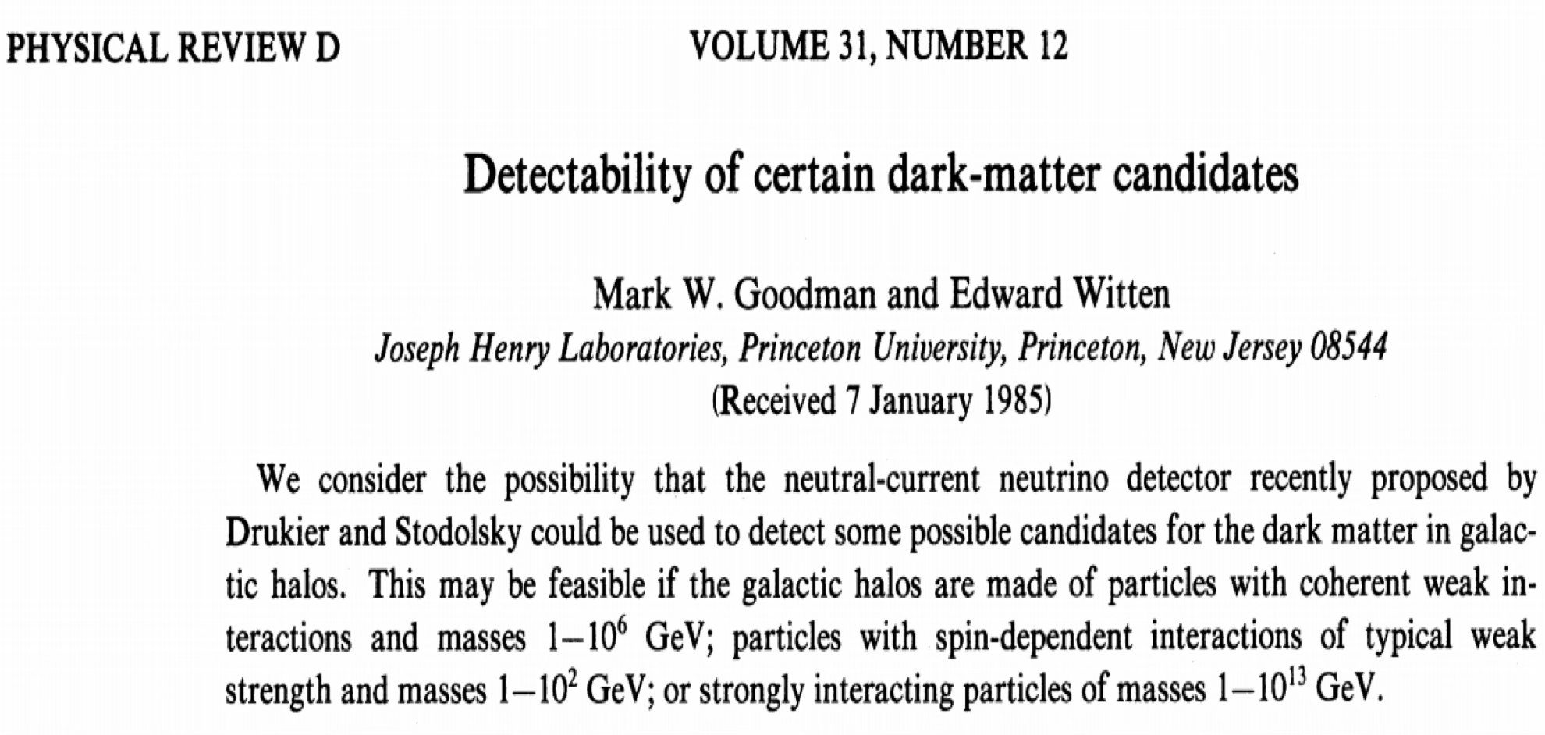
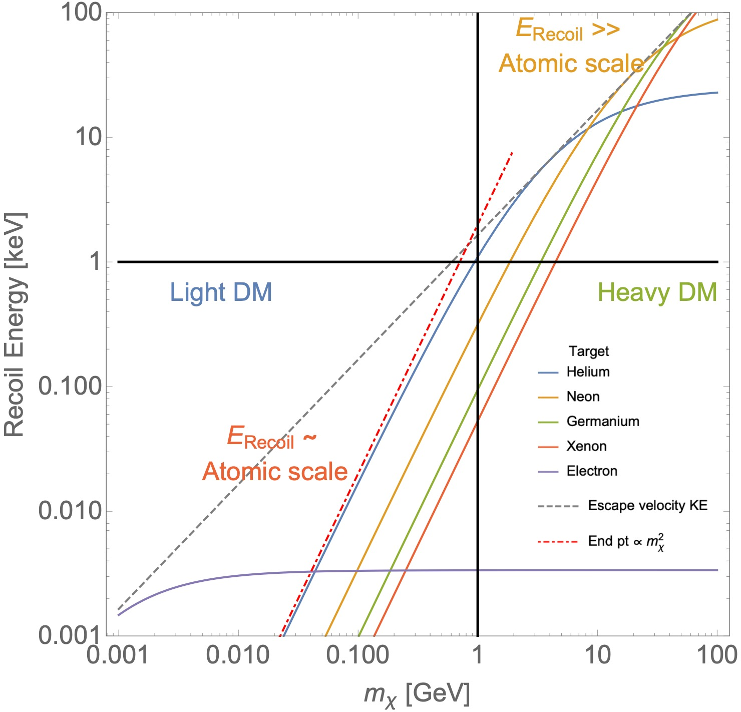
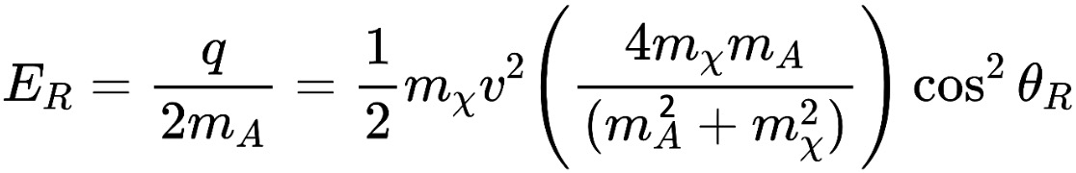
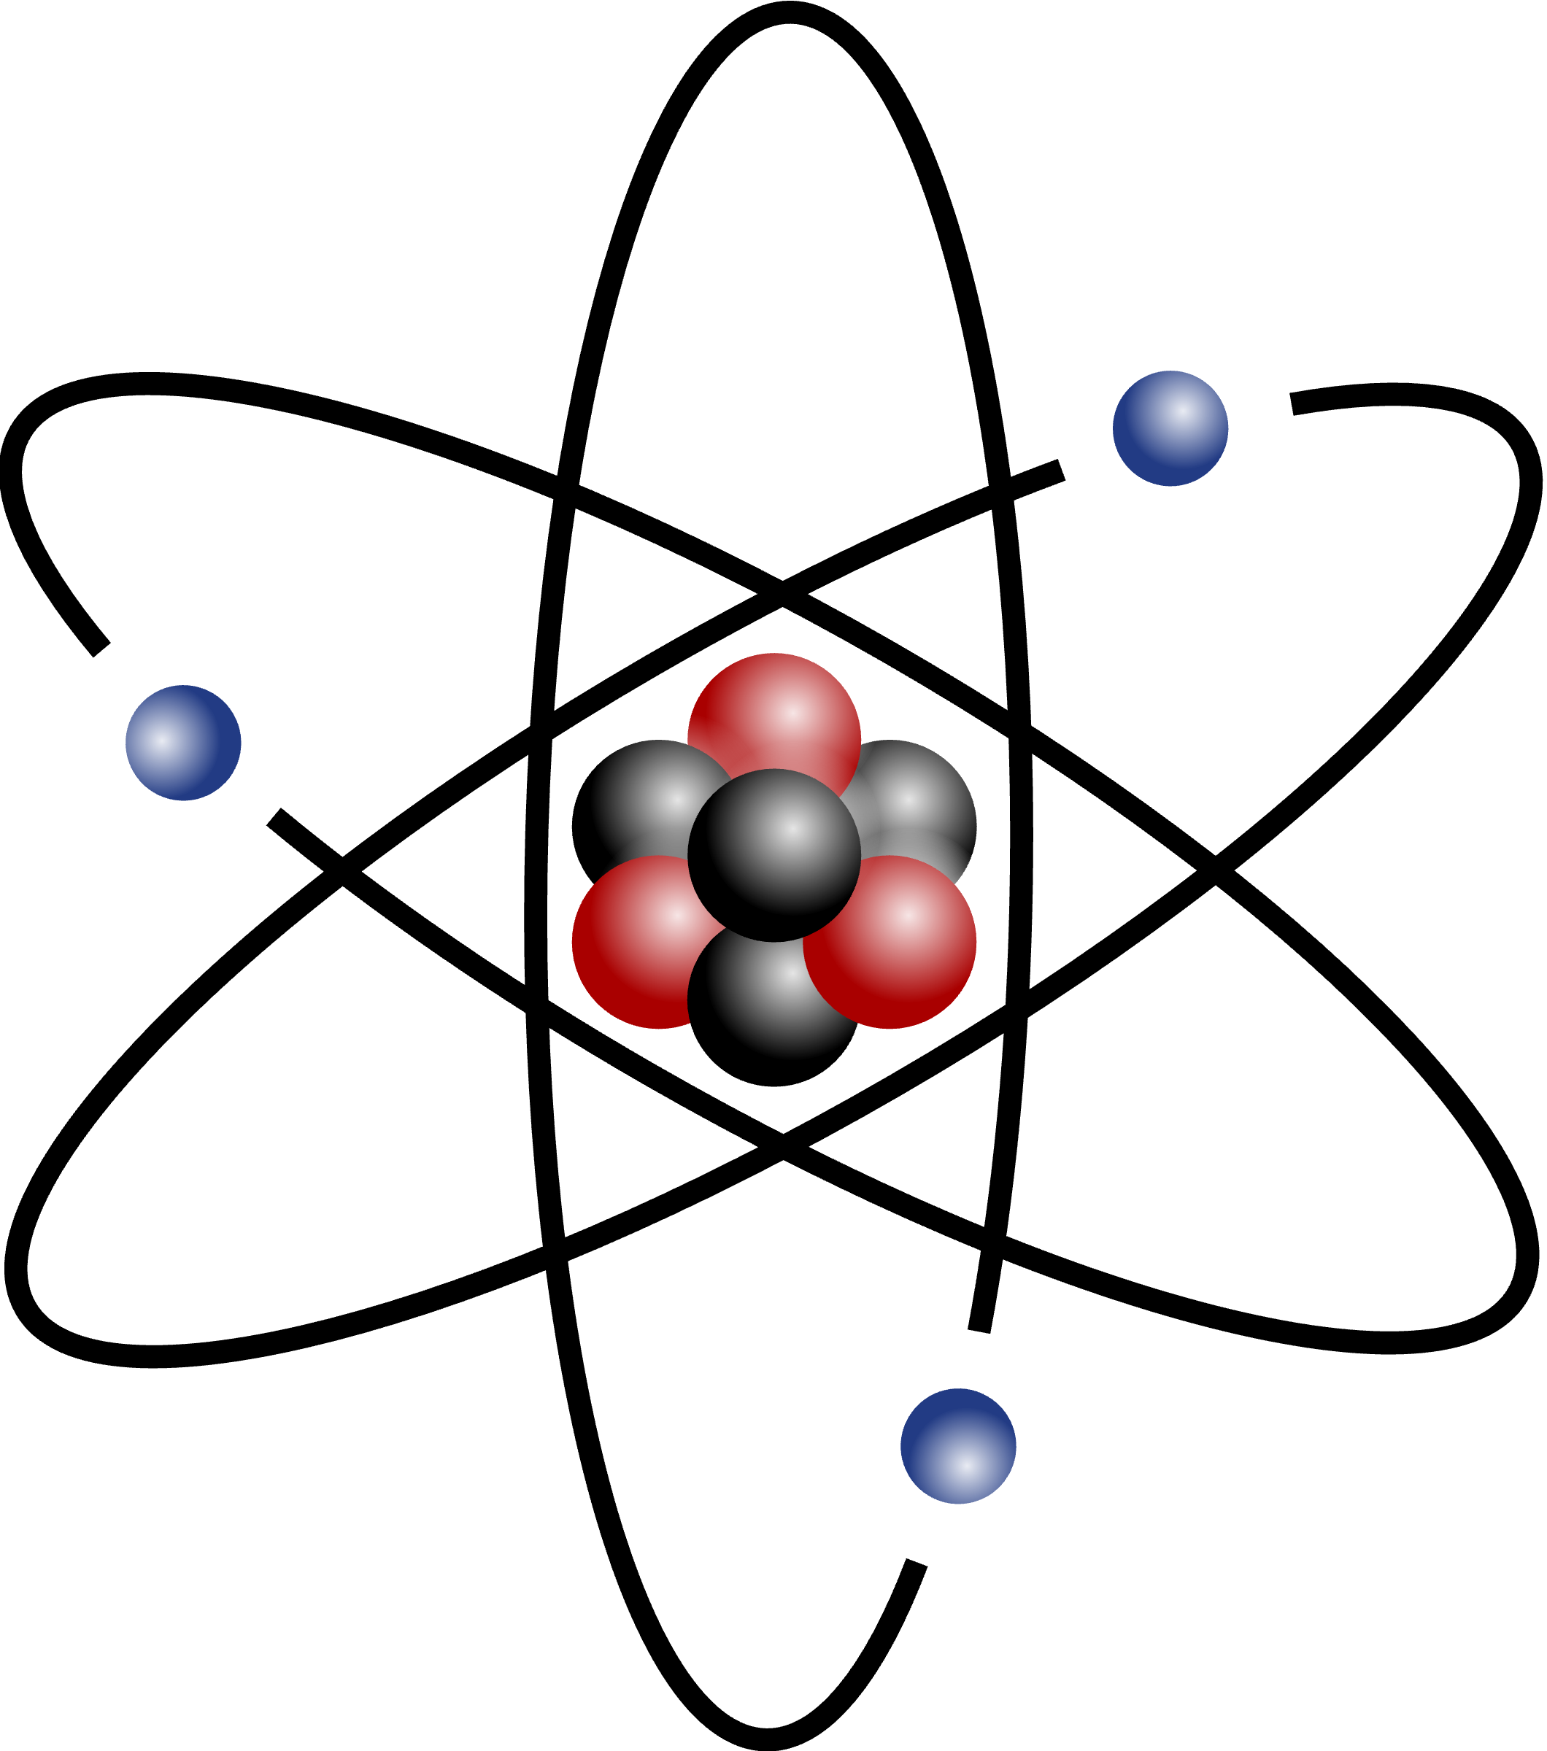

2. Electronic Collective Excitations : Plasmons
Nucleus recoiling
DM
Ionized electron
e
DM
DM
DM
～keV
～0. KeV
Notes:
When we shift from WIMPs to light dark matter, there are two important questions to address: the first is how to get the correct relic density. A fessible way is to introduce the light non-SM mediator, such as secluded dark matter or other new mechanisms. The second question is whether we can detect the light dark matter in direct detection experiments. As we know, if the dark matter mass is lighter than 1 GeV, its nucleus recoil energy in elastic scattering process are usually below the threshold of the detector, and thus can not be observed.

Slide 10
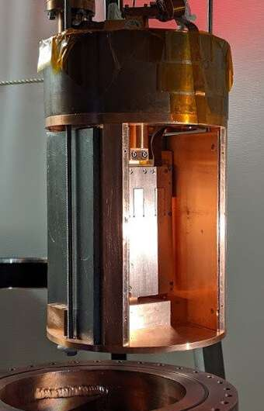
2. Electronic Collective Excitations : Plasmons
Technology (Skipper-CCD)
Conduction bands
detector
DM
Bandgap: ~ eV
DM
Valence bands
Sensei @ SNOLab
Electron recoil ionizing 1−6 e⁻ in the detector, which corresponds to (∼1.2–20 eV) energy depositions
Notes:
When we shift from WIMPs to light dark matter, there are two important questions to address: the first is how to get the correct relic density. A fessible way is to introduce the light non-SM mediator, such as secluded dark matter or other new mechanisms. The second question is whether we can detect the light dark matter in direct detection experiments. As we know, if the dark matter mass is lighter than 1 GeV, its nucleus recoil energy in elastic scattering process are usually below the threshold of the detector, and thus can not be observed.

Slide 11
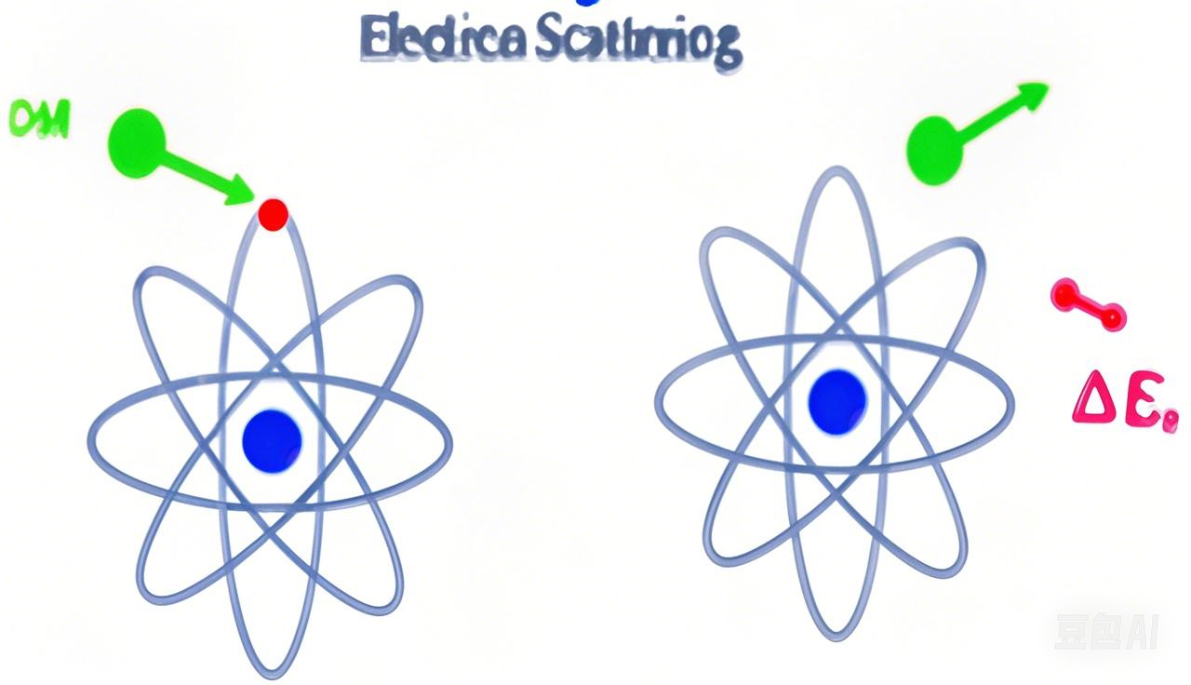
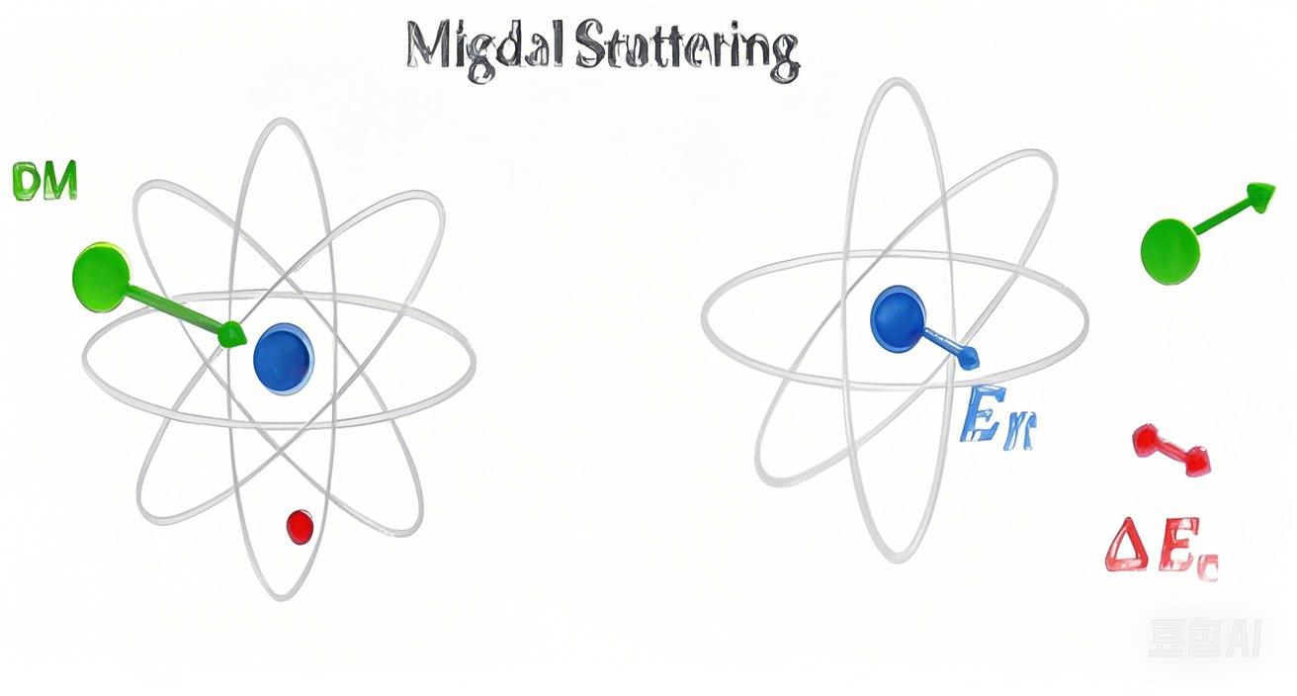

2. Electronic Collective Excitations: Plasmons
Ionization signals
(DM-e, Migdal effect)
Collective Excitations
Notes:
When we shift from WIMPs to light dark matter, there are two important questions to address: the first is how to get the correct relic density. A fessible way is to introduce the light non-SM mediator, such as secluded dark matter or other new mechanisms. The second question is whether we can detect the light dark matter in direct detection experiments. As we know, if the dark matter mass is lighter than 1 GeV, its nucleus recoil energy in elastic scattering process are usually below the threshold of the detector, and thus can not be observed.

Slide 12
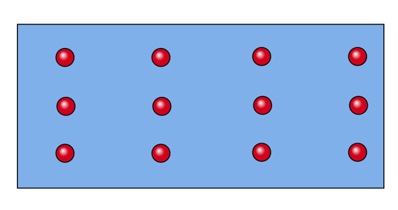
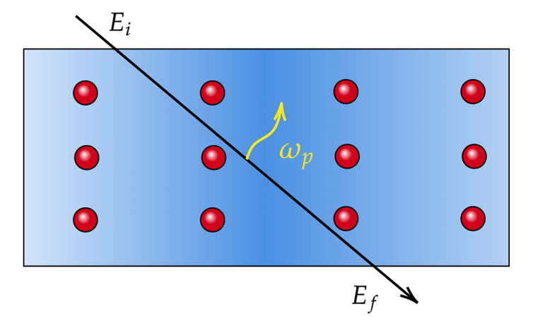
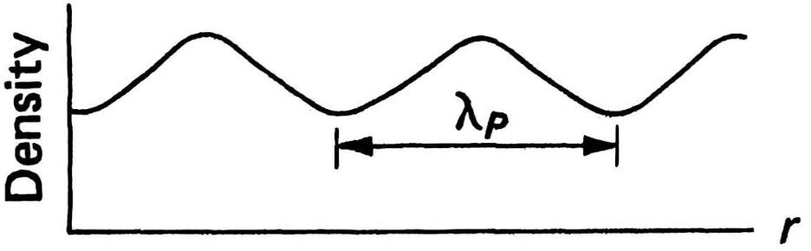
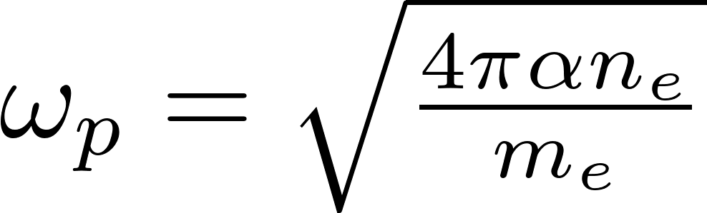
2. Electronic Collective Excitations: Plasmons
electron gas
+
ionic lattice
Plasma wave
Plasmon
quanta of electron density fluctuation
Notes:
Besides nucleus recoils, the dark matter may interact with the electron directly. In particular, for the semiconductor, the energy gap between the conduction band and valence band are very small. This indicates we can access to a lighter dark matter in the solid detector. Moreover, the collective excitation effect, namely the plasmon effect in the semiconductor, can be further used to improve the limits. In the condensate physics, such an effect can be described by the dielectric function. It is a complex function. The real part reflects the electronic structure of the material, and the imaginary part reflects the dissipation process.

Slide 13
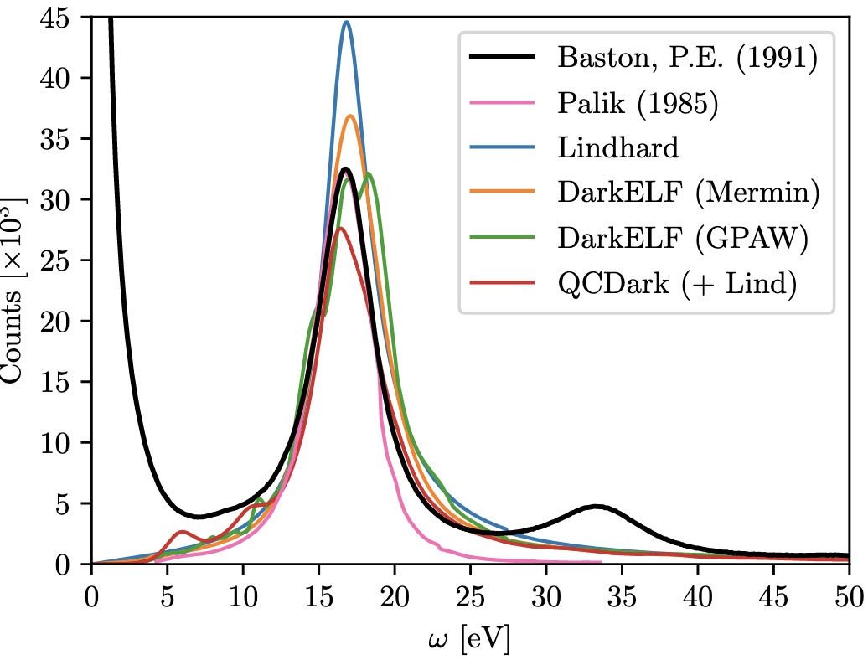

2. Electronic Collective Excitations: Plasmons
How to identify plasmons: Electron Energy Loss Spectroscopy (EELS)
Notes:
Besides nucleus recoils, the dark matter may interact with the electron directly. In particular, for the semiconductor, the energy gap between the conduction band and valence band are very small. This indicates we can access to a lighter dark matter in the solid detector. Moreover, the collective excitation effect, namely the plasmon effect in the semiconductor, can be further used to improve the limits. In the condensate physics, such an effect can be described by the dielectric function. It is a complex function. The real part reflects the electronic structure of the material, and the imaginary part reflects the dissipation process.

Slide 14

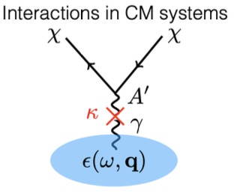

3. Detecting LDM with Plasmons
Liang, Su, LW, Zhu, 2401.11971
DM-induced Plasmon Signals in Solid Detector
Electronic Structure
(polarization)
Dissipation Processes
(absorption and scattering)
Dielectric Function
Notes:
Besides nucleus recoils, the dark matter may interact with the electron directly. In particular, for the semiconductor, the energy gap between the conduction band and valence band are very small. This indicates we can access to a lighter dark matter in the solid detector. Moreover, the collective excitation effect, namely the plasmon effect in the semiconductor, can be further used to improve the limits. In the condensate physics, such an effect can be described by the dielectric function. It is a complex function. The real part reflects the electronic structure of the material, and the imaginary part reflects the dissipation process.

Slide 15
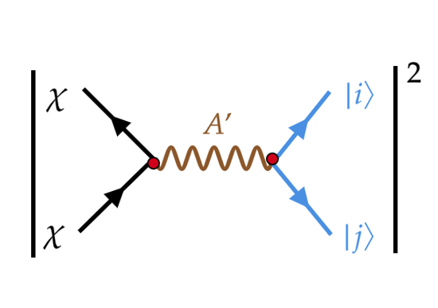
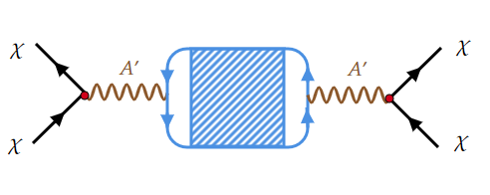
3. Detecting LDM with Plasmons
Liang, Su, LW, Zhu, 2401.11971
Benchmark Model :
Notes:
Supposing a vector interaction between dark matter and the electron, we can derive the scattering cross section, which is proportional to the imaginary part of the inverse dielectric function. We usually call it energy loss function, which can be calculated by the density functional theory. Here you can see the energy loss function can be very large in the low transferred energy and momentum region. This is so called plasmon effect. We also check the condition for a DM to produce such an effect. We found that a relativistic DM is needed.

Slide 16
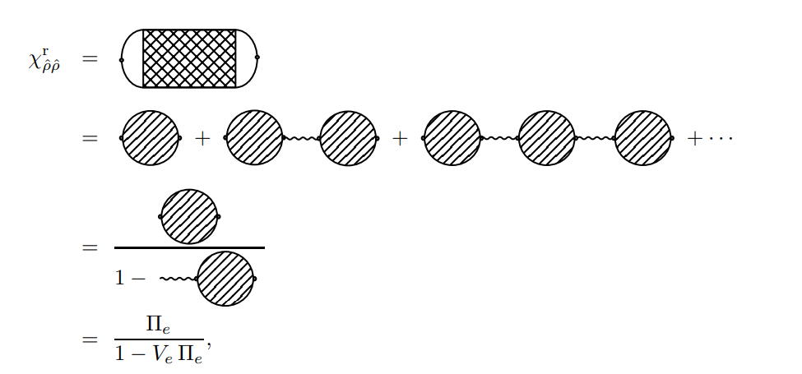

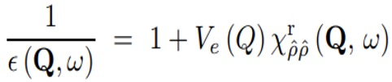

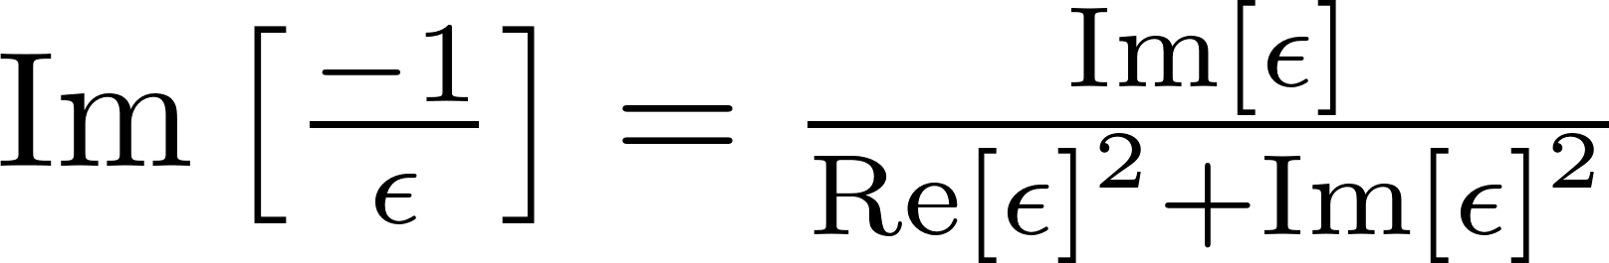
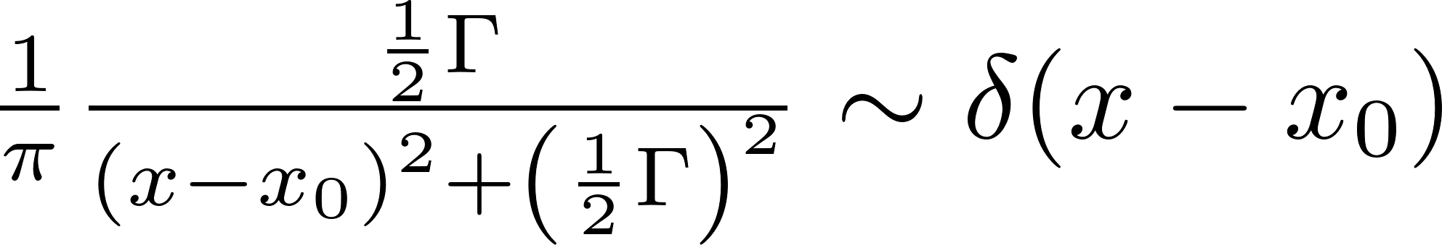
3. Detecting LDM with Plasmons
Liang, Su, LW, Zhu, 2401.11971
Density-Density correlation function (RPA)
Lindhard function
Dielectric Function
Energy Loss Function (ELF)
DM scattering rate
Scattering potential
Notes:
Supposing a vector interaction between dark matter and the electron, we can derive the scattering cross section, which is proportional to the imaginary part of the inverse dielectric function. We usually call it energy loss function, which can be calculated by the density functional theory. Here you can see the energy loss function can be very large in the low transferred energy and momentum region. This is so called plasmon effect. We also check the condition for a DM to produce such an effect. We found that a relativistic DM is needed.

Slide 17
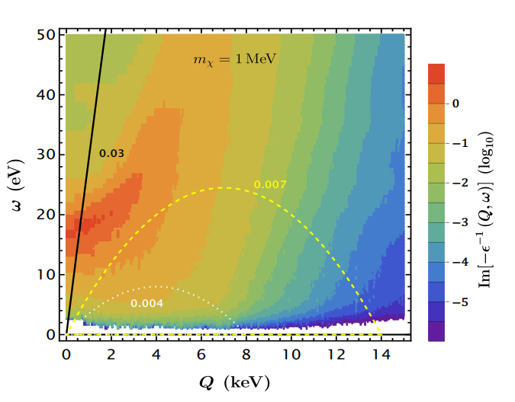

3. Detecting LDM with Plasmons
Liang, Su, LW, Zhu, 2401.11971
Si
Energy Loss Function:
Density Functional Theory
Resonance (plasmon) :
|Q| < 5 keV, ω ∼ 15 eV
To excite plasmon:
V_{min} > q/ω
DM velocity
Low deposited energy
Relativistic Dark Matter
Notes:
Besides nucleus recoils, the dark matter may interact with the electron directly. In particular, for the semiconductor, the energy gap between the conduction band and valence band are very small. This indicates we can access to a lighter dark matter in the solid detector. Moreover, the collective excitation effect, namely the plasmon effect in the semiconductor, can be further used to improve the limits. In the condensate physics, such an effect can be described by the dielectric function. It is a complex function. The real part reflects the electronic structure of the material, and the imaginary part reflects the dissipation process.

Slide 18
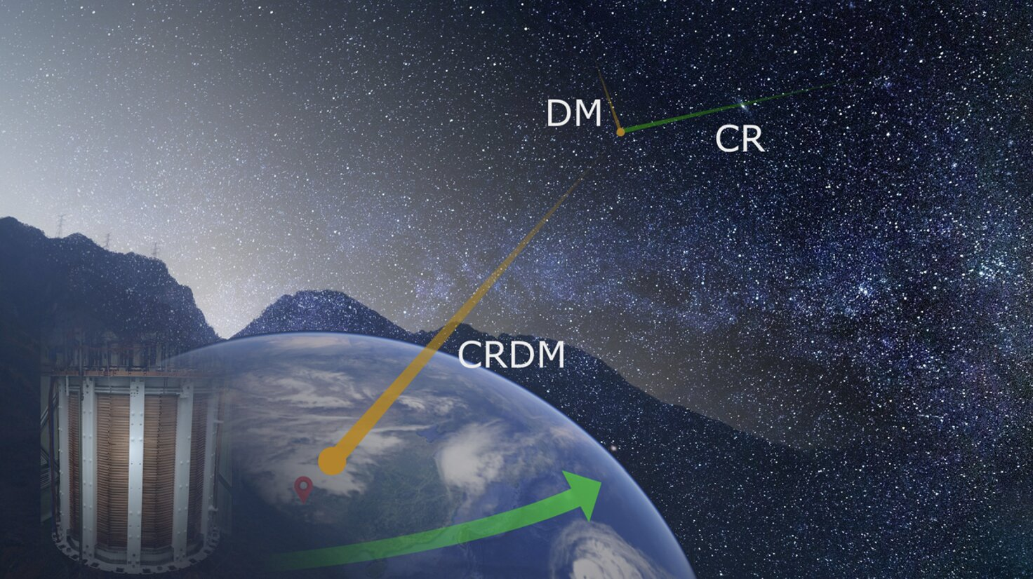
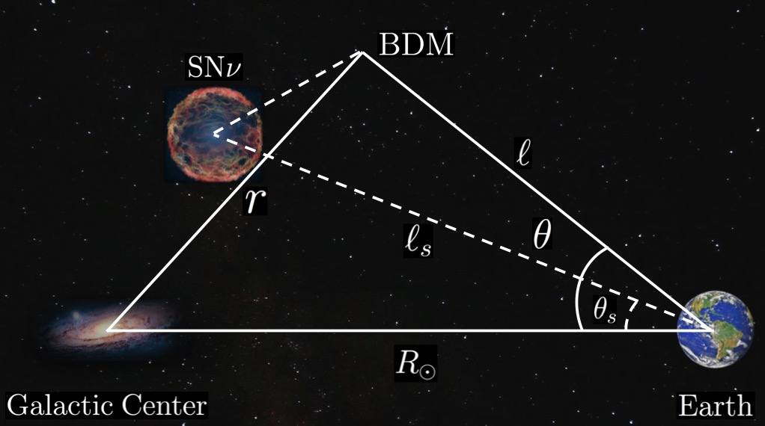
3. Detecting LDM with Plasmons
Cosmic Ray
Supernova Neutrino
0908.1790
1506.03825
2501.07591
1810.07705
1810.10543
Notes:
So we considered the cosmic ray boosted dark matter, in which the dark matter get more energy via its interaction with the electron and positron in high energy cosmic rays. Then, using the sensei data from snolab, we can get the electronic excitation rate andthen transfer the spectrum into observable ionization charge.

Slide 19
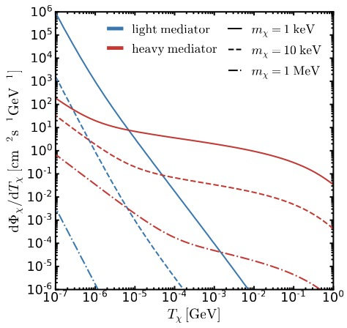


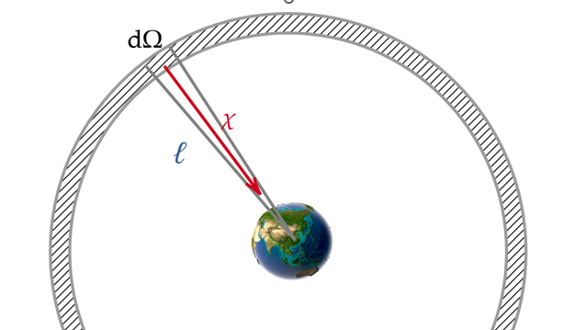

3. Detecting LDM with Plasmons
Cosmic Ray Boosted DM
Liang, Su, LW, Zhu, 2401.11971
CRs
CRs
DM
DM
Notes:
So we considered the cosmic ray boosted dark matter, in which the dark matter get more energy via its interaction with the electron and positron in high energy cosmic rays. Then, using the sensei data from snolab, we can get the electronic excitation rate andthen transfer the spectrum into observable ionization charge.

Slide 20
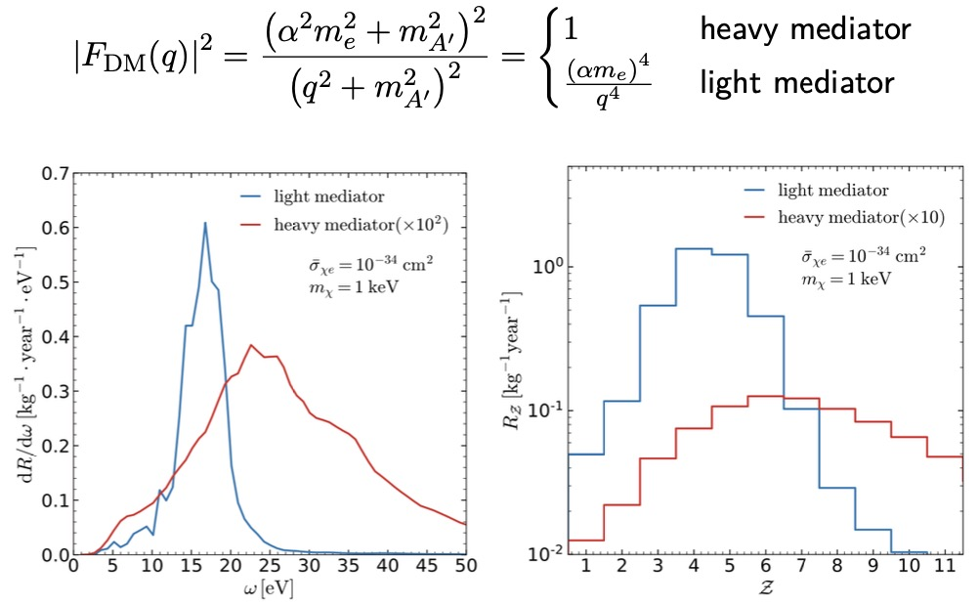
3. Detecting LDM with Plasmons
Liang, Su, LW, Zhu, 2401.11971
Notes:
So we considered the cosmic ray boosted dark matter, in which the dark matter get more energy via its interaction with the electron and positron in high energy cosmic rays. Then, using the sensei data from snolab, we can get the electronic excitation rate andthen transfer the spectrum into observable ionization charge.

Slide 21
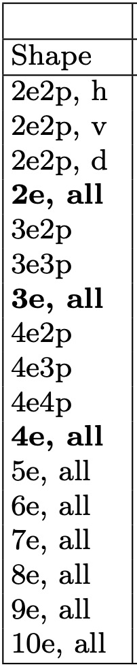
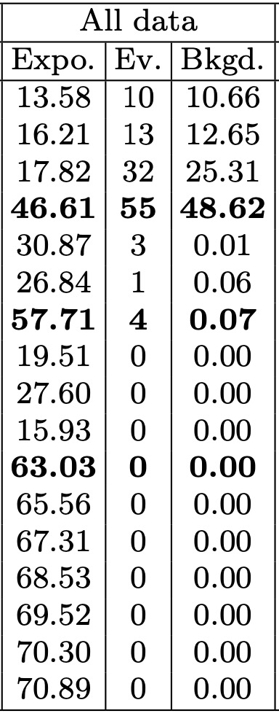
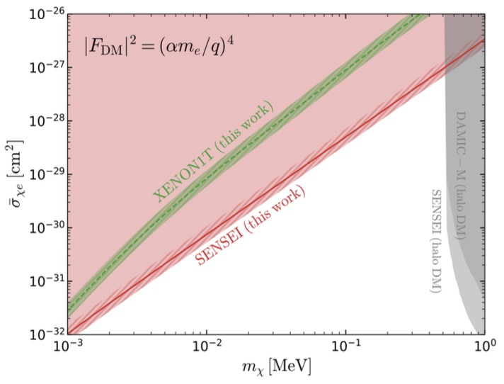
3. Detecting LDM with Plasmons
Liang, Su, WU, Zhu, 2401.11971
2312.13342
SENSEI @ SNOLAB
Light Dark Matter | Noble Liquid Detector (large volume, high threshold) | Solid detector (small volume, low threshold)
Non-Relativistic | ✔️ | ✔️
Relativistic | ✔️ | Collective Excitations
Notes:
Finally, we can derive the limits of DM-electron scattering cross sections. We can see that the limit for light mediator is stronger than that from the Xenon1T, while in the heavy mediator case, it is much weaker than that from xenon1T.
To summarize, a non-relativistic light dark matter can be probed via the Migdal effect in the large noble liquid detector even with the high threshold, while for a relativistic light dark matter, in light of the plasmon effect, one can get a stronger limit even in small solid detector with the low threshold.

Slide 22

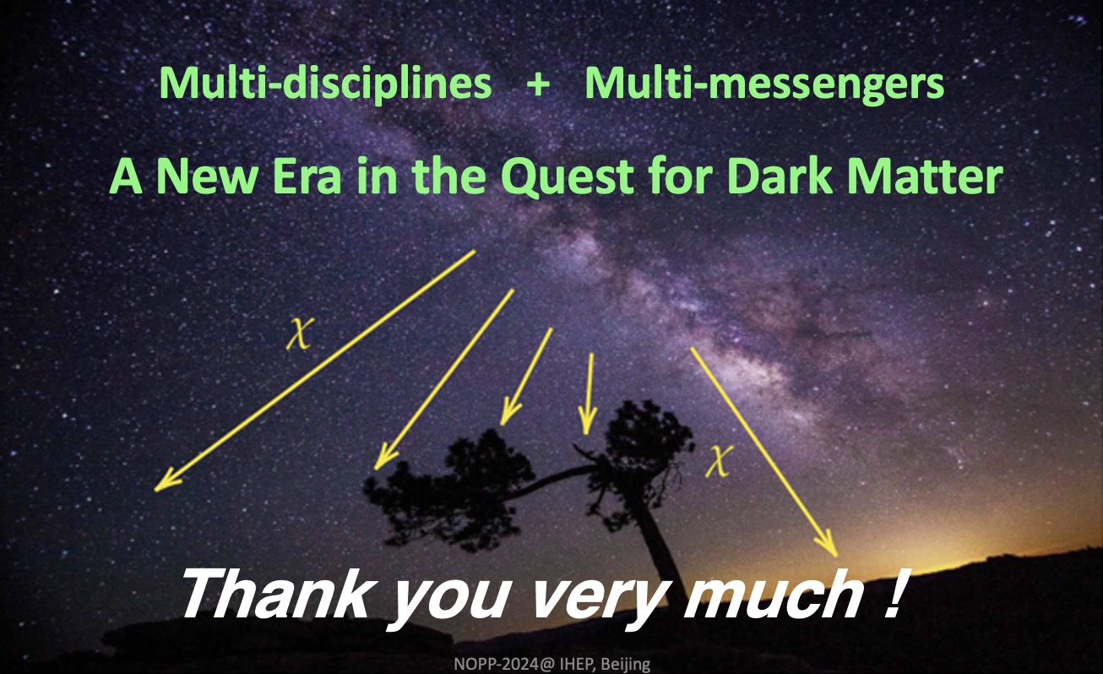
Conclusions
Dark Matter Particle
Direct Detection
(~ 40 years, 9 orders)
2020-Now
2012-Now
1983-Now
Collective Excitations
DM-e
DM-N
Thank you very much !

Slide 23
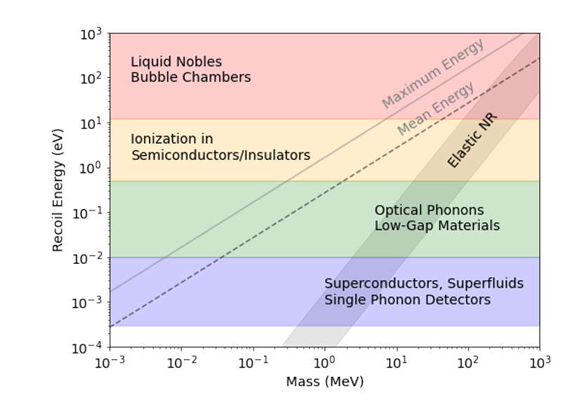
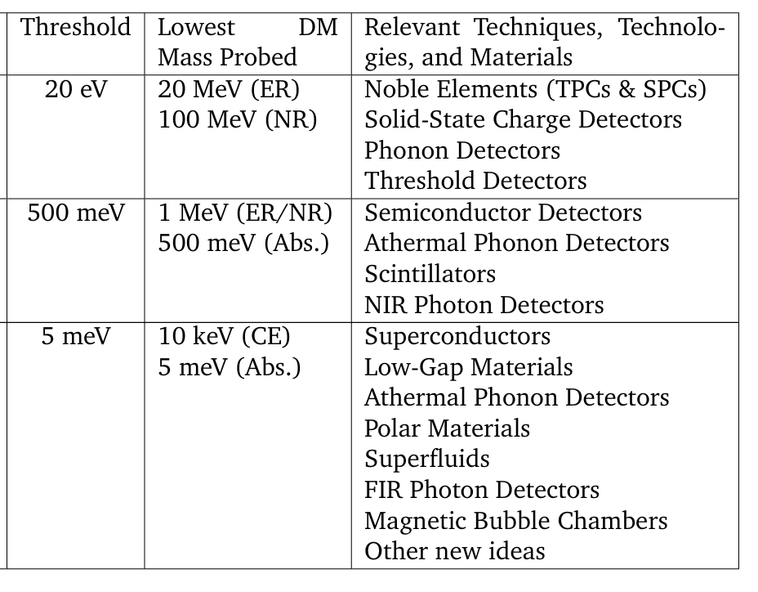
Back Up
Rouven Essig, et.al, arxiv: 2203.08297

Slide 24
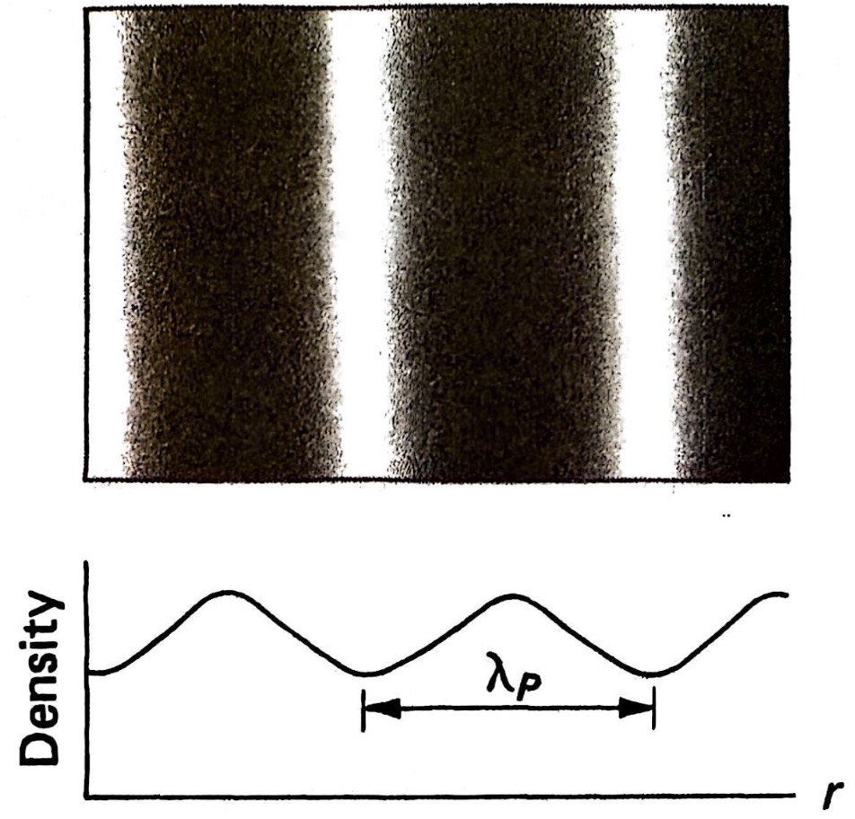
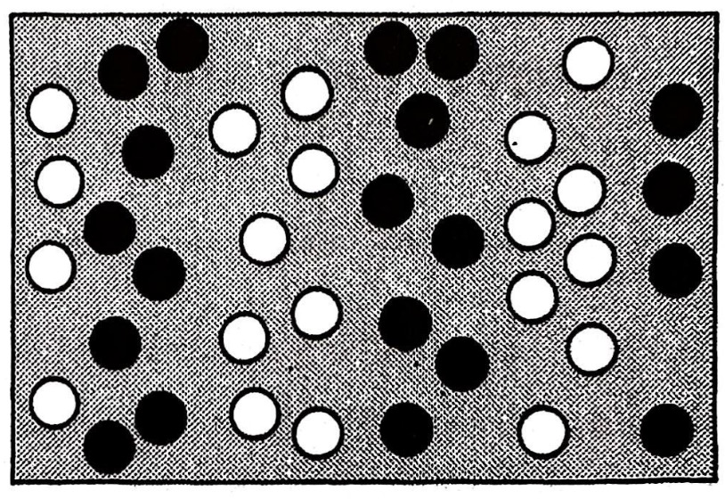
Electron- Particle hole Picture of
Plasma Wave
Plasma Wave in Electron Gas

Slide 25
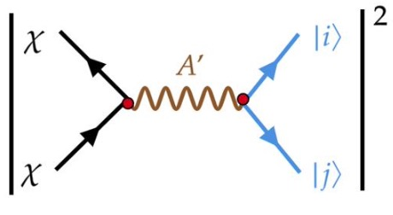
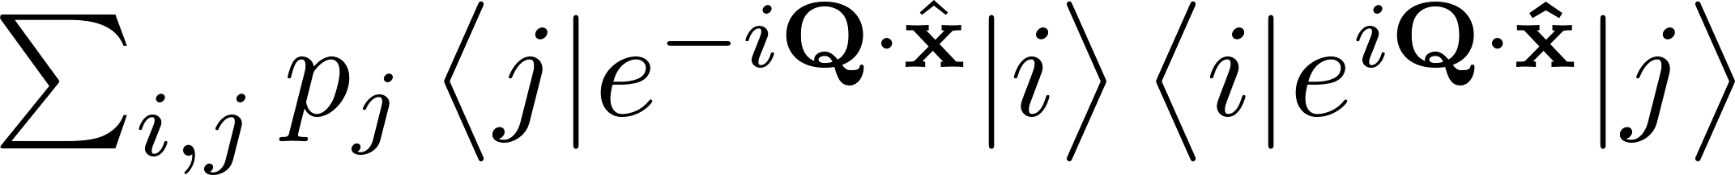
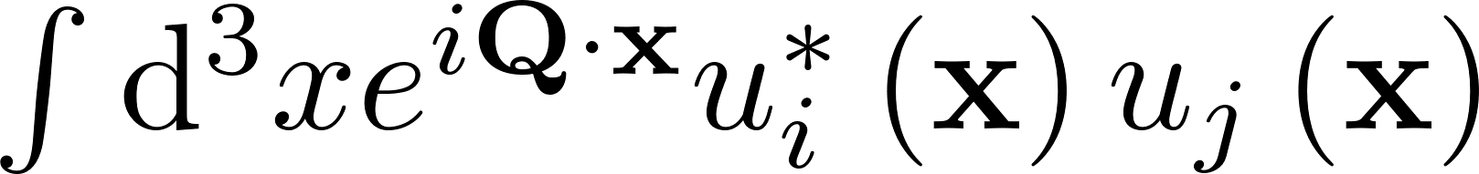


Back Up

Slide 26

Back Up
The calculation of dielectric function:
DarkELF: Including the real and imaginary parts of the dielectric function calculated using the DFT software GPAW.
Simon Knapen, Jonathan Kozaczuk, and Tongyan Lin, Phys. Rev. D 105, 015014(2021).
The Lindhard method:
The Mermin method:
The GPAW method:
Assuming homogenous material and neglecting all dissipation effects.
A generalization of the Lindhard which includes dissipation.
It relies on a first principles calculation with package GPAW.

Slide 27


Back Up
e.g. Cosmic Ray DM
differential electronic excitation rate:

Slide 28



Back Up
DM-Electron scattering in semiconductor
Comparison with EELS data:
The results an incident electron beam kinetic energy of
The data of EELS
Overestimating the response
The position and height of peak is consistent, but GPAW predicts a slightly broader peak.
Underestimates
Ionization charge:
The elastic scattering between incident electrons and lattice, not electron-hole pair excitations.
1509.01598
Silicon: E_{gap} = 1.2eV and ε = 3.8eV.
Rouven Essig, et.al, arxiv: 2403.00123

Slide 29





where
Lindhard function

Slide 30


Slide 31


Slide 32



