Slide 1
强子与重味物理理论实验联合讨论会
Topological diagrams
of charmed baryon decays
报告人： 王 迪
单 位：湖南师范大学

Slide 2
强子与重味物理理论实验联合讨论会
Contents
1
Motivation
2
Topologies of charmed baryon decays
3
Linear correlation of topologies
4
Test the K$\ddot{o}$rner-Pati-Woo theorem
5
Summary

Slide 3
强子与重味物理理论实验联合讨论会
Contents
1
Motivation
2
Topologies of charmed baryon decays
3
Linear correlation of topologies
4
Test the K$\ddot{o}$rner-Pati-Woo theorem
5
Summary

Slide 4
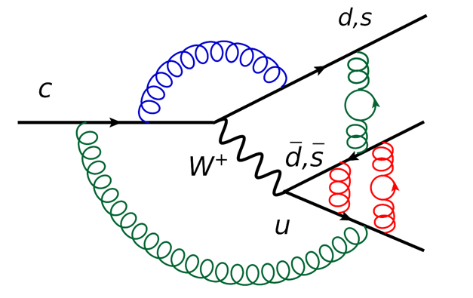
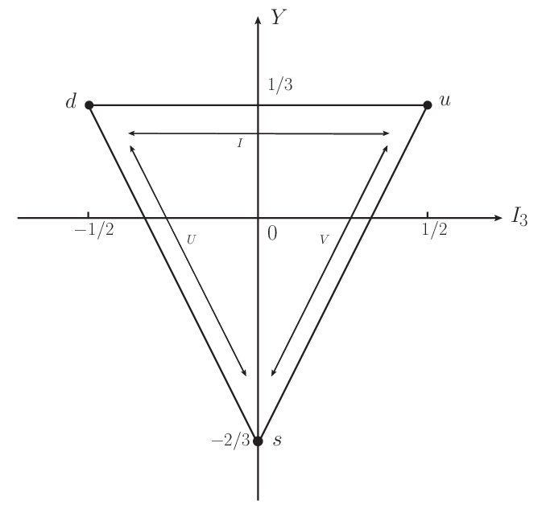
强子与重味物理理论实验联合讨论会
Charmed baryon weak decay
Non-perturbative
Three quarks, complex system
After 2016
Lu:2016ogy, Wang:2017azm, Shi:2017dto, Geng:2017esc, Geng:2017mxn, Wang:2017gxe, He:2018php, Wang:2018utj, He:2018joe, Geng:2018plk, Geng:2018bow, Jia:2019zxi, Geng:2019bfz, Wang:2020gmn, Li:2021rfj, He:2021qnc, Wang:2022wrb …
4

Slide 5
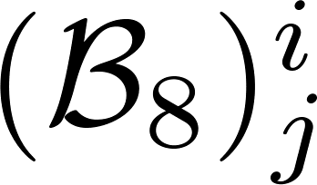
强子与重味物理理论实验联合讨论会
Topological diagram
Defined according to the topologies of quark flow in weak decays
Include all strong interaction effects, perturbative and non-perturbative
X. G. He, Y. J. Shi and W. Wang, Eur. Phys. J. C , no.5, 359 (2020). H. J. Zhao, Y. L. Wang, Y. K. Hsiao and Y. Yu, JHEP 02, 165 (2020). Y. K. Hsiao, Y. L. Wang and H. J. Zhao, JHEP 09, 035 (2022). H. Zhong, F. Xu and H. Y. Cheng, [arXiv:2404.01350 [hep-ph]].
Two baryon octets:
Completeness of topologies, missing penguin diagrams
Relation between topologies and SU(3) irreducible amplitudes
5

Slide 6
强子与重味物理理论实验联合讨论会
Contents
1
Motivation
2
Topologies of charmed baryon decays
3
Linear correlation of topologies
4
Test the K$\ddot{o}$rner-Pati-Woo theorem
5
Summary

Slide 7
强子与重味物理理论实验联合讨论会
Topologies of charmed baryon decays
Effective Hamiltonian
CKM
Operator
Hadrons
…
D. Wang, C. P. Jia and F. S. Yu, JHEP 09, 126 (2021).
7

Slide 8
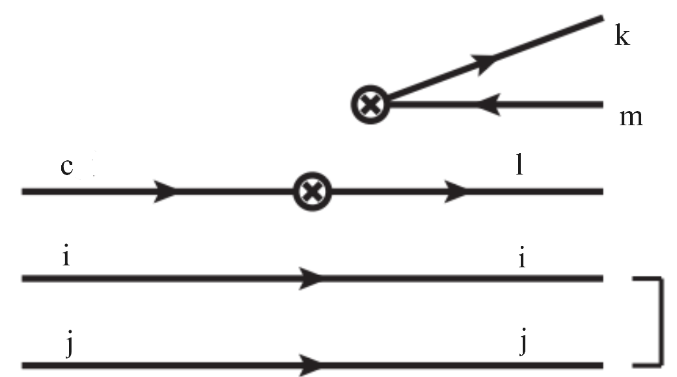
强子与重味物理理论实验联合讨论会
Topology Invariant Tensor
CG coefficient, mode-dependent
Reduced matrix element, mode-independent
Wigner-Eckart theorem
Index-contraction Quark flowing
arXiv:2406.14061
8

Slide 9
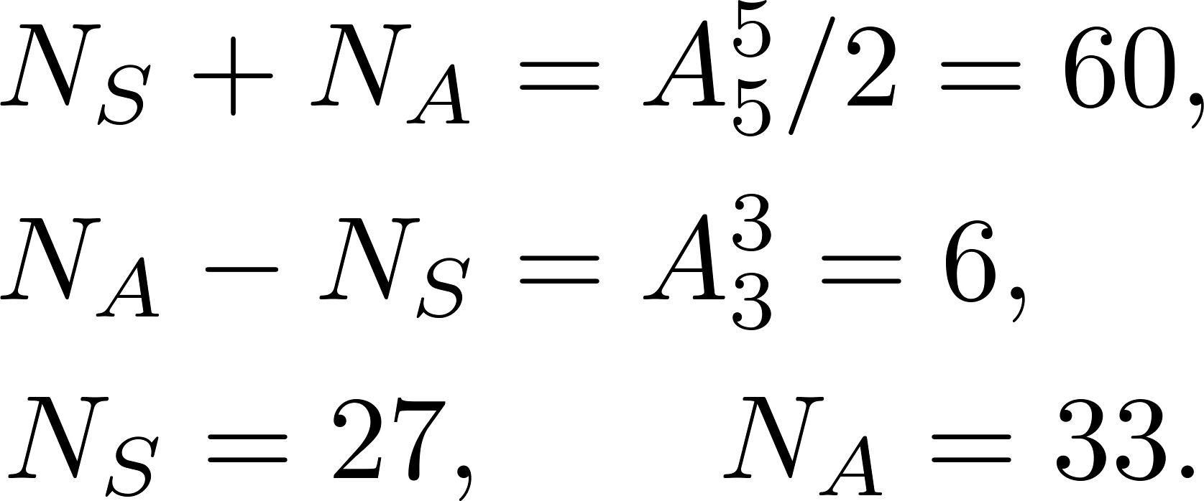
强子与重味物理理论实验联合讨论会
Completeness of topologies
Wavefunction of octet baryon
Decay amplitude
Completeness of topologies
Invariant tensor: all indices are contracted
Computed by permutation!
9

Slide 10
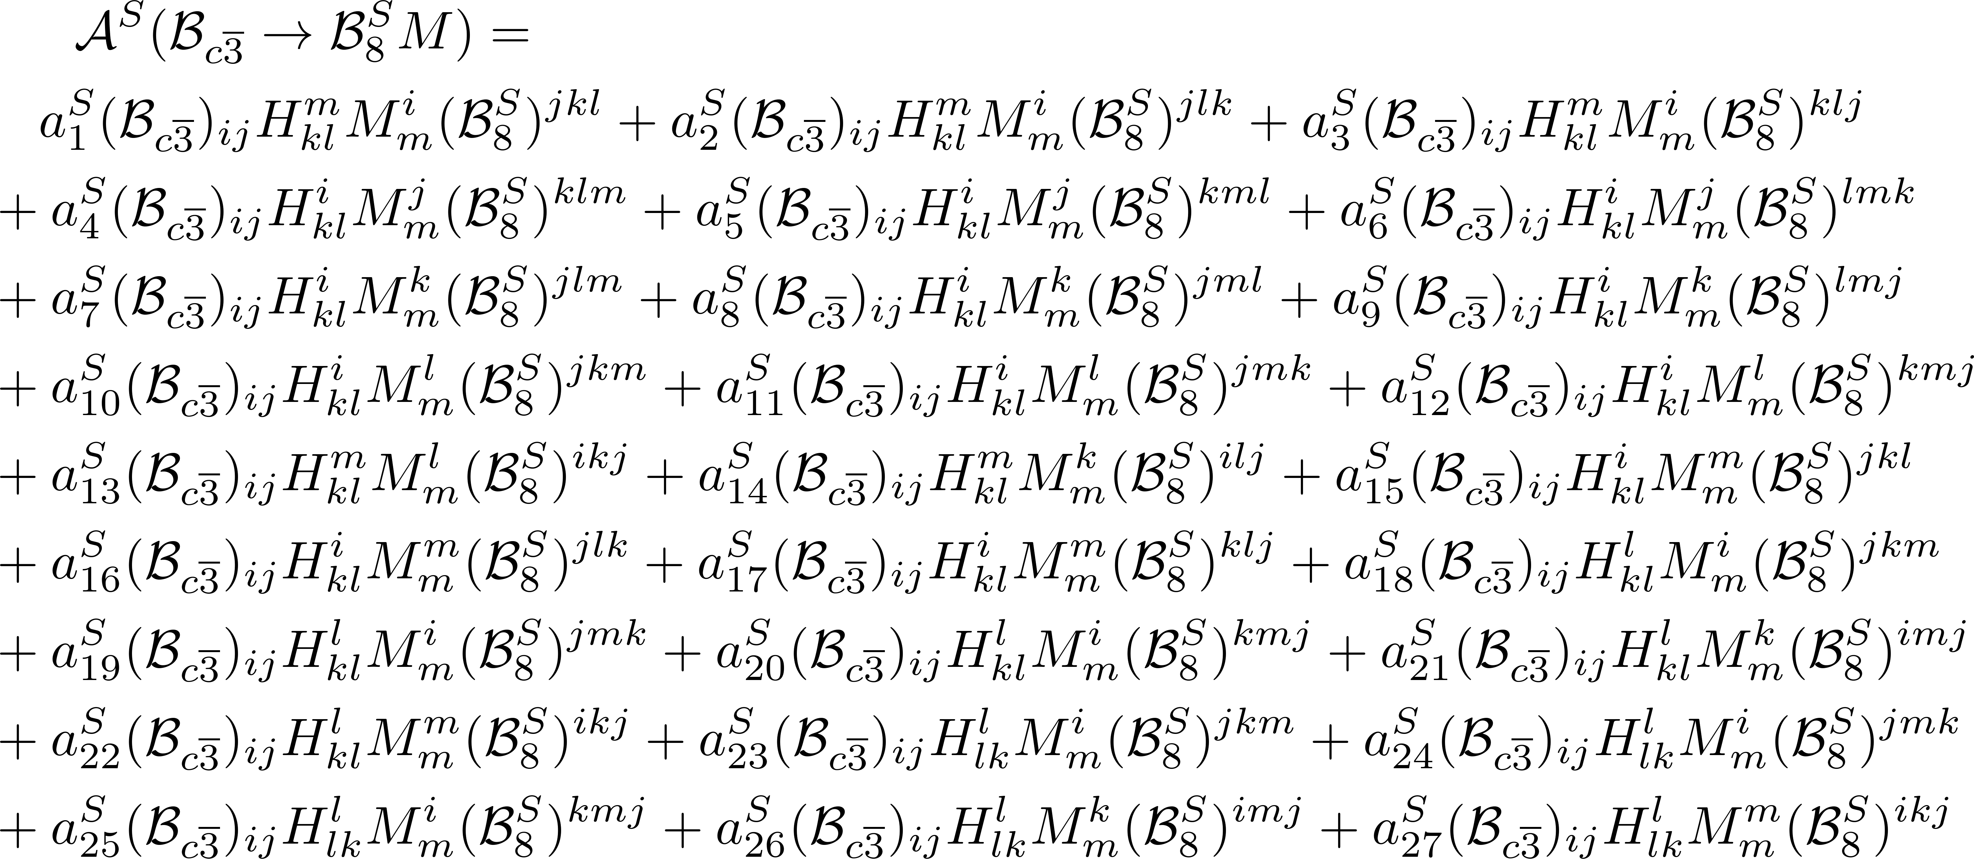
强子与重味物理理论实验联合讨论会
Topologies of charmed baryon decays (S)
10

Slide 11
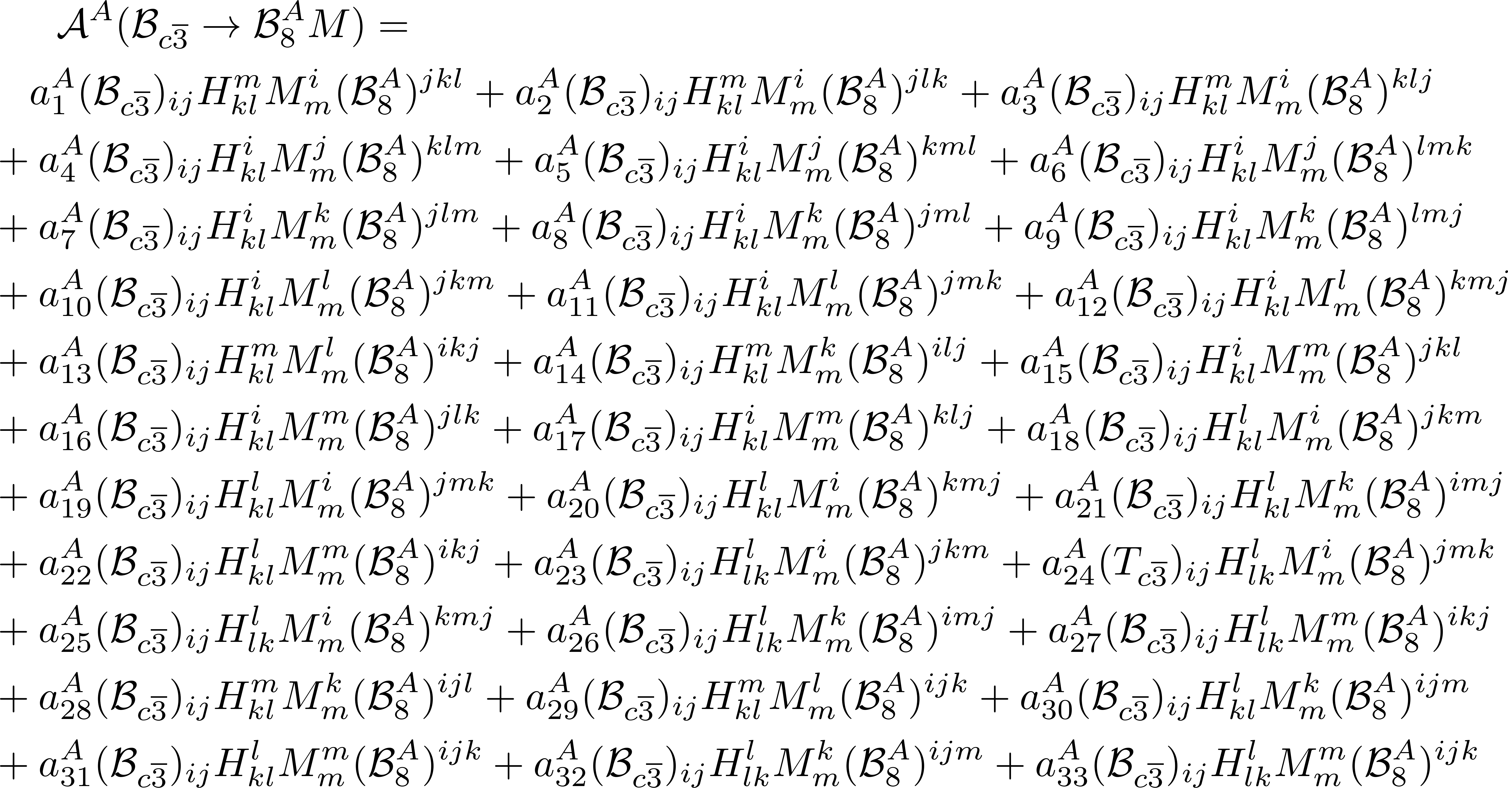
强子与重味物理理论实验联合讨论会
Topologies of charmed baryon decays (A)
11

Slide 12
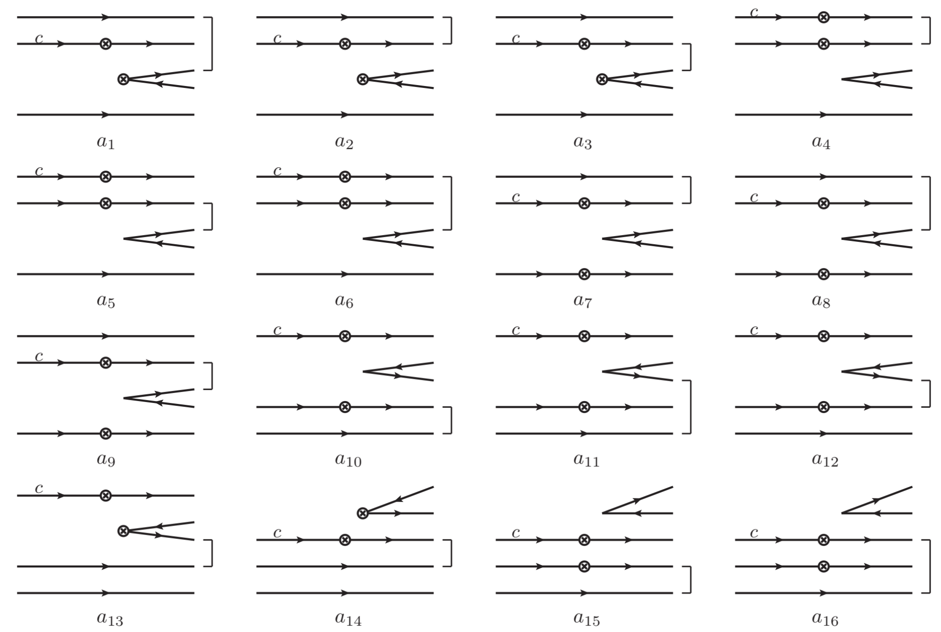
强子与重味物理理论实验联合讨论会
Topologies in charmed baryon decays (A)
12

Slide 13
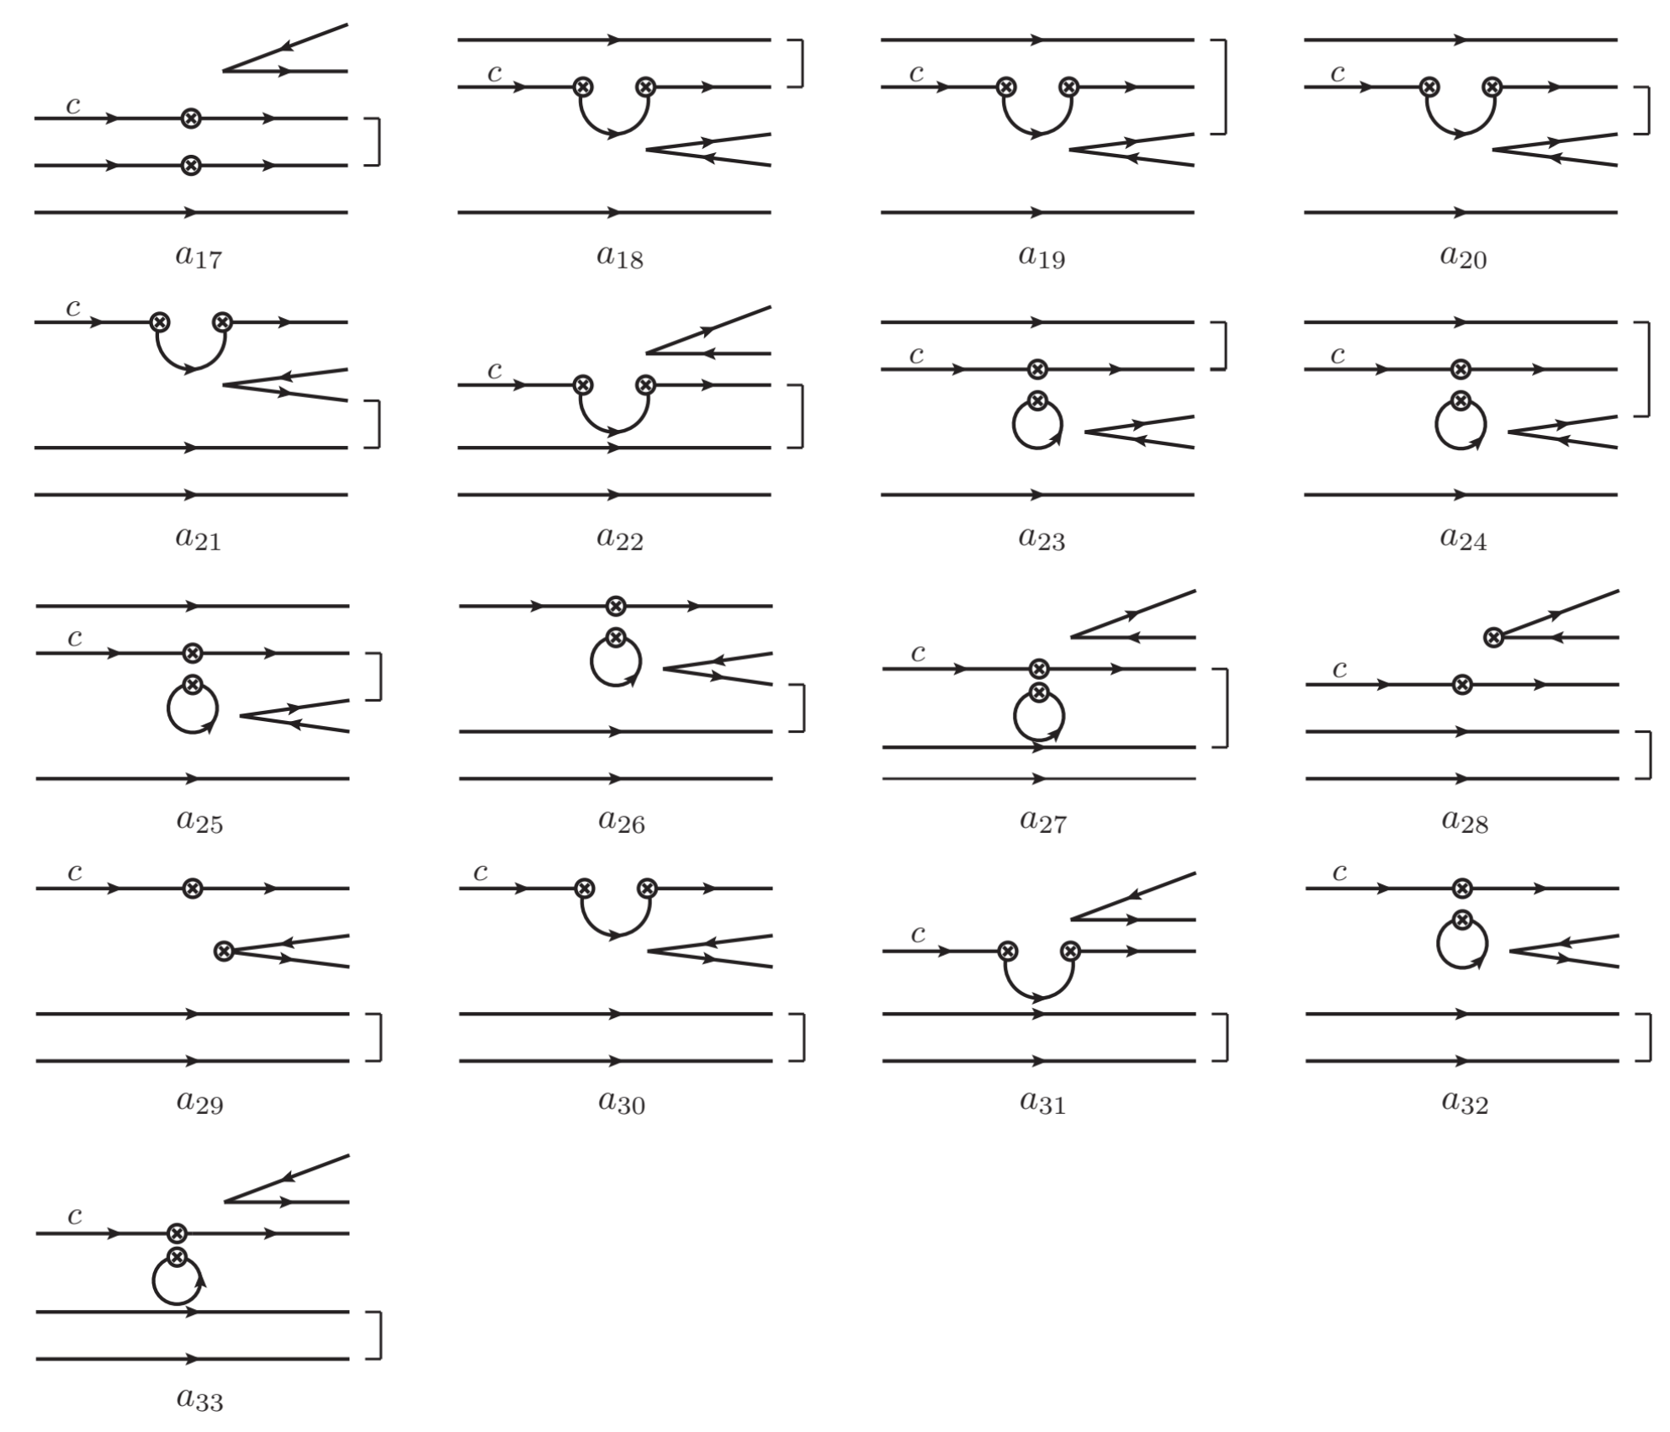
36 diagrams: without quark loop
24 diagrams: with quark loop
13

Slide 14
强子与重味物理理论实验联合讨论会
Contents
1
Motivation
2
Topologies of charmed baryon decays
3
Linear correlation of topologies
4
Test the K$\ddot{o}$rner-Pati-Woo theorem
5
Summary

Slide 15
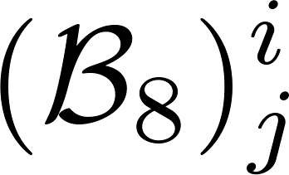
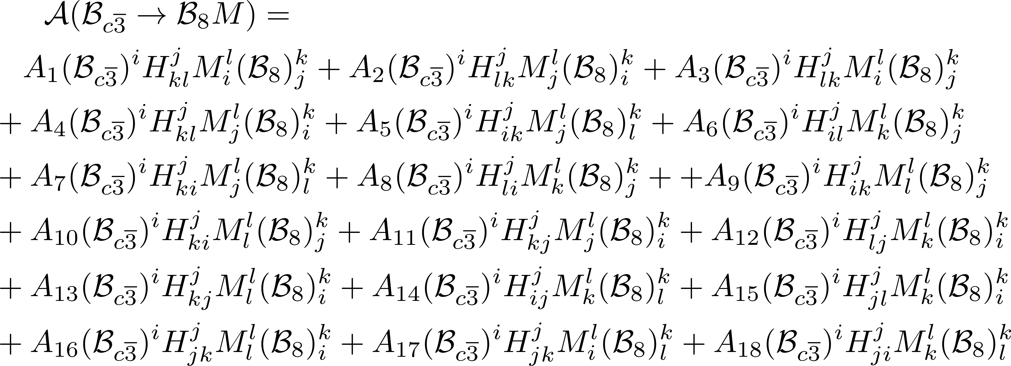
强子与重味物理理论实验联合讨论会
(1,1)-rank Topologies
24-6=18
15

Slide 16
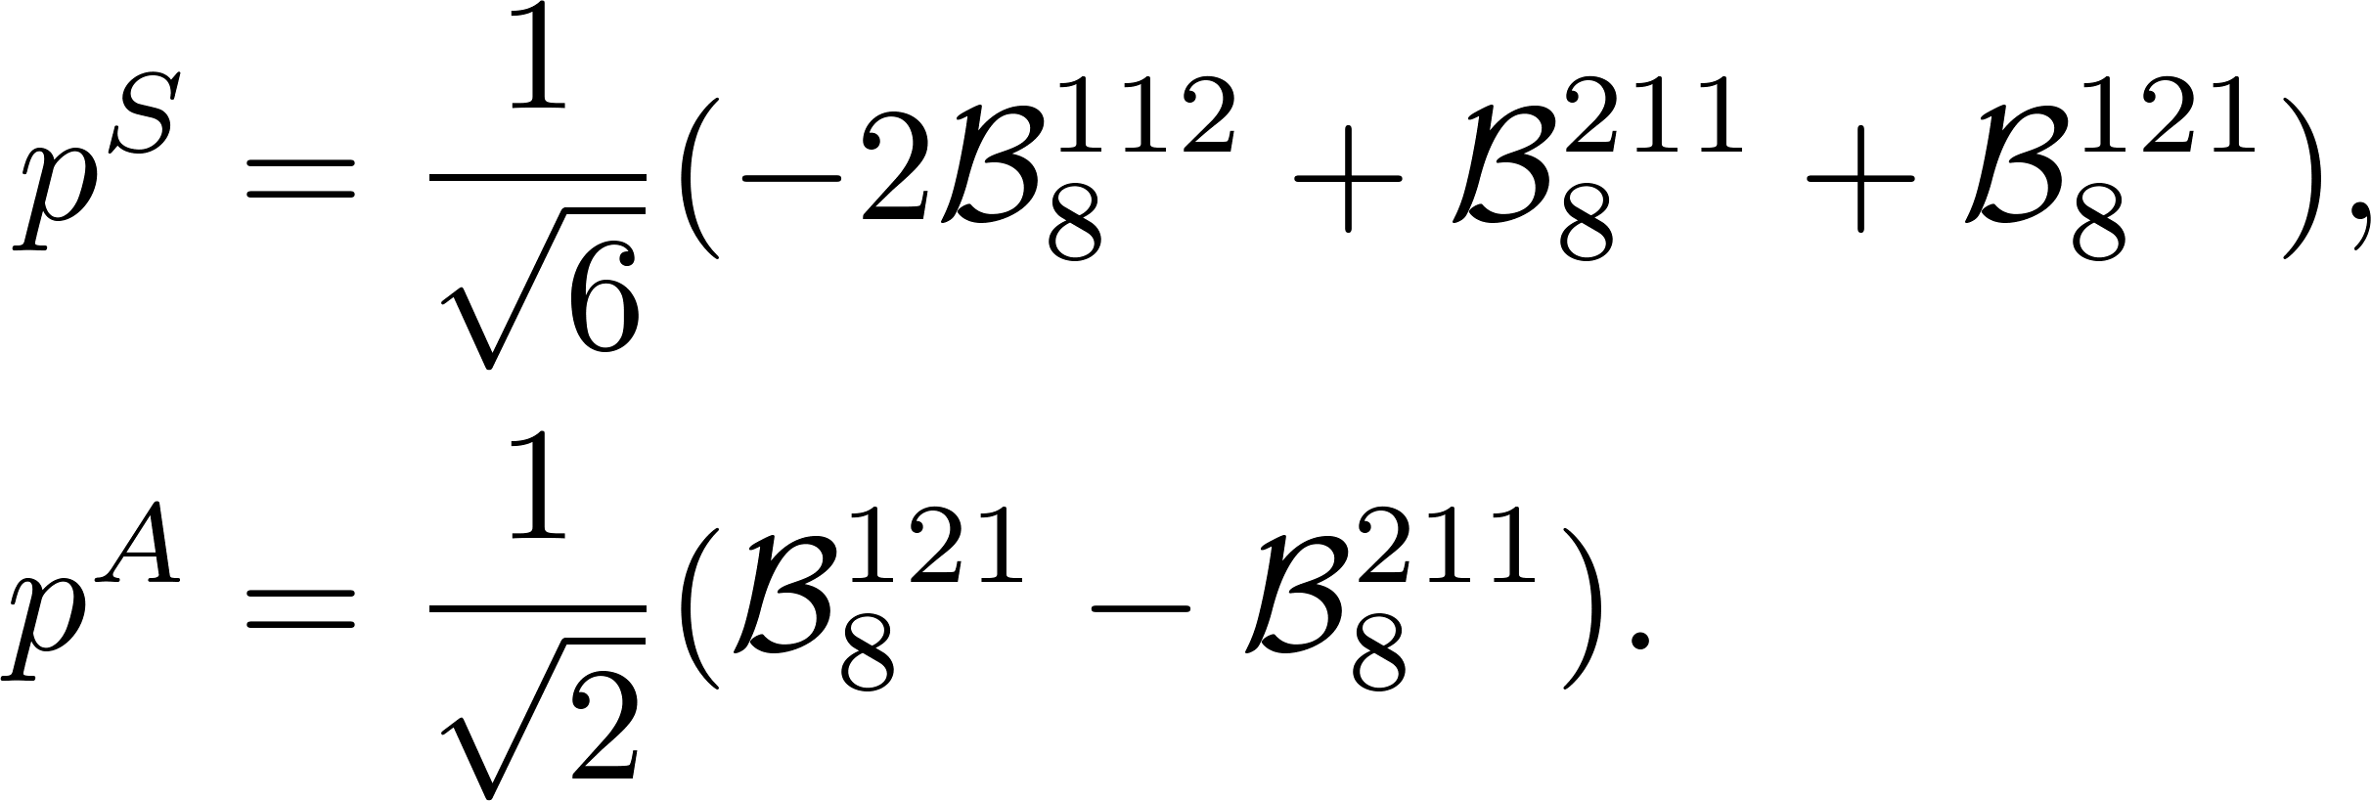
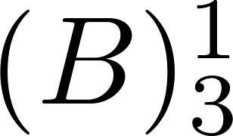
强子与重味物理理论实验联合讨论会
Three indices Two indices
Reducing indices via Levi-Civita tensor
?
arXiv:2406.14061
16

Slide 17
强子与重味物理理论实验联合讨论会
Linear correlation of topologies
Relation between three- and (1,1)-rank octets
Example
17

Slide 18
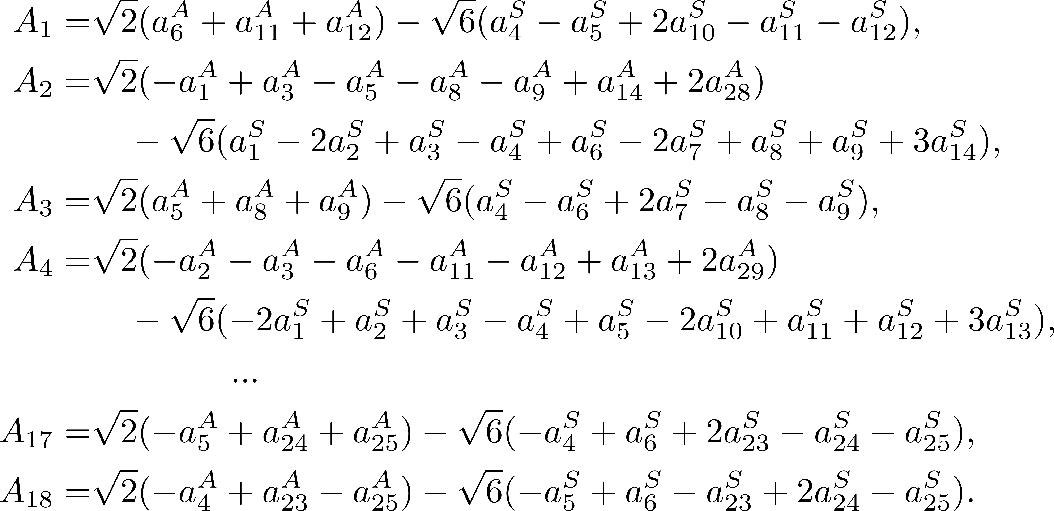
强子与重味物理理论实验联合讨论会
Linear correlation of topologies
18

Slide 19
强子与重味物理理论实验联合讨论会
SU(3) irreducible amplitude
2-rank TDA = IRA
19

Slide 20
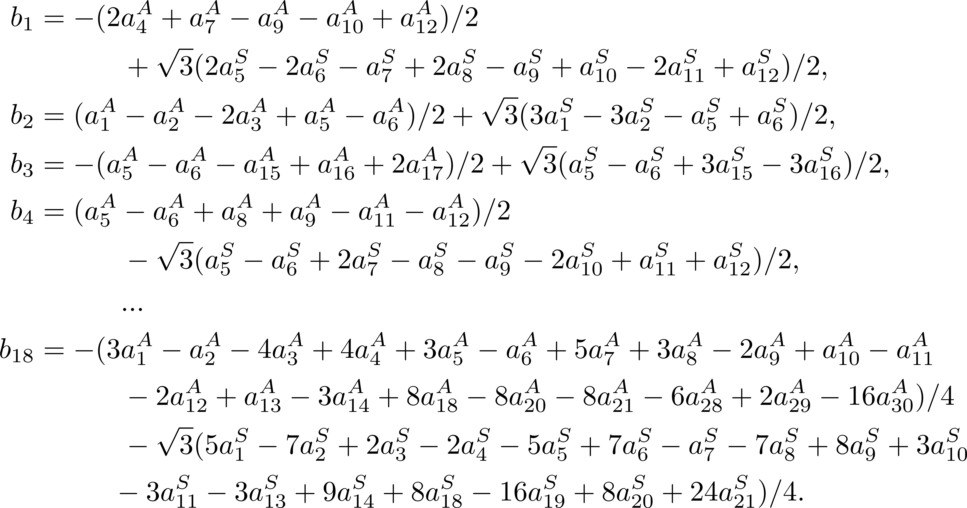
强子与重味物理理论实验联合讨论会
3-rank TDA (1,1)-rank TDA (1,1)- rank IRA
20

Slide 21
强子与重味物理理论实验联合讨论会
Relations between TDA and IRA
The two third-/(1,1)-rank amplitudes are equivalent
Third-rank amplitudes
(1,1)-rank amplitudes
3-rank
TDA
(1,1)-rank
TDA
3-rank
IRA
(1,1)-rank
IRA
Cross Check by different way !
21

Slide 22
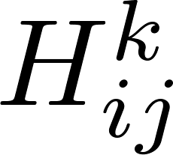
强子与重味物理理论实验联合讨论会
Topologies in the Standard Model
Effective Hamiltonian of charm decay
Non-zero
Tree
Penguin
13 independent amplitudes in the SU(3)F limit: 9+4=13
Four decay amplitudes are very small due to small λb.
22

Slide 23
强子与重味物理理论实验联合讨论会
Contents
1
Motivation
2
Topologies of charmed baryon decays
3
Linear correlation of topologies
4
Test the K$\ddot{o}$rner-Pati-Woo theorem
5
Summary

Slide 24
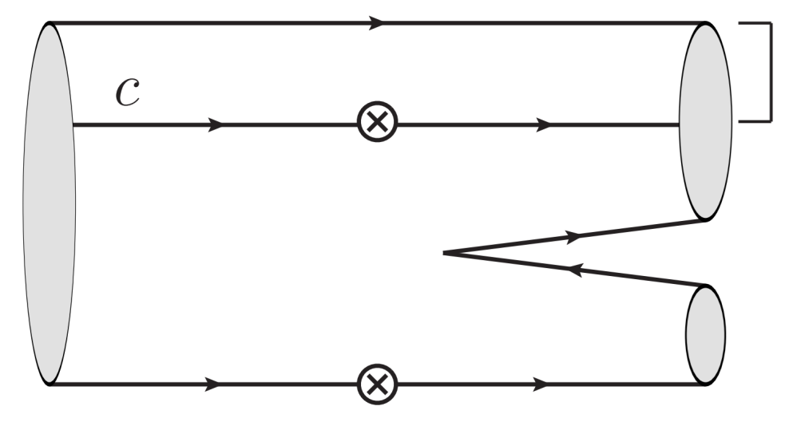
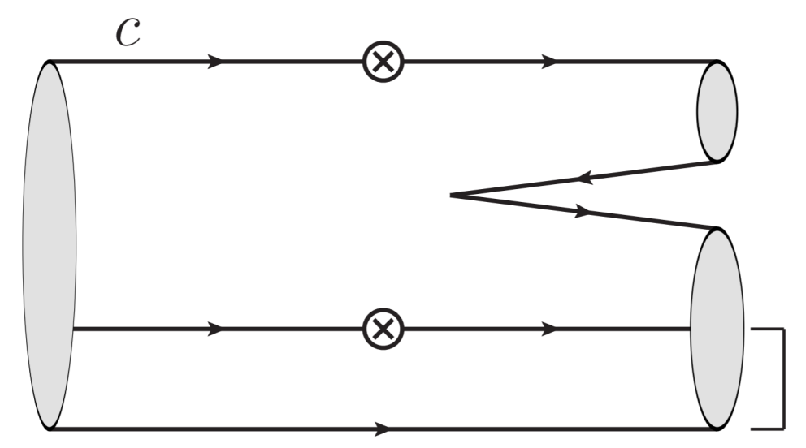
强子与重味物理理论实验联合讨论会
The K$\ddot{o}$rner-Pati-Woo theorem
The K$\ddot{o}$rner-Pati-Woo theorem: If two quarks produced by weak operators enter one baryon, they are anti-symmetric in flavor.
J. G. Korner, Nucl. Phys. B 25, 282-290 (1971).
J. C. Pati and C. H. Woo, Phys. Rev. D 3, 2920-2922 (1971).
Decay amplitudes: 9 5
arXiv:2406.14061
24

Slide 25
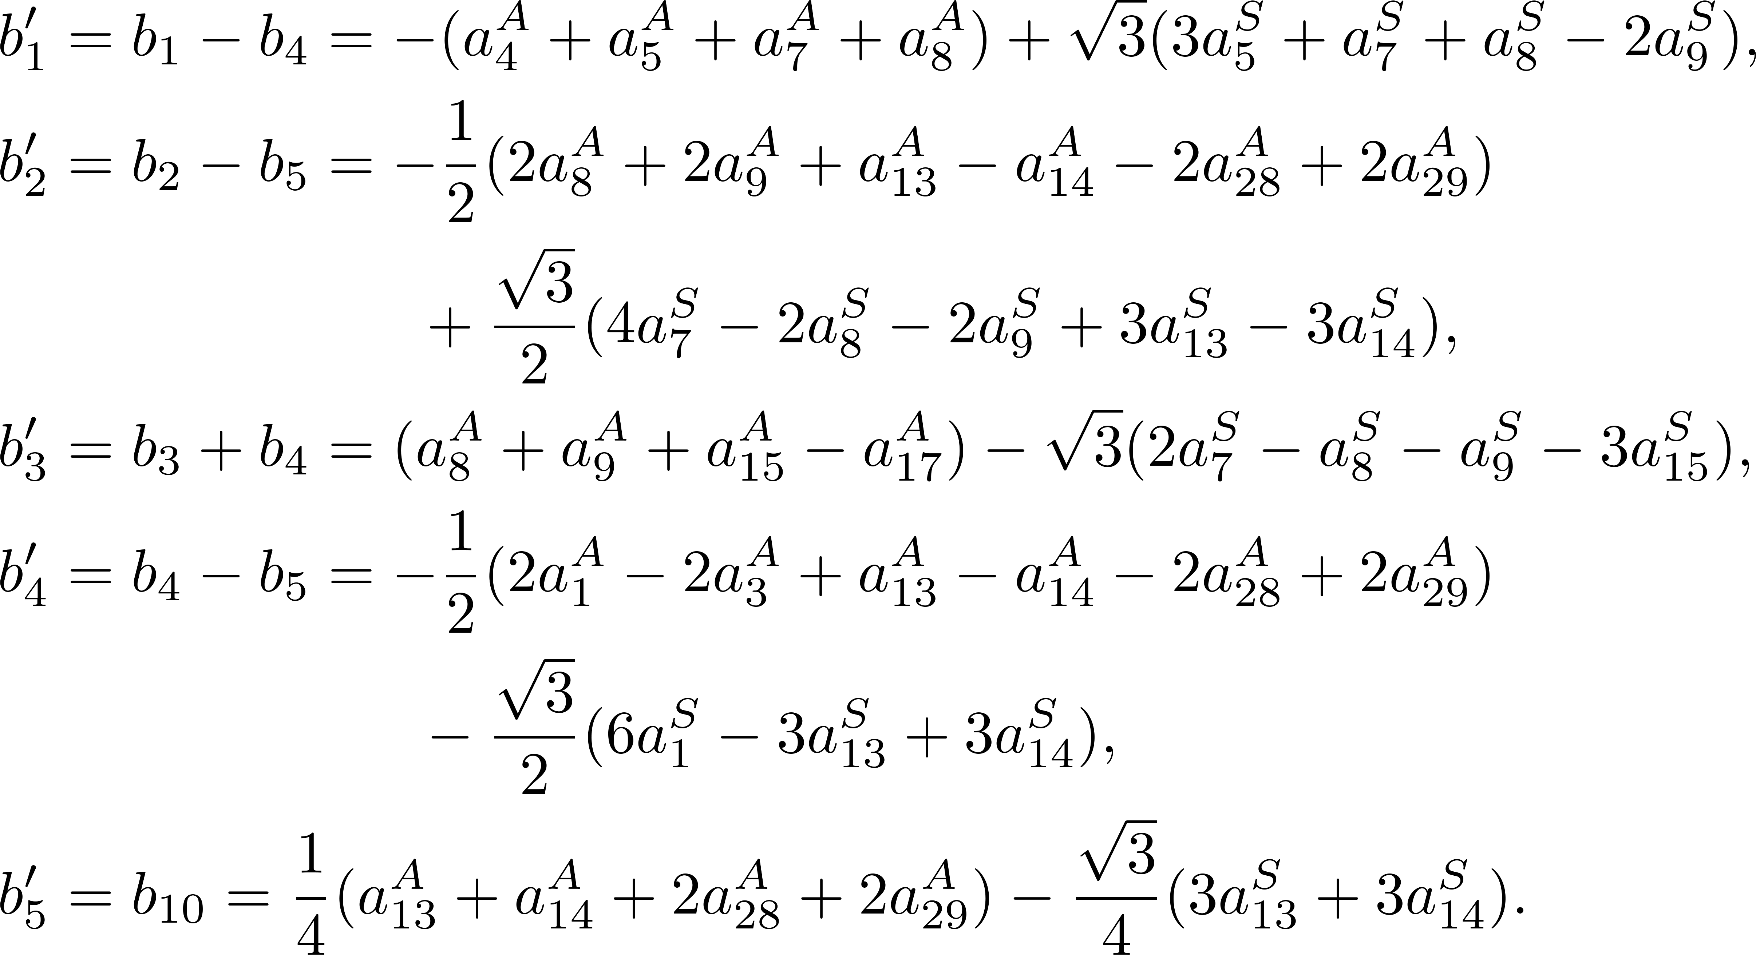
强子与重味物理理论实验联合讨论会
Dominated SU(3) irreducible amplitudes
C. Q. Geng, X. G. He, X. N. Jin, C. W. Liu and C. Yang, Phys. Rev. D 109, no.7, L071302 (2024).
25

Slide 26
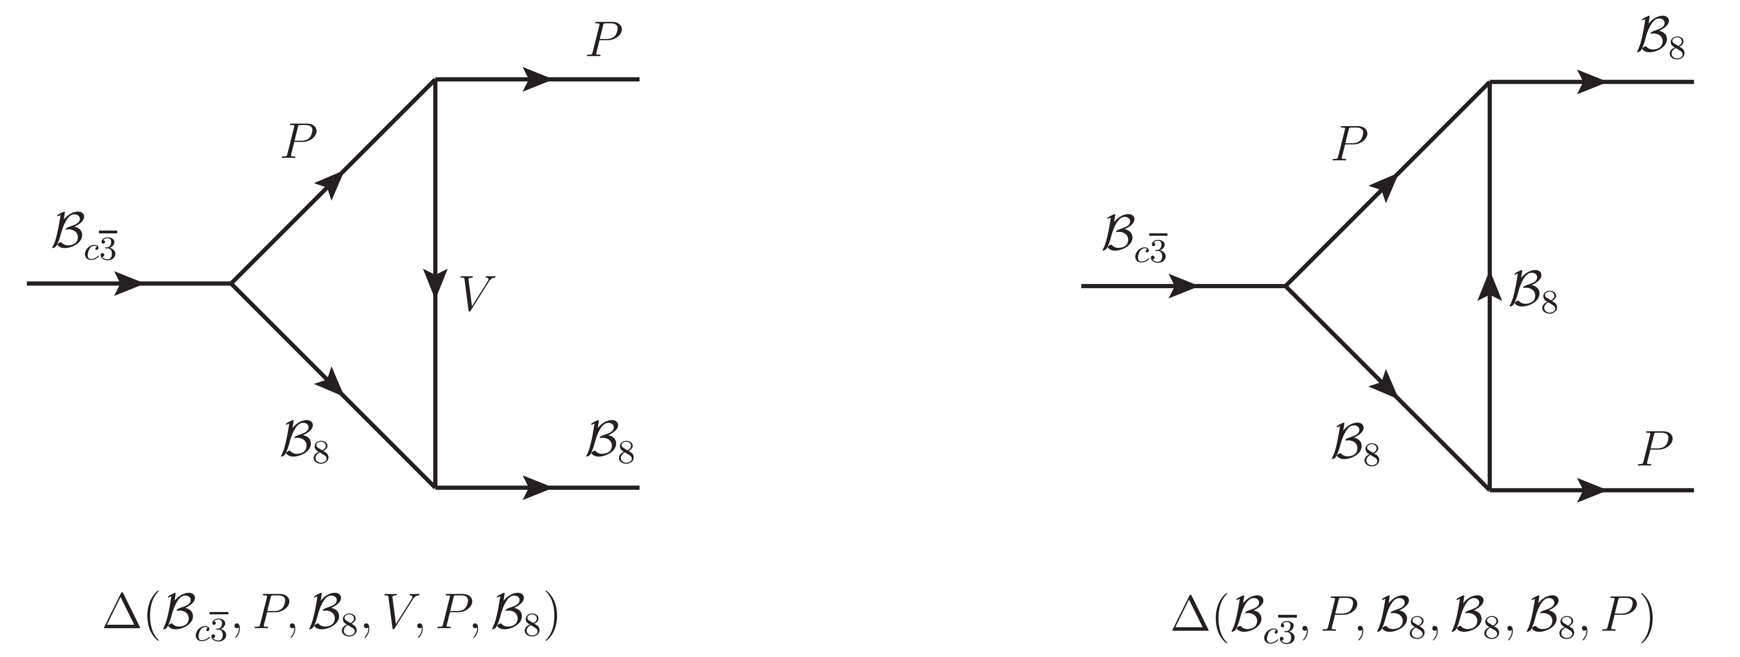
强子与重味物理理论实验联合讨论会
Final-state rescattering
Isospin symmetry + KPW theorem
C. Q. Geng, C. W. Liu and T. H. Tsai, Phys. Lett. B 794, 19-28 (2019).
Final-state rescattering
C. P. Jia, H. Y. Jiang, J. P. Wang and F. S. Yu, JHEP 11, 072 (2024).
26

Slide 27
强子与重味物理理论实验联合讨论会
Final-state rescattering
27

Slide 28
强子与重味物理理论实验联合讨论会
The K$\ddot{o}$rner-Pati-Woo theorem
Fierz transformation
symmetric
If two quarks enter baryon
antisymmetric
?
SU(3)C singlet
antisymmetric
28

Slide 29
强子与重味物理理论实验联合讨论会
Test the K$\ddot{o}$rner-Pati-Woo theorem
Isospin symmetry + KPW theorem
?
M. Ablikim et al. [BESIII], Phys. Rev. D 106, no.5, 052003 (2022).
L. K. Li et al. [Belle] Sci. Bull. 68, 583-592 (2023).
29

Slide 30
强子与重味物理理论实验联合讨论会
Contents
1
Motivation
2
Topologies of charmed baryon decays
3
Linear correlation of topologies
4
Test the K$\ddot{o}$rner-Pati-Woo theorem
5
Summary

Slide 31
强子与重味物理理论实验联合讨论会
Summary
Topologies contributing to the decays are presented.
The linear relations of topologies are derived by tensor contraction and SU(3) decomposition.
Test the Korner-Pati-Woo theorem under isospin symmetry.
Thanks for your attention!
31

