Slide 1
Latest results from the LHCb experiment
钱文斌
中国科学院大学
2025/03/23
第四届强子和重味物理理论与实验联合研讨会
2025/03/23
国科大 钱文斌
1

Slide 2
Outline of the talk
Introduction
Recent results on spectroscopy studies
Recent results on CP violation studies (detailed discussion see Yanxi’s talk)
Prospects and conclusion
2025/03/23
国科大 钱文斌

Slide 3
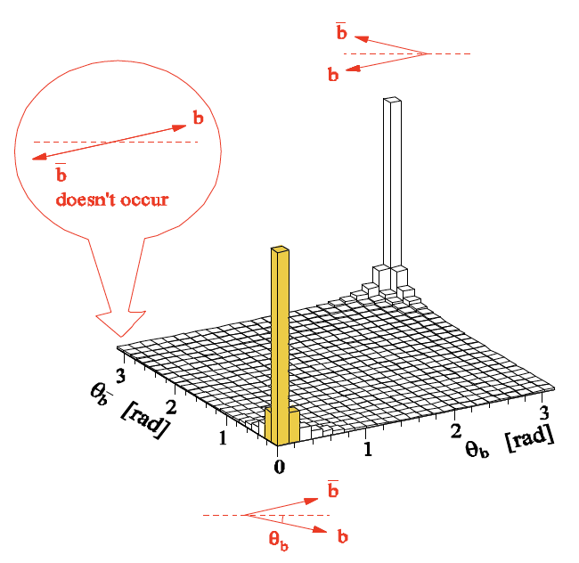
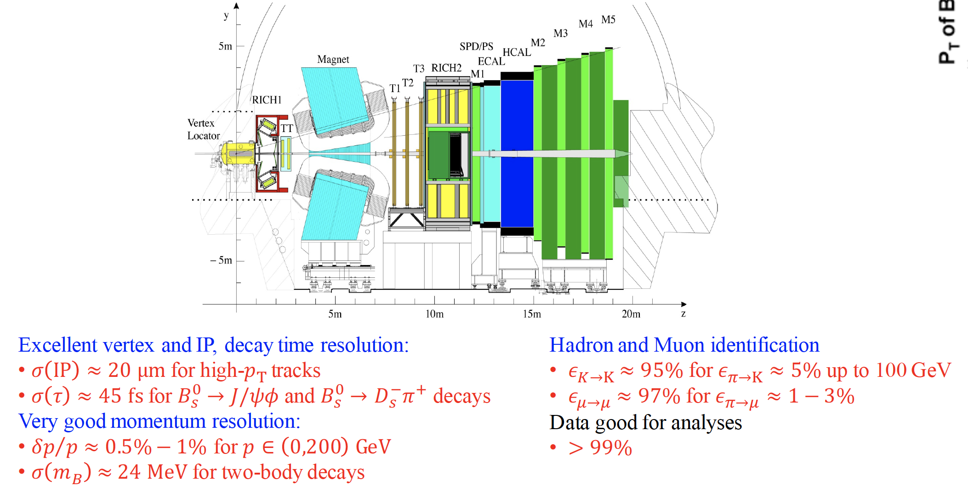
The LHCb detector (Run 1+2)
2008 JINST 3 S08005
Designed for CP violation and heavy flavor studies
2025/03/23
国科大 钱文斌
3

Slide 4
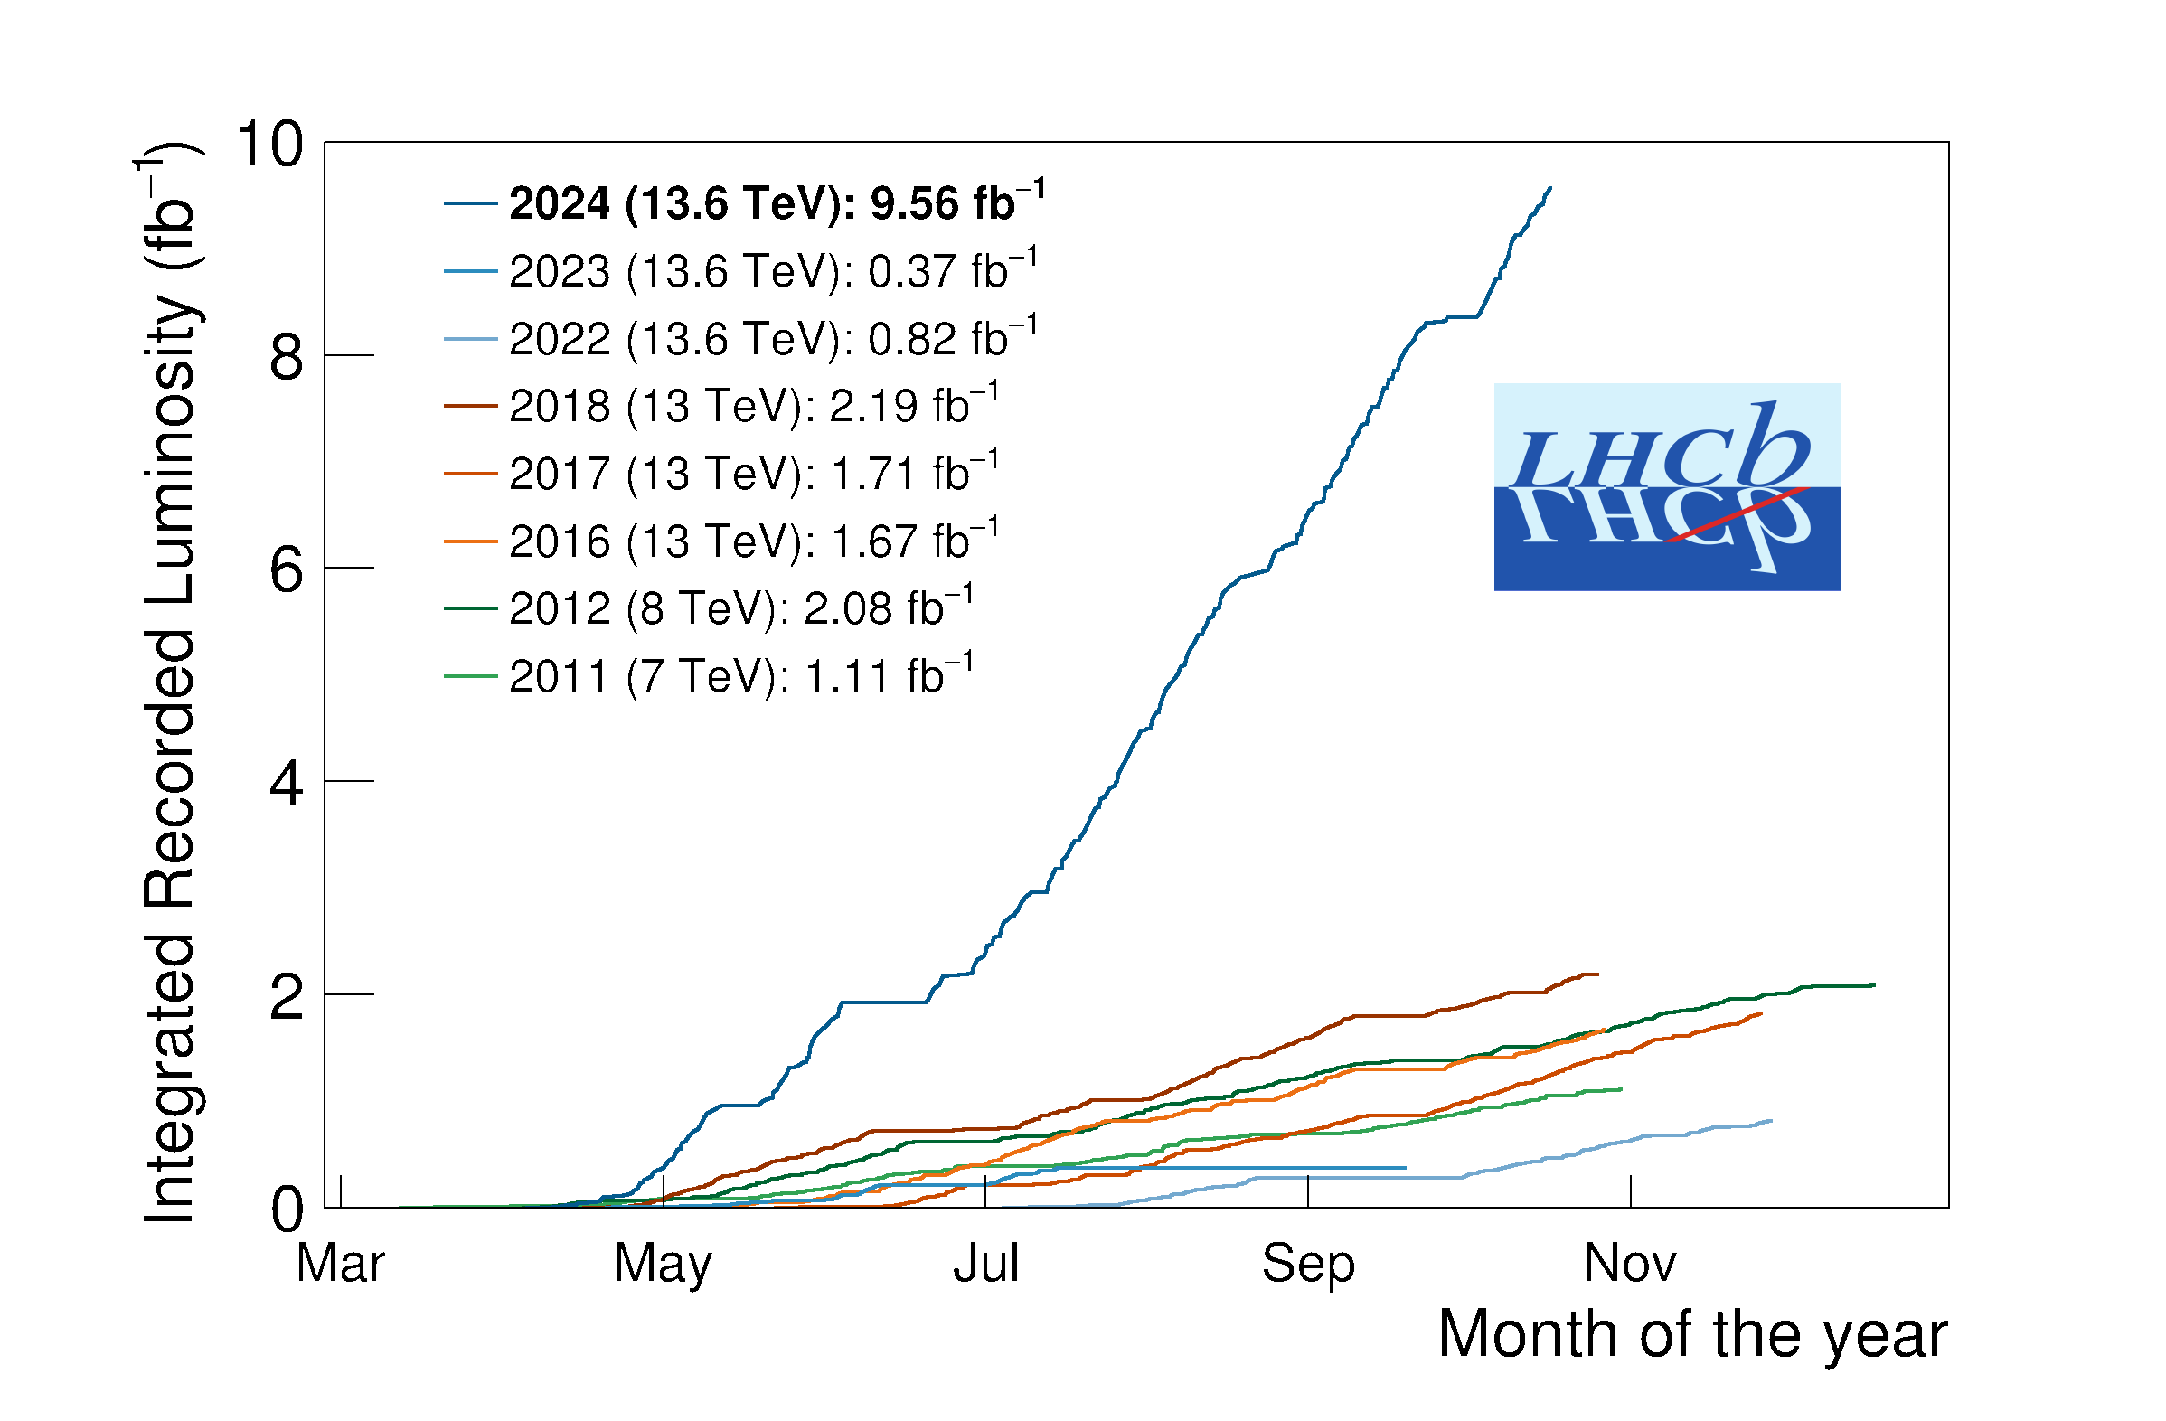
The LHCb status
Run 1:
2011 (7 TeV): 1 fb⁻¹
2012 (8 TeV): 2 fb⁻¹
Run 2:
2015-2018 (13 TeV): 6 fb⁻¹
Run 3:
2024 alone (13.6 TeV): 9.56 fb⁻¹
A new LHCb detector for Run 3 operates at $×5$ higher instantaneous luminosity
Similar performance, while efficiency for hadron final states increased by a factor of 2
2025/03/23
国科大 钱文斌
4

Slide 5
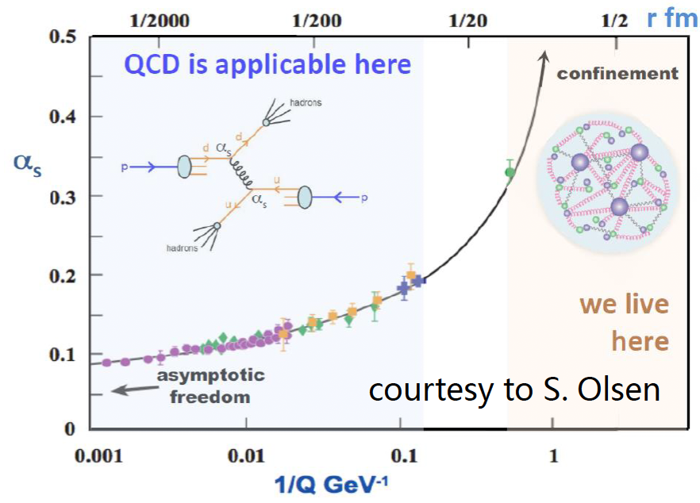
LHCb physics goals
SM model very successful;
Still an effective theory, many unexplained phenomena;
Most related to flavor and hadron physics
Understanding QCD at low energy
New Physics hunting
Properties of QCD confinement
Structures of hadrons
Matter and antimatter asymmetry observed in the Universe
Origin of dark matter? New particles or new forces? Flavor hierarchy
Non-perturbative!
2025/03/23
国科大 钱文斌
5

Slide 6
Outline of the talk
Introduction
Recent results on spectroscopy studies
Recent results on CP violation studies (detailed discussion see Yanxi’s talk)
Prospects and conclusion
2025/03/23
国科大 钱文斌

Slide 7
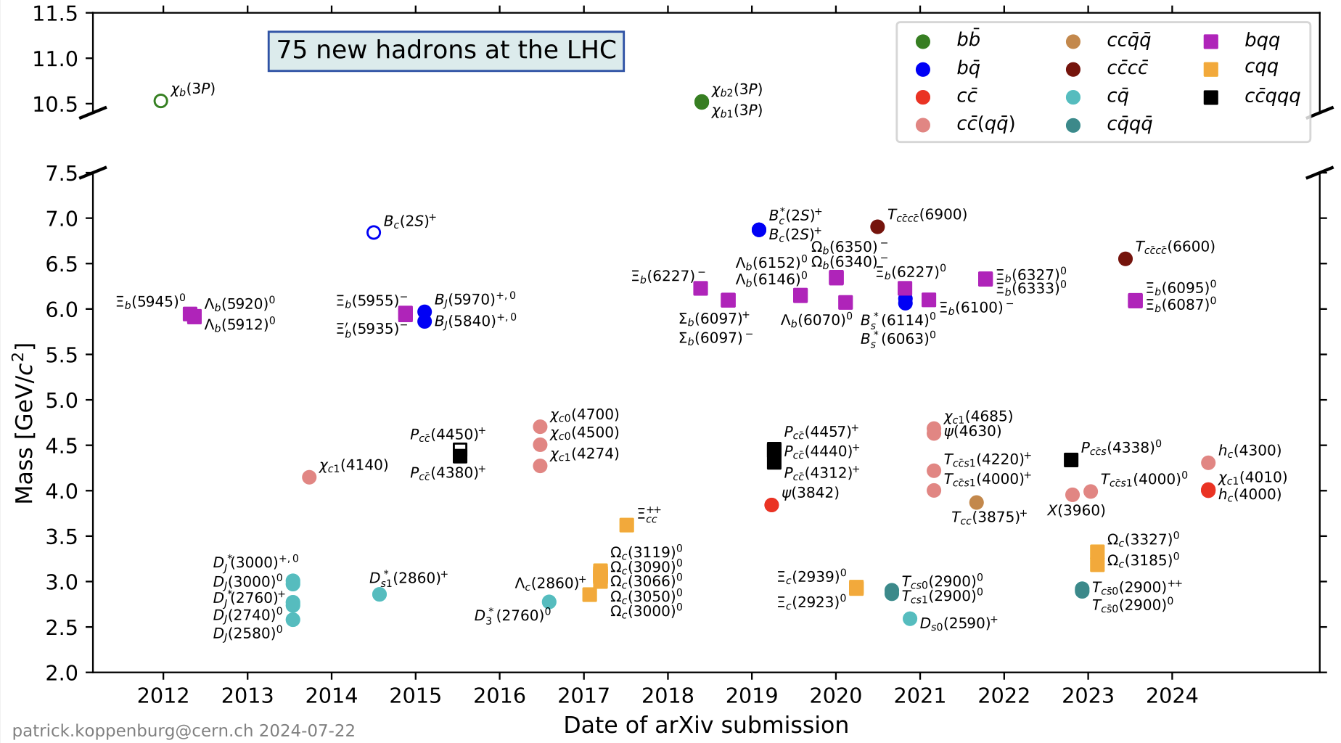
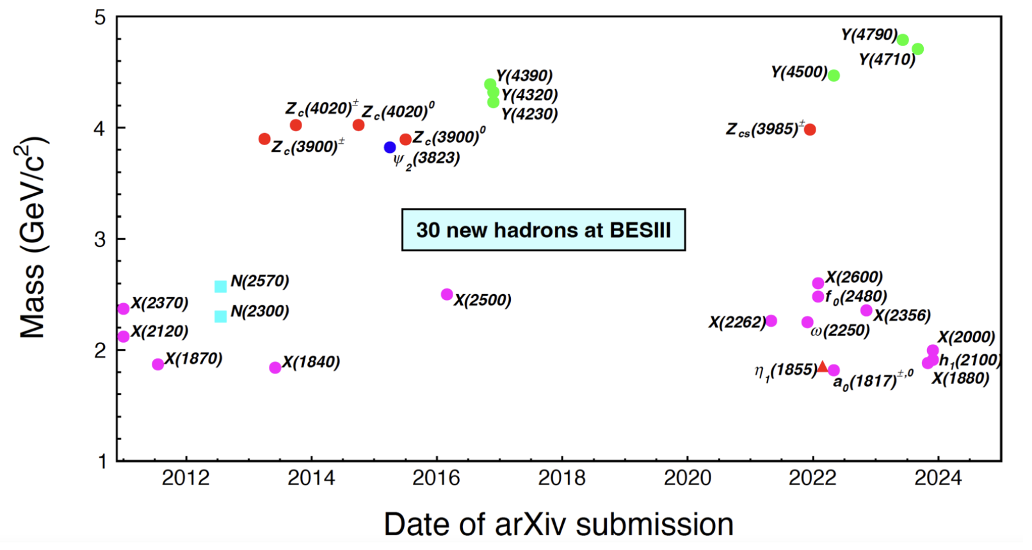
Particle zoo 2.0
Many new hadrons discovered since the discovery of $χ_{c1}(3872)$ in 2003: renaissance and revolution?
75 new hadrons
30 new hadrons
LHC (mainly LHCb)
BESIII
+ 17 new hadrons from Belle (>35 from its start)
> 20 new hadrons since 2022 (only selected ones are shown)
Many can not be explained by conventional quark model
More than 140 new hadrons
2025/03/23
国科大 钱文斌
7

Slide 8
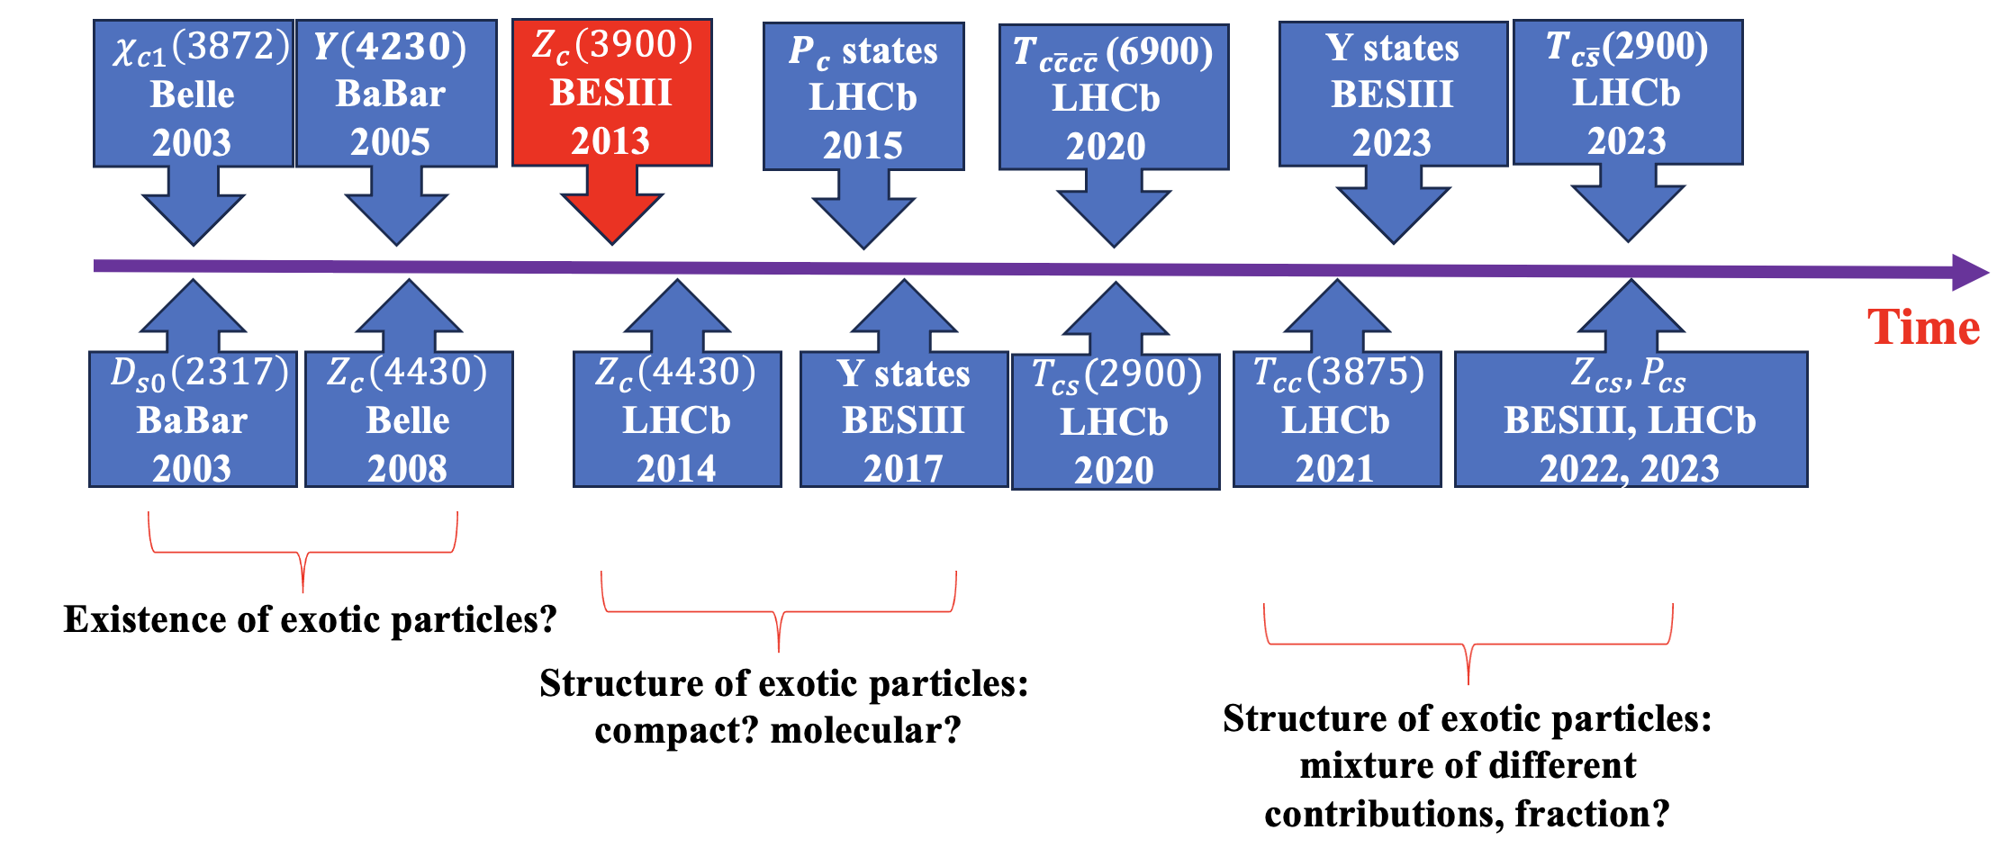
A history of understanding
$c\overline{c}(X)$+ $c\overline{s} (X)$
More states
Better understanding
Unified model for all hadrons?
$$c\overline{c}g$$
$$c\overline{c}$$
+
$$c\overline{c}qq$$
+
+
$$c\overline{c}$$
$$qq$$
+ …
Particle X =
$$cq$$
$$\overline{c}q$$
2025/03/23
国科大 钱文斌
8

Slide 9
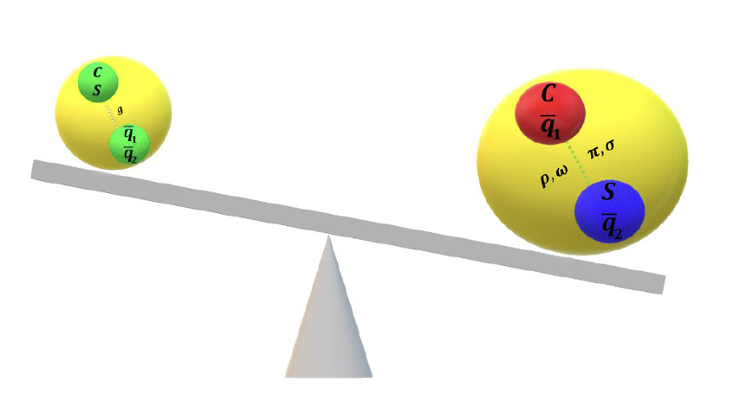
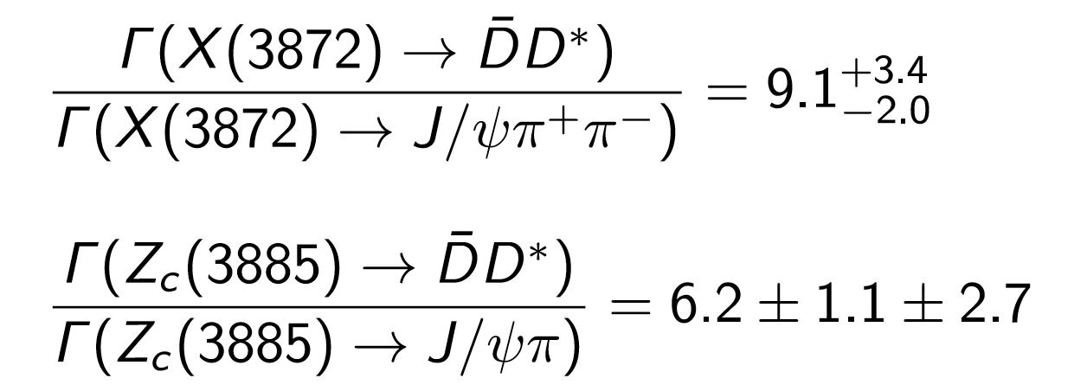
Experimental inputs
$$c\overline{c}g$$
$$c\overline{c}$$
+
$$c\overline{c}qq$$
+
+
$$c\overline{c}$$
$$qq$$
+ …
Particle X =
$$cq$$
$$\overline{c}q$$
Charm + charm + X
charmonium + X
Experimental tasks:
Discover more and understand them through production and decays
However, studies with $B→DDX$decays rather limited
2025/03/23
国科大 钱文斌
9

Slide 10
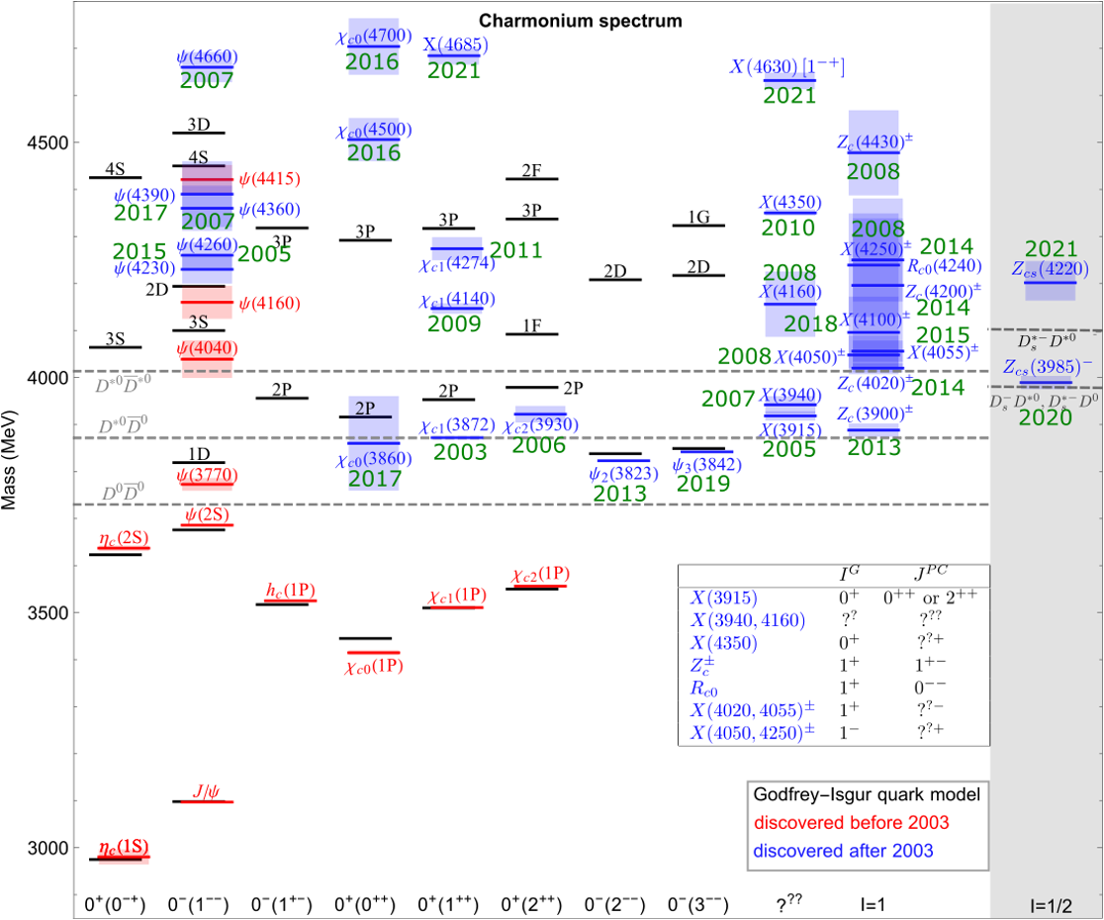
Understanding charmonium(-like) states
PRL 133 (2024) 131902
Three new states observed: $h_{c}\left(4000\right) J^{PC}=1^{+−}$, $χ_{c1}\left(4010\right){ J}^{PC}=1^{++}$, $h_{c}\left(4300\right) J^{PC}=1^{+−}$
courtesy to F.K. Guo
Filling the missing ones or adding more complexity?
2025/03/23
国科大 钱文斌
10

Slide 11
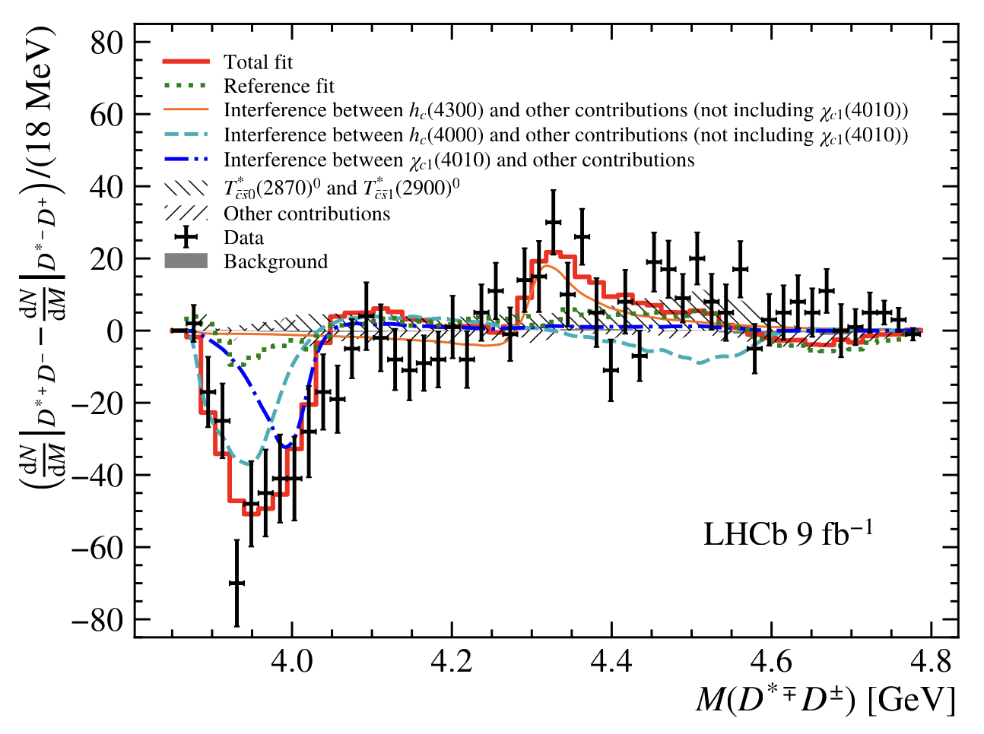
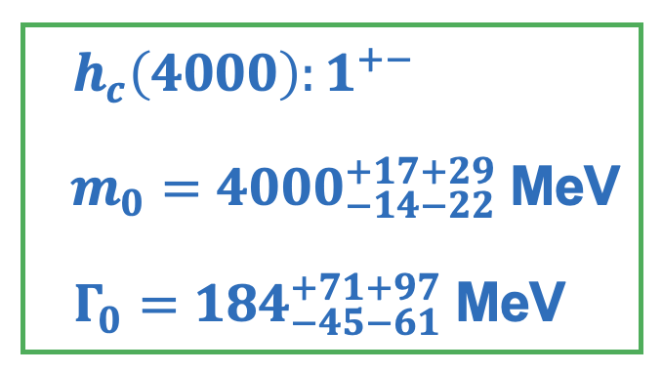
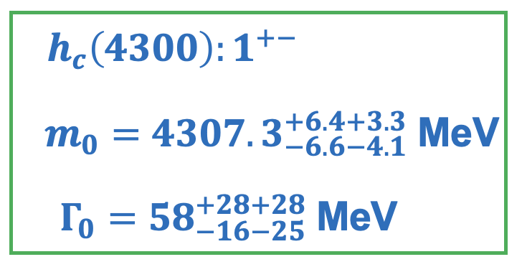
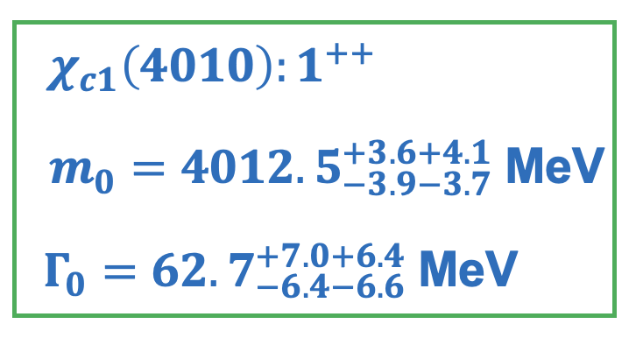
Three new states
Could be QM Predictions $h_{c}(2P)$?
$$h_{c}(4300)$$
Could be QM Predictions $h_{c}(3P)$?
$$χ_{c1}(4010)$$
$$h_{c}(4000)$$
Nature still under debate
Only interference with same J^{P} but different C party remains
2025/03/23
国科大 钱文斌
11

Slide 12
$$T_{cs}→DK$$
Negative in search $T_{c\overline{s}0}{\left(2900\right)}^{++}$
$FF\left(B^{+}→T_{c\overline{s}0}{\left(2900\right)}^{++}D^{∗−},T_{c\overline{s}0}{\left(2900\right)}^{++}→D^{+}K^{+}\right)<3.3\% @ 95\%$ C.L.
Confirming $T_{\overline{c}\overline{s}0}^{∗}{\left(2870\right)}^{0}$ and $T_{\overline{c}\overline{s}1}^{∗}{\left(2900\right)}^{0}$ in a new decay channel $B^{+}→D^{∗+}T_{\overline{c}\overline{s}}^{∗}$
$$T_{\overline{c}\overline{s}0}^{∗}{\left(2870\right)}^{0}$$
$$T_{\overline{c}\overline{s}1}^{∗}{\left(2900\right)}^{0}$$
$$m_{0}$$
$$2914±19$$
$$2866±7$$
$$m_{0}$$
$$2887±10$$
$$2904±5$$
$$Γ_{0}$$
128$±32$
57$±13$
$$Γ_{0}$$
92$±23$
110$±12$
This work
Mass and width agree within 2$σ$
Previous work
2025/03/23
国科大 钱文斌
12

Slide 13
$$T_{cs}→DK$$
Negative in search $T_{c\overline{s}0}{\left(2900\right)}^{++}$
$FF\left(B^{+}→T_{c\overline{s}0}{\left(2900\right)}^{++}D^{∗−},T_{c\overline{s}0}{\left(2900\right)}^{++}→D^{+}K^{+}\right)<3.3\% @ 95\%$ C.L.
Confirming $T_{\overline{c}\overline{s}0}^{∗}{\left(2870\right)}^{0}$ and $T_{\overline{c}\overline{s}1}^{∗}{\left(2900\right)}^{0}$ in a new decay channel $B^{+}→D^{∗+}T_{\overline{c}\overline{s}}^{∗}$
This work
Previous work
Large difference on branching fraction ratio, further hints on structures?
2025/03/23
国科大 钱文斌
13

Slide 14
$$T_{cs}→DK_{S}^{0}$$
PRL 134 (2025) 101901
Amplitude analysis of $B^{+}→D^{−}D^{0}K_{S}^{0}$ finding $T_{\overline{c}\overline{s}0}^{∗}{\left(2870\right)}^{0}$, but not $T_{\overline{c}\overline{s}1}^{∗}{\left(2900\right)}^{0}$ to $D^{0}K_{S}^{0}$
$$\frac{T_{cs0}^{∗}{\left(2870\right)}^{0}→D^{0}K_{S}^{0}}{T_{cs0}^{∗}{\left(2870\right)}^{0}→D^{+}K^{−}}=3.3±1.9$$
$$\frac{T_{cs1}^{∗}{\left(2870\right)}^{0}→D^{0}K_{S}^{0}}{T_{cs1}^{∗}{\left(2870\right)}^{0}→D^{+}K^{−}}=0.15±0.17$$
Similar as $B→D^{∗}T_{cs}$, more spin 0 contributions than spin 1
While 1 from Isospin symmetry?
2025/03/23
国科大 钱文斌
14

Slide 15
$$T_{cs}→D^{∗}K$$
0⁺ can not decay into $D^{∗}K$
$1^{−}$ not found in $D^{∗−}K^{+}$ decays
$FF\left(B^{+}→T_{\overline{c}\overline{s}1}^{∗}{\left(2900\right)}^{0}D^{+},T_{\overline{c}\overline{s}1}^{∗}{\left(2900\right)}^{0}→D^{∗−}K^{+}\right)<1.5\% @ 95\%$ C.L.
$$\frac{Br(T_{\overline{c}\overline{s}1}^{∗}{\left(2900\right)}^{0}→D^{∗−}K^{+})}{Br(T_{\overline{c}\overline{s}1}^{∗}{\left(2900\right)}^{0}→D^{−}K^{+})}<0.21 @ 95\%$$
2024/03/23
国科大 钱文斌
15

Slide 16
Doubly charged tetraquark and its Isospin partner
Around 4K signal events
PRL 131 (2023) 041902
PRD 108 (2023) 012017
$$B^{0}→\overline{D^{0}}D_{s}^{+}π^{−}$$
$$B^{+}→D^{−}D_{s}^{+}π^{+}$$
$$T_{c\overline{s}}^{a}{\left(2900\right)}^{0}$$
$$T_{c\overline{s}}^{a}{\left(2900\right)}^{++}$$
$$FF:\left(4.8±1.1±1.4\right)\%$$
$$FF:\left(1.96±0.87±0.88\right)\%$$
$T_{cs}^{a}\left(2900\right) \text{have} \text{quark} \text{content} c\overline{s}\overline{u}d \text{and} c\overline{s}u\overline{d}$
Two states consist with each other: isospin triplet
No other states are needed currently
2025/03/23
国科大 钱文斌
16

Slide 17
Nature of $D_{s}^{+}(2317)$ and its isospin partner
Discovered more than 20 years ago, however, its structure remains puzzling
$$\vec{s_{l}}$$
$$1/2$$
$$1/2$$
$$3/2$$
BaBar, 2006, searched in $e^{+}e^{−}→c\overline{c}+X$ @10.6 GeV, not found
Belle, 2015, searched in $B→DD_{s}^{+}π$, not found
LHCb, 2023, searched in $B→DD_{s}^{+}π$, found neutral and doubly charged $T_{c\overline{s}}(2900)$
$2900−2317=583$ MeV similar as $M\left(ψ\left(2S\right)\right)−M(ψ(1S))$: radial excitation of $D_{s}{\left(2317\right)}^{+}$
2025/03/23
国科大 钱文斌
17

Slide 18
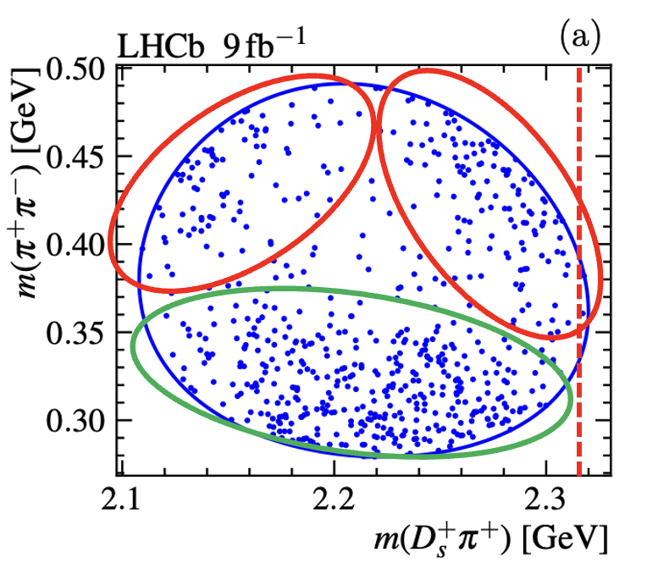
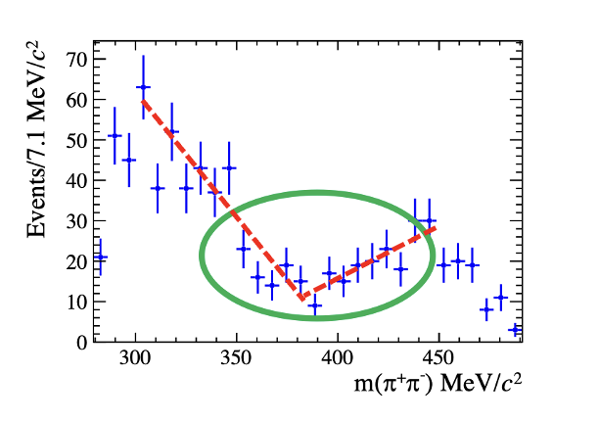
$B→D^{(∗)}D_{s}^{+}π^{+}π^{−}$, $D_{s}{\left(2460\right)}^{+}→D_{s}^{+}π^{+}π^{−}$
Interesting structures seen on Dalitz plot and projections
Very puzzling structures, rarely seen before
Two models to describe the strange shape:
$f_{0}\left(500\right)+f_{0}\left(980\right)+f_{2}(1270)$: puzzling to have large $f_{0}\left(980\right)+f_{2}\left(1270\right)$ contributions, far away from threshold; puzzling $f_{0}\left(500\right)$ mass and width
$f_{0}\left(500\right)+T_{c\overline{s}}^{++}\left(2317\right)+T_{c\overline{s}}^{0}(2317)$
2025/03/23
国科大 钱文斌
18

Slide 19
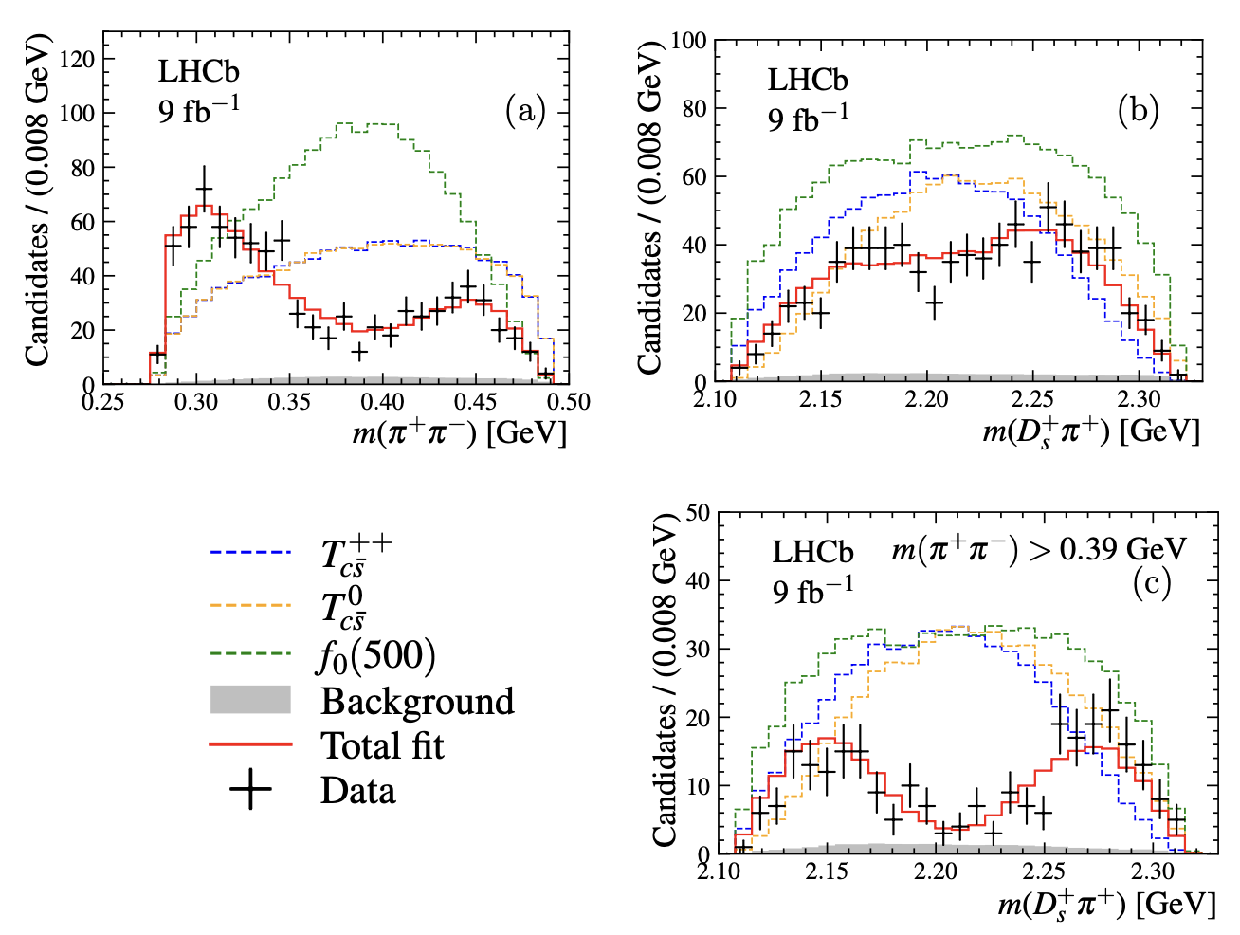
Fit results for models with $T_{c\overline{s}}$
$m\left(π^{+}π^{−}\right)∈\left[279.2, 491.2\right]$ MeV
$f_{0}\left(500\right)$ mass and width agree with other measurements
Scattering length in K-Matrix determined to be
Significance of $T_{c\overline{s}}>10σ$
Coupling, masses and widths of $T_{c\overline{s}}^{0}$ and $T_{c\overline{s}}^{++}$ fixed to be the same; if free, consistent with each other
2025/03/23
国科大 钱文斌
19

Slide 20
Discussion
Both models with and without $T_{c\overline{s}}$ states can describe data
However, models without $T_{c\overline{s}}$ states have some deficiencies and implausible
Model with $T_{c\overline{s}}$ states:
Relationship with $D_{s}{\left(2317\right)}^{+}?$
Indication of exotic structures in $D_{s}{\left(2460\right)}^{+}$?
Mass consistent with $D_{s}{\left(2317\right)}^{+}$
Width significantly larger than $D_{s}{\left(2317\right)}^{+}$
Spin 0⁺
2025/03/23
国科大 钱文斌
20

Slide 21
Extract resonant information
Most exotic states and their properties established in multi-body decays
Amplitude analyses crucial
Amplitude analyses very complicated: main limitations to start an analysis
Enormous data from BESIII, LHCb and other flavor physics experiments: massive CPU time needed to perform analyses
A general PWA framework using modern acceleration technology (such as GPU, AD,…) eagerly needed
We have developed a new framework using TensorFlow
B : $p_{B}^{μ}$
A: $p_{A}^{μ}$
?
$$∼P(p_{B}^{μ},p_{C}^{μ},p_{D}^{μ};θ)$$
C : $p_{C}^{μ}$
…
D : $p_{D}^{μ}$
2025/03/23
国科大 钱文斌
21

Slide 22
TF-PWA
A general and user-friendly partial wave analysis framework
Hao Cai¹, Chen Chen⁵, Shuangshi Fang⁴, Haojie Jing², Yi Jiang², Pei-Rong Li³, Beijiang Liu⁴, Yin-Rui Liu², Xiao-Rui Lyu²,
Runqiu Ma⁴, Rong-Gang Ping⁴, Wenbin Qian², Rongsheng Shi³, Mengzhen Wang⁵, Shi Wang⁴, Zi-Yi Wang²,
Jiajun Wu², Shuming Wu², Liming Zhang⁵,Yang-Heng Zheng²
¹WHU, ²UCAS, ³LZU, ⁴IHEP, ⁵THU
Joint efforts + experience on previous analyses + very good students
Cross-checks performed with several independent fitters developed previously for dedicated analyses: e.g. Z(4430)⁺ and pentaquark search, $B^{0}→\overline{D^{0}}π^{+}π^{−}$ analysis etc.
2025/03/23
国科大 钱文斌
22

Slide 23
Features
Fast
General
Easy to use
GPU based
Vectorized calculation
Automatic differentiation
https://gitlab.com/jiangyi15/tf-pwa
Custom model available
Open access and well supported
Simple configuration file
Automatics process
All necessary functions implemented
2025/03/23
国科大 钱文斌
23

Slide 24
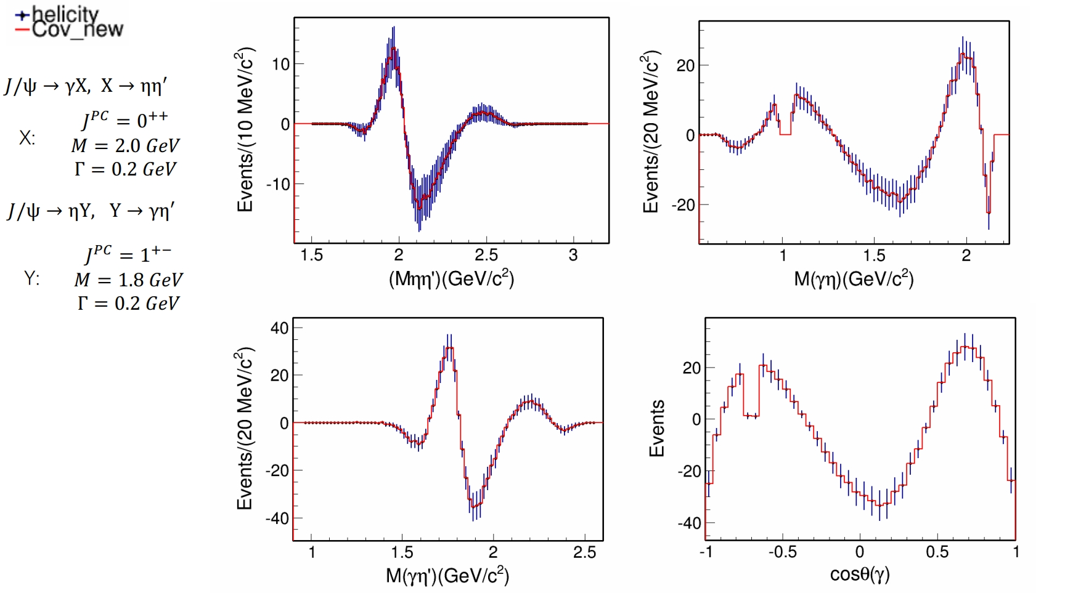
New functions
Default option: helicity formulism based amplitude model
Now also “traditional” covariant tensor formulism
+ Irreducible tensor formulism
$$J/ψ→γηη^{′}$$
Opening possibilities for alignment between theoretical and experimental studies
2025/03/23
国科大 钱文斌
24

Slide 25
Outline of the talk
Introduction
Recent results on spectroscopy studies
Recent results on CP violation studies (detailed discussion see Yanxi’s talk)
Prospects and conclusion
2025/03/23
国科大 钱文斌

Slide 26
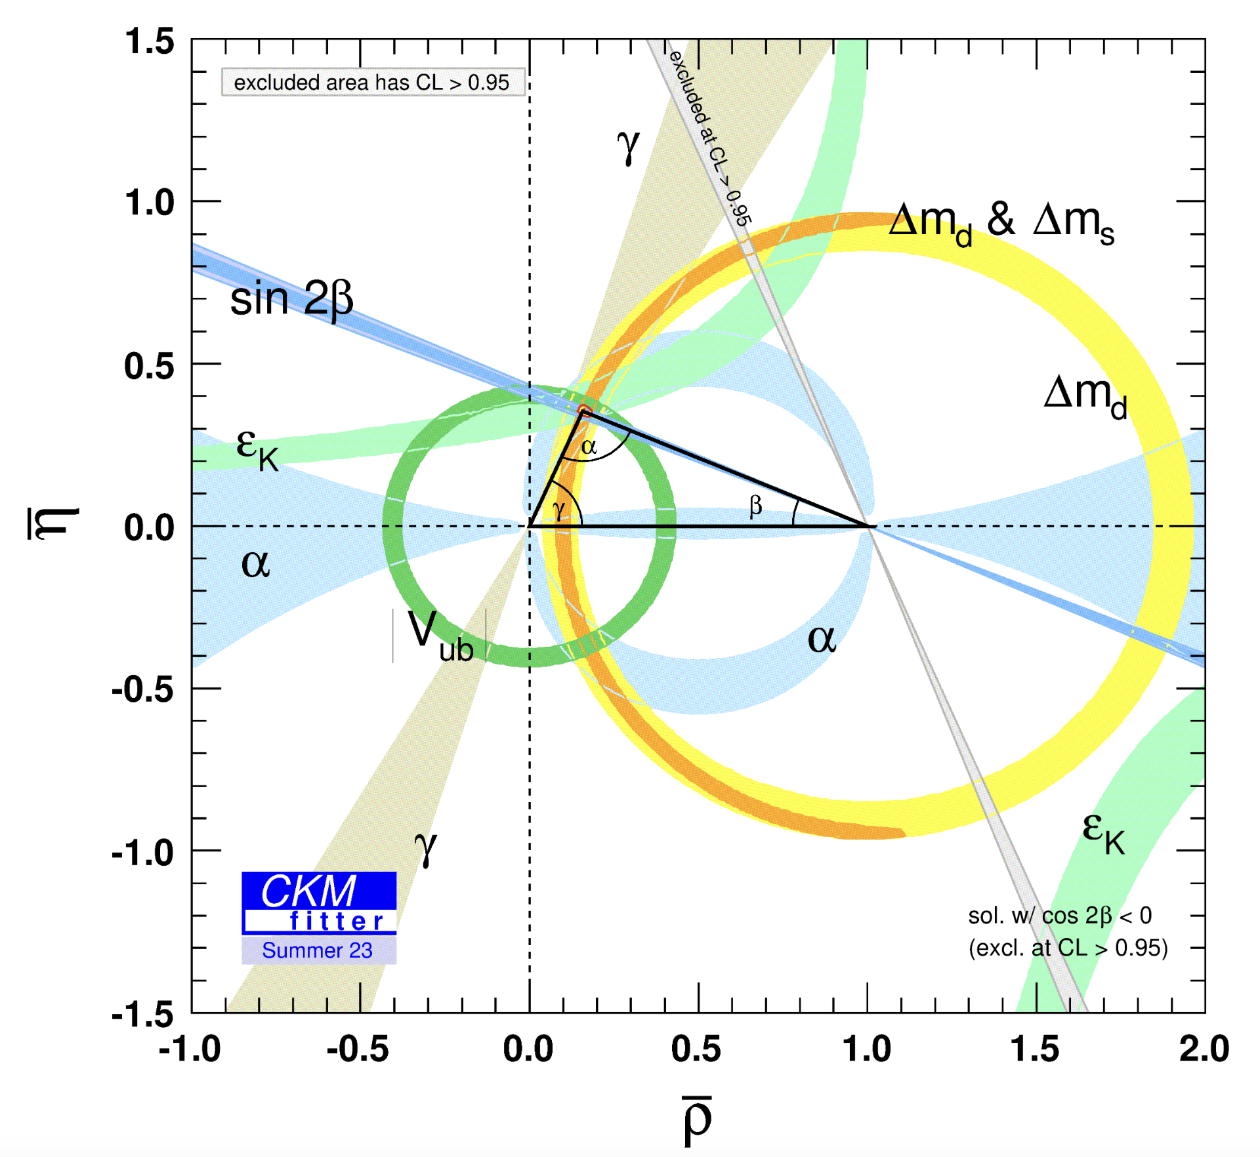
CP violation in baryon decays not yet discovered
1964
1999
2001
2004
2012
2013
2018
2019
????
CP violation (in mixing) in neutral Kaon decays
Direct CP violation in neutral Kaon decays
CP violation in mixing and decay in $B^{0}$ decays
Direct CP violation in $B^{0}$ decays
Direct CP violation in $B^{+}$ decays
Direct CP violation in $B_{s}^{0}$ decays
CP violation in mixing and decay in $B_{s}^{0}$ decays
Direct CP violation in $D^{0}$ decays
Direct CP violation in baryon decays
60 years after discovery of CP violation, strikingly, not yet found in baryon decays
Will it be SM or not, we don’t know
Discover it not only rich our understanding, but also provide new mechanism for generating matter antimatter asymmetry
2025/03/23
国科大 钱文斌
26

Slide 27
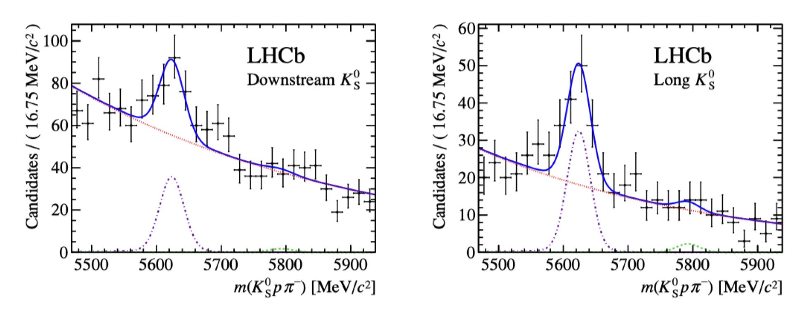
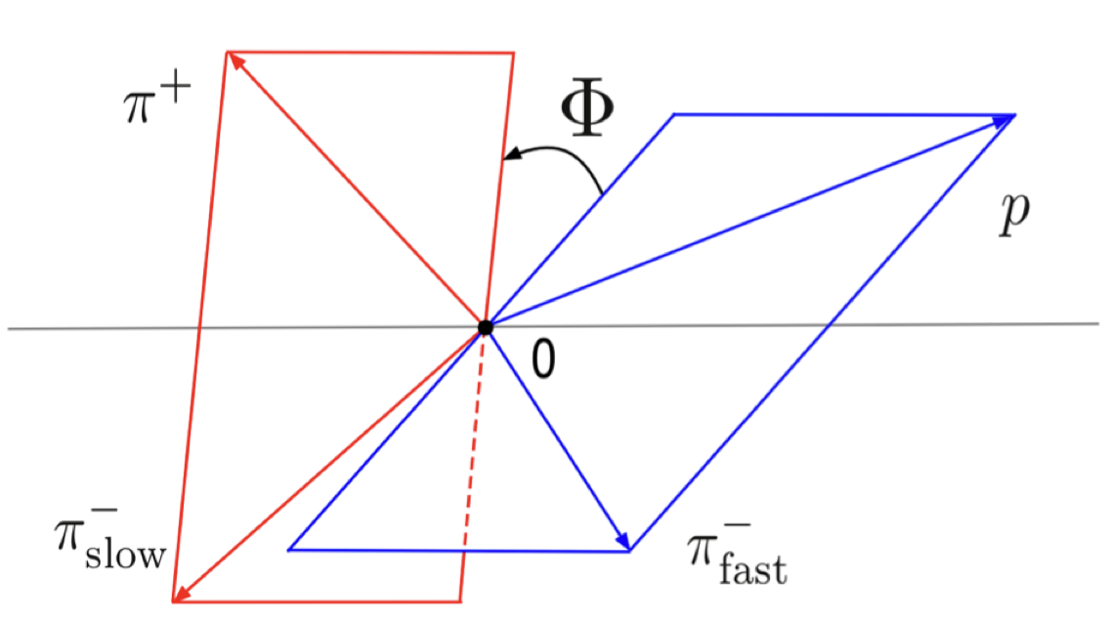
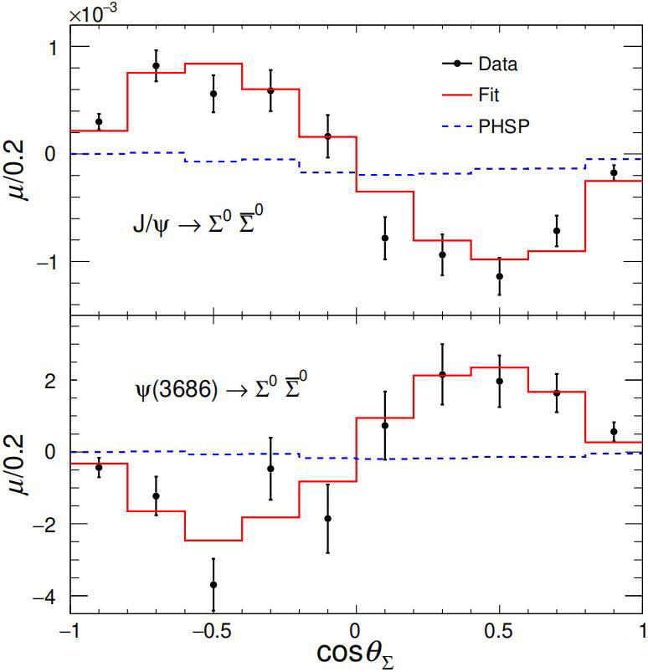
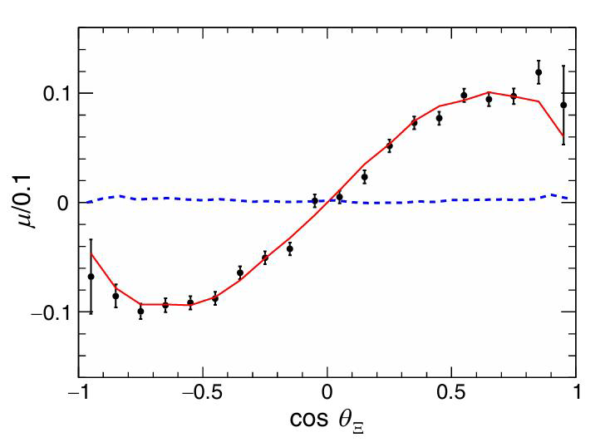
Methods to search for CP violation
JHEP04(2014)087
PRD108(2023)L011101
PRL133 (2024) 101902
Nature Phys.13(2017)391
Many methods have been explored to search for CP violation in baryon decays
Direct CP violation ($∝sin\left(Δδ_{ST}\right)sin(Δφ_{EW})$)
Triple-product asymmetry ($∝cos\left(Δδ_{ST}\right)sin(Δφ_{EW})$)
$$Λ_{b}^{0}→pK_{S}^{0}π^{−}$$
$$Λ_{b}^{0}→pπ^{+}π^{−}π^{+}$$
Decay parameters asymmetry
Important to investigate phase space dependence (amplitude analysis, binned method, energy test etc.)
CPV: b baryon $𝓞(1\%−10\%)$, c baryon $𝓞(0.1\%)$, hyperon $𝓞(0.001\%−0.01\%)$
LHCb: massive production of b baryons!
$J/ψ$ $→Ξ^{0}{\overline{Ξ}}^{0}, Ξ^{0}→Λπ^{0}$
2025/03/23
国科大 钱文斌
27

Slide 28
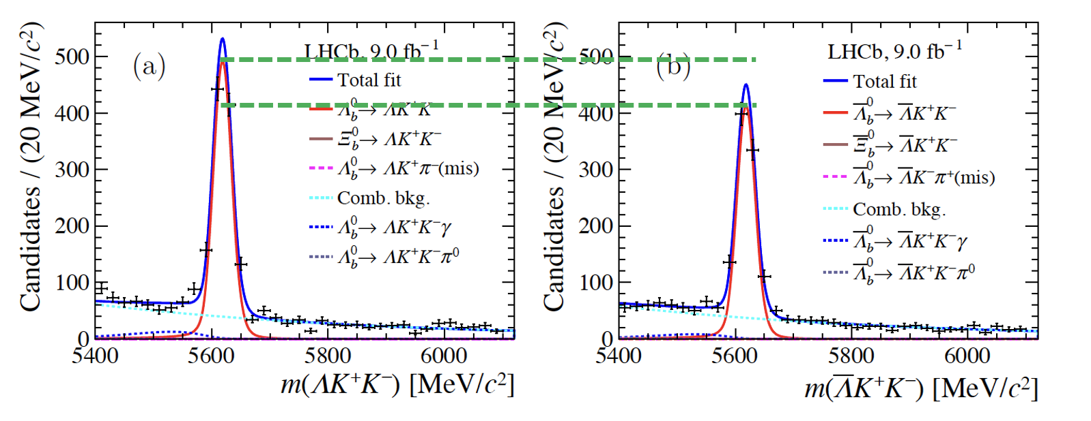
Here we come
PRL 134 (2025) 101802
Preliminary
$$Λ_{b}^{0}→ΛK^{+}K^{−}$$
$$ΔA_{CP}=0.083±0.023±0.016$$
First evidence of CP violation, 3.1$σ$
Three body decays, need to know which resonance contributes
2025/03/23
国科大 钱文斌
28

Slide 29
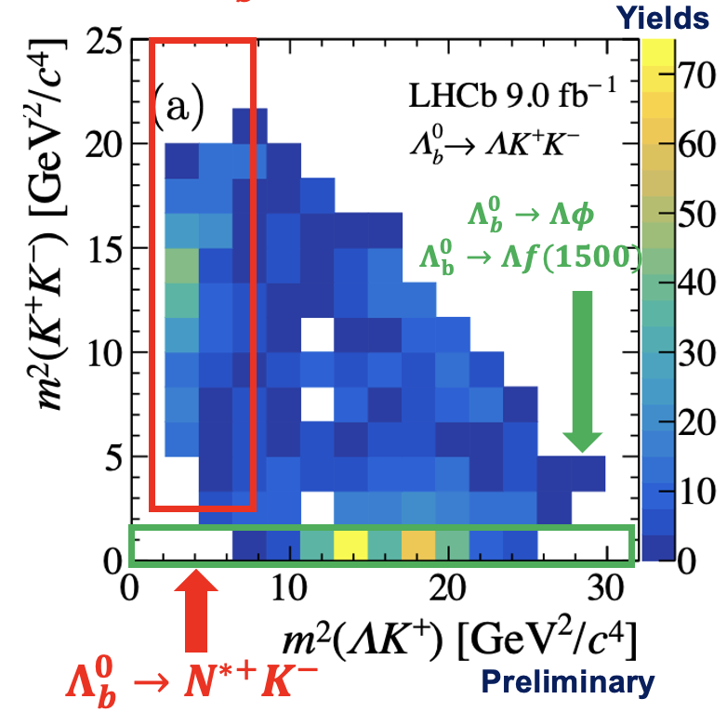
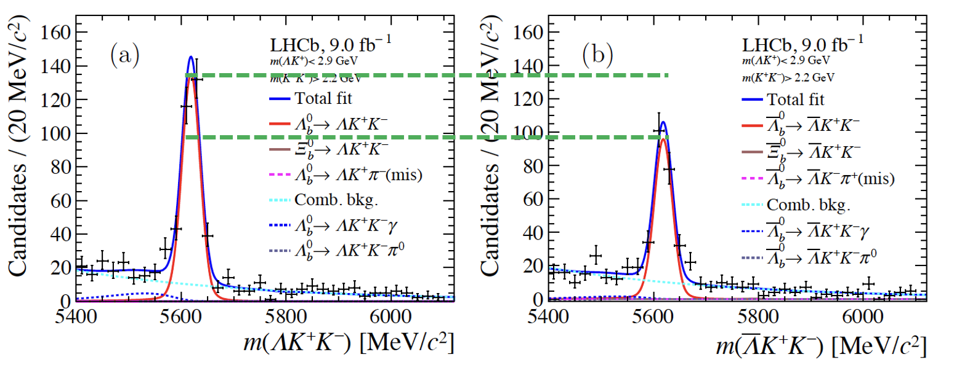
Looking into Dalitz plot ($Λ_{b}^{0}→ΛK^{+}K^{−}$)
PRL 134 (2025) 101802
Preliminary
$$ΔA_{CP}(N^{∗+}K^{−})=0.165±0.048±0.017$$
First evidence of CP violation in local resonant region, 3.2$σ$
region
Consistent with 0 within 2.5$σ$
PRD107 (2023) 053009
$$ΔA_{CP}(Λφ)=0.150±0.055±0.021$$
Predicted CPV (resonant), ~1.5%
2025/03/23
国科大 钱文斌
29

Slide 30
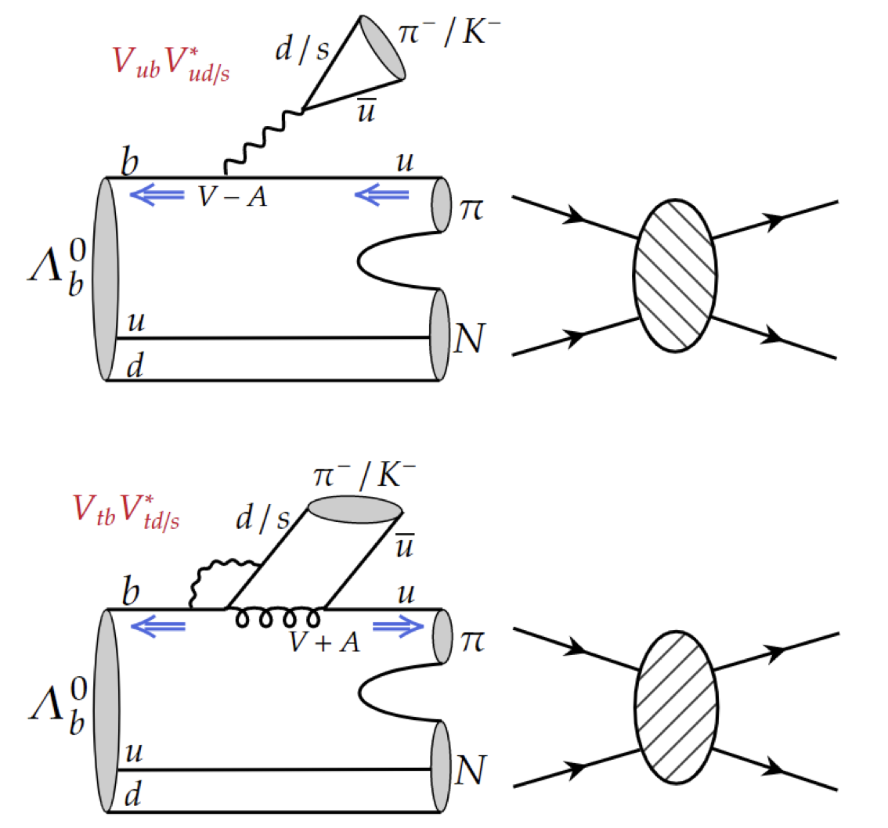
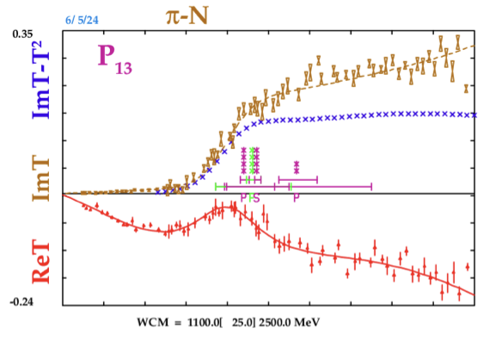
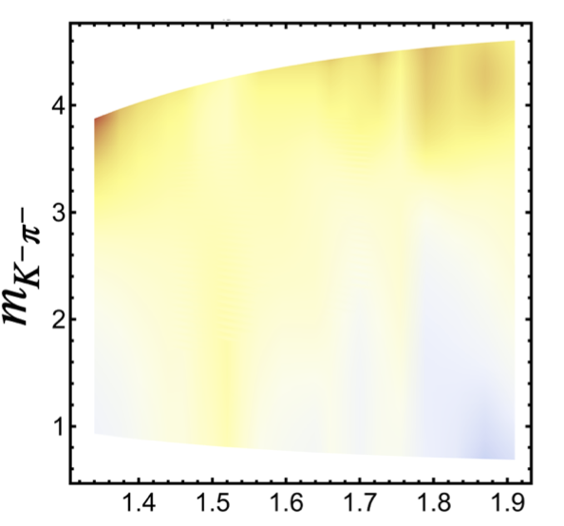
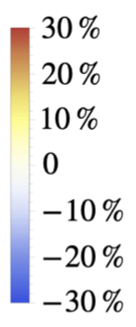
CP violation in $Λ_{b}^{0}→N^{∗+}K^{−}$
CPC48 (2024) 101002
Many $N^{∗+}$contributions： $N\left(1520\right), N\left(1650\right), N\left(1680\right), N\left(1710\right)$ etc. difficult to untangle
Scattering input from SAID program
$Nπ$ scattering
Different scattering amplitudes
CP violation as large as 20$\sim$30% expected
W. Wang et al using U-spin to predict related decays (arXiv:2411.18400)
weak phase
strong phase
2025/03/23
国科大 钱文斌
30

Slide 31
Can we do more?
Phys. Rev. 108 (1959) 1645
More complicated, but also add more information
Decay parameters, first proposed by Lee and Yang (1959) to study hyperon decays
$$α_{∓}= ±\frac{2ℜ(S^{∗}P)}{{\left|S\right|}^{2}+{\left|P\right|}^{2}}=±\frac{2\left|S\right|\left|P\right|\cos{(δ±φ)}}{{\left|S\right|}^{2}+{\left|P\right|}^{2}}$$
$$β_{∓}= ±\frac{2ℑ(S^{∗}P)}{{\left|S\right|}^{2}+{\left|P\right|}^{2}}=±\frac{2\left|S\right|\left|P\right|\sin{(δ±φ)}}{{\left|S\right|}^{2}+{\left|P\right|}^{2}}$$
$$γ= \frac{{\left|S\right|}^{2}−{\left|P\right|}^{2}}{{\left|S\right|}^{2}+{\left|P\right|}^{2}}$$
$$α^{2}+β^{2}+γ^{2}=1$$
New CP observables:
$δ:$ strong phase difference between S and P waves
$φ:$ weak phase difference between S and P waves
$$A_{α}= \frac{α_{+}+α_{−}}{α_{+}−α_{−}}=−tan\left(δ\right)\tan{(φ)}$$
$$R_{β_{1}}= \frac{β_{+}+β_{−}}{α_{+}−α_{−}}=\tan{(φ)}$$
$$R_{β_{2}}= \frac{β_{+}−β_{−}}{α_{+}−α_{−}}=−tan{(δ)}$$
2025/03/23
国科大 钱文斌
31

Slide 32
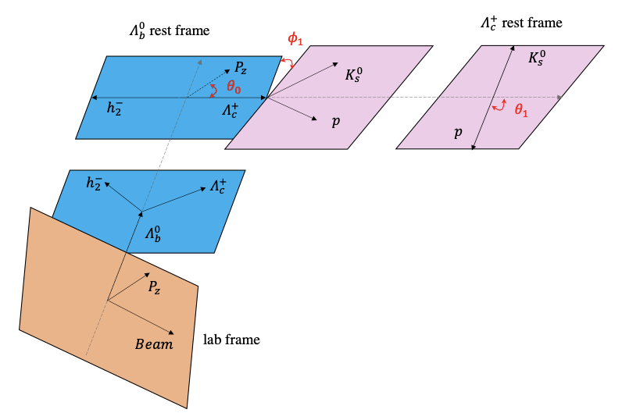
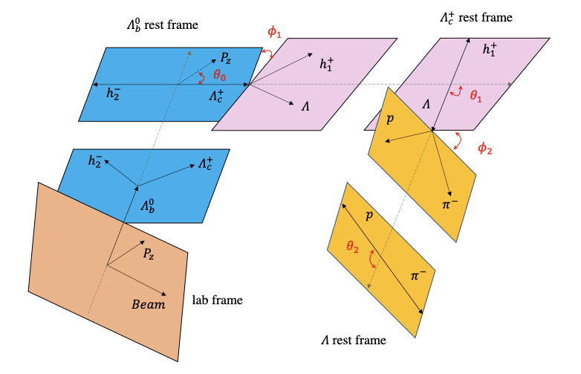
LHCb can contribute
PRL 133 (2024) 261804
Several decay chains considered:
$$Λ_{b}^{0}→Λ_{c}^{+}{(→Λh^{+})h}^{−}, Λ→pπ^{−}$$
$$Λ_{b}^{0}→Λ_{c}^{+}{(→pK_{S}^{0})h}^{−}$$
$$α_{b}:Λ_{b}^{0}→Λ_{c}^{+}h^{−}$$
$$α_{c}:Λ_{c}^{+}→pK_{S}^{0}$$
$$α_{b}:Λ_{b}^{0}→Λ_{c}^{+}h^{−}$$
$$α_{c},β_{c},γ_{c}:Λ_{c}^{+}→Λh^{+}$$
$$α_{s}:Λ→pπ^{−}$$
2025/03/23
国科大 钱文斌
32

Slide 33
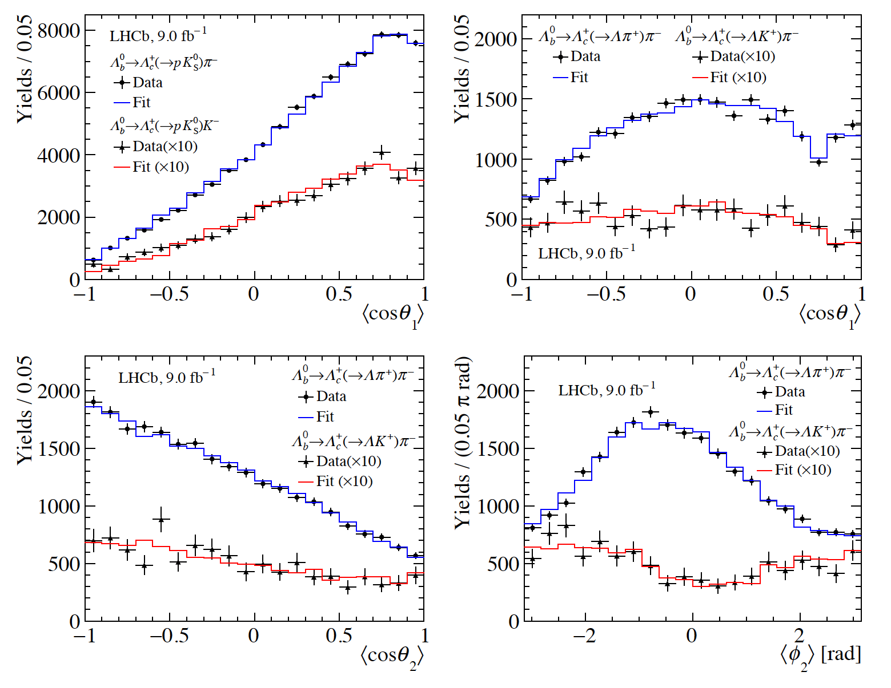
Results of decay parameters
PRL 133 (2024) 261804
$$Λ_{b}^{0}→Λ_{c}^{+}(→pK_{S}^{0})h^{−}$$
$$Λ_{b}^{0}→Λ_{c}^{+}{\left(→Λh^{+}\right)π}^{−}$$
First determination of $α$ in $Λ_{b}^{0}→Λ_{c}^{+}h^{−}$ decays (precision $\sim 0.9\%$ for $Λ_{c}^{+}π^{−}$)
Most precise determinations of $α,(β,γ)$ in $Λ_{c}^{+}→pK_{S}^{0}$ (precision $\sim 1.4\%$) and $Λ_{c}^{+}→Λh^{+}$ decays
Confirmation of $α(Λ→pπ^{−})$ from BESIII (significantly higher than previous measurements)
Results consistent with no CP violation in both $A_{α}$ and $R_{β_{1}} (\text{precision} \sim 2\% \text{for} Λ_{c}^{+}π^{−})$
Pave the way for other decay parameter measurements (more sensitive)
$$Λ_{b}^{0}→Λ_{c}^{+}π^{−}$$
$$Λ_{c}^{+}→Λπ^{+}$$
$$Λ_{b}^{0}→Λ_{c}^{+}K^{−}$$
$$Λ_{c}^{+}→ΛK^{+}$$
$$Λ_{c}^{+}→Λπ^{+}$$
$$Λ_{c}^{+}→Λπ^{+}$$
$$Λ_{c}^{+}→ΛK^{+}$$
$$Λ_{c}^{+}→ΛK^{+}$$
$$Λ_{b}^{0}→Λ_{c}^{+}{\left(→Λh^{+}\right)π}^{−}$$
$$Λ_{b}^{0}→Λ_{c}^{+}{\left(→Λh^{+}\right)π}^{−}$$
2025/03/23
国科大 钱文斌
33

Slide 34
CP violation in baryon decays in near future
Hyperon decays: $Λ→pπ^{−}$ (3.2M events from BESIII)
Charm decays: $Λ_{c}^{+}→pπ^{+}π^{−}, pK^{+}K^{−}$ (LHCb, Run1, $Λ_{c}^{+}$ from $b$ decays)
Beauty baryon decays:
Further explore channels with more data: $Λ_{b}^{0}→pK_{S}^{0}h^{−}$ (Run 1), $Λ_{b}^{0}→J/ψph^{−}$ (Run 1), $Λ_{b}^{0}→pπ^{−}π^{+}π^{−}$ (Run 1 $A_{CP}$, Run 1+2 TPA), $Λ_{b}^{0}→pK^{−}π^{+}π^{−}$ (Run 1) and $Λ_{b}^{0}→pπ^{0}h^{−}$
Especially $Λ_{b}^{0}→pK^{−}π^{+}π^{−} (Λ_{b}^{0}→pπ^{0}K^{−}),$ which also contains resonant contributions from $Λ_{b}^{0}→N^{∗+}\left(→pπ^{+}π^{−}\right)K^{−} (Λ_{b}^{0}→N^{∗+}\left(→pπ^{0}\right)K^{−})$
Unknown suppression factor (QCD related), luck needed to find where it hides！
$$\frac{α_{−}+α_{+}}{α_{−}−α_{+}}=−\left(2.5±4.8\right)×{10}^{−3}$$
With Super $τ$-charm factory, sensitivity around $10^{−4}$, approaching SM prediction
$$A_{CP}\left(Λ_{c}^{+}→pK^{+}K^{−}\right)−A_{CP}\left(Λ_{c}^{+}→pπ^{+}π^{−}\right)=0.003±0.011$$
With prompt $Λ_{c}^{+}$ and Run3 data, precision less than $10^{−3}$, approaching SM predictions
2025/03/23
国科大 钱文斌
34

Slide 35
What if we find 5$σ$ CP violation in baryon?
Next question: is it SM?
2025/03/23
国科大 钱文斌
35

Slide 36
What if we find 5$σ$ CP violation in baryon?
Next question: is it SM?
Answer: measuring $γ$ in baryon decays
Already some interesting work by Q. Qin et. al., PRD108 (2023) L111901
2025/03/23
国科大 钱文斌
36

Slide 37
CPV in $B^{+}→J/ψh^{+}$ decays
PRL 134 (2025) 101801
Important inputs for understanding penguin contributions in CKM angle $β$ and $φ_{s}$ measurements
$ΔA_{CP}=A\left(B^{+}→Jψπ^{+}\right)−A\left(B^{+}→Jψπ^{+}\right)=\left(1.42±0.43±0.08\right)×10^{−2}$
Add further constraints to the ratio between penguin and tree diagrams
2025/03/23
国科大 钱文斌
37

Slide 38
Outline of the talk
Introduction
Recent results on spectroscopy studies
Recent results on CP violation studies
Prospects and conclusion
2025/03/23
国科大 钱文斌

Slide 39
Prospects
Belle II
0.4 ab⁻¹
15 ab⁻¹
50 ab⁻¹
250 ab⁻¹
2019-2022
2024-2027
Run 1
LS1
Run 2
LS1
Run 3
upgrade
2015-2018
2019-2022
2022-2025
2025-2029
2029-2032
2032-2035
2035-future
Run2
LS2
Run3
LS3
Run4
LS4
Run5-6
Phase I
Upgrade
Phase Ib
Upgrade
Phase II
Upgrade
LHCb
23 fb⁻¹
50 fb⁻¹
300 fb⁻¹
HL-LHC
CMS/ATLAS
200 fb⁻¹
3000 fb⁻¹
BESIII/super $τ$-charm/CEPC
BEPCII upgrade + running of super $τ$-charm/CEPC
2025/03/23
国科大 钱文斌

Slide 40
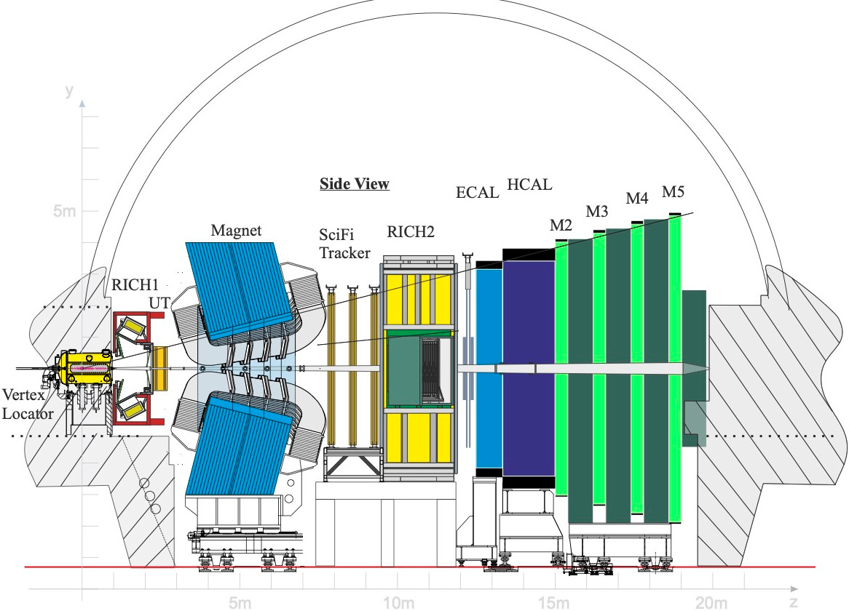
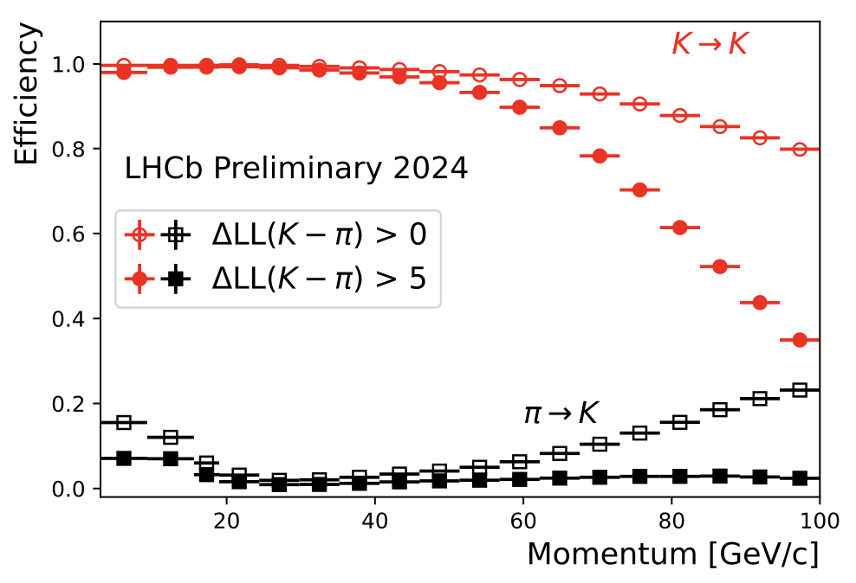
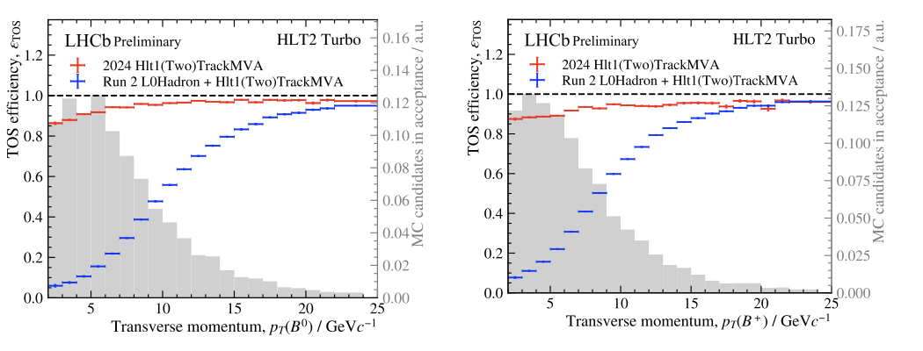
A new LHCb detector
With our new LHCb detector, already collected more data than Run1+2
More importantly, full software trigger ➜ better performance on hadronic final states
New pixel Velo
New UT
New SciFi
Removed M1 and new readout
Similar PID performance
Twice trigger efficiencies (hadronic)
Removed PS/SPD and new readout
New RICH optics and PMS
2025/03/23
国科大 钱文斌
40

Slide 41
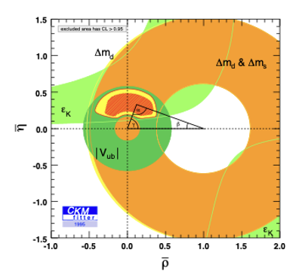
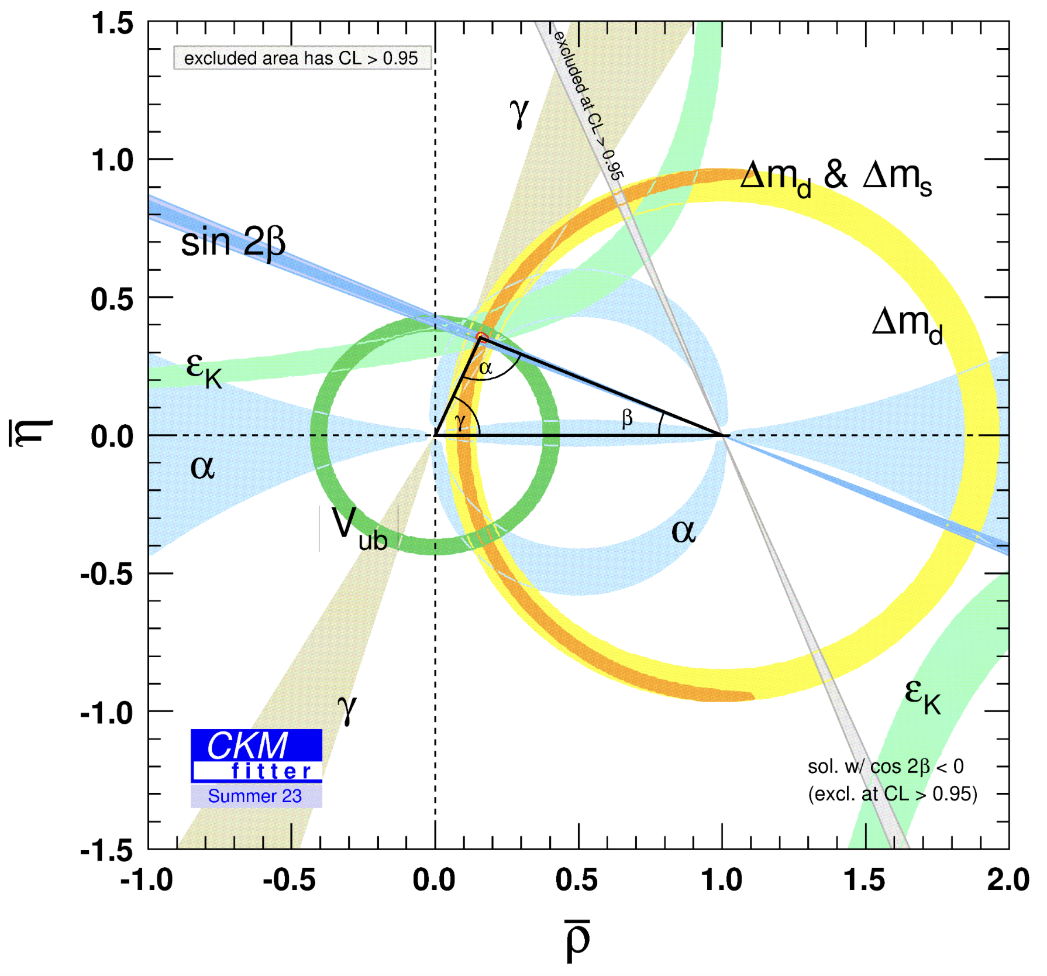
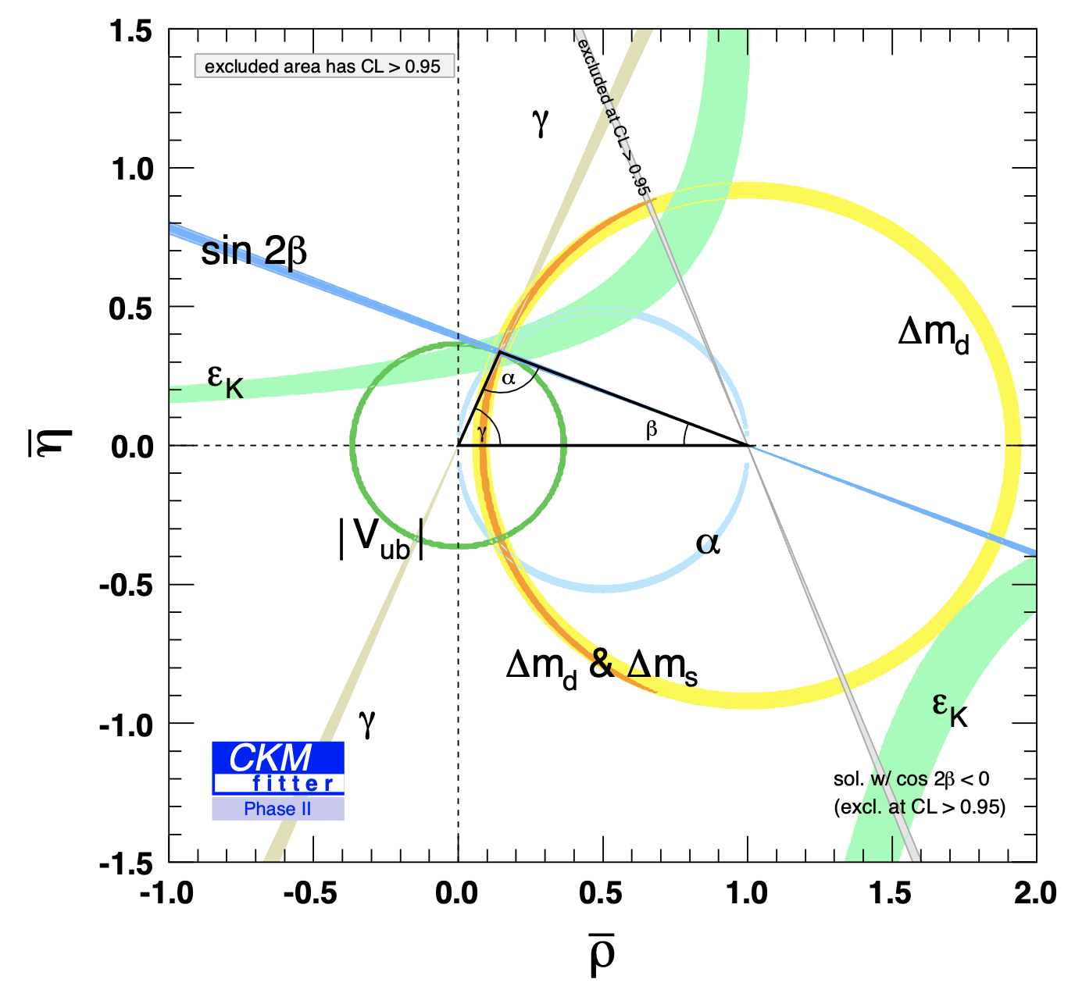
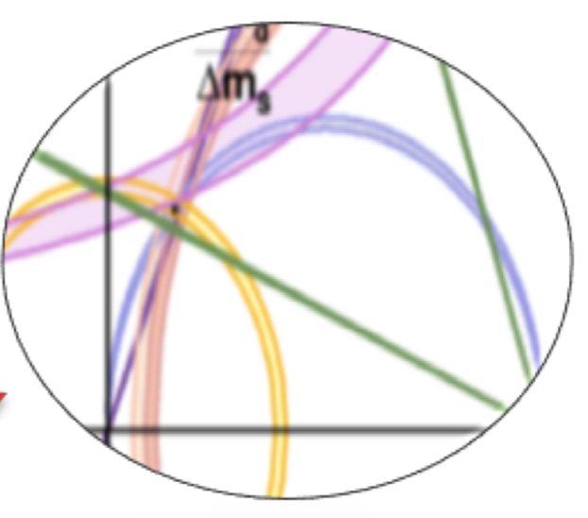
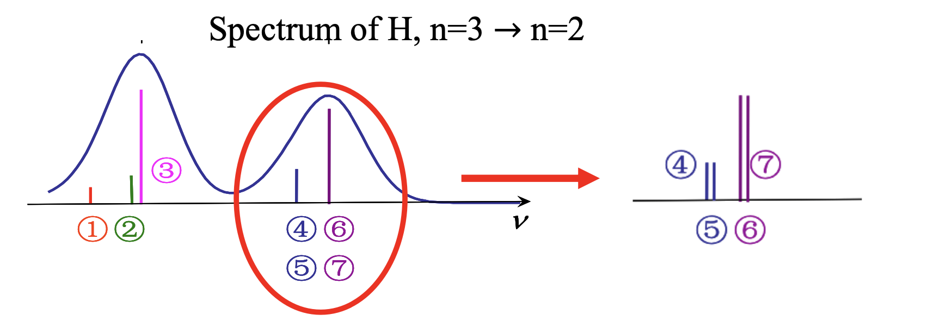
Future of flavor and hadron physics
1995
2023
2040?
Either we find NP, or we understand non-perturbative QCD
2025/03/23
国科大 钱文斌

Slide 42
Thank you for your attention!
2025/03/23
国科大 钱文斌
42

