Slide 1
Evidence for two excited Ω hyperons
罗 涛
复旦大学
第四届强子与重味物理理论与实验联合研讨会
兰州大学，2025/03/21-2025/03/24
arXiv: 2411.11648, accepted by PRL

Slide 2

Outline
01
Motivation
02
Data Sets
03
Event selection
04
Search for Excited $Ω^{−}$ Hyperons
05
Systematic uncertainty
06
Summary
2

Slide 3
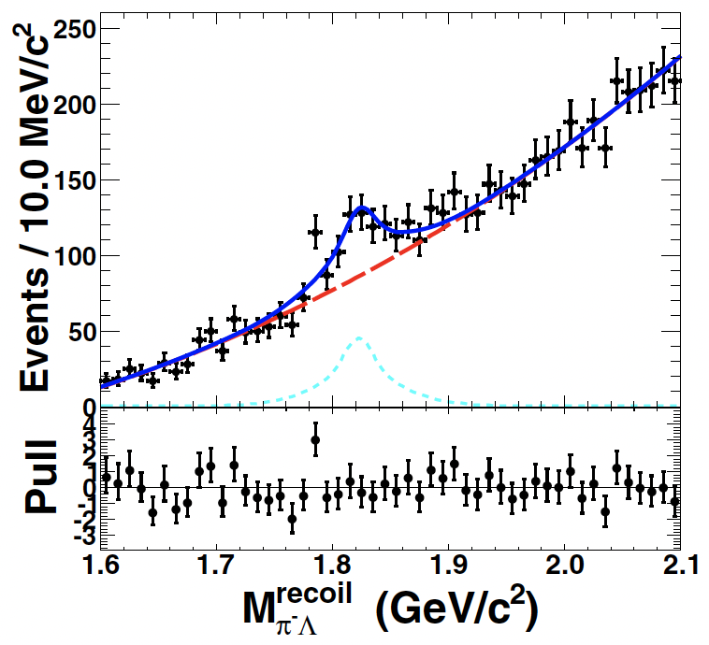
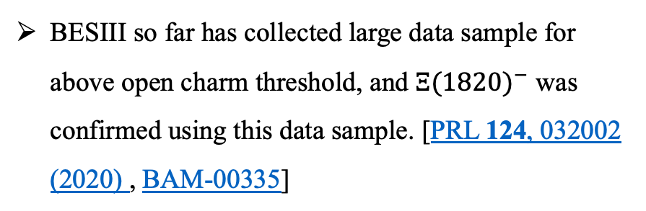
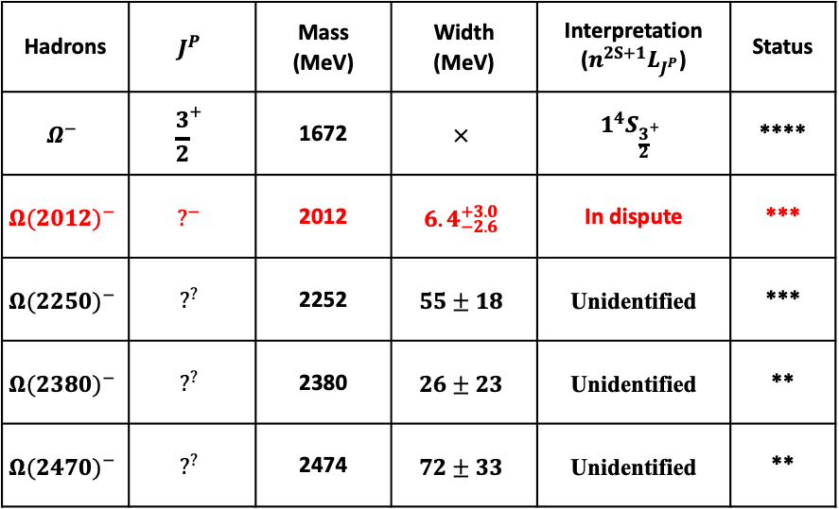
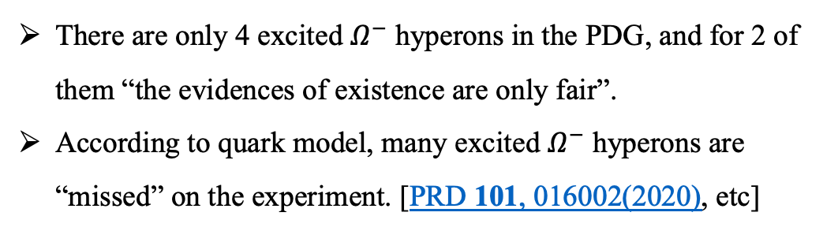
Motivation
From PDG
Hadrons | $$J^{P}$$ | Mass (MeV) | Width (MeV) | Interpretation ($n^{2S+1}L_{J^{P}}$) | Status
$$Ω^{−}$$ | $${\frac{3}{2}}^{+}$$ | 1672 | $$×$$ | $$1^{4}S_{{\frac{3}{2}}^{+}}$$ | ****
$${Ω(2012)}^{−}$$ | $$?^{−}$$ | 2012 | $${6.4}_{−2.6}^{+3.0}$$ | In dispute | ***
$${Ω(2250)}^{−}$$ | $$?^{?}$$ | 2252 | $$55±18$$ | Unidentified | ***
$${Ω(2380)}^{−}$$ | $$?^{?}$$ | 2380 | $$26±23$$ | Unidentified | **
$${Ω(2470)}^{−}$$ | $$?^{?}$$ | 2474 | $$72±33$$ | Unidentified | **
There are only 4 excited $Ω^{−}$ hyperons in the PDG, and for 2 of them “the evidences of existence are only fair”.
According to quark model, many excited $Ω^{−}$ hyperons are “missed” on the experiment. [PRD 101, 016002(2020), etc]
BESIII so far has collected large data sample for above open charm threshold, and ${Ξ(1820)}^{−}$ was confirmed using this data sample. [PRL 124, 032002 (2020) , BAM-00335]
We can search for excited $Ω^{−}$ hyperons using the XYZ data.
3

Slide 4


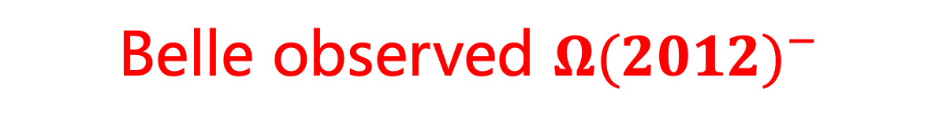
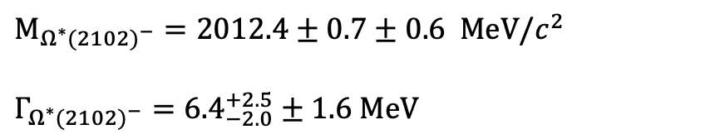
Belle observed ${Ω(2012)}^{−}$
2018年Belle实验在$ΞK$质量谱上发现重子激发态 ${Ω(2012)}^{−}$
$$M_{{Ω^{∗}(2102)}^{−}}=2012.4±0.7±0.6 MeV/c^{2}$$
$$Γ_{{Ω^{∗}(2102)}^{−}}={6.4}_{−2.0}^{+2.5}±1.6 MeV$$
截止目前，仅在Belle实验上被观测到，
没有其他任何实验确认
J. Yelton et al. (Belle Collaboration), PRL 121, 052003 (2018)
4

Slide 5
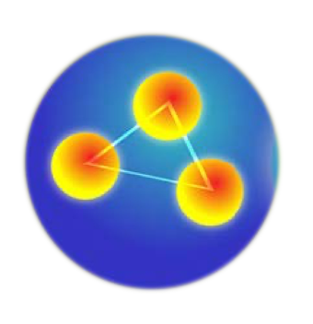
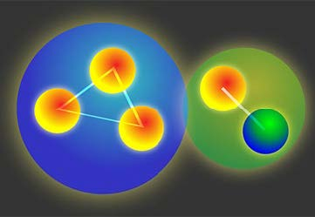





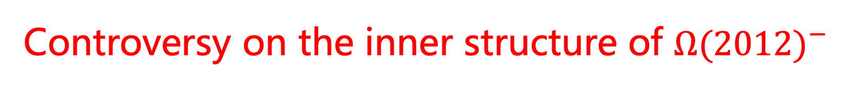
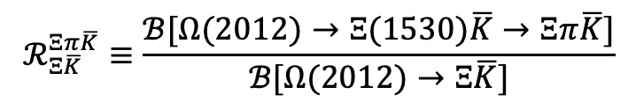

Controversy on the inner structure of ${Ω(2012)}^{−}$
$$ℛ_{Ξ\overline{K}}^{Ξπ\overline{K}}≡\frac{ℬ[Ω(2012)→Ξ(1530)\overline{K}→Ξπ\overline{K}]}{ℬ[Ω(2012)→Ξ\overline{K}]}$$
Measurement in 2019:
S. Jia et al. (Belle Collaboration), PRD 100, 032006 (2019)
Measurement in 2022:
(Belle Collaboration), Phys. Lett. B 860 (2025) 139224
$𝓡_{Ξ\overline{K}}^{Ξπ\overline{K}}<11.9\%$ at 90% C.L.
$$𝓡_{Ξ\overline{K}}^{Ξπ\overline{K}}=0.99±0.26±0.06$$
非常不同
$$s$$
$$Ω(2012)$$
$$s$$
$$s$$
$$s$$
$$s$$
$$u$$
$$Ω(2012)$$
$$s$$
$$\overline{K}$$
$$\overline{u}$$
传统夸克模型:
符合Belle实验2019年的测量结果
M. S. Liu, K. L. Wang, Q. F. Lü, and X. H. Zhong PRD 101, 016002 (2020);
R. N. Faustov and V. O. Galkin, PRD 92, 054005 (2015);
Y. Chen and B. Q. Ma, Nucl. Phys. A 831, 1 (2009);
M. Pervin and W. Roberts, PRC 77, 025202 (2008);
Y. Oh, PRD 75, 074002 (2007).
……
强子分子态:
符合Belle实验2022年的测量结果
Y. H. LinN. Ikeno, G. Toledo, and E. Oset, PRD 101, 094016 (2020);
Y. H. Lin, F. Wang, and B. S. Zou, PRD 102, 074025 (2020);
C. H. Zeng, J. X. Lu, E. Wang, J. J. Xie, and L. S. Geng, PRD 102, 076009 (2020);
J. X. Lu, C. H. Zeng, E. Wang, J. J. Xie, and L. S. Geng, EPJC 80, 361 (2020);
Y. H. Lin and B. S. Zou, PRD 98, 056013 (2018).
……
$$Ξ^{(∗)}$$
VS
5
Notes:
不好意思，在这里只列出部分理论文章，很多专家的重要文章还没有列上。

Slide 6
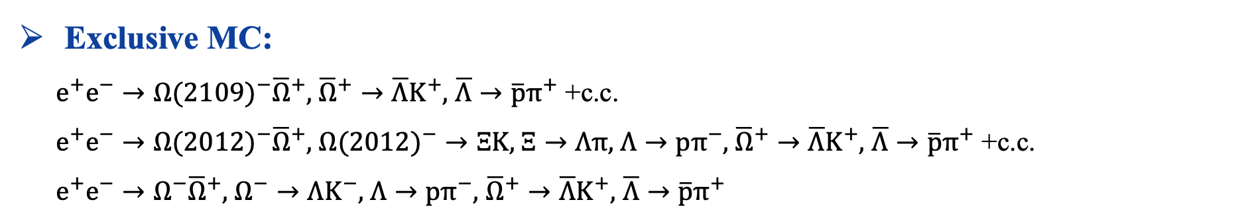
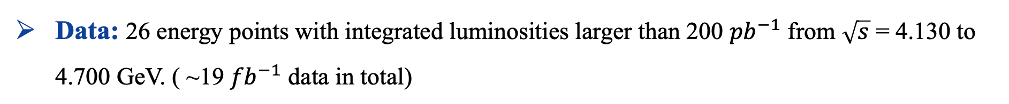
Study on excited Ω hyperons at BESIII
Data sets
Software environment: BOSS 7.0.5
Data: 26 energy points with integrated luminosities larger than 200 ${pb}^{−1}$ from $\sqrt{s}$ = 4.130 to 4.700 GeV. ( ~19 ${fb}^{−1}$ data in total)
Inclusive MC:
The official inclusive MC samples from the Charmonium group.
Exclusive MC:
$e^{+}e^{−}→{Ω(2109)}^{−}{\overline{Ω}}^{+},$ ${\overline{Ω}}^{+}→\overline{Λ}K^{+},$ $\overline{Λ}→\overline{p}π^{+}$ +c.c.
$e^{+}e^{−}→{Ω(2012)}^{−}{\overline{Ω}}^{+},$ ${Ω(2012)}^{−}→ΞK$, $Ξ→Λπ$, $Λ→pπ^{−}$, ${\overline{Ω}}^{+}→\overline{Λ}K^{+},$ $\overline{Λ}→\overline{p}π^{+}$ +c.c.
$e^{+}e^{−}→Ω^{−}{\overline{Ω}}^{+},$ $Ω^{−}→{ΛK}^{−}$, $Λ→pπ^{−},$ ${\overline{Ω}}^{+}→\overline{Λ}K^{+},$ $\overline{Λ}→\overline{p}π^{+}$
6

Slide 7




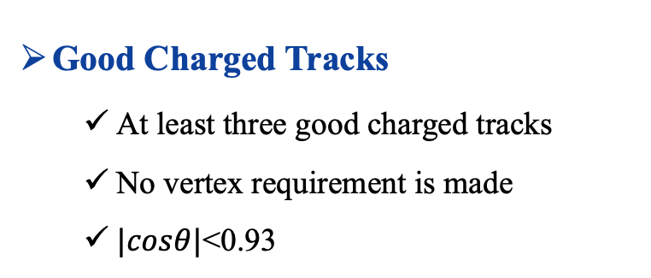




Event selection
$$\overline{p}$$
Good Charged Tracks
  At least three good charged tracks
  No vertex requirement is made
  $|cosθ|$<0.93
$$\overline{Λ}$$
$$π^{+}$$
$${\overline{Ω}}^{+}$$
Tag
$$K^{+}$$
ECM
Particle Identification
For p: Prob(p)>Prob(K), Prob(p)>Prob(π), Prob(p)>0
For π: Prob(π)>Prob(p), Prob(π)>Prob(K), Prob(π)>0
For K: Prob(K)>Prob(p), Prob(K)> Prob(π), Prob (K)>0
$$e^{+}$$
$$e^{−}$$
Recoil
$$Ω^{∗−}$$
The charge-conjugated channel is also implied.
为了提高重建效率，只重建$\overline{Ω}$，然后通过$\overline{Ω}$的反冲谱来研究$Ω$的激发态
7

Slide 8
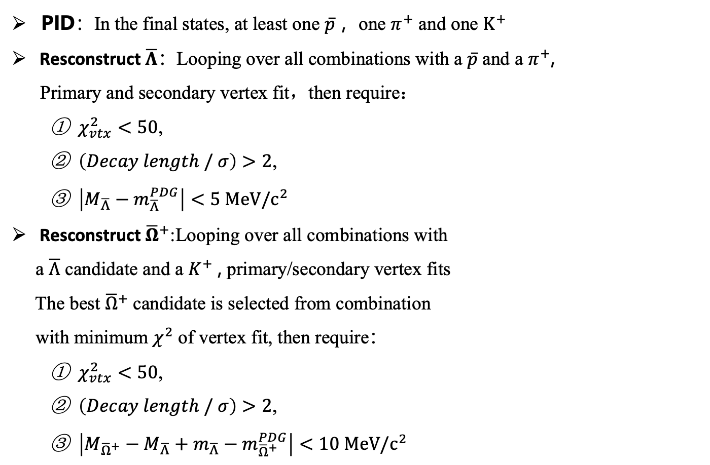
Event selection
PID：In the final states, at least one $\overline{p}$，one $π^{+}$ and one $K^{+}$
Resconstruct $\overline{Λ}$：Looping over all combinations with a $\overline{p}$and a $π^{+}$,
Primary and secondary vertex fit，then require：
  $χ_{vtx}^{2}<50$,
  $\left(Decay length / σ\right)>2$,
  $\left|M_{\overline{Λ}}−m_{\overline{Λ}}^{PDG}\right|<5 MeV/c^{2}$
Resconstruct ${\overline{Ω}}^{+}$:Looping over all combinations with
a $\overline{Λ}$ candidate and a $K^{+}$, primary/secondary vertex fits
The best ${\overline{Ω}}^{+}$candidate is selected from combination
with minimum $χ^{2}$ of vertex fit, then require：
  $χ_{vtx}^{2}<50$,
  $\left(Decay length / σ\right)>2$,
  $\left|M_{{\overline{Ω}}^{+}}−M_{\overline{Λ}}+m_{\overline{Λ}}−m_{{\overline{Ω}}^{+}}^{PDG}\right|<10 MeV/c^{2}$
信号区
边带区
The charge-conjugated channel is also implied, only take the reconstruction of $\overline{Ω}$as example
8

Slide 9

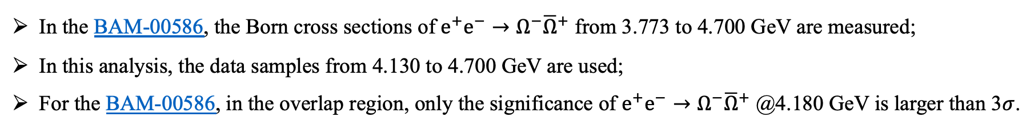
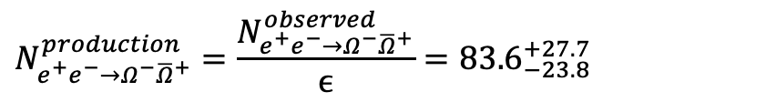


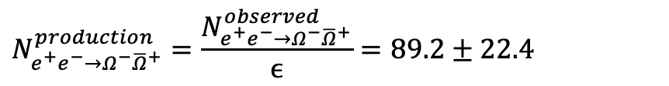

Validate our event selection @4.180 GeV
In the BAM-00586, the Born cross sections of $e^{+}e^{−}→Ω^{−}{\overline{Ω}}^{+}$ from 3.773 to 4.700 GeV are measured;
In this analysis, the data samples from 4.130 to 4.700 GeV are used;
For the BAM-00586, in the overlap region, only the significance of $e^{+}e^{−}→Ω^{−}{\overline{Ω}}^{+}$ @4.180 GeV is larger than 3$σ$.
Compare our results of production yield of $e^{+}e^{−}→Ω^{−}{\overline{Ω}}^{+}$ @4.180 GeV.
From BAM-00586
From this analysis
$$N_{e^{+}e^{−}→Ω^{−}{\overline{Ω}}^{+}}^{observed}={13}_{−3.7}^{+4.3}$$
$$N_{e^{+}e^{−}→Ω^{−}{\overline{Ω}}^{+}}^{observed}=17.7±4.5$$
$$ϵ=15.55 \%$$
$$ϵ=19.83 \%$$
$$N_{e^{+}e^{−}→Ω^{−}{\overline{Ω}}^{+}}^{production}=\frac{N_{e^{+}e^{−}→Ω^{−}{\overline{Ω}}^{+}}^{observed}}{ϵ}={83.6}_{−23.8}^{+27.7}$$
$$N_{e^{+}e^{−}→Ω^{−}{\overline{Ω}}^{+}}^{production}=\frac{N_{e^{+}e^{−}→Ω^{−}{\overline{Ω}}^{+}}^{observed}}{ϵ}=89.2±22.4$$
Consistent
9

Slide 10
Search for excited Ω hyperons
Comparison between data and sideband
Comparison between data and inclusive MC
Apart from the $Ω$ ground state，There are two structures around 2.0 and 2.1 $GeV/c^{2}$
10

Slide 11
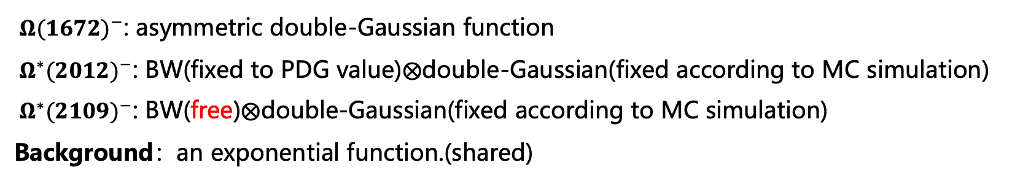
Evidence for two excited Ω hyperons
Simultaneous fit
arXiv: 2411.11648, accepted by PRL
${ Ω(1672)}^{−}$: asymmetric double-Gaussian function
${ Ω^{∗}(2012)}^{−}$: BW(fixed to PDG value)$⨂$double-Gaussian(fixed according to MC simulation)
${ Ω^{∗}(2109)}^{−}$: BW(free)$⨂$double-Gaussian(fixed according to MC simulation)
Background：an exponential function.(shared)
11

Slide 12





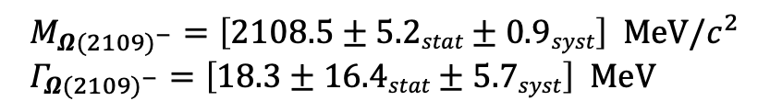

Evidence for two excited Ω hyperons
Simultaneous fit
arXiv: 2411.11648, accepted by PRL
$${Ω(2109)}^{−}$$
$${Ω(2012)}^{−}$$
$N_{{Ω(2109)}^{−}}=53 ±19$
$N_{{Ω^{∗}(2012)}^{−}}=24 ±8$
$$M_{{Ω(2109)}^{−}}=\left[2108.5±5.2stat±0.9syst\right] MeV/c^{2} \\ Γ_{{Ω(2109)}^{−}}=\left[18.3±16.4stat±5.7syst\right] MeV$$
Significance = 3.5σ
$${ Ω(1672)}^{−}$$
Significance = 4.1σ [A new excited Ω state]
$N_{{Ω(1672)}^{−}}=92 ±11$
12

Slide 13
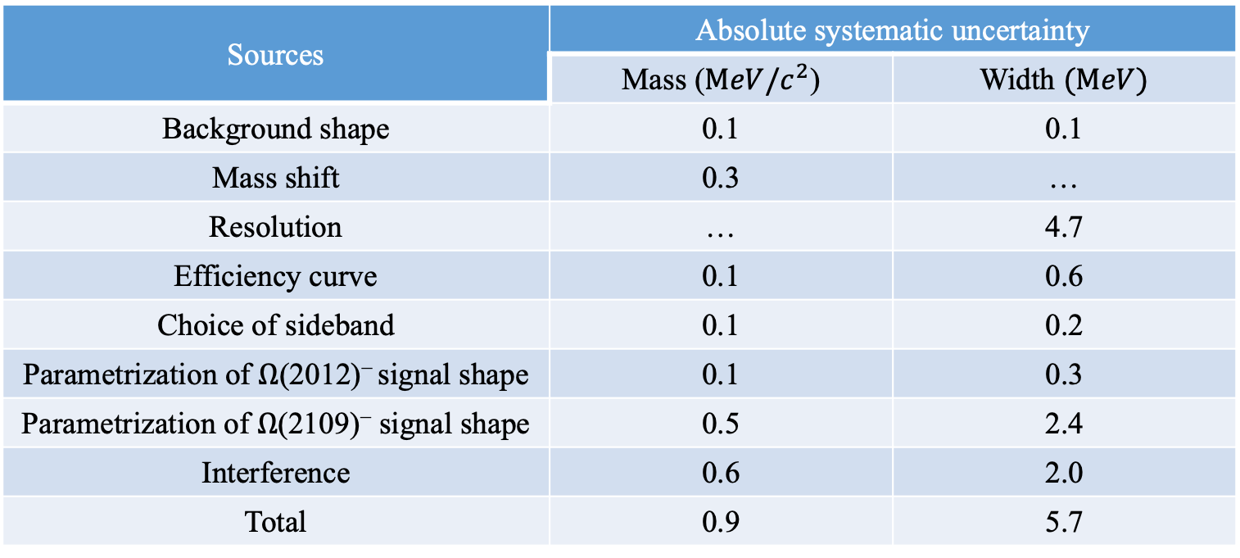
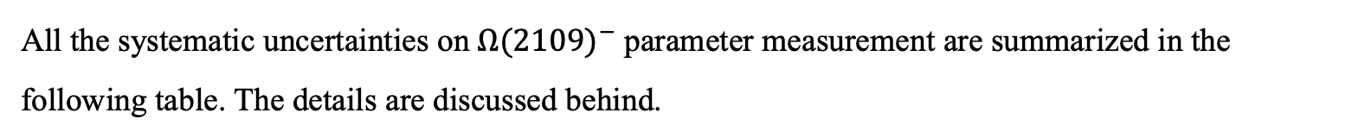
Systematic uncertainty
All the systematic uncertainties on ${Ω(2109)}^{−}$parameter measurement are summarized in the following table. The details are discussed behind.
Sources | Absolute systematic uncertainty
 | Mass ($MeV/c^{2}$) | Width $(MeV)$
Background shape | 0.1 | 0.1
Mass shift | 0.3 | …
Resolution | … | 4.7
Efficiency curve | 0.1 | 0.6
Choice of sideband | 0.1 | 0.2
Parametrization of $Ω$(2012)⁻ signal shape | 0.1 | 0.3
Parametrization of $Ω$(2109)⁻ signal shape | 0.5 | 2.4
Interference | 0.6 | 2.0
Total | 0.9 | 5.7
13

Slide 14
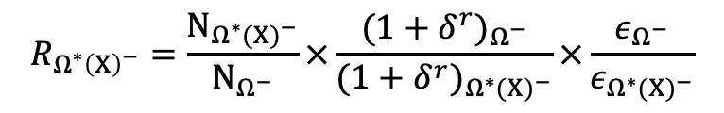
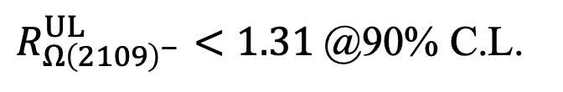
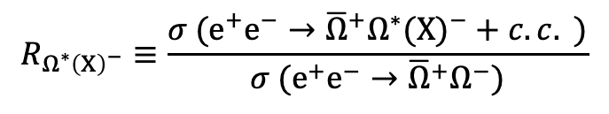
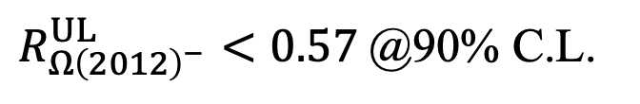
Measurement of production cross sections
Ratio of production cross sections：
Method to measure the X-section ratio：
$$R_{Ω^{∗}{\left(X\right)}^{−}}≡\frac{σ (e^{+}e^{−}→{{\overline{Ω}}^{+}Ω^{∗}(X)}^{−}+c.c. )}{σ (e^{+}e^{−}→{{\overline{Ω}}^{+}Ω}^{−})}$$
$$R_{Ω^{∗}{\left(X\right)}^{−}}=\frac{N_{{Ω^{∗}(X)}^{−}}}{N_{Ω^{−}}}×\frac{{(1+δ^{r})}_{Ω^{−}}}{{(1+δ^{r})}_{{Ω^{∗}(X)}^{−}}}×\frac{ε_{Ω^{−}}}{ε_{{Ω^{∗}(X)}^{−}}}$$
Results of the X-section ratios：
$$R_{Ω{\left(2012\right)}^{−}}=0.36±0.13(stat)±0.04(syst)$$
$R_{Ω{\left(2012\right)}^{−}}^{UL}<0.57$ @90% C.L.
$$R_{Ω{\left(2109\right)}^{−}}=0.93±0.35(stat)±0.13(syst)$$
$R_{Ω{\left(2109\right)}^{−}}^{UL}<1.31$ @90% C.L.
14

Slide 15
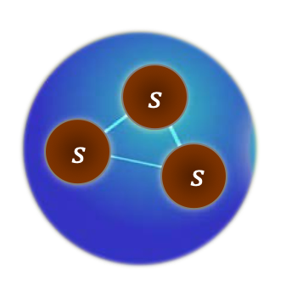

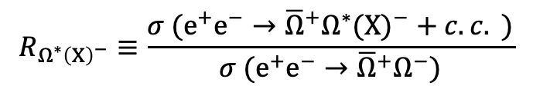

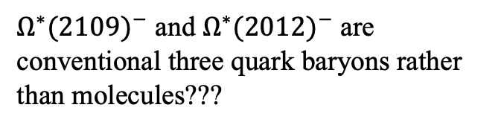
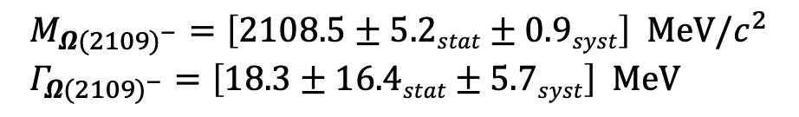
Discussion on the results
arXiv:2411.11648
LQCD, Hadron Spectrum Collaboration
PRD 87, 054506 (2013)
${Ω^{∗}(2109)}^{−}$, Significance = 4.1σ [A new excited Ω state]
$$M_{{Ω(2109)}^{−}}=\left[2108.5±5.2stat±0.9syst\right] MeV/c^{2} \\ Γ_{{Ω(2109)}^{−}}=\left[18.3±16.4stat±5.7syst\right] MeV$$
${Ω^{∗}(2012)}^{−}$, Significance = 3.5σ
$M_{{Ω(2012)}^{−}}=\left[2012.4±0.9\right] MeV/c^{2}$ (PDG)
${Ω^{∗}(2109)}^{−}$ and ${Ω^{∗}(2012)}^{−}$ are conventional three quark baryons rather than molecules???
Consistent
$$R_{Ω^{∗}{\left(X\right)}^{−}}≡\frac{σ (e^{+}e^{−}→{{\overline{Ω}}^{+}Ω^{∗}(X)}^{−}+c.c. )}{σ (e^{+}e^{−}→{{\overline{Ω}}^{+}Ω}^{−})}$$
$$R_{Ω{\left(2012\right)}^{−}}=0.36±0.13(stat)±0.04(syst)$$
What can these tell us？
$$R_{Ω{\left(2109\right)}^{−}}=0.93±0.35(stat)±0.13(syst)$$
15

Slide 16
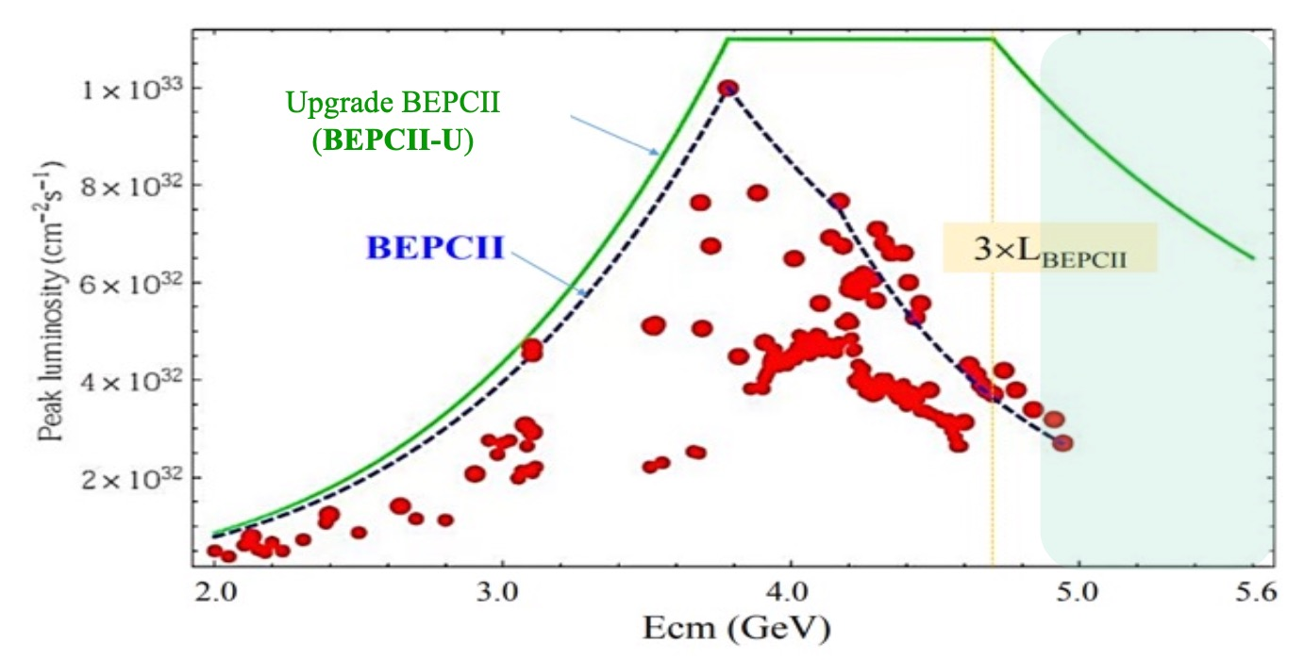
Prospect
Opportunities to study excited baryons in the BEPCII-U phase
BEPCII upgrade ( 2024 –2028 )：Highest beam energy: 2.8 GeV
Need directions from theorists on how to better make use of the new data!
Notes:
这是我报告的提纲！

Slide 17
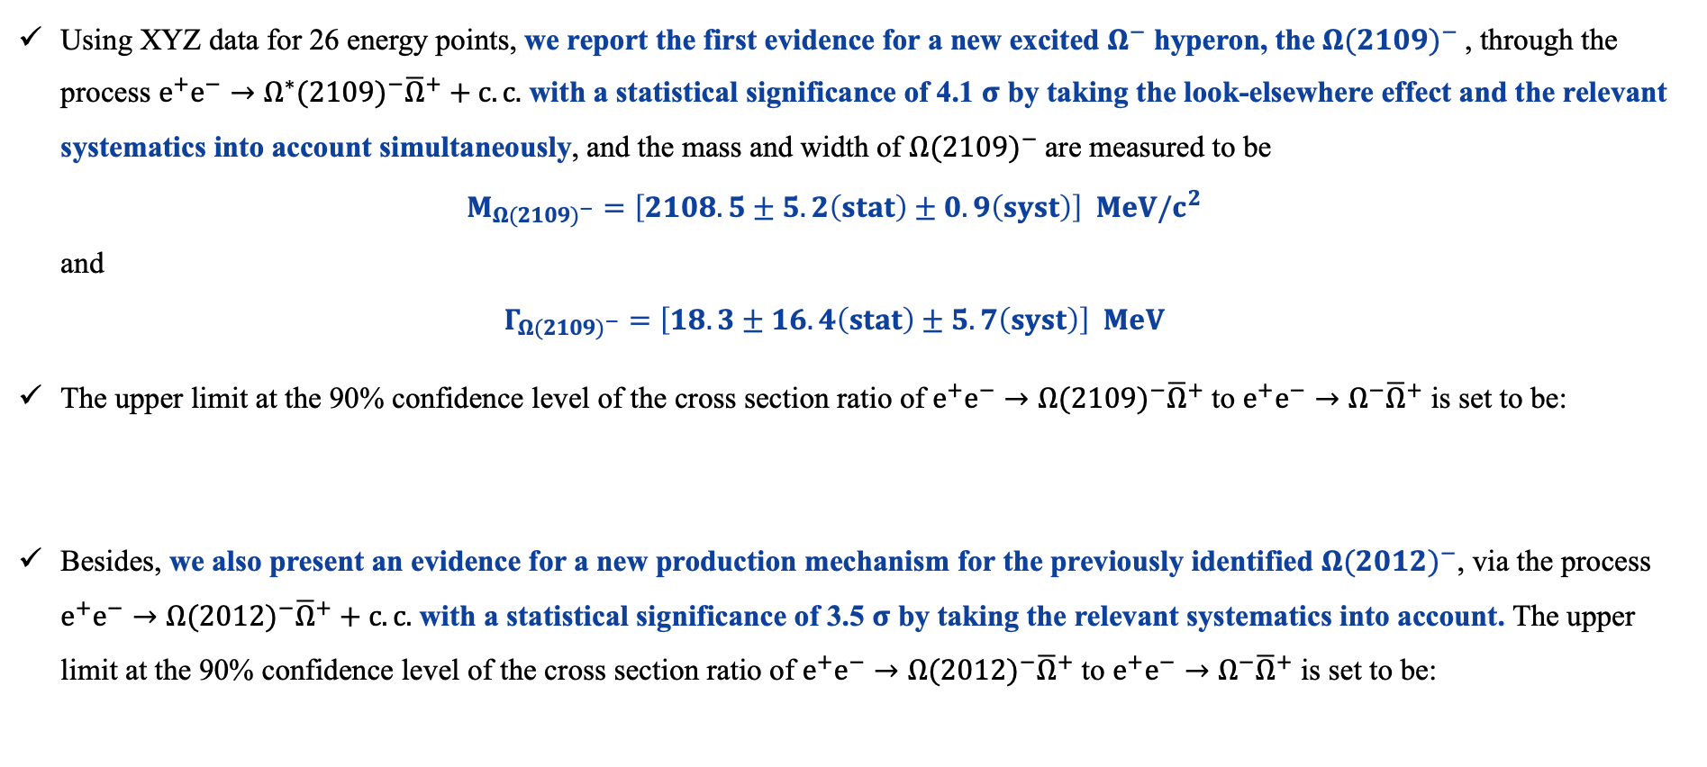


Summary
Using XYZ data for 26 energy points, we report the first evidence for a new excited $Ω^{−}$ hyperon, the ${Ω(2109)}^{−}$, through the process $e^{+}e^{−}→{Ω^{∗}(2109)}^{−}{\overline{Ω}}^{+}+c.c.$ with a statistical significance of 4.1 $σ$ by taking the look-elsewhere effect and the relevant systematics into account simultaneously, and the mass and width of ${Ω(2109)}^{−}$are measured to be
$M_{{Ω(2109)}^{−}}=\left[2108.5±5.2\left(stat\right)±0.9\left(syst\right)\right] MeV/c^{2}$
and
$Γ_{{Ω(2109)}^{−}}=\left[18.3±16.4\left(stat\right)±5.7\left(syst\right)\right] MeV$
The upper limit at the 90% confidence level of the cross section ratio of $e^{+}e^{−}→{Ω(2109)}^{−}{\overline{Ω}}^{+}$ to $e^{+}e^{−}→Ω^{−}{\overline{Ω}}^{+}$ is set to be:
Besides, we also present an evidence for a new production mechanism for the previously identified ${Ω(2012)}^{−}$, via the process $e^{+}e^{−}→{Ω(2012)}^{−}{\overline{Ω}}^{+}+c.c.$ with a statistical significance of 3.5 $σ$ by taking the relevant systematics into account. The upper limit at the 90% confidence level of the cross section ratio of $e^{+}e^{−}→{Ω(2012)}^{−}{\overline{Ω}}^{+}$ to $e^{+}e^{−}→Ω^{−}{\overline{Ω}}^{+}$ is set to be:
$$R_{Ω{\left(2109\right)}^{−}}=0.93±0.35(stat)±0.13(syst)$$
$R_{Ω{\left(2109\right)}^{−}}^{UL}<1.31$ @90% C.L.
$$R_{Ω{\left(2012\right)}^{−}}=0.36±0.13(stat)±0.04(syst)$$
$R_{Ω{\left(2012\right)}^{−}}^{UL}<0.57$ @90% C.L.
17

Slide 18
Backup

Slide 19
