Slide 1
Probing the nature of charmonium and charmonium-like states around ${\overline{D}}^{(∗)}D^{(∗)}$ mass thresholds in $B$ decays
Qi Wu (吴琦) 河南师范大学
Collaborate with Li-Sheng Geng (耿立升) , Ming-Zhu Liu (刘明珠) and Qi-Wei Yuan (袁奇伟)
Based on EPJC 84, 147 (2024) and EPJC 85, 188 (2025)
第四届强子与重味物理理论与实验联合研讨会 2025.03.23 兰州

Slide 2
Outline
Charmonium and charmonium-like states around ${\overline{D}}^{(∗)}D^{(∗)}$ mass thresholds
Producing charmonium-like states in $B$ decay
Producing charmonium states in $B$ decay
Summary

Slide 3
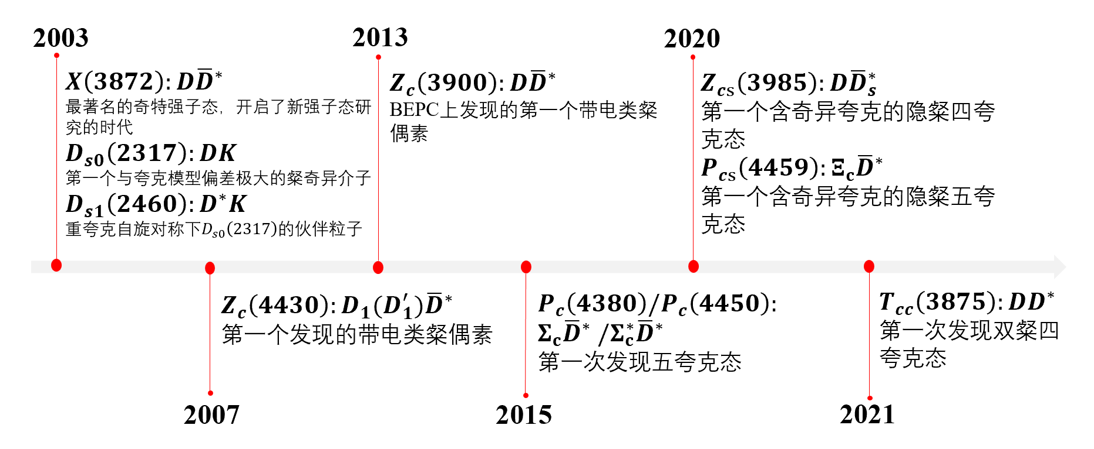
New hadron states

Slide 4
$X(3872)$ and $X_{2}(4013)$
$D{\overline{D}}^{∗}$ loosely bound state:
Potential model
M.B. Voloshin, L.B. Okun, JETP. 23, 333 (1976) ; A. De Rujula, H. Georgi, S.L. Glashow, PRL. 38, 317 (1977)
QCD sum rule
Z.G. Wang, T. Huang, EPJC 74(5), 2891 (2014)
Decay and production property
M.B. Voloshin, PLB 579, 316 (2004); E.S. Swanson, PLB 598, 197 (2004) E. Braaten, M. Kusunoki, PRD 69, 074005 (2004) ………
$χ_{c1}\left(2P\right)$ state
T. Barnes, S. Godfrey, PRD 69, 054008 (2004); E.J. Eichten, K. Lane, C. Quigg, PRD 69, 094019 (2004)
C. Meng, K.T. Chao, PRD 75, 114002 (2007); X. Liu, Y.M. Wang, EPJC 49, 643 (2007)
Tetraquark state
J. Vijande, et al, Int. J. Mod. Phys. A 20, 702 (2005); L. Maiani, et al, PRD 72, 031502 (2005)
F.S. Navarra, M. Nielsen, PLB 639, 272 (2006)
Hybrid state
F.E. Close, S. Godfrey, Phys. Lett. B 574, 210 (2003);B.A. Li, Phys. Lett. B 605, 306 (2005) A.A. Petrov, J. Phys. Conf. Ser. 9, 83 (2005)

Slide 5
$Z_{c}(3900)$ and $Z_{c}(4020)$
Virtual states or resonant states
Chen et al., 2310.15965; Nakamura et al., 2312.17658; JAPC Collaboration Phys.Lett.B 772 (2017) 200-209; Albaladejo et al., Phys.Lett.B 755 (2016) 337-342; He et al., Eur.Phys.J.C 78 (2018) 2, 94; Ortega et al., Eur.Phys.J.C 79 (2019) 1, 78
Compact tetraquark states
Wang et al., Phys.Rev.D 89 (2014) 5, 054019; Qiao et al., Eur.Phys.J.C 74 (2014) 10, 3122
Mixing of Compact tetraquark and molecules
Wuaet al., ArXiv: 2312.14224
Kinetic effect
Wang et al., Phys.Rev.Lett. 111 (2013) 13, 132003; Chen et al., Phys.Rev.D 88 (2013) 3, 036008; Liu et al., Phys.Rev.D 88 (2013) 014013
Lattice QCD
Prelovsek et al., Phys.Lett.B 727 (2013) 172-176; Chen et al., Phys.Rev.D 89 (2014) 9, 094506; HAL QCD Coll, Phys.Rev.Lett. 117 (2016) 24, 242001; Yan et al., Phys.Rev.D 109 (2024) 1, 014026

Slide 6
$Y(4230)$ and $Y(4360)$
Mixing of 𝜓(4𝑆) and 𝜓(3𝐷)
Jun-Zhang Wang et al., Phys.Rev.D 99 (2019) 11, 114003; Hui-Feng Fu et al., Eur.Phys.J.C 79 (2019) 6, 460
Compact tetraquark states
Wang et al., Nucl.Phys.B 973 (2021) 115592
$Y(4230)$ and $Y(4360)$ as hadronic molecules of $\overline{D}D_{1}$ and ${\overline{D}}^{∗}D_{1}$
Leon von Detten et al., ArXiv: 2402.03057; Zhi-Peng Wang et al., arXiv:2312.03512; Yu Lu et al., Phys.Rev.D 96 (2017) 11, 114022; Yu Lu et al., Phys.Rev.D 104 (2021) 9, 094006
T-Ji, X-K Dong, F-K Guo and B-S Zou Phys.Rev.Lett. 129 (2022) 10, 102002

Slide 7
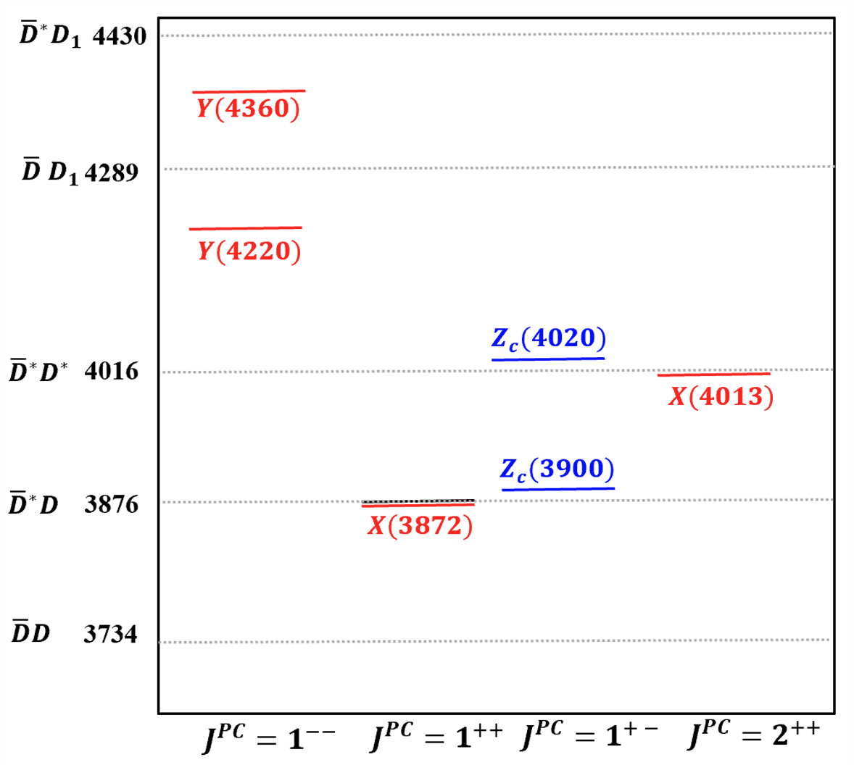
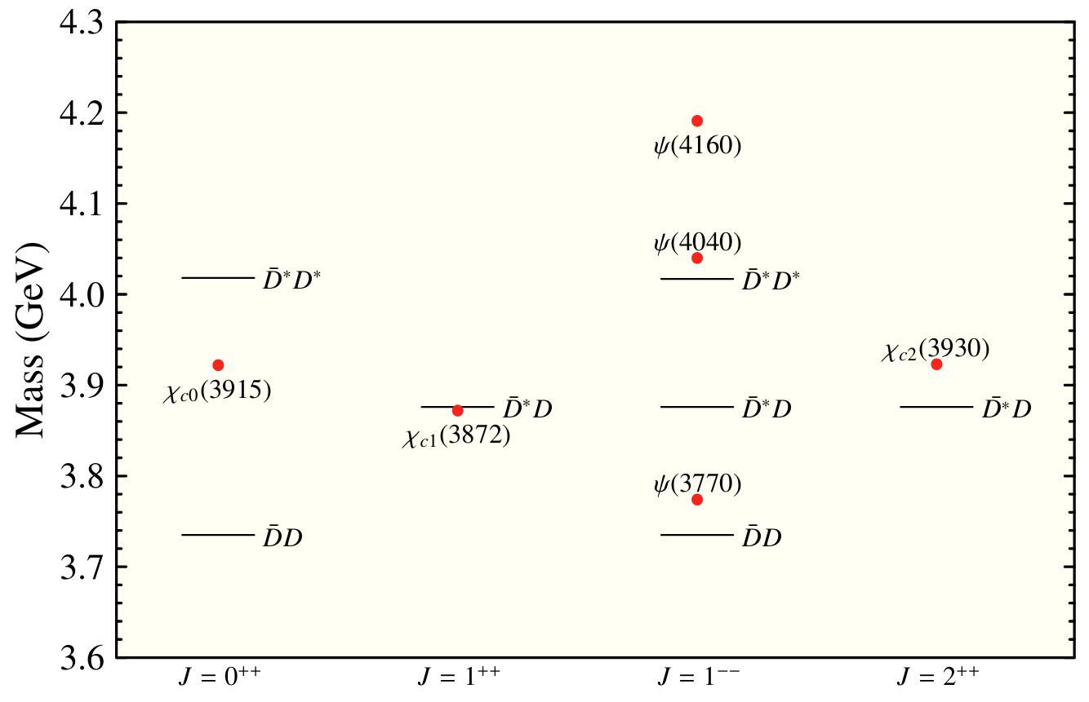
Near threshold states

Slide 8
Motivation
A complete understanding of the ratio $B[B^{0}→X\left(3872\right)K^{0}]/B[B^{+}→ X\left(3872\right)K^{+}]$ and the absolute branching fractions in a unified frame work is still missing
Another puzzle related to the four $D^{(∗)}{\overline{D}}^{∗}$ molecules is that although the $X(3872)$ has been observed in multiple channels of $B_{(s)}$ decays, the other three have not, which calls for an explanation
Predicting the production rates of $Y(4230)$ and $Y(4360)$ in B decays

Slide 9
Outline
Charmonium and charmonium-like states around ${\overline{D}}^{(∗)}D^{(∗)}$ mass thresholds
Producing charmonium-like states in $B$ decay
Producing charmonium states in $B$ decay
Summary

Slide 10
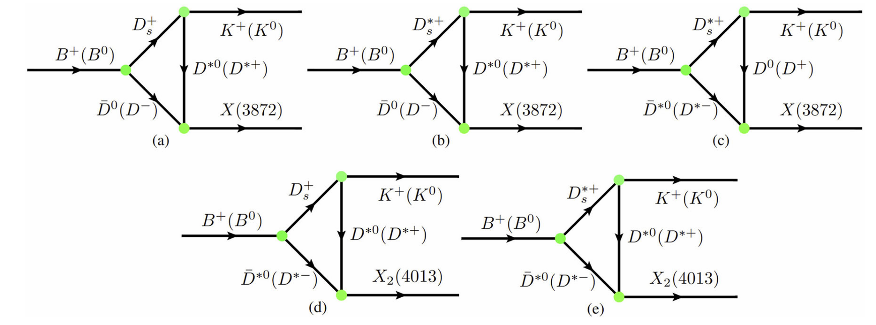
Triangle diagram mechanism
Producing XZ states in $B$ decay
Producing Y states in $B$ decay

Slide 11
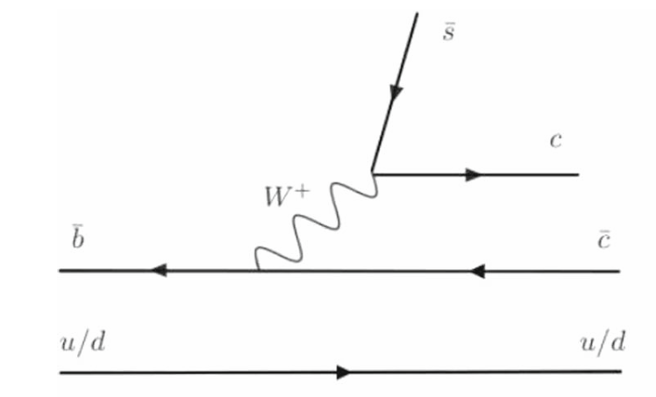
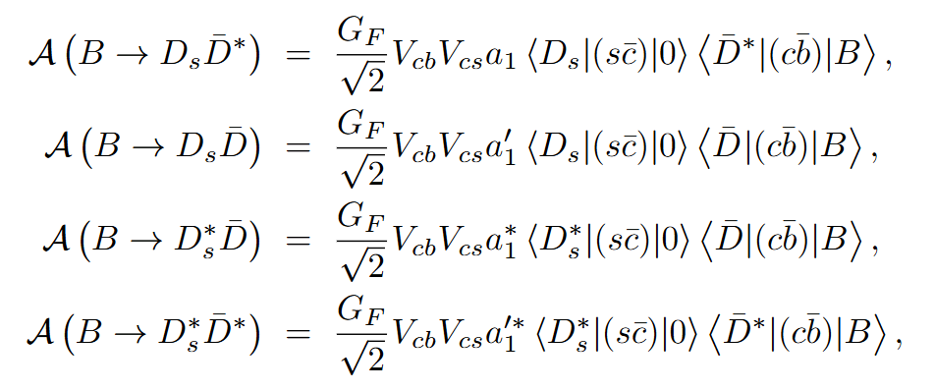
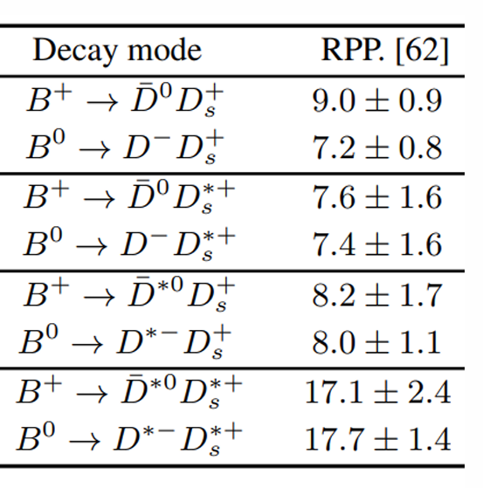
Effective Lagrangian Approach
Weak interaction: Naive Factorization
$$a_{1+}=0.929, a_{10}=0.955$$
$$a_{1+}^{′}=0.791,a_{10}^{′}=0.736$$
$$a_{1+}^{∗}=0.812,a_{10}^{∗}=0.834$$
$$a_{1+}^{′∗}=0.833,a_{10}^{′∗}=0.880$$
$$a_{1}^{p}=1.07(μ=m_{b})$$
H.N.Li, C.D.Lu, F.S.Yu, PRD86, 036012 (2012)

Slide 12
Effective Lagrangian Approach
Current matrix elements
Covariant light-front quark model
R.C.Verma,J.Phys.G39,025005(2012)
$$3.68×{10}^{−3} (NFA)$$
$$\left(1.5±0.6\right)×{10}^{−3}(Exp.)$$
$$B(B→{\overline{D}}_{1}π)$$
$$0.63$$

Slide 13
Effective Lagrangian Approach
Hadron rescattering: SU(4) symmetry
Lippmann-Schwinger equation
$$T={\left(1−VG\right)}^{−1}V$$
G is the two-body propagator
$$G\left(s\right)=\int{\frac{d^{3}q}{{\left(2π\right)}^{3}}\frac{e^{−2q^{2}/Λ^{2}}}{\sqrt{s}−m_{1}−m_{2}−q^{2}/\left(2μ_{12}\right)+iε}},$$
The dynamically generated states correspond to poles in the unphysical sheet
$$G^{II}\left(s,m_{1},m_{2}\right)=G^{I}\left(s,m_{1},m_{2}\right)+iμ_{12}\frac{p}{2π}e^{−2p^{2}/Λ^{2}},$$
The couplings between the molecular states and their constituents
$$g_{i}g_{j}=\lim_{\sqrt{s}→\sqrt{s_{0}}}\left(\sqrt{s}−\sqrt{s_{0}}\right)T_{ij}\left(\sqrt{s}\right),$$
PRC 62, 034903 (2000); PRC 63, 034901 (2001)
Dynamical generation of molecules

Slide 14
Determine the couplings and uncertainties
Weak vertices
The experimental uncertainties of the branching fractions of $B→{\overline{D}}^{(∗)}D_{s}^{(∗)}$ lead to about 10% uncertainty for the effective Wilson coefficient a1. (Phys.Rev.D 107 (2023) 1, 016003)
Light hadron vertices
$g_{D_{s}D^{∗}K}=g_{D_{s}^{∗}DK}=10 and g_{D_{s}^{∗}D^{∗}K}=7.0{ GeV}^{−1}$ Large SU(4)-flavor symmetry breaking
SU(3)-flavor symmetry breaking $f_{π}\&f_{K}$ 19%
SU(4)-flavor symmetry breaking $f_{D}\&f_{K}$ 33% Consistent with EPJA 53,92 (2017)
Molecules vertices
The uncertainties are mainly from the cutoff in the loop function G--- 10% uncertainty
 | $$X(3872)$$ | $$X_{2}(4013)$$ | $$Z_{c}(3900)$$ | $$Z_{c}(4020)$$ | $$Y(4230)$$ | $$Y(4360)$$
$$g_{n}$$ | 3.86 GeV | 5.36 GeV | 5.02 GeV | 1.25 | 15.66 GeV | 3.49
$$g_{c}$$ | 3.39 GeV | 4.86 GeV | 5.02 GeV | 1.25 | 15.66 GeV | 3.49

Slide 15
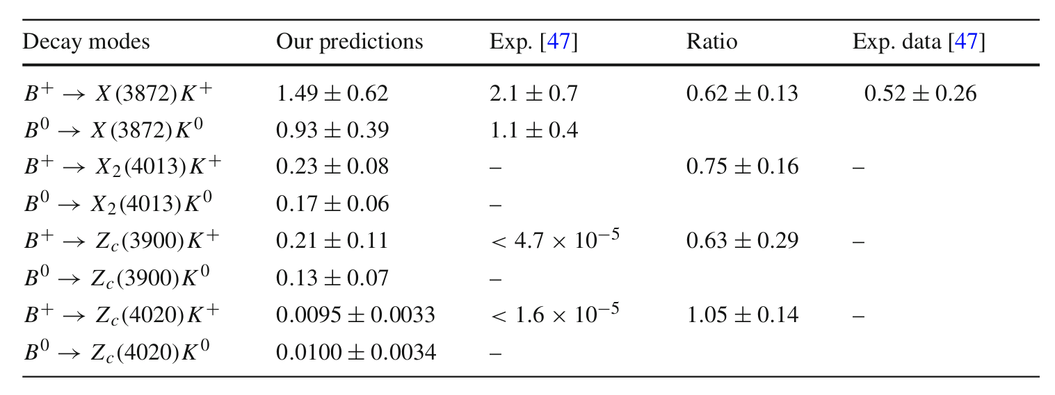
Branching fractions and their ratios
Well describe the production rates of X(3872) in both $B^{+}$ and $B^{0}$ mesons as well as their ratio without extra parameters；
The predicted branching fractions of $B^{+}→Z_{c}\left(3900\right)K^{+}$ and $B^{+}→Z_{c}\left(4020\right)K^{+}$ are safely under the upper limit of the exp. data.

Slide 16
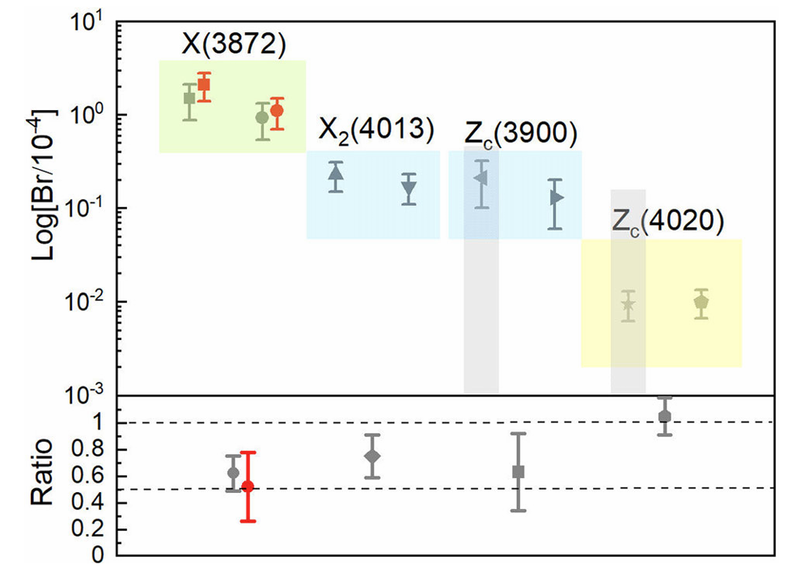
Branching fractions and their ratios
Production rates are in order:
$X\left(3872\right)>X_{2}\left(4013\right)∼Z_{c}\left(3900\right)>Z_{c}(4020)$
The branching fractions $B^{+}→X\left(3872\right)K^{+}$ and $B^{0}→X\left(3872\right)K^{0}$ as well as their ratio are in reasonable agreement with the experimental data
A hierarchy for the branching fractions of ${\overline{D}}^{(∗)}D^{(∗)}$molecules in B decays

Slide 17
Branching fractions and their ratios
Branching fractions of $X(3872)$ in other processes ($10^{−4}$)
Branching fractions of $Z_{c}$ states in other processes ($10^{−6}$)

Slide 18
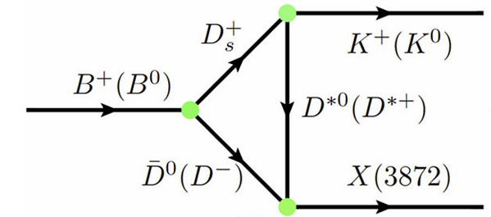
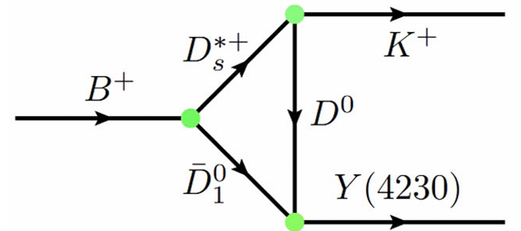
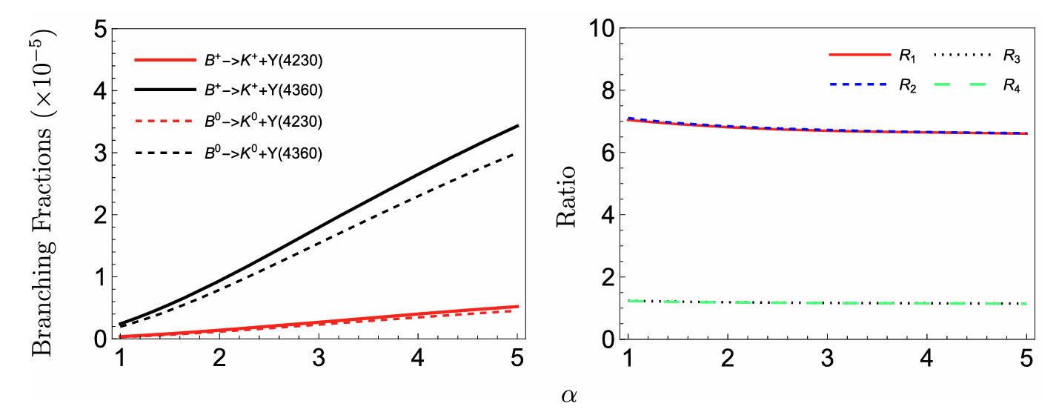
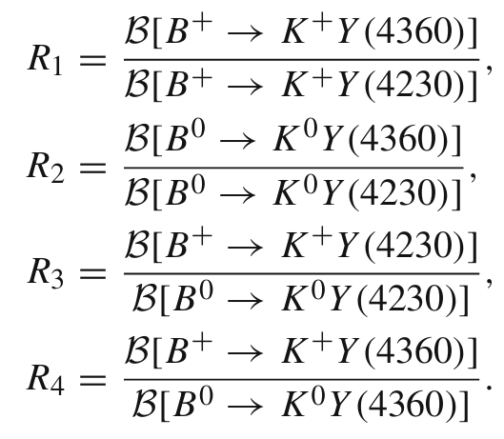
Branching fractions and their ratios
The branching fractions of $B→KY(4230)$ and $B→KY(4360)$ are up to the order of ${10}^{−6}$ and ${10}^{−5}$;
The ratios are almost independent on $α$, which can be tested by experiment in future.

Slide 19
Branching fractions and their ratios
Further discussion
$$R_{1}=R_{2}=7⇒\text{the} \text{production} \text{rates} \text{of} \text{Y}\text{(4360) }\text{in} \text{B} \text{decays} \text{are} \text{larger} \text{than} \text{those} \text{of} \text{Y}\text{(4230) }\text{in} \text{B} \text{decays}$$
$R_{3}=R_{4}=1⇒$ the small isospin breaking effect of the production of Y(4230) and Y(4360) in $B^{+}$ and $B^{0}$ decays
$$\frac{B_{r}[B→(Y\left(4230\right)→J/ψπ^{+}π^{−})K]}{B_{r}[B→J/ψπ^{+}π^{−}K]}∼{10}^{−4}$$
$$B_{r}[Y\left(4230\right)→J/ψπ^{+}π^{−}]∼10\%$$
X.Y. Gao, C.P. Shen, C.Z. Yuan, Phys. Rev. D 95, 092007 (2017).
$$B_{r}[B→J/ψπ^{+}π^{−}K]∼{10}^{−3}$$
R.L. Workman et al. (PDG), PTEP 2022, 083C01 (2022)
$$\frac{B_{r}[B→(Y\left(4360\right)→J/ψπ^{+}π^{−})K]}{B_{r}[B→J/ψπ^{+}π^{−}K]}∼{10}^{−3}$$
$$B_{r}[Y\left(4360\right)→J/ψπ^{+}π^{−}]∼10\%$$
J. Zhang, L. Yuan, R. Wang, Adv. High Energy Phys. 2018, 5428734 (2018).
Y(4360) is more likely to be detected than Y(4230) in the decay $B→J/ψπ^{+}π^{−}K$

Slide 20
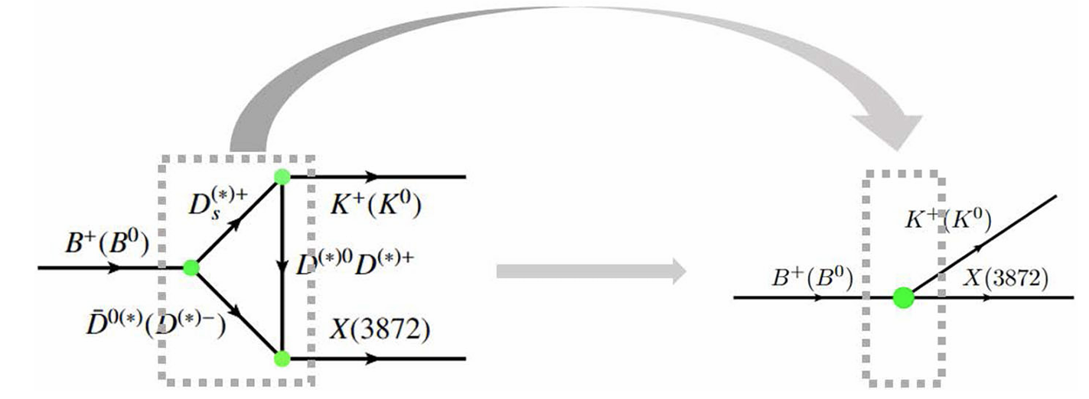
Decay constants of XYZ states as molecules
$$M_{X\left(3872\right)}f_{X\left(3872\right)}ε^{μ}$$
Decay constants of XZ states as ${\overline{D}}^{(∗)}D^{(∗)}$molecules
Decay constant of X(3872) as a pure charmonium is 329 MeV
Eur.Phys.J.C 51 (2007) 841-847

Slide 21
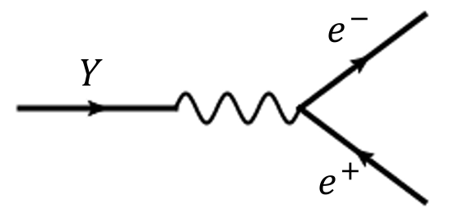
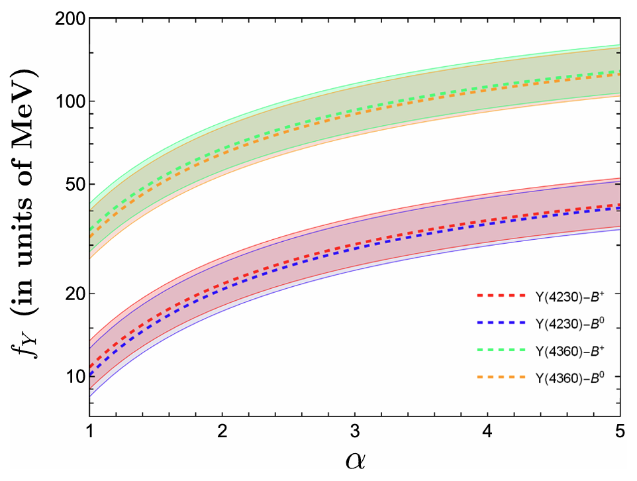
Decay constants of XYZ states as molecules
Decay constants of Y states as ${\overline{D}}_{1}D^{(∗)}$molecules
$$Γ\left[Y\left(4230\right)→e^{+}e^{−}\right]=36.4∼206.6 eV$$
$$Γ\left[Y\left(4360\right)→e^{+}e^{−}\right]=123.8∼1001.7 eV$$
J. Zhang, L. Yuan, R. Wang, Adv. High Energy Phys. 2018, 5428734 (2018).

Slide 22
Outline
Charmonium and charmonium-like states around ${\overline{D}}^{(∗)}D^{(∗)}$ mass thresholds
Producing charmonium-like states in $B$ decay
Producing charmonium states in $B$ decay
Summary

Slide 23
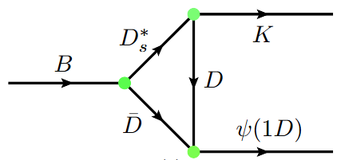
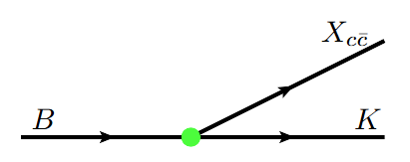
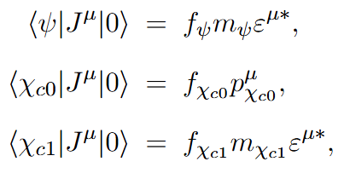
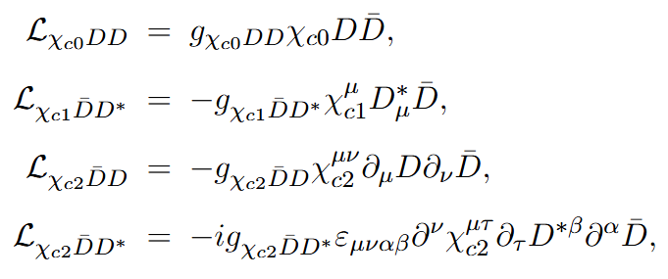
Charmonium production from B decay
Factorize $B→c\overline{c}+K$ into short-range and long-range contributions
$$\sum_{BC}^{​}{\int{c_{BC}\left(p\right)d^{3}p|BC,p⟩}}$$
$$|Ψ>$$
$$=$$
$$c_{A}|A>$$
$$+$$
$$B→ψ\left(3770\right)K$$
$$+$$

Slide 24
Charmonium production from B decay
Charmonia couplings to a pair of charmed mesons
Q. Deng, R.-H. Ni, Q. Li, and X.-H. Zhong, Phys. Rev. D 110, 056034 (2024)

Slide 25
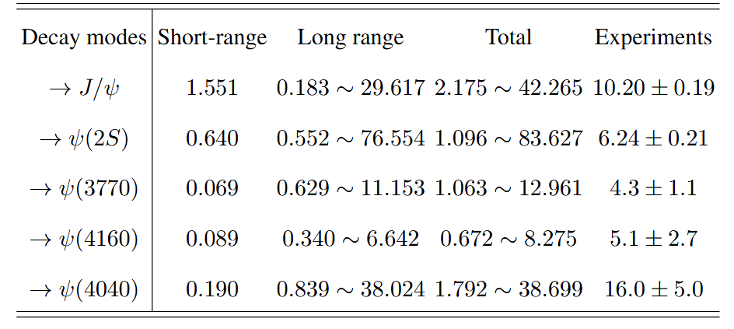
Charmonium production from B decay
B meson decaying into vector charmonium state and kaon meson
B meson decaying into P wave charmonium state and kaon meson (in progress)

Slide 26
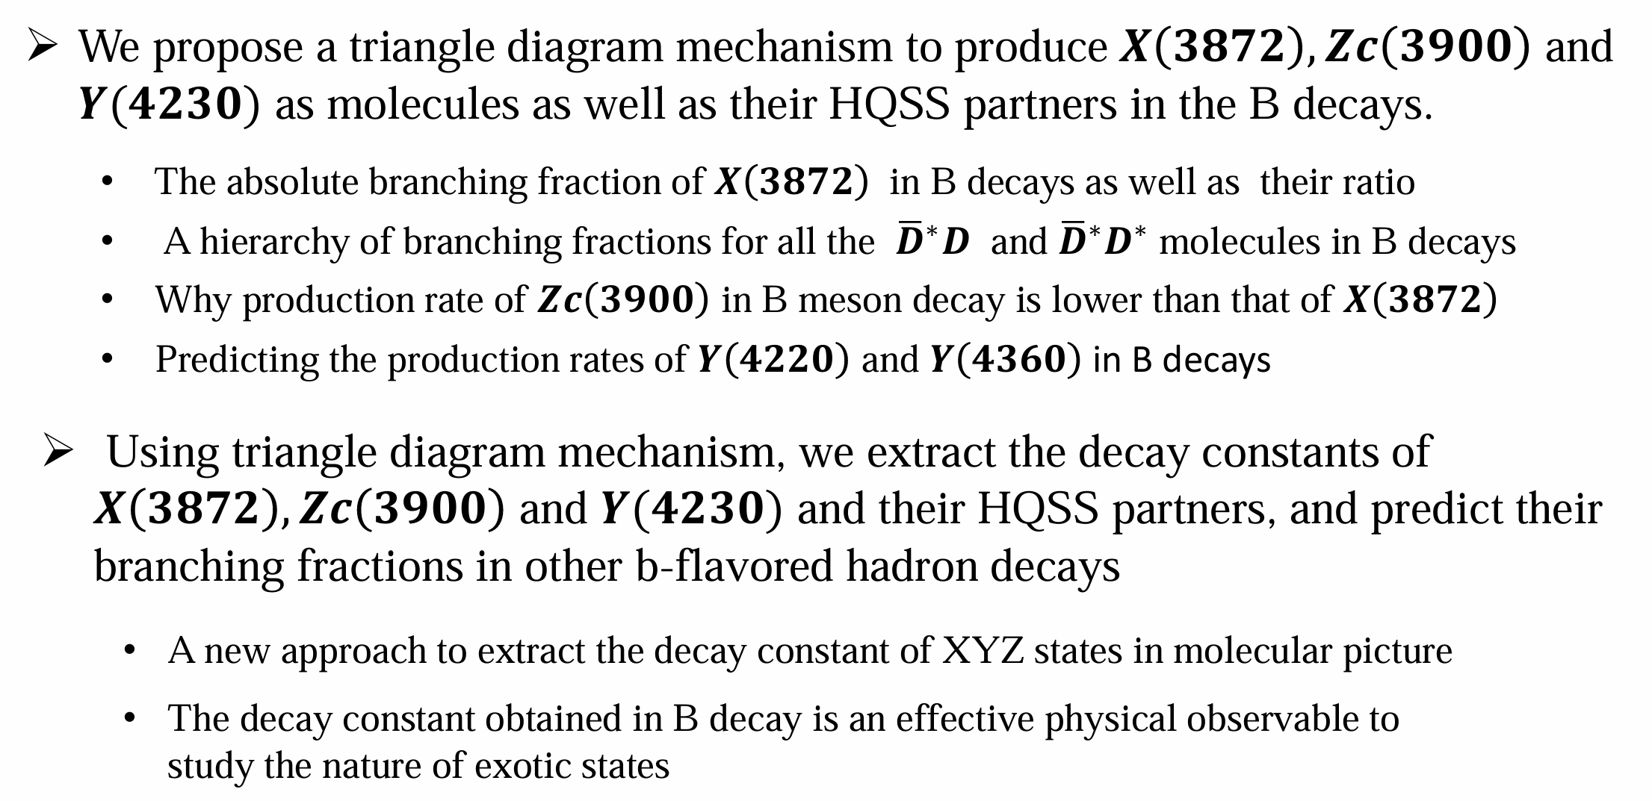
Summary

Slide 27
Thank you for your attention!

