Slide 1
第四届强子与重味物理理论和实验联合研讨会
Analytic Calculations for High Order Corrections
毕业论文答辩
答辩人：小不点 答辩时间：5.5 指导老师：大不点
陈龙斌
2025-03-24

Slide 2
OutLine
Motivation
Analytic calculations for Top quark inclusive decay
Analytic calculations of two-loop Nucleon mass in EOMS scheme
Conclusion

Slide 3
Precision: Important way to new physics
Significant progresses has been made in recent years experiment measurement and precise theoretical calculations.
Precise Top quark physics study is crucial to discover new physics.
Nucleon mass is one of the most fundamental parameter of nature, understanding of QCD.
To obtain high order corrections, a crucial step is to calculate Feynman amplitudes and integrals.
01
毕业论文答辩
Motivation
答辩人：小不点 答辩时间：5.5 指导老师：大不点

Slide 4
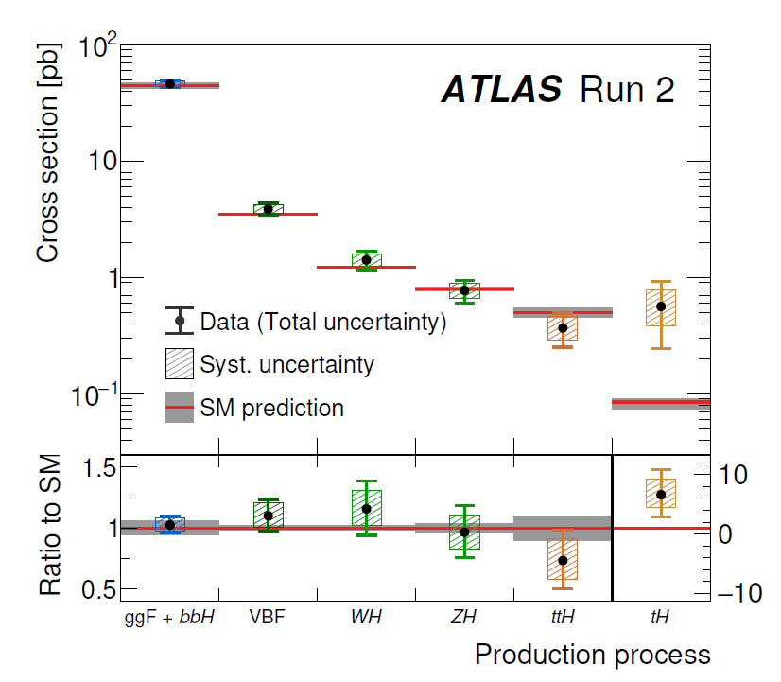
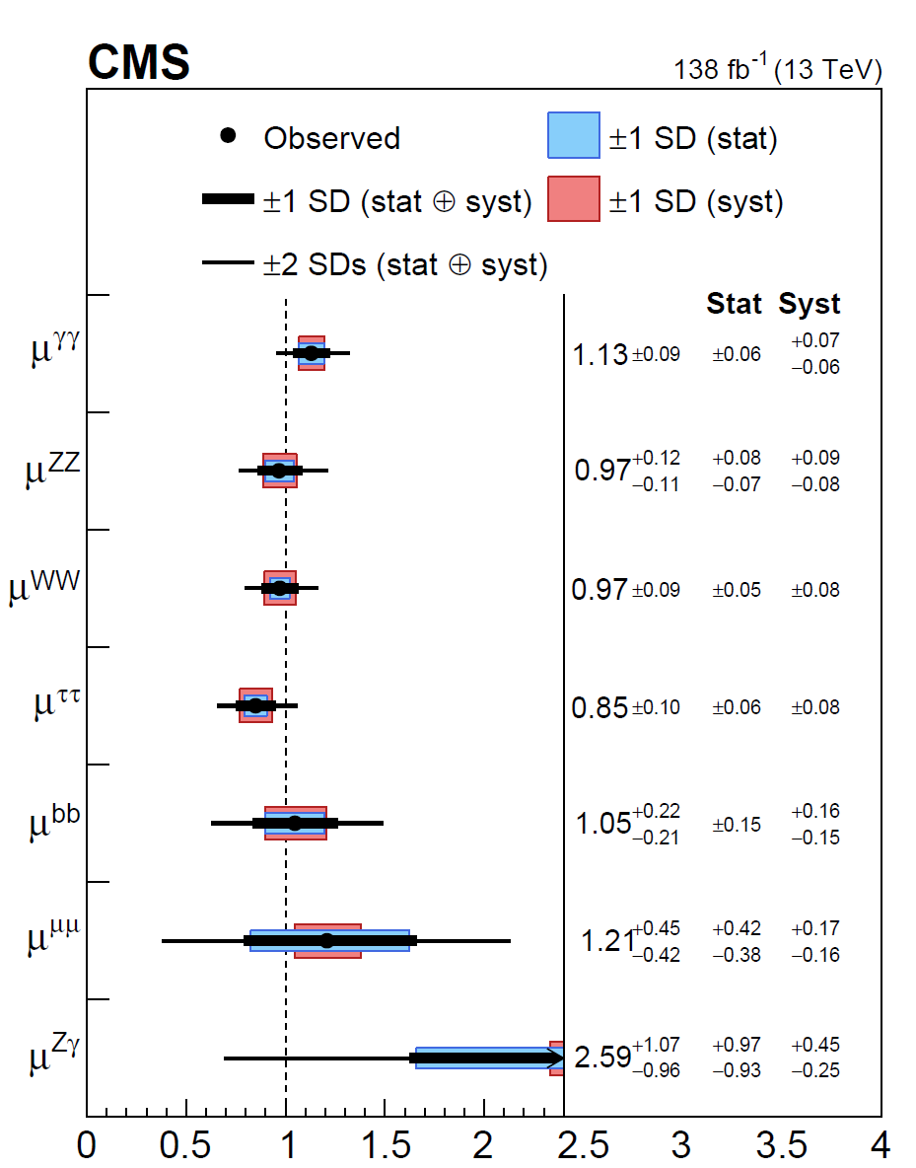
States of precise measurement
$$μ=\frac{σ_{exp}}{σ_{SM}}$$
ATLAS
CMS
毕业论文答辩
答辩人：小不点 答辩时间：5.5 指导老师：大不点
Nature 2022

Slide 5
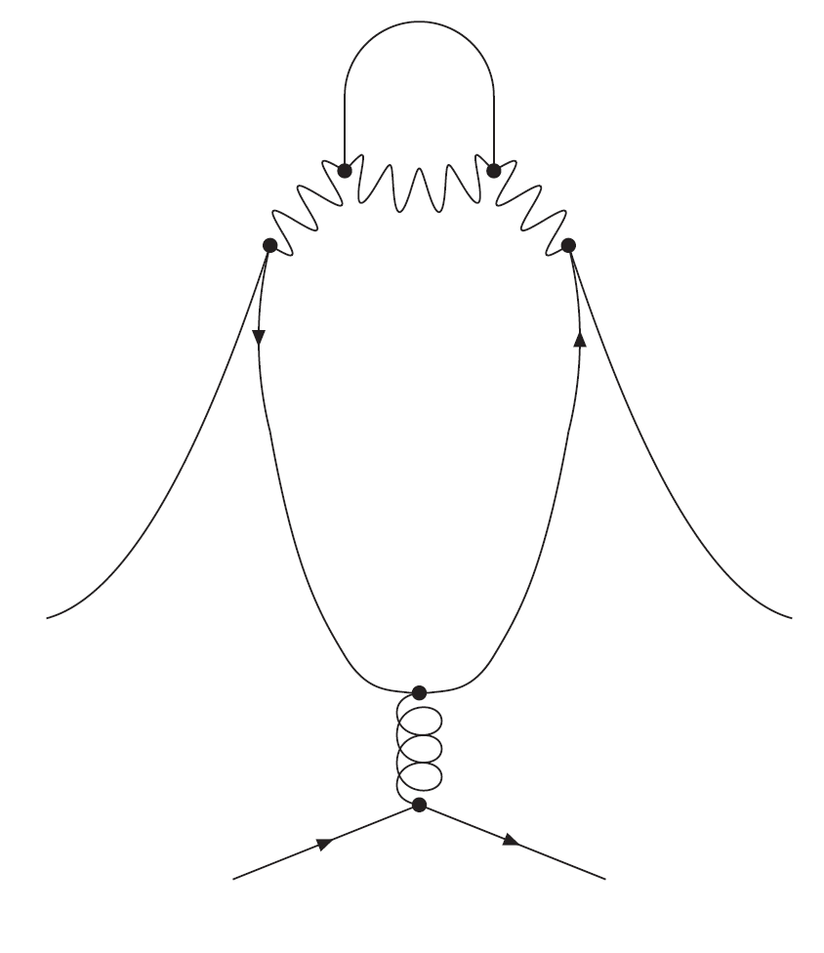
Perturbative Quantum Field Theory
1. Generate and Reduce Amplitudes
2. Calculate Feynman Integrals
3. Renormalization and Cancel Divergences
毕业论文答辩
答辩人：小不点 答辩时间：5.5 指导老师：大不点

Slide 6
Calculation of Feynman Integrals
Numerical ways: AMFLOW, AmpRed, FIESTA, pySecdec
Analytic ways: Differential Equations with UT-Basis, Mellin Barnes…
Analytic calculation of the high order corrections have many benefits. We can obtain the numerical effect of high order corrections very fast, expand them at any kinematic point, and integrate them to obtain more interesting results.
毕业论文答辩
Liu,Ma,2022
Chen,2024
答辩人：小不点 答辩时间：5.5 指导老师：大不点

Slide 7
Calculation Methods
alpha representation
毕业论文答辩
Julian S. Schwinger(1951)
Mellin-Barnes Representation
答辩人：小不点 答辩时间：5.5 指导老师：大不点
arXiv: 2211.13733

Slide 8
Method of Differential Equations
$f_{i}:$master integrals, x:Lorentz invariant kinematics

Slide 9
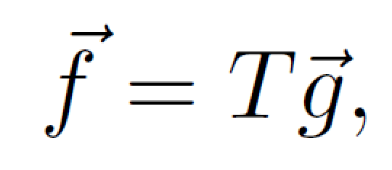
Choosing Canonical Basis
(basis with Uniform Transcendentality)
For random basis g，the DEs form:
d=4-2$∈$
We can choose new basis f:

Slide 11
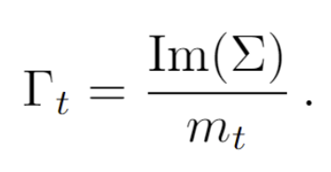
Top quark inclusive decay
02
毕业论文答辩
答辩人：小不点 答辩时间：5.5 指导老师：大不点
2212.06341, 2309.00762, In collaboration with
Hai Tao Li, Zhao Li, Jian Wang, Yefan Wang, Quan-feng Wu

Slide 12
Pedagogical examples：NLO master Integrals-“kite integrals”
毕业论文答辩
答辩人：小不点 答辩时间：5.5 指导老师：大不点

Slide 13
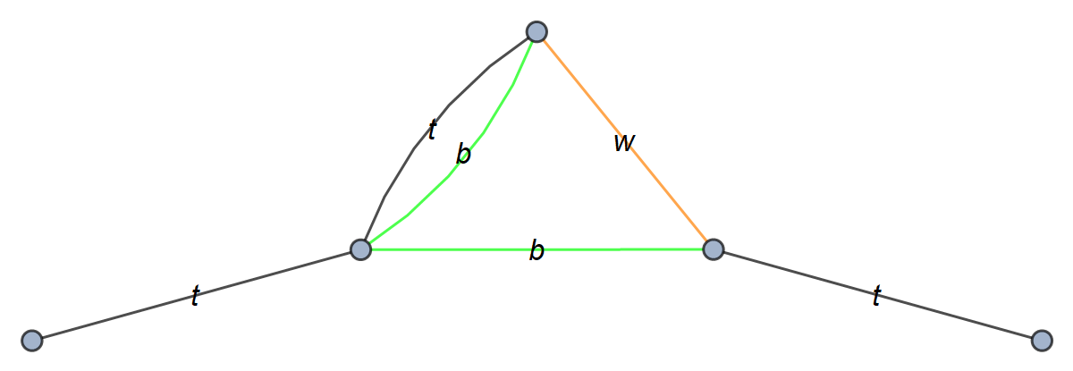
IBP Reduce to four Master Integrals

Slide 14
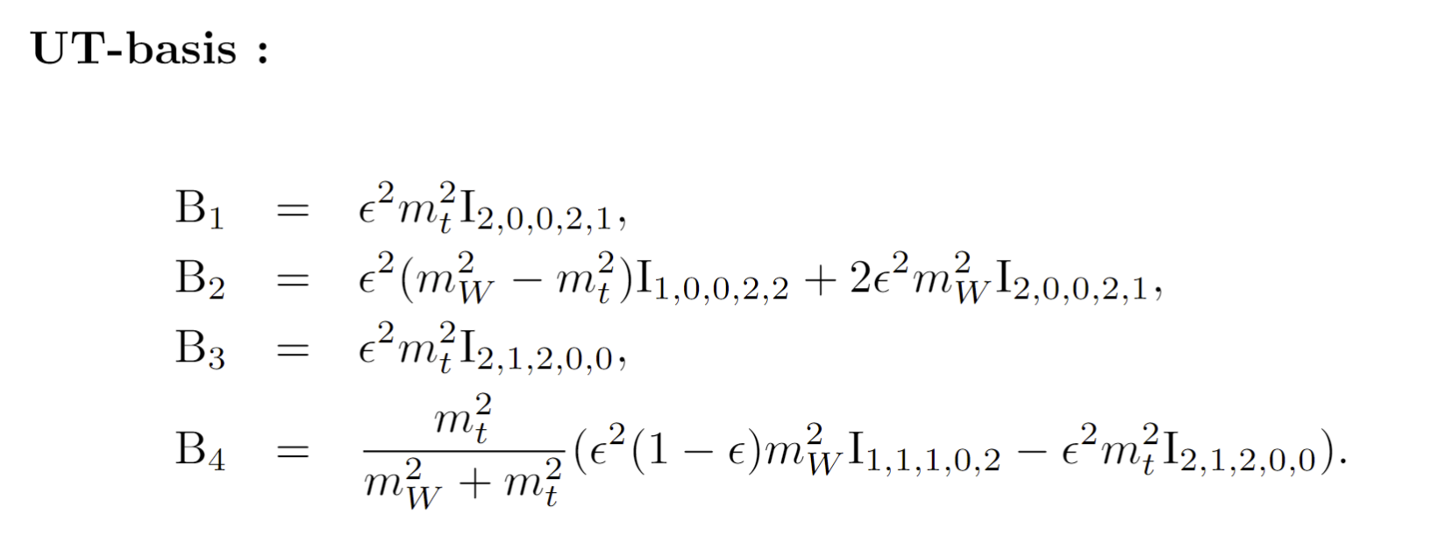
UT Basis for NLO Master Integrals
Construct UT Basis:
CANONICA
1705.06252
DlogBasis
2002.09492
Libra
2012.00279
….

Slide 15
Differential Equations
毕业论文答辩
答辩人：小不点 答辩时间：5.5 指导老师：大不点

Slide 16
Choosing alternative Basis
Replaced with
Make the UT Basis more simple.

Slide 17
Calculate the UT basis order by order in $∈$ expansion
Integrate Iteratively

Slide 18
Determination of Integration Constants (a more convenient way )
Combing analytic calculation with AMFLOW, PSLQ, C can be obtained in a easier way.

Slide 19
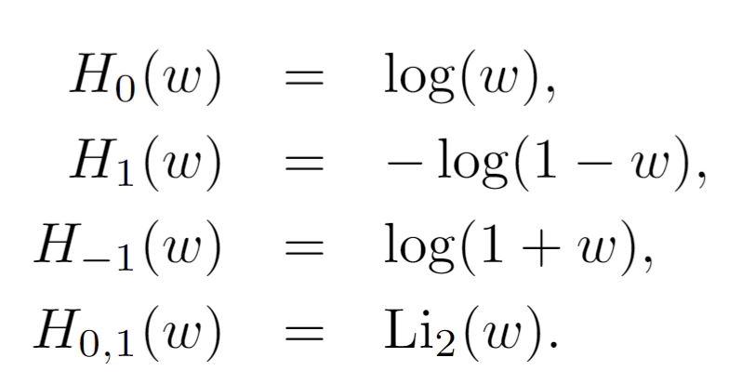
Results of UT basis (Harmonic Polylogarithms hep-ph/9905237)
Evaluation :HPL hep-ph/0507152

Slide 20
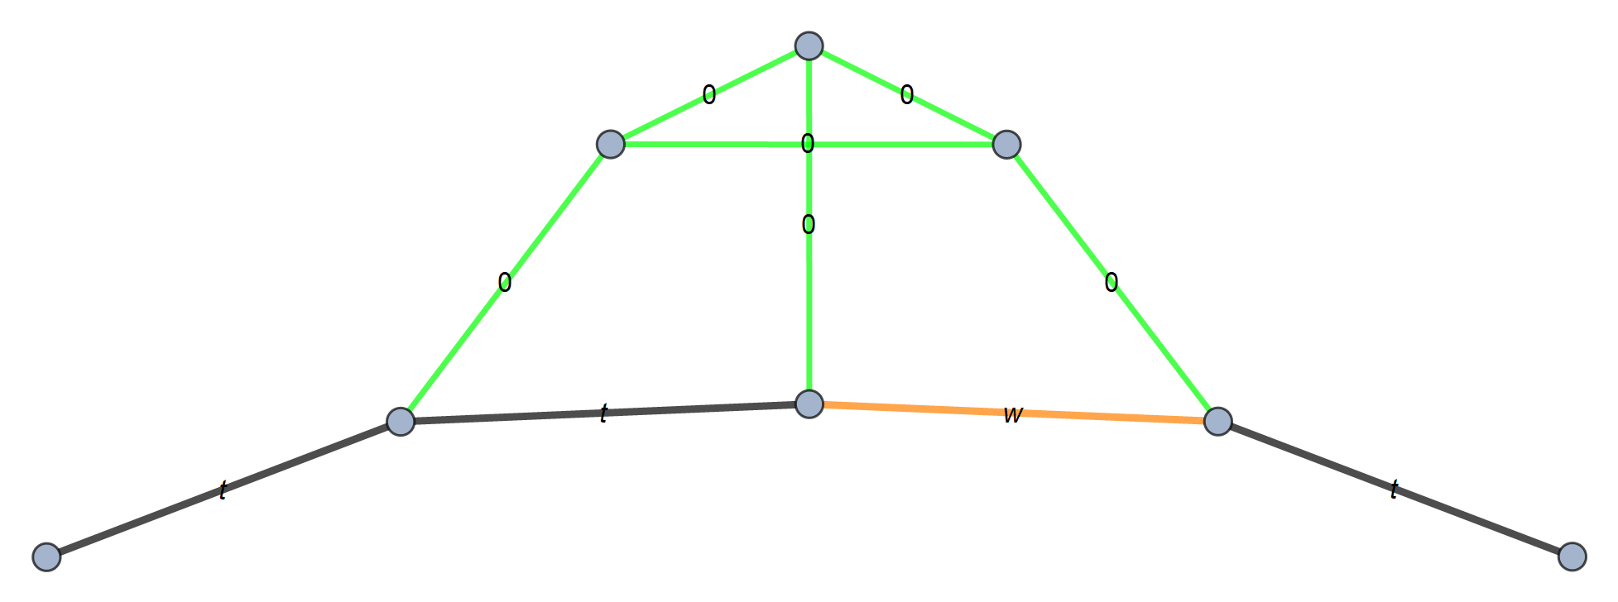
Calculation of NNLO integral Families
(B)
(A)
(D)
(C)
(E)

Slide 21
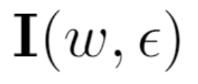
UT basis
DEs
Letters

Slide 22
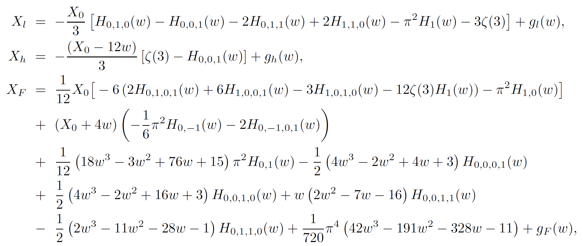
NNLO decay width

Slide 23
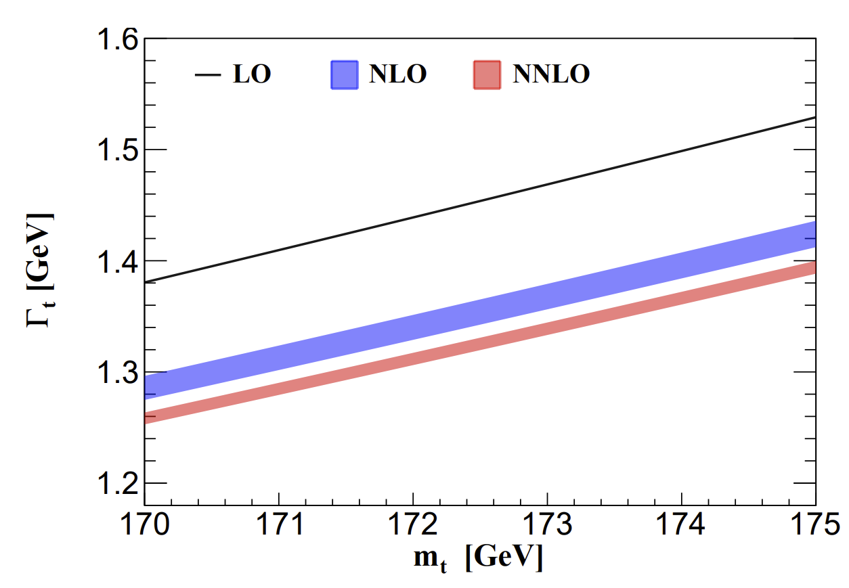
Top quark decay width up to NNLO
Cited by PDG
NNNLO QCD corrections is need
The most precise measurement decay width is Γ𝑡 = 1.36 ± 0.02 (stat.) ± 0.14 (syst.) GeV by CMS
μ ∈ [mt/2, 2mt]

Slide 24
Two-typical four-loop master integrals for leading color contribution
毕业论文答辩
答辩人：小不点 答辩时间：5.5 指导老师：大不点

Slide 25
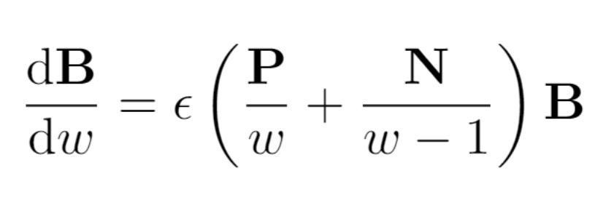
185 master integrals
DEs for NNNLO Leading Color MIs
毕业论文答辩
答辩人：小不点 答辩时间：5.5 指导老师：大不点

Slide 26
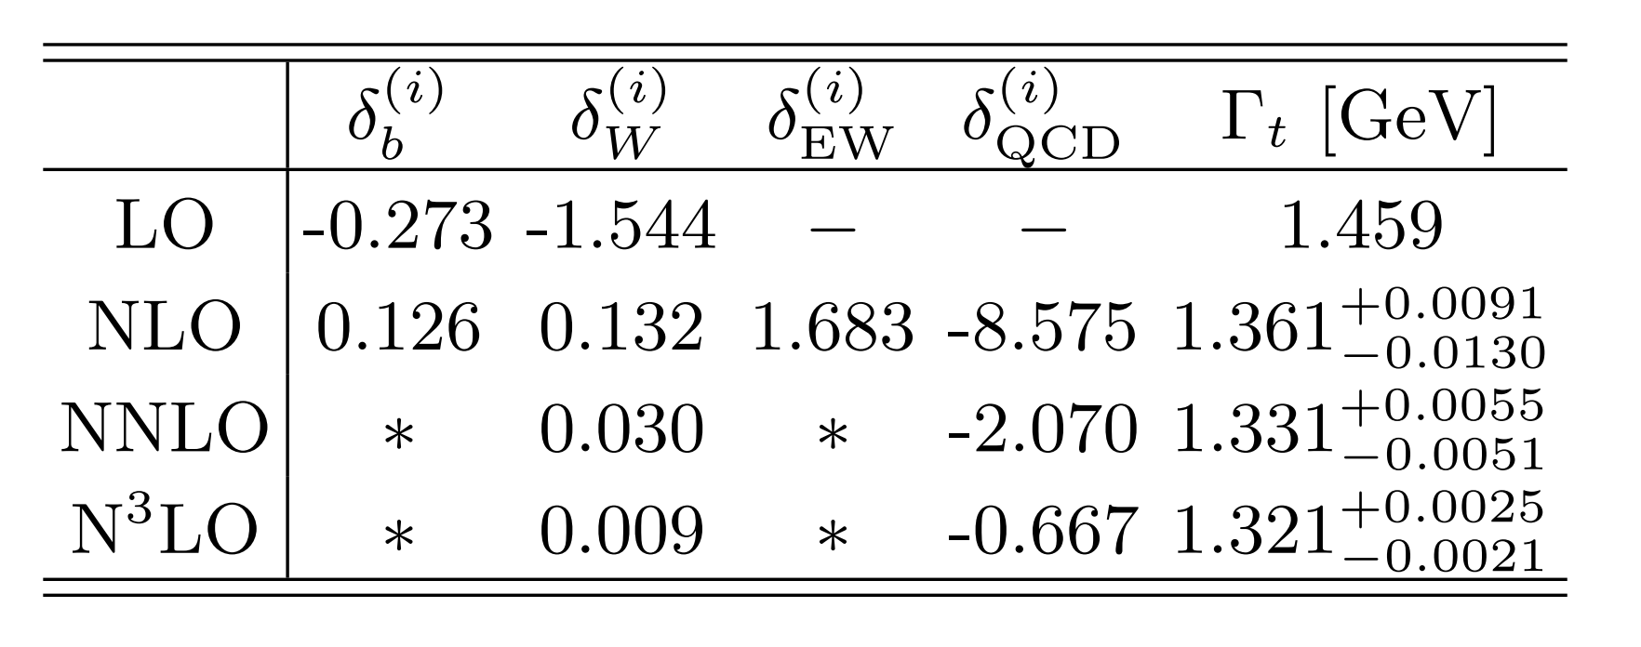
Agree with:
Chen, Chen, Guan, Ma, 2309.01937
Top-quark width at different values of $m_{t}$
%
In $e^{+}e^{−}$ collider, the decay width can be measured with an accuracy of 2% level
Best fit relation:

Slide 27
The dilepton invariant mass spectrum for $b→X_{u}e{\overline{ν}}_{e}$ up to NNNLO
Xin-Qiang’s Talk

Slide 28
The scale uncertainties are around ±12%, ±9%,
and ±6% at NLO, NNLO and N3LO, respectively, at
$\frac{{\text{q}}^{2} }{m_{b}^{2}}$ = 0.2.

Slide 29
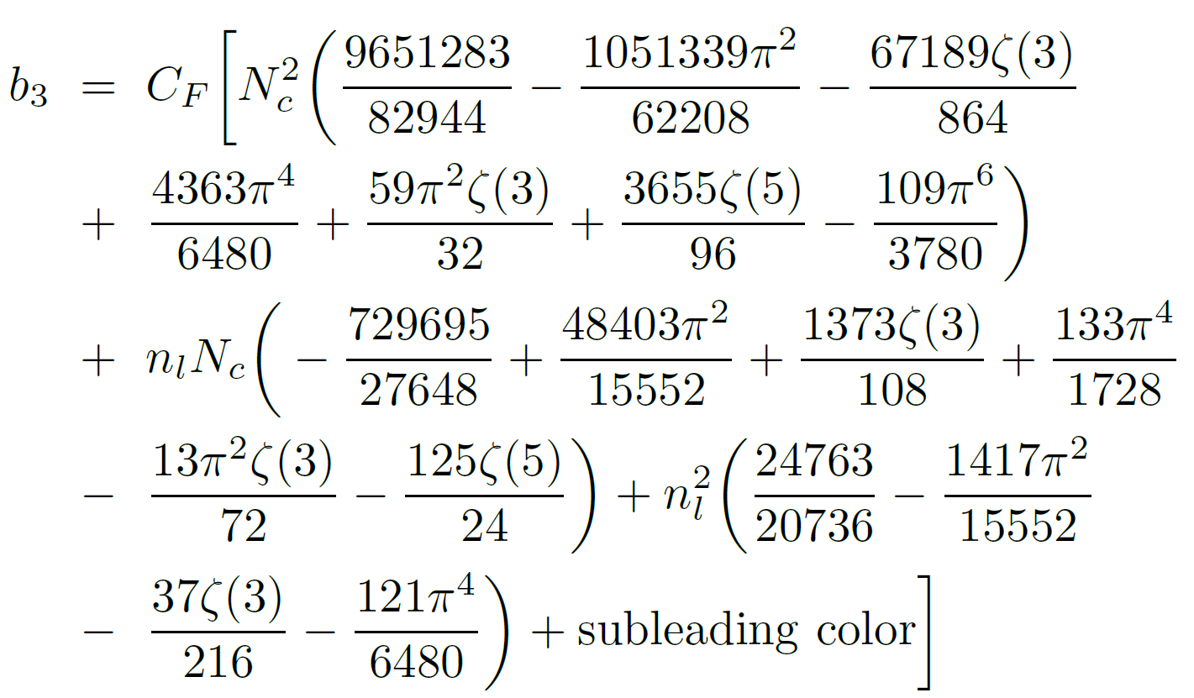
The semileptonic decay width of b-quark

Slide 30
Scale dependence of the b-quark semi-leptonic decay width normalized by the LO width in the on-shell mass scheme. The solid and dashed lines represent the results in the MSbar and on-shell mass schemes, respectively.

Slide 31
03
毕业论文答辩
Analytic calculations of two-loop nucleon mass in EOMS scheme
答辩人：小不点 答辩时间：5.5 指导老师：大不点
2406.04124, In collaboration with Siwei Hu, Yu Jia, Zhewen Mo

Slide 32
Chiral perturbative theory (ChPT)
De-Liang Yao’s Talk
ChPT —— QCD low energy EFT
Degree of freedom —— meson and baryon (pion and nucleon)
Mesonic sector
Power counting
Steven Weinberg Physica A 96 (1979)
J. Gasser and H. Leutwyler Annals Phys. 158 (1984)
$ℒ_{ππ}^{(2)}= \frac{F^{2}}{4}Tr\left(∂_{μ}U∂^{μ}U\right)+\frac{F^{2}}{4}Tr\left(χU^{†}+U^{†}χ\right), U=exp(i\frac{\vec{π}∙\vec{σ}}{F})$
$${SU(2)}_{R}×{SU(2)}_{L}$$
Well defined expansion
$M_{π}=136 MeV ≪ Λ_{χ}=Ο\left(1GeV\right)$, $q \sim M_{π}/Λ_{χ}$
$∂_{μ} \sim Ο\left(q\right)$, $M_{π} \sim Ο\left(q\right)$, $χ=M_{π}^{2} \sim Ο(q^{2})$

Slide 33
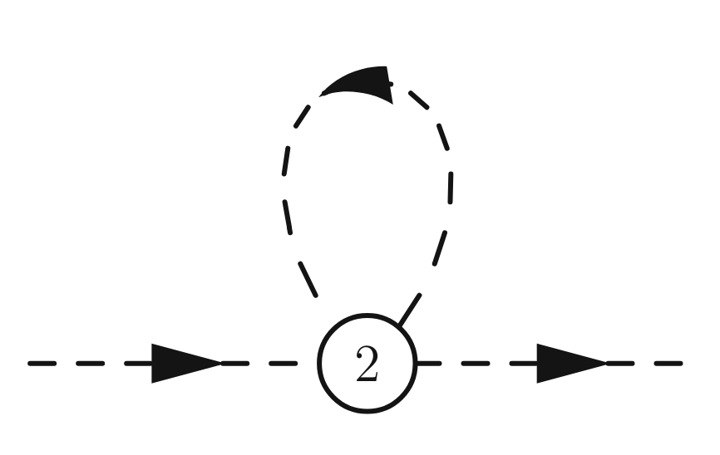
Power counting -- Mesonic sector
Power counting -- consist with dimension
$M_{π}=136 MeV ≪Λ_{χ}=4πF$, $q \sim M_{π}/Λ_{χ}$
$∂_{μ} \sim Ο\left(q\right)$, $M_{π} \sim Ο\left(q\right)$
$D=dim×N_{Loop} −2×N_{I}+ ∑{i N}_{V_{i}}$
$$dim×1−2×1+2 → Ο(q^{4})$$

Slide 34
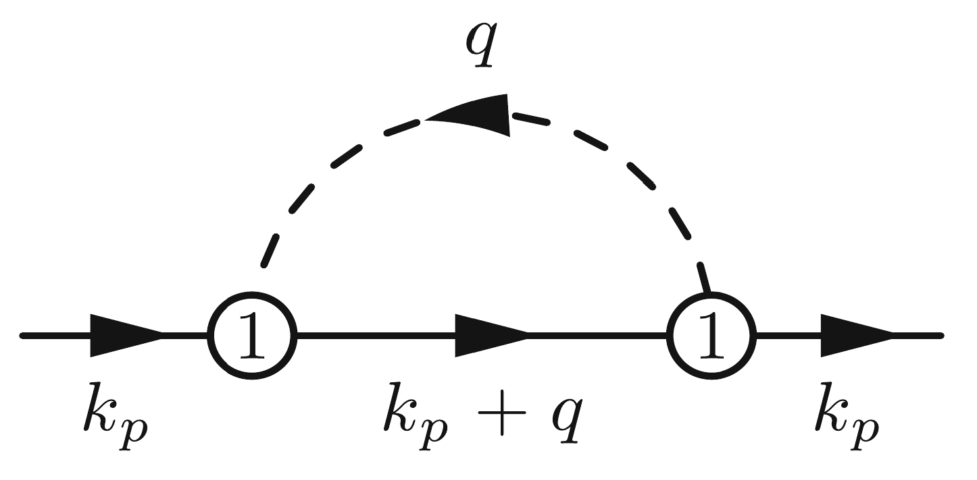
Baryon Chiral perturbative theory (BChPT)
Baryon sector
Power counting breaking (PCB)
$M_{π}≪Λ_{χ}$, $m_{N}\sim Λ_{χ}$
$∂_{μ}π \sim Ο\left(q\right)$, $M_{π} \sim Ο\left(q\right)$, $m_{N} \sim Ο\left(q^{0}\right)$, $∂_{μ}Ψ \sim Ο\left(q^{0}\right)$
J. Gasser et al. Nucl.Phys.B 307 (1988)
$$D=dim×N_{L} −2×N_{I,π}−1×N_{I,N}+ ∑{i N}_{V_{i}}$$
$$dim×1−2×1−1×1+2 → Ο(q^{3})$$
PCB terms
Power counting breaking
A new scale get involved in the Feynman Integral

Slide 35
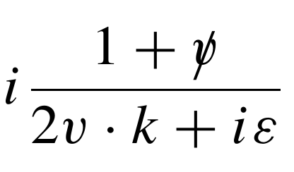
Renormalization
V. Bernard et al. Nucl.Phys.B 388 (1982)
PCB – ill-defined cutoff of Feynman diagram
Heavy Baryon ChPT (HBChPT)
$p=mv+k$, $v=(1,0,0,0)$, $m → ∞$
Non-relativistic
Infrared Regularization (IR)
Discard the contribution near the pole $p^{2}=m^{2}$ (regular part).
Introduce un-physical cut, poor convergence
Extended-on-mass-shell scheme (EOMS)
counterterms absorb only the divergence and PCB terms
Keeps the relativity and analyticity
Phenomenological success
E.E. Jenkins and A.V. Manohar Phys.Lett.B 255 (1991)
T. Becher and H. Leutwyler Eur.Phys.J. 9 (1999)
J. Gegelia and G. Japaridze Phys.Rev.D 60 (1999)
T. Fuchs et al. Phys.Rev.D 68 (2003)
L. Durand and P. Ha Phys.Rev.D 58 (1998)
L.S Geng et al. Phys.Rev.Lett. 101 (2008)
L.S Geng Front.Phys.(Beijing) 8 (2013)

Slide 36
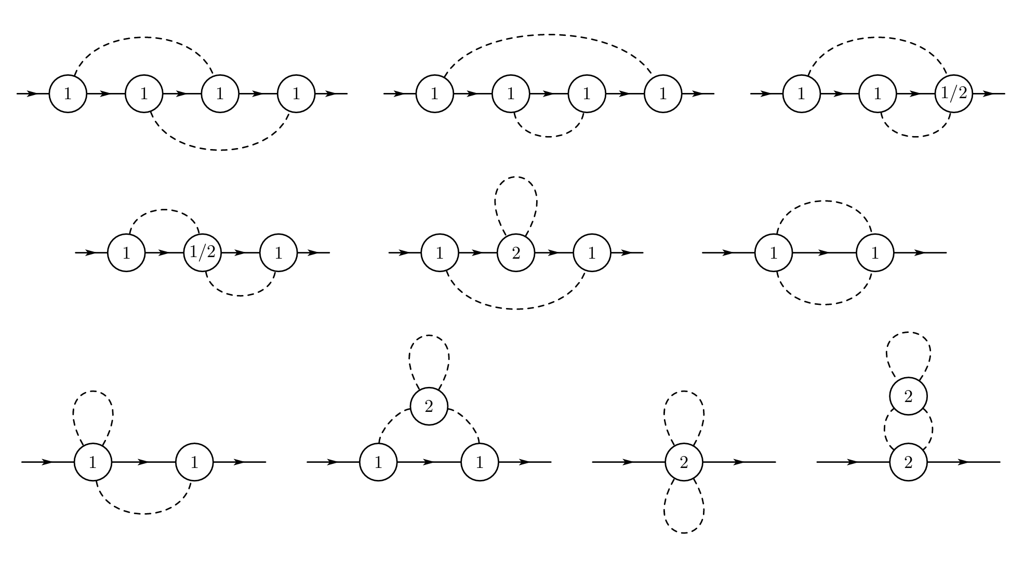
Two-Loop Master Integrals
Two-loop Feynman Diagrams

Slide 37
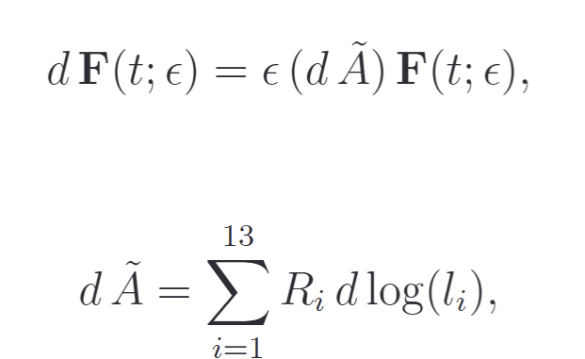
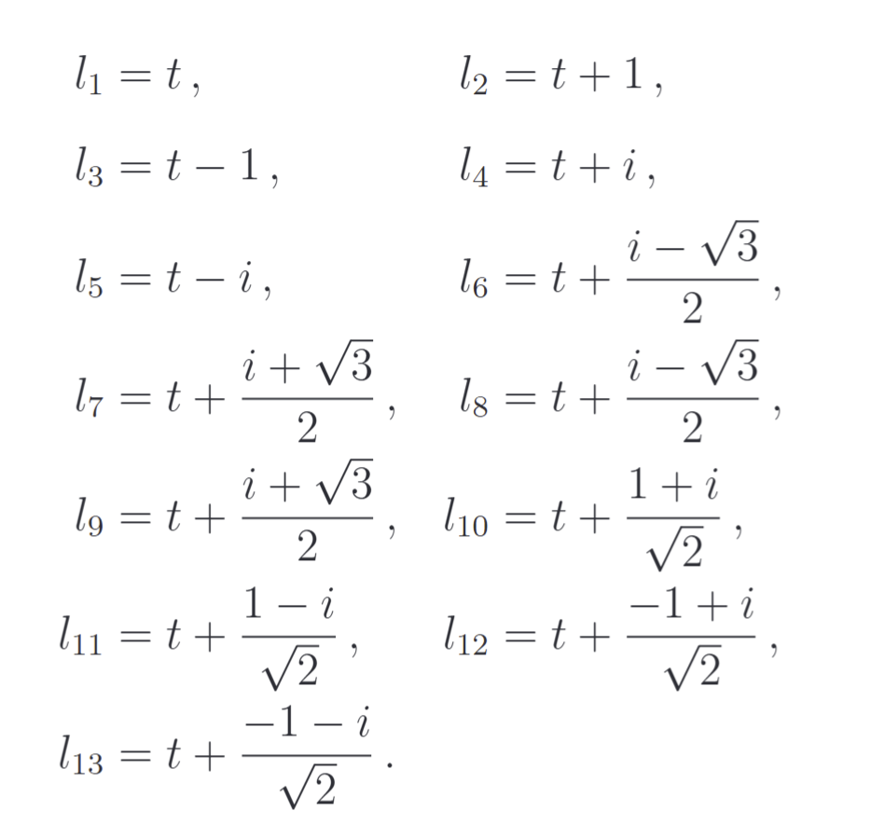
Canonical DEs
UT-Basis

Slide 38
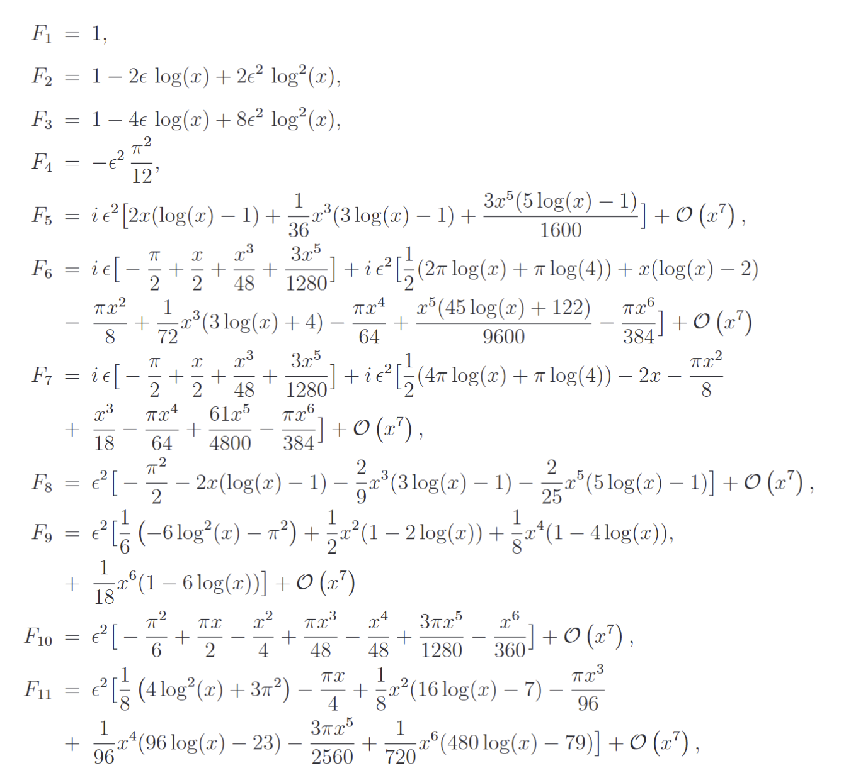
Analytic Results of MIs and Expansion

Slide 39
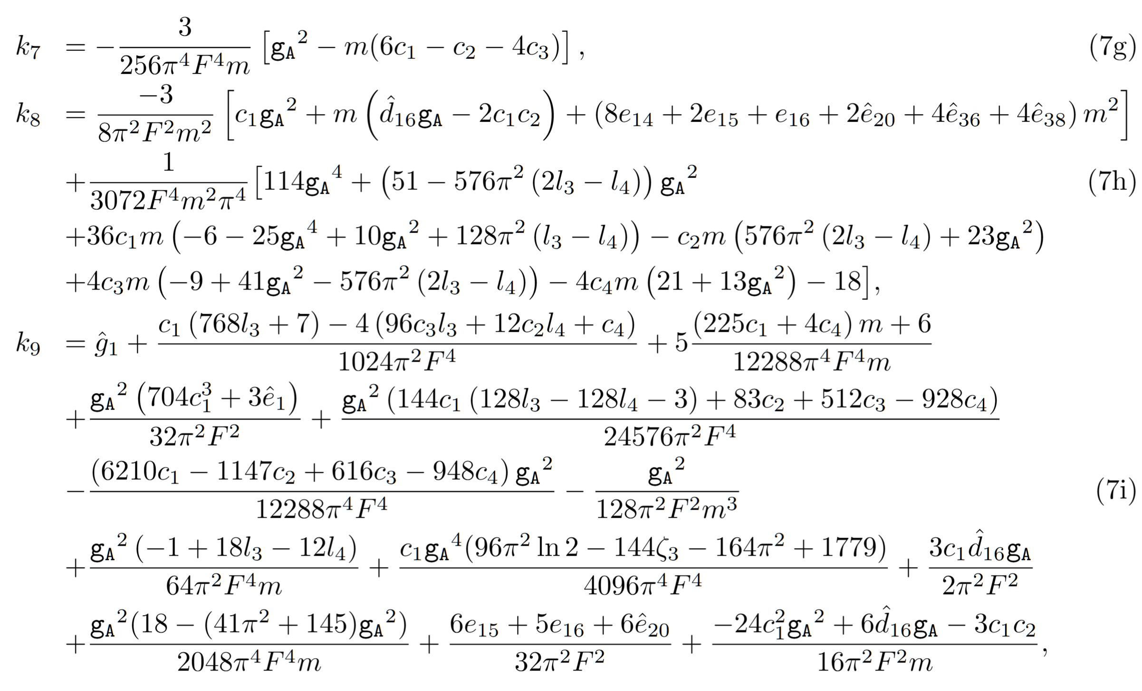
Results
Two-loop results
Tree level and one loop
Leading logarithms consist with IR and BChPT

Slide 40
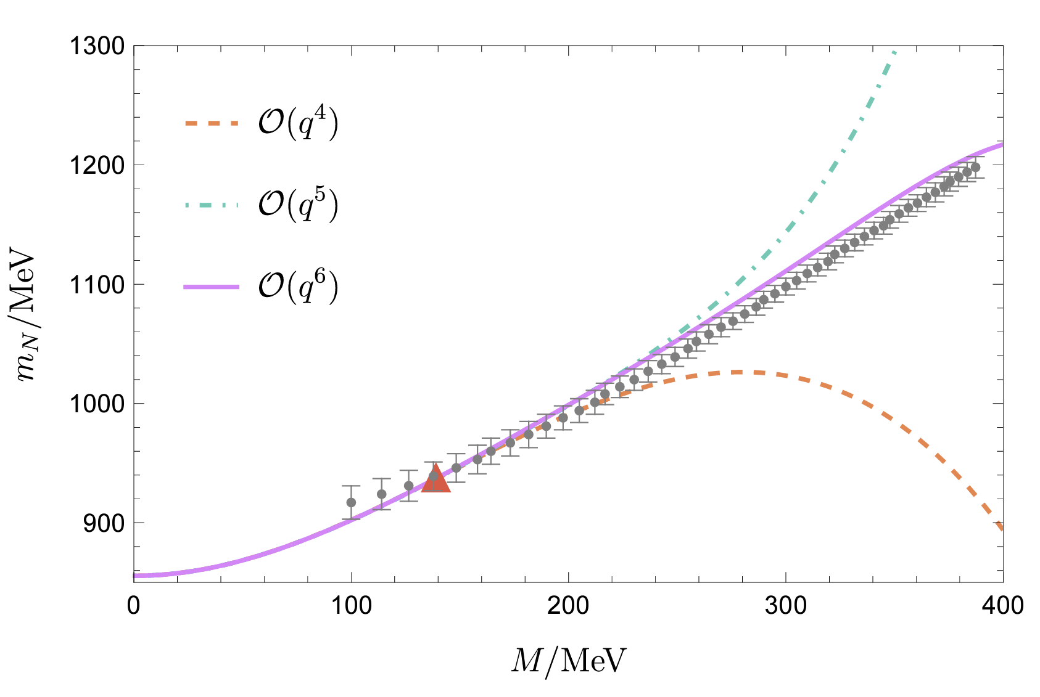
The πN sigma term as a function of M. Lattice Data taken from PhysRevLett.131.261902.
M dependence of nucleon mass.
Lattice Data taken from PhysRevLett.121.212001.
Fit e1 and g1
Nucleon mass in the chiral limit m=856.6±1.7MeV

Slide 41
Conclusion
We calculate the master integrals for top quark decay analytically up to NNNLO Leading color, and obtained the most precise decay width analytically, the convergence of perturbation series works well.
Analytic two-loop calculation of $m_{N}$,verify EOMS renormalization still works at two loop, present the most precise prediction of nucleon mass in chiral limit.
Extend the computational method to other processes…
毕业论文答辩
答辩人：小不点 答辩时间：5.5 指导老师：大不点

Slide 42
毕业论文答辩
Thank You！
答辩人：小不点 答辩时间：5.5 指导老师：大不点
陈龙斌

