Slide 1
Lattice Parton Collaboration
The Baryon LCDA from
Lattice QCD
张沐华 上海交通大学
muhuazhang@sjtu.edu.cn
In collaboration with：华俊(SCNU)，王伟(SJTU)，白颢阳(IHEP)
2025.3.24 兰州
第四届强子与重味物理理论与实验联合研讨会

Slide 2
Motivation
Quasi DA & Lattice setup
CONTENTS
Hybrid renormalization
2D matching
Summary and outlook

Slide 3
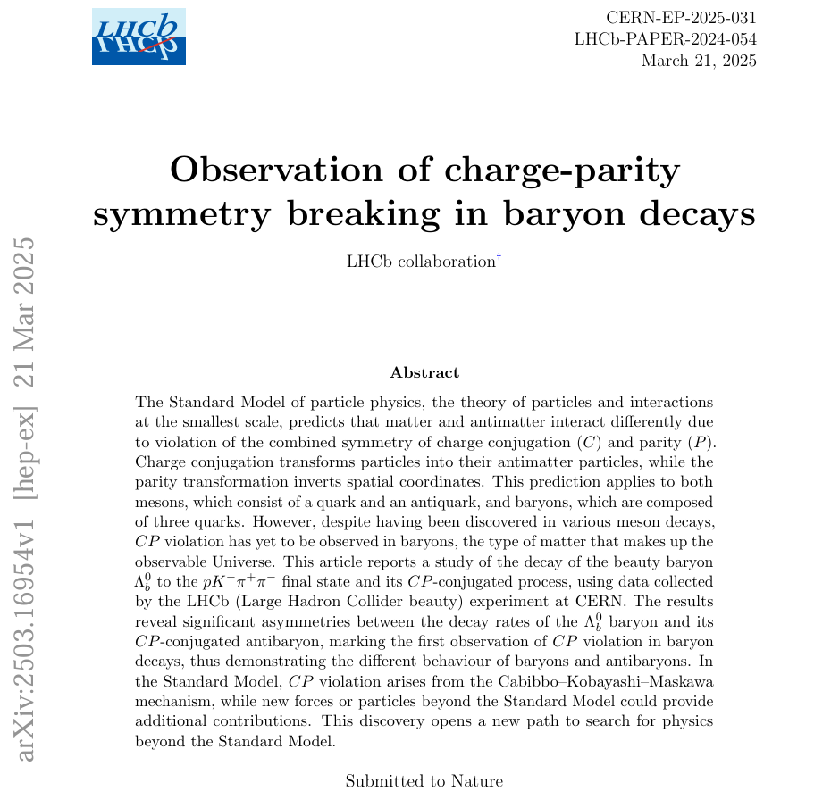
Motivation
重子CP破坏
祝贺LHCb中国组！!
3

Slide 4
Motivation
Light meson: $π$, $K$…
Baryon: $Λ$, Proton…
$${{(1−x}_{1}−x_{2})P}_{z}$$
$$s$$
$$u$$
$${xP}_{z}$$
✕
$$P_{z}$$
✕
$$P_{z}$$
$${\overline{x}P}_{z}$$
$$d$$
$${x_{2}P}_{z}$$
$$\overline{d}$$
$$u$$
$${x_{1}P}_{z}$$
CP violation of Baryon
Hadronic Decay / CKM matrix
Non-Perturbative property
New physics BSM…
CPV well established in K, B and D mesons
First observation of CPV in baryon decays
4

Slide 5
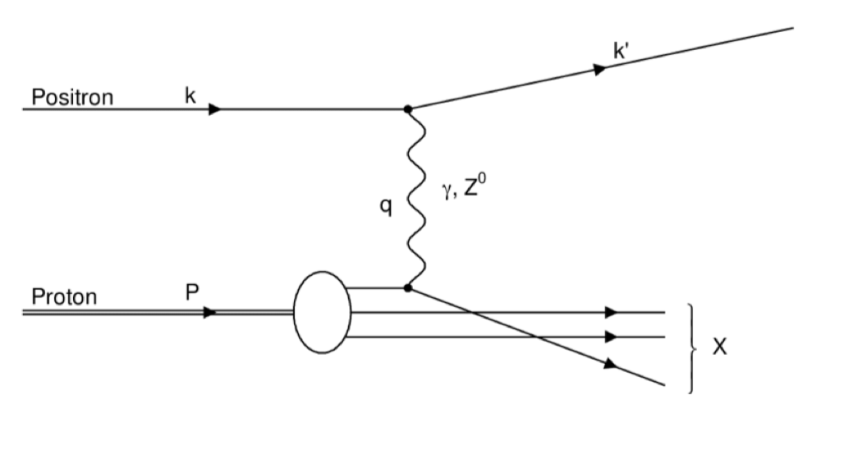
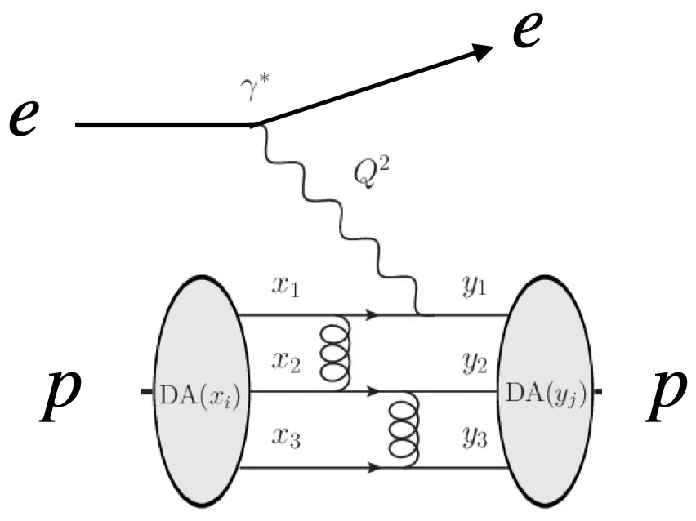
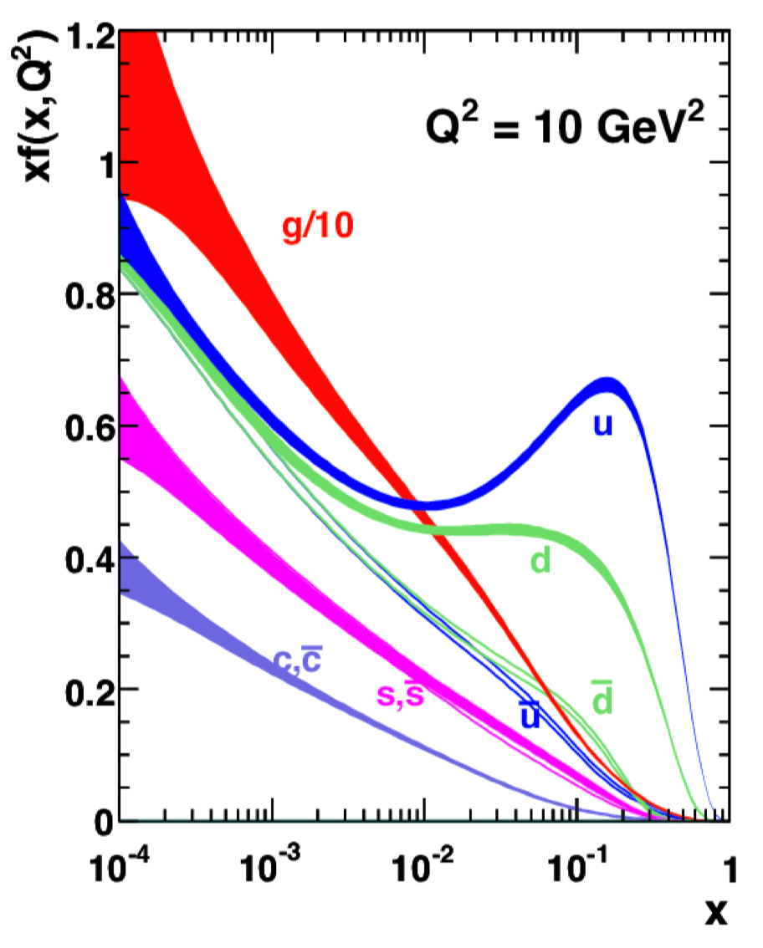
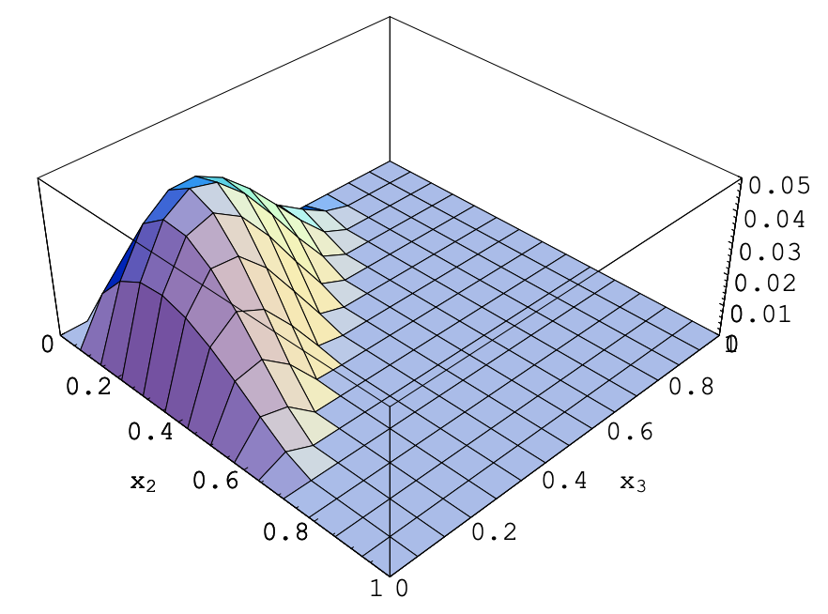
Motivation
PDF: inclusive processes
LCDA: hard exclusive processes
Complementary
1-particle distributions
3-particle distributions
5
V.Braun, NPB, 589,381(2000)

Slide 6
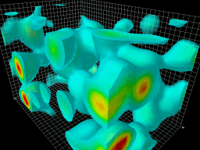
Motivation
Light Baryon LCDAs: (1980s - now)
Asymptotic LCDAs
Chernyak, Zhitnitsky, 1983
Sum rules
King, Sachrajda, 1987; Chernyak, Ogloblin, Zhitnitsky 1989;
Stefanis, Bergmann, 1993; Braun, Fries, Stein 2000;
Braun, Lenz, Wittmann 2006;
Model parametrization
Bell, Feldmann, Wang, Matthew 2013
Lattice with OPE
Lattice is powerful
Moments is not enough
QCDSF collaboration, 2008, 2009;
RQCD collaboration, 2016, 2019
Baryon LCDA from LaMET Phys.Rev.D 111 (2025) 3, 034510, …………
(1 Lattice spacing, renormalization scheme ……)
6

Slide 7
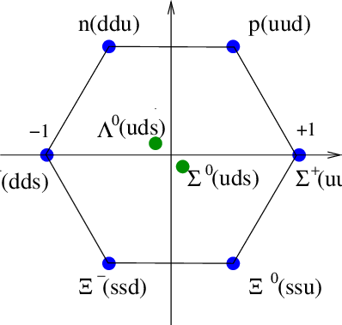
Light-cone DA
Definition of baryon LCDA:
$${{(1−x}_{1}−x_{2})P}_{z}$$
$$s$$
✕
$$P_{z}$$
$$d$$
$${x_{2}P}_{z}$$
$$u$$
$${x_{1}P}_{z}$$
C.Han JHEP 07 (2024) 019
V.L.C & I.R.Z NPB 24652(1984)
G.R.Farrar et.al. NPB 311585(1989)
Leading twist octet baryon LCDA:
7

Slide 8
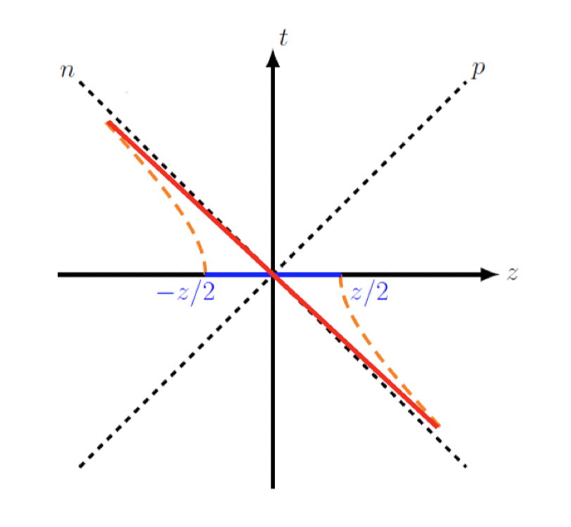
LaMET
Large Momentum Effective Theory (LaMET)
$$\frac{ξ^{−}}{\sqrt{2}}$$
Boosting $P^{z}$
EFT
$$−\frac{ξ^{−}}{\sqrt{2}}$$
Quasi-DA and LCDA share the same IR property;
At large $P^{z}≫Λ_{QCD}$, quasi can be factorized as matching formula:
Quasi-DA
Matching kernel
LCDA
High power correction
8

Slide 9
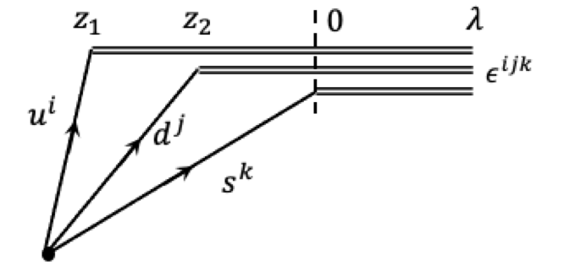
Quasi-DA
$${{(1−x}_{1}−x_{2})P}_{z}$$
Corresponding quasi-DA on Euclidean lattice:
$$s$$
✕
$$P_{z}$$
$$d$$
$${x_{2}P}_{z}$$
$$u$$
$${x_{1}P}_{z}$$
leading twist of quasi-DA matrix elements:
9

Slide 10
Non-local 2pt
Nonlocal 2-point function related to baryon quasi-DA:
$${{(1−x}_{1}−x_{2})P}_{z}$$
$$s$$
✕
$$P_{z}$$
leading twist
$$d$$
$${x_{2}P}_{z}$$
sink:
$$u$$
$${x_{1}P}_{z}$$
source:
10

Slide 11
Lattice Setup
CLQCD Ensembles
Ensemble | Volume | Lattice spacing | $π$ mass | measurement | $$P^{z}$$
C24P29 | $${24}^{3}×72$$ | 0.105 fm | 293 MeV | 864*4 | 0, 2.45, 2.94, 3.43 GeV
F32P30 | $${32}^{3}×96$$ | 0.077 fm | 303 MeV | 777*4 | 0, 2.50, 3.00, 3.50 GeV
H48P32 | $${48}^{3}×144$$ | 0.052 fm | 317 MeV | 550*6 | 0, 2.34, 2.80, 3.28 GeV
11

Slide 12
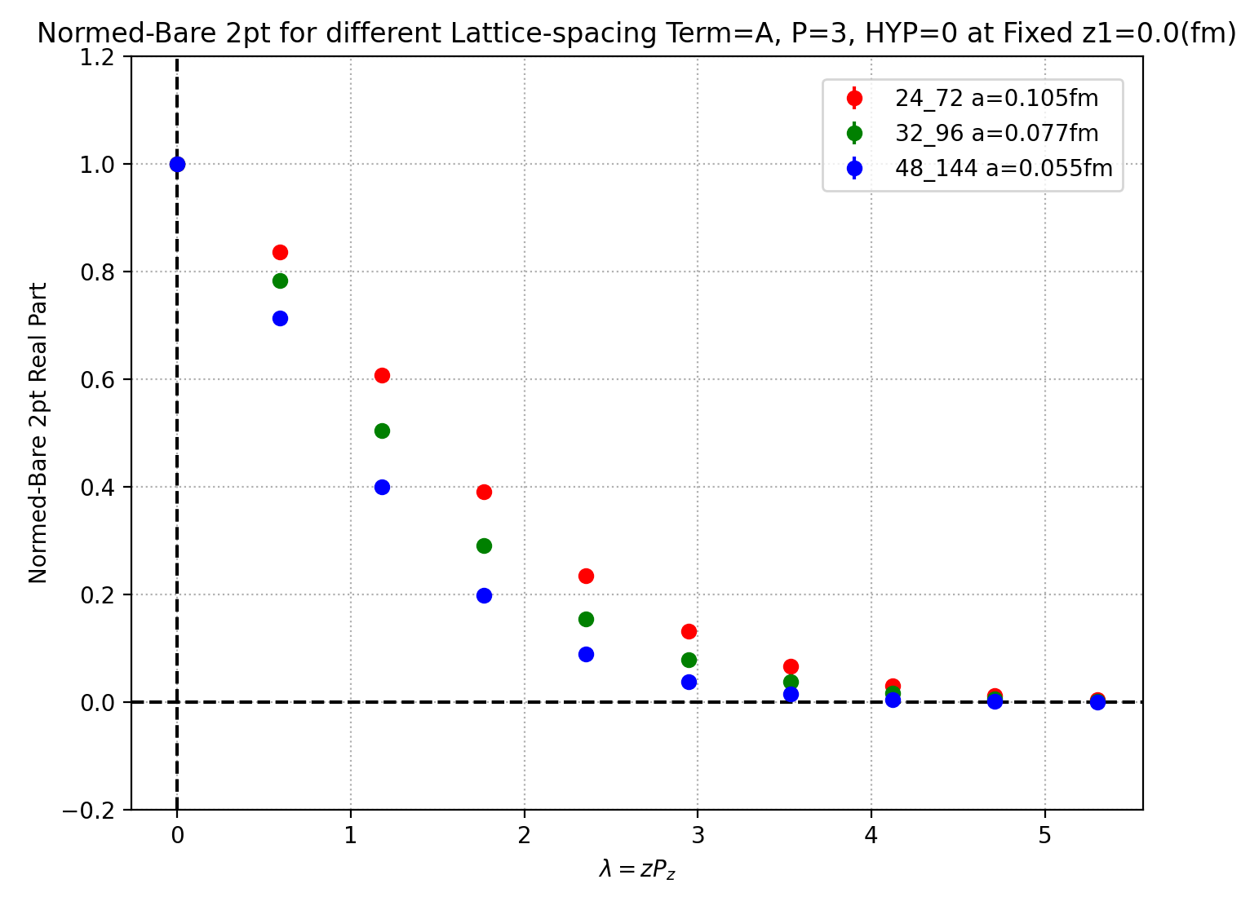
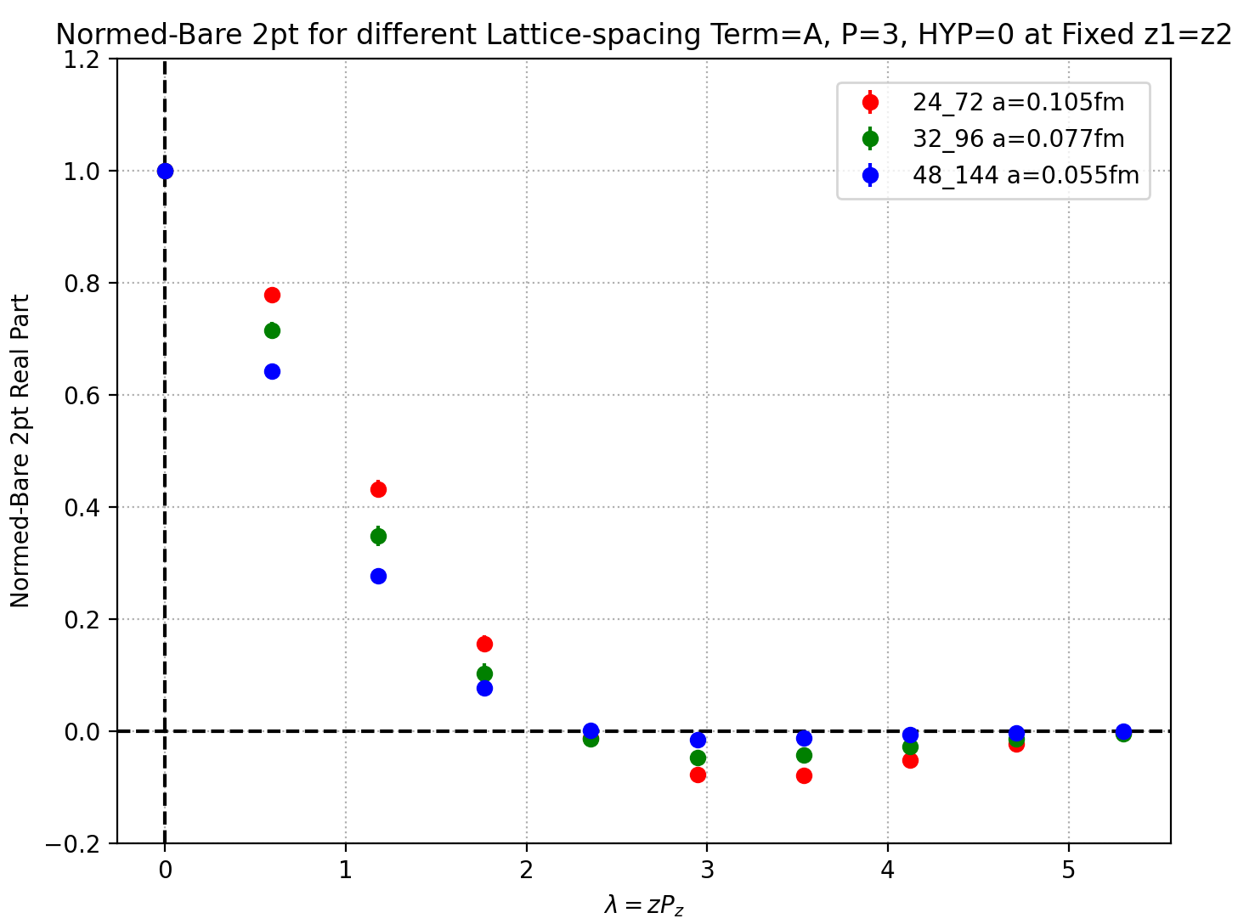
Bare matrix element
z-dependence on different lattice-spacing $a$
Z1=0 Re:
Z1=Z2 Re:
12

Slide 13
Renormalization
Inconsistency between Lattice & perturbative calculation
2 variables leads 3 singular log terms $⟹$ 3 singular lines on z1-z2 plane
…… from interchange limits $a→0$ & $z→0$
Validity of factorization of quasi-DAs relies on the consistency of renormalization employed in both Lattice & perturbative calculations.
Proper renormalization scheme to:
eliminate both UV divergence and log singularity simultaneously
13

Slide 14
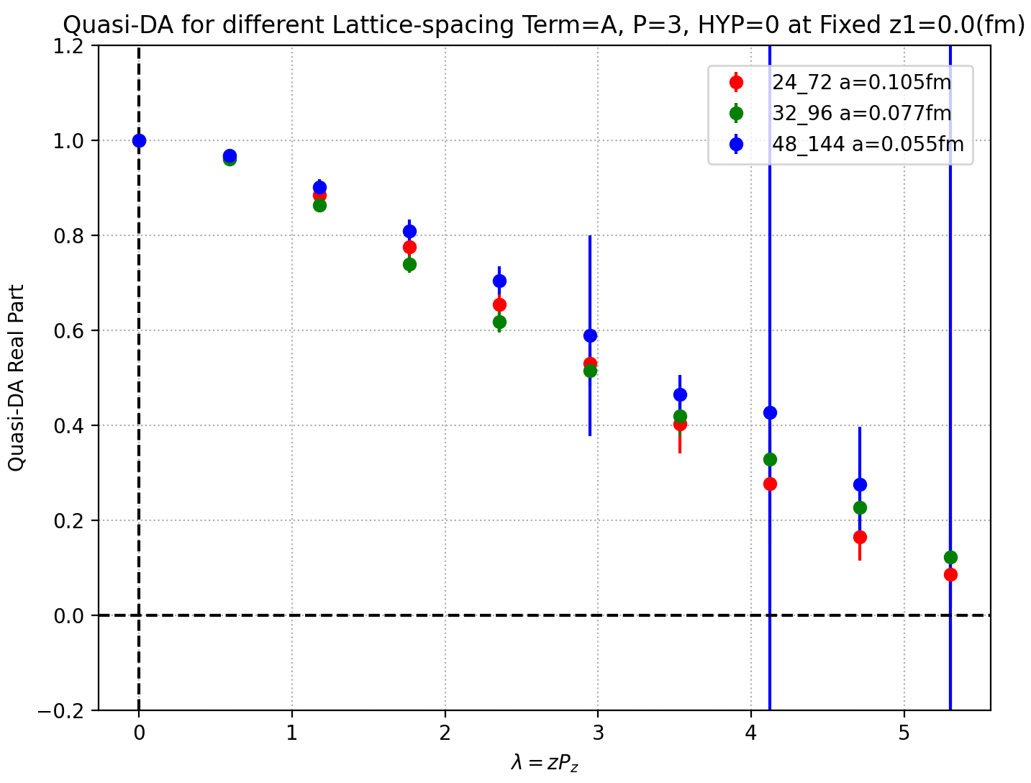
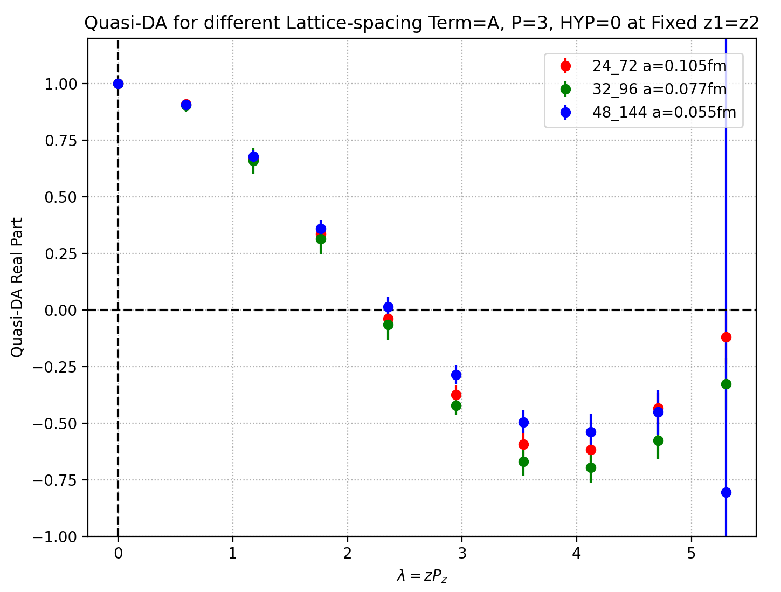
Ratio scheme
z-dependence on different lattice-spacing $a$
Z1=0 Re:
Z1=Z2 Re:
14

Slide 15
Self-renormalization
Fit 0-momentum matrix element
Renormalization factor
15

Slide 16
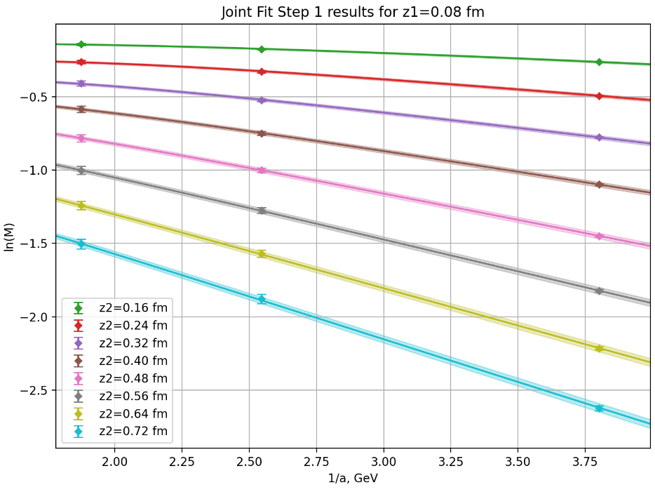
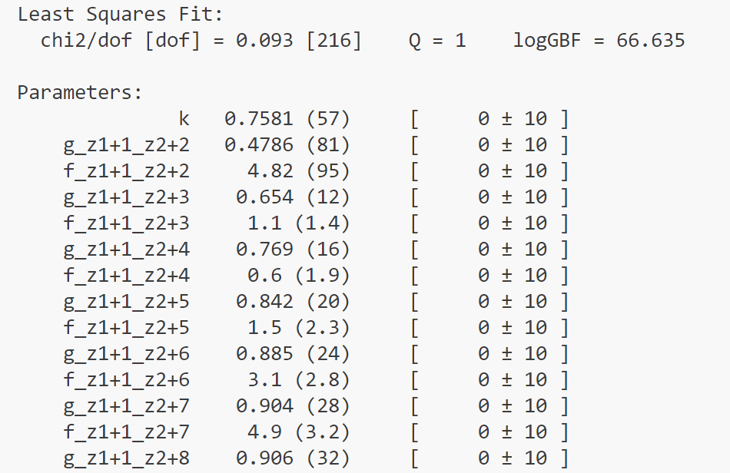
Fit step-1
Step-1 fit result
Interpolate to a0 = 0.08 fm
z1, z2: 0.08 ~ 0.72 fm
16

Slide 17
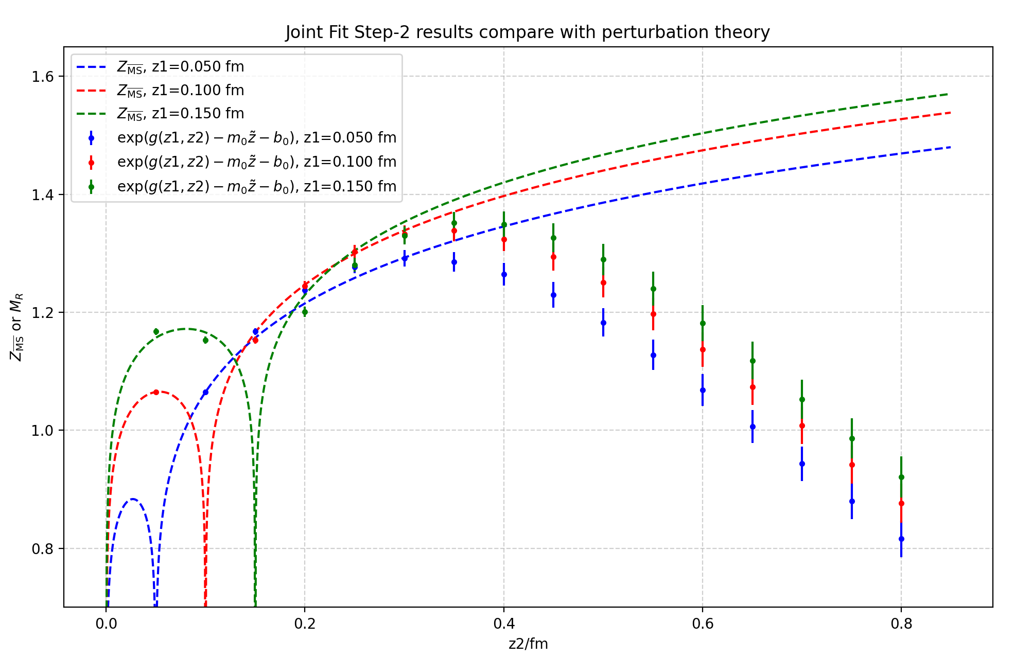
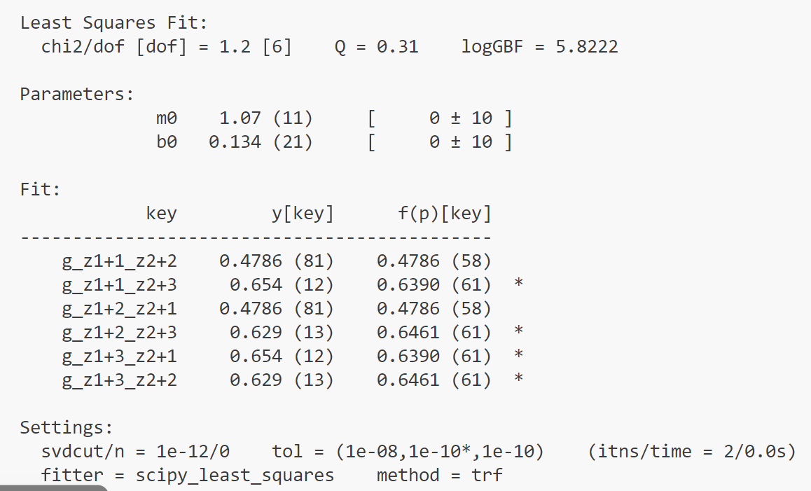
Fit step-2
Step-2 fit result
z1, z2: 0.08 ~ 0.24 fm
17

Slide 18
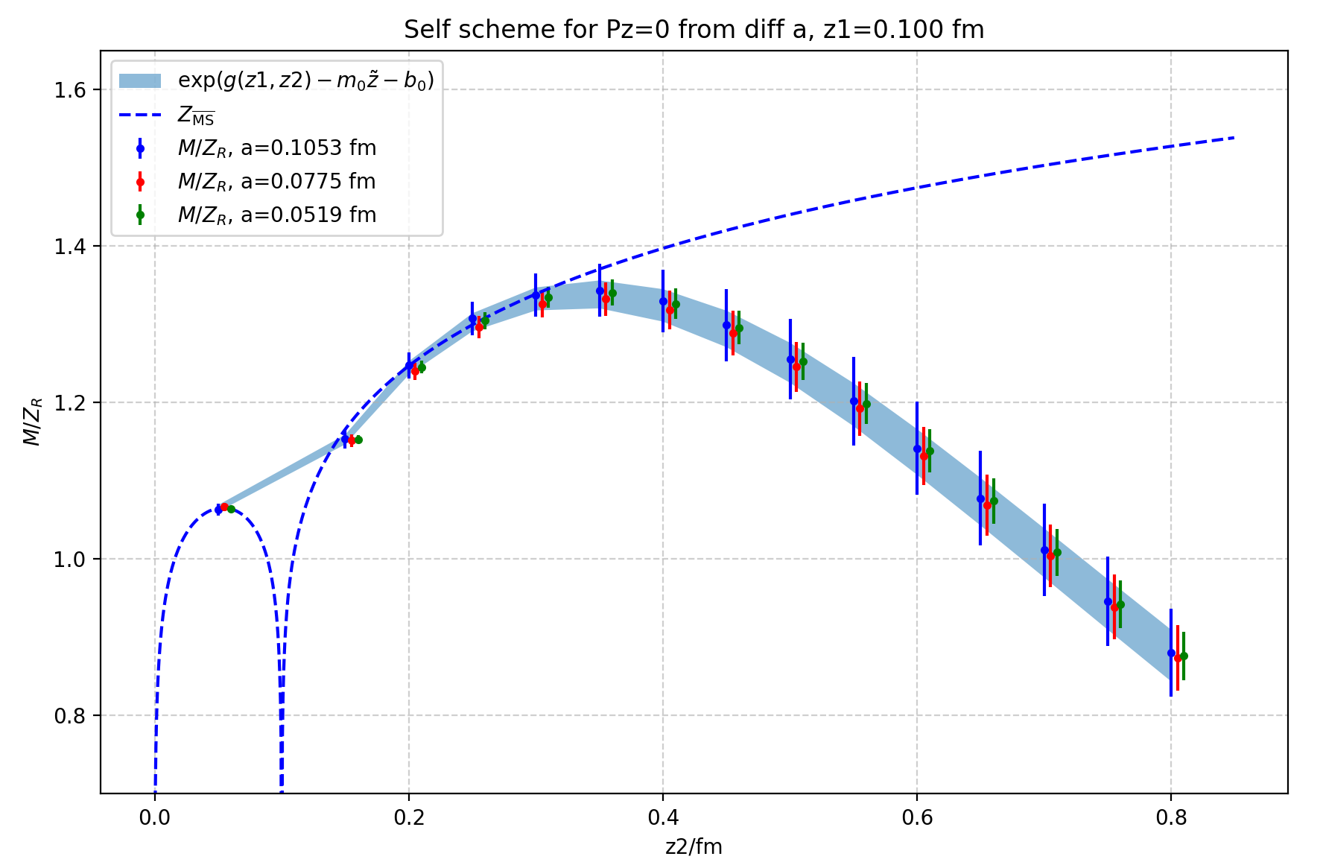
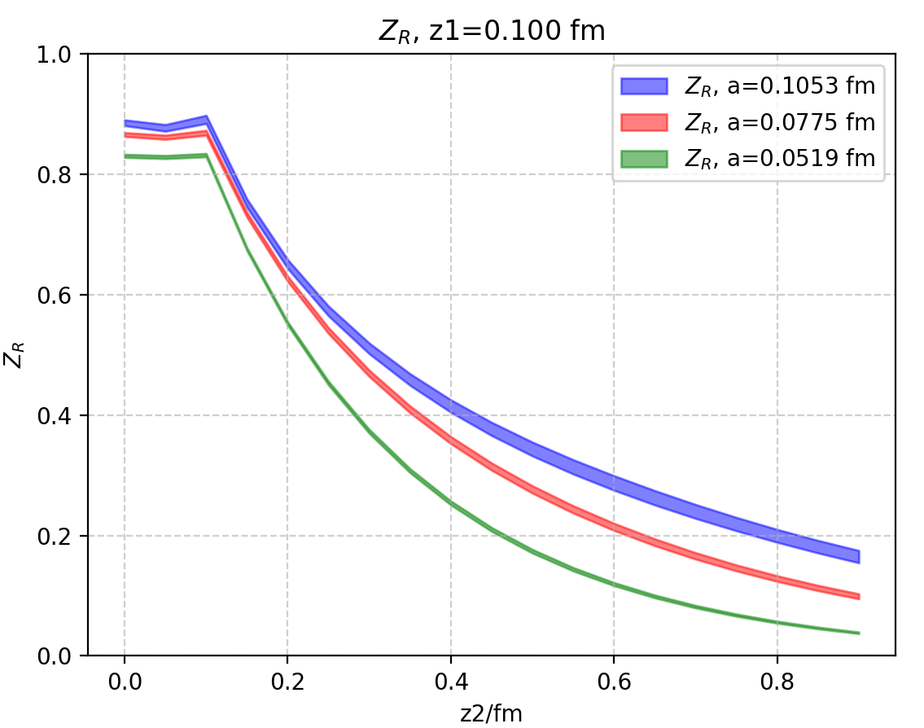
Self-renormalization
18

Slide 19
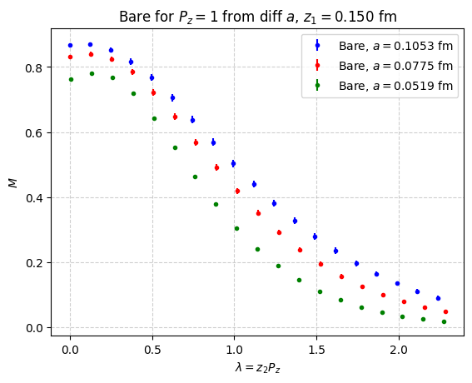
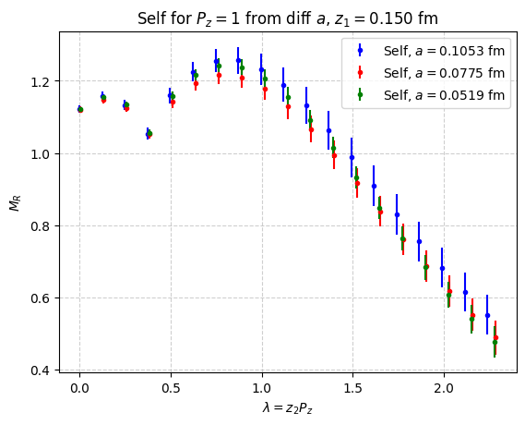
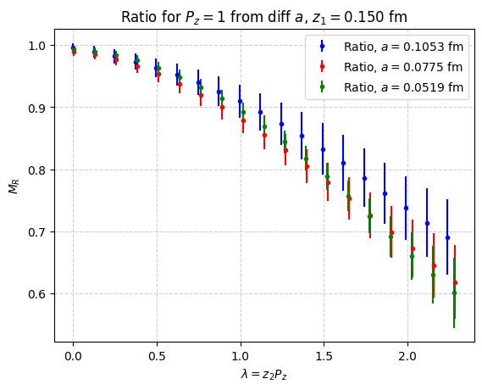
Self-renormalization
Bare Matrix Element
Self scheme
Ratio scheme
19

Slide 20
Hybrid scheme
Short distance for $z_{1}$, $z_{2}$, $|z_{1}−z_{2}|$：
Eliminate singular log terms through Ratio scheme
Large distance：
Avoid uncontrollable extra IR effects through Self-renormalization
Keep the renormalized matrix element continues among different regions
20

Slide 21
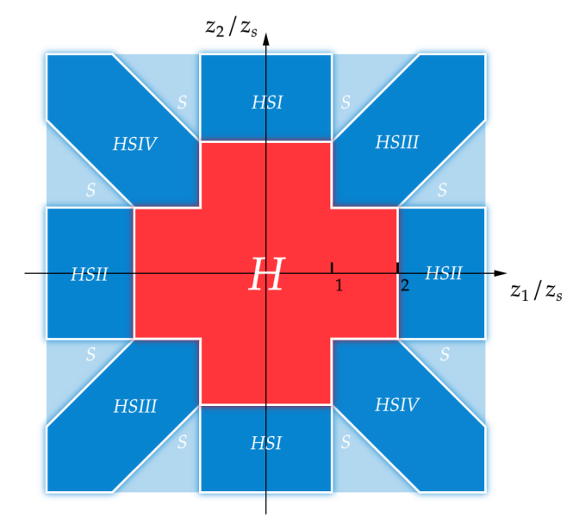
Hybrid scheme
$$z_{i}= z_{1},z_{2},|z_{1}−z_{2}|$$
H region: Ratio scheme
HSI-HSIV regions:
Ratio scheme for short $z_{i}$
Self-renormalization for large $z_{i}$
S regions: Self-renormalization
Singular logs of $z_{1}$, $z_{2}$, $\left|z_{1}−z_{2}\right|$ factorize
at 1-loop level:
21

Slide 22
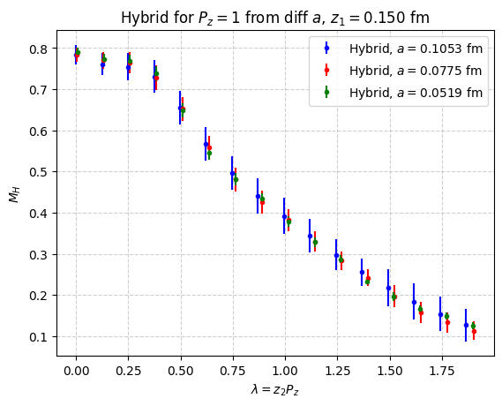
Hybrid scheme
Hybrid scheme
22

Slide 23
2-D Effective Matching
LaMET factorization for Baryon LCDA:
Matching kernel:
$$x_{3}=y_{3}$$
$$x_{2}=y_{2}$$
$$x_{1}=y_{1}$$
Double plus function
C.Han et.al. JHEP 12 044 (2023), JHEP 07 019 (2024)
23

Slide 24
2-D Effective Matching
LaMET factorization for Baryon LCDA:
(Phys.Rev.D 111 (2025) 3, 034510)
Inverse matching:
$C\left(x_{1},x_{2},y_{1},y_{2}\right)→$ 4 Dimensional tensor $→$ Reduce to 2D matrix $→$inverse
Iterative matching:
The difference between $\tilde{φ}(x_{1},x_{2})$ and $φ(x_{1},x_{2})$ introduces error only at higher order
24

Slide 25
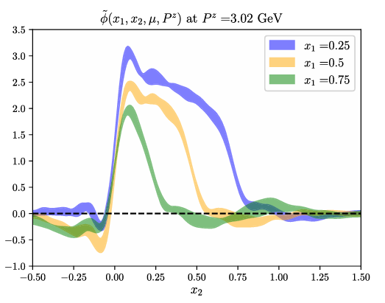
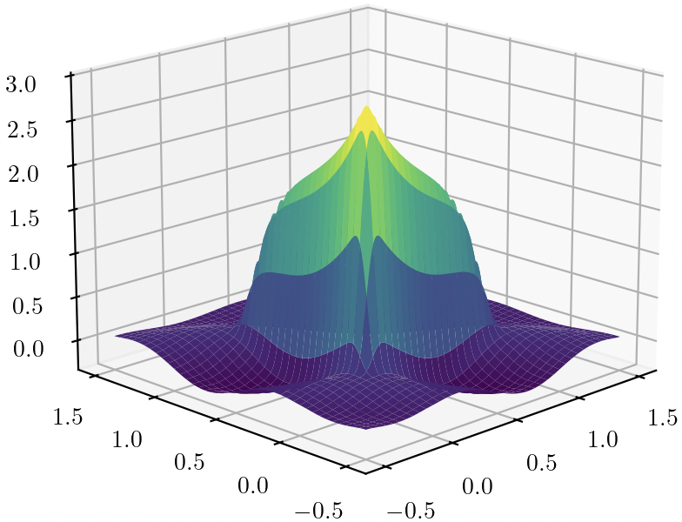
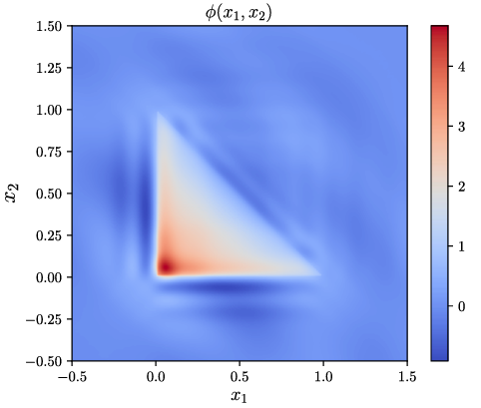
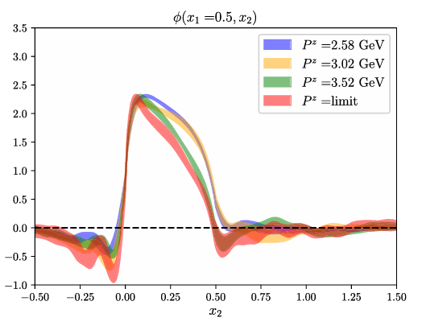
Numerical results
Quasi-DA
Matching
Lagre $P_{z}$ Limit
LCDA
Phys.Rev.D 111 (2025) 3, 034510
25

Slide 26
Summary and outlook
The first numerical computation of baryon LCDA in LaMET has been attempted (Phys.Rev.D 111 (2025) 3), but with incomprehensive renormalization scheme;
What we have done:
3 different lattice spacings;
performed Hybrid scheme renormalization;
strategy optimized for large momentum;
Extrapolation (?) , Fourier transformation, Matching implementation ……
All 3 structures of leading twist LCDAs for both Proton & Lambda
Thanks For Your Attention ！
26

