Slide 1
Unambiguous detection of high energy vortex states via the superkick effect
Zhengjiang Li, Shiyu Liu, Bei Liu, Liangliang Ji, and Igor P. Ivanov
December 18, 2024 in Zhuhai
arXiv:2406.06795 [hep-ph] Zhengjiang Li, Shiyu Liu, Bei Liu, Liangliang Ji, and Igor P. Ivanov
1
Notes:
Hello everyone my name is Liu Shiyu, come from Shanghai Institute of Optics and Fine Mechanics.
My topic is Unambiguous detection of high energy vortex states via the superkick effect.

Slide 2
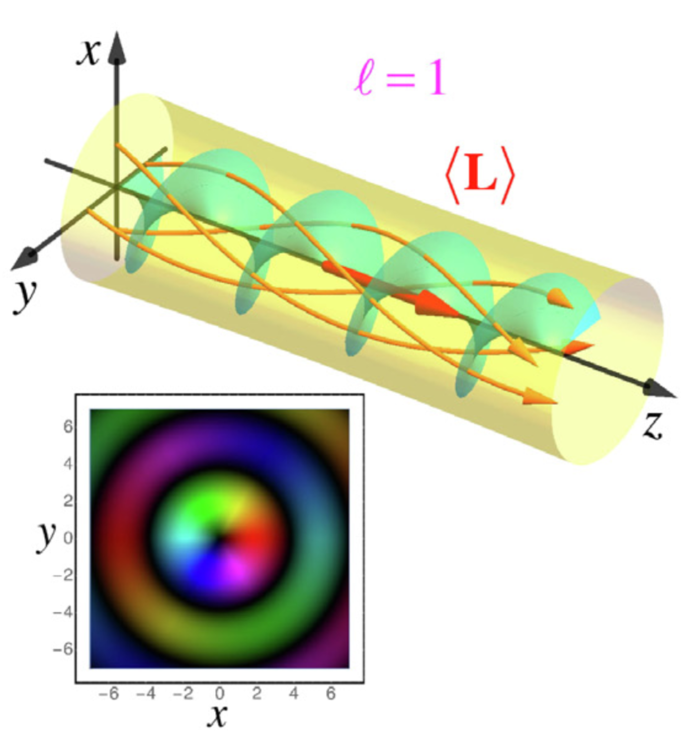
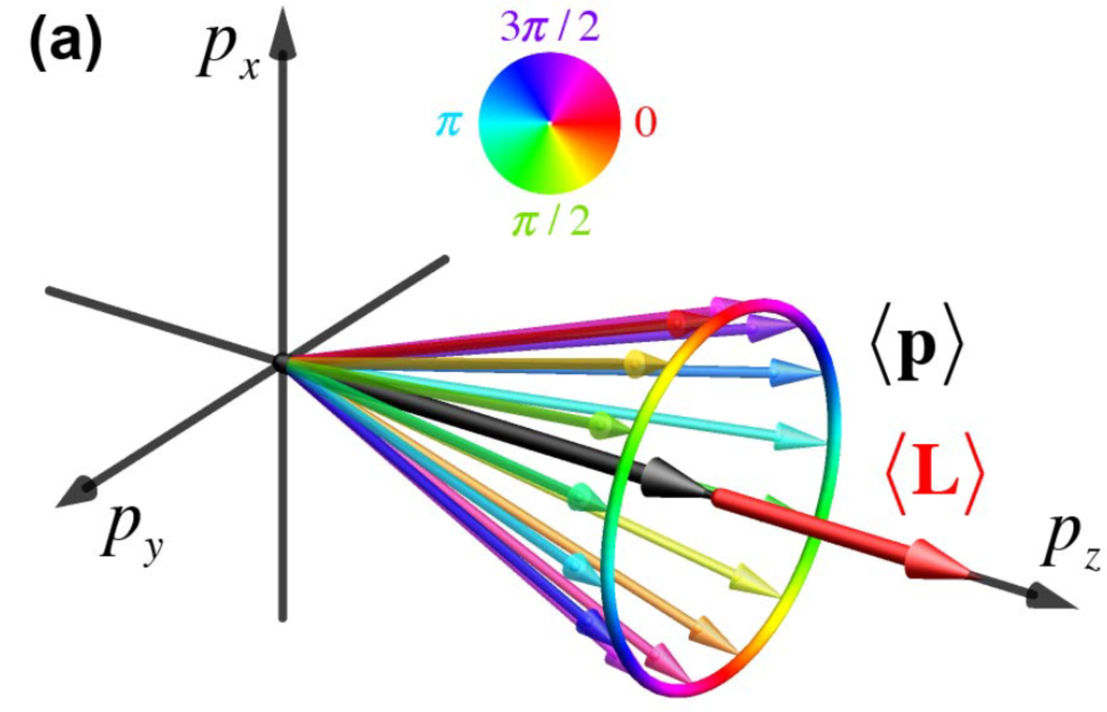
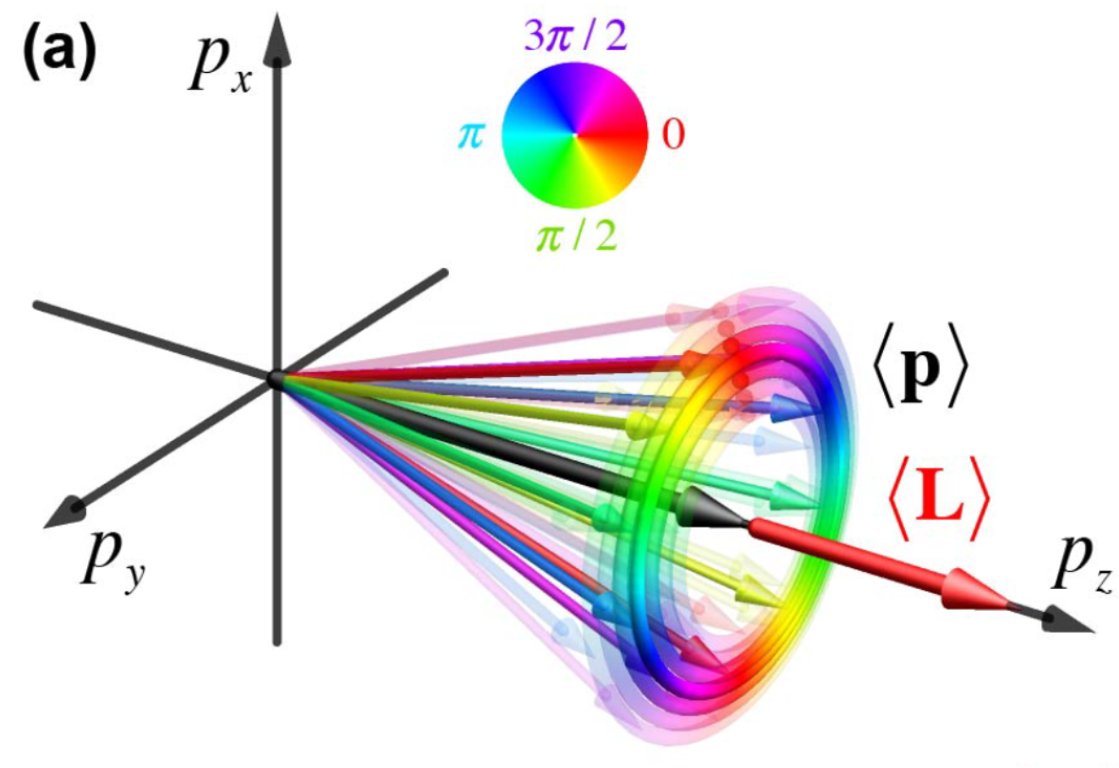
Vortex States
Cylindrical solutions of the wave equation
Possesses a nonzero z-projection of the intrinsic orbital angular momentum (OAM)
Vortex feature: phase factor $ψ\left(r\right){∝e}^{iℓφ}$, $\left\langle L_{Z}\right\rangle =ℓℏ$
Typical Vortex States: Bessel State and Laguerre-Gaussian State
$$\frac{\sqrt{ℓ}}{σ_{1⊥}}$$
2
Notes:
Here are some basics ideas about the vortex states.
And Professor Igor has already made a presentation on this knowledge.
Vortex state is the solution of the wave equation in cylindrical coordinate.
It possesses a nonzero z-projection of the intrinsic orbital angular momentum.
The main feature of the vortex state comes from a phase exponential i\ell phi.
There are two commonly used Vortex State： Bessel State and Laguerre-Gaussian State。
For the Bessel State，the magnitude of the transverse momentum is determined. It is kappa in this expression.
For the Laguerre-Gaussian State,
the magnitude of the transverse momentum have a distribution, the mean value of the magnitude of the transverse momentum is sqrt(l) over sigma

Slide 3
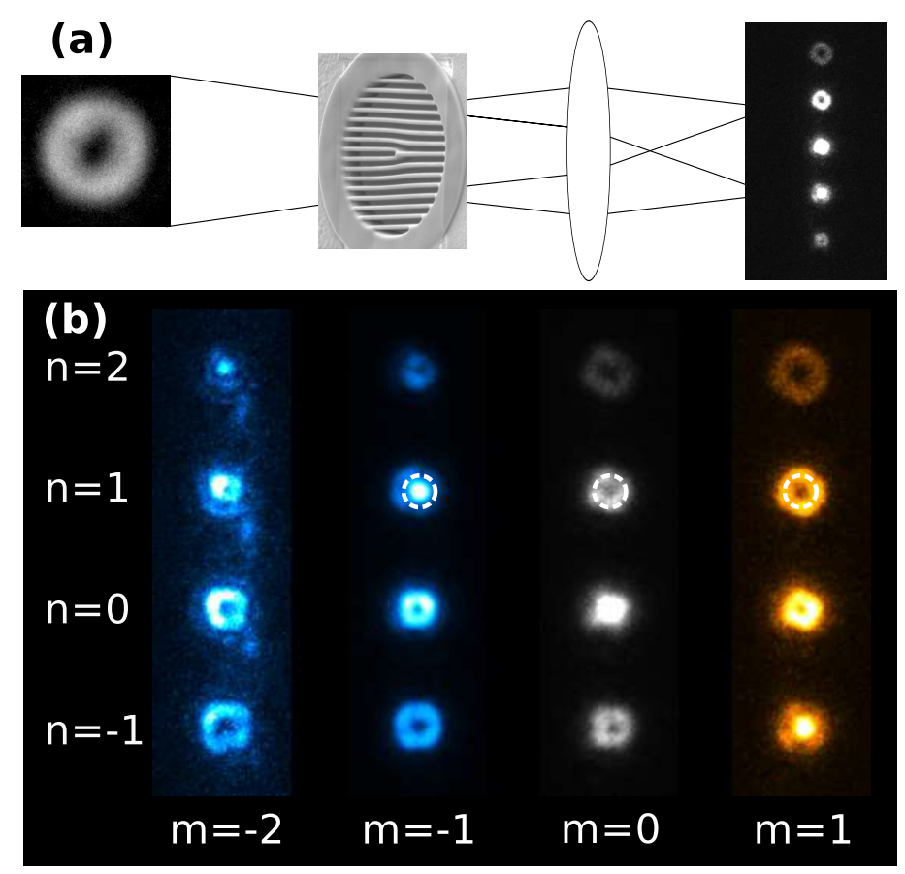
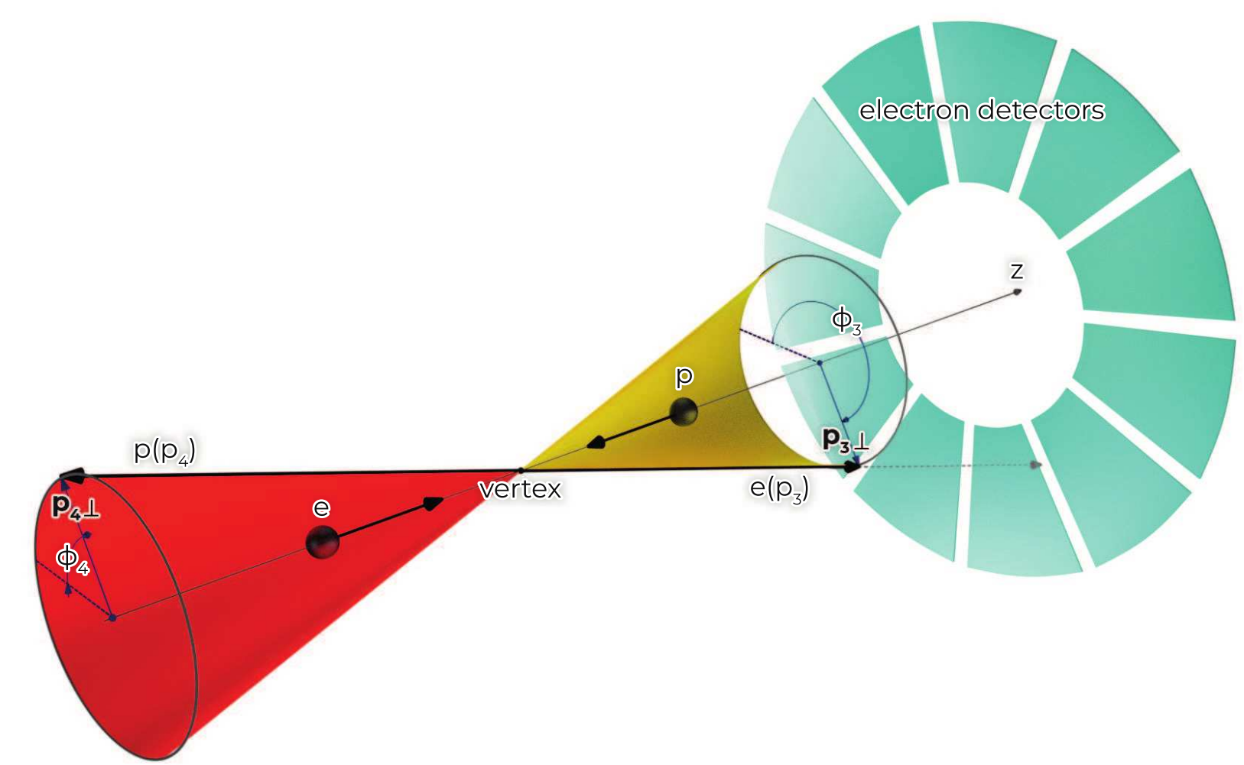
Detection of Vortex Particles
Diffraction: (fork, triangular, knife-edge)
Generalized Measurement:
reveal the phase structure of the final wave function.
Eur. Phys. J. C 82, 1008 (2022)
$$m_{f}=m_{i}+n ℓ$$
it relies on a special detector, which are yet to be demonstrated at high energies.
PhysRevA.89.025803
Notes:
Once a vortex state is produced ，one must verify that it indeed carries a non-zero OAM。
In low energy regime，this can be done by diffraction.
Diffraction with gratings of different shapes can reflect the OAM characteristic。
At higher energies, this method becomes impossible due to the very short de Broglie wavelength。
Recently , a generalized measurement procedure was suggested to reveal the phase structure of the final wave function.
it relies on a special detector, which are yet to be demonstrated at high energies.
In our research, we propose a method which can unmistakably reveal the vortex phase in a high energy wave packet.

Slide 4
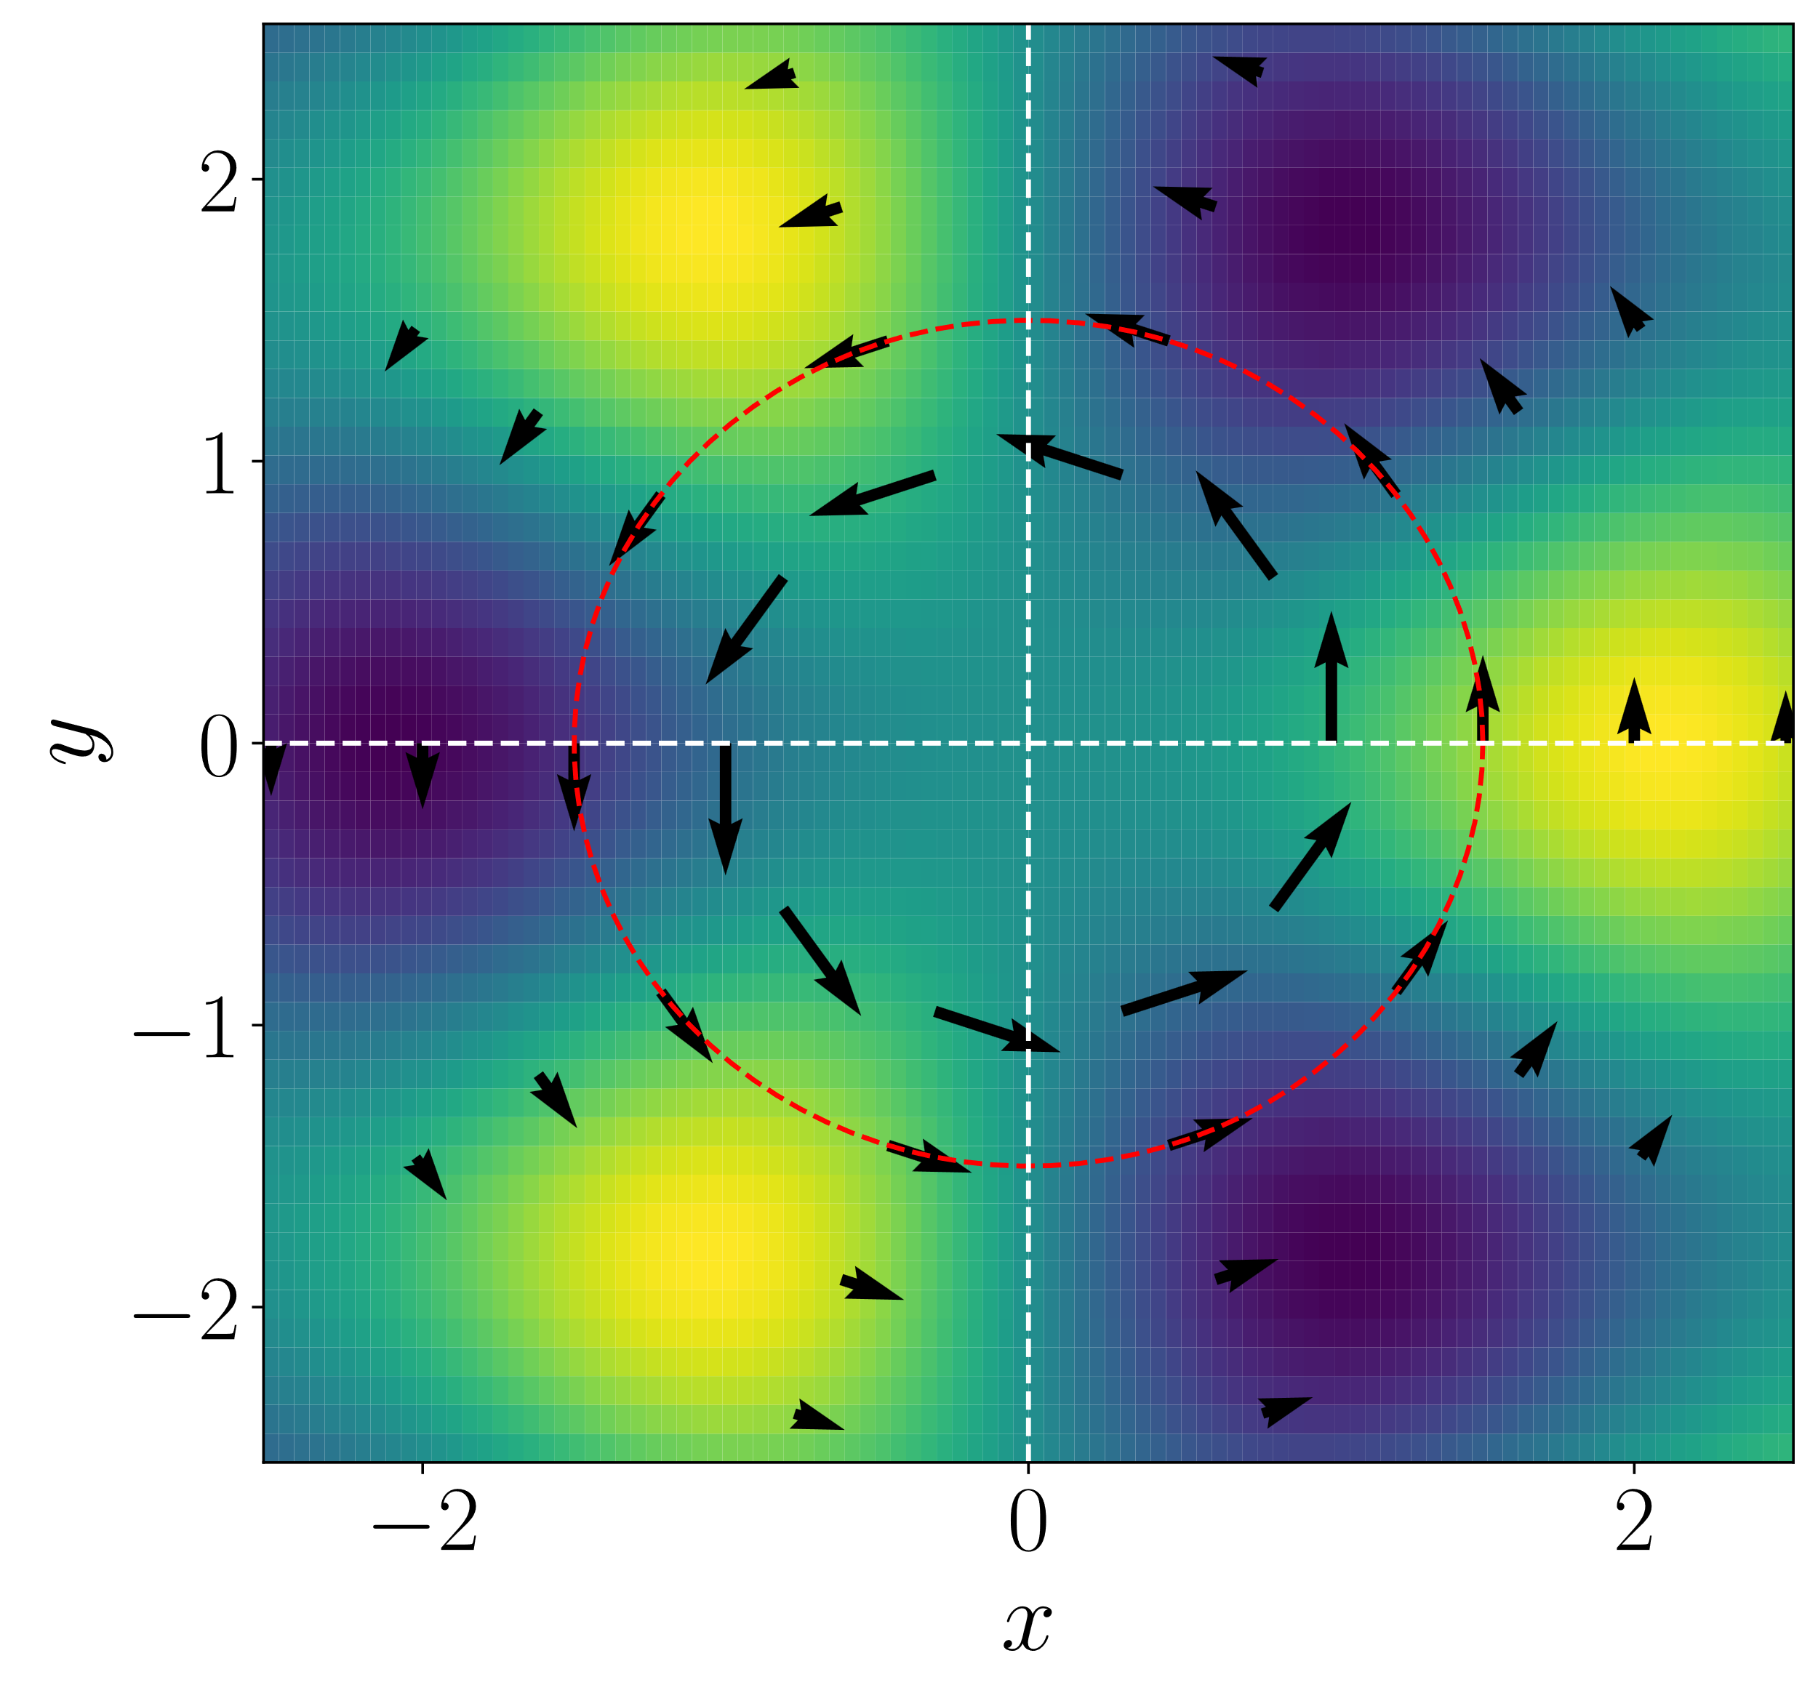
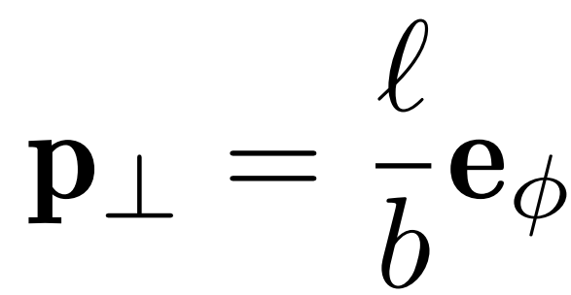
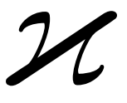
Superkick Effect
Barnett and Berry [J. Opt. 15 125701] predicted a “superkick” effect.
The gradient of the phase produces the local momentum :
For a sufficiently small b, this local momentum can much larger than the photon transverse momentum
A photon absorbed by the pointlike probe exerts a much larger momentum transfer than it actually carries.
Notes:
This method relies on the superkick effect. Here, I will give An Intuitive Physical Picture about the Superkick Effect.
The superkick effect was first predicted by Barnett and Berry in 2013.
We know that the phase gradient can produce a local momentum.
In a vortex state, the local momentum can be written as l/b.
That means For a sufficiently small b, this local momentum can much larger than the photon transverse momentum.
So when you place a pointlike probe particle at small b,
a photon absorbed by this particle exerts a much larger momentum transfer than it actually carries.

Slide 5
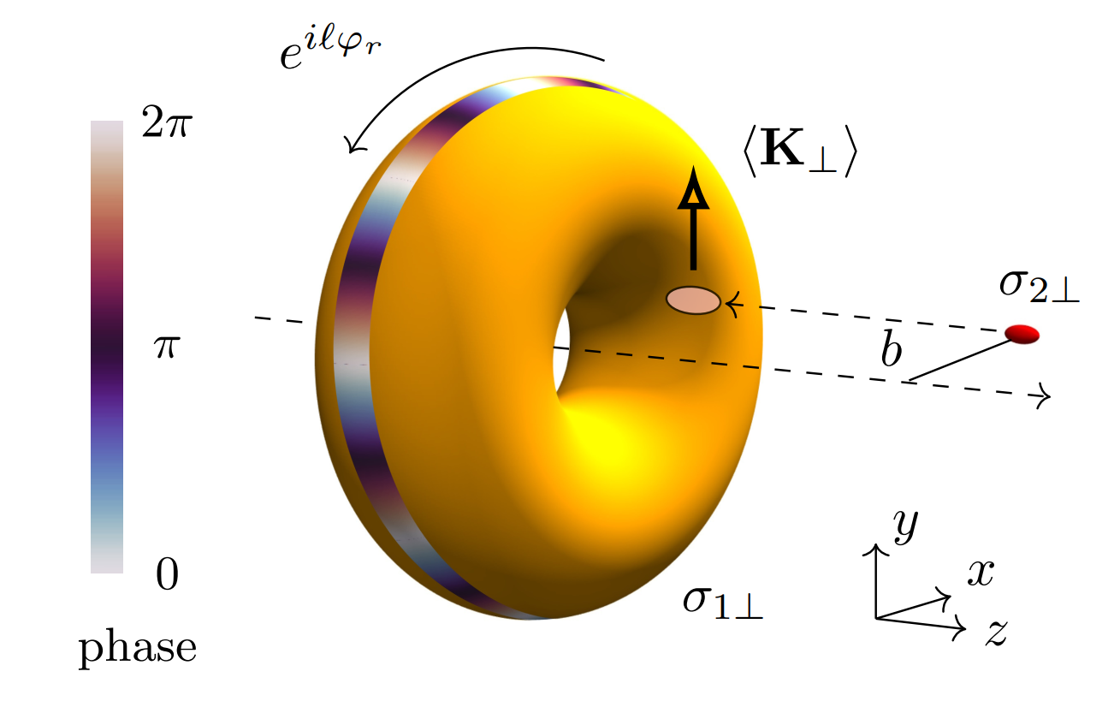
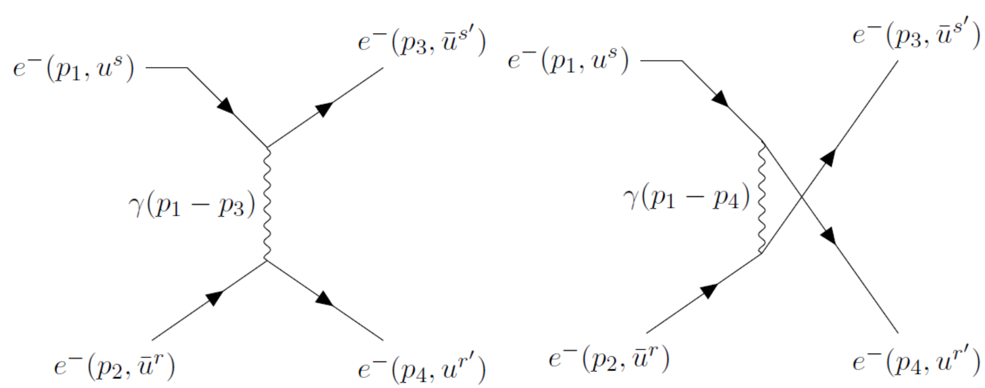
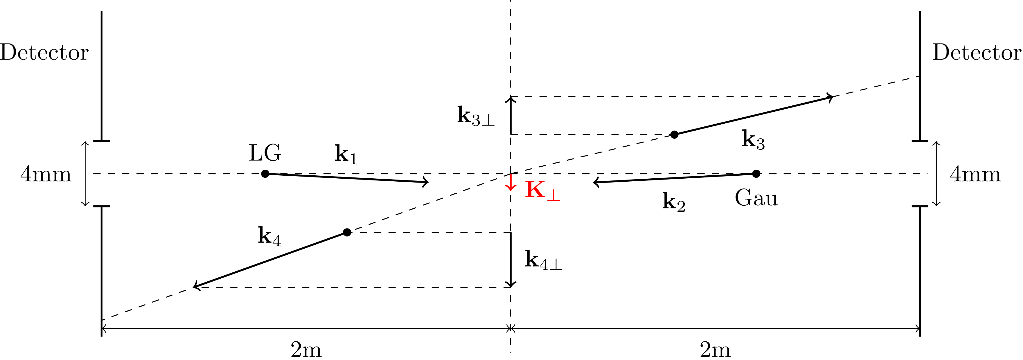
Proof-of-Principle Experiment
Møller Scattering: $e^{−}e^{−}→e^{−}e^{−}$
A broad LG and a compact Gaussian wave packets collide at non-zero impact parameter $b$ along axis $x$
The detectors installed close to the beam axis capture the scattered electrons in coincidence and measure their deflection angles.
The total final transverse momentum $K_{⊥}=k_{3⊥}+k_{4⊥}$ can be determined on event-by-event basis
Notes:
Here is our experimental proposal.
We will illustrate the idea with Møller scattering , and this is the feynman diagram of moller scattering.
A broad LG and a compact Gaussian wave packets of the transverse sizes
of σ1⊥ and σ2⊥ collide at a non-zero impact parameter b along axis x.
Here is the experimental layout.
we expect that
The average value of K_total
is non-zero and, remarkably, orthogonal to b⊥.
And ⟨K⊥⟩ can be much larger than the typical transverse momentum of
the LG state.
This effect is known as the superkick effect.

Slide 6
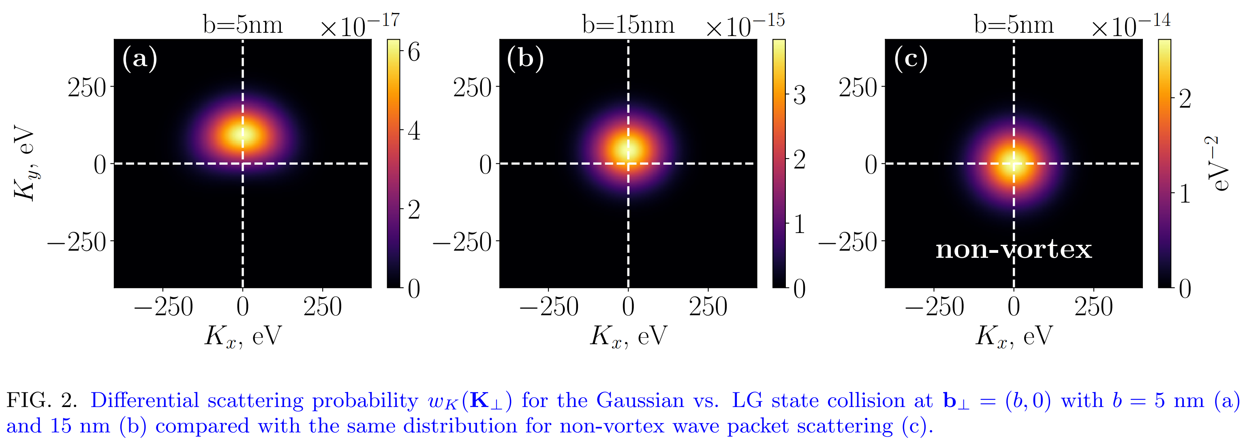
Numerical Study
We undertook a numerical study of Møller scattering of an LG and a Gaussian wave packets using the exact expressions for the wave functions and scattering amplitude
$p_{1z}=−p_{2z}=10$MeV, $j_{z}=\frac{7}{2}$ (unpolarized), $σ_{1⊥}=10$nm, $σ_{2⊥}=2$nm
Shift of the center of the momentum $K_{⊥}$
Orthogonal to $b_{⊥}$
Without vortex phase factor, the center does not move
Notes:
To validate our ideas,
We undertook a numerical study of Møller scattering of an LG and a Gaussian wave packets using the
exact expressions for the wave functions and scattering amplitude.
Here we calculate the differential probability with respect to the total transvers momentum.
These are the parameters we used in our calculation.
In Fig. 2(a),(b), we show wK for b = 5 and 15 nm, We observe a sizable shift of the intensity peak towards positive Ky values, which is orthogonal to bx.
To demonstrate that ⟨K⊥⟩ ⊥ b⊥ is indeed an unmistakable feature of a phase vortex,
in Fig. 2(c) we show the same wK(K⊥) computed for a non-vortex state which lacks the vortex phase factor in momentum space.
As expected, off-axis collision of non-vortex states can not generate the ⟨K⊥⟩ orthogonal to b⊥.

Slide 7
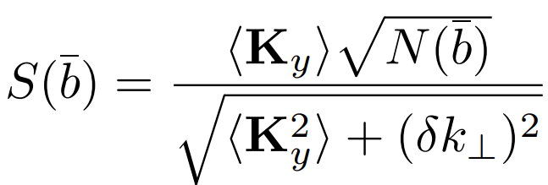
Feasibility Study
Realistic experiment：
16nA electron beams running ${10}^{3}$s
${N_{0}=10}^{14}$ electron collision attempts
transverse jitter:
Average the differential probability around $\overline{b}$ with radius $2σ_{2⊥}$
Limited statictics:
Average scattering events at $\overline{b}$ : $N\left(\overline{b}\right)=N_{0}W(\overline{b})$
Uncertainty final momentum:
The detector pixel size $20μm$
Transverse momentum uncertainty $δk_{⊥}=100$eV
Consider all these imperfections:
Statistical significance is defined to measure the confidence that $\left\langle K_{y}\right\rangle$ is nonzero
The effect to be clearly visible if $S>5$
Notes:
In the previous page ,all of the situations are ideal.
unlimited statistics, absolutely stable beams, and perfect final electron momentum measurement. In a realistic experiment, these conditions will not be met.
First, we considerd the transverse jitter, event-by-event fluctuations of the impact parameter b⊥ .
We averaged the differential probability around $\overline{b}$with radius $2σ_{2⊥}$
To considerd the Limited scattering events，we integrate ¯ wK with respect to K⊥ and obtain the total scattering probability W (¯b).
we consider electron beams at the average current of 16 nA, and an experiment running for 103 seconds
So there are 1014 electron collision attempts; at b ∼ σ1⊥, we expect to detect ∼ 104 events.
Then we considered the Uncertainty of final momentum. Here we supposed that the detector pixel size is 20 um. That correspond to the scattered electron transverse momentum uncertainty delta k is around 100eV.
Given all these imperfections and limited statistics, a Statistical significance is defined to measure the confidence that $\left\langle K_{y}\right\rangle$ is nonzero
Although the superkick effect is expected to be the strongest at b ≪ σ1⊥, the very low scattering probability makes this effect poorly visible. For b around sigma1, this effect is decreased, but the scattered event is more, the statistical significance grows well above 5 and makes the effect clearly visible.

Slide 8
Conclusions
We described a novel, superkick-based method to unmistakably detect the vortex state of a high-energy electron.
Numerical calculations taking into account experimental imperfections confirm that the effect can be detected in a realistic experimental setting.
Such a proof-of-principle experiment will support the proposal and, at the same time, demonstrate for the first time the reality of the superkick effect itself.
Notes:
Here are some conclusions.

Slide 9
Thank you!

