Slide 1
Entanglement & Nonlocality A Prelude from a no energy physicist
Peking University
Workshop on Quantum Entanglement at the Energy Frontier
26 April 2025
KAM, Chonfai
dubussygauss@gmail.com

Slide 2
Want to know more? Read my book, and the physics today article regarding Wu’s first experiment on photon experiment!

Slide 3
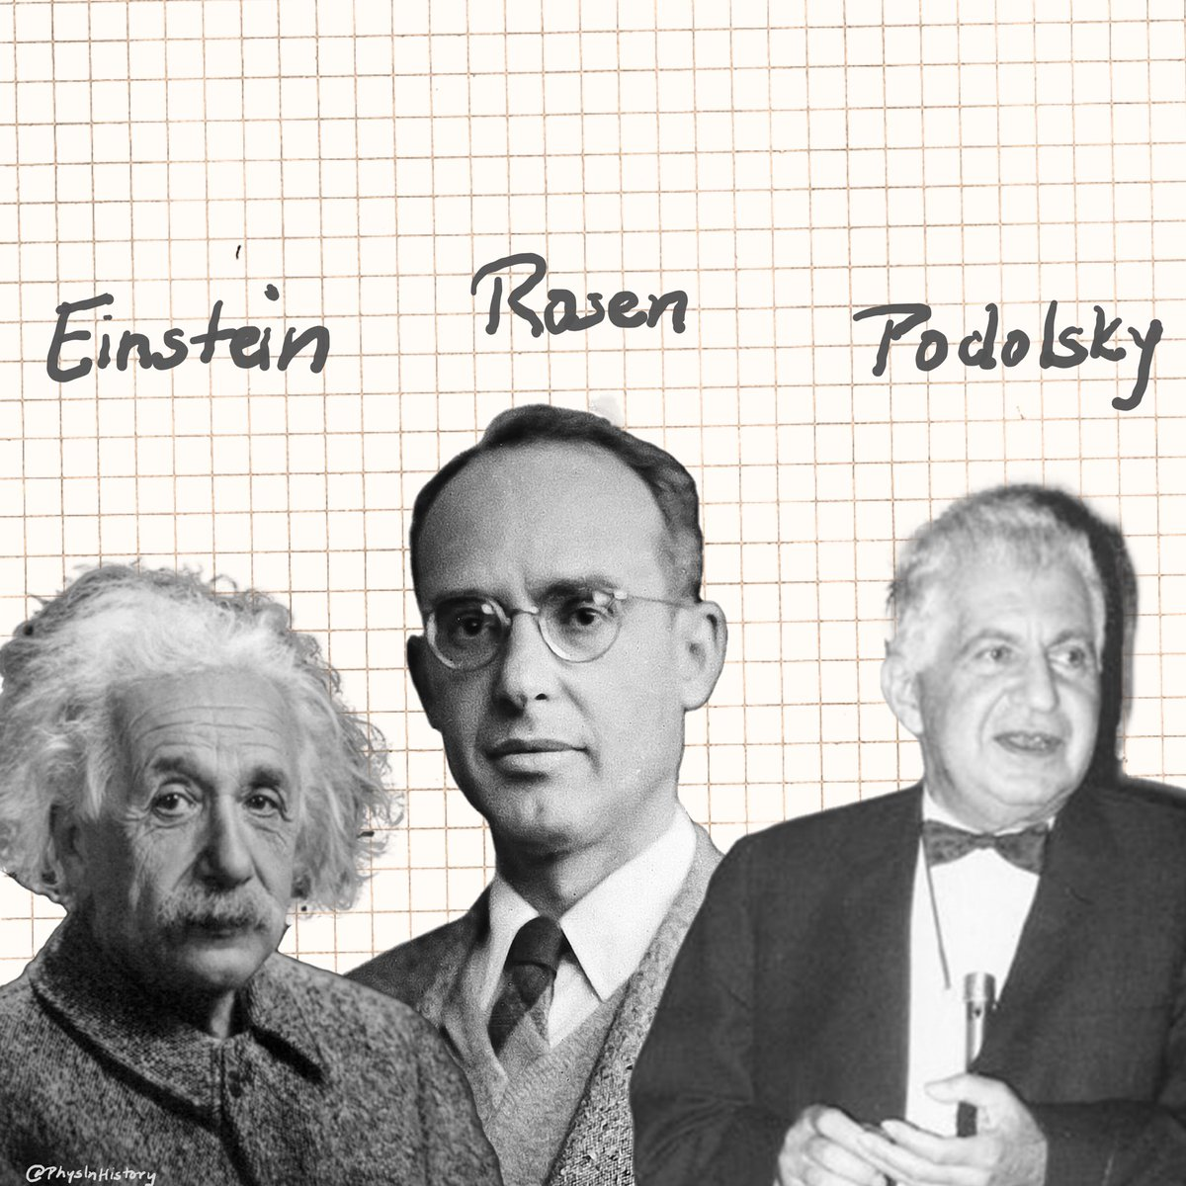
(EPR Paradox, 1935)
momentum: p
momentum: - p
position: x
Position: x+L
The probability overlap between any quantum particles, may be very small, but never zero. The non-zero behavior is how information shared by two quantum particles.
Spukhafte Fernwirkung,
“spooky action at a distance”

Slide 4
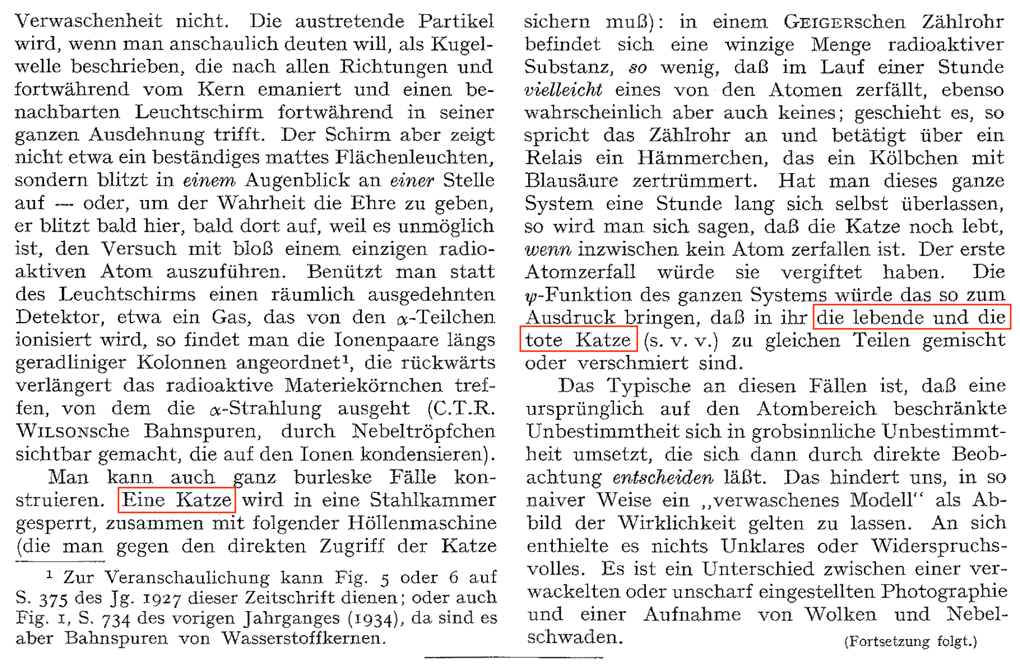
Schrödinger:A cat alive and dead?
Shortly after EPR paper, Schrödinger wrote another paper. He described alive and dead cat.
He used Verschränkung (entanglement) to describe spooky action at a distance in a letter to Einstein the same year.
The first one!

Slide 5
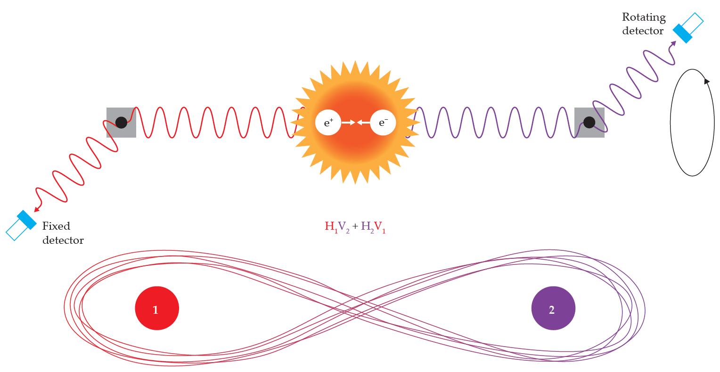
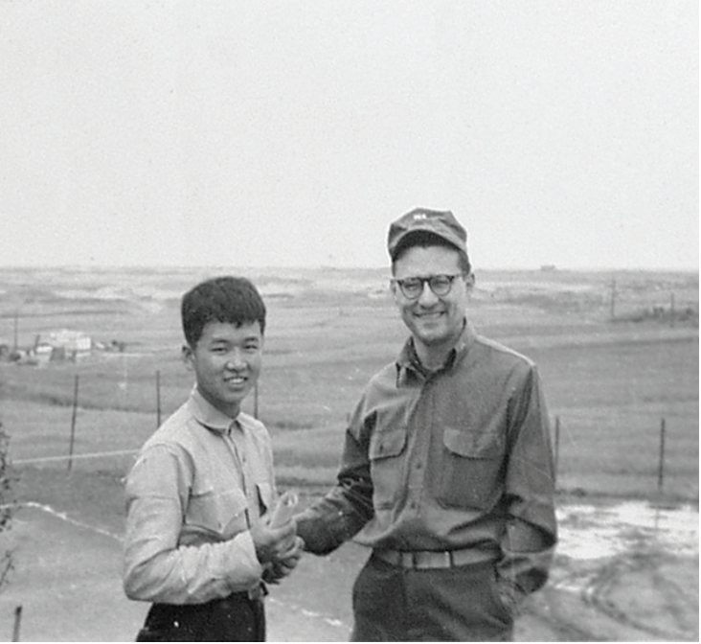
(Wu- Shaknov, 1950) The FIRST photon entanglement experiment, 15 years after the EPR paper
Photons are quantum particles
1935, EPR (theory)
1946, John Wheeler (theory)
1949, Wu and Shaknov (experiment)

Slide 7
“Quantum entanglement occurs when two systems share a common quantum mechanical state.”
Nonclassical, Indefinite,
Non-separable…
“Quantum entanglement is a physical resource, like energy, associated with the peculiar nonclassical correlations that are possible between separated quantum systems.”
All negative descriptions
“Quantum entanglement … a pair of particles are generated in such a way that the individual quantum states of each are indefinite until measured, and the act of measuring one determines the result of measuring the other...”
Is there a positive definition of quantum entanglement?
“Quantum entanglement is the phenomenon where the quantum state of each particle in a group cannot be described independently of the state of the others.”

Slide 8
?
(Intrinsic)
Entanglement
Nonlocality
(Extrinsic)
Lev 1 Definition:
Entangled states are non-product states
Lev 1 Definition:
Non-local states are those without “element of reality”
Lev 2 Definition: Entangled states as SLOCC classes
Lev 2 Definition:
Non-local states are those violate Bell inequalities
?
Lev 3 Definition:
?
Lev 3 Definition:
Non-local states are sheaves without global sections

Slide 9
Entanglement: Level 2
Schmidt decomposition
Bipartite:
r = 1, product state;
r > 1, entangled state
S_{k}
S_{k-1}
Onion Structure
⋮
S₁

Slide 10
Entanglement: Level 2
Multipartite:
Canonical Polyadic (CP) decomposition
[1]
Open Problem: Is there a quantum algorithm exists for efficiently determining the CP rank of a general multipartite entangled state?
[1] Hillar, C. J., & Lim, L. H. (2013). Most tensor problems are NP-hard. Journal of the ACM (JACM), 60(6), 1-39.

Slide 11
Segré Variety
Bipartite:
Segré Variety: The common zero locus of homogeneous polynomials of degree 2:
(*)
Segré Embedding:
Concurrence

Slide 12
Multipartite:
Duality: Point in X ↔ Plane in Y; Point in Y ↔ Plane in X
(Not full-rank)
Tri-qubit Hyperdeterminant:
Det(B) ≠ 0: Genuinely Entangled

Slide 13
Nonlocality: Level 2
Bipartite:
Bell-CHSH inequality
Bell state → Maximal violation
Exact computation of the finite-dimensional Grothendieck constant K_{G}(d) is NP-hard for general d [2]
[2] Briët, J., Regev, O., & Saket, R. (2015, October). Tight hardness of the non-commutative Grothendieck problem. In 2015 IEEE 56th Annual Symposium on Foundations of Computer Science (pp. 1108-1122). IEEE.

Slide 14
Quantum Rigidity
Bell state ← Maximal violation
Quantum Rigidity: any quantum state satisfying these conditions must be a maximally entangled Bell state, modulo local unitary transformations
Moreover, any slight deviation from the Tsirelson bound results in only minor variations from the Bell state.

Slide 15
Mermin inequality
Mermin Polynomial
Why?
Det(GHZ_{n}) = 0 (n > 3)
Mermin inequalities, which involve GHZ states, do not exhibit quantum rigidity

Slide 16
Five-qubit “Bell” Inequality with Rigidity
Acín Polynomial [3]
[3] F. Baccari, R. Augusiak, I. Šupic and A. Acín Physical Review ´ Letters, 125, 260507 2020

Slide 17
Five-qubit Code
Five-qubit code: Simultaneous eigenstate of four commuting stabilizer operators
?

Slide 18
Five-qubit “Bell” Inequality with Rigidity
Rigidity!

Slide 19
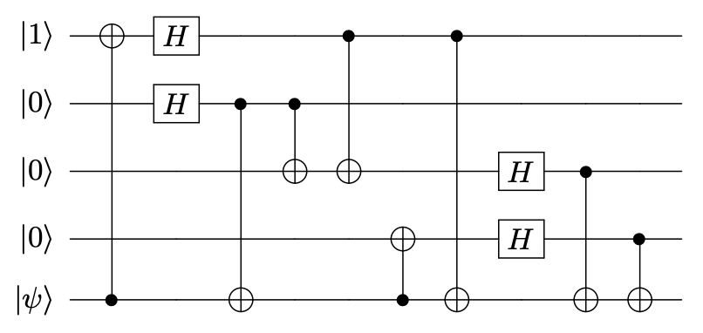
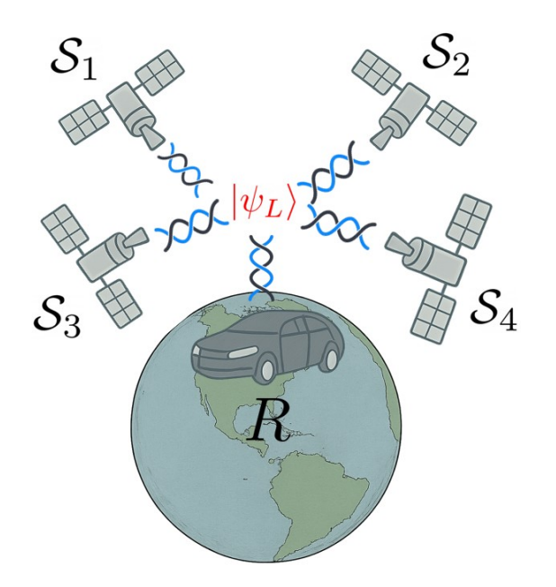
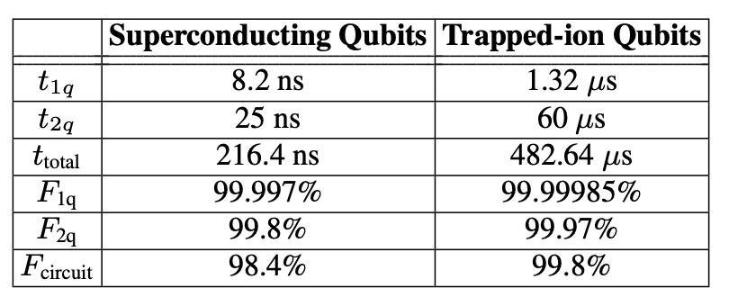
Application: Quantum-Secured Device-Independent GPS [4]
1. No cloning
2. No tampering
[4] Kam, C. F., & Kuo, E. J. (2025). Quantum-Secured Device-Independent Global Positioning System. arXiv preprint arXiv:2504.08465.

Slide 20
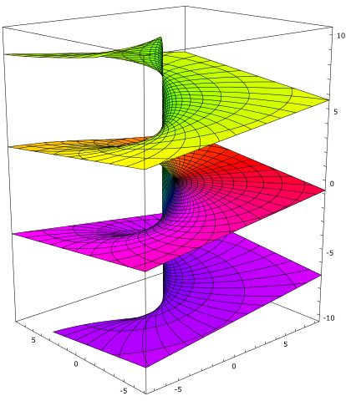
What is sheaf?
Sheaf theory: the general theory for gluing consistent local data on overlapping sets as a coherent global data.
Set
Local Data
Global Data
Neighboring disks
Converge power series on a disk
Entire complex function extended across Riemann sphere
The analytic continuation of complex functions consists of one of the earliest motivating examples of sheaf of continuous functions, or more precisely, holomorphic functions.

Slide 21
What is sheaf?
Some poetic or surreal writing deliberately plays with this idea.
This can be seen in avant-garde poetry, dream-like storytelling
Peter is sawing the sky through the telescope
Breakdown in semantic continuity
Peter is losing the duck through the telescope
Set
Local Data
Global Data
collection of statements
linguistic neighborhood
logically consistent and meaningful statement
The linguists have used the sheaf theory for decades in natural language processing.

Slide 22
What is sheaf of sections?
For Möbius band, no global continuous section—the twisting prevents such a choice. However
Locally sections exist over small open sets
Local sections can be patched together, but not always globally
The sheaf captures this obstruction and helps determine global properties
Set
Local Data
Global Data
S¹/ Base Space
Line segment [0,1]/ Local gauge field
Mobius band/ Global gauge field
Sections describe fields in physics

Slide 23
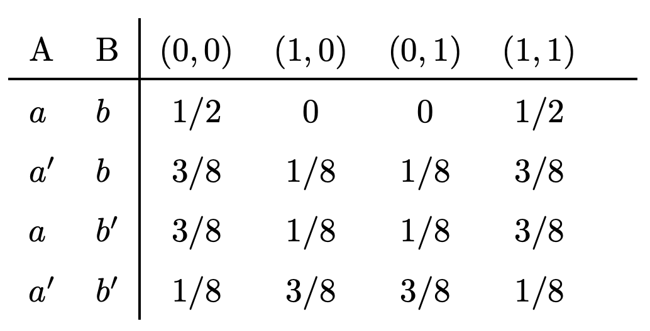
Nonlocality: Level 3
Bell Scenario
Context C
Outcome O
Event O^{C} (section)
Probability Distribution

Slide 24
Nonlocality: Level 3
Sheaf of sections: a table of events/ joint probabilities,
Local Sections: probability distributions for outcomes restricted to a subset of observers.
Global section: the existence of a single global probability distribution across all settings, explained by deterministic hidden variables.
Bell inequalities: no global section exists for quantum correlations [5]
This gluing property makes presheaf a sheaf
[5] Abramsky, S., & Brandenburger, A. (2011). The sheaf-theoretic structure of non-locality and contextuality. New Journal of Physics, 13(11), 113036.

Slide 25
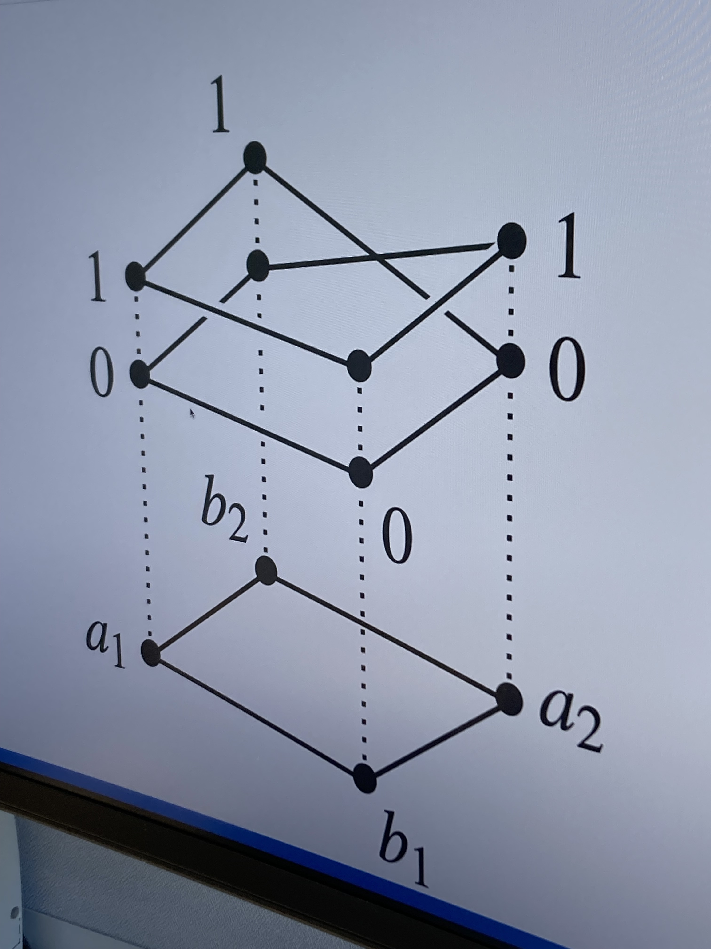
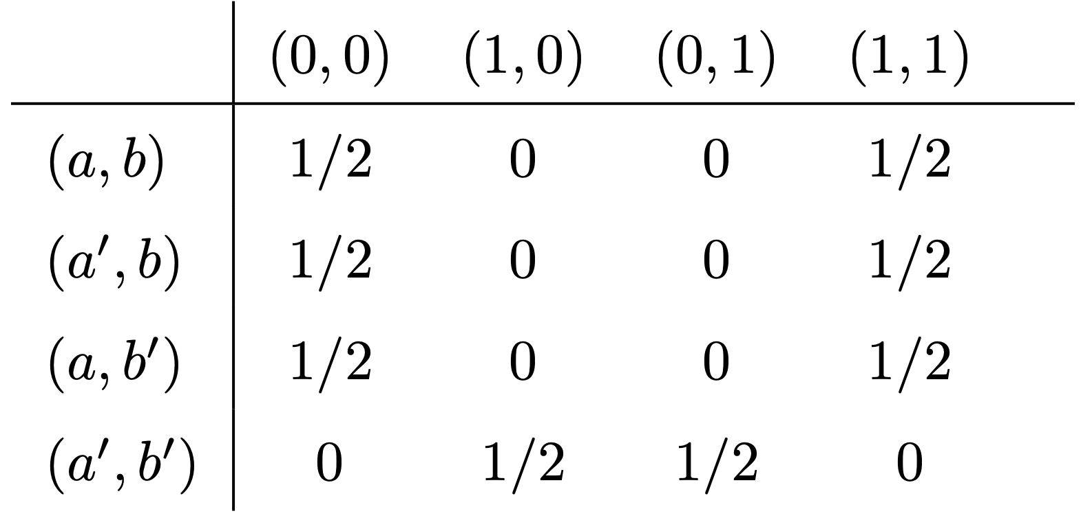
Nonlocality: Level 3
PR Box
Our old friend: Mobius band!
Global section does not exists!

