Slide 1
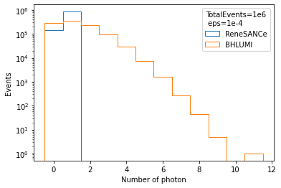
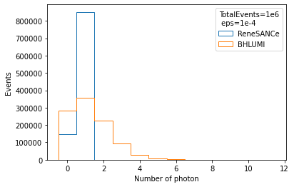
The Photon Number Distribution of BHLUMI&ReneSANCe
(log y axis)
eps:=infrared cut of soft real photons,E_γ>eps/2*√s
In ReneSANCe,only 1 photon emittance is allowed.
In BHLUMI,multiple photon emittance is included,Possion ditributed.

Slide 2
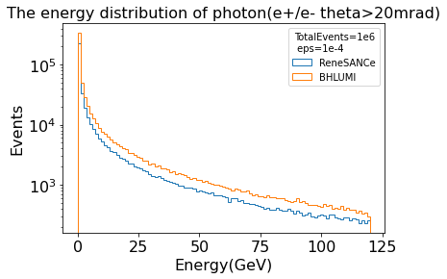
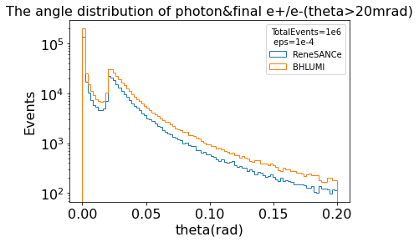
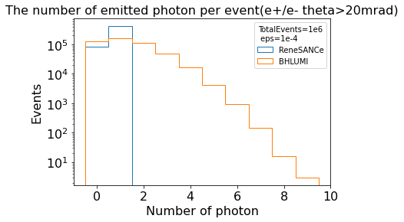
No difference

Slide 3
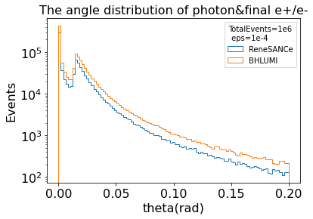
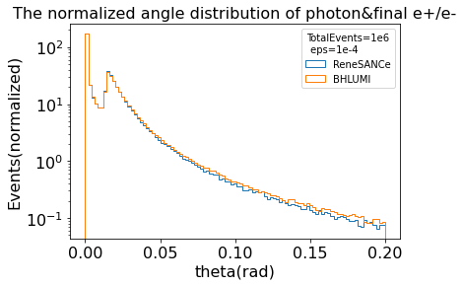
The angle(γ&final e+/e-)ditribution
e+/e- theta cut:>0.0136rad
Normalization means choose a factor to force the total photon number of BHLUMI to equal with ReneSANCe.
The shape almost coincide after normalization
The 2nd peak due to e+/e- theta cut(FSR)

Slide 4
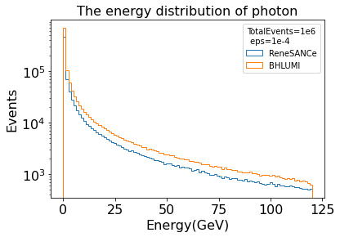
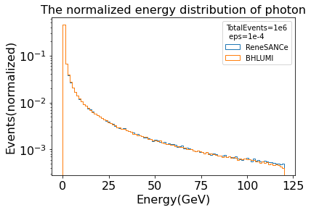
The γ energy ditribution
eps:=infrared cut of soft real photons,E_γ>eps/2*√s

Slide 5
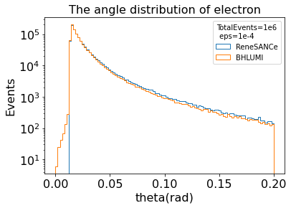
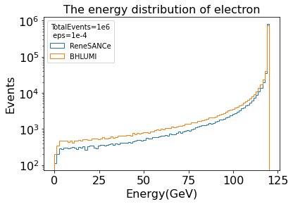
Electron distribution
Difference due to electron contribution below theta cut in BHLUMI

Slide 6
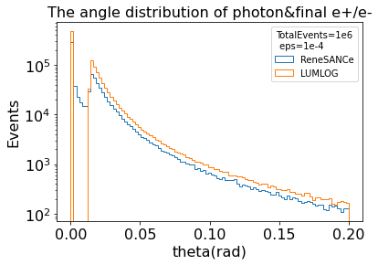
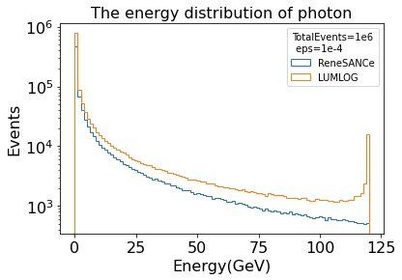
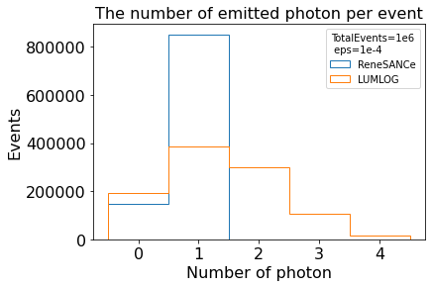
LUMLOG(Sub-generator of BHLUMI)

Slide 7
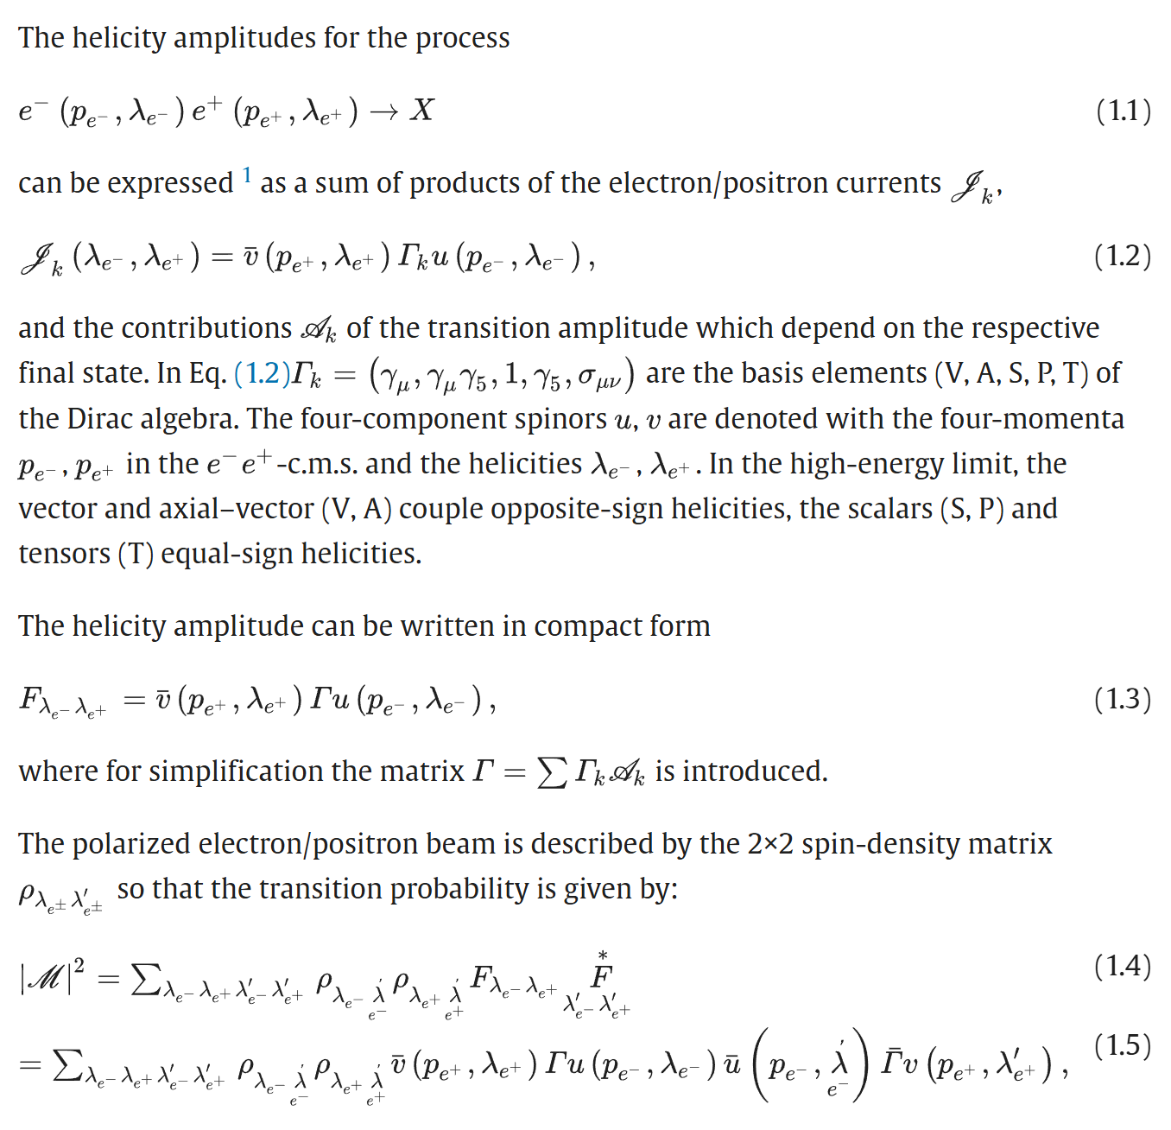
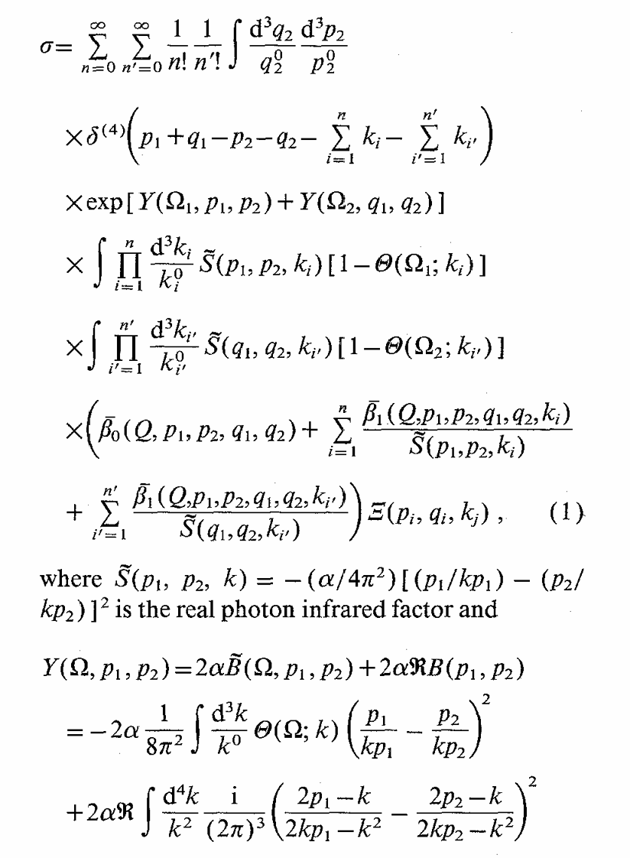
Master formula
ReneSANCe
No specific formula for bhabha
Ref.
multiphoton generator of BHLUMI
n photon is allowed,but only O(alpha^3) is caculated

Slide 8
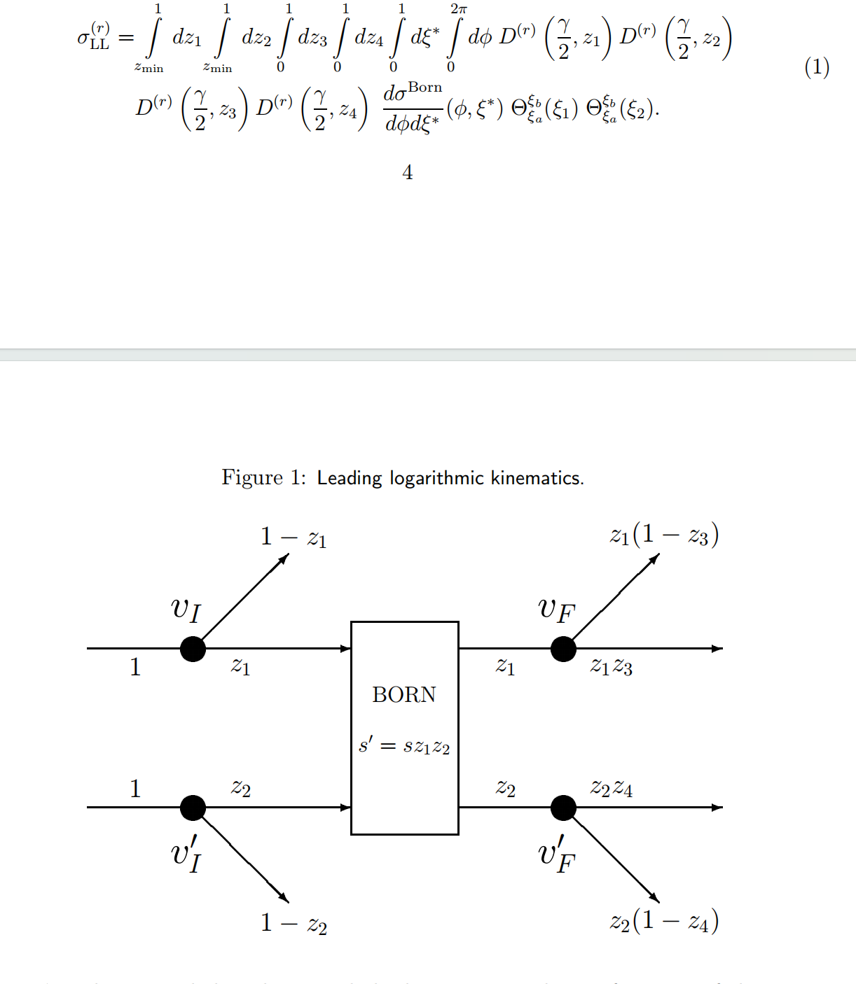
Master Formula
LUMLOG

