Slide 1
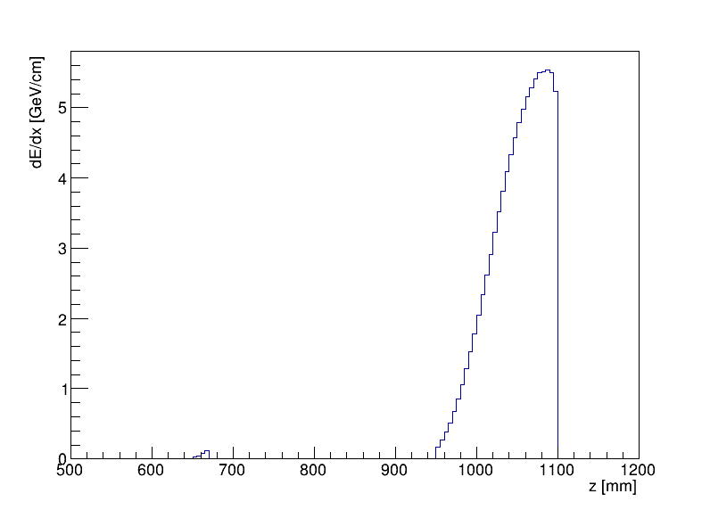
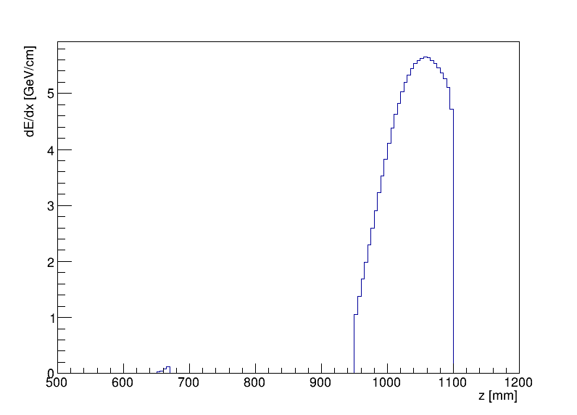
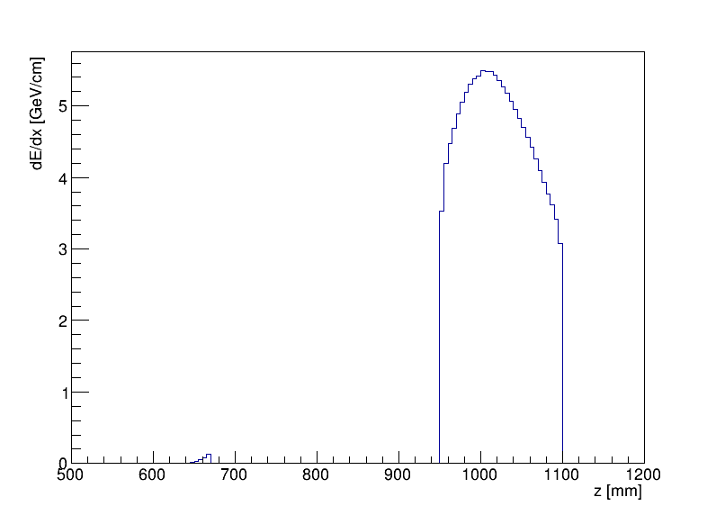
LumiCal $dE/dx$ at different theta
Theta = 1.3 deg
Theta = 1.4 deg
Theta = 1.5 deg
$$560 mm×\tan{1.4 deg}≈13.7 mm$$
$$900 mm×\tan{1.4 deg}≈22.0 mm$$
Maximum at theta between
1.4 deg and 1.5 deg

Slide 2
Theta = 1.5 deg
Theta = 1.4 deg

Slide 3
TwoGam (BesTwoGam)
$$e^{+}+e^{−}→e^{+}+e^{−}+e^{+}+e^{−}$$
其他还可以产生：
$$μ^{+}μ^{−}, τ^{+}τ^{−}, q\overline{q}$$
(pic from DIAG36)
$$\sqrt{s}=240 GeV$$
ptcut 0.8
w2min 0.01
IRAD 0
ptcut Threshold between high-Pt (QCD) and low-Pt models (QPM,VDM)
w2min is the lower limit on the SQUARE of the invariant mass of the produced system
IRAD initial state radiation

Slide 4
TwoGam (BesTwoGam)

Slide 5
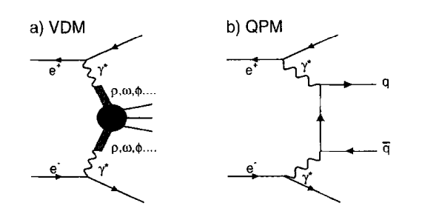
Total cross section ...............: 9496. +/- 500. nb
Total cross section after user cuts: 9496. +/- 500. nb
Total QPM cross section: 9496. +/- 500. nb
Total VDM cross section: 0.000 +/- 0.00 nb
Total QCD cross section: 0.000 +/- 0.00 nb
QPM : Quark Parton Model
Ref : Measurement of the cross-section for the process γ∗γ∗ → hadrons at LEP,
https://doi.org/10.1016/S0370-2693(99)00278-6
VDM : Vector Dominance Model
Dominant if the virtuality of the two photons satisfy
$Q_{1}^{2}≈Q_{2}^{2}≈0$

Slide 6
TwoGam (BesTwoGam)
$\sqrt{s}=240 GeV$ w2min = 0.01 DOUCUT FALSE
No tag
$$σ=9496 ±500 nb$$
Single tag
T1MIN = 1.228 deg
T1MAX = 178.872 deg
$$σ=0.6959±0.0609 nb$$
Double tag
T1MIN = T2MIN = 1.228 deg
T1MAX = T2MAX = 178.872 deg
$$σ=(3.836±0. 115)×{10}^{−3} nb$$
(y = 12 mm at z = 560 mm)

Slide 7
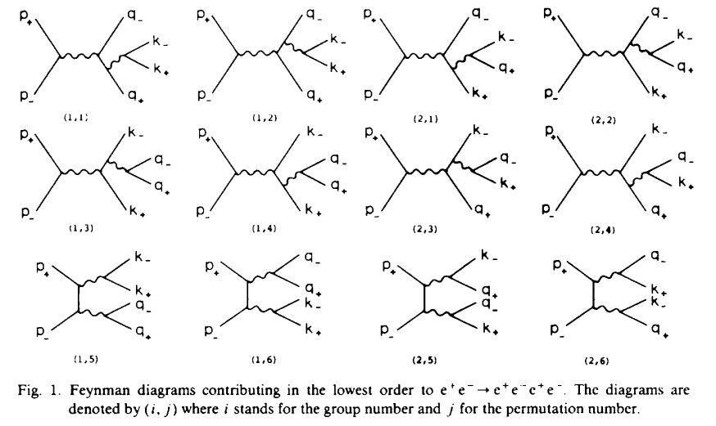
DIAG 36
Subgenerator A “Multiperipheral” “多边”
Subgenerator B “Bremsstrahlang” “轫致辐射”
Subgenerator D “Annihilation” “湮灭”
Subgenerator C “Conversion” “转化”

