Slide 1
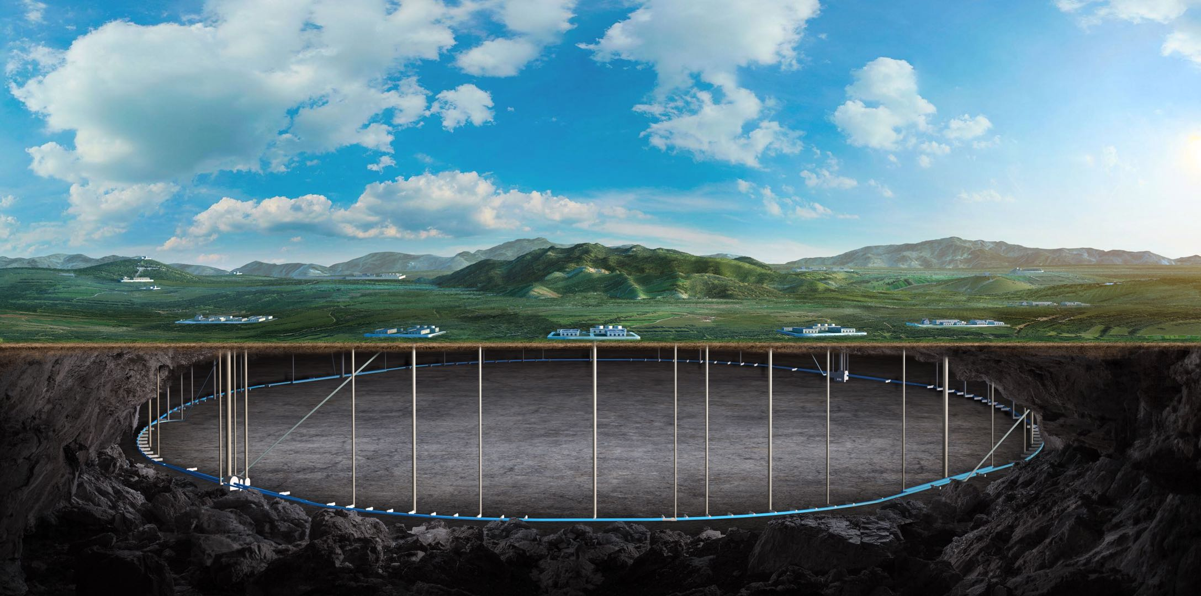
CEPC MDI SC magnet cryostat design
Xiaochen Yang, Xiangzhen Zhang
2024.12.11
Cryogenics Group, Accelerator Division Institute of High Energy Physics(IHEP)

Slide 2
Content
Introduction
Weight optimization of the cryostat
Summary

Slide 3
1. Introduction
In CEPC, there are two combined-function Superconducting magnets in MDI
Each combined-function magnet includes double aperture high gradient quadrupole (Q1a, Q1b, Q2) and anti-solenoid, around each side of the IP point.
The cryostat is used to provide the cryogenic environment for SC magnets, which is below 5.0 K.
ITEM | Q1a | Q1b | Q2 | Anti-solenoid
Central field gradient (T/m) | 142.3 | 85.4 | 96.7
Cooling type | LHe | LHe | LHe | LHe
Operating current (A) | 780 | 650 | 770 | 1300
Magnetic storage energy (KJ) | 16.7 | 15.2 | 32.1 | 730
Cross section parameter (mm) | Φ40~61 | Φ52~78 | Φ62~88 | 70 sections
Magnet mechanical length (m) | 1.23 | 1.23 | 1.53 | 5.1
Net weight (Kg) | 25 | 32 | 43 | 302
Total weight of magnets (Kg) |  |  |  | 402
From Yingshun Zhu

Slide 4
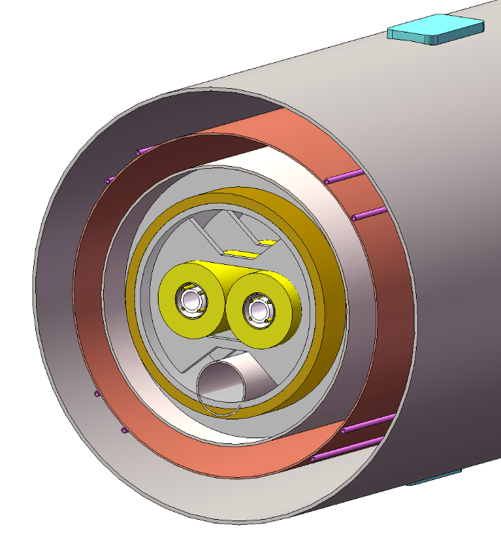
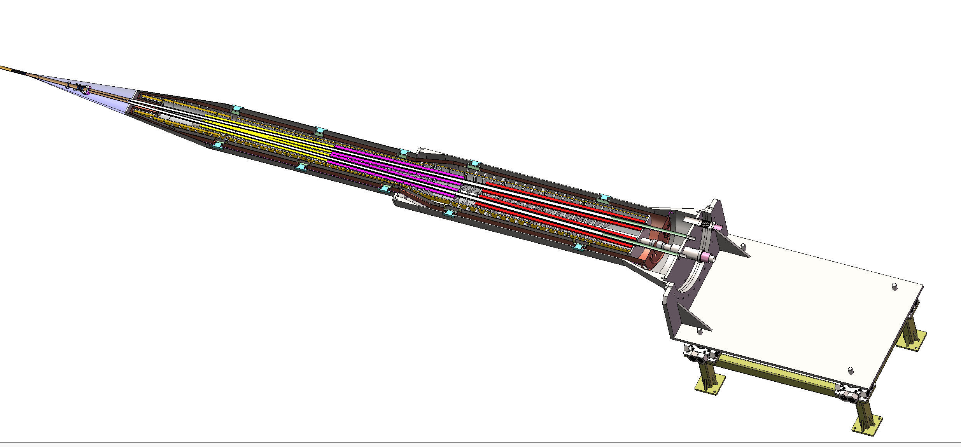
1. Introduction
Cryostat of SC magnet
The superconducting magnets Q1a,Q1b and Q2 are supported on the inner wall of the solenoid.
The anti-solenoid is supported by a ring on the inner wall of the helium tank.
Vacuum
Thermal shield
1985mm
LHe tank
1915mm
Support
Anti-solenoid
2885mm
Anti-solenoid
Q1a
Beam chamber
Q1a
Q1b
Q2
Notes:
标注尺寸

Slide 5
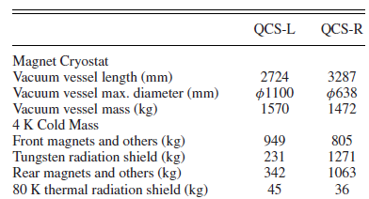
2. Weight optimization of the cryostat
before
Items | Weight (kg) | Main materials
Vacuum vessel | 1184 | SS
Helium Vessel | 195 | SS
Thermal shield and pipes | 148 | copper
SC quadrupoles | 100 | Copper & Aluminum
Anti-solenoids | 302 | Copper & Aluminum
Skeleton supports | 92 | Aluminum
Liquid Helium | 90 | Liquid Helium
Total weight | 2111
Cryostat length: 5.75 m
Total weight: 2.111 ton
SuperKEKB
The vacuum vessel is the primary optimization target.
Notes:
标注尺寸

Slide 6
2. Weight optimization of the cryostat
after
Items | Weight (kg) | Main materials
Vacuum vessel | 510 | Ti
Helium Vessel | 74 | SS
Thermal shield and pipes | 43 | Aluminum
SC quadrupoles | 100 | Copper & Aluminum
Anti-solenoids | 302 | Copper & Aluminum
Skeleton supports | 92 | Aluminum
Liquid Helium | 90 | Liquid Helium
Total weight | 1109
Cryostat length: 5.75 m
Total weight: 1.109 ton
Notes:
标注尺寸

Slide 7
2. Weight optimization of the cryostat
Commonly used metals in vacuum system manufacturing:
Low carbon steel, stainless steel, copper, aluminum, tungsten, niobium, titanium, indium, etc.
 | 密度 (Kg/m³) | 强度（MPa） | 屈服点（MPa） | 弹性模量（MPa） | 比强度（N·m/kg）
2024-T0 Al | 2770 | 145 | 130 | 71000 | 0.052
Low carbon steel | 7780 | 230 | 195 | 190000 | 0.029
Aluminum | 2698 | 75 | 80 | 42000 | 0.027
Aluminum alloy | 2698 | 180 | 100 | 71000 | 0.06
Copper | 8960 | 200 | 70 | 108000 | 0.022
Titanium | 4540 | 275 | 344 | 67000 | 0.060
Titanium alloy | 4540 | 680 | 800 | 104000 | 0.149
304 Stainless Steel | 7900 | 603 | 270 | 206000 | 0.076
Indium | 7330 | --- | --- | ---
Notes:
标注尺寸

Slide 8
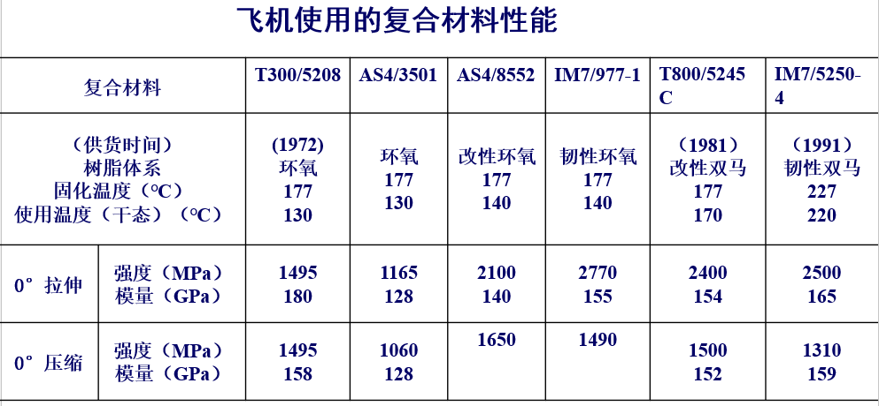
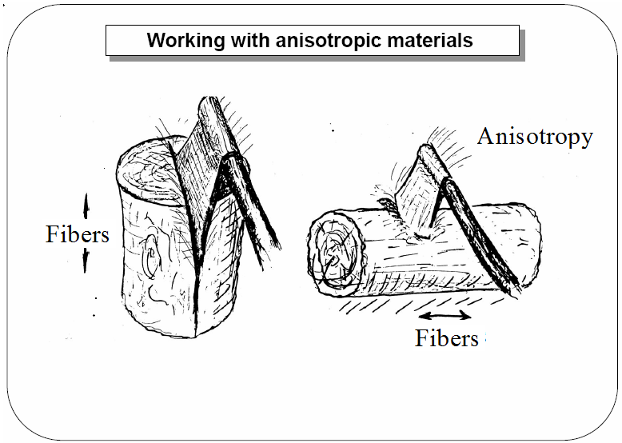
2. Weight optimization of the cryostat
Carbon fiber and its composite materials
 | 密度 (Kg/m³) | 强度（MPa） | 屈服点（MPa） | 弹性模量（MPa） | 比强度（N·m/kg）
304 Stainless Steel | 7900 | 603 | 270 | 206000 | 0.076
Carbon composite materials | ~1500 | 2000 | --- | --- | 2
Notes:
标注尺寸

Slide 9
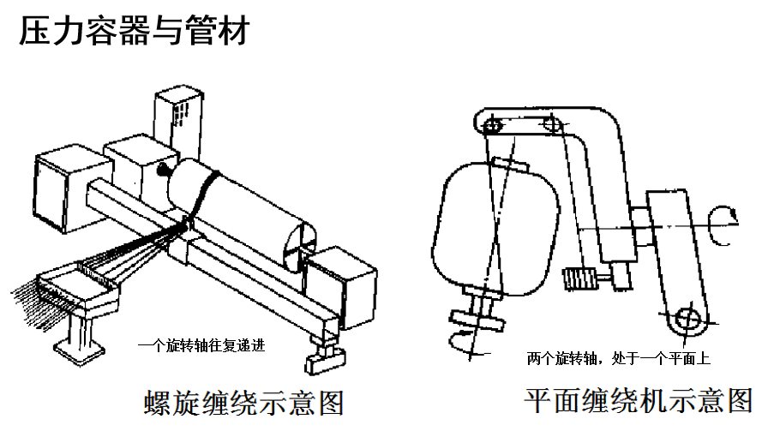
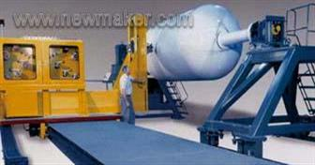
2. Weight optimization of the cryostat
Carbon fiber and its composite materials
缺点：
Surface floating carbon
Poor machinability
Anisotropic
Poor vacuum flange sealing performance
Notes:
标注尺寸

Slide 10
2. Weight optimization of the cryostat
根据GB/T 150.3-2011压力容器厚度的计算
Vacuum vessel
计算条件
压力${ p}_{c}$ | 1 | MPa
温度 t | 300 | K
内径 $D_{i}$ | 472&626 | mm
负偏差 $c_{1}$ | 0.3 | mm
腐蚀裕量 $c_{2}$ | 0.00 | mm
焊接接头系数 $∅$ | 0.8 | ---
计算厚度：$δ=\frac{{ p}_{c}D_{i}}{2\left[σ\right]∅−{ p}_{c}}=1.29/1.7$
名义厚度：$δ_{n}=2/2$
有效厚度：$δ_{e}=δ_{n}$- $c_{1}$- $c_{2}=1.7/1.7$
950mm
1915mm
2885mm
472mm
626mm
3mm
3mm
Materials: Ti
Weight: 340kg
Notes:
标注尺寸

Slide 11
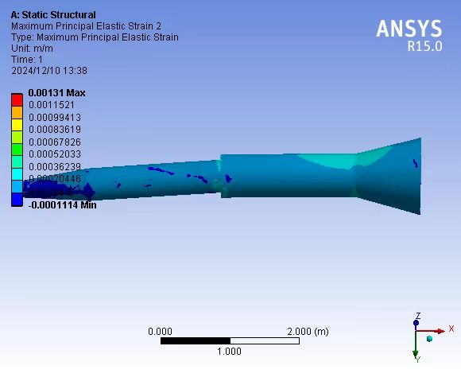
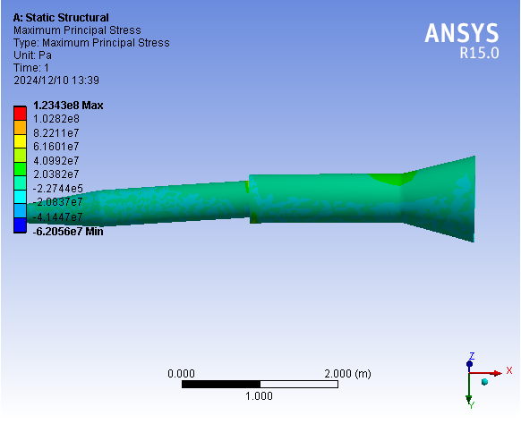
2. Weight optimization of the cryostat
Vacuum vessel
Thickness:2mm
Max stress:
123MPa
Max strain:
0.0013m/m
Notes:
标注尺寸

Slide 12
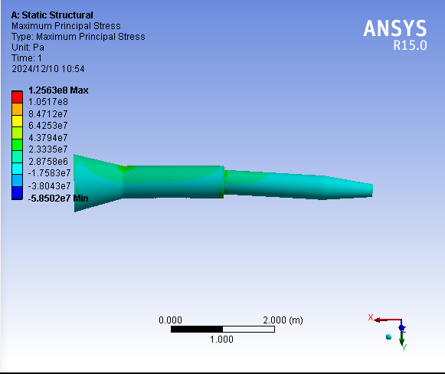
2. Weight optimization of the cryostat
Vacuum vessel
Thickness:3mm
Max stress:
120MPa
Max strain:
0.0005m/m
Notes:
标注尺寸

Slide 13
2. Weight optimization of the cryostat
根据GB/T 150.3-2011压力容器厚度的计算
Helium tank
计算条件
压力${ p}_{c}$ | 1 | MPa
温度 t | 4 | K
内径 $D_{i}$ | 298&454 | mm
负偏差 $c_{1}$ | 0.3 | mm
腐蚀裕量 $c_{2}$ | 0.00 | mm
焊接接头系数 $∅$ | 0.8 | ---
计算厚度：$δ=\frac{{ p}_{c}D_{i}}{2\left[σ\right]∅−{ p}_{c}}=0.61/0.95$
名义厚度：$δ_{n}=2/2$
有效厚度：$δ_{e}=δ_{n}$- $c_{1}$- $c_{2}=1.7/1.7$
2800mm
2300mm
298mm
454mm
2mm
2mm
Materials: Ti
Weight: 79kg
Notes:
标注尺寸

Slide 14
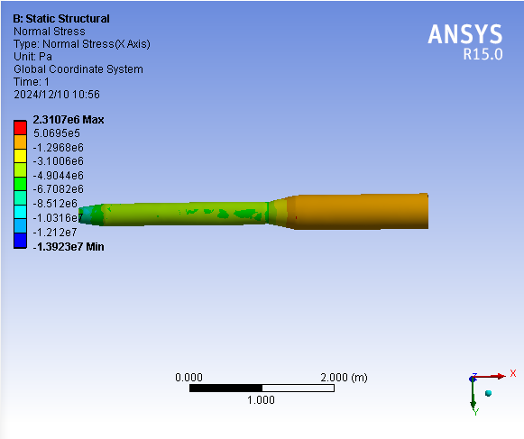
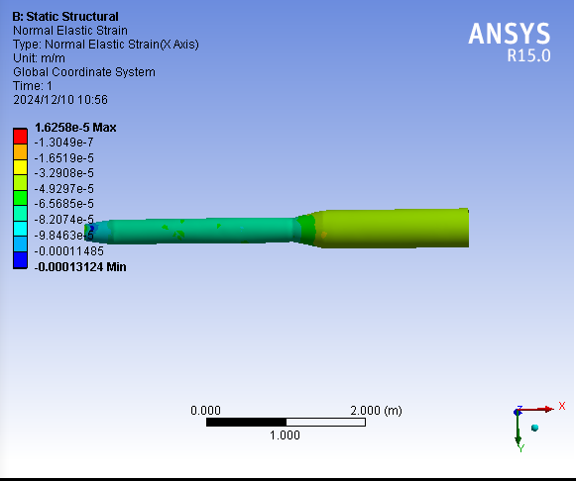
2. Weight optimization of the cryostat
Helium tank
Max stress:
2.3MPa
Max strain:
0.016mm/m
Notes:
标注尺寸

Slide 15
2. Weight optimization of the cryostat
Thermal shield
Materials: Copper
Weight: 148kg
Materials: Aluminum
Weight: 43kg
Notes:
标注尺寸

Slide 16
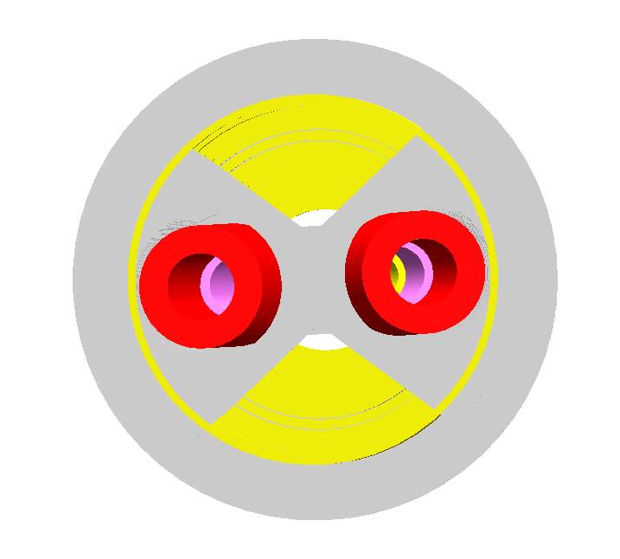
2. Weight optimization of the cryostat
Skeleton supports Weight: 142kg
Skeleton supports Weight: 92kg
Support of SC magnet
Notes:
标注尺寸

Slide 17
Summary
Design status of cryomodule:
The cryostat weight has been optimized to be approximately 1.109 tons.
The strain and stress has been calculated and checked, which meets the requirement.
 | Main materials | Weight (kg) | Strain(m/m) | Stress(MPa) | Temperature difference(K)
Vacuum vessel | Titanium alloy | 340 | 5E-4 | 125 | ----
Helium Vessel | Titanium | 79 | 1.6E-5 | 2.3 | ----
Thermal shield and pipes | Aluminum | 43 | ---- |  | 8K
Skeleton supports | Aluminum | 92 | ---- |  | ----
Works to be done:
Optimization of the cryostat supports .

Slide 18
Thanks for your attention!

