Slide 1
CEPC C-band test facility plan
张敬如
2024.12.11

Slide 2
主要内容
背景介绍
研究内容
  微波器件的研制
  测试台的搭建和运行
现有条件
经费需求
人员
时间节点

Slide 3
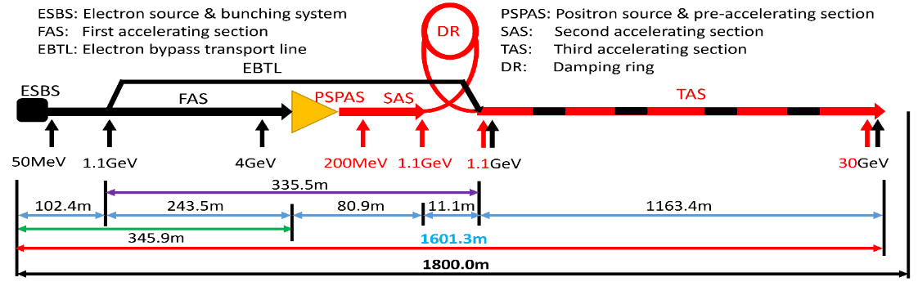
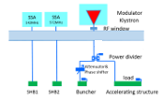
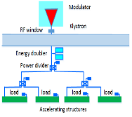
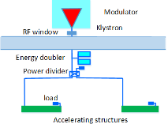
LINAC RF system introduction
RF distribution of the 30 GeV linac
  S-band, 80 MW klystron, the number of S-band Acc. Structure is 93, big hole s-band structure after the positron source is 16. the number of pulse compressor is 33
    1-1(ESBS), 1 accelerating structure, 22MV/m
    1-4 (FAS), 21 sets, 84 standard accelerating structures, with pulse compressor, 22MV/m
    1-2(PSPAS), 8 sets, 16 big hole accelerating structures, 22MV/m, with pulse compressor
    1-2(SAS), 4 sets, 8 accelerating structures, 27MV/m , with pulse compressor
  C-band, 50 MW klystron, C-band structures: 470, with 235 pulse compressors
    1.1GeV-30GeV, 1-2(TAS), 235 sets, 470 accelerating structures, ~40MV/m,
Parameter | Unit | S-band |  | C-band
Frequency | MHz | 2860 |  | 5720
Length | m | 3.1 | 2.0 | 1.8
Cavity mode |  | 2π/3 |  | 3π/4
Aperture | mm | 19~26 | 25 | 12~16
Gradient | MV/m | 22/27 | 22 | 40~45
Cells (include coupler cells) |  | 86 | 55 | 89
Number of Acc. Stru. |  | 93 | 16 | 470
Number of Klystron |  | 33 |  | 236
Klystron Power | MW | 80 |  | 50
S-band
C-band

Slide 4
Motivation
In the CEPC baseline design, the average accelerating gradient is 40MV/m, which is very high. We need to verify the reliability of the entire system.
In order to meet the availability requirements of the collider, the availability of the linear accelerator is required to be very high. We need to verify the availability of the whole accelerating unit.
 | IHEP | SINAP | Spring8 | INFN | PSI
Frequency(MHz) | 5712 | 5712 | 5712 | 5712 | 5712
Mode | 3π/4 | 4π/5 | 2π/3 | 2π/3 | 2π/3
Length (m) | 1.8 | 1.8 | 2 | 1.4 | 2
Gradient at high power test bench(MV/m) | - | 50^{[1]} | 50.1^{[2]} | 36^{[3]} | 52^{[4]}
Operating gradient with beam (MV/m) | - | 41.7(max., private talk) | 41.4 | 36 | 28
W. Fang, et al. THE C-BAND TRAVELING-WAVE ACCELERATING STRUCTURE FOR COMPACT XFEL AT SINAP . NIMA 2016
T. Sakurai, et al. C-band disk-loaded-type accelerating structure for a high acceleration gradient and high-repetition-rate operation. PRAB 20, 042003 (2017)
3. D. Alesini, et al. HIGH POWER TEST RESULTS OF THE SPARC C-BAND ACCELERATING STRUCTURES. IPAC 2014
4. F. Loehl, et al. STATUS OF THE SWISSFEL C-BAND LINEAR ACCELERATOR. FEL 2013

Slide 5
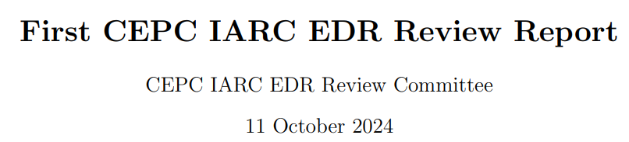
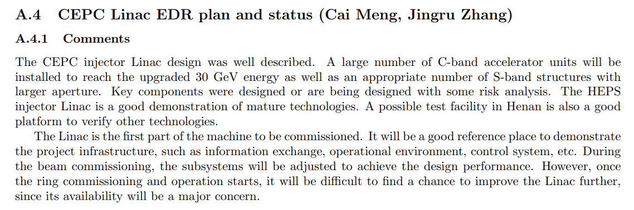
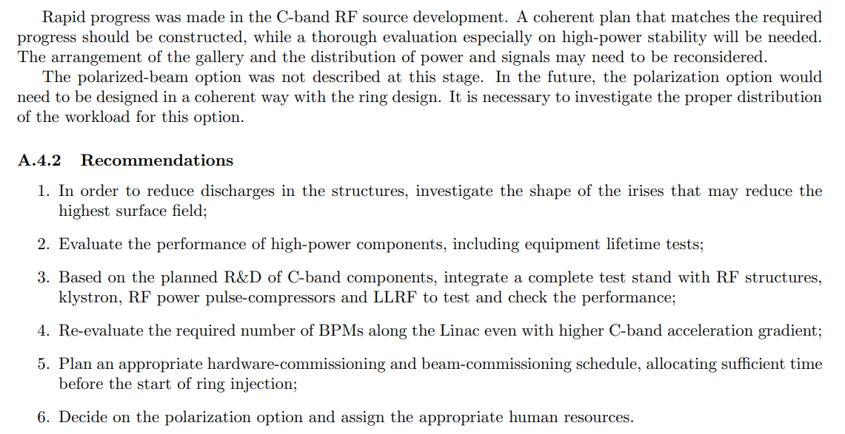
专家评审意见

Slide 6
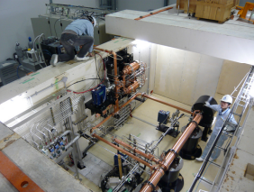
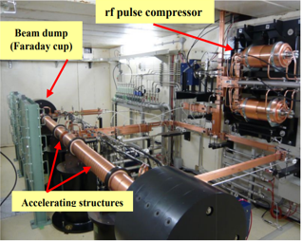
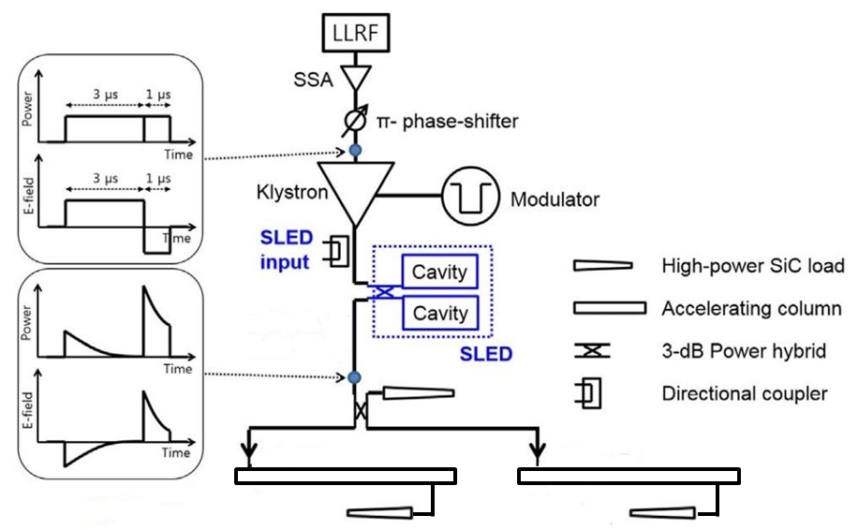
C-band RF system
This is a high power test bench of Spring-8 before their mass-production
We hope we can establish the C-band test bench and test the components. With pulsed compressor, waveguides, directional couplers, loads, bend and straight waveguides, etc.
It is a complete unit and should cooperation with C-band power source

Slide 7
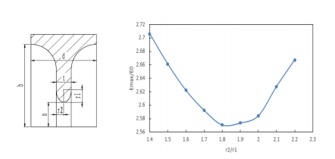
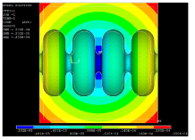
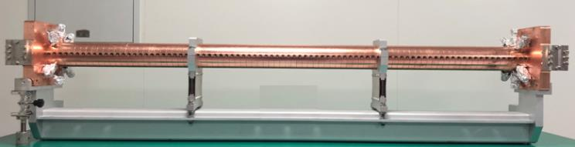
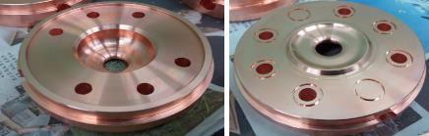
C-band accelerating structure
The R&D of C-band accelerating structure at IHEP
  The beam dynamics of linac based on this design
  Constant gradient, 3π/4 mode, 1.8 meters long (Including mechanical length, Effective length is about 1.7m)
    Round cavity shape
    Racetrack symmetrical magnetic coupling
No high power test and beam testing
Cavity shape
The deformation caused by temperature variation

Slide 8
C-band accelerating structure
The design parameters between different lab
  Mode :3π/4, 2π/3, 4π/5
  Length
  Disc thickness
Though the phase advance is deferent, the other key parameters is similar
 | IHEP | Spring8 | SINAP¹
Frequency: f（MHz） | 5712 | 5712 | 5712
No. of Cells | 87+2 | 100 regular cells +2 coupler | 89+2
Phase advance | 3π/4 | 2π/3 | 4π/5
Total length(m) | 1.8 | 2 | 1.784
Length of cell : d (mm) | 19.675 | 17.495 | 20.994
Disk thickness: t (mm) | 4.5 | 4 | 5
Average aperture: 2a (mm) | 14.04 | 15.938~12.107 | 15
Average diameter : 2b (mm) | 45.6 | 43.196~41.869 | -
Shunt impedance(average) : Rs (MΩ/m) | 66.05 | 66 | 62
Quality factor : Q | 11358~11186 | 9300/8900(measured) | 10470
Group velocity: Vg/c (%) | 2.8% ~ 0.96% | 2.3%(average) | 1.7%(average)
Filling time : t_{f} (ns) | 350 | 290 | 330
Attenuation factor : τ | 0.56 | 0.59 | 0.585
Epeak/E0 | 2.57 | 2.6 | 2.6
1. W. Fang, et al. THE C-BAND TRAVELING-WAVE ACCELERATING STRUCTURE FOR COMPACT XFEL AT SINAP

Slide 9
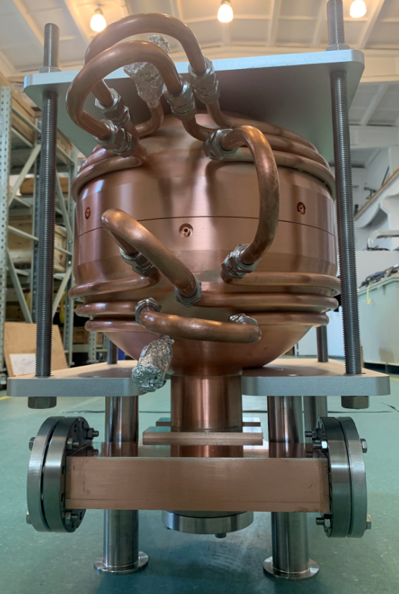
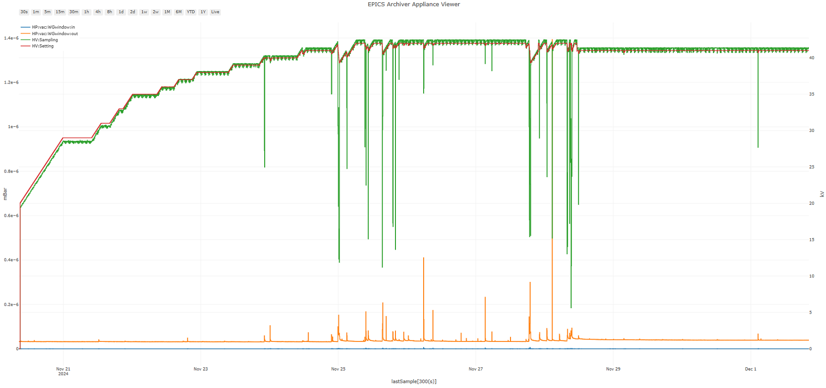
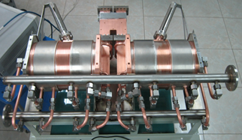
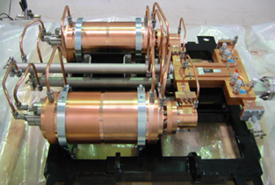
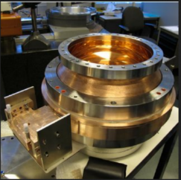
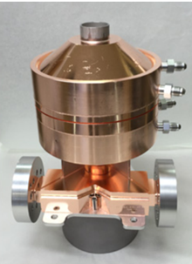
C-band RF system-what EDR can do
The model selection of the pulse compressor(PC)
  SLAC type (Two cavities)
  BOC type
  Spherical type
No direct high power experience
A
B
C
入腔功率~70 MW
S-band of IHEP
Two cavities PC
Spring8 C-band PC
BOC type PC（Swiss FEL）
Spherical PC（Xband of SLAC）

Slide 10
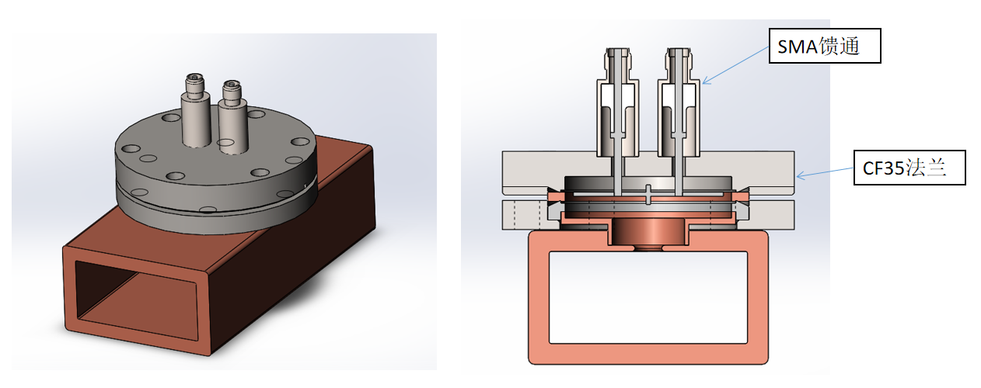
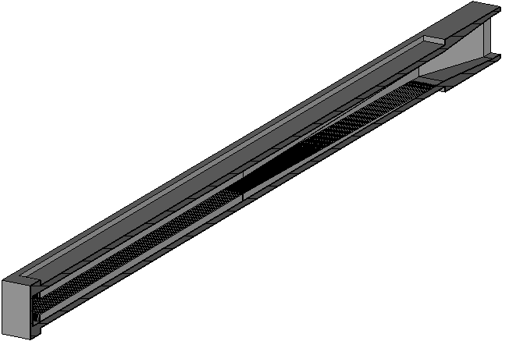
Waveguid & Load
High directional coupler
Load
waveguide（Localization）
  E-bend, H-bend, Straight waveguide, Extraction waveguide, Power divider etc.
Waveguide taper
BJ48
End cavity
Match section
Regular section

Slide 11
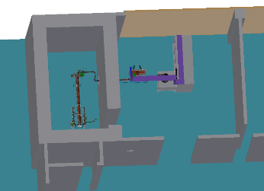
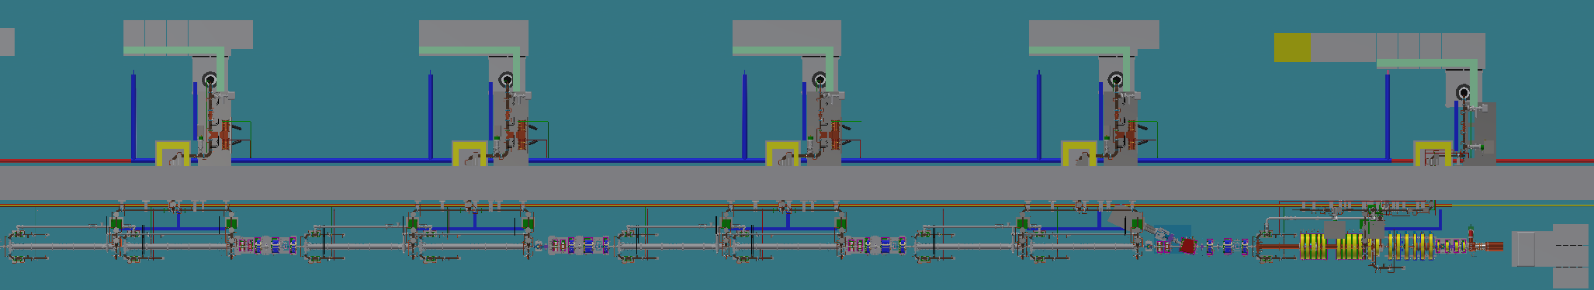
现有条件
场地&功率源
  HEPS直线末端，加速管测试厅屏蔽设计，可进行高功率测试
  80MW, 100Hz (Baseline: 50MW, 100Hz)速调管和配套调制器2025年7月可以加工完毕（周祖圣）

Slide 12
经费需求
合计：200万
 | 数量 | 单价 | 总价 | 说明
加速结构及二层支架* | 1 | 60 | 60 | 含材料、安装、测试费等
脉冲压缩器、波导、功分器、负载等 | 1套 | 80 | 80 | 含材料、加工、安装、测试费等
性能诊断、真空设备及其它辅助设备 | 1套 | 60 | 60 | 离子泵、真空规，角阀，暗电流测试，打火测试，场地改造等
  *为节省经费，将利用之前的加速结构，只新加工一个加速结构

Slide 13
人员
主要参加人员
 | 姓名 | 主要负责 | 职称
1 | 李京祎 | 场地等的总体协调 | 研究员
2 | 何大勇 | C波段功率源调制器 | 高级工程师
3 | 刘劲东 | C波段测试台控制 | 工程师
4 | 张敬如 | C波段加速结构的设计及高功率实验总协调 | 研究员
5 | 施华 | 波导元器件的设计及研制 | 副研究员
6 | 贺祥 | 微波传输部分的设计及高功率实验 | 高级工程师
7 | 马新朋 | 微波信号源 | 副研究员
8 | 甘楠 | 微波低电平 | 副研究员
9 | 肖欧正 | 脉冲压缩器的研制及调试 | 副研究员
10 | 李飞 | 功率源调制器 | 工程师
11 | 周祖圣 | 功率源速调管 | 研究员
12 | 邓秉林 | 真空及支架 | 高级工程师
13 | 彭永宜 | 高功率性能诊断 | 助理研究员
14 | 曹恒郡 | 脉冲压缩器的研制 | 学生

Slide 14
时间节点
2025.1.1-2025.12.31，完成系统设计，加速管和脉冲压缩器的的设计，完成无氧铜材料的采购
2026.1.1-2026.6.30，完成加速管和脉冲压缩器的加工调试，搭建高功率测试台，进行高功率测试
2026.7.1-2026.12.31，完成高功率测试，完成高功率长期运行，总结经验，发表文章

Slide 15
总结
基于CEPC直线加速器建设，脉冲压缩器、负载、LLRF之类的
利用已有场地和功率源，搭建测试台，不仅对自研C-band功率源性能进行验证，而且可以对微波关键器件进行高功率验证
通过测试台，可以完成对整个加速单元的综合性能测试并进行改进优化，同时可以开展相关技术研究，带动学科发展

Slide 16
谢谢！

