Slide 1
CEPC transfer line EDR design with all the injection/extraction kickers
Cui Xiaohao, Chen Jinhui
2024/12/11

Slide 2
Introduction
From Linac to Damping ring (e⁺)
From Linac to Booster (e⁺/e⁻)
From Booster to Collider Off-axis injection (e+/e-)
On-axis injection (e+/e-)
Collider to dump(e+/e-)
Damping Ring
Positron
Linac
Booster
Electron
Collider

Slide 3
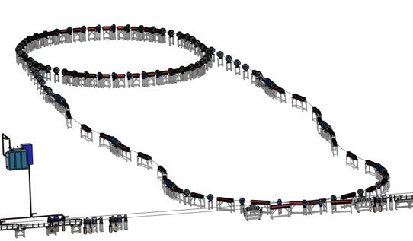
1. From Linac to Damping ring
Energy: 1.1 GeV
Beam: positron
Linac repetition: 100Hz
Double bunch mode needed for Z
Before damping ring, Energy spread of the beam should be reduced in order to match the RF acceptance of the damping ring.
After damping ring, Bunch of the beam should be reduced to control the energy spread after acceleration.
Damping ring circumference | 150 m
Store time of the bunches: | 20 ms
Bunch number: | 2 or 4

Slide 4
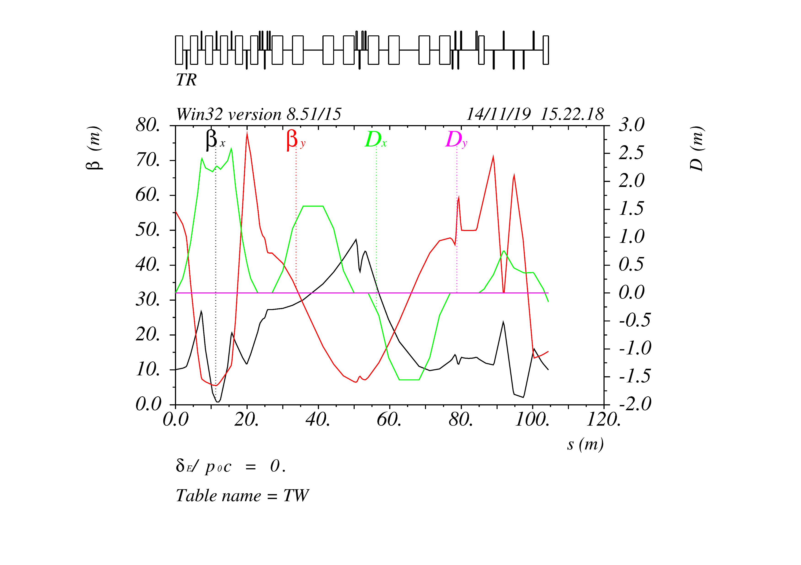
1. From Linac to Damping ring
Arcs
Chicane
Matching
T=0
T=10ms
T=20ms-250ns
T=20 ms
T=30ms-250ns

Slide 5
1. From Linac to Damping ring
0.5m
Lambertson
Kicker
0.25 m
Top View:
1.25m
1.25m
0.847m
1m
0.5m
0.25 m
Side View:

Slide 6
1. From Linac to Damping ring
Lambertson: In-vacuum Lambertson, L=0.5m, sep = 6mm, φ=30mm
Kicker: slotted-pipe kicker, L=0.25m, repetition rate=100Hz, pulse width=250ns

Slide 7
2. From Linac to Booster
Energy: 30 GeV
Beam: positron & electron
Linac repetition: 100Hz
Different bunch pattern in the booster for Higgs, W , Z and tt.
horizontal bending section and one vertical bending section
Vertical bending section matches the 100m height

Slide 8
2. From Linac to Booster
Twiss parameters of the transfer line from linac to booster

Slide 9
2. From Linac to Booster
Low Energy injection point of the booster

Slide 10
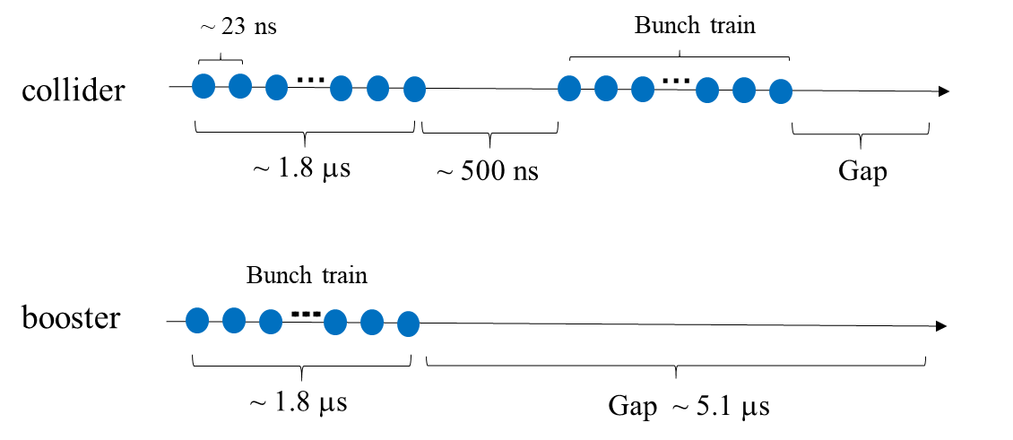
2. From Linac to Booster
Lambertson: In-air Lambertson, L=2m, sep = 10 mm
Kicker: strip-line kicker, L=1m, repetition rate=100Hz, pulse width=46ns
Bunch structure for Z mode

Slide 11
3. From Booster to Collider-Off Axis
Energy: 45 GeV, 80 GeV, 120 GeV, 180 GeV
Beam: positron & electron
Extraction for different bunch patterns.
For tt, Higgs and W energy, injection into the collider is bunch by bunch; and for Z energy, injection is train by train.
Booster
Transport line
2.4 m
Collider

Slide 12
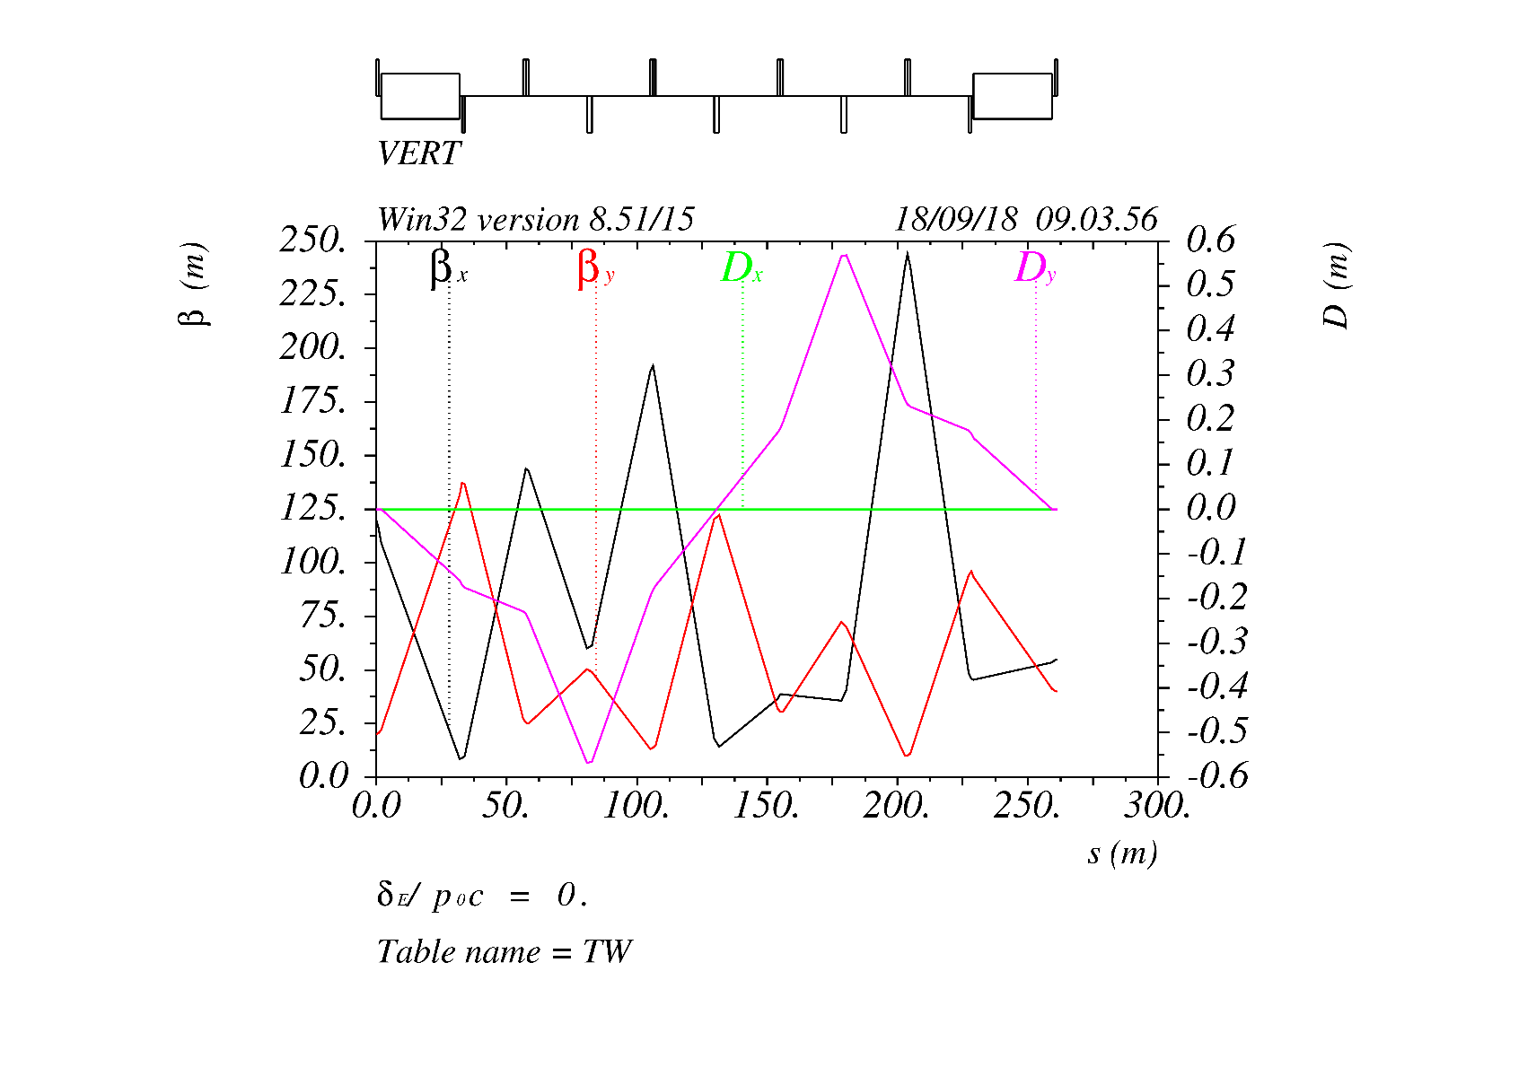
3. From Booster to Collider-Off Axis
Transport line optics for off-axis and on-axis injection

Slide 13
3. From Booster to Collider-Off Axis
Extraction from the Booster:
Lambertson: In-air Lambertson, L=3m (5 for each extraction point), sep = 10 mm
Kicker: delay line dipole kicker, L=1m, repetition rate=1000Hz, pulse width=440~2400ns

Slide 14
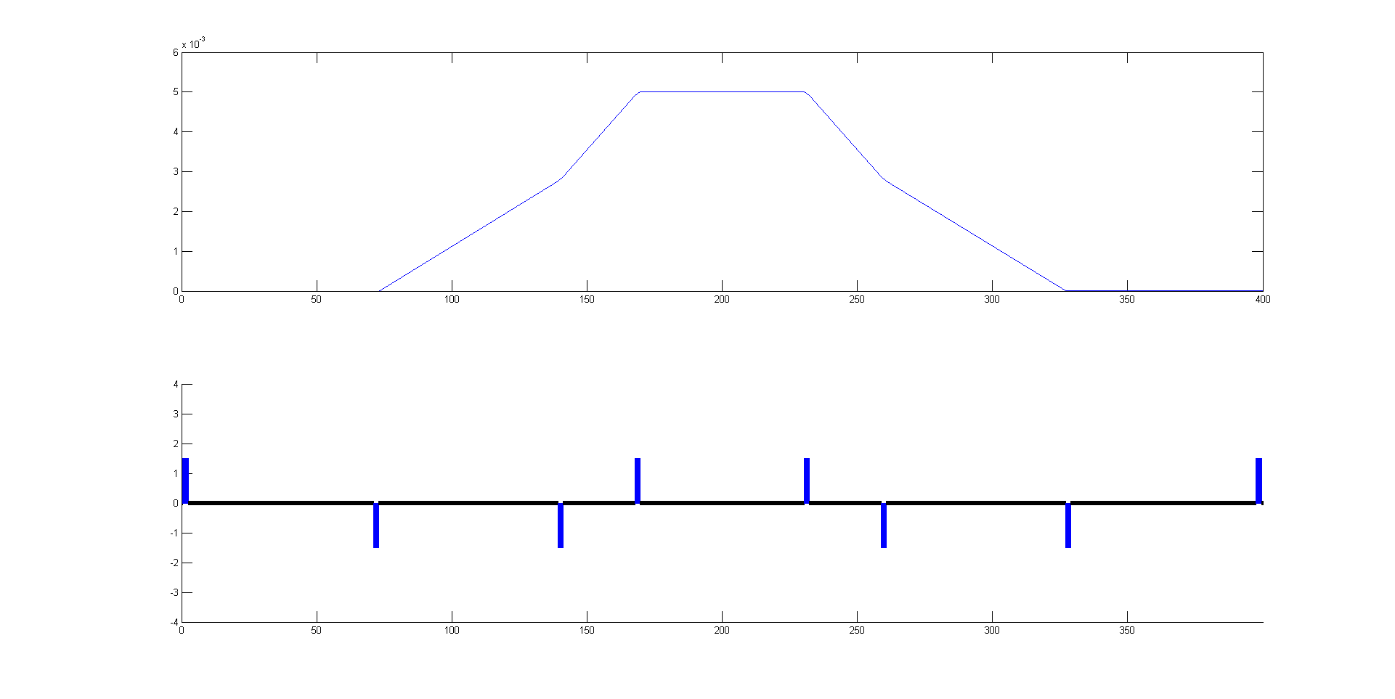
3. From Booster to Collider-Off Axis
2. Injection to collider
60m
26m
66m
68m

Slide 15
3. From Booster to Collider-Off Axis
2. Injection to collider
Lambertson: In-air Lambertson, L=3m (12 for injection point), sep = 2 mm
Kicker: delay line dipole kicker, L=0.7m, repetition rate=1000Hz, pulse width=440~2400ns

Slide 16
4. On axis injection
1. Extraction from collider
Lambertson: In-vacuum Lambertson, L=3m (10 for each extraction point), sep = 2 mm
Kicker: ferrit-core dipole kicker, L=0.7 m, repetition rate=1000Hz, pulse width=1360ns

Slide 17
4. On axis injection
2. Injection to booster
Lambertson: In-air Lambertson, L=3m (10 for each extraction point), sep = 10 mm
Kicker: Nonlinear kicker, L=0.7 m, repetition rate=1000Hz

Slide 18
4. On axis injection
3. Extraction from booster
Lambertson: In-air Lambertson, L=3m (10 for each extraction point), sep = 10 mm
Kicker: ferrit core dipole kicker, L=0.7 m, repetition rate=1000Hz, pulse width=1360ns

Slide 19
4. On axis injection
4. Injection to collider
Lambertson: In-vacuum Lambertson, L=3m (10 for each extraction point), sep = 2 mm
Kicker: ferrit-core dipole kicker, L=0.7 m, repetition rate=1000Hz, pulse width=1360ns

Slide 20
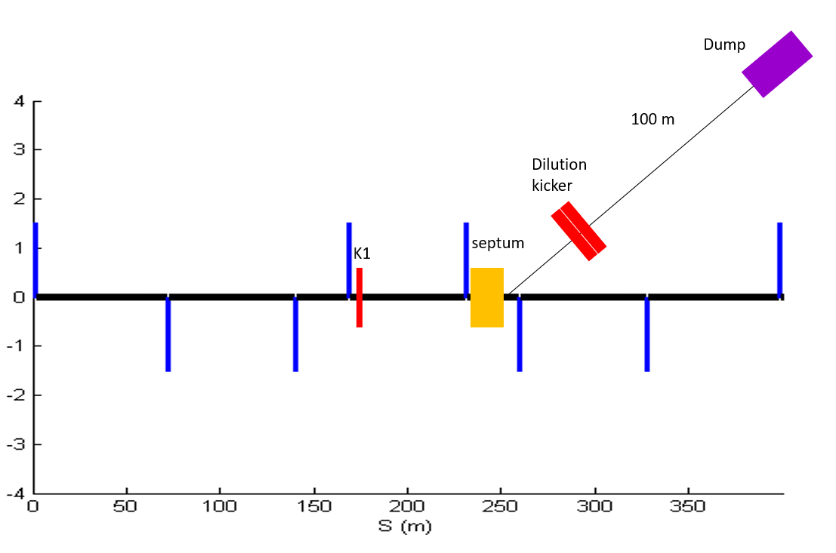
5. From Collider to the Beam dump
For machine and detector protection;
Use one kicker and one septum to get the beams into the dump line, so all bunches can be dumped in one turn;
Horizontal and vertical dilution kickers are used to change the position of different bunches at the dump, in order to reduce the beam damage to the dump.

Slide 21
5. From Collider to the Beam dump
Lambertson: In-vacuum Lambertson, L=3m (12 for each extraction point), sep = 6 mm
Kicker: delay line kicker, L=0.7 m, pulse width=1360ns, , pulse width=440~2400ns

Slide 22
Summary
1. This talk gives a general overview of all the transfer lines in CEPC.
2. The requirement on the injection/extraction kickers and Lambertson magnets are discussed.

Slide 23
Thank You

