Slide 1



CEPC CCT type SC quadrupole design status
Yingshun Zhu
On behalf of CEPC IR SC magnet system
Dec. 11, 2024, CEPC Day

Slide 2
Content
Introduction
CCT type SC quadrupole design status
Next step plan
Conclusion

Slide 3
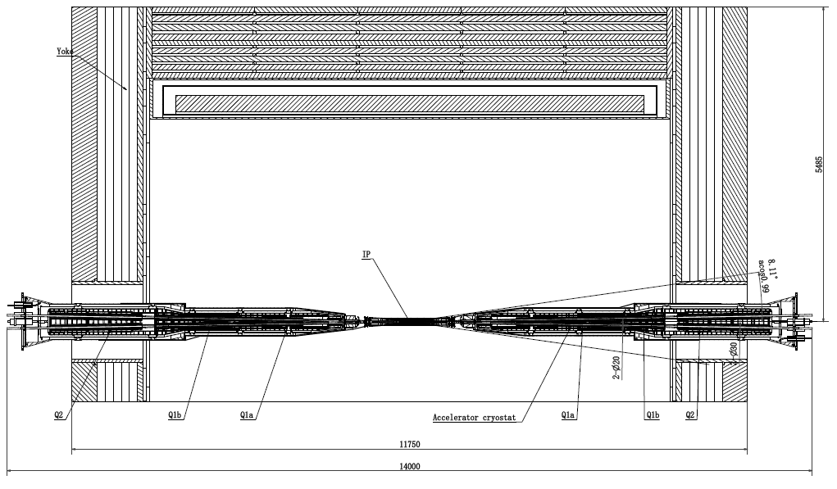
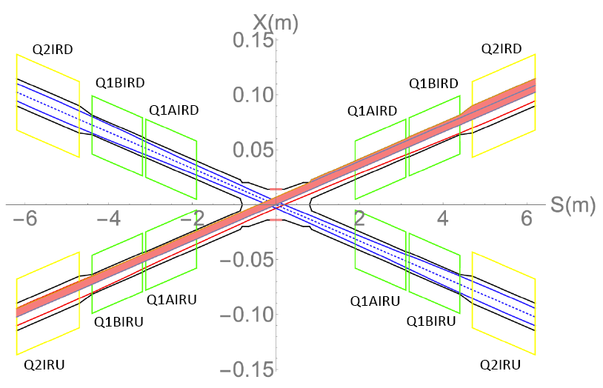
Introduction
In CEPC interaction region, to final focus the beam for high luminosity, compact high gradient double aperture quadrupole magnets (Q1a, Q1b, Q2) are required on both sides of IP points
To cancel the effect of the detector solenoid field on the beam, anti-solenoids before Quadrupoles and outside Quadrupoles are needed
There are a total of 4 combined-function SC magnets in CEPC interaction region
One combined-function magnet includes: quadrupole Q1a, Q1b, Q2, and Anti-solenoid

Slide 4
Introduction
EDR requirements of CEPC Final Focus quadrupoles are based on L* of 1.9 m, beam crossing angle of 33 mrad
Design requirement of CEPC Interaction Region quadrupole magnets:
1) Basic requirement of CEPC Interaction Region quadrupole magnets
Magnet | Field gradient (T/m) |  |  |  | Magnetic length (m) | Width of GFR (mm) | Minimal distance between two aperture beam lines (mm)
 | tt | Higs | W | Z
Q1a | 140.7 | 142.3 | 94.9 | 109.7 | 1.21 | 14.92 | 62.71
Q1b | 58.9 | 85.4 | 57.0 | 64.8 | 1.21 | 18.17 | 105.28
Q2 | 51.3 | 96.7 | 64.5 | 0.0087 | 1.5 | 24.48 | 155.11
2) Ratio of multipole field to quadrupole field ≤ 3×10⁻⁴
3) Integral dipole field at the center of one aperture is zero
Local dipole field at each longitudinal position ≤300 Gs (Higgs) or ≤100 Gs (Z)
From Detector background, Preliminary

Slide 5
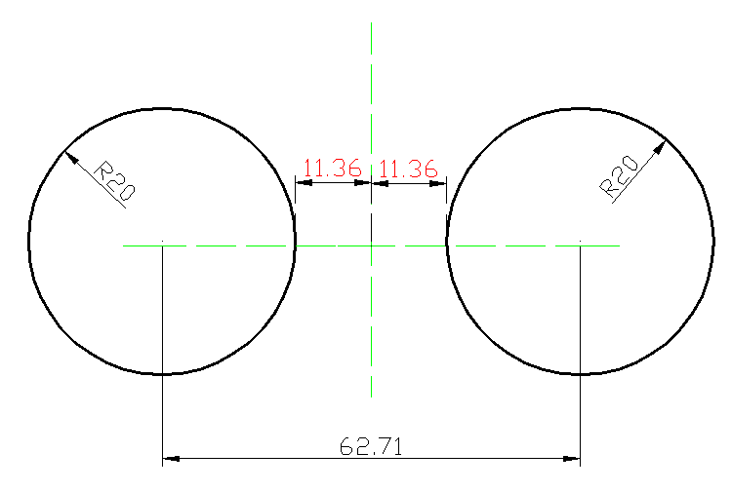
CCT type SC quandrupole design status
Design and optimization of IR SC magnets is on going
The design of Q1a is the most challenging
Minimal distance between two aperture beam lines: 62.71 mm
Leaving space for beam pipe, helium vessel, quadrupole coil inner radius: 20 mm
It is challenging to meet stringent design requirement
1) High field gradient: 142.3T/m
2) Limited radial space
Limited radial space in the magnet middle:
R: [20mm, 31.36mm], only 11.36mm available
3) Magnetic field crosstalk between two apertures
High order field harmonics ≤ 3×10⁻⁴
Local dipole field: ≤300 Gs (Higgs)
or ≤100 Gs (Z)

Slide 6
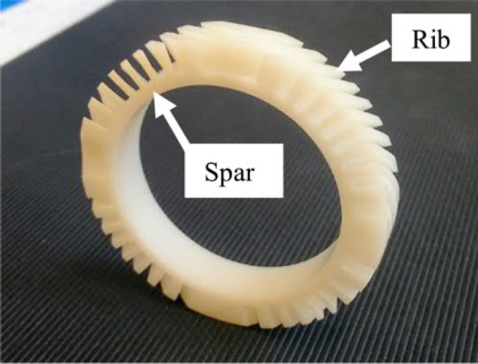
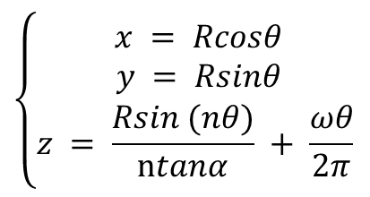
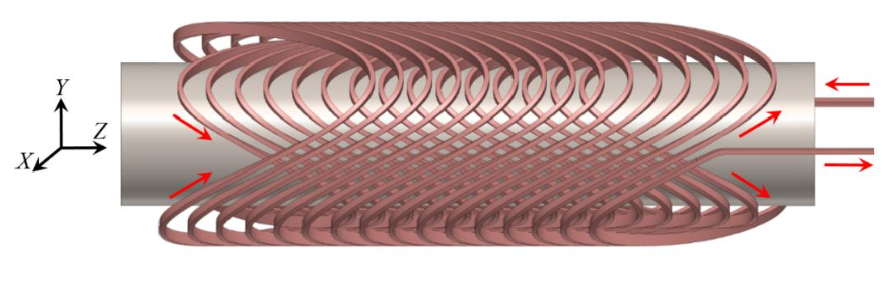
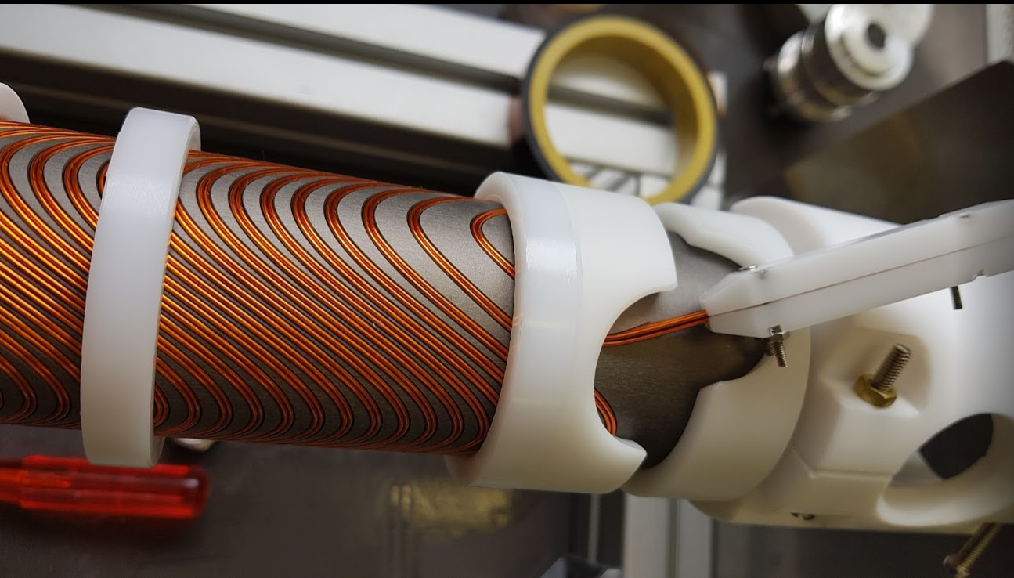
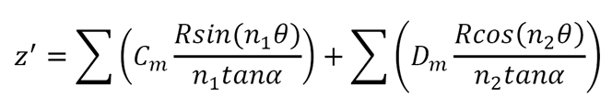
CCT quadrupole
The CCT (Canted Cosine Theta) coil is based on a pair of conductors wound and powered such that their transverse field sum up and solenoid fields cancel
Usually, the conductor is wound on a pre-cut groove in a supporting cylinder
The theoretical position of each conductor is given by equations
Self correction of multipole field: Changing each turn conductor path, multipole fields can be added
Ideal conductor path
Integrated field harmonics=0
Correction on path
n=1 dipole; n=3 sextupole

Slide 7

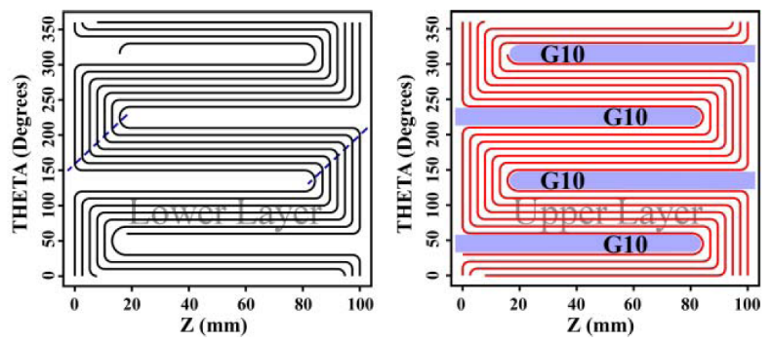
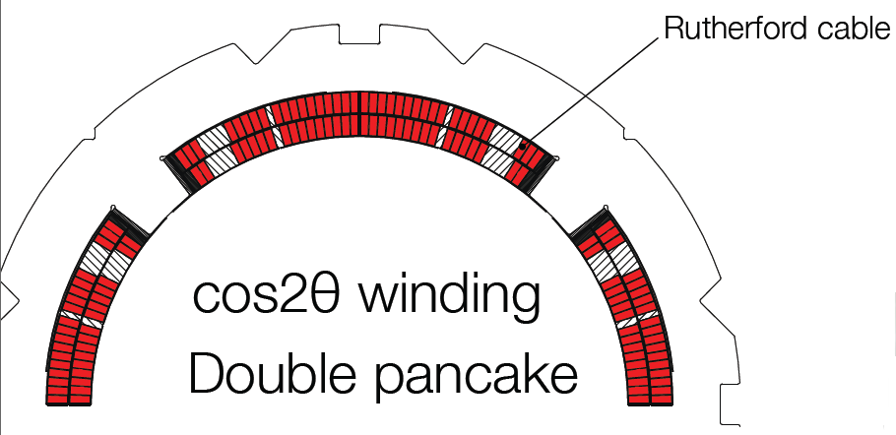

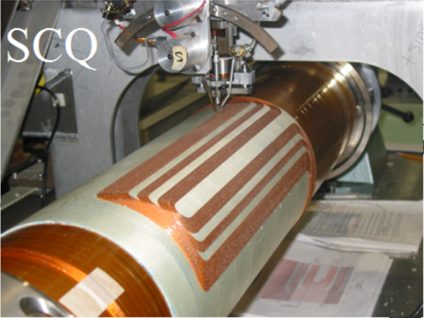
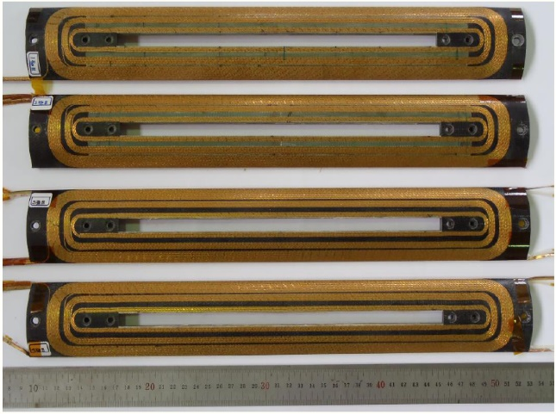
CCT quadrupole
Requirement on local dipole field is relaxed to ≤ 300Gs (Higgs)
Compact magnet structure, reduce weight
Field crosstalk varies with longitudinal position
Three kinds of quadrupole coil structures are studied
CCT quadrupole coil is the selected option (Iron-free, coil self correction)
CCT coil
Direct winding Serpentine coil
Cos2θ coil
Generate magnetic field that varies longitudinally

Slide 8
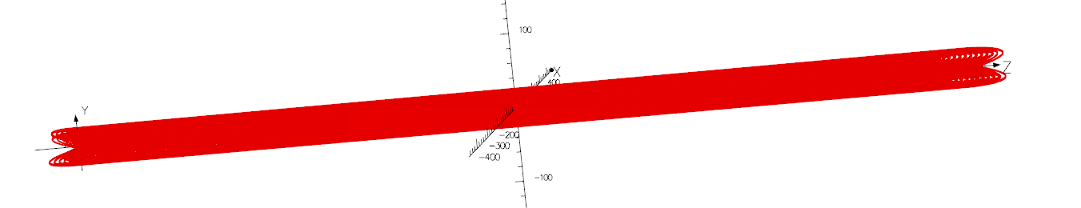
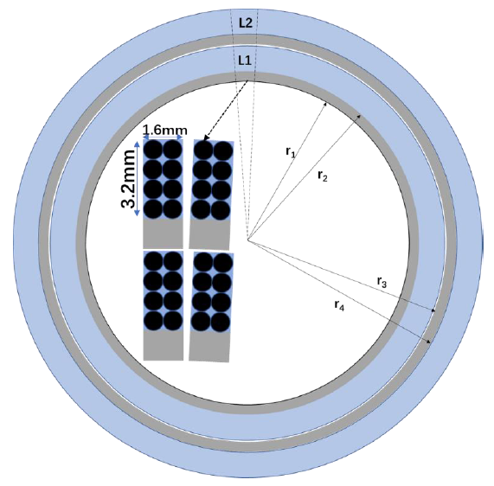
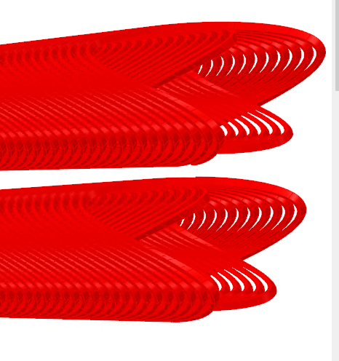
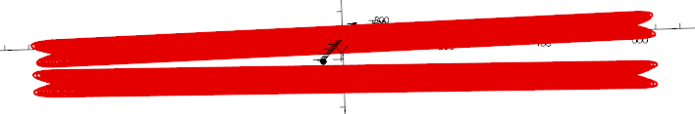
Traditional CCT quadrupole design status
Magnetic design of Q1a, Q1b, Q2 with CCT coil is performed
0.7mm round wire, HTS or LTS conductor (Bi-2212, Nb₃Sn, NbTi, etc)
Two layers CCT quadrupole coil. The inner radius of the skeleton is 20mm
8 wires in a groove
Q1a Conductor canted angle: 17 deg, pitch: 7.2 mm
Excitation current: 780 A @ 4.2 K (2K is also under study)
Field gradient is calculated using theoretical formula, and OPERA-3D

Slide 9
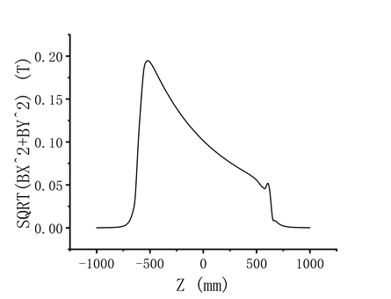
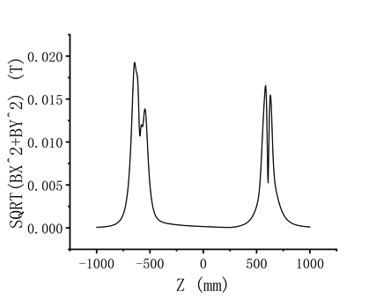
Traditional CCT quadrupole design status
Q1a: Dipole and multipole field before coil self correction (Higgs)
Q1a: Dipole and multipole field after coil self correction (Higgs)
Rref=7.46mm
n | bn (Bn/B2) | an (An/B2) | Required integrated field harmonics
2 | 10000 |  | Bn/B2 ≤3×10-4
3 | -61.0 | -0.8
4 | 10.3 | 0.2
5 | -1.6 | -0.04
6 | 0.2 | 0.01
7 | -0.03 | <0.01
n | bn (Bn/B2) | an (An/B2) | Required integrated field harmonics
2 | 10000 |  | Bn/B2 ≤3×10-4
3 | 0.07 | -0.80
4 | -0.05 | 0.13
5 | -1.4 | -0.06
6 | 0.16 | 0.01
7 | -0.03 | <0.01
Requirement: Local dipole field ≤300 Gs (Higgs)

Slide 10
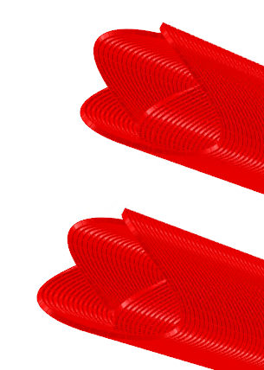
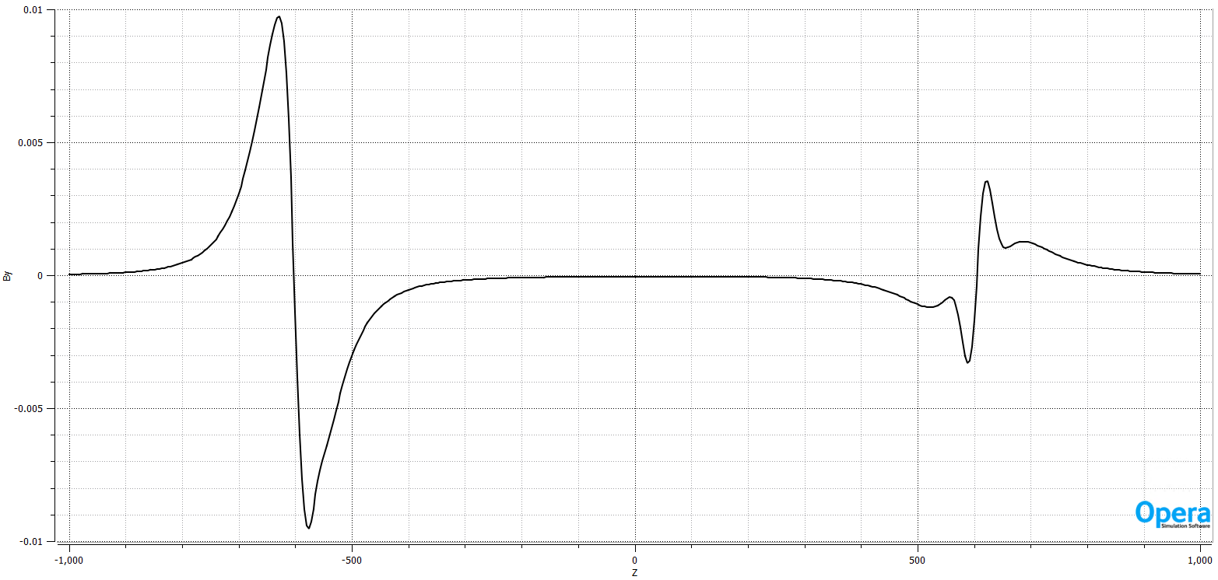
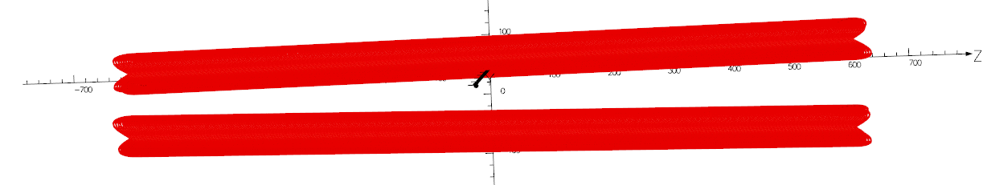
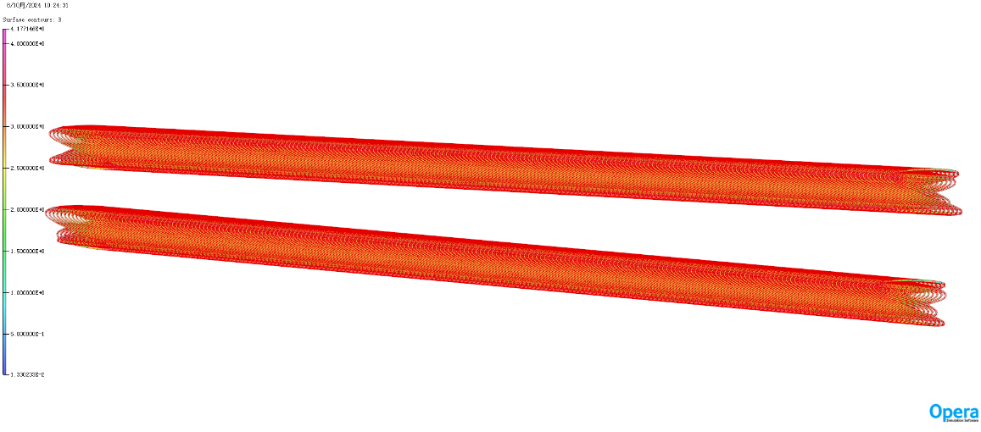
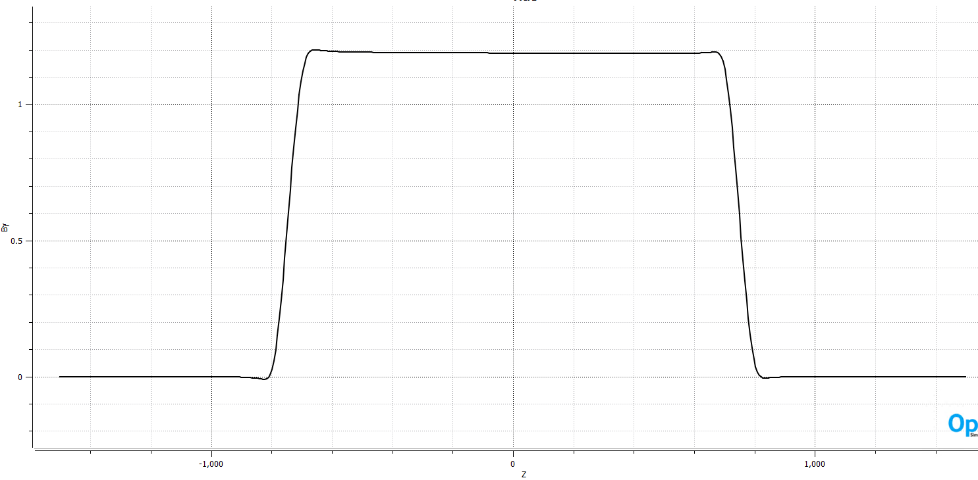
Traditional CCT quadrupole design status
Q1b, Q2 quadrupoles: 8 wires in a groove, 0.8 mm diameter
Q1b: Canted angle: 30 deg pitch 4.2 mm
Q2: Canted angle: 17 deg pitch 7.2 mm
Using CCT coil self correction, calculated integrated field harmonics meets the requirement
Q1b
Q2

Slide 11
Traditional CCT quadrupole design status
Calculated integrated field gradient and field harmonics meet the requirements
 |  | Calculated integrated field gradient (T) | Required integrated field gradient (T) | Calculated integrated field harmonics | Required integrated field harmonics
Q1a | tt | 170.25 | 170.25 | Bn/B2 ≤2×10⁻⁴ | Bn/B2 ≤3×10⁻⁴
 | H | 172.18 | 172.18
 | W | 114.83 | 114.83
 | Z | 132.74 | 132.74
Q1b | tt | 71.27 | 71.27 | Bn/B2 ≤2×10⁻⁴ | Bn/B2 ≤3×10⁻⁴
 | H | 103.33 | 103.33
 | W | 68.92 | 68.92
 | Z | 78.41 | 78.41
Q2 | tt | 76.95 | 76.95 | Bn/B2 ≤2×10⁻⁴ | Bn/B2 ≤3×10⁻⁴
 | H | 145.05 | 145.05
 | W | 96.75 | 96.75
 | Z | 0.013 | 0.013

Slide 12
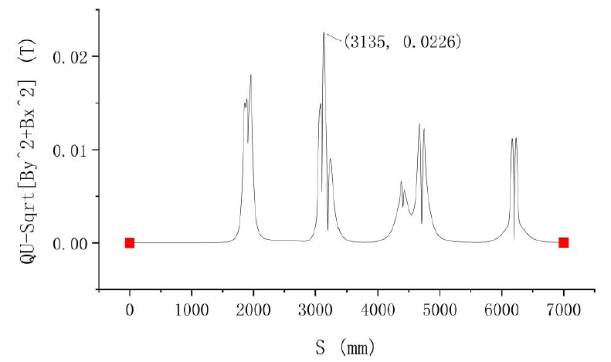
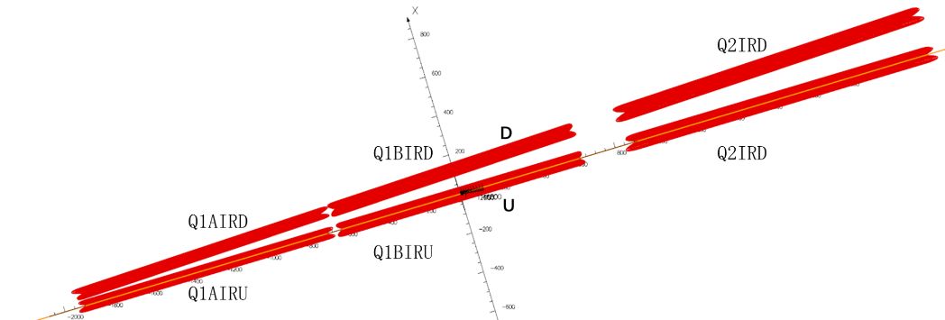
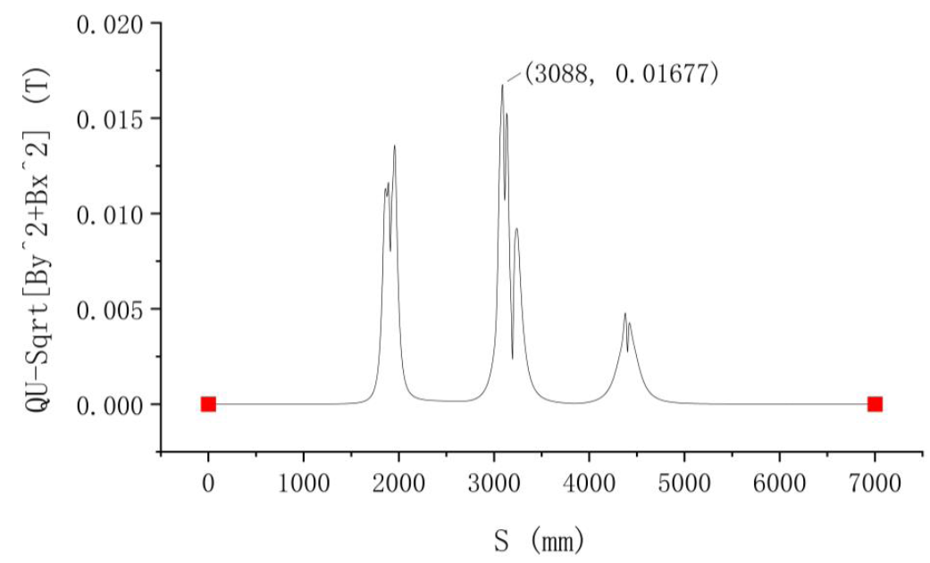
Traditional CCT quadrupole design status
Combined 3D magnetic field simulation of Q1a, Q1b, Q2
Many optimizations have been made
Q1a local dipole field (max 167.7Gs) exceeds the requirement at Z mode
Higgs mode
Dipole field distribution
Z mode
Dipole field distribution
Requirement: Local dipole field ≤100 Gs (Z mode)

Slide 13
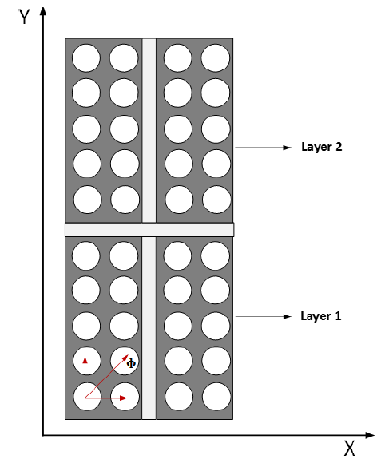
Direct winding CCT coil
Direct winding CCT coil
Combining direct winding technology and CCT coils, a new design is obtained
Divide the CCT coil into many layers
Wind CCT coil layer by layer using Direct winding machine
Adjacent layers of coils are separated by epoxy and insulation material
Winding machine directly winds the coil based on theoretical position of each conductor
CCT Coil
Direct winding technology

Slide 14
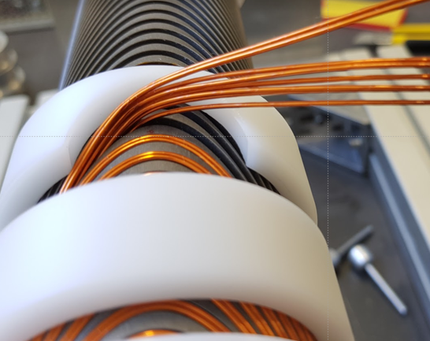
Direct winding CCT coil
FCC-ee
Traditional CCT coil
Conductors in groove, each layer requires a skeleton
Besides quadrupole coil, multiple sets of corrector coils are needed in CEPC IR
Direct winding CCT coil is preferred
Advantages of Direct winding CCT coil:
Accurate wire position and high magnetic field precision
No gap between adjacent layers or coils
Compact structure for SC magnets with multiple coils
Coil self correction is used to solve magnetic field crosstalk
Pre-stress can be applied by wrapping fiberglass on coil layers
Magnetic field harmonics can be corrected during multi-layer winding process
(field measurement at room temperature )
BNL

Slide 15
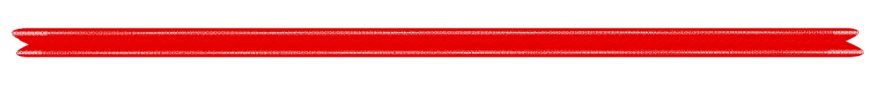
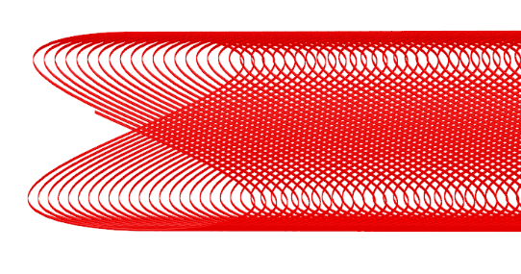
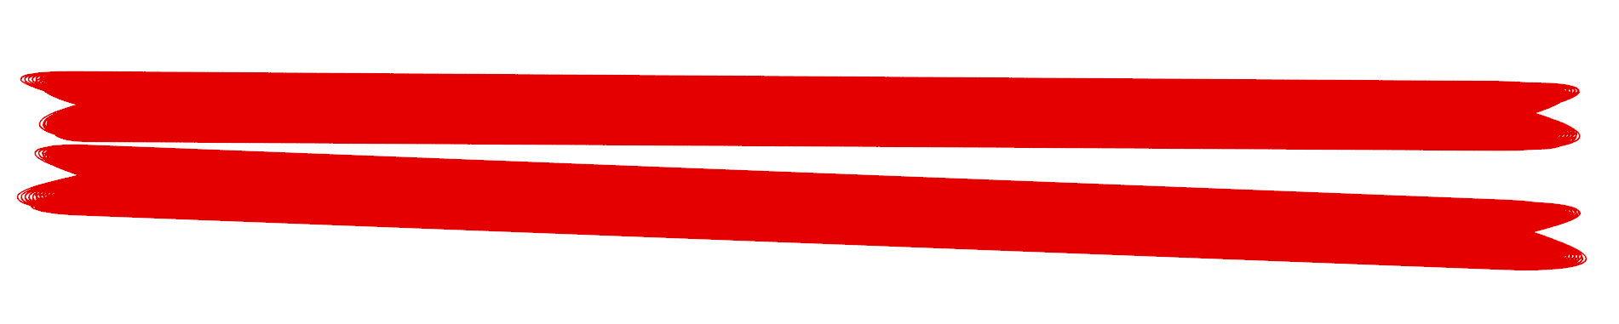
Direct winding CCT quadrupole design status
Q1a Direct winding CCT coil
Preliminary design
Round 0.7mm conductor, canted angle: 24 deg
8 layers CCT quadrupole coil. The inner radius of the coil is 20mm
Excitation current: 730A @4.2K (2K is also under study)
3D calculation in OPERA-3D
Radius of single aperture <31mm

Slide 16
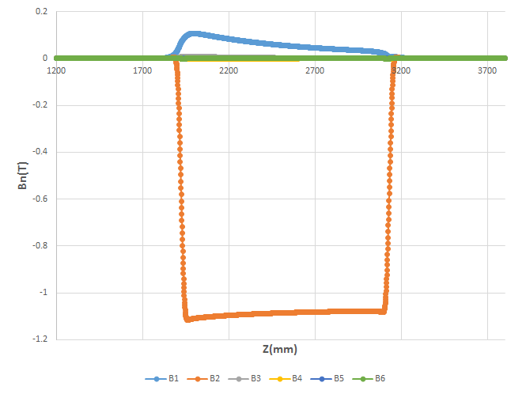
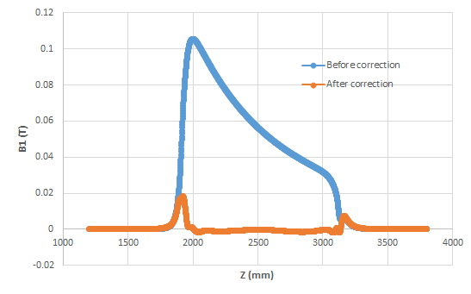
Direct winding CCT quadrupole design status
Q1a Direct winding CCT coil
In 3D calculation, large number of conductor segments
Coil self correction technology is used to solve magnetic field crosstalk
After correction, local dipole field decreases to less than 300Gs (Higgs)
Before correction
Dipole field before and after correction

Slide 17
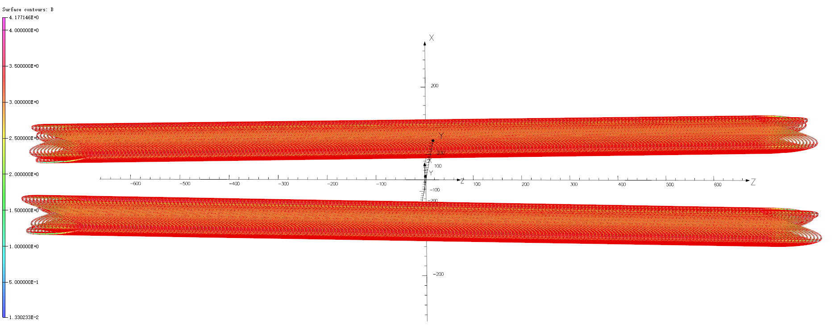

Direct winding CCT quadrupole design status
Q1b Q2 Direct winding CCT coil
Round 0.8mm conductor, canted angle: 24 deg
8 layers CCT quadrupole coil.
After correction, local dipole field decreases to less than 150Gs (Higgs)
Calculated integrated field harmonics are smaller than 2×10⁻⁴
Q1b
Q2

Slide 18
Design parameters of SC quadrupoles with CCT coil
Design parameters of Q1a, Q1b, Q2 magnet with iron-free CCT coil @ Higgs
 | Q1a | Q1b | Q2
Field gradient (T/m) | 142.3 | 85.4 | 96.7
Magnetic length (m) | 1.21 | 1.21 | 1.5
Excitation current (A） | 780 (Traditional) 730 (Direct winding) | 640 | 760
Conductor diameter (HTS or LTS, mm) | 0.7 | 0.8 | 0.8
Current density (A/mm²) | 2030 / 1900 | 1270 | 1510
Maximum dipole field in aperture (Gs) | 226 | 124 | 127
Stored energy (KJ) | 16.7 | 15.2 | 36.1
Peak field in coil (T) | 4.3 | 3.8 | 4.2
Integrated field harmonics | <2×10⁻⁴
(Single aperture) Coil inner radius (mm) | 20 | 26 | 31
(Single aperture) Coil outer radius (mm) | 30.5 | 39 | 44
Magnet mechanical length (m) | 1.23 | 1.23 | 1.53
Net weight (kg) | 25 | 32 | 43
Total weight of Q1a, Q1b, Q2 (kg) | 100
For comparison, old net weight with iron option (kg) | Q1a: 93, Q1b:124, Q2: 235 Total weight of Q1a, Q1b, Q2: 452

Slide 19
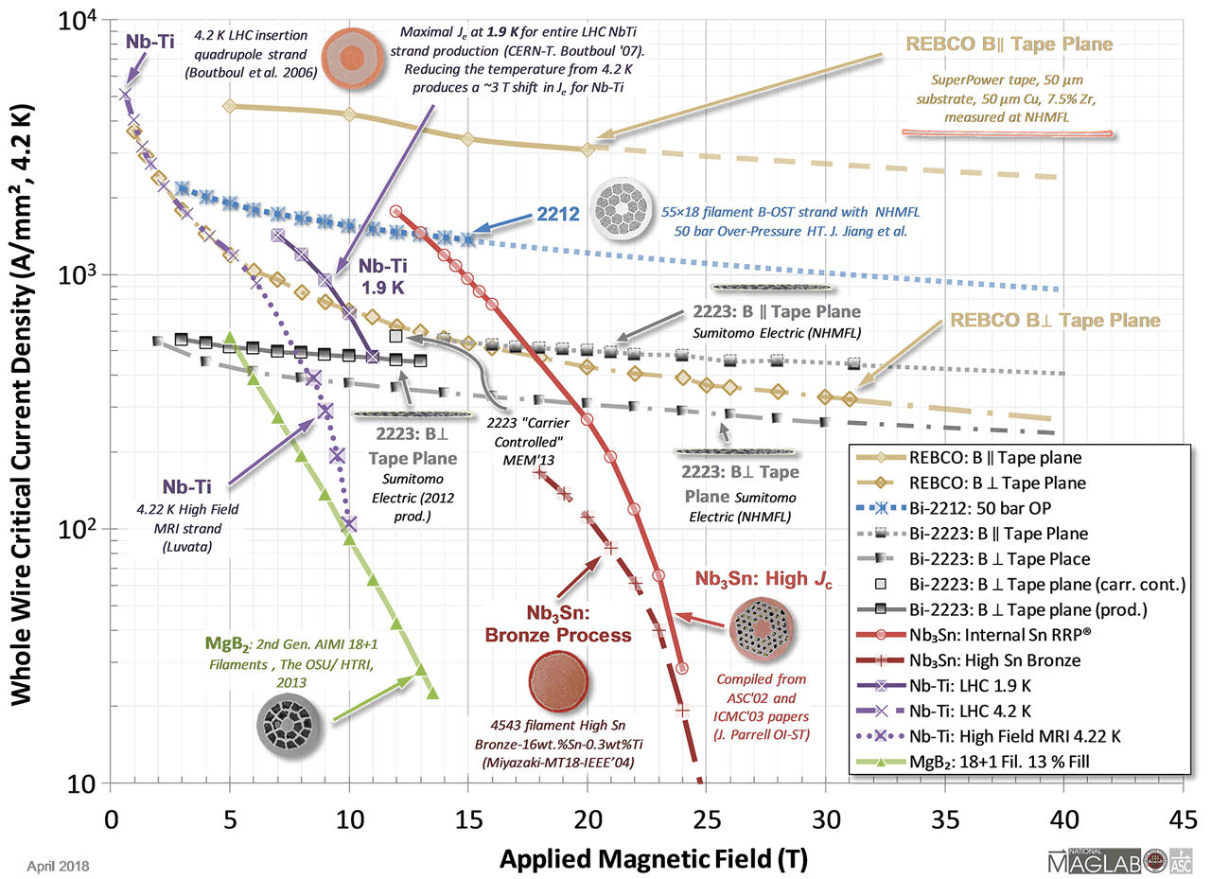
Superconductor Critical current density VS magnetic field @4.2K
From USPAS
2018 and 2022

Slide 20
Working temperature
Working temperature for CEPC IR quadrupole: 4.2K and 2K both considered
One disadvantage of CCT coil: Low magnetic efficiency
To meet the field gradient, superconductor with high current carrying performance is required (>2100A/mm² around 4T)
Temperature 2K helps to get more robust and stable design of quadrupole
  2K VS 4.2K, superconductor critical field increases more than 20%
  2K is also beneficial for Cryogenic performance
  But the cost of Cryogenic system will increase

Slide 21
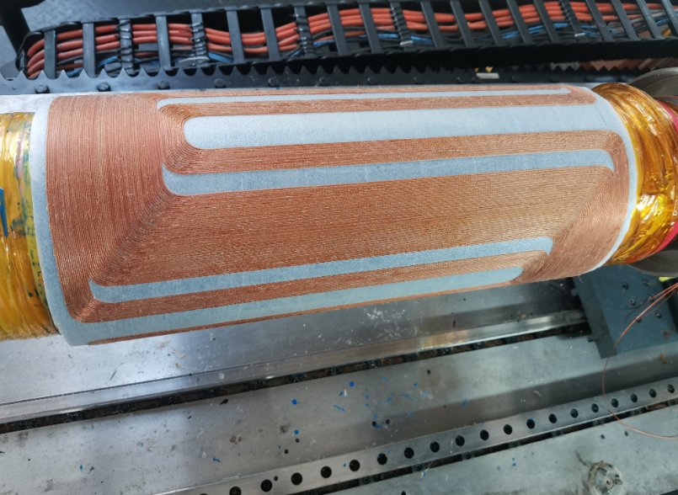
Can maximum field in Q1a coil reaches 4.3 T ?
In 3D calculation, maximum field in Q1a coil reaches 4.3 T @ 142.3T/m
Can it be realized using Direct winding CCT quadrupole?
BEPCII-U SC Quadrupole (Direct winding Serpentine)
  3.6 T in coil @ 530A (2.8GeV)
  4.3 T in coil @ 630A
  Max stable current 630A in Cryogenic test
Estimation: CEPC Q1a can reach the design field gradient

Slide 22
Next step plan
Next step plan
2025
Further iteration and optimization of SC quadrupoles
Perform winding experiments of CCT coil with self correction
Detailed magnetic field analysis, mechanical analysis, quenching analysis of each magnet
Summary of SC magnet design, main parameters and calculation results
Preliminary cost estimation
2026
Research and determine magnet manufacturing technology route
Magnet engineering design
Cost evaluation of SC quadrupole magnets
2027
Draft and revise Engineering design report of SC quadrupole magnets

Slide 23
Conclusion
Iron free CCT quadrupole coil is selected in EDR SC quadrupoles design
Two CCT options are used:
  Direct winding CCT coil, and Traditional CCT coil
Preliminary design of CCT quadrupole coil is obtained
Q1a local dipole field exceeds the requirement at Z mode; all other design requirements can be met for Q1a, Q1b, Q2 at four modes
Detailed magnet design and optimization, mechanical and quench analysis, and engineering design will be performed
Winding experiment on CCT quadrupole coil with self correction is planned

Slide 24
Thanks for your attention!
CEPC Day

