Slide 1



Progress of the CEPC Muon Detector
Xiaolong Wang
(for the Muon Detector Group)
Fudan University
Dec. 11th, 2024, CEPC Day

Slide 2
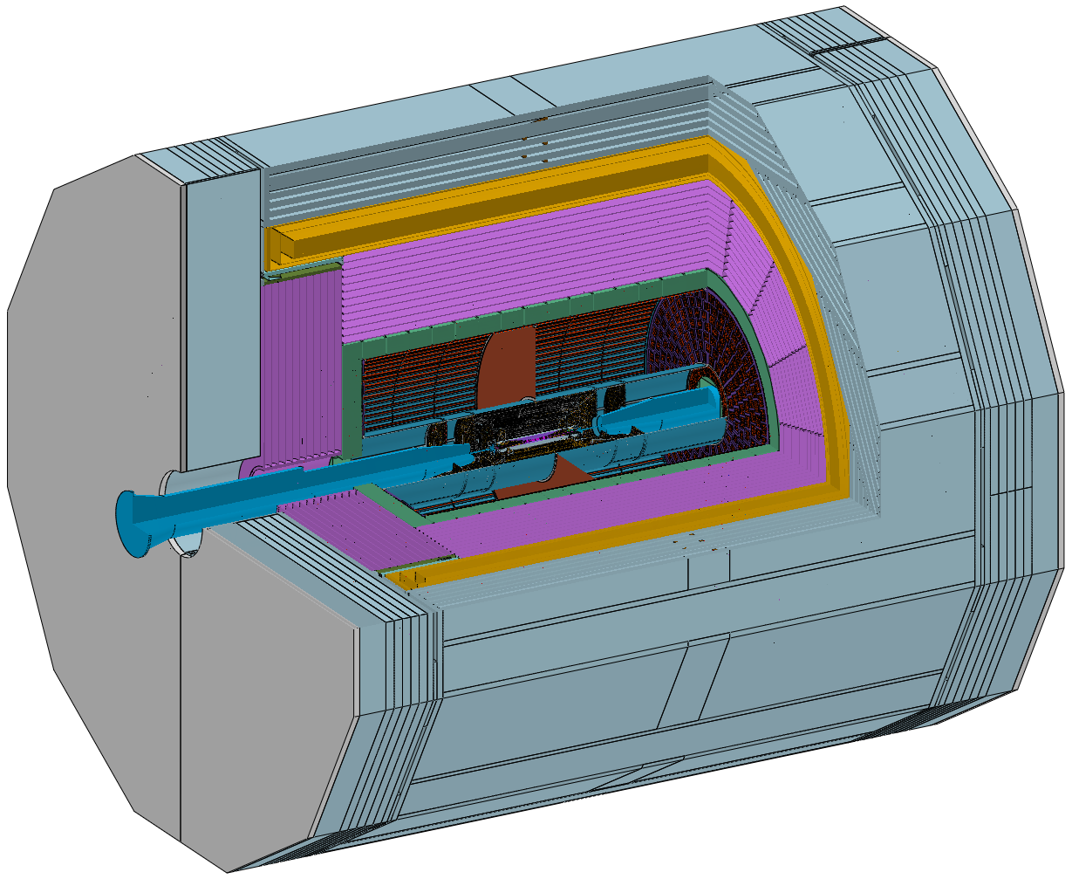
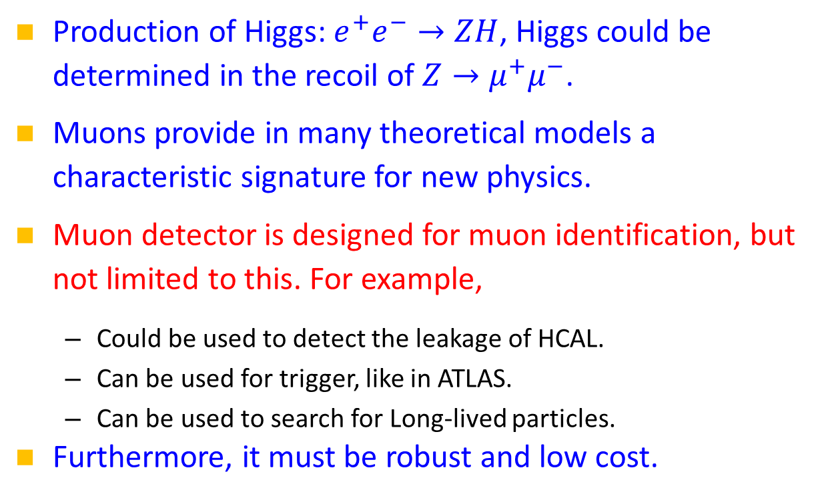
Introduction
Muon detector, the outermost detector with the largest volume, clean environment.
Production of Higgs: $e^{+}e^{−}→ZH$, Higgs could be determined in the recoil of $Z→μ^{+}μ^{−}$.
Muons provide in many theoretical models a characteristic signature for new physics.
Muon detector is designed for muon identification, but not limited to this. For example,
  Could be used to detect the leakage of HCAL.
  Can be used for trigger, like in ATLAS.
  Can be used to search for Long-lived particles.
Furthermore, it must be robust and low cost.
Key requirements:
Muon ID
Track reconstruction

Slide 3
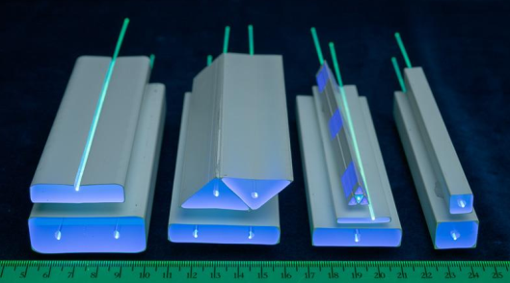
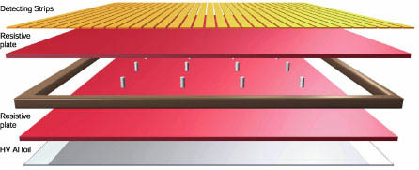
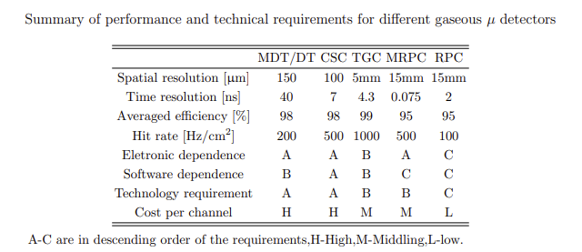
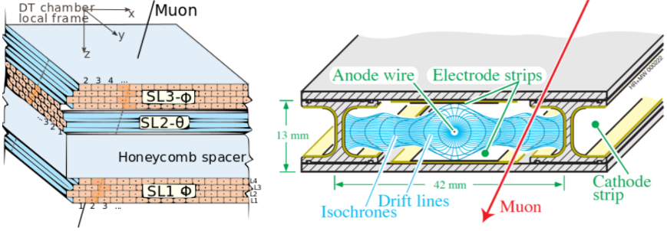
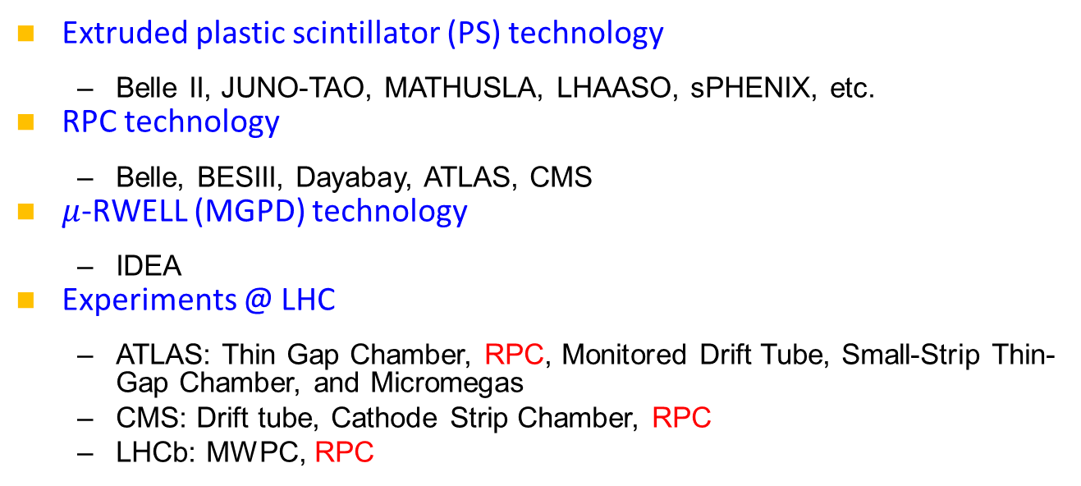
Technology survey and our choices
Extruded plastic scintillator (PS) technology
  Belle II, JUNO-TAO, MATHUSLA, LHAASO, sPHENIX, etc.
RPC technology
  Belle, BESIII, Dayabay, ATLAS, CMS
$μ$-RWELL (MGPD) technology
  IDEA
Experiments @ LHC
  ATLAS: Thin Gap Chamber, RPC, Monitored Drift Tube, Small-Strip Thin-Gap Chamber, and Micromegas
  CMS: Drift tube, Cathode Strip Chamber, RPC
  LHCb: MWPC, RPC
Simple structure:
PS bar+WLS fiber+SiPM
+PS

Slide 4
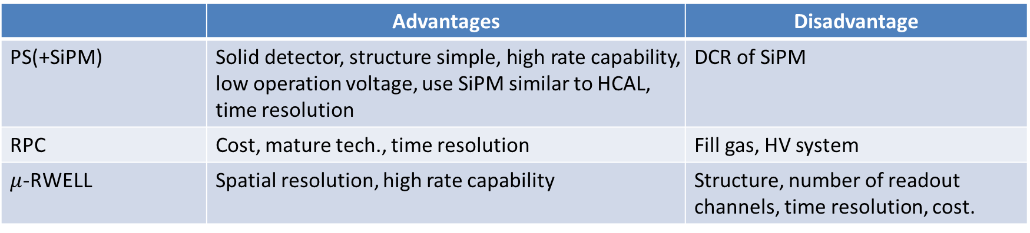

Comparisons
 | Advantages | Disadvantage
PS(+SiPM) | Solid detector, structure simple, high rate capability, low operation voltage, use SiPM similar to HCAL, time resolution | DCR of SiPM
RPC | Cost, mature tech., time resolution | Fill gas, HV system
$μ$-RWELL | Spatial resolution, high rate capability | Structure, number of readout channels, time resolution, cost.
disadvantages
PS bar and RPC have similar cost.
Rate capability: $5\sim 10kHz/cm^{2}$
Our choice: PS(+SiPM) as the baseline option, RPC for comparison in R&D.
Questions to rate capability are mainly due to the readouts and the area close the beam pipes.

Slide 5
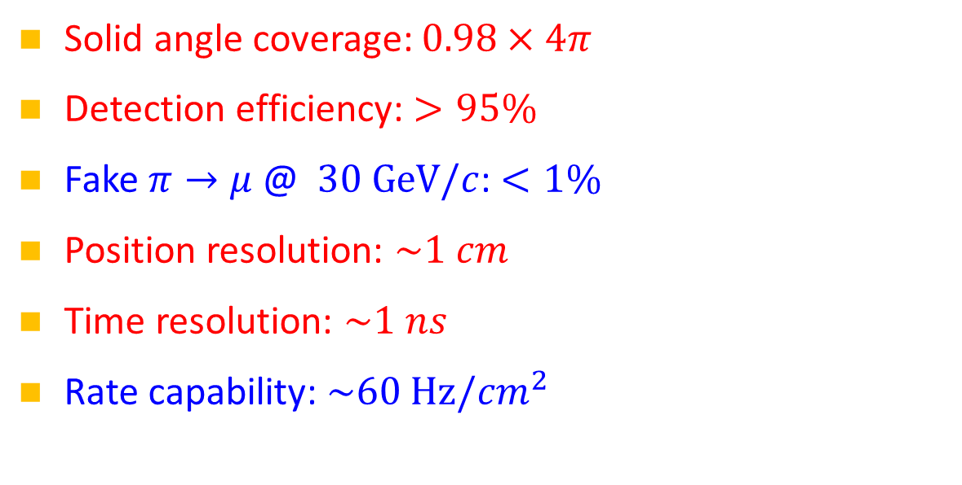
Performance should be delivered
Solid angle coverage: $0.98×4π$
Detection efficiency: $>95\%$
Fake $π→μ$ @ $30 GeV/c$: $<1\%$
Position resolution: $\sim 1 cm$
Time resolution: $\sim 1 ns$
Rate capability: $\sim 60 Hz/cm^{2}$

Slide 6
Guidelines followed in detector design
Guidelines for the design:
  Cost must be low.
  Maximize the performance of the detector as much as possible
  Detector module should be robust.
  Structure should be simple.
  Keep the space for future improvements.
  Keep one eye on New Physics.
    SUSY at ATLAS/CMS, dark sector at Belle II, LLP recently
Large size detector!
Advantages of detector.
Work with theorists.

Slide 7
Overall of the detector
  Muon detector is one of the sub-detector
  Strong connections to mechanics, yoke, and magnetic.

Slide 8
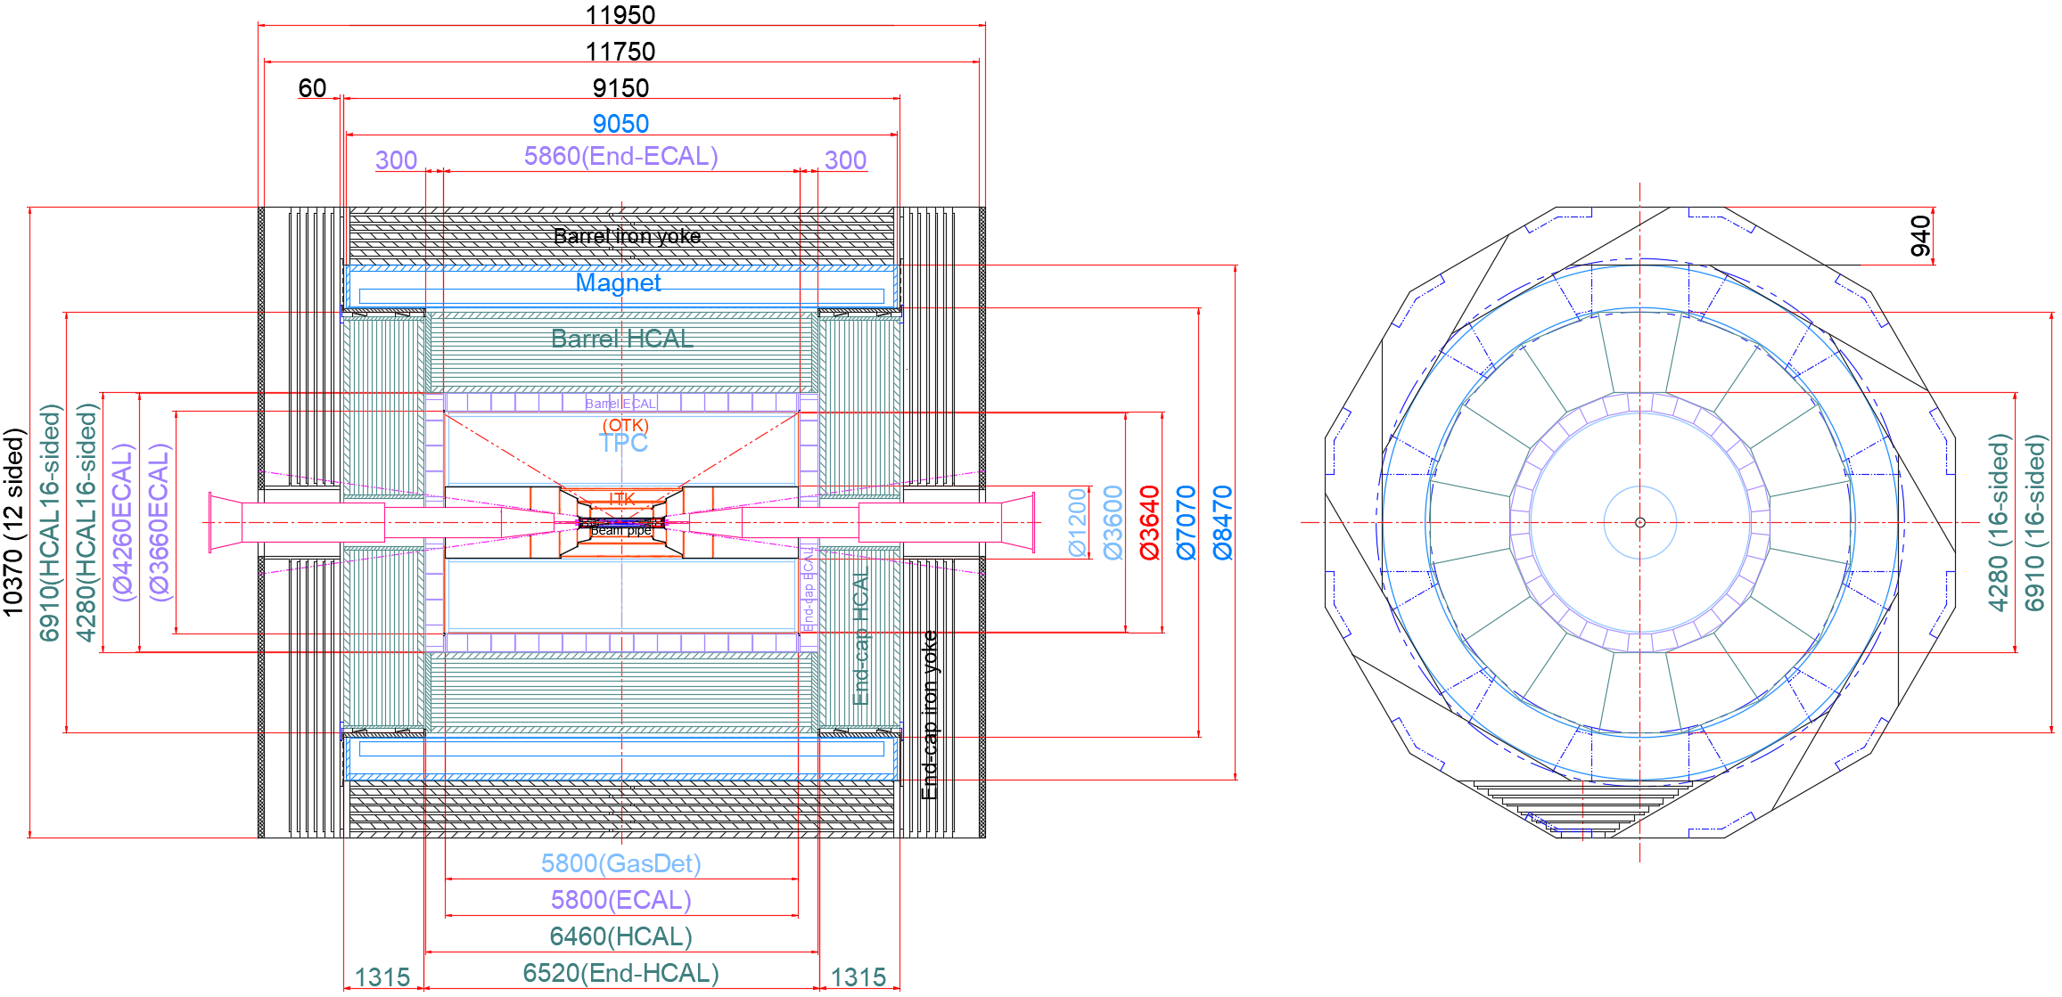
Introduction-Mechanics
From Quan JI
2. Detector layers and dimensions:
Overall dimension :
length : 11,950 mm
Height : 10,370 mm
Further optimization and improvement are needed

Slide 9
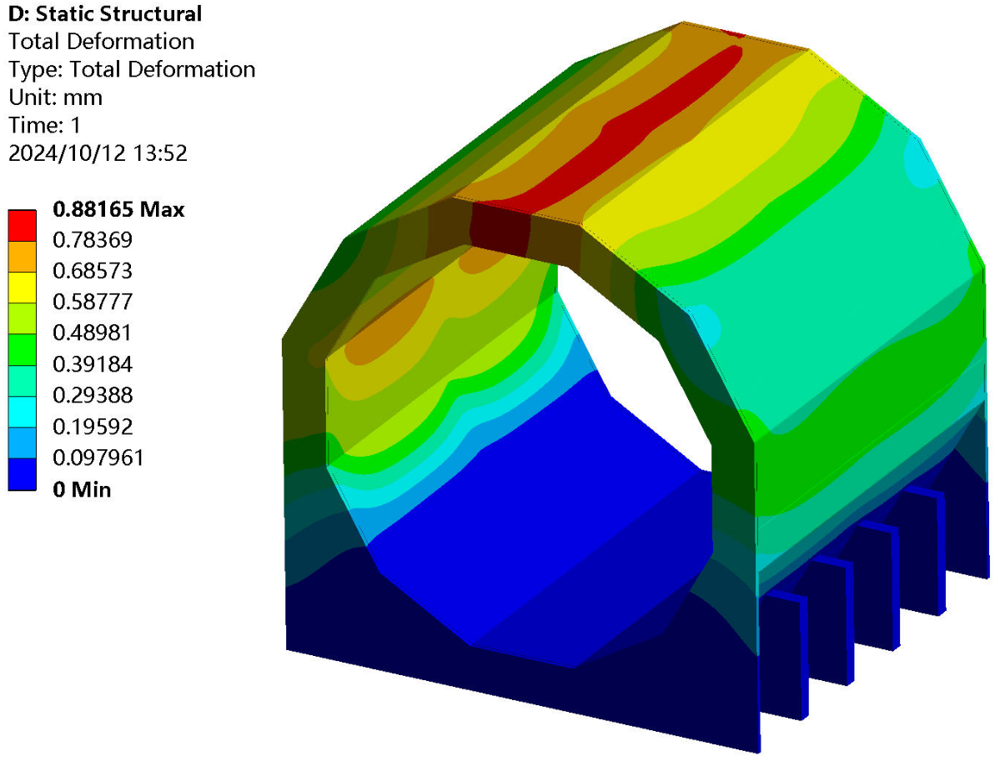
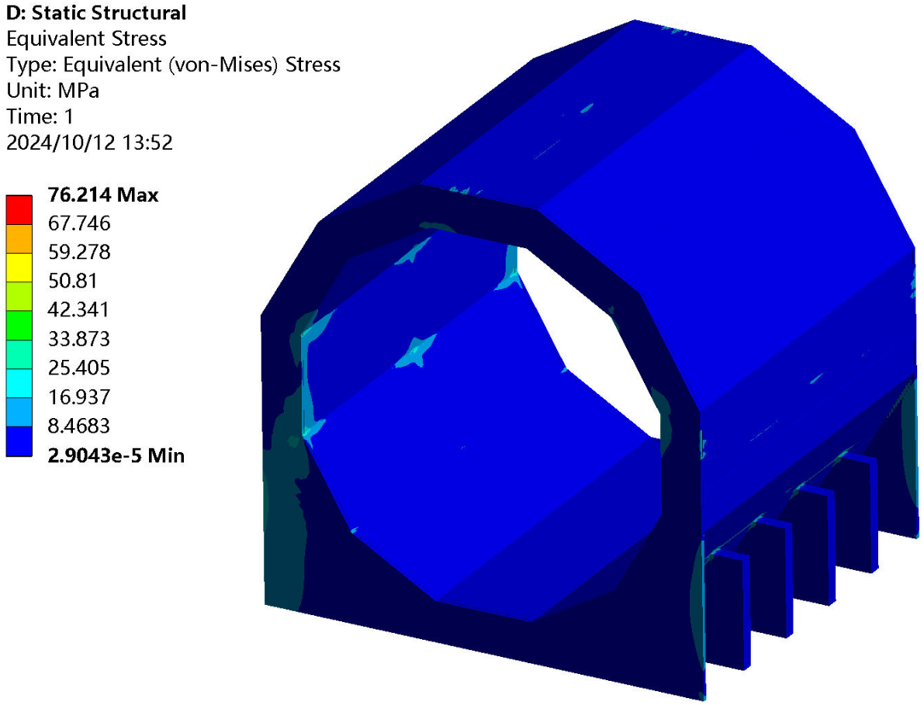
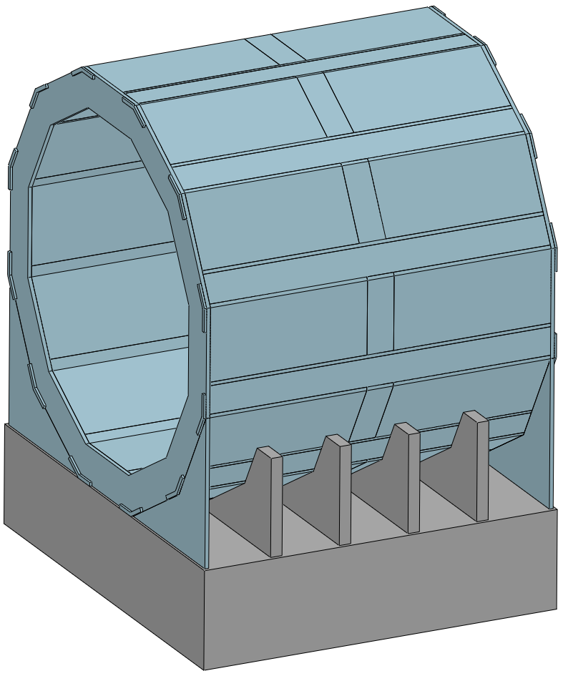
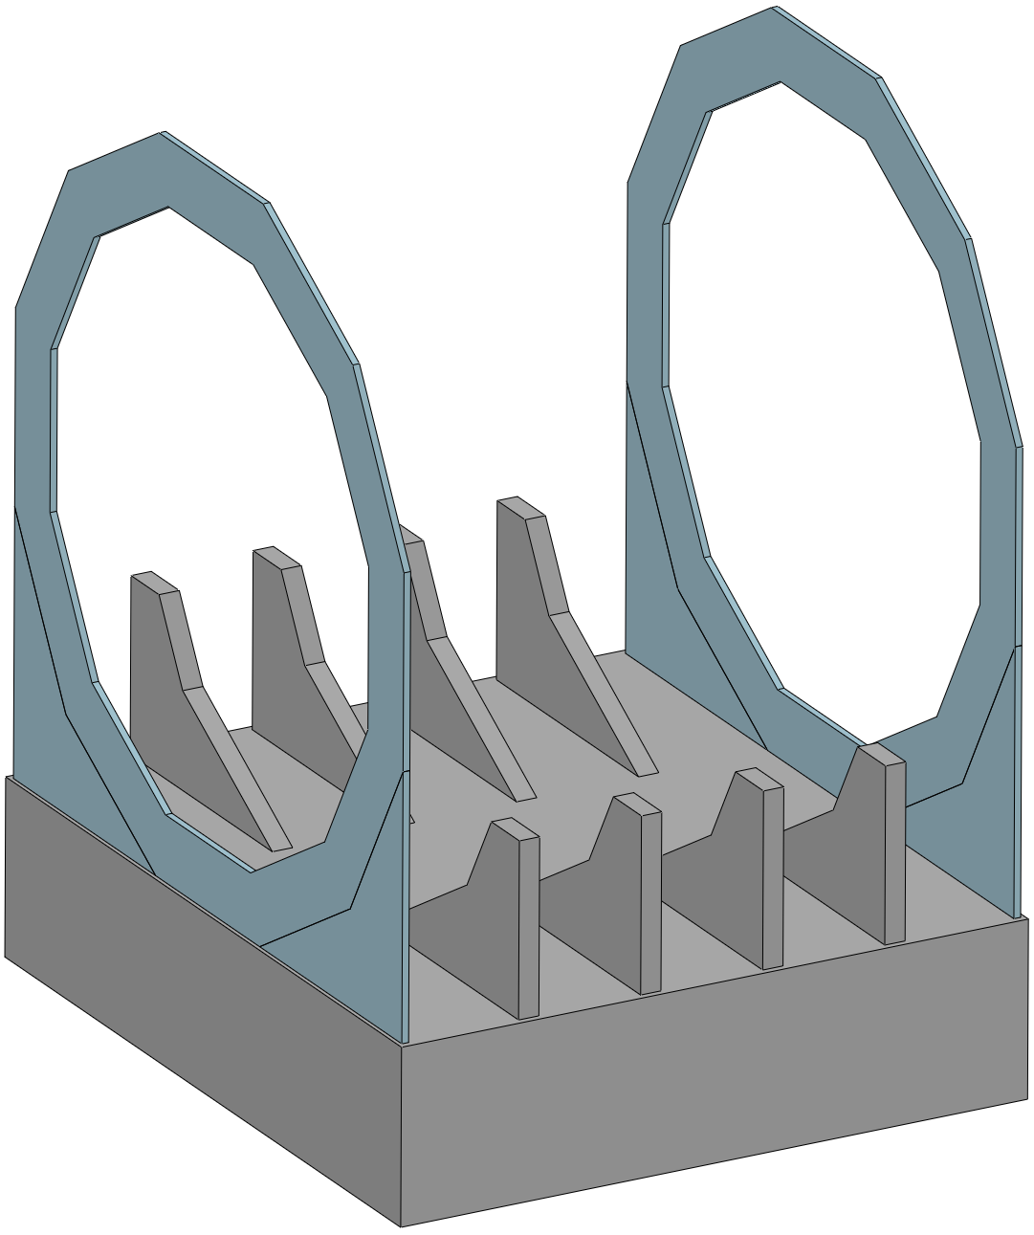
Detailed installation Design
From Quan JI
1. Overall reliability and safety assessment
Yoke : 1560 t
Deformation of yoke
without detectors
Deformation : ≈ 0.9 mm
Stress : ≈ 76 MPa
Conclusion :
Meet requirement
(< 1 mm)
Two end flanges
and
barrel supports
can reduce the deformation
End Support
Barrel supports
Drawing of the Endcap and Barrel support

Slide 10
Design of the Muon detector

Slide 11
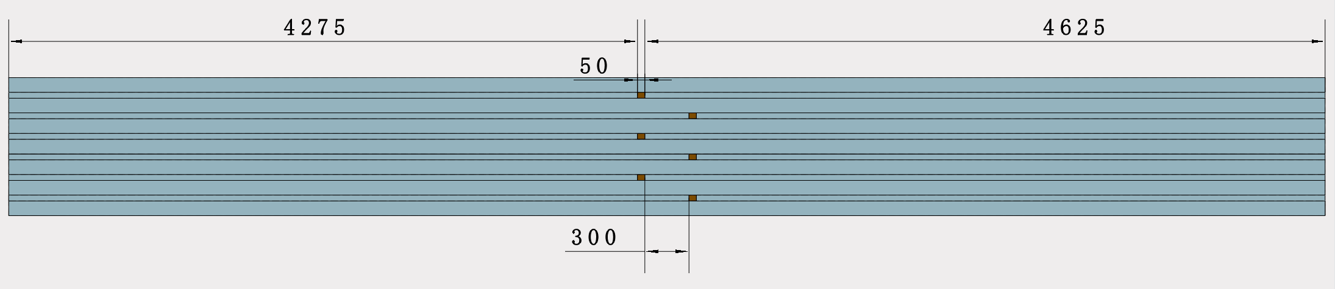
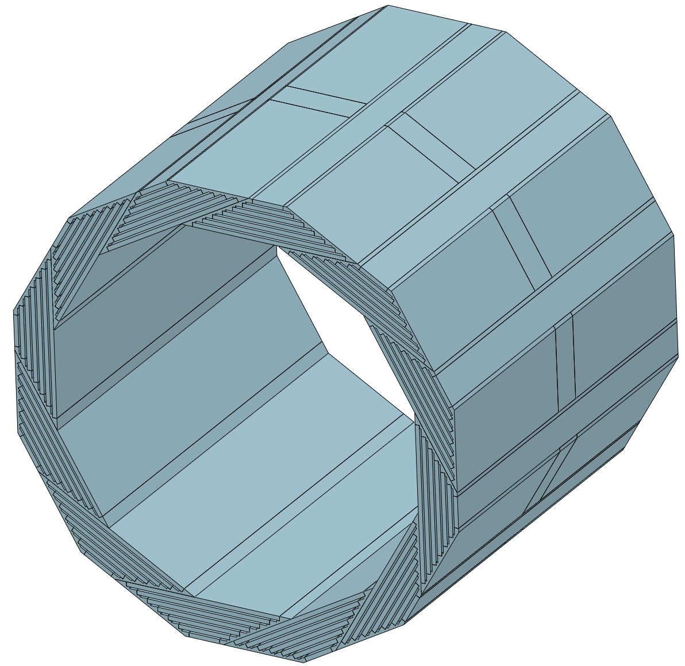

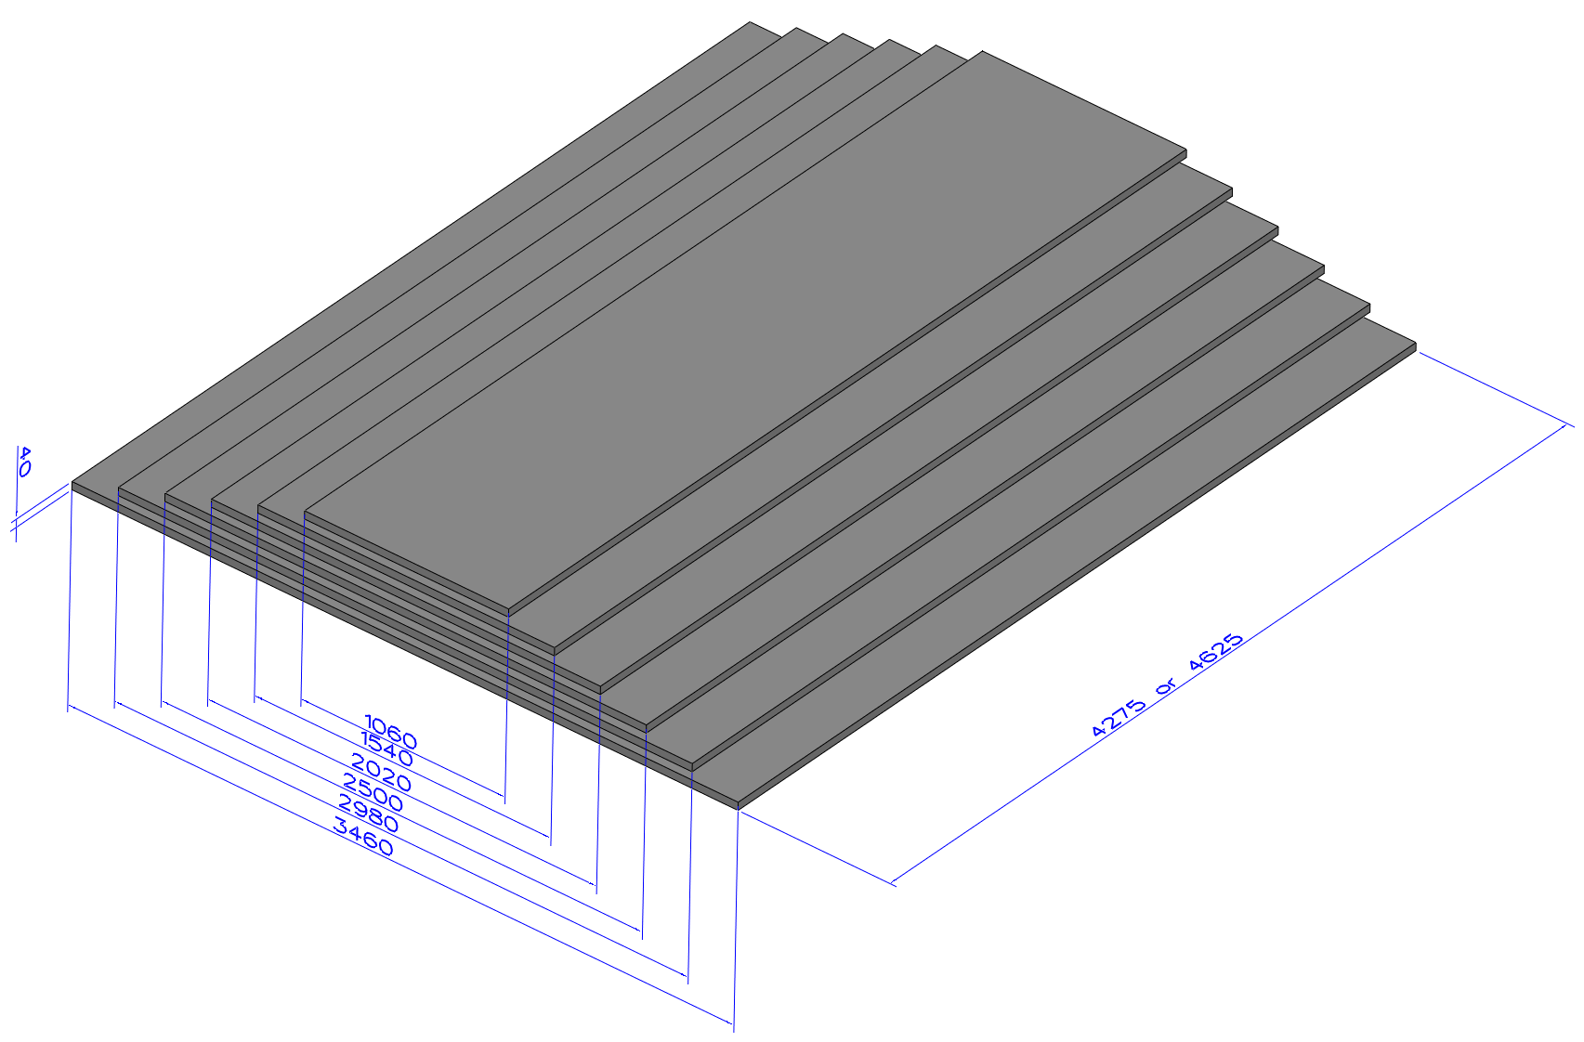

Geometry of Muon detector - Barrel
Geometry: 6 superlayers, to cover the detection as much as possible
  Barrel: Helix dodecagon sectors.
  Rectangle modules inserted between iron plates.
  Cable: towards the gaps between barrel and endcaps.
cables
$L = 4.275m$or $4.625m$
cables
Vary the separation position to avoid dead zone in the middle of barrel.
5185
4245
Will come back to cable and chimney later.
11

Slide 12
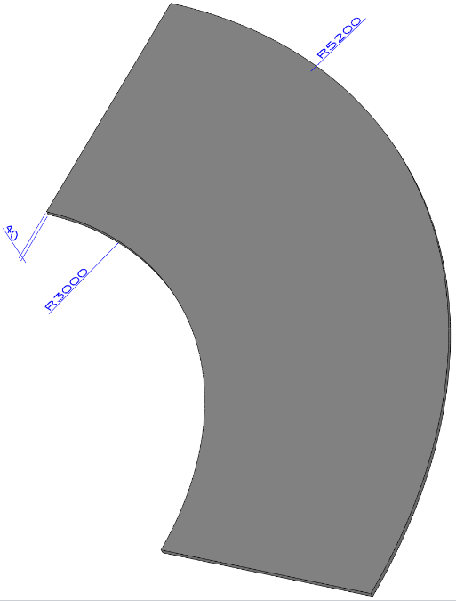
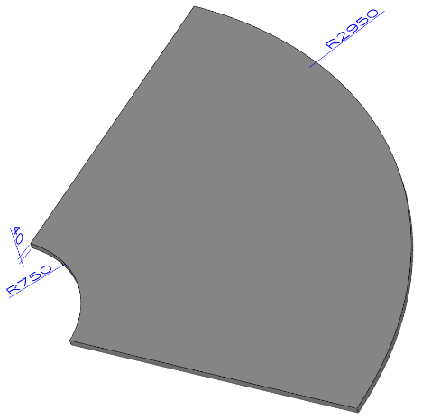
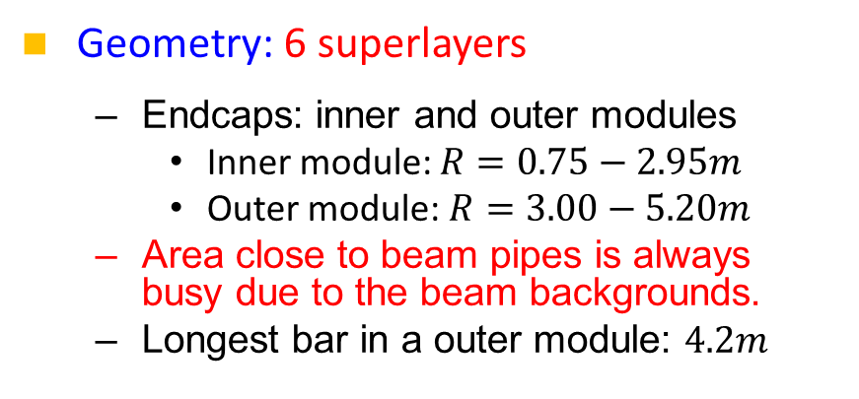
Geometry of Muon detector - Endcap
Geometry: 6 superlayers
  Endcaps: inner and outer modules
    Inner module: $R=0.75−2.95m$
    Outer module: $R=3.00−5.20m$
  Area close to beam pipes is always busy due to the beam backgrounds.
  Longest bar in a outer module: $4.2m$
Outer module
Cables
Windows for cables
Inner module
Will come back to cable later.
12

Slide 13
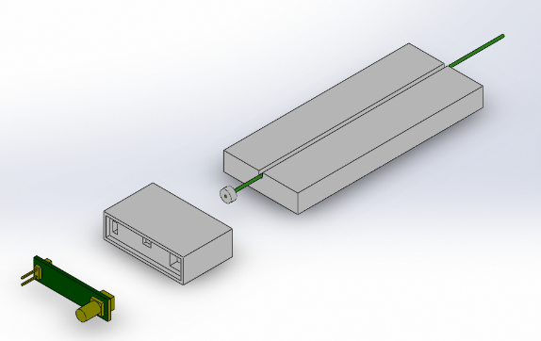
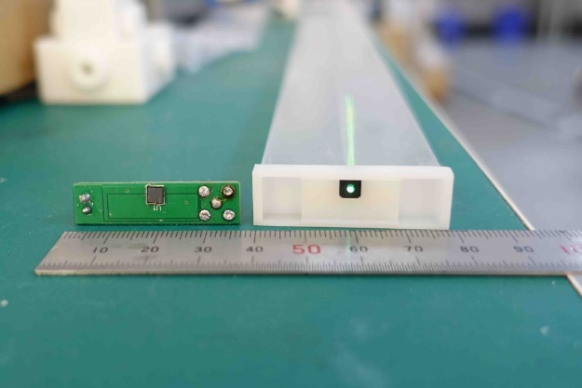
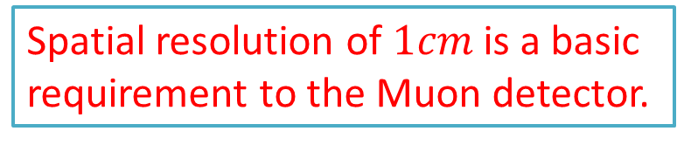
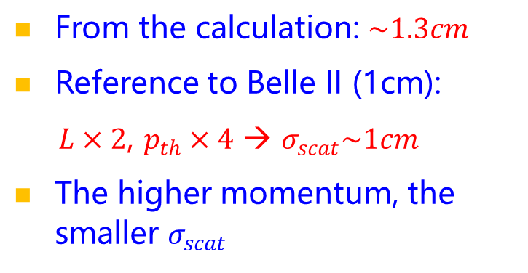
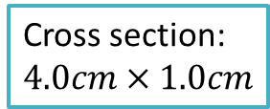
Spatial resolution of $1 cm$
Structure of a detector channel:
  Extruded scintillator, WLS fiber, SiPM
From the calculation: $\sim 1.3cm$
Reference to Belle II (1cm):
$L×2$, $p_{th}×4$ → $σ_{scat}\sim 1cm$
The higher momentum, the smaller $σ_{scat}$
Cross section: $4.0cm×1.0cm$
Spatial resolution of $1cm$ is a basic requirement to the Muon detector.

Slide 14
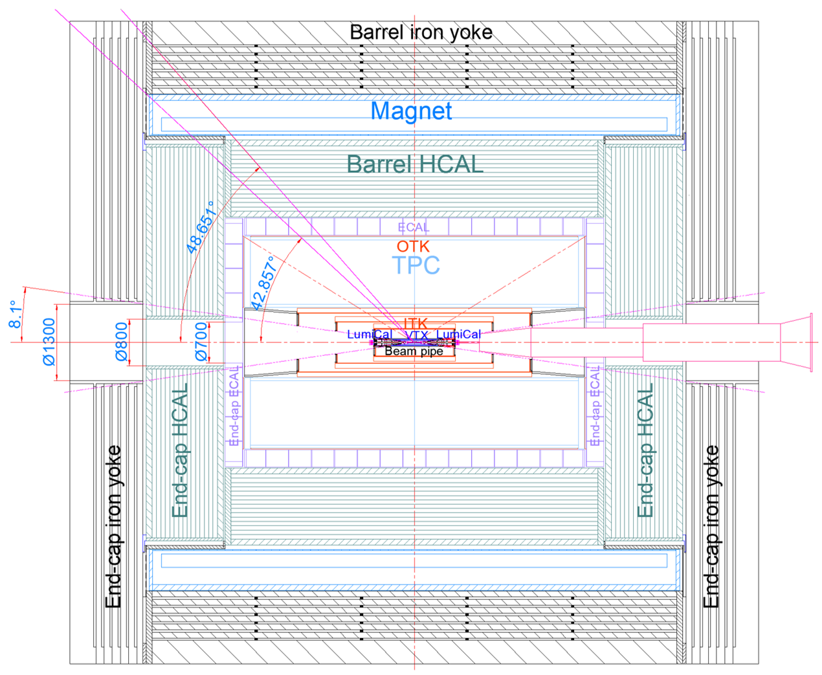
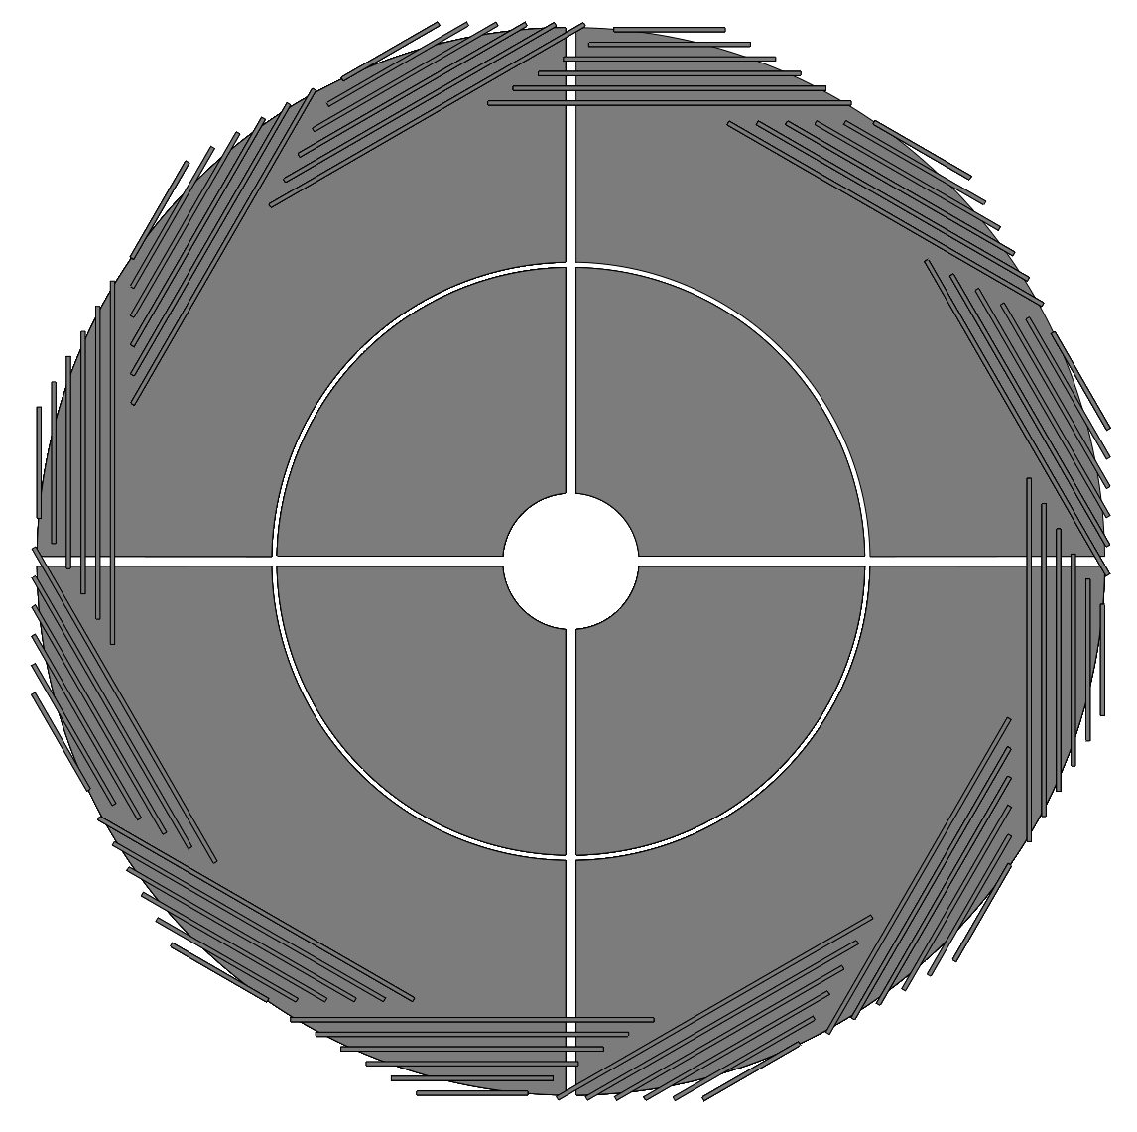
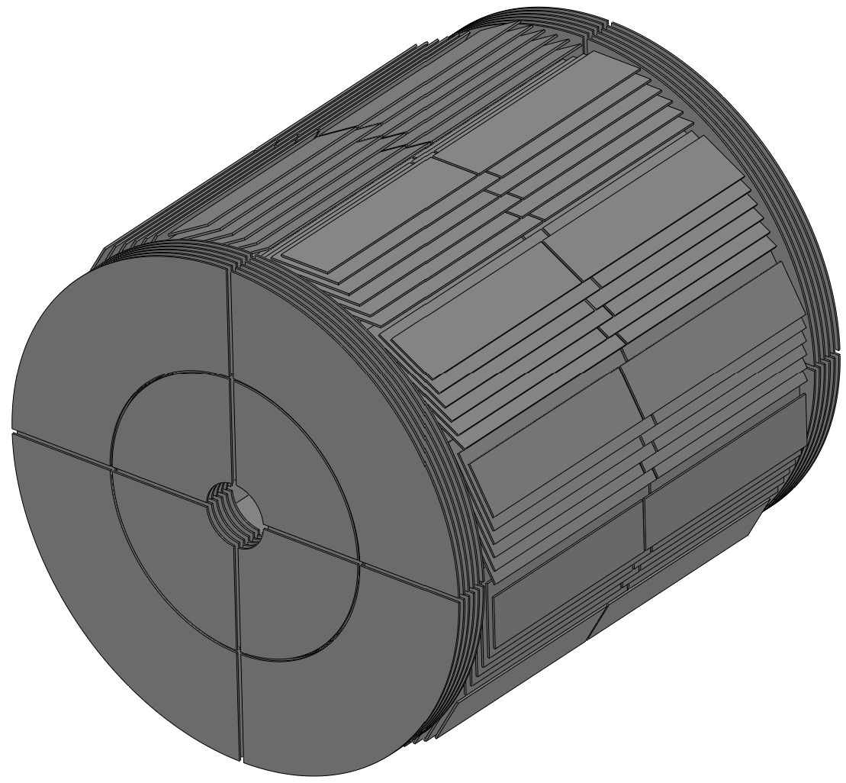
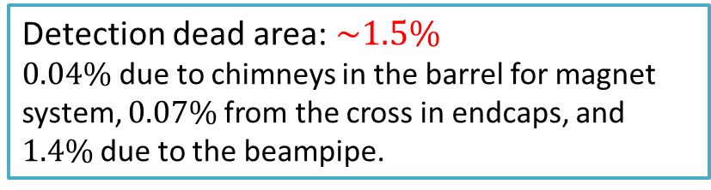
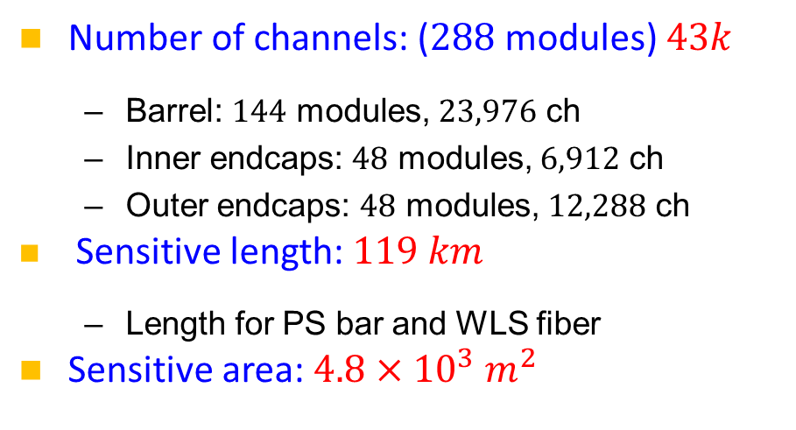
Overall of the design
Number of channels: ($288$modules) $43k$
  Barrel: $144$ modules, $23,976$ ch
  Inner endcaps: $48$ modules, $6,912$ ch
  Outer endcaps: $48$ modules, $12,288$ ch
Sensitive length: $119 km$
  Length for PS bar and WLS fiber
Sensitive area: $4.8×{10}^{3} m^{2}$
Chimney for magnet system
Detection dead area: $\sim 1.5\%$
$0.04\%$ due to chimneys in the barrel for magnet system, $0.07\%$from the cross in endcaps, and $1.4\%$due to the beampipe.
14

Slide 15
Simulation for the performance

Slide 16
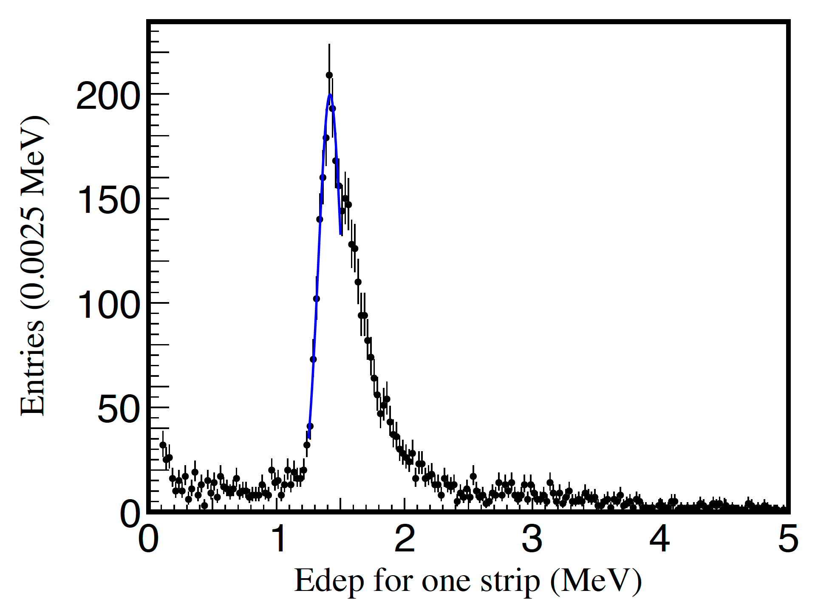
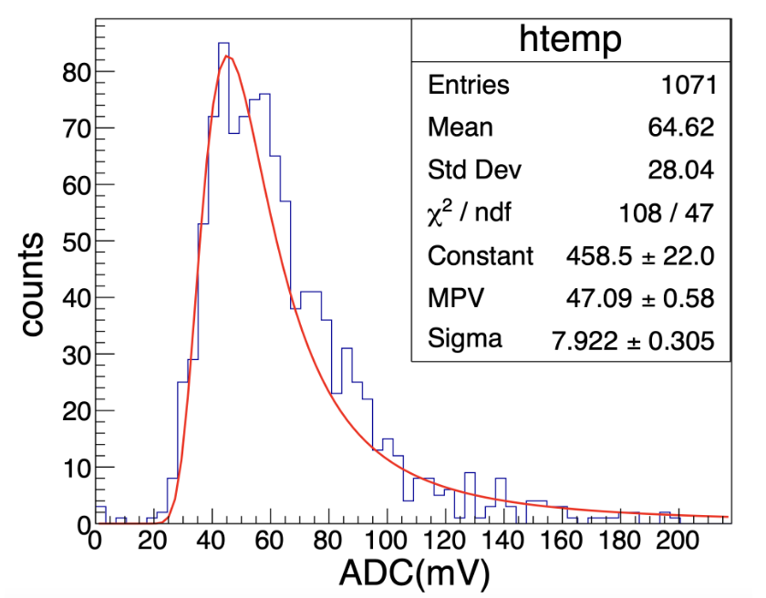
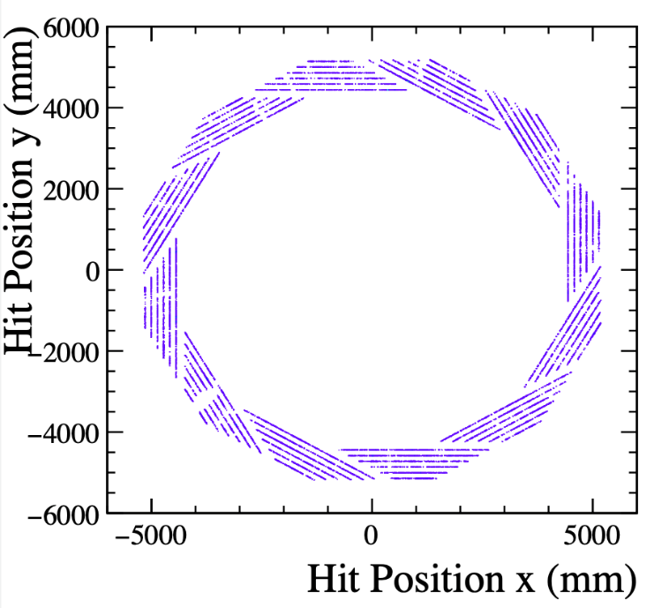
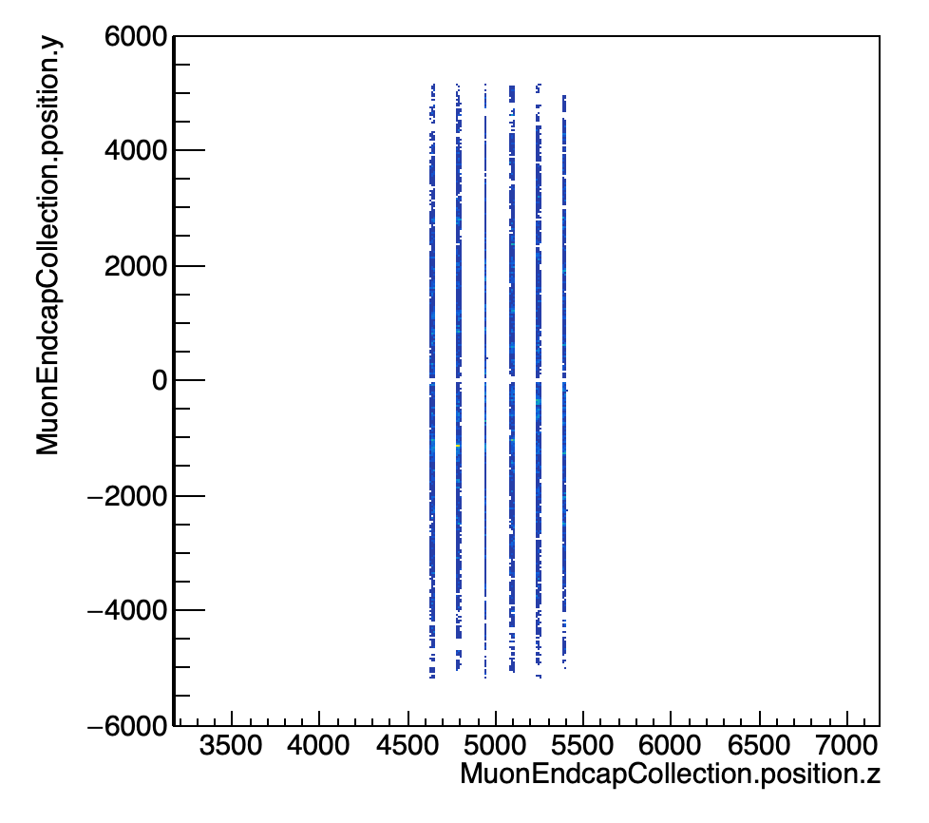
Detector Simulation
Everything based on CEPCSW framework.
Simulation for 10 GeV muons with Geant4.
Muon detector geometry is clearly visible!
Deposited energy peak at 1.4 MeV, similar to CR testing.
[2024 JINST 19 P06020]
Deposited energy from simulation
ADC distribution from CR testing
Hits in Barrel
Hits in Endcap
Digitization from deposited energy to ADC counts
Experimental version implemented:
  A simplified model from deposited energy to ADC counts (Raw hits).
  Efficiency of each channel (~95%) is simulated.
  Pedestal (~1mV) is simulated as well.
  Only for barrel at the moment.

Slide 17
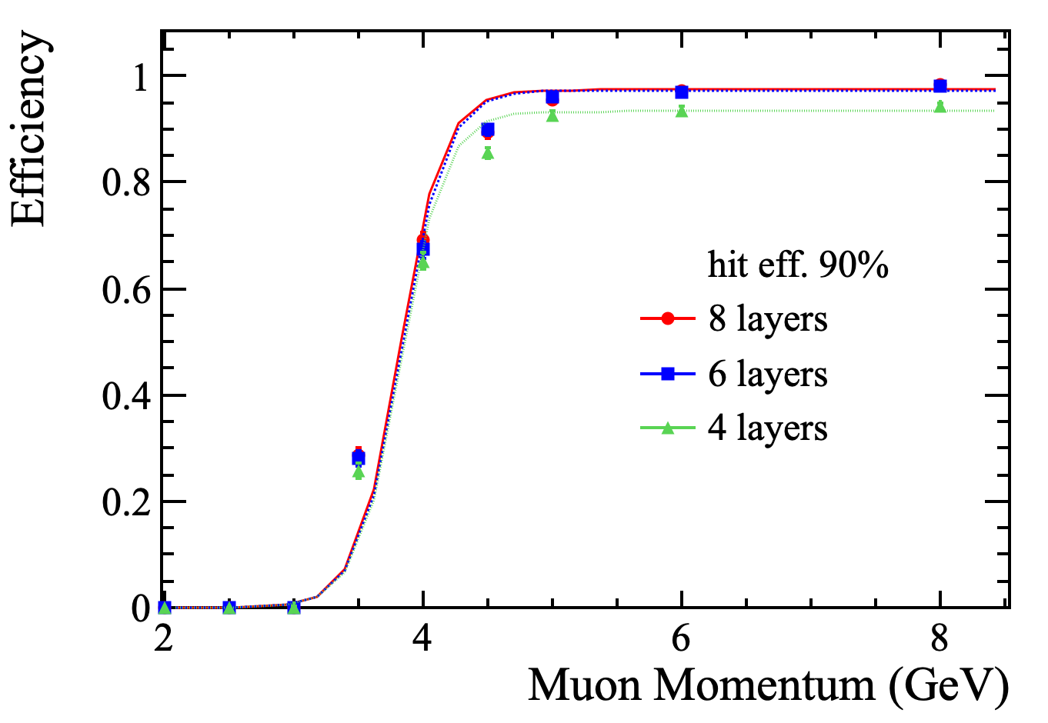
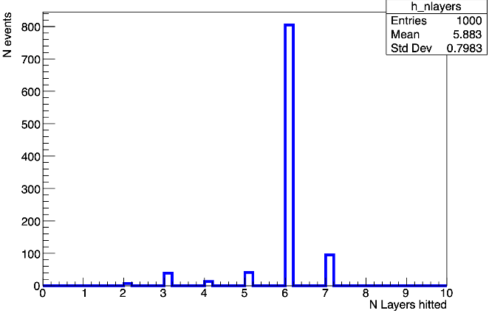
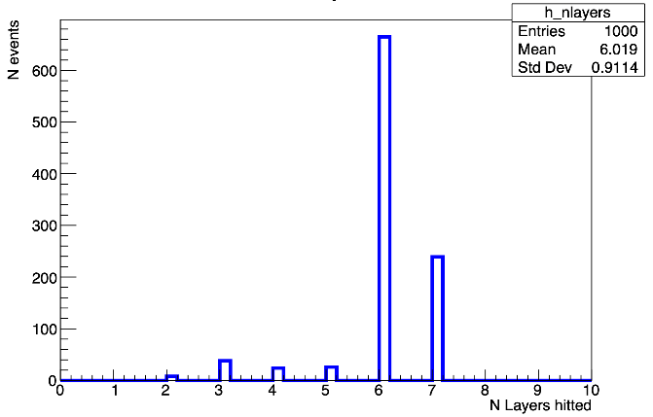
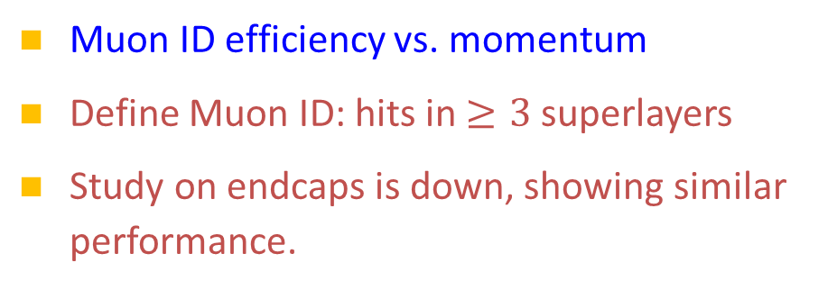
Muon ID from simulation
Muon ID efficiency vs. momentum
Define Muon ID: hits in $≥3$ superlayers
Study on endcaps is down, showing similar performance.
Muon ID efficiency of the barrel
4 GeV
5 GeV
10 GeV
20 GeV
The efficiency threshold is due to the large size of the detector and the magnet field.

Slide 18
Electronics, cabling and installation

Slide 19
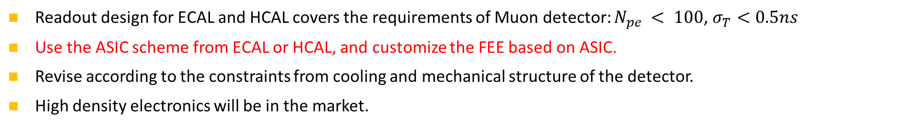
Baseline for SiPM readout
– high density electronis
Readout design for ECAL and HCAL covers the requirements of Muon detector: $N_{pe} < 100$, $σ_{T}<0.5ns$
Use the ASIC scheme from ECAL or HCAL, and customize the FEE based on ASIC.
Revise according to the constraints from cooling and mechanical structure of the detector.
High density electronics will be in the market.

Slide 20
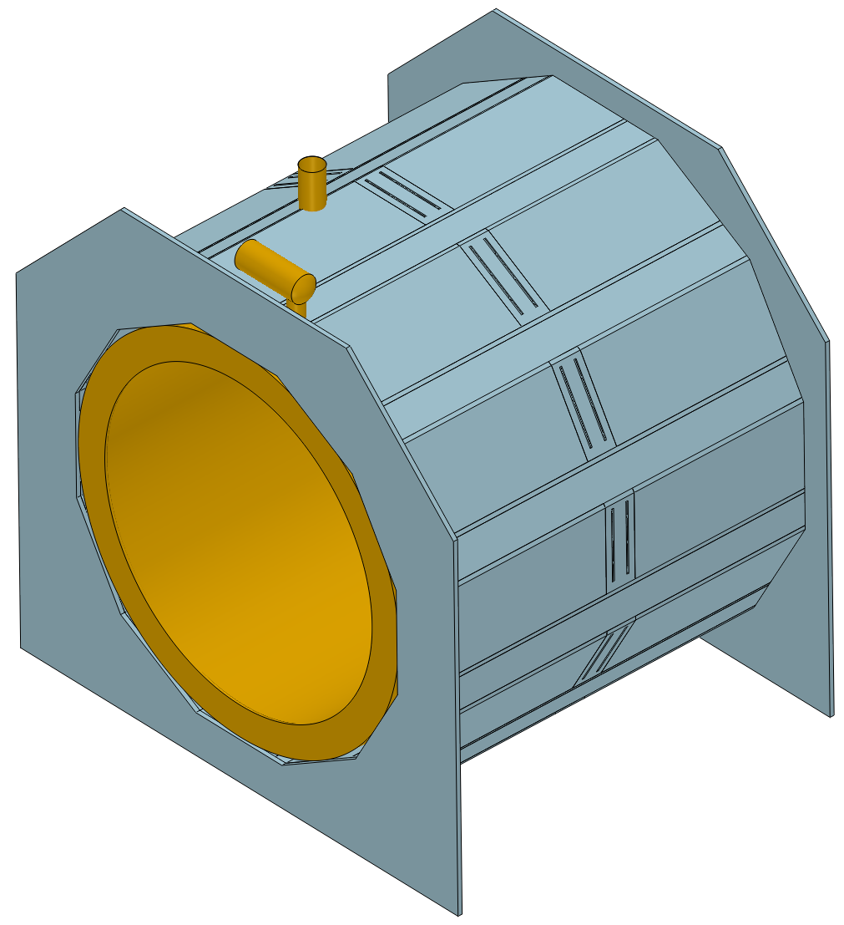
Barrel - installation
Output positions of cables and fibers are at the two sides. To be consistent with other sub-detectors.
Detector module with a high density readout board inside.
Install from the side.

Slide 21
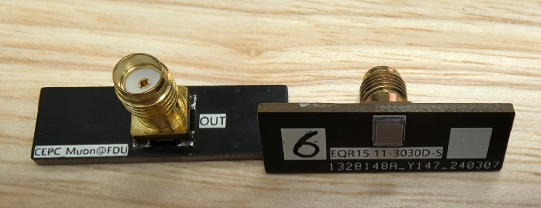
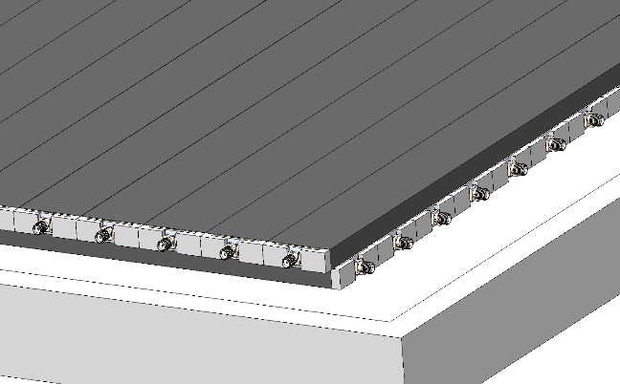

Module and electronics
Detector module
  Superlayer with perpendicular channels
  Carriers for preamps held at the frame
  Space between PS bars and aluminum layer is allowed for long cables.
  All the electronics should be integrated into the module.
Micro-coaxial cable
An example
Board at corner
High Density electronic board, $<10cm×10cm$
superlayer
Hole for 1-2 cables and2-4 fibers
Data output via fibers
Module
Electronic board

Slide 22
Why to use micro-coaxial cable
Cables and fibers
As many as 115 channels, with the longest cable of 4.6 m
SiPM side
High density readout board
As many as 86 channels, with the longest cable of 4.2 m
SiPM side
Similar for the cabling inside the endcap modules.

Slide 23
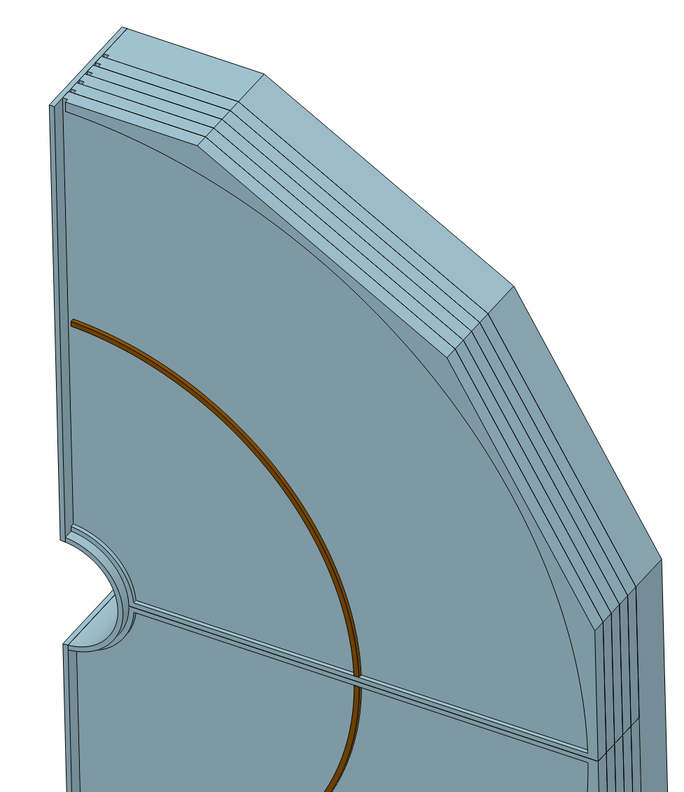
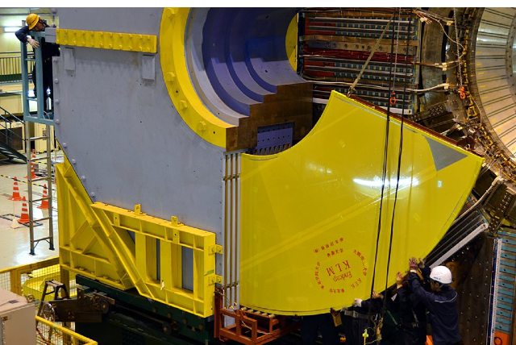
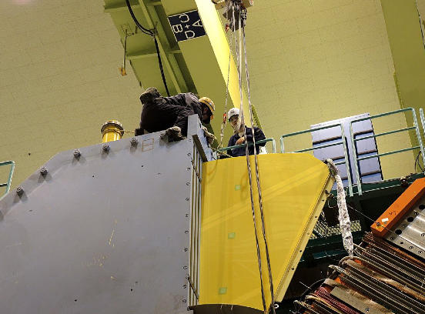
Endcaps - installation
Cables and fibers
Slide Rail and Positioning
Readout boards
Gaps for cables and fibers
reinforcement rib
Slide Rail and Positioning

Slide 24
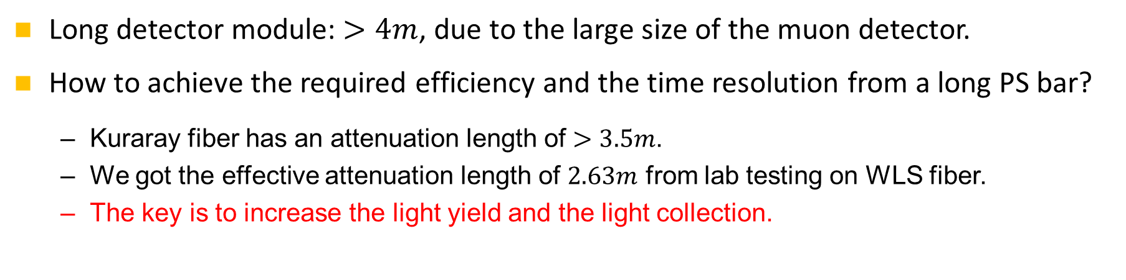
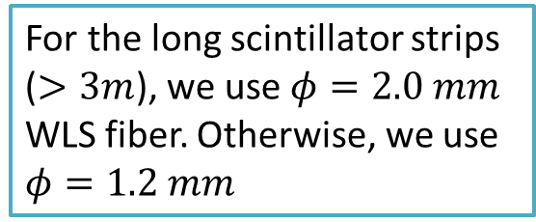
Is it possible to build a long detector module?
Long detector module: $>4m$, due to the large size of the muon detector.
How to achieve the required efficiency and the time resolution from a long PS bar?
  Kuraray fiber has an attenuation length of $>3.5m$.
  We got the effective attenuation length of $2.63m$ from lab testing on WLS fiber.
  The key is to increase the light yield and the light collection.
For the long scintillator strips ($>3m$), we use $φ=2.0 mm$ WLS fiber. Otherwise, we use $φ=1.2 mm$

Slide 25
Some R&D results
Published papers:
Design and performance of a high‑speed and low‑noise preamplifier for SiPM, Nucl. Sci. Tech. 34, 169(2023)
Design and test for the CEPC muon subdetector based on extruded scintillator and SiPM, JINST 19 P06020(2024)

Slide 26
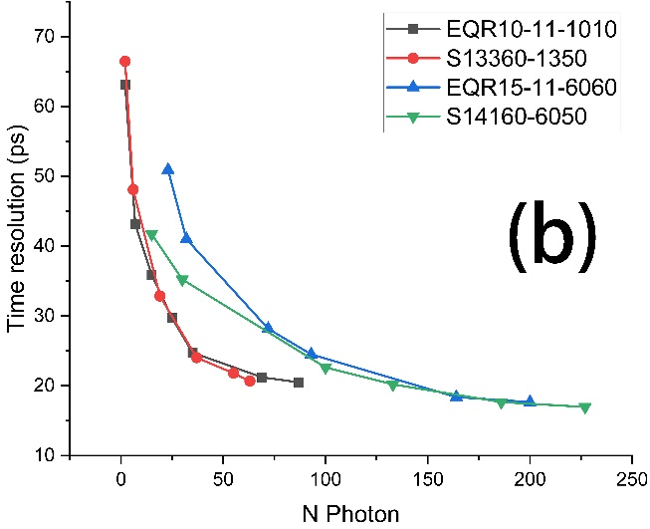
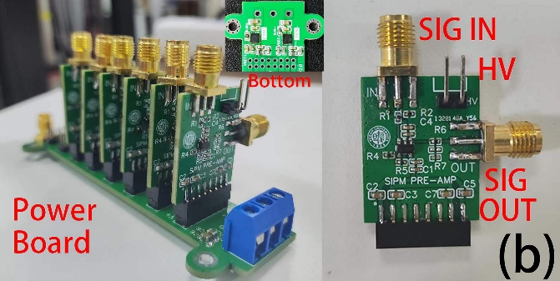
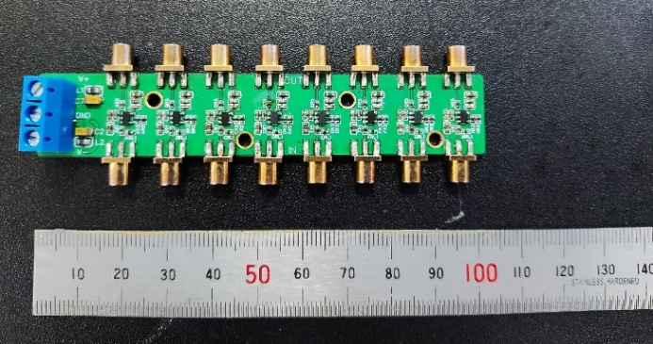


R&D for front-end electronics
Many kinds of preamps for SiPM have been designed and tested.
  Design high‑speed and low‑noise preamp for SiPM.
    Baseline noise of 0.6 mV, bandwidth of 426 MHz, and time resolution of 20 ps.
    Test with laser input at 20MHz.
    Clear $N_{pe}$ spectrum.
NST34,169(2023)

Slide 27




Prototype and CR test
Studies of SiPMs, WLS fibers
Prototype:
  $1.5m$ PS bar + WLS fiber ($1.2mm$) + NDL SiPM/MPPC ($3.0mm/1.3mm$)
Performance:
  $ε>98\%$ can be obtained
  Time resolution better than $1.5ns$
Properties of SiPMs
$1.5m$ PS bars
Effective attenuation length of fiber $L_{Att}=2.63±0.37 m$
NDL SiPM
Time resolution
JINST 19 P06020(2024)
27

Slide 28











Improvements on the scint. strip
Simulation for single channel
  Fiber embedding: groove → hole, $N_{pe}×1.4$
  Diameter of fiber: $1.2mm$→ $2.0mm$, $N_{pe}×2.8$
Very new R&D, like the production in Fermilab.
Fiber embedding: Groove → hole
No new fiber available yet, we use three $1.2mm$fibers.
Optical glue can increase the $N_{pe}$ by 25-30%. Tested!
Use NDL EQR15 $3mm×3mm$
$1.65m$ new scint with $2.5mm$ diameter hole
Without optical glue
Trigger at middle
$$σ_{T}<1ns$$
$$ε=95\%$$
New scintillator provided by GNKD, with our R&D!
Scintillator production at Fermilab
Very positive to the design of long module ($>4m$).

Slide 29

Summary
Muon detector will be designed for muon ID, but not limited to this.
Detailed design:
  Barrel: 6 layers, 2 long modules per layer, helix dodecagon
  Endcaps: 6 layers, 4 sectors per layer, two modules (inner and outer) per sector
  Large area modules with long PS bars.
  $43k$ channels, $4.8×{10}^{3} m^{2}$ area, and $119 km$ long fiber, in total.
Consideration in details: electronics, cabling, and installation.
R&D on detector channel shows very good performance.

Slide 30
Thank you for your attention!
Oct. 21st, 2024, CEPC Detector Ref-TDR Review

Slide 31



About track reconstruction
Preliminary
Tracking in the muon detector may be used to rescue some energy leakage of HCAL:
  Magnet field in the iron layers can be simulated;
  Most charged particles in the tail of a hadronic shower are $π^{±}$ and $μ^{±}$.
  If we can reconstruct the momentum of these charged particles, or add their masses, at least.
Tracking in the Muon detector can extend the search of LLP from $L<3.5 m$to $L<4.9m$.
Hadron cluster
Magnet field in Muon detector

Slide 32





And the chimneys for magnetics

Slide 33









Add chimneys
Input the chimneys of the magnet system.
It contributes a dead zone of <0.4%.
Modify the module, or remove the structural ribs
Divided into three modules: A(middle), B (small), C(large)

Slide 34


Detector Optimization
Muon id efficiency vs. momentum
Define Muon ID: 3 or more hits reconstructed in the muon detector
Efficiency vs number of layers
Observation:
  6 layers and 8 layers show almost same efficiency: ~98%
  4 layers efficiency is too low: ~94% ($ε\sim 95\backslash \%$ of one channel is not included)
Discussion：
because layer 7 and 8 are very short, do not add much on the total coverage.
Barrel

Slide 35
Positions of electronic boards
Vary the positions in different layers to reduce the dead zone.
High density electronic boards

Slide 36

Endcaps - installation
Cables and fibers
Slide Rail and Positioning

Slide 37
New PS bar with optical glue
1.65m long bar, with 3 WLS fibers.
Trigger at far end.

Slide 38



Stage scheme (M x N x O)
SiPM
AMP
Discri
TDC
8~16 ch
TaoTie
Data Aggregation & Data Buffering & Event Building
ChiTu Data Interface
KinWoo
Optical Module
TDAQ
LV-3
LV-2
LV-1
LV-2
HV-1
HV-Filter
HV-2
FEE
xM
xN
xO
Example:
For each module
For each ch
For each sector

Slide 39
Alternative: discrete device scheme
FEB (Front-end Electronics Board)
  Commercial chips with radiation tolerance based on past studies for particle physics experiments
  FPGA based TDC for TOA and TOT measurement with ~1 ns time resolution
  ADC for charge measurement or TOT calibration
  DAC for threshold setting or SiPM bias voltage adjustment

Slide 40

Near-term test environment
Reuse JUNO-TAO electronics for readout, clock synchronization and TDAQ
  To accelerate the development schedule
FPGA board
MPT2321 chip
HDMI + Power control

Slide 41
Bandwidth requirement
Muon | Readout Channel | Hit rate/Hz (preliminary worst case) | Data format | Raw data rate / Gbps
Barrel | 23976 | 10 k | 48bit (8b BX+ 10b ADC + 2b range + 9b TOT + 7b TOA+ 4b chn ID + 8b chip ID) | 11.51
Inner endcaps | 6912 | 10k~100 k, Average 20 k |  | 6.64
Outer endcaps | 12288 | 10 k |  | 5.90
Total | ~43.2 k |  |  | ~24.04
Very preliminary, conservative estimation according to data from Belle II experiment.
We assigning a faculty to take care of this issue.

