Slide 1
Progress of HCAL mechanical design
Pei Yatian，Zhang Junsong
On behalf of HCAL and Mechanics group

Slide 2
Outline
Overview of HCAL structure
Components, cable routing and installation of active layer
Cooling structure
Overview of cable and pipe routing
Next plan
Mainly focused on detect box design and installation, cable and pipe routing

Slide 3
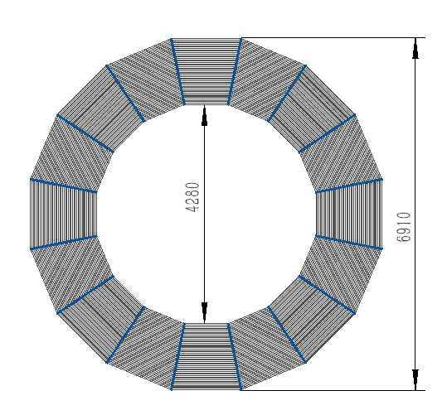
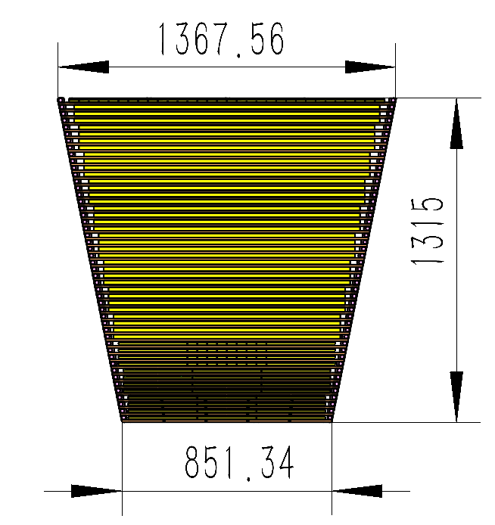
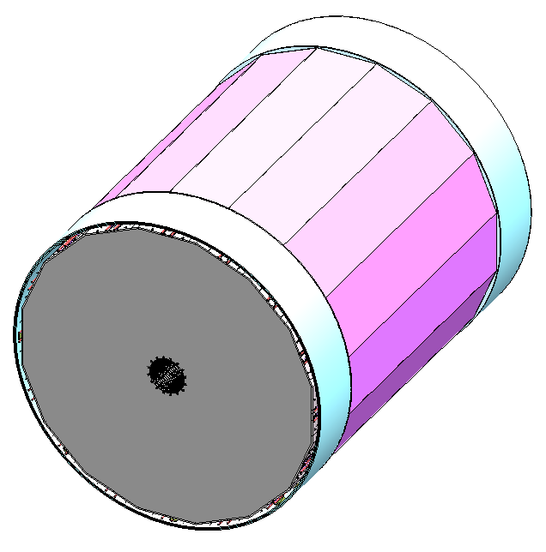
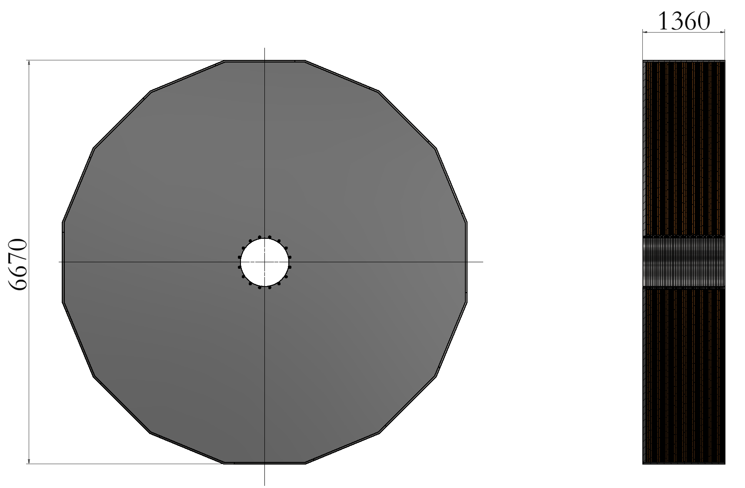
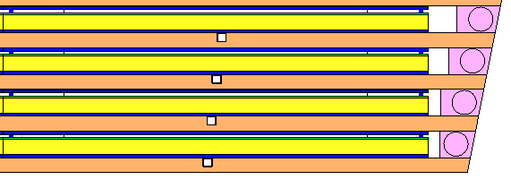
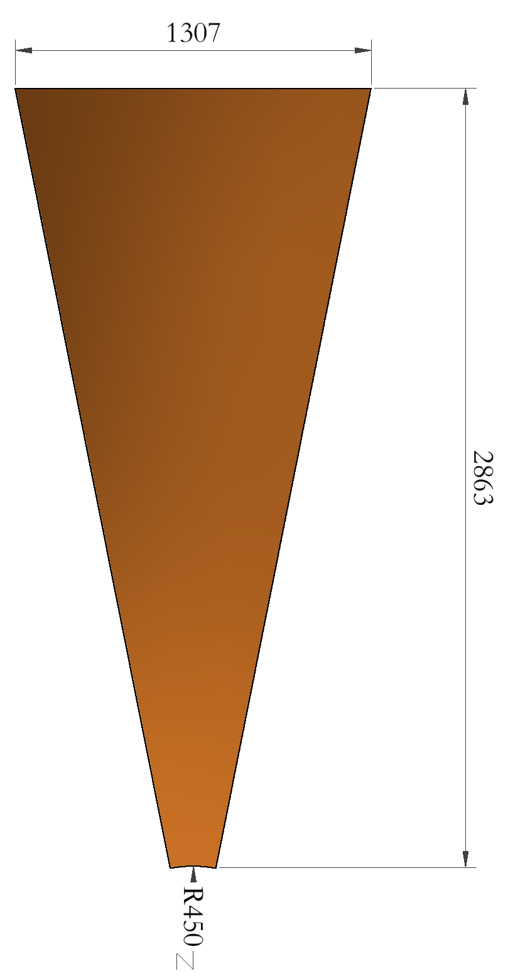
Overview of HCAL structure
General
Barrel HCAL
Support ring
1 wedge
End HCAL
Absorber layer (9.8mm)
Active layer
(17.4mm)
Bottom support plate （50mm）
Absorber layer (9.8mm)
Active layer
(17.4mm)
Trapezoid plate
Support stiffeners
1 wedge

Slide 4
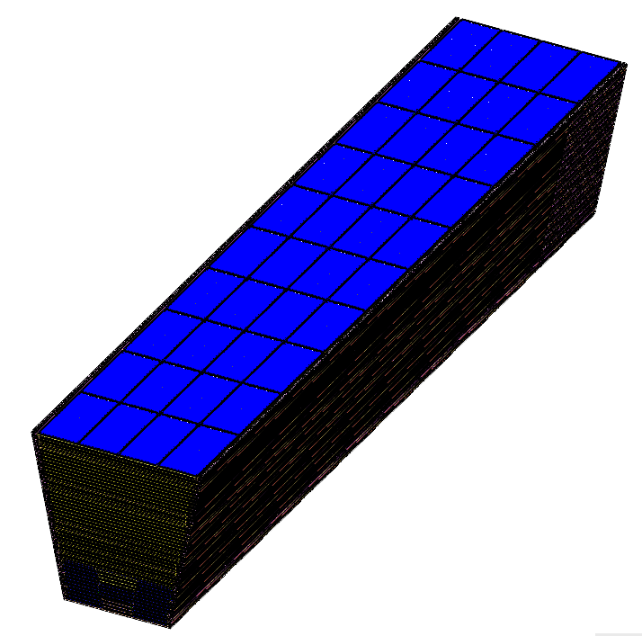
Overview of HCAL structure
Mainly focused on detect box design and installation, cable and pipe routing
Challenges of mechanical design:
(1)How to arrange the cables to ensure not increasing the dead zone area?
Cables are located in box, no other space are occupied
(2)How to control the temperature uniformity of key components?
Water cooling pipe
Box

Slide 5
Components, cable routing and installation of active layer

Slide 6
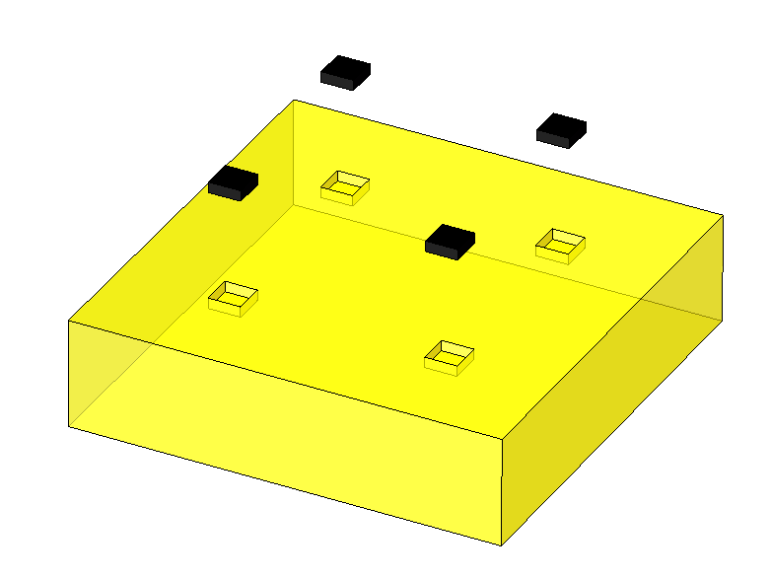
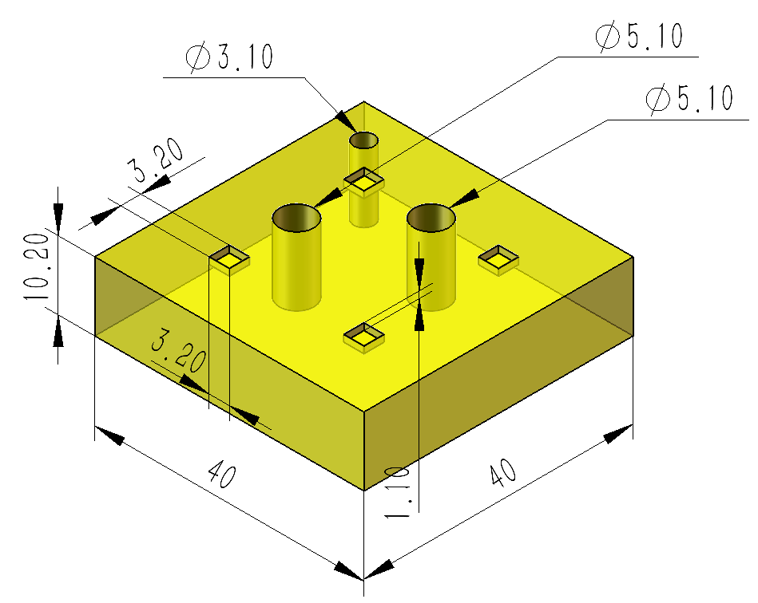
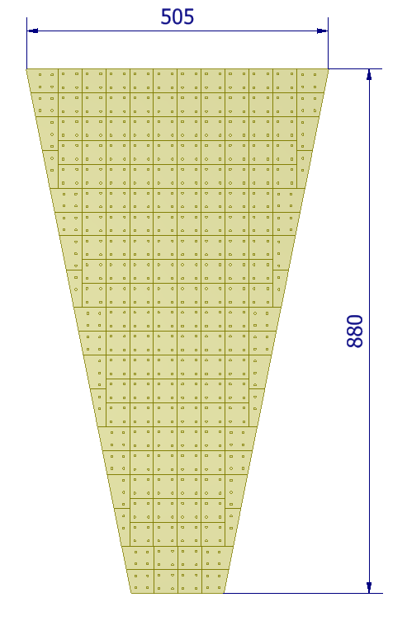
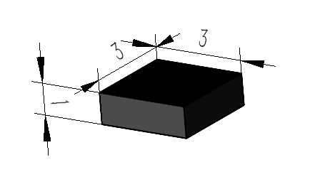
One cell
Cell:
One cell consists of 4 SiPMs and one glass scintillator
Normal one:
40mm*40mm*10.2mm
Corner glass scintillator: there are four pyramid-shaped holes to locate SiPMs
Trapezoid glass scintillator: there are four kinds of trapezoid glass for end HCAL
SiPM

Slide 7
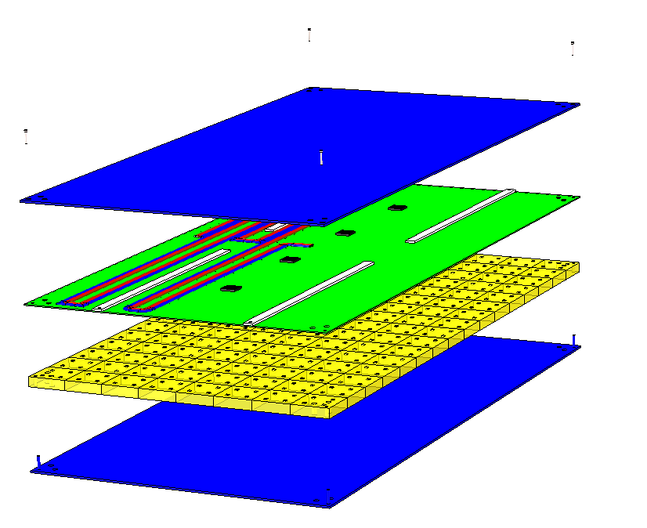
One box-barrel
4-M1.6 bolts: Connecting the components of each box
Upper cover plate
2.2mm gasket: Playing a role of buffer layer to prevent ASIC chip from being compressed by upper cover plate
Cables：the longest one is about 2.9m
ASIC chip：One chip corresponds to 32 or 28 channels.
One channel corresponds to one glass scintillator.
PCB plate: gasket is glued on it
Cell：128/112/96 cells in one box, SiPM is welded on PCB plate
Bottom cover plate
Barrel HCAL box

Slide 8
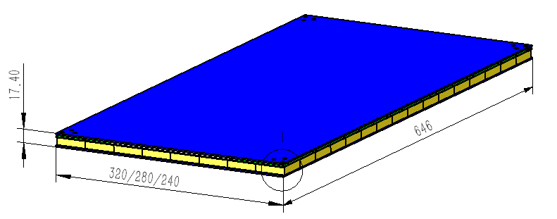
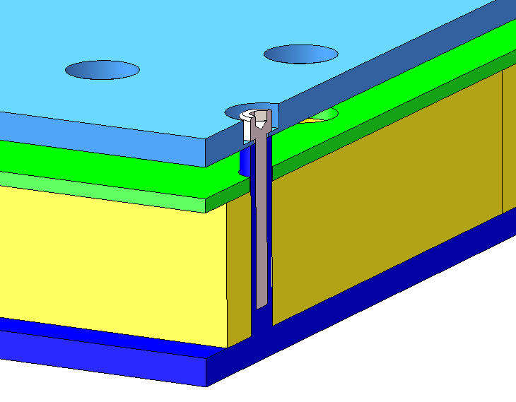
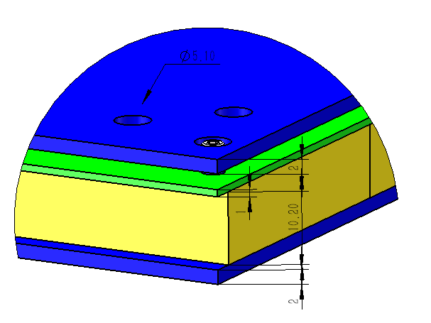
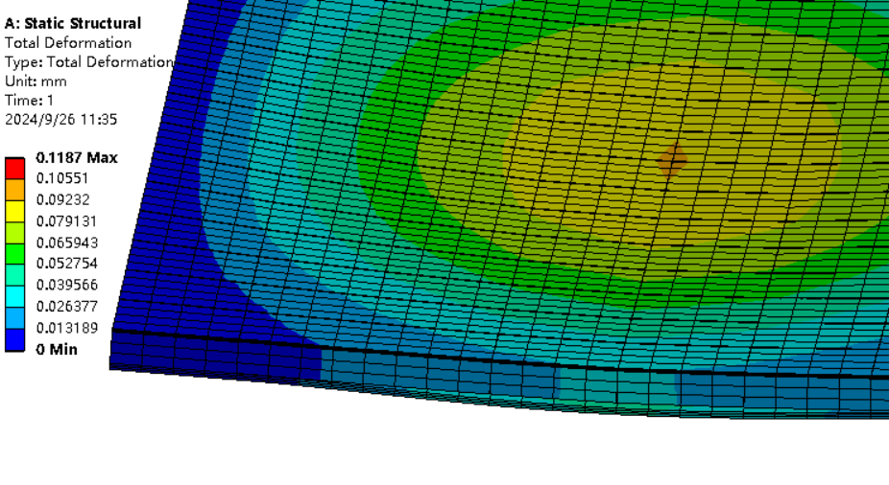
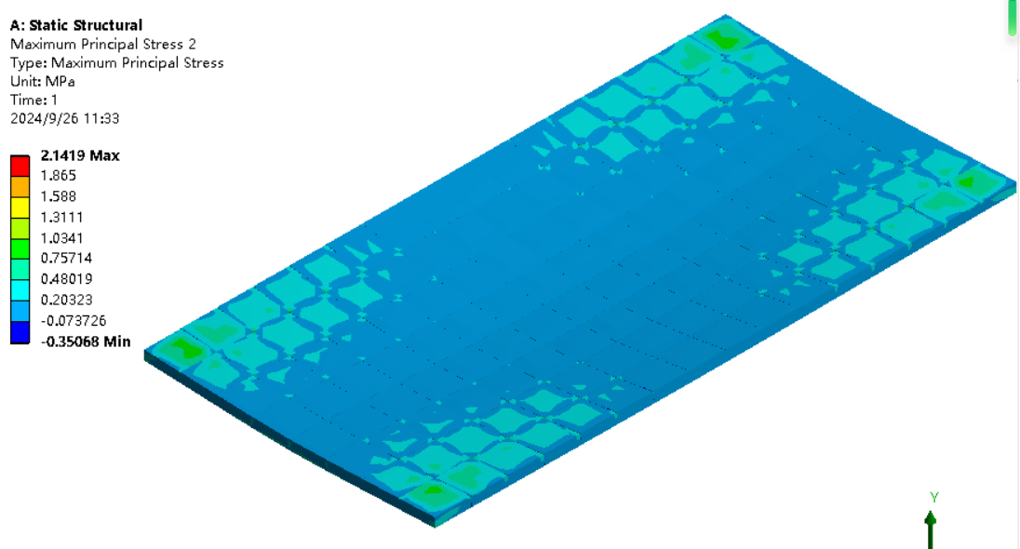
One box-barrel
counterbore
M1.6 bolts
Two φ5.1 holes：
Connecting absorber layer
Inside thread pin
Maximum principal stress 2.1MPa of GS
Maximum deformation
0.11mm
Gravity condition during moving

Slide 9
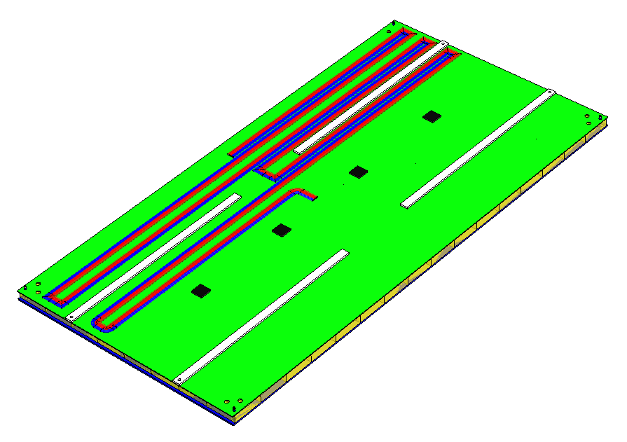
Cable of one box-barrel
5 cables of each box
Cables need to be collected within one box when leave factory
Each of them is 2mm in diameter
Cable length: 0.4m~2.9m
Cables are located between upper cover plate and PCB plate

Slide 10
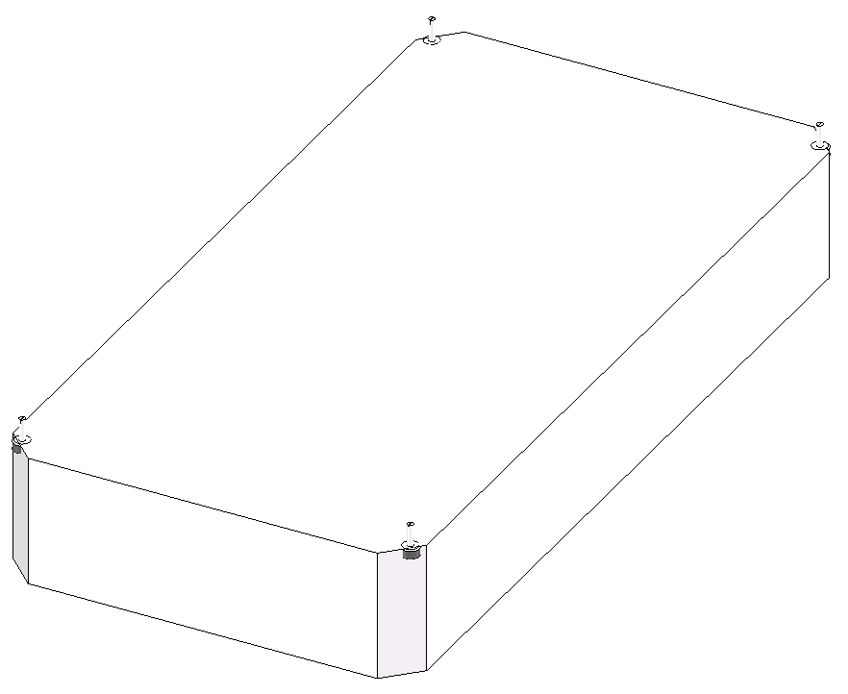
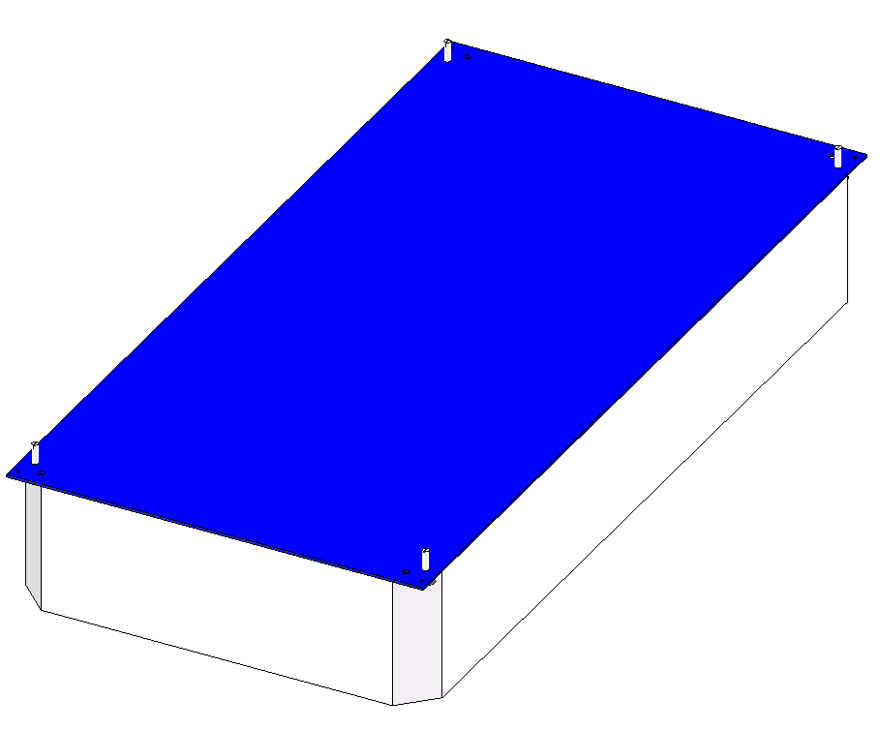
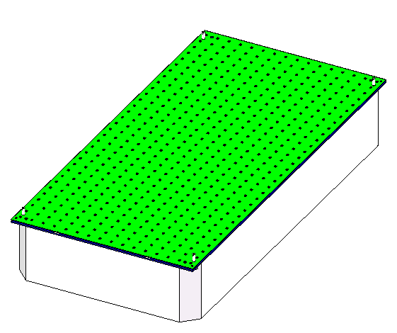
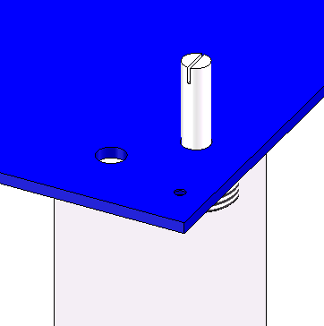
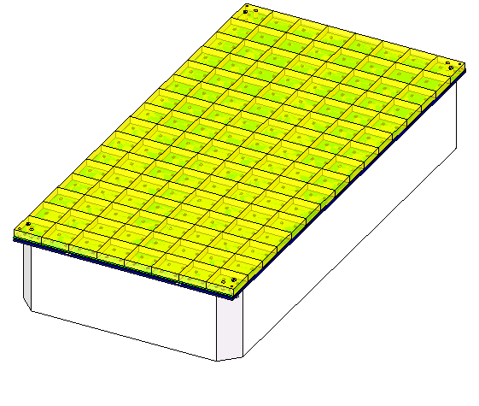
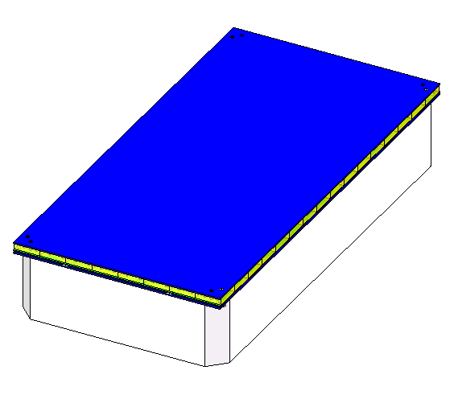
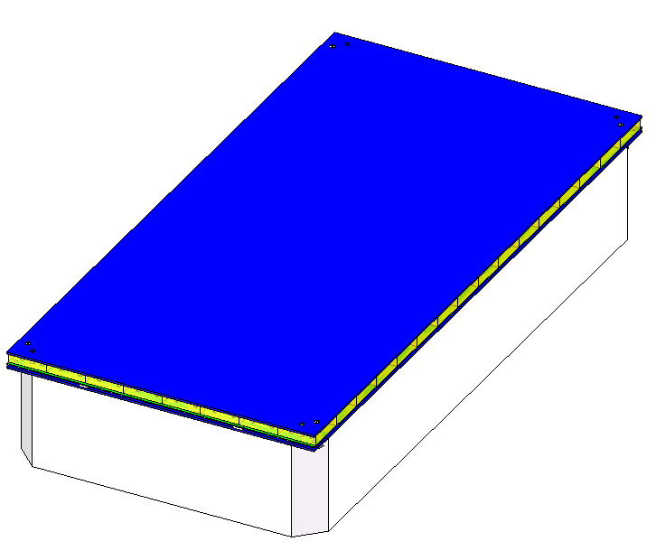
How to assemble one box-barrel
4 locating pins
Assembling PCB plate
(SiPMs and chips are pre-welded on plate)
Assembling platform
Assembling upper cover plate
Reverse assembling: Need to be turn-over
Gluing glass scintillators
Assembling bottom cover plate
Assembling four M1.6 fixing bolts

Slide 11
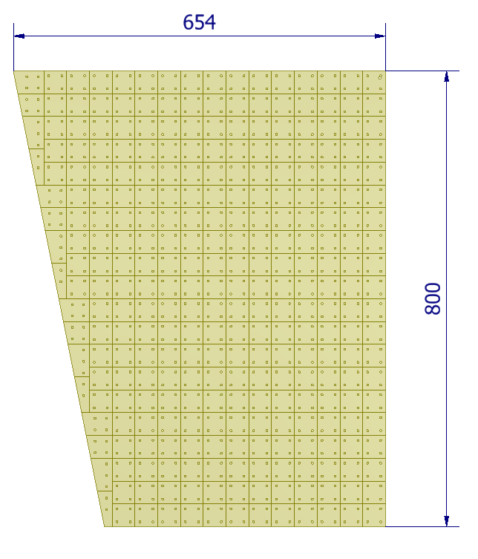
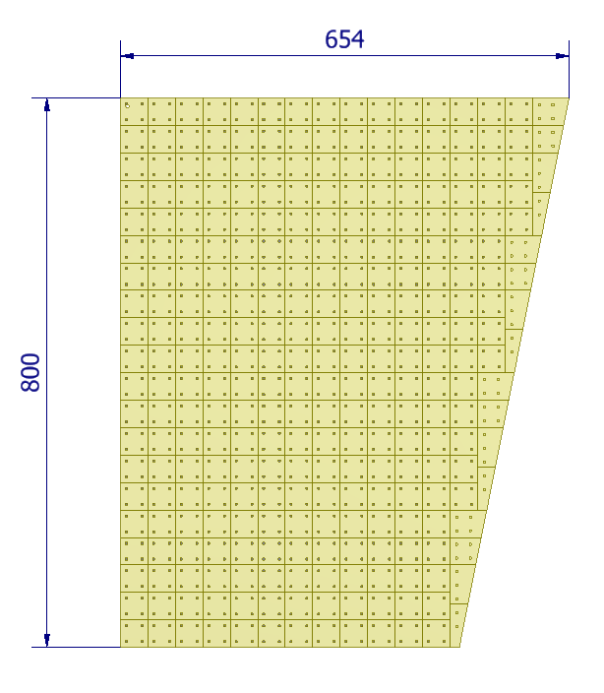
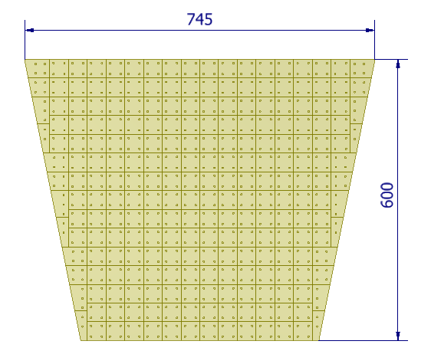
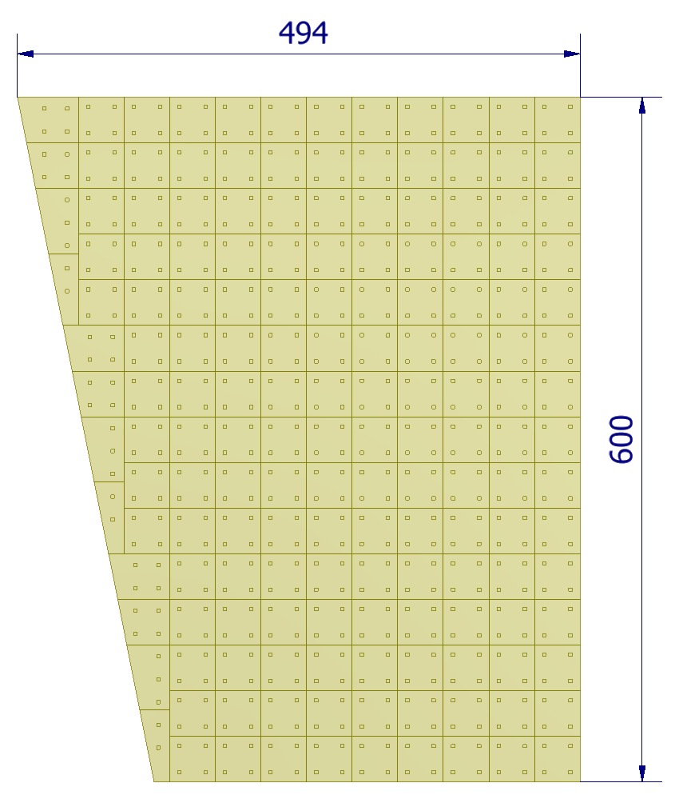
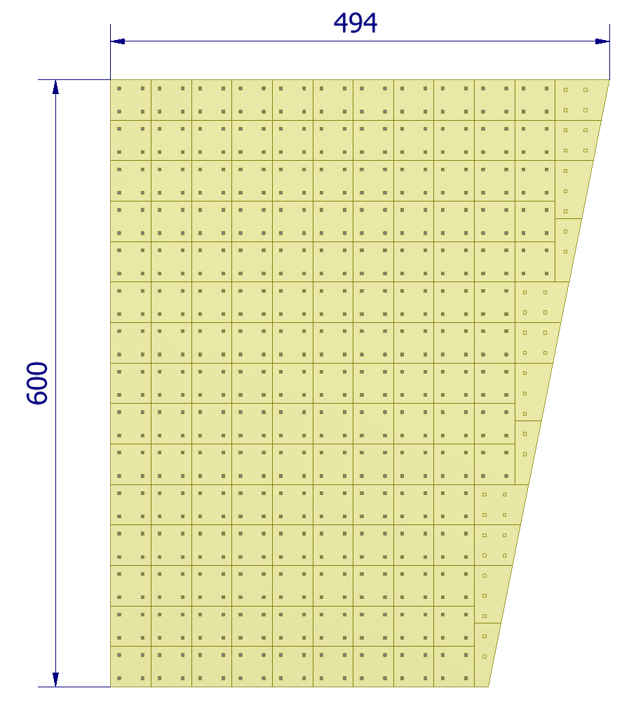
One box-end HCAL
286 glass scintillators
286 glass scintillators
258 glass scintillators
174 glass scintillators
174 glass scintillators
274 glass scintillators
End HCAL box: four kinds of boxes

Slide 12
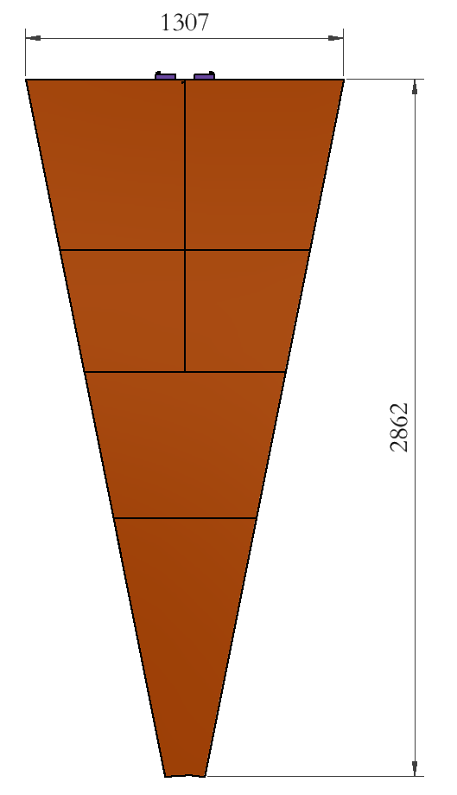
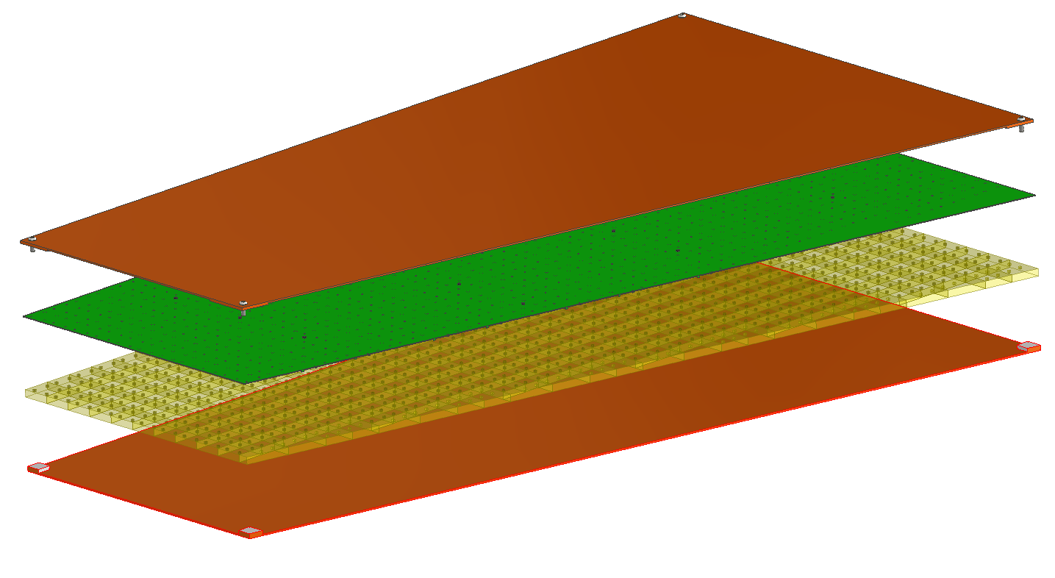
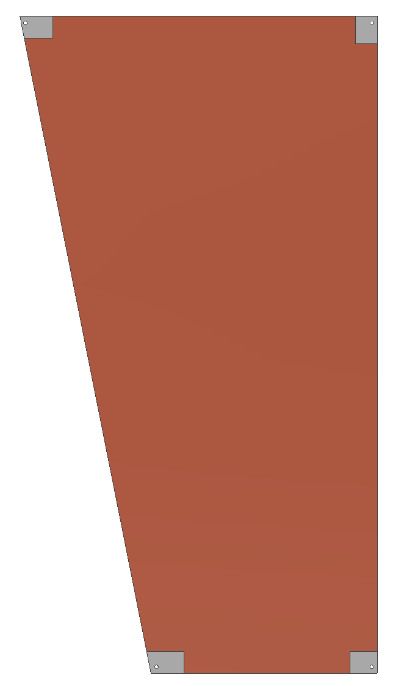
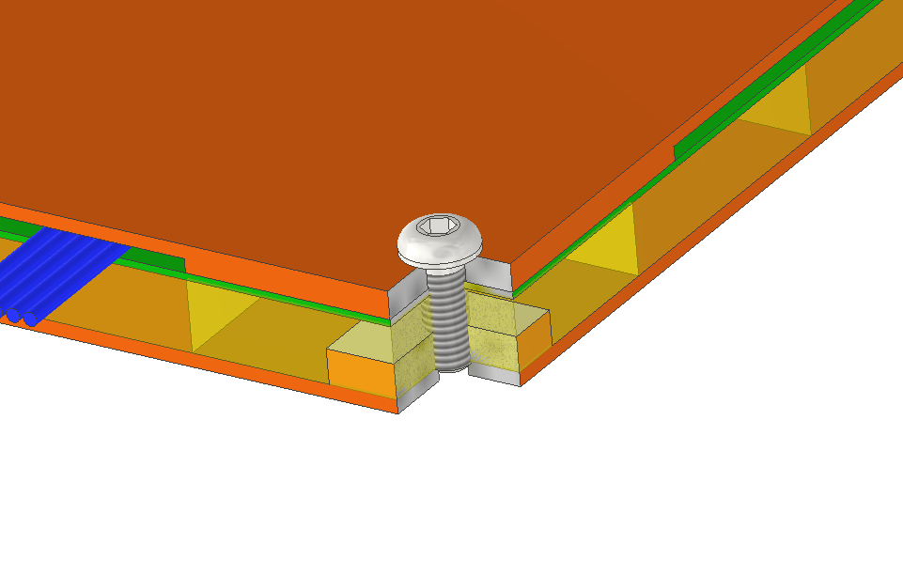
One box-end HCAL
upper cover plate
PCB & chip & SiPM
Glass scintillator
lower cover plate
4 types Box
2mm boss
Avoid compression between cover plate and chip
There are 6 boxes in one module
1452 glass scintillators
M6 bolted connection

Slide 13
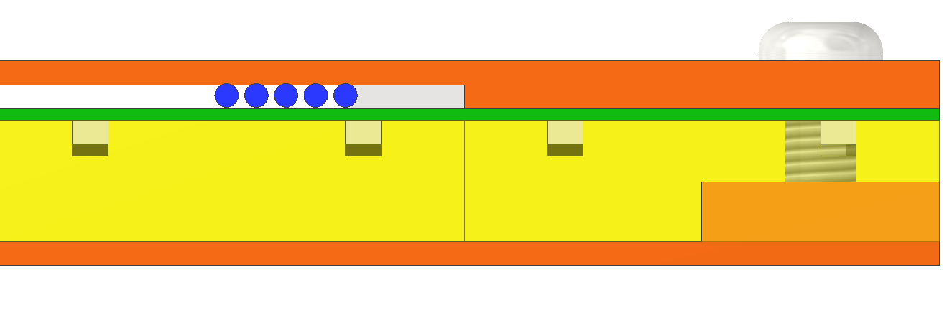
Cables of one box-end HCAL
12mm
5 cables of each box
Cables need to be collected within one box when leave factory
Each of them is 2mm in diameter
Cables are located between upper cover plate and PCB plate
Box assembling procedure is same with barrel HCAL

Slide 14
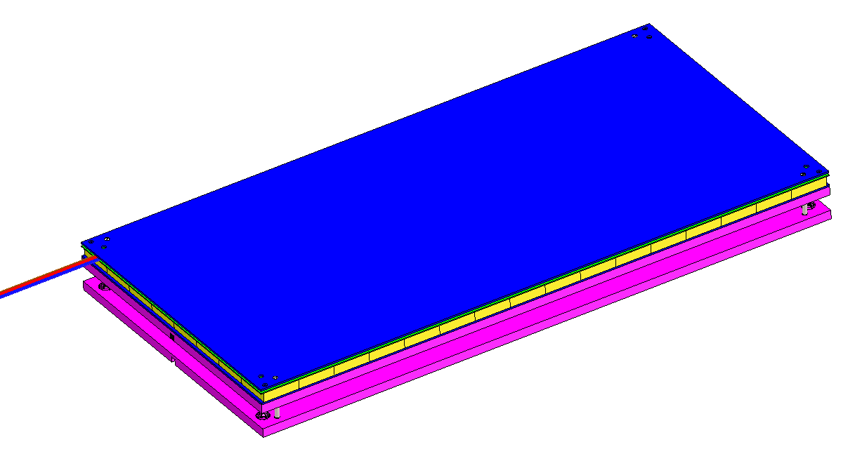
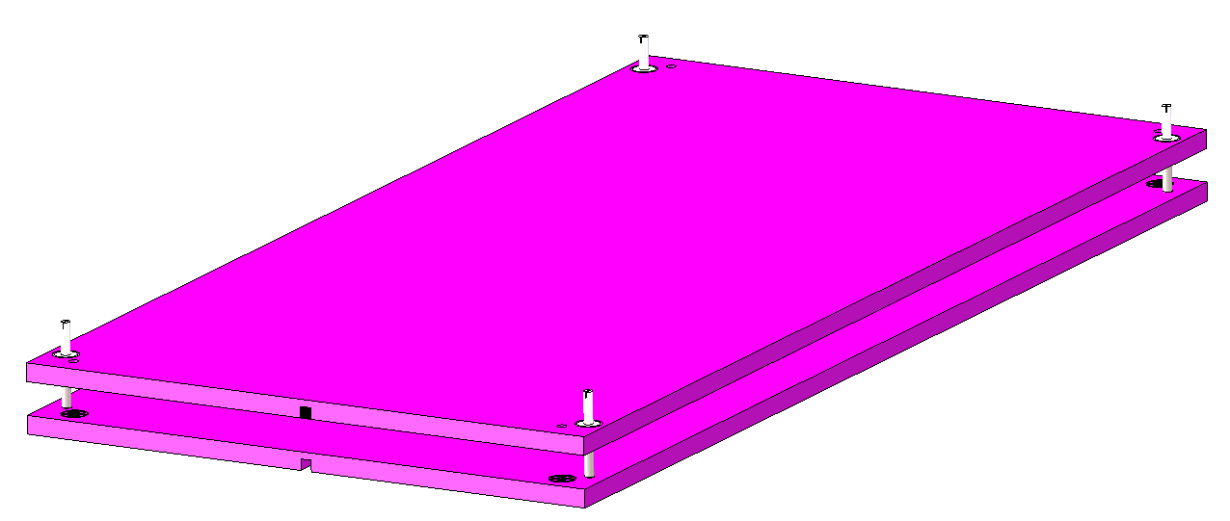
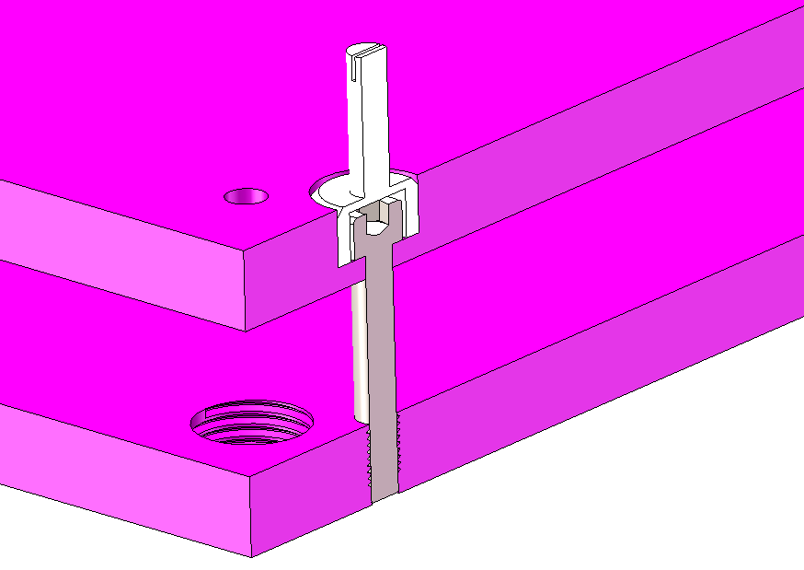
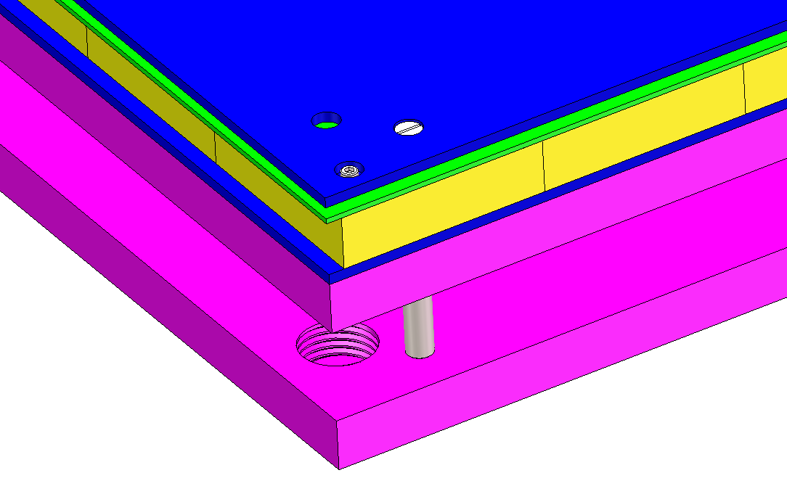
How to install one box-barrel
4 locating pins
Φ5 bar
pin
M14 thread
4-M5 bolts used to fix two neighbor absorber layer
Positioning the box

Slide 15
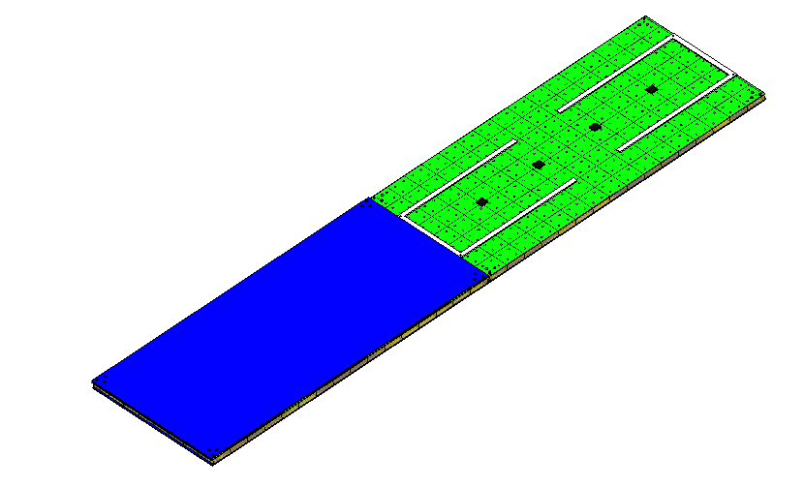
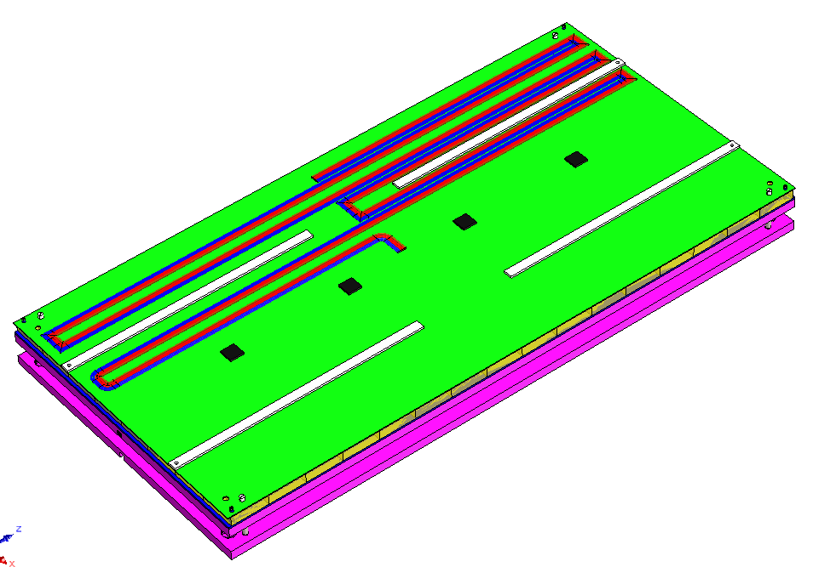
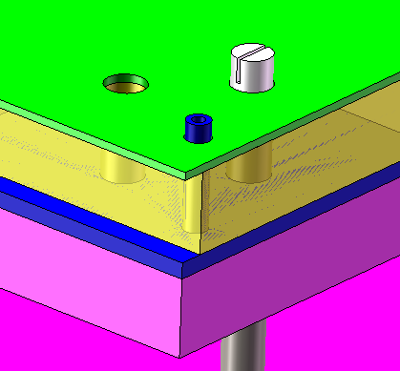
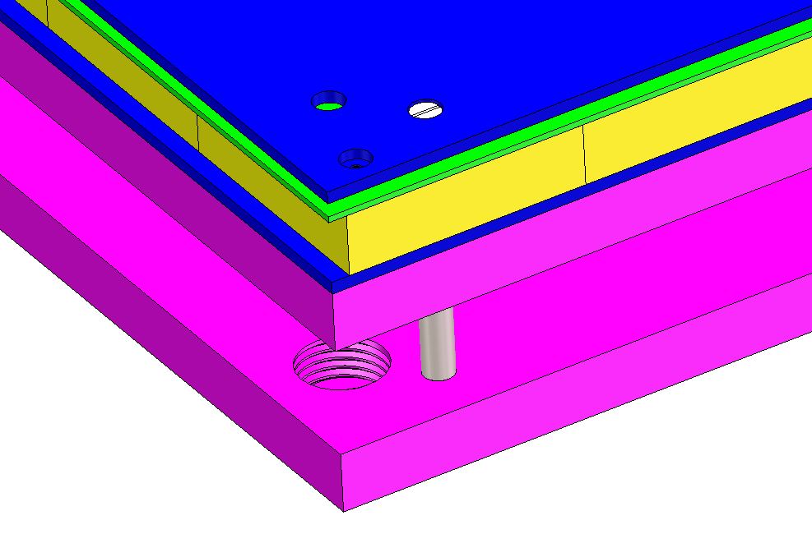
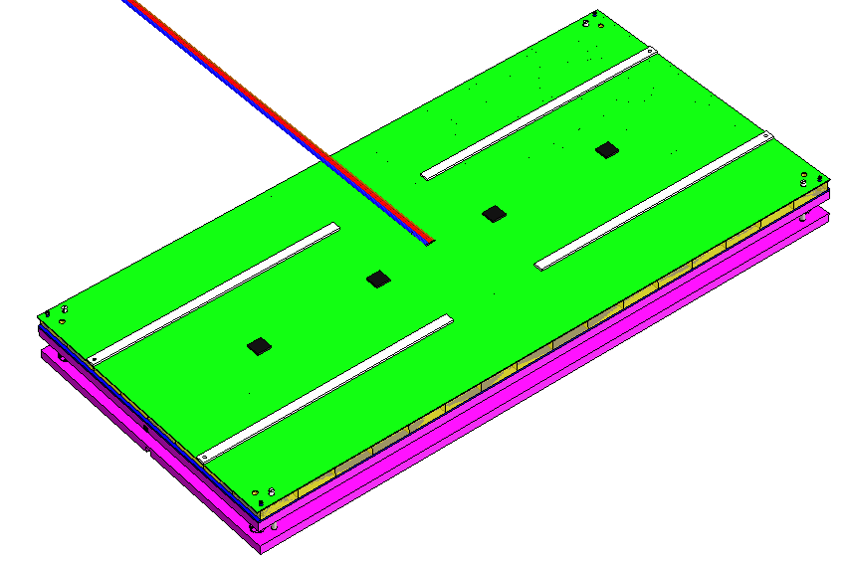
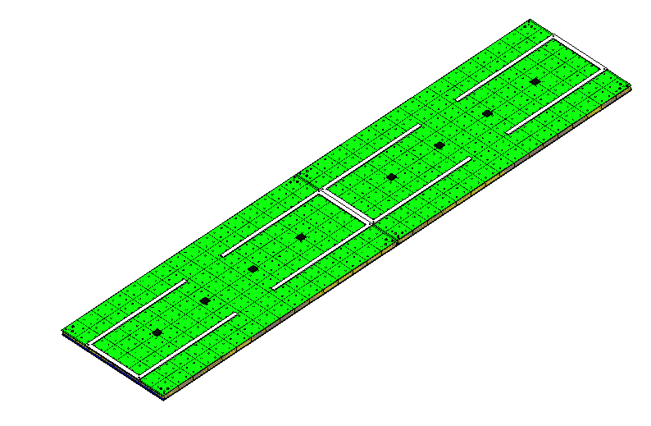
How to install next box-barrel
Positioning with pins
Removing four
M1.6 bolts
Removing the upper cover plate and make the cables straight
Removing the upper cover plate and make the cables straight

Slide 16
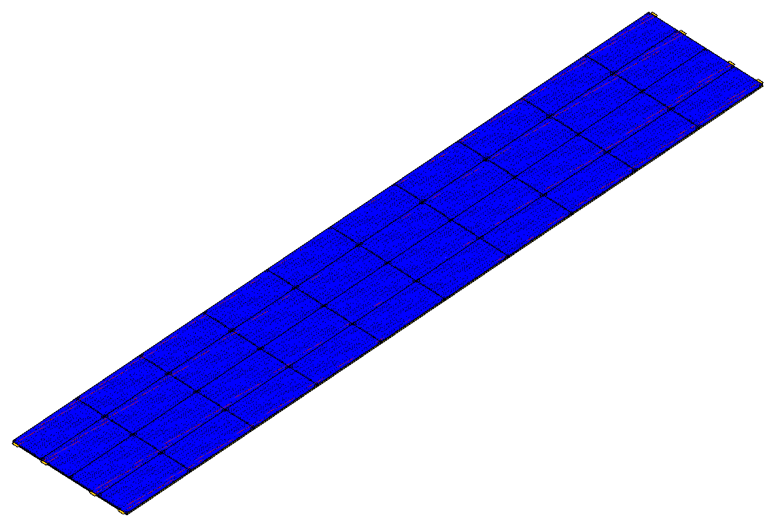
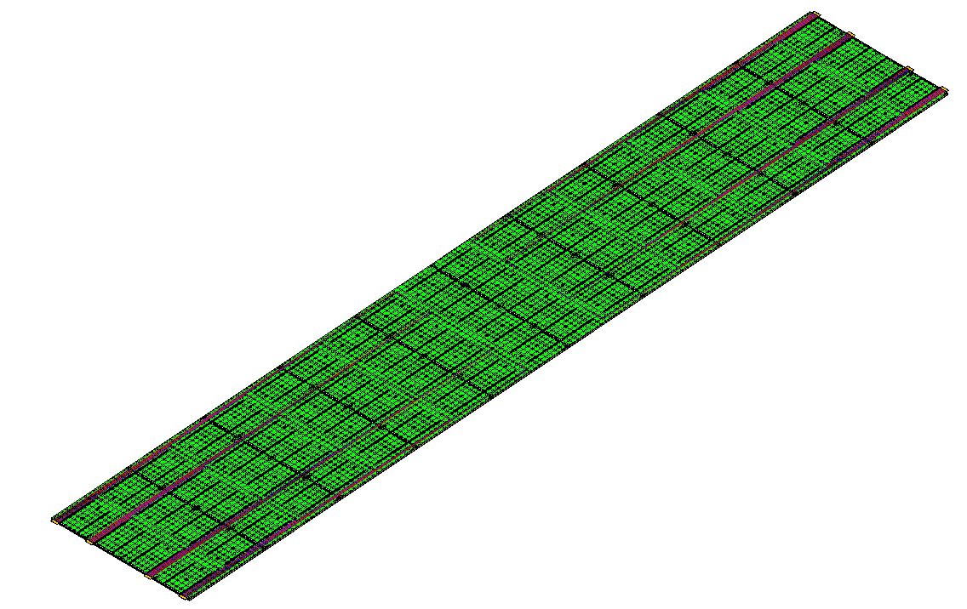
How to install one layer-barrel
1-10
1-9
1-5
1-8
1-4
1-3
1-7
②
1-6
1-2
1-1
③
④
48th layer as an example
Final situation of one layer
Step continuing:
After finishing installation of 1-1 to 1-5 boxes, cables need to be bended and arranged first time
After finishing installation of 1-6 to 1-10 cables need to be bended and arranged second time
The installation sequence for each region is like this picture
Boxes can be installed in parallel for all 4 regions

Slide 17
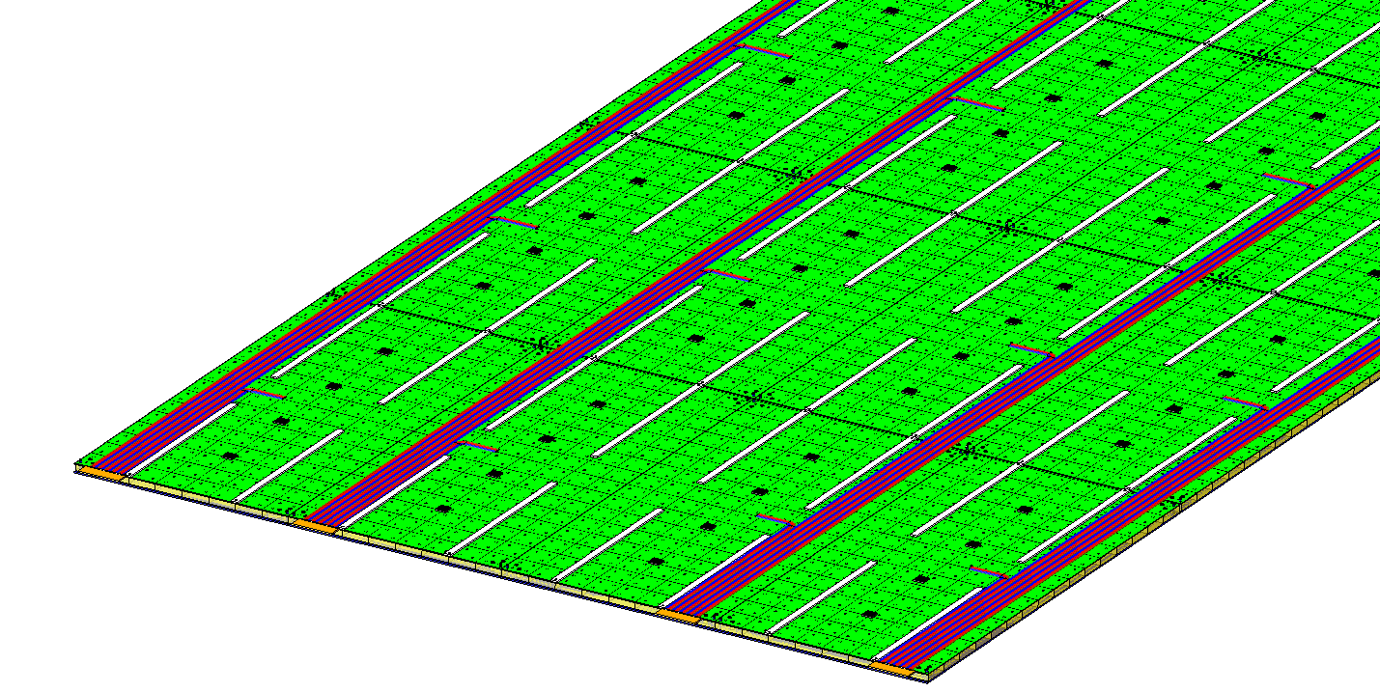
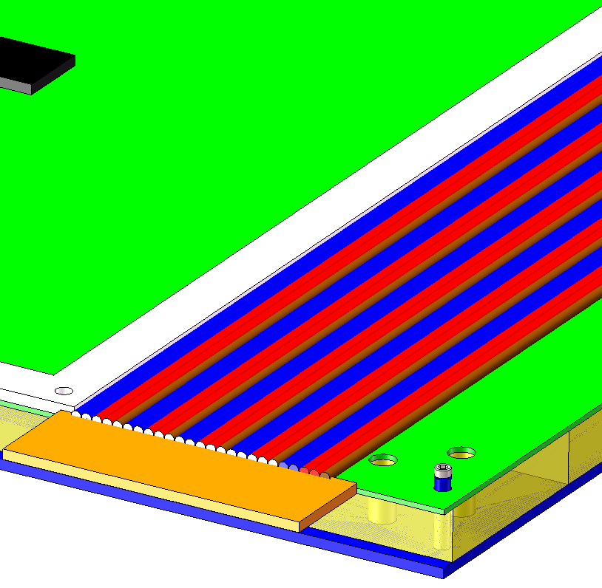
How to install one layer-barrel
1-10
1-9
1-5
1-8
1-4
1-3
1-7
1-6
1-2
1-1
③
Administration board
There are 2*4 or 2*3 administration boards for each layer, each boards is 20mm*60mm
The input of one board is 25 cables and output of one board is 2 cables and one fiber

Slide 18
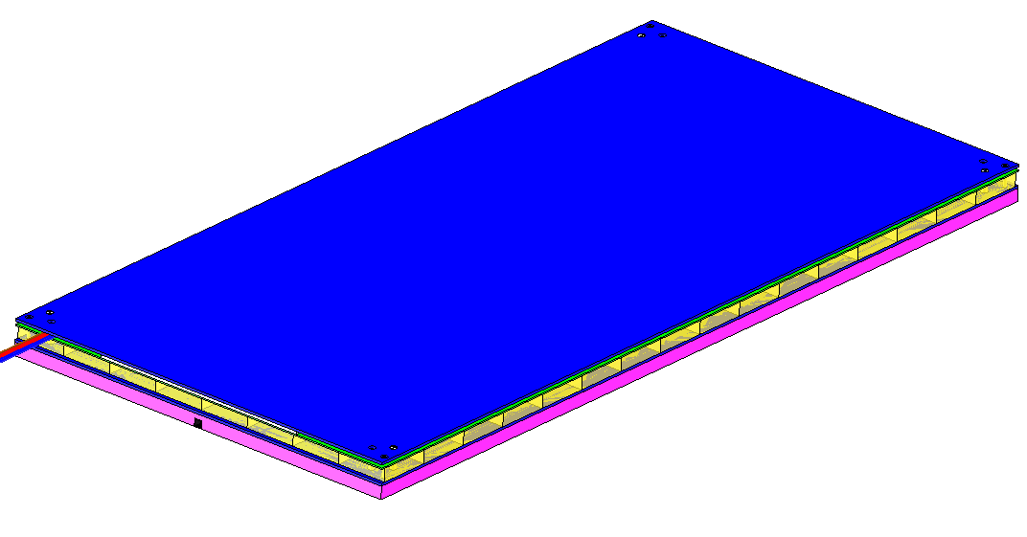
How to install the next layer-barrel
One box with lower absorber
Installing all the upper cover plate and M1.6 bolts
Add 0.2mm thermal conductive silicone on the top surface

Slide 19
How to install the next layer-barrel
Using four M5 bolts to connect the two neighbor absorber layer through the box
Installing the upper absorber layer
Hide the corner
Glass scintillator
M5 bolts
Pin

Slide 20
How to install end ECAL box
From one box to next layer
50mm bottom support plate
The boxes are mounted horizontally on an absorber plate and are divided into 16 zones, each separated by a rib plate
The dimension of the administration board is 60mmX20mm
The administration board leads three cables with diameter of 3mm
Next absorber layer

Slide 21
Statistic
Barrel HCAL
 | Box quantities/wedge | Glass quantities/ wedge
1st ~3rd layer | 30/layer | 3200/layer
4th ~7th layer | 30/layer | 3360/layer
8th~10th layer | 30/layer | 3520/layer
11th~14th layer | 30/layer | 3680/layer
15th~18th layer | 30/layer | 3840/layer
19th~22nd layer | 40/layer | 4000/layer
23rd~25th layer | 40/layer | 4160/layer
 | Box quantities/wedge | Glass quantities/ wedge
26th ~29th layer | 40/layer | 4320/layer
30th ~33rd layer | 40/layer | 4480/layer
34th~36th layer | 40/layer | 4640/layer
37th~40th layer | 40/layer | 4800/layer
41st~44th layer | 40/layer | 4960/layer
45th~48th layer | 40/layer | 5120/layer
Total | 1740 | 200800

Slide 22
Statistic
 | Cable quantities in layer/wedge | Cable quantities at end/ wedge
1st ~3rd layer | 150/layer | 2*9/layer
4th ~7th layer | 150/layer | 2*9/layer
8th~10th layer | 150/layer | 2*9/layer
11th~14th layer | 150/layer | 2*9/layer
15th~18th layer | 150/layer | 2*9/layer
19th~22nd layer | 200/layer | 2*12/layer
23rd~25th layer | 200/layer | 2*12/layer
 | Cable quantities/wedge | Cable quantities at end/ wedge
26th ~29th layer | 200/layer | 2*12/layer
30th ~33rd layer | 200/layer | 2*12/layer
34th~36th layer | 200/layer | 2*12/layer
37th~40th layer | 200/layer | 2*12/layer
41st~44th layer | 200/layer | 2*12/layer
45th~48th layer | 200/layer | 2*12/layer
Total | 8700 | 2*522
There are 27840 boxes in total, 3212800 glass scintillator
There are 139200 cables in the layer in total, 16704 cables at end in total

Slide 23
Statistic
End HCAL
 | Box quantities/wedge | Glass quantities/ wedge
1st ~48th layer | 4/layer | 1452/layer
Total | 192 | 69696
 | Cable quantities in layer/wedge | Cable quantities at end/ wedge
1st ~48th layer | 20 | 6
Total | 960 | 288
There are 3072*2 boxes in total, 1115136*2 glass scintillators
There are 15360*2 cables in the layer in total, 4608*2 cables at end in total

Slide 24
How to route the administration board cables
Administration board
Edge sealing
Cables
Support ring
Administration board cables located on one end of each wedge
Cables routing from support ring on one end

Slide 25
How to route the administration board cables
One module is equipped with two administration boards, with each board connecting three cables. These cables are bundled together and routed to the outside of the endcap HCAL.
Cable bundle
Cable
bundle

Slide 26
Cooling
Forced air cooling
Natural convection
Water cooling
入口流速 （m/s） | T_{max} (℃） | T_{min} (℃）
1 | 27.05 | 25.31
2 | 26.92 | 25.16
3 | 26.88 | 25.12
4 | 26.85 | 25.08
5 | 26.84 | 25.07
The temperature difference is higher than 3℃ of natural convection and forced air cooling
The temperature difference is lower than 2℃ of water cooling

Slide 27
Cooling
ASIC chip
Upper cover plate
Glass scintillator
and SiPM
PCB plate
Lower cover plate
Thermal interfacial material
Cooling pipe
Absorber layer
The cooling pipe is a square tube for each layer, the edge length is 6mm, the thickness is 0.5mm

Slide 28
Cooling
Cooling pipe
Cooling pipe：
φ8mm
There are 3 pipes for 1st to 18th layer
There are 4 pipes for 19th to 48th layer
Totally sixteen φ8mm pipes need to be leaded out

Slide 29
Cooling
Water outlet
Cooling pipe
Water inlet
Series connection of 5 layers in each module; and then reach to the main cooling pipe in parallel
Main cooling pipe:
12mm outer diameter,
11mm inner diameter
Totally 32 pipes need to be leaded out

Slide 30
Overview of cable and pipe routing

Slide 31
Next plan
Doing FEA for each box based on the present structure
Doing FEA for barrel absorber structure based one the new bolts connection
Getting the mechanical parameters of glass scintillator with experiment

Slide 32
Thanks

