Slide 1
Effect of vector meson spin coherence on the observables for the chiral magnetic effect in heavy-ion collisions
Diyu Shen, Jinhui Chen, arXiv:2409.04675v1

Slide 2
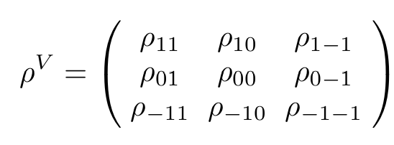
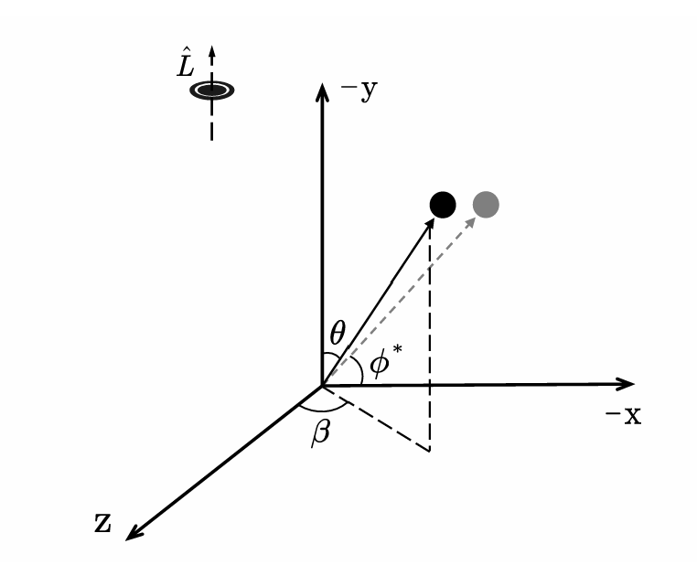
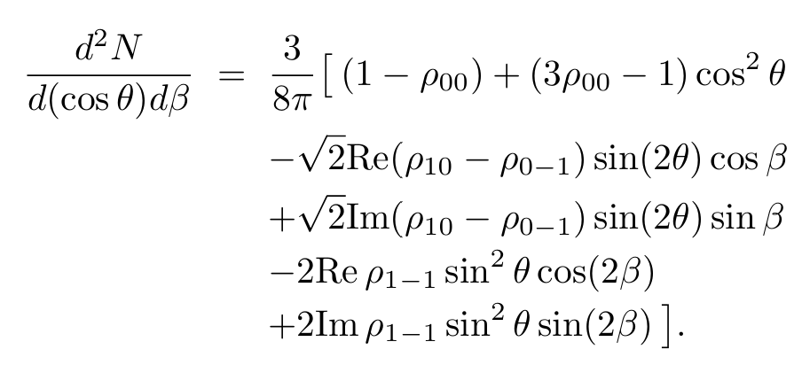
Such as ϕ, $k^{∗0}$,$ρ,Λ$and J/Ψ
spin density matrix for vector meson :
If a vector meson decays to two particles with the same mass,
The distribution of the $π^{±}$emission angle in the rest frame

Slide 3
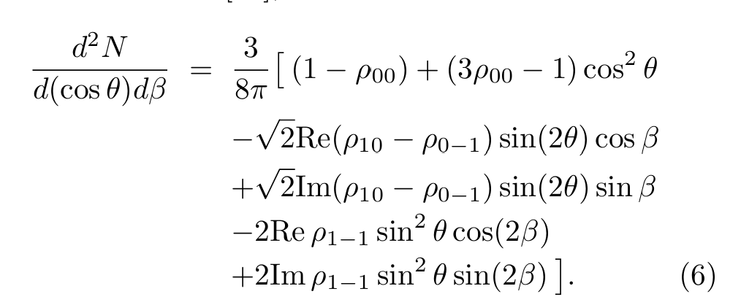
$θ,β$ is in a polar coordinate system with the -y-axis as the polar axis.
$θ^{∗},φ^{∗}$ is in a polar coordinate system with the z-axis as the polar axis.
$$dΩ=d\left(cosθ\right)dβ=d\left(cosθ^{∗}\right)dφ^{∗}$$

Slide 4
CME observable:
CME background form resonance decay
$$Δγ_{Bkg}=\frac{N_{ρ}}{N_{π^{+}}N_{π^{−}}^{ }}\left\langle \cos\left(φ_{π^{+}}+φ_{π^{−}}−2φ_{ρ}\right)\right\rangle v_{2,ρ}$$
Or

Slide 5
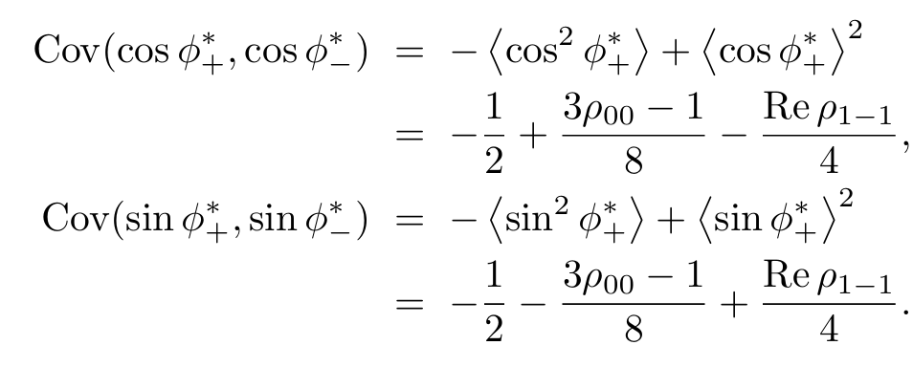
take $φ_{−}^{∗}=φ_{+}^{∗}+π$
in the rest frame
in the lab frame, add a factor f0

Slide 6
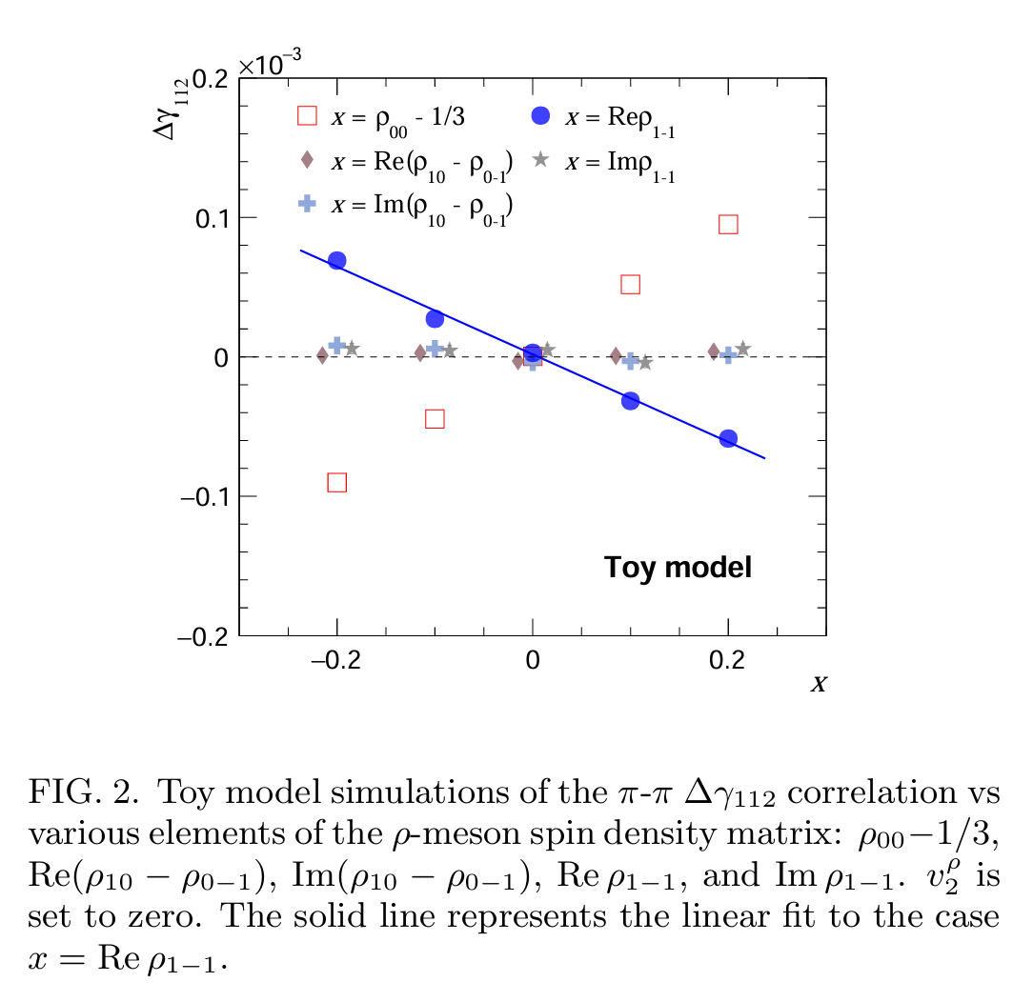
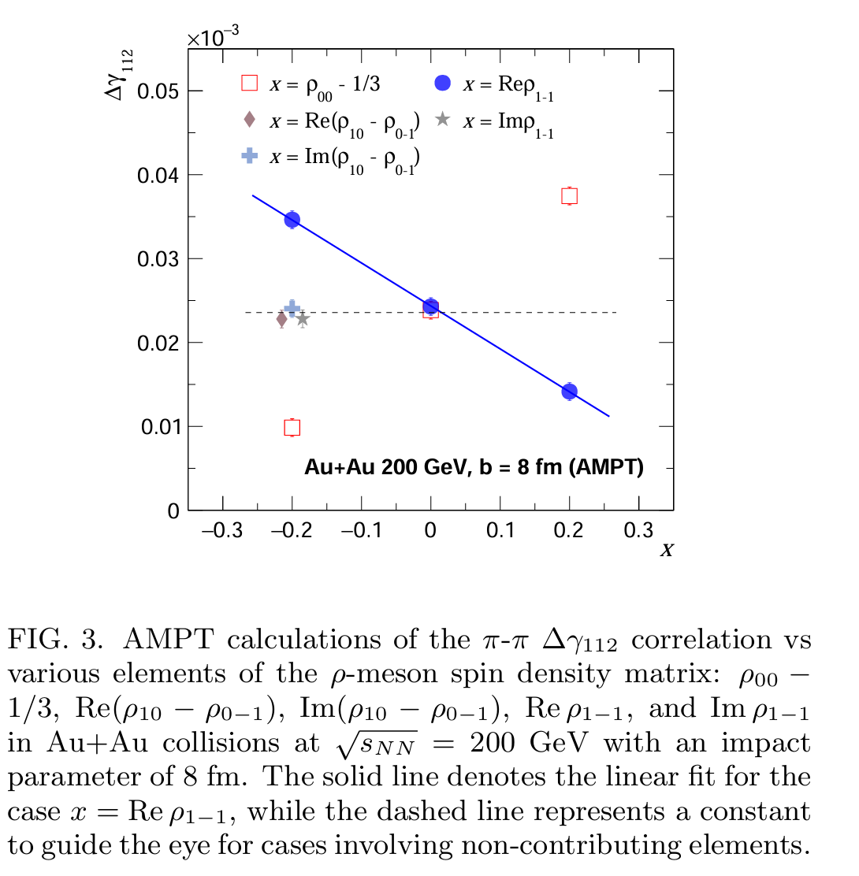
Other components have no contributions to ∆γ
Adding other contribution to ∆γ

Slide 7
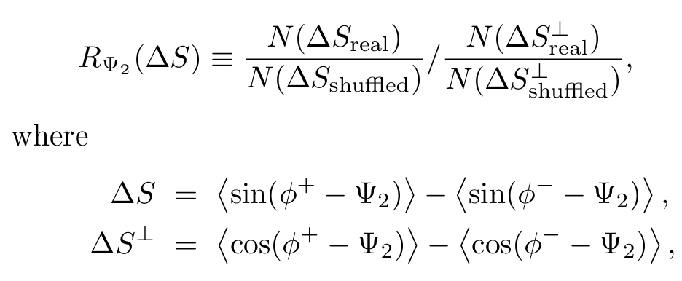
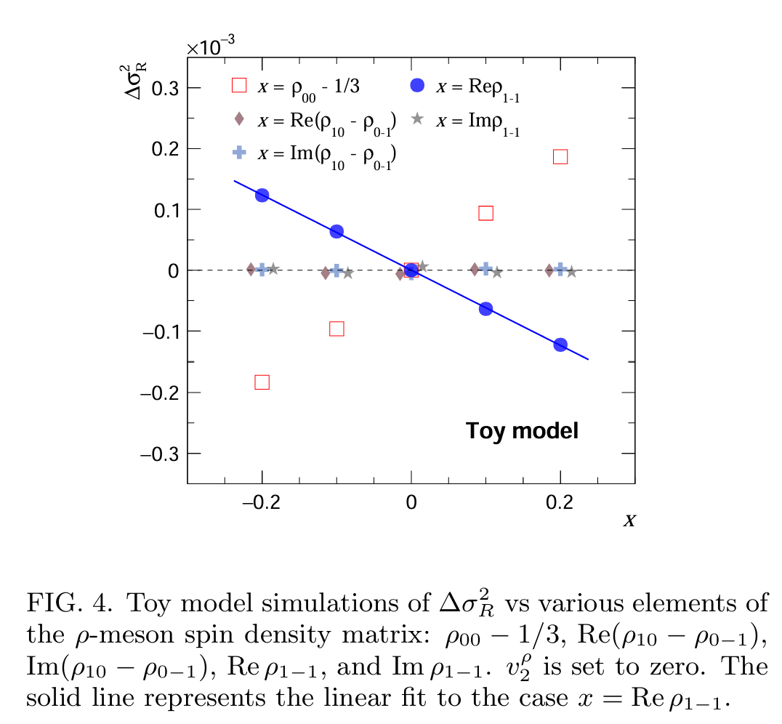
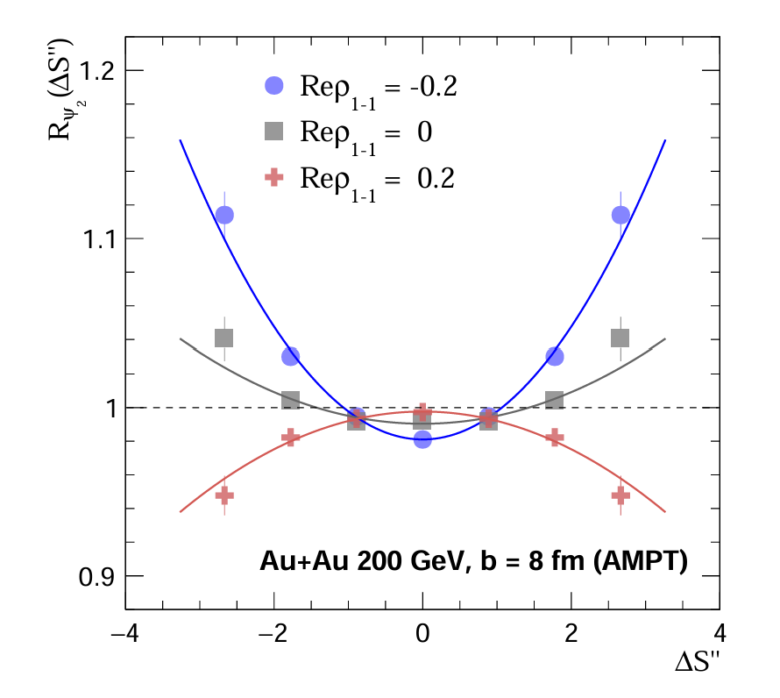
For another CME observable $R_{Ψ_{2}}(ΔS)$

Slide 8
A Novel Approach to Search for the Chiral Magnetic
Effect from STAR and the Future Prospect
Huan Zhong Huang
The 1st International Workshop on Physics at High Baryon Density (PHD2024)
Nov. 1-4, 2024 @ CCNU

Slide 9
$$Δγ_{Bkg}=\frac{N_{ρ}}{N_{π^{+}}N_{π^{−}}^{ }}\left\langle \cos\left(φ_{α}+φ_{β}−2φ_{ρ}\right)\right\rangle v_{2,ρ}$$
$∼v_{2}/N$

Slide 10
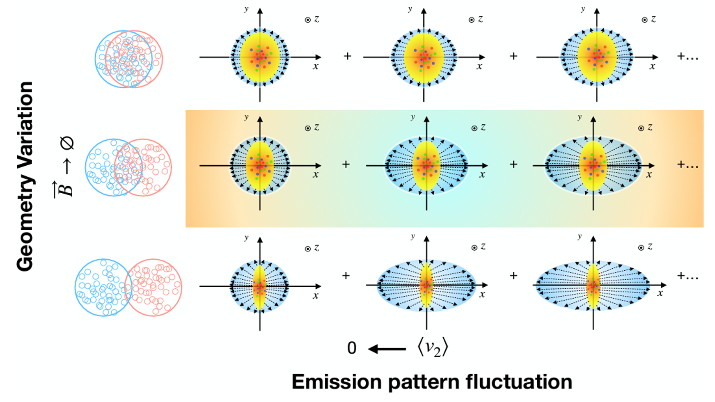
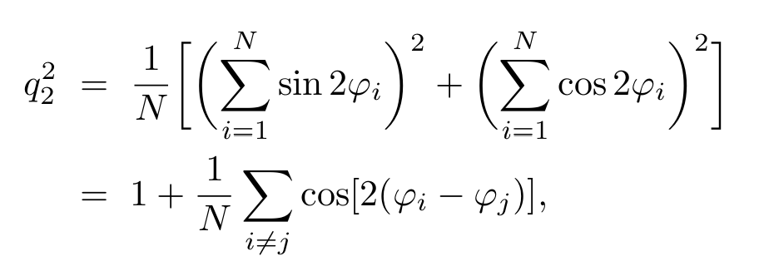
Event Shape Selection
Ideally, if we control centrality(eccentricity), we control flow for everything.
But large event-by-event fluctuations could dominate the observable.
$$v_{2}=\frac{1}{N}\sum_{i=1}^{N}{cos2φ_{i}}$$
$$v_{2}\{2\}=\frac{1}{N}\sum_{i≠j}^{ }{cos⁡[2\left(φ_{i}−φ_{j}\right)]}$$
CME background event by event comes from combined eccentricity and emission patterns

Slide 11
$$v_{2}=\frac{1}{N}\sum_{i=1}^{N}{cos2φ_{i}}$$
$$v_{2}\{2\}=\frac{1}{N(N−1)}\sum_{i≠j}^{ }{cos⁡[2\left(φ_{i}−φ_{j}\right)]}$$
After normalization:

Slide 12
Considering resonances decay,
the v2 and the corresponding q2 of the parent resonances are more relevant
For each pair of POI, the pair azimuthal angle, $φ^{P}=(φ_{1}+φ_{2})/2$

Slide 13
We can measure Δγ vs q2 and v2 vs q2, then plot Δγ vs v2
$$q_{2}^{2}$$
$$v_{2}$$
$$Δγ$$

Slide 14
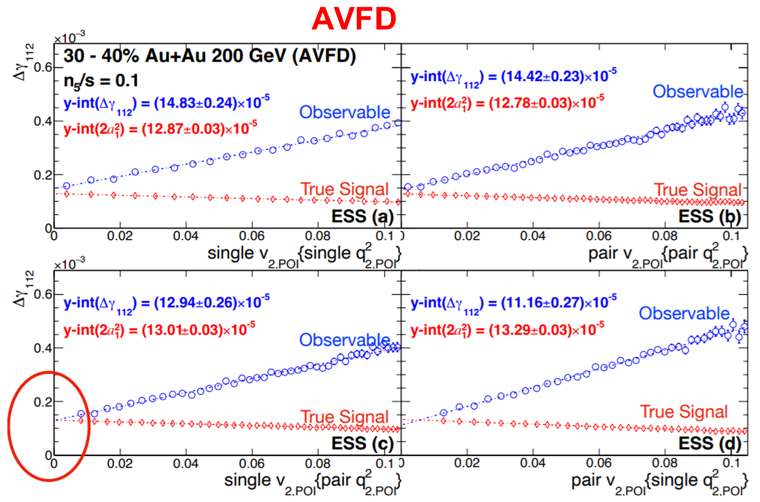
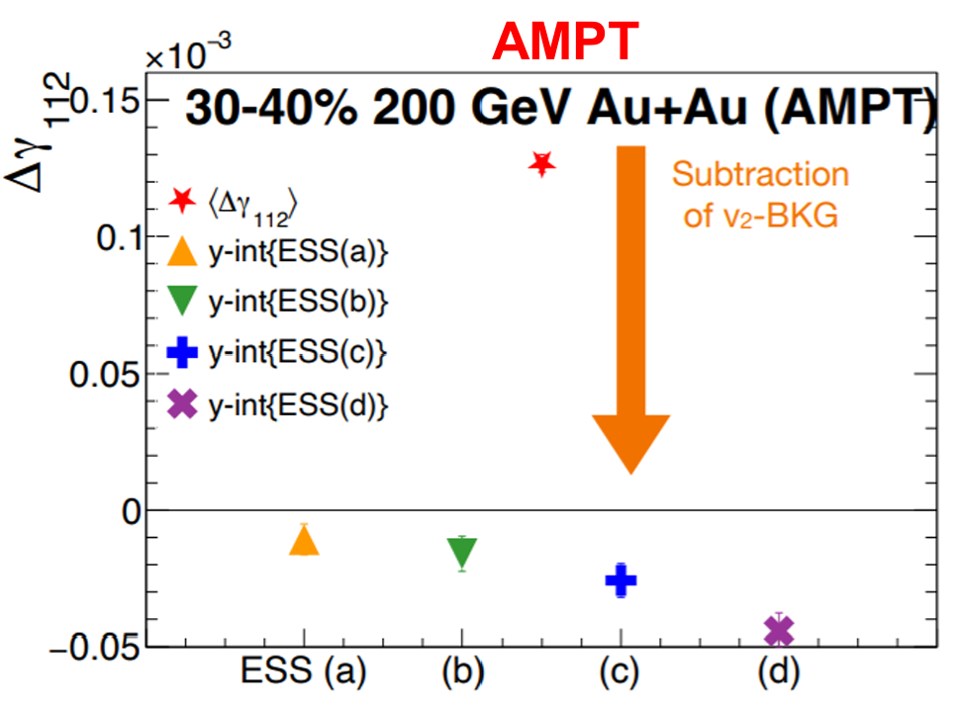
AMPT(no CME): all ESS recipes over-estimate the BKG
AVFD: the optimal ESS recipe (c) accurately matches the input CME signal.

Slide 15
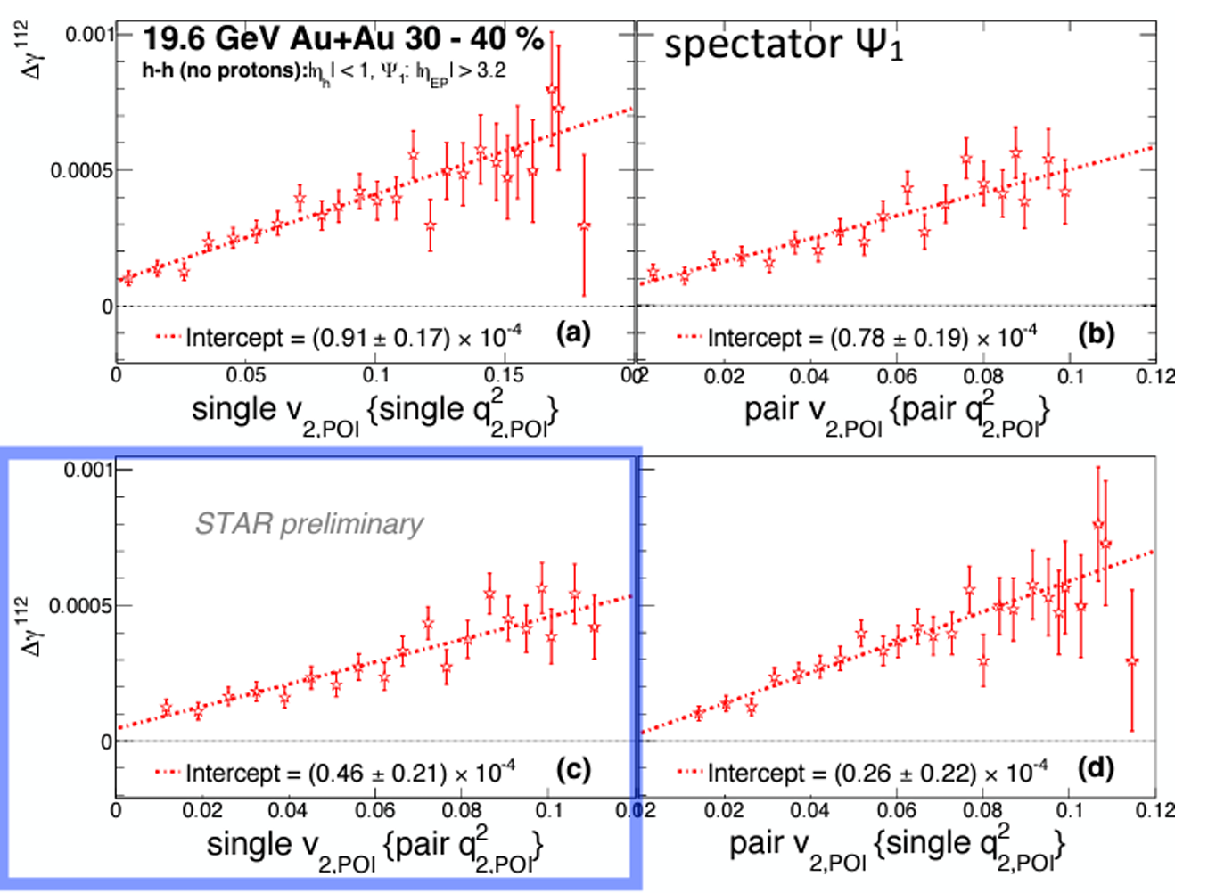
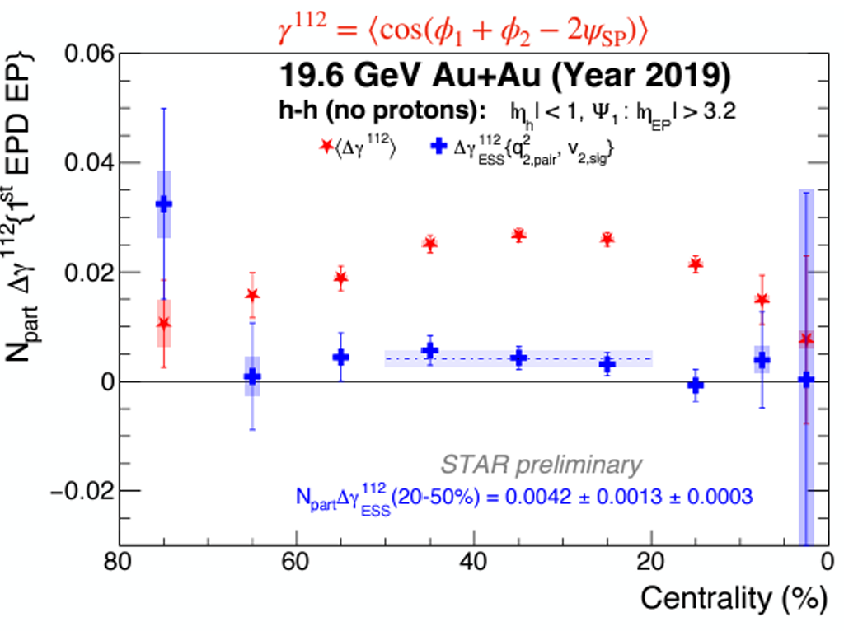
STAR preliminary
total
signal

Slide 16
