Slide 1
The progress of laser polarization and focusing
20241204
Mengyu Su

Slide 2
Outline
Laser Transmission Experiment
  Long-term plan
  202412 laser polarization experiment plan
  202412 laser focusing experiment plan
The parameter of new laser
TODO list

Slide 3
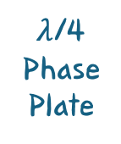
Laser Transmission Experiment Plan
$λ$/4 Phase Plate
Hollow Beam Splitter
laser power meter
Focus Lens
Laser
Reflector 1
Pockels Cell
laser polarimeter
wall
Table1
Silica window
Laser targets
e-
Photon Detector
Aperture stops
Reflector 2
Compton Photons
IP
Table2
Table3

Slide 4
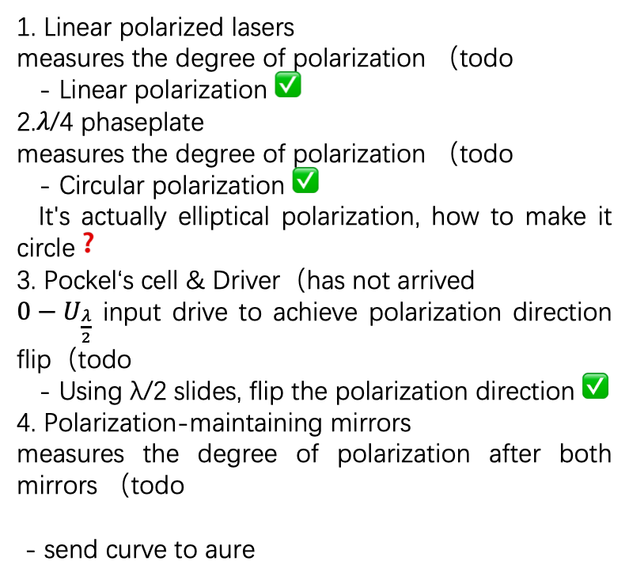

Laser Transmission Experiment Plan202412
Laser polarization Experiment(Underway)
1. Linear polarized lasers
measures the degree of polarization （todo
- Linear polarization ✅
2.𝜆/4 phaseplate
measures the degree of polarization （todo
- Circular polarization ✅
It's actually elliptical polarization, how to make it circle❓
3. Pockel‘s cell & Driver（has not arrived
$0−U_{\frac{λ}{2}}$ input drive to achieve polarization direction flip（todo
- Using λ/2 slides, flip the polarization direction ✅
4. Polarization-maintaining mirrors
measures the degree of polarization after both mirrors （todo
- send curve to aure
$λ$/4 Phase Plate
Laser
Reflector 1
Pockels Cell
Table1
Aperture stops
Reflector 2
e-
Table2
Table3

Slide 5
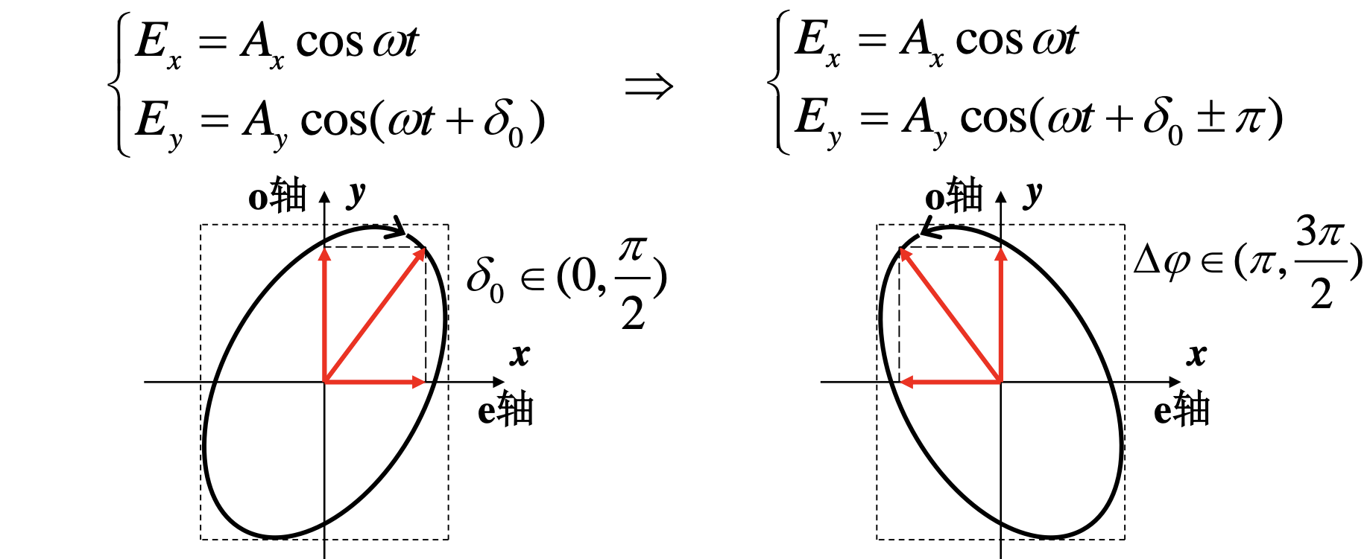
Degree of polarization measurement
Measure the polarization by Glan prism & power meter
Laser Polarimeter (Thorlabs) –send to aurelien
Polarization direction measurement
  The circularly polarized light is adjusted to elliptically polarized light by using a 1/4 waveplate, and the ellipse is mirrored on the O-axis after passing through the 1/2 waveplate

Slide 6

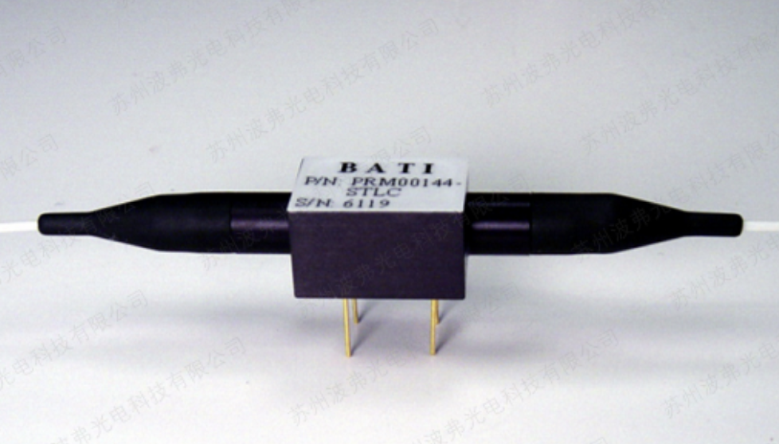
Pockels Cell Alternative - Polarization rotator- todo
Under the action of the external electric field, some isotropic media will produce birefringence phenomenon, and the birefringence of crystals with birefringence properties will also change. When the applied electric field acts on the electro-optical crystal, the electro-optical crystal is like a wave plate with a phase delay related to the applied electric field, and with the change of the applied electric field, the polarization state of the outgoing light passing through the electro-optical crystal will change, so that the intensity of the outgoing light of the polarizer is modulated, which is electro-optical modulation.
A polarization rotator provides a continuous rotation of any polarized light through any control voltage applied. The device acts as a half-wave plate with a rotating shaft.

Slide 7



Laser Transmission Plan
202412 Laser focusing experiment (coming soon)
1.The focal lengths of F1、F2、F3 are 0.1m，-0.1m，0.2m
2. The three lenses are placed on a longitudinal slide rail, and the spot size, waist position and size at the IP are adjusted by adjusting the F1-F2-F3 distance
3. Based on the spot size information on the laser target, the spot size, waist position and size at the IP are calculated(later
$$0.1m$$
$$0.4m$$
$\sim 20.5m$ to IP
Focus Lens
Laser
Reflector 1
F1
F2
F3
Table1
Silica window
Laser targets
e-
Aperture stops
Reflector 2
Table2
自己测透镜焦距、测出口参数
棚屋内相机测beam size
Table3

Slide 8


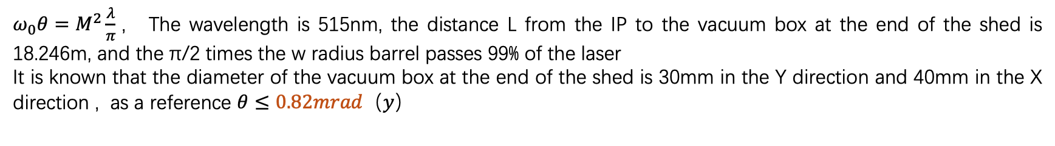

The corset width corresponds to the far-field divergence angle
$ω_{0}θ=M^{2}\frac{λ}{π}$， The wavelength is 515nm, the distance L from the IP to the vacuum box at the end of the shed is 18.246m, and the π/2 times the w radius barrel passes 99% of the laser
It is known that the diameter of the vacuum box at the end of the shed is 30mm in the Y direction and 40mm in the X direction , as a reference $θ≤0.82mrad（y）$
$0.82mrad$/3
PS. Effect of w0 on laser Jitter:
w0>0.85mm
Rayleigh length >4.4m
jitter<zR/c=14.6ns
$0.82mrad$/2
Laser beam waist：
w0=1mm
0.85mm<w0<1.25mm
$$M^{2}=1.3$$
Notes:
IP束腰取1mm合理

Slide 9
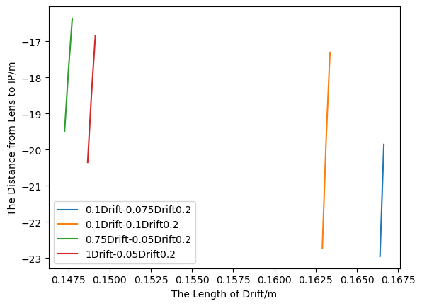
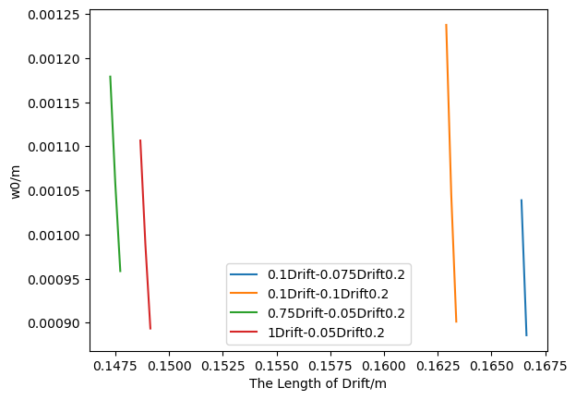
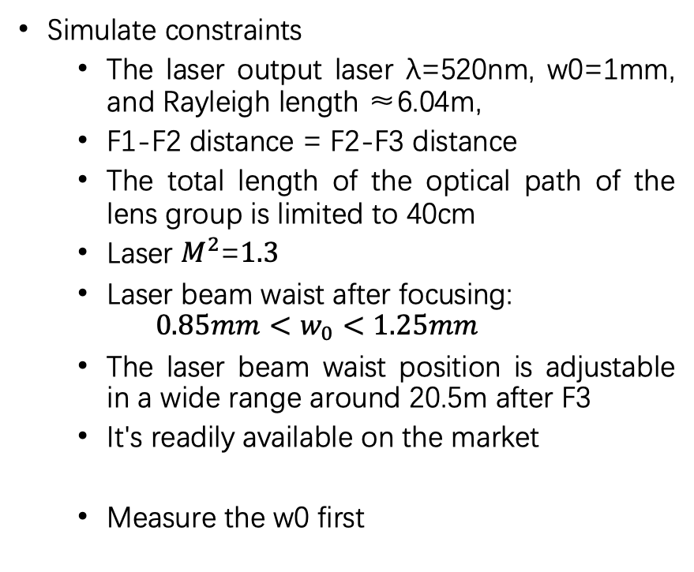
Lens focal length selection
Simulate constraints
  The laser output laser λ=520nm, w0=1mm, and Rayleigh length ≈6.04m,
  F1-F2 distance = F2-F3 distance
  The total length of the optical path of the lens group is limited to 40cm
  Laser $M^{2}\text{=}1.3$
  Laser beam waist after focusing:
  $$0.85mm<w_{0}<1.25mm$$
  The laser beam waist position is adjustable in a wide range around 20.5m after F3
  It's readily available on the market
  Measure the w0 first
F1=0.1m
F2=-0.1m
F3=0.2m

Slide 10
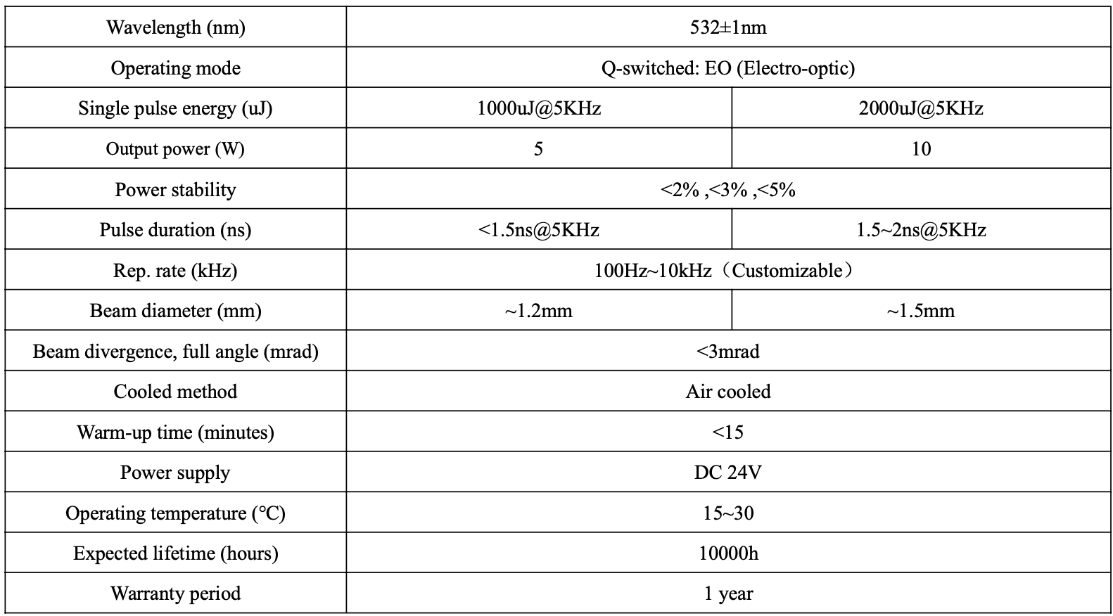
The parameter of new laser （Changchun Laser）
Jitter: <1ns
Average power: 5W/10W
Change rep.rate
polarization

Slide 11
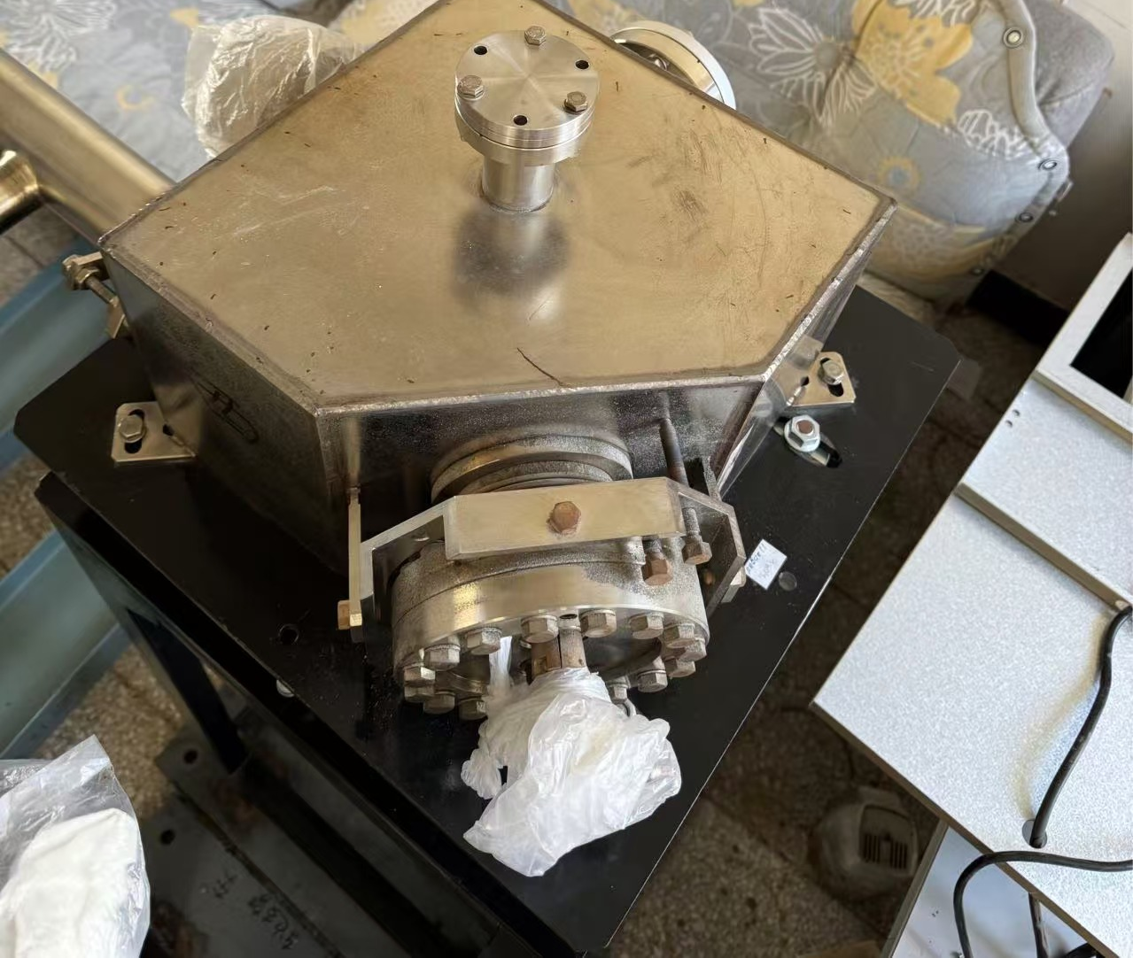
Todo list
Mirror box in vacuum
Finish the polarization experiment
Finish the focusing experiment
Motorized remote control system
Hollow Beam Splitter

Slide 12
Back up

