Slide 1
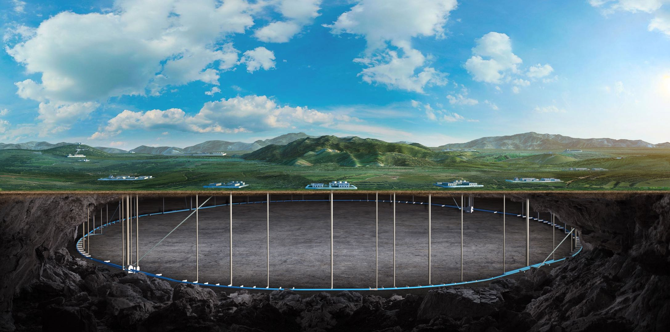
CEPC vertex Detector
Zhijun Liang

Slide 2
International collaboration
Meeting with Jérôme Baudot (vertex group leader in IPHC ) in Pixel2024
Agree to collaboration in FCPPL and DRD3 framework
Apply for new proposals for vertex chip R & D in FCPPL and DRD3 projects
Propose a work package in DRD3 workshop last week
Propose a new work package for vertex chip R & D
Preparing a work package document

Slide 3
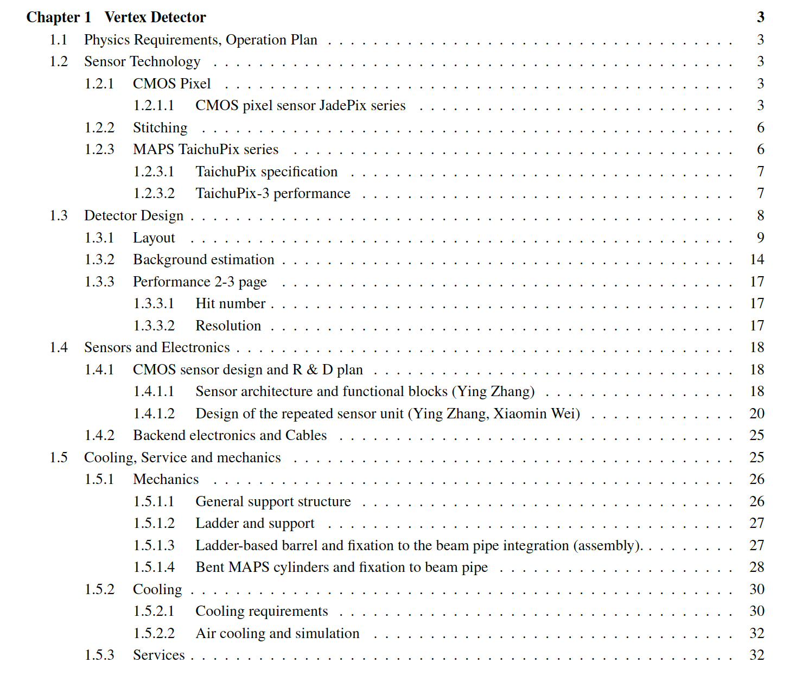
Ref-TDR
More than 30 pages ready
R & D part
ready
Detector design
Physics Layout (1st draft ready)
Stitching design (1st draft ready)
Mechanics (1st draft ready)
https://latex.ihep.ac.cn/project/6745179fef5108a66841008a

